Slide 1
RF Engineering
Scattering (S)-Parameters
Christine Völlinger & Manfred Wendt – CERN

Slide 2
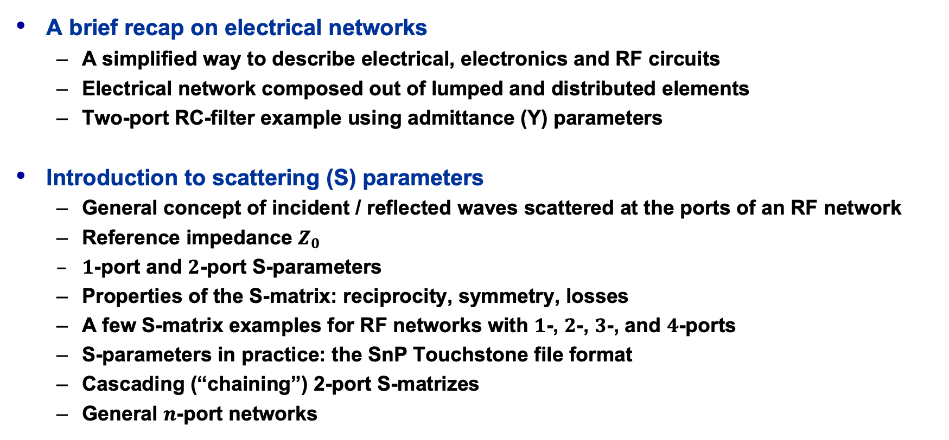
Outline and Objectives
A brief recap on electrical networks
  A simplified way to describe electrical, electronics and RF circuits
  Electrical network composed out of lumped and distributed elements
  Two-port RC-filter example using admittance (Y) parameters
Introduction to scattering (S) parameters
  General concept of incident / reflected waves scattered at the ports of an RF network
  Reference impedance $Z_{0}$
  $1$-port and $2$-port S-parameters
  Properties of the S-matrix: reciprocity, symmetry, losses
  A few S-matrix examples for RF networks with $1$-, $2$-, $3$-, and $4$-ports
  S-parameters in practice: the SnP Touchstone file format
  Cascading (“chaining”) 2-port S-matrizes
  General $n$-port networks
Please note the references
to the JUAS proceedings!
JUAS Proc. 2024
II.2.x.y.z, p. nnn

Slide 3




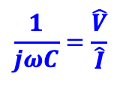




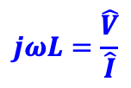



Electrical Networks (1)
The electromagnetic behavior or RF circuits and systems, like any other electrical / electronics circuit or system can be described by Maxwell’s equations
  These equations need to be solved, taking all the boundaries and materials into account
However, this is far too complicated and inconvenient for most practical situations!
  simplified electrical network description based on approximative lumped or distributed elements
    With given characteristics and values of each circuit element represented by a symbol in an electrical network, following the laws of Ohm and Kirchhoff. Here some examples:
$$∇∙E=\frac{ρ}{ε}, ∇×B−\frac{∂E}{c^{2}∂t}=μJ, ∇×E+\frac{∂B}{∂t}=0, ∇∙B=0$$
lumped, passive, linear
lumped, passive,
non-linear
lumped, active,
non-linear
distributed, passive,
linear
resistor $R$
inductor $L$
capacitor $C$
diode $D$
transistor $T$
transmission-line $TL$
$$v=L\frac{di}{dt}$$
$$i=C\frac{dv}{dt}$$
$$R=\frac{v}{i}$$
$$Z_{0}, γ$$
$$jωL=\frac{\hat{V}}{\hat{I}}$$
$$\frac{1}{jωC}=\frac{\hat{V}}{\hat{I}}$$
$$i=I_{S}(e^{v/V_{T}}−1)$$
npn transistor
JUAS Proc. 2024
II.2.7.1, p. 829

Slide 4


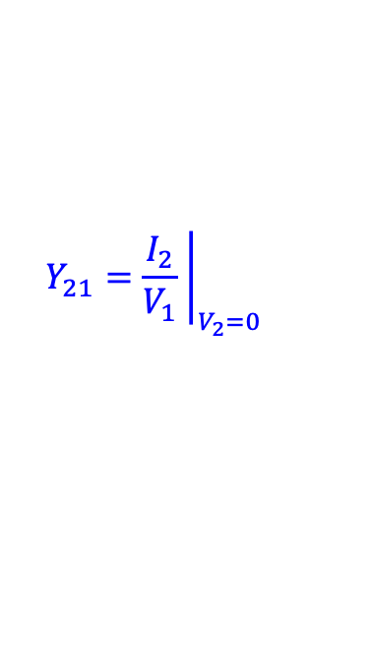






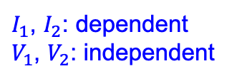









Electrical Networks (2)
Complex electrical, electronics and RF systems are divided into functional blocks, i.e., networks, with $n$-ports, each port has two terminals
  The two-port network is most popular, typical examples for two-port networks are filters, attenuators, amplifiers, etc.
The characteristic behavior of the $n$-port network is defined by a set of $2n$ parameters, linked to their ports.
  A two-port network has four parameters as port voltages ($V_{1}$, $V_{2}$) and port currents ($I_{1}$, $I_{2}$),
  two are independent, the other two are dependent parameters.
  Various combinations of dependent and independent port voltages and currents exist, accordingly various $n×n$ matrix definitions for linear $n$-port networks exist, known as $Y$-, $Z$-, $h$- and $g$- parameters.
$Y$- parameters
$$I_{1}$$
$$I_{2}$$
2
$$Y_{11}={\left.\frac{I_{1}}{V_{1}} \right|}_{V_{2}=0}$$
$$Y_{12}={\left.\frac{I_{1}}{V_{2}} \right|}_{V_{1}=0}$$
1
$$I_{1}=Y_{11}V_{1}+Y_{12}V_{2}$$
$$+$$
$$+$$
$$V_{1}$$
2-port network
$$V_{2}$$
$$I_{2}=Y_{21}V_{1}+Y_{22}V_{2}$$
$$−$$
$$−$$
$$Y_{21}={\left.\frac{I_{2}}{V_{1}} \right|}_{V_{2}=0}$$
$$Y_{22}={\left.\frac{I_{2}}{V_{2}} \right|}_{V_{1}=0}$$
1’
2’
$I_{1}$, $I_{2}$: dependent
$V_{1}$, $V_{2}$: independent
$$I_{1}$$
$$I_{2}$$
JUAS Proc. 2024
II.2.7.1, pp. 829/830

Slide 5



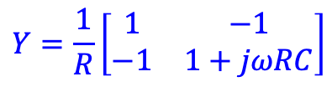




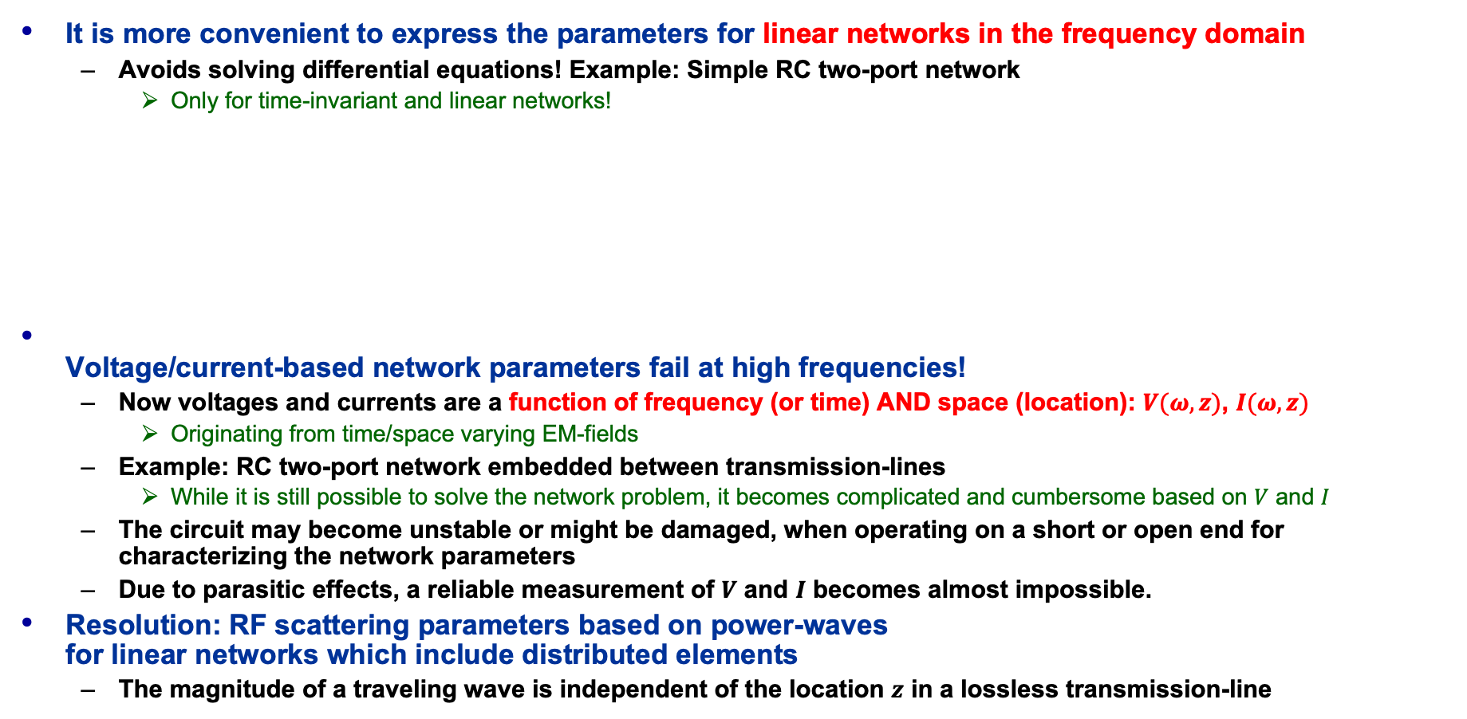










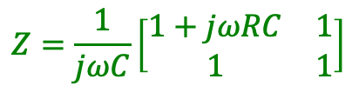



Electrical Networks (3)
It is more convenient to express the parameters for linear networks in the frequency domain
  Avoids solving differential equations! Example: Simple RC two-port network
    Only for time-invariant and linear networks!
Voltage/current-based network parameters fail at high frequencies!
  Now voltages and currents are a function of frequency (or time) AND space (location): $V(ω, z)$, $I(ω,z)$
    Originating from time/space varying EM-fields
  Example: RC two-port network embedded between transmission-lines
    While it is still possible to solve the network problem, it becomes complicated and cumbersome based on $V$ and $I$
  The circuit may become unstable or might be damaged, when operating on a short or open end for characterizing the network parameters
  Due to parasitic effects, a reliable measurement of $V$ and $I$ becomes almost impossible.
Resolution: RF scattering parameters based on power-waves
for linear networks which include distributed elements
  The magnitude of a traveling wave is independent of the location $z$ in a lossless transmission-line
linear two-port
$$\acute{I_{1}}$$
$$I_{2}$$
$Y$- parameters:
$Z$- parameters:
$$I_{1}$$
$$I_{2}$$
$$\acute{I_{2}}$$
$$I_{1}$$
$$R$$
$$Y=\frac{1}{R}\left[\begin{matrix}1 & −1 \\ −1 & 1+jωRC\end{matrix}\right]$$
$$Z=\frac{1}{jωC}\left[\begin{matrix}1+jωRC & 1 \\ 1 & 1\end{matrix}\right]$$
$$\acute{V_{1}}$$
$$TL$$
$$V_{1}$$
$$V_{1}$$
$$R$$
$$V_{2}$$
$$V_{2}$$
$$TL$$
$$\acute{V_{2}}$$
$$C$$
$$C$$
JUAS Proc. 2024
II.2.7.1, p. 830

Slide 6
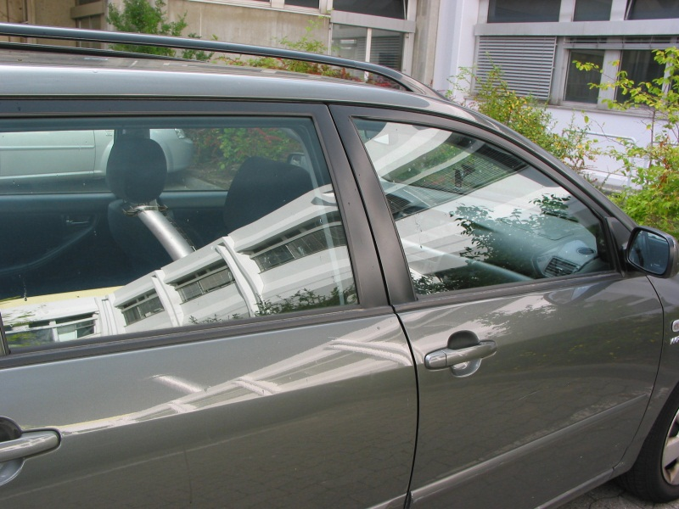
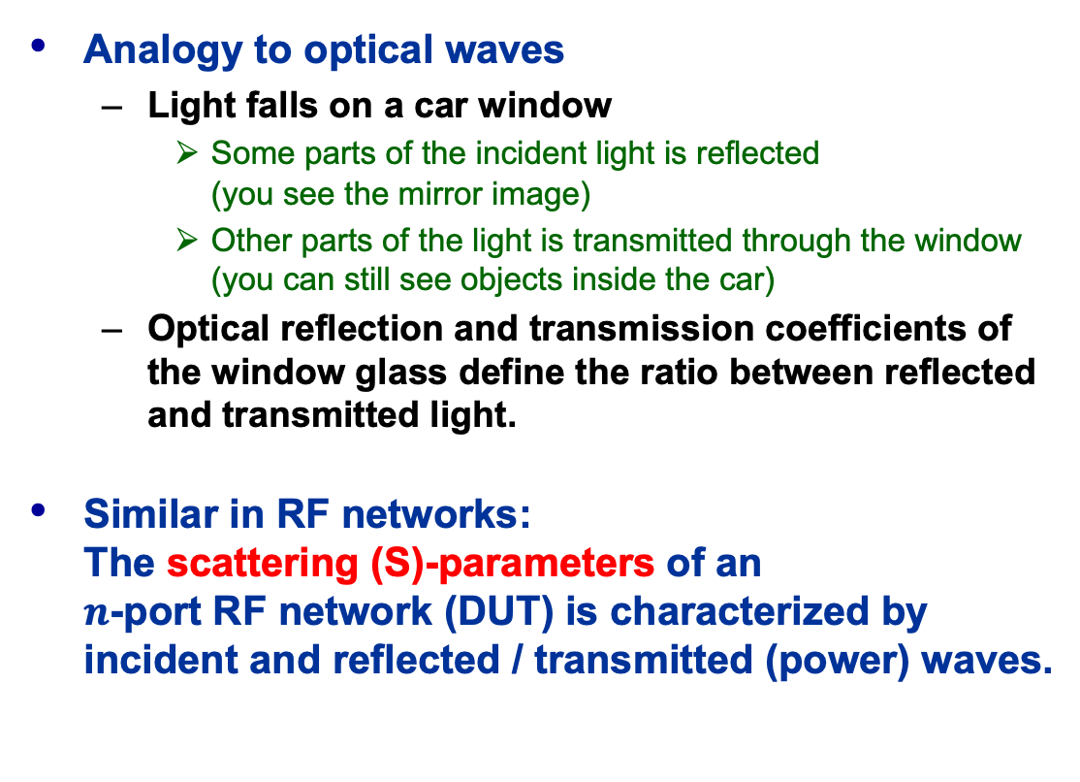
Principle of Scattering (S)-Parameters
Analogy to optical waves
  Light falls on a car window
    Some parts of the incident light is reflected
    (you see the mirror image)
    Other parts of the light is transmitted through the window
    (you can still see objects inside the car)
  Optical reflection and transmission coefficients of the window glass define the ratio between reflected and transmitted light.
Similar in RF networks:
The scattering (S)-parameters of an
$n$-port RF network (DUT) is characterized by incident and reflected / transmitted (power) waves.
JUAS Proc. 2024
II.2.7.1, p. 831

Slide 7


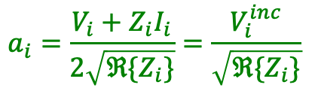




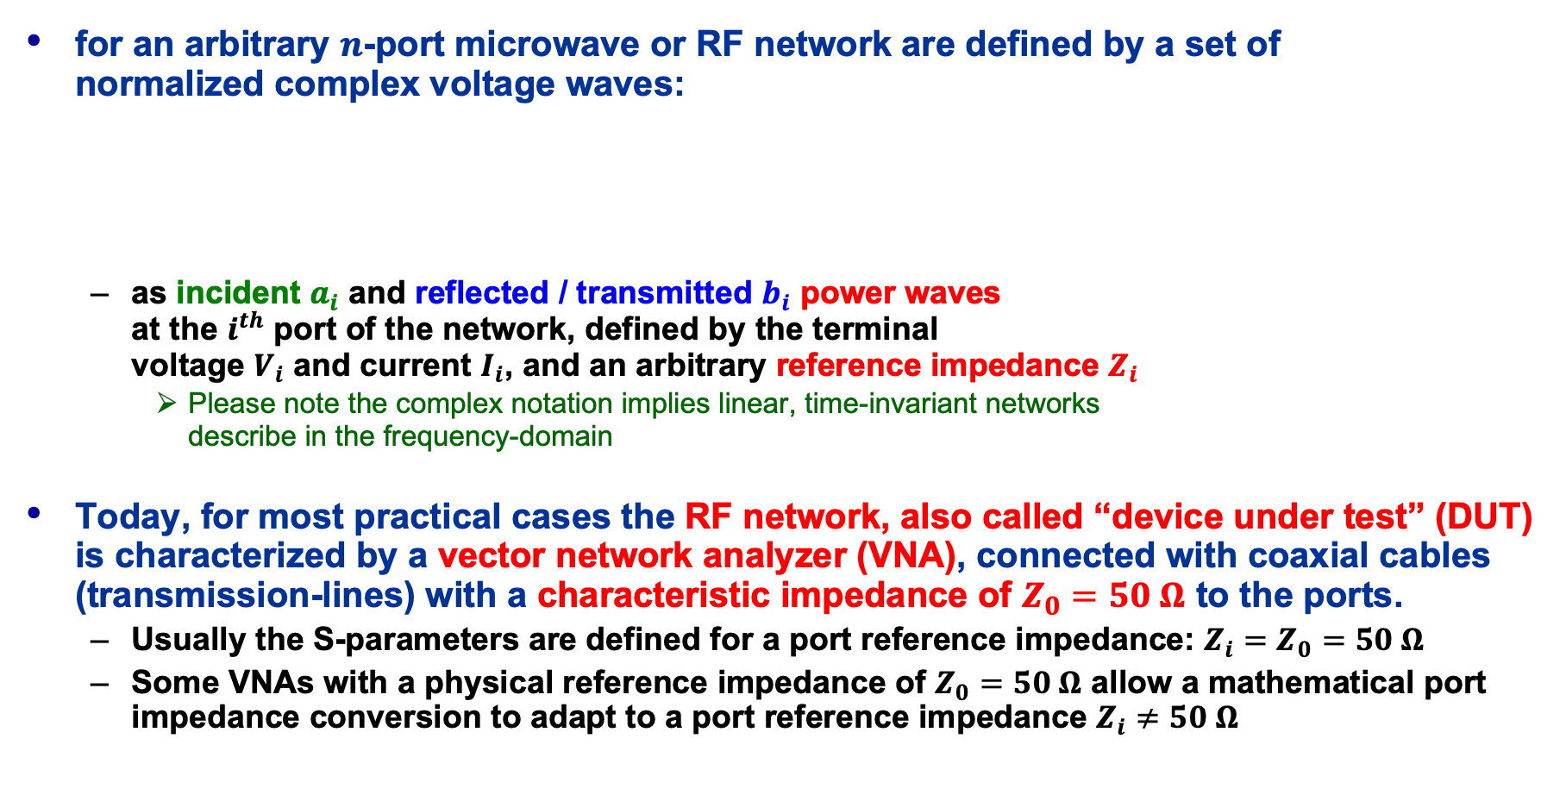






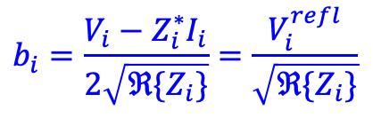

Generalized S-Parameters
for an arbitrary $n$-port microwave or RF network are defined by a set of
normalized complex voltage waves:
  as incident $a_{i}$ and reflected / transmitted $b_{i}$ power waves
  at the $i^{th}$ port of the network, defined by the terminal
  voltage $V_{i}$ and current $I_{i}$, and an arbitrary reference impedance $Z_{i}$
    Please note the complex notation implies linear, time-invariant networks
    describe in the frequency-domain
Today, for most practical cases the RF network, also called “device under test” (DUT) is characterized by a vector network analyzer (VNA), connected with coaxial cables (transmission-lines) with a characteristic impedance of $Z_{0}=50 Ω$ to the ports.
  Usually the S-parameters are defined for a port reference impedance: $Z_{i}=Z_{0}=50 Ω$
  Some VNAs with a physical reference impedance of $Z_{0}=50 Ω$ allow a mathematical port impedance conversion to adapt to a port reference impedance $Z_{i}≠50 Ω$
incident wave at port $i$:
reflected wave at port $i$:
$$a_{1}$$
$$b_{2}$$
$$a_{i}=\frac{V_{i}+Z_{i}I_{i}}{2\sqrt{ℜ\{Z_{i}\}}}=\frac{V_{i}^{inc}}{\sqrt{ℜ\{Z_{i}\}}}$$
$$b_{i}=\frac{V_{i}−Z_{i}^{∗}I_{i}}{2\sqrt{ℜ\{Z_{i}\}}}=\frac{V_{i}^{refl}}{\sqrt{ℜ\{Z_{i}\}}}$$
$Z_{i}^{∗}$:
conjugate
complex
$$b_{1}$$
$$1$$
$n$-port
(DUT)
$$2$$
$$a_{2}$$
$$n$$
$$a_{n}$$
$$b_{n}$$
JUAS Proc. 2024
II.2.7.2, pp. 831/832

Slide 8

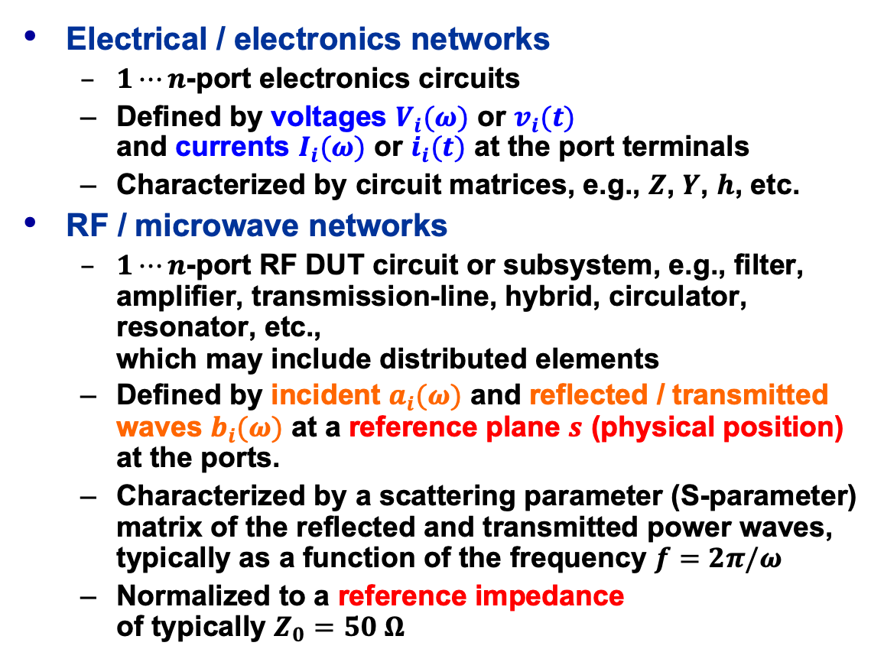





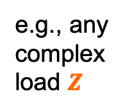
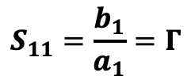

S-Parameters – $1$-port
Electrical / electronics networks
  $1⋯n$-port electronics circuits
  Defined by voltages $V_{i}(ω)$ or $v_{i}(t)$
  and currents $I_{i}(ω)$ or $i_{i}(t)$ at the port terminals
  Characterized by circuit matrices, e.g., $Z$, $Y$, $h$, etc.
RF / microwave networks
  $1⋯n$-port RF DUT circuit or subsystem, e.g., filter, amplifier, transmission-line, hybrid, circulator, resonator, etc.,
  which may include distributed elements
  Defined by incident $a_{i}(ω)$ and reflected / transmitted waves $b_{i}(ω)$ at a reference plane $s$ (physical position) at the ports.
  Characterized by a scattering parameter (S-parameter) matrix of the reflected and transmitted power waves, typically as a function of the frequency $f=2π/ω$
  Normalized to a reference impedance
  of typically $Z_{0}=50 Ω$
DUT
(device under test)
$$a_{1}$$
$$I_{1}$$
e.g., any
complex
load $Z$
1
$$Z_{0}$$
$$S_{11}$$
$$V_{1}$$
$$b_{1}$$
C
R
L
1’
$$S_{11}=\frac{b_{1}}{a_{1}}=Γ$$
1-1’ reference plane
(port 1)
1-port RF network (DUT) example
S-Parameters allow to characterize the DUT with the measurement equipment located at some physical distance
All high frequency effects of distributed elements are included with respect to the reference plane
JUAS Proc. 2024
II.2.7.3, pp. 832/833

Slide 9













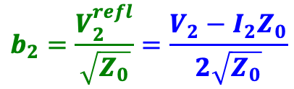


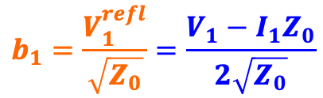





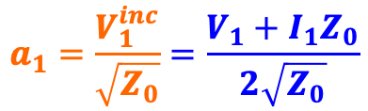
S-Parameters – $2$-port (1)
$$Z_{s}=Z_{0}$$
$$I_{1}$$
DUT
$$I_{2}$$
$$a_{1}$$
$$b_{2}$$
1
$$Z$$
2
$$V_{0}$$
$$Z_{0}$$
$$S_{11}$$
$$V_{1}$$
$$V_{2}$$
$$Z_{0}$$
$$Z_{L}=Z_{0}$$
$$S_{21}$$
$$b_{1}$$
1’
2’
port 1
port 2
Analysis of the forward S-parameters:
  $3+$-port networks still can be fully characterized with a $2$-port VNA, but always remember:
  ALWAYS: Terminated unused ports
  in their characteristic impedance!
$$a_{1}=\frac{V_{1}^{inc}}{\sqrt{Z_{0}}}=\frac{V_{1}+I_{1}Z_{0}}{2\sqrt{Z_{0}}}$$
  Independent
  parameters:
  Dependent
  parameters:
$$S_{11}={\left.\frac{b_{1}}{a_{1}} \right|}_{a_{2}=0}≡input reflection coefficient$$
$$(Z_{L}=Z_{0}⇒a_{2}=0)$$
$$S_{21}={\left.\frac{b_{2}}{a_{1}} \right|}_{a_{2}=0}≡forward transmission gain$$
$$b_{1}=\frac{V_{1}^{refl}}{\sqrt{Z_{0}}}=\frac{V_{1}−I_{1}Z_{0}}{2\sqrt{Z_{0}}}$$
$$b_{2}=\frac{V_{2}^{refl}}{\sqrt{Z_{0}}}=\frac{V_{2}−I_{2}Z_{0}}{2\sqrt{Z_{0}}}$$

Slide 10


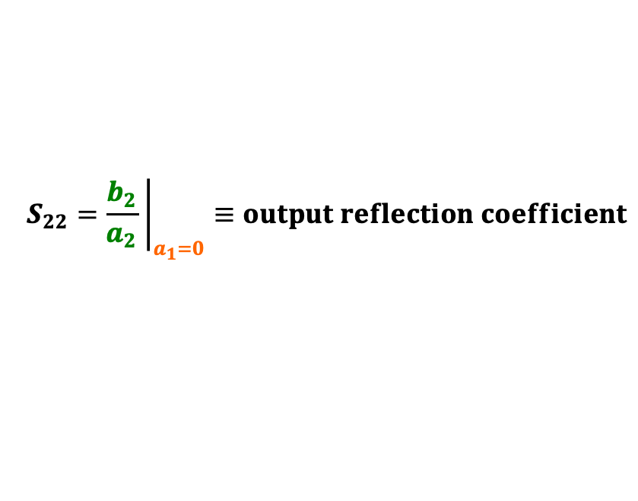











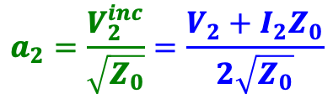





S-Parameters – $2$-port (2)
$$I_{1}$$
DUT
$$I_{2}$$
$$a_{2}$$
$$Z_{S}=Z_{0}$$
$$b_{1}$$
1
$$Z$$
2
$$b_{2}$$
$$V_{0}$$
$$Z_{L}=Z_{0}$$
$$Z_{0}$$
$$V_{1}$$
$$V_{2}$$
$$Z_{0}$$
$$S_{12}$$
$$S_{22}$$
1’
2’
port 1
port 2
Analysis of the reverse S-parameters:
  Examples of 2-ports DUT: filters, amplifiers, attenuators, transmission-lines (cables), etc.
  ALL ports ALWAYS need to be terminated
  in their characteristic impedance!
  Independent
  parameters:
  Dependent
  parameters:
$$S_{22}={\left.\frac{b_{2}}{a_{2}} \right|}_{a_{1}=0}≡output reflection coefficient$$
$$(Z_{L}=Z_{0}⇒a_{1}=0)$$
$$a_{2}=\frac{V_{2}^{inc}}{\sqrt{Z_{0}}}=\frac{V_{2}+I_{2}Z_{0}}{2\sqrt{Z_{0}}}$$
$$S_{12}={\left.\frac{b_{1}}{a_{2}} \right|}_{a_{1}=0}≡reverse transmission gain$$
$$b_{1}=\frac{V_{1}^{refl}}{\sqrt{Z_{0}}}=\frac{V_{1}−I_{1}Z_{0}}{2\sqrt{Z_{0}}}$$
$$b_{2}=\frac{V_{2}^{refl}}{\sqrt{Z_{0}}}=\frac{V_{2}−I_{2}Z_{0}}{2\sqrt{Z_{0}}}$$
JUAS Proc. 2024
II.2.7.4, pp. 833-835

Slide 11



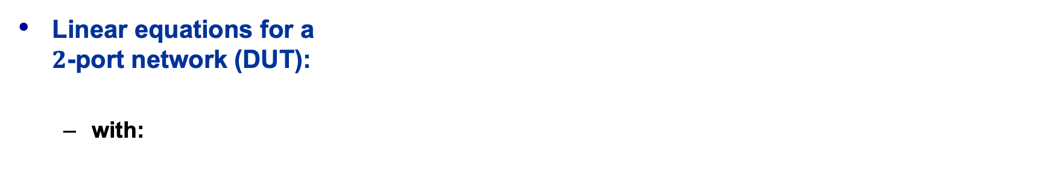





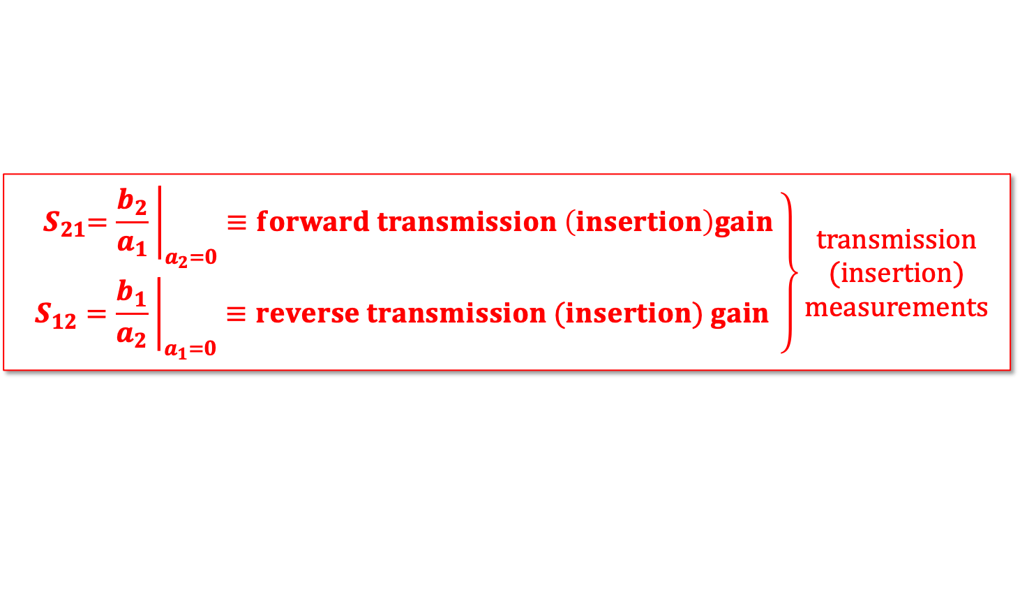

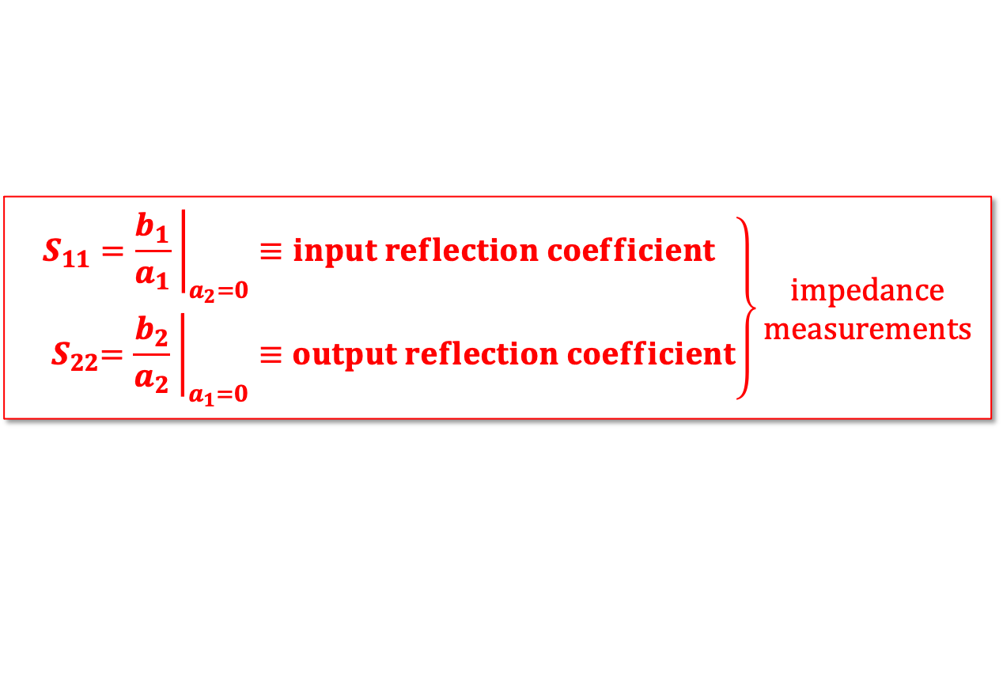


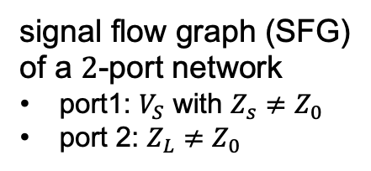



S-Parameters – $2$-port (3)
$$b_{S}=\frac{V_{S}\sqrt{Z_{0}}}{Z_{S}{+Z}_{0}}$$
port 1
port 2
Linear equations for a
$2$-port network (DUT):
  with:
$$b_{1}=S_{11}a_{1}+S_{12}a_{2} \\ b_{2}=S_{21}a_{1}+S_{22}a_{2}$$
$$a_{1}$$
$$S_{21}$$
$$b_{2}$$
$$1$$
$$Γ_{L}=\frac{Z_{L}{−Z}_{0}}{Z_{L}{+Z}_{0}}$$
$$Γ_{S}=\frac{Z_{S}{−Z}_{0}}{Z_{S}{+Z}_{0}}$$
$$S_{11}$$
$$S_{21}$$
$$\left.\begin{matrix}S_{11}={\left.\frac{b_{1}}{a_{1}} \right|}_{a_{2}=0}≡input reflection coefficient \\ { S}_{22}={\left.\frac{b_{2}}{a_{2}} \right|}_{a_{1}=0}≡output reflection coefficient\end{matrix}\right\}\begin{matrix}impedance \\ measurements\end{matrix}$$
$$b_{1}$$
$$S_{12}$$
$$a_{2}$$
signal flow graph (SFG)
of a $2$-port network
port1: $V_{S}$ with $Z_{s}≠Z_{0}$
port 2: $Z_{L}≠Z_{0}$
$$\left.\begin{matrix}{ S}_{21}={\left.\frac{b_{2}}{a_{1}} \right|}_{a_{2}=0}≡forward transmission \left(insertion\right)gain \\ S_{12}={\left.\frac{b_{1}}{a_{2}} \right|}_{a_{1}=0}≡reverse transmission (insertion) gain\end{matrix}\right\}\begin{matrix}transmission \\ (insertion) \\ measurements\end{matrix}$$
JUAS Proc. 2024
II.2.7.4, pp. 835/836

Slide 12


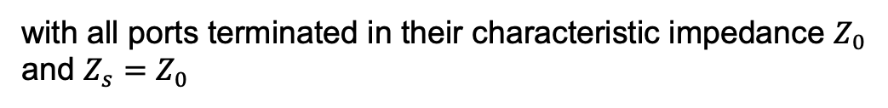

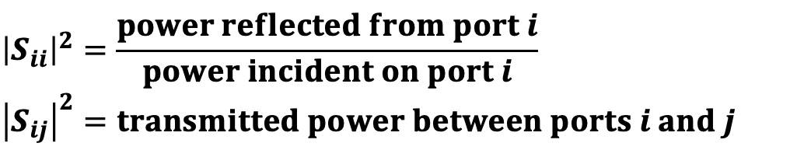
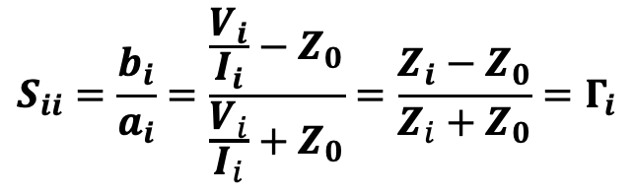
S-Parameters – $n$-port (1)
Reflection coefficient and impedance at the $i^{th}$-port of a RF network (DUT):
Power reflection and transmission for a $n$-port network (DUT):
$$S_{ii}=\frac{b_{i}}{a_{i}}=\frac{\frac{V_{i}}{I_{i}}−Z_{0}}{\frac{V_{i}}{I_{i}}+Z_{0}}=\frac{Z_{i}−Z_{0}}{Z_{i}+Z_{0}}=Γ_{i}$$
$$Z_{i}=Z_{0}\frac{1+S_{ii}}{{1−S}_{ii}} with Z_{i}=\frac{V_{i}}{I_{i}}being the input impedance at the i^{th}port$$
Here the US notation is used, where power $={\left|a_{i}\right|}^{2}$.
European notation (often): power $={{\left|a_{1}\right|}^{2}}/2$
These conventions have no impact on the S-parameters,
they are only relevant for absolute power calculations
$${\left|S_{ii}\right|}^{2}=\frac{power reflected from port i}{power incident on port i} \\ {\left|S_{ij}\right|}^{2}=transmitted power between ports i and j$$
with all ports terminated in their characteristic impedance $Z_{0}$
and $Z_{s}=Z_{0}$
JUAS Proc. 2024
II.2.7.5, p. 837

Slide 13

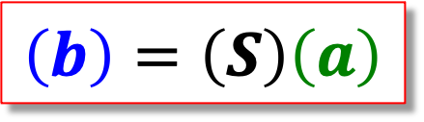
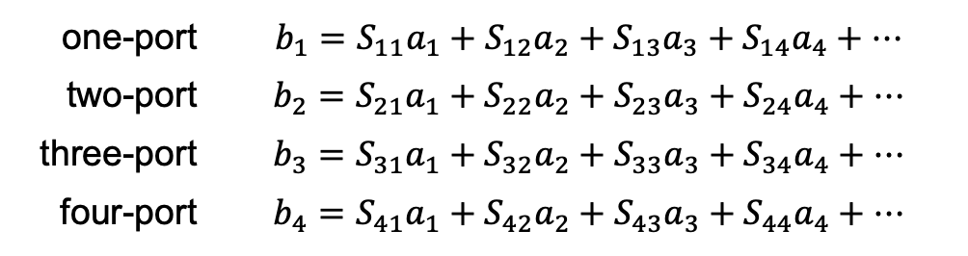
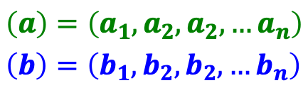
The Scattering Matrix
Waves traveling towards the n-port:
Waves traveling away from the n-port:
The relation between $a_{i}$ and $b_{i}$ ($i=1...n$) can be written as a
system of $n$ linear equations
($a_{i}=$ the independent variable, $b_{i}=$ the dependent variable)
  in compact matrix form follows
$$\left(a\right)=\left(a_{1},a_{2},a_{2},…a_{n}\right) \\ \left(b\right)=\left(b_{1},b_{2},b_{2},…b_{n}\right)$$
one-port | $$b_{1}=S_{11}a_{1}+S_{12}a_{2}+S_{13}a_{3}+S_{14}a_{4}+⋯$$
two-port | $$b_{2}=S_{21}a_{1}+S_{22}a_{2}+S_{23}a_{3}+S_{24}a_{4}+⋯$$
three-port | $$b_{3}=S_{31}a_{1}+S_{32}a_{2}+S_{33}a_{3}+S_{34}a_{4}+⋯$$
four-port | $$b_{4}=S_{41}a_{1}+S_{42}a_{2}+S_{43}a_{3}+S_{44}a_{4}+⋯$$
$$\left(b\right)=\left(S\right)\left(a\right)$$
JUAS Proc. 2024
II.2.7.5, p. 837/838

Slide 14
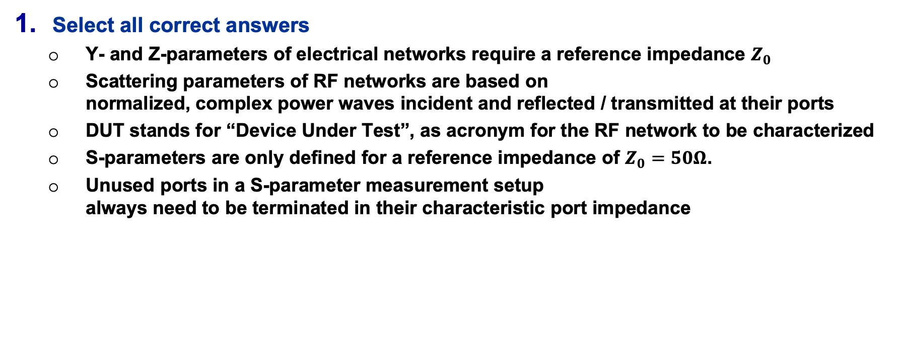
Quiz (1)
Select all correct answers
  Y- and Z-parameters of electrical networks require a reference impedance $Z_{0}$
  Scattering parameters of RF networks are based on
  normalized, complex power waves incident and reflected / transmitted at their ports
  DUT stands for “Device Under Test”, as acronym for the RF network to be characterized
  S-parameters are only defined for a reference impedance of $Z_{0}=50Ω$.
  Unused ports in a S-parameter measurement setup
  always need to be terminated in their characteristic port impedance

Slide 15


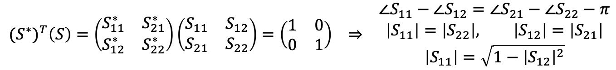
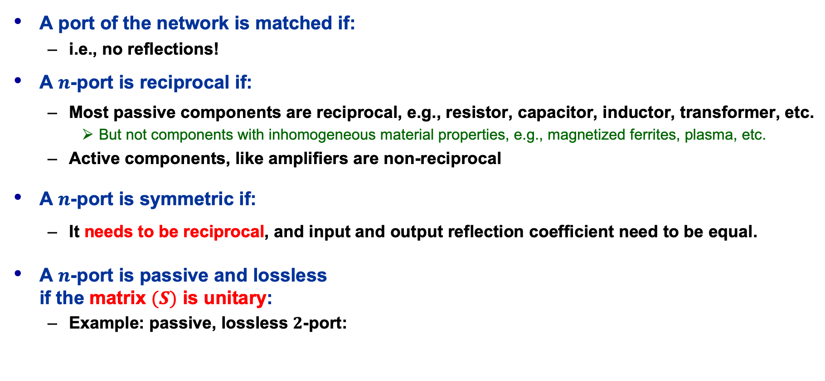
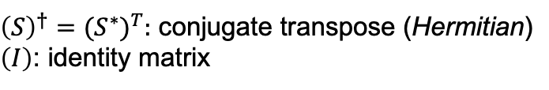



S-Matrix Properties
A port of the network is matched if:
  i.e., no reflections!
A $n$-port is reciprocal if:
  Most passive components are reciprocal, e.g., resistor, capacitor, inductor, transformer, etc.
    But not components with inhomogeneous material properties, e.g., magnetized ferrites, plasma, etc.
  Active components, like amplifiers are non-reciprocal
A $n$-port is symmetric if:
  It needs to be reciprocal, and input and output reflection coefficient need to be equal.
A $n$-port is passive and lossless
if the matrix $(S)$ is unitary:
  Example: passive, lossless $2$-port:
$$S_{ii}=0$$
$${(S)}^{T}=(S) ⇒ S_{ij}=S_{ji} ∀ i, j$$
${\left(S\right)}^{T}:$ transpose
Matrix symmetry
Matrix symmetry and
electrical symmetry
$$S_{ij}=S_{ji} ∧ S_{ii}=S_{jj}$$
${\left(S\right)}^{†}={(S^{∗})}^{T}:$ conjugate transpose (Hermitian)
$\left(I\right)$: identity matrix
$${\left(S\right)}^{†}\left(S\right)={\left(S\right)}^{T}{\left(S\right)}^{∗}=\left(I\right)$$
$${(S^{∗})}^{T}\left(S\right)=\left(\begin{matrix}S_{11}^{∗} & S_{21}^{∗} \\ S_{12}^{∗} & S_{22}^{∗}\end{matrix}\right)\left(\begin{matrix}S_{11} & S_{12} \\ S_{21} & S_{22}\end{matrix}\right)=\left(\begin{matrix}1 & 0 \\ 0 & 1\end{matrix}\right) ⇒ \begin{matrix}∠S_{11}−∠S_{12}=∠S_{21}−∠S_{22}−π \\ \left|S_{11}\right|=\left|S_{22}\right|, \left|S_{12}\right|=\left|S_{21}\right| \\ \left|S_{11}\right|=\sqrt{1−{\left|S_{12}\right|}^{2}}\end{matrix}$$
JUAS Proc. 2024
II.2.7.6, p. 838/839

Slide 16
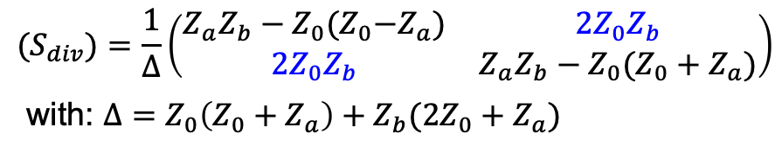

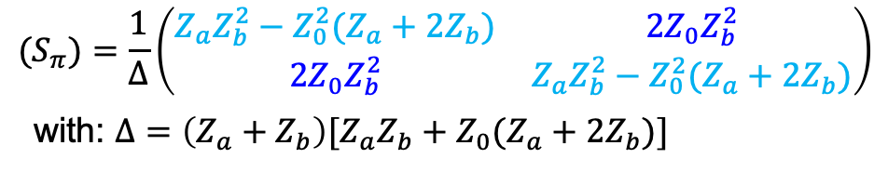





Examples for Symmetry and Reciprocity
$π$-network
voltage-divider network
1
2
1
2
$$Z_{a}$$
$$Z_{a}$$
$$Z_{b}$$
$$Z_{b}$$
$$Z_{b}$$
1’
2’
1’
2’
symmetry
$$(S_{π})=\frac{1}{Δ}\left(\begin{matrix}Z_{a}Z_{b}^{2}−Z_{0}^{2}(Z_{a}+2Z_{b}) & 2Z_{0}Z_{b}^{2} \\ 2Z_{0}Z_{b}^{2} & {Z_{a}Z_{b}^{2}−Z_{0}^{2}(Z_{a}+2Z}_{b})\end{matrix}\right)$$
with: $Δ=\left(Z_{a}+Z_{b}\right)[Z_{a}Z_{b}+Z_{0}(Z_{a}+2Z_{b})]$
$${(S}_{div})=\frac{1}{Δ}\left(\begin{matrix}Z_{a}Z_{b}−Z_{0}{(Z}_{0}−Z_{a}) & 2Z_{0}Z_{b} \\ 2Z_{0}Z_{b} & Z_{a}Z_{b}−Z_{0}(Z_{0}+Z_{a})\end{matrix}\right)$$
with: $Δ=Z_{0}\left(Z_{0}+Z_{a}\right)+Z_{b}(2Z_{0}+Z_{a})$
$S_{12}=S_{21}∧ S_{11}=S_{22} ⇒ reciprocal and symmetric$
$S_{12}=S_{21}∧ S_{11}≠S_{22} ⇒ reciprocal,but not symmetric$
Without prof: The S-matrix is always reciprocal for symmetric networks.
JUAS Proc. 2024
II.2.7.6, p. 840/841

Slide 17

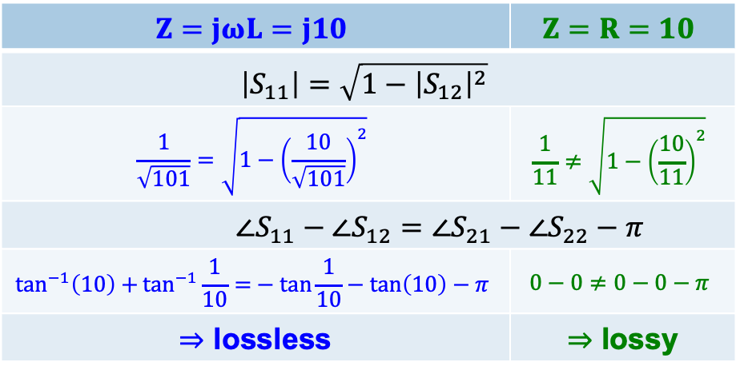

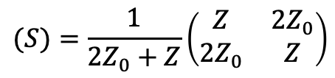

Numerical lossless / lossy Example
$2$-port series-network
1
2
$$Z$$
$$Z=jωL=j10$$ | $$Z=R=10$$
$$\left|S_{11}\right|=\sqrt{1−{\left|S_{12}\right|}^{2}}$$
$$\frac{1}{\sqrt{101}}=\sqrt{1−{\left(\frac{10}{\sqrt{101}}\right)}^{2}}$$ | $$\frac{1}{11}≠\sqrt{1−{\left(\frac{10}{11}\right)}^{2}}$$
$$∠S_{11}−∠S_{12}=∠S_{21}−∠S_{22}−π$$
$$\tan^{−1}\left(10\right)+\tan^{−1}{\frac{1}{10}=}−\tan{\frac{1}{10}}−\tan\left(10\right)−π$$ | $$0−0≠0−0−π$$
$⇒$ lossless | $⇒$ lossy
1’
2’
$$(S)=\frac{1}{2Z_{0}+Z}\left(\begin{matrix}Z & 2Z_{0} \\ 2Z_{0} & Z\end{matrix}\right)$$
$$S_{11}=S_{22} ∧ S_{12}=S_{21}$$
JUAS Proc. 2024
II.2.7.6, p. 841

Slide 18

Quiz (2)
Prompts |  | Possible Answers
matched | A4 | $S_{ii}=S_{ij}$
symmetric | B3 | ${\left(S^{∗}\right)}^{T}(S)=\left(I\right)$
reciprocal | C6 | $S_{ij}=S_{ji} ∧ S_{ii}=S_{jj}$
passive and lossless | D2 | $S_{ii}=0$
 |  | $Γ=+j$
 |  | $S_{ij}=S_{ji}$

Slide 19

Quiz (3)
port 1
port 2
$$a_{1}$$
$$a_{2}$$
$2$-port
$$b_{1}$$
$$b_{2}$$
Mark all correct answers for the S-parameters of a 2-port RF network
  $a_{1}$ and $b_{1}$ are independent parameters
  $S_{11}$ is the input reflection coefficient
  $a_{1}$ and $a_{2}$ are the incident waves at port 1 and port 2, respectively.
  $b_{1}$ and $b_{2}$ are the transmitted waves between port 1 and port 2, and vice versa.
  $S_{21}$ and $S_{12}$ are the forward and reverse transmission gains.
  To characterize the S-parameters at port 2, port 1 needs to be terminated
  in its characteristic port impedance.

Slide 20



S-Matrix Examples – $1$-port
Examples for $1$-port S-matrices are any simple, passive (complex) impedances $Z$
  Any R, L, C, RL, RC, LC and RLC circuit or any combinations of those elements leading to a single port network, which of course also my include distributed (transmission-line) elements
  “Special” cases are:
    $Z=Z_{0} ⇒ S_{11}=0$ (matched, ideal termination)
    $Z=0 ⇒ S_{11}=−1$ (ideal short)
    $Z=∞ ⇒ S_{11}=+1$ (ideal open)
  If $\left|S_{11}\right|>1$ an active element is involved, e.g., a reflection amplifier
Strictly speaking, a simple RF resonator, e.g., a “pill-box” cavity, is a $3$-port
  One coaxial or waveguide port as RF power coupler, plus two beam (waveguide) ports.
However, for many practical cases it can be treated as $1$-port
  The mode of interest,
  e.g., TM010, is trapped with no or negligible fields contribution near the beam-ports
  We consider only a single coupler to characterize,
  e.g., the TM010 mode in terms of a $1$-port S-parameter measurement
    Typically applying an RLC-parallel equivalent circuit
$$\left(S\right)=S_{11}=Γ$$
JUAS Proc. 2024
II.2.7.7.1, pp. 842/843

Slide 21






































S-Matrix Examples – $2$-port
Ideal (matched: $Z=Z_{0}$) transmission-line of length $ℓ$
  For a lossless transmission-line:
  For a lossless line of length $ℓ=λ/4$:
Ideal attenuator
signal flow graph (SFG):
$$\left(S\right)=\left(\begin{matrix}0 & e^{−γℓ} \\ e^{−γℓ} & 0\end{matrix}\right)$$
$γ=α+jβ$: propagation constant
$α$: attenuation constant in [Np/m]
$β=2π/λ$: phase constant [rad/m]
port 1
port 2
$$a_{1}$$
$$e^{−γℓ}$$
$$b_{2}$$
$$α=0 ⇒ \left|S_{21}\right|=\left|S_{12}\right|=1$$
$$\left(S\right)=\left(\begin{matrix}0 & −j \\ −j & 0\end{matrix}\right)$$
$$b_{1}$$
$$e^{−γℓ}$$
$$a_{2}$$
SFG example: 3 dB attenuator
$$\left(S\right)=\left(\begin{matrix}0 & k \\ k & 0\end{matrix}\right)$$
$k=V_{2}/V_{1}={10}^{−(ΔdB/20)}$: attenuation $k<1, k∈ℝ$
$ΔdB=20\log_{10}{V_{1}/V_{2}}$: attenuation in dB
$α=−\ln{k}$: attenuation in neper
port 1
port 2
$$S_{21}=\frac{b_{2}}{a_{1}}=\frac{1}{\sqrt{2}}$$
$$a_{1}$$
$$k=1/\sqrt{2}$$
$$b_{2}$$
$T$-attenuator:
$$R_{A}=\frac{1−k}{1+k}Z_{0} \\ R_{B}=\frac{2k}{1−k^{2}}Z_{0}$$
$π$-attenuator:
$$R_{1}=\frac{1−k}{1+k}Z_{0} \\ R_{2}=\frac{1−k^{2}}{2k}Z_{0}$$
$$1$$
$$R_{A}$$
$$R_{A}$$
$$2$$
$$1$$
$$R_{2}$$
$$2$$
$$R_{1}$$
$$R_{1}$$
$$S_{12}=\frac{a_{2}}{b_{1}}=\frac{1}{\sqrt{2}}$$
$$R_{B}$$
$$b_{1}$$
$$k=1/\sqrt{2}$$
$$a_{2}$$
$$1’$$
$$2’$$
$$1’$$
$$2’$$
JUAS Proc. 2024
II.2.7.7.2, pp. 843/844

Slide 22















S-Matrix Examples – $2$-port
Ideal amplifier (gain stage)
Low-noise RF transistor
  Avago VMMK-1218
  E-pHEMT GaAs FET
    The S-parameters are different at other frequencies
    and operational conditions
    The transistor requires impedance matching networks at in- and output
port 2
port 1
$$a_{1}$$
$$G_{V}$$
$$b_{2}$$
$$\left(S\right)=\left(\begin{matrix}0 & 0 \\ G_{V} & 0\end{matrix}\right)$$
$G_{V}=V_{out}/V_{in}={10}^{g/20}$: voltage gain $G_{V}>1$
$g=20\log_{10}{V_{0ut}/V_{in}}$: voltage gain in dB
$$\left(S\right)=\left(\begin{matrix}0.78e^{j158°} & 0.08e^{−j24°} \\ 3.43e^{j42°} & 0.3e^{−j159°}\end{matrix}\right)$$
Datasheet Avago VMMK-1218:
$$f=10 GHz, Z_{0}=50Ω, T_{A}=25°C,$$
$$V_{ds}=2V, I_{ds}=20mA$$
port 1
port 2
$$a_{1}$$
$$3.43e^{j42°}$$
$$b_{2}$$
$$.78e^{j158°}$$
$$.3e^{−j159°}$$
$$b_{1}$$
$$.08e^{−j24°}$$
$$a_{2}$$
JUAS Proc. 2024
II.2.7.7.2, pp. 844/845

Slide 23


























S-Matrix Examples – $3$-port
$3$-port resistive power divider
  The transfer-loss between $ij$-ports is 6 dB.
Ideal circulator
  Matched, but not reciprocal
port 1
port 2
$$a_{1}$$
$$b_{2}$$
$$\begin{matrix}b_{1}=\frac{1}{2}\left(a_{2}+a_{3}\right) \\ b_{2}=\frac{1}{2}\left(a_{1}+a_{3}\right) \\ b_{3}=\frac{1}{2}\left(a_{1}+a_{2}\right)\end{matrix}$$
$$Z_{0}/3$$
$$Z_{0}/3$$
$$\left(S\right)=\frac{1}{2}\left(\begin{matrix}0 & 1 & 1 \\ 1 & 0 & 1 \\ 1 & 1 & 0\end{matrix}\right)$$
$$b_{1}$$
$$a_{2}$$
$$Z_{0}/3$$
port 3
$$a_{3}$$
$$b_{3}$$
$$a_{2}$$
Isolator, based on the circulator
  Terminating, e.g., port 3 internally results in a $2$-port, called isolator
$$b_{2}$$
port 2
$$\left(S\right)=\left(\begin{matrix}0 & 0 & 1 \\ 1 & 0 & 0 \\ 0 & 1 & 0\end{matrix}\right)$$
$$\begin{matrix}b_{1}=a_{3} \\ b_{2}=a_{1} \\ b_{3}=a_{2}\end{matrix}$$
$$\left(S\right)=\left(\begin{matrix}0 & 0 \\ 1 & 0\end{matrix}\right)$$
$$b_{2}=a_{1}$$
port 1
port 3
port 1
port 2
$$a_{1}$$
$$b_{3}$$
$$a_{1}$$
$$b_{2}$$
$$b_{1}$$
$$a_{3}$$
JUAS Proc. 2024
II.2.7.7.3, pp. 845/846

Slide 24




S-Matrix Example – $4$-port
Ideal directional coupler
  Matched, symmetric, infinite isolation
  Distinguishes between forward and reflected
  signal power on the main line port 1-2
    Forward power at coupled port 3
    Reflected power at coupled port 4
port 1
port 2
transmitted
input
$$\left(S\right)=\left(\begin{matrix}0 & τ & κ & 0 \\ τ & 0 & 0 & κ \\ κ & 0 & 0 & τ \\ 0 & κ & τ & 0\end{matrix}\right)$$
isolated
port 4
port 3
coupled
$$τ:transmission coefficient \\ κ:coupling coeffient$$
double-symmetry
https://en.wikipedia.org/wiki/Power_dividers_and_directional_couplers
JUAS Proc. 2024
II.2.7.7.4, pp. 846/847

Slide 25







S-Matrix Example – 4-port
Ideal, lossless TEM directional coupler
  The coupled port 3 is in-phase with the input port 1
  The main line output port 2 is in quadrature phase ($π/2$ phase delay) with the input port 1
  Lossless TEM direction coupler:
$$\left(S\right)=\left(\begin{matrix}0 & −jt & k & 0 \\ −jt & 0 & 0 & k \\ k & 0 & 0 & −jt \\ 0 & k & −jt & 0\end{matrix}\right)$$
Lossless conditions:
$$\sum_{k=1}^{N}{{\left|S_{ki}\right|}^{2}=1}$$
$${\left(S\right)}^{†}\left(S\right)=\left(I\right) ⇒\sum_{k=1}^{N}{S_{ki}S_{kj}^{∗}=0 ∀ i≠j} ∧\sum_{k=1}^{N}{S_{ki}S_{ki}^{∗}=\sum_{k=1}^{N}{{\left|S_{ki}\right|}^{2}=1}}$$
$$\sum_{k=1}^{N}{S_{ki}S_{kj}^{∗}=0 }$$
$$\sum_{k=1}^{N}{{\left|S_{ki}\right|}^{2}=1} ⇒ k^{2}+t^{2}=1 ⇒ t=\sqrt{1−k^{2}}$$
$$\left(S\right)=\left(\begin{matrix}0 & −j\sqrt{1−k^{2}} & k & 0 \\ −j\sqrt{1−k^{2}} & 0 & 0 & k \\ k & 0 & 0 & −j\sqrt{1−k^{2}} \\ 0 & k & −j\sqrt{1−k^{2}} & 0\end{matrix}\right)$$
JUAS Proc. 2024
II.2.7.7.4, pp. 847/848

Slide 26

S-Parameters in Practice
In practice, S-parameters are a function of the frequency: $S(f)$
  Some instruments or applications can also provide time-domain S-parameters
In most real-world practical situations, S-parameters are acquired by a measurement, e.g., characterization of a RF component or sub-system by a VNA.
  By characterizing the DUT over a range of frequencies, $f_{min}<f<f_{max}$ in steps of $Δf$
Also, numerical RF analysis tools (Qucs, ADS, Microwave Office, etc.)
generate S-parameters through linear RF circuit / systems simulations.
  Numerical EM software tools (CST, HFSS, etc.) and PCB tools (Cadence Allegro)
  can also generate S-parameters
Both application types, VNA measurements and RF/EM simulation software exchange S-parameters on a file basis
  The SnP Touchstone ASCII file format is de-facto the industry standard for S-parameters
  Example Touchstone s2p file:
JUAS Proc. 2024
II.2.7.8, pp. 848/849

Slide 27






SnP Touchstone S-Parameter Files
$2$-port VNA file
! header
Touchstone v1.1 example file
v2.0 is different, file ext. *.ts
# format
frequency $f$
${|S}_{11}|$[dB]
${∠S}_{11}$[deg]
JUAS Proc. 2024
II.2.7.8, p. 849
The file name extension specifies the number $n$ of ports
  Attention: NOT equal to the number of columns! The carriage return (CR) is different between s1p, s2p and s3p, s4p files!
The comment header (!) includes general information, e.g., type of instrument, measurement time, etc.
The format line (#) defines the format (mag[dB]/angle[deg], mag/angle, real/imag), stimulus units and the reference impedance
The column delimiter varies, e.g., space, comma, semicolon, etc.
  Column order in the example file: f_Hz S11_dB S11_deg S21_dB S21_deg S12_dB S12_deg S22_dB S22_deg

Slide 28

















T-Parameters
Cascading e.g., $2$-port S-parameter networks is important to characterize a larger RF system.
  Solution: Scattering transfer (T) parameters, which directly relates the waves at input and output
  T-parameters enable cascaded $2$-port networks by simply multiplying their matrices:
  Relation between $2$-port T-parameters and S-parameters:
$$a_{1}^{(1)}$$
$$a_{2}^{(1)}$$
$$a_{1}^{(2)}$$
$$a_{2}^{(2)}$$
$$\left(T\right)=\left(\begin{matrix}T_{11} & T_{12} \\ T_{12} & T_{22}\end{matrix}\right) ⇒ \begin{matrix}b_{1}=T_{11}a_{2}+T_{12}b_{2} \\ a_{1}=T_{21}a_{2}+T_{22}b_{2}\end{matrix}$$
$$T^{(1)}$$
$$T^{(2)}$$
$$b_{1}^{(1)}$$
$$b_{2}^{(1)}$$
$$b_{1}^{(2)}$$
$$b_{2}^{(2)}$$
$$\left(T\right)=\left(T^{(1)}\right)\left(T^{(2)}\right)⋯\left(T^{\left(N\right)}\right)$$
$$\left(T\right)=\frac{1}{S_{21}}\left(\begin{matrix}−det⁡(S) & S_{11} \\ −S_{22} & 1\end{matrix}\right)$$
$$\left(S\right)=\frac{1}{T_{22}}\left(\begin{matrix}T_{12} & det⁡(T) \\ 1 & −T_{21}\end{matrix}\right)$$
with: $\det\left(S\right)=S_{11}S_{22}−S_{12}S_{21}$
with: $\det\left(T\right)=T_{11}T_{22}−T_{12}T_{21}$
JUAS Proc. 2024
II.2.7.9, pp. 850/851

Slide 29












ABCD-Parameters
Also called “chain” parameters, used for cascading networks based on V and I
  Useful for chaining a mix of lumped elements and transmission-lines
  Chaining 2-port ABCD-parameter networks:
  Relation between $2$-port ABCD-parameters
  and S-parameters:
$$\left(ABCD\right)=\left(\begin{matrix}A & B \\ C & D\end{matrix}\right) ⇒ \begin{matrix}V_{1}=AV_{2}−BI_{2} \\ I_{1}=CV_{2}−DI_{2}\end{matrix}$$
$$I_{1}^{(1)}$$
$${−I}_{2}^{(1)}$$
$$I_{1}^{(2)}$$
$${−I}_{2}^{(2)}$$
$${ABCD}^{(1)}$$
$${ABCD}^{(2)}$$
$$V_{1}^{(1)}$$
$$V_{2}^{(1)}$$
$$V_{1}^{(2)}$$
$$V_{2}^{(2)}$$
Please try to follow
Example II.2.7.3
JUAS Proc. 2024
II.2.7.10, p. 852/853
$$\left(ABCD\right)=\left({ABCD}^{(1)}\right)\left({ABCD}^{(2)}\right)⋯\left({ABCD}^{\left(N\right)}\right)$$
$$\left(T\right)=\frac{1}{2S_{21}}\left(\begin{matrix}\left(1+S_{11}\right)\left(1−S_{22}\right)+S_{12}S_{21} & {[\left(1+S_{11}\right)\left(1+S_{22}\right)−S_{12}S_{21}]Z}_{0} \\ {\left[\left(1−S_{11}\right)\left(1−S_{22}\right)−S_{12}S_{21}\right]/Z}_{0} & \left(1−S_{11}\right)\left(1+S_{22}\right)+S_{12}S_{21}\end{matrix}\right)$$
$$\left(S\right)=\frac{1}{A+B/Z_{0}+CZ_{0}+D}\left(\begin{matrix}A+B/Z_{0}−CZ_{0}−D & 2(AD−BC) \\ 2 & −A+B/Z_{0}−CZ_{0}+D\end{matrix}\right)$$
JUAS Proc. 2024
II.2.7.10, pp. 851/852

Slide 30










General $n$-Port Networks
A general $n$-port may include ports of different technologies, i.e., waveguides, as well as TEM transmission-lines, such as coaxial lines, microstrip lines etc.
  In the frequency range of interest different modes may propagate at each physical port, e.g., several waveguide modes in a rectangular waveguide and/or higher order modes in a coaxial line..
  Each EM-mode must then be represented
  by a distinct modal port.
    This is very important in EM-simulation
    to ensure the absorption of the energy for all modes!
  The number of modal ports needed
  generally, increases with frequency,
  as more waveguide modes can propagate.
$$H_{10}$$
$$H_{11}^{x}$$
modal
$5$-port
physical
$3$-port
$$H_{20}$$
$$H_{11}^{y}$$
$$TEM$$
$H_{11}^{x}, H_{11}^{y}$: $x, y$-polarization of the $E_{11}$ circular mode
JUAS Proc. 2024
II.2.7.11, pp. 853-855

Slide 31
Summary
The scattering (S) parameters are based on incident and reflected normalized complex voltage waves (power waves), defined at the ports of a RF network.
S-Parameters are used to characterize a linear, time-invariant RF component, circuit or sub-system as function of frequency under realistic operational conditions
  The S-parameters are given in a matrix notation, and have complex values
The characteristic of the S-matrix may provide additional details about the network, such as reciprocity, symmetry, losses.
Typically, the S-parameters matrix of a RF network is acquired by measurement characterization with a vector network analyzer (VNA), or by a numerical analysis, e.g., circuit analysis or electromagnetic simulation software
The S-parameter matrices of a set of networks can be converted to transfer (T) parameter matrices to enable a simple cascading of those networks
The number of logical, modal ports might be higher than the number of physical ports for a general RF network utilizing various transmission-line technologies.

Slide 32
Backup Slides

Slide 33













The Scattering Matrix (2)
Its simplest form is for
a passive 1-port network:
  with the reflection coefficient:
Most popular is the
2-port network:
  An unmatched load, present at port 2 with a reflection coefficient $Γ_{load}$ transfers to the input port as:
$$\left(S\right)=S_{11} ⇒ b_{1}=S_{11}a_{1}$$
reference
plane
$$a_{1}$$
$$Γ=S_{11}=\frac{b_{1}}{a_{1}}$$
$1$-port
$$b_{1}$$
port 1
$$\left(S\right)=\left(\begin{matrix}S_{11} & S_{12} \\ S_{12} & S_{22}\end{matrix}\right) ⇒ \begin{matrix}b_{1}=S_{11}a_{1}+S_{12}a_{2} \\ b_{2}=S_{21}a_{1}+S_{22}a_{2}\end{matrix}$$
port 1
port 2
$$a_{1}$$
$$a_{2}$$
$2$-port
$$b_{1}$$
$$b_{2}$$
$$Γ_{in}=S_{11}+\frac{S_{21}Γ_{load}S_{12}}{1−S_{22}Γ_{load}}$$

Slide 34
Numerical lossless / lossy Examples
$2$-port series-network
$4$-port ideal directional coupler
1
$$\left(S\right)=\frac{1}{2}\left(\begin{matrix}0 & \sqrt{3} & j & 0 \\ \sqrt{3} & 0 & 0 & j \\ j & 0 & 0 & \sqrt{3} \\ 0 & j & \sqrt{3} & 0\end{matrix}\right)$$
2
$$(S)=\frac{1}{2Z_{0}+Z}\left(\begin{matrix}Z & 2Z_{0} \\ 2Z_{0} & Z\end{matrix}\right)$$
$$Z$$
$$S_{11}=S_{22} ∧ S_{12}=S_{21}$$
1’
2’
$$Z=jωL=j10$$ | $$Z=R=10$$
$$\left|S_{11}\right|=\sqrt{1−{\left|S_{12}\right|}^{2}}$$
$$\frac{1}{\sqrt{101}}=\sqrt{1−{\left(\frac{10}{\sqrt{101}}\right)}^{2}}$$ | $$\frac{1}{11}≠\sqrt{1−{\left(\frac{10}{11}\right)}^{2}}$$
$$∠S_{11}−∠S_{12}=∠S_{21}−∠S_{22}−π$$
$$\tan^{−1}\left(10\right)+\tan^{−1}{\frac{1}{10}=}−\tan{\frac{1}{10}}−\tan\left(10\right)−π$$ | $$0−0≠0−0−π$$
$⇒$ lossless | $⇒$ lossy
It is evident, this ideal $4$-port coupler is symmetric and reciprocal
It also is matched:
But is it lossless or lossy?
$S_{ij}=S_{ji}∧ S_{ii}=S_{jj}$
$S_{ii}=0$

Slide 35
Numerical lossless / lossy Examples
$2$-port series-network
$4$-port ideal directional coupler
$$\left(S_{dc}\right)=\frac{1}{2}\left(\begin{matrix}0 & \sqrt{3} & j & 0 \\ \sqrt{3} & 0 & 0 & j \\ j & 0 & 0 & \sqrt{3} \\ 0 & j & \sqrt{3} & 0\end{matrix}\right)$$
$$\left(S_{dc}\right)=\frac{1}{2}\left(\begin{matrix}0 & \sqrt{3} & j & 0 \\ \sqrt{3} & 0 & 0 & j \\ j & 0 & 0 & \sqrt{3} \\ 0 & j & \sqrt{3} & 0\end{matrix}\right)$$
$$\left(S_{dc}\right)=\frac{1}{2}\left(\begin{matrix}0 & \sqrt{3} & j & 0 \\ \sqrt{3} & 0 & 0 & j \\ j & 0 & 0 & \sqrt{3} \\ 0 & j & \sqrt{3} & 0\end{matrix}\right)$$
$$\left(S_{dc}\right)=\frac{1}{2}\left(\begin{matrix}0 & \sqrt{3} & j & 0 \\ \sqrt{3} & 0 & 0 & j \\ j & 0 & 0 & \sqrt{3} \\ 0 & j & \sqrt{3} & 0\end{matrix}\right)$$
1
$$\left(S_{dc}\right)=\frac{1}{2}\left(\begin{matrix}0 & \sqrt{3} & j & 0 \\ \sqrt{3} & 0 & 0 & j \\ j & 0 & 0 & \sqrt{3} \\ 0 & j & \sqrt{3} & 0\end{matrix}\right)$$
2
$${(S}_{ser})=\frac{1}{2Z_{0}+Z}\left(\begin{matrix}Z & 2Z_{0} \\ 2Z_{0} & Z\end{matrix}\right)$$
$$Z$$
$$S_{11}=S_{22} ∧ S_{12}=S_{21}$$
1’
2’
$${\left(S\right)}^{†}\left(S\right)=\left(I\right) ⇒\sum_{k=1}^{N}{S_{ki}S_{ki}^{∗}=1} ∧ \sum_{k=1}^{N}{S_{ki}S_{kj}^{∗}=0 ∀ i≠j}$$
$${\left(S\right)}^{†}\left(S\right)=\left(I\right) ⇒\sum_{k=1}^{N}{S_{ki}S_{ki}^{∗}=1} ∧ \sum_{k=1}^{N}{S_{ki}S_{kj}^{∗}=0 ∀ i≠j}$$
$$Z=jωL=j10$$ | $$Z=R=10$$
$$\left|S_{11}\right|=\sqrt{1−{\left|S_{12}\right|}^{2}}$$
$$\frac{1}{\sqrt{101}}=\sqrt{1−{\left(\frac{10}{\sqrt{101}}\right)}^{2}}$$ | $$\frac{1}{11}≠\sqrt{1−{\left(\frac{10}{11}\right)}^{2}}$$
$$∠S_{11}−∠S_{12}=∠S_{21}−∠S_{22}−π$$
$$\tan^{−1}\left(10\right)+\tan^{−1}{\frac{1}{10}=}−\tan{\frac{1}{10}}−\tan\left(10\right)−π$$ | $$0−0≠0−0−π$$
$⇒$ lossless | $⇒$ lossy
Multiply matrix columns by itself with the conjugate complex
  and test for $=1$
$$S_{11}S_{11}^{∗}+S_{21}S_{21}^{∗}+S_{31}S_{31}^{∗}+S_{41}S_{41}^{∗}=(0∙0+\sqrt{3}∙\sqrt{3}+j∙\left(−j\right)+0∙0)/2^{2}=1$$
$$S_{12}S_{12}^{∗}+S_{22}S_{22}^{∗}+S_{32}S_{32}^{∗}+S_{42}S_{42}^{∗}=(\sqrt{3}∙\sqrt{3}+0∙0+0∙0+j∙\left(−j\right))/2^{2}=1$$
$$S_{13}S_{13}^{∗}+S_{23}S_{23}^{∗}+S_{33}S_{33}^{∗}+S_{43}S_{43}^{∗}=(j∙\left(−j\right)+0∙0+0∙0+\sqrt{3}∙\sqrt{3})/2^{2}=1$$
$$S_{14}S_{14}^{∗}+S_{24}S_{24}^{∗}+S_{34}S_{34}^{∗}+S_{44}S_{44}^{∗}=(0∙0+j∙\left(−j\right)+\sqrt{3}∙\sqrt{3}+0∙0)/2^{2}=1$$

Slide 36
Numerical lossless / lossy Examples
$2$-port series-network
$4$-port ideal directional coupler
$$\left(S_{dc}\right)=\frac{1}{2}\left(\begin{matrix}0 & \sqrt{3} & j & 0 \\ \sqrt{3} & 0 & 0 & j \\ j & 0 & 0 & \sqrt{3} \\ 0 & j & \sqrt{3} & 0\end{matrix}\right)$$
1
$$\left(S_{dc}\right)=\frac{1}{2}\left(\begin{matrix}0 & \sqrt{3} & j & 0 \\ \sqrt{3} & 0 & 0 & j \\ j & 0 & 0 & \sqrt{3} \\ 0 & j & \sqrt{3} & 0\end{matrix}\right)$$
2
$${(S}_{ser})=\frac{1}{2Z_{0}+Z}\left(\begin{matrix}Z & 2Z_{0} \\ 2Z_{0} & Z\end{matrix}\right)$$
$$Z$$
$$S_{11}=S_{22} ∧ S_{12}=S_{21}$$
1’
2’
$${\left(S\right)}^{†}\left(S\right)=\left(I\right) ⇒\sum_{k=1}^{N}{S_{ki}S_{ki}^{∗}=1} ∧ \sum_{k=1}^{N}{S_{ki}S_{kj}^{∗}=0 ∀ i≠j}$$
$${\left(S\right)}^{†}\left(S\right)=\left(I\right) ⇒\sum_{k=1}^{N}{S_{ki}S_{ki}^{∗}=1} ∧ \sum_{k=1}^{N}{S_{ki}S_{kj}^{∗}=0 ∀ i≠j}$$
$$Z=jωL=j10$$ | $$Z=R=10$$
$$\left|S_{11}\right|=\sqrt{1−{\left|S_{12}\right|}^{2}}$$
$$\frac{1}{\sqrt{101}}=\sqrt{1−{\left(\frac{10}{\sqrt{101}}\right)}^{2}}$$ | $$\frac{1}{11}≠\sqrt{1−{\left(\frac{10}{11}\right)}^{2}}$$
$$∠S_{11}−∠S_{12}=∠S_{21}−∠S_{22}−π$$
$$\tan^{−1}\left(10\right)+\tan^{−1}{\frac{1}{10}=}−\tan{\frac{1}{10}}−\tan\left(10\right)−π$$ | $$0−0≠0−0−π$$
$⇒$ lossless | $⇒$ lossy
Multiply all different matrix columns with the conjugate complex
  and test for $=0$
$$S_{11}S_{12}^{∗}+S_{21}S_{22}^{∗}+S_{31}S_{32}^{∗}+S_{41}S_{42}^{∗}=(0∙\sqrt{3}+\sqrt{3}∙0+j∙0+0∙(−j))/2^{2}=0$$
$$S_{11}S_{13}^{∗}+S_{21}S_{23}^{∗}+S_{31}S_{33}^{∗}+S_{41}S_{43}^{∗}=(0∙(−j)+\sqrt{3}∙0+j∙0+0∙\sqrt{3})/2^{2}=0$$
$$S_{11}S_{14}^{∗}+S_{21}S_{24}^{∗}+S_{31}S_{34}^{∗}+S_{41}S_{44}^{∗}=(0∙0+\sqrt{3}∙(−j)+j∙\sqrt{3}+0∙0)/2^{2}=0$$
$$S_{12}S_{13}^{∗}+S_{22}S_{23}^{∗}+S_{32}S_{33}^{∗}+S_{42}S_{43}^{∗}=(\sqrt{3}∙(−j)+0∙0+0∙0+j∙\sqrt{3})/2^{2}=0$$
$$S_{12}S_{14}^{∗}+S_{22}S_{24}^{∗}+S_{32}S_{34}^{∗}+S_{42}S_{44}^{∗}=(\sqrt{3}∙0+0∙(−j)+0∙\sqrt{3}+j∙0)/2^{2}=0$$
$$S_{13}S_{14}^{∗}+S_{23}S_{24}^{∗}+S_{33}S_{34}^{∗}+S_{43}S_{44}^{∗}=(j∙0+0∙(−j)+0∙\sqrt{3}+\sqrt{3}∙0)/2^{2}=0$$

