Slide 1
RF Engineering
Introduction to the Smith Chart
Christine Völlinger & Manfred Wendt – CERN

Slide 2
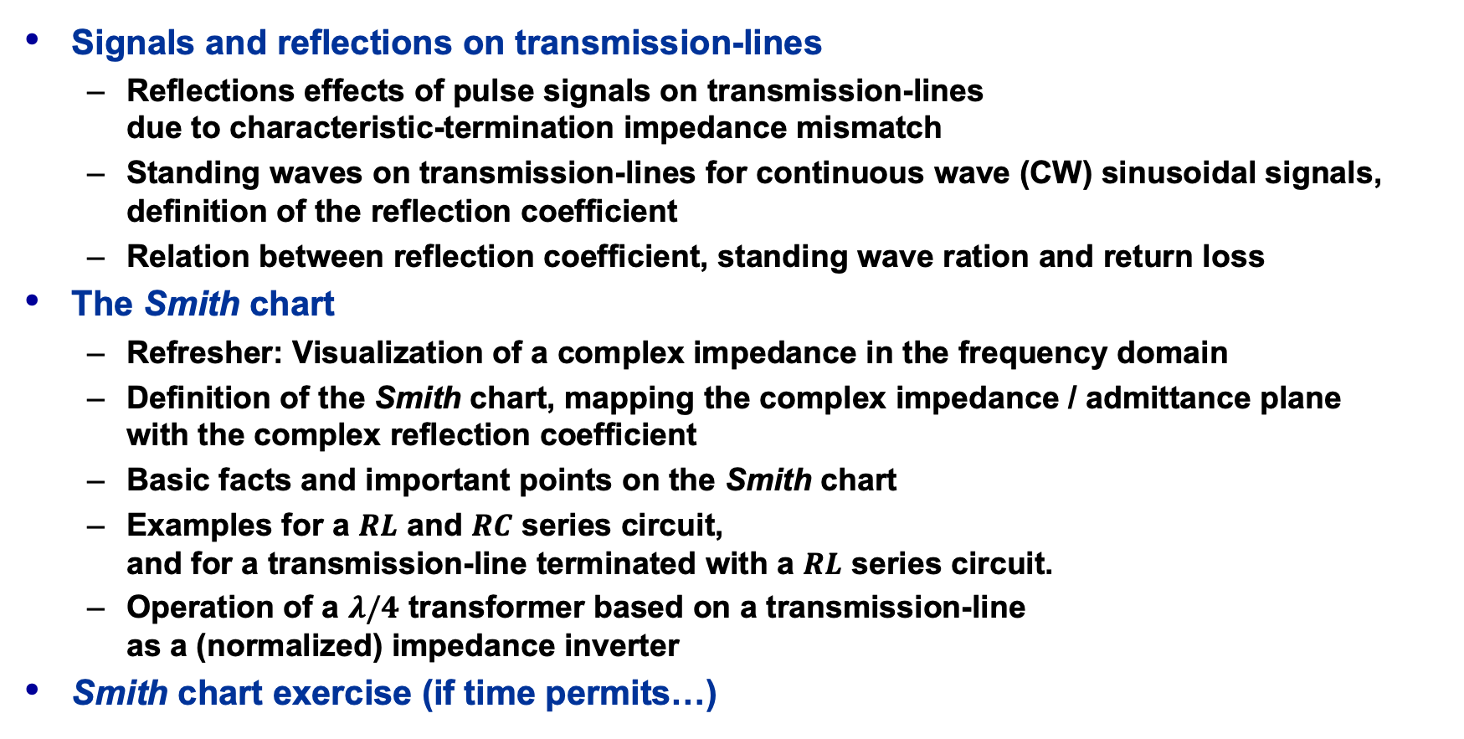
Outline and Objectives
Signals and reflections on transmission-lines
  Reflections effects of pulse signals on transmission-lines
  due to characteristic-termination impedance mismatch
  Standing waves on transmission-lines for continuous wave (CW) sinusoidal signals, definition of the reflection coefficient
  Relation between reflection coefficient, standing wave ration and return loss
The Smith chart
  Refresher: Visualization of a complex impedance in the frequency domain
  Definition of the Smith chart, mapping the complex impedance / admittance plane
  with the complex reflection coefficient
  Basic facts and important points on the Smith chart
  Examples for a $RL$ and $RC$ series circuit,
  and for a transmission-line terminated with a $RL$ series circuit.
  Operation of a $λ/4$ transformer based on a transmission-line
  as a (normalized) impedance inverter
Smith chart exercise (if time permits…)
Please note the references
to the JUAS proceedings!
JUAS Proc. 2024
II.2.x.y.z, p. nnn

Slide 3
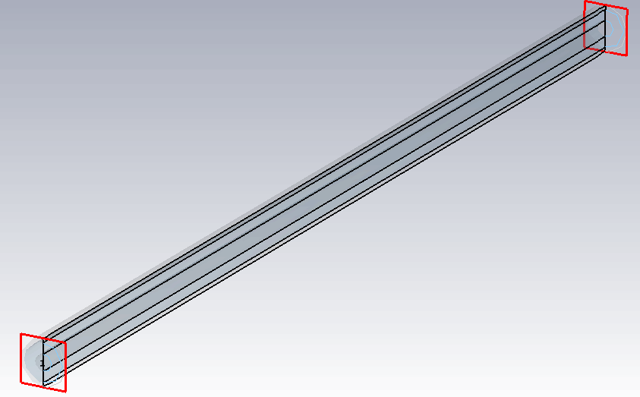



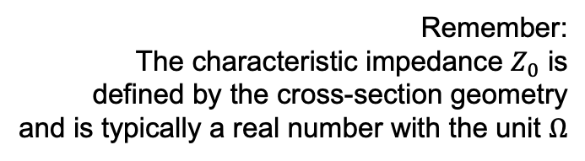


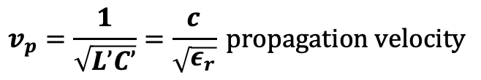
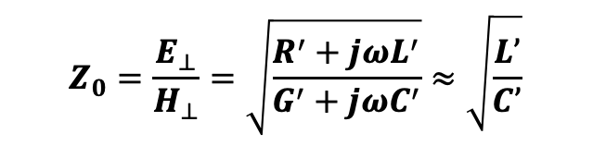




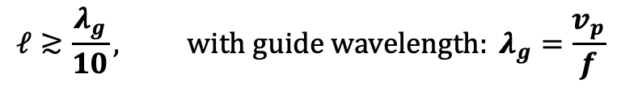


Transmission-lines
TEM: coaxial cable, PCB stripline, micro-stripline, co-planar waveguide, etc.
  but also, TE / TM: waveguides (rectangular, circular, elliptical)
Transport RF energy (EM waves) from a RF source to a load.
Physical length $ℓ$ becomes relevant for
Reflections occur if the load impedance $Z_{L}$
is not matched to the characteristic
impedance $Z_{0}$ of the TL
load
$$Z_{L}$$
transmission-line,
here: TEM coaxial
$$ℓ≳\frac{λ_{g}}{10}, with guide wavelength: λ_{g}=\frac{v_{p}}{f}$$
$$Z_{0}, γ$$
$$f:operating frequency (max.)$$
$$v_{p}=\frac{1}{\sqrt{L’C’}}=\frac{c}{\sqrt{ε_{r}}} propagation velocity$$
$$ℓ$$
Remember:
The characteristic impedance $Z_{0}$ is
defined by the cross-section geometry
and is typically a real number with the unit $Ω$
$$Z_{S}$$
$$Z_{L}=Z_{0} ⇒Γ=0:no reflections$$
$$Z_{0}=\frac{E_{⊥}}{H_{⊥}}=\sqrt{\frac{R^{′}+{jωL}^{′}}{G^{′}+{jωC}^{′}}}≈\sqrt{\frac{L’}{C’}}$$
$$v_{S}$$
$Z_{L}≠Z_{0} ⇒Γ≠0:reflections$!
RF source
with losses no losses

Slide 4
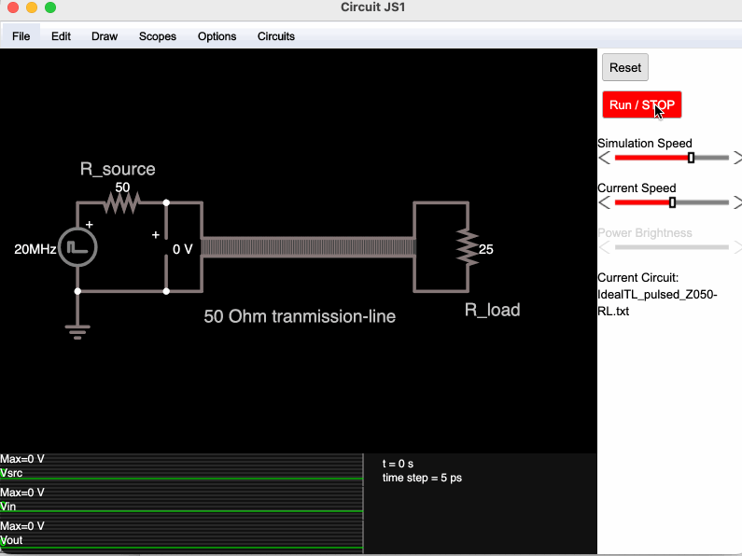
TL: Signal visualization in time-domain
Circuit simulator applet:
https://www.falstad.com/circuit/
  Load file: IdealTL_DCswitched_Z050-RL.txt
    Change the load resistor value:
    RL = 50, 100, 25 Ω
    Operate the switch and observe the signals at the beginning, and at the end of the transmission-line.
  Load file:
  IdealTL_pulsed_Z050-RL.txt
    Change the load resistor value:
    RL = 50, 100, 25 Ω
    Observe the signal waveforms!
    Can you predict the values?!
      (Press Run/STOP and hover with the mouse over the waveform)
JUAS Proc. 2024
II.2.6, p. 807

Slide 5
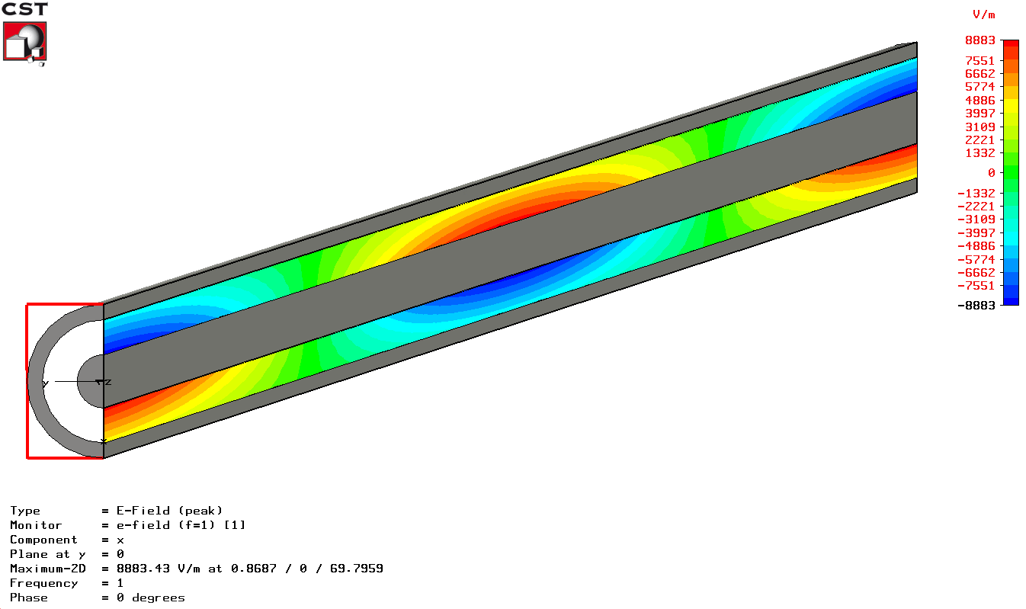
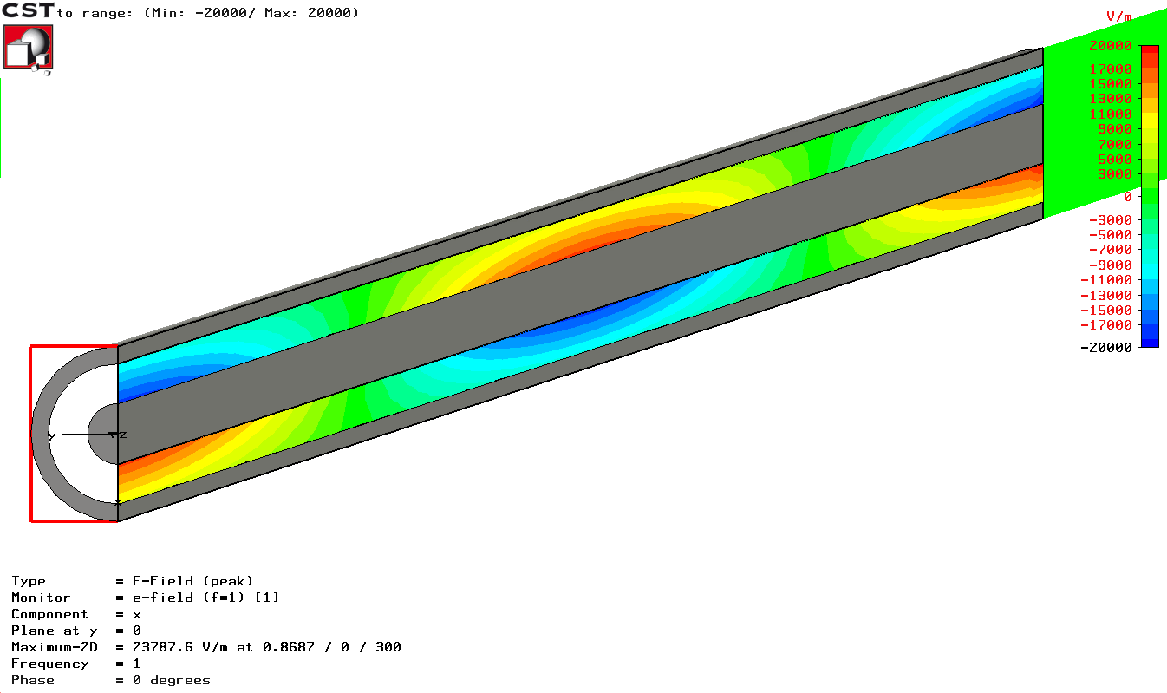
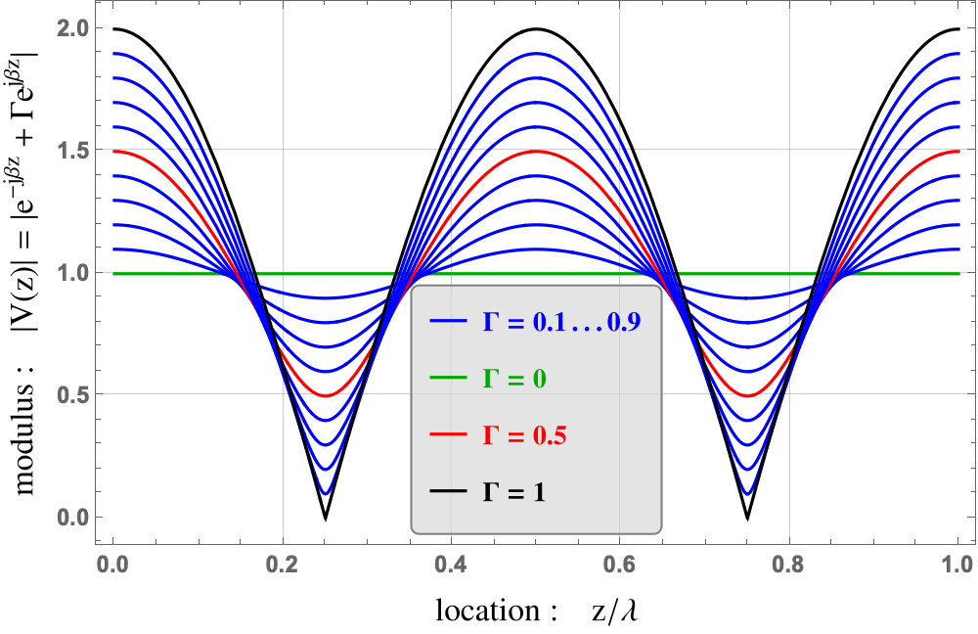
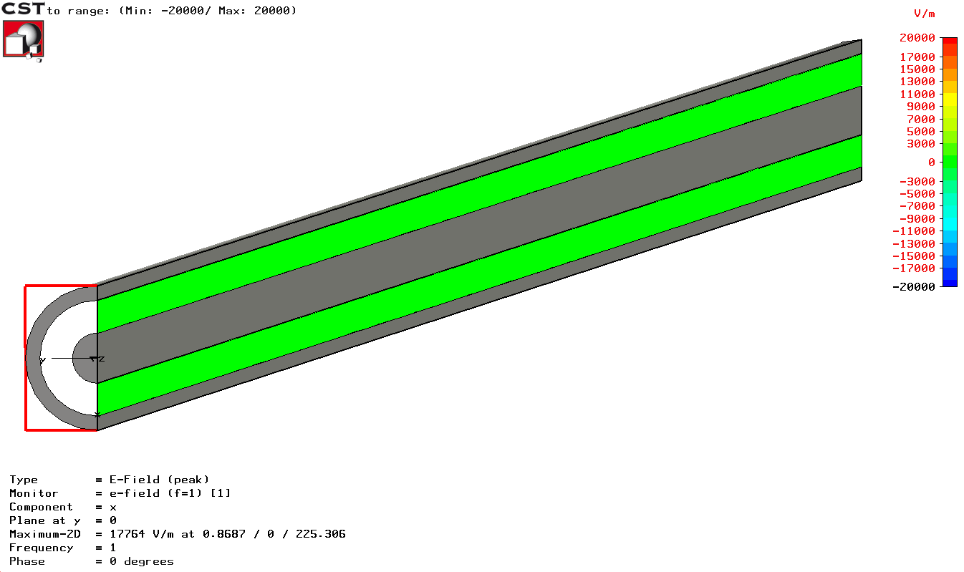


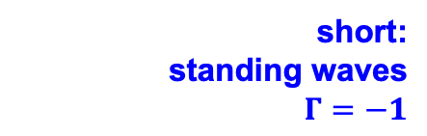

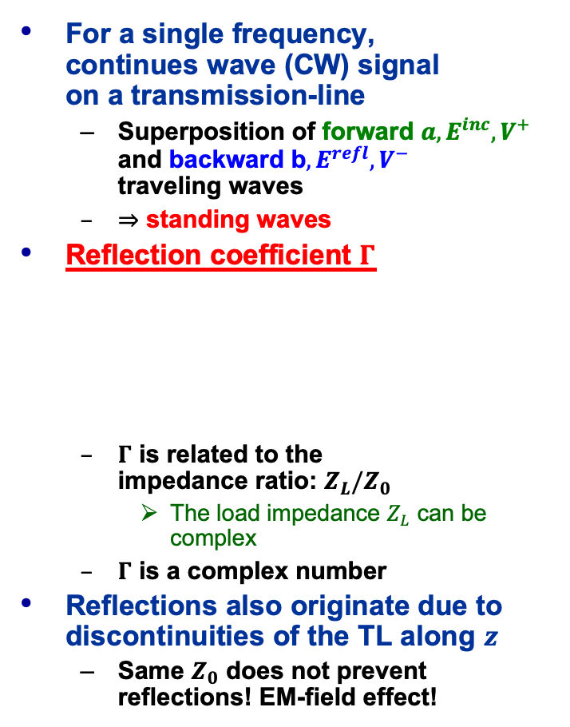

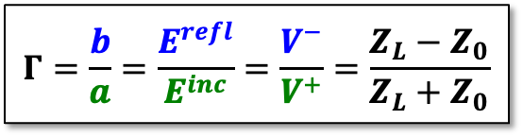



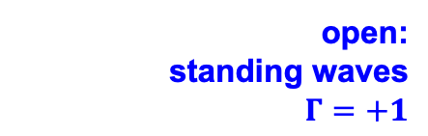
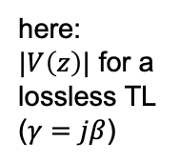
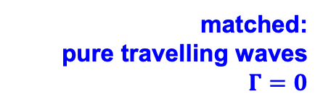


TL: Operating with sinusoidal signals (FD)
For a single frequency,
continues wave (CW) signal
on a transmission-line
  Superposition of forward $a, E^{inc},V^{+}$ and backward b$, E^{refl}, V^{−}$
  traveling waves
  $⇒$ standing waves
Reflection coefficient $Γ$
  $Γ$ is related to the
  impedance ratio: $Z_{L}/Z_{0}$
    The load impedance $Z_{L}$ can be complex
  $Γ$ is a complex number
Reflections also originate due to discontinuities of the TL along $z$
  Same $Z_{0}$ does not prevent reflections! EM-field effect!
$$f=1 GHz$$
$$λ=30 cm$$
incident wave: $V^{+}e^{−γz} ⟹$
reflected wave: $V^{−}e^{γz} ⟸$
$$Z_{S}=Z_{0}$$
transmission-line
load
matched:
pure travelling waves
$$Γ=0$$
p1
$$Z_{0}, γ=jβ$$
p2
$$Z_{L}$$
source
(sine-wave
generator)
$$z$$
$$Γ=\frac{b}{a}=\frac{E^{refl}}{E^{inc}}=\frac{V^{−}}{V^{+}}=\frac{Z_{L}−Z_{0}}{Z_{L}+Z_{0}}$$
$$0$$
$$ℓ$$
open:
standing waves
$$Γ=+1$$
waves
E-fields
voltages
impedances
here:
$|V\left(z\right)|$ for a
lossless TL
($γ=jβ$)
short:
standing waves
$$Γ=−1$$
JUAS Proc. 2024
II.2.6.1, pp. 810/811

Slide 6
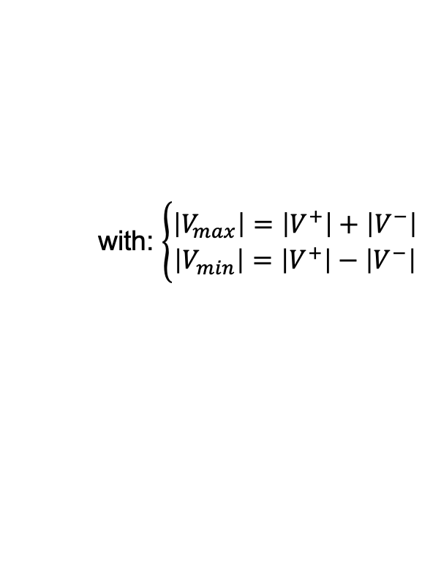
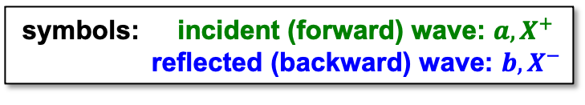
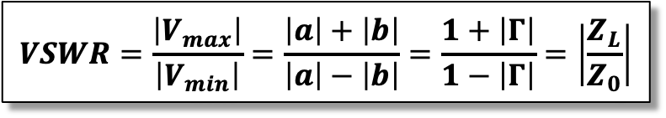
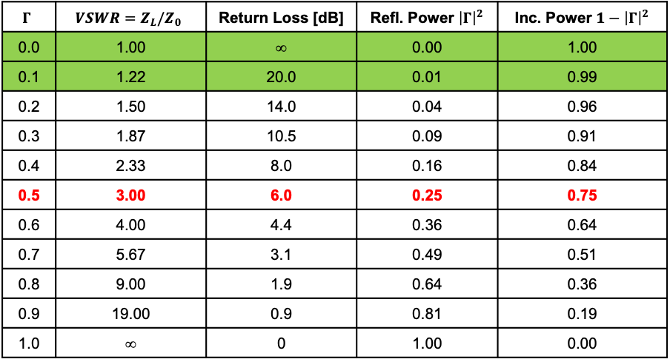
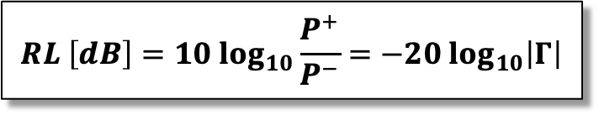
TL: Voltage Standing Wave Ratio (VSWR)
The voltage standing wave ratio (VSWR) expresses the ratio between the maximum and minimum voltage of a standing wave along a transmission-line
  The VSWR is a function of the frequency.
The return loss (RL) is another way
to express reflection effects
$$VSWR=\frac{\left|V_{max}\right|}{\left|V_{min}\right|}=\frac{\left|a\right|+\left|b\right|}{\left|a\right|−\left|b\right|}=\frac{1+\left|Γ\right|}{1−\left|Γ\right|}=\left|\frac{Z_{L}}{Z_{0}}\right|$$
with: $\left\{\begin{aligned}\left|V_{max}\right|=\left|V^{+}\right|+\left|V^{−}\right| \\ \left|V_{min}\right|=\left|V^{+}\right|−\left|V^{−}\right|\end{aligned}\right.$
symbols: incident (forward) wave: $a, X^{+}$
reflected (backward) wave: $b, X^{−}$
$$Γ$$ | $$VSWR=Z_{L}/Z_{0}$$ | Return Loss [dB] | Refl. Power ${\left|Γ\right|}^{2}$ | Inc. Power ${1−\left|Γ\right|}^{2}$
0.0 | 1.00 | ∞ | 0.00 | 1.00
0.1 | 1.22 | 20.0 | 0.01 | 0.99
0.2 | 1.50 | 14.0 | 0.04 | 0.96
0.3 | 1.87 | 10.5 | 0.09 | 0.91
0.4 | 2.33 | 8.0 | 0.16 | 0.84
0.5 | 3.00 | 6.0 | 0.25 | 0.75
0.6 | 4.00 | 4.4 | 0.36 | 0.64
0.7 | 5.67 | 3.1 | 0.49 | 0.51
0.8 | 9.00 | 1.9 | 0.64 | 0.36
0.9 | 19.00 | 0.9 | 0.81 | 0.19
1.0 | ∞ | 0 | 1.00 | 0.00
$$RL \left[dB\right]=10 \log_{10}\frac{P^{+}}{P^{−}}=−20 \log_{10}\left|Γ\right|$$
JUAS Proc. 2024
II.2.6.1, pp. 810/811

Slide 7



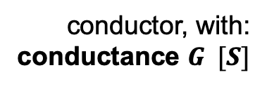
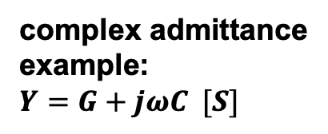


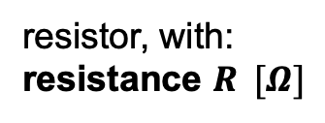

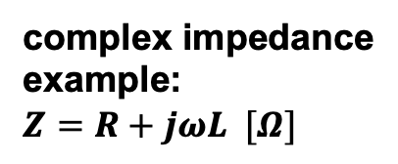
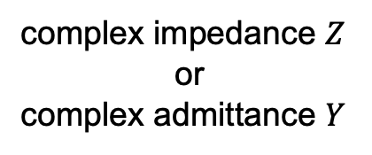
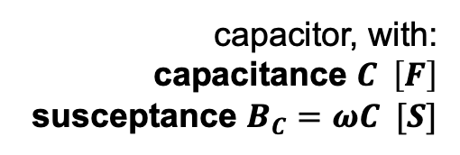


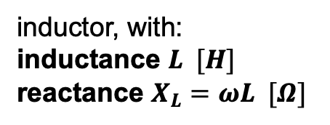

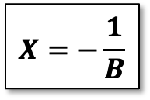
Reminder: Circuit Vocabulary
conductor, with:
conductance $G [S]$
resistor, with:
resistance $R [Ω]$
$$R$$
complex impedance
example:
$Z=R+jωL [Ω]$
$$L$$
inductor, with:
inductance $L [H]$
reactance $X_{L}=ωL [Ω]$
suceptance $B_{L}=1/ωL [S]$
complex admittance
example:
$Y=G+jωC [S]$
capacitor, with:
capacitance $C \left[F\right]$
susceptance $B_{C}=ωC [S]$
$$C$$
$$G$$
reactance $X_{C}=−1/ωC [Ω]$
complex impedance $Z$
or
complex admittance $Y$
Resistance, impedance, reactance are inverse proportional to conductance, susceptance, admittance
$Z$ or $Y$
$$R=\frac{1}{G}$$
$$Z=\frac{1}{Y}$$
$$X=−\frac{1}{B}$$
JUAS Proc. 2024
II.2.6.2, pp. 811/812

Slide 8
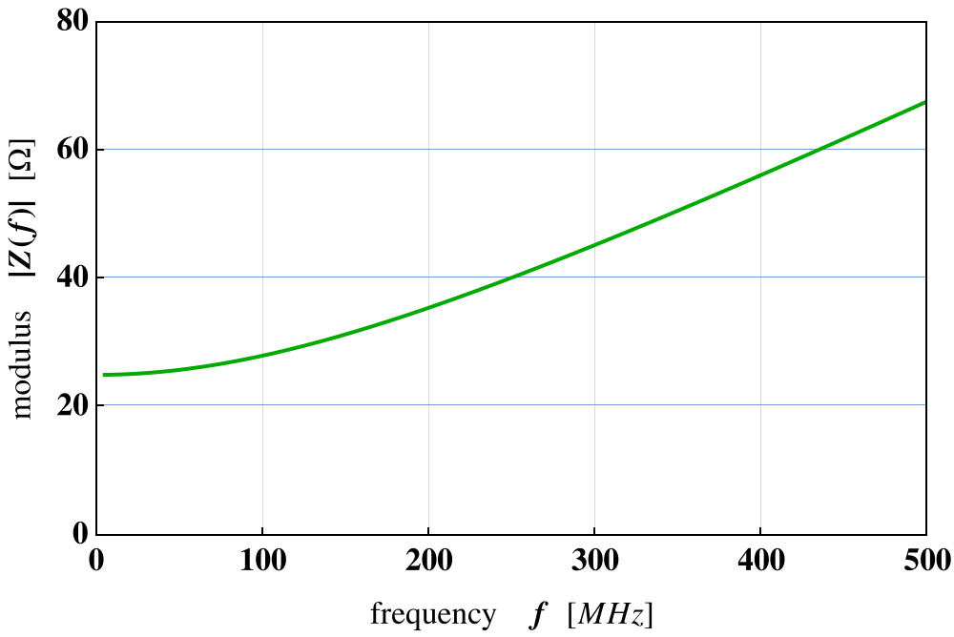
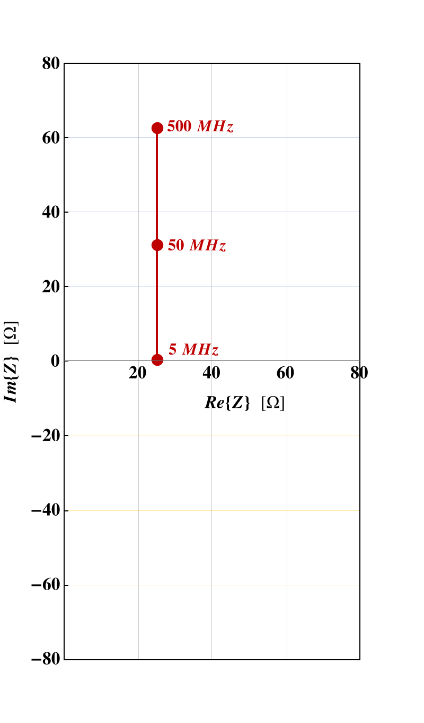
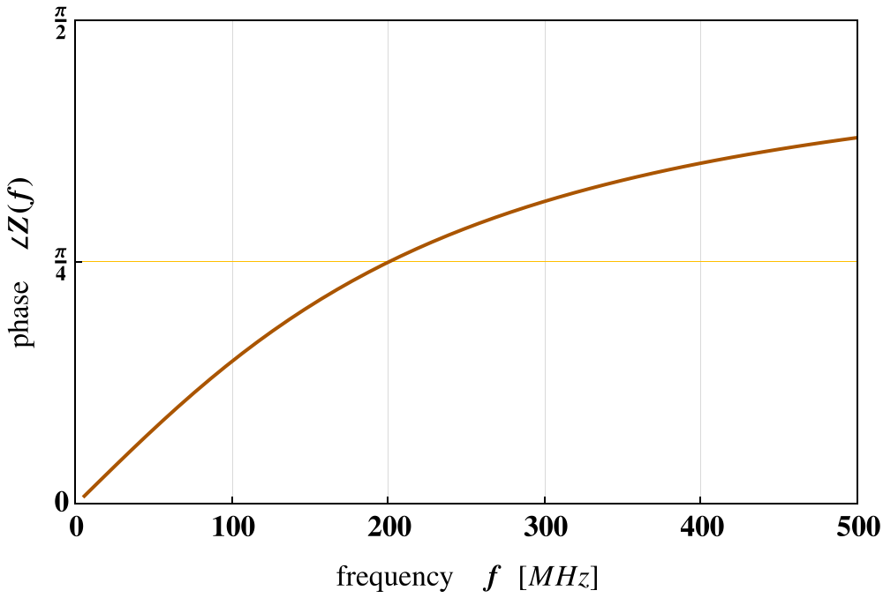
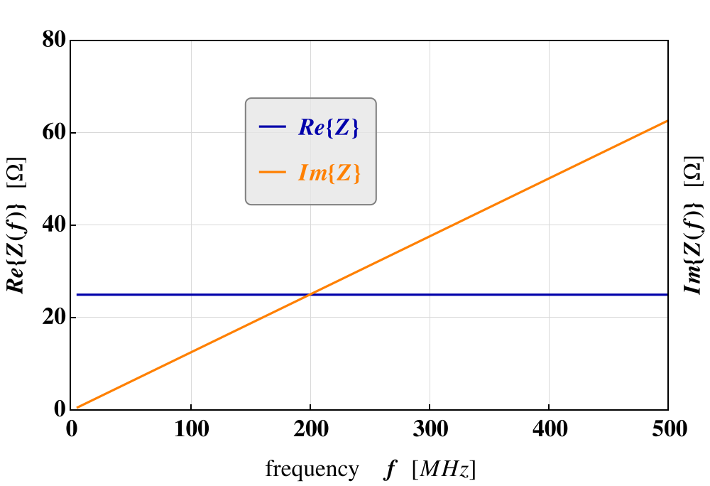



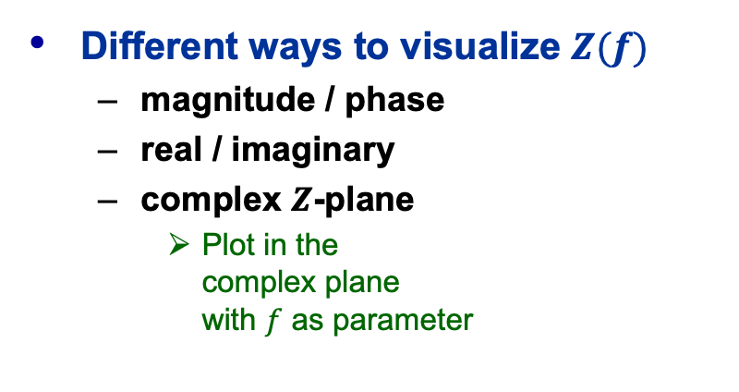

Reminder: The complex $Z$-Plane
Different ways to visualize $Z(f)$
  magnitude / phase
  real / imaginary
  complex $Z$-plane
    Plot in the
    complex plane
    with $f$ as parameter
$$R=25 Ω$$
$$Z(f)$$
$$L=20 nH$$
complex impedance plane
JUAS Proc. 2024
II.2.6.2, p. 813

Slide 9
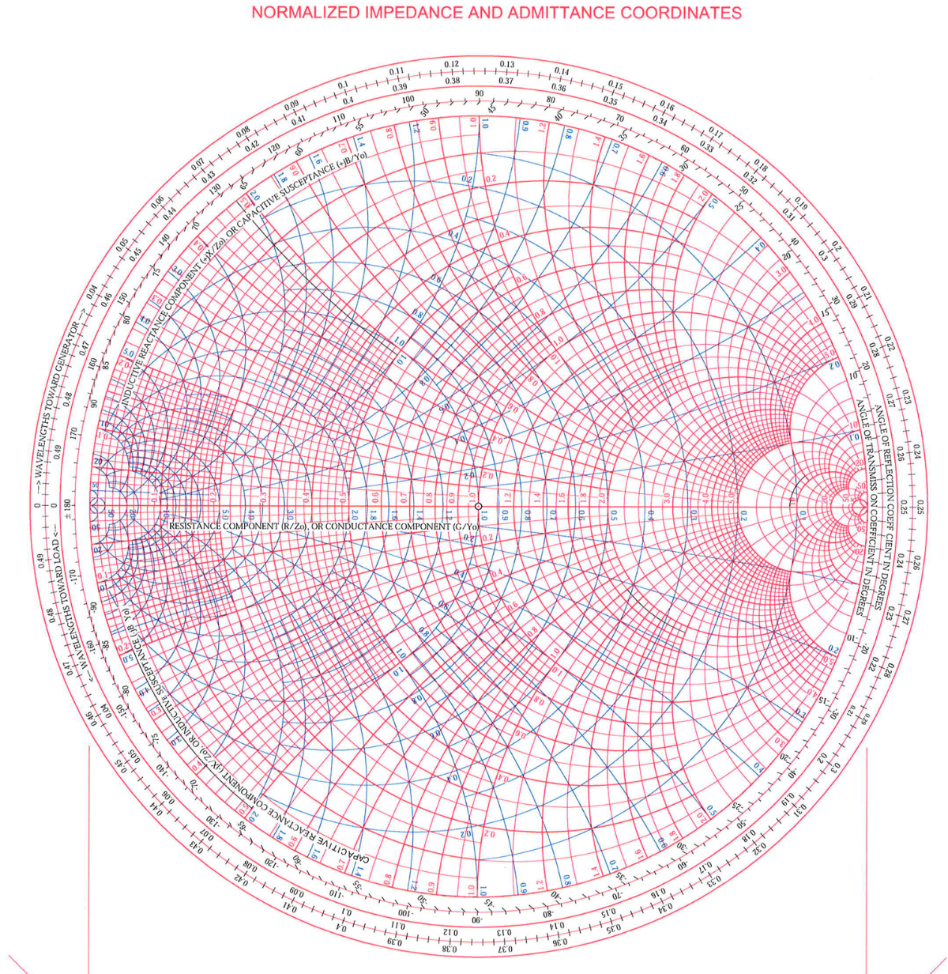

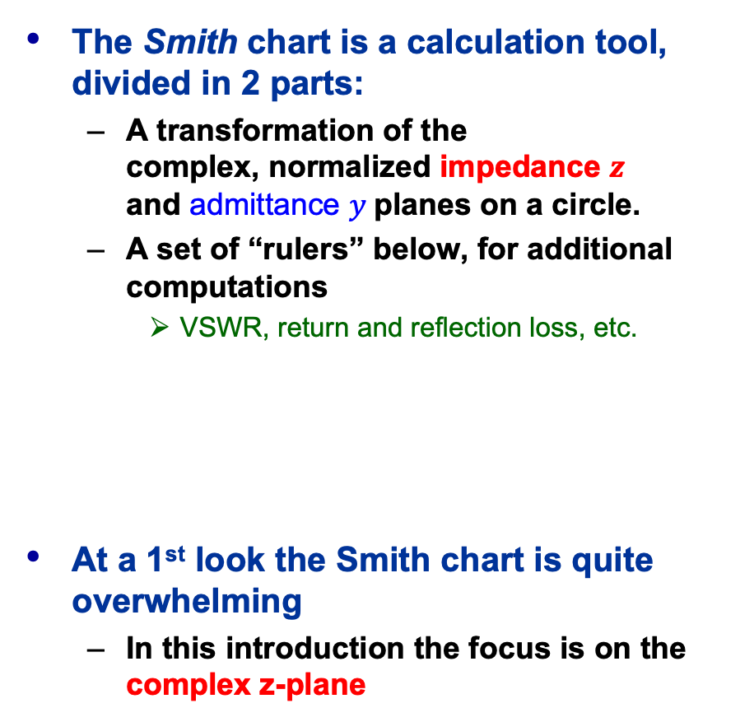
The Smith Chart (1)
The Smith chart is a calculation tool, divided in 2 parts:
  A transformation of the
  complex, normalized impedance $z$
  and admittance $y$planes on a circle.
  A set of “rulers” below, for additional computations
    VSWR, return and reflection loss, etc.
At a 1st look the Smith chart is quite overwhelming
  In this introduction the focus is on the complex z-plane
JUAS Proc. 2024
II.2.6.3, p. 814

Slide 10

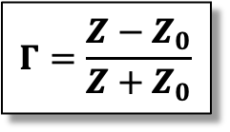









The Smith Chart (2)
The Smith chart (in impedance / admittance coordinates)
represents the complex $Γ$-plane (in polar coordinates) within the unit circle.
It is a conformal mapping of the complex $Z$-plane
on the $Γ$-plane by applying the transformation:
⇒ the real positive half plane of $Z$ is thus
transformed (Möbius) into the interior of the unit circle!
$$ℑ\{Z\}$$
$$\left|Γ\right|$$
complex
$Γ$-plane
$$ℑ\{Z\}$$
$$Γ=\frac{Z−Z_{0}}{Z+Z_{0}}$$
complex
$Z$-plane
$$∠Γ$$
$$Z_{0}$$
$$ℜ\{Z\}$$
$$Z_{0}$$
$$ℜ\{Z\}$$
JUAS Proc. 2024
II.2.6.3, p. 815

Slide 11
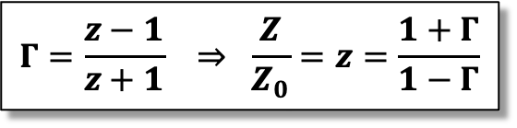
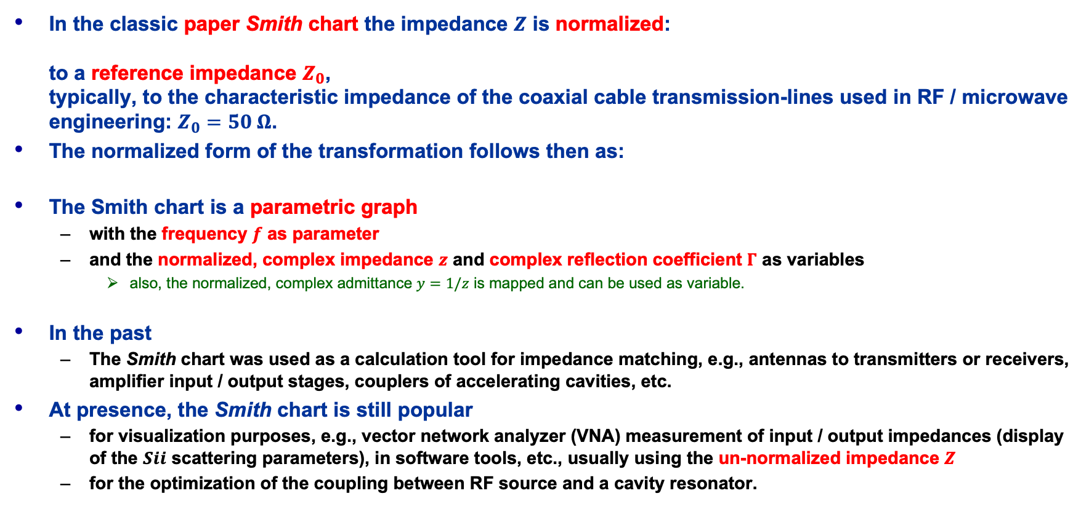
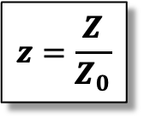
The Smith Chart (3)
$$z=\frac{Z}{Z_{0}}$$
In the classic paper Smith chart the impedance $Z$ is normalized:
to a reference impedance $Z_{0}$,
typically, to the characteristic impedance of the coaxial cable transmission-lines used in RF / microwave engineering: $Z_{0}=50 Ω$.
The normalized form of the transformation follows then as:
The Smith chart is a parametric graph
  with the frequency $f$ as parameter
  and the normalized, complex impedance $z$ and complex reflection coefficient $Γ$ as variables
    also, the normalized, complex admittance $y=1/z$ is mapped and can be used as variable.
In the past
  The Smith chart was used as a calculation tool for impedance matching, e.g., antennas to transmitters or receivers, amplifier input / output stages, couplers of accelerating cavities, etc.
At presence, the Smith chart is still popular
  for visualization purposes, e.g., vector network analyzer (VNA) measurement of input / output impedances (display of the $Sii$ scattering parameters), in software tools, etc., usually using the un-normalized impedance $Z$
  for the optimization of the coupling between RF source and a cavity resonator.
$$Γ=\frac{z−1}{z+1} ⇒ \frac{Z}{Z_{0}}=z=\frac{1+Γ}{1−Γ}$$
JUAS Proc. 2024
II.2.6.3, p. 815

Slide 12

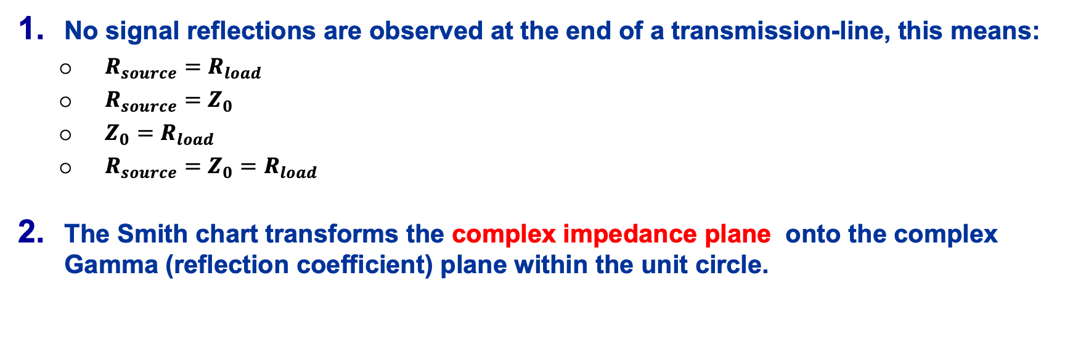


Quiz (1)
$$R_{source}$$
$$Z_{0}$$
$$R_{load}$$
No signal reflections are observed at the end of a transmission-line, this means:
  $R_{source}=R_{load}$
  $R_{source}=Z_{0}$
  $Z_{0}=R_{load}$
  $R_{source}=Z_{0}=R_{load}$
The Smith chart transforms the complex impedance plane onto the complex
Gamma (reflection coefficient) plane within the unit circle.

Slide 13
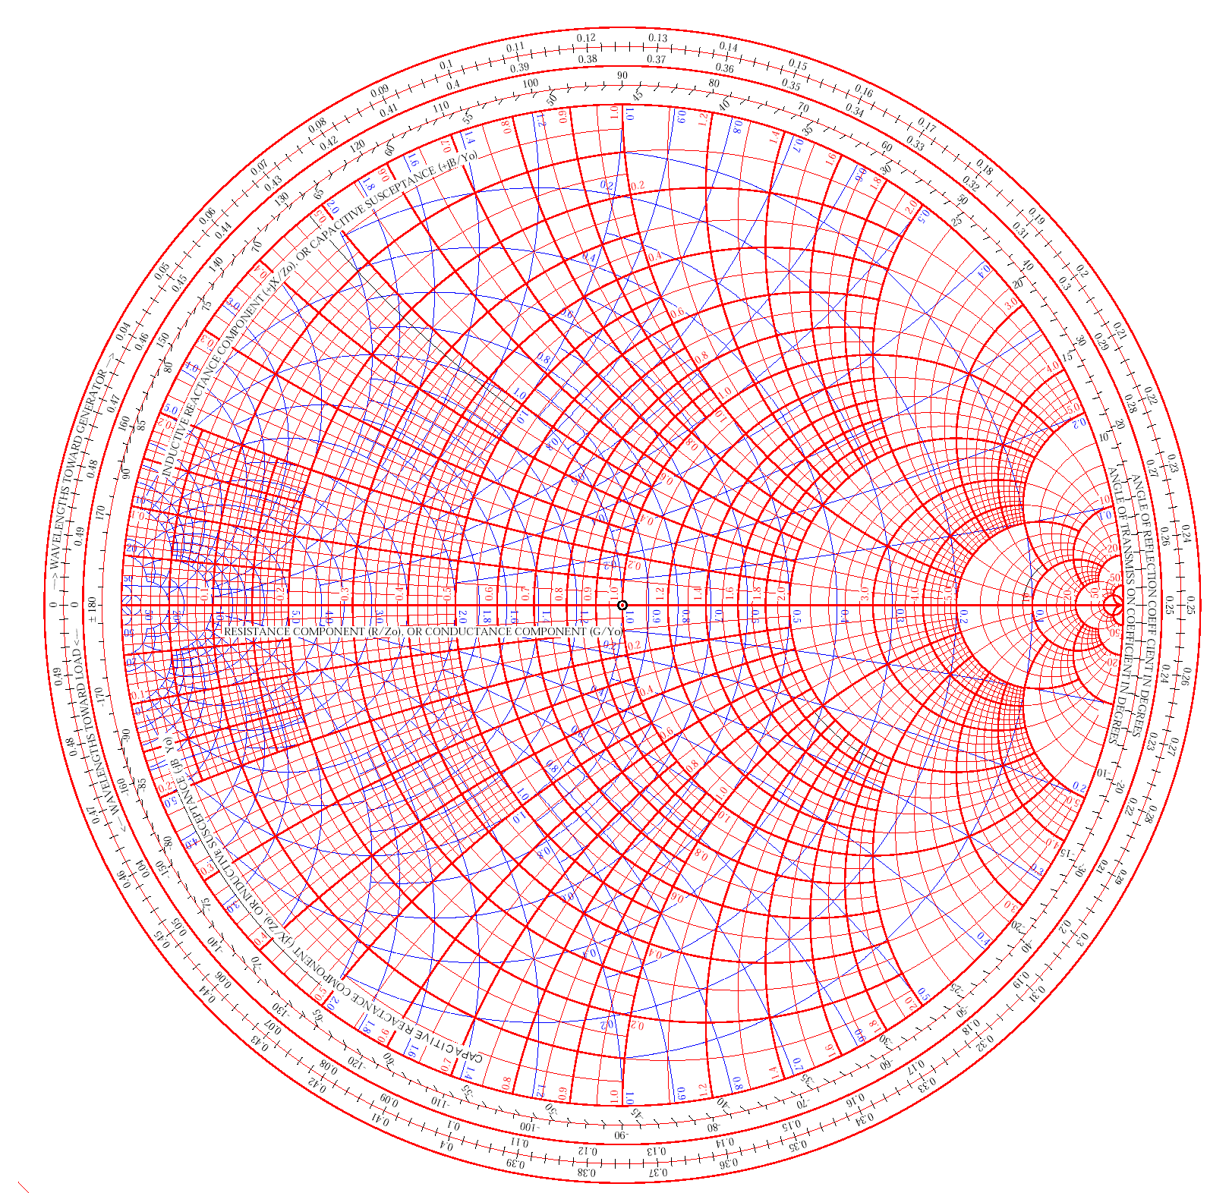

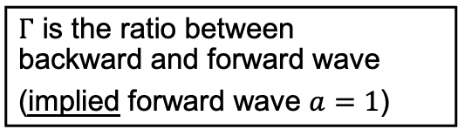
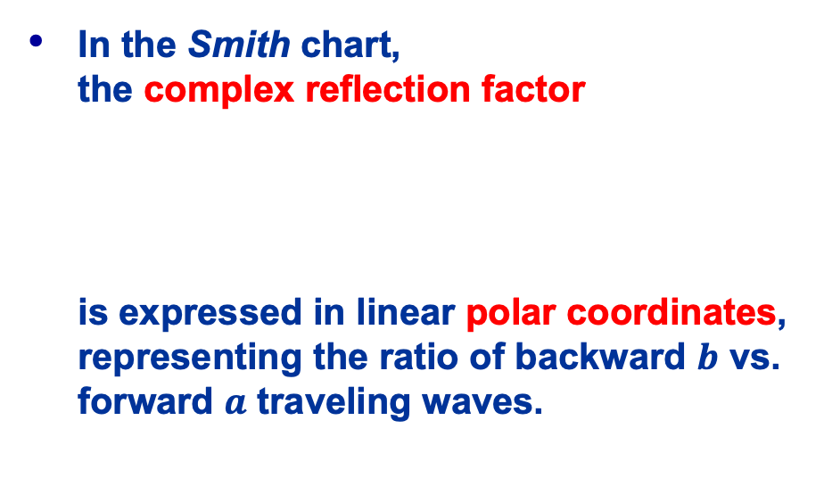
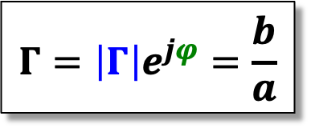





The Smith Chart (4)
$$ℑ\{Γ\}$$
In the Smith chart,
the complex reflection factor
is expressed in linear polar coordinates, representing the ratio of backward $b$ vs. forward $a$ traveling waves.
$$\left|Γ\right|$$
$$Γ=\left|Γ\right|e^{jφ}=\frac{b}{a}$$
$$arg\left(Γ\right)$$
$$ℜ\{Γ\}$$
$$φ$$
$$0$$
$Γ$ is the ratio between
backward and forward wave
(implied forward wave $a=1$)
JUAS Proc. 2024
II.2.6, p. 816

Slide 14










The Smith Chart (5)
$$ℑ\{Γ\}$$
The distance from the center of the directly proportional to the
magnitude of the reflection factor $\left|Γ\right|$ and
permits an easy visualization
of the matching performance.
  In particular, the perimeter
  of the diagram represents
  total reflection: $\left|Γ\right|=1$.
  (power dissipated in the load) =
  (forward power) – (reflected power)
$$\left|Γ\right|=1$$
$$\left|Γ\right|=0.75$$
$$\left|Γ\right|=0.5$$
$$\left|Γ\right|=0.25$$
$$\left|Γ\right|=0$$
$$ℜ\{Γ\}$$
$$P={\left|a\right|}^{2}−{\left|b\right|}^{2}$$
$$={\left|a\right|}^{2}\left(1−{\left|Γ\right|}^{2}\right)$$
available source power
mismatch losses
JUAS Proc. 2024
II.2.6.3, p. 816

Slide 15













The Smith Chart – “Important Points”
$$ℑ\left(z\right)=1$$
Important Points:
Short Circuit
$Γ=−1, z=0$
Open Circuit
$Γ=+1, z→∞$
Matched Load
$Γ=0, z=1$
On the circle $\left|Γ\right|=1$:
lossless element
Upper half:
”inductive” =
positive imaginary part of $Z$
Lower half:
”capacitive” =
negative imaginary part of $Z$
  Outside the circle, $Γ>1$:
  active element, e.g., tunnel diode reflection amplifier
$$ℑ\{Γ\}$$
$$Γ=j$$
Short Circuit
$$ℜ(z)=0$$
$$z=0 \\ Γ=−1$$
$$\left|Γ\right|=1$$
Open Circuit
$$z=∞ \\ Γ=+1$$
$$ℜ(z)=1$$
inductive
$$ℑ\left(z\right)=−1$$
$$ℜ\{Γ\}$$
capacitive
$$z=1 \\ Γ=0$$
$$Γ=−j$$
Matched Load
JUAS Proc. 2024
II.2.6.3, p. 816

Slide 16














The Smith Chart – Basic Example (1)
incident wave $⇒$
reflected wave $⇐$
$$R=25 Ω$$
resistive
reactive
$$Z_{0}=50 Ω$$
$$Z=R+X_{L}$$
with: $X_{L}=jωL$
$ω=2πf$
$$L=20 nH$$
Complex impedance based on
lumped element components
Calculate $Z$ for a given frequency, e.g., $f=50 MHz$: $Z=\left(25+j6.28\right) Ω$
Calculate the normalized impedance $z=Z{/Z}_{0}=0.5+j0.126$
  Locate $z$ in the Smith chart
  Retrieve $Γ=0.34∠161°=0.34e^{j2.81}$
Repeat for other frequencies…
JUAS Proc. 2024
II.2.6.3, pp. 817/818

Slide 17








The Smith Chart – Basic Example (2)
incident wave $⇒$
reflected wave $⇐$
$$R=25 Ω$$
$$Z_{0}=50 Ω$$
$$Z=R+{jX}_{L}$$
with: $X_{L}=ωL$
$$L=20 nH$$
…and for different component values and circuit combinations
incident wave $⇒$
reflected wave $⇐$
$$R=50 Ω$$
$$Z_{0}=50 Ω$$
$$Z=R+{jX}_{C}$$
with: $X_{C}=\frac{−1}{ωC}$
$$C=20 pF$$
JUAS Proc. 2024
II.2.6.3, pp. 817/818

Slide 18

Quiz (2)
Smith chart
(simplified)
A
Prompts |  | Possible Answers
Point A | A5 | $Γ=+1, z→∞$
Point B | B4 | $Γ=−j$
Point C | C1 | $Γ=0, z=1,$ match
Point D | D3 | Point in the capacitive half plane
Point E | E6 | $Γ=+j$
 |  | $Γ=−1, z=0$
 |  | Point in the inductive half plane
E
D
C
B

Slide 19

Quiz (3)
Smith chart
(simplified)
Trace with marker points in the simplified
Smith chart for an RL series impedance
  $f_{B}>f_{A}$
  $f_{B}<f_{A}$
  There is no frequency $f$ related to points A and B
  $f_{A}=f_{B}$
A
B
Please try to complete
Exercise II.2.6.2
JUAS Proc. 2024
II.2.6.3, p. 820

Slide 20













The Smith Chart – TL Transformer (1)
$$Γ_{in}=Γe^{−j2βℓ}⇒$$
$$Γ⇒$$
incident wave $⇒$
The lossless transmission-line adds a phase delay of $2βℓ$, seen at its input, $Γ_{in}$, to the reflection coefficient $Γ$ at its output:
This results in a transformation of the impedance $Z$ at the end of the line to a different impedance $Z_{in}$ at the input of the line
  The Smith chart offers an effective, simple graphical way to calculate this transmission-line based impedance transformation
reflected wave $⇐$
$$Z_{in}⇒$$
$$Z_{0}, β$$
$$Z$$
$$ℓ$$
$$Γ_{in}=Γe^{−j2βℓ}$$
S-parameter of a lossless transmission-line:
  Phase delay (electrical length) of
  with: $β=\frac{2π}{λ_{g}}=k$ (wave number)
backward
transmission
coefficient S12
$$S=\left[\begin{matrix}0 & e^{−jβℓ} \\ e^{−jβℓ} & 0\end{matrix}\right]$$
forward
transmission
coefficient S21
$$βℓ=θ$$
JUAS Proc. 2024
II.2.6.4.3, pp. 825/826

Slide 21













The Smith Chart – TL Transformer (2)
$$Γ_{in}=0.58∠−54°⇒$$
$$Γ=0.58∠90°⇒$$
$$Z=\left(25+j43.4\right) Ω$$
@ $f=345 MHz$
$$z_{in}=1.02−j1.43⇒$$
$$z=0.5+j0.87⇒$$
$$R=25 Ω$$
$$Z_{in}=\left(50.8−j71.3\right) Ω⇒$$
$$Z_{0}=50 Ω$$
$$ℓ=\frac{λ}{5}$$
$$L=20 nH$$
Based on the previous example
Calculate the normalized impedance $z$ for
$f=345 MHz and$ locate the point in the Smith chart.
  Notice the corresponding value of $Γ$,
  and read the $λ$-length value on the rim
Add $ℓ=λ/5$ by rotating $Γ$ by $2βℓ=4π/5≡144°$
  From $0.125 λ$ to $0.325 λ$
    The phase is subtracted, therefore clockwise rotation!
Notice the value of $Γ_{in}$ and read the corresponding
value of the normalized impedance $z_{in}$
  Calculate the transformed impedance $Z_{in}@f=345 MHz$
  What is the equivalent circuit, and what are the component values?
    …and what is the physical length $ℓ$ of the transmission-line?
      assuming a coaxial cable as transmission-line with a dielectric constant of $ε_{r}=2.1$
JUAS Proc. 2024
II.2.6.4.3, pp. 825/826

Slide 22














The Smith Chart – TL Transformer (3)
impedance $z$
A transmission-line
of length
transforms a reflection $Γ$ at the end of the line to its input as
This results the unitless, normalized impedance $z$ at the end of the line to be transformed into:
at the beginning of the line
A short circuit at the end of the
$λ/4$-transformer is transformed
to an open, and vice versa
  This is the principle
  of the $λ/4$-resonator.
$$ℓ=λ/4≡βℓ=\frac{π}{2}$$
$$Γ$$
$$Γ_{in}=Γ e^{−j2βℓ}=Γ e^{−jπ}=−Γ$$
$$Γ$$
$$2βℓ \\ =π$$
$$Γ_{in}$$
$$z=0$$
$$2βℓ \\ =π$$
$$z→∞$$
$$z_{in}=1/z$$
$$Γ_{in}$$
impedance $1/z$
when adding a transmission-line
to some terminating impedance we rotate
clockwise through the Smith-Chart
JUAS Proc. 2024
II.2.6.4.3, pp. 827

Slide 23

A Smith Chart matching Exercise
A network analyzer measurement of a RF amplifier, operated at $f=500 MHz$ shows a reflection coefficient of $Γ=0.242e^{−j76°}$
  Locate $Γ$ in the paper Smith chart
  What is the un-normalized impedance $Z$ ?
  What is the lumped-element series equivalent circuit
  and what are the element values the make up $Z$ ?
  What circuit element , and its value, is required to match the impedance to $Z_{0}=50 Ω$ ?
    Please use the paper Smith chart and find the value of the normalized matching impedance
    Then de-normalize the value and calculate the value of the lumped element.

Slide 24




$$Γ=0.242e^{−j76°}$$
Locate $∠≅−76°$ on the circle
ANGLE OF REFLECTION COEFFICIENT IN DEGREES
  Mark with a line
Locate $\left|Γ\right|≅0.242$ on the ruler
RFL. COEFF, E or I
  Mark the point crossing the $∠$-line
$$\left|Γ\right|≅0.242$$
$$∠≅−76°$$
$$\left|Γ\right|=1$$

Slide 25





$$z=1−j0.5$$
Follow the real part circle to $ℛ≅1$
on the real axis
RESISTANCE COMPONENT ($R/Z_{0}$)
  $ℛ(z)≅1$
Follow the imaginary part to $ℑ≅−0.5$
to the positive imaginary axis
CAPACITIVE REACTANCE COMPONENT ($−jX/Z_{0}$)
  $ℑ\left(z\right)=−0.5$
De-normalize the impedance for $Z_{0}=50 Ω$
  $ℑ\left(Z\right)<0 ⇒$capacitive
$$ℜ(z)≅1$$
$$Γ≅0.242e^{−j76°}$$
$$Z=z Z_{0}=\left(1−j0.5\right)50 Ω=\left(50−j25\right)Ω$$
$$z≅1−j0.5$$
$$ℑ\left(z\right)≅−0.5$$

Slide 26










Impedance Matching
As the imaginary part of the impedance is negative,
the lumped-element equivalent series-impedance circuit is a RC series circuit
  We are in the lower, capacitive half plane of the Smith chart
We need to compensate the capacitive element
by an inductive series element to get $Z\left(f=500 MHz\right)=Z_{0}=50 Ω$
  This is called a “dual” network:
  This is equivalent with the Smith chart operation:
$$Z=R+jX=R+\frac{1}{jωC}=\left(50−j25\right)Ω$$
$$⇒ R=50 Ω ,$$
$$\frac{1}{2πfC}=25 Ω ⇒ C=\frac{1}{2π 500∙{10}^{6}s^{−1} 25 V/A}≅12.7 pF$$
$$L$$
$$?$$
$$R$$
$$Z=Z_{0}$$
$$Z$$
$$C$$
$$ωL=\frac{1}{ωC} ⇒ L=\frac{1}{ω^{2}C}$$
$$X_{L}=2πfL=25 Ω$$
$$⇒ L=\frac{25 V/A}{2π 500∙{10}^{6}s^{−1}}=7.96 nH$$

Slide 27

Final Remarks
The Smith chart is a special type of a parametric plot for the complex impedance or admittance, mapped to the complex reflection coefficient.
The use of the Smith chart can be viewed in two ways:
  As a calculation and impedance matching tool as originally envisioned.
    However, today this will happen rather rarely!
    Please notice: All the examples presented are based on the paper-style Smith chart,
    which is always based on an unitless, normalized impedance $z=Z/Z_{0}$
  As a visualization tool for the complex impedance, along with the reflection coefficient
    Still very popular and useful for displaying and analyzing $S_{ii}$ on a vector network analyzer, also used in data-sheets, and RF simulation and education software.
    Here the Smith chart utilizes the actual complex impedance $Z$ in units of $Ω$! Markers on the parametric trace give all relevant information, including the element values of a selected equivalent circuit.
Old, but excellent information on transmission-lines and standing waves:
  https://www.youtube.com/watch?v=I9m2w4DgeVk
  https://www.youtube.com/watch?v=DovunOxlY1k&t=38s
Smith chart education software (only for MS-Windows):
  https://www.fritz.dellsperger.net/smith.html

Slide 28
Backup Slides

Slide 29

Navigation in the Smith Chart (1)
This is a “bilinear” transformation with the following properties:
Generalized circles are transformed into generalized circles
  circle $→$ circle
  straight line $→$ circle
  circle $→$ straight line
  straight line $→$ straight line
Angles are preserved locally
    a straight line is equivalent to a circle with infinite radius
    a circle is defined by 3 points
    a straight line is defined by 2 points

Slide 30

Navigation in the Smith Chart (2)
in red: impedance plane ($=z$)
in blue: admittance plane ($=y$)
Series L
Shunt L
Shunt C
 | Up | Down
Red circles | Series L | Series C
Blue circles | Shunt L | Shunt C
Series C

Slide 31




Navigation in the Smith Chart (3)
$$G$$
$$R$$
Toward load
Toward generator
Red arcs | Resistance $R$
Blue arcs | Conductance $G$
Con-centric circle | Transmission line going Toward load Toward generator

