Slide 1
RF Engineering
A very brief Introduction into QucsStudio
Christine Völlinger & Manfred Wendt – CERN

Slide 2
Circuit Simulation
Three ways to analyze a RF subsystem or component
  Applying Maxwell’s equations, analytical (if possible), but usually numerically
  Approximation by an equivalent circuit, to be analyzed analytically or numerically
  Building the RF subsystem or component, and characterize it by measurements
In an ideal world all three methods will agree
Even simple equivalent circuit problems quickly become too complicated
to be solved analytically
  Industry offers a large variety of numerical circuit and system simulation tools, e.g., Advance Design System (ADS), Microwave Office, many SPICE variants, etc.
    Some include EM Maxwell solvers, linear, transient and harmonic balance solvers, and digital signal processing and system design including FPGAs
  Freeware tools, e.g., Qucs, Qucs-S, QucsStudio, LTSpice, Ngspice, SPICE, etc., have many limitations, but are educationally valuable!

Slide 3
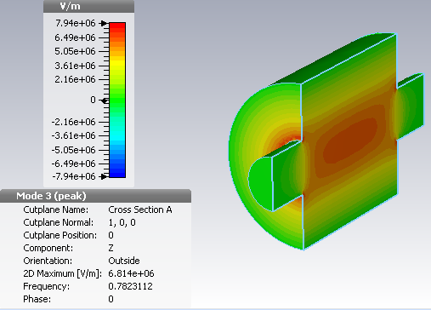
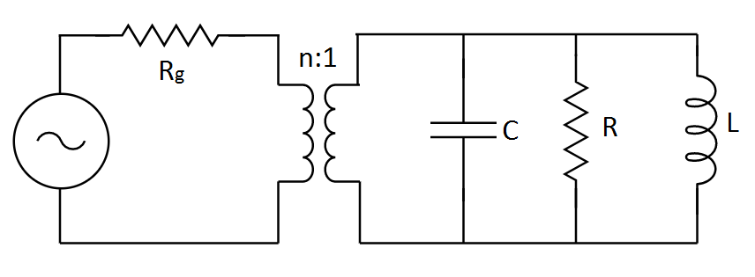
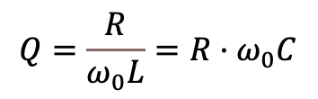

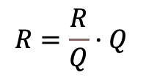

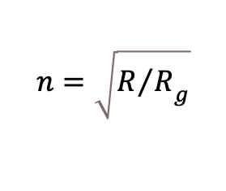
Example: Pillbox TM010 Mode
A cylindrical resonator was analyzed numerically and by measurement characterization:
We can extract the values of an equivalent
$RLC$ parallel circuit for critical coupling ($R_{g}=50 Ω$):
Method | Q₀ value | R/Q | R_{shunt} (MΩ)
Frequency shift | 6180.3 | 15.54 | 9.6
Phase shift |  | 16.55 | 10.2
CST | 6408.4 | 13.21 | 10.1
From CST electric field |  | 14.61 | 9.5
$$R=\frac{R}{Q}·Q$$
$$ω_{0}=\frac{1}{\sqrt{LC}}$$
Element | Value
R | 84.655 kΩ
L | 2.6883 nH
C | 15.405 pF
n | 41.14
$$Q=\frac{R}{ω_{0}L}=R·ω_{0}C$$
$$n=\sqrt{{R/R}_{g}}$$

Slide 4
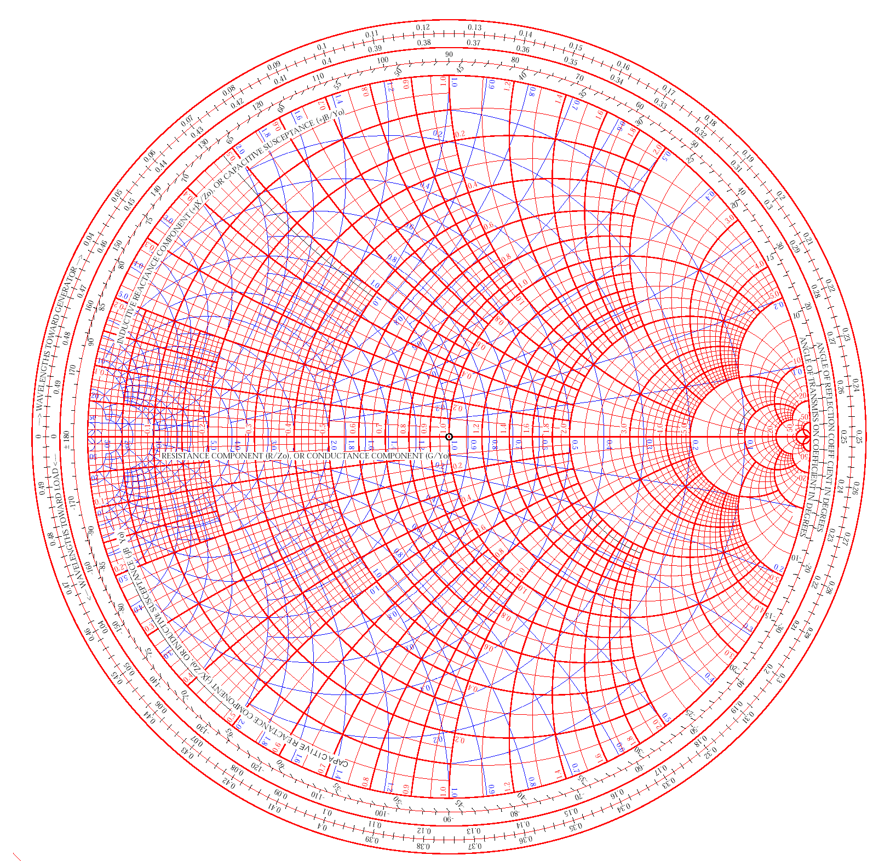






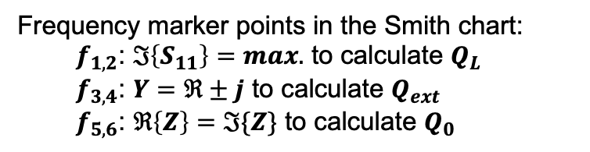








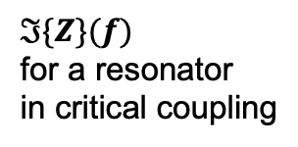
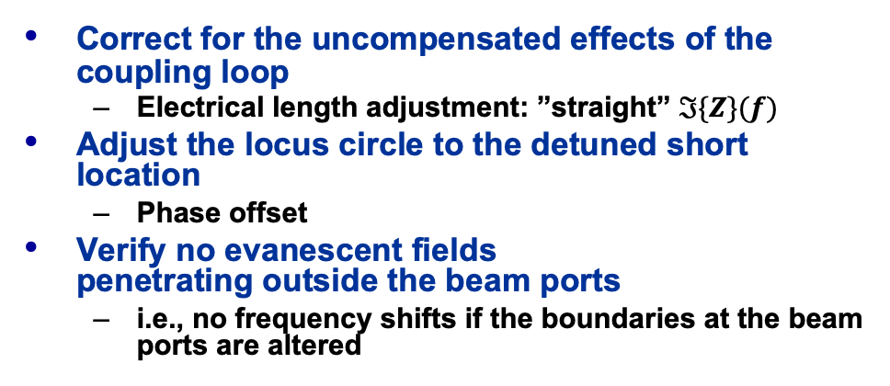


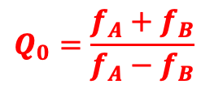
Q-factor from $S_{11}$ Measurement
arbitrary coupling (here: over-critical)
$ℑ\{Z\}(f)$
for a resonator
in critical coupling
$$f_{B}$$
critical coupling
detuned
short
position
($Z=0$)
$$f_{1}$$
Y$=±j$
$$f_{3}$$
$$ℜ\left\{Z\right\}=ℑ\{Z\}$$
$$f_{B}$$
$$f_{5}$$
$$Q_{0}=\frac{f_{A}+f_{B}}{f_{A}−f_{B}}$$
$$f_{A}$$
$$f_{res}$$
$$f_{A}$$
$$f_{6}$$
Correct for the uncompensated effects of the coupling loop
  Electrical length adjustment: ”straight” $ℑ\{Z\}(f)$
Adjust the locus circle to the detuned short location
  Phase offset
Verify no evanescent fields
penetrating outside the beam ports
  i.e., no frequency shifts if the boundaries at the beam ports are altered
$$f_{4}$$
detuned
open
position
($Y=0$)
$$f_{2}$$
Frequency marker points in the Smith chart:
  $f_{1,2}$: $ℑ\left\{S_{11}\right\}=max.$ to calculate $Q_{L}$
  $f_{3,4}$: $Y=ℜ±j$ to calculate $Q_{ext}$
  $f_{5,6}$: $ℜ\left\{Z\right\}=ℑ\{Z\}$ to calculate $Q_{0}$

Slide 5
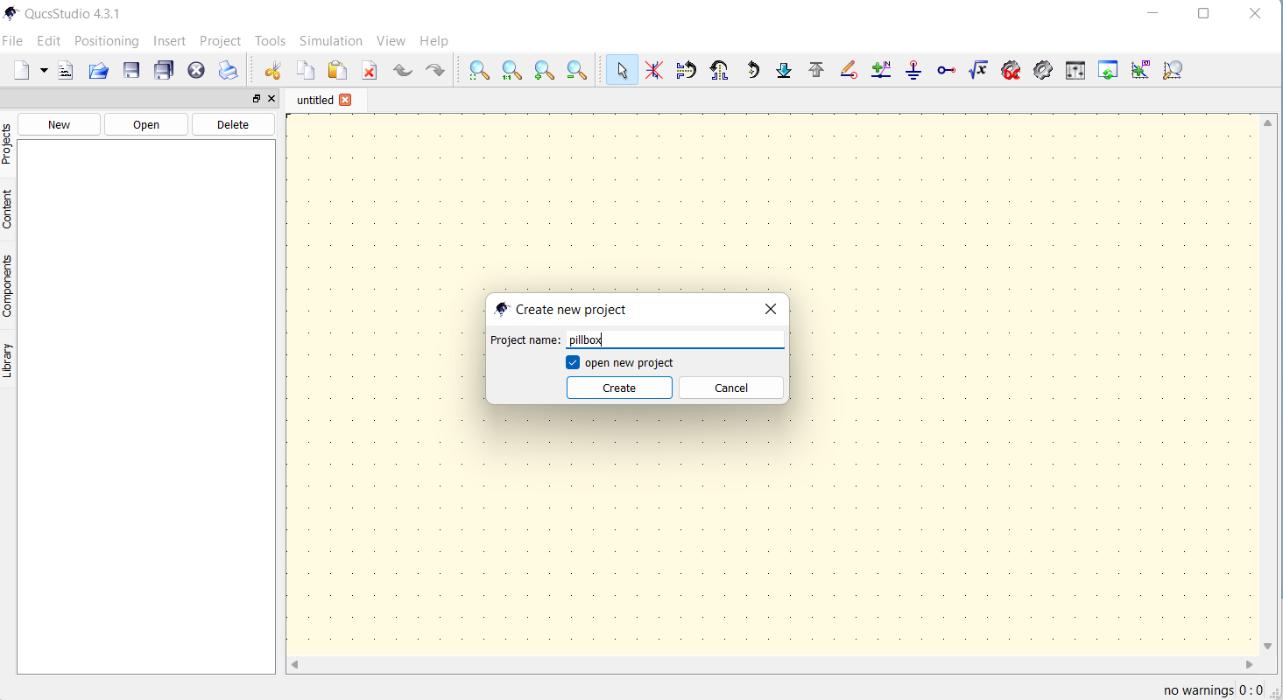
QucsStudio (1)
Is a better maintained derivate of Qucs
  Runs unfortunately only under Windows and files are incompatible with Qucs
Locate “start.bat”
in the installation folder
to start the program
  Eventually link a shortcut
  on the desktop screen
  for convenience
Open a “New project” and give it meaningful name, e.g., “pillbox”
  The project name will be automatically extended by “_prj”, e.g., “pillbox_prj”
  You find the project folder under “…User/username/.qucs/pillbox_prj”.

Slide 6
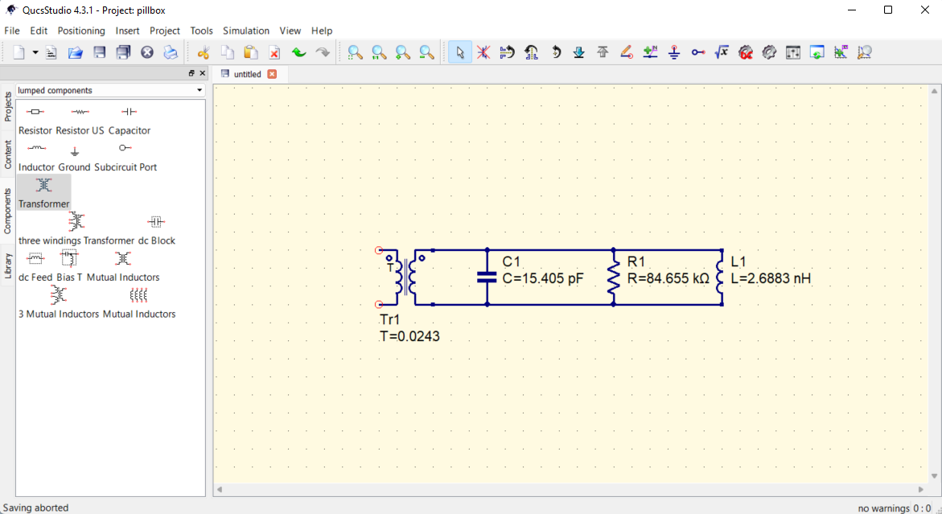
QucsStudio (2)
Locate the “Component” tap and select “lumped components” from the drop-down bar (default)
Select your components on the schematics screen and edit the values
  Use “esc” to unselect an action
Wire up the components

Slide 7
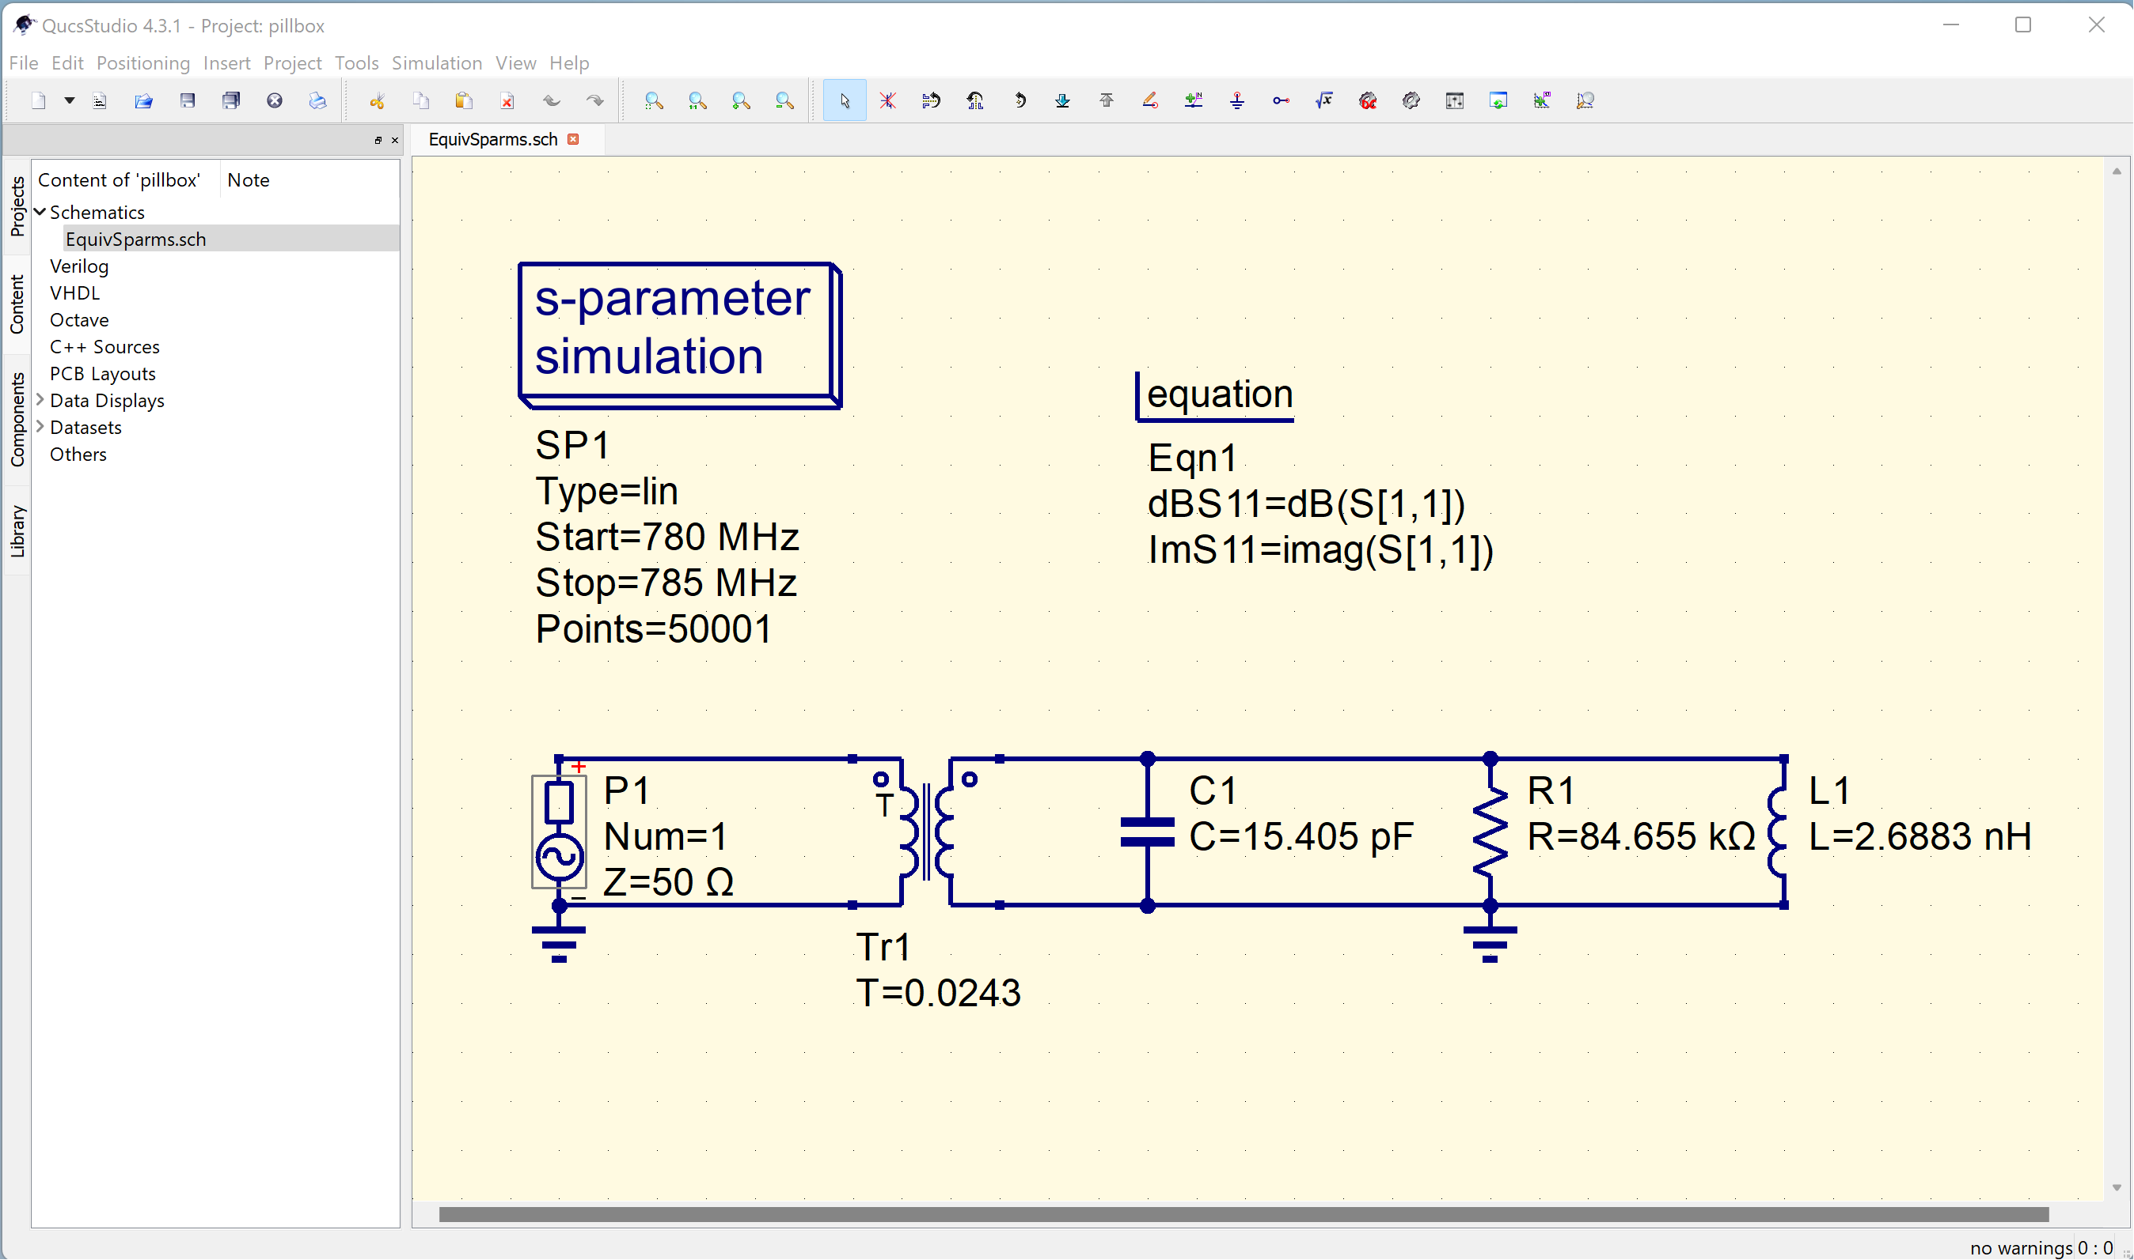

QucsStudio (3)
Finalize the schematics input by adding
  “power source” and “s-parameter simulation”, grounding, “equation” for dBS11 and ImS11
  Save your schematic under a meaningful name
$$T=0.0243:1 ≡1:41.14$$

Slide 8
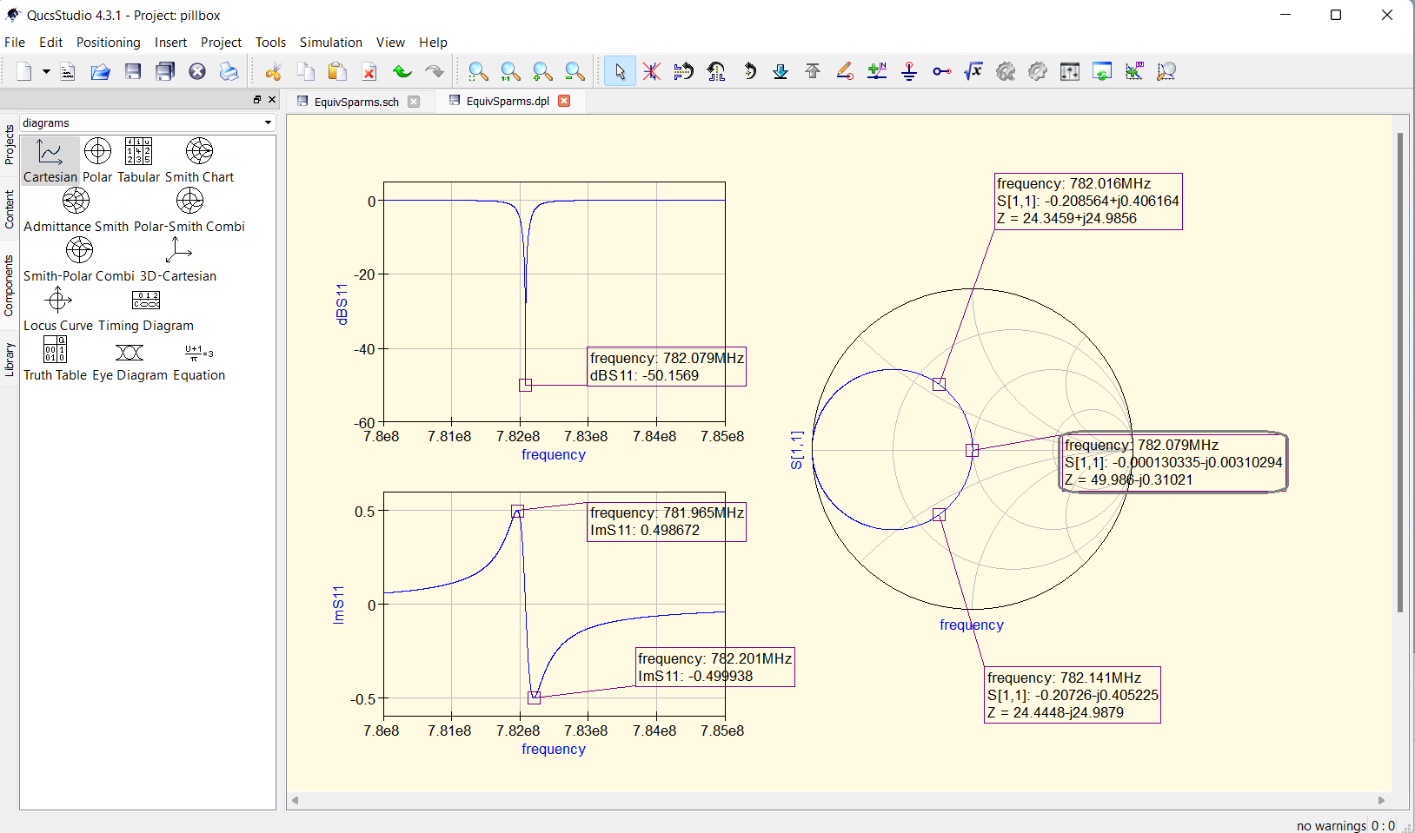
QucsStudio (4)
Execute the “simulation” and display the results using “Cartesian” and “Smith Charts” plots
  Use the “dBS11”and “ImS11” data defined by the equations
  Add markers to the traces with an appropriate format
  Save you data display and schematics for later use, “Save All”

