Slide 1
RF Engineering
Beyond Pillbox Resonators
Christine Völlinger (CERN) & Manfred Wendt (BNL)

Slide 2
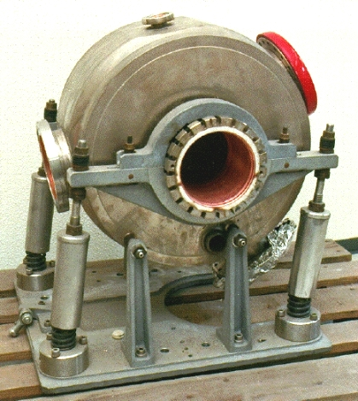
Pillbox Cavity is not all…
Cavity from DORIS Storage ring (1970-ish, very early electron/positron collider)

Slide 3
Pillbox Cavity is not all… so let’s look at some exotic examples.

Slide 4
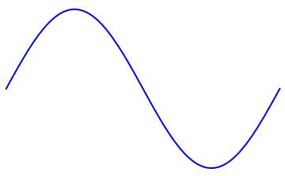
Coaxial Line goes RF Cavity (in low frequency range)
Frequencies below ~10 MHz come with RF wavelengths that are largely above >30 m.
With classical cavity (pillbox design), we would need huge cavities → not suited for accelerators
Line resonators: λ/2 or λ/4 resonator
E-field
---H-field
E-field
E-field
λ/2 resonator
Beam orientation
λ/4 resonator
Electric Short
Electric Short
Electric Open
Electric Short
Beam orientation
Beam orientation

Slide 5
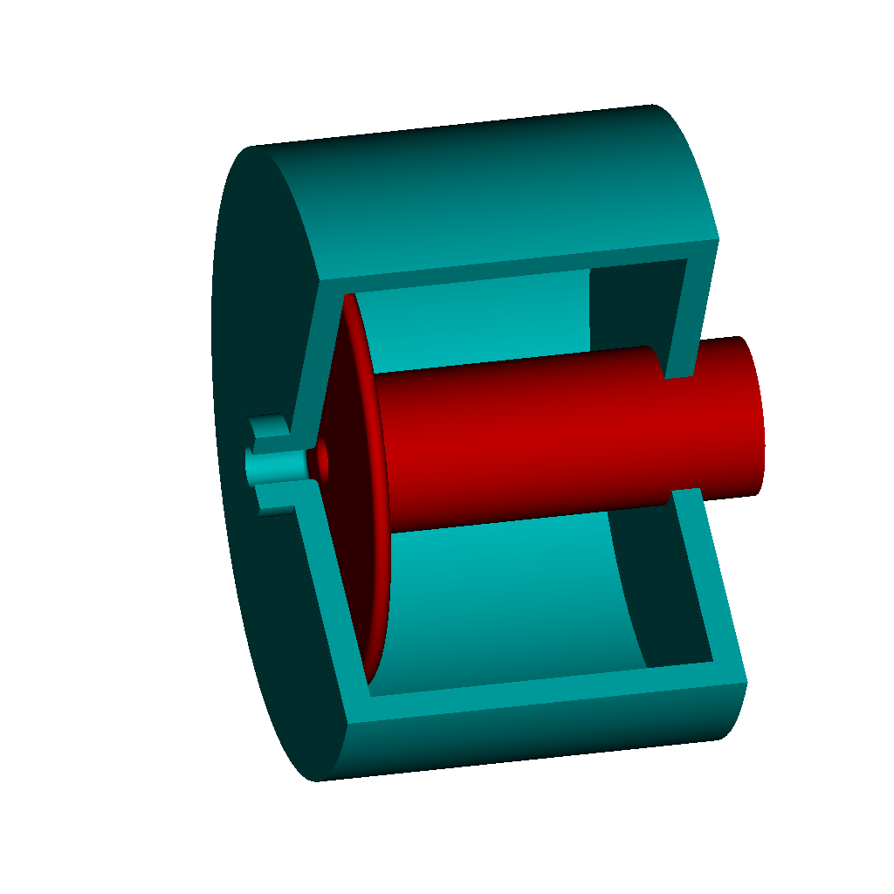
QW-Cavities in low frequency range
How to implement this?
E-field
Beam orientation
λ/4 resonator
Ceramic gap = Electric Open
Electric Open
Electric Short
This side acts like a capacitor, we speak of capacitive loading.
The interruption of the metallic beam pipe with a ceramic gap is not unusual… has been used since a long time and is no engineering challenge.
However, the cavity at 10 MHz is still rather long (7.5 m to be precise).
Solution is: increase the capacitance!
Image: H. Damerau

Slide 6
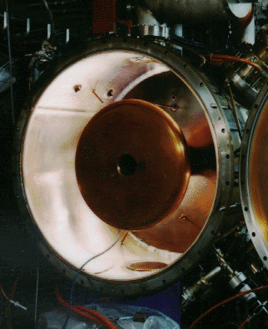
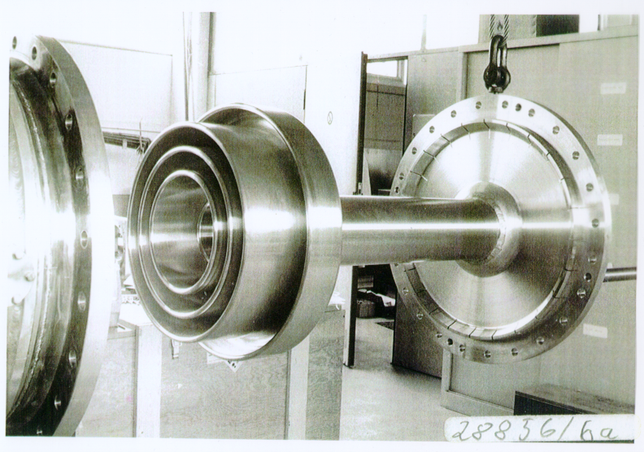
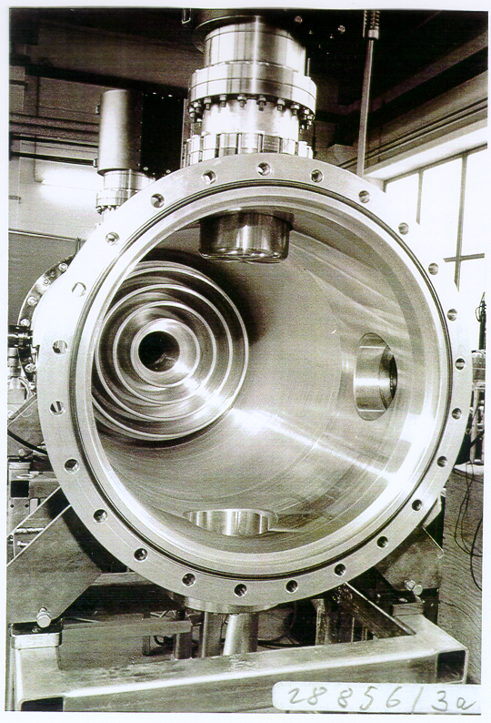
Capacitive Loading in Real World
Add capacitive load at gap of cavity to shorten the resonator
NSLS, 52.88 MHz
DESY PIA, 10.4 MHz, inner cond.
Outer conductor
~1 m
Image: M. Nagl
Significantly reduces cavity size (recall: at 10 MHz, QW is 7.5m).
Works on a determined, fixed frequency only.
Adds small losses due to capacitor implementation.
Advantage: entire cavity can be held in vacuum.

Slide 7

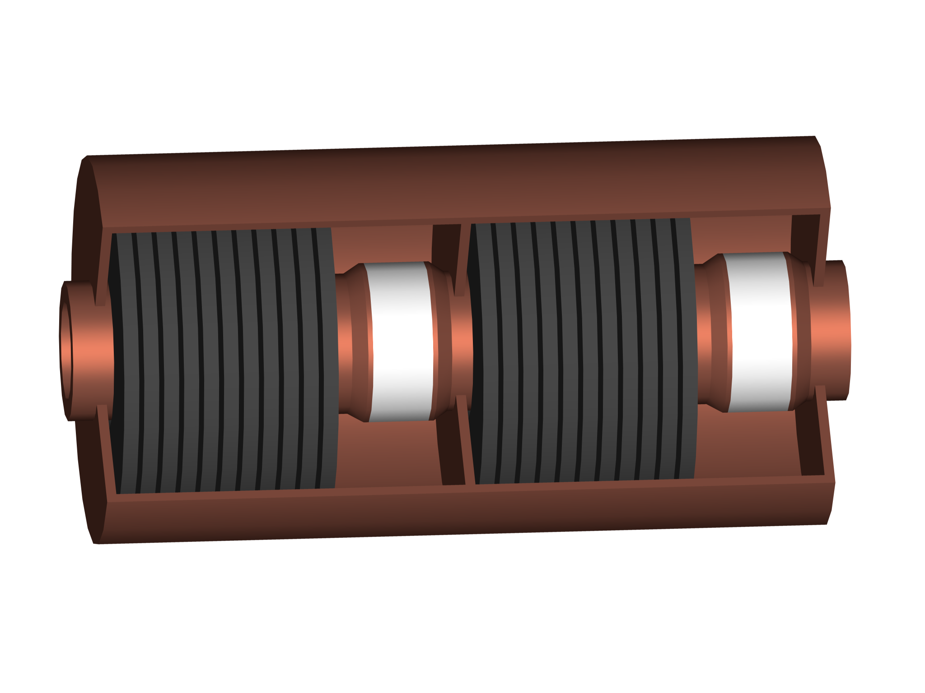
RF cavities in low frequency range
Generally: with same geometric length, the frequency goes down,
if inductance or capacitance goes up.
Leads to an increase in electrical length (i.e. cavity appears longer than it is). Same effect as if you fill your coaxial line with some material to make the line “longer”.
Add more capacitive or inductive loading
resonance frequency
Images: H. Damerau
Plate
capacitor
Ferrite inductivity
(also allows frequency tuning)

Slide 8
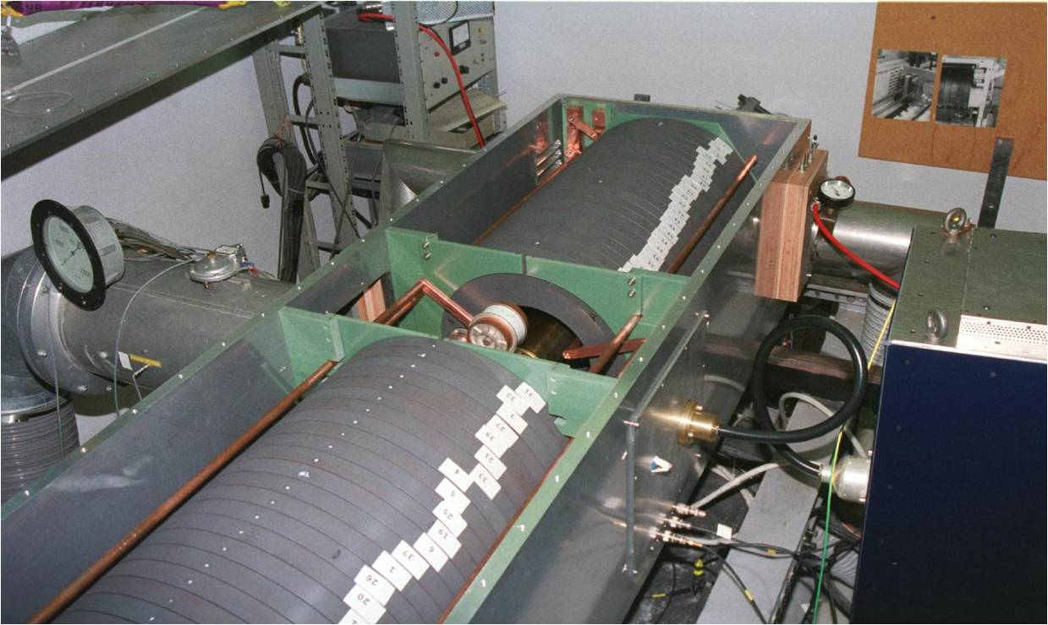
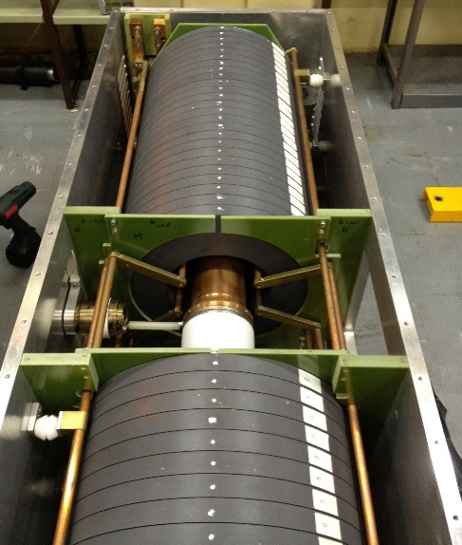
Tunable cavities – example (former) PSB
Makes use of spinnel ferrites.
Tuning via external magnetic field.
So-called “figure-of-eight” biasing
(= parallel biasing)
Cavity, operating 8-12 MHz
Ferrite material is lossy and brings the Q of the cavity down.
Q₀ = 50
PSBooster Cavity, below 20 MHz
Beam vacuum pipe with ceramic gap.

Slide 9
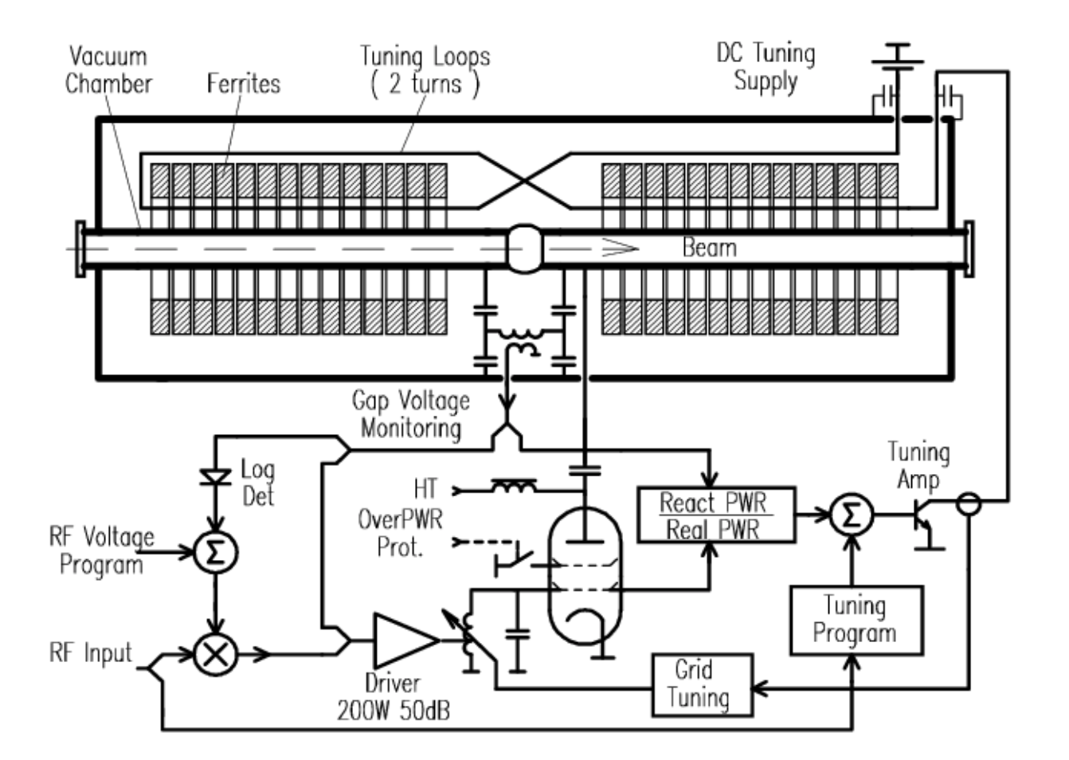
Tunable cavities – figure-of-eight biasing

Slide 10
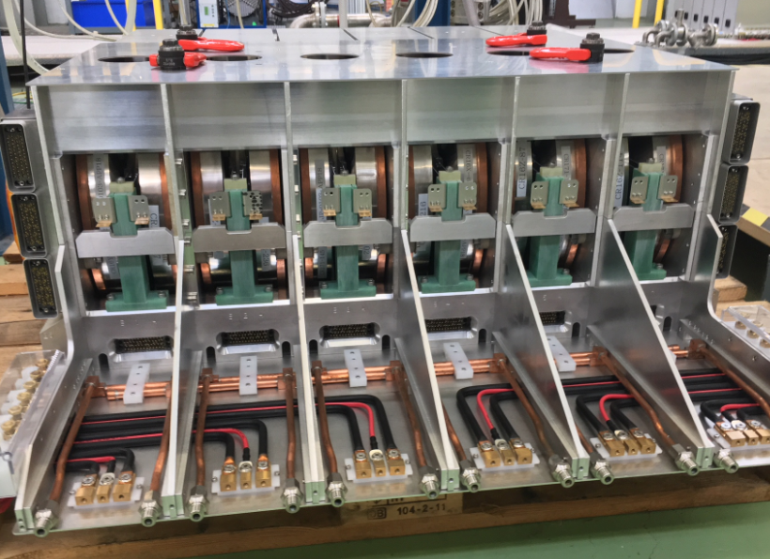
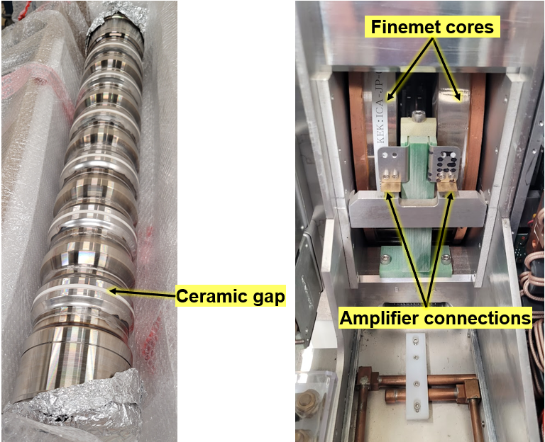
Tunable cavities – the PSB finemet cavity
Image: M. Paoluzzi
CERN PSB Finemet cavity,
0.6-18 MHz

Slide 11
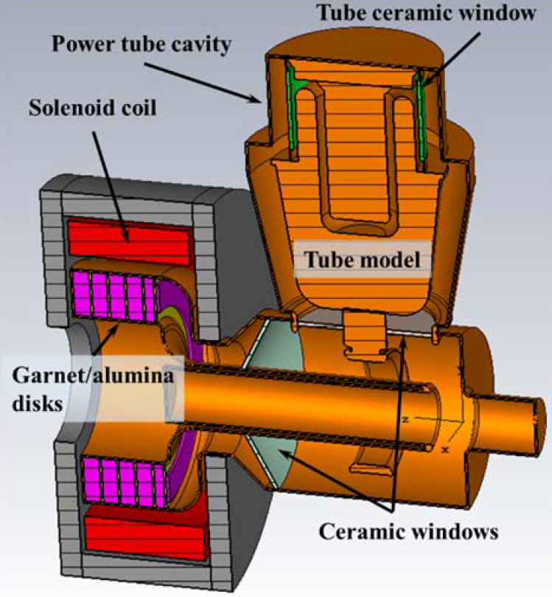
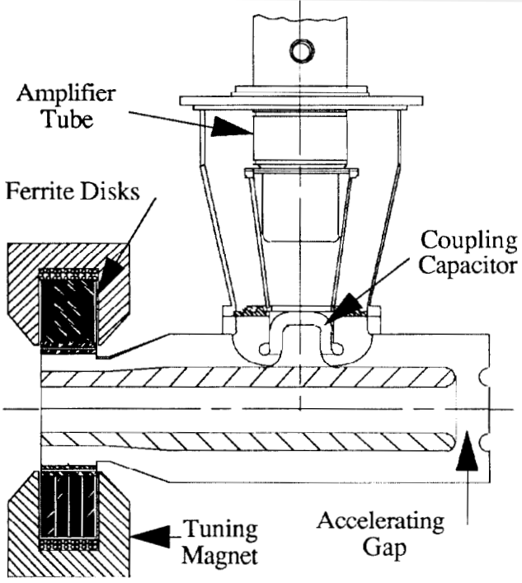
Tunable cavities – higher frequencies
These cavities work with perpendicular biasing, and new type of low loss ferrites (garnet).
FNAL Booster 2nd harmonic,
76 MHz – 106 MHz, 100 kV
SSC Low Energy Booster,
~47 MHz to 60 MHz
C. C. Friedrichs et al., PAC91, p. 1020
R. L. Madrak, IPAC16, p. 130

Slide 12
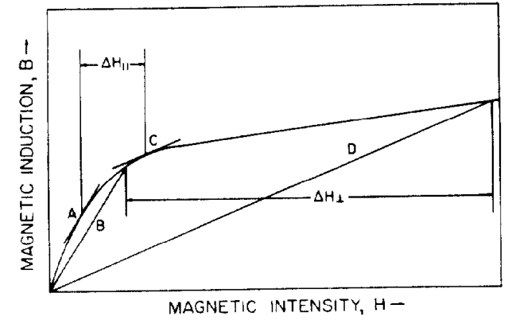
Tunable cavities at higher frequencies
From: Smythe, IEEE, TNS [3]
Parallel bias
(= H_{mag,bias} is parallel H_{RF})
Perpendicular bias
(= H_{mag,bias} is perpendicular H_{RF})
Garnets are ferrites with a magnetic field-dependent relative permeability.
Exposed to a (slowly varying) magnetic field, their µ-value covers a certain range until they saturate.
Problems are the garnet outgassing (cannot be in vacuum), the limited Q-value of the the cavity due to material losses and the rather large H-fields needed.

Slide 13
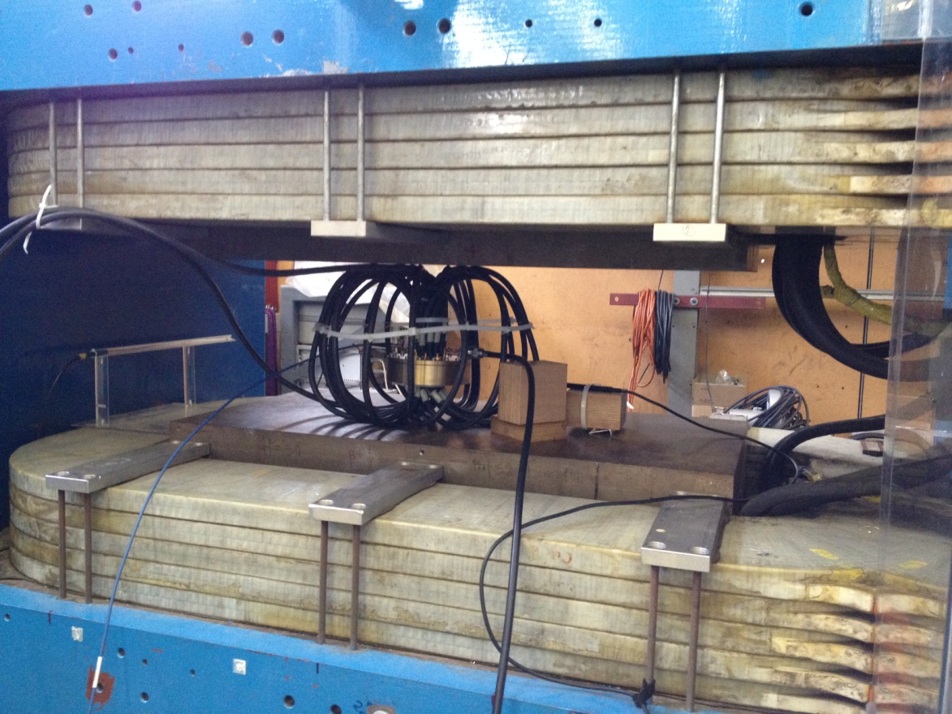
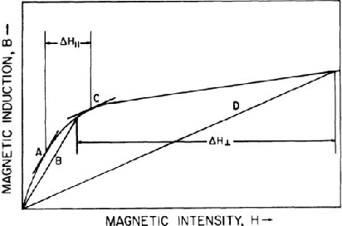
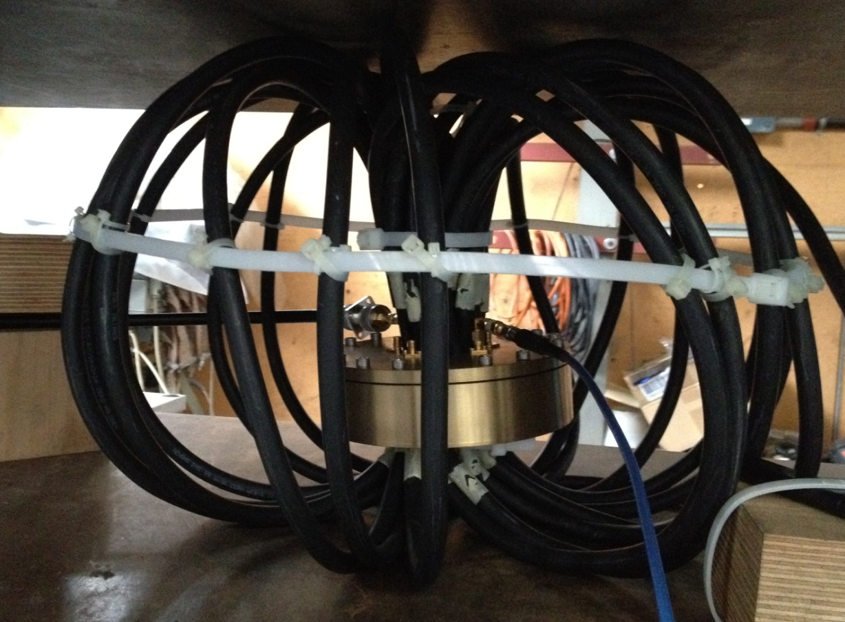
Can that also work on a single-gap cavity?
Perp. bias
Par. bias

Slide 14
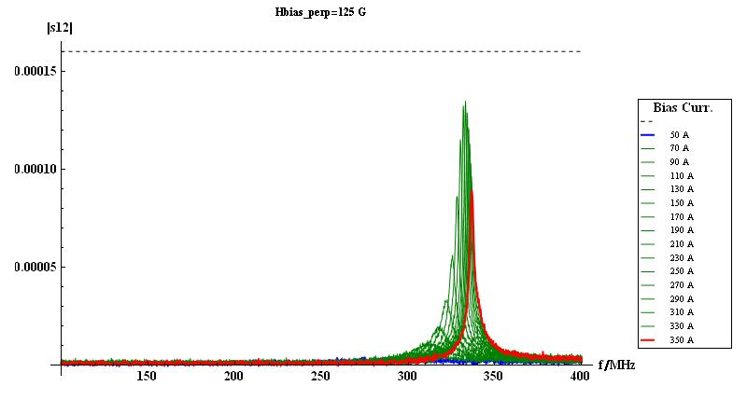
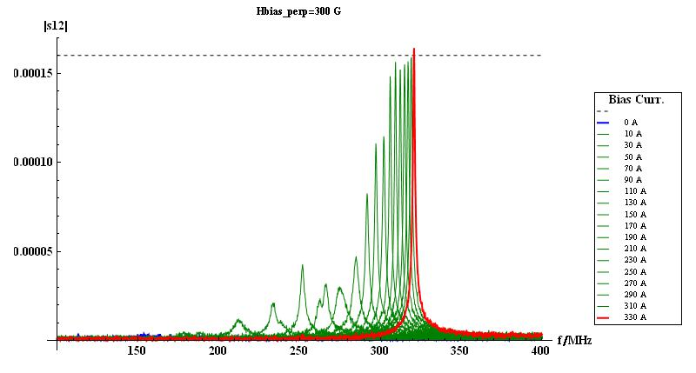
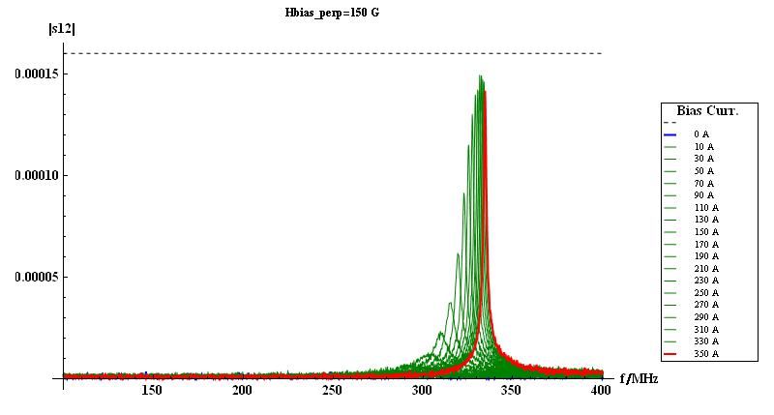
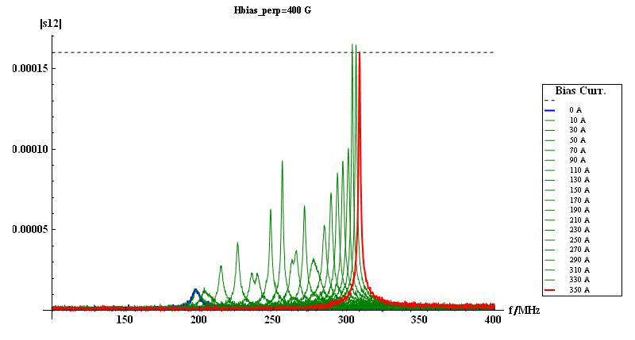
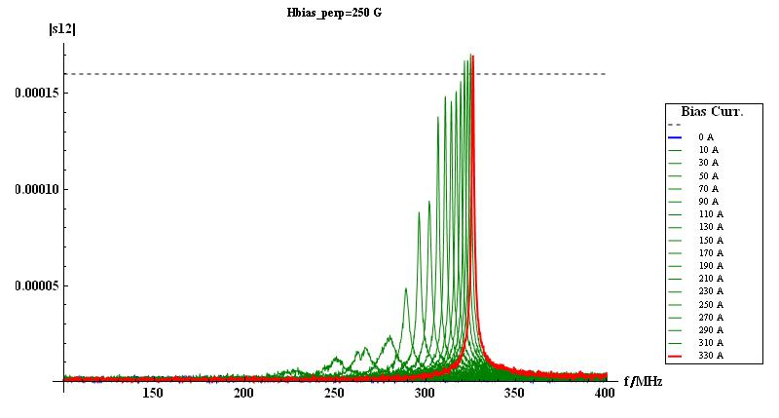
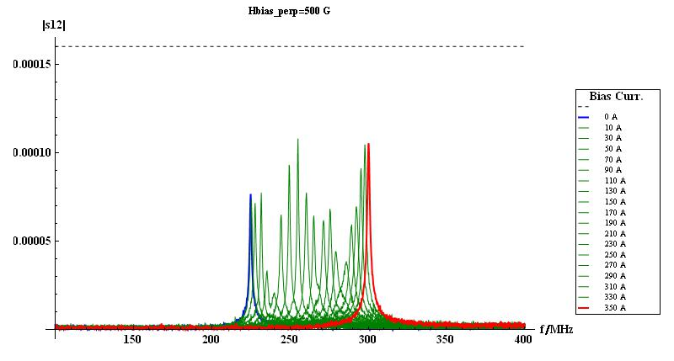
Can that also work on a single-gap cavity?
Resonance peaks due to different magnetic bias fields
tuning range

Slide 15
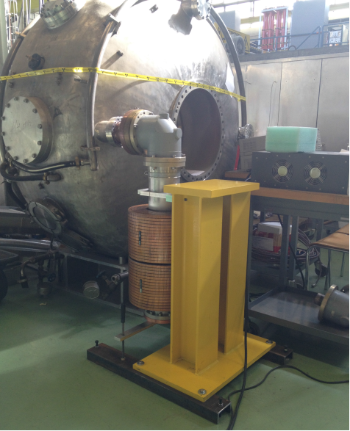
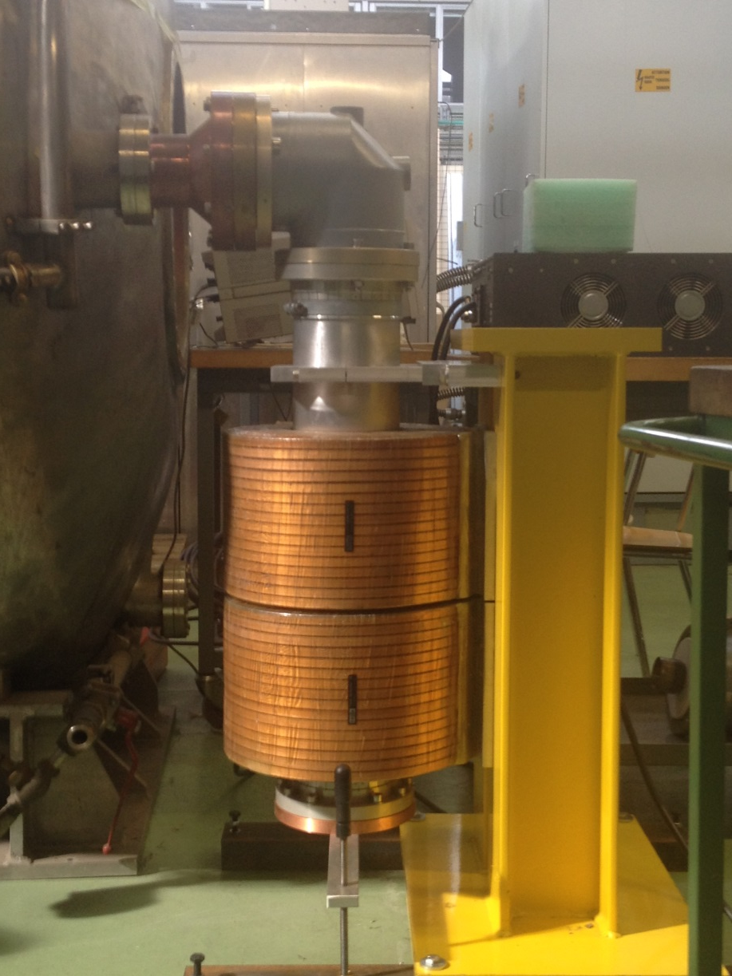
Applying the tuning principle
to a single-gap cavity
Coupler to cavity
Support structure

Slide 16
QW-Cavities in low frequency range
Only remains to look at the last example…
E-field
λ/4 resonator
Ceramic gap = electric Open
Electric Open
Electric Short
Recall:
this side acts like a capacitor, making use of capacitive loading.
Beam orientation

Slide 17
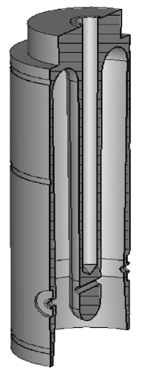
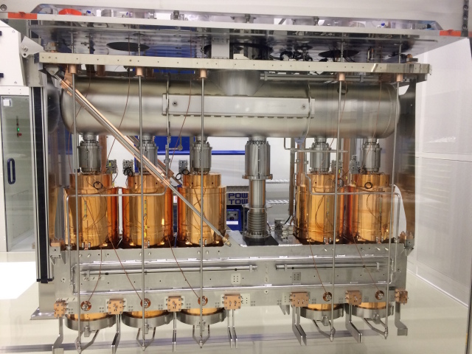
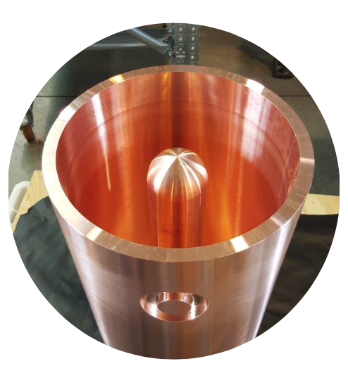
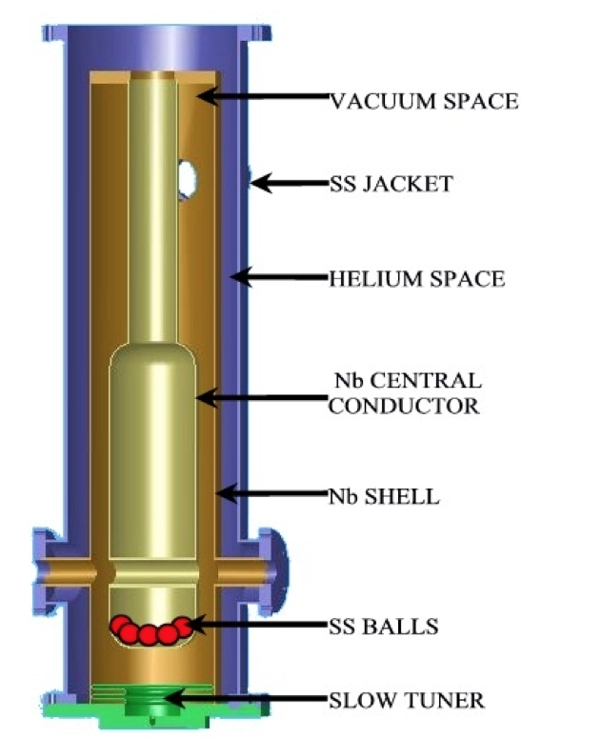
QW-Cavity at HIE-Isolde (CERN)
Small side-remark for mechanical engineers:
New technology came with unforeseen problems: the inner conductor was made hollow for weight reasons, but then started to vibrate heavily.
Suggested solution: filled with heavy SS-spheres which work as suppressors.
Accelerator for radioactive ion beams of REX-Isolde at CERN.
100 MHz superconducting Nb on Cu structure.
6 MV with Q > 5 x 10⁸
Consisting of 4 cryomodules with 5 cavities each.
Images: F. Gerigk, CERN
Image: A. Roy, APAC 2007, THYMA04

Slide 18
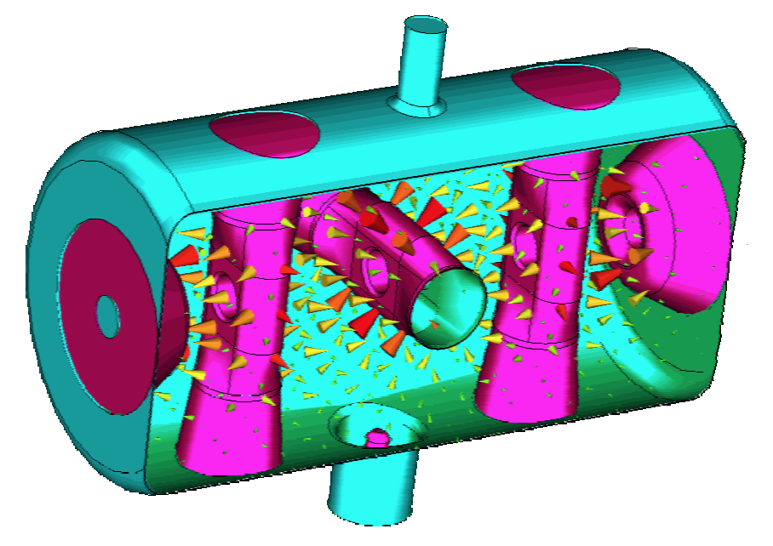
Exotic TEM-Cavity (Spoke Cavity)
JUST TO CONFUSE YOU!
BUT THIS IS REAL.
Spoke cavities are made of 1…n combined
λ/2 –wave TEM cavities.
Typically, they have 1…3 spokes and are superconducting.
Used for lower to medium beta.
Image: F. Gerigk, RF CAS Berlin 2024.
Reference: E. Zaplatin et al: “Triple Spoke Cavities at FZJ” EPAC 2004

Slide 19
Thank you for your attention.

Slide 20
Let’s have a break!

Slide 21
Further reading…
POZAR, David M., “Microwave Engineering”, 4th edition, Wiley and sons.
ZHANG, Keqian, “Electromagnetic Theory for Microwaves and Optoelectronics”, 2nd edition, Springer
BHAT, Shiban, “Stripline-like transmission Lines for Microwave Integrated Circuits”,
New Age International Publishers
HOFFMANN, “Integrated Microwave Circuits”, Springer
SAAD, “Microwave Engineers’ Handbook”, vol. 1,

