Slide 1


Eigenmodes simulation of a cylindrical resonator with CST
Michela Neroni*
Acknowledgments: Andrea Mostacci, Christine Vollinger, Manfred Wendt
*michela.neroni@cern.ch

Slide 2
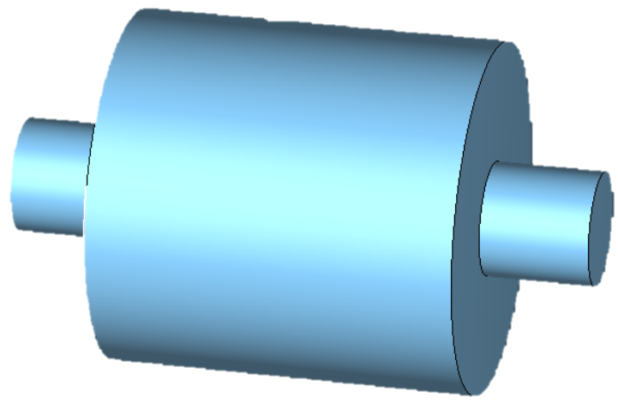
Eigenmodes simulation of a cylindrical resonator with CST
CST Studio Suite: the Eigenmode solver
Model geometry
Simulation set-up
Eigenmodes results
Field plots
Figures of merit: Q, R/Q

Slide 3
CST Studio Suite: the Eigenmode solver
CST Studio Suite® is an Electromagnetic Field Simulation Software. It includes different modules for design and optimization of accelerator devices operating in a wide range of frequencies.
https://www.3ds.com/products/simulia/cst-studio-suite
With the Eigenmode solver, the Maxwell’s eigenvalues problem is solved. The problem involves finding the eigenvalues and eigenmodes of the equations which correspond to the medium’s resonant frequencies and associated electric and magnetic field distributions.
Other electromagnetic simulation software exits:
ANSYS HFSS (Tutorial JUAS23 and described in the JUAS proceedings)→ it has a free student version:
https://www.ansys.com/academic/students/ansys-electronics-desktop-student
JUAS proceedings: chapter II.2.5, pp. 794-806

Slide 4
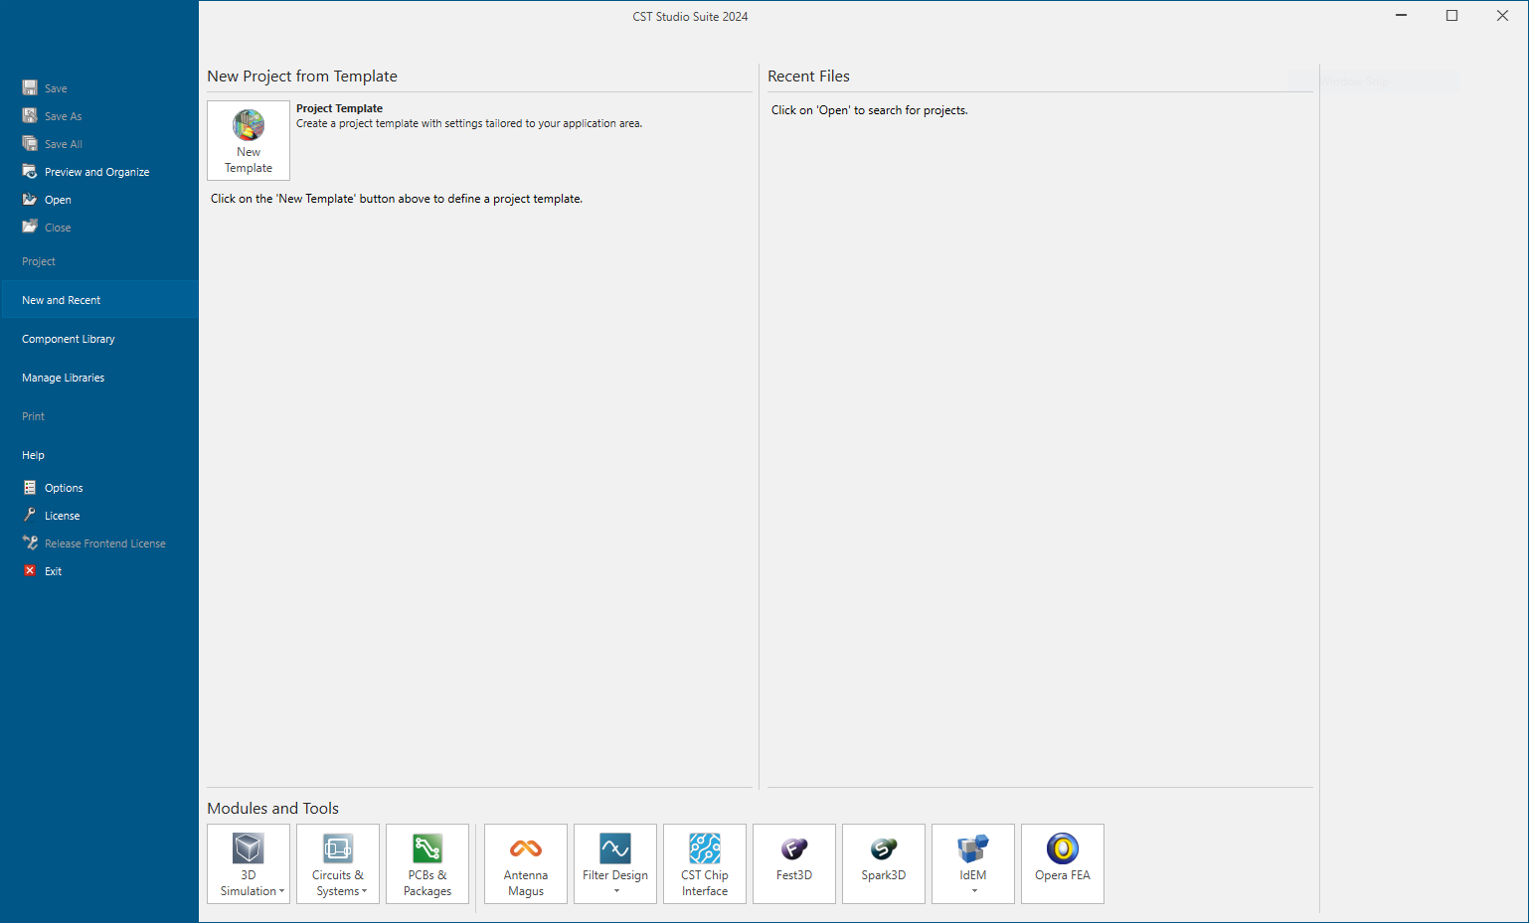
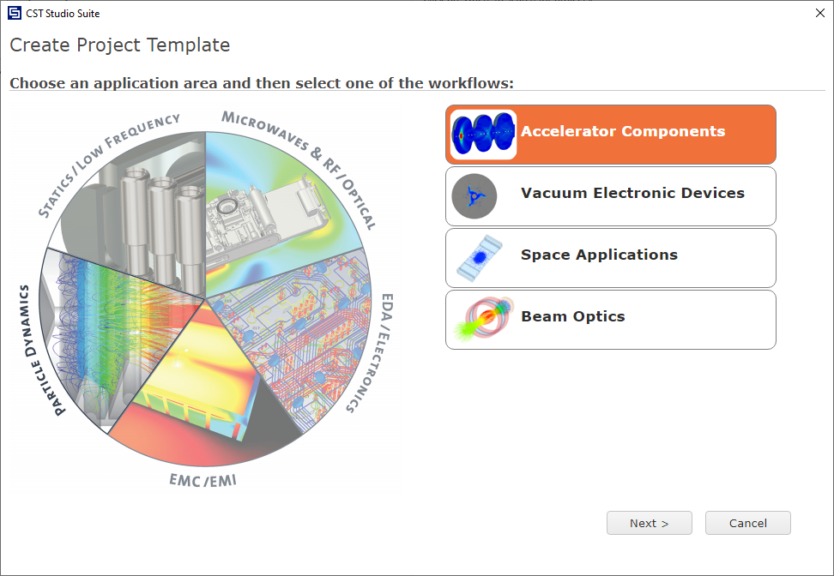
CST Studio Suite: the Eigenmode solver

Slide 5
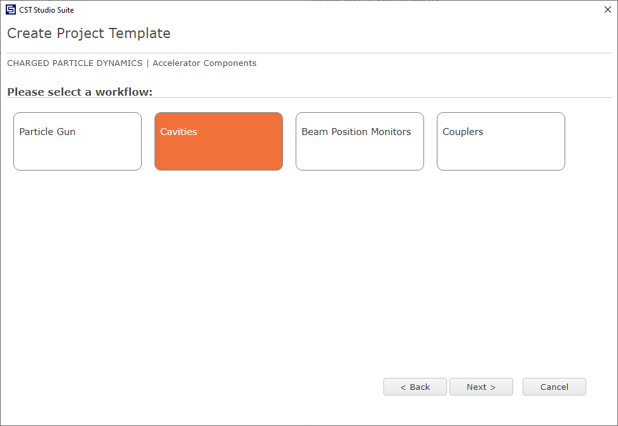
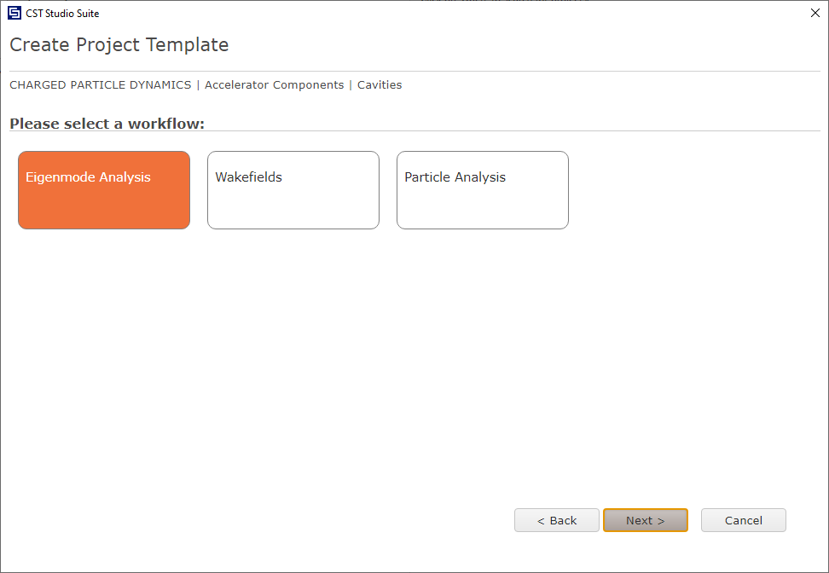
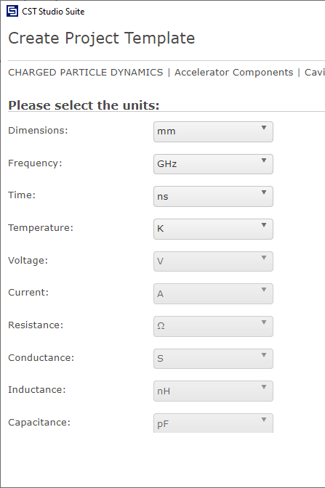
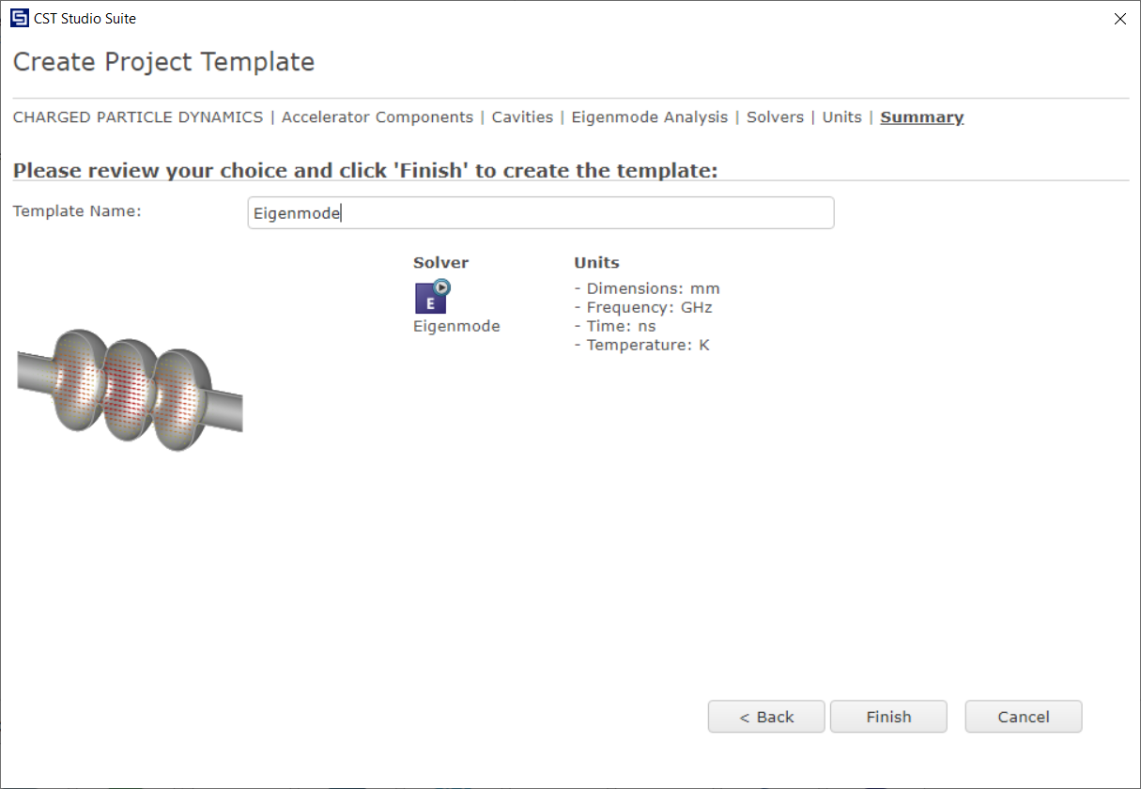
CST Studio Suite: the Eigenmode solver
3
2
1
4

Slide 6
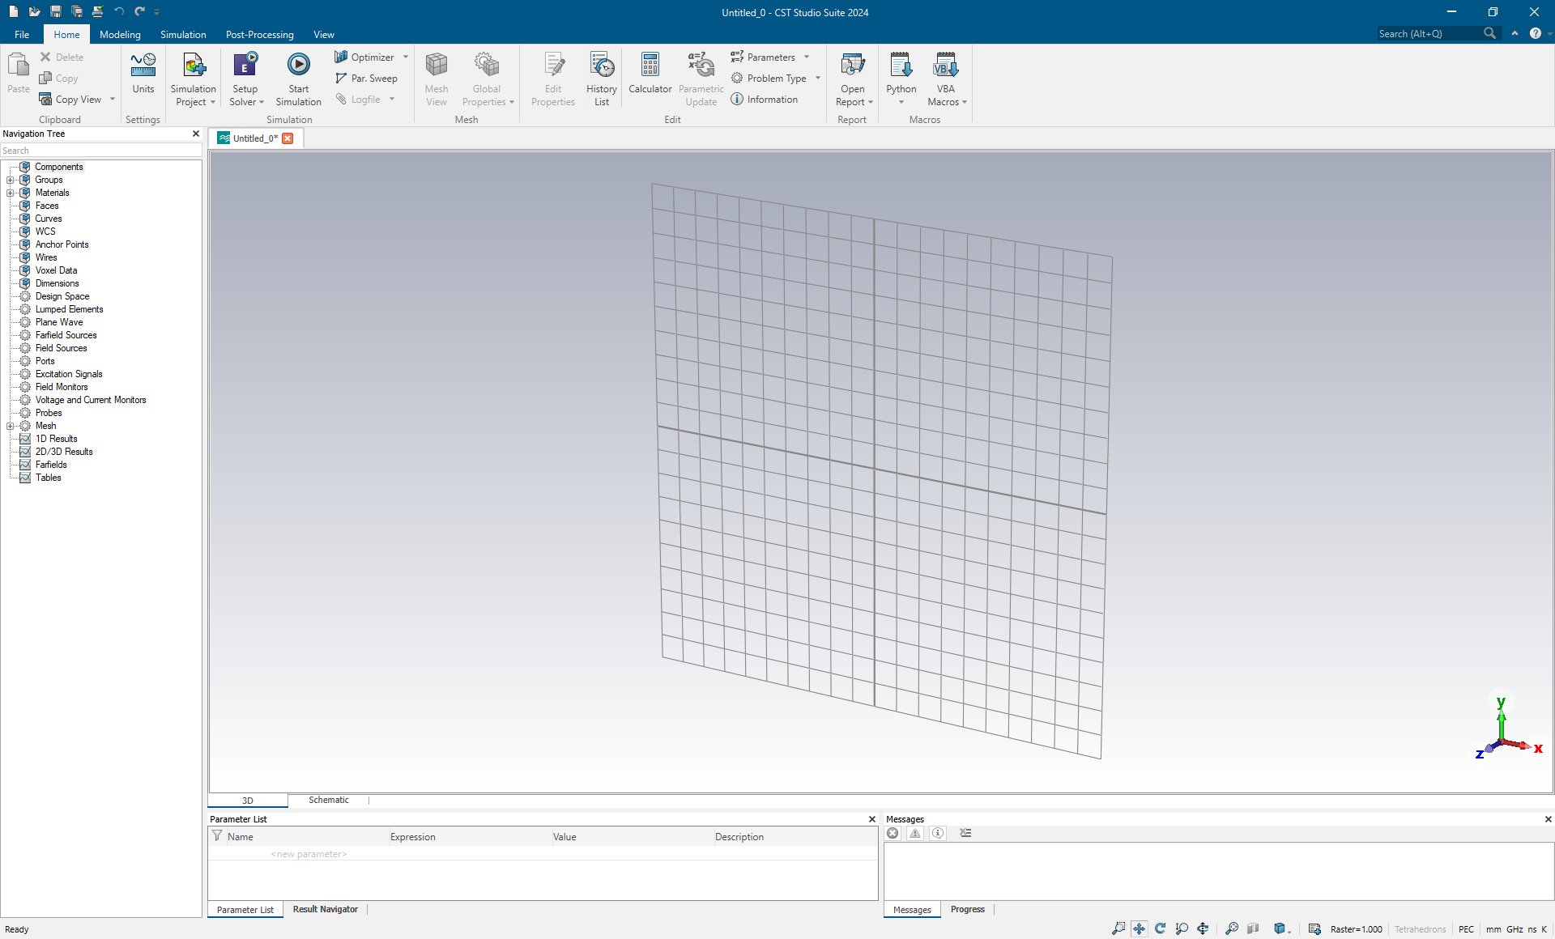
CST Studio Suite: the Eigenmode solver
Save the project with the name ‘Cavity-JUAS25’

Slide 7
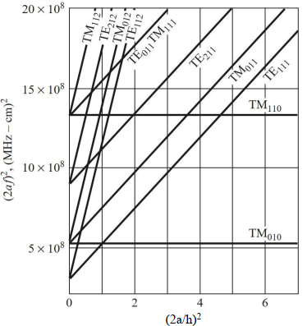
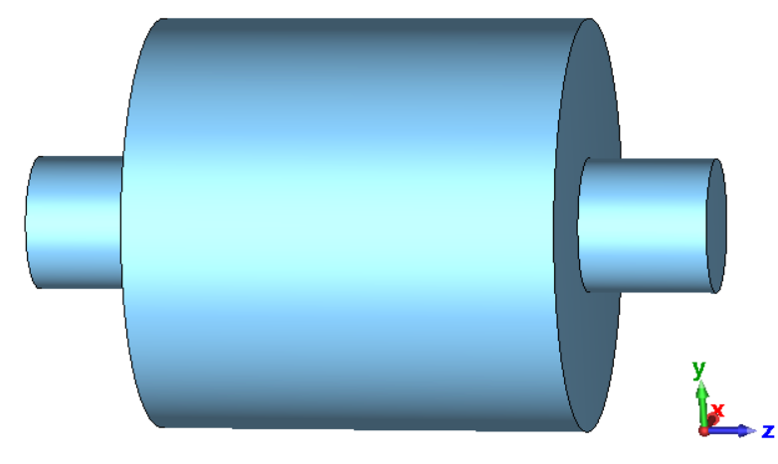

Model geometry
* Pozar, Microwave engineering, 4th ed., Wiley
Properties
l_cavity = 310 mm
d_cavity = 296 mm
l_port = 92 mm
d_port = 96 mm
port
cavity
port
h
What is the fundamental mode?
Is this a pillbox cavity?
a

Slide 8
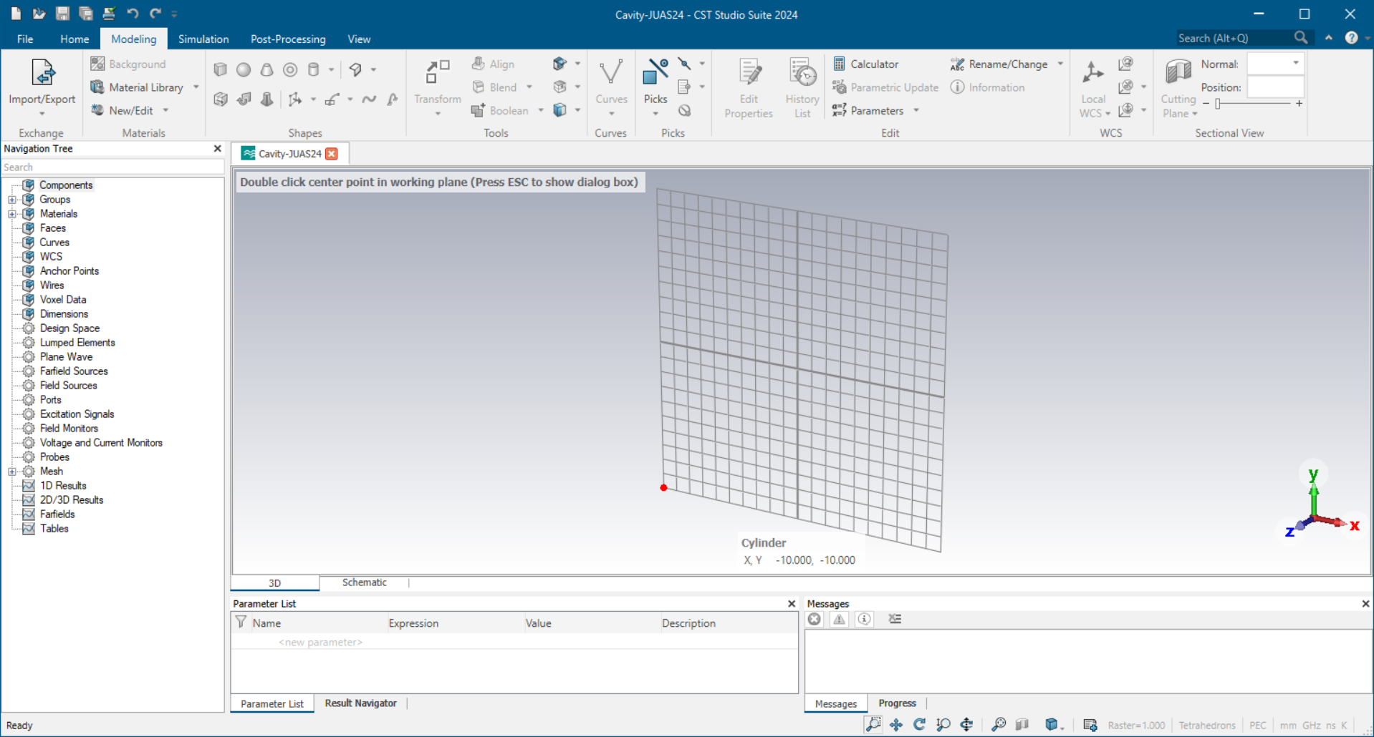
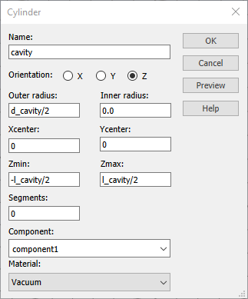
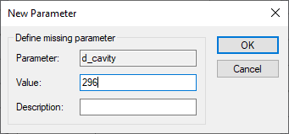
Model geometry
Let’s build the model…
1
From Modeling, select the cylindrical shape.
Press ESC to open a dialog box where the coordinates can be inserted.
2
When typing a variable, a new window will pop up and you will be able to select the variable type, unit and value
3
To symmetrically center the cylinder respect to the origin of the axis
Select material as vacuum

Slide 9
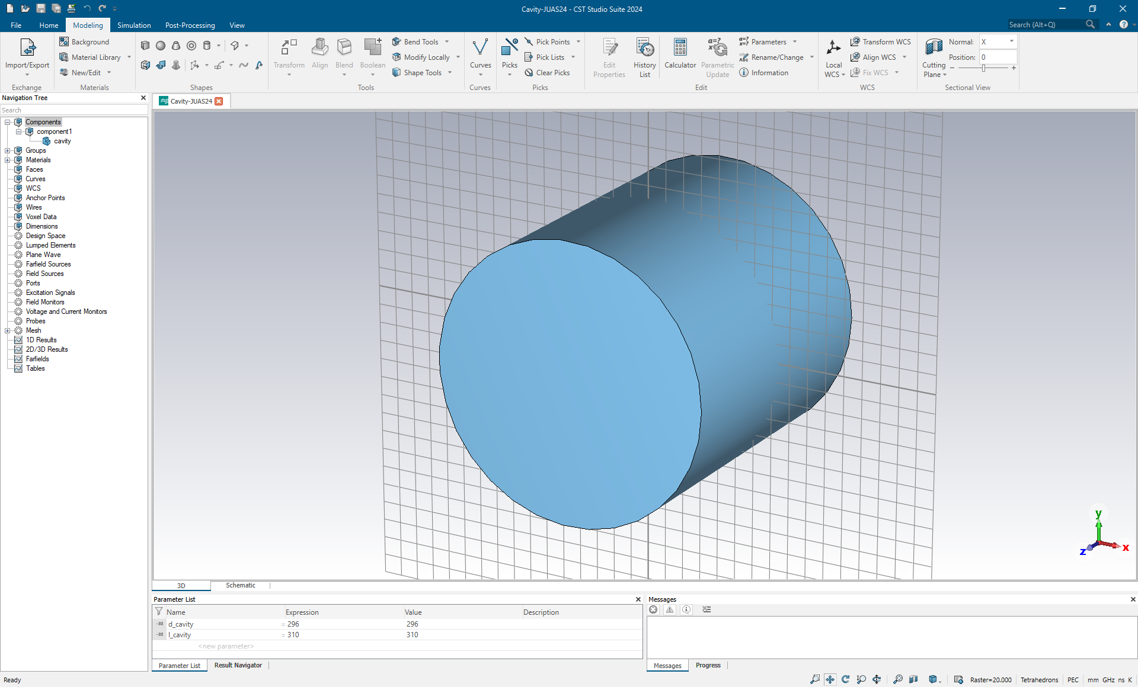
Model geometry
Let’s build the model…
You can access the cavity geometry here
Spacebar to fit the full model into the view
Click here to activate the rotation
You can access and modify the created variables under the Parameter List

Slide 10
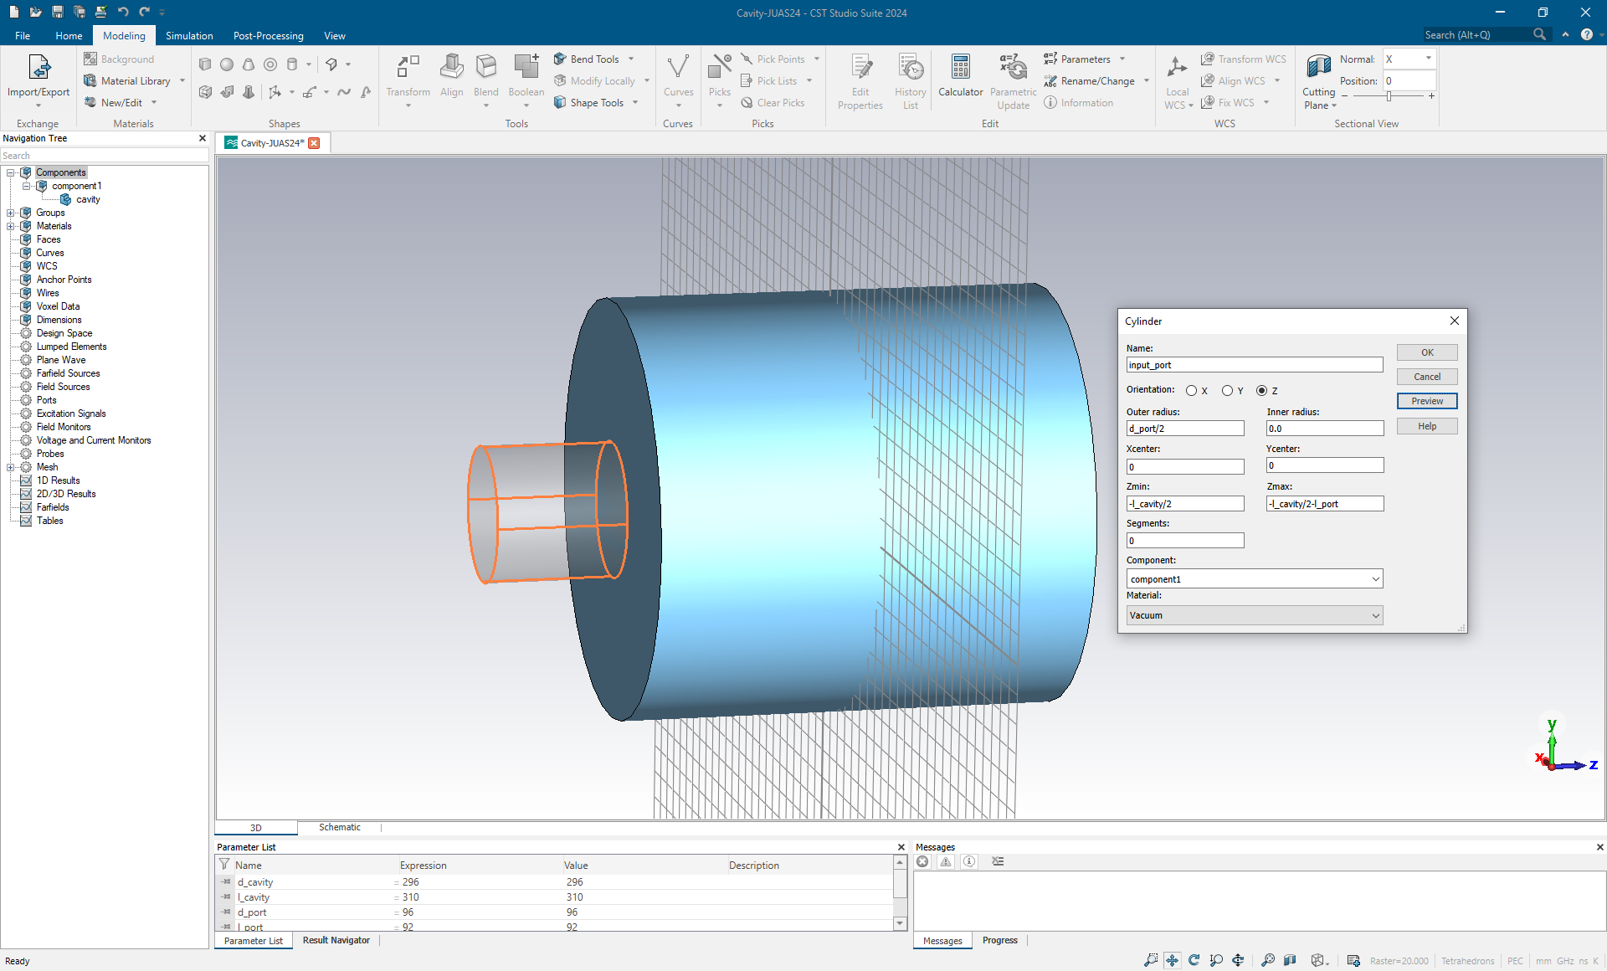
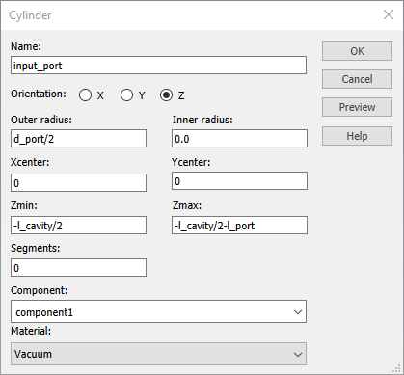
Model geometry
The input and output ports can be built following the same procedure.
l_port = 92 mm
d_port = 96 mm

Slide 11
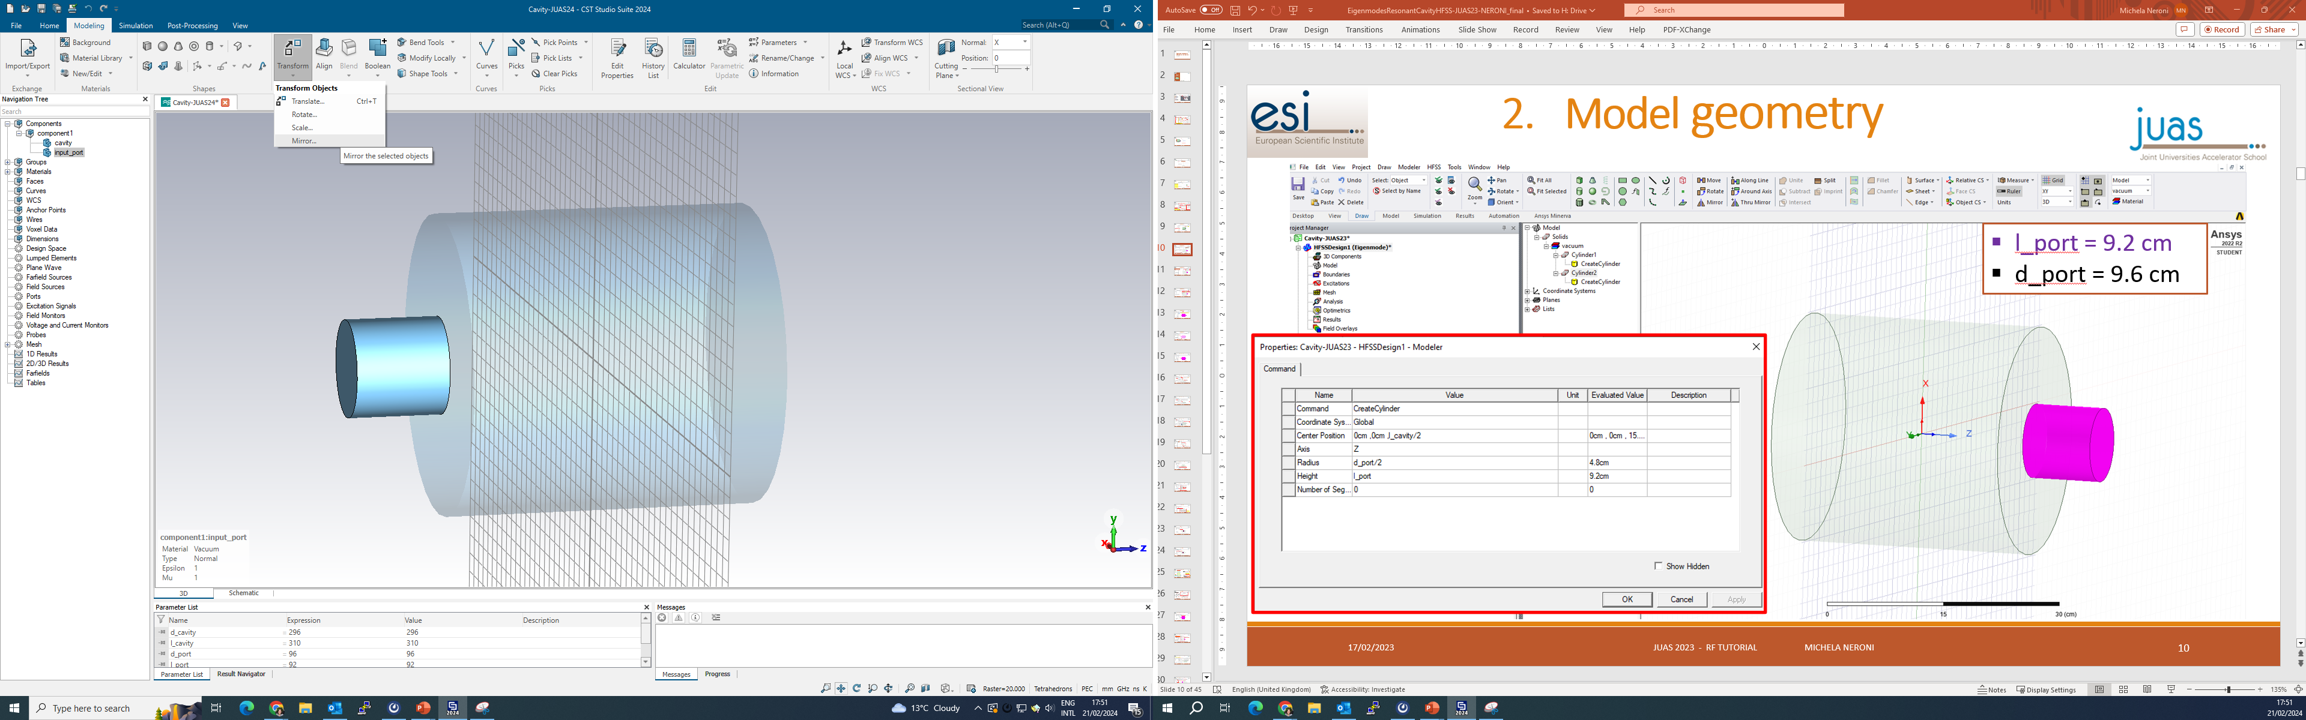
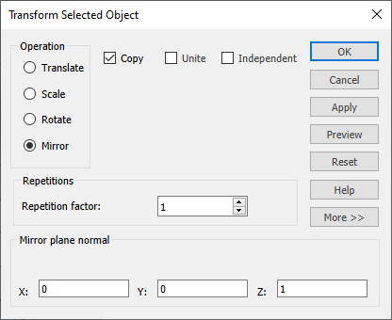
Model geometry
The output port can be created mirroring the input port with respect to the XY plane
1
2
Select the input_port under Components
Click on Transform → Mirror
3

Slide 12
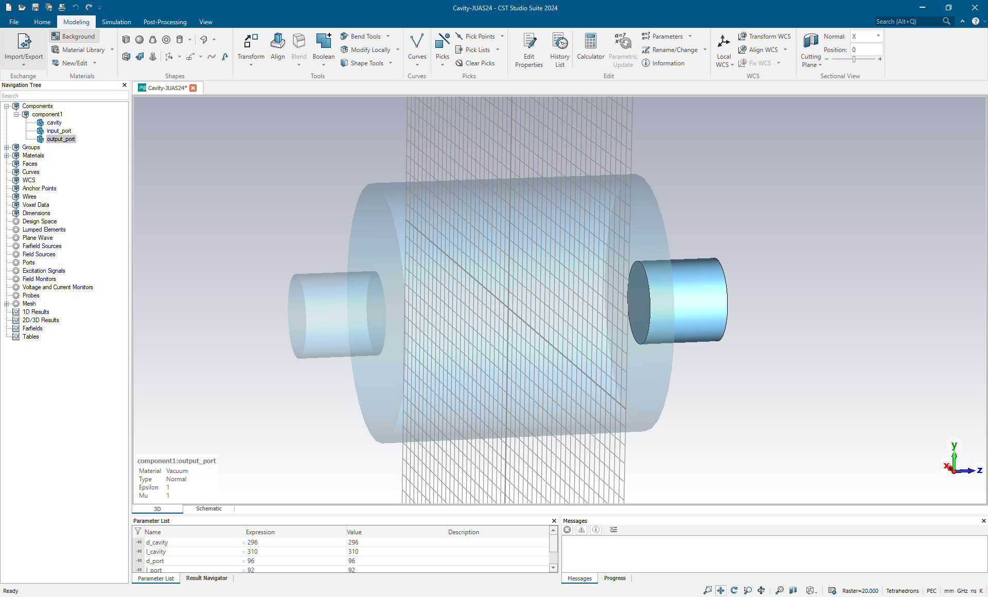
Model geometry
You can rename the second port as “output_port”
The model is now complete!

Slide 13
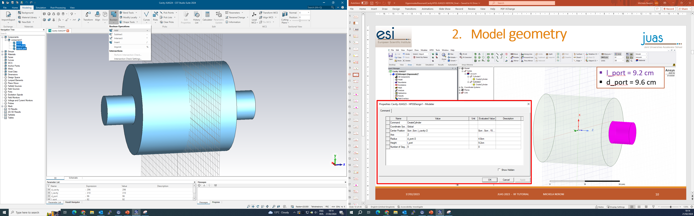
Model geometry
After creating the three cylinders, let’s unite them
2
1
Select the cavity and the two ports
Click on Boolean → Add

Slide 14
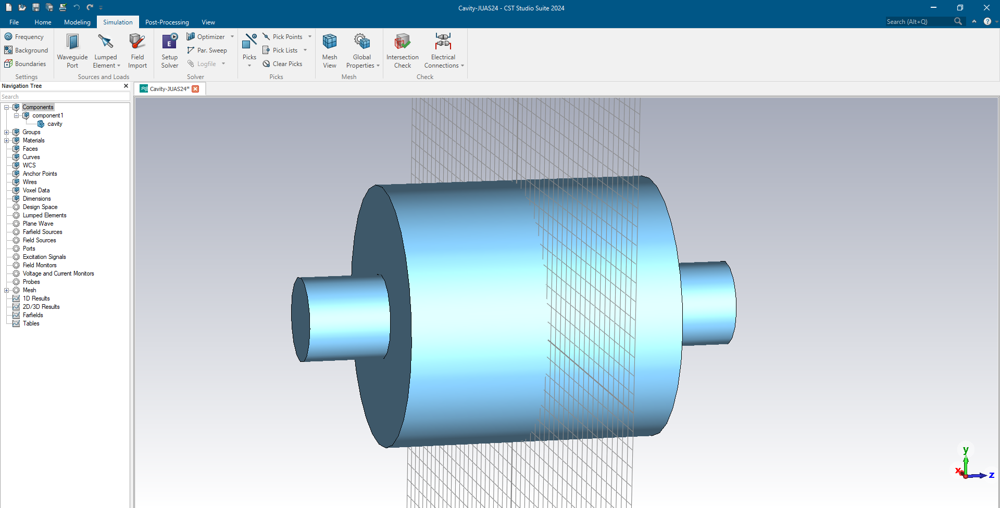
Simulation set-up
After finalizing the 3D geometry, we can move to the Simulation tab.
We would need to define, from the Settings at the top left:
1- Frequency
2- Background
3- Boundaries

Slide 15
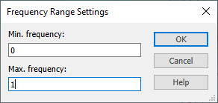
Simulation set-up
1
Click on Frequency
2
Let’s choose a range of Frequency from 0 to 1 GHz

Slide 16
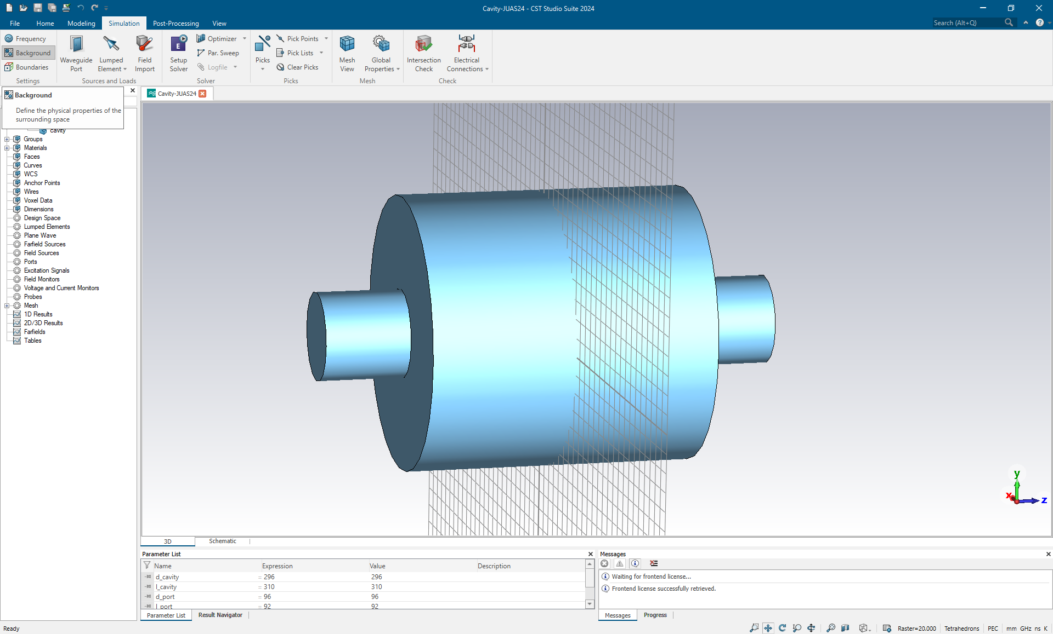
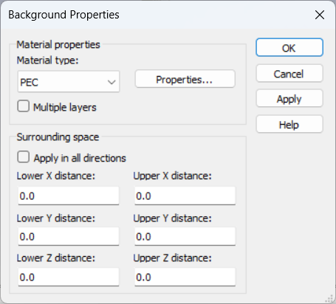
Simulation set-up
1
Click on Background
2

Slide 17
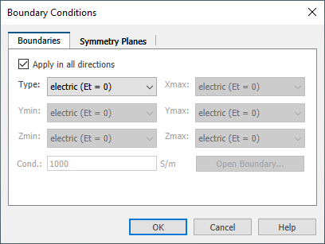
Simulation set-up
1
Click on Boundaries
2
Let’s impose the condition of zero tangential electric field at the wall

Slide 18
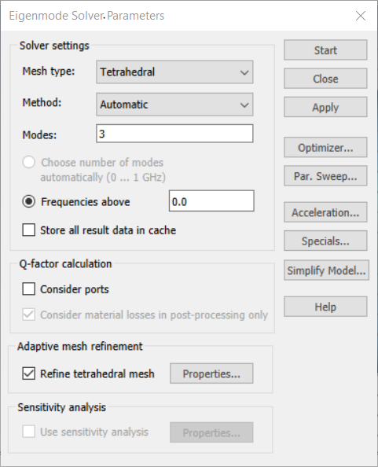
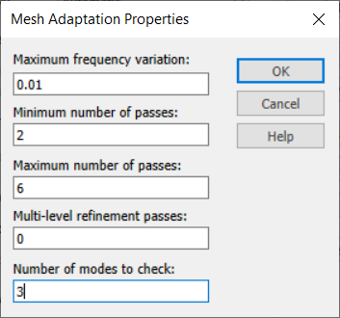
Simulation set-up
1
Click on Setup Solver to input the Eigenmodes simulation settings
2
3
Click on Start to run the simulation
We want to see the first three eigenmodes
Adaptive mesh refinement process will refine the mesh until convergence criterium is satisfied.
Select 3 modes to be checked during the mesh adaptation

Slide 19
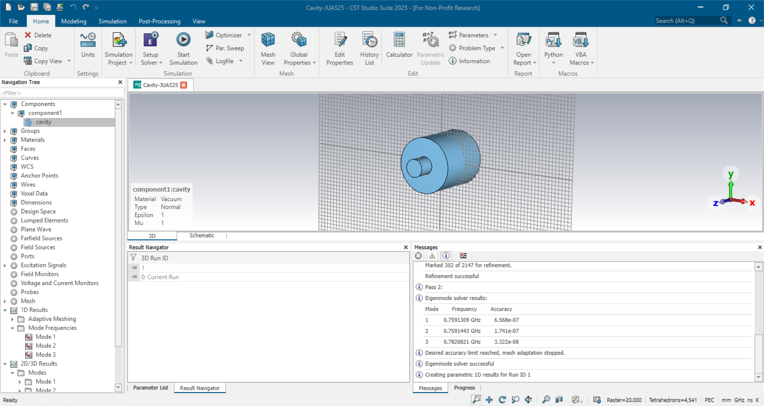
Eigenmodes results
You can see the results of frequencies of the first three resonant modes in the Messages tab, or under 1D Results, Mode Frequencies in the Navigation Tree.
To distinguish which type of modes we obtained, we need to look at the field pattern. A TM mode would have a component of electric field on the propagation axis-z.

Slide 20
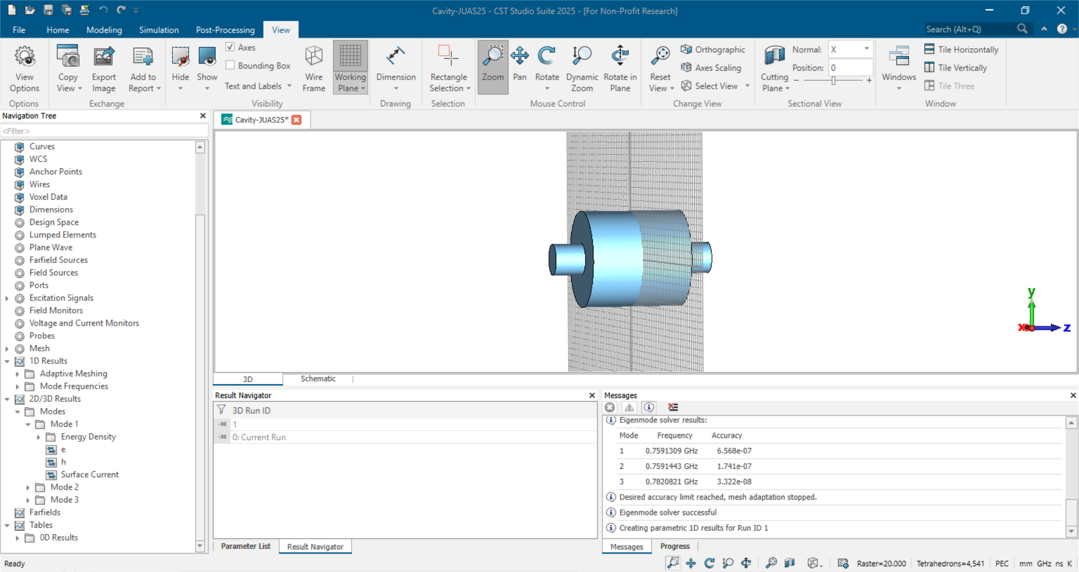
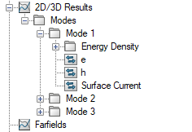
Field plots
Let’s have a look to the field pattern of each mode
The E-field, H-field and other quantities for each mode can be found in the Navigation Tree, under 2D/3D Results.

Slide 21
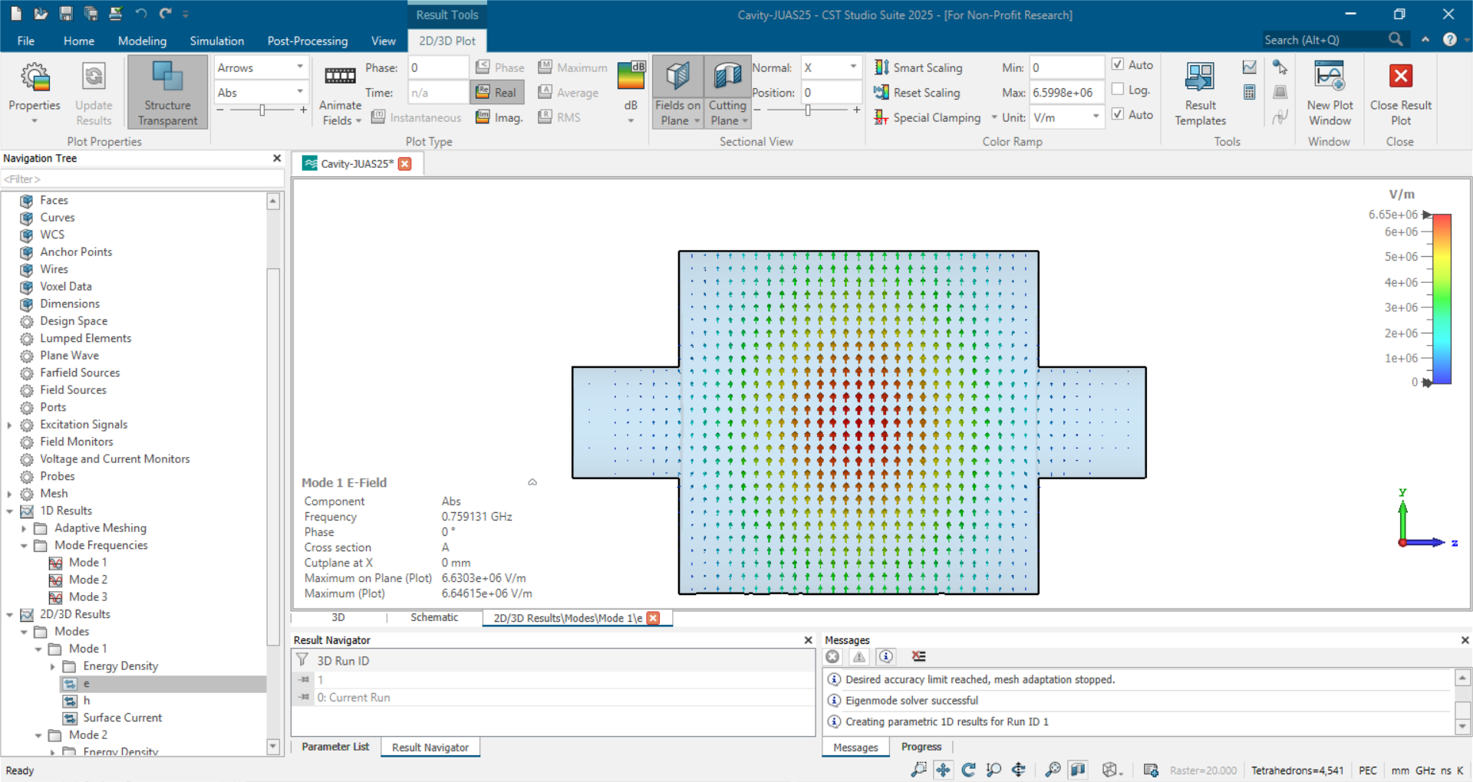
Field plots
From the 2D/3D Plot toolbar, you can change the view and plot the field on a plane
We can look at the E-field of the first mode on the YZ plane to understand if it has a longitudinal component.

Slide 22
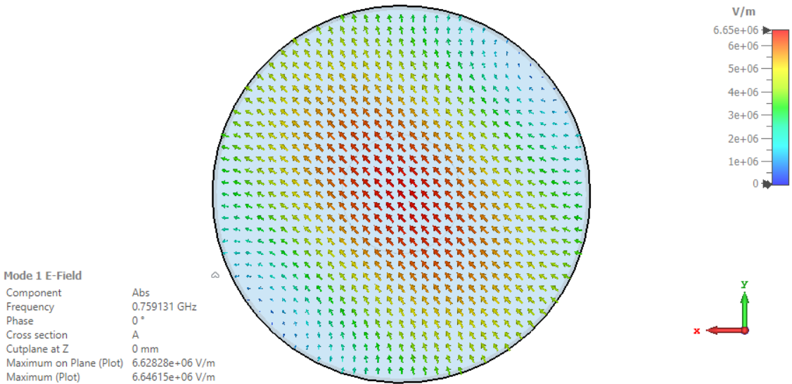
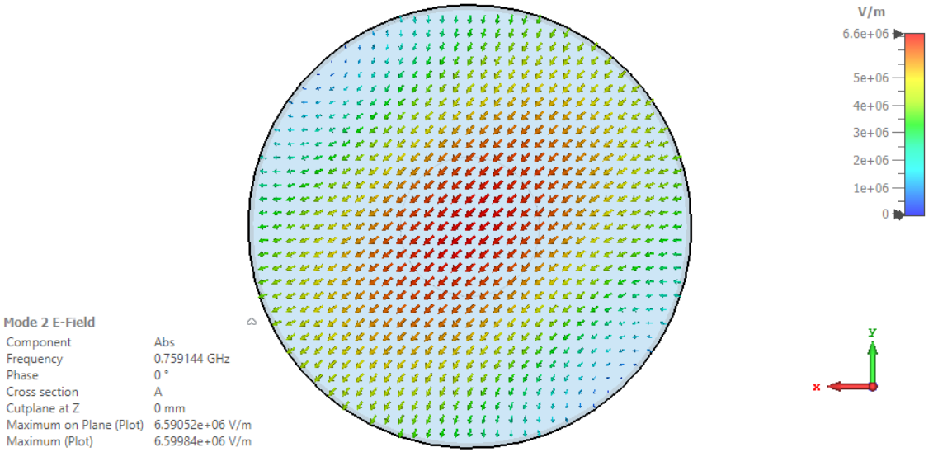
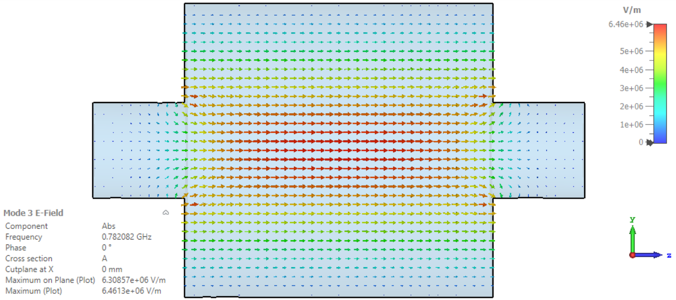
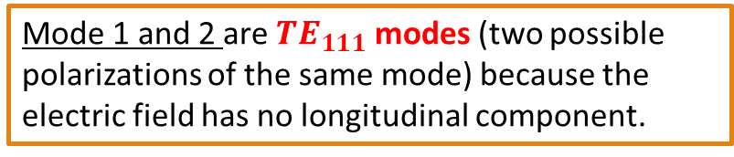
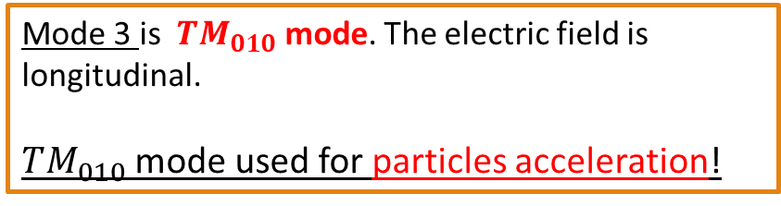
Field plots
Mode 1 and 2 are $TE_{111}$ modes (two possible polarizations of the same mode) because the electric field has no longitudinal component.
It is not a pillbox cavity because the fundamental mode (lowest cut-off frequency) corresponds to a TE mode!
Mode 3 is $TM_{010}$ mode. The electric field is longitudinal.
$TM_{010}$ mode used for particles acceleration!

Slide 23
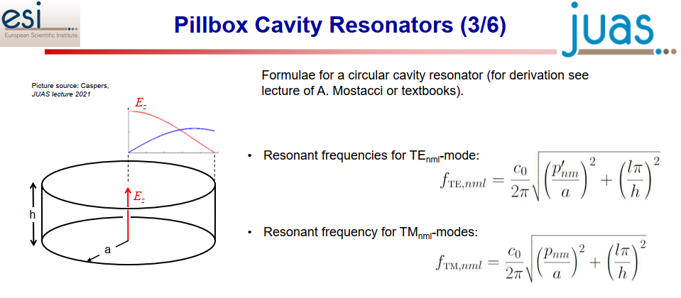
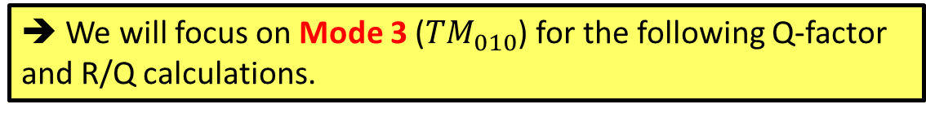
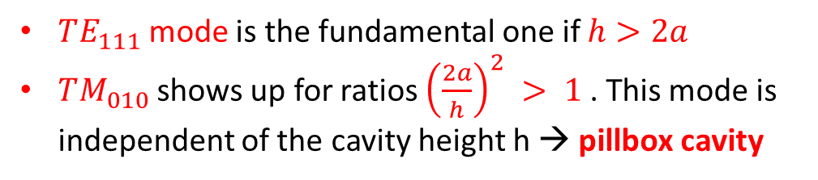
Field plots
From the RF lectures…
Mode's chart
*
C. Vollinger – RF Engineering lecture (22nd February)
$TE_{111}$mode is the fundamental one if $h>2a$
$TM_{010}$ shows up for ratios ${\left(\frac{2a}{h}\right)}^{2} > 1$. This mode is independent of the cavity height h → pillbox cavity
➔ We will focus on Mode 3 ($TM_{010}$) for the following Q-factor and R/Q calculations.
* Pozar, Microwave engineering, 4th ed., Wiley

Slide 24
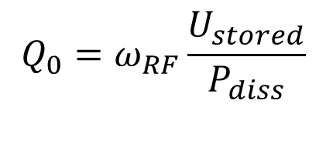
Figures of merit: Q, R/Q
From the RF lectures…
The unloaded Q factor it’s a measure of the resonance quality.
$$Q_{0}=ω_{RF}\frac{U_{stored}}{P_{diss}}$$
Energy stored in the cavity
Power dissipated in the resonator (through the walls). It is directly related to the magnetic field H:
The Q factor can be calculated by making use of the perturbation method:
The electromagnetic problem is solved ignoring the losses as a first step. Including the information on the material conductivity of the walls, we introduce a power dissipation which can be calculated from the H-field of the mode and the conductivity of the wall material.

Slide 25
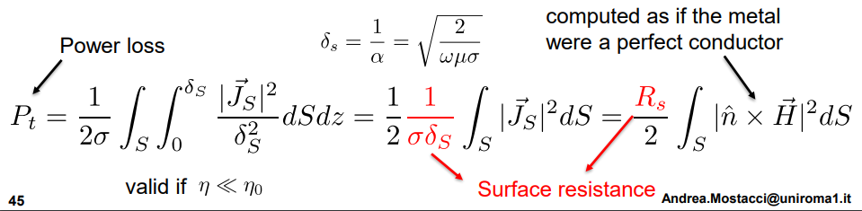
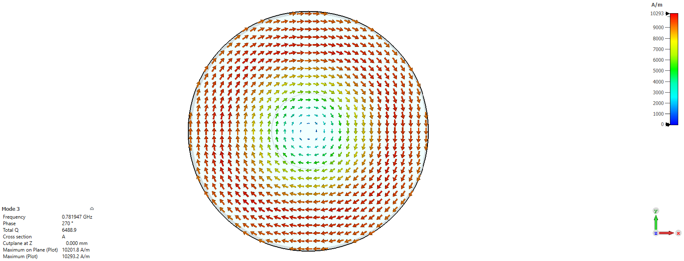
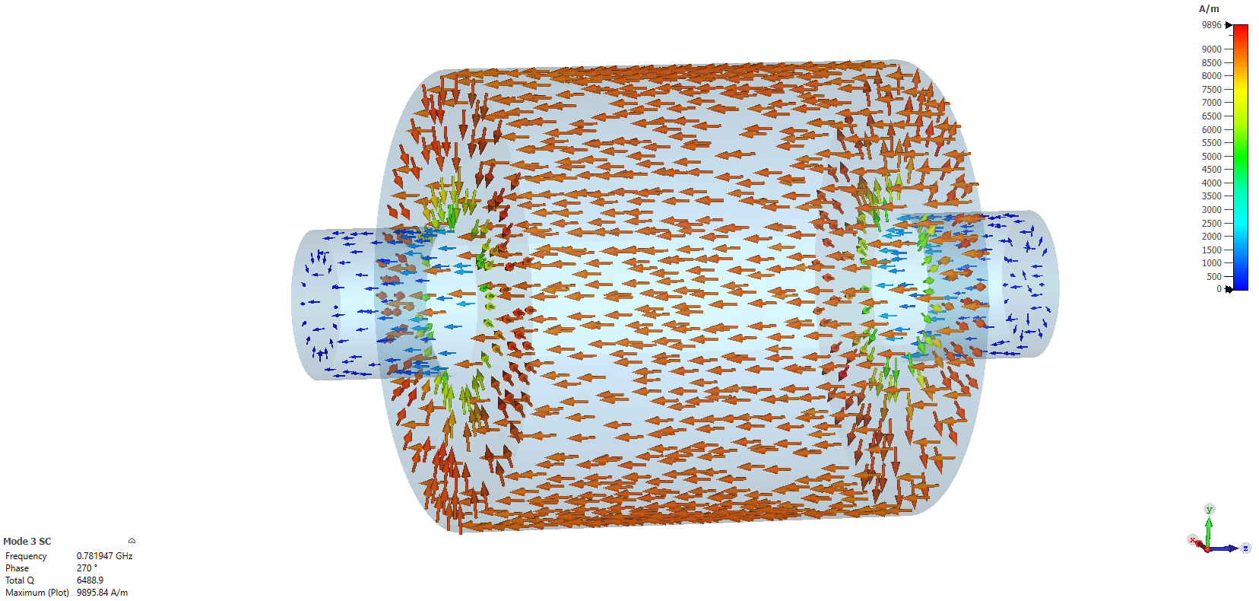
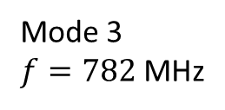
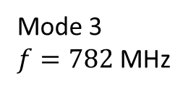
Figures of merit: Q, R/Q
See A. Mostacci “Introduction to RF” – JUAS 2025
Circumferential H-field on XY plane
Surface current density
Mode 3
$f=782$ MHz
Mode 3
$f=782$ MHz

Slide 26
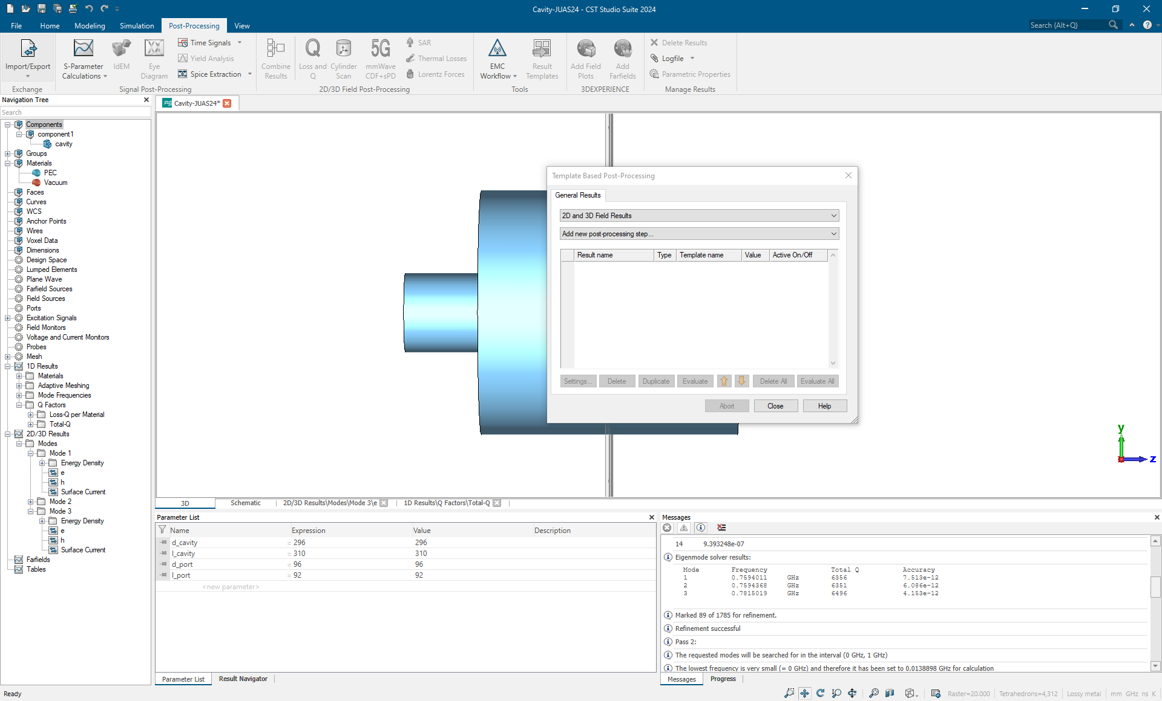
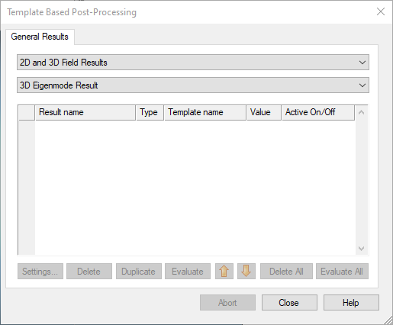
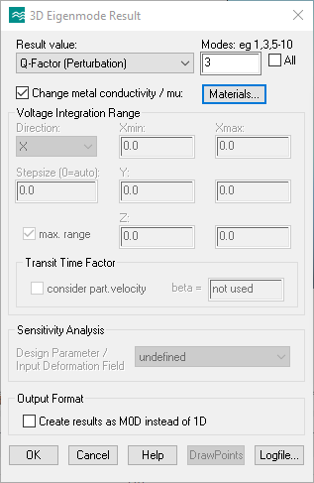
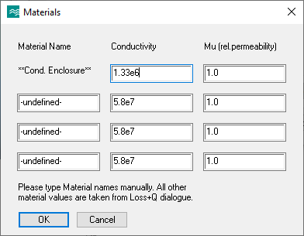
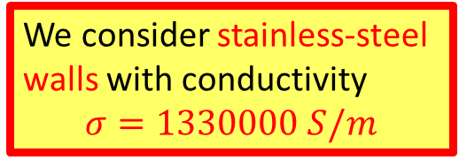
Figures of merit: Q, R/Q
1
Click on Result Templates
Select Q-factor (Perturbation) and Mode 3 (the one of interest for acceleration)
4
2
3
5
We consider stainless-steel walls with conductivity
$$σ=1330000 S/m$$

Slide 27


Figures of merit: Q, R/Q
From the Result Template, the Q factor can be evaluated:
$$Q=6364$$
$${Q≅10}^{4} \text{for} \text{normal} \text{conducting} \text{cavities}$$
2
1

Slide 28


Figures of merit: Q, R/Q
Another important figure of merit for accelerators is the R over Q.
From the RF lectures…
C. Vollinger – RF Engineering lecture (21st February)
It is a measure of the cavity ability to convert the stored energy into acceleration. It is related to the cavity geometry (useful for cavities design).
CST uses the so called “Linac definition” of R-over-Q (different solvers can use a different definition):
$${\left(\frac{R}{Q}\right)}_{linac}=\frac{V_{acc}^{2}}{ωU}=\frac{{\left|\int_{beamline}{E_{z} e^{\frac{jωz}{c}}dz}\right|}^{2}}{ωU}$$

Slide 29



Figures of merit: Q, R/Q
1
Click on Result Templates
4
2
3
Select R over Q and Mode 3.
Direction Z for field integration
Transient time factor → consider particle velocity → $β=1$

Slide 30




Figures of merit: Q, R/Q
From the Result Template, the R-over-Q can be evaluated:
2
$$\frac{R}{Q}=26 Ω$$
The actual R-over-Q of the cavity is $\left(\frac{R}{Q}\right)=\frac{1}{2}{\left(\frac{R}{Q}\right)}_{linac}≅13 Ω$
1
Normal conducting accelerating cavities R/Q $≅{10}^{2} Ω$

Slide 31
Additional exercises
Vary the cavity length and radius to test yourself in guessing the fundamental mode.
Try to change the material electrical conductivity to observe how the Q factor changes. What happens to the R/Q?

Slide 32
References
CST Studio Suite®, https://www.3ds.com/products/simulia/cst-studio-suite
Mostacci, A., “Introduction to RF”, JUAS24, Archamps, February 2024
Vollinger, C. et Wendt, M., “RF Engineering”, JUAS24, Archamps, February 2024
Pozar, D. M., “Microwave Engineering”, 4th edition, Wiley and sons
Wendt, M., “RF Training: Numerical Analysis”, CAS Advanced, Sevrier, November 2022
Udongwo, S. et al., “Numerical Simulations”, CAS 2023, RF for Accelerators, Berlin, June 2023
Migliorati, M., “Simulation of a Pillbox cavity with CST”, JUAS18, Archamps, February 2018
CST Studio Suite® 2024 Help

