Slide 1
RF Engineering
Accelerating Structures
Christine Völlinger (CERN) & Manfred Wendt (BNL)

Slide 2
Contents of this lecture
Dispersion diagram.
General accelerating structures, and the concept of standing wave and travelling wave cavities.
Higher order mode (HOM couplers) on the example of the SPS 200 MHz TWC.

Slide 3
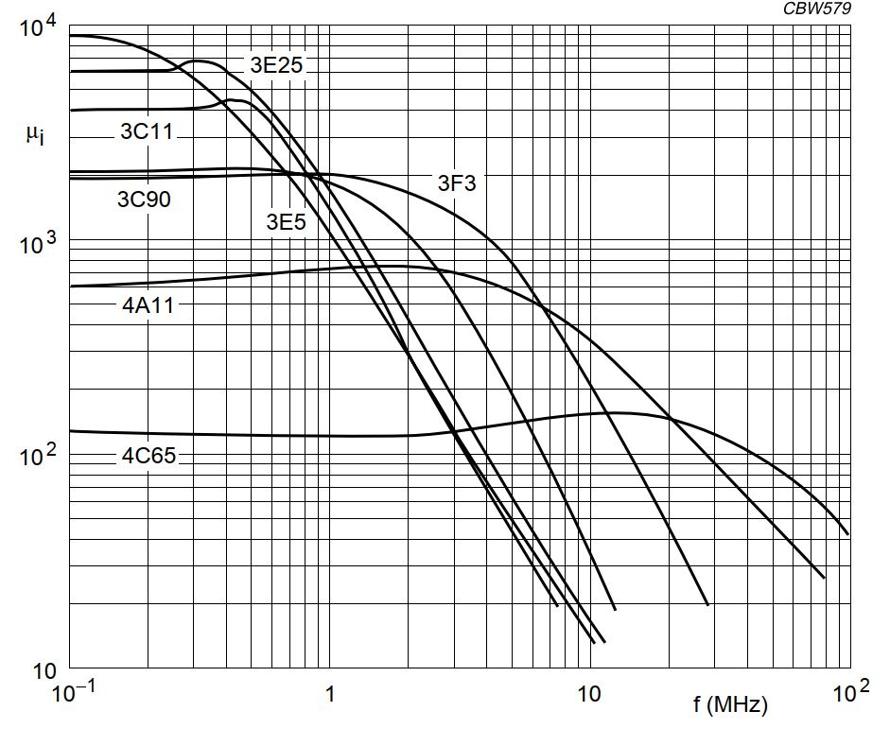

Dispersion (1/3)
Dispersion generally denotes frequency dependent behaviour.
Best known example is dispersive media, changing its characteristics as a function of frequency.
magnetic loss tangent
Transmission lines and waveguides also show dispersive behaviour.
Source: Ferroxcube Data Handbook

Slide 4
Dispersion (2/3)
If phase velocity and attenuation of a transmission line or wave guide are constants that do not change with frequency, THEN the phase of a signal that contains more than one frequency will not be distorted (= no dispersion).
If the phase velocity is different for different frequencies, THEN the line is dispersive.
This means that individual components of a wave will not maintain their original phase relationship when they propagate.
We will experience a signal distortion if the signal contains more than one frequency.
Dispersion = no single phase velocity can be attributed to the signal as a whole.
Different v_{p} means that some signal components travel faster than others.
If dispersion is small, a group velocity can be defined: v_{g}.
Group velocity = speed at which a signal propagates and at which power is transported.
For more details see: lecture of Andrea Mostacci or textbooks, for example: Pozar, Microwave engineering, Wiley

Slide 5
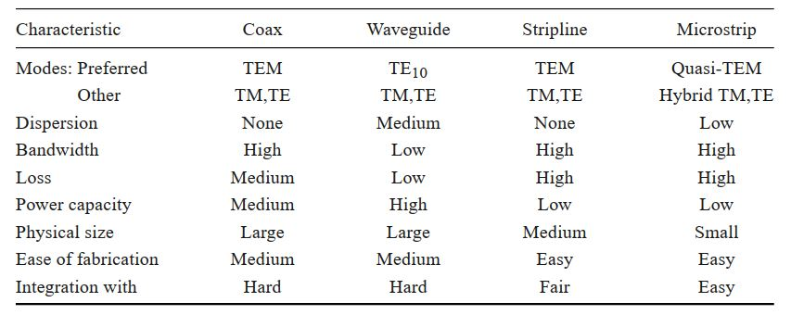
Dispersion (3/3)
Comparison of Transmission lines and waveguides
Source: Pozar, Microwave engineering, 4th ed., Wiley

Slide 6

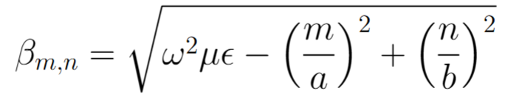
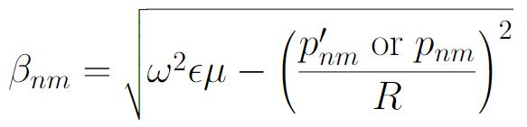
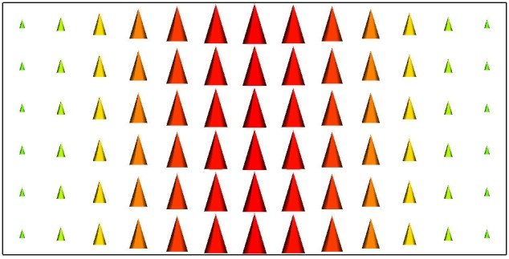
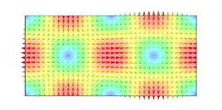
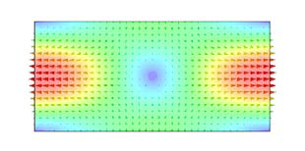
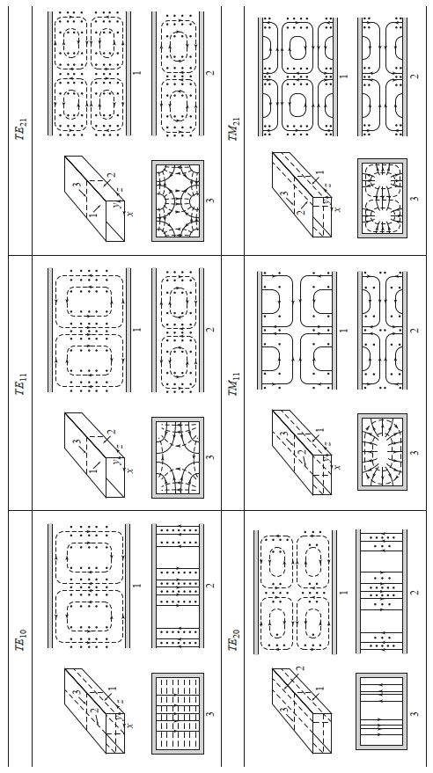
Dispersion – Remark to Waveguides
Recall phase velocity:
Phase constant of rectangular waveguide
Phase constant of round waveguide
defined
TE₁₀-mode
TE₂₁-mode
TE₁₁-mode
Coax to waveguide transition… will excite all modes that “fit” this field pattern.
Any discontinuity will need all possible modes to fulfill the boundary condition on the discontinuity, thus “excite” all modes.
Mode conversion (one mode converting into another mode) happens “easily” and not only unintentionally.
Mode converters are built to convert from one mode to another.

Slide 7
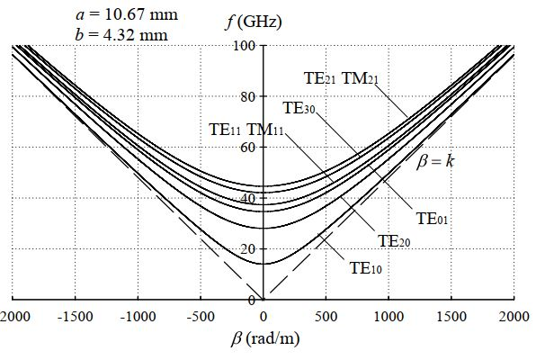
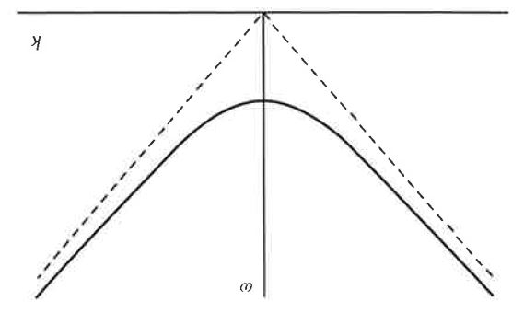






Dispersion Diagram
general dispersion relation
dispersion relation
of waveguide
Tangent at point on the dispersion curve
Source: Zhang, Electromagnetic Theory for Microwaves and Optoelectronics, Springer
v_{g} is zero at cut-off frequency
v_{g} is smaller than c₀
v_{p} can be larger than c₀
From origin to point on the dispersion curve

Slide 8
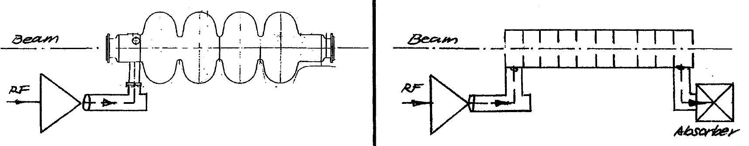
RF-systems
source: F. Caspers et al., JUAS 2021
RF systems
Single gap cavity
“Pillbox type”
Multiple cell cavities
Standing wave cavities
Travelling wave cavities
RF load
Typically used in applications with low beam loading,
e.g. ring accelerators (storage rings)
Typically used in applications with high beam loading, e.g. linear accelerators (linacs)
Multiple cell cavities
Notes:
There are MANY ways to implement an RF system..it first good to know what we have in our toolbox and then select the best tool for the job to be done..what is beam loading? in short: how much energy stored in the cavity is taken out by the beam..per passage..

Slide 9
Disc-loaded circular waveguide (1/2)
Disc-loaded waveguide is a circular metallic waveguide with periodically added metallic discs and holes for particle passage and for coupling of the cells.
We speak of a coupled-cavity chain structure.
EM-fields need to fulfill boundary conditions on the metallic discs.
Disc-loaded waveguide can operate in travelling-wave as slow wave structure or in standing-wave mode.
In standing wave mode, the cells present a “concatenation” of TM₀₁₀-mode “pillbox”-type cavities.

Slide 10
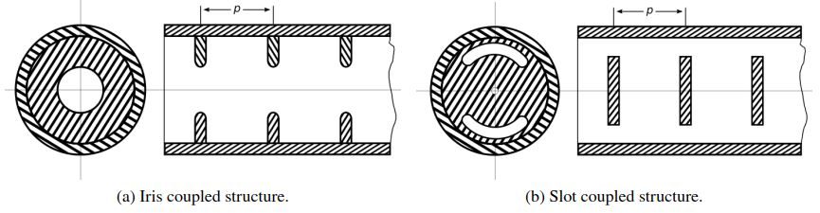
Disc-loaded circular waveguide (2/2)
Source: Kramer, Studies of HOM-couplers for the Upgrades Travelling Wave Acceleration System in the CERN SPS, PhD, CERN-THESIS-2019-371
Different coupling mechanisms between the individual cells exits, either on the side or in the center.
We speak of iris-coupled-structure and slot-coupled-structure.
For slot-coupled-structures, the center opening for the beam can be very small and is often ignored in the EM-calculations.
Example: 0-mode structure in standing wave (SW) … can be derived from pillbox TM₀₁₀-mode.
The name of the resonant mode is given by the phase advance between two consecutive cells.

Slide 11
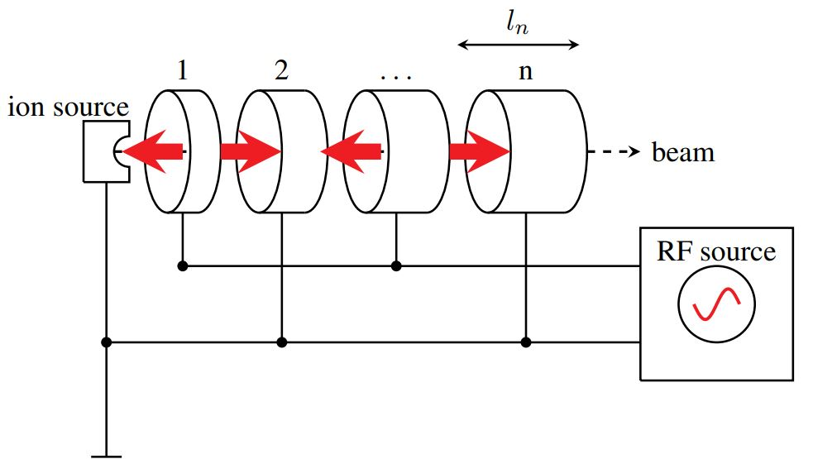
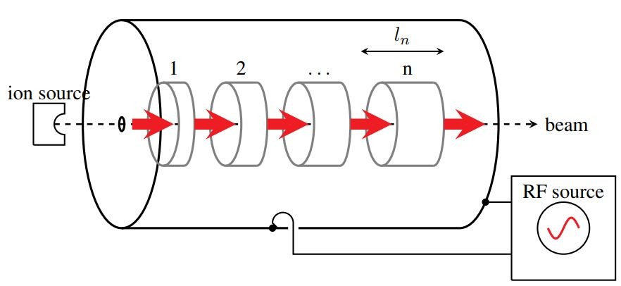
Example of 1st Accelerating Cavities (SW, 1/3)
How does this work?
source: F. Gerigk, CAS Ebeltoft, Cavity Types, 2010
Wideroe-type linac (= drift-tube-linac)
Alvarez-type linac (= drift-tube-linac)
Pi-mode structure
0-mode structure
Remember: The name of the resonant mode is given by the phase advance between two consecutive cells.

Slide 12
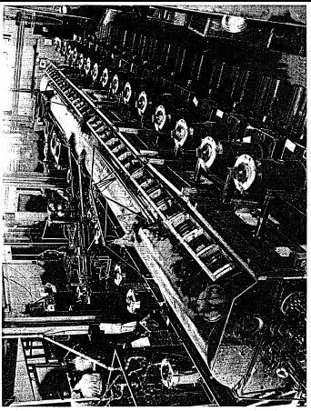
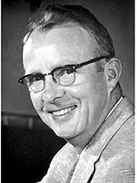
Side Remark about the linac-frequency…
Luis Alvarez and the Drift Tube Linac
The WW2 effort forced many scientist to develop the competences and gave the components to go to higher frequencies (in the MHz – GHz range) .
Alvarez tried acceleration of a proton beam to the MeV range using the Wideröe principle.
He worked at MIT on radar during the war. In 1945, he had the tools and the competences to build his own accelerator.
The 1st Drift Tube Linac by L. Alvarez and his team at Berkeley, reaches 32 MeV in 1947.
Choice of Frequency :
Alvarez received from the US Army a stock of 2’000 (!) surplus 202.56 MHz transmitters, produced for a radar surveillance system.
26 were installed to power the DTL with a total of 2.2 MW.
They were soon replaced because unreliable, but this frequency remained as the standard linac frequency.
Following M. Vretenar,
RF CAS 2023
12

Slide 13
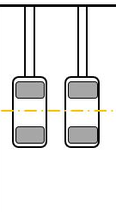
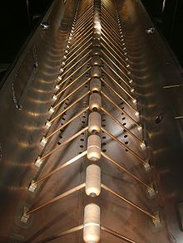
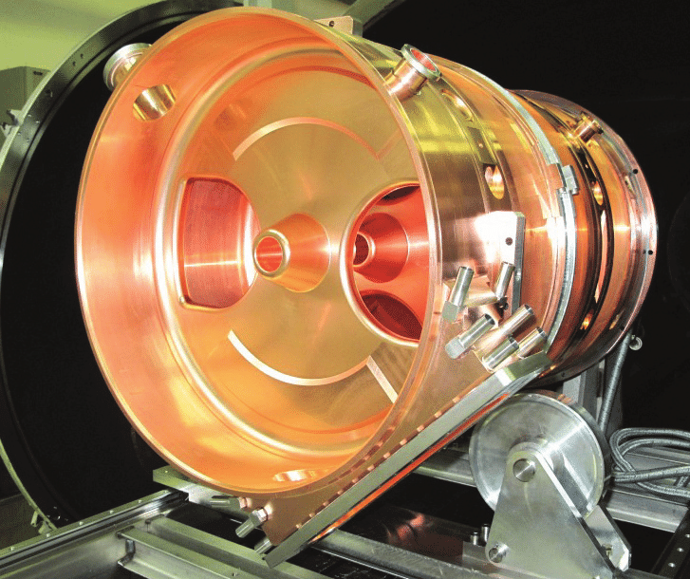
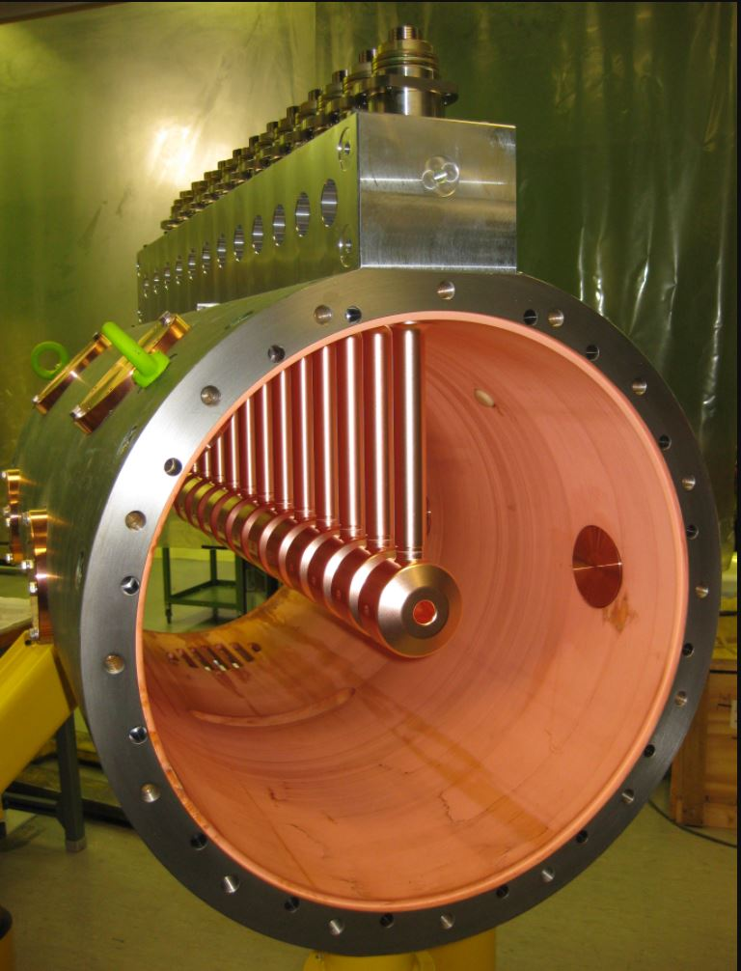
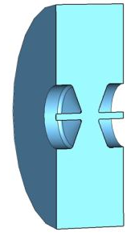
Example of Pi-mode Cavities (SW, 2/3)
How does this look in reality?
Slot-coupled-structure (PIMS)
at CERN
Drift tube structure, CERN
Picture of Linac1, CERN
Note that a ‘cell’ is not necessarily a pillbox-type shape. In drift tube structures, a cell is the area between two drifttubes and looks in principle like a pillbox with nose cones.
sources: P. Bourquin et al., Development Status of the Pi-mode Accelerating Structure (PIMS) for LINAC4, Proc. Of LINAC08, Canada.
C. Plostinar (ed.), Comparative Assessment of HIPPI Normal Conducting Structures, CARE-report-2002-0771

Slide 14
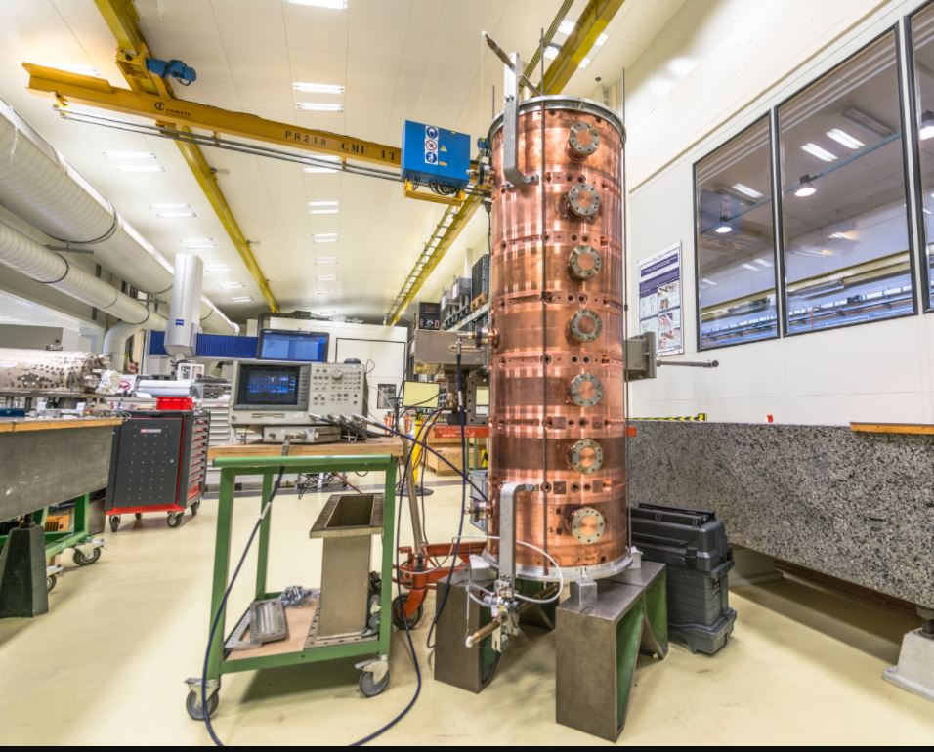
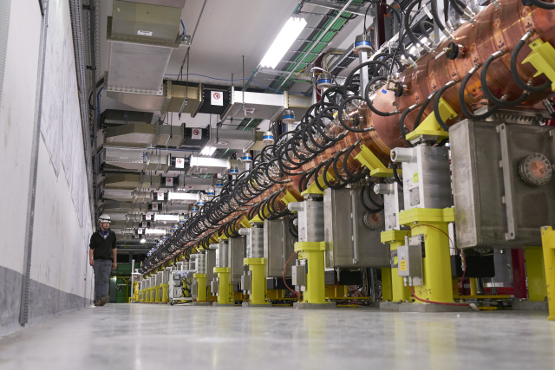
Example of Pi-mode Cavities (SW, 3/3)
Slot-coupled-structure (PIMS) at CERN
PIMS cell
PIMS test set-up
Completed LINAC4, CERN
Picture sources: CERN cds
R. Wegner et al., Linac4 PIMS Construction and First Operation, IPAC2017, Copenhagen.
P. Bourquin et al., Development Status of the Pi-mode Accelerating Structure (PIMS) for LINAC4, Proc. Of LINAC08, Canada

Slide 15

Waveguide becomes Slow Wave Structure
To get power transferred to the beam, the accelerating field needs to be kept in phase with the charged particle.
For single gap cavities, this means that the resonance needs to be synchronous with the particle phase. We can then concatenate many “pillbox cavities” to one multi-cell pattern.
Another way to reduce phase velocity is to build the disc-loaded waveguide where discs are added in a periodic pattern (schematic pictures look the same).
As for the concatenated “pillbox cavities”, a multi-cell pattern builds up. The addition of discs inside the cylindrical waveguide induces multiple reflections between the discs and results in a change of the dispersion curve. The structure can then be used in travelling wave mode.
If the wave is travelling with speed-of-light, and we slow down this wave (=reduce phase velocity), we obtain so-called slow wave structures (SWS).
Slow wave structures are known from dielectrics (where the EM-wave slows down due to permittivity ), but here we will discuss slow-wave structures with metallic boundaries used for particle acceleration.

Slide 16
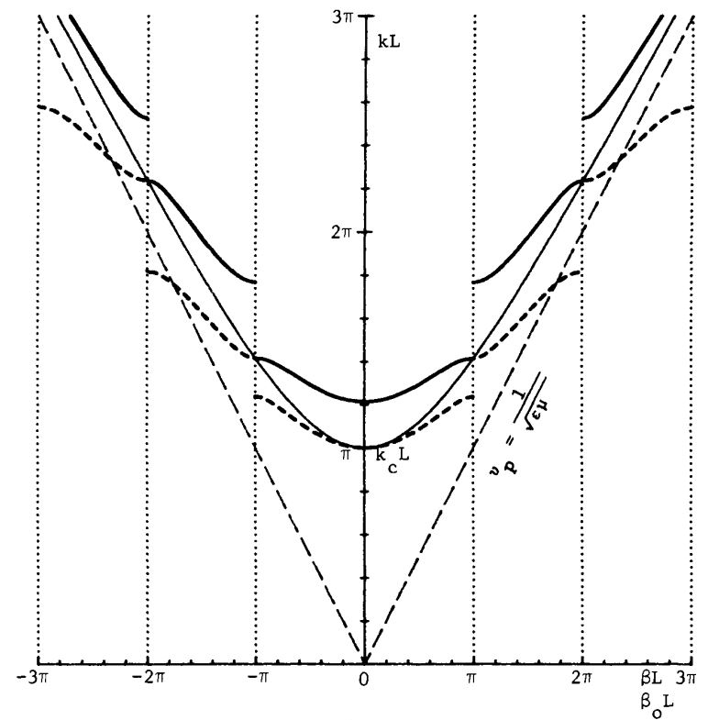

Slow wave structure (1/7)
source: G. Dome, RF Systems: Waveguides and Cavities, aip-conf-proc.153-1296
Slow wave structures work in the range of v_{p}< c₀.
The addition of discs inside the cylindrical waveguide induces multiple reflections between the discs and results in a change of the dispersion curve.
The disc-loaded structure can then be used in travelling wave mode.
The dispersion curve changes from continuous to splitting up into different modes which are slowed down. We speak of pass-bands. These modes are separated by stopbands.

Slide 17
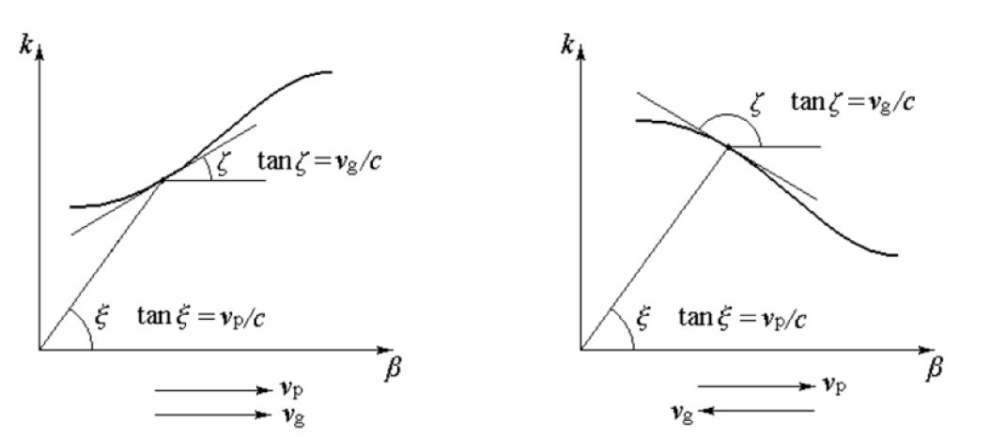
Slow wave structure (2/7)
Dispersion Curves, phase- and group velocity for FW and BW wave in periodic structure.
Forward wave (FW)
v_{g} and v_{p} point in the same direction.
Backward wave (BW)
v_{g} and v_{p} point in the opposite direction.
For the advanced RF-fans:
1. All guides modes in common transmission lines, metallic and dielectric waveguides are forward waves.
2. For transmission lines of “high-pass filter” type, the phase constant β decreases with increasing frequency.
3. “High-pass filter” type lines are modelled with a distributed series capacitance and a shunt inductance
(i.e., opposite of what we did in the transmission line modelling!).
4. Forward and backward type of waves – this makes no difference for the direction of the beam.
Source: Zhang, Electromagnetic Theory for Microwaves and Optoelectronics, Springer

Slide 18
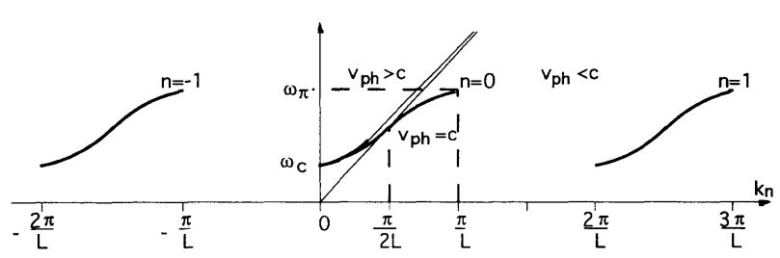
Slow wave structure (3/7)
Dispersion diagram of periodic structure (uniform waveguide is shown for orientation)
Dispersion diagram shows the periodicity of the structure.
For a given mode, there is a limited pass band of possible frequencies.
The passbands are separated by
stopbands where the specific
mode cannot propagate.
At both ends of the passband, the group velocity is zero and wave propagation stops.
source: M. Weiss, Introduction to RF Linear Accelerators.
When group velocity and phase velocity are in the same direction, we speak about forward waves, if they are in different direction, we speak about backward waves. This has nothing to do with the direction of the particle travelling.

Slide 19
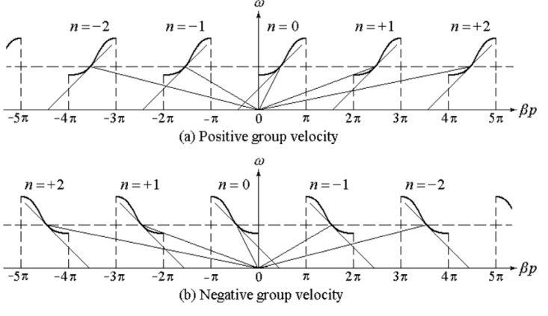
Slow wave structure (4/7)
The request to fulfill the periodic boundary conditions leads to the concept of space harmonics (instead of wave modes).
Space harmonics are closely connected the so-called Floquet Theorem (we will not cover this here).
The Floquet Theorem describes the relation between the phase constant of the n-th space harmonic and is a fundamental theorem of periodic structures.
Source: Zhang, Electromagnetic Theory for Microwaves and Optoelectronics, Springer

Slide 20
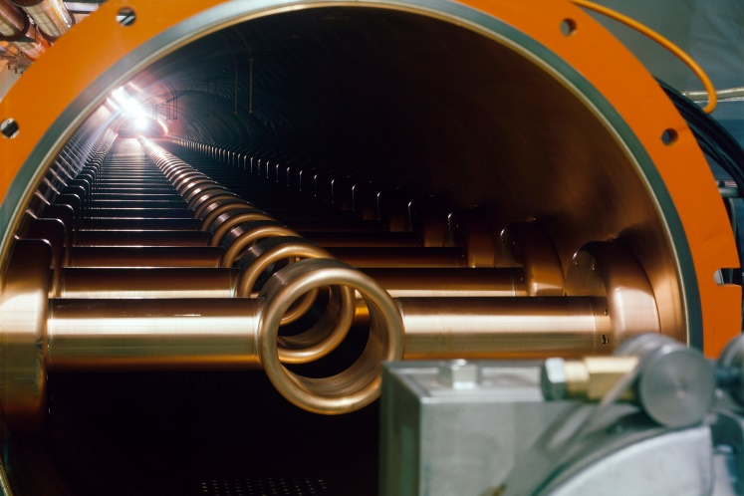

Slow wave structure (5/7)
As was shown before, drift tubes can be used instead of separating discs to slow down the EM-field. The theory for drift tubes is very similar to calculating a slot-coupled structure. Just imagine that the slot is very large.
Inside view of the SPS travelling wave structure © CERN.
In travelling wave (TW) mode, the field propagates through each cell.
The phase advance per cell (distance between the discs, or periodic spacing of drift tubes) determines the length of the cell:
Remember? was already introduced for the single gap cavity as distance that a particle travels during one RF-period.

Slide 21
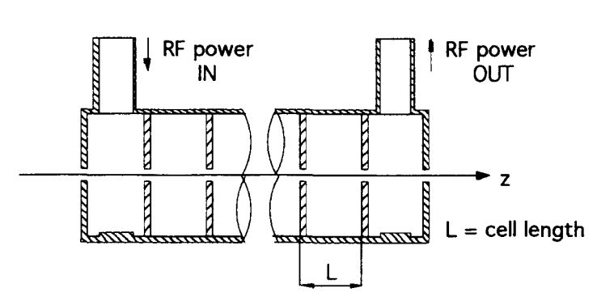
Slow wave structure (6/7)
The only missing component for our travelling wave system are the input and output couplers.
These have to be matching the structure to avoid that standing waves are building up inside the periodic structure.
Often, higher order modes (HOMs) are building up in the structure due to the finite length
(end covers are put there).
Note that a matching network is used to obtain the travelling state. This network is only matching the fundamental mode and not the HOMs!
I.e. the fundamental mode is travelling, others might be travelling, partially travelling or standing modes.

Slide 22
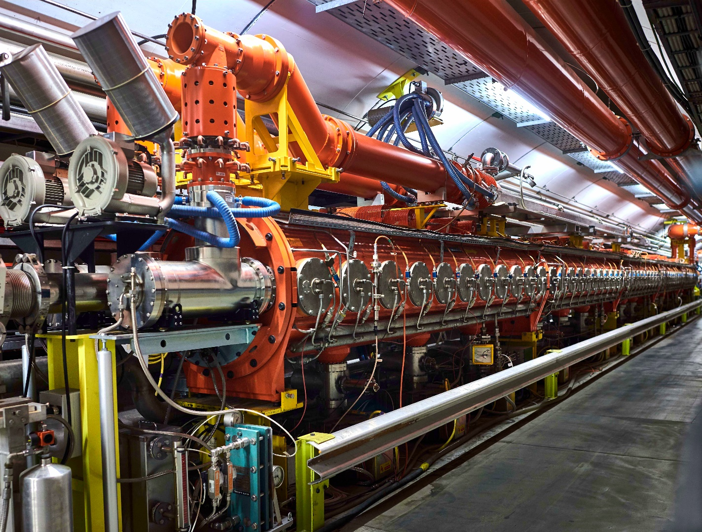
Slow wave structure (7/7)
SPS 200 MHz travelling wave cavity (16m long).
Backward wave structure
Water cooled coaxial load
RF OUT side
RF IN side
Drift tube
with water cooling
beam direction
© CERN

Slide 23
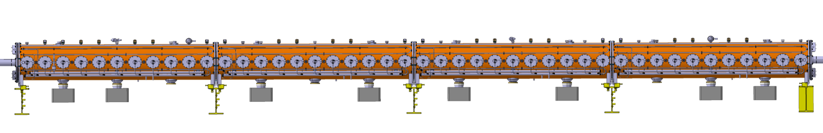
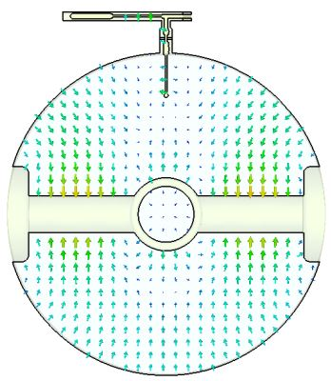
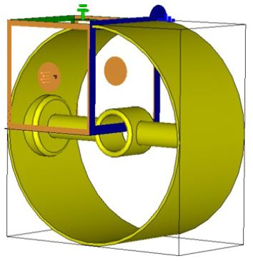
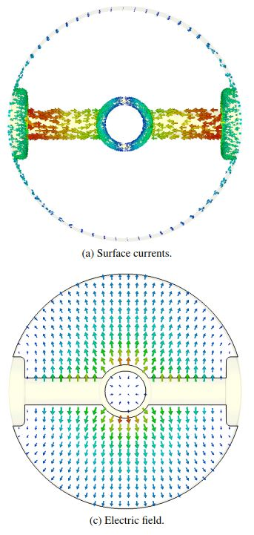
200 MHz TWC of SPS (1/3)
courtesy: E. Montesinos, CERN
Cavity is part of the LHC injector chain and was upgraded recently and equipped with new power amplifiers to reach a higher accelerating voltage.
The cavity was entirely modelled in CST, so that we could well see the fields of the fundamental and the HOMs.
Modelling in CST
(P. Kramer, CERN)
Single cell CST model with symmetries
(no HOM coupler)
Electric field of fundamental mode in the
Cross-section
Surface currents on the
Drift tube
E-field in a cell with HOM-coupler (22π/33 mode)

Slide 24
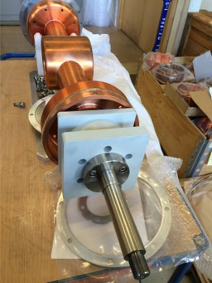
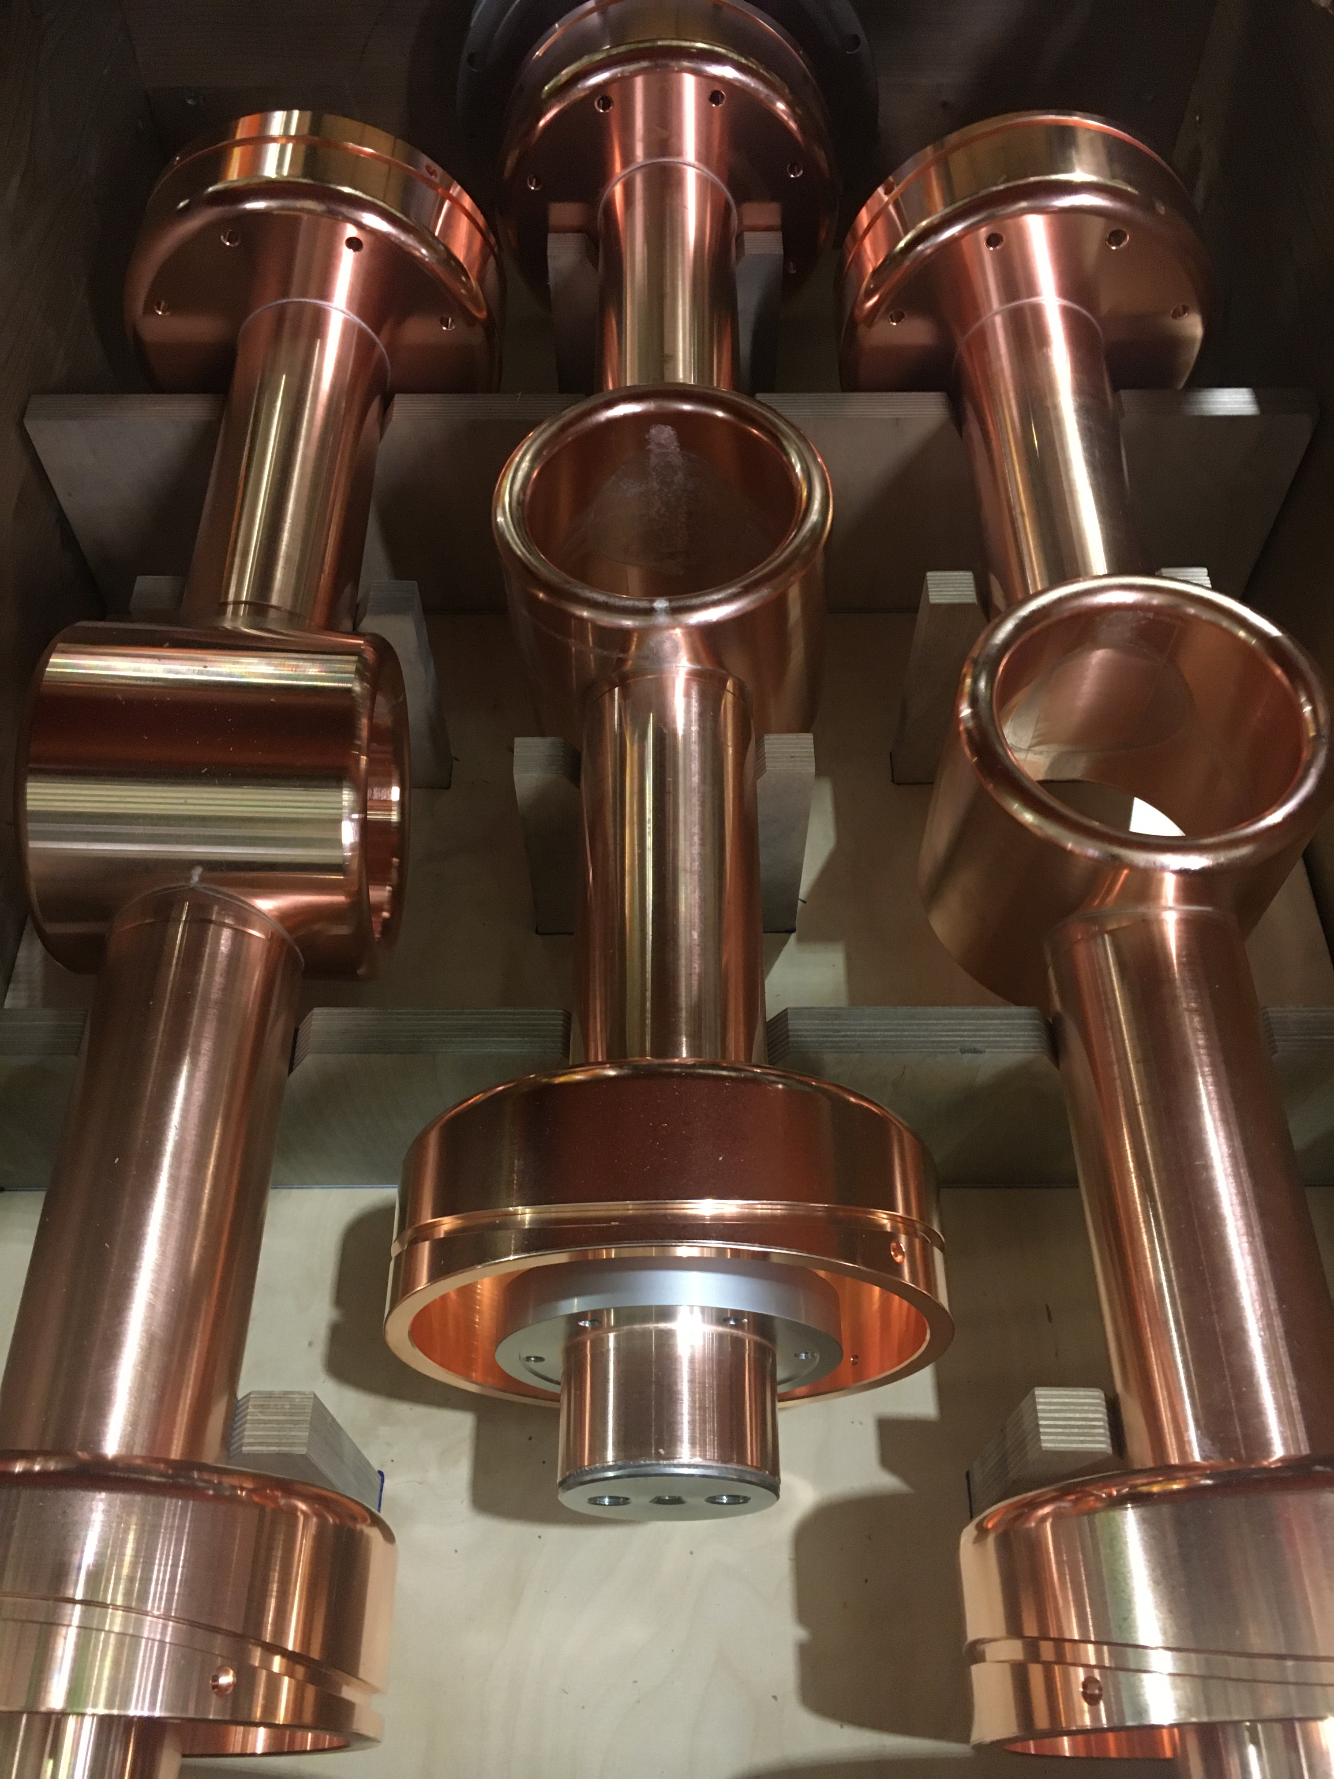
200 MHz TWC of SPS (2/3)
courtesy: E. Montesinos, CERN
Single cell CST model with symmetries
(no HOM coupler)
Electric field of fundamental mode in the
Cross-section

Slide 25
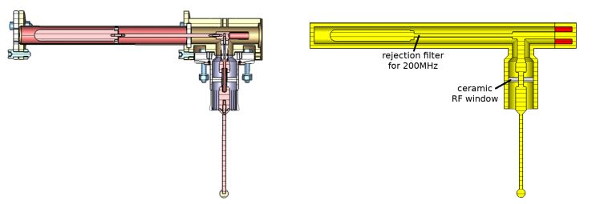
200 MHz TWC of SPS (3/3)
courtesy: E. Montesinos, CERN
Cavity is part of the LHC injector chain and was upgraded recently and equipped with new power amplifiers to reach a higher accelerating voltage.
A number of HOMs are developing, mostly as standing wave and these were taken out by HOM-couplers.
Most harmful was the mode at 630 MHz, each section of the cavity has a number of these Hom couplers installed:
Modelling in CST
(P. Kramer, CERN)
Schematic illustration
E-field pick-up probe

Slide 26
630 MHz - HOM Couplers
courtesy: E. Montesinos, CERN

Slide 27
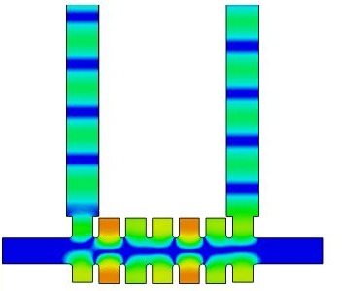
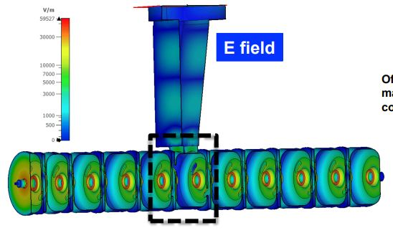
Travelling vs. Standing wave
Just to recall: Andrea has already demonstrated the principle of standing and travelling waves in a multi-cell structure with fantastic animations!
travelling wave
standing wave

Slide 28
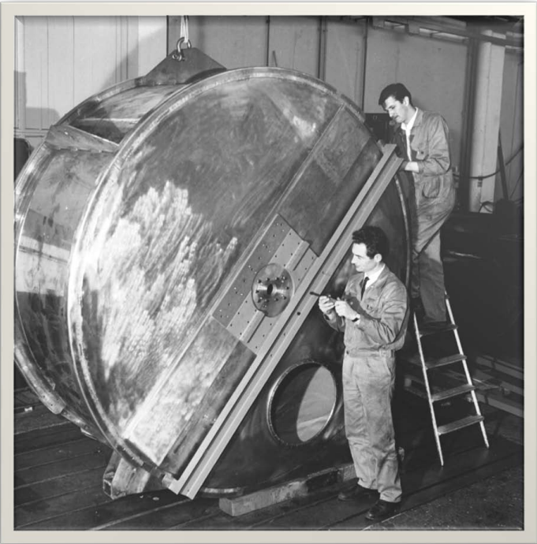
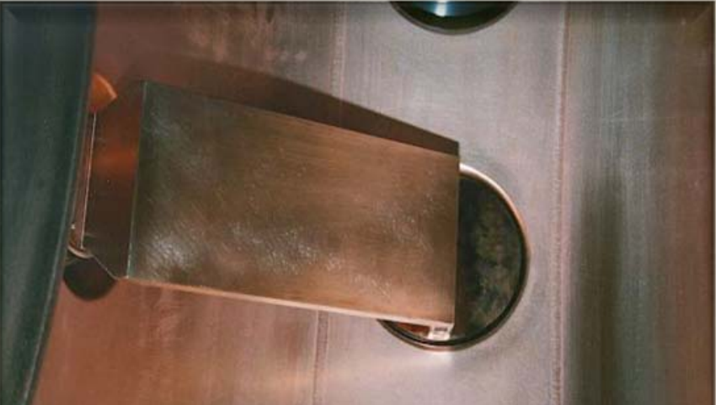
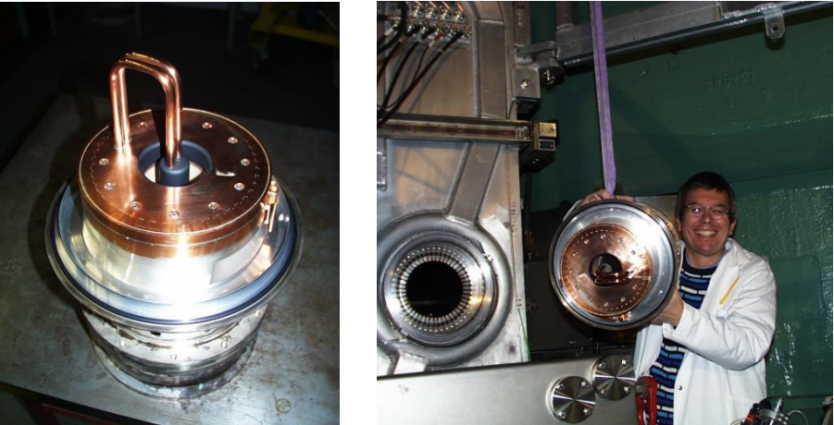
Large Pillbox-geometries
PS 19 MHz cavity (picture from 1966)
Inductive coupling loops
courtesy: E. Jensen, CERN
L. Stigelin
Taken from CAS lecture of H. Damerau, CERN
courtesy: E. Jensen, CERN

Slide 29
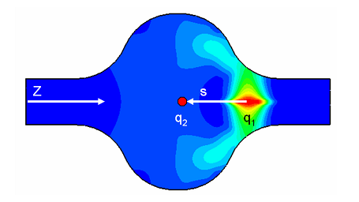

Beam impedances (from mitigation side…)
Wakefields and beam impedances are used to describe EM-interaction of charged particle beams with its environment.
Moving particles lead to EM-fields trailing behind which impact on the following particles.
wakefields
lead to
wake potentials
Picture from CST indicating a lead charge q1 and a “test charge” q2 following the wake at a distance s.
CST is the program which is most used by our team for wake field calculation.
( www.cst.com )
Fourier transform to
beam impedance
Wake potential calculation from CST
Derivation e.g. in Zotter & Kheifets Impedances and Wakes in High Energy Particle Accelerators, World Scientific, 1998
Very good explanations by of M. Migliorati at JUAS lectures!

Slide 30
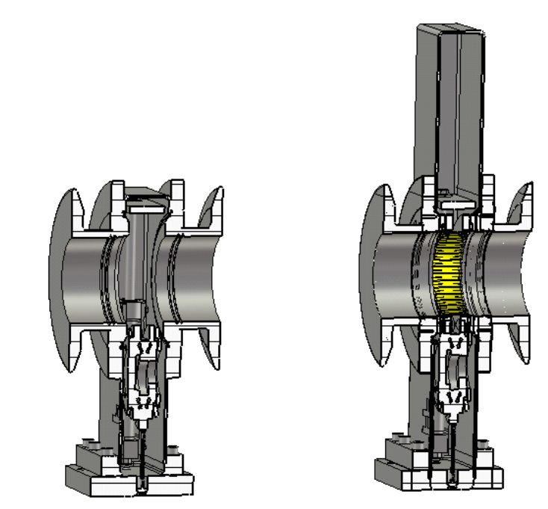
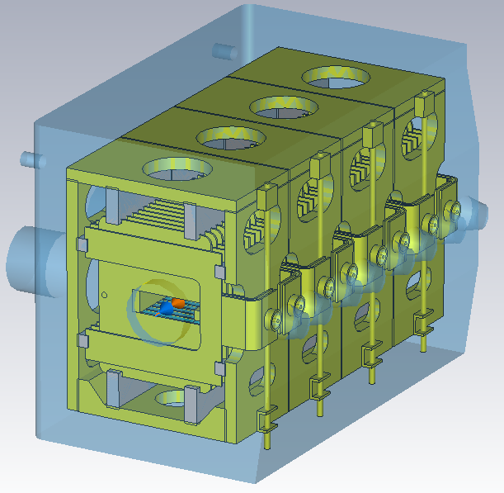
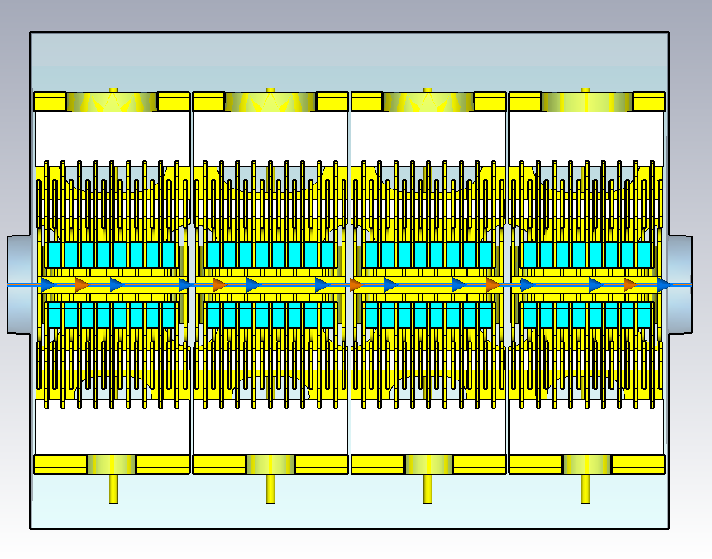
Beam impedances (from mitigation side…)
Beam impedances are problematic since they can cause performance limitations in (mostly circular) accelerators.
For example: contribution to beam instabilities (see talk of B. Salvant during 1st JUAS lectures).
Charged particle beam generates EM-fields at any cross-sectional change of the vacuum pipe. Therefore, all elements which interrupt the smooth beam pipe gives a contribution to beam impedance and potentially needs to be mitigated.
Example: SPS valve
Example: PS kicker magnet

Slide 31
Beam impedances (from mitigation side…)
Longitudinal EM-fields can impact on:
Effective amplitude and phase of the accelerating RF-field leading to an impact on the rate of acceleration, the energy distribution in the bunch and the effective bunch length…
Secondary effect can be an impact on accelerator optics (due to change of momentum), a change of beam focusing or change of closed orbit, and…
Transverse EM-fields can impact on:
Cross-section of the particle bunch, change of closed orbit, change of betatron frequency, and…
Both effects increase with higher beam currents and can lead to transverse or longitudinal beam instabilities.

Slide 32
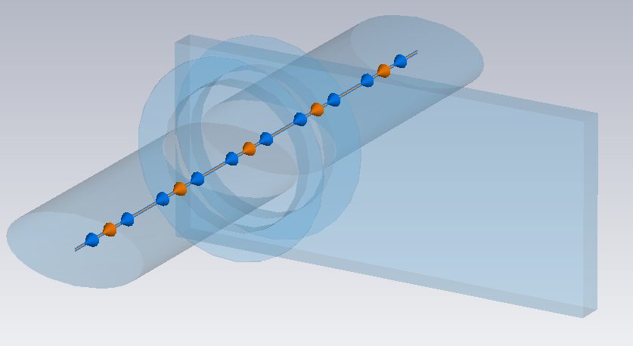
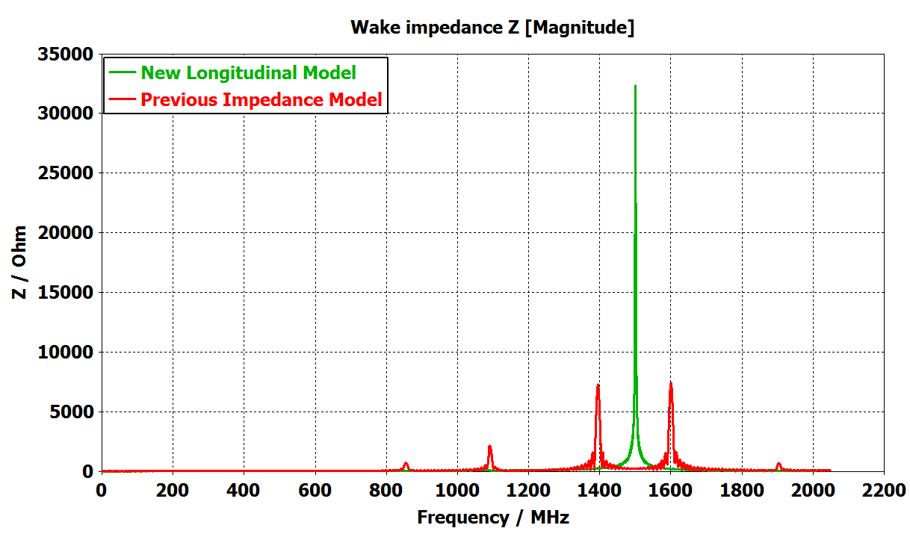
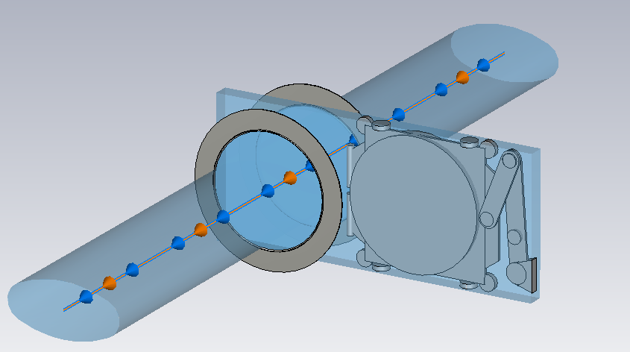
UHV Gate Valve: CST Models
Mitigation of sector valve PS (1/3)
10 Valves total
No internal model available
  Not included in previous model
  Proprietary
  Drawn using datasheet
  Measurements necessary
Previous Impedance Model
New Longitudinal Impedance Model
Source of :
Microwave Instability
B. Popovic

Slide 33
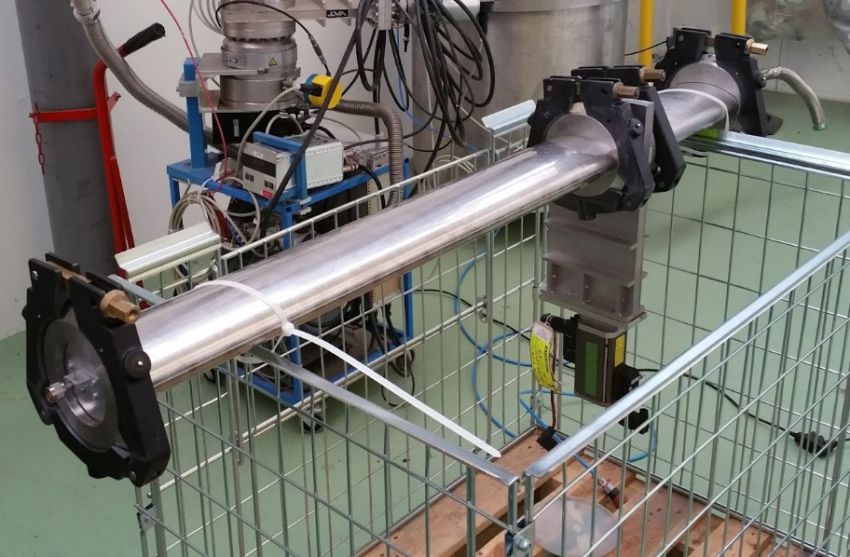

UHV Gate Valve: Measurement Setup
Mitigation of sector valve PS (2/3)
Measured using probe method
Setup closed at both ends
  Traps travelling wave modes
  TE_{11p}
Investigated resonances at
  1.2 GHz, 1.34 GHz & 1.5 GHz

Slide 34

UHV Gate Valve: Comparing Measurement & Simulation Results
Mitigation of sector valve PS (3/3)
TE₁₁₉
TE₁₁₈
TE₁₁₁
TE₁₁₆
TE₁₁₇
TE₁₁₂
TE₁₁₅
TE₁₁₃
Cavity Mode
TM₀₁₀
1504.18
Q: 1184
TE₁₁₄
TE₁₁₆
1345.67 MHz
Q: 1442
TE₁₁₁
1207.04 MHz
Q: 2352

Slide 35
Thank you for your attention!

