Slide 1
RF Engineering
RF Components
– A personal selection –
Christine Völlinger & Manfred Wendt – CERN

Slide 2
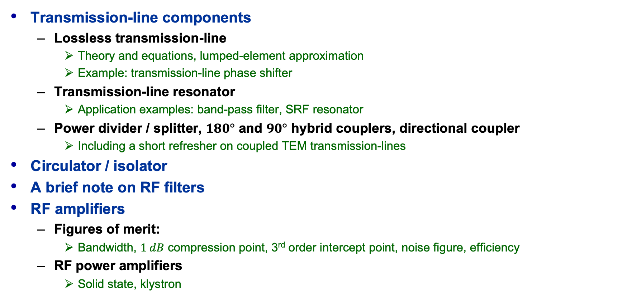
Outline and Objectives
Transmission-line components
  Lossless transmission-line
    Theory and equations, lumped-element approximation
    Example: transmission-line phase shifter
  Transmission-line resonator
    Application examples: band-pass filter, SRF resonator
  Power divider / splitter, $180°$ and $90°$ hybrid couplers, directional coupler
    Including a short refresher on coupled TEM transmission-lines
Circulator / isolator
A brief note on RF filters
RF amplifiers
  Figures of merit:
    Bandwidth, $1 dB$ compression point, 3rd order intercept point, noise figure, efficiency
  RF power amplifiers
    Solid state, klystron
Please note the references
to the JUAS proceedings!
JUAS Proc. 2024
II.2.x.y.z, p. nnn

Slide 3
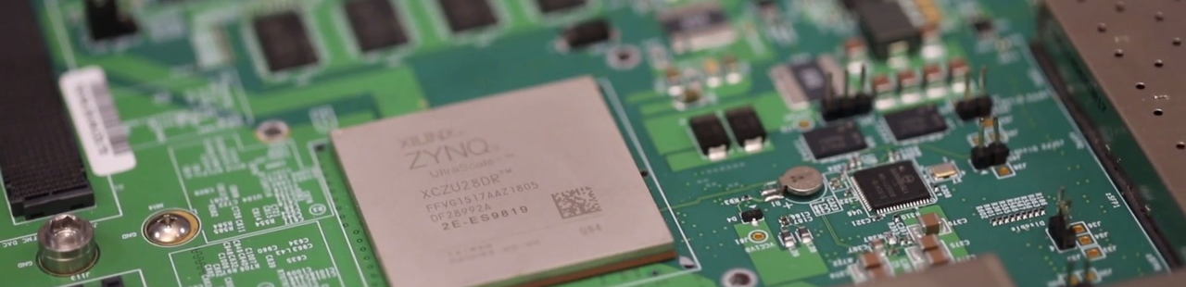
Digital (mathematical) RF: The RF-SoC
Low-power low-level RF (LLRF) signals can be processed digitally
  RF System-on-Chip: processors, FPGA, ADCs and DACs
    8x ADC (5 GBPS, 12-bit, 70 dB dynamic range), 8x DAC (9.8 GBPS), incl. up-down converters
    Multi-core processors, on-chip memory, many I/O options
  For frequencies <2 GHz, operation in the 1st Nyquist passband
Not part of this lecture …yet

Slide 4

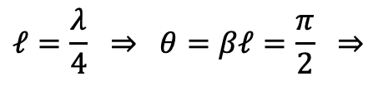

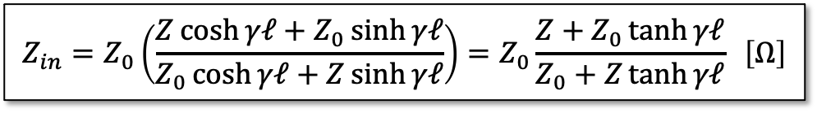

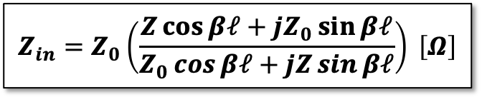










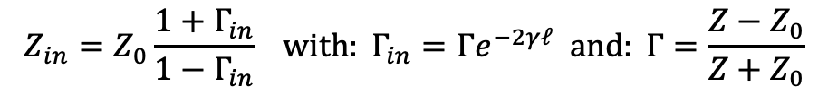


Transmission-lines with arbitrary load
Transmission-line terminated with an arbitrary impedance $Z$:
Lossless transmission-line:
$$Z_{in}=Z_{0}\frac{1+Γ_{in}}{1−Γ_{in}} with: Γ_{in}=Γe^{−2γℓ} and: Γ=\frac{Z−Z_{0}}{Z+Z_{0}}$$
$$Γ_{in}⇒$$
$$Γ⇒$$
$$Z_{in}=Z_{0}\left(\frac{Z\cosh{γℓ+Z_{0}\sinh{γℓ}}}{Z_{0}\cosh{γℓ+Z\sinh{γℓ}}}\right)=Z_{0}\frac{Z+Z_{0}\tanh{γℓ}}{Z_{0}+Z\tanh{γℓ}} \left[Ω\right]$$
$$Z_{in}⇒$$
$$Z_{0}, γ$$
$$Z$$
$$ℓ$$
  Popular applications
    Quarter-wave line:
    Terminated (matched) line:
    Open line:
    Shorted line:
$$α=0 ⇒$$
$$ℓ=\frac{λ}{4} ⇒ θ=βℓ=\frac{π}{2} ⇒$$
$$Z_{in}=\frac{Z_{0}^{2}}{Z}$$
$$Z_{in}=Z_{0}\left(\frac{Z\cos{βℓ+jZ_{0}\sin{βℓ}}}{Z_{0}\cos{βℓ+jZ\sin{βℓ}}}\right) \left[Ω\right]$$
$$Z=Z_{0} ⇒$$
$$Z_{in}=Z_{0}$$
$$Z→∞ ⇒$$
$$Z_{in}=−jZ_{0}cot{βℓ}$$
$$Z=0 ⇒$$
$$Z_{in}=jZ_{0}tan{βℓ}$$
JUAS Proc. 2024
II.2.8.1, pp. 856-859

Slide 5
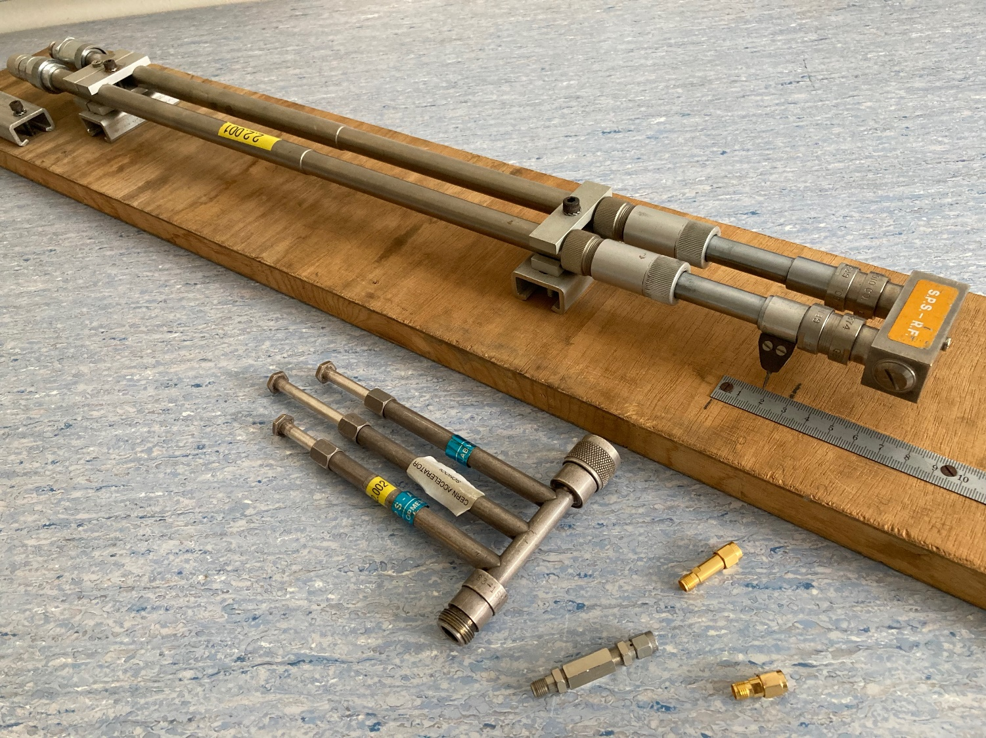
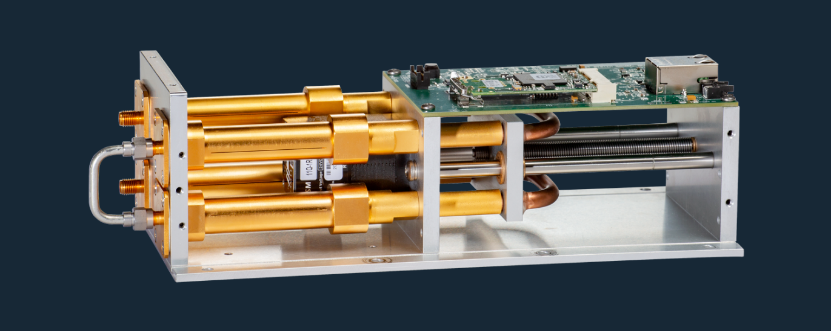
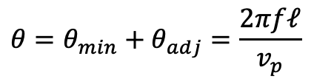
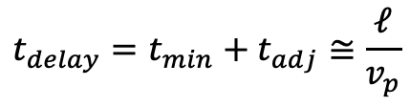
Lossless Transmission-lines
Low-loss transmission-lines, “air-dielectric” coaxial lines with adjustable length are used as phase shifter / trimmer,
or as time delay element for
broadband signals.
“trombone”-style
phase shifter
$$t_{delay}=t_{min}+t_{adj}≅\frac{ℓ}{v_{p}}$$
$$θ=θ_{min}+θ_{adj}=\frac{2πfℓ}{v_{p}}$$
precision delay line (motorized)
3-stub tuner
(for impedance
matching)
SMA fixed
delays
courtesy Colby Instruments
SMA phase trimmer
JUAS Proc. 2024
II.2.8.1.1, pp. 856-858

Slide 6
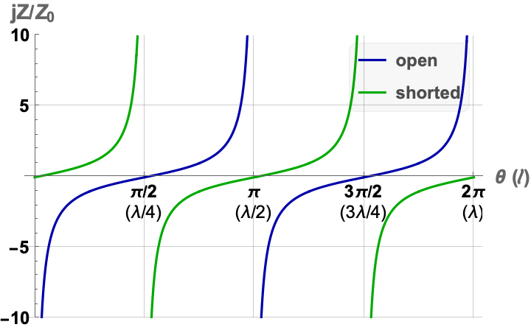

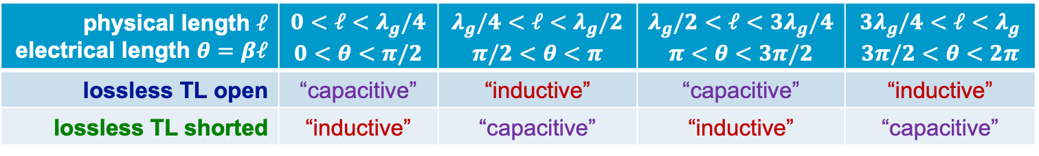

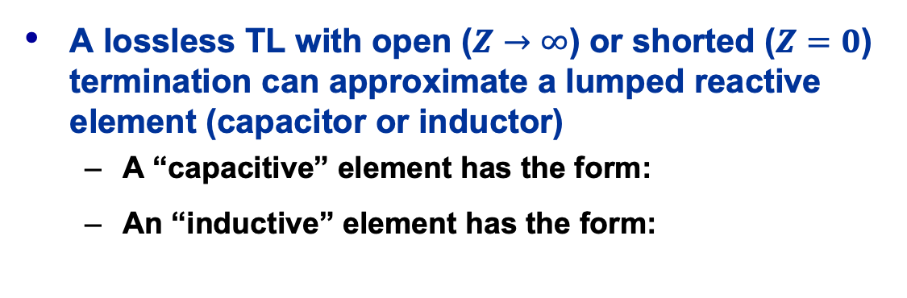

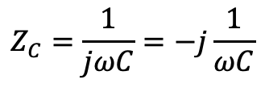
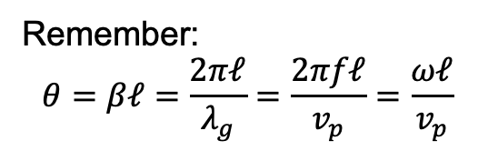
Open / Shorted Transmission-lines
physical length $ℓ$ electrical length $θ=βℓ$ | $$0<ℓ<λ_{g}/4 \\ 0<θ<π/2$$ | $$λ_{g}/4<ℓ<λ_{g}/2 \\ π/2<θ<π$$ | $$λ_{g}/2<ℓ<3λ_{g}/4 \\ π<θ<3π/2$$ | $$3λ_{g}/4<ℓ<λ_{g} \\ 3π/2<θ<2π$$
lossless TL open | “capacitive” | “inductive” | “capacitive” | “inductive”
lossless TL shorted | “inductive” | “capacitive” | “inductive” | “capacitive”
$$Z_{in,open}=−jZ_{0}cot{βℓ}$$
$$Z_{in,short}=jZ_{0}tan{βℓ}$$
Remember:
$$θ=βℓ=\frac{2πℓ}{λ_{g}}=\frac{2πfℓ}{v_{p}}=\frac{ωℓ}{v_{p}}$$
inductive
A lossless TL with open ($Z→∞$) or shorted ($Z=0$) termination can approximate a lumped reactive element (capacitor or inductor)
  A “capacitive” element has the form:
  An “inductive” element has the form:
$$Z_{C}=\frac{1}{jωC}=−j\frac{1}{ωC}$$
capacitive
$$Z_{L}=jωL$$
JUAS Proc. 2024
II.2.8.1.1, pp. 856-859

Slide 7



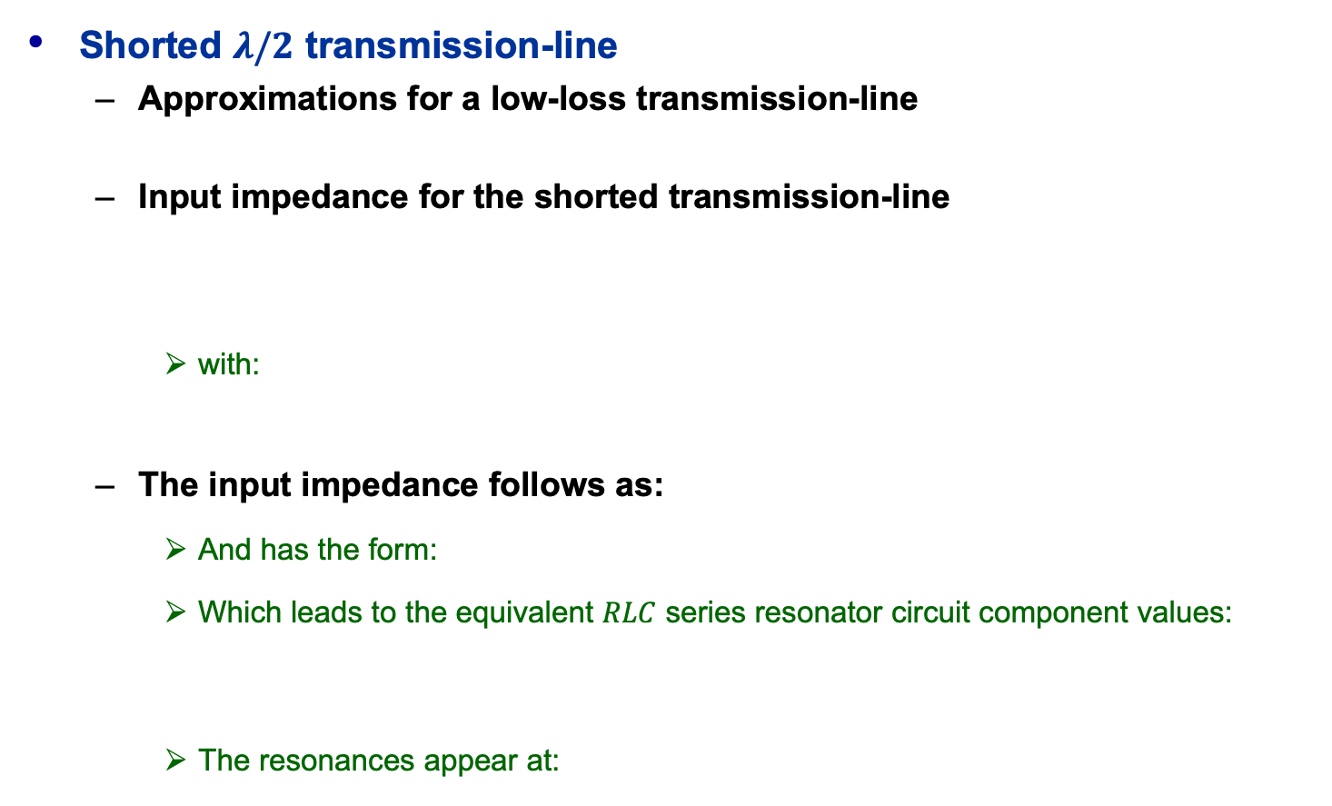




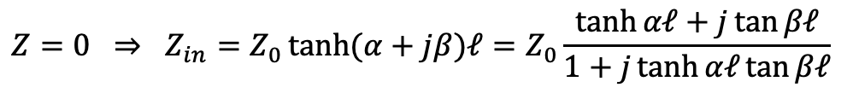
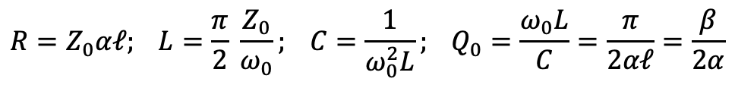








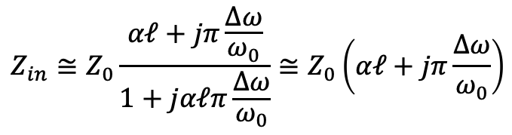

A $λ/2$ Transmission-line Resonator
Shorted $λ/2$ transmission-line
  Approximations for a low-loss transmission-line
  Input impedance for the shorted transmission-line
    with:
  The input impedance follows as:
    And has the form:
    Which leads to the equivalent $RLC$ series resonator circuit component values:
    The resonances appear at:
$$V$$
$$n=1$$
$$αℓ≪1 ⇒ \tanh{αℓ≅αℓ , near resonance: ω=ω_{0}+Δω} with: Δω small$$
$$z$$
$$n=2$$
$$Z=0 ⇒ Z_{in}=Z_{0}\tanh{(α+jβ)ℓ}=Z_{0}\frac{\tanh{αℓ+j\tan{βℓ}}}{1+j\tanh{αℓ}tan{βℓ}}$$
shorted
$$Z_{in}⇒$$
$$Z_{0}, γ$$
$$ℓ=\frac{λ}{2}=π\frac{v_{p}}{ω_{0}} ⇒βℓ=π+π\frac{Δω}{ω_{0}}⇒ \tan{βℓ=\tan\left(π+π\frac{Δω}{ω_{0}}\right)=\tan\left(π\frac{Δω}{ω_{0}}\right)≅}π\frac{Δω}{ω_{0}}$$
$$ℓ=\frac{n}{2}λ_{g}$$
$$Z_{in}≅Z_{0}\frac{αℓ+jπ\frac{Δω}{ω_{0}}}{1+jαℓπ\frac{Δω}{ω_{0}}}≅Z_{0}\left(αℓ+jπ\frac{Δω}{ω_{0}}\right)$$
$$L$$
$$C$$
$$R$$
$$Z_{in}=R+j2LΔω$$
$$≅0$$
$$Z_{in}⇒$$
series equivalent circuit
$$R=Z_{0}αℓ; L=\frac{π}{2} \frac{Z_{0}}{ω_{0}}; C=\frac{1}{ω_{0}^{2}L}; Q_{0}=\frac{ω_{0}L}{C}=\frac{π}{2αℓ}=\frac{β}{2α}$$
$$Z_{in}=R+j\left(ωL−\frac{1}{ωC}\right)$$
$$ℓ=\frac{n}{2}λ_{g}, n=1, 2, 3,…$$
JUAS Proc. 2024
II.2.8.1.4, pp. 860-866

Slide 8
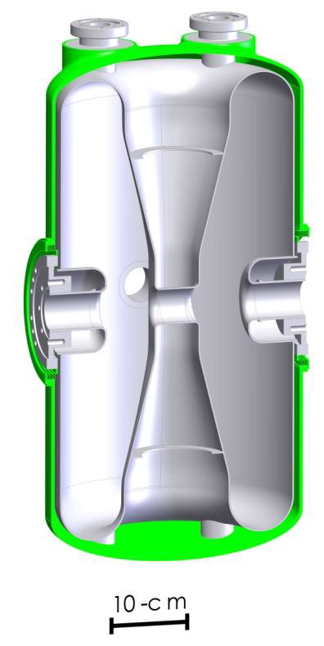
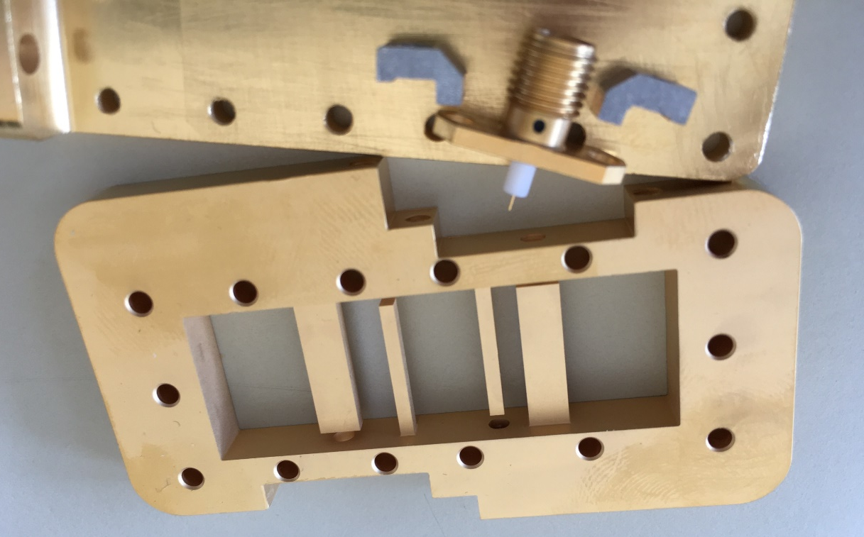
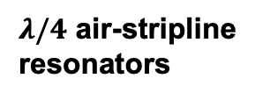

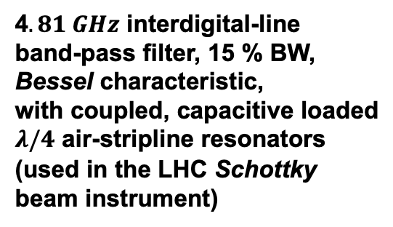

Transmission-line Resonator Applications
Typically, TL resonators are utilized in the $f≈100 MHz$ range
Superconducting half-wave resonators (SC-HWR)
gained popularity in low-$β$ heavy-ion linacs
Open-ends of TL resonators are often capacitive loaded
  Enables fine-tuning of the resonant frequency
$322.5 MHz$SC-HWR (FRIB)
shorted
E-field
beam
$λ/4$ air-stripline
resonators
gaps
4$.81 GHz$ interdigital-line
band-pass filter, 15 % BW,
Bessel characteristic,
with coupled, capacitive loaded
$λ/4$ air-stripline resonators
(used in the LHC Schottky
beam instrument)
open with
capacitive load
shorted
courtesy Jeremiah P. Holzbauer
JUAS Proc. 2024
II.2.8.1.4, pp. 860-866

Slide 9


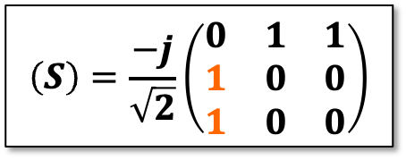
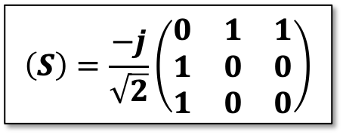










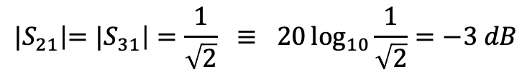


Power Divider / Combiner
The Wilkinson power divider utilizes
two $λ/4$ impedance transformers of
$\sqrt{2}Z_{0}$ to match the two output ports 2
and 3 in parallel to the input port 1
  A resistor $2Z_{0}$ provides matching for, and isolation
  between the output ports, but does not dissipate
  power in case of equal signals at the output ports.
  The network is matched, reciprocal and symmetric,
  but not lossless.
  Provides only a coupling loss compared to the resistive divider
    At the expense of a narrow bandwidth, which can be improved using multi-stage stepped impedance $λ/4$-transformers
  The Wilkinson power divider is typically realized in planar transmission-line technology, e.g., stripline or micro-strip line.
    Variants include different port impedances and more ports.
$$\left(S\right)=\frac{−j}{\sqrt{2}}\left(\begin{matrix}0 & 1 & 1 \\ 1 & 0 & 0 \\ 1 & 0 & 0\end{matrix}\right)$$
$$\left(S\right)=\frac{−j}{\sqrt{2}}\left(\begin{matrix}0 & 1 & 1 \\ 1 & 0 & 0 \\ 1 & 0 & 0\end{matrix}\right)$$
$$\frac{V_{in}}{\sqrt{2}}∠−90°$$
$$λ_{g}/4$$
$$π/2$$
$${\sqrt{2}Z}_{0}$$
$$Z_{0}$$
port 2
$$V_{in}$$
port 1
$$Z_{0}$$
$${2Z}_{0}$$
$${\sqrt{2}Z}_{0}$$
$$Z_{0}$$
port 3
$${|S}_{21}\left|={|S}_{31}\right|=\frac{1}{\sqrt{2}} ≡ 20\log_{10}{\frac{1}{\sqrt{2}}=−3 dB}$$
$$λ_{g}/4$$
$$π/2$$
$$\frac{V_{in}}{\sqrt{2}}∠−90°$$
JUAS Proc. 2024
II.2.8.1.6.1, pp. 867/868

Slide 10


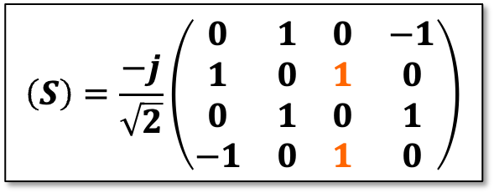
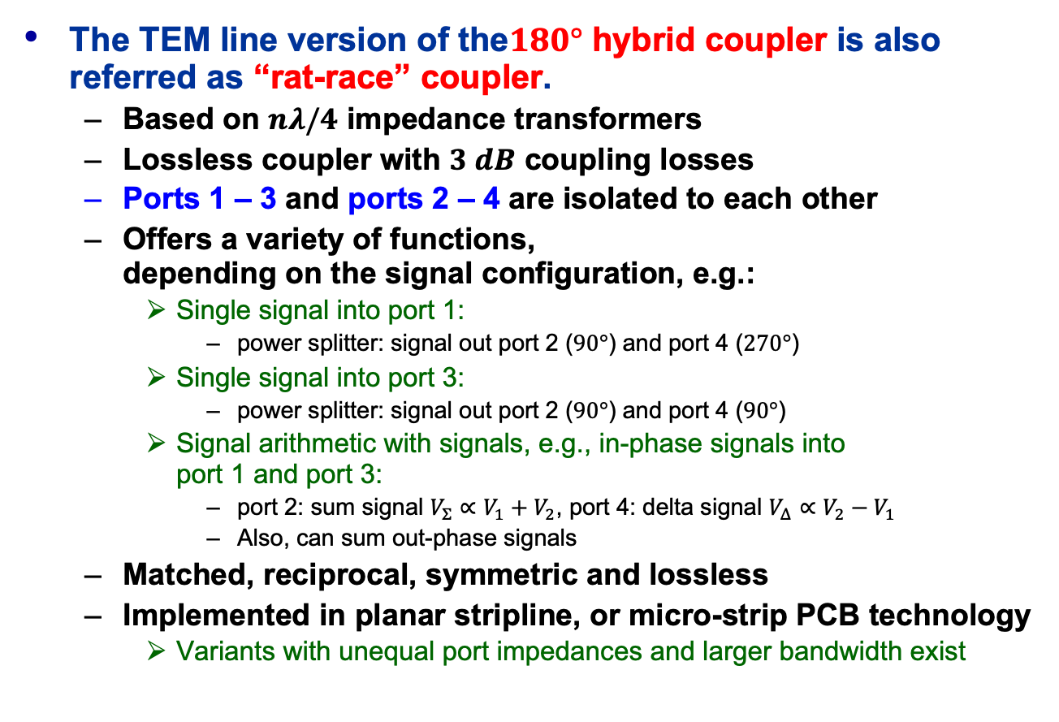

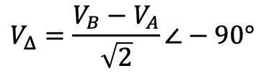



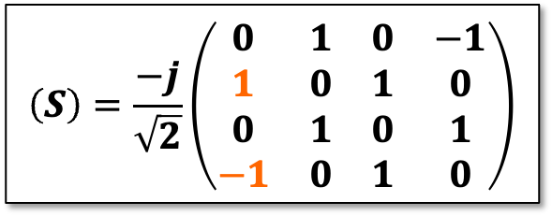
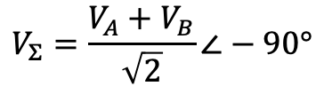








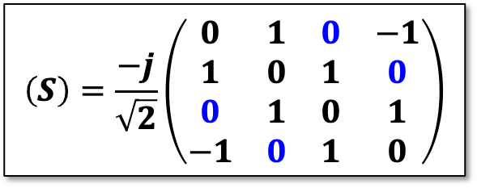






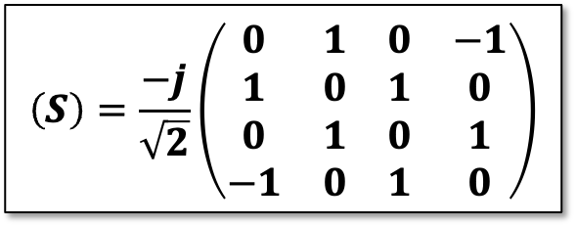




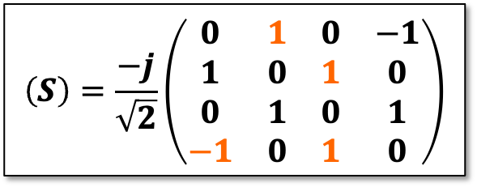

$180°$ Hybrid Coupler
$$V_{2}=\frac{V_{3}}{\sqrt{2}}∠−90°$$
$$V_{2}=\frac{V_{1}}{\sqrt{2}}∠−90°$$
The TEM line version of the$180°$ hybrid coupler is also referred as “rat-race” coupler.
  Based on $nλ/4$ impedance transformers
  Lossless coupler with $3 dB$ coupling losses
  Ports 1 – 3 and ports 2 – 4 are isolated to each other
  Offers a variety of functions,
  depending on the signal configuration, e.g.:
    Single signal into port 1:
      power splitter: signal out port 2 ($90°$) and port 4 ($270°$)
    Single signal into port 3:
      power splitter: signal out port 2 ($90°$) and port 4 ($90°$)
    Signal arithmetic with signals, e.g., in-phase signals into
    port 1 and port 3:
      port 2: sum signal $V_{Σ}∝V_{1}+V_{2}$, port 4: delta signal $V_{Δ}∝V_{2}−V_{1}$
      Also, can sum out-phase signals
  Matched, reciprocal, symmetric and lossless
  Implemented in planar stripline, or micro-strip PCB technology
    Variants with unequal port impedances and larger bandwidth exist
$$V_{Σ}=\frac{V_{A}+V_{B}}{\sqrt{2}}∠−90°$$
port 2
port 3
$$V_{3}$$
$$V_{B}$$
$$π/2$$
$$Z_{0}$$
$$λ_{g}/4$$
$$Z_{0}$$
$$π/2$$
$$π/2$$
$$λ_{g}/4$$
$${\sqrt{2}Z}_{0}$$
$$λ_{g}/4$$
port 1
$$Z_{0}$$
$${3λ}_{g}/2$$
$$Z_{0}$$
port 4
$$V_{1}$$
$$V_{A}$$
$${\sqrt{2}Z}_{0}$$
$${\sqrt{2}Z}_{0}$$
$$V_{4}=\frac{V_{1}}{\sqrt{2}}∠−270°$$
$$V_{4}=\frac{V_{3}}{\sqrt{2}}∠−90°$$
$$V_{Δ}=\frac{V_{B}−V_{A}}{\sqrt{2}}∠−90°$$
$$3π/2$$
$${3λ}_{g}/4$$
$$\left(S\right)=\frac{−j}{\sqrt{2}}\left(\begin{matrix}0 & 1 & 0 & −1 \\ 1 & 0 & 1 & 0 \\ 0 & 1 & 0 & 1 \\ −1 & 0 & 1 & 0\end{matrix}\right)$$
$$\left(S\right)=\frac{−j}{\sqrt{2}}\left(\begin{matrix}0 & 1 & 0 & −1 \\ 1 & 0 & 1 & 0 \\ 0 & 1 & 0 & 1 \\ −1 & 0 & 1 & 0\end{matrix}\right)$$
$$\left(S\right)=\frac{−j}{\sqrt{2}}\left(\begin{matrix}0 & 1 & 0 & −1 \\ 1 & 0 & 1 & 0 \\ 0 & 1 & 0 & 1 \\ −1 & 0 & 1 & 0\end{matrix}\right)$$
$$\left(S\right)=\frac{−j}{\sqrt{2}}\left(\begin{matrix}0 & 1 & 0 & −1 \\ 1 & 0 & 1 & 0 \\ 0 & 1 & 0 & 1 \\ −1 & 0 & 1 & 0\end{matrix}\right)$$
$$\left(S\right)=\frac{−j}{\sqrt{2}}\left(\begin{matrix}0 & 1 & 0 & −1 \\ 1 & 0 & 1 & 0 \\ 0 & 1 & 0 & 1 \\ −1 & 0 & 1 & 0\end{matrix}\right)$$
JUAS Proc. 2024
II.2.8.1.7.1, pp. 870/871

Slide 11


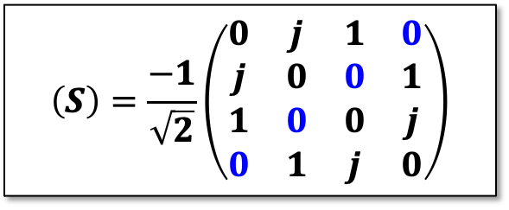
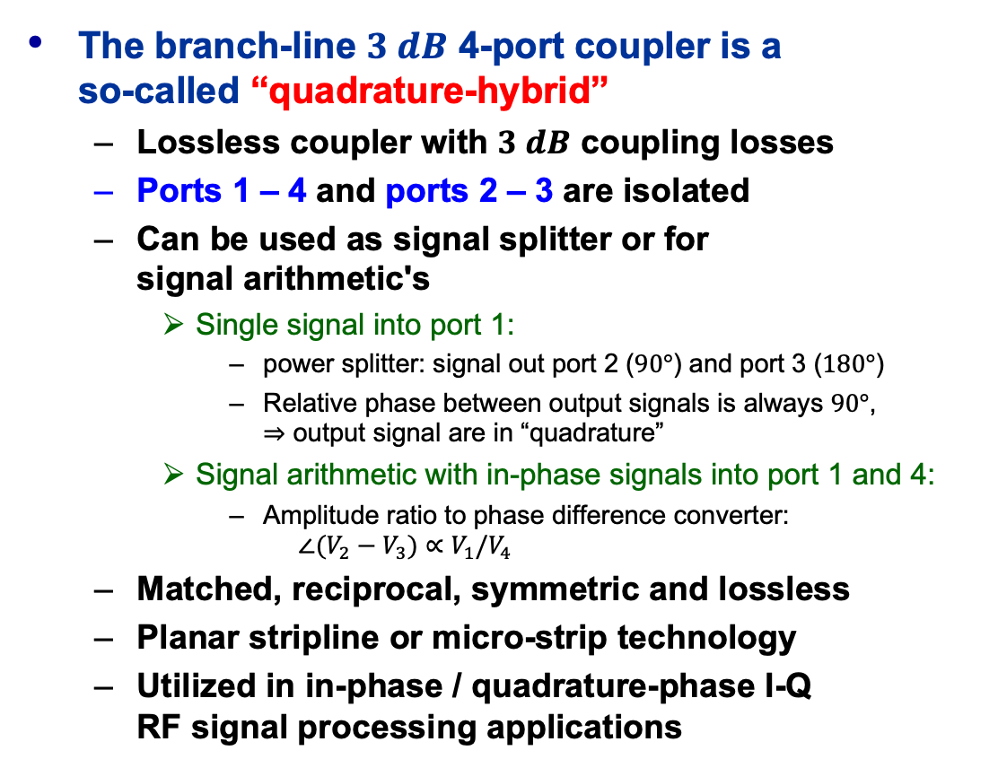



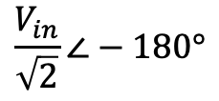

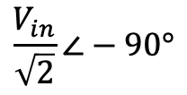
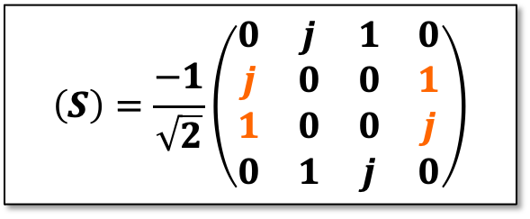












9$0°$ Hybrid Coupler
$$\sqrt{\frac{V_{A}^{2}+V_{B}^{2}}{2}}∠\tan^{−1}\left(\frac{V_{A}}{V_{B}}\right)$$
The branch-line $3 dB$ 4-port coupler is a
so-called “quadrature-hybrid”
  Lossless coupler with $3 dB$ coupling losses
  Ports 1 – 4 and ports 2 – 3 are isolated
  Can be used as signal splitter or for
  signal arithmetic's
    Single signal into port 1:
      power splitter: signal out port 2 ($90°$) and port 3 ($180°$)
      Relative phase between output signals is always $90°$,
      $⇒$ output signal are in “quadrature”
    Signal arithmetic with in-phase signals into port 1 and 4:
      Amplitude ratio to phase difference converter:
      $∠(V_{2}−V_{3})∝V_{1}/V_{4}$
  Matched, reciprocal, symmetric and lossless
  Planar stripline or micro-strip technology
  Utilized in in-phase / quadrature-phase I-Q
  RF signal processing applications
$$\frac{V_{in}}{\sqrt{2}}∠−90°$$
$$V_{in}$$
$$V_{A}$$
port 1
$$Z_{0}$$
$$Z_{0}/\sqrt{2}$$
$$Z_{0}$$
port 2
$$π/2$$
$$λ_{g}/4$$
$$Z_{0}$$
$$λ_{g}/4$$
$$Z_{0}$$
$$π/2$$
port 4
$$Z_{0}$$
$$Z_{0}/\sqrt{2}$$
$$Z_{0}$$
port 3
$$V_{B}$$
$$\sqrt{\frac{V_{A}^{2}+V_{B}^{2}}{2}}∠\tan^{−1}\left(\frac{V_{B}}{V_{A}}\right)$$
$$\frac{V_{in}}{\sqrt{2}}∠−180°$$
$$\left(S\right)=\frac{−1}{\sqrt{2}}\left(\begin{matrix}0 & j & 1 & 0 \\ j & 0 & 0 & 1 \\ 1 & 0 & 0 & j \\ 0 & 1 & j & 0\end{matrix}\right)$$
$$\left(S\right)=\frac{−1}{\sqrt{2}}\left(\begin{matrix}0 & j & 1 & 0 \\ j & 0 & 0 & 1 \\ 1 & 0 & 0 & j \\ 0 & 1 & j & 0\end{matrix}\right)$$
$$\left(S\right)=\frac{−1}{\sqrt{2}}\left(\begin{matrix}0 & j & 1 & 0 \\ j & 0 & 0 & 1 \\ 1 & 0 & 0 & j \\ 0 & 1 & j & 0\end{matrix}\right)$$
$$\left(S\right)=\frac{−1}{\sqrt{2}}\left(\begin{matrix}0 & j & 1 & 0 \\ j & 0 & 0 & 1 \\ 1 & 0 & 0 & j \\ 0 & 1 & j & 0\end{matrix}\right)$$
JUAS Proc. 2024
II.2.8.1.7.3, pp. 872-874

Slide 12






































Coupled Transmission-lines
even mode
odd mode
$$+$$
$$+$$
$$+$$
$$−$$
magnetic “wall”
(symmetry)
$$Z_{0e}=\frac{\sqrt{ε_{r}}}{c{C’}_{0e}}$$
electric “wall”
(symmetry)
$$Z_{0o}=\frac{\sqrt{ε_{r}}}{c{C’}_{0o}}$$
$${C’}_{0e}={C’}_{p}+{C’}_{f}+{C’}_{fe}$$
strip transmission-lines
$${C’}_{0o}={C’}_{p}+{C’}_{f}+{C’}_{fo}$$
$${C’}_{f}/2$$
$${C’}_{p}/2$$
$${C’}_{p}/2$$
$${C’}_{f}/2$$
$${C’}_{f}/2$$
$${C’}_{p}/2$$
$${C’}_{p}/2$$
$${C’}_{f}/2$$
$${C’}_{fe}/2$$
$${C’}_{fe}/2$$
ground-planes
$$ε_{r}$$
$$+$$
$$+$$
$$ε_{r}$$
$$+$$
$$−$$
$${C’}_{fe}/2$$
$${C’}_{fe}/2$$
$${C’}_{fo}$$
$${C’}_{f}/2$$
$$s$$
$${C’}_{f}/2$$
$${C’}_{f}/2$$
$${C’}_{f}/2$$
$${C’}_{p}/2$$
$${C’}_{p}/2$$
$${C’}_{p}/2$$
$${C’}_{p}/2$$
image plane
image plane
symmetry plane
“even” and “odd”-mode analysis of the electrostatic cross-section structure
  applies for asymmetric conductor configurations as well
JUAS Proc. 2024
II.2.8.1.7.4, pp. 874/875

Slide 13

















Directional-Coupler (1)
$${{(1−k}^{2}) V}_{in}∠−90°$$
$$V_{in}$$
port 1
$$λ_{g}/4$$
port 1
$$λ_{g}/4$$
$$λ_{g}/4$$
$$λ_{g}/4$$
port 2
port 2
main line
$$k_{2}$$
$$k_{1}$$
$$k_{2}$$
$$k$$
coupled line
port 3
port 4
port 3
3-section
planar TEM directional coupler
port 4
single section
planar TEM directional coupler
$${k V}_{in}∠0°$$
The ideal coupler is matched:
The transfer functions are:
$$S_{ii}=0$$
$$S_{31}\left(θ\right)=S_{13}\left(θ\right)=S_{42}\left(θ\right)=S_{24}\left(θ\right)=\frac{jk\sin{θ}}{\sqrt{1−k^{2}}\cos{θ+j\sin{θ}}}$$
$$S_{21}\left(θ\right)=S_{12}\left(θ\right)=S_{43}\left(θ\right)=S_{34}\left(θ\right)=\frac{\sqrt{1−k^{2}}}{\sqrt{1−k^{2}}\cos{θ+j\sin{θ}}}$$
$$S_{41}=S_{14}=S_{32}=S_{23}=0$$
JUAS Proc. 2024
II.2.8.1.7.4, pp. 877-879

Slide 14











Directional-Coupler (2)
The coupling factor $k$ is linked to the even- and odd-mode impedances:
  Typical values:
  $kdB=3 dB,6 dB, 10 dB, 20 dB, 30 dB$
    $k$ appears at the midband at
  The ports need to be terminated
  with the characteristic impedance:
The electrical length $θ$ is related to the physical length of the coupled line $ℓ$
RF power source
$$P^{inc}$$
$$P^{refl}$$
accelerating
cavity
$$k=\frac{Z_{0e}/Z_{0o}−1}{Z_{0e}/Z_{0o}+1}$$
dir. Coupler
e.g., $k=20 dB$
$${kP}^{inc}$$
$${kP}^{refl}$$
beam
The directional couplers allows the simultaneous measurement of forward and reverse travelling waves on a transmission-line
  insertion loss in the main line vs. coupling factor:
$$θ=\frac{π}{2} ⇒ f_{c}=\frac{c}{4ℓ\sqrt{ε_{r}}}$$
$$Z_{0}=\sqrt{Z_{0e}Z_{0o}}$$
$$S_{21}=\sqrt{1−k^{2}}$$
coupling [dB] | insertion loss [dB]
3 | 3.00
6 | 1.25
10 | 0.46
20 | 0.044
30 | 0.004
$$θ=βℓ=\frac{2πℓ}{λ_{g}}=\frac{2πfℓ}{v_{p}}≅\frac{2πfℓ\sqrt{ε_{r}}}{c}$$
JUAS Proc. 2024
II.2.8.1.7.4, pp. 881/882

Slide 15





Directional-Coupler (3)
TEM directional couplers are backward couplers
Waveguide directional couplers are based on hole or slot coupling, and exist as forward or backward couplers
  utilizing constructive interferences
Both, TEM and waveguide directional couplers are used
as beam coupling device for beam diagnostics or manipulation
  as beam signal pickup, broadband beam kicker, etc.
commercial
waveguide
directional
coupler
stripline BPM
pickup
SPS broadband kicker
courtesy
Narda-ATM
LHC Schottky beam pickup
JUAS Proc. 2024
II.2.8.1.7.4, pp. 879/880

Slide 16









Circulator / Isolator
RF power source
High-power
circulator
waveguide circulator
Port 2
$$P^{inc}$$
$$P^{refl}$$
accelerating
cavity
Port 1
$$P^{refl}$$
dir. Coupler
e.g., $k=20 dB$
Port 3
high-power
load
beam
$${kP}^{inc}$$
$${kP}^{refl}$$
$$\left(S\right)=\left(\begin{matrix}0 & 0 & 1 \\ 1 & 0 & 0 \\ 0 & 1 & 0\end{matrix}\right)$$
Circulators exist in high-power waveguide,
and in low-power, small size stripline formats
  A magnetically polarized ferrite rod or disks provides a vertical magnetic field for the non-reciprocal properties
    RF power is transmitted, e.g., clockwise between
    port 1 – 2, port 2 – 3, and port 3 – 1.
    A pair of permanent magnets is used for biasing purposes
  The circulator does not operate at DC
  or very low frequencies
stripline circulator
Port 2
ground plates
Port 1
ferrite disc
Port 3
JUAS Proc. 2024
II.2.8.2, pp. 881/882

Slide 17







RF Filters (1)
port 2
RF filter are passive 2-port networks
  Often lossless, but there exist also absorptive filter designs
  Most RF filters are symmetric (and reciprocal),
  but in most cases not matched.
RF filters are frequency selective elements
  categorized in low-pass,
    All four types are based on a normalized low-pass prototype ($ω_{c}=1, R_{L}=1$) and a specific transfer function characteristic, e.g., Chebyshev, Butterworth, Bessel-Thomson, Gaussian, etc.
  Filters may also be designed for a specific time-domain response waveform or for time-delay applications (all-pass filter).
$$R_{S}$$
port 1
RF filter
$$R_{L}$$
high-pass,
band-pass
and band-stop
Low-pass filter (LPF)
High-pass filter (HPF)
Band-pass filter (BPF)
Band-stop filter (BSF)
JUAS Proc. 2024
II.2.8.3, pp. 883/884

Slide 18


RF Filters (2)
$n=5$ lossless low-pass ladder network
Industry offer a wide selection of RF filters, however, sometimes a special in-house design is required
RF filter design and realization is not always trivial
  Follow filter and network theory
  Fix key parameters
    Cut-off or center frequency, bandwidth,
    filter characteristic, number of sections
  Selection of a LP lumped element prototype
  Transformation to LPF, HPF, BPF, etc.,
  as required
  Realization with lumped, semi-lumped or distributed elements, or cavity resonators
    depending on the frequency range
  Consider imperfections
    Spurious passbands, insertion loss, tolerances, out-of-band reflections,
    time domain characteristic, etc.
Please try to work out
Exercise II.2.8.1
JUAS Proc. 2024
II.2.8.3, pp. 885-887

Slide 19






Filters (3)
Gaussian BPF example
  $n=3$, $f_{c}=200 MHz$, $BW=10 MHz$
  $3 dB$ insertion loss
  “Hairpin” stripline structure on a Rogers RO4360G2 substrate
  ($ε_{r}=6.15$)
  $\sim 100 ns$ impulse response
port vias
JUAS Proc. 2024
II.2.8.3, p. 887

Slide 20











RF Amplifiers (1)
$$P_{in}$$
g
$$P_{out}$$
Figures of merit:
$3 dB$ bandwidth ($BW$)
  Band-pass-like characteristic,
  typically, no DC transmission
  Often Butterworth or Chebyshev response
    not suitable for broadband pulse transmission
  Bandwidth depends on technology
    “buzz” words: narrow- or broad-band, octave, multi-octave, ultra-wide bandwidth,
$$\left(S\right)=\left(\begin{matrix}0 & 0 \\ G_{V} & 0\end{matrix}\right)$$
$$V_{in}$$
$$V_{out}$$
An ideal RF amplifier has a matched impedance, linear gain-stage with a voltage gain:
  Usually, the gain $g$ is expressed in $dB$
  with the power gain:
    assuming $Z_{in}=Z_{out}=Z_{0}$
$$G_{V}=\frac{V_{out}}{V_{in}}={10}^{g/{20}}$$
$$g=20\log_{10}{\frac{V_{out}}{V_{in}}=10\log_{10}\frac{P_{out}}{P_{in}} [dB]}$$
$$G_{P}=\frac{P_{out}}{P_{in}}=G_{V}^{2}$$
JUAS Proc. 2024
II.2.8.4, pp. 888/889

Slide 21










RF Amplifiers (2)
Maximum output power:
$1 dB$ compression point
  Near the maximum output power,
  the gain $g$ becomes non-linear
    The output signal is “compressed” wrt. the
    input signal, i.e., the gain $g$ is reduced
  A gain reduction of $1 dB$ is called
  the $1 dB$ compression point
    and defines the maximum output power ${OP}_{1dB}$
    as well as the maximum input power ${IP}_{1dB}$
The power of RF amplifiers is expressed in Watt $[W]$ or $\left[dBm\right]$
  $dBm$ is an absolute logarithmic scale for power, with a reference of $P_{ref}=1 mW$
output
power
$$[dBm]$$
theoretical
response
compression
region
$${OP}_{1dB}$$
$$1 dB$$
actual response
$1 dB$ compression
point, $P_{1dB}$
linear response
$$g [dB]$$
linear
region
input
power
$$[dBm]$$
$${IP}_{1dB}$$
$$P [dBm]$$ | $$P [W]$$ | $V \left[RMS\right]$ (for $R=50 Ω$)
30 dBm | 1 W | 7.07 V
20 dBm | 100 mW | 2.24 V
0 dBm | 1.0 mW | 224 mV
-20 dBm | 10 μW | 22.4 mV
-120 dBm | 1.0 fW | 224 nV
- 174 dBm | 4.0e-21 W | 0.446 nV
$$P \left[dBm\right]=10\log_{10}{\frac{P [W]}{P_{ref}} with: P_{ref}=1 mW}$$
Noise power in a
bandwidth B = 1 Hz
at room temperature
JUAS Proc. 2024
II.2.8.4, pp. 889-891

Slide 22
















RF Amplifiers (3)
Non-linear behavior: Intermodulation and the 3rd-order intercept (TOI) point
  At higher power levels amplifiers produce non-linearities, known as intermodulation (IM) products
    This happens well before saturation, the amplifier may still be in the “linear” region
output
power
$$[dBm]$$
automatic TOI measurement on a spectrum analyzer
theoretical
response
3rd order intercept
point (TOI), $IP3$
compression
region
$$OIP3$$
$$f_{L}=995 MHz$$
$$f_{U}=1005 MHz$$
saturation
$${OP}_{1dB}$$
$$1 dB$$
actual response
$$f_{L3rd}=985 MHz$$
$$f_{U3rd}=1015 MHz$$
linear
region
$1 dB$ compression
point, $P_{1dB}$
linear response
slope: $g [dB]$
3rd order IM response
slope: $3g [dB]$
input
power
$$[dBm]$$
$${IP}_{1dB}$$
$$IIP3$$
JUAS Proc. 2024
II.2.8.4.2.2, pp. 891/892

Slide 23













RF Amplifiers (4)
$1 dB$ compression point and TOI
  Based on extrapolation of the ideal (theoretical) gain response
  3rd order IM measurement utilizes
  a two-tone excitation
    Same level, slightly different frequencies
    3rd order intermodulation
    products:
  Assume a sinusoidal input signal
  and the amplifier with a non-linear, odd transfer symmetry $O\left(−v_{in}\right)=−O\left(v_{in}\right):$
    applying the Tailor expansion approximation:
  The 3rd order intercept point (TOI) follows as:
  And the $1 dB$ compression point as:
    The TOI is a factor ~10 above the P1dB
$$v_{in}\left(t\right)=\hat{a}\cos{ωt}$$
$$O\left(v_{in}\right)=Gv_{in}−D_{3}v_{in}^{3}+…$$
gain
3rd order distortions
$$f_{L}, f_{U} with:Δf=\frac{f_{U}−f_{L}}{2}≪\frac{f_{U}+f_{L}}{2}$$
$$\cos^{3}\left(ωt\right)≅\frac{3}{4}\cos\left(ωt\right)+\frac{1}{4}\cos{(3ωt)}$$
$$v_{out}$$
$$O(v_{in})$$
$$f_{U3rd}=\frac{f_{U}+f_{L}}{2}+3Δf$$
$${\hat{a}}_{TOI}^{2}=\frac{4G}{3D_{3}}$$
$$f_{L3rd}=\frac{f_{U}+f_{L}}{2}−3Δf$$
$$v_{in}$$
$${\hat{a}}_{P1dB}^{2}=\frac{{10}^{1/20}−1}{{10}^{1/20}}\frac{4G}{3D_{3}}≅0.10875\frac{4G}{3D_{3}}$$
JUAS Proc. 2024
II.2.8.4.2, pp. 893/894

Slide 24

















RF Amplifiers (5)
Other important figures of merit
  For high-power amplifiers:
  The power amplifier efficiency
  For low-noise amplifiers (LNA):
  The noise-figure
    The noise-factor is defined as:
      added noise by the amplifier,
      and from the input
    with:
source
$$N_{i}$$
$$N_{a}$$
$$G_{P}$$
$$PAE=\frac{P_{out}−P_{in}}{P_{ACwall}}$$
$$S_{i}$$
$${SNR}_{i}=\frac{S_{i}}{N_{i}}$$
$${SNR}_{o}=\frac{S_{o}}{N_{o}}=\frac{S_{i}G_{P}}{N_{i}G_{P}+N_{a}}$$
    The noise-figure follows as:
$$F=\frac{{SNR}_{i}}{{SNR}_{o}}=\frac{{S_{i}}/{N_{i}}}{{S_{o}}/{N_{o}}}=1+\frac{N_{a}}{N_{i}G_{P}}$$
$$NF=10\log_{10}{F=10\log_{10}{\frac{{SNR}_{i}}{{SNR}_{o}} [dB]}}$$
$S_{i}$ signal power at the input
$G$ amplifier gain
$N_{i}=kT_{0}BW$ noise power at the input
$BW$ effective noise bandwidth
$N_{o}$ noise power at the output,
including amplified input noise
$T_{o}$ temperature of the source resistor
$k=1.38∙{10}^{−23} [J/K]$ Boltzmann constant
$N_{a}$ added noise power by the amplifier
JUAS Proc. 2024
II.2.8.4.3, pp. 895-899

Slide 25






RF Power Amplifiers
How much RF power is required?
  Power to accelerate the beam → Wanted
  Power to compensate the beam induced voltage $V_{ind}$ → $P_{refl}$
  Power to compensate the power dissipated in the cavities → Heat
  Power to compensate the electrical losses in the RF distribution system → Heat
$$P_{beam}=ΔU_{turn}{∙f}_{rev}$$
$$P_{amp}$$
$$P_{diss}=\frac{V^{2}}{2R_{shunt}}$$
$$P_{beamload}=I_{beam}{∙V}_{ind}$$
$$P_{loss}$$
JUAS Proc. 2024
II.2.8.4.4, pp. 900/901

Slide 26

The ideal RF Power Amplifier
Has a perfect linear gain $g=10\log_{10}{\frac{P_{out}}{P_{in}} [dB]}$, no saturation and infinite power
Large bandwidth, amplifies all frequencies equally
  and has a flat group-delay, thus no overshot or ringing for pulse signals
Has no, or only minimum delay
Is perfectly impedance-matched and input and output, i.e., no reflections: $S_{11}=S_{22}=0$
Does not add noise
Is unconditionally stable, resistant to reverse power and $S_{12}=0$
Is radiation-hard
Unfortunately, such a RF amplifier has not been invented yet!
Here a look on some real-world RF power amplifier principles
JUAS Proc. 2024
II.2.8.4.4, pp. 900/901

Slide 27




Basics of RF solid state amplifiers
Using a NPN / PNP pair of
bipolar junction transistors (BJT)
in a push-pull configuration
  NPN BJT active on $V_{in}>0$
    Stays passive for $V_{in}<0$
  PNP BJT active on $V_{in}<0$
    Stays passive for $V_{in}>0$
  Push-pull operation
  Class B or AB operation optimized for efficiency and distortions
  Requires symmetric,
  but different types of BJTs
    NPN for the positive signals
    PNP for the negative signals
NPN BJT
$$V_{in}$$
$$V_{out}$$
+
$$V_{DC}$$
-
PNP BJT
JUAS Proc. 2024
II.2.8.4.4.3, pp. 906-909

Slide 28









Basics of RF solid state amplifiers
Using a pair of NPN
bipolar junction transistors (BJT)
in a push-pull configuration
  Requires balanced-to-unbalanced (balun) transformers at input and output
    Provides non-inverted ($0°$) and inverted ($180°$) signals
  Again: Push-pull operation
    Only one transistor is active per half-wave
  Substantially simplifies the design
    Easy to get symmetric transistor pairs with same type of technology
    However, balun design still a challenge!
NPN BJT
$$V_{in}$$
input balun
output balun
$$0°$$
$$V_{out}$$
+
$$V_{DC}$$
-
$$180°$$
NPN BJT
$$0°$$
Balun:
Balanced-to-unbalanced
(or vice versa)
$$180°$$
Ampleon AN11325
2-way Doherty amplifier with BLF888A
JUAS Proc. 2024
II.2.8.4.4.3, pp. 906-909

Slide 29



Example: Soleil 45 kW CW, 352 MHz
Electron storage ring for synchrotron light
operating 352 MHz RF
JUAS Proc. 2024
II.2.8.4.4.3, pp. 906-909

Slide 30



Examples: Soleil and ESRF
Large-scale solid-state RF power amplifier installations
  Require many power combiners to moderate the power per amplifier module to get to several tens of kilowatts
45 kW per tower (2004 and 2007)
150 kW per tower (2012)
JUAS Proc. 2024
II.2.8.4.4.3, pp. 906-909

Slide 31



Example: BESSY II
500 MHz CW RF amplifiers
  4x 80 kW for the storage ring
  40 kW for the booster synchrotron
  Power per module limited by the RF transistors
  The limit increases with time as RF power transistor technology advances
Amplifier modules
80 kW unit
Combiner
JUAS Proc. 2024
II.2.8.4.4.3, pp. 906-909

Slide 32

Example: SPS
200 MHz solid-state RF amplifiers
  2x 1.6 MW peak power
  2x 16 towers per amplifier
  80 RF power modules per tower
  1280 modules with 5120 per amplifier
    Presently the largest RF solid-state installation in a particle accelerator
1.6 MW at
cavity input
From LLRF
1/16 splitter
courtesy:
E. Montesinos
JUAS Proc. 2024
II.2.8.4.4.3, pp. 906-909

Slide 33


Basics of a linear beam tube
Klystron: a complete mini-accelerator
Linear vacuum tube
  Electron gun
    Heated cathode
    Anode with a “hole”,
    allowing free electrons to pass through
  Drift space
  Collector
    Is at a higher potential then the anode
    Electrons a moving with constant velocity between anode and collector
collector
+
drift space
-
$$U_{beam}$$
anode
e⁻
electron gun
e⁻
e⁻
e⁻
e⁻
e⁻
$$U_{a}$$
+
-
cathode and filament
JUAS Proc. 2024
II.2.8.4.4.2, pp. 904-906

Slide 34

Basics of a linear beam tube
Klystron: a complete mini-accelerator
Linear vacuum tube
  Two cavity resonators and a drift in-between
  RF input (buncher) cavity
    Modulates the velocity of the electrons
  Drift space
    Trailing electrons move faster and catch-up
    Leading electrons move slower and fall behind
  RF output (catcher) cavity
    Located where the maximum bunching appears
    Same resonance frequency as the buncher
    Kinetic beam energy is converted into RF power
  Solenoidal magnet
    To compensate the space charge
collector
catcher
cavity
+
magnet system
drift space
-
$$U_{beam}$$
e⁻
buncher
cavity
e⁻
e⁻
e⁻
Cavity
Coupling
loop
anode
electron gun
$$U_{a}$$
+
-
cathode and filament
Beam
line
Accelerating
gap
JUAS Proc. 2024
II.2.8.4.4.2, pp. 904-906

Slide 35





Example: Klystrons driving accelerator RF
LHC: 2x 8 cavities, each driven by a separate 400 MHz klystron, 330 kW CW
  1st time a klystron amplifier powers a hadron collider
LEP: Significant more power
was required to feed LEP (until 2000)
  ~50 MW CW @ 352 MHz
CLIC: 12 GHz klystron
for pulsed operation
  50 MW during 1.5 𝝁s
courtesy:
E. Montesinos
G. McMonagle
JUAS Proc. 2024
II.2.8.4.4.2, pp. 904-906

Slide 36
RF Power Amplifiers
Power capability
of commercially
available amplifier types
JUAS Proc. 2024
II.2.8.4.5, pp. 910/911
courtesy:
E. Jensen

Slide 37
I could not cover everything…
Power RF
  Multipactor, protection system
Low-level RF (LLRF)
  I-Q modulation / demodulation
  RF signal generation (VCO, XCO), phase-lock loop (PLL)
  Longitudinal beam control, feedback systems and components
More RF components
  RF switch, attenuator, termination resistor, diode, mixer, MMIC
Digital RF
  Sampling theory, ADC, DAC, digital filters (CIC, IIR, FIR), NCO
  Digital hardware: FPGA, RFSoC
    Please note: With the technology advances most LLRF signal processing and gymnastics
    can be fully accomplished in the digital domain!

Slide 38
Backup Slides

Slide 39












Transmission-lines (1)
Waveguides (TE10)
Semi-rigid
coaxial cables
0.141”, SMA,
$$DC⋯18 GHz$$
PCB microstrip-line (TEM)
WR-137:
5.85$⋯8.20 GHz$
WR-284:
$$2.60⋯3.95 GHz$$
WR-90:
8.2$⋯12.4 GHz$
RG-type
coaxial cables
RG58
7/8”
1/2”
1/4”
Low-loss, high-power
air coaxial
transmission-line
VNA
SiO2
semi-rigid
& flex
N-type
corrugated
coaxial cables,
foamed PE & air
BNC
Coaxial cables (TEM)
with and w/o connectors
SMA
MCX

Slide 40

Transmission-lines (2)
Transmission-lines transport RF energy (waves) between components
and sub-systems and exist in a large variety. Most popular are
  Coaxial cables, always in TEM operation below the TE11 cut-off frequency
    Popular connectors are BNC (Bayonet Neill–Concelman), N-type and SMA (Sub-Miniature version A)
    There exist a large variety of coaxial cables and connectors for HOM-free operation up to $110 GHz$
  PCB (printed circuit board)-based planar quasi-TEM transmission-lines
    Popular are microstrip, stripline and coplanar-waveguide structures
  Rectangular waveguides, usually in TE10-mode operation
    For low-loss (high-power), high-frequency RF signal transmission
    Clumsy and expensive, however, for some applications the only solution
TEM transmission-lines (coaxial cables, PCB planar lines) operate
from DC (direct current: $0 Hz$) to a frequency given by the 1st higher-order mode
  Various frequency depended losses contribute,
  therefore, high insertion losses at high frequencies
Rectangular waveguides do not operate at DC or low frequencies!
  Instead utilize the TE10 mode for the signal transmission

Slide 41
















Refresher: Some TL Equations (1)
Characteristic impedance
  for a TEM transmission-line
    with losses
    lossless, non-magnetic media ($μ_{r}=1$)
Propagation constant
  for a TEM transmission-line
    attenuation constant
    phase constant (wave number)
Equivalent circuit
TEM TL segment
$$L’$$
$$R’$$
$$γ=\sqrt{(R’+jωL’)(G’+jωC’)}$$
$$Z_{0}=\sqrt{\frac{R’+jωL’}{G’+jωC’}} [Ω]$$
$$γ=α+jβ=\sqrt{jωμ(σ+jωε)}$$
$$C’$$
$$G’$$
$$Δℓ$$
$$α=ω\sqrt{\frac{με}{2}\left(\sqrt{1+\frac{σ^{2}}{ω^{2}ε^{2}}}−1\right)} [\frac{Np}{m}]$$
$$Z_{0}≅\frac{\sqrt{μ_{0}ε_{0}ε_{r}}}{C’}=\frac{\sqrt{ε_{r}}}{cC’}=\frac{1}{v_{p}C’} [Ω]$$
$$Z_{0}≅\sqrt{\frac{L’}{C’}} [Ω]$$
$$β=ω\sqrt{\frac{με}{2}\left(\sqrt{1+\frac{σ^{2}}{ω^{2}ε^{2}}}+1\right)} [\frac{rad}{m}]$$
The characteristic impedance can be
calculated from 2D electrostatic equations
$$Z_{0}≅\frac{L’}{\sqrt{μ_{0}ε_{0}ε_{r}}}=\frac{cL’}{\sqrt{ε_{r}}}=v_{p}L’ [Ω]$$
$$β=\frac{2π}{λ_{g}}=k [\frac{rad}{m}]$$
$$β=ω\sqrt{L’C’}$$

Slide 42
















Refresher: Some TL Equations (2)
Wave impedance
Speed of light
Phase velocity
  non-magnetic media ($μ_{r}=1$)
Wavelength
  non-magnetic media:
  ($μ_{r}=1$)
Electrical length
  for a TEM line of physical length $ℓ$
Permeability:
Permittivity:
in media
Characteristic impedance of free space
in free space
guide wavelength (in media)
$$η=\sqrt{\frac{μ}{ε}} [Ω]$$
$$η_{0}=\sqrt{\frac{μ_{0}}{ε_{0}}}≅120π \left[Ω\right]≅377 [Ω]$$
$$λ_{0}=λ=\frac{c}{f} [m]$$
$$λ_{g}=\frac{c}{f\sqrt{μ_{r}ε_{r}}}=\frac{λ_{0}}{\sqrt{μ_{r}ε_{r}}} [m]$$
$$λ_{g}≅\frac{c}{f\sqrt{ε_{r}}} [m]$$
$$c=\frac{1}{\sqrt{μ_{0}ε_{0}}}≅2.997925∙{10}^{8} [\frac{m}{s}]$$
$$θ=βℓ=2π\frac{ℓ}{λ_{g}} \left[rad\right]$$
$$θ=βℓ=360\frac{ℓ}{λ_{g}} \left[deg\right]$$
$$v_{p}=\frac{1}{\sqrt{L’C’}}=\frac{1}{\sqrt{με}}=\frac{1}{\sqrt{μ_{0}μ_{r}ε_{0}ε_{r}}}=\frac{c}{\sqrt{μ_{r}ε_{r}}} [\frac{m}{s}]$$
$$μ=μ_{0}μ_{r}$$
$$μ_{0}≅4π∙{10}^{−7} [H/m]$$
$$v_{p}≅\frac{c}{\sqrt{ε_{r}}} [\frac{m}{s}]$$
$$ε=ε_{0}ε_{r}$$
$$ε_{0}≅8.854∙{10}^{−12} [F/m]$$

Slide 43










Transmission-lines – Coaxial Cables
The characteristic impedance is defined by the cross-section geometry:
The attenuation losses in the propagation constant $γ$
are dominated by the material properties:
  Propagation constant:
  Attenuation constant:
    The attenuation losses are dominated
    by conductor and dielectric losses
  Conductor losses:
  Dielectric losses:
    with:
$$Z_{0}=\frac{η_{0}}{2π\sqrt{ε_{r}}}\ln\left(\frac{D}{d}\right)≈\frac{60 Ω}{\sqrt{ε_{r}}}\ln\left(\frac{D}{d}\right) [Ω]$$
$$ε_{r}$$
$$γ=α+jβ$$
$$α=α_{c}+α_{d}+α_{r}+α_{l}$$
For inner and outer conductor in copper:
$${μ_{rD}=μ_{rd}=μ}_{rCu}=1; ρ_{D}=ρ_{d}=ρ_{Cu}=1.72∙{10}^{−8} Ωm$$
$$α_{c}=\frac{\sqrt{fμ_{0}/π}}{2Z_{0}}\left(\frac{\sqrt{μ_{rD}ρ_{D}}}{D}+\frac{\sqrt{μ_{rd}ρ_{d}}}{d}\right) [Np/m]$$
$$α_{c}=6∙{10}^{−9}\sqrt{fε_{r}}\frac{D+d}{dD\ln\left(D/d\right)} [dB/m]$$
$$α_{d}=πf\sqrt{μ_{0}ε_{0}ε_{r}}\tan{δ_{ε}} [Np/m]$$
$$α_{d}=91∙{10}^{−9}f\sqrt{ε_{r}}\tan{δ} [dB/m]$$
$$resistivity: ρ=\frac{1}{σ} \left[Ωm\right]; loss tangent: \tan{δ_{ε}=\frac{ε”}{ε’}}; permittivity: ε=ε’−jε” \left[F/m\right]; permeability: μ=μ’−jμ” [H/m]$$

Slide 44







Transmission-lines – Microstrip-line
Microstrip-line:
  Metallic strip conductor of width $w$ and thickness $t$
  on a dielectric substrate of height $h$ over a conductive ground plane.
    Typically, the dielectric layer is a low-loss printed circuit board substrate
    Quasi-TEM field as the EM-field propagates in two medias of different $ε_{r}$
    Complicated analytical approximations to calculate the properties ($Z_{0}$, $ε_{eff}$, losses, high-order modes, etc.)
Other popular planar structures are coplanar waveguides and striplines
$$ε_{r}=1$$
$$w$$
$$t$$
$$h$$
$$ε_{r}≠1$$

Slide 45

















Transmission-line Resonators (2)
Shorted $λ/4$ transmission-line
  Approximations for a low-loss transmission-line
  Input impedance for the shorted transmission-line
    with:
  The input impedance follows as:
    And has the form:
    Which leads to the equivalent $RLC$ series resonator circuit component values:
    The resonances appear at:
$$V$$
$$n=1$$
$$αℓ≪1 ⇒ \tanh{αℓ≅αℓ , near resonance: ω=ω_{0}+Δω} with: Δω small$$
$$z$$
$$n=2$$
$$Z=0 ⇒ Z_{in}=Z_{0}\tanh{(α+jβ)ℓ}=Z_{0}\frac{1{−j\tanh{αℓ}\cot{βℓ}}}{\tanh{αℓ}−j\cot{βℓ}}$$
shorted
$$Z_{in}⇒$$
$$Z_{0}, γ$$
$$ℓ=\frac{λ}{4}=\frac{π}{2}\frac{v_{p}}{ω_{0}} ⇒βℓ=\frac{π}{2}+\frac{π}{2}\frac{Δω}{ω_{0}}⇒ \cot{βℓ=−tan\left(\frac{π}{2}\frac{Δω}{ω_{0}}\right)≅}−\frac{π}{2}\frac{Δω}{ω_{0}}$$
$$ℓ=\frac{2n−1}{4}λ_{g}$$
$$≅0$$
$$Z_{in}≅Z_{0}\frac{1+jαℓ\frac{π}{2}\frac{Δω}{ω_{0}}}{αℓ+j\frac{π}{2}\frac{Δω}{ω_{0}}}≅\frac{Z_{0}}{αℓ+j\frac{π}{2}\frac{Δω}{ω_{0}}}$$
$$Z_{in}=\frac{1}{(1/R)+j2ΔωC}$$
$$Z_{in}⇒$$
$$L$$
$$R$$
$$C$$
$$R=\frac{Z_{0}}{αℓ}; C=\frac{π}{4} \frac{1}{ω_{0}Z_{0}}; L=\frac{1}{ω_{0}^{2}C}; Q_{0}=ω_{0}RC=\frac{π}{4αℓ}=\frac{β}{2α}$$
parallel equivalent circuit
$$Z_{in}=\frac{1}{\frac{1}{R}−j\frac{1−ω^{2}LC}{ωL}}$$
$$ℓ=\frac{2n−1}{4}λ_{g}, n=1, 2, 3,…$$

Slide 46








Transmission-line Resonators (3)
Open $λ/2$ transmission-line
  Approximations for a low-loss transmission-line
  Input impedance for the open transmission-line
    with:
  The input impedance follows as:
    And has the form:
    Which leads to the equivalent $RLC$ series resonator circuit component values:
    The resonances appear at:
$$V$$
$$n=1$$
$$αℓ≪1 ⇒ \tanh{αℓ≅αℓ , near resonance: ω=ω_{0}+Δω} with: Δω small$$
$$z$$
$$n=2$$
$$Z=0 ⇒ Z_{in}=Z_{0}\coth{(α+jβ)ℓ}=Z_{0}\frac{1{+j\tanh{αℓ}\tan{βℓ}}}{\tanh{αℓ}+j\tan{βℓ}}$$
open
$$Z_{in}⇒$$
$$Z_{0}, γ$$
$$ℓ=\frac{λ}{2}=π\frac{v_{p}}{ω_{0}} ⇒βℓ=π+π\frac{Δω}{ω_{0}}⇒ \tan{βℓ=\tan\left(π+π\frac{Δω}{ω_{0}}\right)=\tan\left(π\frac{Δω}{ω_{0}}\right)≅}π\frac{Δω}{ω_{0}}$$
$$ℓ=\frac{n}{2}λ_{g}$$
$$≅0$$
$$Z_{in}≅Z_{0}\frac{1+jαℓπ\frac{Δω}{ω_{0}}}{αℓ+jπ\frac{Δω}{ω_{0}}}≅\frac{Z_{0}}{αℓ+jπ\frac{Δω}{ω_{0}}}$$
$$Z_{in}=\frac{1}{(1/R)+j2ΔωC}$$
$$Z_{in}⇒$$
$$L$$
$$R$$
$$C$$
$$R=\frac{Z_{0}}{αℓ}; C=\frac{π}{2} \frac{1}{ω_{0}Z_{0}}; L=\frac{1}{ω_{0}^{2}C}; Q_{0}=ω_{0}RC=\frac{π}{2αℓ}=\frac{β}{2α}$$
parallel equivalent circuit
$$Z_{in}=\frac{1}{\frac{1}{R}−j\frac{1−ω^{2}LC}{ωL}}$$
$$ℓ=\frac{n}{2}λ_{g}, n=1, 2, 3,…$$

Slide 47







Transmission-line Resonators (4)
Open $λ/4$ transmission-line
  Approximations for a low-loss transmission-line
  Input impedance for the open transmission-line
    with:
  The input impedance follows as:
    And has the form:
    Which leads to the equivalent $RLC$ series resonator circuit component values:
    The resonances appear at:
$$V$$
$$n=2$$
$$n=1$$
$$αℓ≪1 ⇒ \tanh{αℓ≅αℓ , near resonance: ω=ω_{0}+Δω} with: Δω small$$
$$z$$
$$Z=0 ⇒ Z_{in}=Z_{0}\coth{(α+jβ)ℓ}=Z_{0}\frac{\tanh{αℓ}{−j\cot{βℓ}}}{1−j\tanh{αℓ}\cot{βℓ}}$$
open
$$Z_{in}⇒$$
$$Z_{0}, γ$$
$$ℓ=\frac{λ}{4}=\frac{π}{2}\frac{v_{p}}{ω_{0}} ⇒βℓ=\frac{π}{2}+\frac{π}{2}\frac{Δω}{ω_{0}}⇒ \cot{βℓ=−tan\left(\frac{π}{2}\frac{Δω}{ω_{0}}\right)≅}−\frac{π}{2}\frac{Δω}{ω_{0}}$$
$$ℓ=\frac{2n−1}{4}λ_{g}$$
$$Z_{in}≅Z_{0}\frac{αℓ+j\frac{π}{2}\frac{Δω}{ω_{0}}}{1+jαℓ\frac{π}{2}\frac{Δω}{ω_{0}}}≅Z_{0}\left(αℓ+j\frac{π}{2}\frac{Δω}{ω_{0}}\right)$$
$$L$$
$$C$$
$$R$$
$$Z_{in}=R+j2LΔω$$
$$≅0$$
$$Z_{in}⇒$$
series equivalent circuit
$$R=Z_{0}αℓ; L=\frac{π}{4} \frac{Z_{0}}{ω_{0}}; C=\frac{1}{ω_{0}^{2}L}; Q_{0}=\frac{ω_{0}L}{C}=\frac{π}{4αℓ}=\frac{β}{2α}$$
$$Z_{in}=R+j\left(ωL−\frac{1}{ωC}\right)$$
$$ℓ=\frac{2n−1}{4}λ_{g}, n=1, 2, 3,…$$

Slide 48












Semi-lumped TEM Transmission-line Elements
A short transmission-line, $θ<\frac{π}{4}$, can be used as semi-lumped circuit element:
$$j\frac{X}{2}$$
$$j\frac{X}{2}$$
$$\frac{X}{2}=Z_{0}\tan{\frac{ωℓ}{2v_{p}}≈Z_{0}{\left.\frac{ωℓ}{2v_{p}}\right|}_{\frac{ωℓ}{v_{p}}<\frac{π}{4}}}$$
$$jB$$
$$B=Y_{0}\sin{\frac{ωℓ}{v_{p}}≈Y_{0}{\left.\frac{ωℓ}{v_{p}}\right|}_{\frac{ωℓ}{v_{p}}<\frac{π}{4}}}$$
$$Z_{0}=\frac{1}{Y_{0}}, β$$
$$ℓ$$
$$jX$$
$$X=Z_{0}\sin{\frac{ωℓ}{v_{p}}≈Z_{0}{\left.\frac{ωℓ}{v_{p}}\right|}_{\frac{ωℓ}{v_{p}}<\frac{π}{4}}}$$
$$\frac{B}{2}=Y_{0}\tan{\frac{ωℓ}{2v_{p}}≈Y_{0}{\left.\frac{ωℓ}{2v_{p}}\right|}_{\frac{ωℓ}{v_{p}}<\frac{π}{4}}}$$
$$j\frac{B}{2}$$
$$j\frac{B}{2}$$

Slide 49











Low-pass Filter with “semi”-lumped Elements
Gaussian low-pass filter using nine short, coaxial TL elements
$$L_{2}$$
$$L_{4}$$
$$L_{6}$$
$$L_{8}$$
“capacitors”
$$C_{1}$$
$$C_{3}$$
$$C_{5}$$
$$C_{7}$$
$$C_{9}$$
“inductors”

Slide 50









Quiz
case A:
$$\frac{w}{h}=1$$
case B:
$$\frac{w}{h}=2$$
$$ε_{r}=1$$
$$w$$
$$t$$
$$h$$
$$ε_{r}≠1$$
The characteristic impedance $Z_{0}$ of a microstrip line is
  higher for the narrow strip (case A: $w/h=1$), compared to the wide strip (case B: $w/h=2$)
  lower for the narrow strip (case A: $w/h=1$), compared to the wide strip (case B: $w/h=2$)
  the same for both cases (is independent from $w/h$)

Slide 51




Quiz (1)
open
$$Z_{in}⇒$$
$$Z_{0}, β$$
$$ℓ<λ_{g}/4$$
A lossless transmission-line is operated at $βℓ<π/2$.
The input impedance $Z_{in}$
  is capacitive
  is inductive
  has always the characteristic impedance $Z_{0}$

Slide 52



Quiz (2)
shorted
$$Z_{in}⇒$$
$$Z_{0}, γ$$
$$ℓ=λ_{g}/2$$
A half-wave resonator is made of a shorted, low-loss transmission-line.
What lumped element equivalent circuit matches the impedance seen at the input?
  A RLC series circuit
  A LC resonant circuit
  A RLC parallel circuit

Slide 53






Power Divider / Combiner
The 3$dB$ waveguide “T-junction” comes in two forms
  as E-plane T: The sidearm (port 3) couples in series to the parallel E-field,
  and the signals out of the collinear ports 1 and 2 have opposite phase
  as H-plane T: The sidearm (port 3) couples in parallel to the parallel H-field,
  and the signals out of the collinear ports 1 and 2 are in phase
port 3
port 2
port 2
E-plane T
port 3
port 1
port 1
H-plane T
$$\left(S_{E}\right)=\frac{1}{2}\left(\begin{matrix}1 & 1 & \sqrt{2} \\ 1 & 1 & −\sqrt{2} \\ \sqrt{2} & −\sqrt{2} & 0\end{matrix}\right)$$
$$\left(S_{H}\right)=\frac{1}{2}\left(\begin{matrix}1 & −1 & \sqrt{2} \\ −1 & 1 & \sqrt{2} \\ \sqrt{2} & \sqrt{2} & 0\end{matrix}\right)$$

Slide 54
















$180°$ Hybrid Coupler
The $3 dB$ “Magic-T” waveguide 4-port coupler is an E-H plane T
  Basically, a combination of E-plane and H-plane T
  The collinear ports 1 – 2, and the ports 3 – 4 are isolated
  Like the planar rat-race coupler it offers several
  functions depending on the signal configuration
    Single signal into port 3 or 4:
      Operates like a H- or E-plane T with the signals divided into ports 1 and 2
    Signal arithmetic with in-phase signals into ports 1 and 2:
      Port 3: $Σ$-signal $E_{Σ}∝E_{1}+E_{2}$, port 4: $Δ$-signal $E_{Δ}∝E_{1}−E_{2}$
$$In$$
$$Δ∝1−2$$
port 4
port 2
$$Out$$
$$2$$
$$\left(S\right)=\frac{1}{\sqrt{2}}\left(\begin{matrix}0 & 0 & 1 & 1 \\ 0 & 0 & 1 & −1 \\ 1 & 1 & 0 & 0 \\ 1 & −1 & 0 & 0\end{matrix}\right)$$
$$\left(S\right)=\frac{1}{\sqrt{2}}\left(\begin{matrix}0 & 0 & 1 & 1 \\ 0 & 0 & 1 & −1 \\ 1 & 1 & 0 & 0 \\ 1 & −1 & 0 & 0\end{matrix}\right)$$
$$\left(S\right)=\frac{1}{\sqrt{2}}\left(\begin{matrix}0 & 0 & 1 & 1 \\ 0 & 0 & 1 & −1 \\ 1 & 1 & 0 & 0 \\ 1 & −1 & 0 & 0\end{matrix}\right)$$
$$\left(S\right)=\frac{1}{\sqrt{2}}\left(\begin{matrix}0 & 0 & 1 & 1 \\ 0 & 0 & 1 & −1 \\ 1 & 1 & 0 & 0 \\ 1 & −1 & 0 & 0\end{matrix}\right)$$
$$\left(S\right)=\frac{1}{\sqrt{2}}\left(\begin{matrix}0 & 0 & 1 & 1 \\ 0 & 0 & 1 & −1 \\ 1 & 1 & 0 & 0 \\ 1 & −1 & 0 & 0\end{matrix}\right)$$
port 1
port 1
$$1$$
port 3
$$Out$$
$$In$$
$$Σ∝1+2$$

Slide 55




Basics of a Grid Tube
From a diode to a tetrode
It all starts with a
vacuum tube…
  Add a cathode and a heater
    Heated cathode based on
    coated metals, carbides, borides,…
    Thermionic emission of electrons
    → electron cloud
  Add an anode
    And an anode supply voltage $U_{a}$
    anode current $I_{a}$
This a diode
  Reversing $U_{a}→I_{a}=0$
anode
-
$$I_{a}$$
+
$$U_{a}^{∗}$$
-
+
e⁻
e⁻
e⁻
e⁻
e⁻
e⁻
e⁻
e⁻
cathode and filament
* In tube amplifier designs,
voltages are indicated $U$ instead of $V$
courtesy:
E. Montesinos

Slide 56




Basics of a Grid Tube
From a diode to a tetrode
Let’s add a control grid
to get to a triode
  Variation of the grid voltage $U_{g1}$
  proportionally modulates
  the anode current: $I_{a}∝U_{g1}$
    Transconductance: $g_{m}=\frac{ΔI_{a}}{ΔU_{g1}}$
  Limitations of the triode
    Parasitic capacitance $C_{ag1}$between
    anode $a$ and control grid $g1$
    Tendency to oscillations
anode
$$C_{ag1}$$
+
$$U_{a}$$
control
grid
-
e⁻
e⁻
-
e⁻
e⁻
e⁻
$$U_{g1}$$
+
cathode and filament
courtesy:
E. Montesinos

Slide 57


Basics of a Grid Tube
From a diode to a tetrode
Add another grid, the screen grid,
and we finally have the tetrode
  The screen grid is put on a fixed, positive potential (lower anode)
    Decouples anode $a$ and control grid $g1$
    Enables higher gain
  Limitations of the tetrode
    Secondary electron from the anode
    Requires special treatment of the anode to reduce secondary emission
anode
screen
grid
e⁻
e⁻
e⁻
e⁻
+
e⁻
$$U_{a}$$
control
grid
e⁻
e⁻
-
+
$$U_{g2}$$
-
$$U_{g1}$$
-
+
cathode and filament
courtesy:
E. Montesinos

Slide 58



Basics of a Grid Tube
Example of the CERN SPS 200 MHz RF power amplifier
  Based on the
  RS2004 tetrode
    very simplified block schematic
anode
RF
out
control
grid
screen
grid:
grounded
+
RF
in
$$U_{a}$$
+
-
-
$$U_{g2}$$
$$U_{g1}$$
-
+
cathode and filament
courtesy:
E. Montesinos

Slide 59



Example: Tetrode amplifier driving SPS RF
Two transmitters, 2x 1MW @ 200 MHz (almost CW)
Eight tetrodes per amplifier
  In operation since 1976
RS2004 tetrode
Amplifier trolley
Complete transmitter
courtesy:
E. Montesinos

Slide 60


Example: Tetrode amplifier driving PS RF
Frequency range 2.8…10 MHz, ~60 kW per cavity, 11 units
  Real estate constraints required to have the amplifiers installed below the cavities
Tetrode is an obvious choice
  High power in small volume
  Operates in a radiation environment
Amplifier trolley
courtesy:
E. Montesinos

Slide 61
RF Power Amplifier: Tube or Solid-State?
Prefer tube amplifier, when | Prefer solid-state amplifier, when
Amplifier must be installed in the accelerator tunnel Expecting substantial ”spikes” from beam induced voltage Large output power of a single device is required, without combiners Not much real-estate is available High peak power in pulsed mode Amplifier must be compact and/or close to the cavity | Amplifier can be located in a non-radioactive environment Circulator can be installed to protect the amplifier Delay due to unavoidable combiner stages is of little issue Sufficient space can be made available Continuous wave (CW) operation Amplifier can be far away from the cavity
Please note: This are not hard criteria! Decisions may vary on the specific case.

Slide 62

Summary
A short summary on transmission-line equations
Distributed RF components based on TEM transmission-lines
  We covered the basic ideas and principles, and derived the relevant equations
  We could only cover the very fundamental ideas
    TEM transmission-lines as “semi-lumped” were only briefly mentioned,
    without the details on the $π$ and T equivalent circuits, or discontinuities
    The theory of coupled transmission line resonators could not be covered
The most popular TL components were mentioned with some examples
  Power splitter / divider, $90°$ and $180°$ hybrid coupler, directional coupler
Some brief information on RF filters was presented
  The theory of RF filters and networks is far too complex to be covered in this lecture
RF amplifiers have been discussed on the bases of their figures of merit
  Bandwidth, $1 dB$ compression point, 3rd order intercept point, noise figure, efficiency
    Technology aspects or circuit schematics could not be covered
  RF power amplifiers have been briefly mentioned without any theory or technical details
    Tube (tetrode), linear beam tube (klystron) and solid-state (push-pull transistor)

