Slide 1
RF Engineering
RF Measurements
Christine Völlinger & Manfred Wendt – CERN

Slide 2
Outline and Objectives
Overview of RF measurement instruments
  Oscilloscope, spectrum analyzer (SA), signal (FFT) analyzer,
  slotted measurement line, vector network analyzer (VNA)
Reflection measurement with the slotted coaxial air-line
The super-heterodyne receiver principle
  Modulation, down-conversion, mixer, spectrum analyzer block schematics
S-parameter measurements
  Simple measurement setup, VNA block schematics
  VNA calibration
  Synthetic pulse measurements with the VNA
  Measurement example 1: pillbox resonator characterization
    Equivalent circuit parameters, Q-factor measurement in the Smith-chart,
    Slater’s theorem, bead-pull measurement
  Measurement example 2: beam coupling impedance
    Stretched-wire measurement of the longitudinal coupling impedance
Please note the references
to the JUAS proceedings!
JUAS Proc. 2024
II.2.x.y.z, p. nnn

Slide 3
RF Measurements
RF signal
source
Low-level
RF system
High power
RF system
High power RF
waveguide or coaxial
distribution system
LLRF
RF measurement
instrument, e.g.:
spectrum analyzer,
oscilloscope,
diode detector, etc.
High power
RF input coupler
beam
signal
RF field probe
signal
RF cavity resonator
q
v
beam
E
metallic beam pipe

Slide 4
RF Measurement Methods (1)
There are different options to observe RF signals
Here some typical measurement tools:
Oscilloscope: to observe signals as time-domain waveform
  periodic signals
  burst and transient signals with arbitrary waveforms
  application: direct observation of signals from a beam pick-up,
  from a test generator, or from other sources
  visualizes the shape of a waveform, etc.
  limited performance for the evaluation of non-linear effects.

Slide 5
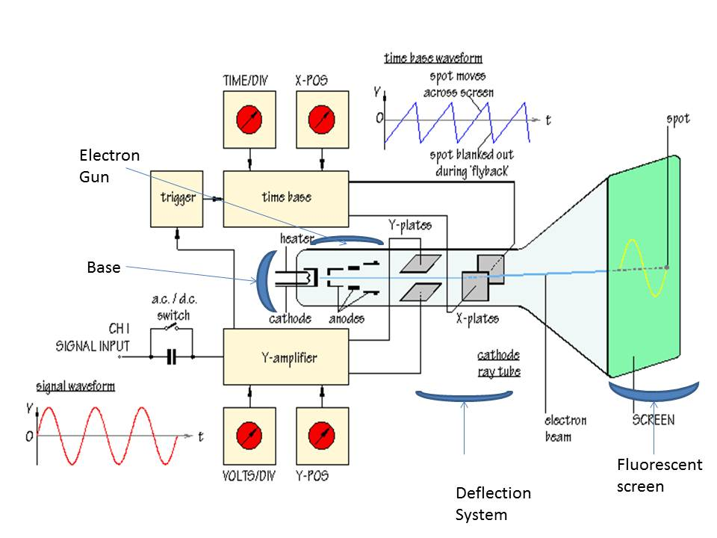
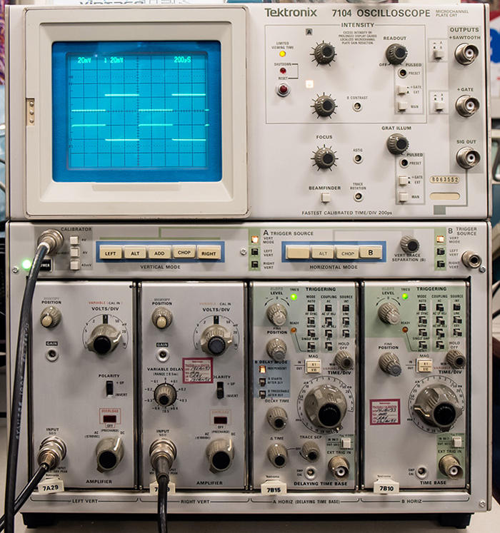
Cathode Ray Tube (CRT) Oscilloscope

Slide 6
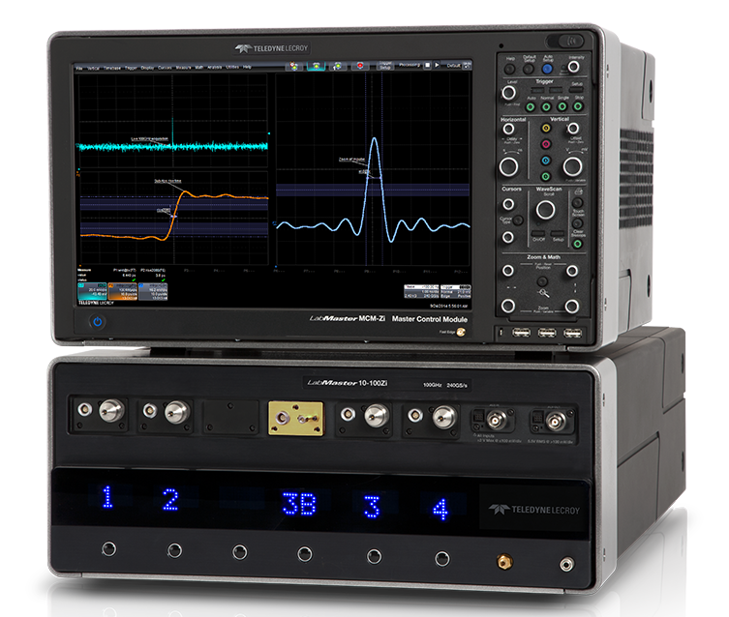
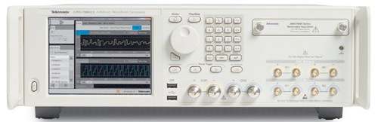
Today: Digital Storage Oscilloscope (DSO)
100 GHz bandwidth
240 GS/s oscilloscope
(LeCroy)
…and digital signal generator
(AWG: arbitrary waveform generator)
Device Under Test (DUT)
50 GS/s, 10-bit AWG (Tektronix)
Signal processing based on fast ADCs and DACs
  Similar “look and feel” as analog oscilloscopes, but better performance
    8…12-bit multi-GS/s ADCs, still, be aware of aliasing effects!
    Fast sampling oscilloscope require sufficient memory resources.
AWG or pulse generator & digital oscilloscope:
Time-domain (TD) test setup
  Device under test (DUT) characterization and trouble shooting
    Impulse, step, or arbitrary waveform (e.g., beam signal) as stimulus signal
    High impedance probe for measurements on the printed circuit board (PCB)

Slide 7
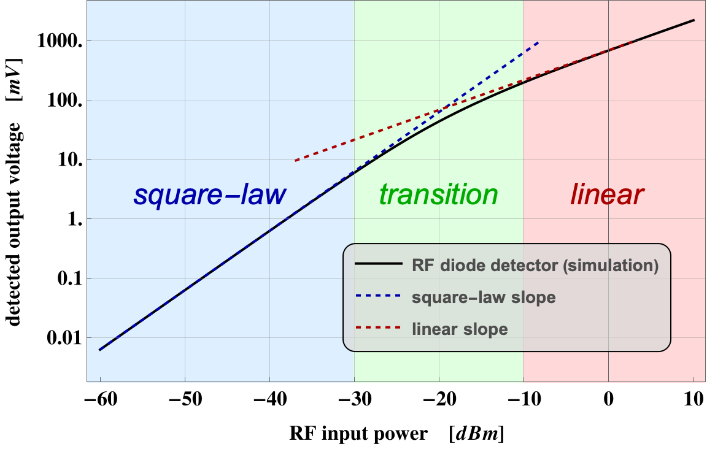
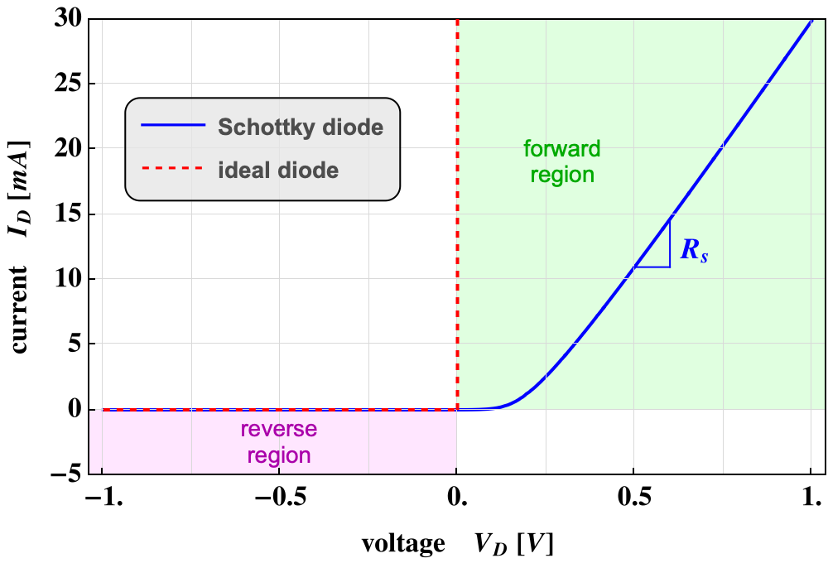
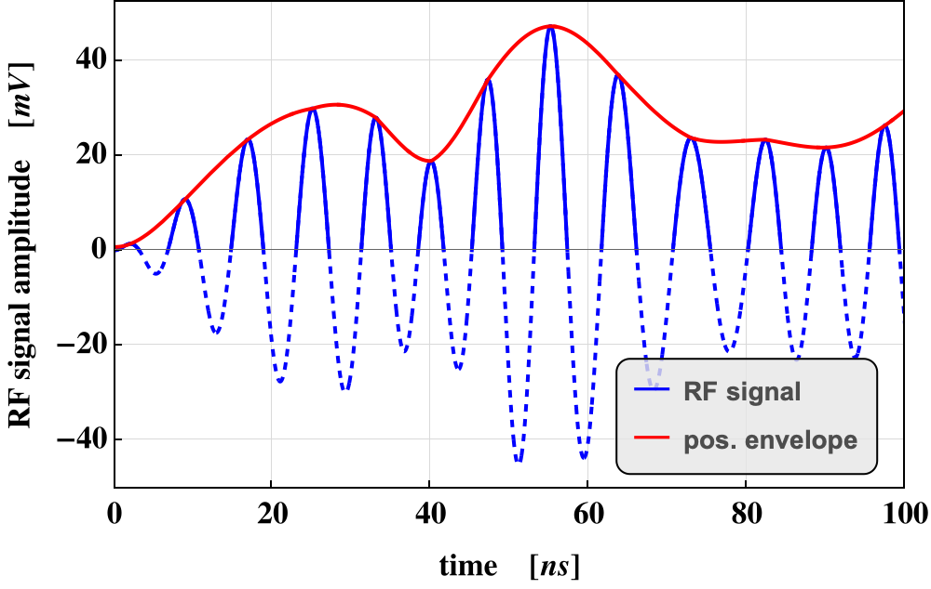







RF Measurements Methods (2)
RF detection (Schottky) diode (RF power meter)
  Supplies a rectified (video) output signal proportional
  to the RF signal level
  Delivers no frequency or phase information, but operates over a very broad frequency range few MHz to many GHz,
  and up to ~60 dB dynamic range.
$$D$$
$$V_{RF}$$
$$C$$
$$V_{det}$$
$$R_{load}$$
$$R_{in}≅50 Ω$$
$$I_{D}=I_{S}(e^{\frac{V_{D}−I_{D}R_{S}}{nV_{T}}}−1)$$

Slide 8
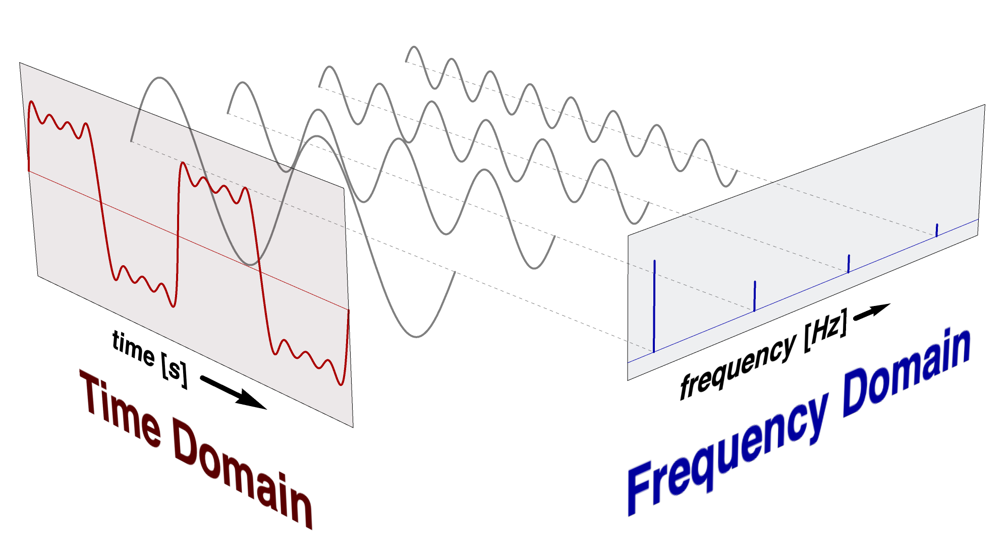
RF Measurements Methods (3)
Spectrum analyzer: to observe signals in a “frequency-domain like” fashion
  sweeps in equidistant steps through a given frequency range
  application: observation of spectrum from the beam, or from a signal generator or RF source, or the spectrum emitted from an antenna to locate EMI issues in the accelerator tunnel, etc.
    Also, DUT characterization in the laboratory, e.g., noise figure measurement on amplifiers (requires a noise source), intermodulation measurements on amplifiers (requires two RF generators).
  Requires periodic signals
  Assumes time-invariance of the measurement object (DUT) throughout the frequency sweep
  Large dynamic range!

Slide 9
RF Measurements Methods (4)
Vector signal analyzer (VSA), sometimes called FFT analyzer
  Acquires the RF signal, after down-conversion to an intermediate (IF) signal,
  in time-domain by fast sampling
  Further numerical treatment in digital signal processors (DSPs)
  Spectrum calculated using Fast Fourier Transform (FFT)
  Combines features of an oscilloscope and a spectrum analyzer:
  Signals can be observed directly in time-domain, or in a frequency-domain like fashion
  Contrary to the SA, also the spectrum of non-periodic signals
  and transients can be measured
  Application: Observation of tune sidebands, transient behavior of a phase locked loop, single pass beam signal spectrum, etc.
  Digital oscilloscopes and FFT analyzers share similar technologies, i.e., fast sampling and digital signal processing, and therefore can provide similar measurement options
    The digital oscilloscope directly digitizes the RF signal
    → limited dynamic range, large instantaneous bandwidth
    The FFT analyzer digitizes the down-converted IF signal
    → large dynamic range, but (still) limited instantaneous bandwidth

Slide 10
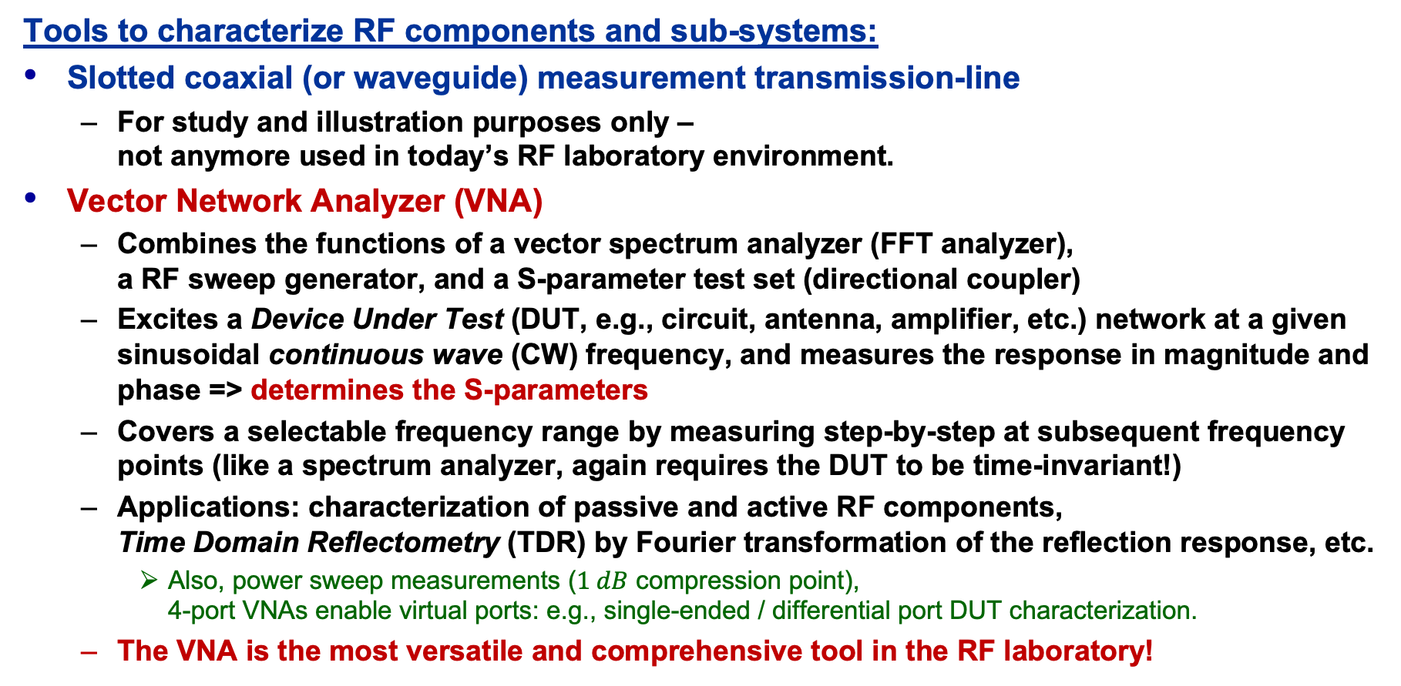
RF Measurements Methods (5)
Tools to characterize RF components and sub-systems:
Slotted coaxial (or waveguide) measurement transmission-line
  For study and illustration purposes only –
  not anymore used in today’s RF laboratory environment.
Vector Network Analyzer (VNA)
  Combines the functions of a vector spectrum analyzer (FFT analyzer),
  a RF sweep generator, and a S-parameter test set (directional coupler)
  Excites a Device Under Test (DUT, e.g., circuit, antenna, amplifier, etc.) network at a given sinusoidal continuous wave (CW) frequency, and measures the response in magnitude and phase => determines the S-parameters
  Covers a selectable frequency range by measuring step-by-step at subsequent frequency points (like a spectrum analyzer, again requires the DUT to be time-invariant!)
  Applications: characterization of passive and active RF components,
  Time Domain Reflectometry (TDR) by Fourier transformation of the reflection response, etc.
    Also, power sweep measurements ($1 dB$ compression point),
    4-port VNAs enable virtual ports: e.g., single-ended / differential port DUT characterization.
  The VNA is the most versatile and comprehensive tool in the RF laboratory!

Slide 11
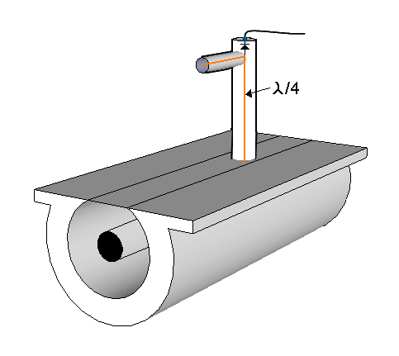
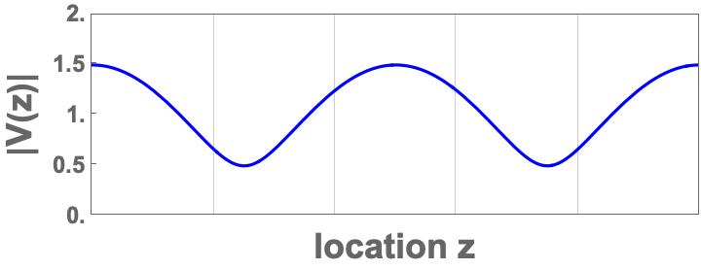
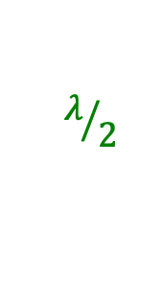
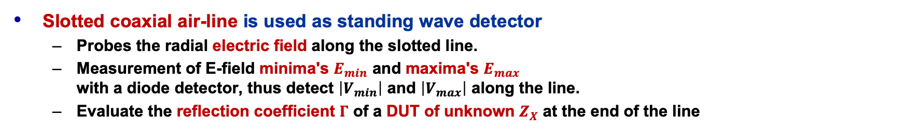
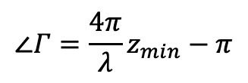




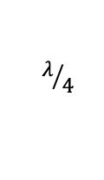
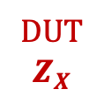
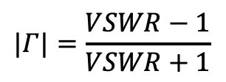


Reflection (VSWR) Measurement
matching
network
V
RF detector
DVM
E-field
probe
$$λ/4$$
$$VSWR=\frac{|V_{max}|}{|V_{min}|}$$
$$Z_{0}$$
$${R_{S}=Z}_{0}$$
DUT
$$Z_{X}$$
$$λ/2$$
$$z_{min}$$
$$|Γ|=\frac{VSWR−1}{VSWR+1}$$
$$ℓ$$
$$∠Γ=\frac{4π}{λ}z_{min}−π$$
Slotted coaxial air-line is used as standing wave detector
  Probes the radial electric field along the slotted line.
  Measurement of E-field minima's $E_{min}$ and maxima's $E_{max}$
  with a diode detector, thus detect $\left|V_{min}\right|$ and $\left|V_{max}\right|$ along the line.
  Evaluate the reflection coefficient $Γ$ of a DUT of unknown $Z_{X}$ at the end of the line
$$Z_{x}=Z_{0}\frac{1−Γ}{1+Γ}$$

Slide 12
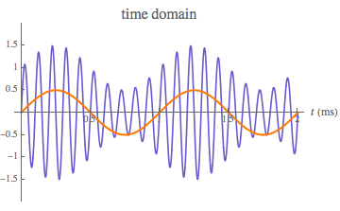
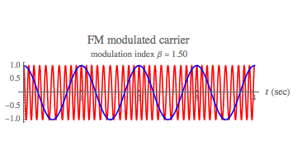
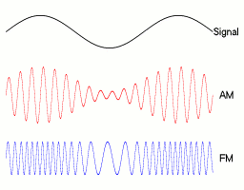
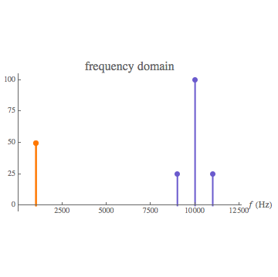
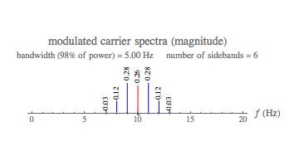
RF Signals & Modulation, without Math!
RF signals are continuous wave (CW),sinusoidal signals
  Often, a high frequency carrier is modulated with low frequency information
  Modulation appears “naturally” in ring accelerators as:
    Modulation is also provided through the LLRF system to the accelerating structures
AM: Betatron oscillations
FM: Synchrotron oscillations

Slide 13
A (too) simple Radio Receiver
broadband
low-noise RF amp
e.g., 87-108 MHz
tunable
narrowband
band-pass filter
RF amp
demodulator
audio amp
…or: How does a ”traditional” analog radio works?
  It was, and still is, difficult to make precisely tunable narrowband, band-pass filters
  for high frequencies (~100 MHz)!!
  high frequency low-noise amplifiers are expensive!
  high frequency demodulators are not trivial.
  direct detection of radio and RF signals is challenging!

Slide 14
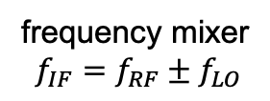
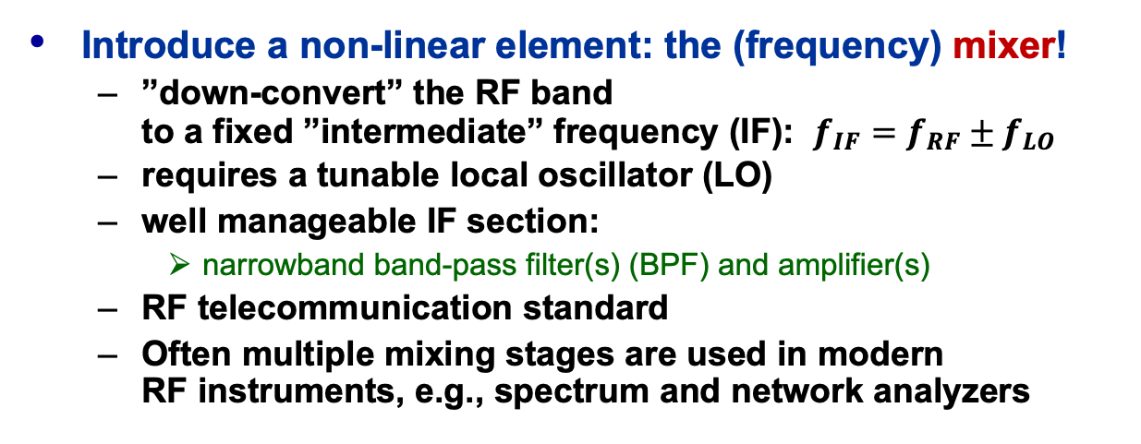



The Super-Heterodyne Receiver
frequency mixer
$$f_{IF}=f_{RF}±f_{LO}$$
ACG
audio amp
$$f_{RF}$$
$$f_{IF}$$
broadband
low-noise RF amp
e.g., 87-108 MHz
IF narrowband
band-pass filter
e.g., 10.7 MHz ± 90 kHz
$$f_{LO}$$
IF amp
demodulator,
e.g., FM PLL or
AM diode detector
Introduce a non-linear element: the (frequency) mixer!
  ”down-convert” the RF band
  to a fixed ”intermediate” frequency (IF): $f_{IF}=f_{RF}±f_{LO}$
  requires a tunable local oscillator (LO)
  well manageable IF section:
    narrowband band-pass filter(s) (BPF) and amplifier(s)
  RF telecommunication standard
  Often multiple mixing stages are used in modern
  RF instruments, e.g., spectrum and network analyzers
tunable
local oscillator (LO)
e.g., 97.7-118.7 MHz

Slide 15





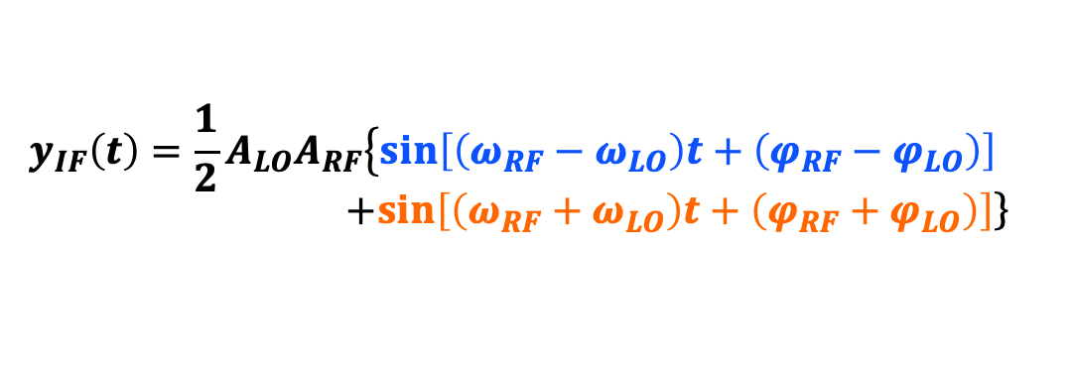















The RF Mixer as Down-Converter
$$y_{RF}\left(t\right)=A_{RF}\sin\left(ω_{RF}t+φ_{RF}\right)$$
$$RF$$
$$IF$$
$$y_{IF}\left(t\right)=y_{RF}\left(t\right)y_{LO}\left(t\right)$$
$$f_{IF}=f_{RF}±f_{LO}$$
Ideal mixer:
Frequency conversion
  $f_{RF}≠f_{LO}$: heterodyne receiver
  $f_{RF}=f_{LO}$: homodyne, demodulator
Real-world mixer:
  Image frequency:
$$LO$$
$$y_{LO}\left(t\right)=A_{LO}\sin\left(ω_{LO}t+φ_{LO}\right)$$
$$y_{IF}\left(t\right)={\frac{1}{2}A}_{LO}A_{RF}\left\{\sin\left[\left(ω_{RF}−ω_{LO}\right)t+\left(φ_{RF}−φ_{LO}\right)\right]\right. \\ +\left.\sin\left[\left(ω_{RF}+ω_{LO}\right)t+\left(φ_{RF}+φ_{LO}\right)\right]\right\}$$
upper sideband
$$f_{LO}$$
lower sideband (also called “base-band”)
$$A$$
The mixer is based on non-linear circuit elements
  e.g., the diode, popular is the double-balanced mixer
$$f$$
$$f_{RF}−f_{LO}$$
$$f_{IM}$$
$$f_{RF}$$
$$f_{RF}+f_{LO}$$
$$RF$$
$$LO$$
$$f_{IF}={mf}_{RF}±{nf}_{LO}$$
$$f_{IM}=f_{LO}−f_{IF}$$
$$IF$$

Slide 16
Simplified Spectrum Analyzer
based on the super-heterodyne principle
RF input
attenuator
pre-selector, or
low-pass filter
log
amp
envelope
detector
mixer
IF gain
IF bandwidth
RF
input
local
oscillator
video
bandwidth
Switchable BW of the
IF filter and video BPF
(analog or digital)
allows to improve the
signal-to noise (S/N)-ratio
sweep
generator
reference
oscillator
display

Slide 17











Vector Signal Analyzer (VSA) or FFT Analyzer
digital data stream
$$t$$
$$t$$
frequency-domain
analog IF waveform
Time
FFT
mixer
$$I$$
ADC
$$f$$
RF
input
NCO
modulation-domain
$$90°$$
$$Q$$
anti-aliasing
filter
Demod
$$I$$
local
oscillator
$$Q$$
digital down-converter:
quadrature demodulator
& digital CIC/FIR filters
$$I$$
RF & analog
signal processing
digital
signal processing
$$t$$
$$Q$$
time-domain
code-domain

Slide 18
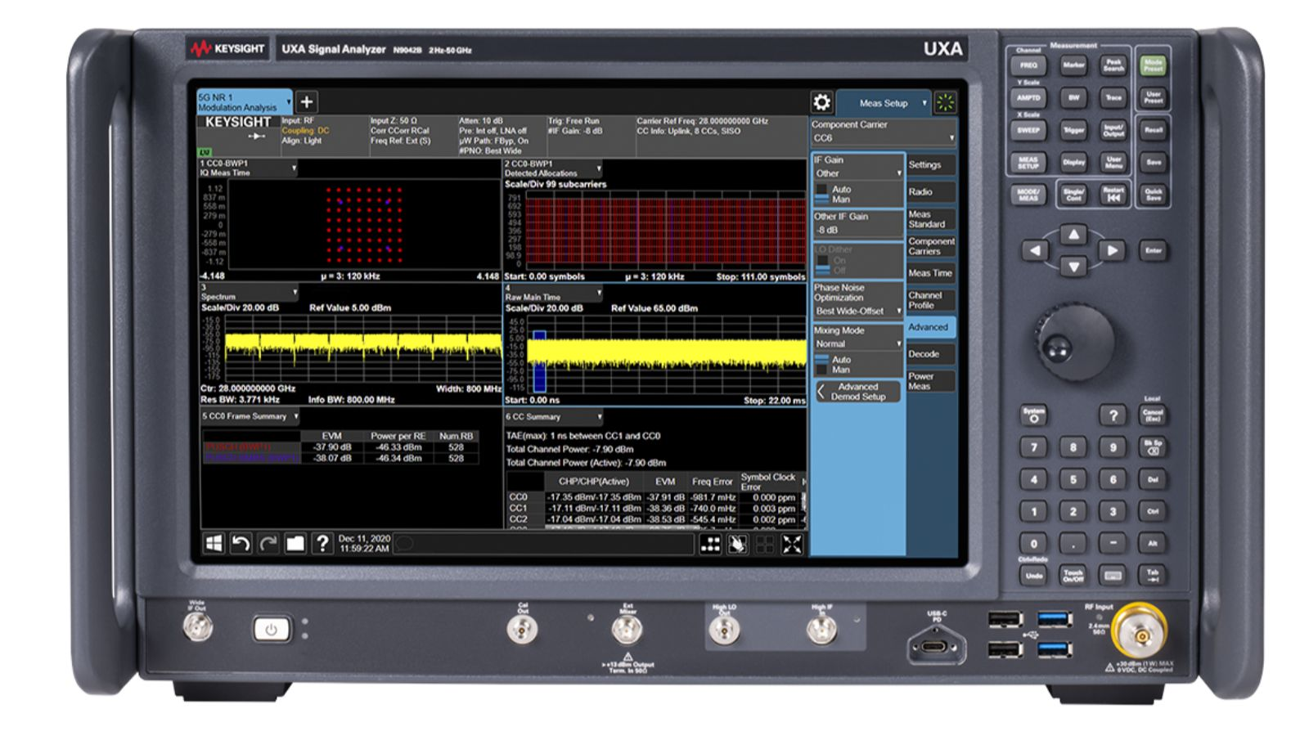
Modern Spectrum (RF Signal) Analyzer

Slide 19
Example: E-cloud investigation in the SPS
Electron cloud beam studies in the SPS (CERN) – courtesy F. Caspers
high-resolution measurement
of the detected beam signal
color-coded spectogram display
of 200 measurement traces
time

Slide 20
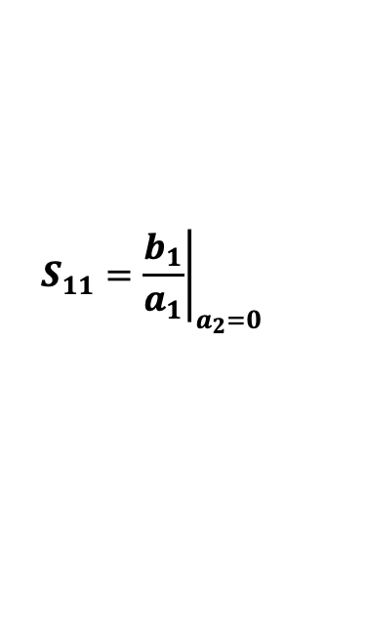

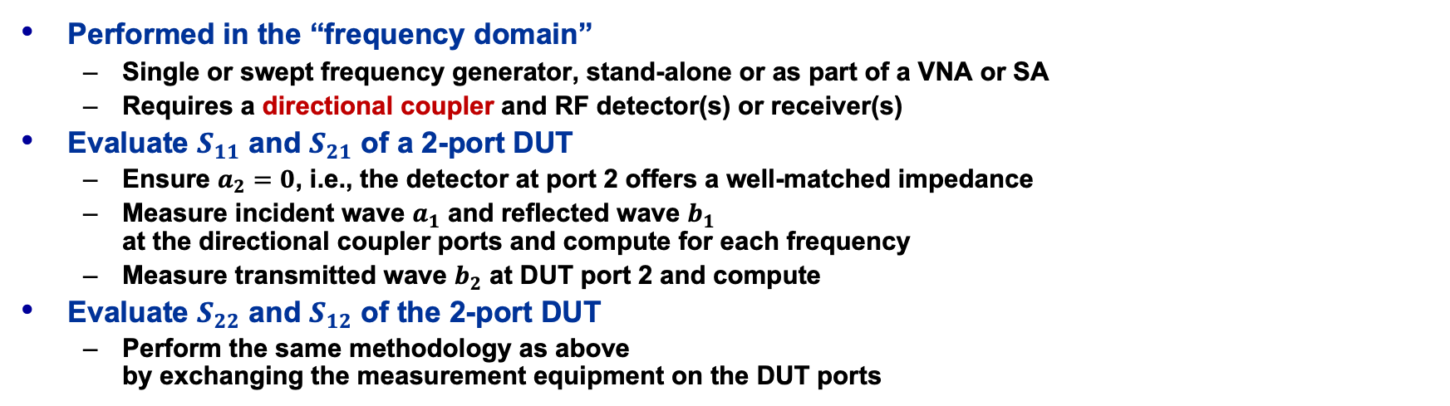

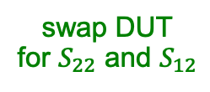

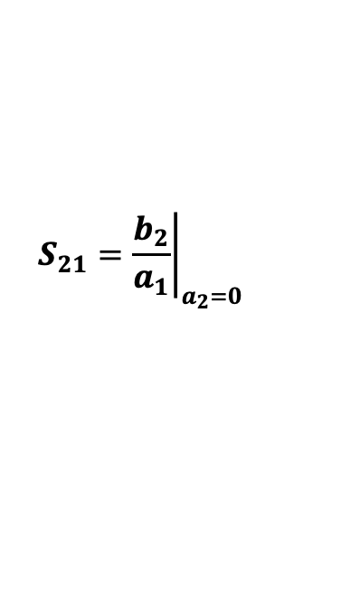

How to measure S-Parameters?
DUT = Device Under Test
$$R_{s}=50Ω$$
DUT
2-port
4-port
RF source
detector
$$∝b_{2}$$
directional coupler
detector
$$∝a_{1}$$
detector
$$∝b_{1}$$
swap DUT
for $S_{22}$ and $S_{12}$
Performed in the “frequency domain”
  Single or swept frequency generator, stand-alone or as part of a VNA or SA
  Requires a directional coupler and RF detector(s) or receiver(s)
Evaluate $S_{11}$ and $S_{21}$ of a 2-port DUT
  Ensure $a_{2}=0$, i.e., the detector at port 2 offers a well-matched impedance
  Measure incident wave $a_{1}$ and reflected wave $b_{1}$
  at the directional coupler ports and compute for each frequency
  Measure transmitted wave $b_{2}$ at DUT port 2 and compute
Evaluate $S_{22}$ and $S_{12}$ of the 2-port DUT
  Perform the same methodology as above
  by exchanging the measurement equipment on the DUT ports
$$S_{11}={\left.\frac{b_{1}}{a_{1}}\right|}_{a_{2}=0}$$
$$S_{21}={\left.\frac{b_{2}}{a_{1}}\right|}_{a_{2}=0}$$

Slide 21








The Vector Network Analyzer (VNA)
RF
source
IF
X-switch
ADC
term
IF $a_{1}$
IF $a_{2}$
directional
couplers
directional
couplers
LO
source
DAQ CTRL
Sig Proc
Display
IF $b_{1}$
IF $b_{2}$
port 1
port 2
2-port VNA
  Simplified block schematic
$$a_{1}$$
$$a_{2}$$
DUT
coaxial
cable
coaxial
cable
$$b_{1}$$
$$b_{2}$$

Slide 22
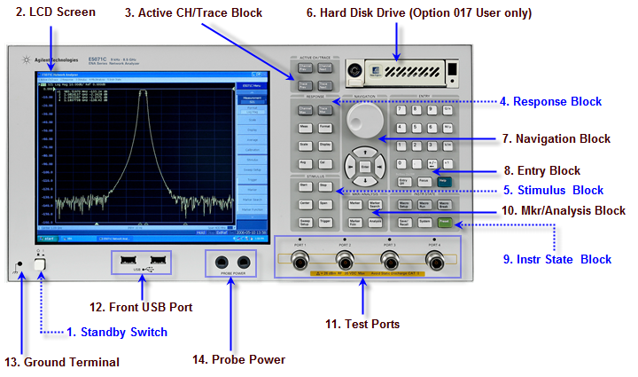
Fun with the VNA!
The “look and feel” between VNAs vary between manufacturers and models
  Concepts and operation is still very similar

Slide 23







VNA Calibration (1)
Calibration is not necessary for pure frequency or phase measurements
Before calibrating the VNA measurement setup,
perform a brief measurement and chose appropriate VNA settings:
  Frequency range (center, span or start, stop)
  Number of frequency points
    Can be sometimes increased by rearranging the VNA memory (# of channels)
  IF filter bandwidth
  Output power level
Calibrate the setup, preferable with an electronic calibration system
if more than 2 ports are used!
  Each port and combination needs to be
  calibrated, with the cables attached
  Choose the appropriate connector type and sex
  The instrument establishes a correction matrix
  and displays the ”CAL” status.
DUT, corr.
error adapter
DUT
$$1$$
$${RF}_{in}$$
$$e_{D}$$
$$e_{S}$$
$$S_{iiDUT}$$
$$S_{iiM}$$
$$e_{RT}$$

Slide 24
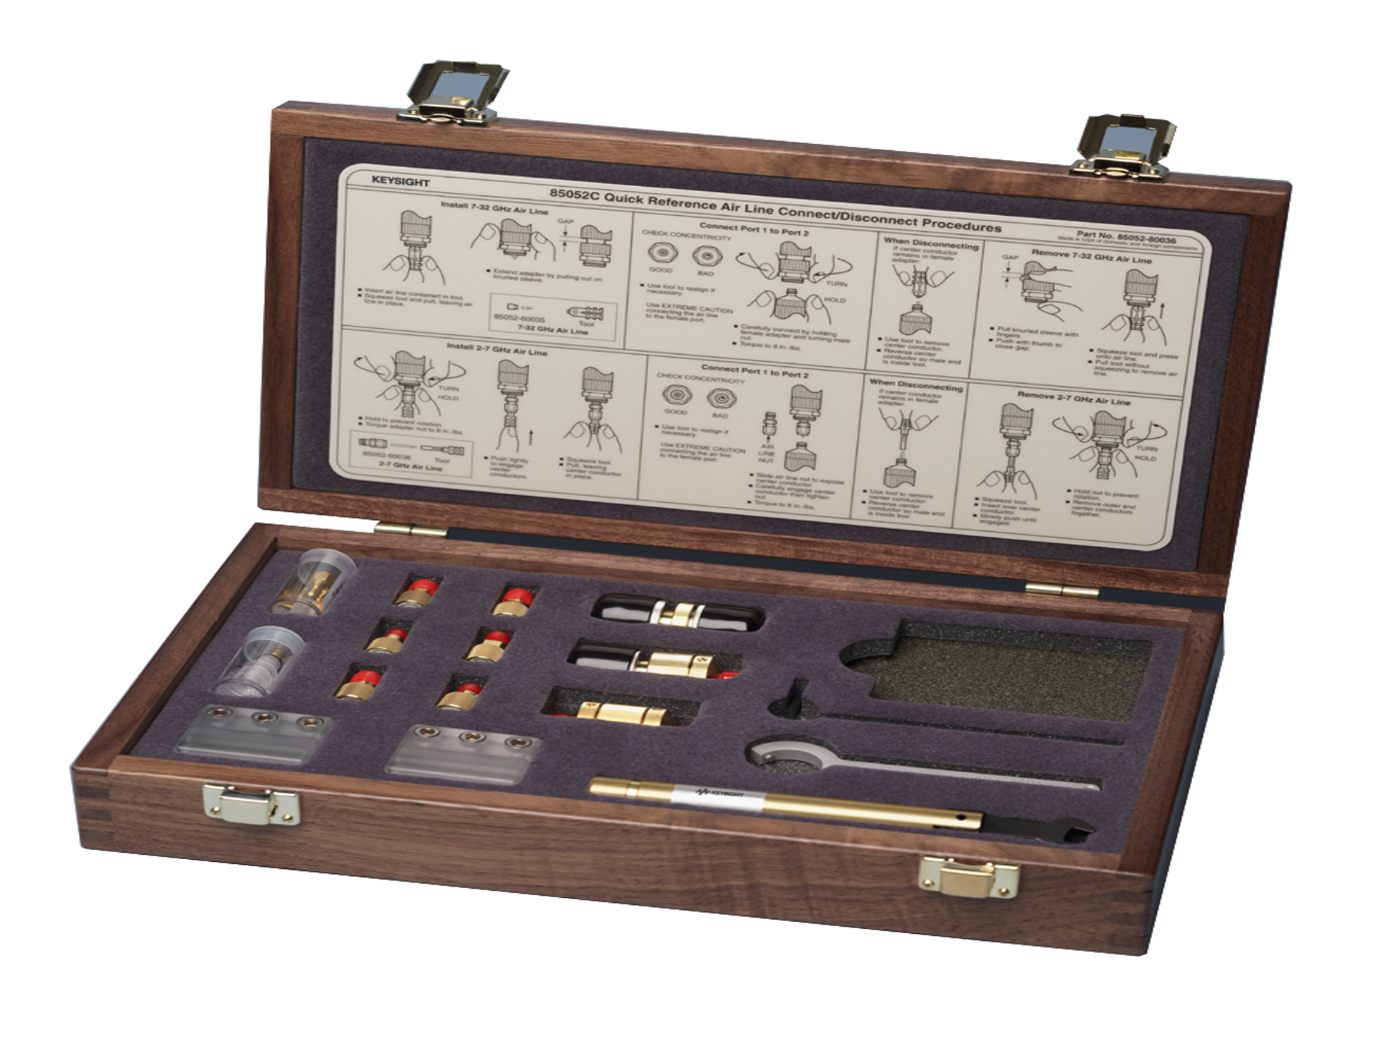
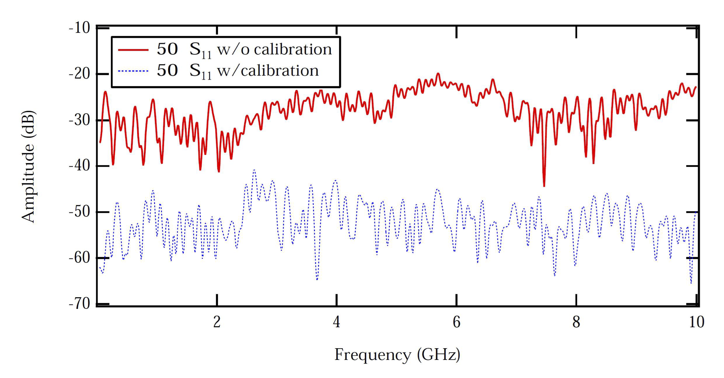
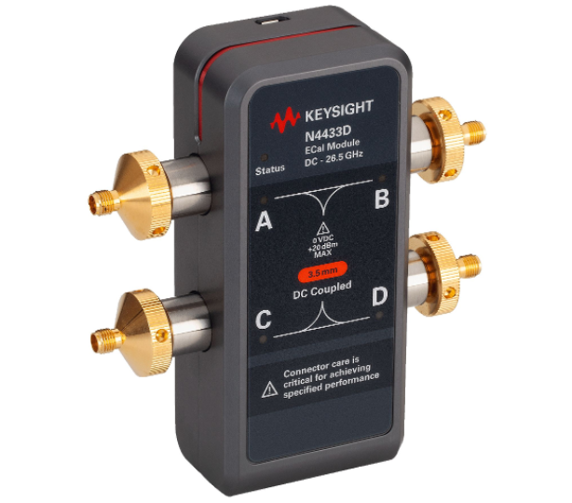
VNA Calibration (2)
Calibration improves the measurement performance
  Return loss improvement by typically 20 dB. Enables mdB accuracy measurements!
  Full 2-port or 4-port calibration with manual calibration kits is prone to errors,
  better use electronic calibration systems.
  Changing VNA settings after calibration will cause the instrument to inter- and extrapolate,
  and the calibration status becomes uncertain!
Cables need to be included in the calibration!
  However, changing coaxial connector types usually not!
  Special VNA cables allows the adaption of different connector types and sex,
  without requiring a re-calibration of the setup!

Slide 25
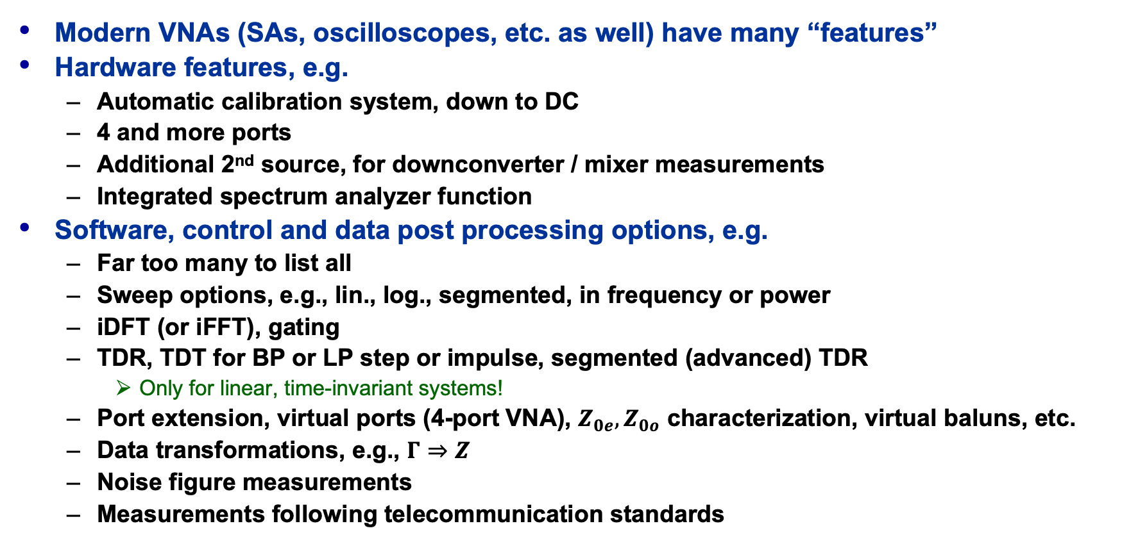
RF Measurement Instrument Features
Modern VNAs (SAs, oscilloscopes, etc. as well) have many “features”
Hardware features, e.g.
  Automatic calibration system, down to DC
  4 and more ports
  Additional 2nd source, for downconverter / mixer measurements
  Integrated spectrum analyzer function
Software, control and data post processing options, e.g.
  Far too many to list all
  Sweep options, e.g., lin., log., segmented, in frequency or power
  iDFT (or iFFT), gating
  TDR, TDT for BP or LP step or impulse, segmented (advanced) TDR
    Only for linear, time-invariant systems!
  Port extension, virtual ports (4-port VNA), $Z_{0e}, Z_{0o}$ characterization, virtual baluns, etc.
  Data transformations, e.g., $Γ⇒Z$
  Noise figure measurements
  Measurements following telecommunication standards

Slide 26
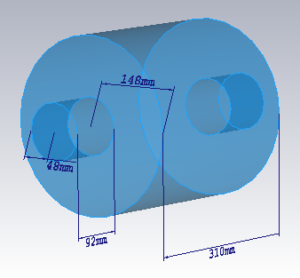
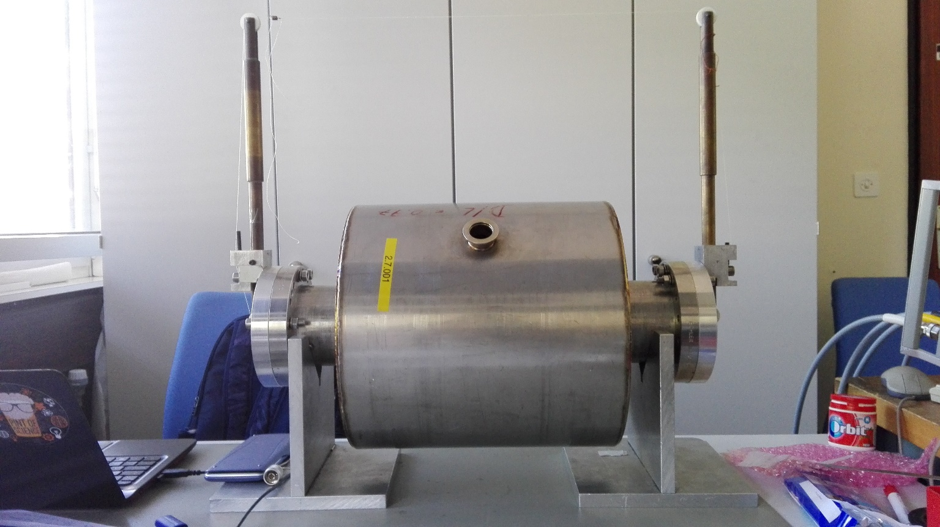
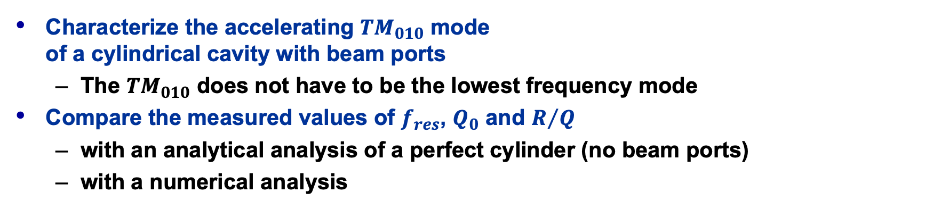

An Example – Pillbox* ${TM}_{010}$ Eigenmode
Characterize the accelerating ${TM}_{010}$ mode
of a cylindrical cavity with beam ports
  The ${TM}_{010}$ does not have to be the lowest frequency mode
Compare the measured values of $f_{res}$, $Q_{0}$ and $R/Q$
  with an analytical analysis of a perfect cylinder (no beam ports)
  with a numerical analysis
* normal conducting!

Slide 27
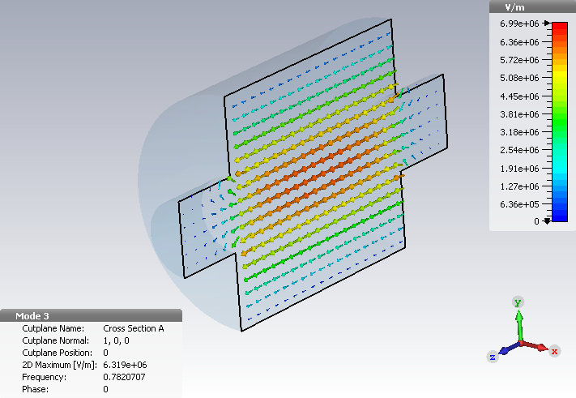
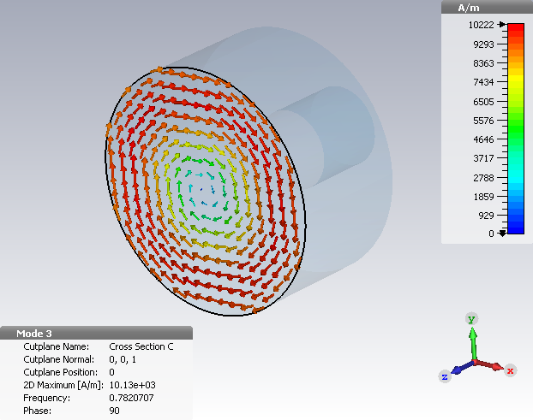
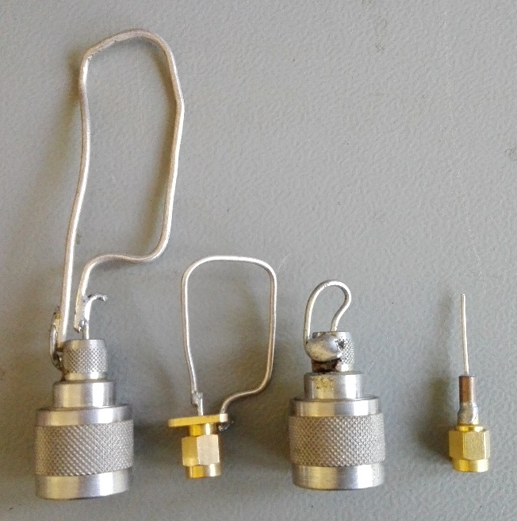
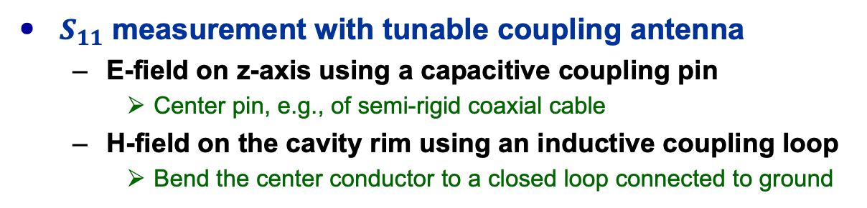
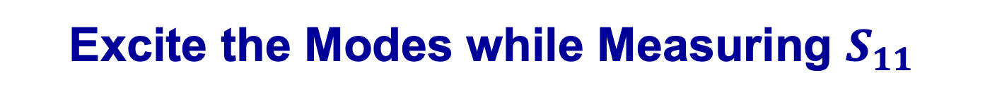
Excite the Modes while Measuring $S_{11}$
sliding capacitive pin antenna probes the E-field
rotating inductive loop antenna probes the H-field
$S_{11}$ measurement with tunable coupling antenna
  E-field on z-axis using a capacitive coupling pin
    Center pin, e.g., of semi-rigid coaxial cable
  H-field on the cavity rim using an inductive coupling loop
    Bend the center conductor to a closed loop connected to ground

Slide 28
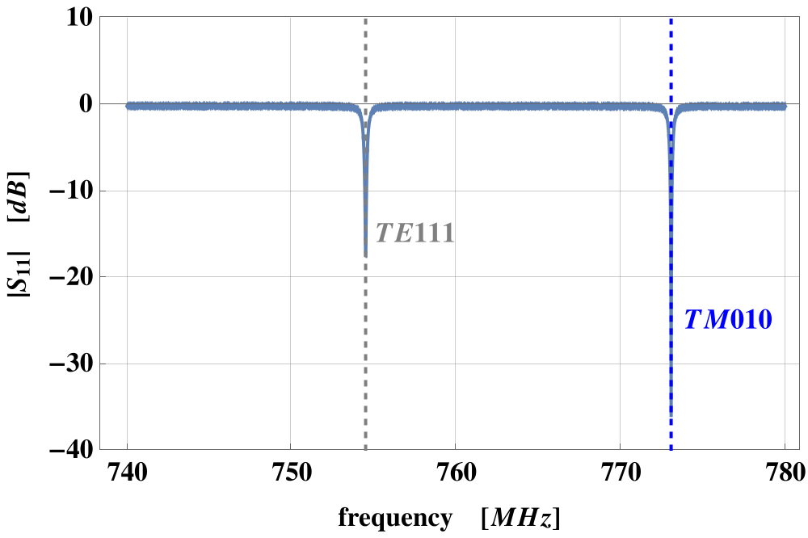
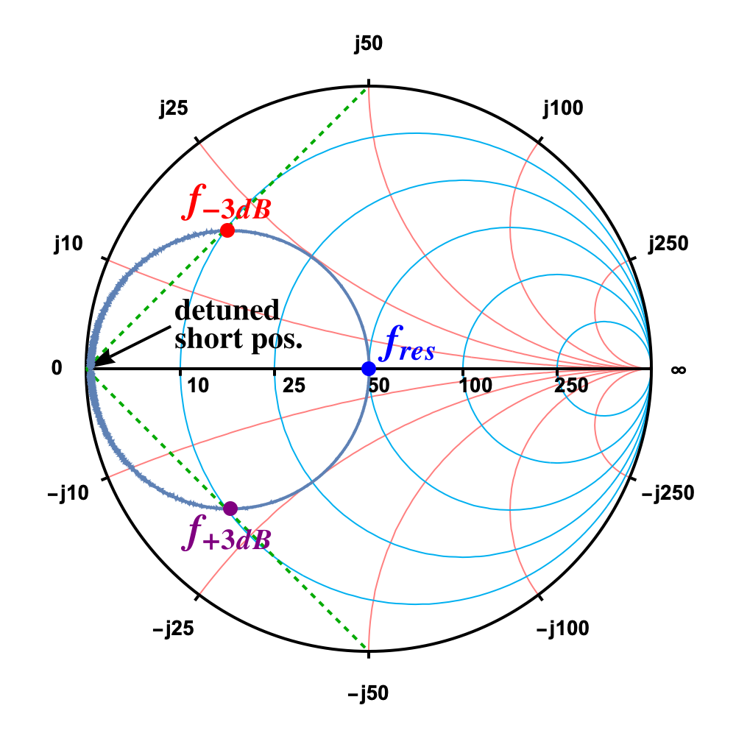
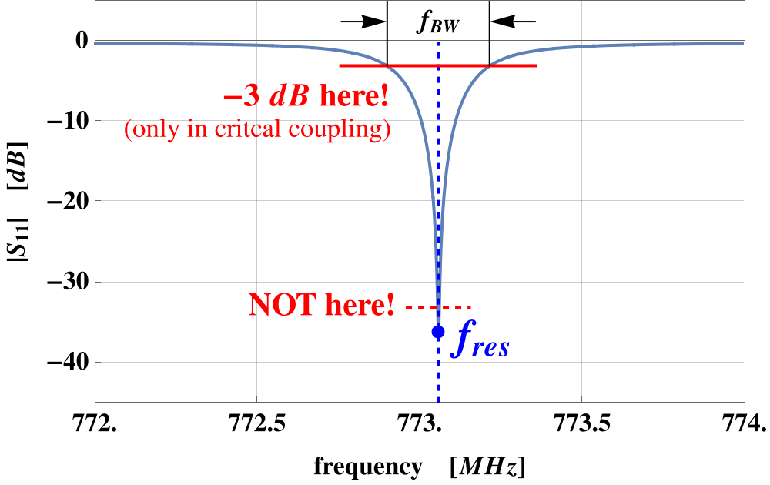
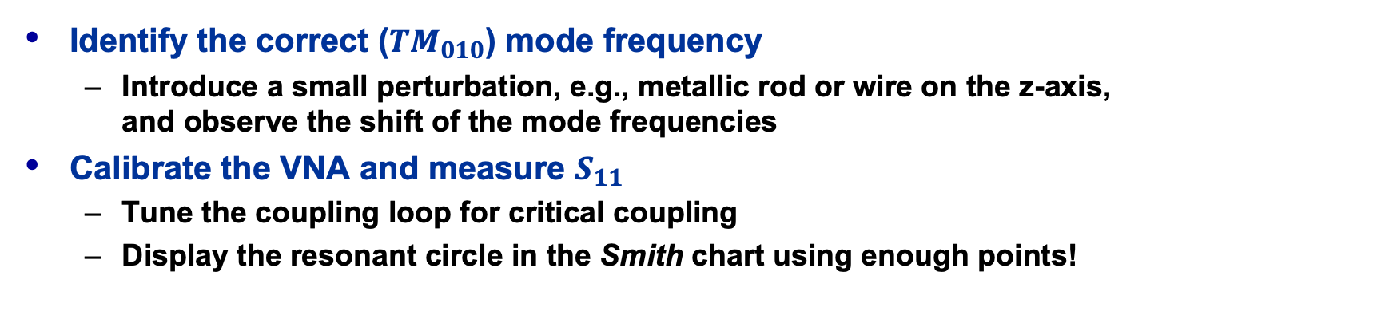
Measurement of Frequency and Q-value
Identify the correct (${TM}_{010}$) mode frequency
  Introduce a small perturbation, e.g., metallic rod or wire on the z-axis,
  and observe the shift of the mode frequencies
Calibrate the VNA and measure $S_{11}$
  Tune the coupling loop for critical coupling
  Display the resonant circle in the Smith chart using enough points!

Slide 29













The Equivalent Circuit of a Resonant Mode
VNA reference plane
after calibration
cavity coupling
equiv. circuit
unloaded
$TM010$-mode
equiv. circuit
VNA
$$Z_{0}=50 Ω$$
$$Z_{TM010}⇒$$
$$R_{s}=Z_{0}$$
$$L$$
$$R \\ =R_{sh}$$
$$C$$
VNA
cable
$$1:k$$
short TL
(coaxial
connection)
ideal transformer
(coupling loop or pin)
$${R=R}_{sh}:\text{shunt} \text{resistor}\text{, } \\ \text{representing} \text{the} \text{losses} \text{of} \text{the} \text{resonator}$$
we have resonance condition, when:
$$ωL=\frac{1}{ωC}$$
$$Z_{TM010}=R$$
at $\text{resonance}\text{:}$
^{→ resonance frequency:}
$$ω_{res}=2πf_{res}=\frac{1}{LC} ⟹ f_{res}=\frac{1}{2π\sqrt{LC}}$$

Slide 30











Useful Formulas of the Equivalent Circuit
Characteristic impedance ”R over Q”
Stored energy at resonance
Dissipated power
Q-factor
Shunt impedance (circuit definition)
Tuning sensitivity
Coupling parameter (shunt impedance
over generator or feeder impedance)
$$X=\frac{R}{Q}=ω_{res}L=\frac{1}{ω_{res}C}=\sqrt{L/C}$$
$$U=U_{e}+U_{m}=\frac{1}{4}{{|V}_{C}|}^{2}C+\frac{1}{4}{{|I}_{L}|}^{2}L$$
$V_{C}$ ... Voltage at the capacitor
$I_{L}$ … Current in the inductor
$$P=\frac{V^{2}}{2 R}$$
$$Q=\frac{R}{X}=\frac{ω_{res} U}{P}$$
$U$ ... stored energy
$P$ ... dissipated power over 1 period
$$R=\frac{V^{2}}{2 P}$$
$$\frac{R}{Q}=\frac{V^{2}}{{2ω}_{res} U}$$
$$\frac{Δf}{f}=\frac{1}{2} \frac{ΔC}{C}=−\frac{1}{2} \frac{ΔL}{L}$$
$$k^{2}=\frac{R}{R_{input}}$$
tune for critical coupling

Slide 31









The Quality Factor ($Q$-Factor)
The quality ($Q$) factor of a resonant circuit is defined as ratio of the stored energy $U$ over the energy dissipated $P$ in one oscillation cycle:
The $Q$-factor of an impedance loaded resonator:
  $Q_{0}$: unloaded Q-value of the unperturbed system
  $Q_{L}$: loaded Q-value, e.g., measured with the impedance of the connected generator
  $Q_{ext}$: external Q-factor, representing the effects of the external circuit
  (generator and coupling circuit)
Q-factor and bandwidth
  This is how we actually ”measure” the Q-factor!
$$Q=2π\frac{energy stored}{energy dissipated in 1 cycle}=\frac{ω_{res}U}{P}$$
tune $k$ for
critical coupling:
$$\frac{1}{Q_{L}}=\frac{1}{Q_{0}}+\frac{1}{Q_{ext}}$$
$$Q_{0}=Q_{ext}$$
$${⟹Q}_{0}=2 Q_{L}$$
$$Q=\frac{f_{res}}{f_{BW}}$$
$${with: f}_{BW}=f_{+3dB}−f_{−3dB}$$
with $Q_{L}$ being our
measured Q-value

Slide 32




















$Q$-factor from $S_{11}$ Measurement
arbitrary coupling (here: over-critical)
$ℑ\{Z\}(f)$
for a resonator
in critical coupling
critical coupling
$$Q_{L}=\frac{f_{res}}{f_{+3dB}−f_{−3dB}}$$
detuned
short
position
($Z=0$)
$$f_{1}$$
Y$=ℜ∓j$
$$f_{3}$$
$$f_{−3dB}$$
$$|ℜ\left\{Z\right\}|=|ℑ\left\{Z\right\}|$$
$$f_{3}=f_{5}$$
$$f_{5}$$
$$Q_{0}=\frac{2\sqrt{f_{+3dB}f_{−3dB}}}{f_{+3dB}−f_{−3dB}}$$
$$≅\frac{f_{+3dB}+f_{−3dB}}{f_{+3dB}−f_{−3dB}}$$
$$f_{res}$$
$$f_{res}$$
$$f_{4}=f_{6}$$
$$f_{6}$$
$$f_{+3dB}$$
match
($Γ=0$)
detuned
open
position
($Y=0$)
$$f_{4}$$
Correct for the uncompensated transmission-line effects
between calibration reference and the coupling loop
  Electrical length adjustment: ”straight” $ℑ\{Z\}(f)$
Adjust the locus circle to the detuned short location
  Phase offset
Verify no evanescent fields penetrating outside the beam ports
  i.e., no frequency shifts if the boundaries at the beam ports are altered
$$f_{2}$$
Frequency marker points in the Smith chart:
$f_{1,2} (f_{−3dB}, f_{+3dB})$: $|ℑ\left\{S_{11}\right\}|=max.$ to calculate $Q_{L}$
  $f_{3,4}$: $Y=ℜ∓j$ to calculate $Q_{ext}$
  $f_{5,6}$: $|ℜ\left\{Z\right\}|=|ℑ\left\{Z\right\}|$ to calculate $Q_{0}$

Slide 33








$R/Q$ Measurement – Slater’s Theorem
Remember from the equivalent circuit:
  $V_{acc}$ is based on the integrated longitudinal E-field component $E_{z}$ along the z-axis ($x=y=0$)
Based on Slater’s perturbation theorem:
  Resonance frequency shift due to a small perturbation object,
  expressed in longitudinal and transverse E and H field components
  $k$: coefficients proportional to the electric or magnetic polarizability of the perturbation object (here: only $k_{∥}^{E}$ for a longitudinal metallic object)
E-field characterization
along the z-axis
transit time related
$$\frac{R}{Q}=\frac{{V_{acc}^{2}}/{{2P}_{d}}}{{ω_{res}U}/{P_{d}}}=\frac{V_{acc}^{2}}{2ω_{res}U}$$
$$V_{acc}=\left|\int{E_{z}\left(z\right)\cos\left(\frac{ωz}{βc_{0}}\right)dz}\right|$$
with:
$$\frac{Δf}{f_{res}}=\frac{1}{U}\left[μ_{0}\left(k_{∥}^{H}{\left|H_{∥}\right|}^{2}+k_{⊥}^{H}{\left|H_{⊥}\right|}^{2}\right)−ε_{0}\left(k_{∥}^{E}{\left|E_{∥}\right|}^{2}+k_{⊥}^{E}{\left|E_{⊥}\right|}^{2}\right)\right]$$
$$k_{∥}^{E}=\frac{π}{3}l^{3}{\left[\sinh^{−1}\left(\frac{2}{3π}\frac{l}{a}\right)\right]}^{−1}$$
$$E\left(z\right)=E_{∥}(z)=\sqrt{U\frac{Δf\left(z\right)}{f_{res}}∙\frac{−1}{{k_{∥}^{E}ε}_{0}}}$$
with:
(metallic ellipsoid, e.g., syringe needle
of half length $l$ and radius $a$)

Slide 34






$R/Q$ Measurement - Bead Pull Method
E-field characterization by evaluating
  The frequency shift $Δf$ ($S_{11}$ reflection measurement with a single probe)
  or
  The phase shift $φ$ at $f_{res}$ ($S_{21}$ transmission measurement with 2 probes)
Exercise with a manual bead-pull through a known cavity
  requires: fishing wire, syringe needle, ruler and VNA
  Compare the measured $E_{z}$ at the maximum $f$ or $φ$ shift (in the center of the cavity)
  with the theoretical estimation (e.g., numerical computed value)
$$\frac{Δf}{f_{res}}=\frac{1}{2 Q_{0}}\tan{φ}$$

Slide 35

















Beam Coupling Impedance
The wake potential
  Lorenz force on $q_{2}$ by the wake field of $q_{1}$:
  Wake potential of a structure, e.g.,
  a discontinuity driven by $q_{1}$
$$\vec{F}=\frac{d\vec{p}}{dt}=q_{2}\left(\vec{E}+c_{0}{\vec{e}}_{z}×\vec{B}\right)$$
$$\vec{w}\left(x_{1},y_{1},x_{2},y_{2},s\right)=\frac{1}{q_{1}}\int_{−∞ (or 0)}^{+∞ (orL)}{dz{\left[\vec{E}(x_{2},y_{2},z,t)+c_{0}{\vec{e}}_{z}×\vec{B}(x_{2},y_{2},z,t)\right]}_{t=\left(s+z\right)/c}}$$
Beam coupling impedance
  Frequency domain representation of the wake potential
  Can be decomposed in longitudinal $Z_{∥}$ and transverse $Z_{⊥}$ components (Panofsky-Wenzel theorem)
  Resonant structures, $i^{th}$ mode:
$$q_{1}$$
$$q_{2}$$
$$y$$
$$Z\left(x_{1},y_{1},x_{2},y_{2},ω\right)=−\frac{1}{c_{0}}\int_{−∞}^{+∞}{ds\vec{ w}\left(x_{1},y_{1},x_{2},y_{2},s\right)e^{−jωs/c_{0}}}$$
$$x_{1},y_{1}$$
$$x_{2},y_{2}$$
$$z$$
$$s$$
$$−x$$
$$0$$
$$L$$
$$R_{sh,i}=Z_{∥,i}=\frac{2k_{loss,i}Q_{i}}{ω_{i}}$$

Slide 36














Stretched-Wire $Z_{∥}$ Measurement
Formulas:
  Normalized electrical length:
  Lumped impedance formula
  Log formula
  Improved log formula
  Transmission coefficient
  Circular beam pipe impedance
VNA
S21 meas.
$$Θ=2π\frac{L}{λ}$$
$$Z_{0}$$
$$Z_{0}$$
P1 P2
$$Z_{∥}=2Z_{pipe}\frac{1−S_{21}}{S_{21}}$$
$Θ≤1$
$$L<D_{pipe}$$
DUT
$$Z_{pipe}$$
$$Z_{∥}=−2Z_{pipe}\ln{S_{21}}$$
-10dB
-10dB
$$Z_{∥}=−2Z_{pipe}\ln{S_{21}\left(1+j\frac{\ln{S_{21}}}{2Θ}\right)}$$
$$R_{match}$$
$$R_{match}=Z_{pipe}−Z_{0}$$
stretched wire
REF
$$S_{21}=\frac{S_{21,DUT}}{S_{21,REF}}$$
-10dB
-10dB
$$Z_{pipe}=\frac{η_{0}}{2π\sqrt{ε_{r}}}\ln{\frac{D}{d}≅60 Ω}\ln{\frac{D_{pipe}}{d_{wire}}}$$
absorbing foam

Slide 37
Summary
No summary, just
Thank you!

