Slide 1
RF Engineering
Cylindrical Resonator
– Summary “Pillbox” Cavity –
Christine Völlinger & Manfred Wendt – CERN

Slide 2
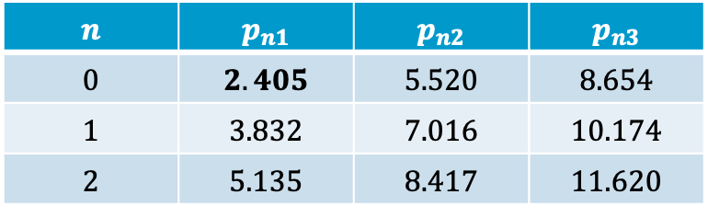

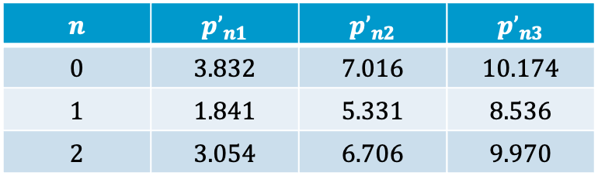
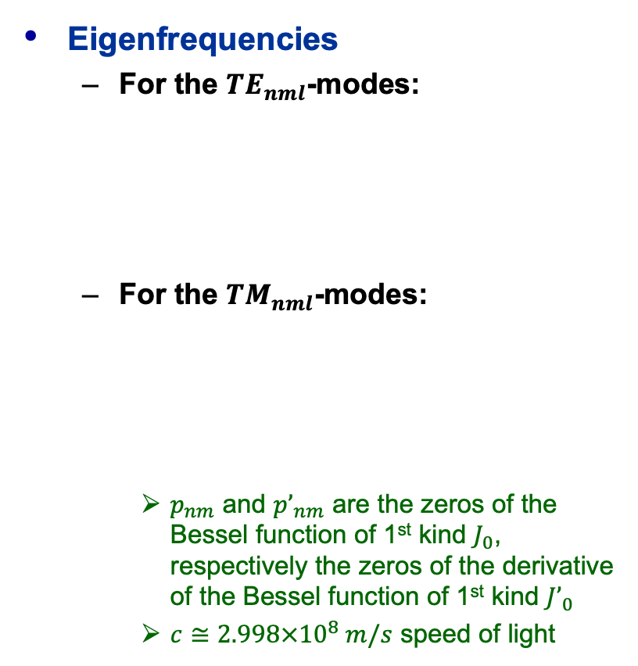
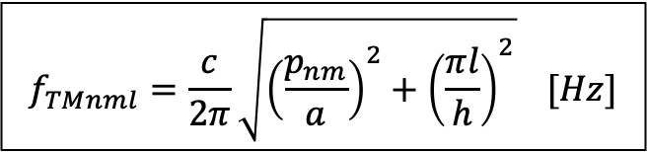
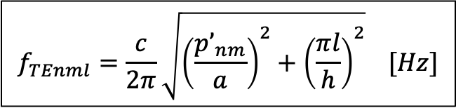

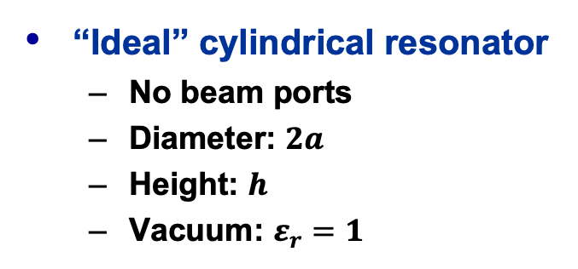
Cylindrical Resonator Equations (1)
Eigenfrequencies
  For the ${TE}_{nml}$-modes:
  For the ${TM}_{nml}$-modes:
    $p_{nm}$ and ${p’}_{nm}$ are the zeros of the Bessel function of 1st kind $J_{0}$, respectively the zeros of the derivative of the Bessel function of 1st kind ${J’}_{0}$
    $c≅2.998×{10}^{8} m/s$ speed of light
“Ideal” cylindrical resonator
  No beam ports
  Diameter: $2a$
  Height: $h$
  Vacuum: $ε_{r}=1$
beam axis
$$f_{TEnml}=\frac{c}{2π}\sqrt{{\left(\frac{{p’}_{nm}}{a}\right)}^{2}+{\left(\frac{πl}{h}\right)}^{2}} [Hz]$$
$$a$$
$$h$$
$$n$$ | $${p’}_{n1}$$ | $${p’}_{n2}$$ | $${p’}_{n3}$$
$$0$$ | $$3.832$$ | $$7.016$$ | $$10.174$$
$$1$$ | $$1.841$$ | $$5.331$$ | $$8.536$$
$$2$$ | $$3.054$$ | $$6.706$$ | $$9.970$$
$$f_{TMnml}=\frac{c}{2π}\sqrt{{\left(\frac{p_{nm}}{a}\right)}^{2}+{\left(\frac{πl}{h}\right)}^{2}} [Hz]$$
$$n$$ | $$p_{n1}$$ | $$p_{n2}$$ | $$p_{n3}$$
$$0$$ | $$2.405$$ | $$5.520$$ | $$8.654$$
$$1$$ | $$3.832$$ | $$7.016$$ | $$10.174$$
$$2$$ | $$5.135$$ | $$8.417$$ | $$11.620$$

Slide 3
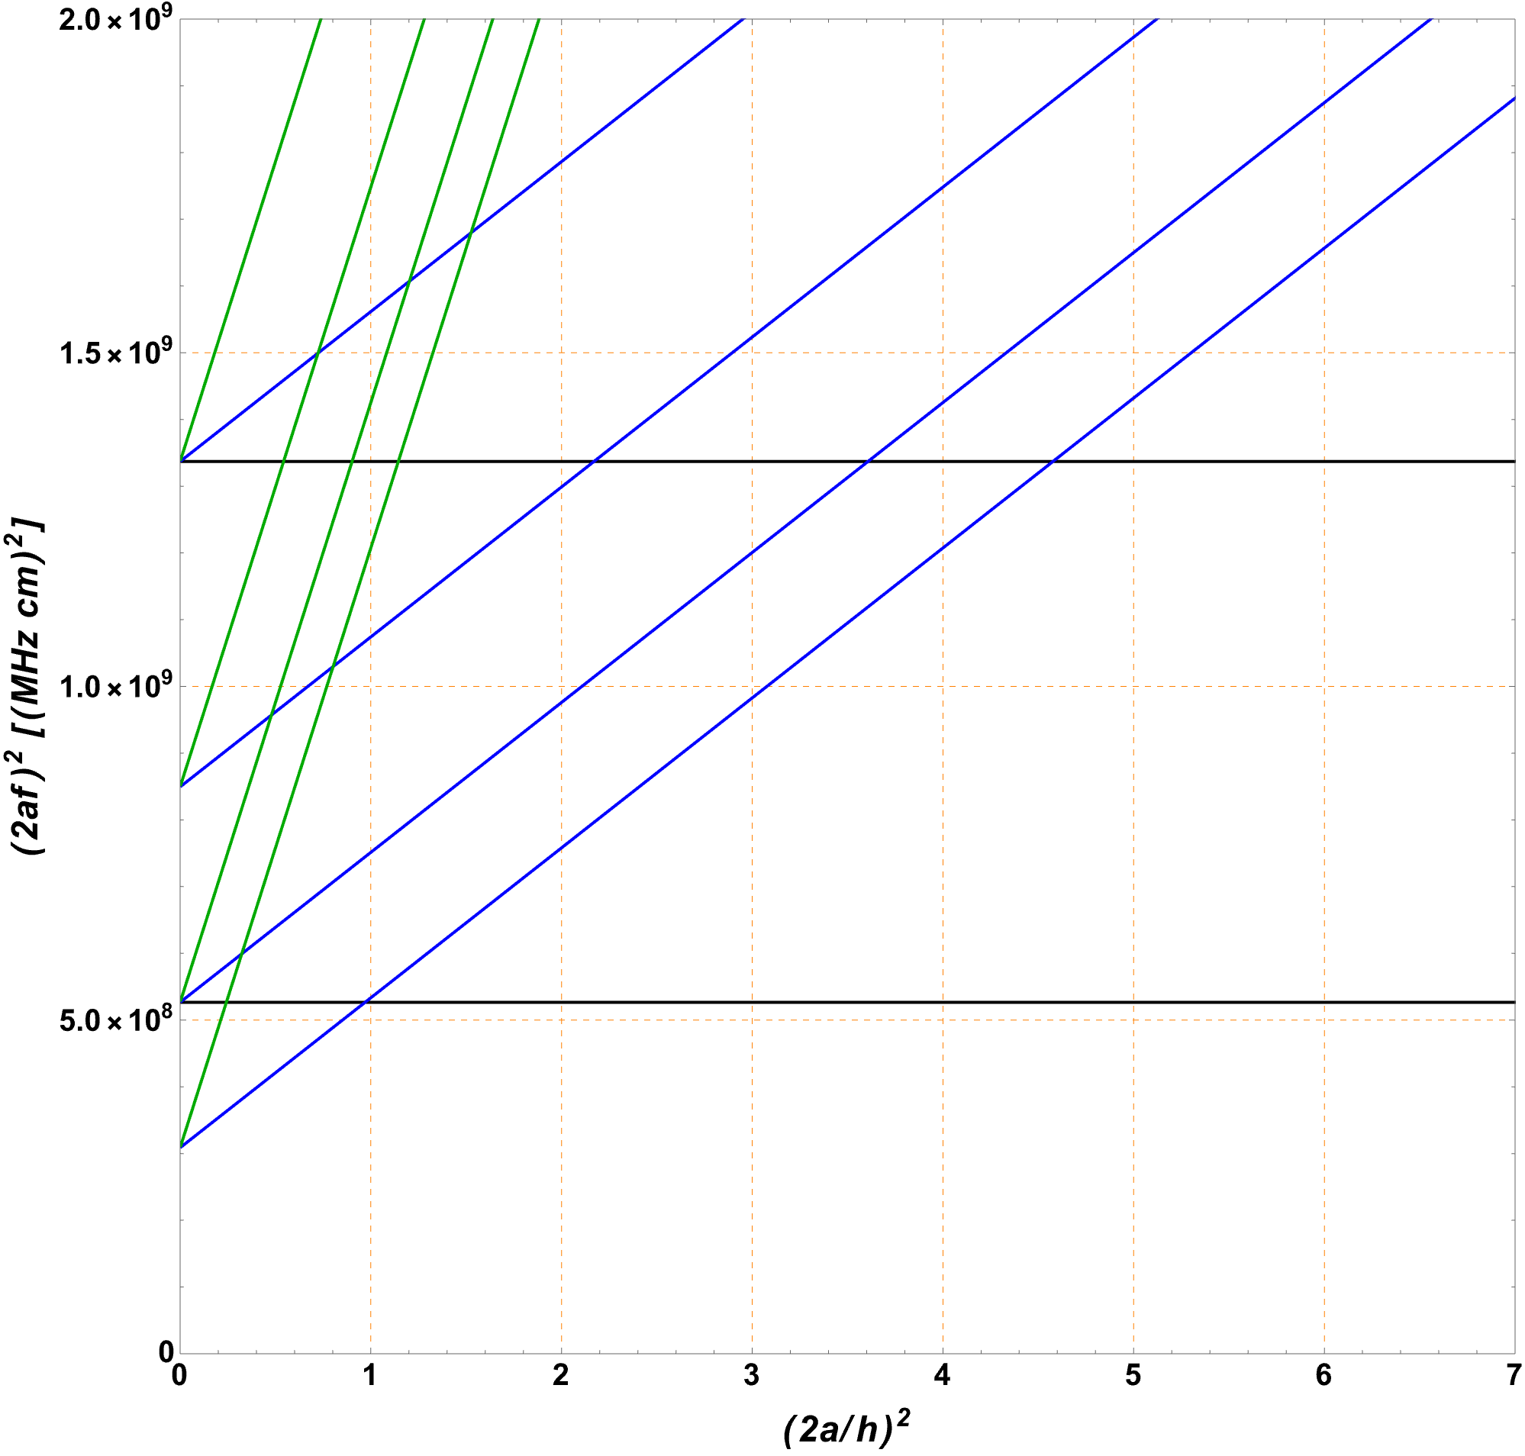
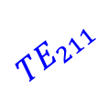

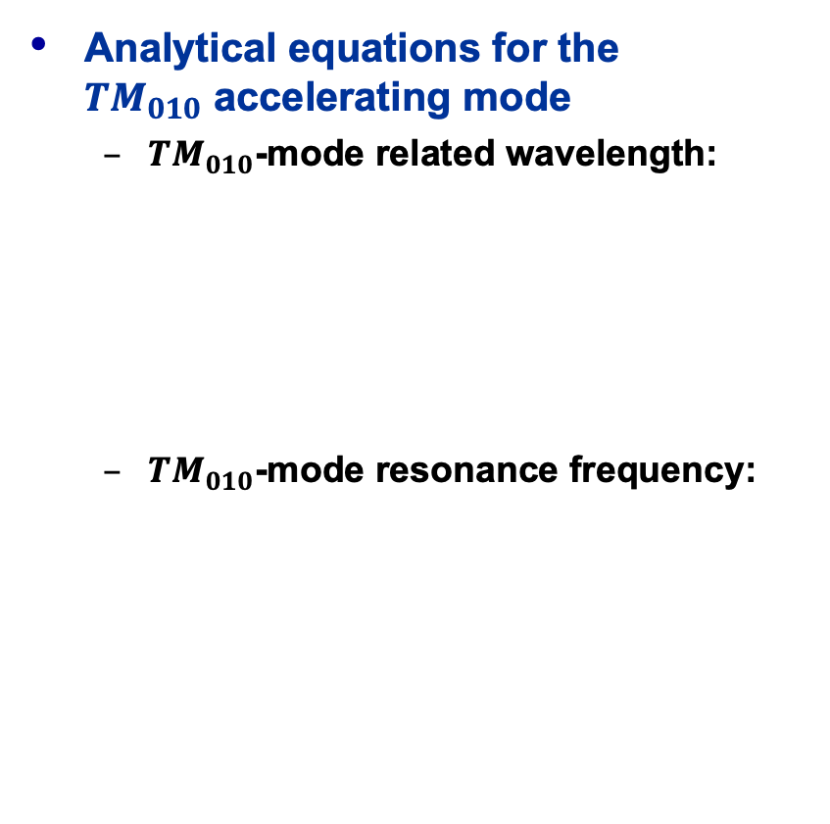


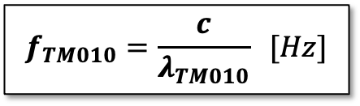



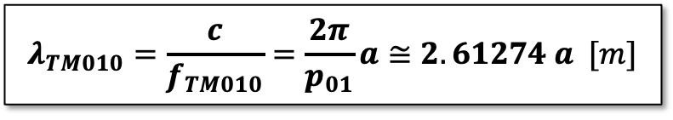


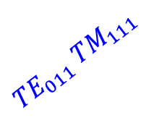
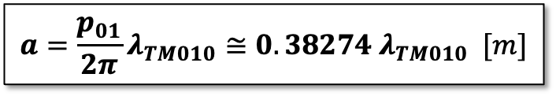
Cylindrical Resonator Equations (2)
Analytical equations for the
${TM}_{010}$ accelerating mode
  ${TM}_{010}$-mode related wavelength:
  ${TM}_{010}$-mode resonance frequency:
$${TM}_{112}$$
$${TE}_{112}$$
$${TE}_{212}$$
$${TM}_{012}$$
$${TE}_{011} {TM}_{111}$$
$${TE}_{211}$$
$${TM}_{011}$$
$${TE}_{111}$$
$$λ_{TM010}=\frac{c}{f_{TM010}}=\frac{2π}{p_{01}}a≅2.61274 a [m]$$
$${TM}_{110}$$
$$a=\frac{p_{01}}{2π}λ_{TM010}≅0.38274 λ_{TM010} [m]$$
$$f_{TM010}=\frac{c}{λ_{TM010}} [Hz]$$
$${TM}_{010}$$
Mode chart for cylindrical resonators

Slide 4


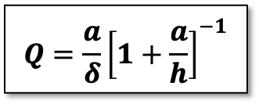


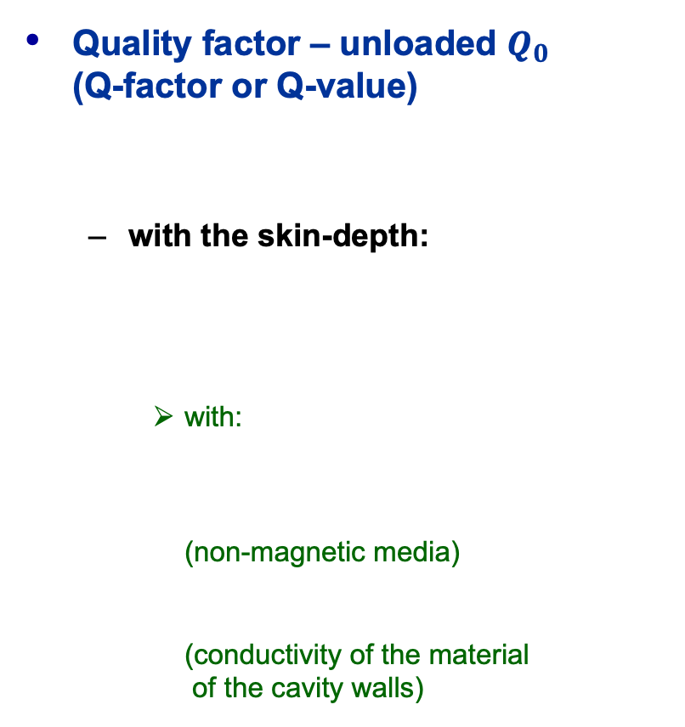

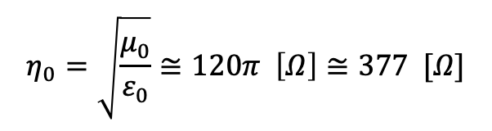



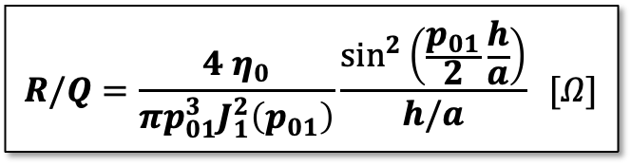
Cylindrical Resonator Equations (3)
Quality factor – unloaded $Q_{0}$
(Q-factor or Q-value)
  with the skin-depth:
    with:
    (non-magnetic media)
    (conductivity of the material
    of the cavity walls)
“Geometry factor” $R/Q$ (R-over-Q)
  With:
$$Q=\frac{a}{δ}{\left[1+\frac{a}{h}\right]}^{−1}$$
$$R/Q=\frac{4 η_{0}}{πp_{01}^{3}J_{1}^{2}\left(p_{01}\right)}\frac{\sin^{2}\left(\frac{p_{01}}{2}\frac{h}{a}\right)}{h/a} [Ω]$$
$$δ=\sqrt{\frac{2}{ω_{TM010}σμ}} [m]$$
$$R/Q≅128 Ω\frac{\sin^{2}\left(\frac{p_{01}}{2}\frac{h}{a}\right)}{h/a}[Ω] \\ ≈185 Ω h/a \left[Ω\right] for: \frac{p_{01}}{2}\frac{h}{a}≪1$$
$$ω_{TM010}=2πf_{TM010}$$
$$μ=μ_{r}μ_{0}≅1×4π∙{10}^{−7} H/m$$
$$η_{0}=\sqrt{\frac{μ_{0}}{ε_{0}}}≅120π \left[Ω\right]≅377 [Ω]$$
$$σ [S/m]$$
$$p_{01}=2.40483$$
$${J_{1}(p}_{01})=0.519147$$

Slide 5

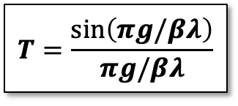


Cylindrical Resonator Equations (4)
Transit time factor
  With:
$$T=\frac{\sin\left(πg/βλ\right)}{πg/βλ}$$
$$β=\frac{v}{c} (relative beam velocity)$$
$$g=h \left[m\right] (gap length)$$
$$λ=λ_{TM010} \left[m\right] (wavelength)$$

Slide 6


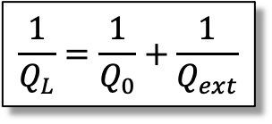




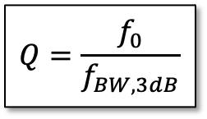

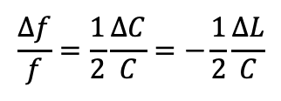


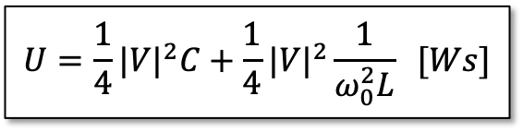

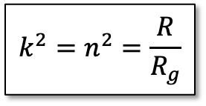






Equivalent Circuit, without Beam
$$ω_{0}=\frac{1}{\sqrt{LC}} [s^{−1}]$$
$$R_{g}$$
$$n:1$$
Resonant frequency:
  with:
Characteristic impedance
“R over Q”
Stored energy at resonance:
Dissipated power
Q-factor (unloaded $Q_{0}$):
Shunt impedance:
(circuit definition)
$$ω=2πf$$
$$C$$
$$R$$
$$L$$
$$X=\frac{R}{Q}=ω_{0}L=\frac{1}{ω_{0}C}=\sqrt{L/C} [Ω]$$
$$k^{2}=n^{2}=\frac{R}{R_{g}}$$
$$U=\frac{1}{4}{|V|}^{2}C+\frac{1}{4}{|V|}^{2}\frac{1}{ω_{0}^{2}L} [Ws]$$
Coupling parameter:
(in critical coupling)
Tuning sensitivity:
More on the Q-factor:
  Critical coupling:
$$P=\frac{V^{2}}{2R} [W]$$
$$\frac{Δf}{f}=\frac{1}{2}\frac{ΔC}{C}=−\frac{1}{2}\frac{ΔL}{C}$$
$$=U_{m}=\frac{1}{4}{{|I}_{L}|}^{2}L$$
$$=U_{e}$$
$$Q=\frac{R}{X}=\frac{ω_{0}U}{P}$$
$$Q=\frac{f_{0}}{f_{BW,3dB}}$$
$$\frac{1}{Q_{L}}=\frac{1}{Q_{0}}+\frac{1}{Q_{ext}}$$
$$R=\frac{V^{2}}{2P} [Ω]$$
$$Q_{0}=Q_{ext}$$
$${⟹Q}_{0}=2 Q_{L}$$

