Slide 1
RF Engineering
Exercises with Dellsperger Smith
Christine Völlinger & Manfred Wendt – CERN

Slide 2
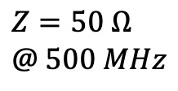







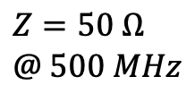







Impedance Matching
Example of a simple impedance matching for a single frequency
$$R=4 Ω$$
$$R=4 Ω$$
$$R=4 Ω$$
$$Z @ 500 MHz?$$
$$Z=50 Ω \\ @ 500 MHz$$
$$L=6.68 nF$$
$$L=6.68 nF$$
$$L=6.68 nF$$
$$Z=50 Ω \\ @ 500 MHz$$
$$Z_{series}= ?$$
$$R_{series}=46 Ω$$
$$Z=R+jωL=\left(4+j21\right) Ω$$
$$Z=R+jωL+Z_{series}=50 Ω$$
$$C_{series}=15.16 pF$$
$$Z_{series}=R_{series}+jX_{series}=50 −\left(4+j21\right) Ω$$
$$⟹ R_{series}=46 Ω$$
$$X_{series}=21 Ω=\frac{1}{ωC_{series}} ⟹ C_{series}=15.16 pF$$

Slide 3
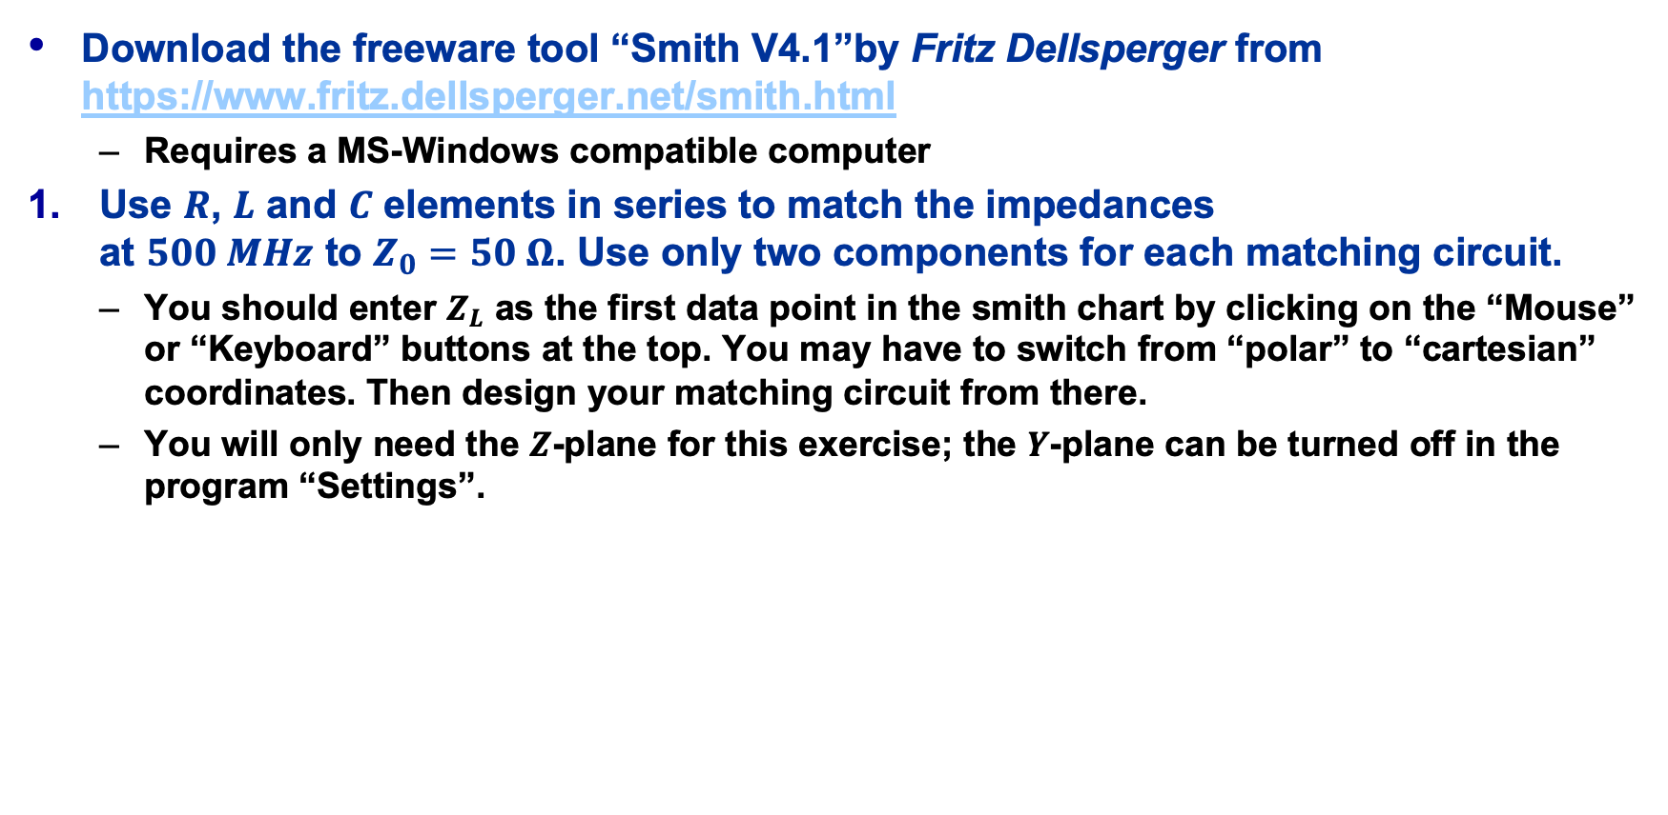
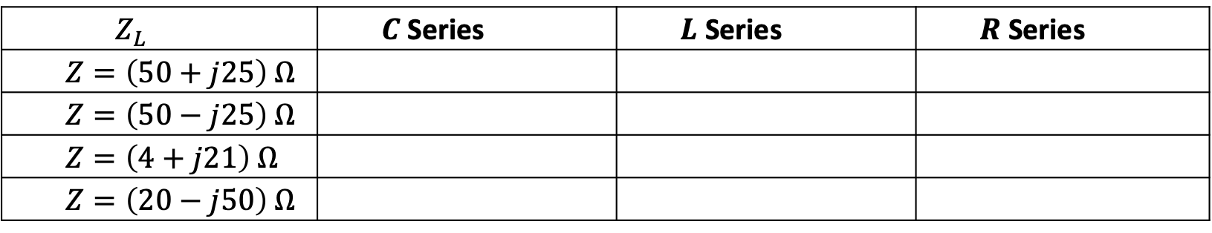
Matching Network Exercises with “Smith V4.1” (1)
Download the freeware tool “Smith V4.1”by Fritz Dellsperger from
https://www.fritz.dellsperger.net/smith.html
  Requires a MS-Windows compatible computer
Use $R$, $L$ and $C$ elements in series to match the impedances
at $500 MHz$ to $Z_{0}=50 Ω$. Use only two components for each matching circuit.
  You should enter $Z_{L}$ as the first data point in the smith chart by clicking on the “Mouse” or “Keyboard” buttons at the top. You may have to switch from “polar” to “cartesian” coordinates. Then design your matching circuit from there.
  You will only need the $Z$-plane for this exercise; the $Y$-plane can be turned off in the program “Settings”.
$$Z_{L}$$ | $C$ Series | $L$ Series | $R$ Series
$$Z=\left(50+j25\right) Ω$$
$$Z=\left(50−j25\right) Ω$$
$$Z=\left(4+j21\right) Ω$$
$$Z=\left(20−j50\right) Ω$$

Slide 4
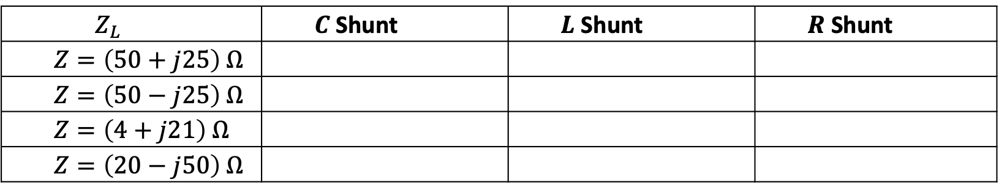

Matching Network Exercises with “Smith V4.1” (2)
Use $R$, $L$ and $C$ elements in parallel to match the impedances
at $500 MHz$ to $Z_{0}=50 Ω$. Use only two components for each matching circuit.
  Hint: You will only need the $Y$-plane for this exercise
  Another hint: Make use of “Undo” if something goes wrong or restart the program.
$$Z_{L}$$ | $C$ Shunt | $L$ Shunt | $R$ Shunt
$$Z=\left(50+j25\right) Ω$$
$$Z=\left(50−j25\right) Ω$$
$$Z=\left(4+j21\right) Ω$$
$$Z=\left(20−j50\right) Ω$$

Slide 5
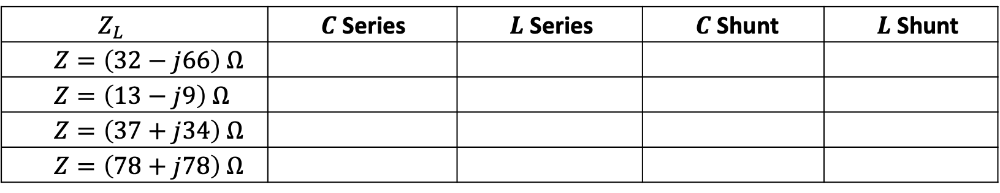
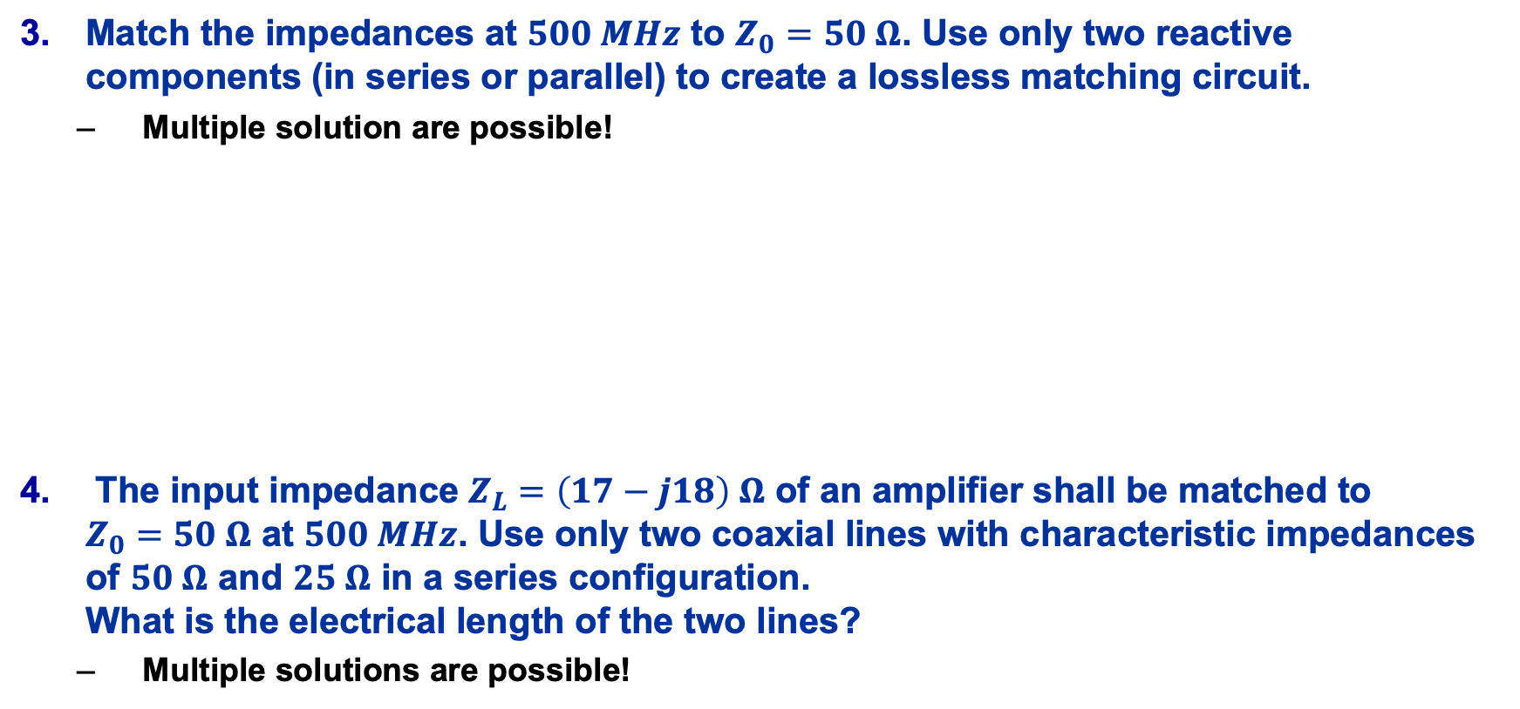
Matching Network Exercises with “Smith V4.1” (3)
Match the impedances at $500 MHz$ to $Z_{0}=50 Ω$. Use only two reactive components (in series or parallel) to create a lossless matching circuit.
  Multiple solution are possible!
The input impedance $Z_{L}=\left(17−j18\right) Ω$ of an amplifier shall be matched to
$Z_{0}=50 Ω$ at $500 MHz$. Use only two coaxial lines with characteristic impedances of $50 Ω$ and $25 Ω$ in a series configuration.
What is the electrical length of the two lines?
  Multiple solutions are possible!
$$Z_{L}$$ | $C$ Series | $L$ Series | $C$ Shunt | $L$ Shunt
$$Z=\left(32−j66\right) Ω$$
$$Z=\left(13−j9\right) Ω$$
$$Z=\left(37+j34\right) Ω$$
$$Z=\left(78+j78\right) Ω$$

