Slide 1
2025 Joint Universities Accelerator School
Superconducting Magnets
Section II
Paolo Ferracin
  (pferracin@lbl.gov)
Lawrence Berkeley National Laboratory (LBNL)

Slide 2
Outline
Section I
  Particle accelerators and magnets
  Superconductivity and practical superconductors
Section II
  Magnetic design
Section III
  Coil fabrication
  Forces, stress, pre-stress
  Support structures
Section IV
  Quench, training, protection

Slide 3
Magnetic design
Introduction
The magnetic design is one of the first steps in the a superconducting magnet development
It starts from the requirements (from accelerator physicists, researchers, medical doctors…others)
  A field “shape”
    Dipole, quadrupole, etc
  A field magnitude
    Usually with low T superconductors from 5 to 20 T
  A field homogeneity
    Uniformity inside a solenoid, harmonics in a accelerator magnet
  A given aperture (and volume)
    Some cm diameter for accelerator magnets, much more for detectors and fusion magnets

Slide 4
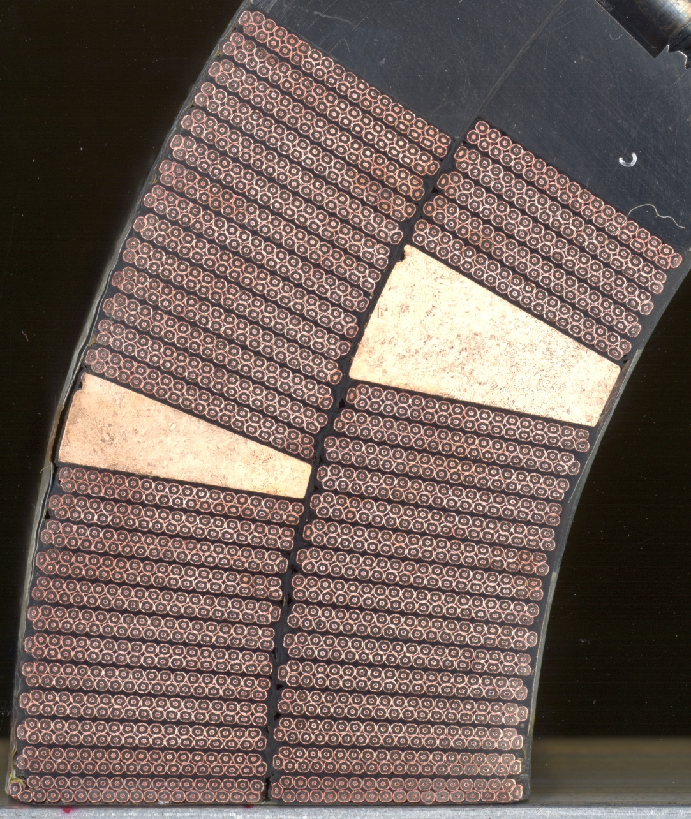
Magnetic design
How much conductor do we need to meet the requirements?
And in which configuration?
Outline
  How do we create a perfect field?
  How do we express the field and its “imperfections”?
  How do we design a coil to minimize field errors?
  Which is the maximum field we can get?
  Overview of different designs

Slide 5
References
Magnetic design
  K.-H. Mess, P. Schmuser, S. Wolff, “Superconducting accelerator magnets”, Singapore: World Scientific, 1996.
  Martin N. Wilson, "Superconducting Magnets", 1983.
  Fred M. Asner, "High Field Superconducting Magnets", 1999.
  S. Russenschuck, “Field computation for accelerator magnets”, J. Wiley & Sons (2010).
  S. Izquierdo Bermudez, “Field Quality in Nb3Sn Superconducting Accelerator Magnets”, PhD thesis, Universidad Politecnica de Madrid, CERN-THESIS-2023-080.
  P. Ferracin, E. Todesco, S. Prestemon, “Superconducting accelerator magnets”, US Particle Accelerator School, www.uspas.fnal.gov.
  E. Todesco, “Masterclass - Design of superconducting magnets for particle accelerators”, https://indico.cern.ch/category/12408/
  A. Jain, “Basic theory of magnets”, CERN 98-05 (1998) 1-26
  L. Rossi, E. Todesco, “Electromagnetic design of superconducting quadrupoles”, Phys. Rev. ST Accel. Beams 10 (2007) 112401.
  L. Rossi and Ezio Todesco, “Electromagnetic design of superconducting dipoles based on sector coils”, Phys. Rev. ST Accel. Beams 9 (2006) 102401.

Slide 6
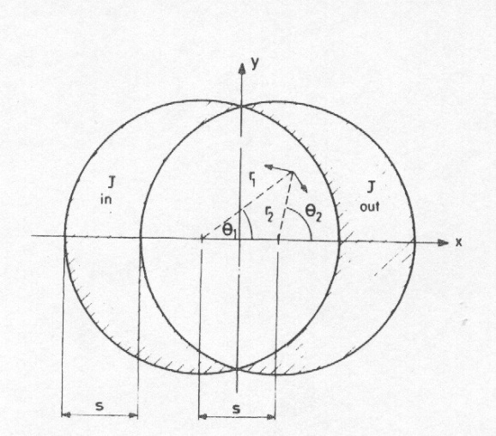
Perfect dipole field
Intercepting circles (or ellipses)
Within a cylinder carrying j₀, the field is perpendicular to the radial direction and proportional to the distance to the centre r:
  Combining the effect of two intersecting cylinders
A uniform current density in the area of two intersecting circles produces a pure dipole
  The aperture is not circular
  Not easy to simulate with a flat cable
Similar proof for intersecting ellipses
-J₀
+J₀
-J₀
+J₀
by M. Wilson

Slide 7
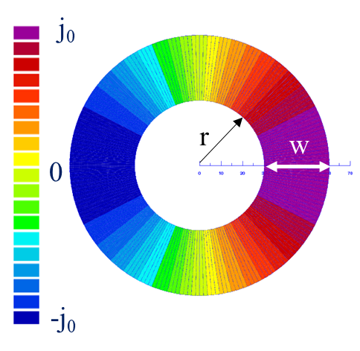

Perfect dipole field
Thick shell with cosθ current distribution
If we assume
  J = J₀ cosθ where J₀ [A/m²] is ⊥ to the cross-section plane
  Inner radius of the coil = r
  Width of the coil = w
The generated field is a pure dipole
Linear dependence on coil width
Easier to achieve with a Rutherford cable
$$B_{y}=−\frac{μ_{0}J_{0}}{2}w$$
by S. Izquierdo Bermudez

Slide 8
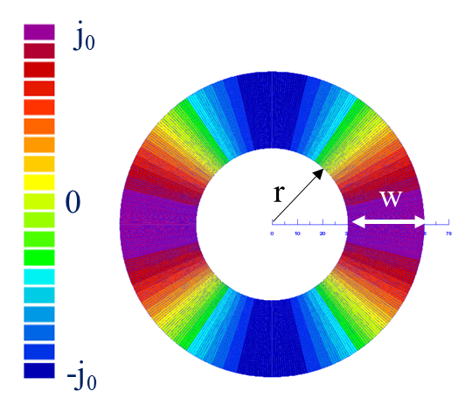
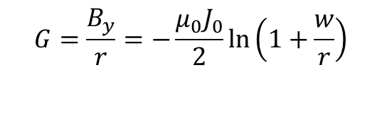
Perfect quadrupole field
Intercepting ellipses or circles
Thick shell with cos2θ current distribution
If we assume
  J = J₀ cos2θ where J₀ [A/m²] is ⊥ to the cross-section plane
  Inner radius of the coil = r
  Width of the coil = w
And so on…
  Perfect sextupoles: cos3θ or 3 intersect. ellipses
  Perfect 2n-poles: cosnθ or n intersecting ellipses
$$G=\frac{B_{y}}{r}=−\frac{μ_{0}J_{0}}{2}\ln\left(1+\frac{w}{r}\right)$$
by S. Izquierdo Bermudez

Slide 9
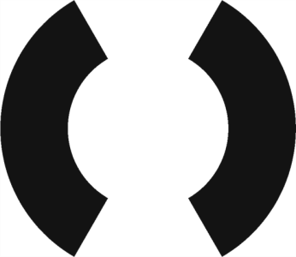
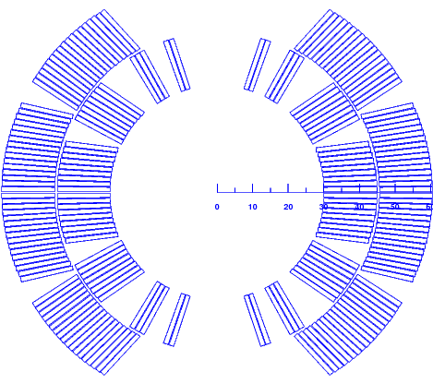
From ideal to practical configuration
How can I reproduce thick shell with a cosθ distribution with a cable?
  Rectangular cross-section and constant J
First “rough” approximation
  Sector dipole
Better ones
  More layers and wedges to reduce J towards 90°
As a result, the field is not perfect anymore
  How can I express in improve the “imperfect” field inside the aperture?

Slide 10
Magnetic design
How much conductor do we need to meet the requirements?
And in which configuration?
Outline
  How do we create a perfect field?
  How do we express the field and its “imperfections”?
  How do we design a coil to minimize field errors?
  Which is the maximum field we can get?
  Overview of different designs

Slide 11
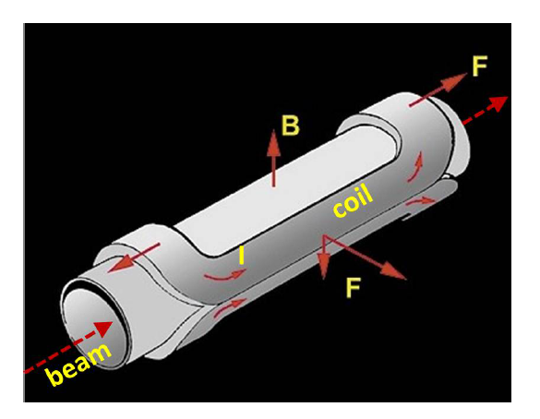
Field representation
Maxwell equations
Maxwell equations for magnetic field
In absence of charge and magnetized material
If (constant longitudinal field), then

Slide 12
Field representation
Analytic functions
If
Maxwell gives
and therefore the function B_{y}+iB_{x} is analytic
where C_{n} are complex coefficients
Advantage: we reduce the description of the field to a (simple) series of complex coefficients
Cauchy-Riemann conditions

Slide 13
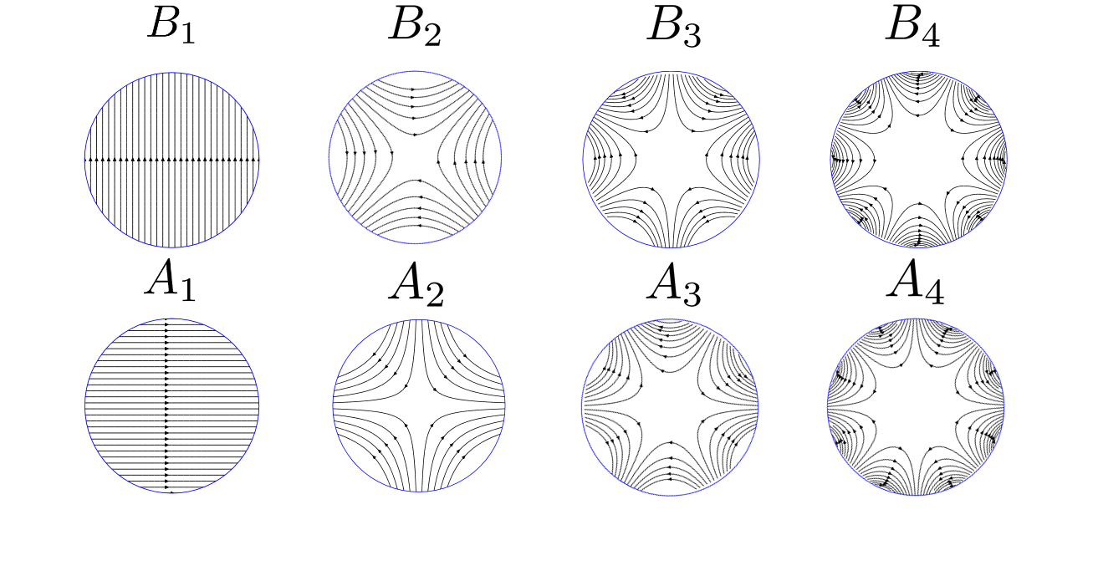
Field representation
Harmonics
What are these coefficients (or harmonics)?
For n=1→ dipole
For n=2→ quadrupole
by J.L. Rudeiros Fernandez

Slide 14
Field representation
Harmonics
So, each coefficient corresponds to a “pure” multipolar field
by J.L. Rudeiros Fernandez

Slide 15
Field representation
Harmonics
The field harmonics are rewritten as (EU notation)
  We factorize the main component (B₁ for dipoles, B₂ for quadrupoles)
  We introduce a reference radius R_{ref} to have dimensionless coefficients
  We factorize 10⁻⁴ since the deviations from ideal field are ∼0.01%
The coefficients b_{n}, a_{n} are called normalized multipoles
  b_{n} are the normal, a_{n} are the skew (adimensional)

Slide 16
Field representation
Harmonics
The coefficients b_{n}, a_{n} are called normalized multipoles
  b_{n} are the normal, a_{n} are the skew (adimensional)
Reference radius is usually chosen as 2/3 of the aperture radius

Slide 17
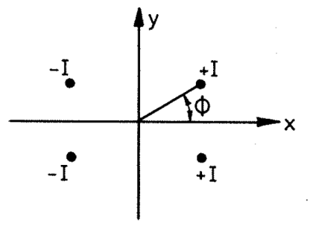

Field representation
Harmonics
One can demonstrate that with line currents with a dipole or a quadrupole symmetry, most of the multipoles cancelled
For n=1→ dipole
  Only b₃, b₅, b₇, ….. are present
For n=2→ quadrupole
  Only b₆, b₁₀, b₁₄, ….. are present
…and so on
These multipoles are called allowed multipoles
The field quality optimization of a coil lay-out concerns only a few quantities
  For a dipole, usually b3 , b5 , b7 , and possibly b9 , b11
K.-H. Mess, et al, [4]
by K.-H. Mess, et al.

Slide 18
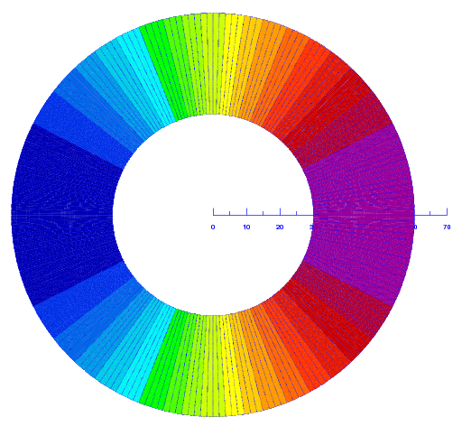
Back to the original issue:
From ideal to practical configuration
How can I reproduce thick shell with a cosθ distribution with a cable?
  Rectangular cross-section and constant J
First “rough” approximation
  Sector dipole
Better ones
  More layers and wedges to reduce J towards 90°
Now, I can use the multipolar expansion to optimize my “practical” cross-section

Slide 19
Magnetic design
How much conductor do we need to meet the requirements?
And in which configuration?
Outline
  How do we create a perfect field?
  How do we express the field and its “imperfections”?
  How do we design a coil to minimize field errors?
  Which is the maximum field we can get?
  Overview of different designs

Slide 20
A “good” field quality dipole
Sector dipole
We compute the central field given by a sector dipole with uniform current density j
We start from Biot-Savart law and integrate
And we obtain
Multipoles n are proportional to sin (n angle of the sector)
  They can be made equal to zero !

Slide 21
A “good” field quality dipole
Sector dipole
First allowed multipole B₃ (sextupole)
  for α=π/3 (i.e. a 60° sector coil) one has B₃=0
Second allowed multipole B₅ (decapole)
  for α=π/5 (i.e. a 36° sector coil) or for α=2π/5 (i.e. a 72° sector coil)
  one has B₅=0
  With one sector one cannot set to zero both multipoles … let us try with more sectors !

Slide 22
A “good” field quality dipole
Sector dipole
Coil with two sectors
  Note: we have to work with non-normalized multipoles, which can be added together
Equations to set to zero B_{3 ,} B₅ and B₅
  There is a one-parameter family of solutions, for instance (48°,60°,72°) or (36°,44°,64°) are solutions

Slide 23
A “good” field quality dipole
Sector dipole
With one wedge one can set to zero three multipoles (B₃, B₅ and B₇)
What about two wedges ?
  One can set to zero five multipoles (B₃, B₅, B₇ , B₉ and B₁₁) ~[0°-33.3°, 37.1°- 53.1°, 63.4°- 71.8°]
One wedge, b₃=b₅=b₇=0
[0°-43.2°,52.2°-67.3°]
Two wedges, b₃=b₅=b₇=b₉=b₁₁=0
[0°-33.3°,37.1°-53.1°,63.4°- 71.8°]

Slide 24
A “good” field quality dipole
Sector dipole
Let us see two coil lay-outs of real magnets
  The RHIC dipole has four blocks

Slide 25
A “good” field quality dipole
Sector dipole
Limits due to the cable geometry
  Finite thickness → one cannot produce sectors of any width
  Cables cannot be key-stoned beyond a certain angle, some wedges can be used to better follow the arch
One does not always aim at having zero multipoles
  There are other contributions (iron, persistent currents …)

Slide 26
A “good” field quality dipole
Sector quadrupole
For a sector coil with one layer, the same results of the dipole case hold with the following transformation
  Angles have to be divided by two
  Multipole orders have to be multiplied by two
First allowed multipole B₆ (dodecapole)
  for α=π/6 (i.e. a 30° sector coil) one has B₆=0

Slide 27
Magnetic design
How much conductor do we need to meet the requirements?
And in which configuration?
Outline
  How do we create a perfect field?
  How do we express the field and its “imperfections”?
  How do we design a coil to minimize field errors?
  Which is the maximum field we can get?
  Overview of different designs

Slide 28
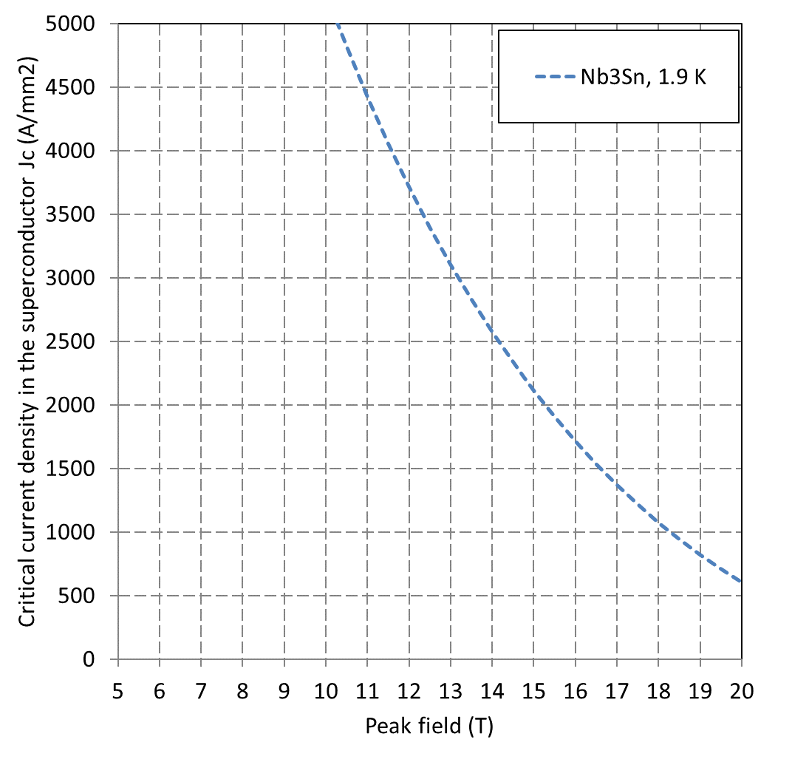
Maximum field and coil thickness
Dipoles
We recall the critical surface
The current density flowing in the insulated cable is reduced by a factor κ (filling ratio)
  It ranges from ¼ to 1/3

Slide 29
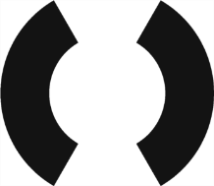
Maximum field and coil thickness
Dipoles
We characterize the coil by two parameters
  γ_{c}: how much field in the centre is given per unit of current density
    For a sector dipole
  λ: ratio between peak field and central field
    For a sector and in general is λ= 1.05 - 1.15
    hyperbolic fit: a~0.045

Slide 30
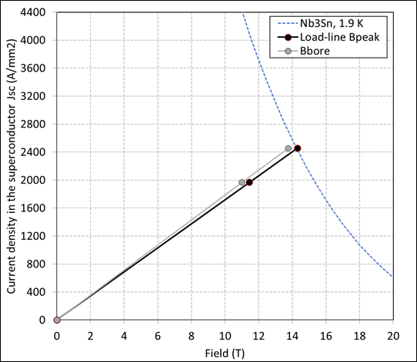
Maximum field and coil thickness
Dipoles
We can now compute what is the highest peak field that can be reached in the dipole
The maximum current density in the superconductor
  short sample limit
And the bore short sample field (in the centre not on the conductor)

Slide 31
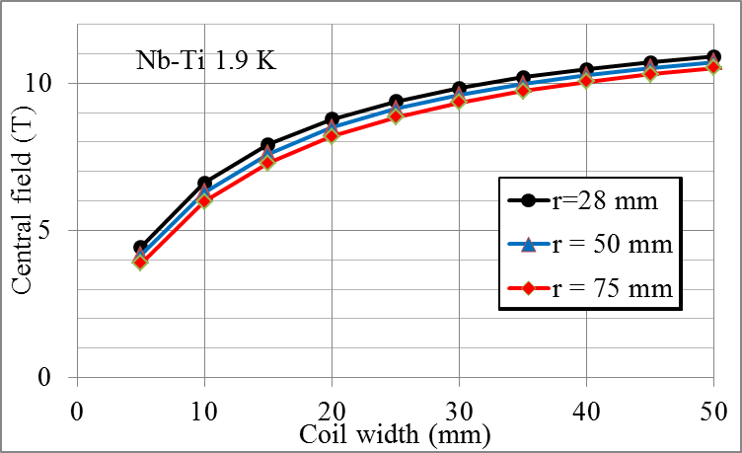
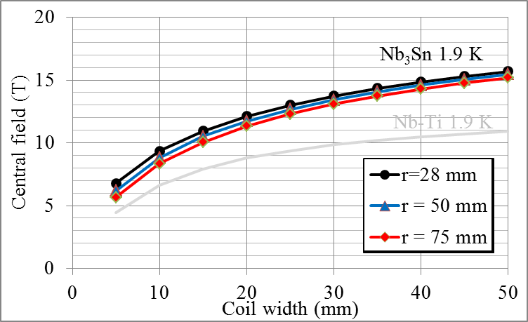
Maximum field and coil thickness
Dipoles
Maximum bore field
Magnets have to work at a given distance from the critical surface, i.e. they are never operated at short sample conditions
  At short sample, any small perturbation quenches the magnet
  One usually operates at a fraction of the loadline: 60% to 90%

Slide 32
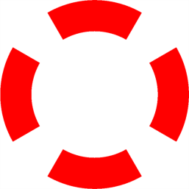
Maximum gradient and coil thickness
Quadrupoles
We characterize the coil by two parameters
  γ_{c}: how much gradient is given per unit of current density
    For a sector quadrupole
  λ: ratio between peak field and gradient ⋅ r
    A good fit, with a₋₁~0.04 and a₁~0.11 is
    reasonable values is λ~λ₀=1.15

Slide 33
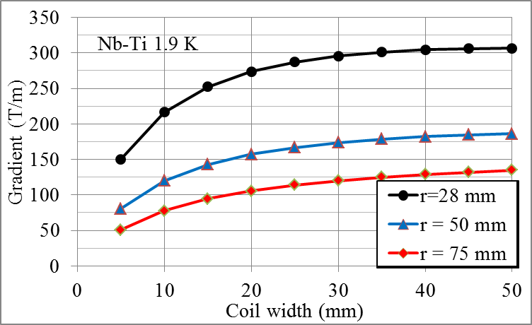
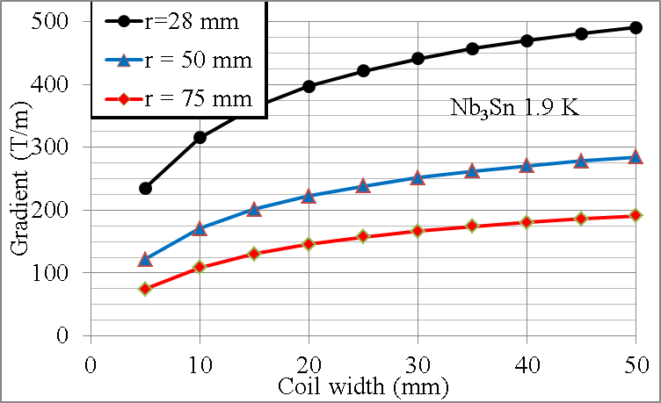
Maximum gradient and coil thickness
Quadrupoles
Therefore, the maximum field, current and gradient
Unlike dipoles, no point in making coils extremely large!

Slide 34
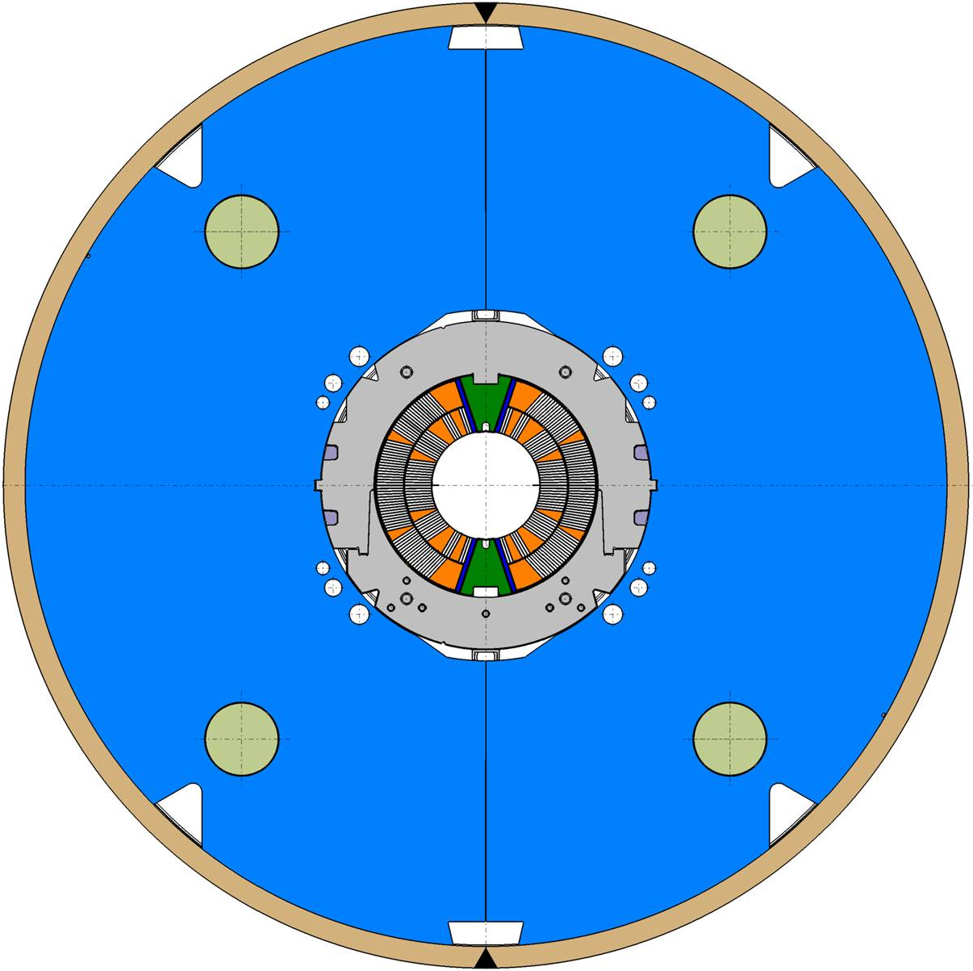
Iron yoke
Keep the return magnetic flux close to the coils, thus avoiding fringe fields
In some cases the iron is partially or totally contributing to the mechanical structure
Considerably enhance the field for a given current density
  The increase is relevant (10-30%), getting higher for thin coils
  This allows using lower currents, easing the protection

Slide 35
Iron yoke
A rough estimate of the iron thickness necessary to avoid fields outside the magnet
  The iron cannot withstand more than 2 T
  Shielding condition for dipoles:
    i.e., the iron thickness times 2 T is equal to the central field times the magnet aperture – One assumes that all the field lines in the aperture go through the iron (and not for instance through the collars)
    Example: in the LHC main dipole the iron thickness is 150 mm
  Shielding condition for quadrupoles:

Slide 36
Iron yoke
The iron yoke contribution can be estimated analytically for simple geometries
  Circular, non-saturated iron: image currents method
  Iron effect is equivalent to add to each current line a second one
    at a distance
    with current
  Limit of the approximation: iron
  is not saturated (less than 2 T)

Slide 37
Iron yoke
Impact of the iron yoke on short sample field
  Large effect (25%) on RHIC dipoles (thin coil and collars)
  Between 4% and 10% for most of the others
  (both Nb-Ti and Nb₃Sn)
D20 and yoke
RHIC main dipole and yoke

Slide 38
Iron yoke
Similar approach can be used in quadrupoles
  Large effect on RHIC quadrupoles (thin coil and collars)
  Between 2% and 5% for most of the others
  The effect is smaller than in dipoles since the
  contribution to B₂ is smaller than to B₁

Slide 39
Magnetic design
How much conductor do we need to meet the requirements?
And in which configuration?
Outline
  How do we create a perfect field?
  How do we express the field and its “imperfections”?
  How do we design a coil to minimize field errors?
  Which is the maximum field we can get?
  Overview of different designs

Slide 40
A review of dipole lay-outs
Tevatron MB

Slide 41
A review of dipole lay-outs
RHIC MB

Slide 42
A review of dipole lay-outs
HERA MB

Slide 43
A review of dipole lay-outs
SSC MB

Slide 44
A review of dipole lay-outs
HFDA dipole

Slide 45
A review of dipole lay-outs
LHC MB

Slide 46
A review of dipole lay-outs
FRESCA

Slide 47
A review of dipole lay-outs
MSUT

Slide 48
A review of dipole lay-outs
D20

Slide 49
A review of dipole lay-outs
HD2

Slide 50
Review of quadrupole lay-outs
RHIC MQX

Slide 51
Review of quadrupole lay-outs
RHIC MQ

Slide 52
Review of quadrupole lay-outs
LEP II MQC

Slide 53
Review of quadrupole lay-outs
LEP I MQC

Slide 54
Review of quadrupole lay-outs
Tevatron MQ

Slide 55
Review of quadrupole lay-outs
HERA MQ

Slide 56
Review of quadrupole lay-outs
LHC MQM

Slide 57
Review of quadrupole lay-outs
LHC MQY

Slide 58
Review of quadrupole lay-outs
LHC MQXB

Slide 59
Review of quadrupole lay-outs
SSC MQ

Slide 60
Review of quadrupole lay-outs
LHC MQ

Slide 61
Review of quadrupole lay-outs
LHC MQXA

Slide 62
Review of quadrupole lay-outs
LHC MQXC

Slide 63
Review of quadrupole lay-outs
LARP HQ

Slide 64
Appendix

Slide 65
Field representation
Harmonics
Important property: starting by the multipolar expansion of a current line (Biot-Savart law)

Slide 66
A “good” field quality dipole
Sector quadrupole
Let’s look at the quadrupoles
First allowed multipole B₆ (dodecapole)
  for α=π/6 (i.e. a 30° sector coil) one has B₆=0
Second allowed multipole B₁₀
  for α=π/10 (i.e. a 18° sector coil) or for α=π/5 (i.e. a 36° sector coil)
  one has B₁₀=0
The conditions look similar to the dipole case …

Slide 67

Maximum field and coil thickness
Dipoles
We recall the equations for the critical surface
  Nb-Ti (linear approximation)
    with s~6.0×10⁸ [A/(T m²)] and B*_{c2}~10 T at 4.2 K or 13 T at 1.9 K
The current density flowing in the insulated cable is reduced by a factor κ (filling ratio)
  It ranges from ¼ to 1/3

Slide 68
Maximum field and coil thickness
Dipoles
We characterize the coil by two parameters
  γ_{c}: how much field in the centre is given per unit of current density
    For a sector dipole
  λ: ratio between peak field and central field
    For a sector and in general is λ= 1.05 - 1.15
    hyperbolic fit: a~0.045

Slide 69
Maximum field and coil thickness
Dipoles
We can now compute what is the highest peak field that can be reached in the dipole
The maximum current density in the superconductor
  short sample limit
And the bore short sample field (in the centre not on the conductor)

Slide 70
Maximum gradient and coil thickness
Quadrupoles
Therefore, the maximum field, current and gradient
Unlike dipoles, no point in making coils extremely large!

