Slide 1
2025 Joint Universities Accelerator School
Exercise on
Superconducting Magnets
Case study
Paolo Ferracin
  (pferracin@lbl.gov)
Lawrence Berkeley National Laboratory (LBNL)

Slide 2
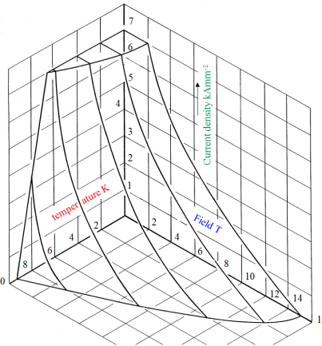
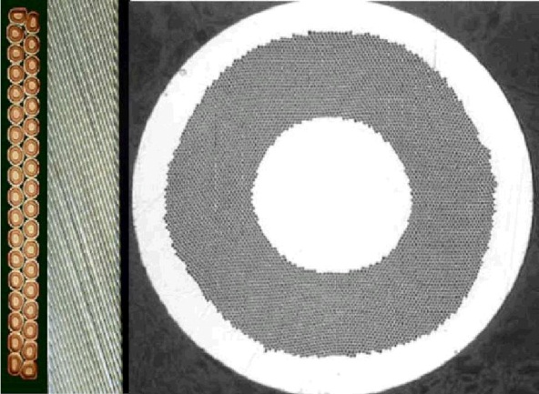
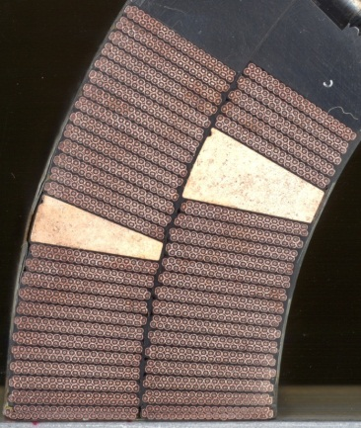
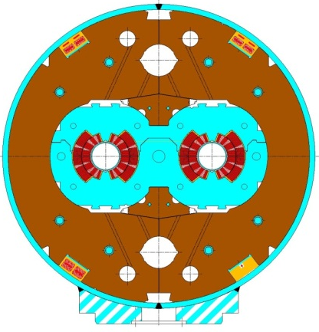
Case study introduction
Goal: outline design of a superconducting magnet
  Apply the theory explained during lectures to a practical case
  Solve a case study using analytical formulas, “back of the envelope” calculation, plots, data, etc. provided during the presentations
    From the superconducting material to the full magnet
  Understand physics and reasoning behind design options
    General dimensions, orders of magnitude of different parameters
Superconducting material
Superconducting strand
Superconducting cable
Superconducting coil
Superconducting magnet

Slide 3
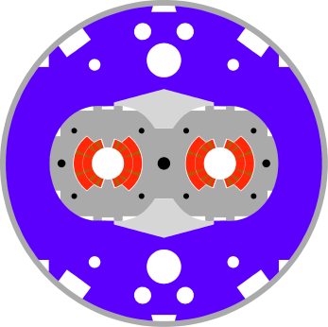
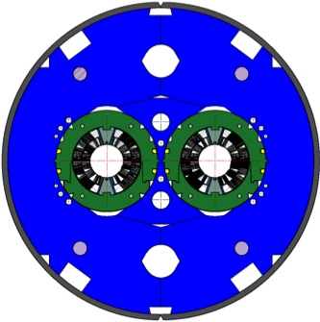

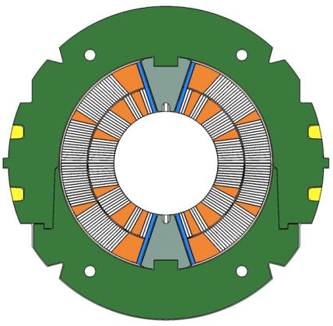
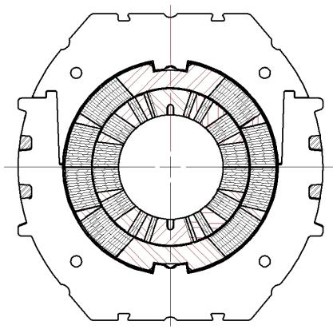

Case study
11 T Nb₃Sn dipole for the LHC collimation upgrade
14.3 m
Nb-Ti 8.3 T
5.5 m
Nb₃Sn 11 T
5.5 m Nb₃Sn
1 m Collimator
5.5 m Nb₃Sn
Second long shutdown: increase of collimation efficiency
  New collimation units
  Some 8.3 T Nb-Ti dipoles replaced by 11 T Nb₃Sn dipoles
  FNAL/CERN collaboration

Slide 4
Case study
11 T Nb₃Sn dipole for the LHC collimation upgrade
  Introduction
    The second phase of the LHC collimation upgrade will enable proton and ion beam operation at nominal and ultimate intensities.
    To improve the collimation efficiency by a factor 15–90, additional collimators are foreseen in the room temperature insertions and in the dispersion suppression (DS) regions.
    To provide longitudinal space of about 3.5 m for additional collimators, a solution based on the substitution of a pair of 5.5-m-long 11 T dipoles for several 14.3-m-long 8.33 T LHC main dipoles (MB) is being considered.
  Goal
    Design a Nb₃Sn superconducting dipole with an 60 mm aperture and a operational field (80% of the current limit I_{ss}) at 1.9 K of 11 T.

Slide 5
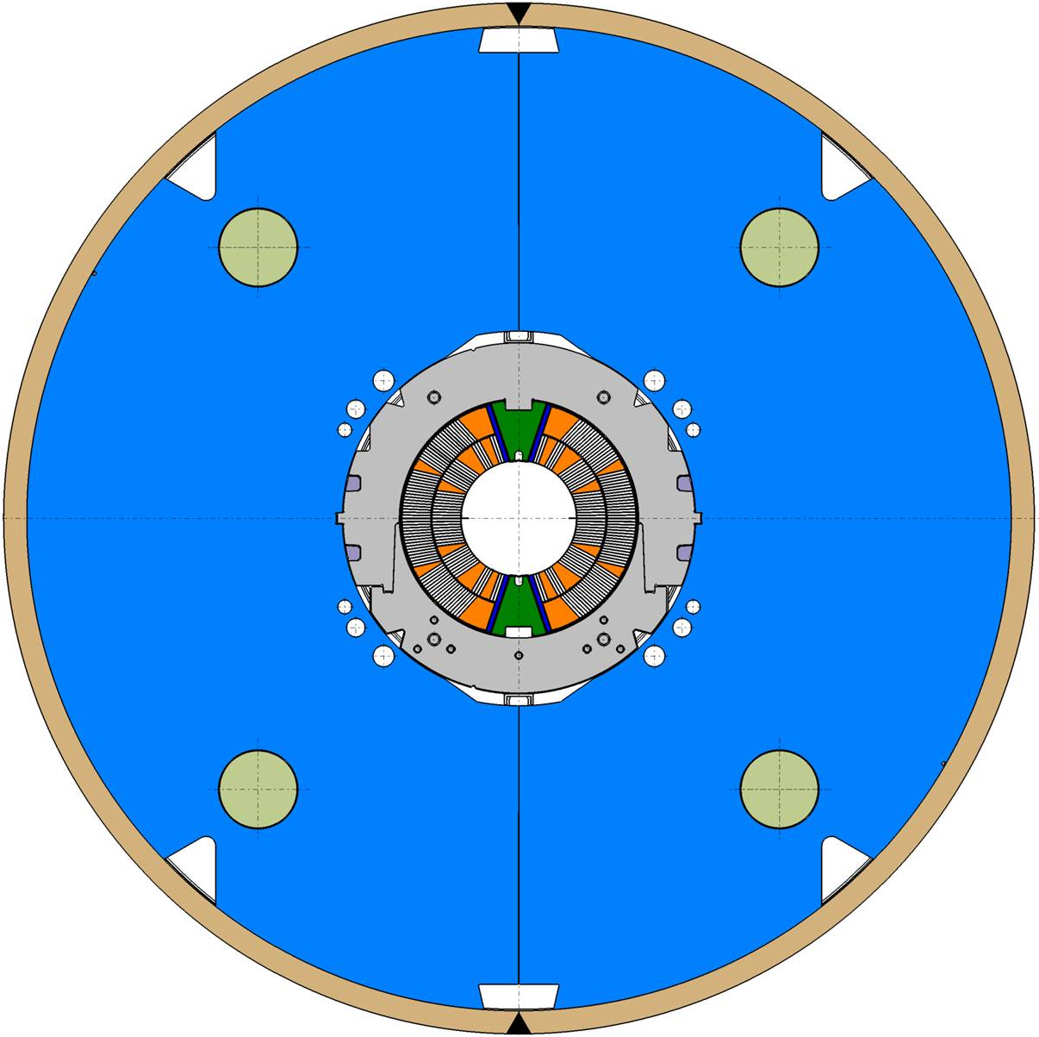
Case study
11 T Nb₃Sn dipole for the LHC collimation upgrade

Slide 6
Case study
11 T Nb₃Sn dipole for the LHC collimation upgrade
  Questions
    Determine and plot critical curves (J_{sc} vs. B) for Nb₃Sn and Nb-Ti at 1.9 K
    Determine coil filling factor (J₀ /J_{sc} ratio or A_{non-Cu_cable}/A_{insulated_cable})
    Compute load-line (J_{sc} vs. B) for a
      Sector coil (60°) with constant current density
    Determine coil size, operational (80% of I_{ss} ), conditions, “short-sample” conditions, and margins
      w
      j_{sc_ss} , j_{o_ss} , B_{bore_ss} , B_{peak_ss}
      j_{sc_op}, j_{o_op} , B_{bore_op} , B_{peak_op}
      T, j_{sc} , B_{peak} margins
    Compare “short sample”, “operational” conditions and margins if the same design uses Nb-Ti superconducting technology with the same coil size w
    Determine e.m forces F_{x} and F_{y} and the accumulated stress on the coil mid-plane in the operational conditions
    Evaluate dimension of collars, iron yoke, and shrinking cylinder, assuming that the support structure is designed to reach 90% of I_{ss}

Slide 7
Case study
11 T Nb₃Sn dipole for the LHC collimation upgrade
  Question
    Determine and plot critical curves (J_{sc} vs. B) for Nb₃Sn and Nb-Ti at 1.9 K

Slide 8
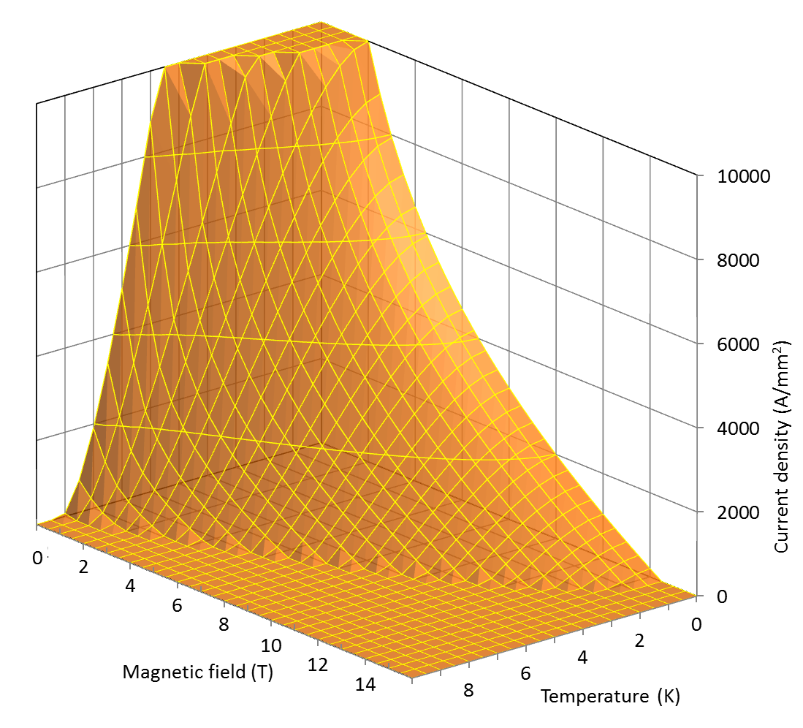
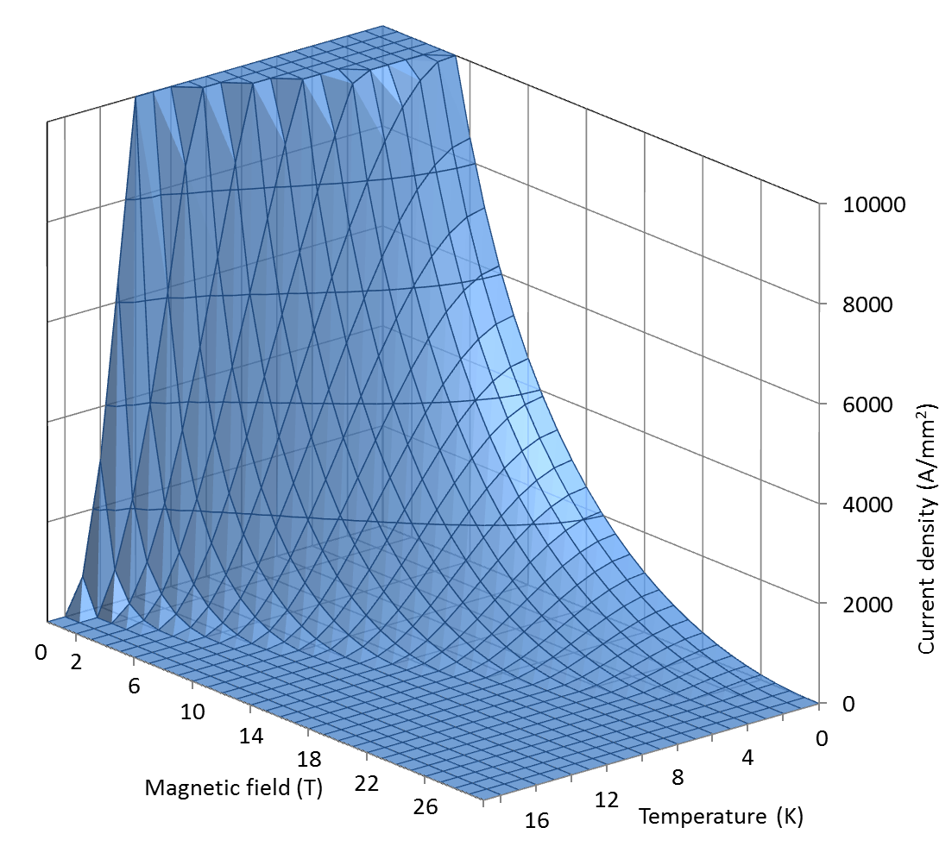
Nb-Ti and Nb₃Sn
Critical surfaces
The critical surface defines the boundaries between superconducting state and normal conducting state in the space defined by temperature, magnetic field, and current densities.
The surface, determined experimentally, can be fitted with parameterization curves.
Nb₃Sn
Nb-Ti

Slide 9
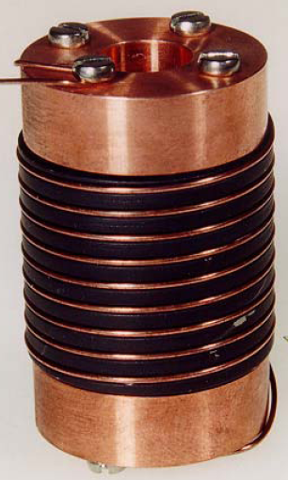
Measurements of the conductor critical current
The critical current of a conductor is measured by winding a sample of the wire around a sample holder.
To avoid premature quenching induced by Lorentz forces during ramping, the wire must be well supported
  Stycast glue may be used to constrain the wire around the holder
In case of Nb₃Sn wires, a sample holder made of titanium is used.
Once the wire is cooled-down and placed in a given magnetic field, the current is increased until the transition occurs.

Slide 10
Nb-Ti parameterization curve
(LHC dipole)
Nb-Ti parameterization
  Temperature and field dependence of B_{C2} and T_{C} are provided by Lubell’s formulae:
  where B_{C20} is the upper critical flux density at zero temperature (14.5 T), and T_{C0} is critical temperature at zero field (9.2 K)
  Temperature and field dependence of Jc is given by Bottura’s formula
  where J_{C,Ref} is critical current density at 4.2 K and 5 T (3000 A/mm²) and C_{Nb-Ti} (27 T), α_{Nb-Ti} (0.63), β_{Nb-Ti} (1.0), and γ_{Nb-Ti} (2.3) are fitting parameters.
α

Slide 11
Nb₃Sn parameterization curve
(typical values for HEP magnets)
Nb₃Sn parameterization
  Temperature, field, and strain dependence of Jc is given by Summers’ formula
  where α_{Nb3Sn} is 900 for ε = -0.003, T_{Com} is 18 K, B_{C20m} is 27.6 T, and C_{Nb3Sn,0} is a fitting parameter equal to 43100000000 AT^{1/2}mm⁻² for a Jc=2900 A/mm² at 4.2 K and 12 T.
  Assume ε = 0.000

Slide 12
Parameterization curves
References
  M.S. Lubell, “Empirical scaling formulas for critical current and critical fields for commercial NbTi,” IEEE Trans. Magn., Vol. MAG-19 No. 3, pp. 754–757, 1983.
  L. Bottura, “A practical fit for the critical surface of NbTi,” IEEE Trans. Appl. Supercond., Vol. 10, No. 1, pp. 1054–1057, 2000.
  L.T. Summers, M.W. Guinan, J.R. Miller and P.A. Hahn, “A model for the prediction of Nb₃Sn critical current as a function of field, temperature, strain and radiation damage,” IEEE Trans. Magn., Vol. 27, No. 2, pp. 2041–2044, 1991.

Slide 13
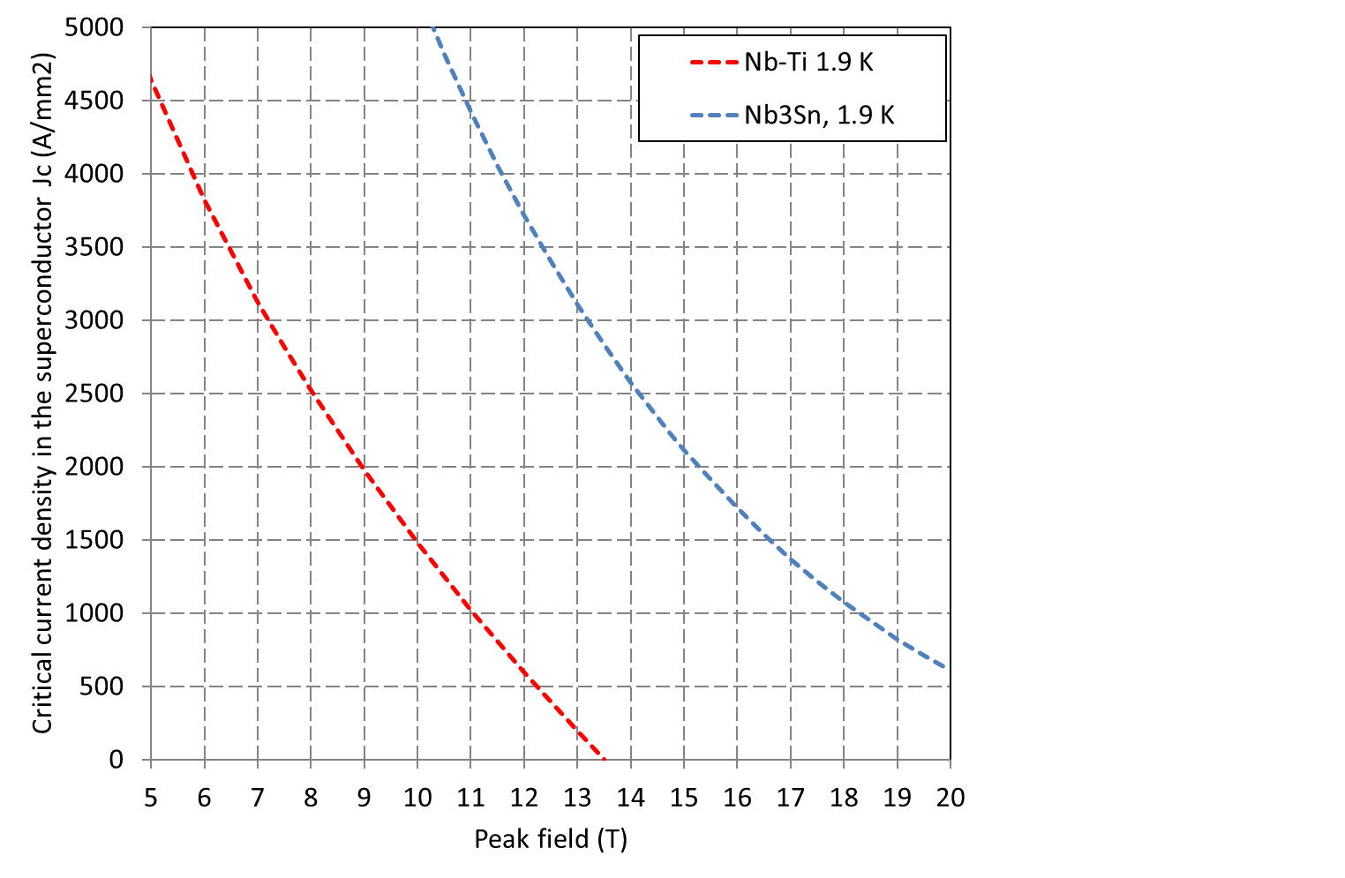
Nb-Ti and Nb₃Sn critical curves at 1.9 K

Slide 14
Case study
11 T Nb₃Sn dipole for the LHC collimation upgrade
  Question
    Determine coil filling factor (J₀ /J_{sc} ratio or A_{non-Cu_cable}/A_{insulated_cable})

Slide 15

Superconducting cables and coils

Slide 16

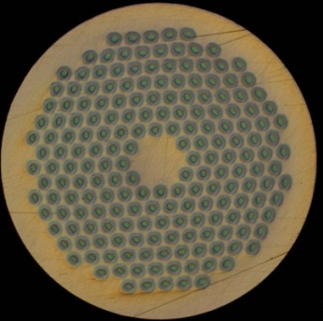
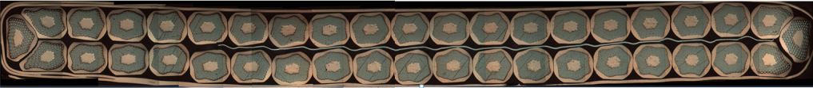
J₀ /J_{sc} ratio
The cable design parameters are:
  Number of wires N_{wire}
  Wire diameter d_{wire}
  Cable mid-thickness t_{cable}
  Cable width w_{cable}
  (Cu/non-Cu) ratio
  Insulation thickness
  Pitch angle
    To be neglected in this comp.

Slide 17
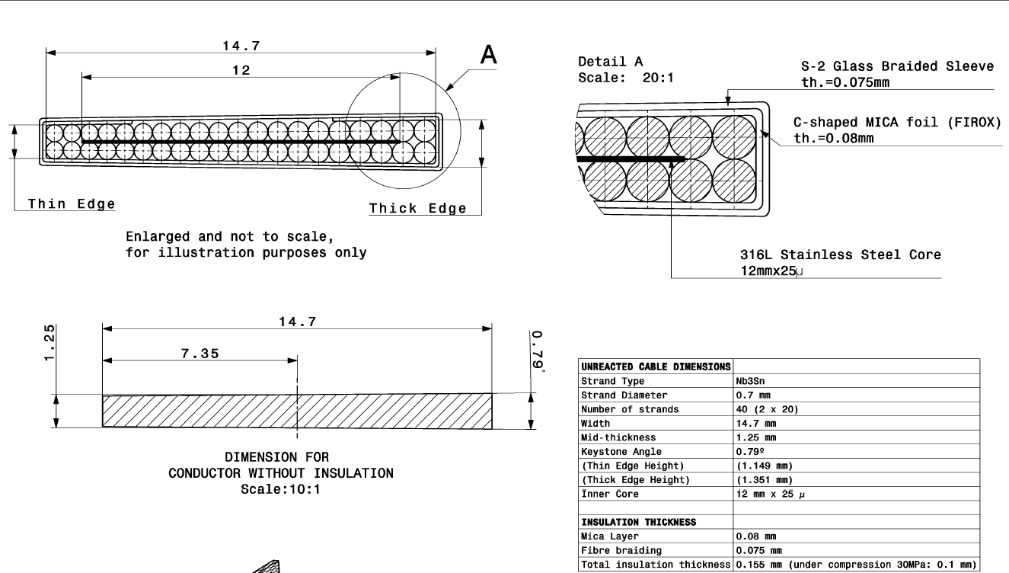
J₀ vs. J_{sc}
Cu to non-Cu ratio: 1.2

Slide 18
J₀ vs. J_{sc}

Slide 19
Case study
11 T Nb₃Sn dipole for the LHC collimation upgrade
  Question
    Compute load-line (J_{sc} vs. B) for a
      Sector coil (60°) with constant current density
    Determine coil size, operational (80% of I_{ss} ), conditions, “short-sample” conditions, and margins
      w
      j_{sc_ss} , j_{o_ss} , B_{bore_ss} , B_{peak_ss}
      j_{sc_op}, j_{o_op} , B_{bore_op} , B_{peak_op}
      T, j_{sc} , B_{peak} margins
    Compare “short sample”, “operational” conditions and margins if the same design uses Nb-Ti superconducting technology with the same coil size w

Slide 20
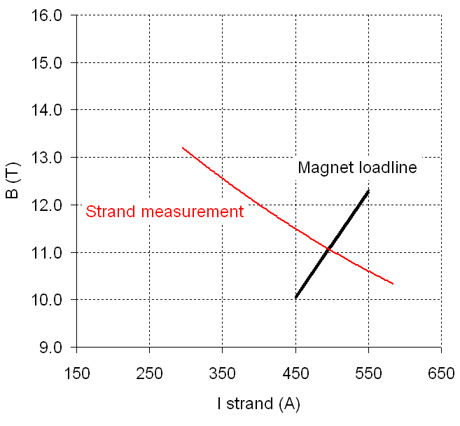
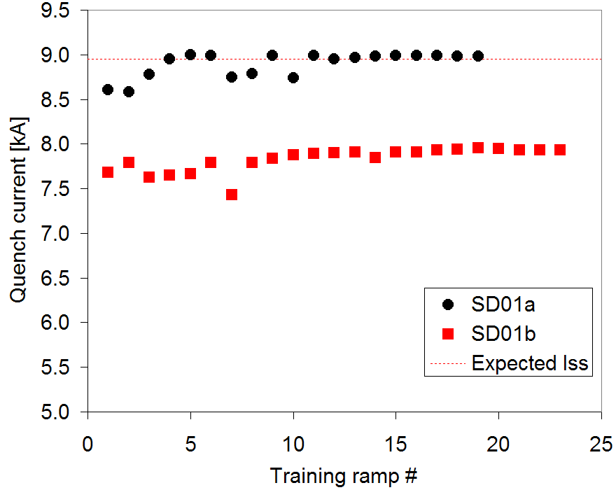
Short sample and operational current
Short sample current
  The critical current is measured in few different conditions of temperature and field. By fitting the data with known parameterizations, the entire critical surface can be reconstructed.
If the magnet reaches the maximum current computed through the intersection of the measured critical surface and the load line, i.e. I_{max} = I_{ss}, one can declare victory (at least from the quench performance point of view).
If the magnet maximum current I_{max} is lower that I_{ss} , the quench performance is expressed in term of fraction of short sample (I_{max}/I_{ss}).
Usually magnets are designed to operate at I_{op} = 0.8 I_{ss} or below.

Slide 21
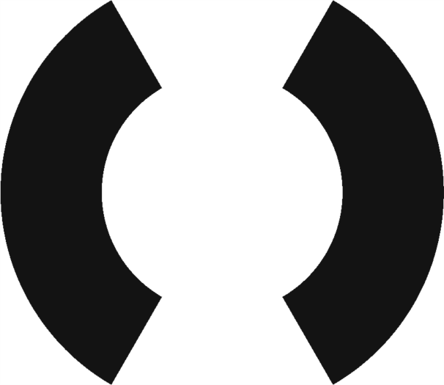
Computation of the load line
Approximations of practical winding cross-sections
Sector coil
  Current density J = J₀ (A per unit area) on a a sector with a maximum angle θ = 60º for a dipole

Slide 22
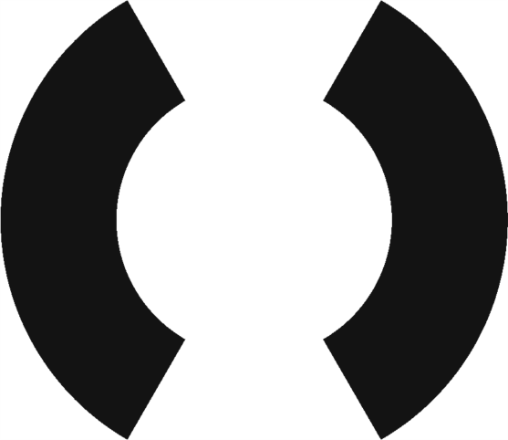
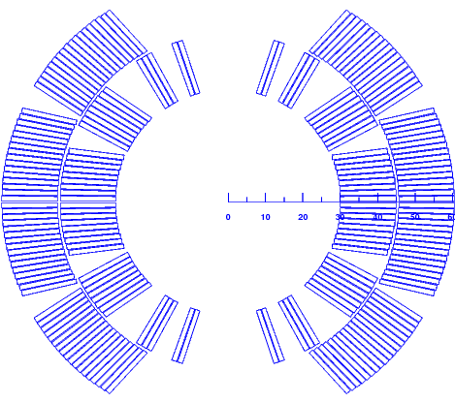
Approximations of practical winding cross-sections

Slide 23
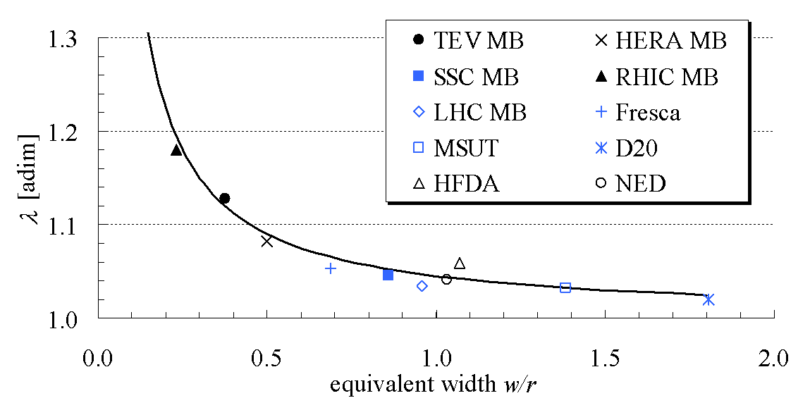
Computation of the load line
Approximations of practical winding cross-sections
Sector coil
  Current density J = J₀ (A per unit area) on a a sector with a maximum angle θ = 60º for a dipole
  Where, B_{bore} is the bore field, j₀ is overall current density and w is the coil width
  “Less ideal” case
    B_{peak} = B_{bore}· ~1.04
    “Not so perfect” field quality
      b₃ = 0
B_{peak}/B_{bore}
L. Rossi, E. Todesco, “Electromagnetic design of superconducting quadrupoles”, Phys. Rev. ST Accel. Beams 9 (2006) 102401.
With a w/r of 30/30 = 1 ➔1.04

Slide 24
Computation of the load line
Sector coil
B_{bore_op} = 11 T
B_{bore_ss} = B_{bore_op} /0.8 = 13.75 T
B_{peak_ss} = B_{bore_ss}· 1.04 = 14.3 T

Slide 25
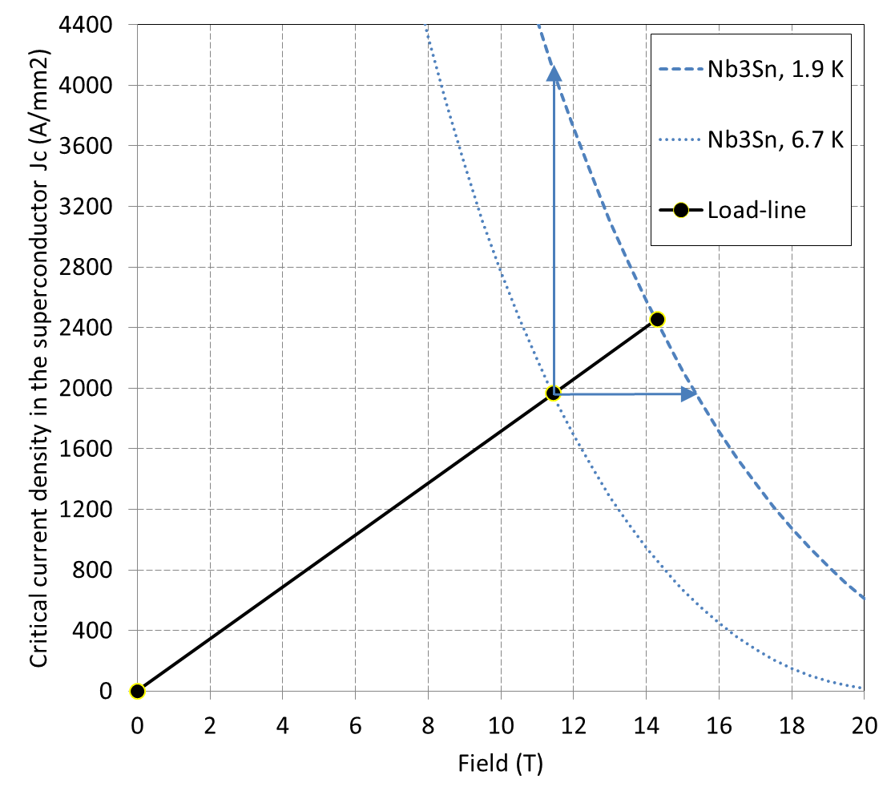
Computation of the load line
Sector coil
B_{bore_op} = 11 T
B_{bore_ss} = B_{bore_op} /0.8 = 13.75 T
B_{peak_ss} = B_{bore_ss}· 1.04 = 14.3 T
From the critical curve
  j_{sc_ss} = 2460 A/mm²
Therefore
  w = 25.25 mm
Results
  j_{sc_ss} = 2460A/mm²
  j_{o_ss} = j_{sc_ss} * λ = 786 A/mm²
  B_{bore_ss} = 13.75 T
  B_{peak_ss} = 14.3 T
  j_{sc_op} = 1965 A/mm²
  j_{o_op} = j_{sc_op} * λ = 629 A/mm²
  B_{bore_op} = 11 T
  B_{peak_op} = 11.44 T
  j_{sc_margin} = 2140 A/mm²
  B_{peak_margin} = 4 T
  T_{margin} = 6.7 K

Slide 26
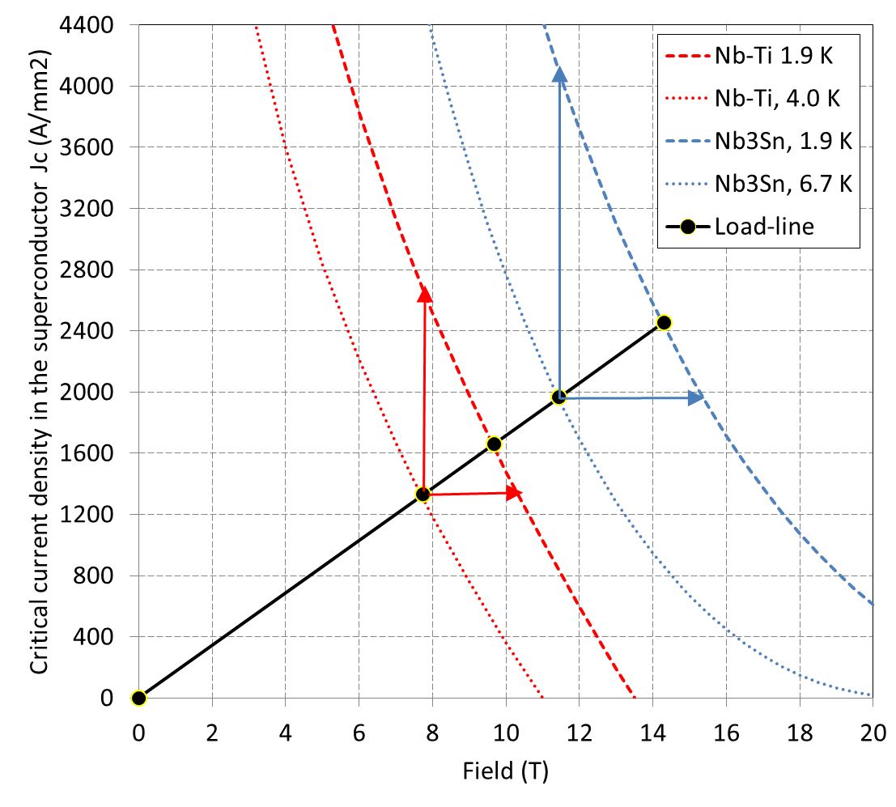
Nb₃Sn vs. Nb-Ti
Sector coil
Nb-Ti parameters
w = 25.25 mm
Results
  j_{sc_ss} = 1660 A/mm²
  j_{o_ss} = j_{sc_ss} * λ = 532 A/mm²
  B_{bore_ss} = 9.3 T
  B_{peak_ss} = 9.7 T
  j_{sc_op} = 1330 A/mm²
  j_{o_op} = j_{sc_op} * λ = 425 A/mm²
  B_{bore_op} = 7.45 T
  B_{peak_op} = 7.74 T
  J_{margin} = 1370 A/mm²
  B_{margin} = 2.5 T
  T_{margin} = 2.1 K

Slide 27
Comparison

Slide 28
Case study
11 T Nb₃Sn dipole for the LHC collimation upgrade
  Question
    Determine e.m forces F_{x} and F_{y} and the accumulated stress on the coil mid-plane in the operational conditions with sector coil approximation

Slide 29
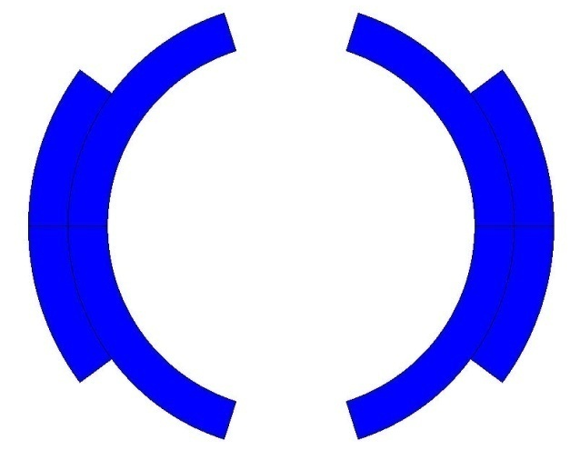
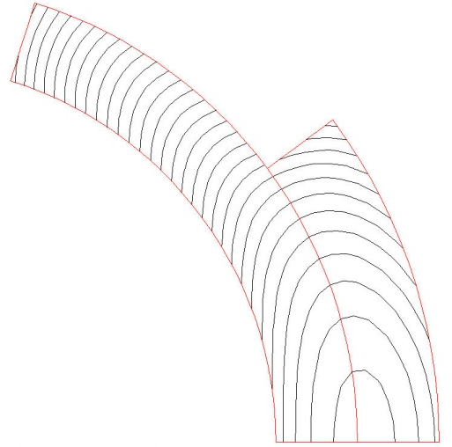
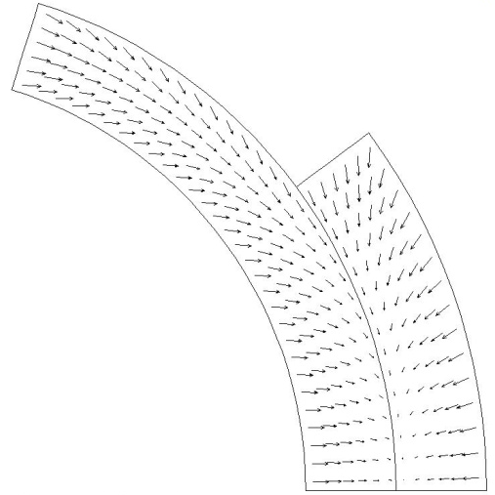
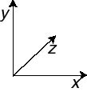
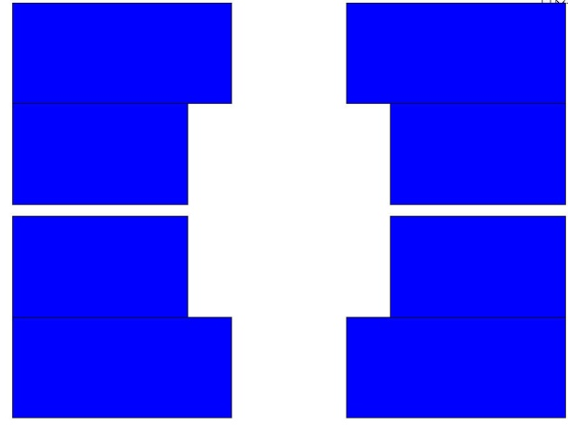
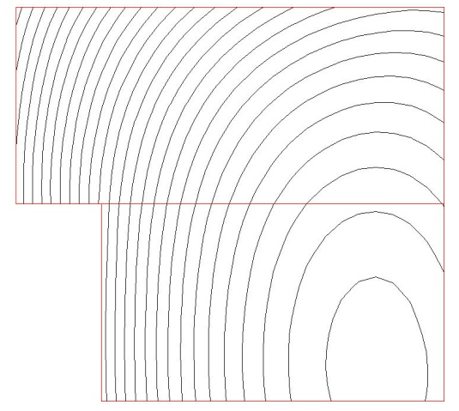
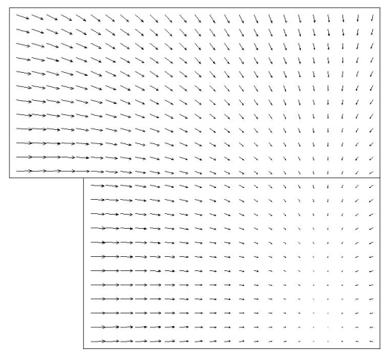
E.m. forces and stresses
The e.m. forces in a dipole magnet tend to push the coil
  Towards the mid plane in the vertical-azimuthal direction (F_{y}, F_{θ} < 0)
  Outwards in the radial-horizontal direction (F_{x}, F_{r} > 0)
Tevatron dipole
HD2

Slide 30
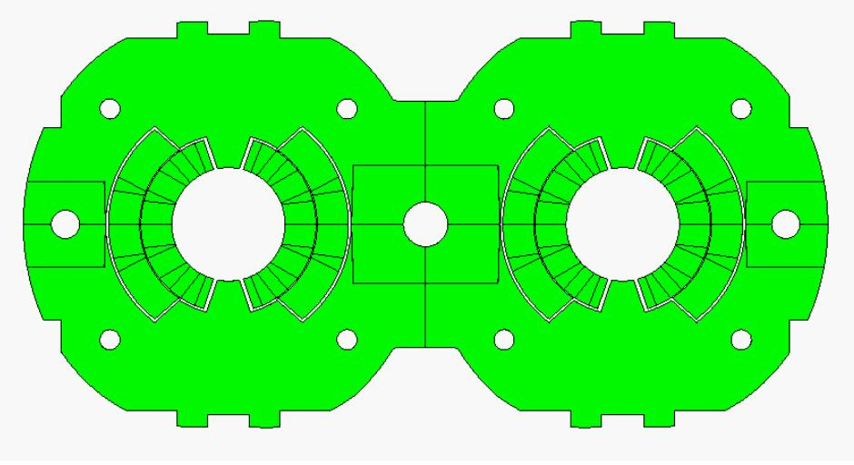
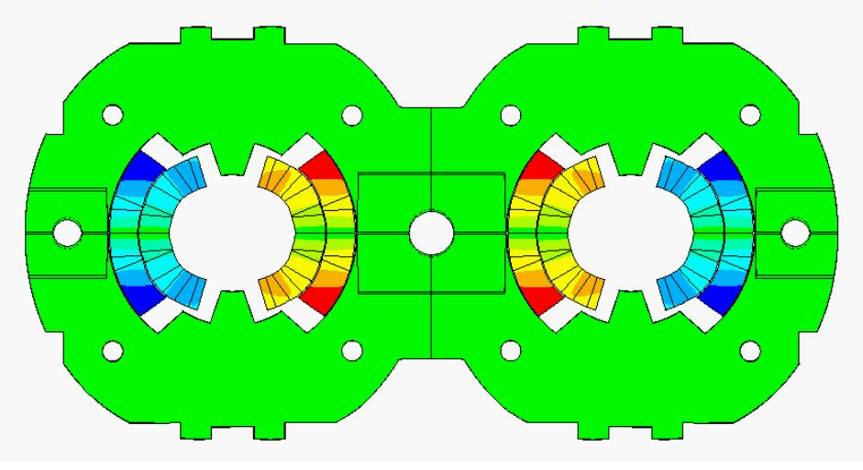
E.m. forces and stresses
LHC dipole at 0 T LHC dipole at 9 T
Usually, in a dipole or quadrupole magnet, the highest stresses are reached at the mid-plane, where all the azimuthal e.m. forces accumulate (over a small area).
Displacement scaling = 50

Slide 31
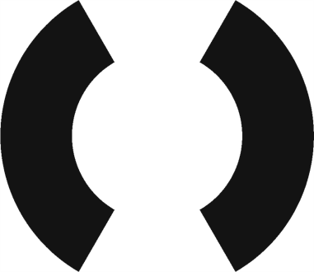
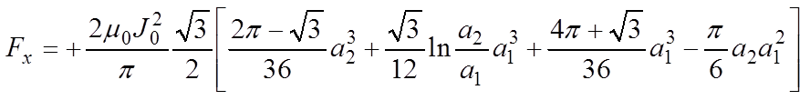
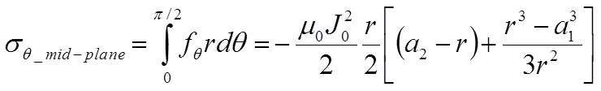
E.m. forces and stresses
Sector coil approximation
For a dipole sector coil, with an inner radius a₁, an outer radius a₂ and an overall current density j_{o} , each block (quadrant) see
  Horizontal force outwards
  Vertical force towards the mid-plan
  In case of frictionless and “free-motion” conditions, no shear, and infinitely rigid radial support, the forces accumulated on the mid-plane produce a stress of

Slide 32
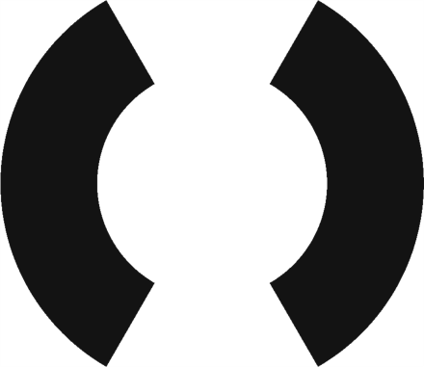
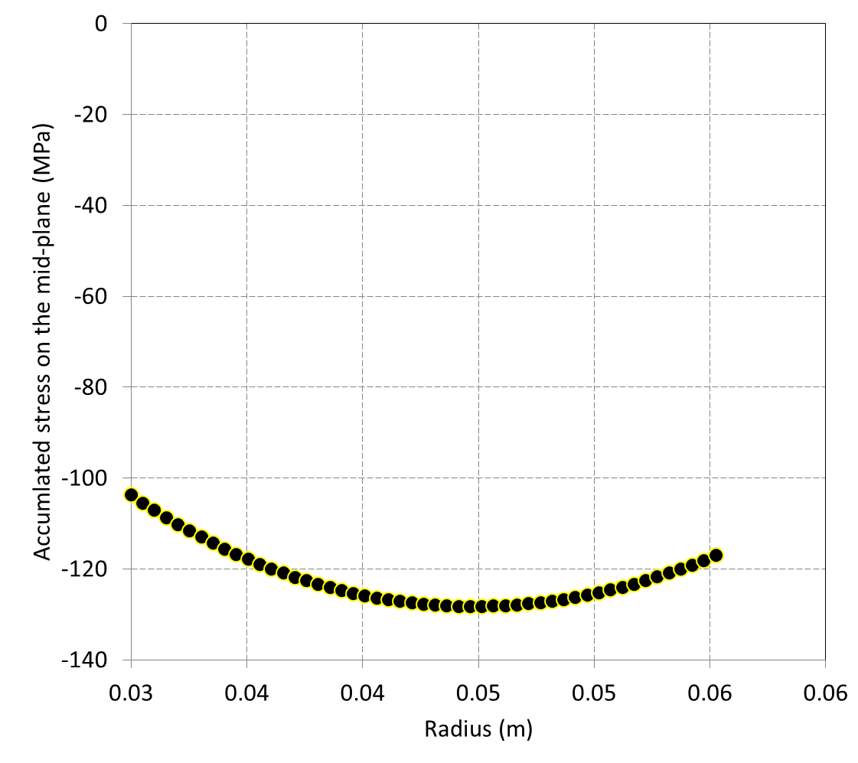
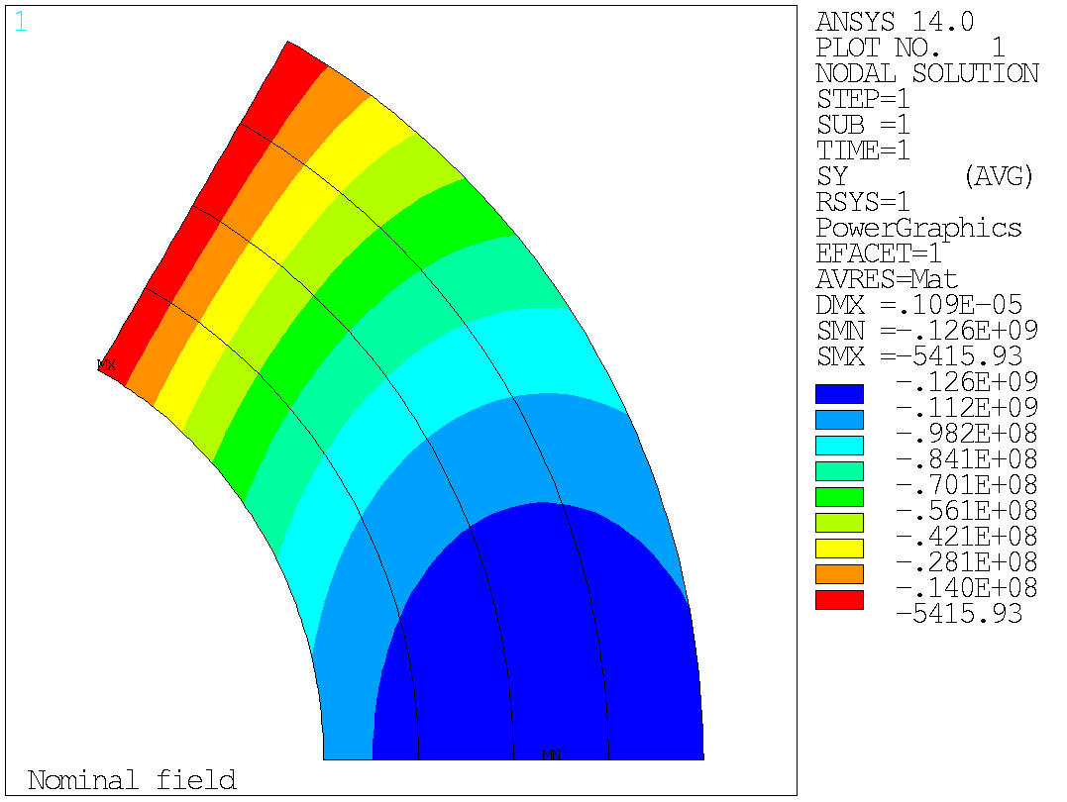
E.m. forces and stresses
Sector coil approximation
In the operational conditions (B_{bore_op} = 11.0 T)
  F_{x} (quadrant) = +2.29 MN/m
    F_{x} (total) = +4.60 MN/m = 460 t/m
  F_{y} (quadrant) = -2.10 MN/m
The accumulates stress on the coil mid-plane is

Slide 33
Comparison

Slide 34
Case study
11 T Nb₃Sn dipole for the LHC collimation upgrade
  Question
    Evaluate dimension of collars, iron yoke, and shrinking cylinder, assuming that the support structure is designed to reach 90% of I_{ss}

Slide 35
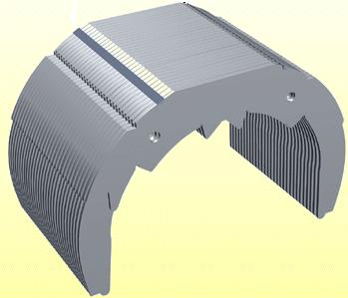
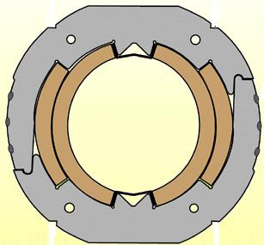
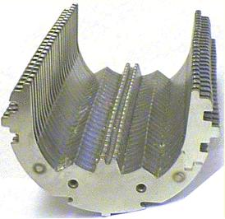
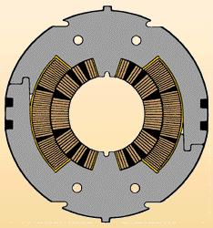
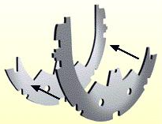
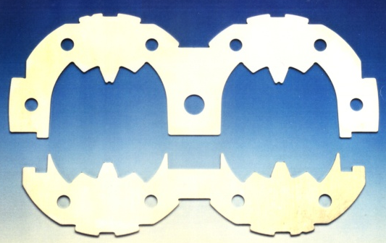
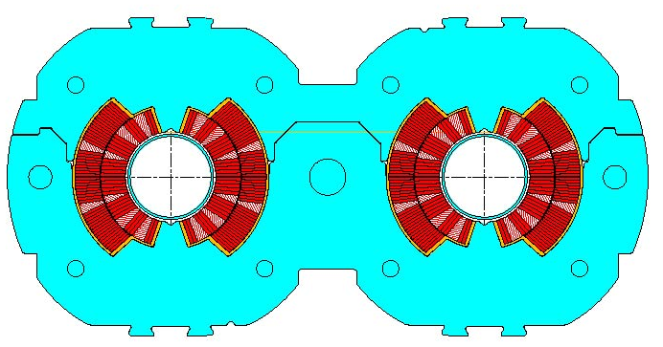
Support structure
Collars
Collars were implemented for the first time in the Tevatron dipoles.
Since then, they have been used in all but one (RHIC) the accelerator magnets and in most of the R&D magnets.
They are composed by stainless-steel or aluminum laminations few mm thick.
By clamping the coils, the collars provide
  coil pre-stressing;
  rigid support against e.m. forces (it can be self-supporting or not);
  precise cavity (tolerance ± 20 μm).
Tevatron
SSC
LHC
MJB Plus, Inc., [2]
L. Rossi, [1]

Slide 36
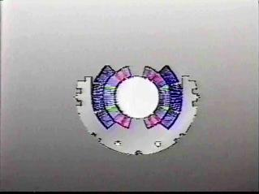
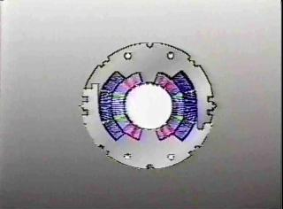
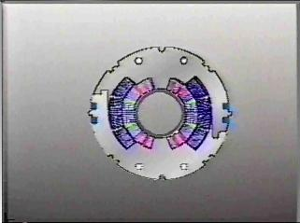
Support structure
Collars
Collaring procedure
  Collars are pre-assembled in packs (several cm long) and placed around the coil.
    The collar laminations are divided in “short” and “long”.
  Since the uncompressed coil is oversized with respect to the collar cavity dimension, at the beginning of the collaring procedure the collars are not locked (open).
  The coil/collar pack is then introduced into a collaring press.
  The pressure of the press is increased until a nominal value.
  Collars are locked with keys, rods or welded, and the press released.
  Once the collaring press is released, the collar experience a “spring back” due to the clearance of the locking feature and deformation.

Slide 37
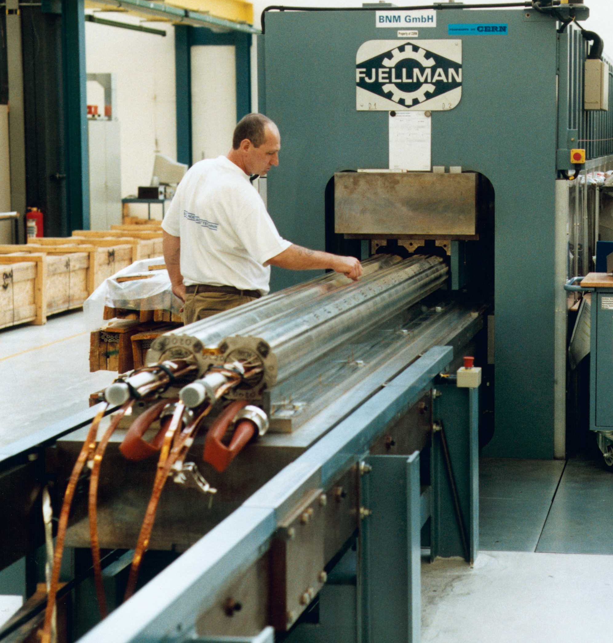



Support structure
Collars
Collaring of a dipole magnet
Collaring of a quadrupole magnet

Slide 38








Dimension of the support structure
Collars
We assume a 25 mm thick collar
  Images not in scale

Slide 39


Without iron yoke

Slide 40


With iron yoke
The iron yoke thickness can be estimated with

Slide 41

Dimension of the yoke
The iron yoke thickness can be estimated with
Therefore, being
  B_{bore} = 12.2 T (at 90% of I_{ss} )
  r = 30 mm and
  B_{sat} = 2 T
we obtain
  t_{iron} = ~190 mm

Slide 42

Support structure
Shell (or shrinking cylinder)
The cold mass is contained within a shell (or shrinking cylinder).
The shell constitutes a containment structure for the liquid Helium.
It is composed by two half shells of stainless steel welded around the yoke with high tension (about 150 MPa for the LHC dipole).
  With the iron yoke, it contributes to create a rigid boundary to the collared coil.
If necessary, during the welding process, the welding press can impose the desired curvature on the cold mass.
  In the LHC dipole the nominal sagitta is of 9.14 mm.

Slide 43




Support structure
Shell (or shrinking cylinder)

Slide 44


Support structure
Shell (or shrinking cylinder)
The shell tension provided by the welding may contribute to the overall support of the collared coil.
An often (SSC, LHC) implemented approach is the line-to-line fit.
  When the yoke is put around the collared coil, a gap (vertical or horizontal) remains between the two halves; this gap is due to the collar deformation induced by coil pre-stress.
  After welding, the shell tension closes the gap, and good contact is provided between yoke and collar.
  After cool-down, despite the higher thermal contraction of the collared coil with respect to iron, the gap remain closed (high rigidity), and the collared coil in good contact with the yoke.
Aluminum spacer may be used to control the yoke gap.

Slide 45
Dimension of the support structure
We assume that the shell will close the yoke halves with the same force as the total horizontal e.m. force at 90% of I_{ss}
We assume an azimuthal shell stress after cool-down of
  σ_{shell} = 200 MPa

Slide 46
Dimension of the support structure
We assume that the shell will close the yoke halves with the same force as the total horizontal e.m. force at 90% of I_{ss}
  F_{x_total} = F_{x_quadrant} * 2 = +6.8 MN/m
Assuming an azimuthal shell stress after cool-down of
  σ_{shell} = 200 MPa
The thickness of the shell is
  t_{shell} = F_{x_total} /2/1000/ σ_{shell} ~ 17 mm

Slide 47

Comparison

