Slide 1
Antonio Capizzello
Ass. Professor Aristoteles University Thessaloniki
Radiation Oncologist
Physics and Technology in Fighting Cancer:
Radiotherapy Innovation

Slide 2
Radiotherapy innovation
Innovative radiotherapy results from the evolution in radiation technology, but also from the integration of advanced imaging before and during radiotherapy, and the availability of high performing computer systems.
This has lead to the development of a broad range of new techniques, intensity-modulated (IMRT), stereotactic body (SBRT) and adaptive (ART) radiotherapy to name but a few.
The increased potential of novel technologies and techniques to target the tumor, while limiting the dose – and toxicity – to the surrounding organs, has further paved the way to the adoption of new irradiation schedules (such as hypofractionation – fewer but higher doses per treatment) and new indications (e.g. oligometastatic disease, combinations with new systemic agents)
Notes:
Innovazione in radioterapiaLa radioterapia innovativa deriva dall'evoluzione della tecnologia delle radiazioni, ma anche dall'integrazione di imaging avanzato prima e durante la radioterapia e dalla disponibilità di sistemi informatici ad alte prestazioni. Ciò ha portato allo sviluppo di un'ampia gamma di nuove tecniche, radioterapia a intensità modulata (IMRT), stereotassica corporea (SBRT) e adattiva (ART), per citarne solo alcune. Il potenziale aumentato di nuove tecnologie e tecniche per colpire il tumore, limitando al contempo la dose (e la tossicità) agli organi circostanti, ha ulteriormente aperto la strada all'adozione di nuovi programmi di irradiazione (come l'ipofrazionamento, dosi inferiori ma più elevate per trattamento) e nuove indicazioni (ad esempio, malattia oligometastatica, combinazioni con nuovi agenti sistemici)

Slide 3
Innovative radiotherapy technologies and techniques can come at a cost, due to higher initial investments and the additional time and resources required to enable their safe and high-quality implementation and use.
To counteract rising costs, innovation in radiotherapy planning (e.g. through increasingly automated planning AI) and dose delivery can in turn increase productivity and reduce treatment duration (e.g. through hypofractionation).
Although there is a tendency to propagate innovations based on the pure belief that new is better, even if the evidence remains limited and uncertain, the radiotherapy community, together with all relevant stakeholders, including patients, should take responsibility and not accept a poor evidence base and small benefits of new radiotherapy interventions at any cost.
The use of innovative technologies, techniques and treatments should ensure real value to patients at fair and just prices.

Slide 4
Some innovations represent major changes that impact outcomes gradually, such as new dose-fractionated schedules, new drug and radiotherapy combinations, or technologies with distinct biological, physical or imaging properties such as particle therapy or MRI-guided radiotherapy. However, the innovation may not be seen as a major breakthrough at the outset, but as a series of smaller, incremental changes, the impact of which gradually becomes apparent over time.
The translation of the innovation into improved outcomes, particularly reduced toxicity and the resulting impact on quality of life, may only become apparent months or years after therapy.
Furthermore, new radiotherapy techniques and technologies often require specific training, leading to learning curves, with outcomes dependent on the skill of the operator, the experience of the multidisciplinary team, and the quality assurance processes incorporated.

Slide 5
Major and Incremental Innovations
New Dose Fractionation Schedules
New Radiotherapy-Drug Combinations
Technologies with distinct physical or biological properties (e.g., particle therapy, MR-guided radiotherapy).
Incremental Changes:
New Immobilization Devices
Advanced Computer Planning Algorithms (with Art. Int. )
Often result in improved patient outcomes over time.

Slide 6
Challenges in Translating Innovation
Outcome Dependency: Impact of innovations may take months or years to be realized
Learning Curves: Requires training and multidisciplinary collaboration to achieve optimal results.
Evidence Generation: Takes time for formal evidence to mature due to the time dependency of outcomes.

Slide 7
Costs and Efficiency in Radiotherapy Innovation
Higher Initial Costs
Advanced technologies may require significant investment
Workflow Efficiency
Automated treatment planning and new delivery techniques like hypofractionation can optimize workflows and reduce costs

Slide 8
Value-Based Healthcare (VBHC) in Radiation Oncology
Definition:
VBHC focuses on achieving health outcomes that matter most to patients per dollar spent
Examples:
Hypofractionation:
Fewer fractions lead to cost savings, reduce treatment burden, and enhance value
Reduced toxicities also lower healthcare and societal costs over the patient’s lifetime

Slide 9
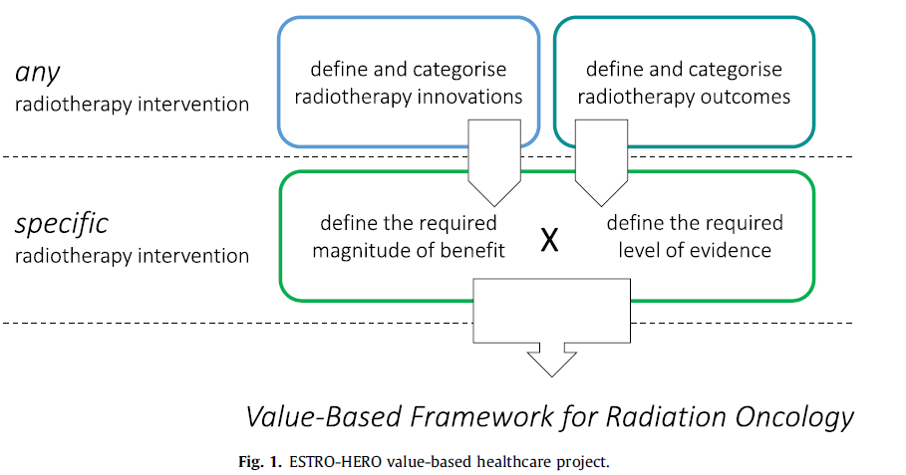
according ESTRO-HERO Health Economics in Radiation Oncology
To evaluate innovations in oncology and build consensus, three key areas need to be explored that provide strong evidence-based support to address the heterogeneity within radiation oncology
Area 1
Area 2
Area 3
Notes:
1 define and categorise the spectrum of innovations in radiation oncology
2 define and classify the range of innovations in radiation oncology: classify them into technologies, techniques and treatments, before considering whether they represent gradual or incremental innovations
3 define outcomes to support the performance of innovations in radiation oncology

Slide 10
Evaluating Radiotherapy Innovations
Innovations are evaluated based on clinical evidence, expected benefit, and cost-effectiveness
( High vs. Low Value )
Tools for Appraisal:
Tools like the ESMO Magnitude of Clinical Benefit Scale
ASCO Value Framework,
NCCN Blocks appraise the value of oncology interventions
Outcomes in Radiation Oncology:
In addition to survival and quality of life, outcomes may include
local control organ preservation and functional aspects (e.g., speech improvement in mouth cancer)

Slide 11
Tiers for Evaluating Radiotherapy Outcome
Tier 1: Health status after treatment (e.g., survival, local control, functional outcome)
Tier 2: Recovery process and treatment burden (e.g., time to remission, acute toxicities)
Tier 3: Long-term consequences of care (e.g., recurrences, long-term toxicities, quality of life)

Slide 12
Conclusion
Radiotherapy Innovation:
Built on advances in technology, imaging, and computation, allowing for better tumor targeting and reduced toxicity.
Value-Based Approach:
Innovations should deliver real patient value at fair costs, ensuring high-quality care and favorable outcomes
Collaboration and Evaluation:
Future advancements in radiotherapy will depend on multidisciplinary collaboration, evidence-based assessment, and value-based healthcare approaches

