Slide 1



Particle Therapy Masterclass – tangible impacts
Nermine muradi
Physics Department
Universty Of Tetova & OSMU Nikola Stein,
North Macedonia

Slide 2
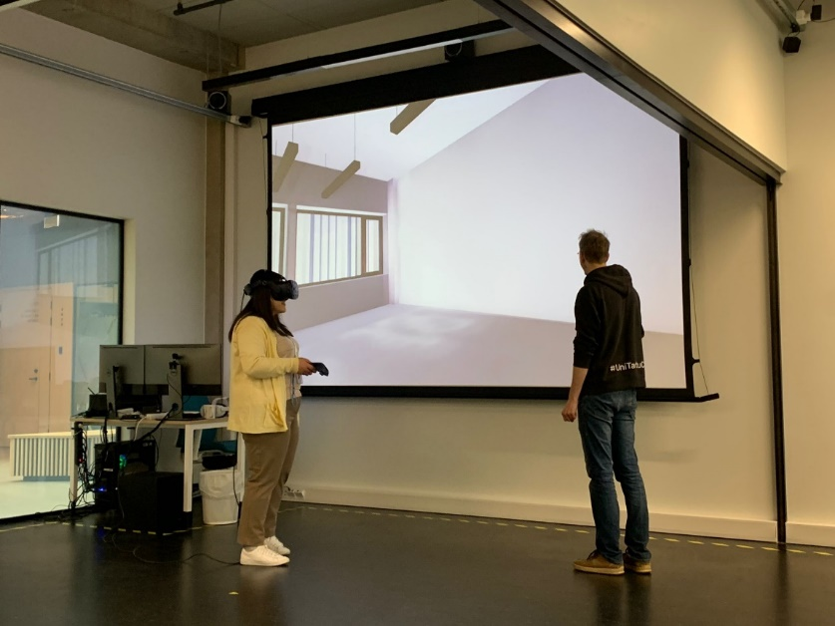
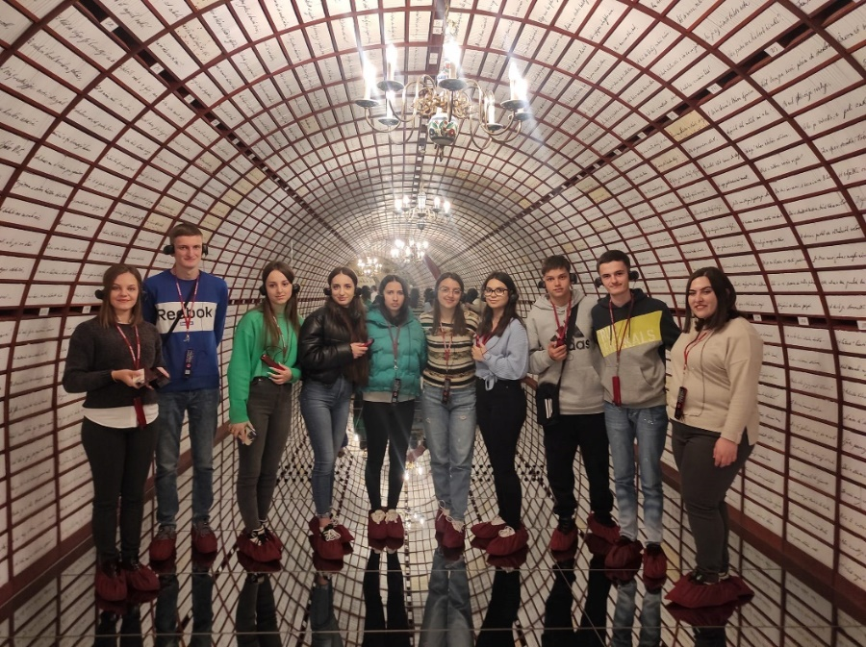
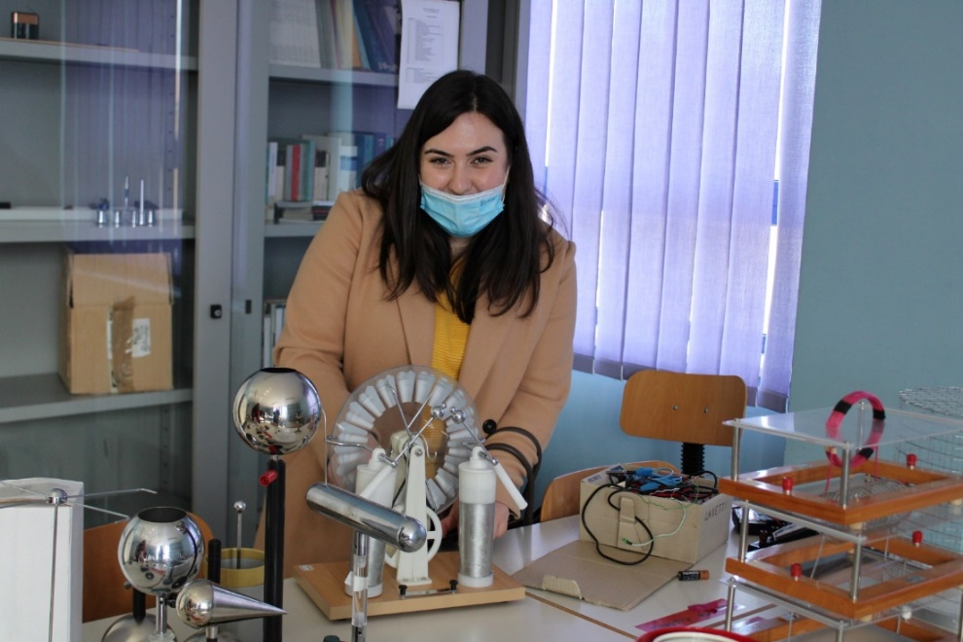
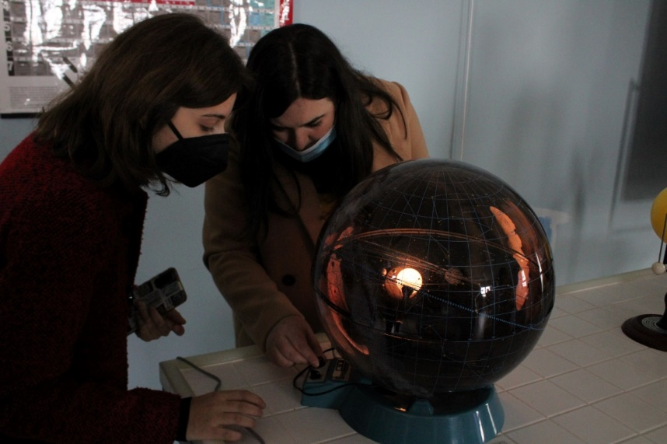

Eramsus + exchanges
Learning never exhaust the mind.

Slide 3
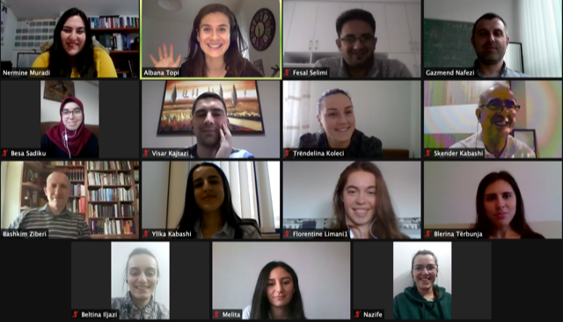
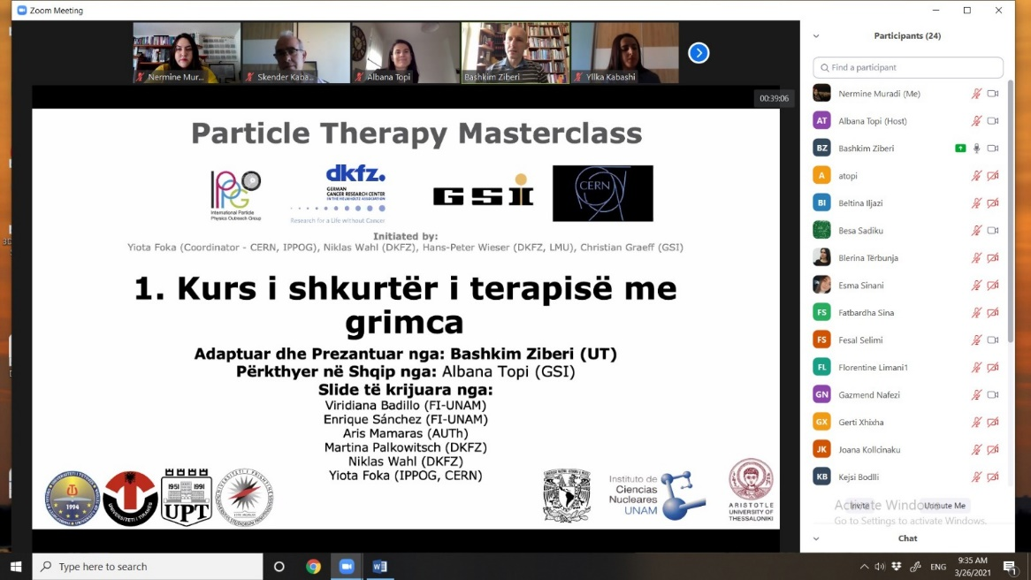
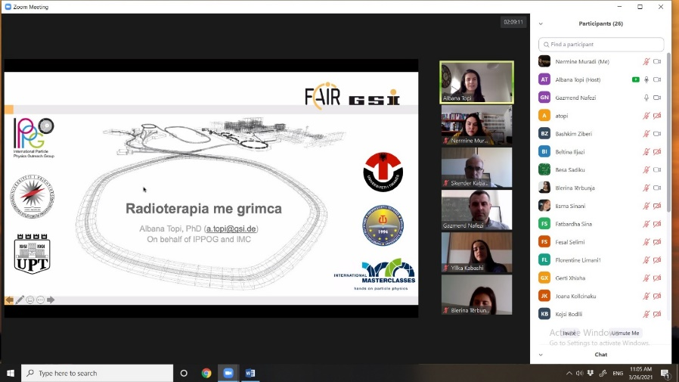
Particle Therapy Masterclass 2021
Albana Topi GSI :
North Macedonia
Kosovo
Albania

Slide 4
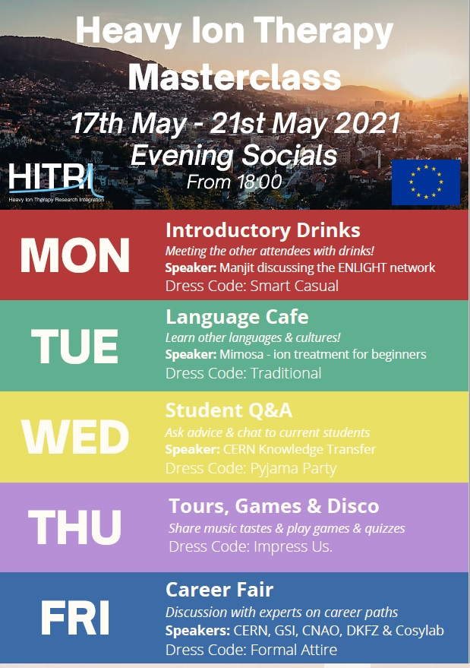
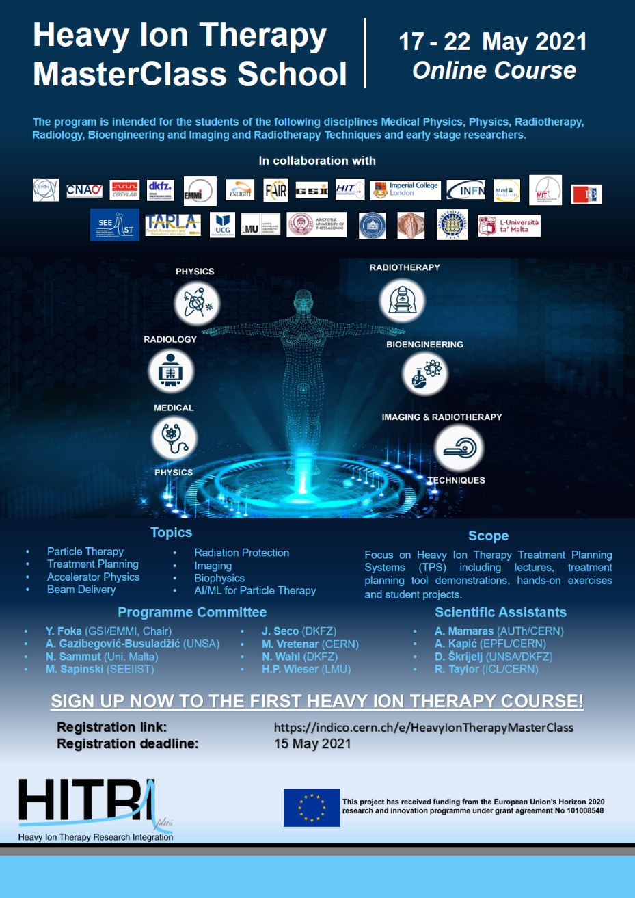
Heavy Ion Therapy Masterclass School 17 -21 May 2021

Slide 5
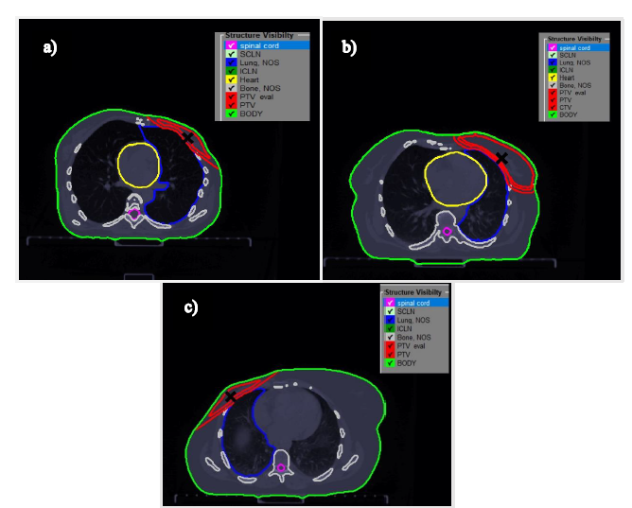
Master thesis:
Simulations of treatment planning of breast cancer and comparison with real cases
First case beam angles 131.3°, 131.3° and 308.4°, and third with three different beams coming in angles 131.3° , 308.4° dhe 355°.
131.5°, 131.5° and 308.9°, and three beams 131.5°, 308.9° and 350°.
229.1°, second plan with two beams in angles 53.5° and 229.1°, and third plan with three beams 10 °, 53.3° and 229.1°.

Slide 6
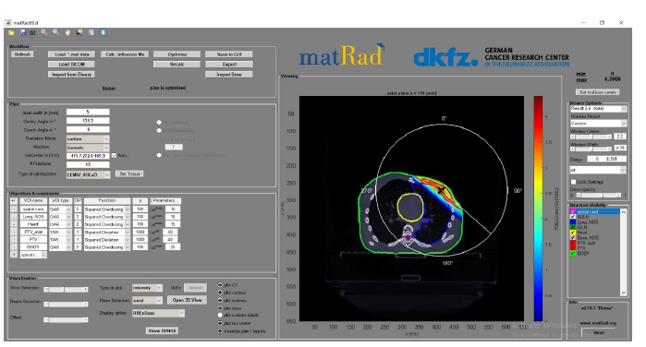
Master thesis:
Simulations of treatment planning of breast cancer and comparison with real cases
40 Gy in 15 fractions

Slide 7
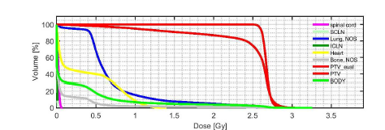
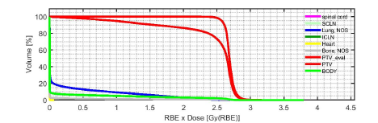
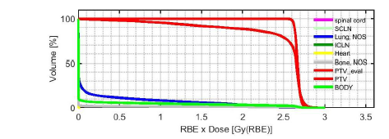
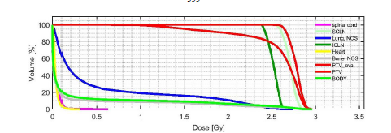
Master thesis:
Simulations of treatment planning of breast cancer and comparison with real cases
DVH photon beam in three different beams coming in angles 131.3° , 308.4° and 355°.
DVH proton beam in three different beams coming in angles 131.3° , 308.4° and 355°.
DVH carbon beam in three different beams coming in angles 131.3° , 308.4° and 355°.
DVH photon beam in three different beams coming in angles 131.3° , 308.4° dhe 355° in clinic

Slide 8
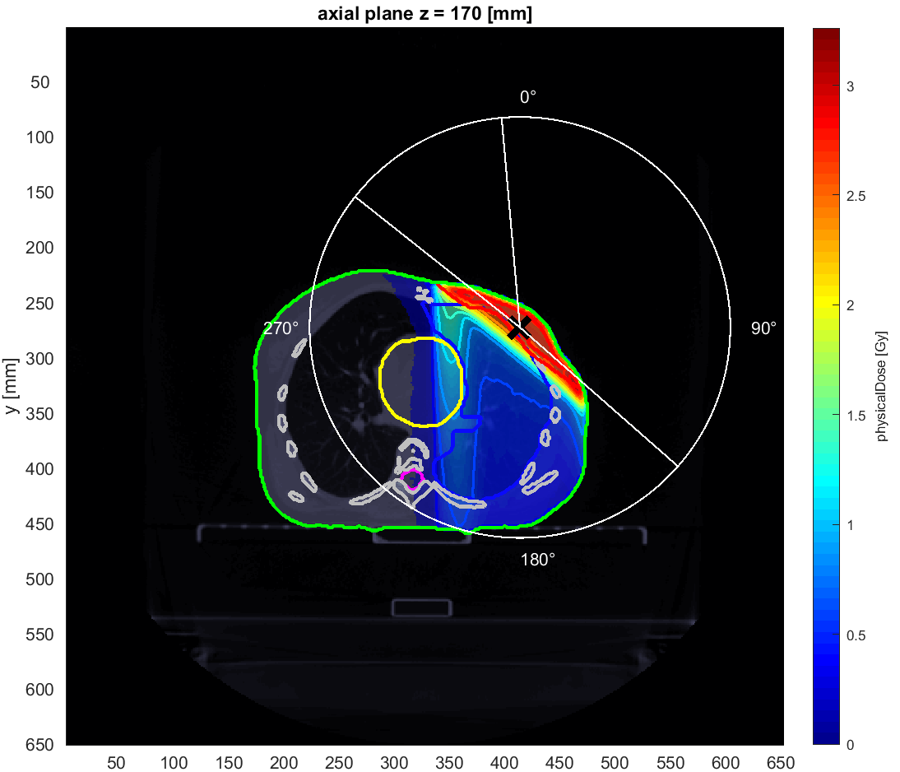
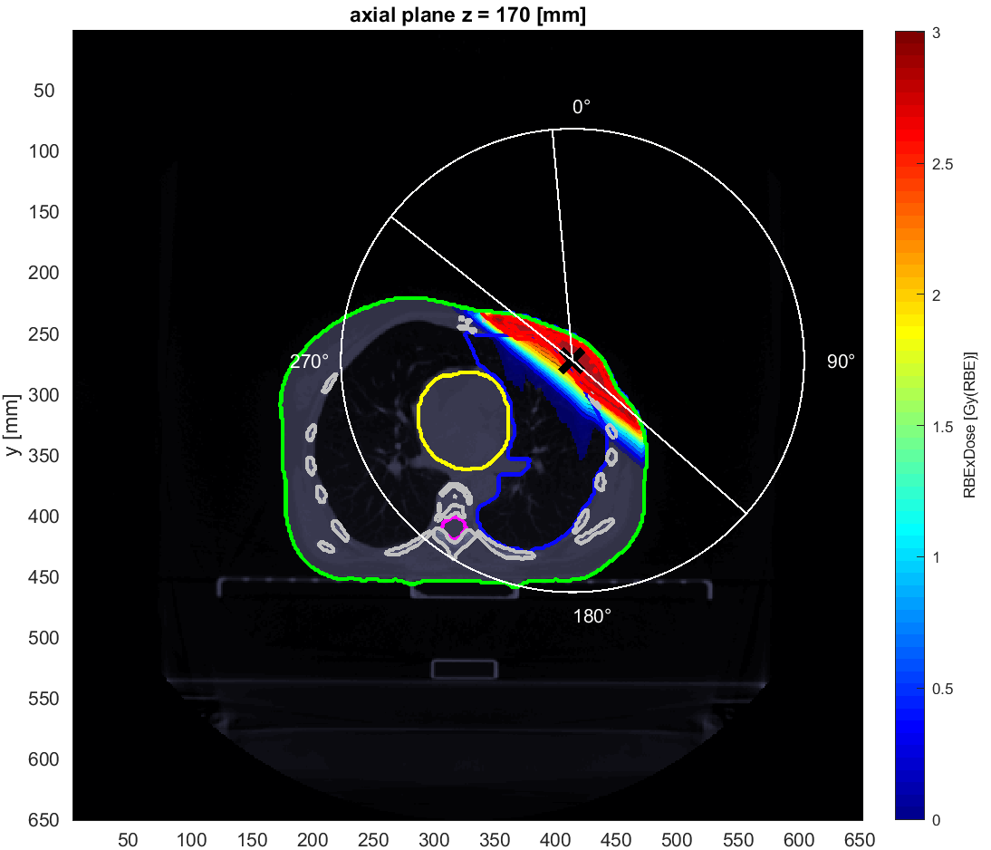

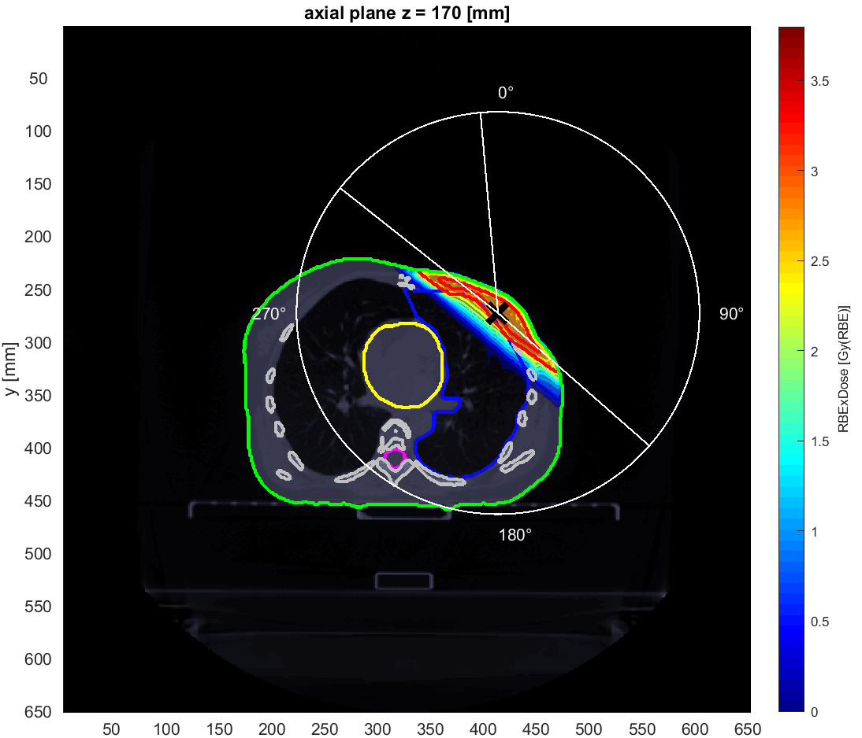
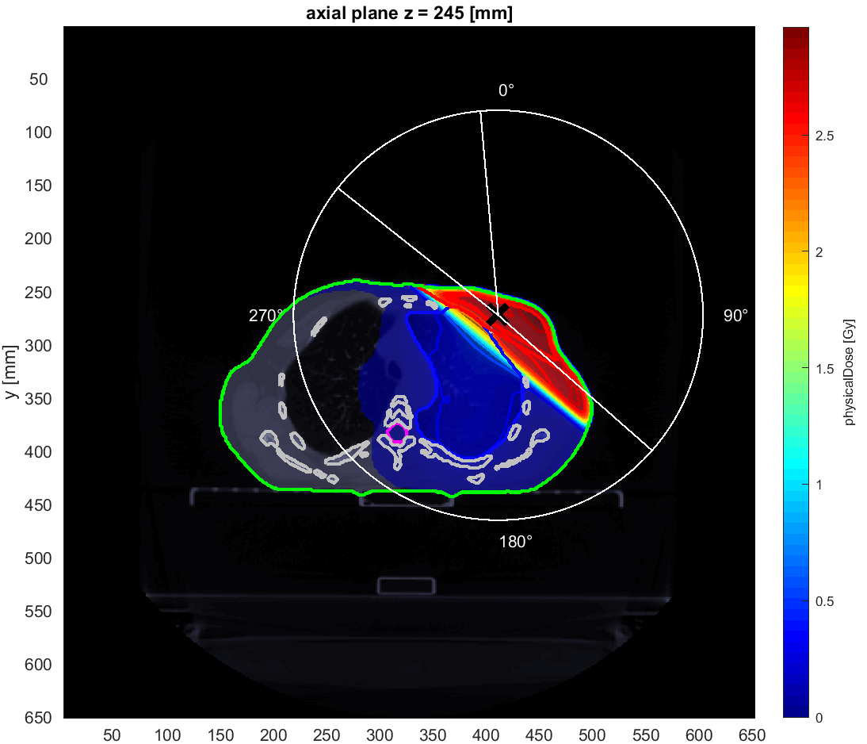
MDR photons vs protons 73.4% for the lungs, 99.9% for the heart and 56% for the body
0.19% for PTV
MDR photons vs carbons: 71% for the lungs, 99% for the heart and 54 % for the body

Slide 9
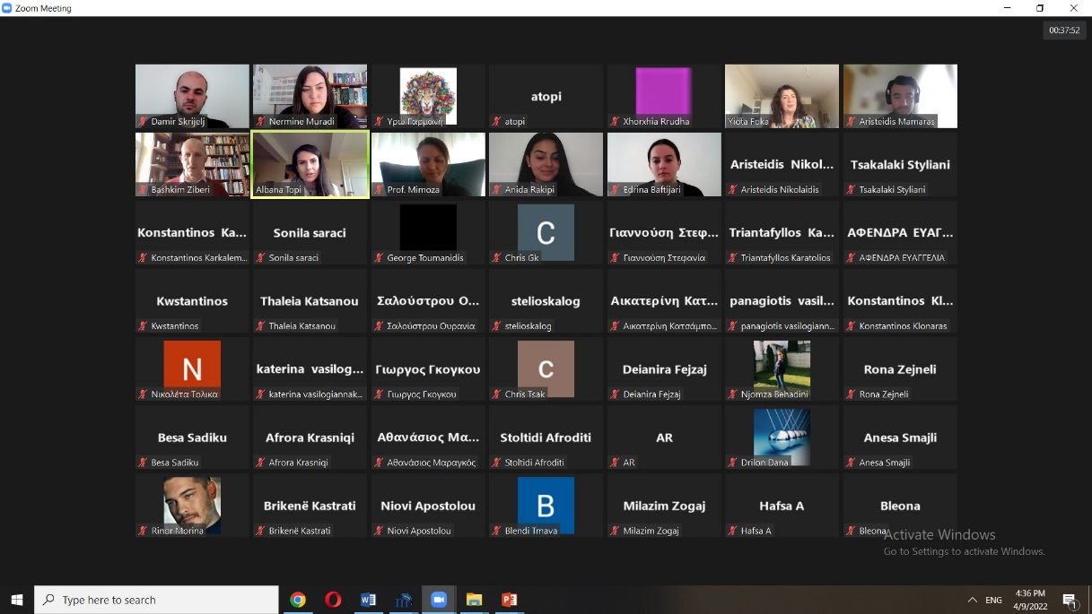
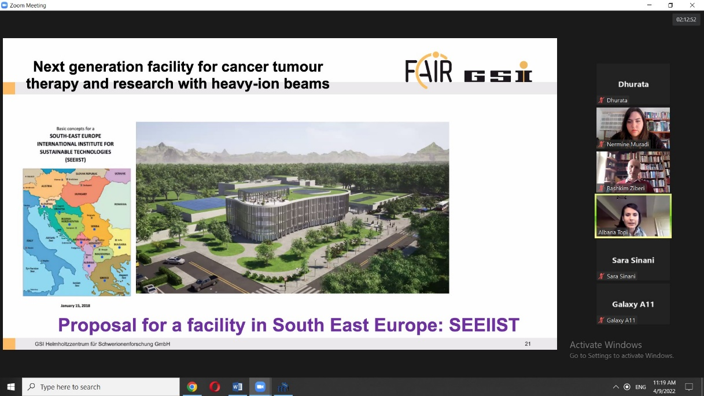
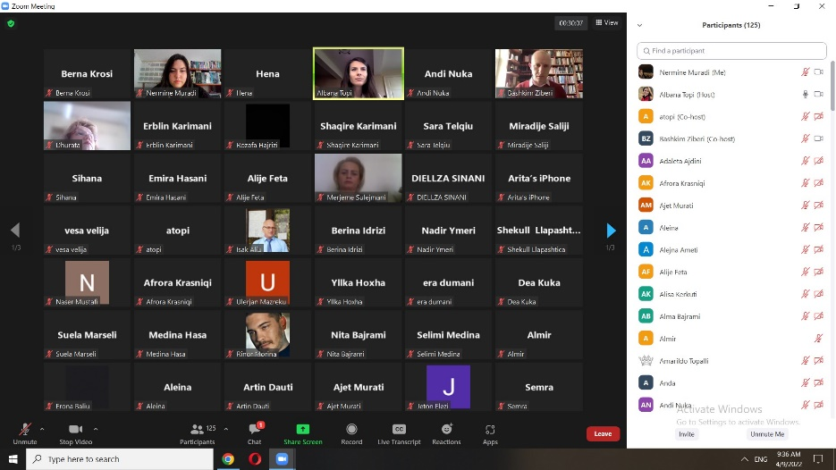
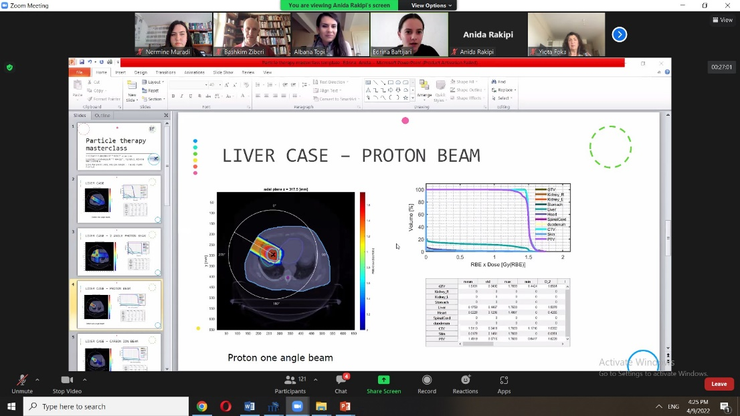
Particle Therapy Masterclass 2022
140 high school pupils - online

Slide 10
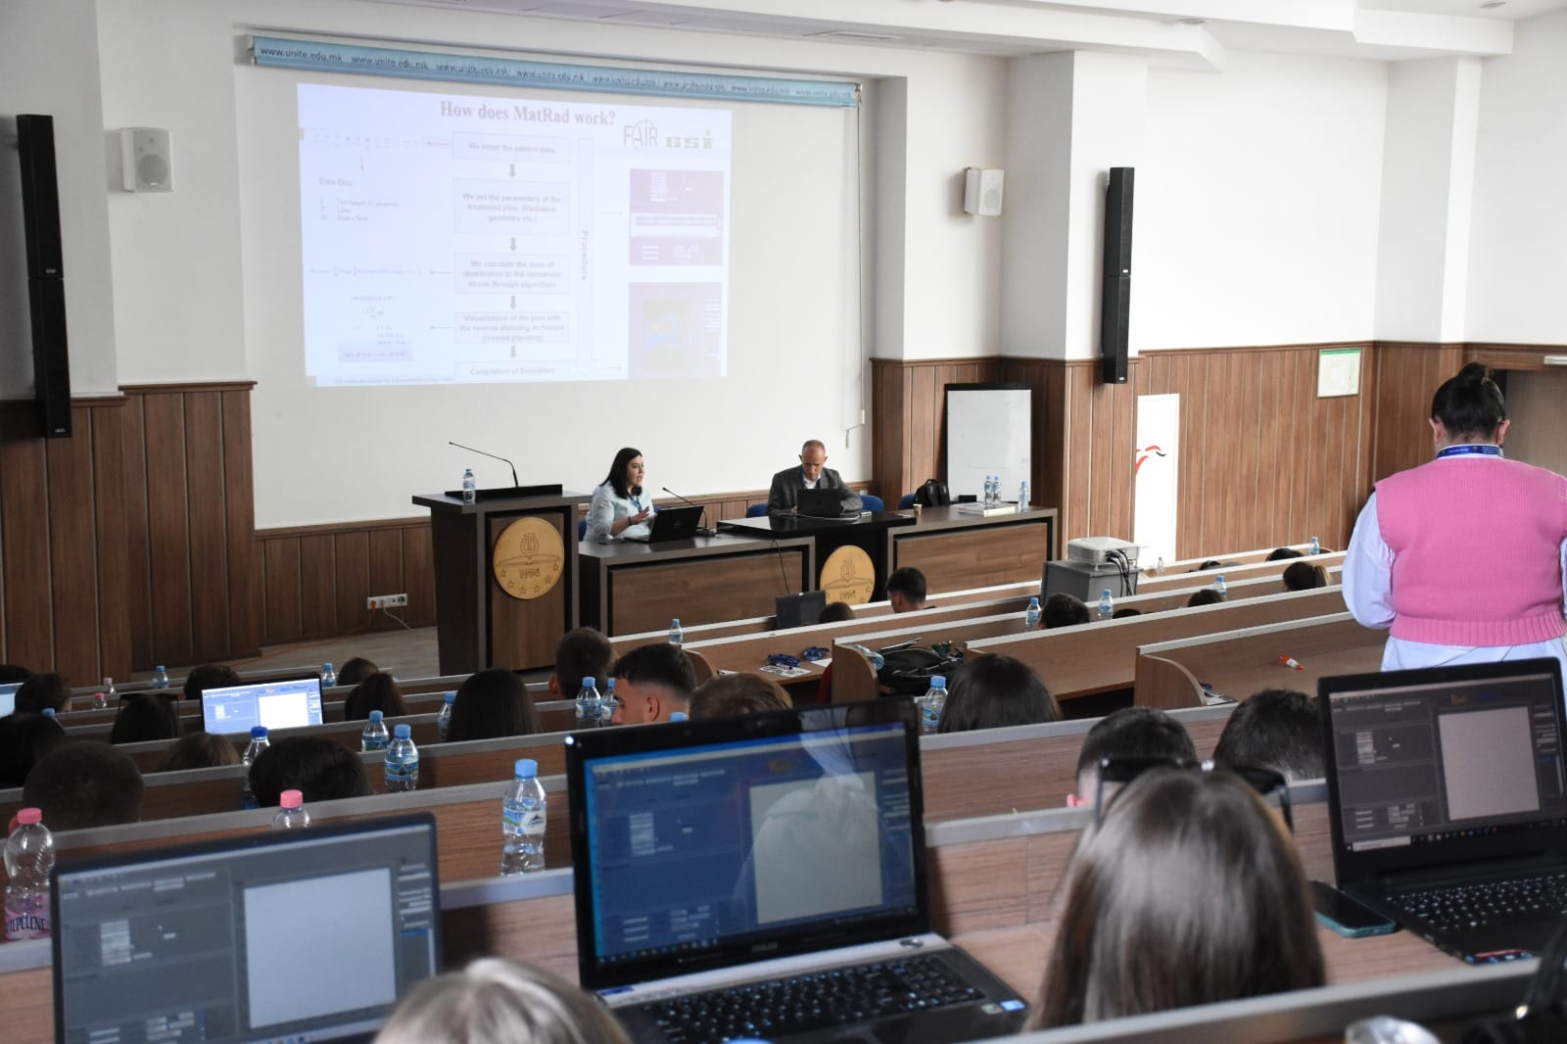
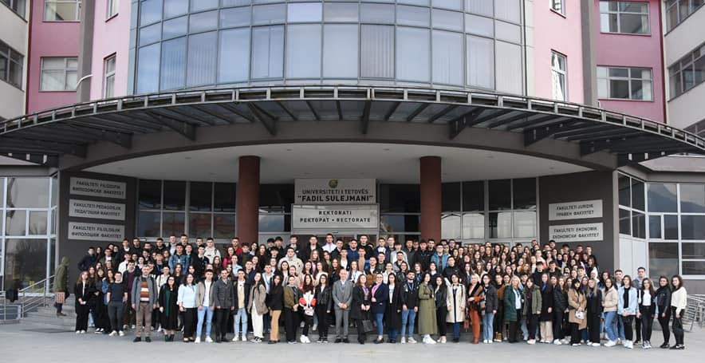
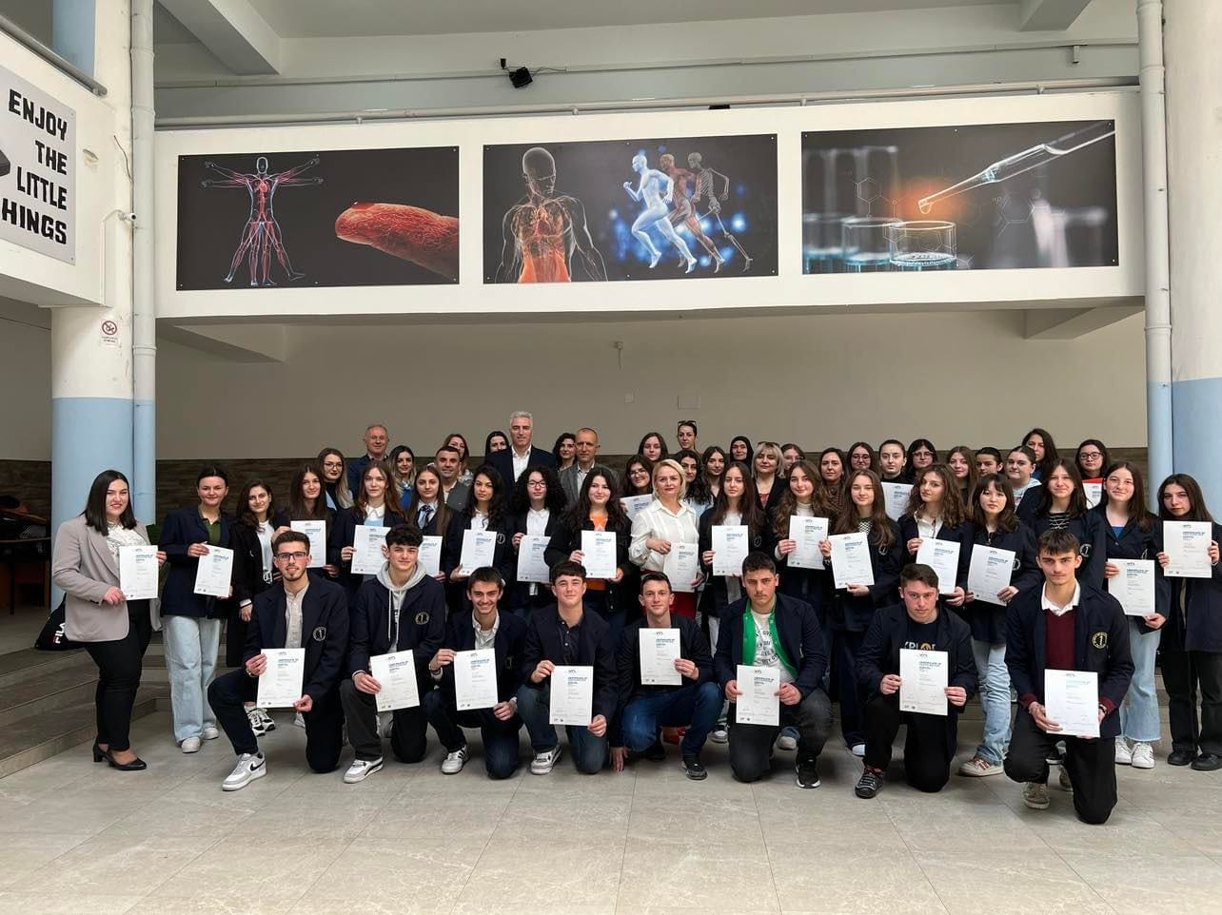
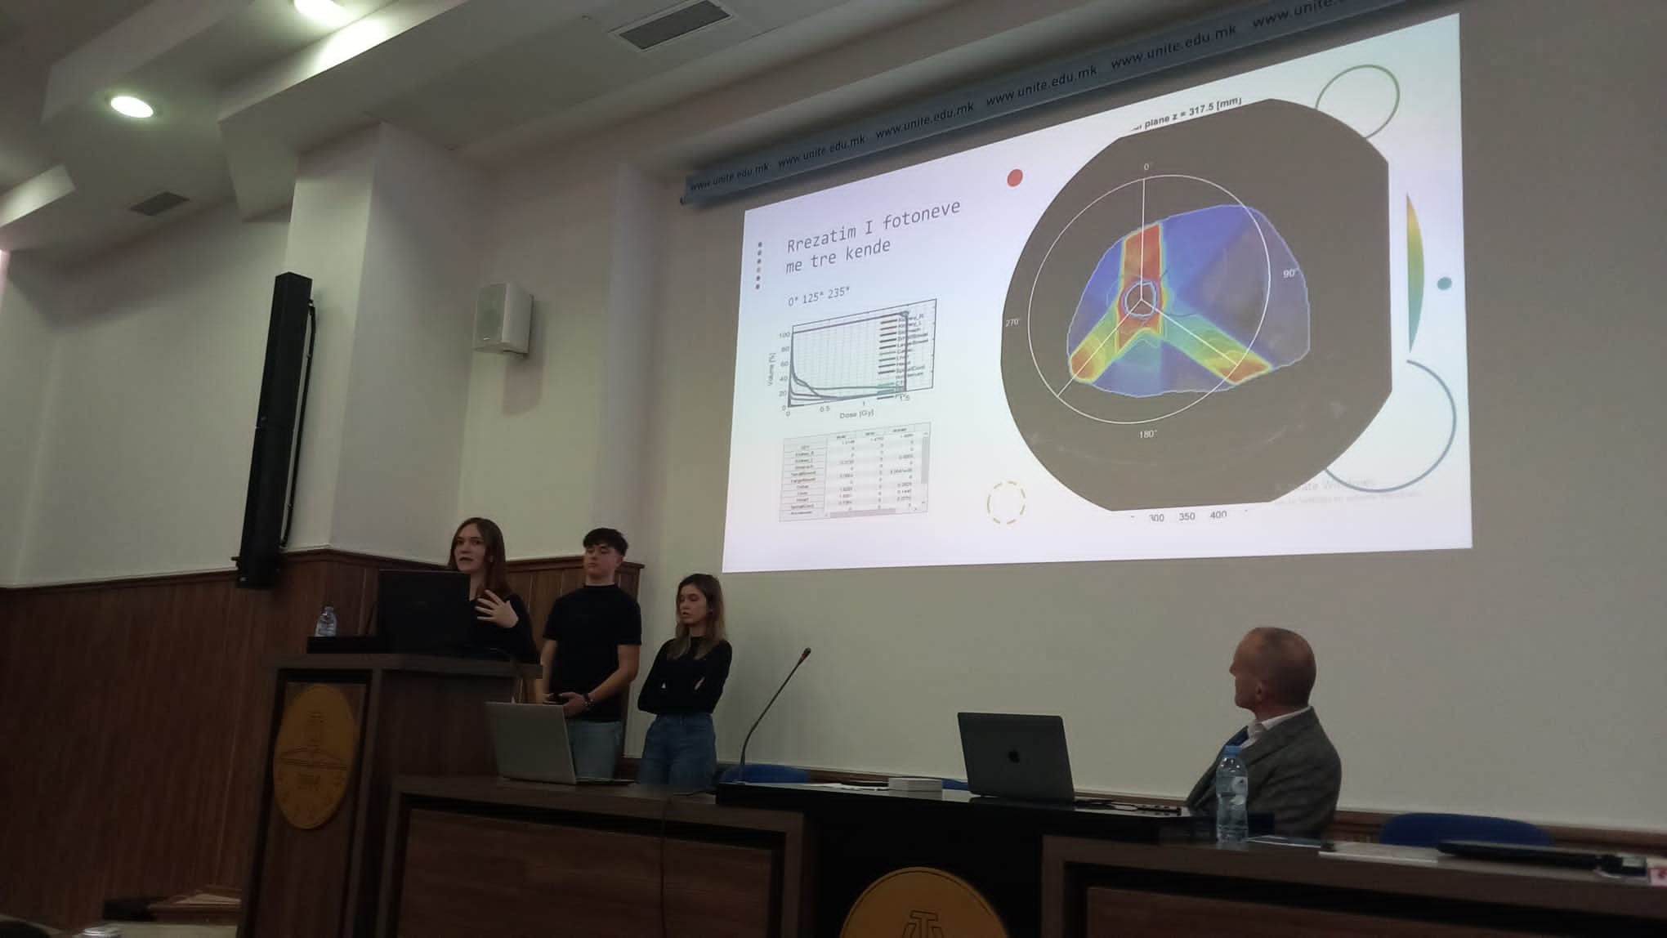
Particle Therapy Masterclass 2023
200 high schools students UT

Slide 11
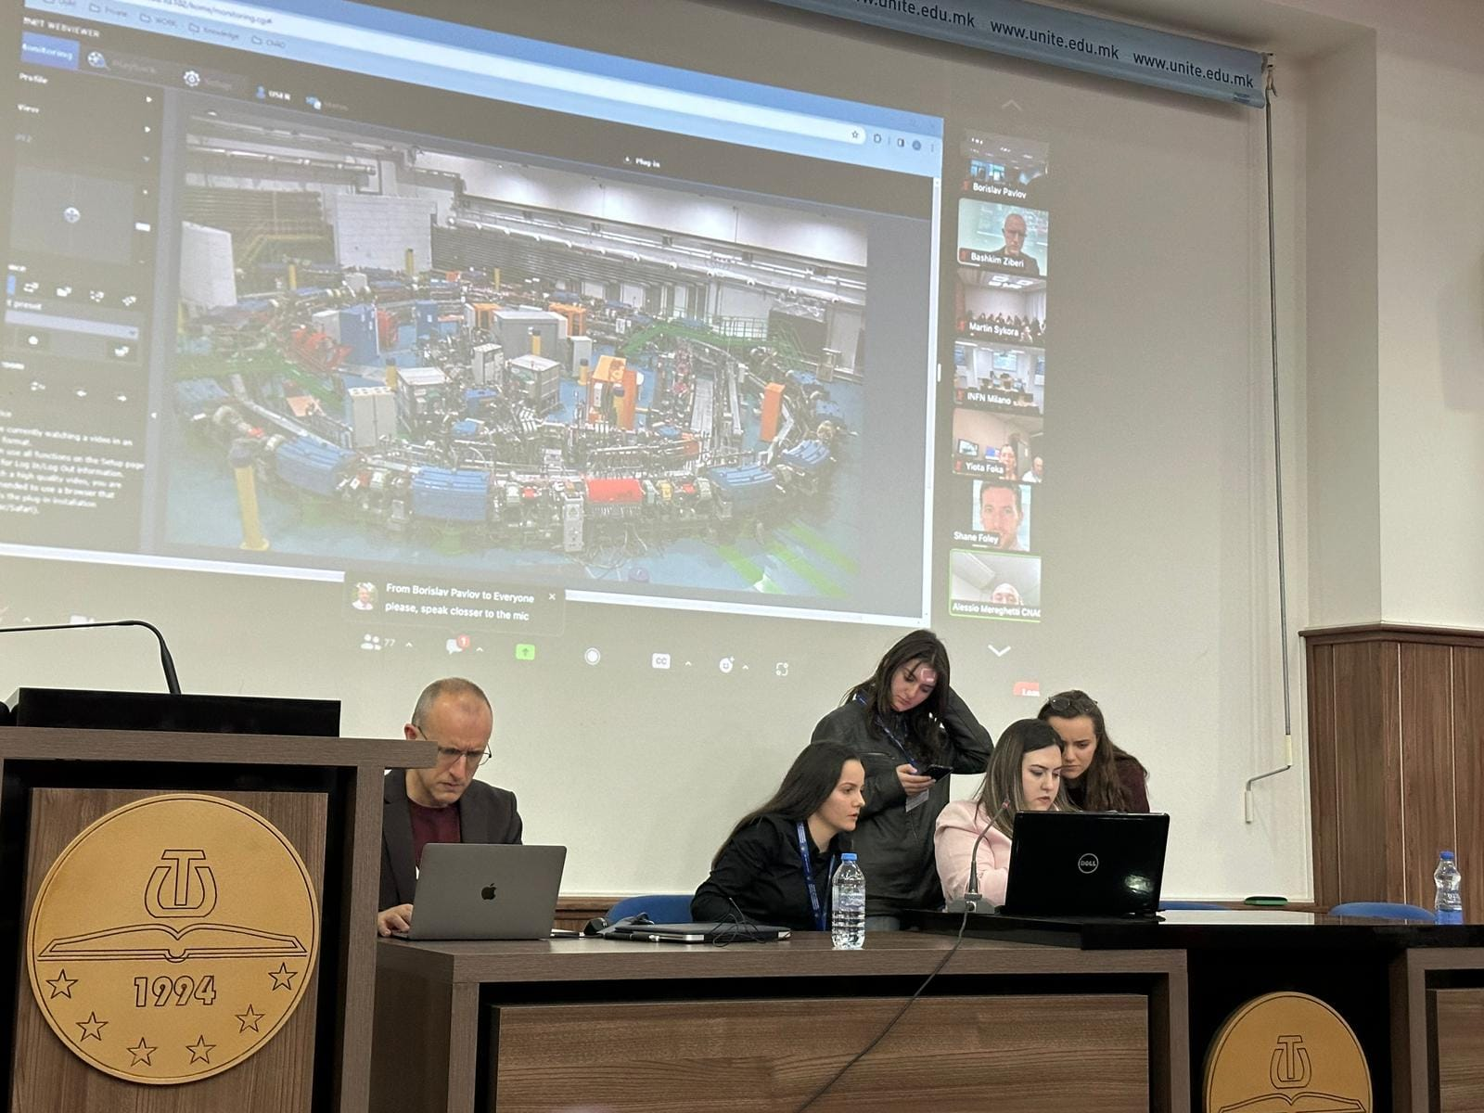
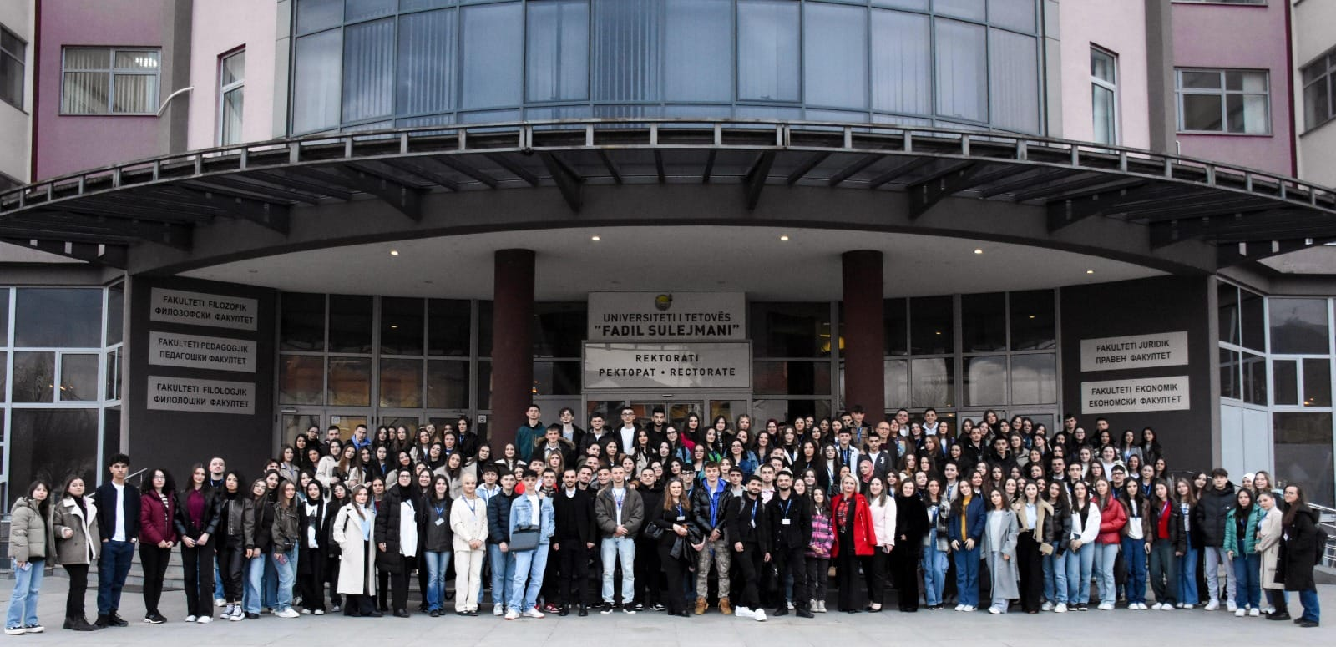
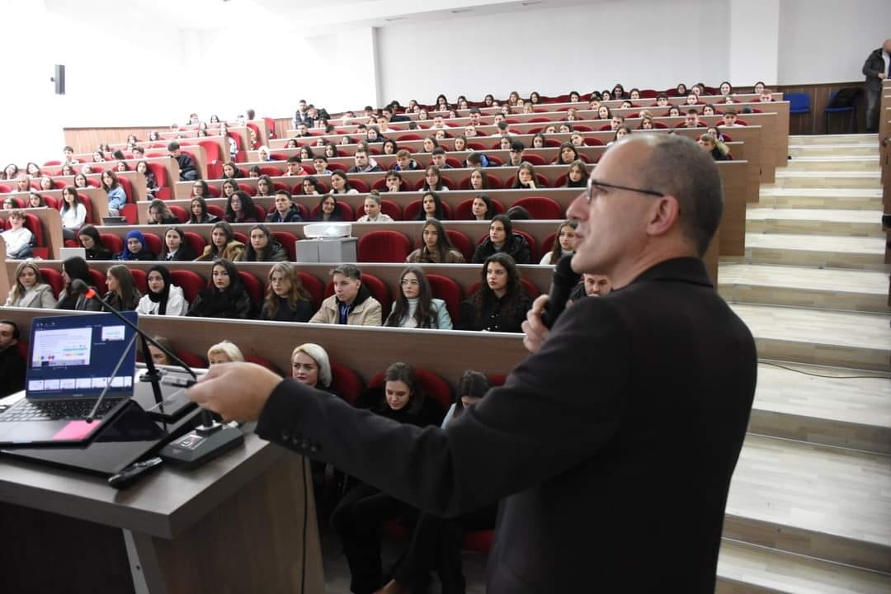
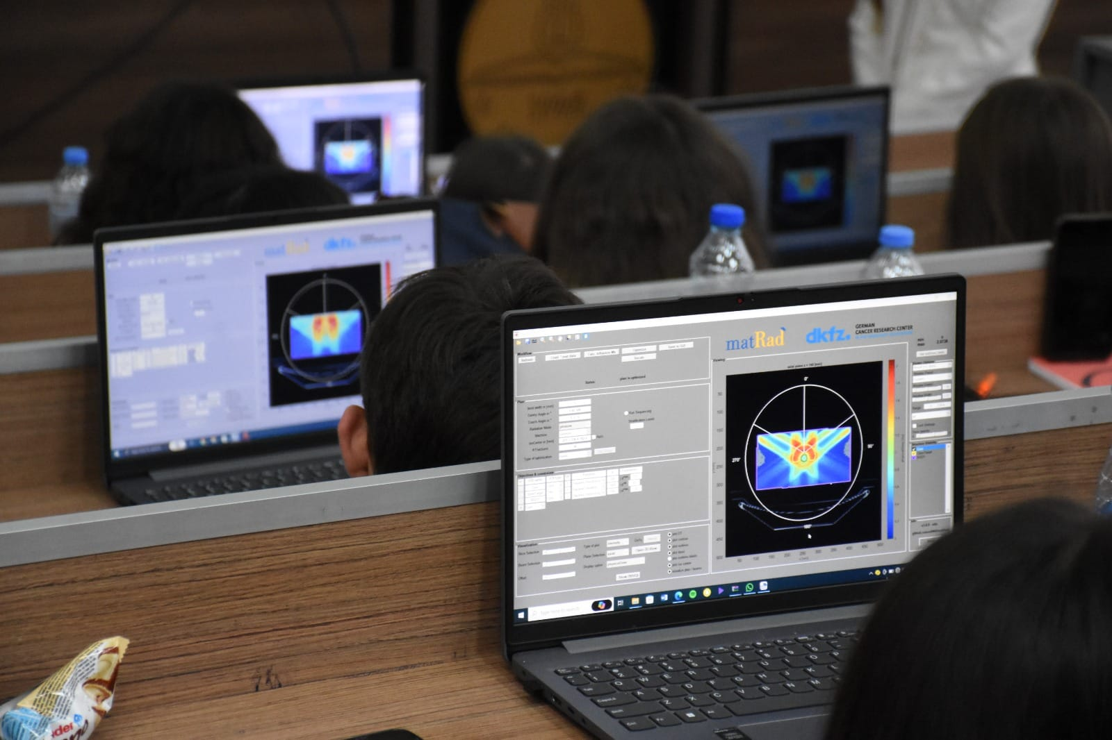
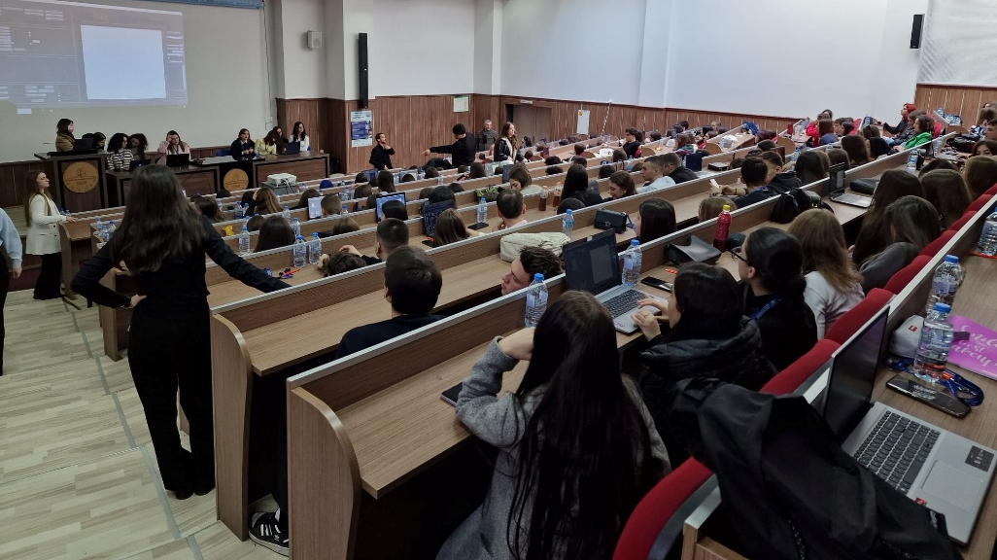
Particle Therapy Masterclass 2024
272 high school students Tetova

Slide 12
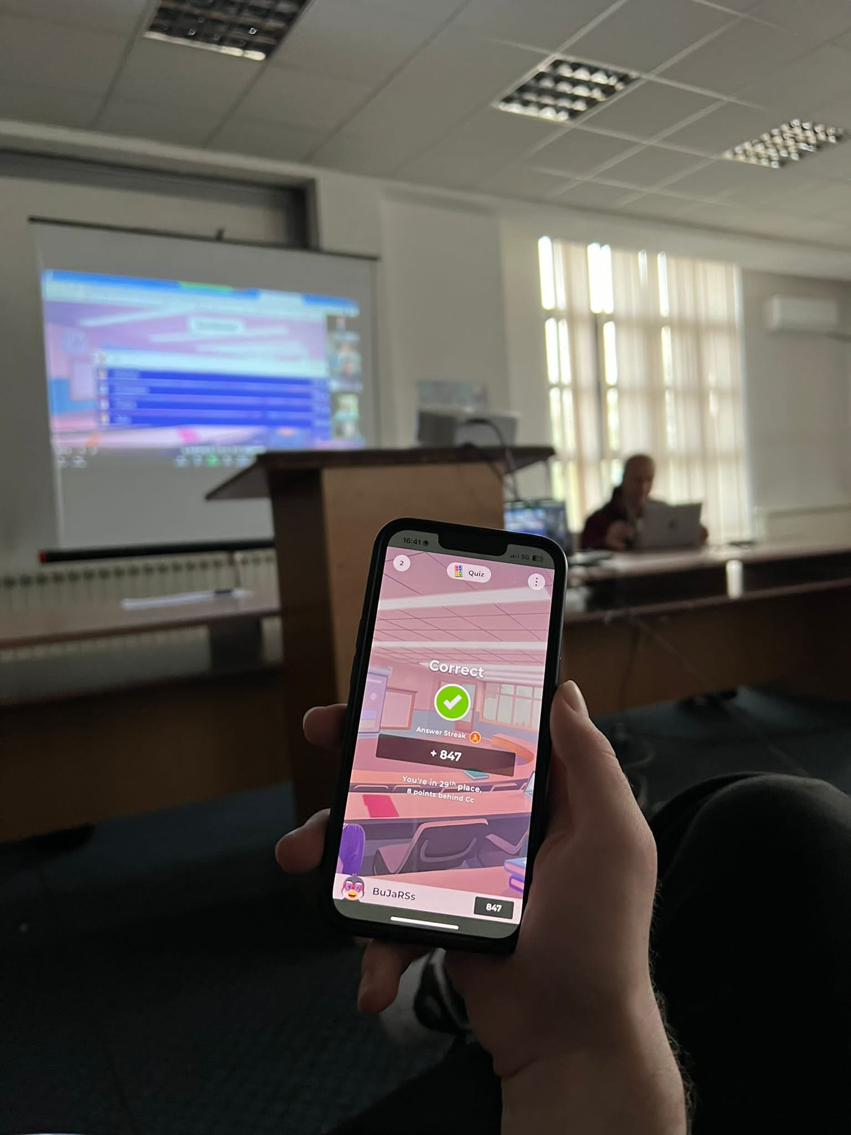
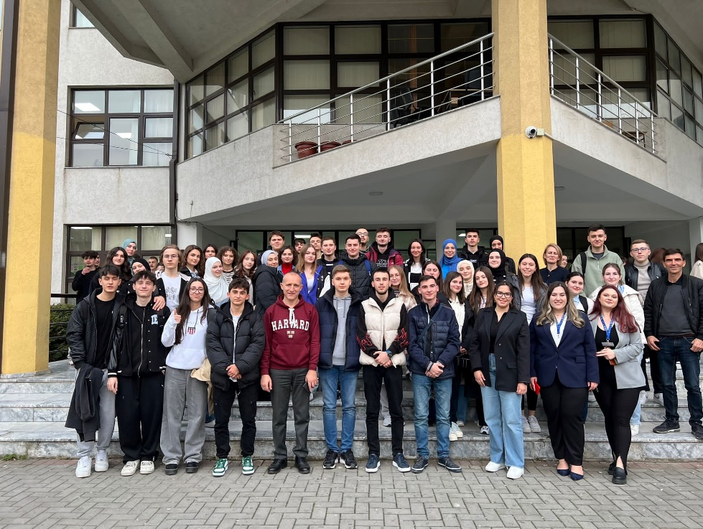
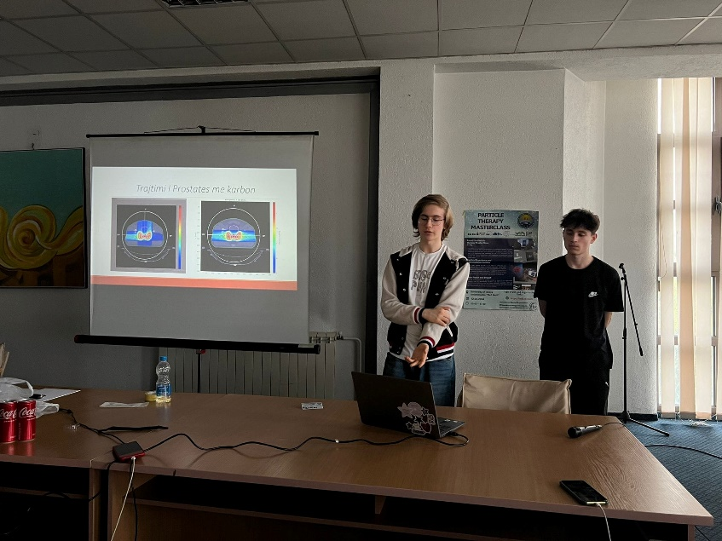
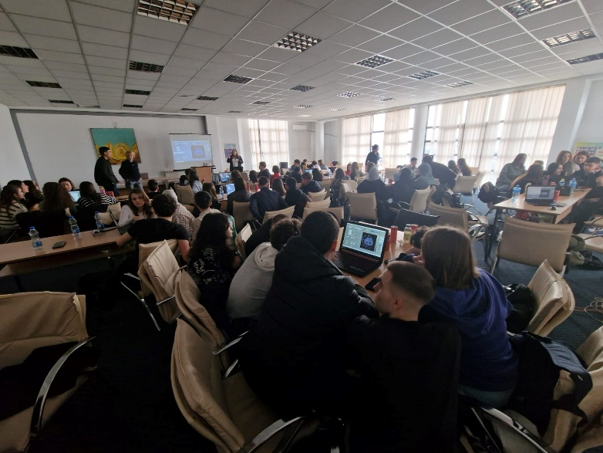
Particle Therapy Masterclass 2024
100 high school students Skopje

Slide 13
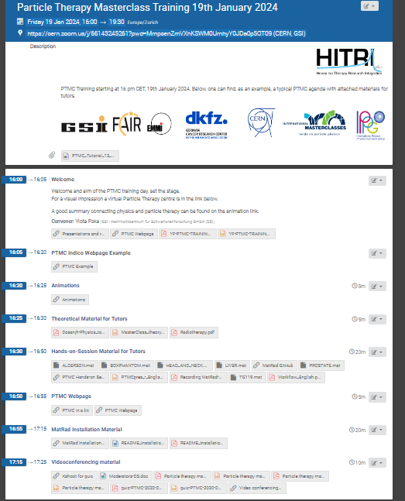
Particle Therapy Masterclass 2024
272 Tetova, 100 high school students Skopje
-Train the tutors sessions
4 Bachelor students
4 Bachelor and Master thesis
- Many friendships, connection and sharing information from HitriSchools

Slide 14
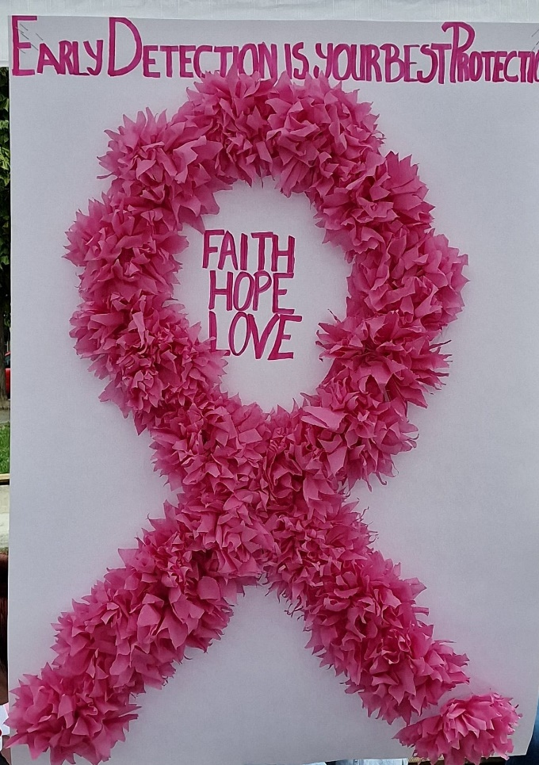
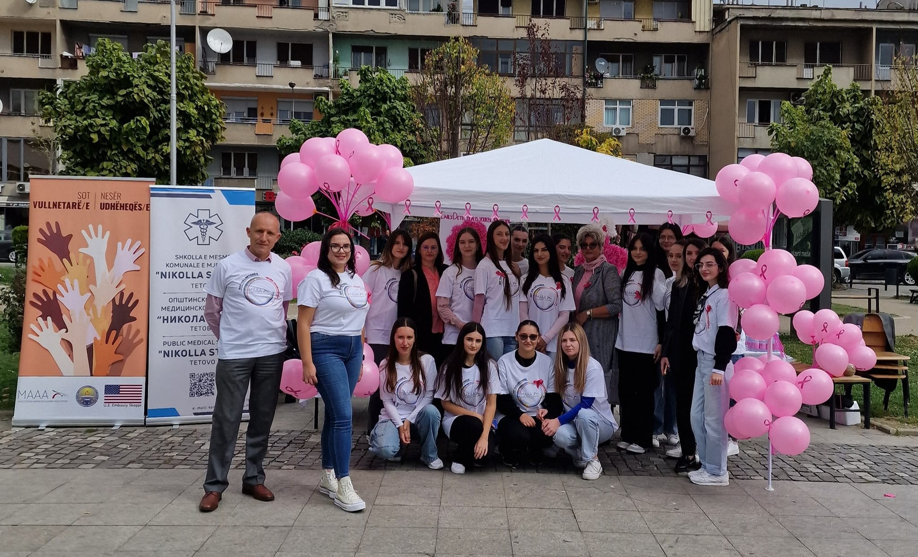
Breast month cancer awareness
Here’s to strong woman, may we know them, may we be them or may be raise them

Slide 15

AIM: SURVIVAL AND QUALITY OF LIFE
Thank you

