Slide 1
Technical Meeting on MQXFB08 Coils:
Introduction
Susana Izquierdo Bermudez, Nicholas Lusa, Penelope Quassolo, Lucie Baudin
06/11/2024

Slide 2
Objective
Summarize manufacturing data and non-conformities for the coils to be assembled in MQXFB08, built using the same procedures as MQXFB03/04/05/06/07 coils
Agenda
  Conductor and cable: J. Fleiter, S. Hopkins
  Coil fabrication: N. Lusa
  Coil ordering: E. Ravaioli and P. Matilde Quassolo

Slide 3
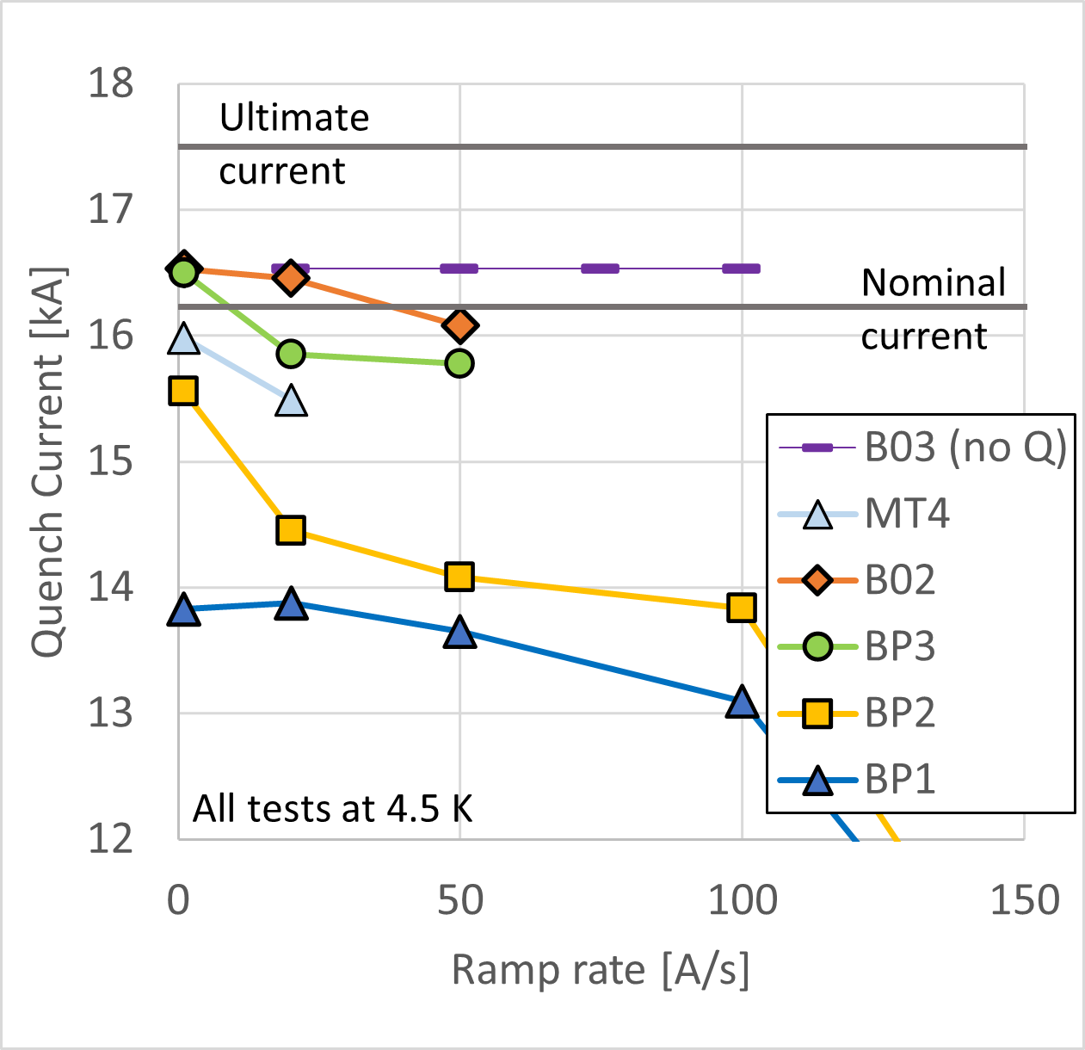
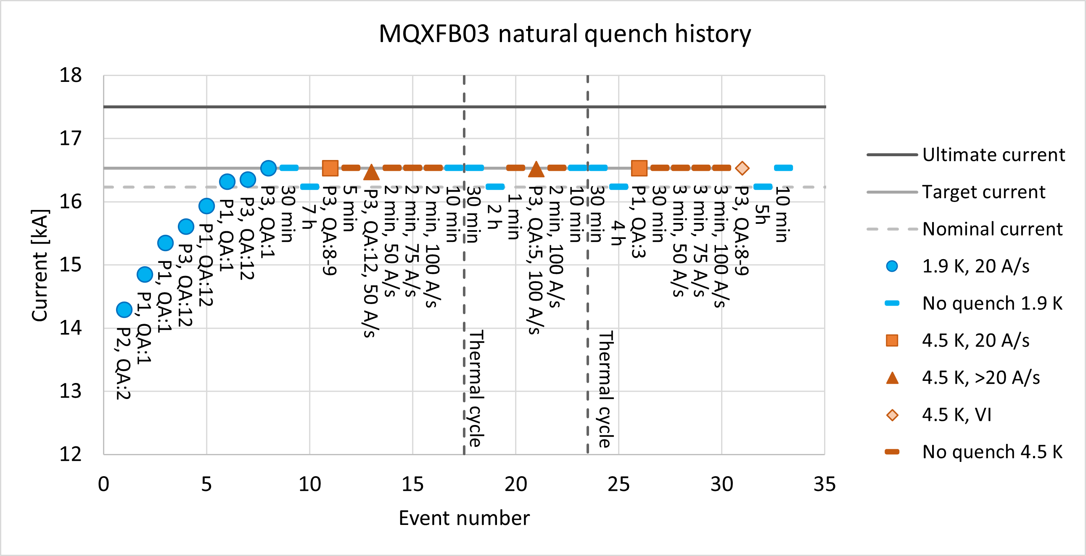
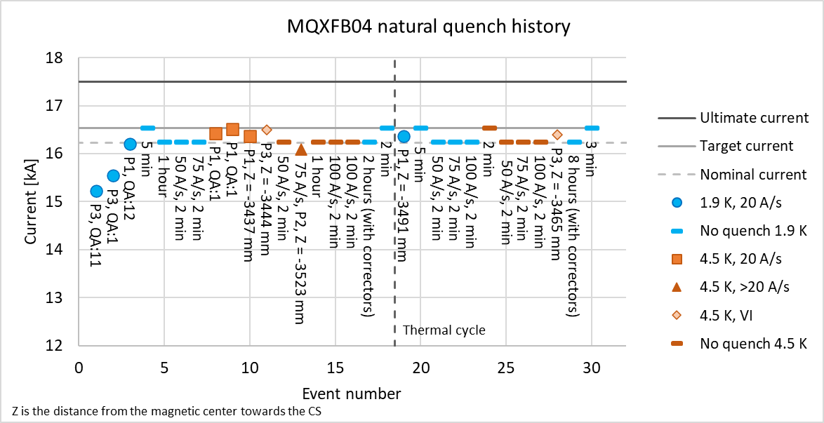
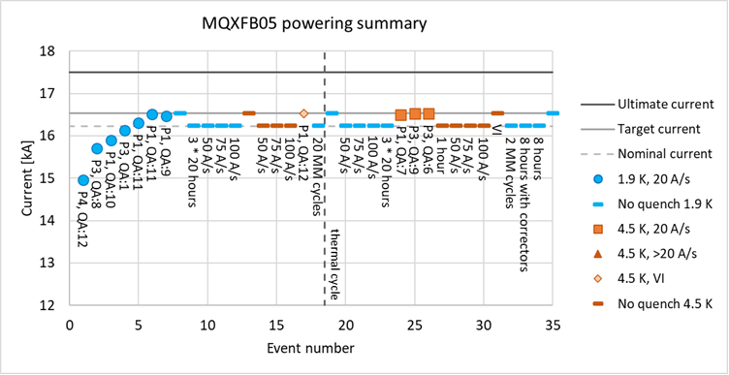
Introduction – MQXFB magnet performance
  MQXFB03 implement a series of features to improve the coils→ no signs of conductor limitation
  MQXFB04 and MQXFB05 confirms the results
  Status of next magnets:
    MQXFB06: cold mass assembly done, plan to test January 2025
    MQXFB07: cold mass assembly ongoing

Slide 4
Main documents –
Acceptance criteria
Acceptance Criteria
Conductor performance | EDMS 2268225
Heat treatment | EDMS 2333499
Impregnation | EDMS 2428078
Coil geometry | EDMS 2496377
Electrical tests | EDMS 2447487
Also see:
  MIP: EDMS 1996152
  Flow Chart: EDMS 1736688

Slide 5
Main fabrication reports
MTF link (FUFs, NCR and all info) | CR148 | CR149 | CR150 | CR151
Conductor performance | 3185366 | 3185367 | 3185368 | 3185369
Cabling | 3091621 | 2772479 | 2774489 | 2791624
Heat treatment | 3135945 | 3137247 | 3152611 | 3160739
Coil geometry | 3150945 | 3160720 | 3169187 | 3176430
Final electrical tests | 3139769 | 3172270 | 3162694 | 3172811

