Slide 1
MQXFB08 Coils:
Coil fabrication, manufacturing data and NC
N. Lusa, S. Izquierdo Bermudez, L. Baudin, A. Vieitez Suarez, P. M. Quassolo, L. Grand-Clement, R. Berthet
On behalf of MQXFB Coil Fabrication and QA team
https://indico.cern.ch/event/1470347/
06/11/2024

Slide 2
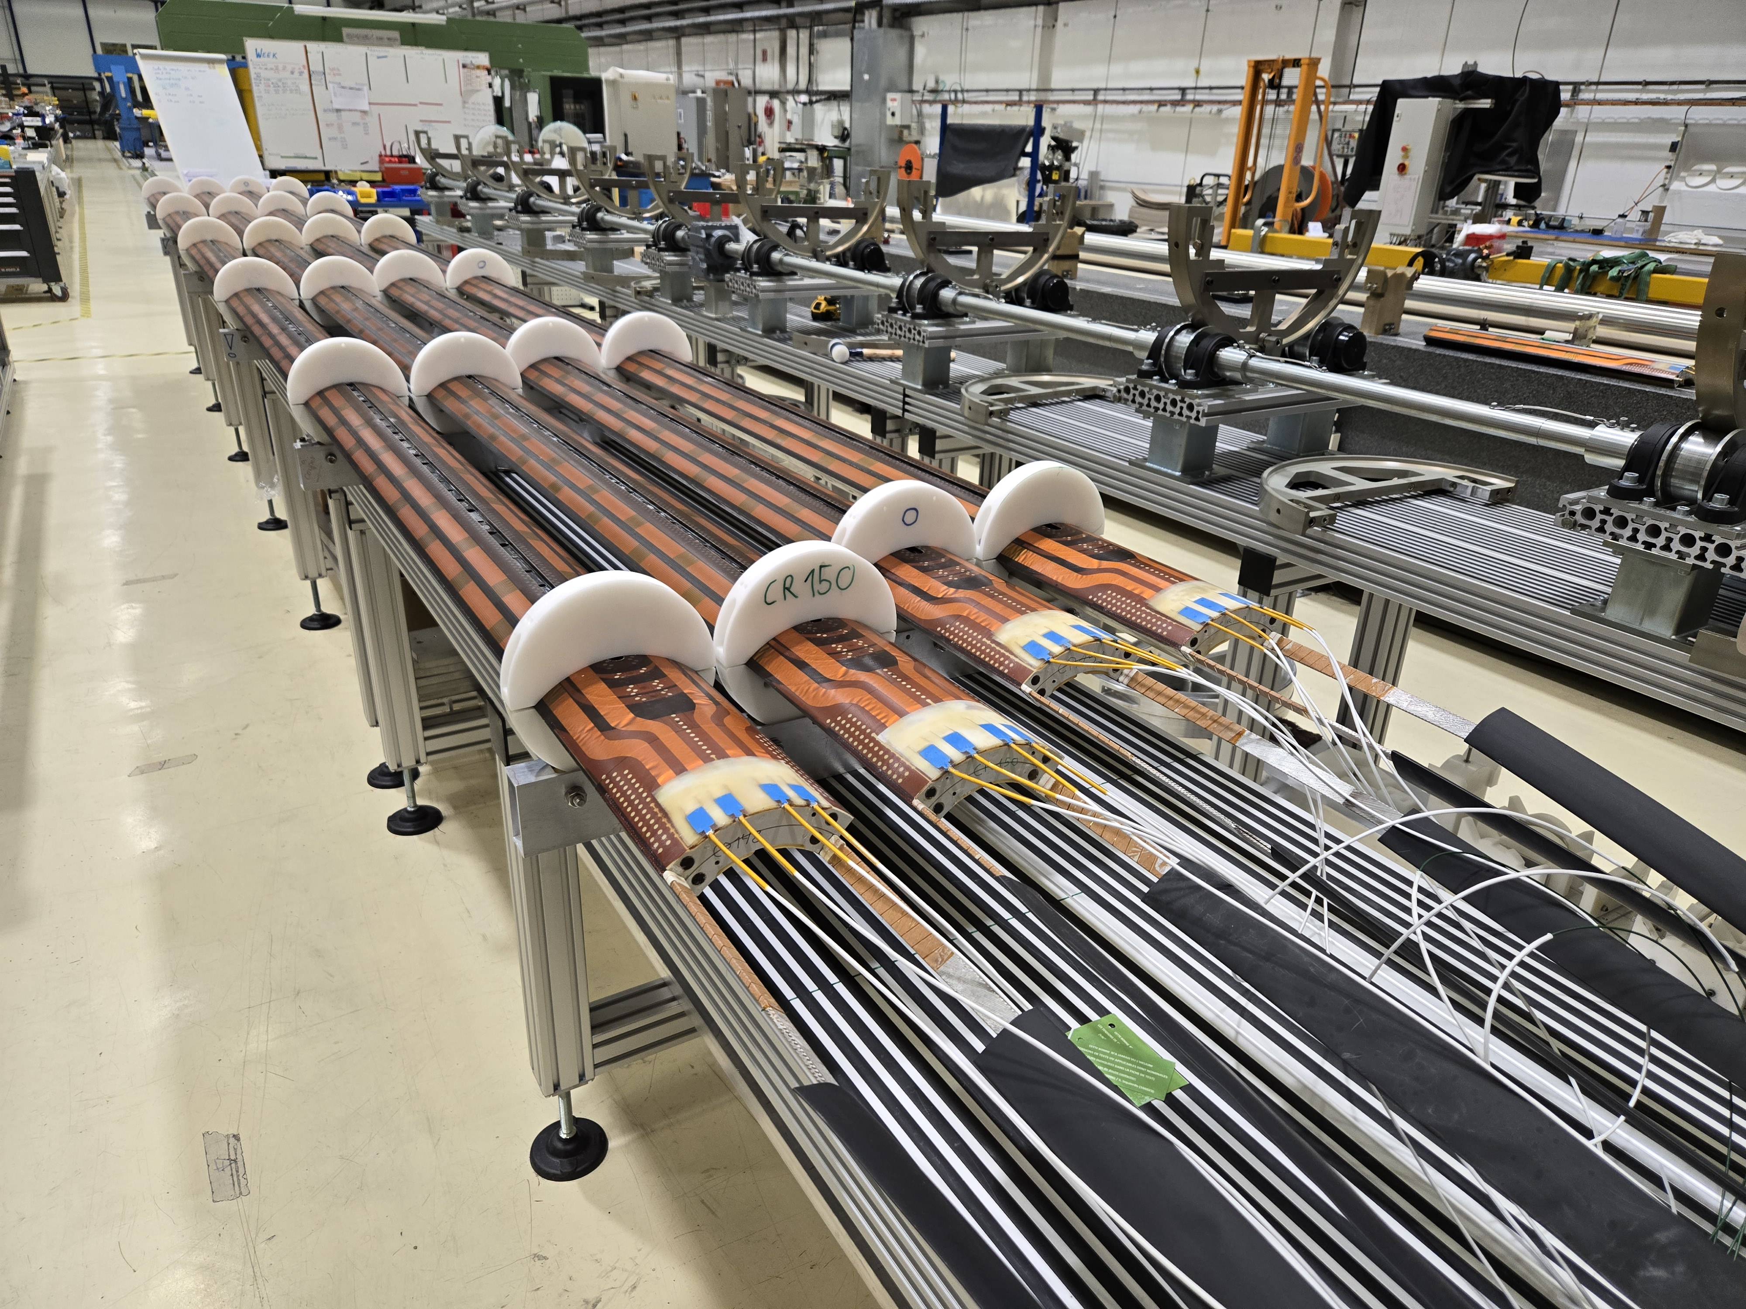
Coils for MQXFB08
Virgin coils available at the time of assembling MQXFB08
  Coil 109: Spare coil of MQXFBP1 (no b₆ correction)
  Coil 114: Quarantined, due to the electrical insulation issue QH to coil
  Coil 116: Quarantined, due to conductor damage during handling
  Coil 122: Conform coil
  Coils 148-149-150-151: Coils proposed for MQXFB08

Slide 3
Outline
Manufacturing data
Non-conformities
Conclusion/Proposal

Slide 4
Outline
Manufacturing data
  Analysis of MQXFBP2 coils and comparison improvements with respect to MQXFBP1 available here
  Analysis of MQXFBP3 coils and comparison improvements with respect to MQXFBP2 available here
  Analysis of MQXFB02 coils and comparison improvements with respect to MQXFBP3 available here
  Analysis of MQXFB03 coils and comparison improvements with respect to MQXFB02 available here
  Coil fabrication data and non-conformities of MQXFB04 coils available here
  Coil fabrication data and non-conformities of MQXFB05 coils available here
  Coil fabrication data and non-conformities of MQXFB06 coils available here
  Coil fabrication data and non-conformities of MQXFB07 coils available here
Non-conformities
Conclusion/Proposal

Slide 5
Cable insulation thickness
Target insulation thickness is 145 (+0 µm/-10 µm)
Fine tuning insulation thickness

Slide 6
Cable insulation thickness
Target insulation thickness was 145 ± 5 µm
  Measured insulation systematically above target
  Fine tuning of the insulation parameters in 2023 → well centered aroud 145 µm
  Since then, recurrent mechanical instability → popped strands detected during the cable insulation inspection (not in the last 4 cables used for CR151, CR152, CR153 and CR154)
    Insulated cable HCMQXFBC09-4200419A (used in coil CR143)
    Insulated cable HCMQXFBC09-4200454A (used in coil CR145)
    Insulated cable HCMQXFBC09-4200455A (used in coil CR148)
    Insulated cable HCMQXFBC09-4200409A (used in coil CR149)
    Insulated cable HCMQXFBC09-4200412A (used in coil CR150)
Details in NCRs section

Slide 7
Reaction and impregnation fixture closure
REACTION
The torque required to close the fixture is directly linked to the number of heating cycle the bolts were subjected to
  Nominal torque required: 160 Nm
  For B08 coils nominal torque was required (no need to further increase the torque)
  IMPREGNATION
  Very reproducible from coil to coil
    OL impregnation closure: 60 Nm
    IL impregnation closure: 120 Nm (never needed more)
  Gap between blocks/plate is measured at determined steps of the closure
  The 4 coils proposed for B08 assembly were impregnated using the same impregnation fixture (#15)

Slide 8
Coil elongation during reaction fixture opening
Coil elongation during reaction fixture opening
Magnet | Coil # | CS [mm] | NCS [mm] | Total [mm] | Total/L_{m} | Fab. Line
B03 | CR128, 129, 130, 131 | 2.6 - 4.2 | 3.1 - 4.8 | 5.7 - 8.7 | 0.8 - 1.2 ‰ | CERN
B04 | CR132, 133, 134, 135 | 2.1 - 4.3 | 2.9 - 3.8 | 5.1 - 8.0 | 0.7 - 1.1 ‰
B05 | CR136, 137, 139, 140 | 2.0 - 3.4 | 2.1 - 3.6 | 4.1 - 7.0 | 0.6 - 1.0 ‰
B06 | CR141, 142, 143, 144 | 2.9 - 3.4 | 2.8 - 3.7 | 5.8 - 6.6 | 0.8 - 0.9 ‰
B07 | CR138, 145, 146, 147 | 2.0 - 3.4 | 2.6 - 3.5 | 4.6 - 6.9 | 0.6 - 1.0 ‰
B08 (proposal) | CR148 | 2.8 | 2.6 | 5.4 | 0.7 ‰
 | CR149 | 1.9 | 2.2 | 4.1 | 0.6 ‰
 | CR150 | 2.7 | 2.9 | 5.6 | 0.8 ‰
 | CR151 | 1.6 | 2.0 | 3.6 | 0.5 ‰
 | AUP 146 -147 | 2.9 - 3.6 | 0.6 - 0.4 | 3.6 - 4 | 0.8 ‰ - 0.9 ‰ | FNAL
 | AUP 237 -238 | 1.6 - 2.1 | 1.6 - 2.1 | 3.1 - 4.1 | 0.7 ‰ - 1 ‰ | BNL

Slide 9
Pole gaps
In new generation MQXFB coils pole gaps in the middle of the coil are not closed after reaction, as it is the case for AUP coils
Pole gap 1.5 mm
Pole gap 1.1 mm
Pole gap 1.2 mm
RE
LE

Slide 10
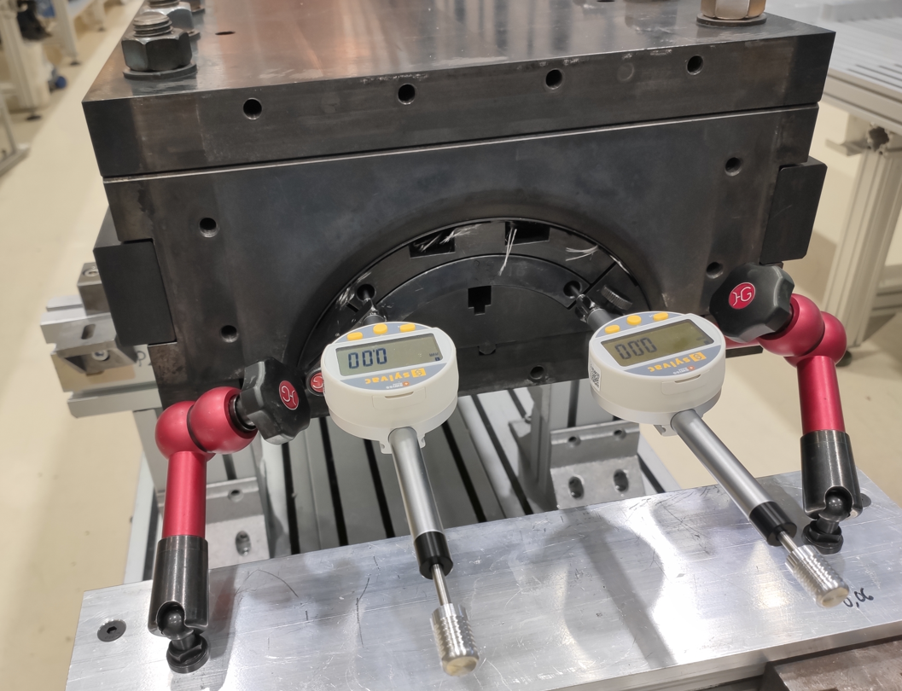
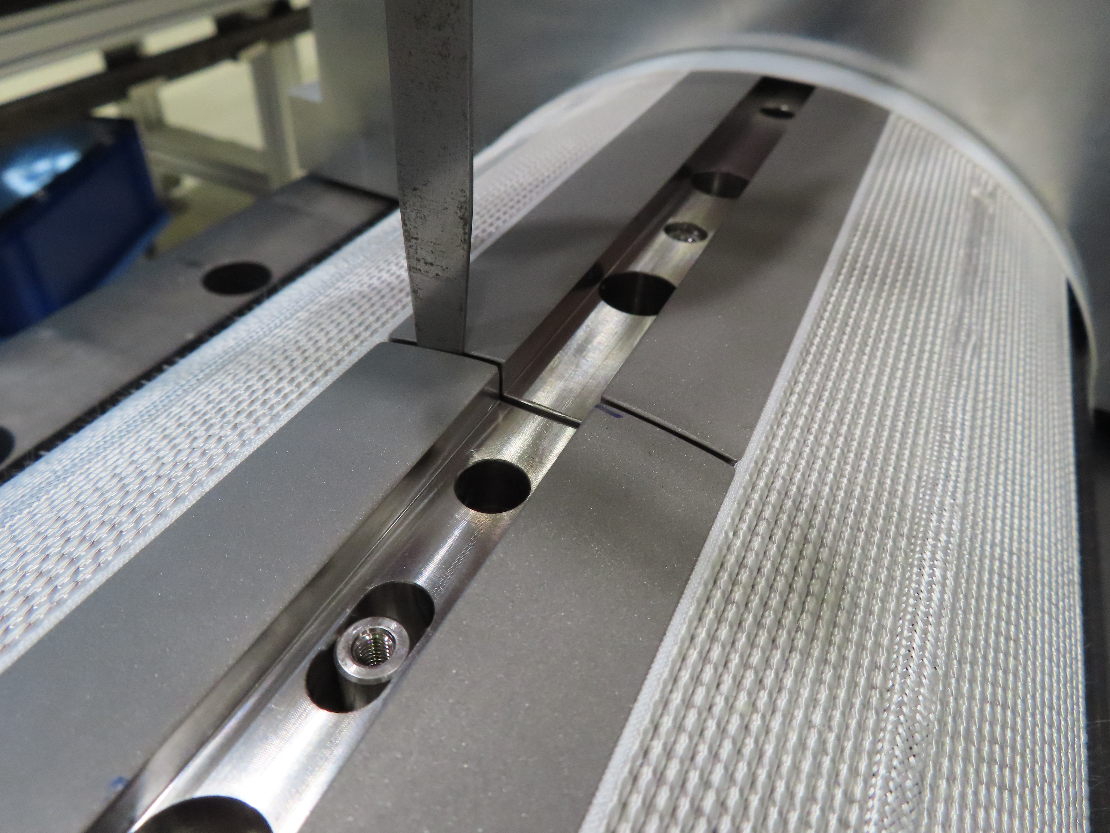
Pole gaps vs Coil elongation
The reacted coil gradually elongates on both ends during the mold opening and pole gap increases (indico 1220226)
From coil CR150 pole increased: 2.46 mm/m → 2.69 mm/m
Coil # | Total /L_{m} [‰] | Manufacturing line
CR127 | 1.50 | CERN w/ binder
CR128 – CR151 | 0.83 | CERN new gen. coils
AUP 146 – 147 | 0.89 | FNAL
AUP 237 – 238 | 0.88 | BNL

Slide 11
Coil hump after reaction

Slide 12
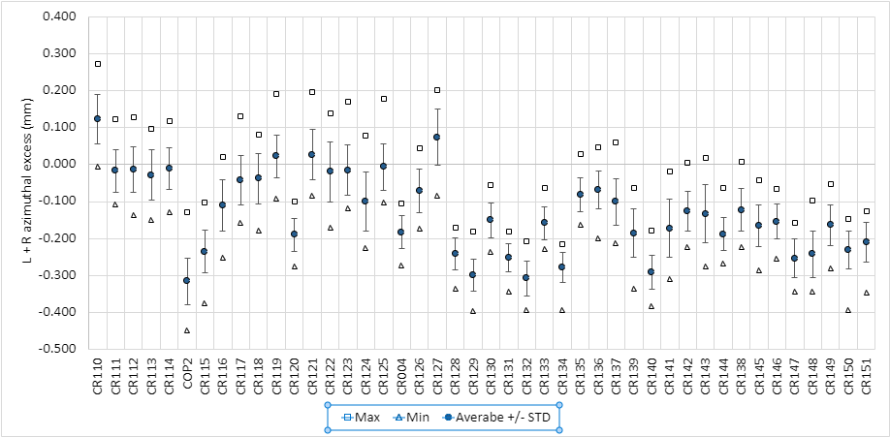
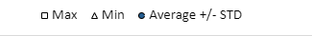
Impregnated coil geometry (Faro arm) - L+R
The coils do not have ‘belly’

Slide 13
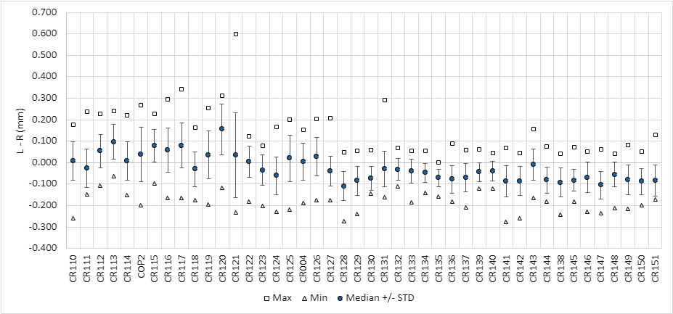
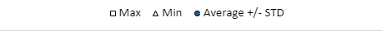
Impregnated coil geometry (Faro arm) – L-R
In terms of asymmetry, within specification (<0.3 mm) → no need of pole key machining

Slide 14
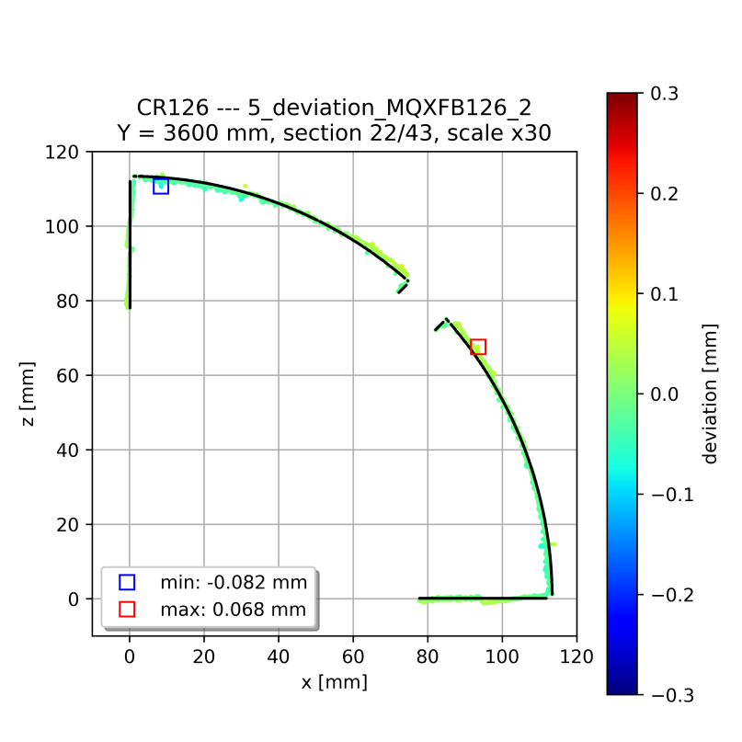
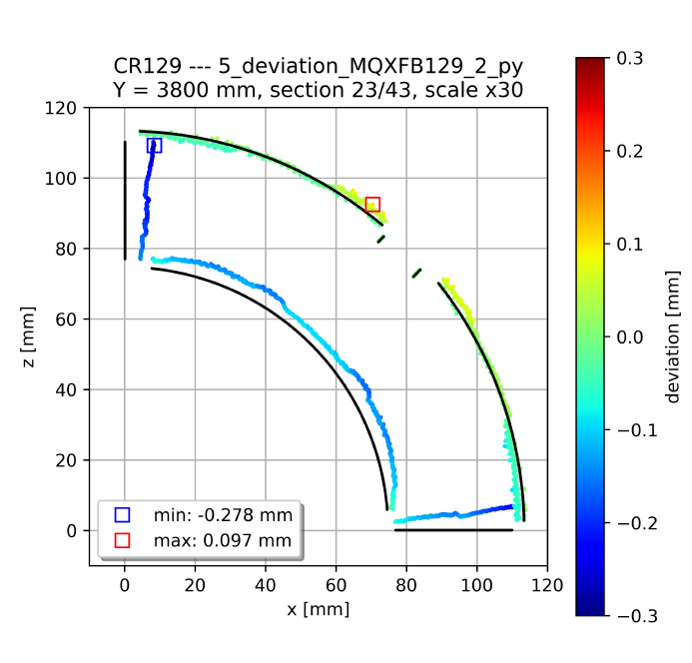
Impregnated coil geometry (Faro arm)
Typical cross-section standard coil
Systematic behavior in terms of coil shape to previous coils without binder: mid-plane has a little ‘wedge’ (the coil covers 89.6 degrees instead of 90 degrees)
Based on FEM we expect ≈ 15 MPa increase in the mid-plane stress (inner edge) under conservative assumptions, confirmed with a mock-up test, see https://indico.cern.ch/event/1260584/
Typical cross-section coil without binder in the OL
Further detail about coil metrology in Penelope’s presentation

Slide 15
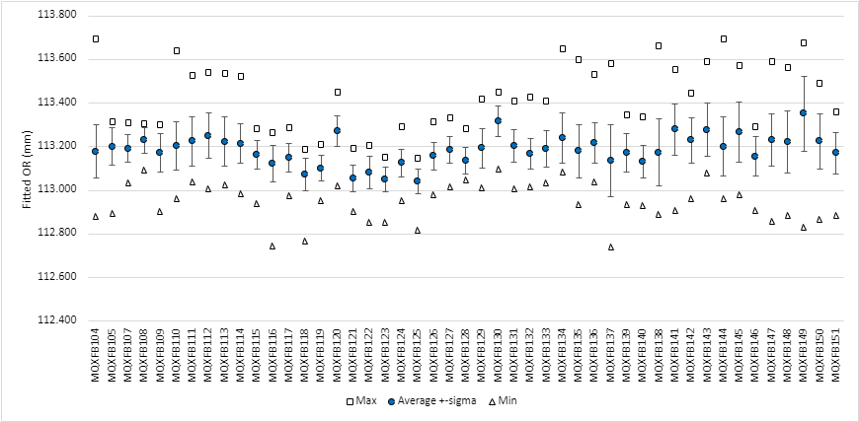
Impregnated coil geometry (Faro arm) - OR
The proposed coils are very similar in terms of OR

Slide 16
Final coil length
B03
Pole gap change: 1.5 mm → 1.1 mm
B03
Pole gap change (1.5 mm → 1.1 mm)
Pole gap change:
1.1 mm → 1.2 mm
B04
B04
B05
B05
B07
B08 proposal
B07 proposal
B06
B06

Slide 17
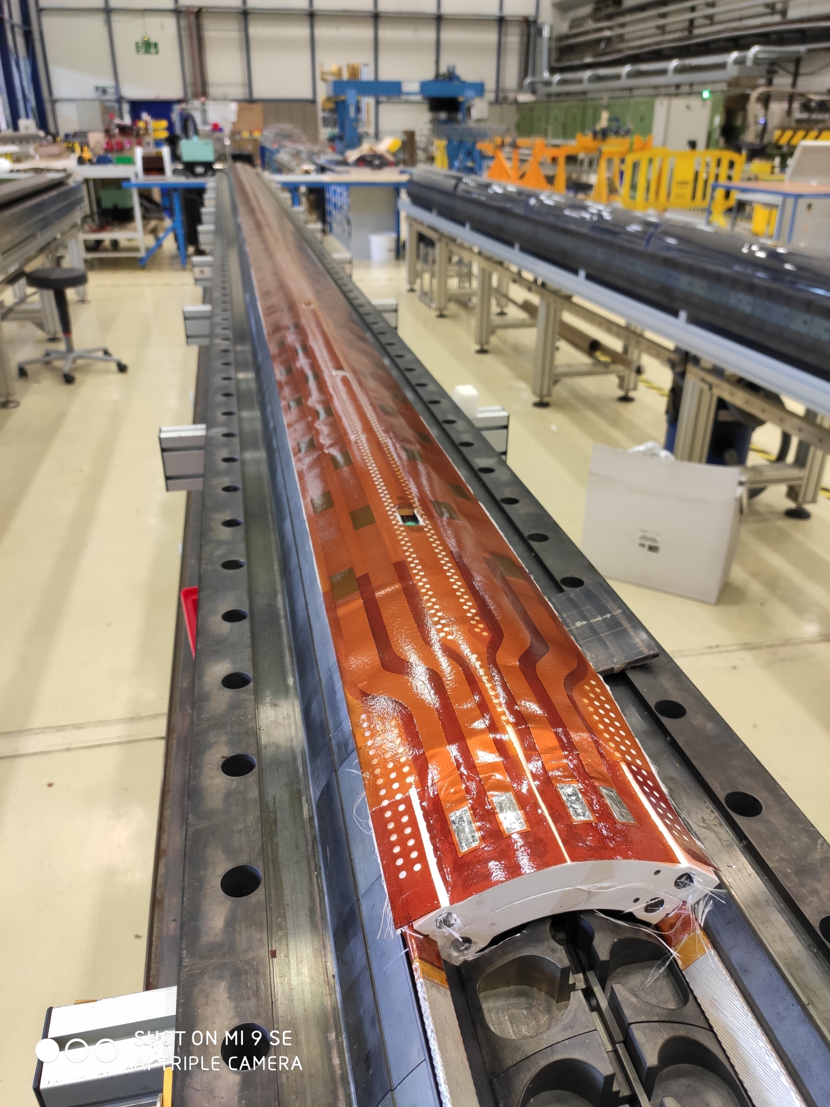
Dielectric strength
Coil to pole
Since coil 114, coil to pole insulation always above the minimum desired thanks to the reduction of ceramic binder and the use of heat cleaned fiber glass around the pole
QH to coil
From coil 126, ‘mini-swap’ quench heaters with improved fabrication process and higher qualification test voltages (see EDMS 2646046)
  From production performance monitoring plots EDMS 2374351

Slide 18
Dielectric strength

Slide 19
Outline
Manufacturing data
Non-conformities
Conclusion/Proposal

Slide 20
Analysis of non-conformities
CR148 | 3093358 | Popped strands during cable insulation inspection | Non-critical level 2
 | 3118068 | Emergency stop during outer layer curing | Non-critical level 1
 | 3129199 | Dwell1 and dwell2 durations out of specifications | Non-critical level 1
CR149 | 2811007 | Popped strands observed during cable inspection | Non-critical level 3
 | 3138474 | Dwell1 duration out of specification | Non-critical level 1
 | 3154270 | Superficial defect on the OD of the impregnated coil | Critical level 3
CR150 | 3132312 | Popped strand repair | Non-critical level 1
CR151 | 3170110 | Epoxy resin leak during impregnation | Non-critical level 1
Very minor, not described in further detail in the slides
Described in detail in the next slides
Series of minor nonconformities in heat treatment, see next slides

Slide 21
RHT NCR – dwell1
The duration of dwell1 is slightly out of specification in 2 out of 4 coils:
  CR148: 52.11 h
  CR149: 52.02 h
  CR150: 51.84 h
  CR151: 51 h
  Spec. 52 h maximum allowed
Temperature homogeneity within specification
Dwell1 duration reduced

Slide 22
RHT NCR – dwell2
The duration of dwell2 is out of specification for 1 coil out of 4:
  CR148: 52.29 h
  CR149: 51.74 h
  CR150: 51.34 h
  CR151: 50.94 h
  Spec. 52 h maximum allowed
Temperature homogeneity within specification
Dwell2 duration reduced

Slide 23
RHT NCR – dwell3
The duration of dwell3 is within specification for the 4 coils (52 h max. allowed)
Temperature homogeneity within specification and Dwell3 mean H/2 within specifications
Dwell3 duration reduced

Slide 24
CR148 (NCR 3093358) → Popped strands during cable inspection
During the visual inspection of the cable insulation, 102 popped strands were detected between 30m and 442m from the beginning of the spool
All the popped strands were set back using a dedicated pliers
The popped strands are expected to be in the outer layer of the coil
During winding no popped strand was detected by the operator
Investigations pointed to:
  Cable insulation process
    This issue starts appearing in a systematic way with the fine-tuning of the insulation parameters → phenomenon still to be understood
    Issue not observed in the last 4 ULs of cable received

Slide 25
CR149 (NCR 2811007) → Popped strands during cable inspection
During the visual inspection of the cable insulation, 1 important popped strand was detected at 6.5m from the beginning of the spool, then several minor ones up to 285m (about 50 popped strands)
All the popped strands were set back using a dedicated pliers
The popped strands are expected to be in the outer layer of the coil
During winding no popped strand was detected by the operator
Investigations pointed to:
  Cable fabrication
    No strand in the cable is affected by the non-standard oil issue
    No indication the problem is related to the cabling machine
  Cable insulation process
    This issue starts appearing in a systematic way with the fine-tuning of the insulation parameters → phenomenon still to be understood
    Issue not observed in the last 4 ULs of cable received

Slide 26
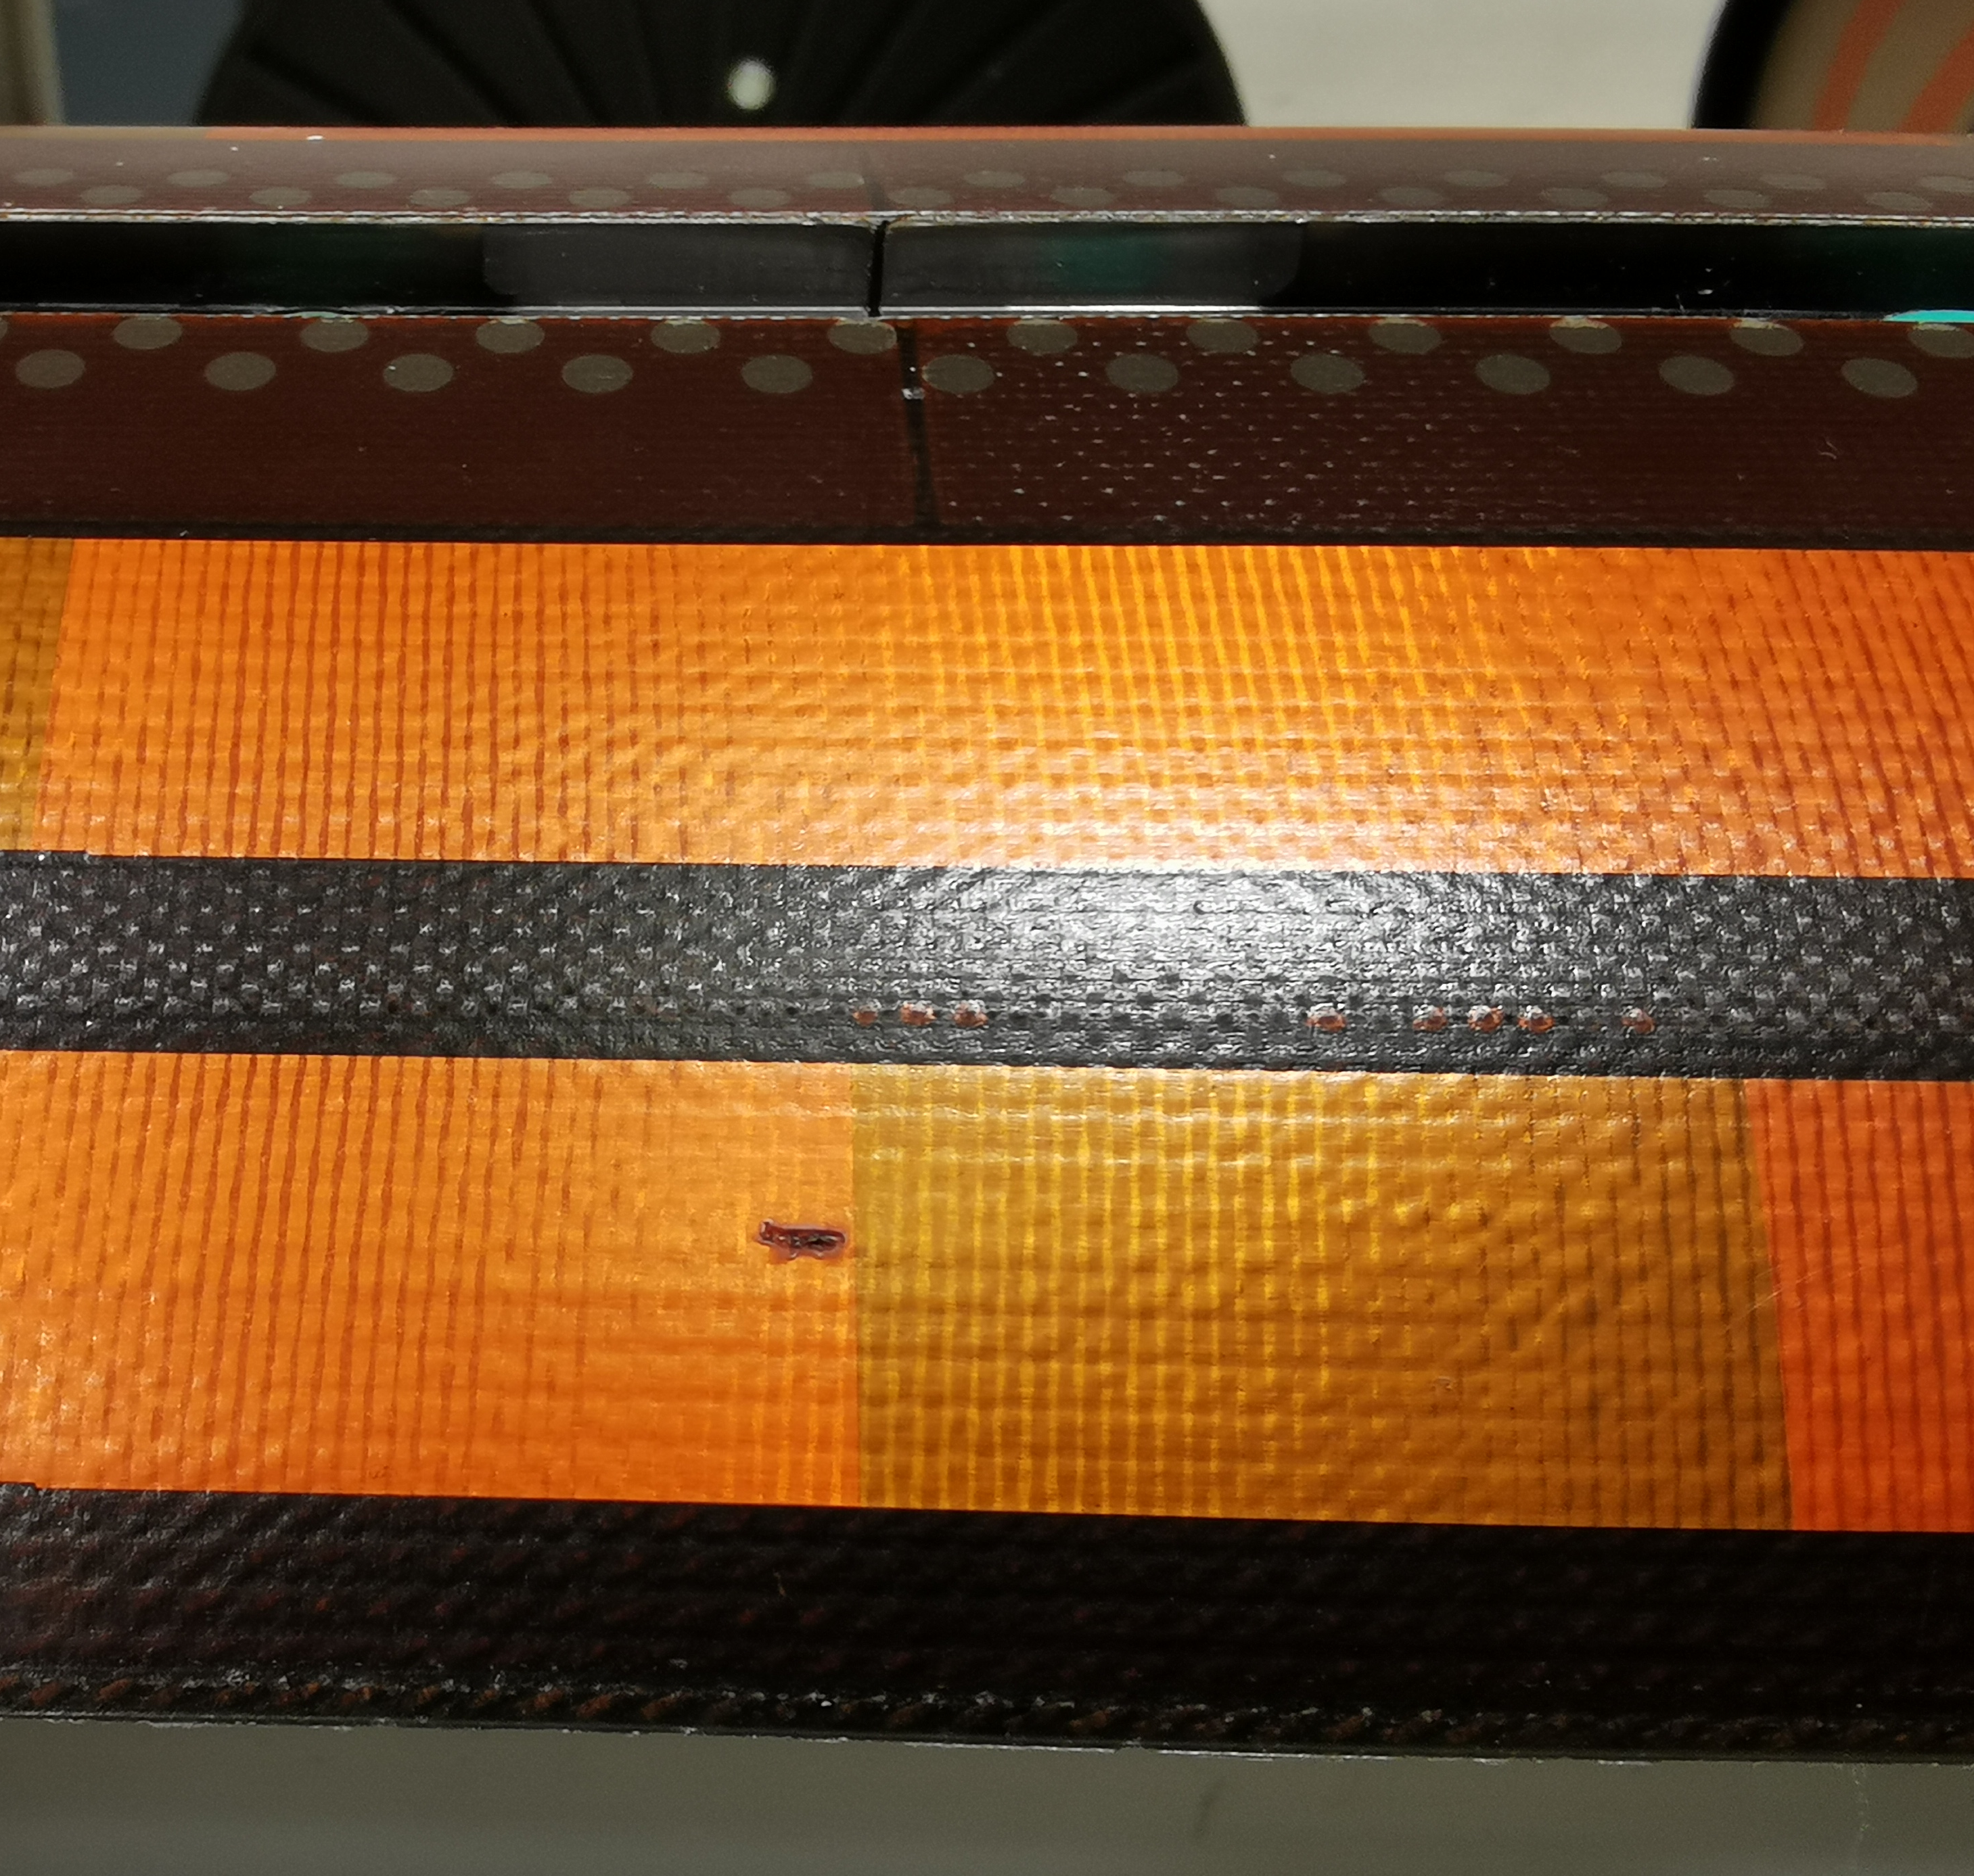
CR149 (NCR 3154270) → Defect on the QH after impregnation
  Superficial defect on the OD impregnated coil at the level of the heater strip at 5620 mm from LE side
  Pictures taken during preparation for impregnation were checked
    No defect was present neither on the OD of the reacted coil nor on the QH surface
  Action plan
  Thanks to EN-MME and TE-MSC-LMF-EE the following steps were performed
    Replica of the superficial defect to assess the depth (EDMS 3155368)
    Microscopy to better define the defect and its origin (EDMS 3155368)
    Staged dielectric test to assess the insulation QH to coil (EDMS 3156284)

Slide 27
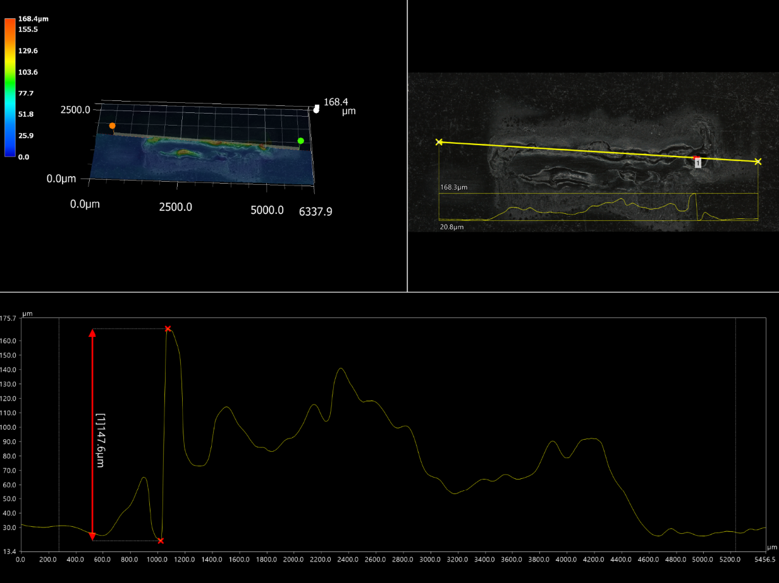
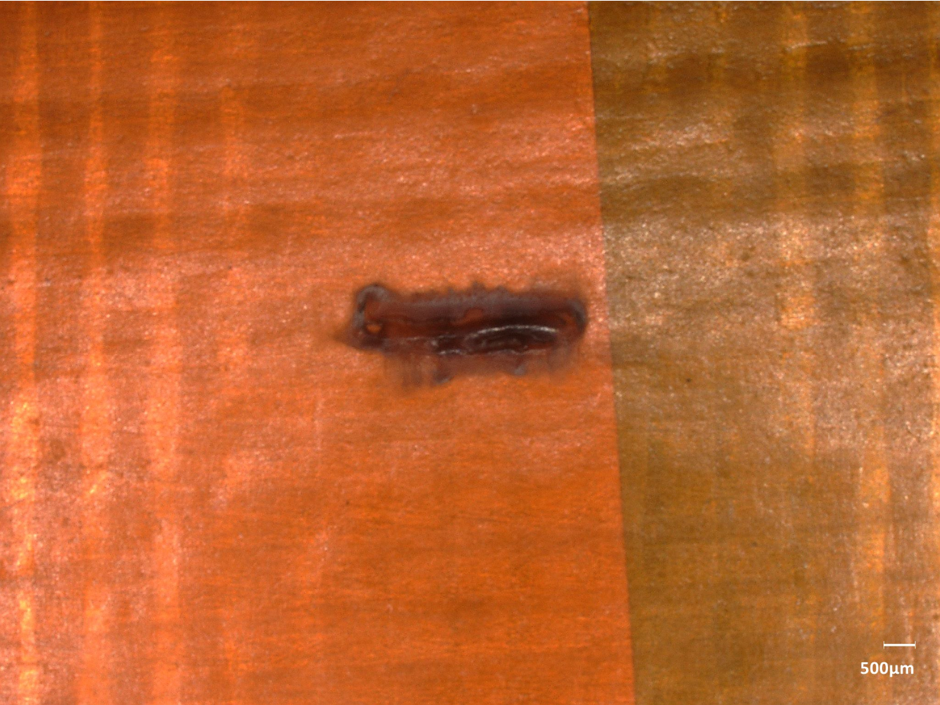
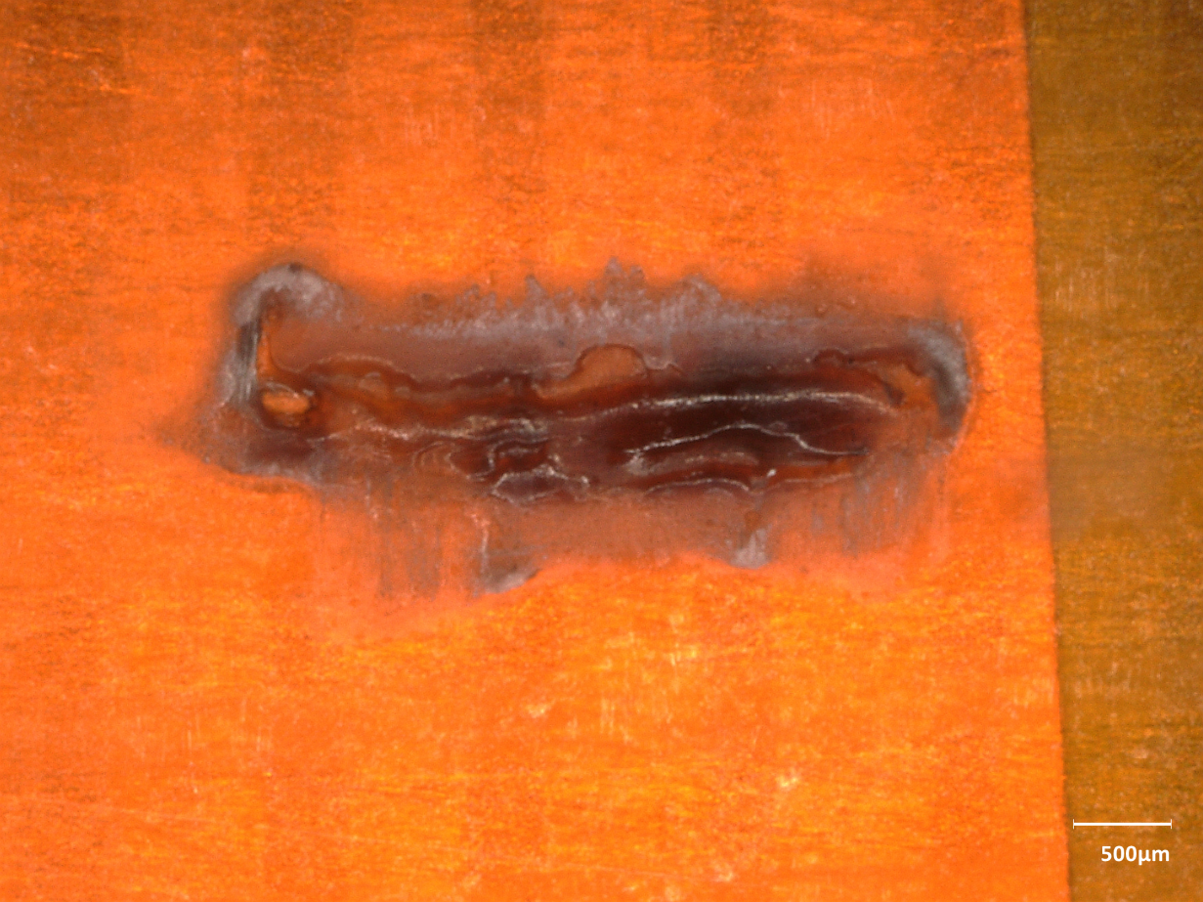
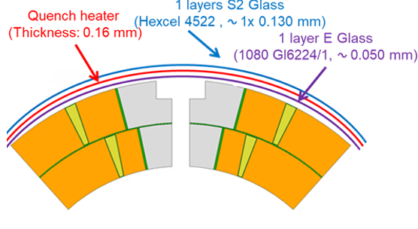
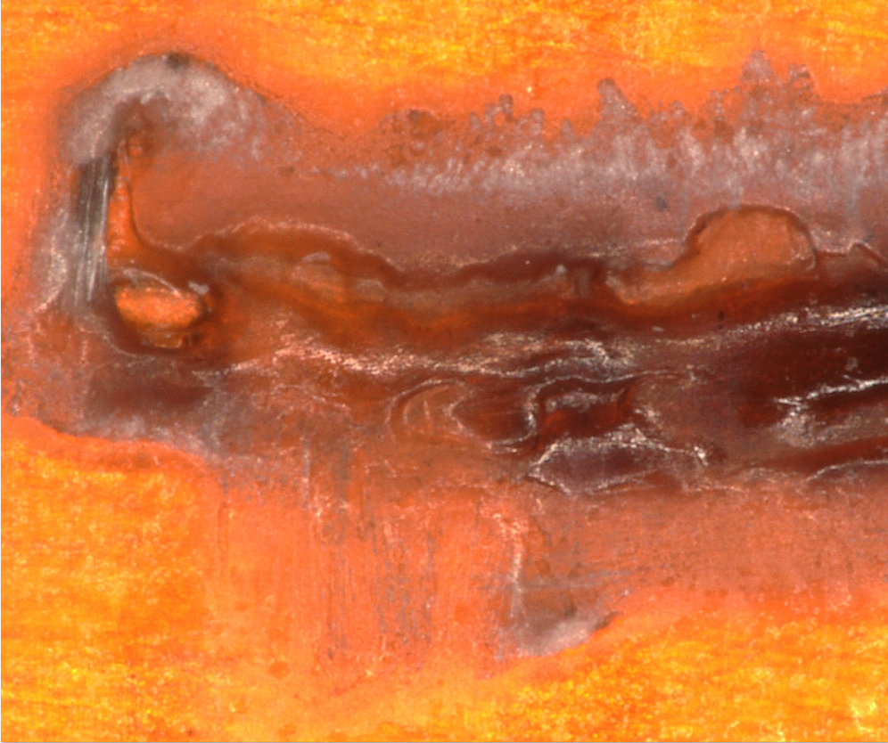
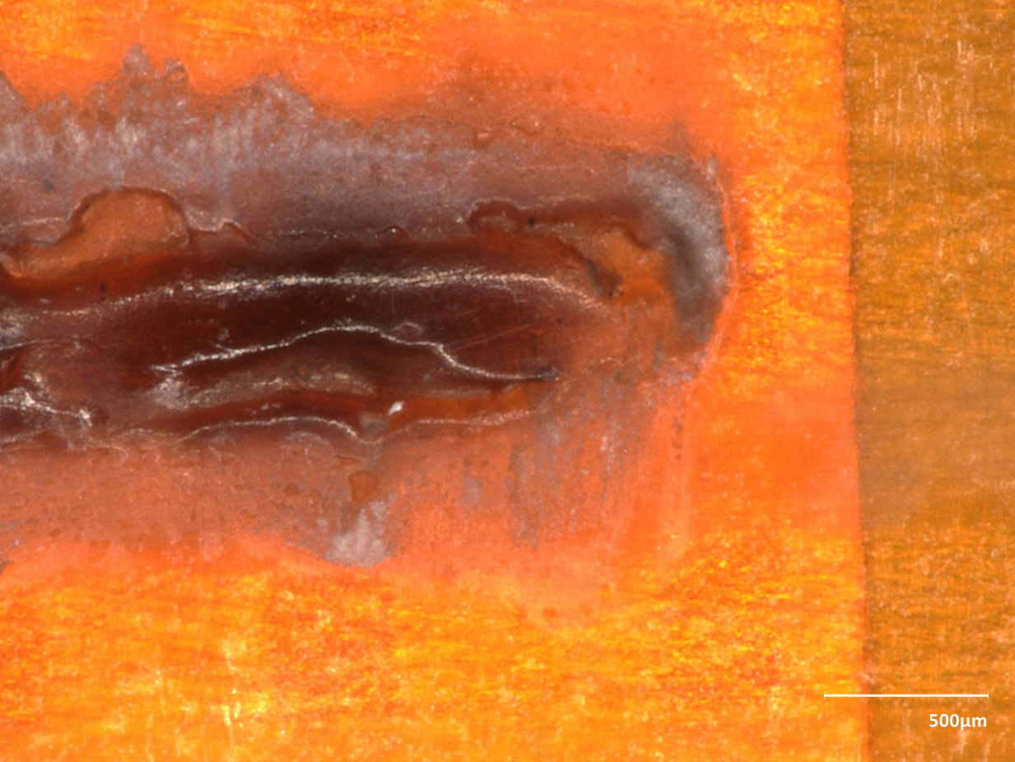
Results 1/2
  Based on the analysis of the replica the maximum depth of the defect is 150µm (in principle above the QH)
  Inspection of the surface showed a shallow cavity with a burnt aspect and no metallic particle was observed
  The electrical test passed successfully up to nominal (3.7kV for 120s)

Slide 28
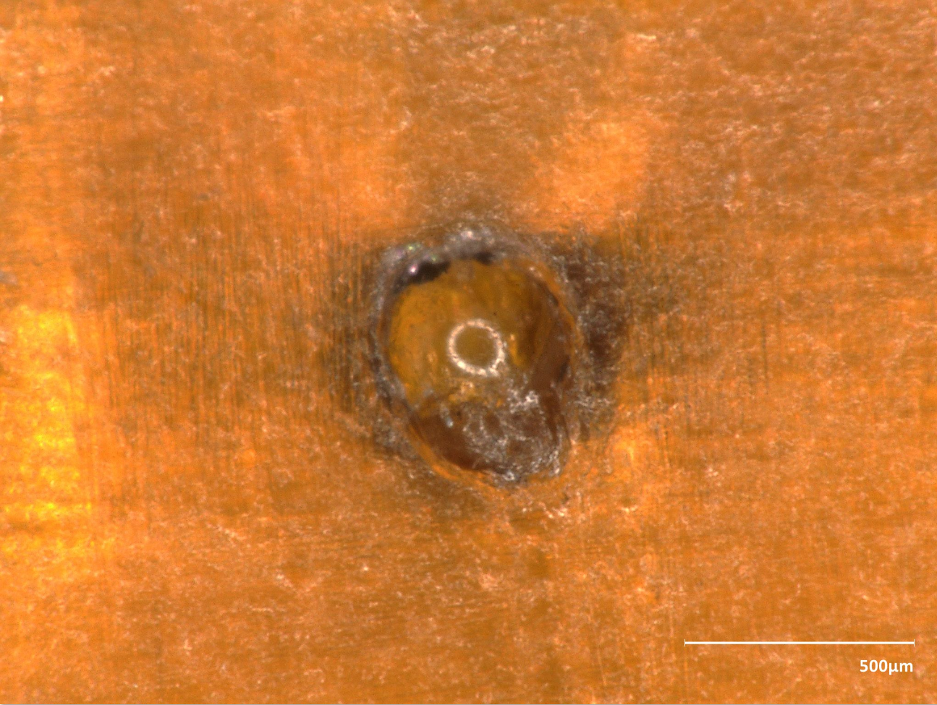
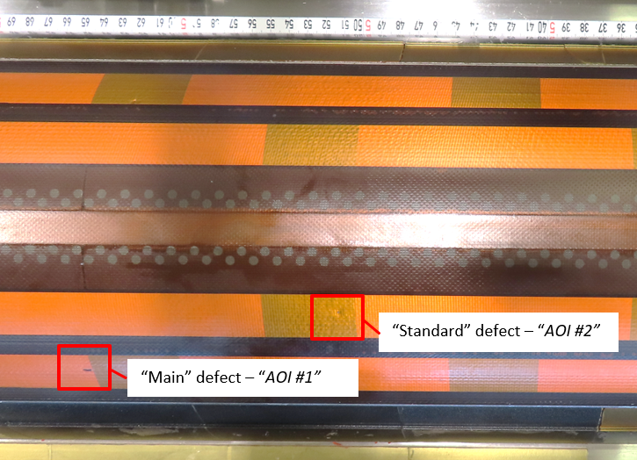
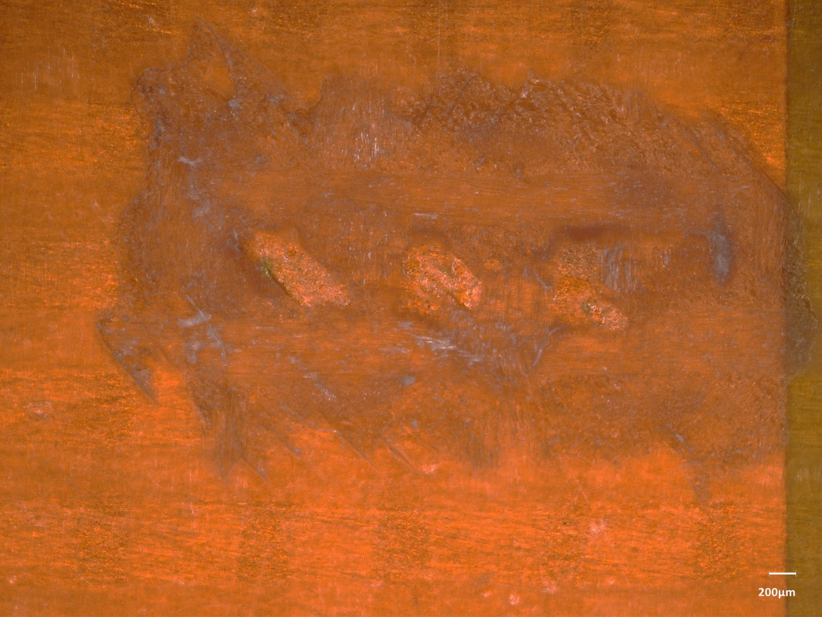
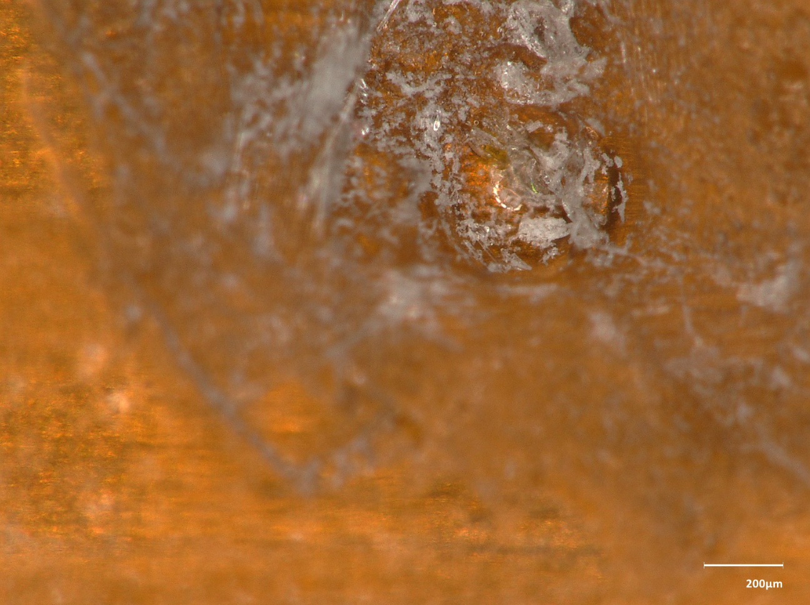
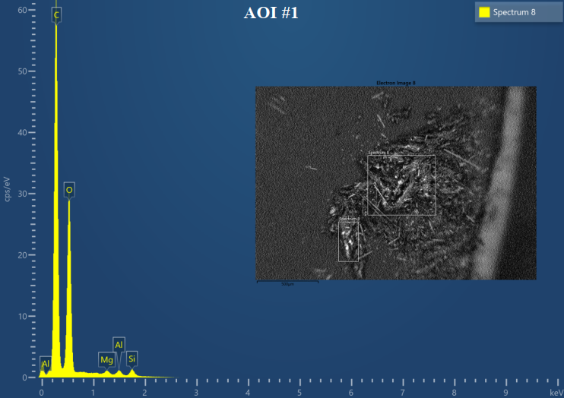
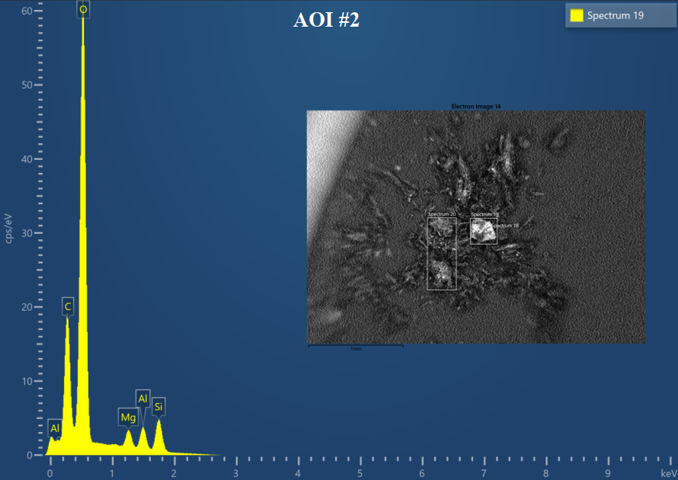
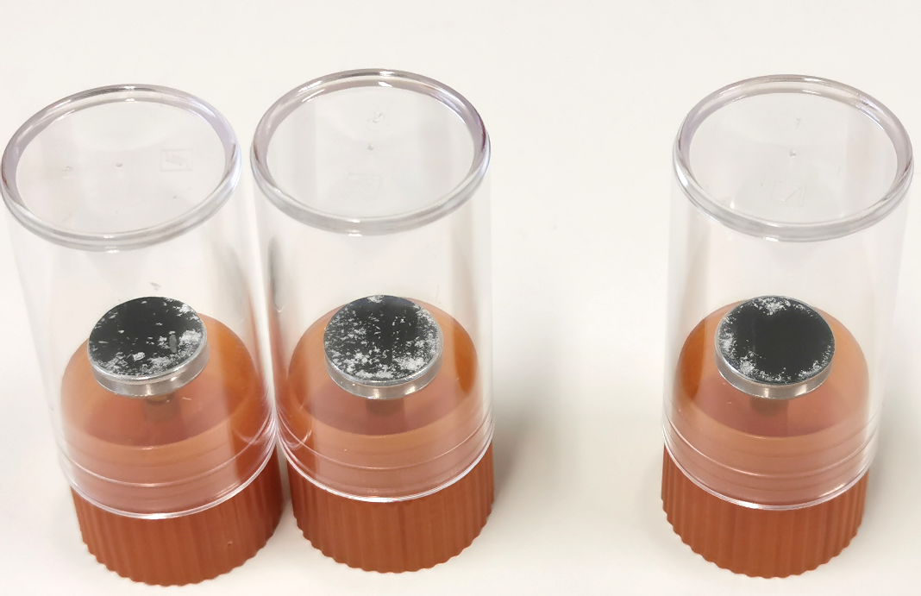
Results 2/2
  It was decided to collect samples from the main defect (AOI#1) and from a more standard one (AOI#2) to analyse with SEM-EDS (EDMS 3175548)
Defect AOI#1
Defect AOI#2
S2 glass composition: 64-66% SiO₂, 9-11% Al₂O₃, 9-11% MgO

Slide 29
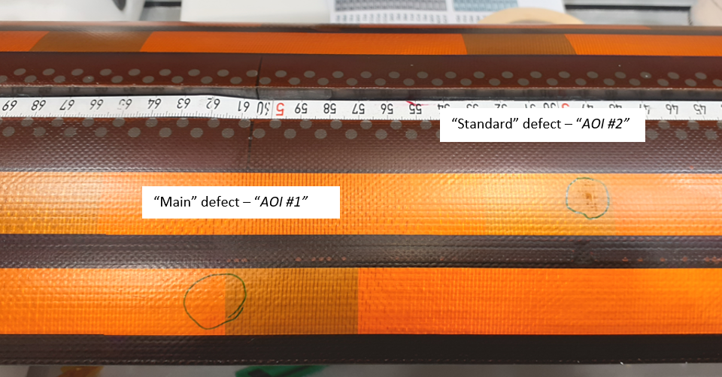
The end of the story
    The main defect AOI#1 disappered during the manual scratching (very superficial as from replica measurement)
    The integrity of the quench heater was not compromised (confirmed by the microscopy)
    SEM-EDS analysis did not reveal any exogeneous particle (only S2 glass chemical composition)
    Local repair of the scratched area was performed
    Coil acceptance electrical test successfully performed
More details in technical note EDMS 3177956

Slide 30
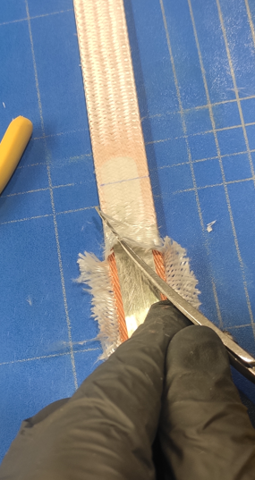
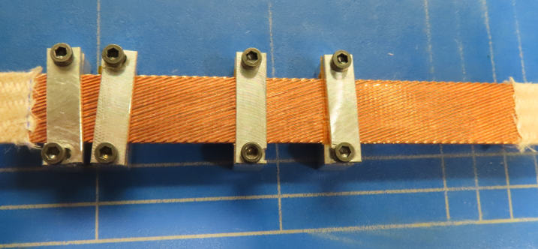
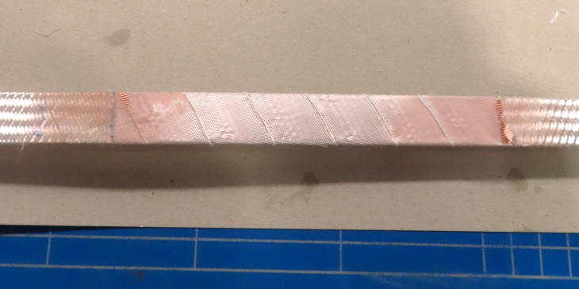
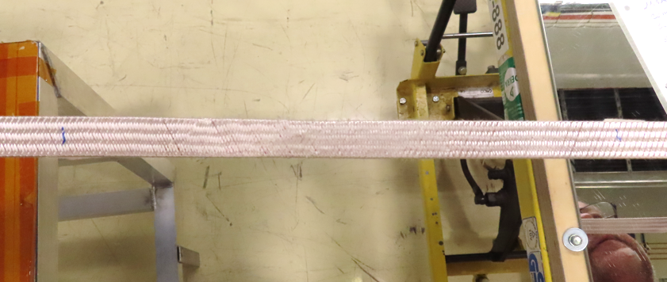
CR150 (NCR 3132312) → Popped strand repair
During the cable insulation inspection, among several minor popped strands, a more pronounced one was detected at 641m from the beginning of the spool
  For the major one an in-situ intervention at the supplier company was performed
Standard ‘repair’ strategy did not work (overthickness of 0.8mm)
  Decision to locally remove the S2 glass insulation to set back in place the concerned strand and restore the insulation
    S2 glass removal from the concerned area
    Strand back in place via dedicated clamps
    Restoring of the cable insulation wrapping 1 layer of 0.125 mm S2 glass desized
1
2
3

Slide 31
Outline
Manufacturing data
Non-conformities
Conclusion/Proposal

Slide 32
Conclusion/Proposal
Use CR148 - CR149 - CR150 - CR151 for MQXFB08 assembly
The coil instrumentation started and the magnet loading is planned for either the end of the year or beginning of 2025

Slide 33
Thank you!

