Slide 1

MQXFB08: Coil ordering
Penelope Matilde Quassolo, Susana Izquierdo Bermudez, Emmanuele Ravaioli
06/11/2024

Slide 2
Background
With the introduction of the mini-swap in MQXFB magnets, there is a bit less margin in the protection at low field to tolerate the spread on QH parameters (circuit resistance, capacitance/voltage of the HFU…).
The stablished requirements for the quench heater resistance are:
  Quench heater resistance at 293 K between 5.6 and 7.3 Ω
  Quench heater resistance at nominal operation conditions between 3.2 and 4.2 Ω
  At least 6 quench heater circuits with at least 3.4 Ω resistance at nominal operation conditions
To assure the fulfill of the requirements with margin, in addition to the usual criteria to select coil ordering (RRR and Cu/Sc ratio), a check on the spread of the QH resistance circuit is performed systematically before the assembly of every magnets, starting from MQXFB04.

Slide 3
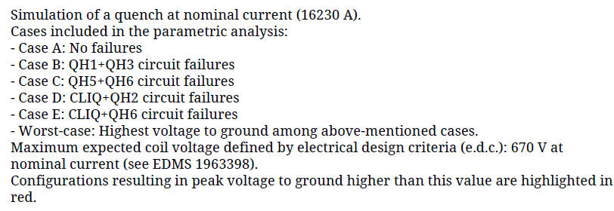
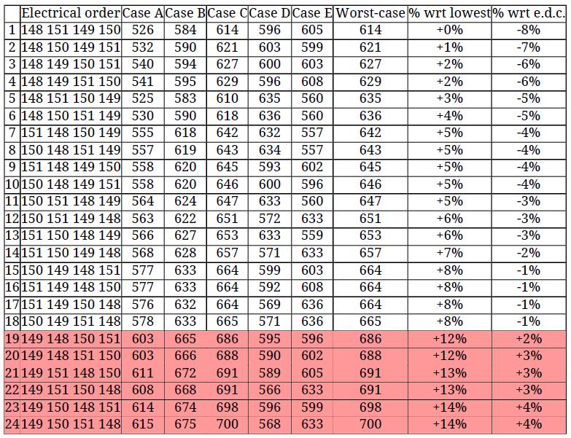
Coil sorting according to coil material properties
(RRR and Cu/Sc ratio)
Generated by E. Ravaioli, TE-MPE-PE

Slide 4
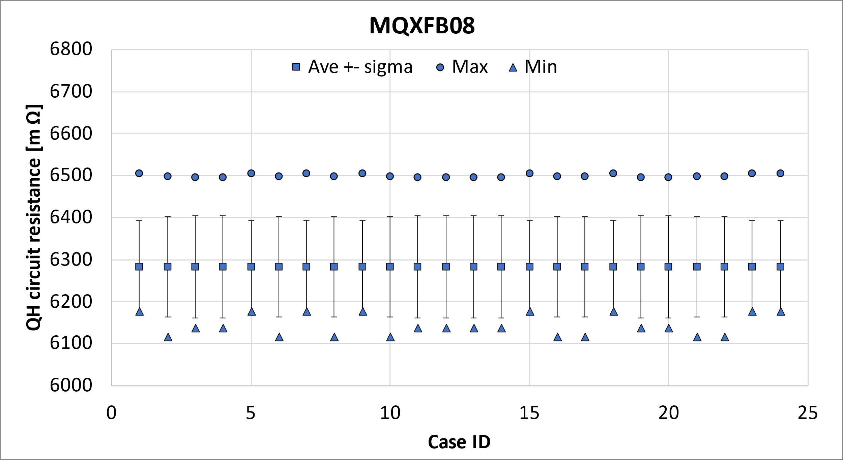
Coil sorting according to QH resistance
 | Electrical order
CASE ID | P1 | P2 | P3 | P4
1 | 148 | 151 | 149 | 150
2 | 148 | 150 | 149 | 151
3 | 148 | 149 | 150 | 151
4 | 148 | 149 | 151 | 150
5 | 148 | 151 | 150 | 149
6 | 148 | 150 | 151 | 149
7 | 151 | 148 | 150 | 149
8 | 150 | 148 | 151 | 149
9 | 151 | 148 | 149 | 150
10 | 150 | 148 | 149 | 151
11 | 150 | 151 | 148 | 149
12 | 150 | 151 | 149 | 148
13 | 151 | 150 | 148 | 149
14 | 151 | 150 | 149 | 148
15 | 150 | 149 | 148 | 151
16 | 151 | 149 | 148 | 150
17 | 151 | 149 | 150 | 148
18 | 150 | 149 | 151 | 148
19 | 149 | 148 | 150 | 151
20 | 149 | 148 | 151 | 150
21 | 149 | 151 | 148 | 150
22 | 149 | 151 | 150 | 148
23 | 149 | 150 | 148 | 151
24 | 149 | 150 | 151 | 148

Slide 5
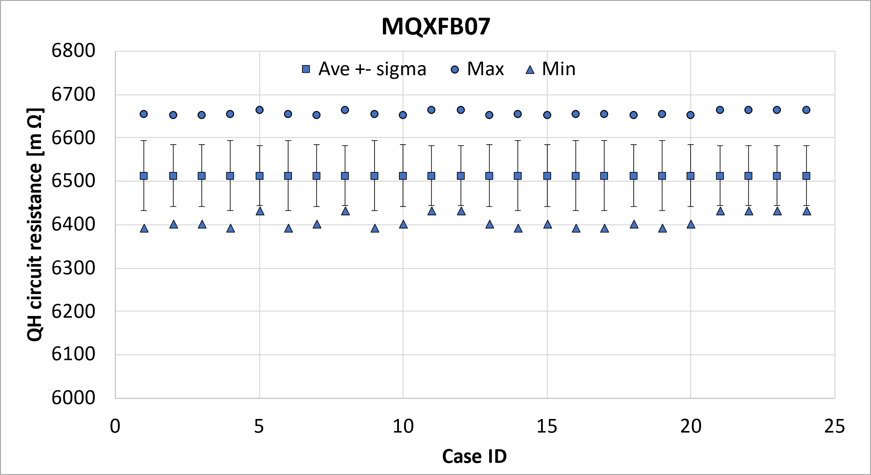
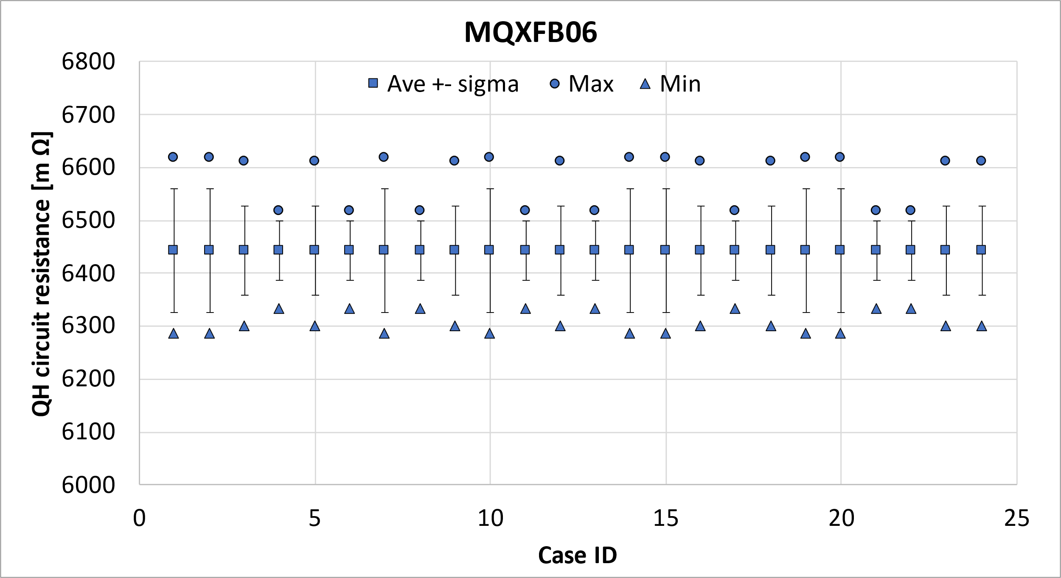
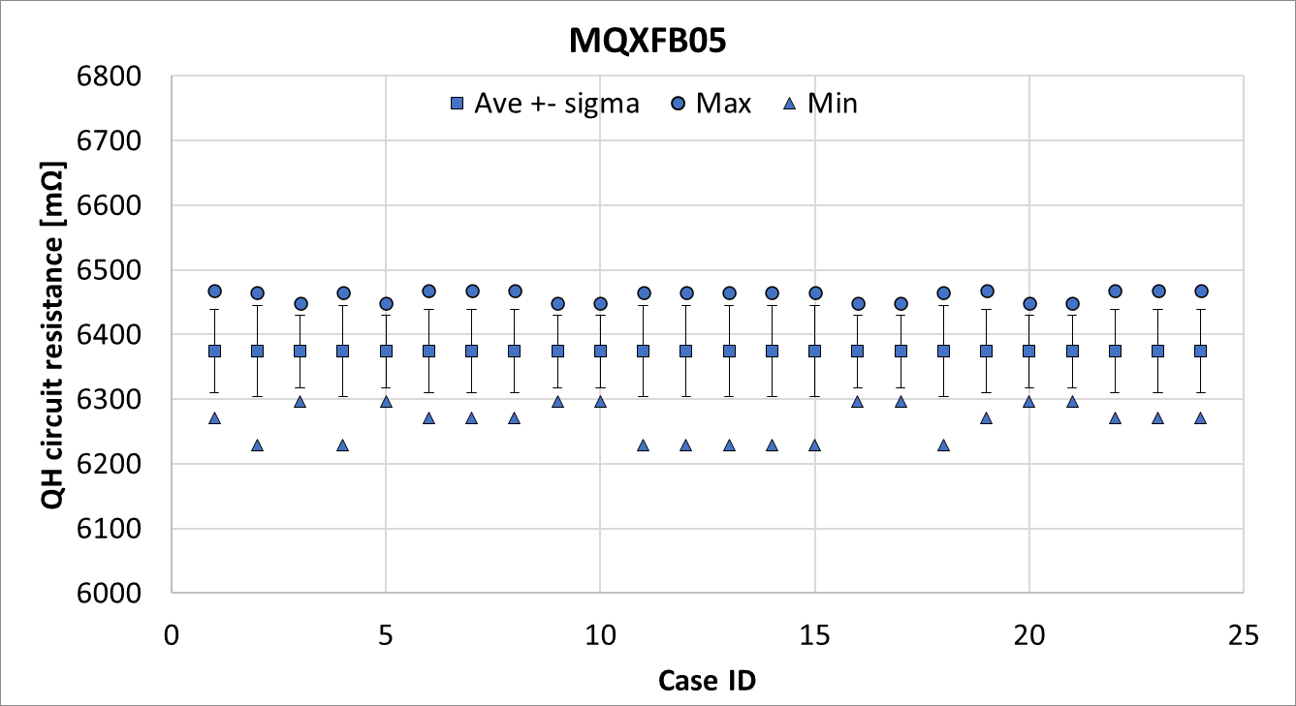
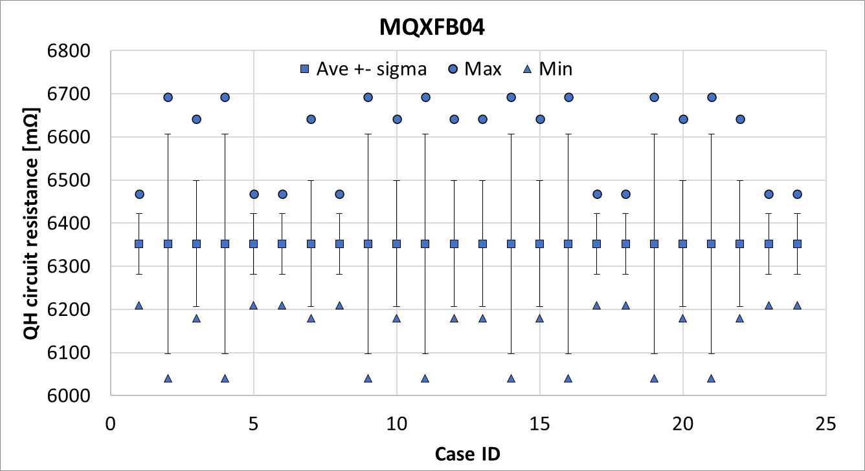
MQXFB08, B07, B06, B05 and B04

Slide 6
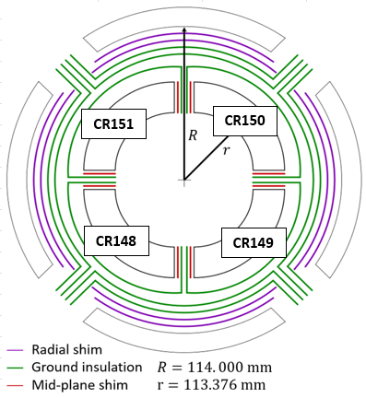
Conclusion
Here is presented the coils ordering for MQXFB08

Slide 7
References
Quench heater parameters MQXF (22/01/2022) https://indico.cern.ch/event/1119409/
NCR MQXFBP3 QH resistance EDMS 2782298
Quench heater parameters MQXF (09/07/2021) https://indico.cern.ch/event/950696/
NCR MQXFBP2 QH resistance EDMS 2643444
HL-MCF Meeting #121 Update on the MQXFB QH Resistances https://indico.cern.ch/event/1305402/

Slide 8
Additional slides

Slide 9
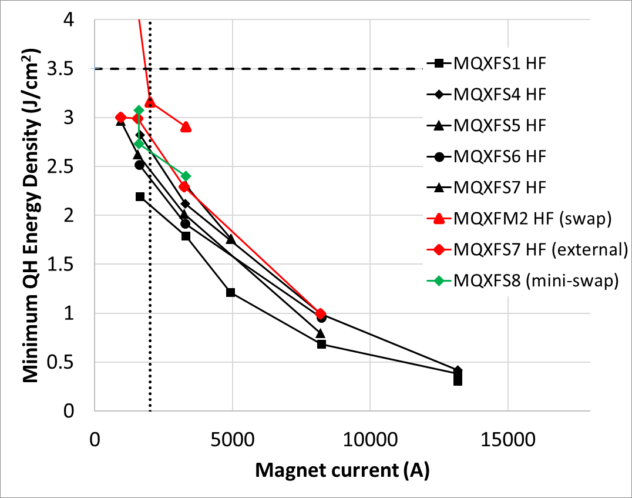
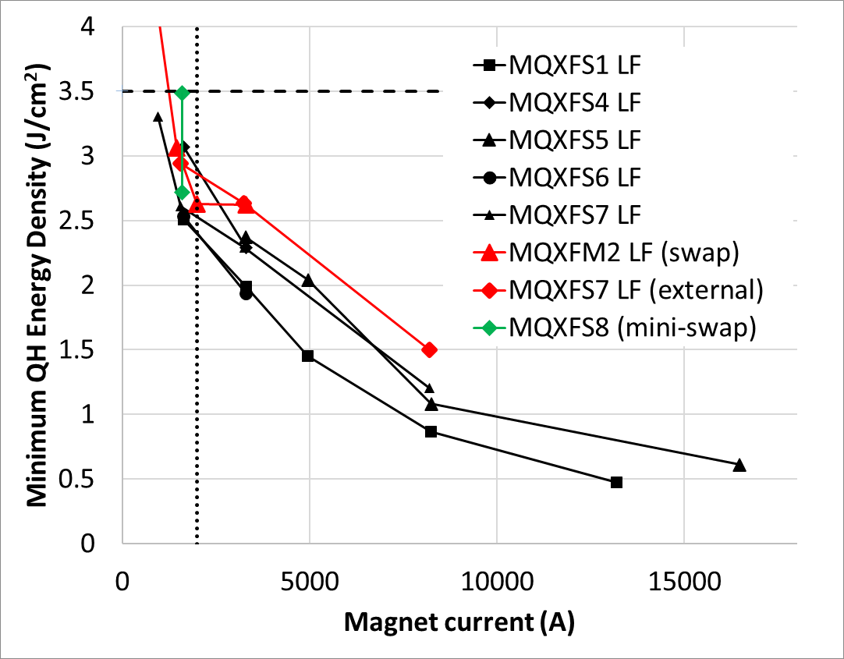
Minimum energy density
Nominal U_{d}= 3.5 J/cm²
Nominal U_{d}= 3.5 J/cm²
Minimum Energy Density = 2.5 – 2.7 J/cm² (to initiate a quench at 2 kA)
Final QH configuration:
  MQXFB mini swap (more protection tests planned in S8, to have more statistics)
  MQXFA impregnated heaters in direct contact with the coil (S1-S6)

Slide 10
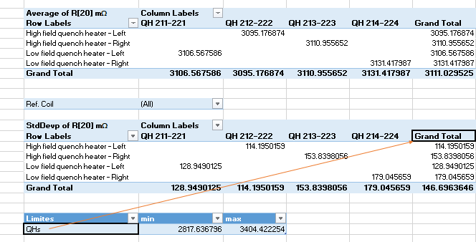
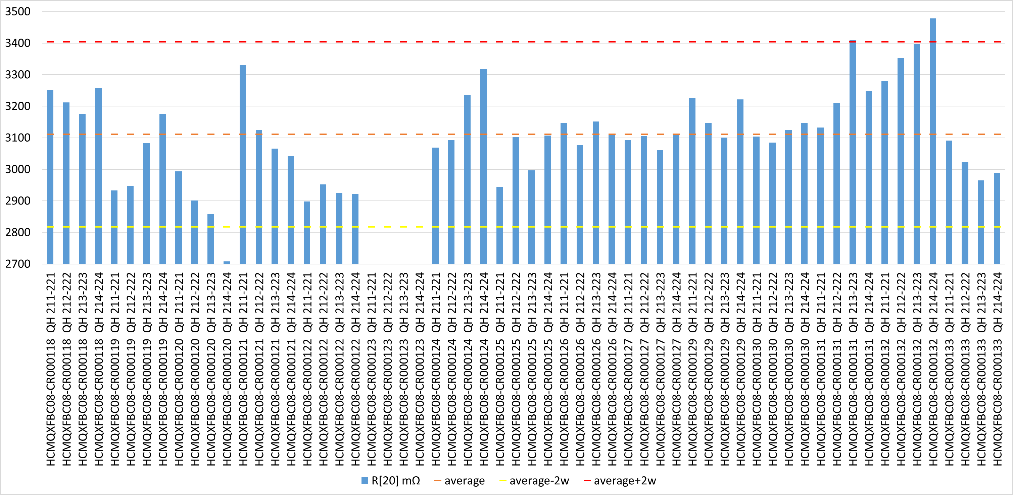
QH resistance – individual strips
The target was 3.1 ± 0.26 (2.84-3.36 ohms, i.e., ± 8 %)
With few exceptions, we are within the target
In case we are slightly out of the tolerance in the individual strips, the expected heater circuit resistance after assembly is checked and if possible, the coil can be placed in the optimal position to compensate for deviations
  The driving parameter is the peak voltage to ground based on conductor properties, but in general several configurations are able to fulfill requirements
  So far, this optimization was not needed.
Ave+2*sigma
Ave-2*sigma

Slide 11
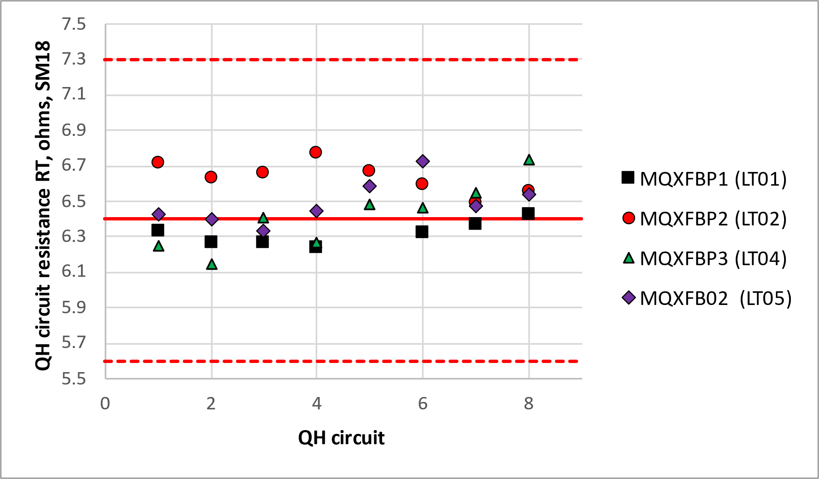
Quench heater circuit resistance, tolerance range at warm, SM18
SM18 ranges follow 180 tolerances for electrical QA, i.e., 5.6 – 7.3 ohms (i.e, +- 13 %)
  Previous target 6-6.8 ohms (i.e, +- 6 %)
  For reference, LHC dipoles was 22 ohms +- 4.5 ohms (i.e, +- 20 %)
The maximum difference between warm before test and warm after test shall be < 0.05 ohms (as LHC dipoles)
Remark: all data corresponds to magnets assembled in temporary cold mass configuration
https://edms.cern.ch/document/2909934

Slide 12
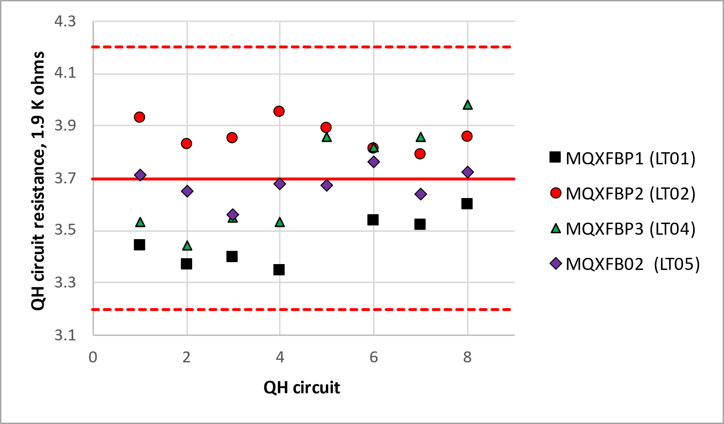
Quench heater circuit resistance, tolerance range at cold, SM18
At cold, we keep the same spread that at warm, i.e., 13 %
  Target is 3.7 +- 0.5 ohms (i.e., 3.2 to 4.2 ohms, before it was 3.5-3.9 ohms)
    The resistance of at least 4 circuits shall be larger than 3.4 ohms to assure sufficient margin to initiate a quench at low current
  For reference, LHC dipoles was 12.5 ohms +- 3 ohms (i.e, +- 24 %)
Remark: all data corresponds to magnets assembled in temporary cold mass configuration
https://edms.cern.ch/document/2909934

Slide 13
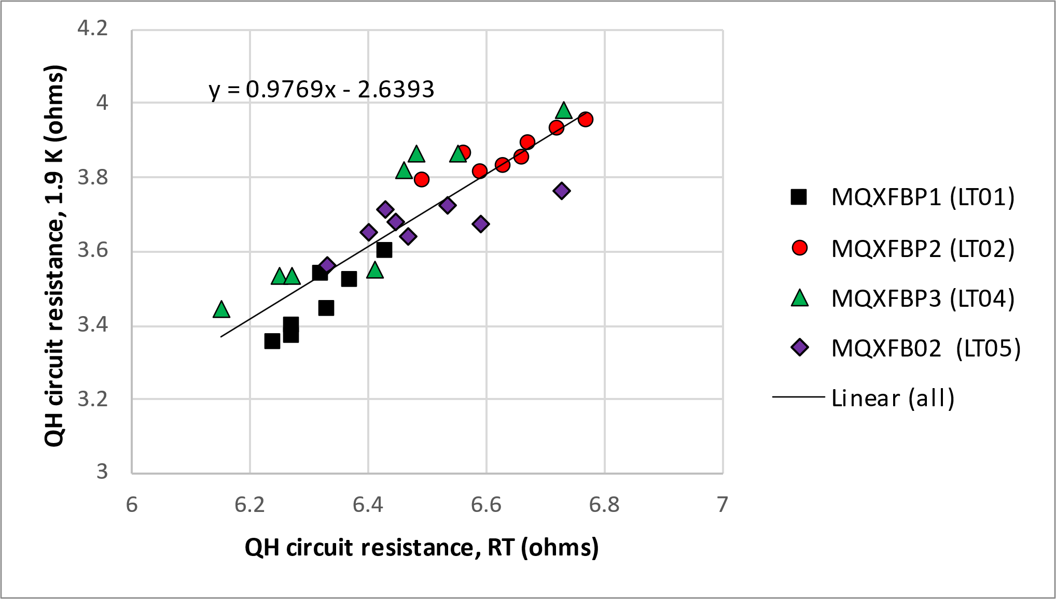
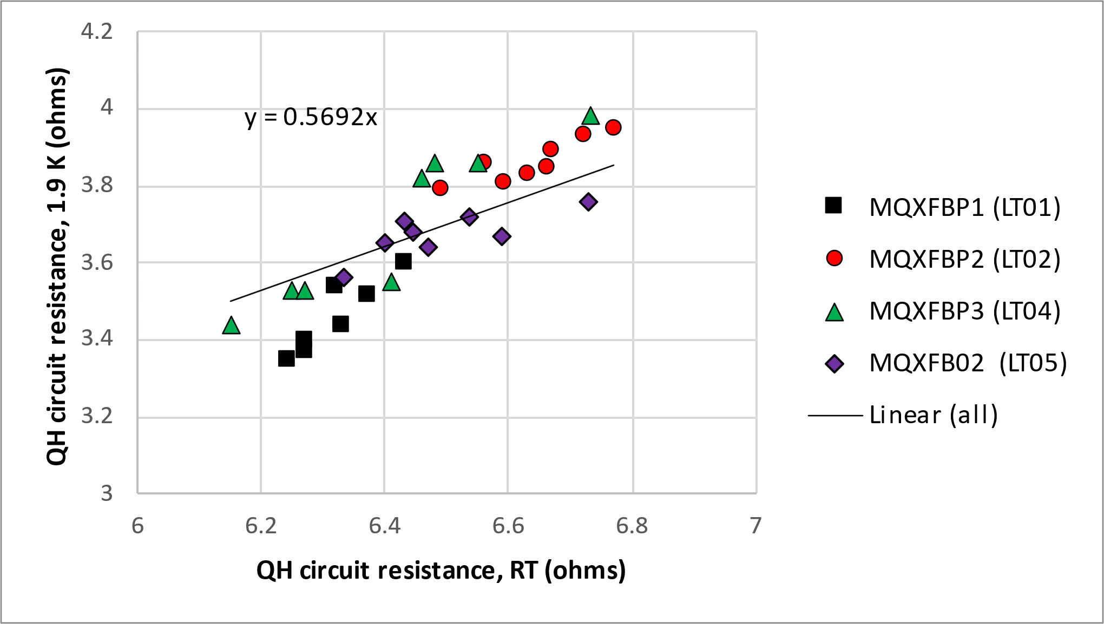
Cold vs warm
https://edms.cern.ch/document/2909934
Remark: after MQXFBMT4 test, enough information to decouple the RRR from quench heaters and wiring, to maybe find a better correlation in terms of RRR

