Slide 1
Status of the Accelerator
Matteo Solfaroli BE/OP
160th LHCC OPEN Session
Nov 18th, 2024

Slide 2
Outline
2024 run highlights
  low beta pp, pp ref run, IONS
2025 configuration
2025 schedule options

Slide 3
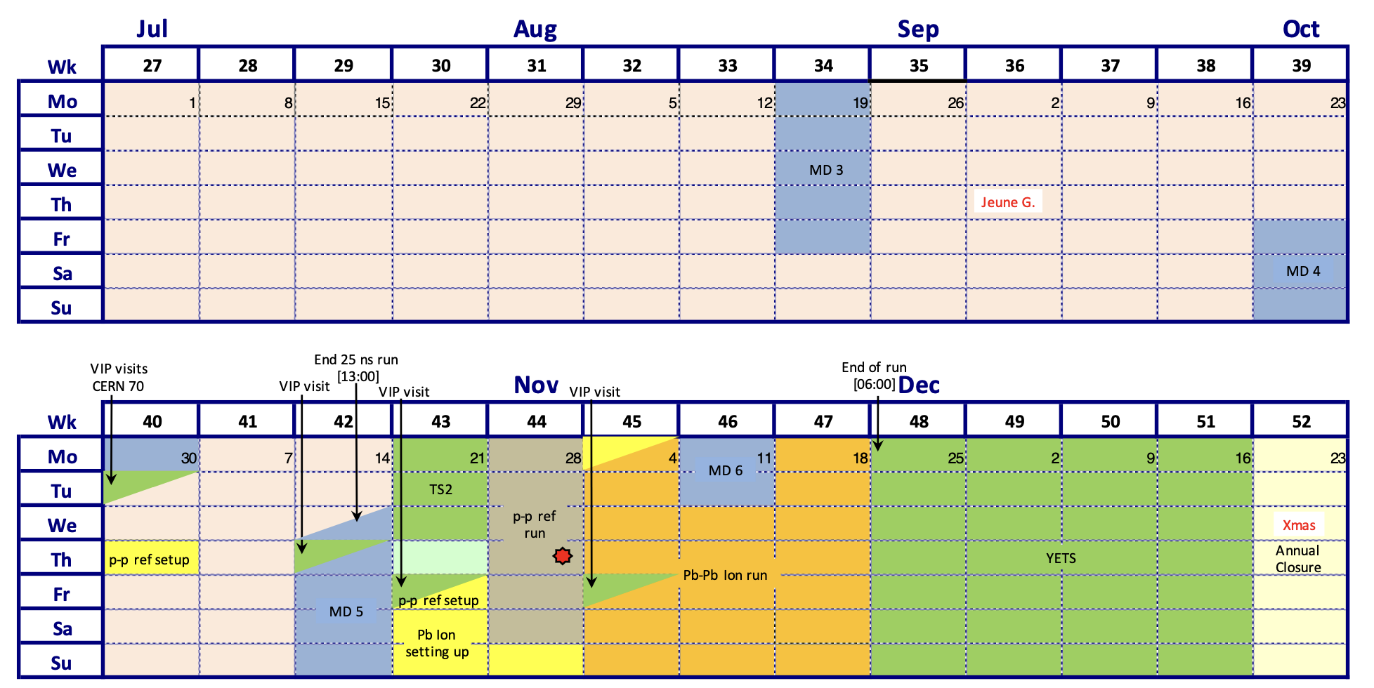
2024 LHC schedule v.2.2 – Q3+Q4
2024 low beta run completed
2024 pp reference run completed
2024 IONS run ongoing
End of 2024 run on Monday 25th November @6am
today

Slide 4
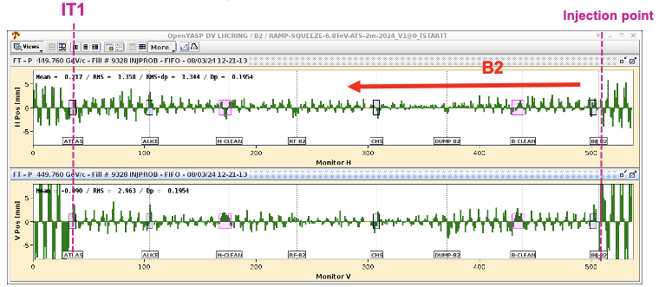
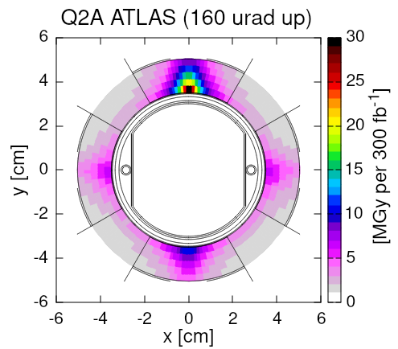
LHC in 2024
First injection: 8th March (3 days early)
pp run
ref run
IONS run
March
Q1
April
May
June
July
August
September
October
Q4
November
Reverse Polarity optics
commissioned (~ +1 week)

Slide 5
Reversed Polarity (RP) optics
The magnets in inner triplet regions see localised high dose rates due to collision debris, which can lead to damage and failure
Local optics change to redistribute the radiation, allowing for longer lifetime of the equipment:
Implemented in P1 in 2024, as most critical
Peak dose distribution profile along the triplet region
Example for IP1

Slide 6
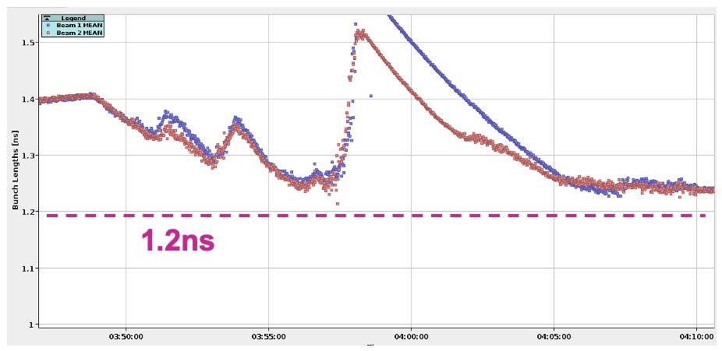
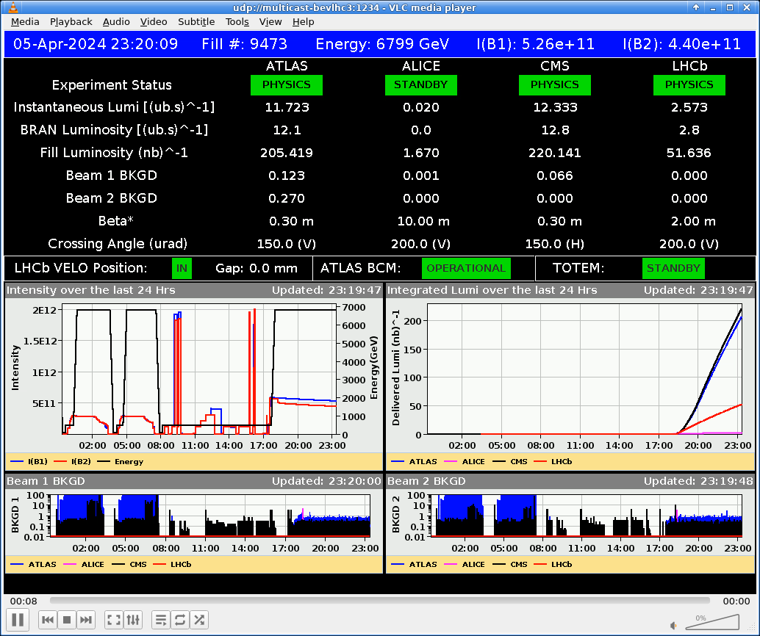
LHC in 2024
First injection: 8th March (3 days early)
Bunch length control/target
Limit RF module heating risk
pp run
ref run
IONS run
Q1
March
Q1
April
May
Q2
June
July
Q3
August
September
October
Q4
November
Q4
Reverse Polarity optics
commissioned (~ +1 week)
First Stable Beams @6.8 TeV 5th April (3 days early)
LHCb VELO closed for the 1st time

Slide 7
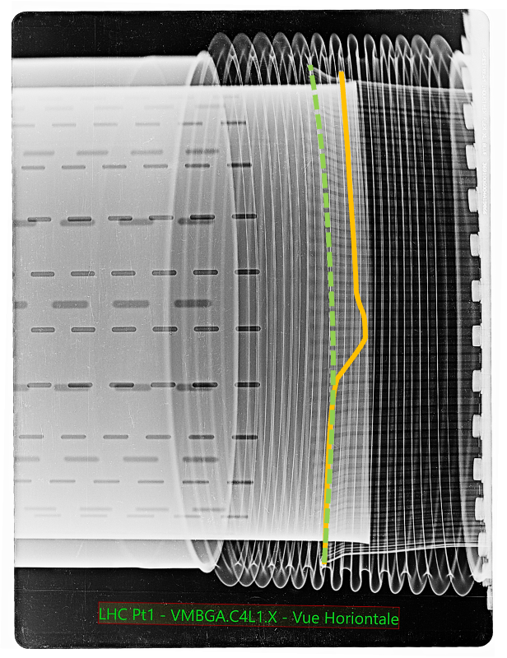
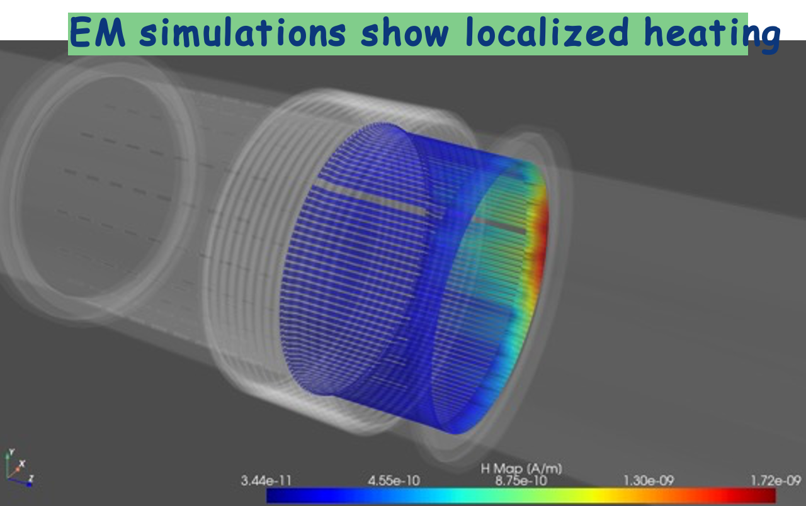
RF finger vacuum modules
VISUAL INSPECTION
annealed/plasticised spring on the 212 mm vacuum module due to localized temperature increase to more than 500°C
IMPACT in 2023
~5 days lost
Bunch intensity limited to 1.6e¹¹ p/b
Difficult to identify intensity limitation (strong dependence on contact quality)
Simulations to assess impact of beam parameters on power deposition
Consolidation plan:
47 replaced during 23/24 EYETS
24 foreseen in 24/25 YETS
  No failure expected with ideal contact
LMC 479: limit bunch intensity at 1.6e¹¹ p/b, while maximizing the bunch length throughout the cycle
Improved control of bunch length provides a safety factor of ~2 or more in power deposition

Slide 8
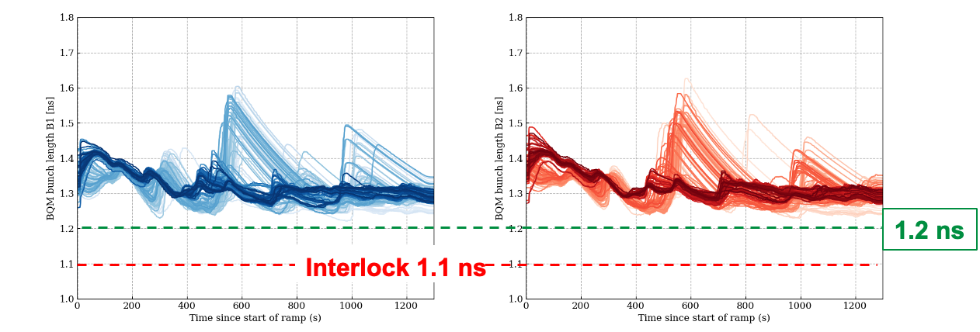
Beam power and bunch length
Longitudinal blow-up control significantly improved
  bunch lengths in the ramp >1.25 ns, compared to 1.1 ns in 2023
  Interlock implemented at 1.1 ns, then moved to 1.2 ns
  According to simulations, this lowers the beam power by > factor 2
This operational improvement together with the upcoming completion of the warm vacuum modules consolidation can open a window for future higher intensity tests/operation,
without impacting availability

Slide 9
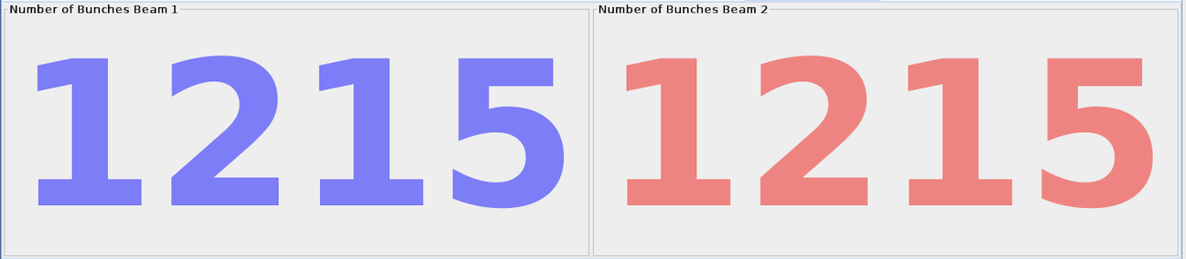
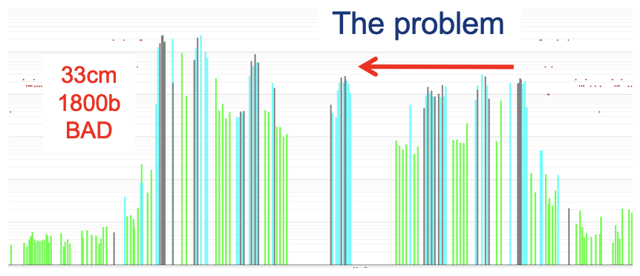
LHC in 2024
First injection: 8th March (3 days early)
Bunch length control/target
Limit RF module heating risk
1200 bunches on 14th April (10 days early)
pp run
ref run
IONS run
March
Q1
April
May
June
July
August
September
October
Q4
November
Reverse Polarity optics
commissioned (~ +1 week)
First Stable Beams @6.8 TeV 5th April (3 days early)
β* limited to 36 cm 17th April
LHCb VELO closed for the 1st time

Slide 10
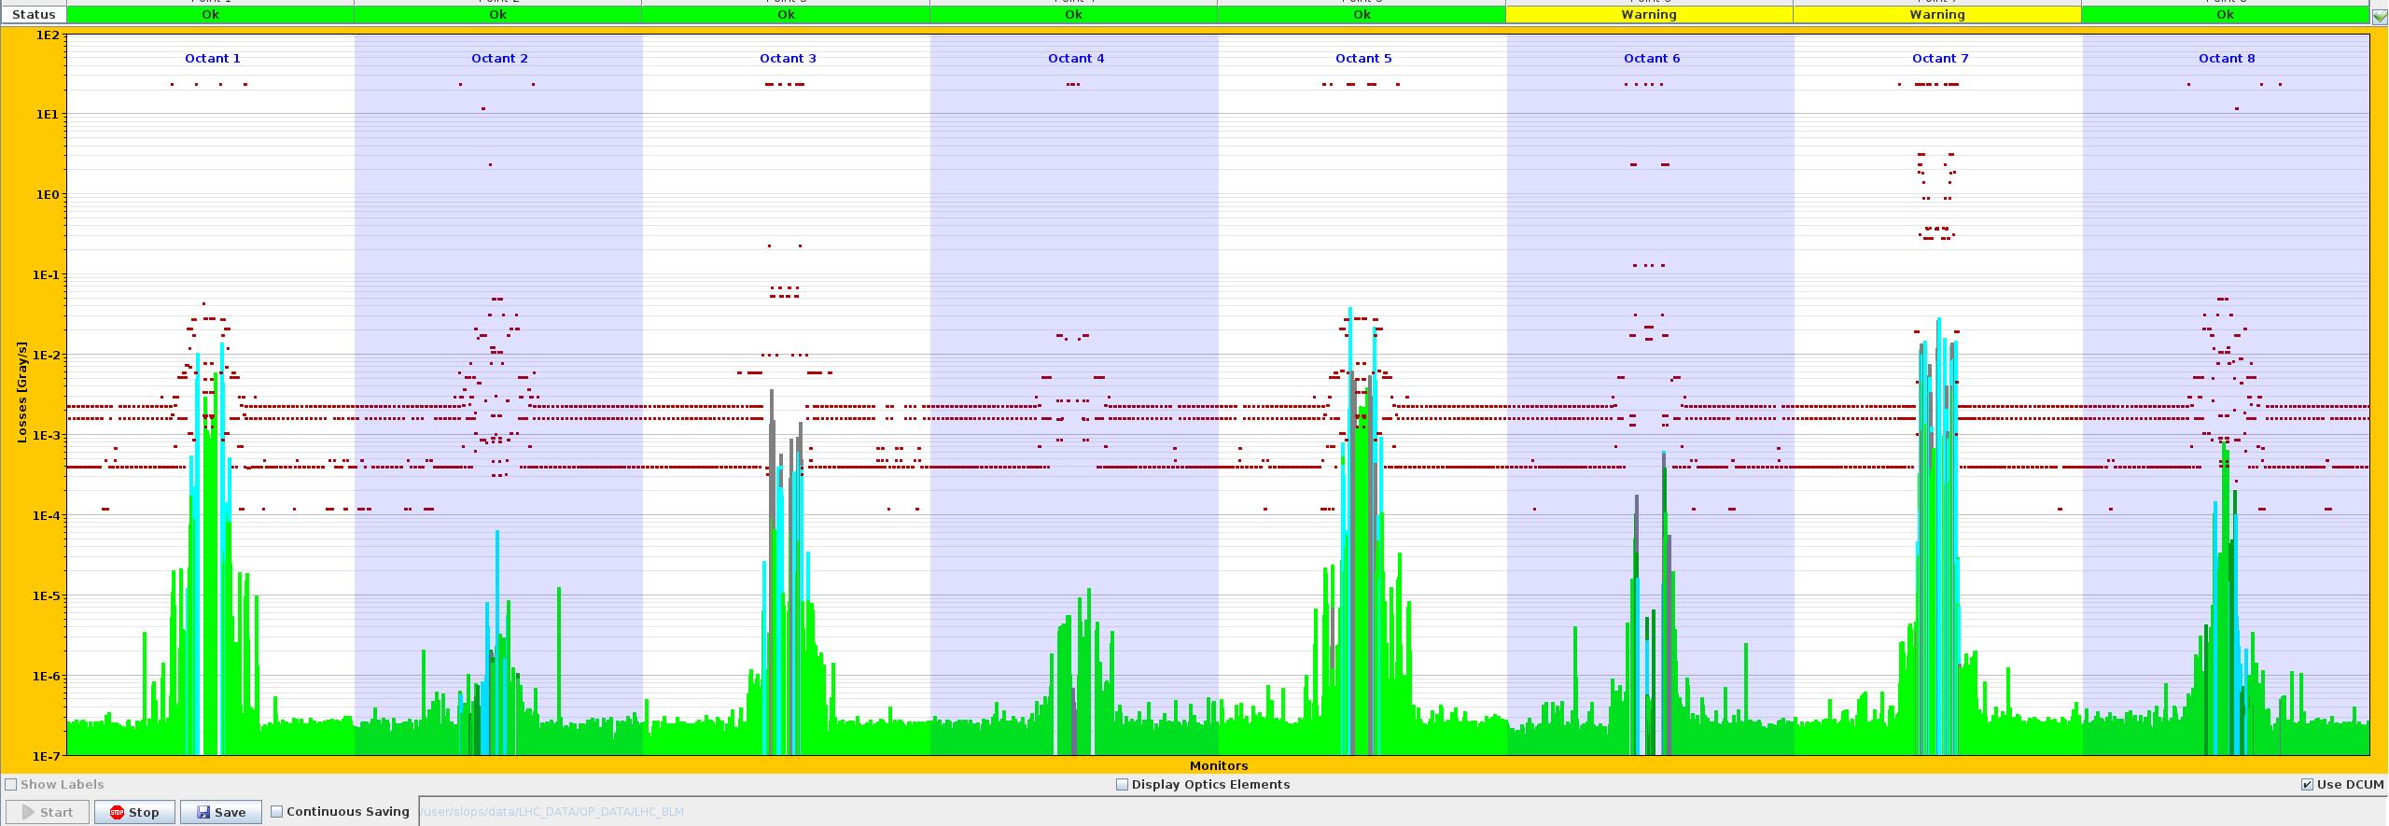
Beta* limitation (36 cm)
Significant losses on secondary collimator in fill 9530 (17th April)
300-400 um orbit shift is needed to induce observed hierarchy breakage
Highest losses in the
middle of insertion (instead of extremities, where primary collimators are located)
Broken hierarchy can compromise protection
➔ limitation on beta* (about 1-2% loss)

Slide 11
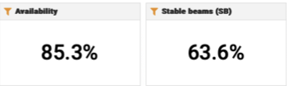
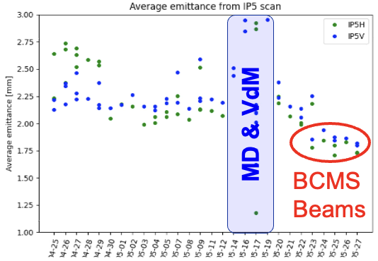
LHC in 2024
VdM & Calibration
Runs, 16 – 20 May
First injection: 8th March (3 days early)
Bunch length control/target
Limit RF module heating risk
1200 bunches on 14th April (10 days early)
BCMS beams
May
pp run
ref run
IONS run
March
Q1
April
May
June
July
August
September
October
Q4
November
Reverse Polarity optics
commissioned (~ +1 week)
First Stable Beams @6.8 TeV 5th April (3 days early)
β* limited to 36 cm 17th April
LHCb VELO closed for the 1st time

Slide 12
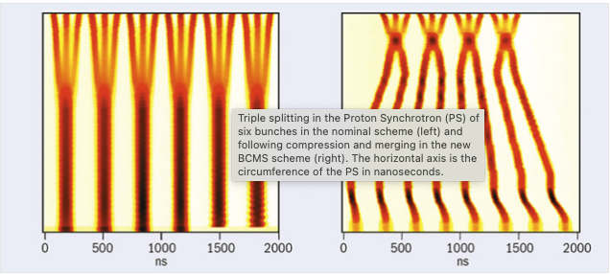
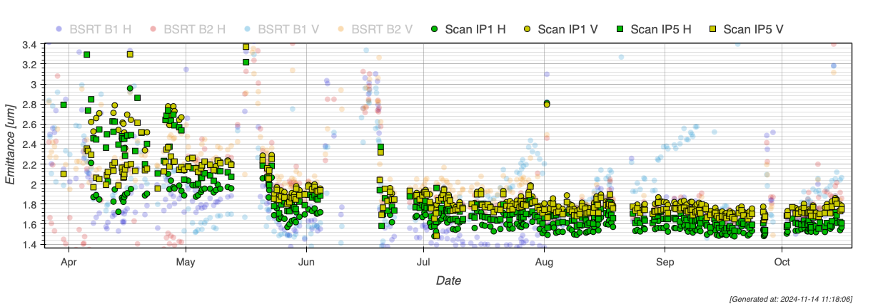
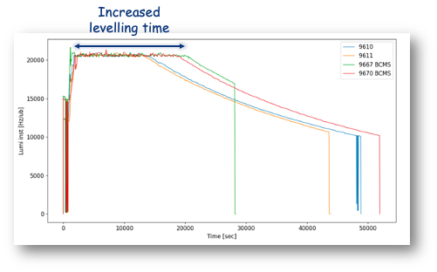
BCMS beam
With a filling scheme based on 3x36b patterns, the standard 25 ns and Batch Compression and (bunch) Merging and (bunch) Splitting (BCMS) beams are interchangeable transparently
Optimized BCMS beams deployed in the LHC in May
  Brightness theoretical 10% higher
  Better equivalent cross-section (provided emittance is preserved)
  Smaller emittance also beneficial for losses reduction, especially at injection
Standard: ~ 2 µm
BCMS
~ 1.7 µm

Slide 13
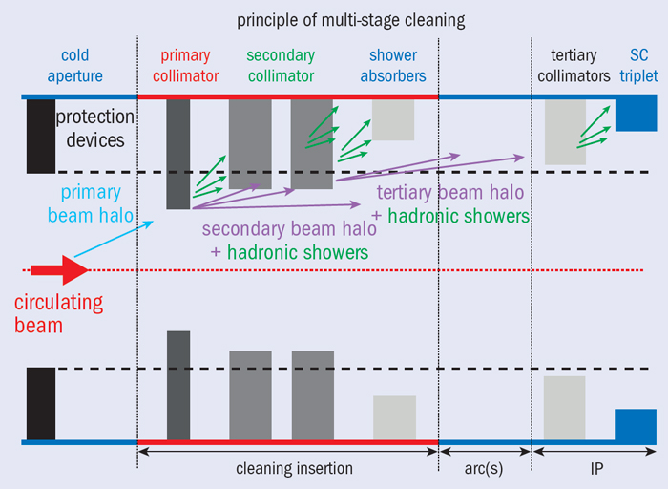
LHC in 2024
VdM & Calibration
Runs, 16 – 20 May
First injection: 8th March (3 days early)
Bunch length control/target
Limit RF module heating risk
1200 bunches on 14th April (10 days early)
BCMS beams
May
pp run
ref run
IONS run
March
Q1
April
May
June
July
August
September
October
Q4
November
Reverse Polarity optics
commissioned (~ +1 week)
First Stable Beams @6.8 TeV 5th April (3 days early)
β* limited to 36 cm 17th April
β* back to 30 cm 17th June
LHCb VELO closed for the 1st time

Slide 14
Beta* limitation (36 cm)
Significant losses on secondary collimator in fill 9530 (17th April)
300-400 um orbit shift is needed to induce observed hierarchy breakage
Highest losses in the
middle of insertion (instead of extremities, where primary collimators are located)
Broken hierarchy can compromise protection
➔ limitation on beta* (about 1-2% loss)
Studies, tests and simulations indicated that losses are generated by particles in the off-momentum halo (not core of the beam)
Various mitigations put in place to improve the behaviour
Machine re-validated after TS#1 with mitigations in place
Beta* limitation lifted

Slide 15
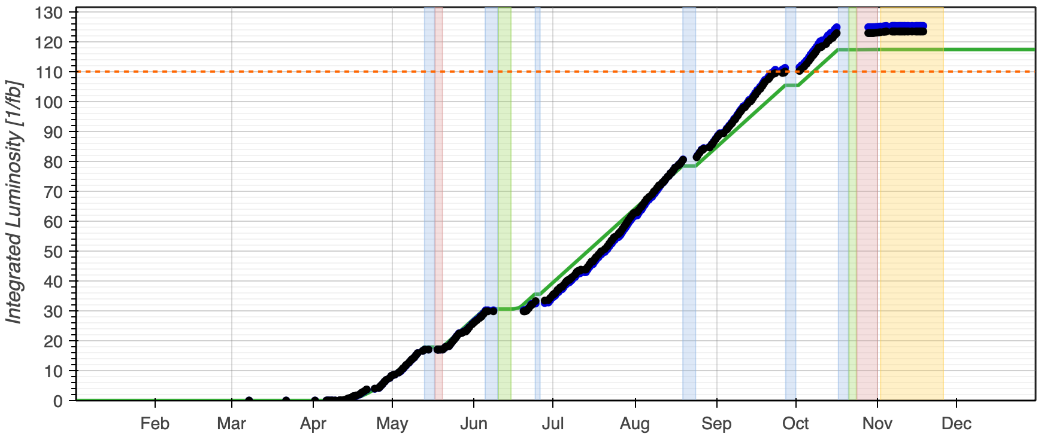

LHC in 2024
VdM & Calibration
Runs, 16 – 20 May
Stable Lumi
Production
Summer period
First injection: 8th March (3 days early)
Bunch length control/target
Limit RF module heating risk
1200 bunches on 14th April (10 days early)
BCMS beams
May
Beyond 110 fb⁻¹
pp run
ref run
IONS run
March
Q1
April
May
June
July
August
September
October
Q4
November
Reverse Polarity optics
commissioned (~ +1 week)
First Stable Beams @6.8 TeV 5th April (3 days early)
β* limited to 36 cm 17th April
β* back to 30 cm 17th June
LHCb VELO closed for the 1st time

Slide 16
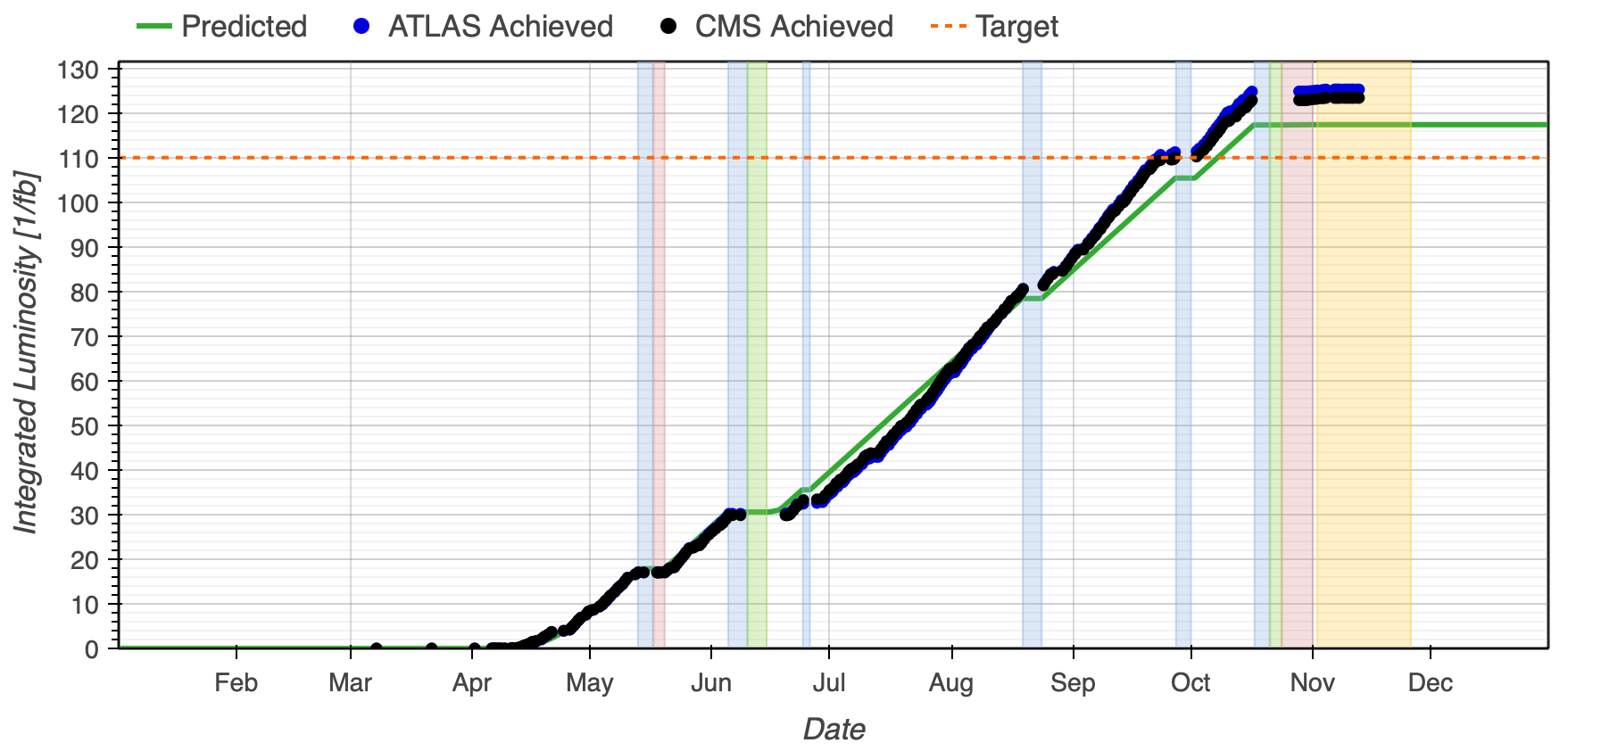
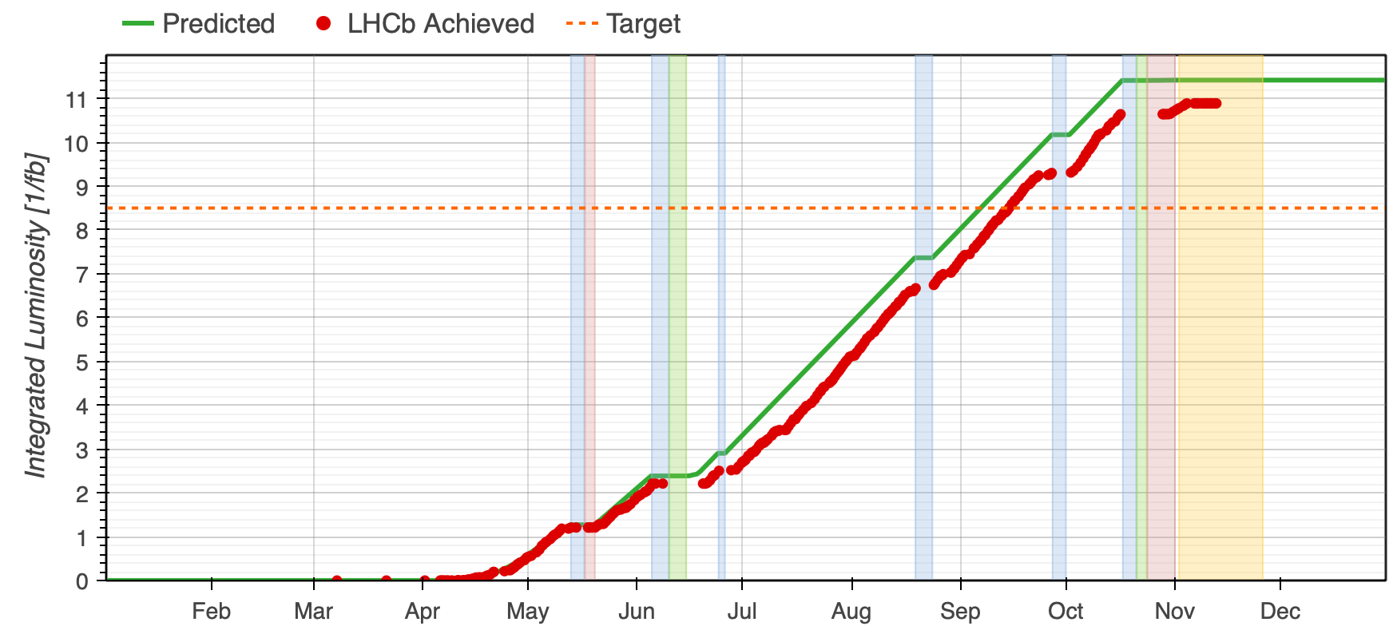
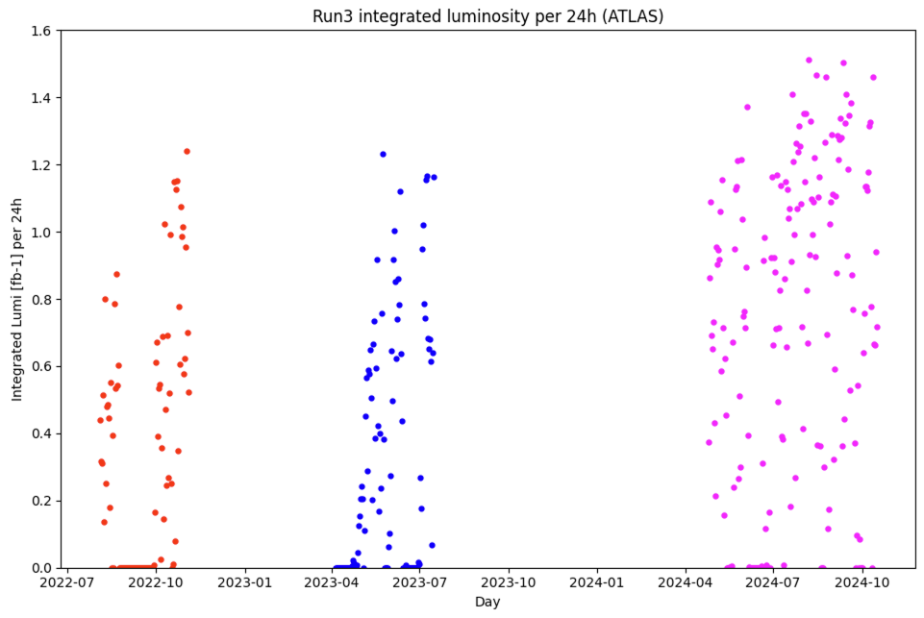
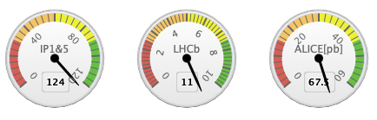
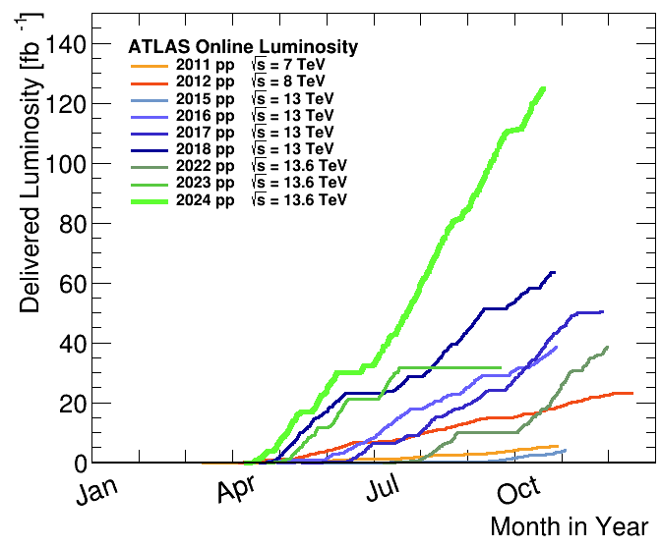
Production
124 fb⁻¹ in ATLAS/CMS
11 fb⁻¹ in LHCb
67.5 pb⁻¹ in ALICE
Highest production rate ever
Peak luminosity at ~2.1e³⁴ cm⁻¹ s⁻¹ (limited by cryogenic)
2024 AVG rate = 0.83 fb⁻¹/24h
2024 highest rate = 1.5 fb⁻¹/24h
(midnight to midnight)
LS1
LS2

Slide 17
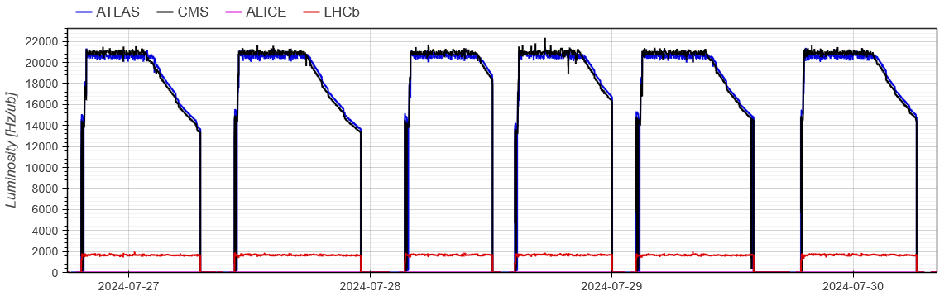
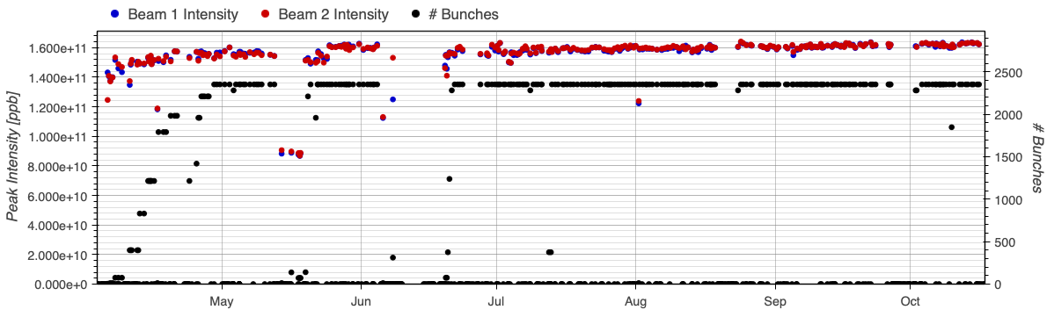
Production
Combined (beta* + offset) levelling allowed for
  6-7 hours levelling with BCMS beams
  Well balanced luminosity between CMS and ATLAS
LHCb levelled through the entire fill
Bunch intensities stable at 1.6e¹¹ ppb at start of stable beams
Stored energy ~410 MJ / beam @6.8 TeV (~100 kg TNT)

Slide 18
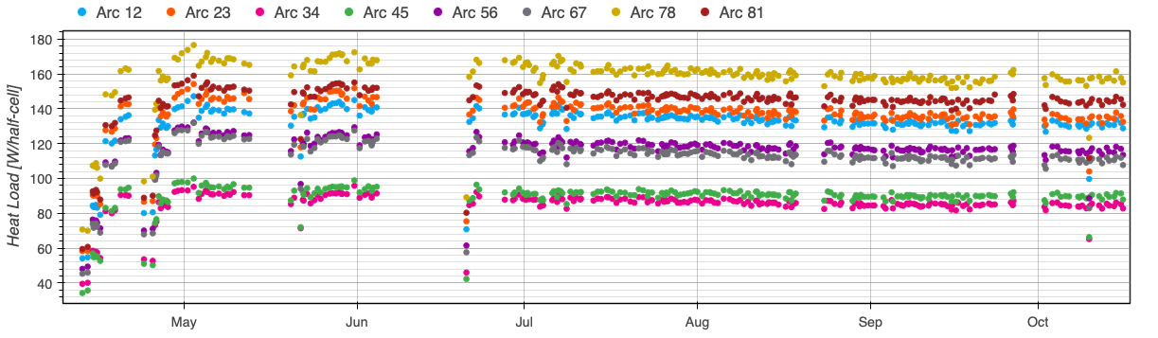
Heat load
Electron cloud induced heat-load mainly limits:
  Train length
  Total number of bunches
  Bunch intensity
After reconfiguration of cryogenic systems operated with 25ns beam (then BCMS) providing better homogeneity between bunches, beam quality and operability
~10% margin gained by conditioning over 2024 (not enough for an additional full train)

Slide 19
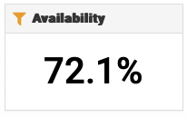
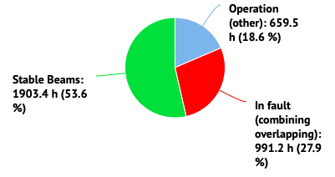
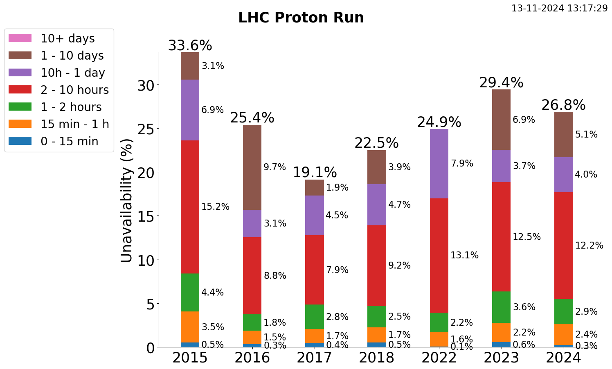
Availability
Availability is THE key factor for accelerator performance
Availability factor was ~constant through Run2 and Run3 for small (<24h) faults
Minor differences in numbers are due to slightly different choices in term of dates (including or not scrubbing run, TS recovery etc)
NOTE: the availability of the proton run is calculated on the effective time from the retrospetctively calculated schedule (long faults are not included)

Slide 20
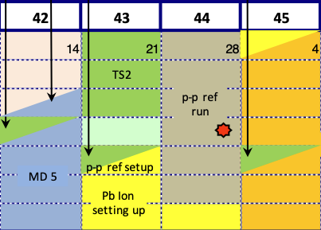
LHC in 2024
VdM & Calibration
Runs, 16 – 20 May
Stable Lumi
Production
Summer period
First injection: 8th March (3 days early)
Bunch length control/target
Limit RF module heating risk
1200 bunches on 14th April (10 days early)
BCMS beams
May
Beyond 110 fb⁻¹
pp run
ref run
IONS run
March
Q1
April
May
June
July
August
September
October
Q4
November
Reverse Polarity optics
commissioned (~ +1 week)
First Stable Beams @6.8 TeV 5th April (3 days early)
β* limited to 36 cm 17th April
β* back to 30 cm 17th June
pp reference run 28th Oct – 2nd Nov
LHCb VELO closed for the 1st time

Slide 21
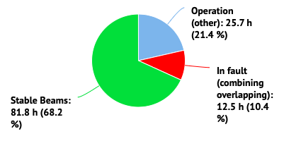
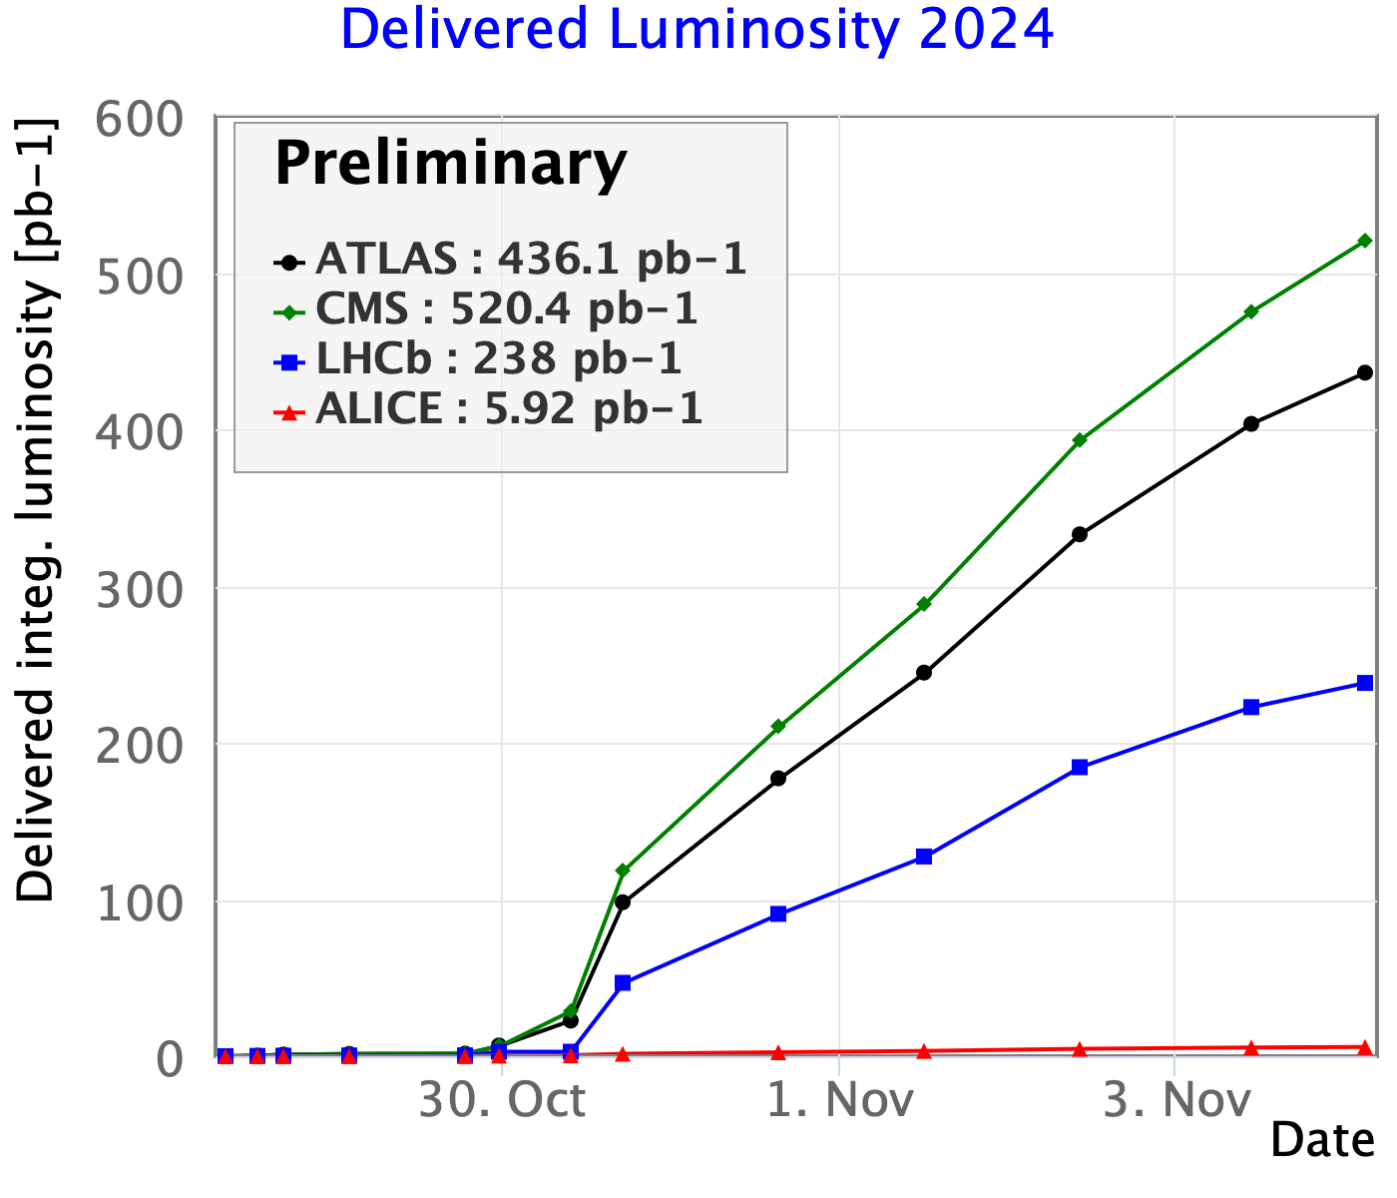
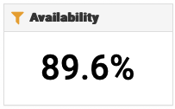
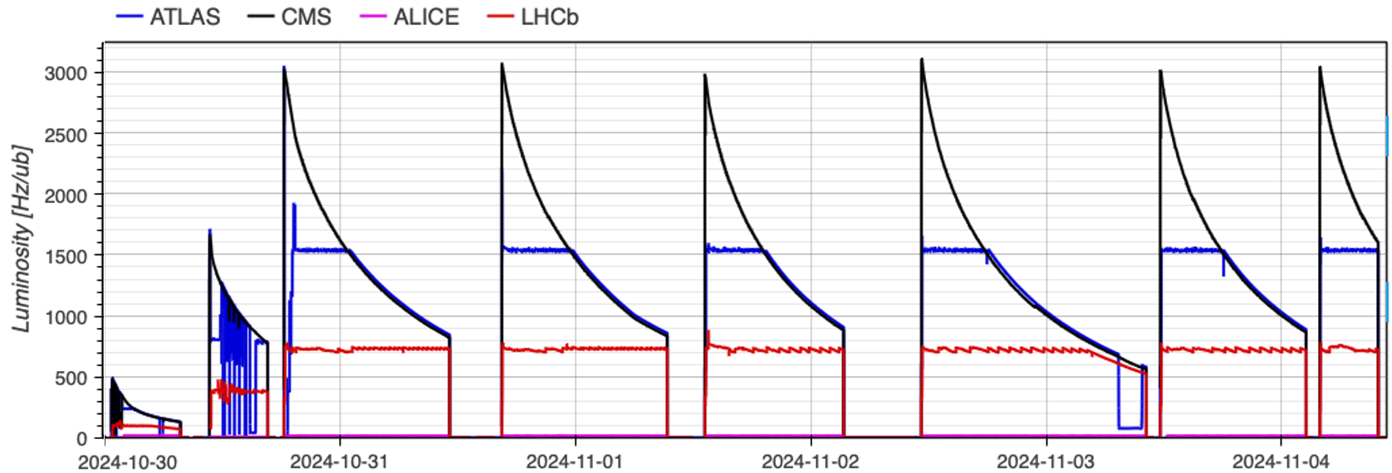
Luminosity production for pp ref run
7-day run (extended by one day to satisfy higher targets, as a consequence of the Run3 extension), results only possible as blessed by excellent machine availability!
Exp | Requested lumi [pb⁻¹] | Delivered/recorded lumi [pb⁻¹]
ATLAS | 350 | 436 (390)
ALICE | 5.5 | 5.9 (5.5)
CMS | 350 | 520 (~520)
LHCb | >100 | 246 (~240)

Slide 22
LHC in 2024
VdM & Calibration
Runs, 16 – 20 May
Stable Lumi
Production
Summer period
First injection: 8th March (3 days early)
Bunch length control/target
Limit RF module heating risk
IONS run ongoing (YETS starts on 25th November)
1200 bunches on 14th April (10 days early)
BCMS beams
May
Beyond 110 fb⁻¹
pp run
ref run
IONS run
March
Q1
April
May
June
July
August
September
October
Q4
November
Reverse Polarity optics
commissioned (~ +1 week)
First Stable Beams @6.8 TeV 5th April (3 days early)
β* limited to 36 cm 17th April
β* back to 30 cm 17th June
pp reference run 28th Oct – 2nd Nov
LHCb VELO closed for the 1st time

Slide 23
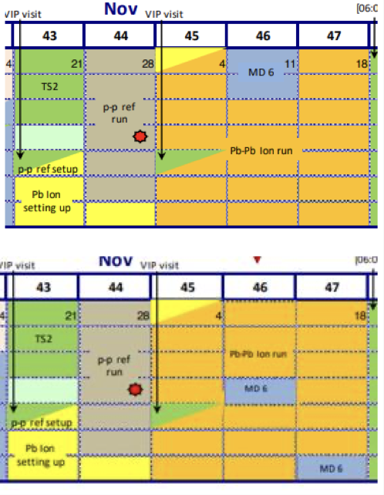
IONS run
Pb-Pb physics run @6.8 Z TeV
4 days commissioning
  Partially anticipated to optimize process
18 days physics (including VdM and intensity ramp-up)
Breaks for VIP visit, MDs
Already deployed in 2023:
Slip-stacking for 50 ns beams
Crystals
TCLD collimators
BFPP orbit bump in all IRs
v2.2
v2.3

Slide 24
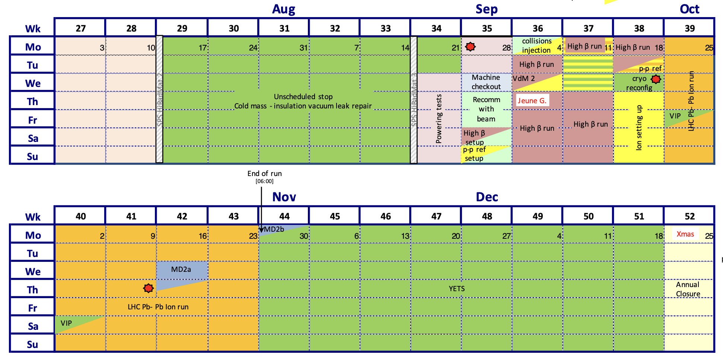
IONS run
2023 run was heavily affected by:
Radiation on Quench Protection System: beam dumps & magnet quench ➔ levelled lumi
  Consolidation of HW with rad-tol equipment
10 Hz Horizontal orbit oscillations: beam dumps
  Implemented delay of cryo valve opening
Transverse losses during the ramp: beam dumps
  More relaxed collimator strategy
  Squeeze partially separated from energy ramp
  Smoother orbit corrections
HW goniometer instability
  Control system developed (automatic optimisation algorithm deployed)
Strong background in ALICE
  IP1 dispersion corrected (same as in 2023)

Slide 25
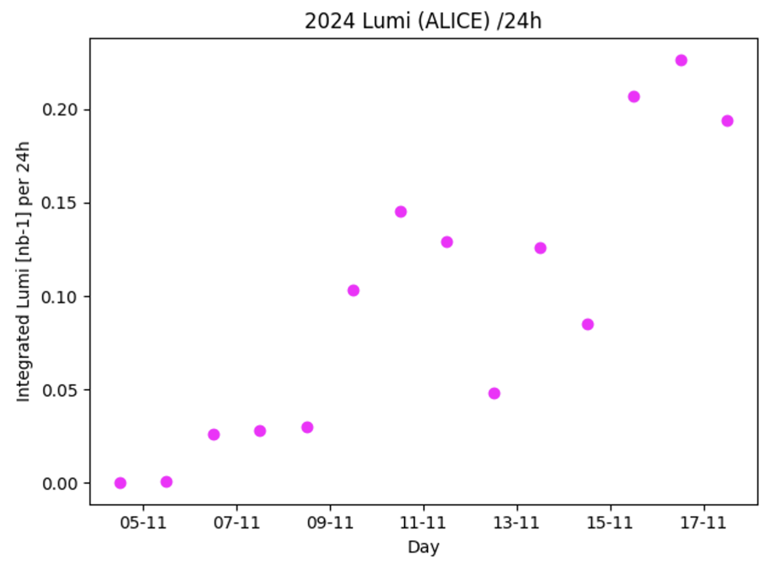
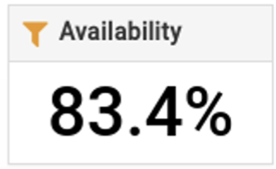
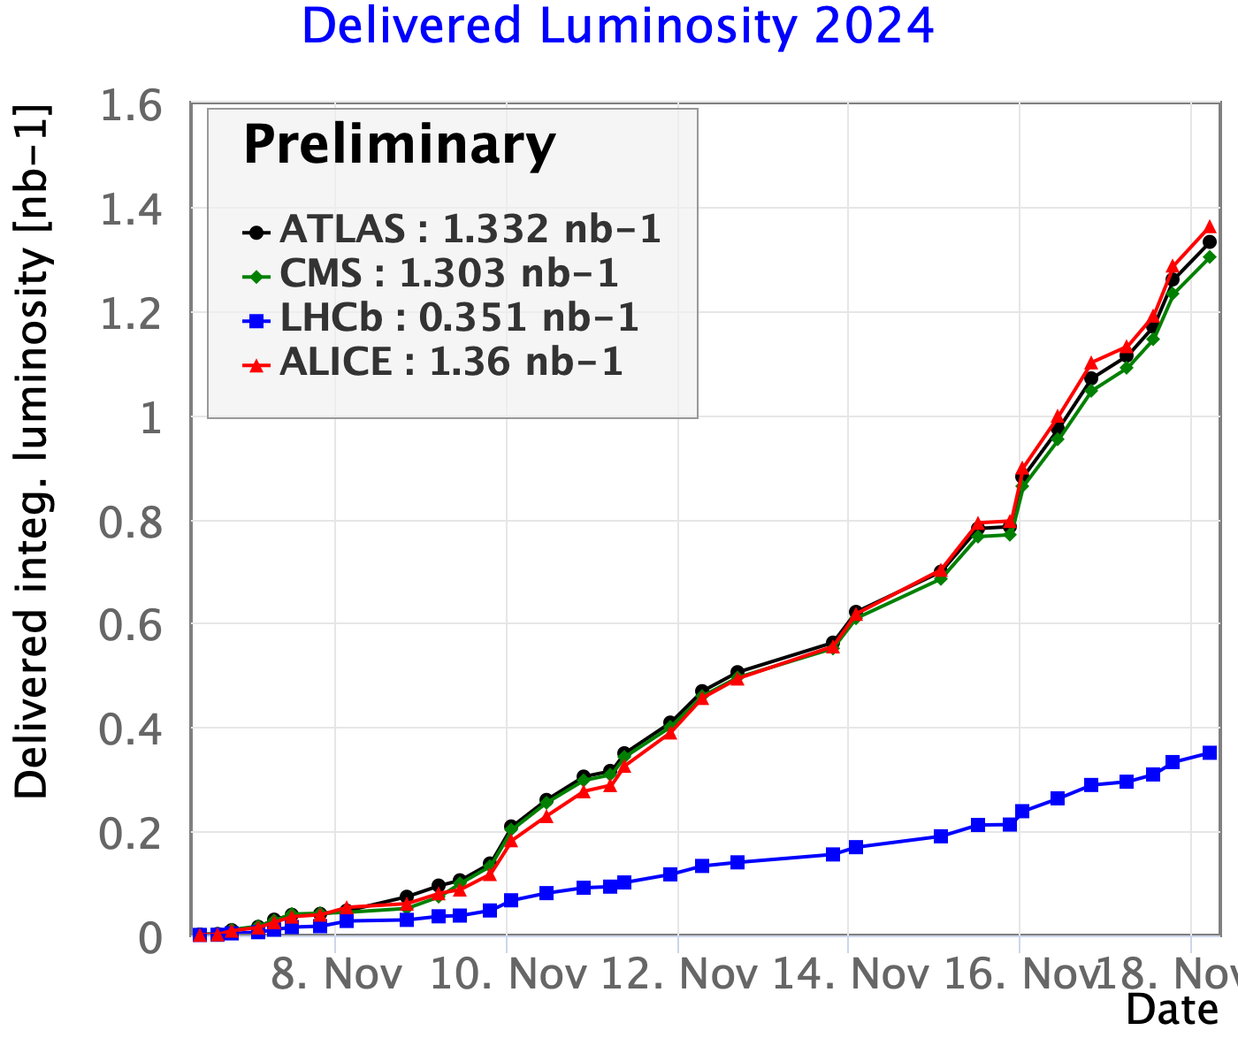
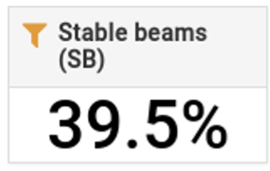
IONS run
30% of 2023 data in one w/e
so far…
Delivered luminosity 1.36 nb⁻¹
  70% of 2023 overall production
~0.7 nb⁻¹ just over the weekend
  30% of 2023 overall production
Reached levelling at the target instantaneous luminosity of 6.4e²⁷, > 1h levelling in IP2
Injector optimisation led to high bunch intensity at LHC (up to ~2.2e⁸ Pb/bunch in collisions), storing up to 26.7 MJ beam (HL design = 22 MJ)

Slide 26
Outline
2024 run highlights
  low beta pp, pp ref run, IONS
2025 configuration
2025 schedule options

Slide 27
2025/2026 configuration - introduction
Aim at one unique configuration for the rest of Run3, to avoid commissioning overhead in 2026
Radiation distribution depends on optics choice and crossing angle sign
  Regular Xing angle sign change in IP1 was applied so far (only possible on V plane)
There are potentially four configurations for each IP:
  Nominal vs Reverse Polarity optics
  H-V crossing angle
  only condition: maintain alternated planes for Xing angles (VH or HV) in IP1 and IP5 respectively for Long Range Beam-Beam compensation (mandatory for high intensity pp physics)
Radiation impact is particularly important for Inner Triplet and D1 magnets, as their replacement comes with a VERY high cost
The radiation limits assume all of the magnet receives the same dose
  In reality there are hot(ter) and cold(er) areas (numbers refer to hottest spot)

Slide 28
Proposal summary
Assumption: 100 fb⁻¹ (2025) + 100 fb⁻¹ (2026)
(beyond expectations (100 + 50 /fb⁻¹) in 25/26 for a total of ~530 /fb⁻¹)
Proposal |  | Comment | IT main quads [MGy] (limit 30 MGy) |  | D1 [MGy] (limit 90 MGy)
IP1 | IP5 |  | IP1 | IP5 | IP1 | IP5
NOM-H | RP-V | Preservation of FWD physics in P1 PPS rotation in 2025 | 30.7 | 27.8 | 102.5 | 73
RP-H (‘25) NOM-H (‘26) | RP-V | Partial preservation of FWD physics in P1 PPS rotation in 2025 | 28.5 | 27.8 | 90.5 | 73
RP-H | RP-V | Best for magnets protection PPS rotation in 2025 End of FWD physics program in P1 | 25.5 | 27.8 | 77.5 | 73
RP-V (‘25) RP-H (‘26) | RP-H (‘25) RP-V (‘26) | Good for magnet protection Minor preservation of FWD physics program in P1 PPS rotation in 2026 | 28.5 | 31.7 | 77.5 | 73

Slide 29
Proposal summary
Assumption: 100 fb⁻¹ (2025) + 100 fb⁻¹ (2026)
(beyond expectations (100 + 50 /fb⁻¹) in 25/26 for a total of ~530 /fb⁻¹)
Proposal |  | Comment | IT main quads [MGy] (limit 30 MGy) |  | D1 [MGy] (limit 90 MGy)
IP1 | IP5 |  | IP1 | IP5 | IP1 | IP5
NOM-H | RP-V | Preservation of FWD physics in P1 PPS rotation in 2025 | 30.7 | 27.8 | 102.5 | 73
RP-H (‘25) NOM-H (‘26) | RP-V | Partial preservation of FWD physics in P1 PPS rotation in 2025 | 28.5 | 27.8 | 90.5 | 73
RP-H | RP-V | Best for magnets protection PPS rotation in 2025 End of FWD physics program in P1 | 25.5 | 27.8 | 77.5 | 73
RP-V (‘25) RP-H (‘26) | RP-H (‘25) RP-V (‘26) | Good for magnet protection Minor preservation of FWD physics program in P1 PPS rotation in 2026 | 28.5 | 31.7 | 77.5 | 73

Slide 30
Implications
Configuration NOM-H in P1 & RP-V in P5 has some implications:
  CT-PPS rotation (vertical Xing angle in IP5)
  Significant decrease of background for FASER/SND
    Simulations show lower background than in 2023
  Preservation of ATLAS forward physics program (AFP)
  Use of flat optics, due to inversion of Xing planes and beam screen orientation
    already tested in MD
  Impact on D1 non-negligible (see next slide)

Slide 31
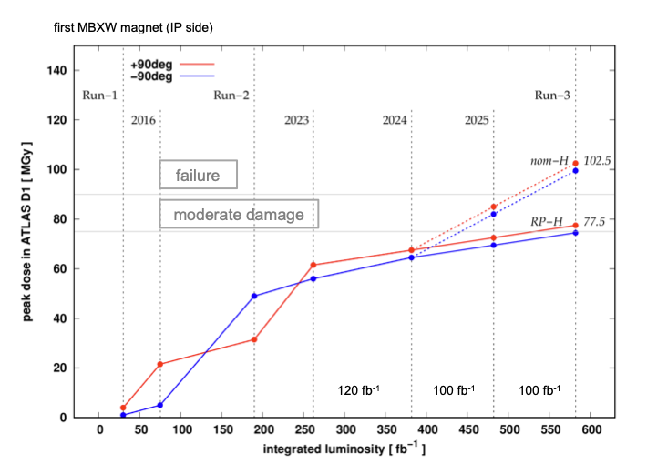
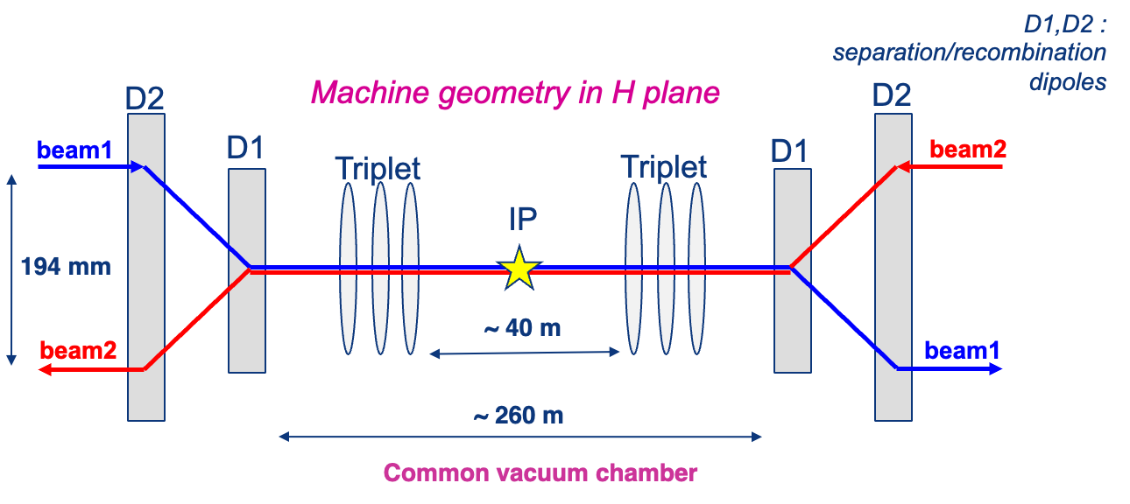
RD1
530 fb⁻¹
In the Interaction Regions, beams are combined into a common vacuum chamber then re-separated in the horizontal plane
Re-establishing NOM optics in P1 will push radiation on D1 beyond the estimated damage limit
RD1 circuits is composed of 6 WARM magnets per side of the IP. Failure would impact the first modules (possibly on both sides)
The risk of failure has to be taken seriously and (if possible) anticipated
Options under study:
  Magnets replacement in YETS 25/26
  Operation with reduced number of magnets
To be reviewed towards the end of 2025…

Slide 32
Outline
2024 run highlights
  low beta pp, pp ref run, IONS
2025 configuration
2025 schedule options

Slide 33
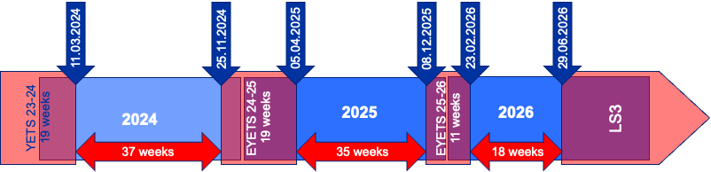
2025/2026 schedule options
LS3 start shifted from 17th November 2025 to 29th June 2026
  Additional p-p and Pb-Pb or perhaps p-Pb runs in 2026
  YETS 25-26 with minimum length of 11 weeks – machine kept at 20 K to secure Helium inventory
  Assumption of machine configuration change in 2025, but NOT in 2026
  HL-LHC and CMS need pre-LS3 cooldown for LS3 schedule optimisation
Three scenarios (A, B and C) considered – each with different Pb ion runs
2025: 35 weeks YETS to YETS
  → 165 physics days
2026: 18 weeks YETS to YETS
  → 88 physics days

Slide 34



2025/2026 schedule options
Current proposal by LPC
Option A is excluded
  vetoed by CMS: does not ensure sufficient pre-LS3 cooldown
Option B assumed to be most likely
Option C not yet excluded
  vetoed by ALICE: risk of losing PbPb physics considered too great
  Decision also depends on the possibility to use p-Pb running in 2026 as pre-LS3 RP cooldown
Option A
All Pb ion physics in 2025, pre-LS3 RP cooldown by low-µ run and MDs
Option B
Split Pb ion run about equally – setting-up overhead ~7 days
Option C
All Pb ion physics in 2026 and 2025 cooldown by low-µ run and MDs
A and C are more efficient (less setup time, more physics time)
B offers a compromise between risks and cooldown

Slide 35
Conclusions
2024 Run is (so far) very successful
  pp low beta: target overpassed (best year ever for production!)
    Best production rate, highest integrated lumi, highest beam energy stored,…
  pp reference: (ambitious) expectations accomplished
  IONS run: (on)going very well
2025/2026 machine configuration was chosen
  Preservation of forward physics
  Solutions in case of magnets failure identified
2025/2026 schedule options to be refined and optimized for final decision at RB
Thanks for your attention

