Slide 1

214th TE Technical Meeting (TE-TM)
4 November 2024
WP16
Commissioning of the cryogenic system of the HL-LHC Inner Triplet (IT) String without magnets and next steps
A. Onufrena, A. Perin, A. Lees, O. Pirotte, J. Gery, T. Colin, R. Mauny, M. Pezzetti, T. Barbe, A. Tovar, N. Guillotin, D. Valencon, N. Trikoupis, V. Gahier, T. Dupont, all the Cryogenics and WP16 Teams
https://indico.cern.ch/event/1470595/

Slide 2
Outline
Introduction and cryogenic infrastructure of IT String
Overview of commissioning phases
Main commissioning results
  Cold compressor
  Heat loads and pressure drop on the lines
  Estimated cooling capacity
Next steps and conclusions

Slide 3
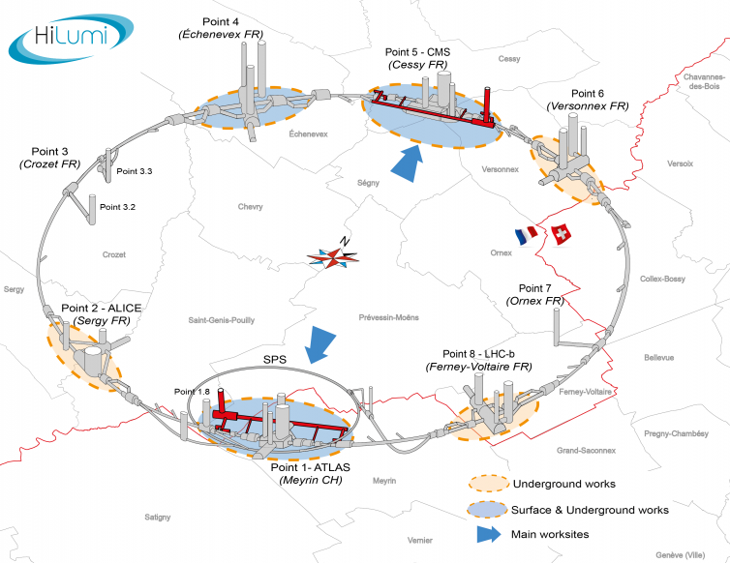
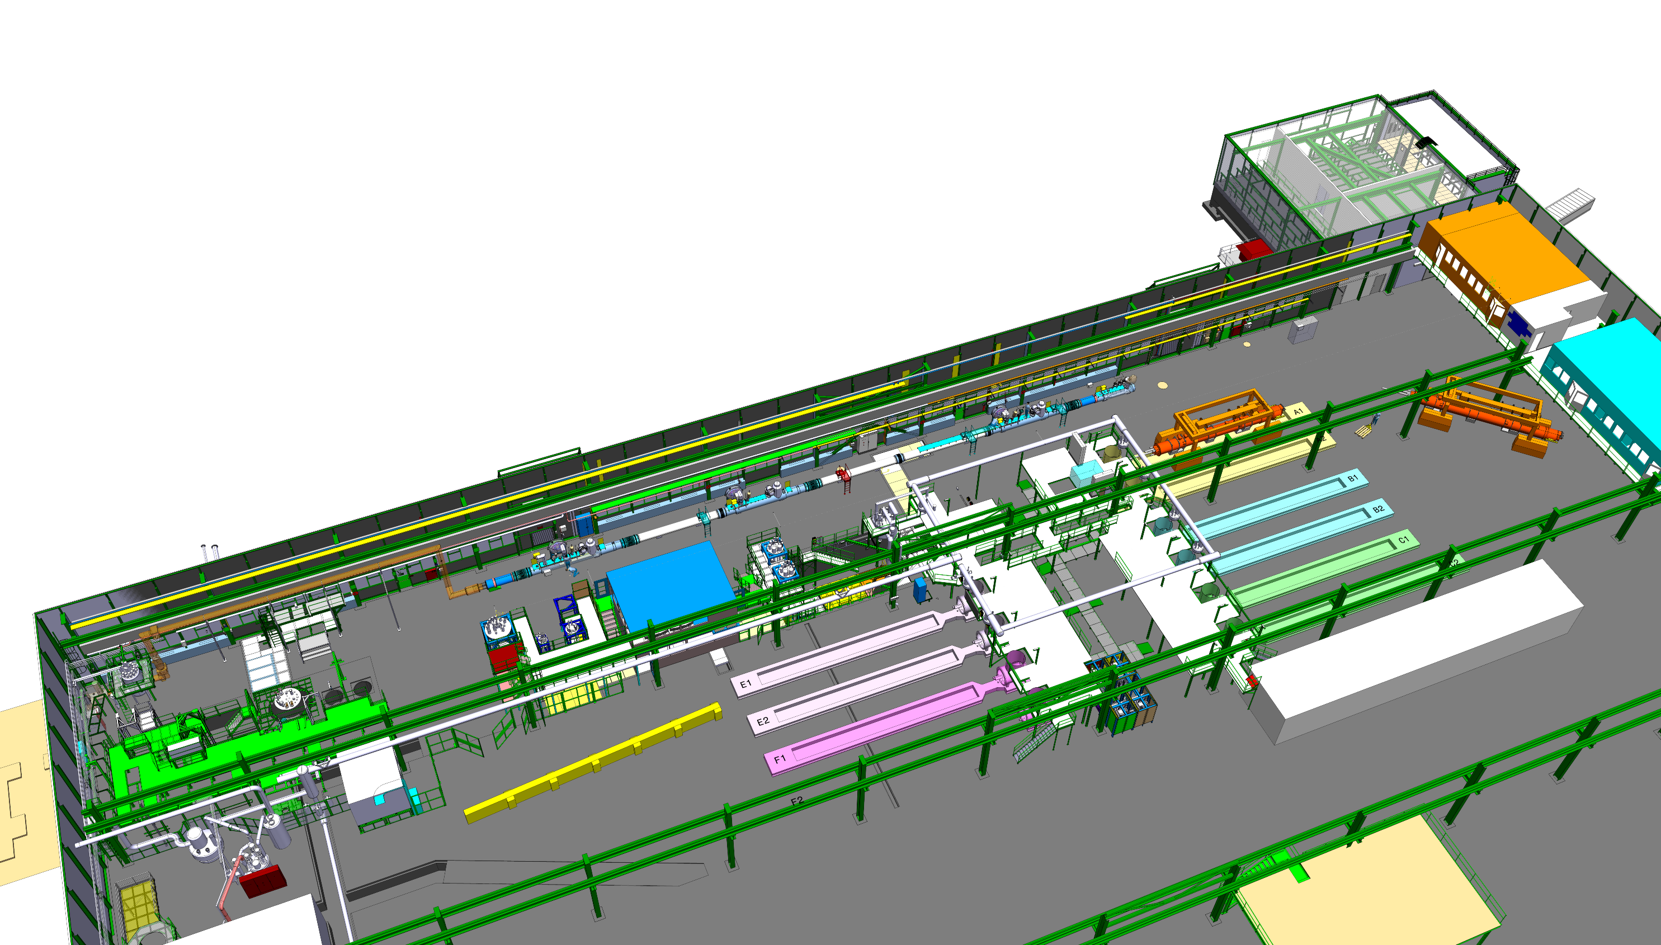
Introduction
Key objectives
Validate collective behaviour of the magnets & their systems in the conditions as similar as possible to the operational ones
Obtain information about the operational behaviour in advance to speed up the commissioning in the LHC tunnel
IT String test facility: consists of all magnet circuits from D1 to Q1 and cold powering with their respective systems (cryogenics, quench protection, …)
Q1
D1
CP
Q3
Q2b
Q2a
For the High Luminosity LHC (HL-LHC) project, the final focusing Inner Triplet (IT) superconducting magnets around ATLAS and CMS will be replaced by a new 60 m-long set of higher performance Nb₃Sn magnets
SM18 hall

Slide 4
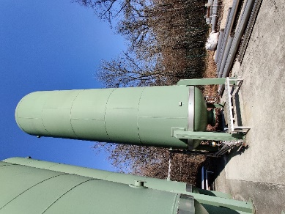
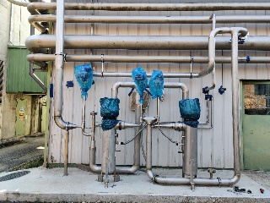
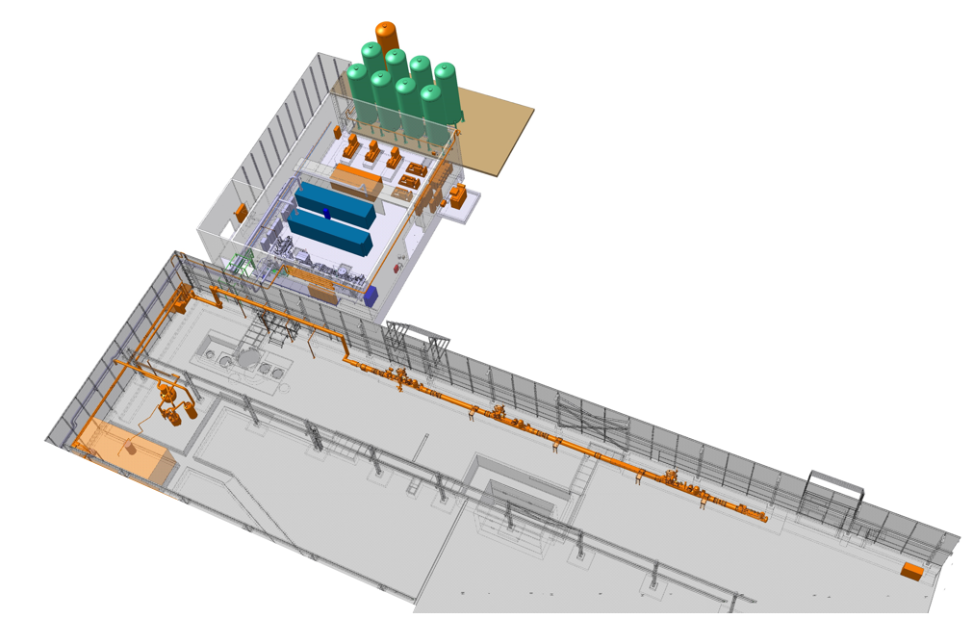
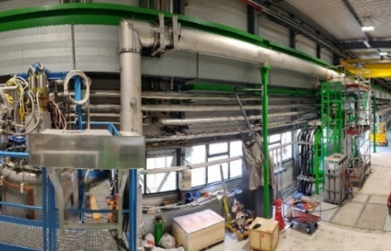
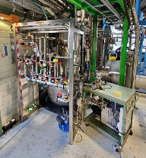
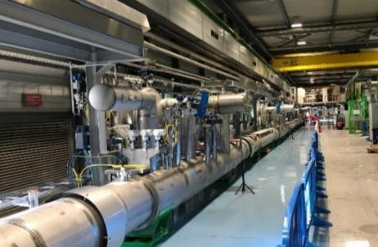

Cryogenic architecture for HL-LHC IT String in SM18
Warm Quench Buffer
Specific to the IT String
SQXL: cryogenic distribution line
PCDS: proximity cryogenic distribution system
CC: cold compressor
WQB: warm quench buffer
Gas management system of DFHX
Data acquisition & control system
Part of SM18 infrastructure
Warm quench buffer
Existing refrigerator
Warm pumping units
Main helium storage
Warm quench buffer (WQB)
TL05
Warm pumping units (WPUs)
2 x 15 kW heaters
Quench line
SQXL
Gas management panel
PCDS ($≈$70 m)
60 m-long cryogenic distribution line (SQXL)
Number if items/assemblies tracked : >1000
Instrumentation: 376 items with 190 not in magnets & cold powering
Thermometers : 227 with 81 not in mag. & cold powering
Valves : 185 total, 31 cryogenic
Cold compressor
(CCU)
Refrigerator
IT magnets area

Slide 5
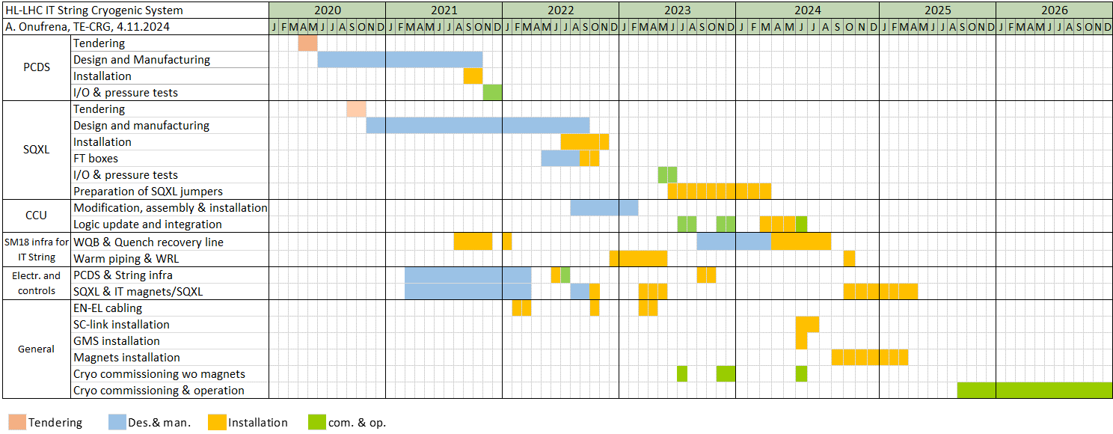
Project overview
Cryogenic system was under design and construction from 2020 and underwent three commissioning runs in 2023-2024
Today
Cryogenic system was built and ready for commissioning in 2023
Planned start of commissioning with magnets in 2025
Tendering and construction
Three commissioning runs

Slide 6
Outline
Introduction and cryogenic infrastructure of IT String
Overview of commissioning phases
Main commissioning results
  Cold compressor
  Heat loads and pressure drop on the lines
  Estimated cooling capacity
Next steps and conclusions

Slide 7
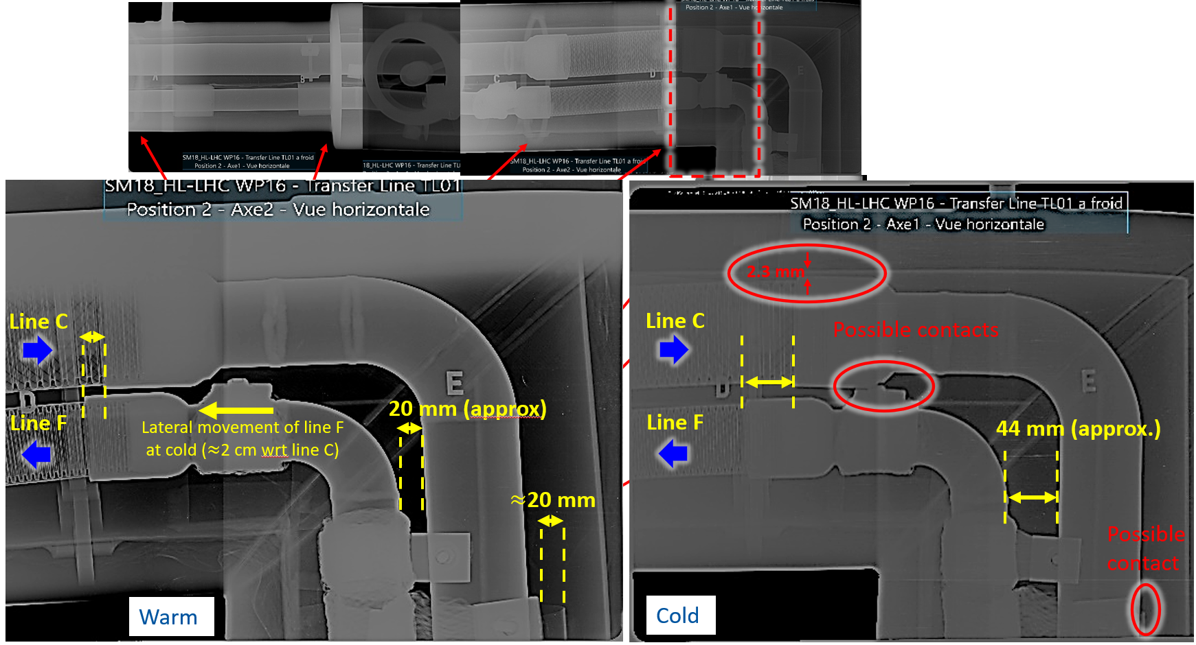
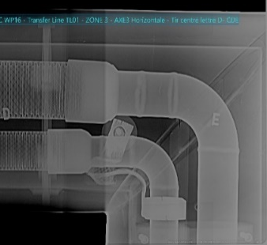
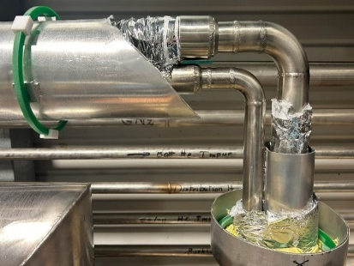
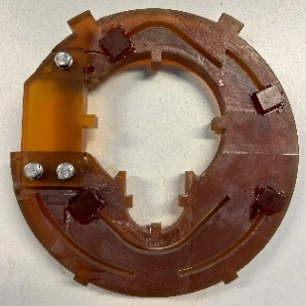
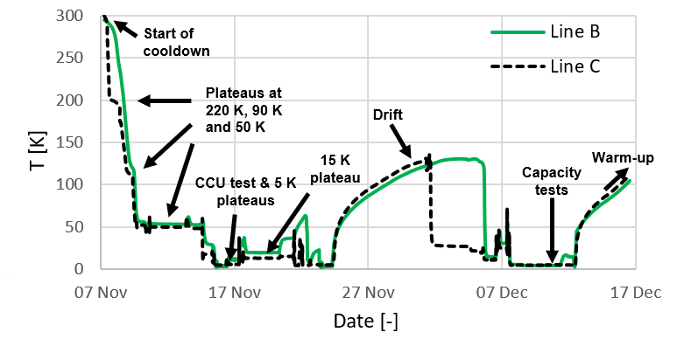
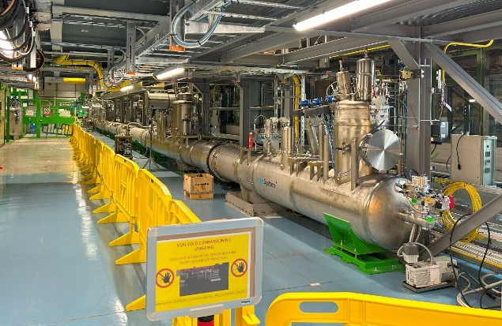
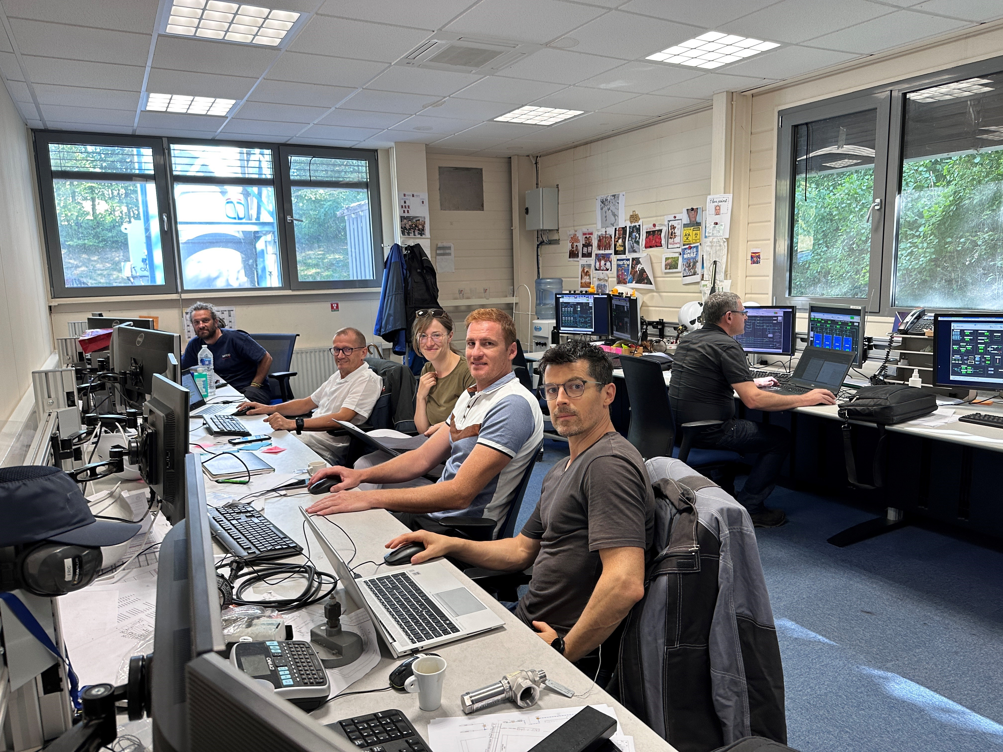
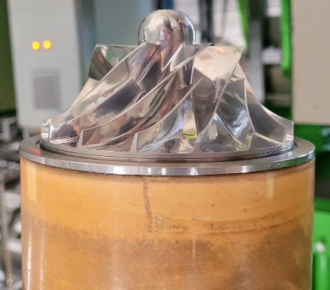
Heat load in TL01, contacts and repair
IT String commissioning phases
Strategy: commission the cryogenic system in a standalone mode before operation with magnets (allows to anticipate and resolve any potential issues)
Phase 1b
Phase 1c
Jun 2023 (and before)
Jul-Aug 2023
Aug-Oct 2023
Nov 2023
Dec 2023
Jan-Apr 2023
May 2023
Jun 2023
Jul - Oct 2024
  Phase 1: commissioning of the cryogenic system without magnets (complete!)
  Phase 2: commissioning (and then operation) of the cryogenic system with magnets (2nd half of 2025)
System ready for the cooldown
  Phase 1a
  Controlled cooldown
  Mechanical integrity validation
  Heat load on some segments is higher than expected
  Phase 1b (further validation and studies):
  System thermal characterization (heat loads, pressure drop)
  X-ray inspection of TL01 line at cold
  Further tuning of control loops and CCU logic test
  Phase 1c (additional studies):
  CCU logic validation
  TL01 repair validation and capacity measurements
Cryogenics operating team
Repair of the cold compressor (CCU)

Slide 8
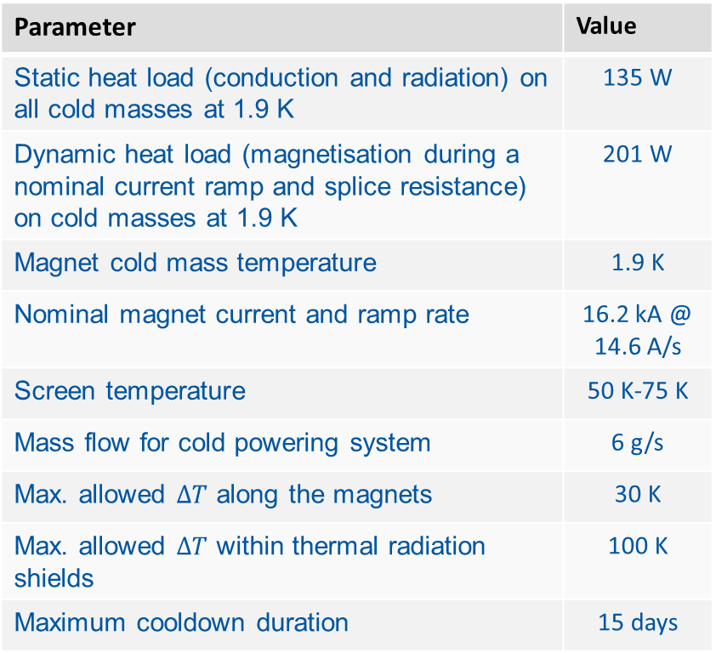

Requirements and operating parameters of the cryogenic system
Operating requirements for IT String (derived from HL-LHC)
Parameter | Value
Static heat load (conduction and radiation) on all cold masses at 1.9 K | 135 W
Dynamic heat load (magnetisation during a nominal current ramp and splice resistance) on cold masses at 1.9 K | 201 W
Magnet cold mass temperature | 1.9 K
Nominal magnet current and ramp rate | 16.2 kA @ 14.6 A/s
Screen temperature | 50 K-75 K
Mass flow for cold powering system | 6 g/s
Max. allowed $ΔT$ along the magnets | 30 K
Max. allowed $ΔT$ within thermal radiation shields | 100 K
Maximum cooldown duration | 15 days
336 W of heat load at 1.9 K
$ΔT$ drives the cooldown speed

Slide 9
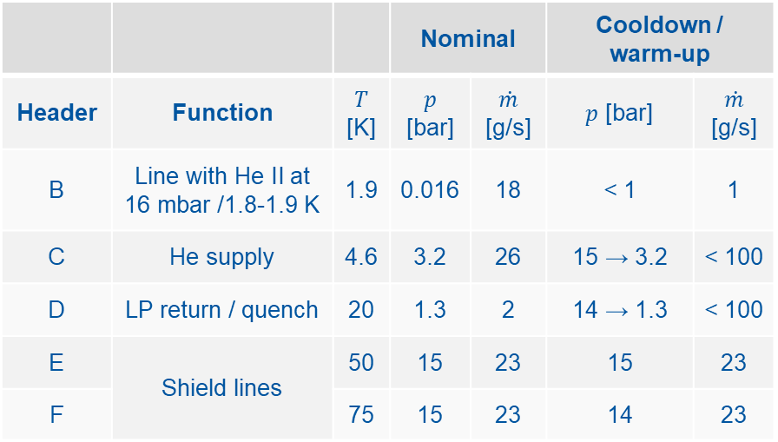
Requirements and operating parameters of the cryogenic system
Operating requirements for IT String (derived from HL-LHC)
Parameter | Value
Static heat load (conduction and radiation) on all cold masses at 1.9 K | 135 W
Dynamic heat load (magnetisation during a nominal current ramp and splice resistance) on cold masses at 1.9 K | 201 W
Magnet cold mass temperature | 1.9 K
Nominal magnet current and ramp rate | 16.2 kA @ 14.6 A/s
Screen temperature | 50 K-75 K
Mass flow for cold powering system | 6 g/s
Max. allowed $ΔT$ along the magnets | 30 K
Max. allowed $ΔT$ within thermal radiation shields | 100 K
Maximum cooldown duration | 15 days
336 W of heat load at 1.9 K
Flows, temperatures and pressures in the headers during the commissioning
 |  |  | Nominal |  | Cooldown / warm-up
Header | Function | $T$ [K] | $p$ [bar] | $\dot{m}$ [g/s] | $p$ [bar] | $\dot{m}$ [g/s]
B | Line with He II at 16 mbar /1.8-1.9 K | 1.9 | 0.016 | 18 | < 1 | 1
C | He supply | 4.6 | 3.2 | 26 | 15 → 3.2 | < 100
D | LP return / quench | 20 | 1.3 | 2 | 14 → 1.3 | < 100
E | Shield lines | 50 | 15 | 23 | 15 | 23
F |  | 75 | 15 | 23 | 14 | 23
Goal: validate that these conditions can be achieved by the cryogenic system
$ΔT$ drives the cooldown speed

Slide 10
IT String flow scheme for standalone commissioning
Cold Box (CB)
Bypass
Phase separator
Caps
Future IT magnets

Slide 11
IT String flow scheme for standalone commissioning
Warm pumps (WPU)
Proximity cryogenics (PCDS)
Cold compressor (CCU)
Cold Box (CB)
Cryogenic distribution line (SQXL)
Bypass
Phase separator
Caps

Slide 12
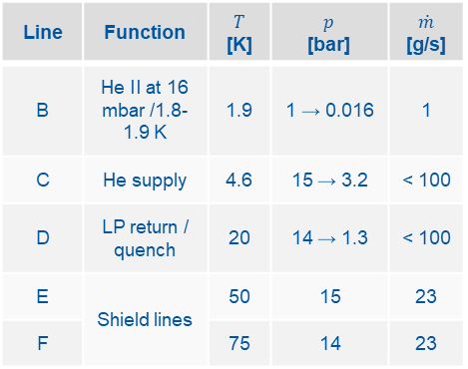
Cooldown: 300 K → 4.5 K / 1.8 K (Line B)
14 bar → 1.3 bar
15 bar → 3 bar
Nominal conditions in the headers
Line | Function | $T$ [K] | $p$ [bar] | $\dot{m}$ [g/s]
B | He II at 16 mbar /1.8-1.9 K | 1.9 | 1 → 0.016 | 1
C | He supply | 4.6 | 15 → 3.2 | < 100
D | LP return / quench | 20 | 14 → 1.3 | < 100
E | Shield lines | 50 | 15 | 23
F |  | 75 | 14 | 23
Phase separator

Slide 13
Cooldown: 300 K → 4.5 K / 1.8 K (Line B)
15 bar
14 bar
14 bar → 1.3 bar
15 bar → 3 bar
Nominal conditions in the headers
Line | Function | $T$ [K] | $p$ [bar] | $\dot{m}$ [g/s]
B | He II at 16 mbar /1.8-1.9 K | 1.9 | 1 → 0.016 | 1
C | He supply | 4.6 | 15 → 3.2 | < 100
D | LP return / quench | 20 | 14 → 1.3 | < 100
E | Shield lines | 50 | 15 | 23
F |  | 75 | 14 | 23
Phase separator

Slide 14
Cooldown: 300 K → 4.5 K / 1.8 K (Line B)
15 bar
14 bar
14 bar → 1.3 bar
15 bar → 3 bar
Nominal conditions in the headers
1 bar → 16 mbar
Line | Function | $T$ [K] | $p$ [bar] | $\dot{m}$ [g/s]
B | He II at 16 mbar /1.8-1.9 K | 1.9 | 1 → 0.016 | 1
C | He supply | 4.6 | 15 → 3.2 | < 100
D | LP return / quench | 20 | 14 → 1.3 | < 100
E | Shield lines | 50 | 15 | 23
F |  | 75 | 14 | 23
Phase separator

Slide 15
Outline
Introduction and cryogenic infrastructure of IT String
Overview of commissioning phases
Main commissioning results
  Cold compressor
  Heat loads and pressure drop on the lines
  Estimated cooling capacity
Next steps and conclusions

Slide 16
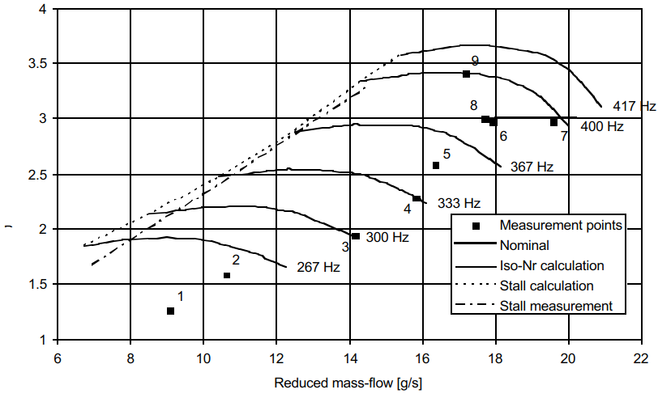
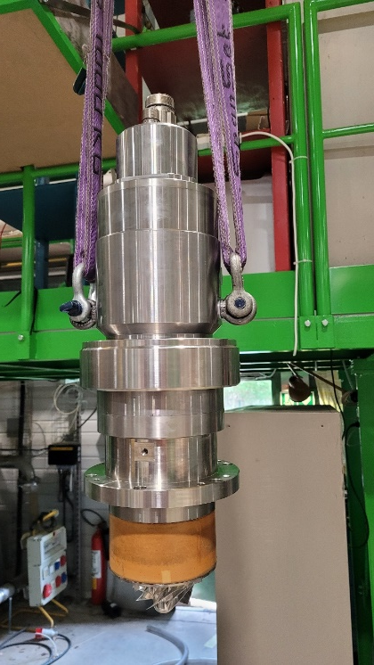
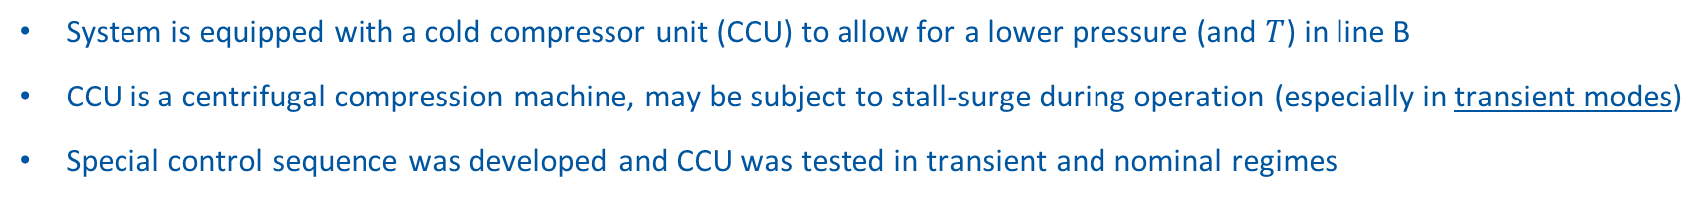





Cold compressor logic validation
System is equipped with a cold compressor unit (CCU) to allow for a lower pressure (and $T$) in line B
CCU is a centrifugal compression machine, may be subject to stall-surge during operation (especially in transient modes)
Special control sequence was developed and CCU was tested in transient and nominal regimes
3
Total $\dot{m}$ [g/s]
4
Lower $T$
Higher $T$
$\dot{m}$ in magnets [g/s]
1
2
5
$\dot{m}$ in SC-link [g/s]
Nominal operation
Pressure in line B [mbar]
Examples of CCU operation curves on its performance map
1 → Start (𝑚 ̇ corresponds to static 𝑄 ̇ of the magnets + SC-link) & thermalisation
1-2 → Start the CCU which controls the pressure in line B
2-3 → Transient: pre-loading of the magnets
3-4 → Ramp / nominal operation
4-5 → Deceleration and controlled stop
CCU head during re-integration
Results: sequence was validated, developed logic was able to ensure operation in the stable (1h) and transient regimes (temperature and heat load variation, quench-like pressure rises) within stall-surge limits

Slide 17
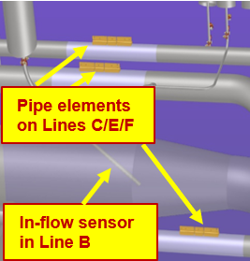
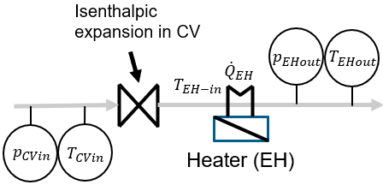
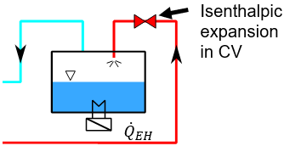

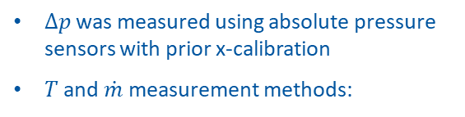
Pressure drop and heat loads
Pressure drops and heat loads of distribution system consisting of proximity cryogenics (PCDS) and cryo distribution line (SQXL) were measured
TL05
$Δp$ was measured using absolute pressure sensors with prior x-calibration
$T$ and $\dot{m}$ measurement methods:
SQXL
Lines TL01 / TL02 / TL03
PCDS ($≈$70 m)
60 m-long cryogenic distribution line (SQXL)
IT magnets area
6 kW refrigerator

Slide 18
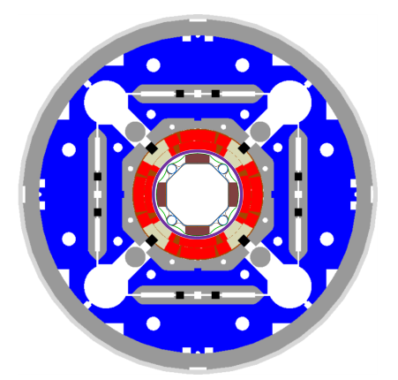

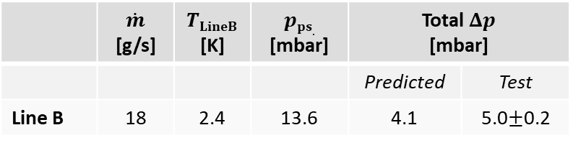
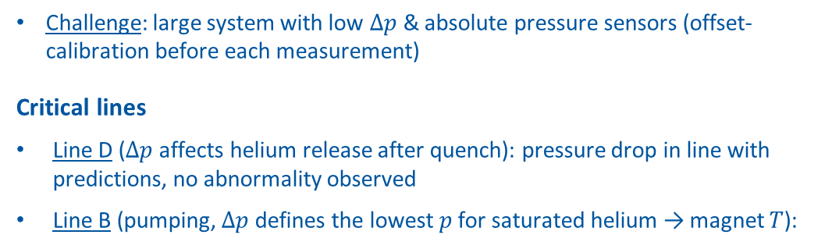
Pressure drop
Bayonet HX (Line B to pumps)
Challenge: large system with low $Δp$ & absolute pressure sensors (offset-calibration before each measurement)
Critical lines
Line D ($Δp$ affects helium release after quench): pressure drop in line with predictions, no abnormality observed
Line B (pumping, $Δp$ defines the lowest $p$ for saturated helium → magnet $T$):
Warm Quench Buffer
Magnet bath at 1.3 bar (Line D to quench buffer)
 | $\dot{m}$ [g/s] | $TLineB$ [K] | $pps.$ [mbar] | Total $Δp$ [mbar]
 |  |  |  | Predicted | Test
Line B | 18 | 2.4 | 13.6 | 4.1 | 5.0$±$0.2
Cross-section of IT magnet
Magnet temperature analysis:
Worst case scenario: test results transfer into 17.5 mbar and 1.82 K inside the bayonet HX during nominal operation → margin for operation (0.3 K below $λ$-point)
Result: measured pressure drop is in line with predicted values and compatible with operations

Slide 19

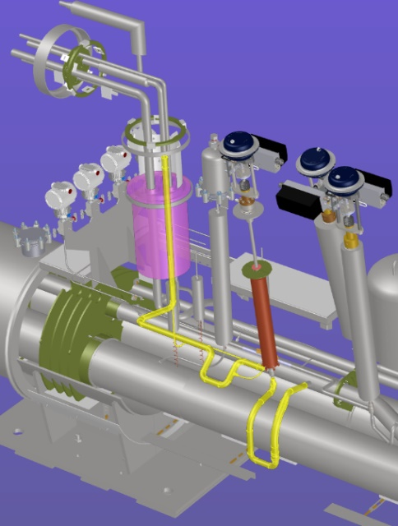
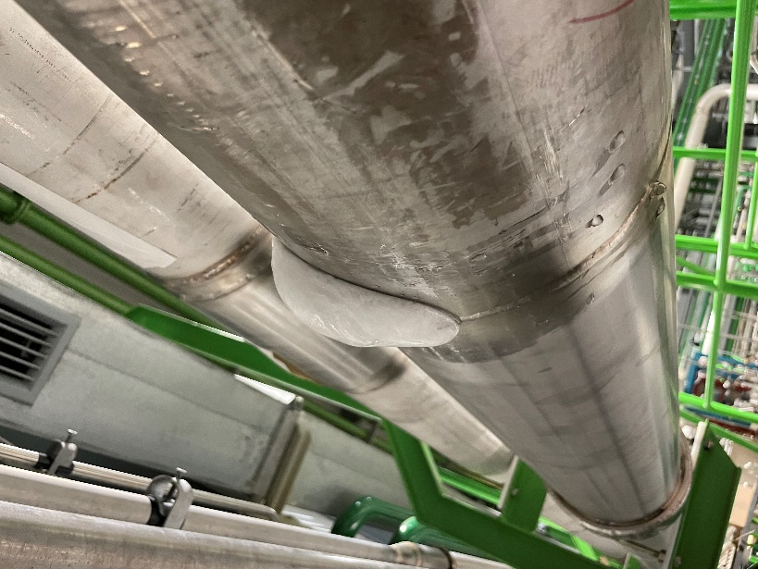
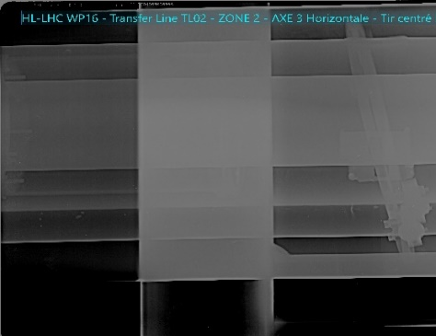
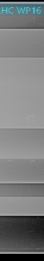
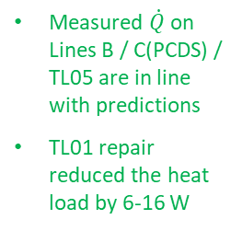
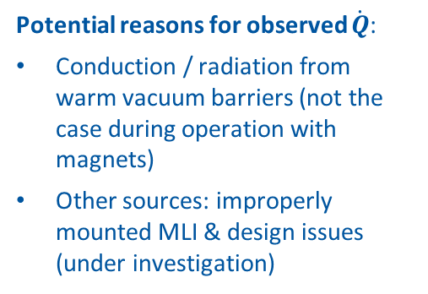
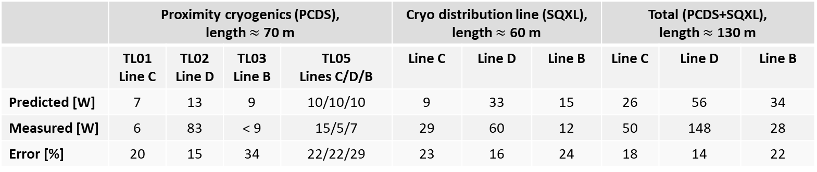
Heat loads
 | Proximity cryogenics (PCDS), length $≈$ 70 m |  |  |  | Cryo distribution line (SQXL), length $≈$ 60 m |  |  | Total (PCDS+SQXL), length $≈$ 130 m
 | TL01 Line C | TL02 Line D | TL03 Line B | TL05 Lines C/D/B | Line C | Line D | Line B | Line C | Line D | Line B
Predicted [W] | 7 | 13 | 9 | 10/10/10 | 9 | 33 | 15 | 26 | 56 | 34
Measured [W] | 6 | 83 | < 9 | 15/5/7 | 29 | 60 | 12 | 50 | 148 | 28
Error [%] | 20 | 15 | 34 | 22/22/29 | 23 | 16 | 24 | 18 | 14 | 22
Measured $\dot{Q}$ on Lines B / C(PCDS) / TL05 are in line with predictions
TL01 repair reduced the heat load by 6-16 W
$\dot{Q}$ on Line D inside TL02 is higher than expected
Effect of warm vacuum barriers
  Ice on TL02 (Line D)
Bent spacer inside TL02
Potential reasons for observed $\dot{Q}$:
Conduction / radiation from warm vacuum barriers (not the case during operation with magnets)
Other sources: improperly mounted MLI & design issues (under investigation)
Control Valve
Vacuum barrier
Line C
Piping

Slide 20
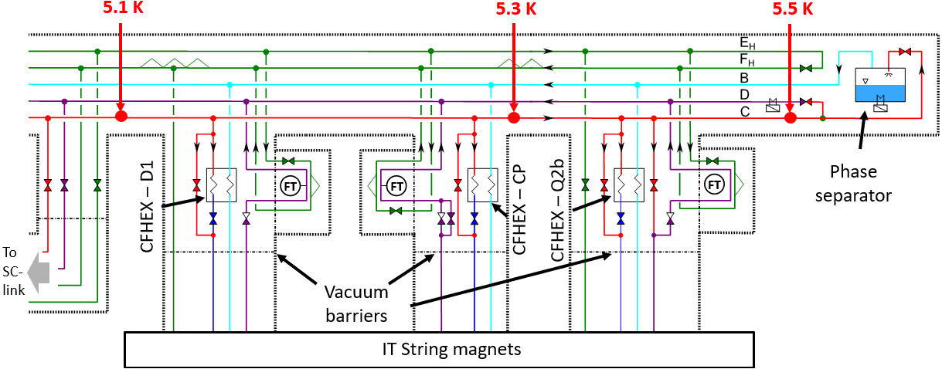
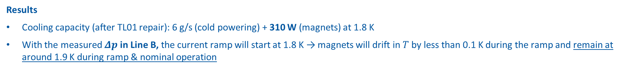
Capacity tests
Goal: validate that the cryogenic system can provide sufficient cooling for the magnets
Highest heat dissipation during 19-minute nominal magnet ramp (14.6 A/s): 135 W (static) + 201 W (dynamic) → 336 W
Capacity tests: nominal fluid conditions during the ramp → cooling power can be calculated from temperatures in Line C
Results
Cooling capacity (after TL01 repair): 6 g/s (cold powering) + 310 W (magnets) at 1.8 K
With the measured $Δp$ in Line B, the current ramp will start at 1.8 K → magnets will drift in $T$ by less than 0.1 K during the ramp and remain at around 1.9 K during ramp & nominal operation
Conclusion: cryogenic system has a sufficient cooling capacity to keep the magnets at 1.9 K during nominal operation

Slide 21
Outline
Introduction
Cryogenic infrastructure of IT String
Overview of commissioning phases
Main commissioning results
  Cold compressor
  Heat loads and pressure drop on the lines
  Estimated cooling capacity
Next steps and conclusions

Slide 22
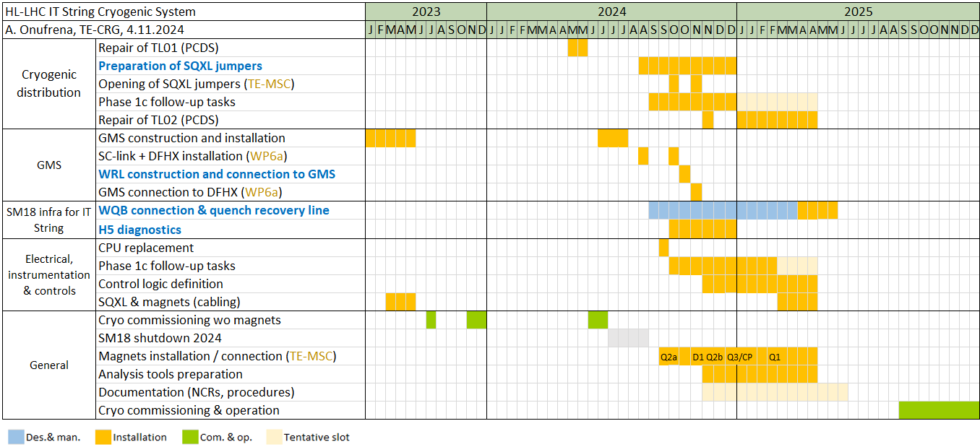
Next steps: planning for 2025
Magnets planned to be in place by Mar 2025 and commissioning with magnets is planned for Q3-Q4 of 2025 → aim to have the cryogenic system ready by May 2025
Planned start of commissioning with magnets in Q3-Q4 2025
Phase 1a
Phase 1b
Phase 1c
Today
Target to be ready by end of May 2025

Slide 23


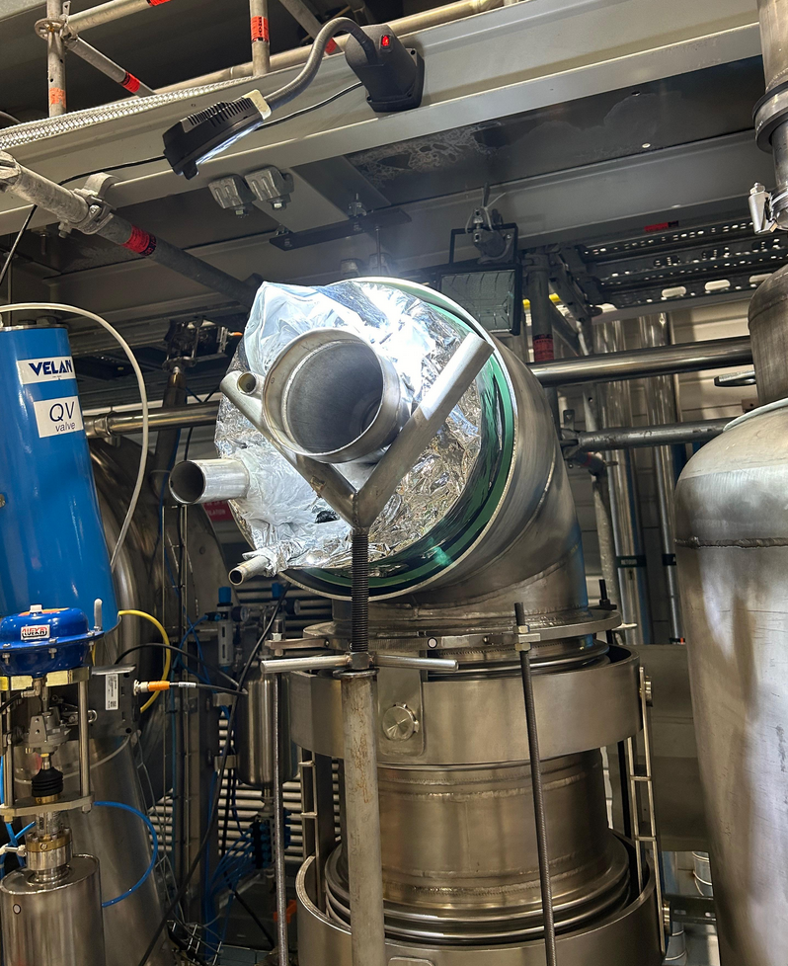
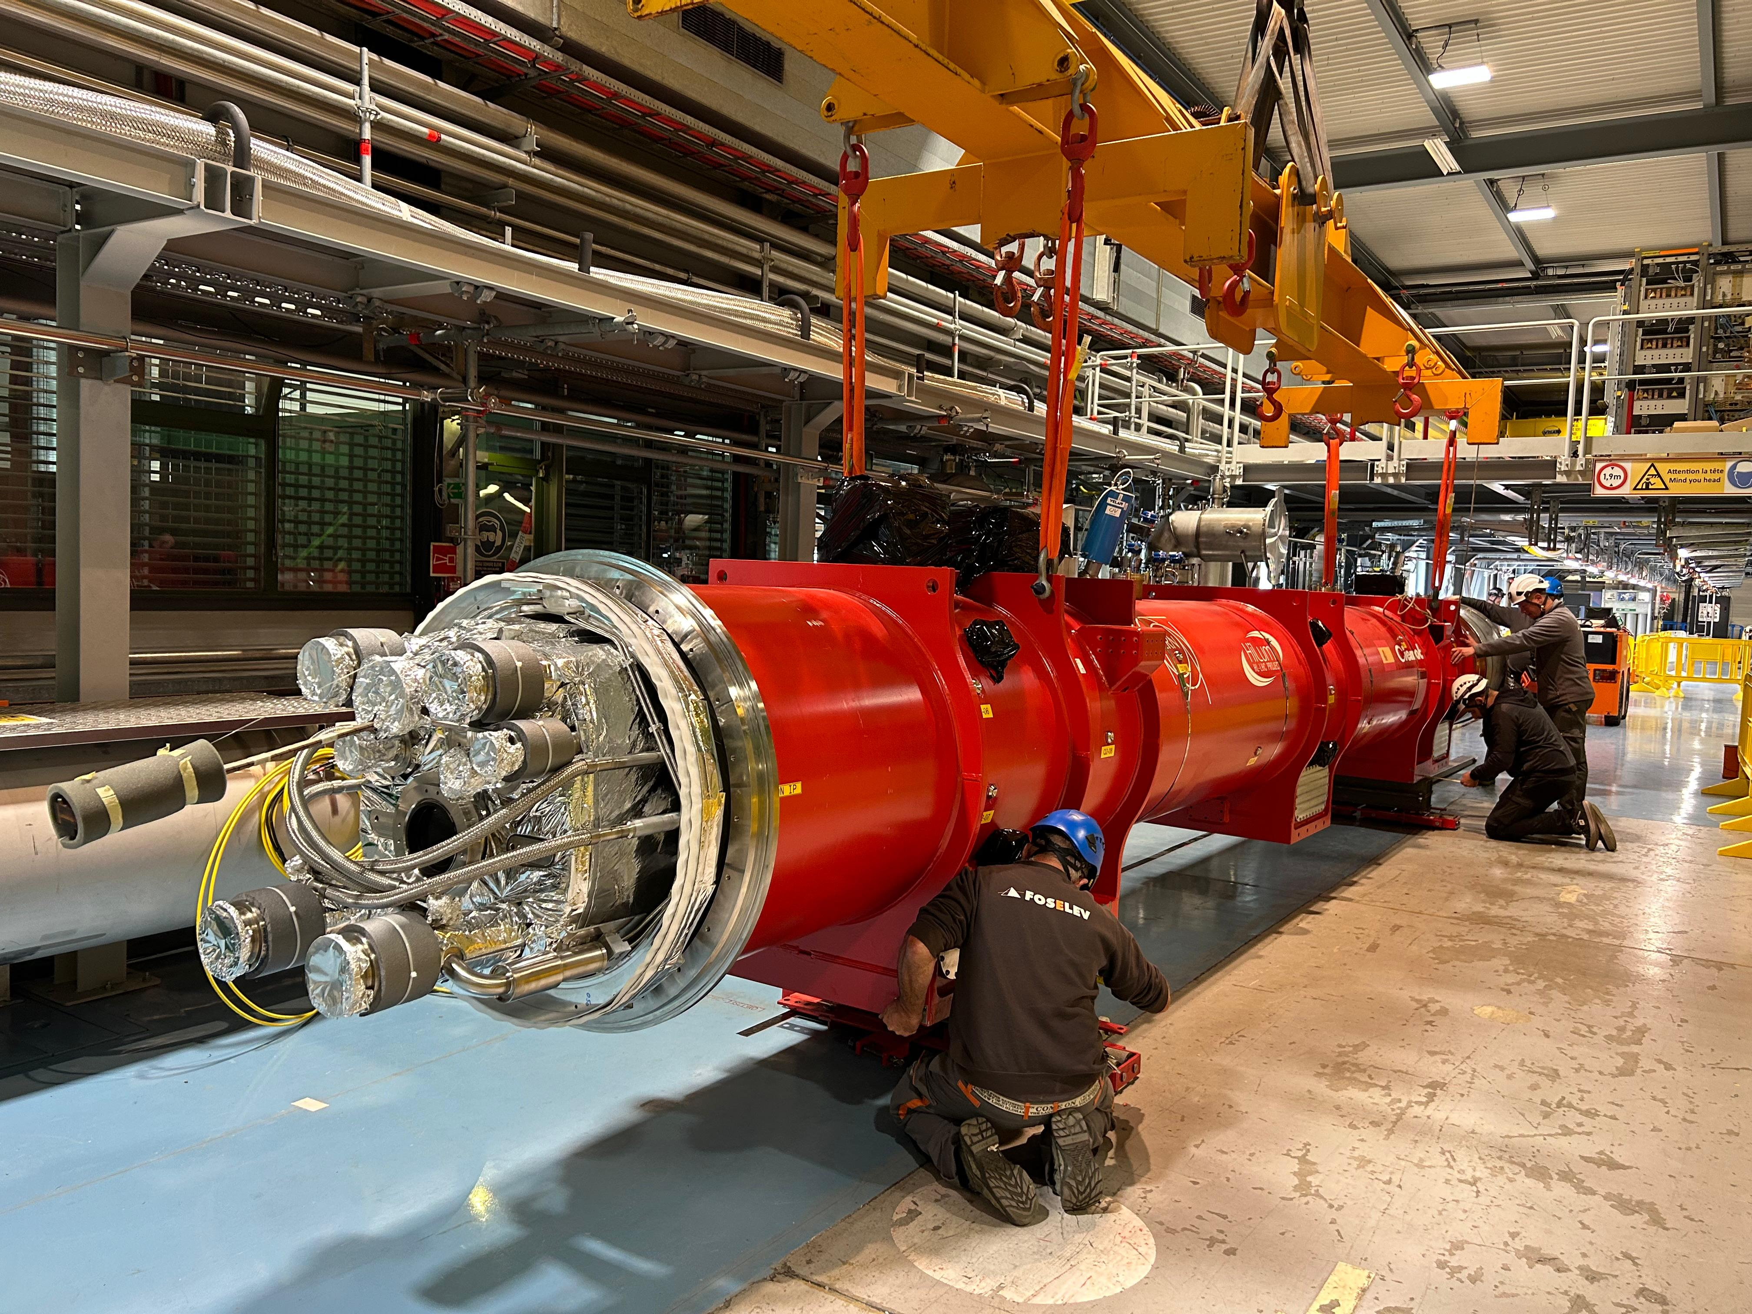
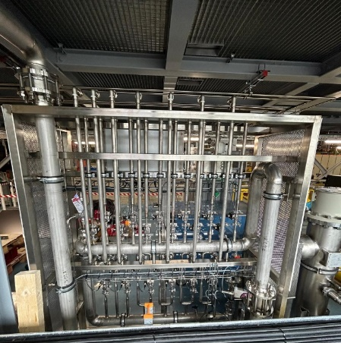
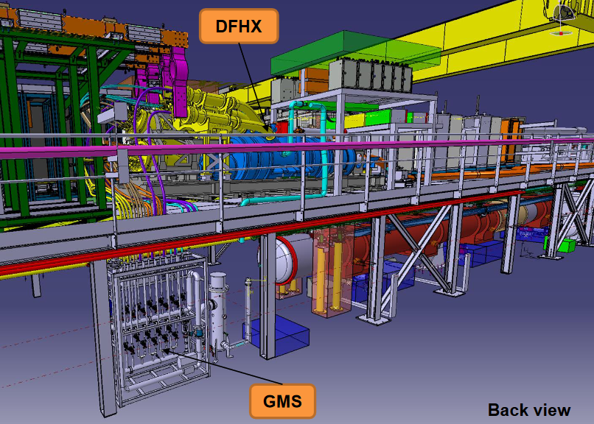
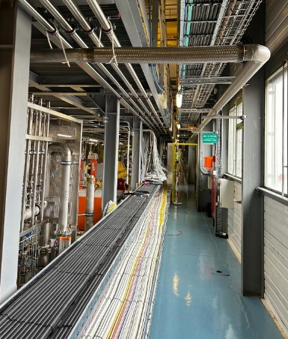
Quench buffer
Next steps: preparation of commissioning with magnets
Mechanical activities
SQXL jumper preparation for magnet connection is on-going
  Q2a arrived and D1 jumper open (TE-MSC)
  D1 installation planned this week
Connection of cold powering:
  Gas management system (GMS) installed
  Warm recovery line (WRL) constructed and connected to GMS
  GMS to be connected to DFHX (WP6a)
Warm quench buffer connection
  Design / preparation for fabrication of connection are on-going
  Connection is planned for Mar-Apr 2025
Mechanical consolidations following commissioning without magnets (TL02, valve checks) are on-going
Open D1 jumper
Installation of Q2a
TL02
Gas management system (GMS) for cold powering
Connection of WRL
Connection of bayonet from DFHX
Installed warm recovery line (WRL)

Slide 24
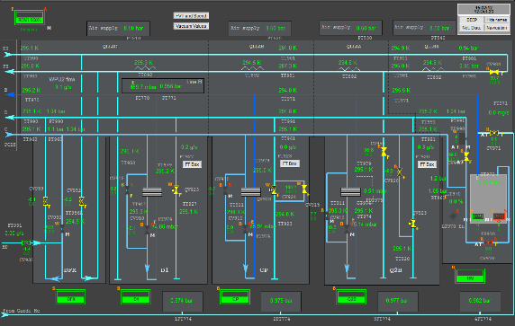
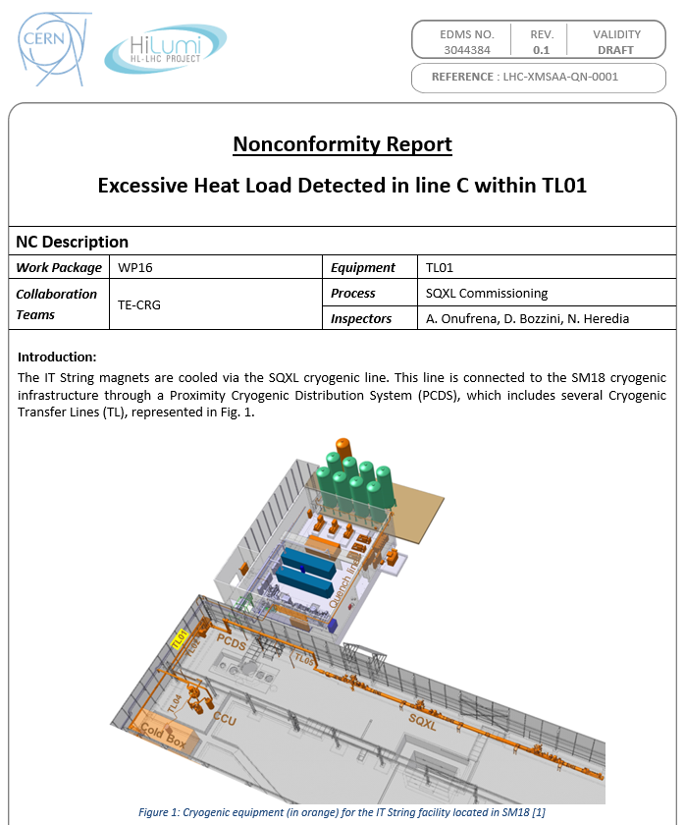
Next steps: preparation of commissioning with magnets
Electrical activities
Cabling of the magnet & cold powering instrumentation
  Rack side: GMS and DFHX connection is in progress
  IT String side (magnet and DFHX): connections are in preparation
H5 diagnostics and installation of HL-LHC-like CPU (on-going)
Fast acquisition and data acquisition validation
Instrumentation consolidations following commissioning
Preparation for commissioning with magnets
Preparation of test procedures and documentation
  IT String commissioning document (sequences, functional specification)
  NCRs (TL01 completed, TL02 in preparation)
Control logic and analysis tools (to be defined and programmed)
Review of interfaces with other systems (vacuum, quench protection)
Control logic to be defined

Slide 25
Conclusions
Cryogenic system for IT String has been built and commissioned in a standalone mode (without magnets and cold powering)
Mechanical integrity and functionality of instrumentation were validated
IT String cooldown procedure was validated, and nominal conditions were achieved in all lines
Heat loads and pressure drop measured (system characterization) → higher heat loads than expected on Lines C/D
The cryogenic system has a sufficient cooling capacity to keep the magnets at 1.9 K → system has been validated for the IT String operation
Activities in preparation for commissioning with magnets (Phase 2) are on-going

Slide 26


Slide 27
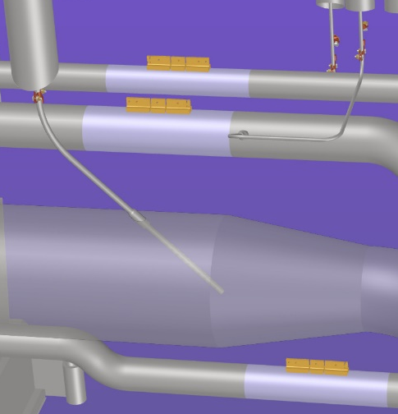

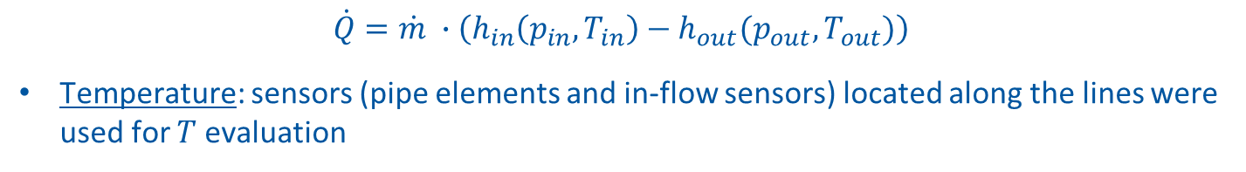


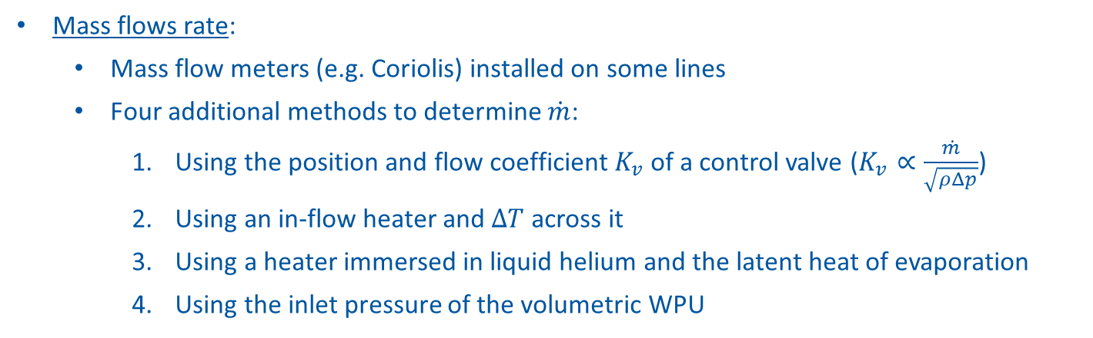




Heat loads: measurement methods and challenges
Challenges: high uncertainties at low $\dot{m}$, low $ΔT$ near $c_{p}$ peak for Line C, stratification of supercritical fluid at low $\dot{m}$, radiation shield $T$ drift during tests at low $\dot{m}$
Pipe elements on Lines C/E/F
$$\dot{Q}=\dot{m} ∙\left(h_{in}\left(p_{in}, T_{in}\right)−h_{out}(p_{out}, T_{out})\right)$$
Temperature: sensors (pipe elements and in-flow sensors) located along the lines were used for $T$ evaluation
In-flow sensor in Line B
Isenthalpic expansion in CV
$${\dot{Q}}_{EH}$$
$$p_{EHout}$$
$$T_{EHout}$$
Mass flows rate:
  Mass flow meters (e.g. Coriolis) installed on some lines
  Four additional methods to determine $\dot{m}$:
    Using the position and flow coefficient $K_{v}$ of a control valve ($K_{v}∝\frac{\dot{m}}{\sqrt{ρΔp}}$)
    Using an in-flow heater and $ΔT$ across it
    Using a heater immersed in liquid helium and the latent heat of evaporation
    Using the inlet pressure of the volumetric WPU
$$T_{EH−in}$$
$$p_{CVin}$$
$$T_{CVin}$$
Heater (EH)
Isenthalpic expansion in CV
$${\dot{Q}}_{EH}$$

