Slide 2

High Intensity ECN3 (HI-ECN3) Project:
SPS Beam Dump Facility
M. Fraser (SY-ABT-BTP) presenting on behalf of the HI-ECN3 Project Team
214th TE-TM meeting, CERN, Geneva, Switzerland
4th November 2024
https://hiecn3.web.cern.ch

Slide 3
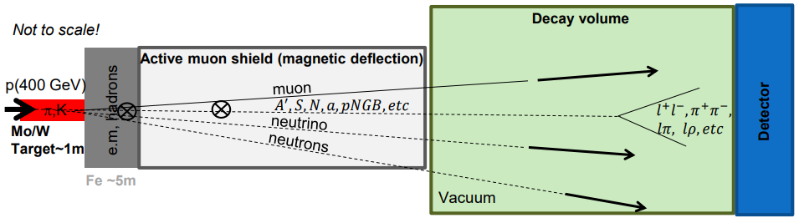
Beam Dump Facility (BDF) / SHiP
Direct search for Feebly Interacting Particles (FIPs) at a new Beam Dump Facility to be installed in ECN3 to exploit 4×10¹⁹ protons (400 GeV/c) per year for 6×10²⁰ POT over 15 years to overcome the small cross-section of ultra-rare events:
SHiP Physics Proposal: Rep. Prog. Phys. 79 (2016) 124201 published 2016
SPS Beam Dump Facility Comprehensive Design Study: CERN-2020-002 published 2020
High energy → production of charmed and beauty mesons
High ppp & POT → overcome small production cross-section of rare events of hidden particles
High ρ, Z & A → maximize p⁺ interaction
Shortest λ → force absorption of K & π to reduce muon & neutrino background
R. Jacobsson

Slide 4


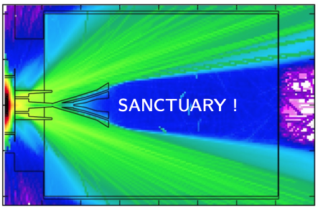



C. Ahdida et al., Findings of the Physics Beyond Colliders ECN3 Beam Delivery Task Force, CERN-PBC-REPORT-2023-001
SHiP’s bow wave is made of $μ$ & $\overline{μ}̅$ …
Richard will discuss the SHiP magnet systems in detail
$$μ^{−}$$
Expected background:
< 1 event for 6×10²⁰ POT
$$μ^{+}$$
R. Jacobsson

Slide 5

Study Project $→$ Approved Project
Upgrade of beam intensity at North Area and SHiP beam-dump (BDF/SHiP) experiment approved recently…
… with ~ 62 MCHF (over 7 years) reserved for the High Intensity upgrade of ECN3 (HI-ECN3) project in CERN’s Medium-Term Plan ratified by CERN Council in June 2024.
Approved together with ~ 170 MCHF for consolidation of the North Area (NA-CONS project)
The HI-ECN3 project is a part of CERN’s…
“…broad diverse scientific programme, complementary to the collider and carried out mainly at the injectors: continuously upgraded and expanded (e.g. recently the ECN3 beam intensity upgrade at the North Area).”
Fabiola Gianotti
For more information on the competitive ECN3 decision process:
C. Ahdida et al., Findings of the Physics Beyond Colliders ECN3 Beam Delivery Task Force, CERN-PBC-REPORT-2023-001
G. Arduini, C. Vallée, J. Jaeckel (eds.) Post-LS3 Experimental Options in ECN3, CERN-PBC-REPORT-2023-003

Slide 6
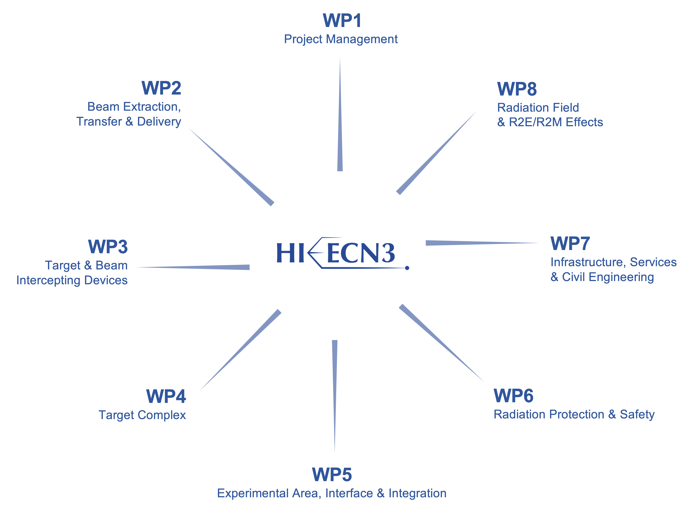
HI-ECN3 Project Structure
Experiment Project Leader: Richard JACOBSSON
SHiP Experiment Safety Correspondent: Letizia DI GIULIO
TE in SHiP Collaboration
TE-MSC: SHiP spectrometer magnet
PL: Matthew FRASER
DPL: Claudia AHDIDA
TE in WP2
TE-MSC: TCC2 magnets / BDF dilution system
TE-MPE: Machine protection
Francesco VELOTTI & Laurie NEVAY
Luigi ESPOSITO
TE in WP3
TE-MPE: Machine protection
Rui FRANQUEIRA XIMENES
Fernando PEDROSA
TE in WP4
TE-MSC: Magnetised hadron stopper
TE in WP5
TE-CRG: Dismantling NA62 LKr calorimeter / cooling of SHiP muon shield
Jean-Louis GRENARD
Claudia AHIDIDA
Project Safety Officer (PSO): Melania AVERNA
Project & Experiment Safety Support (PESS) Correspondent: Jamie CURRIE
Francois BUTIN

Slide 7
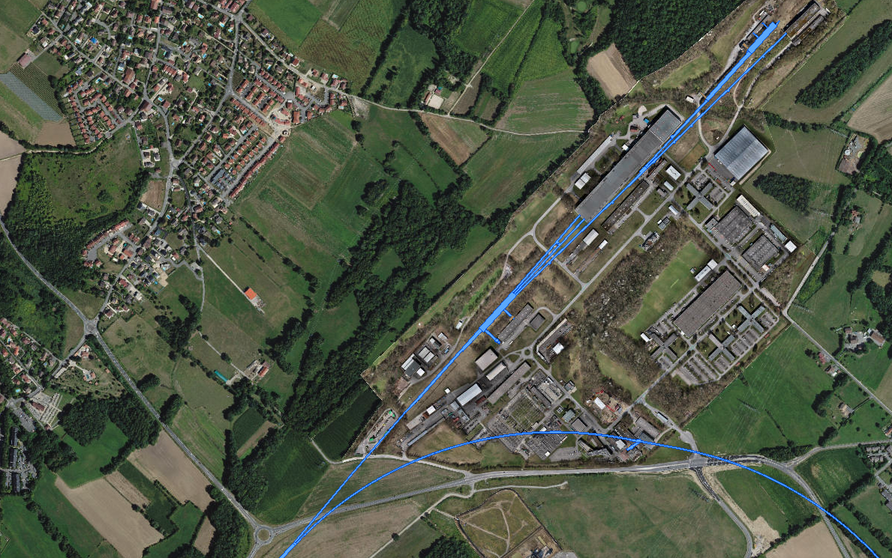
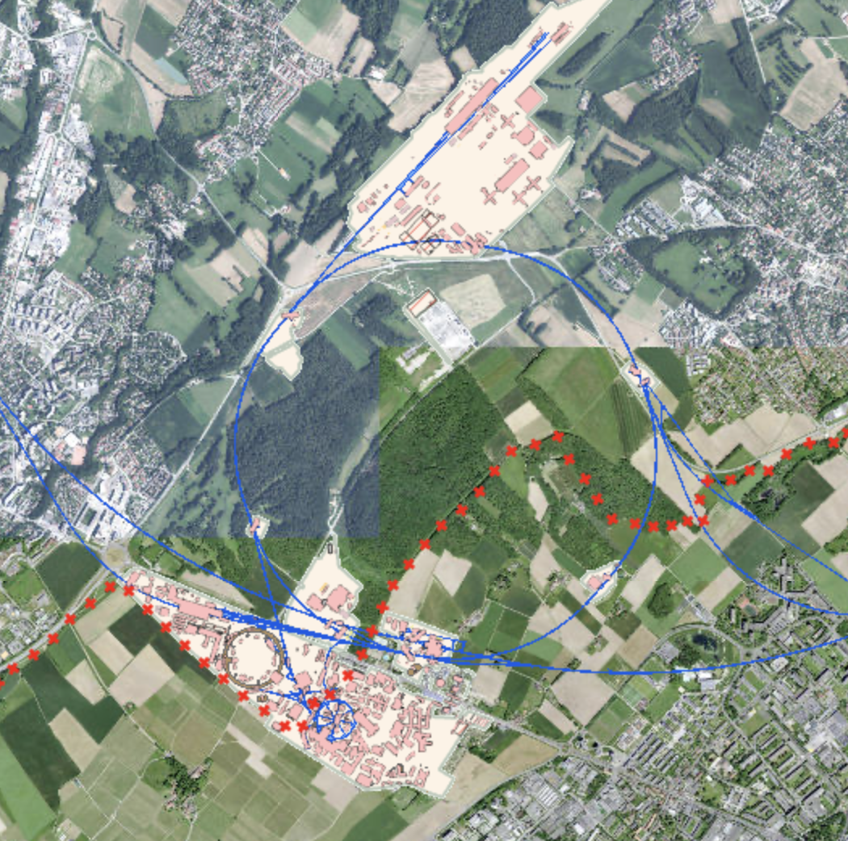
NA-CONS consolidation project
North Area Consolidation & Upgrade
HI-ECN3 project
ECN3
Timeline = completion in LS3 (2026-2029) and LS4
Timeline = completion after LS3
EHN2
EHN1
TCC8: T10 / TAX
→ BDF
TCC2 Targets:
T2 / T4 / T6
New Beam Dump (TIDVG4)
CERN Prévessin Site
TDC2: TT20 splitters
~ 1.7 km !
Transfer Tunnel (TT) 20:
inc. TT20 TED
SPS Slow Extraction from
Long Straight Section 2 (LSS2)

Slide 8
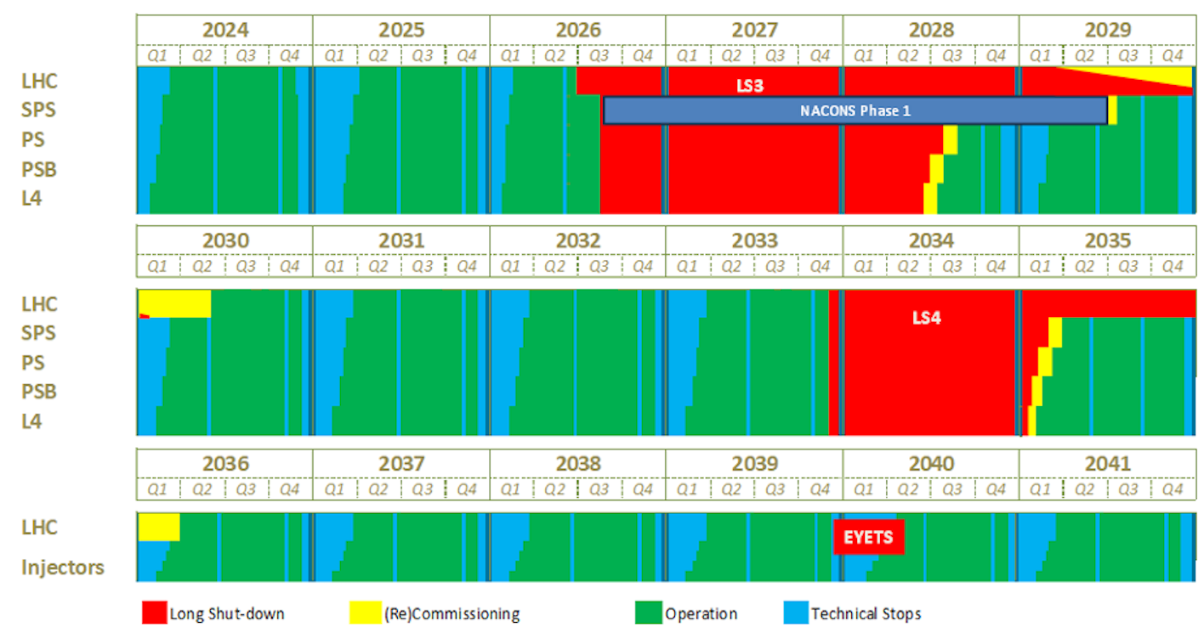
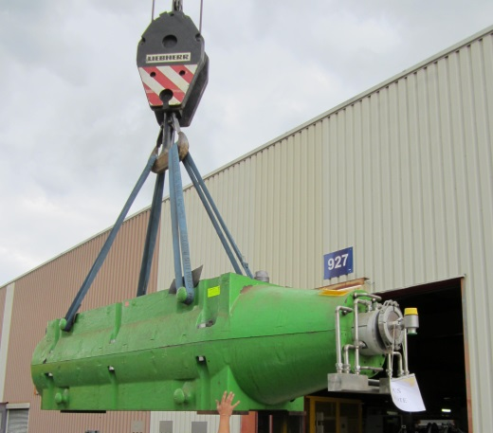
M. Lamont, Updated schedule for CERN’s accelerators, CERN Bulletin, 4 October 2024
CERN Accelerator Schedule
Today
NA available exclusively for EHN1/2 from mid-2029:
Test-beam users & other POT demanding experiments
(e.g. AMBER, MuonE)
ECN3 beam to dump in P42 for commissioning of TCC2
whilst construction ongoing
HI-ECN3
TDR Phase
NA-CONS Phase I
HI-ECN3
Commissioning
HI-ECN3
Operation
NA-CONS Phase II
(TBC)
Operation out to late 2040s:
beyond HL-LHC
(frequency & length of LS’s TBC)
NA-CONS
HI-ECN3 Operation

Slide 9
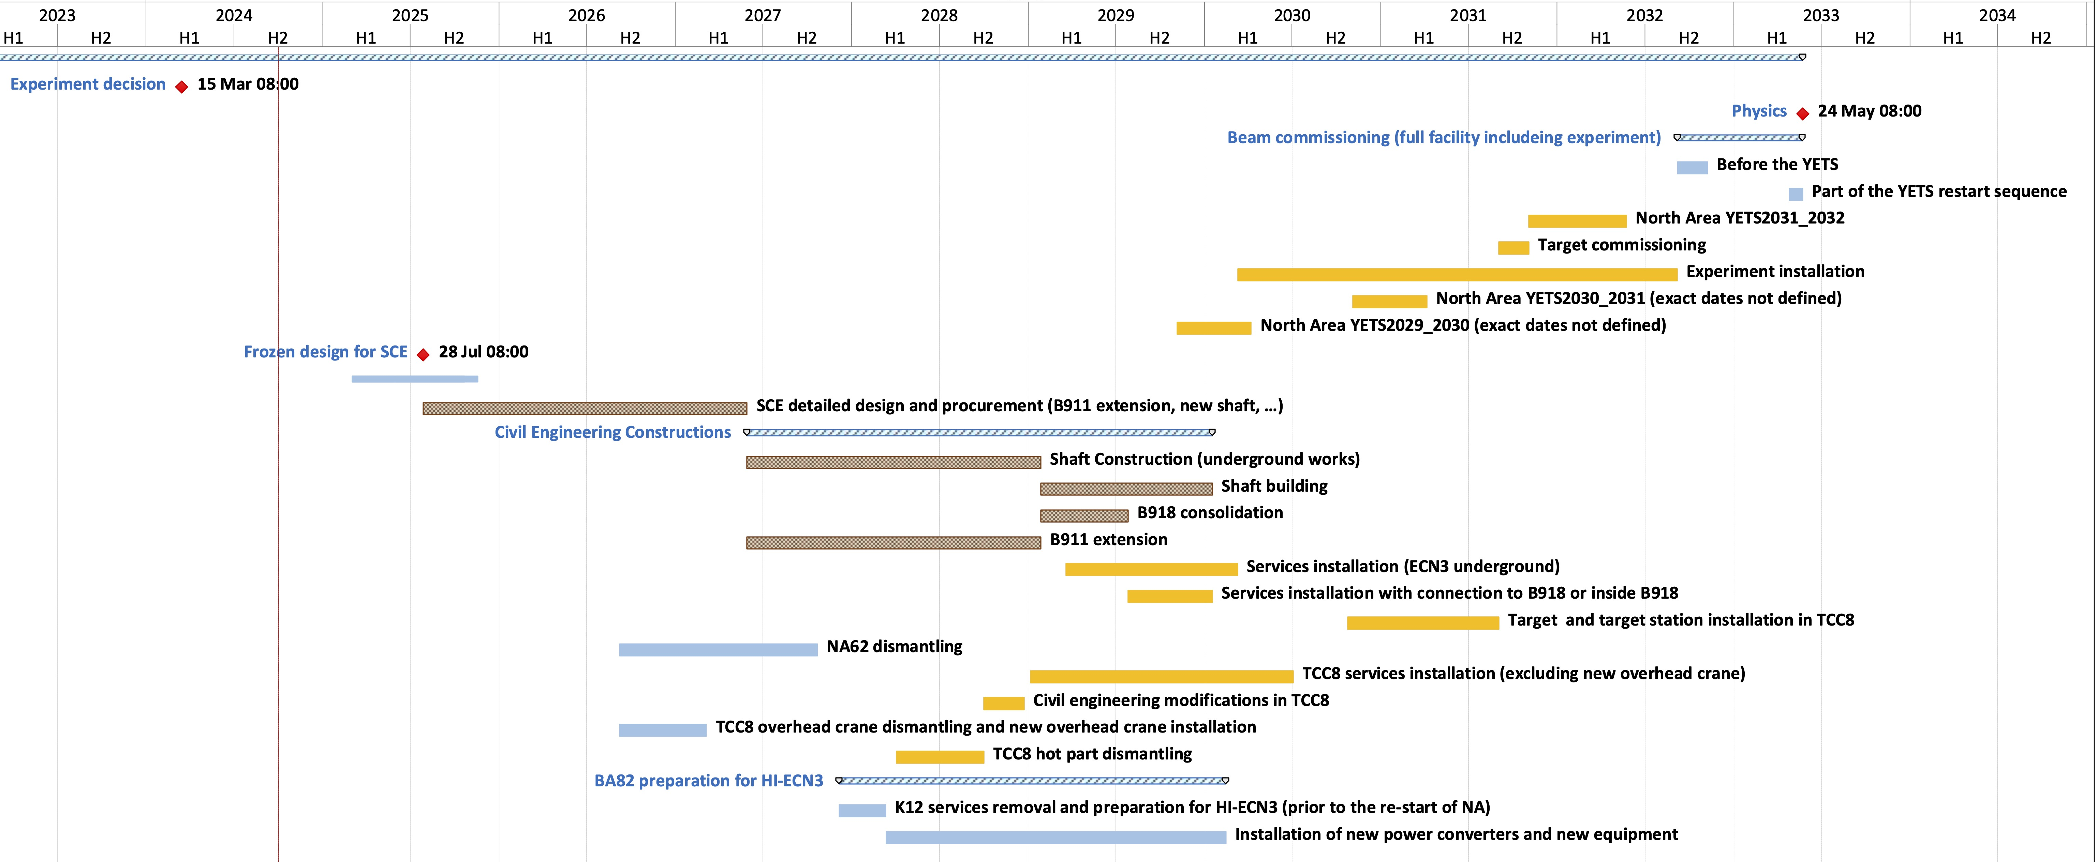
HI-ECN3 Project Timeline
Beam on BDF Target
Long Shutdown 3
Upgrades to NA with NA-CONS
TDR Phase
(Facility)
TDR extension?
Critical path:
CE procurement & works
LS4
Below freezing design for SCE!
(Detailed design for consultant before contractor Invitation to Tender)
July 2026
Dismantling

Slide 10
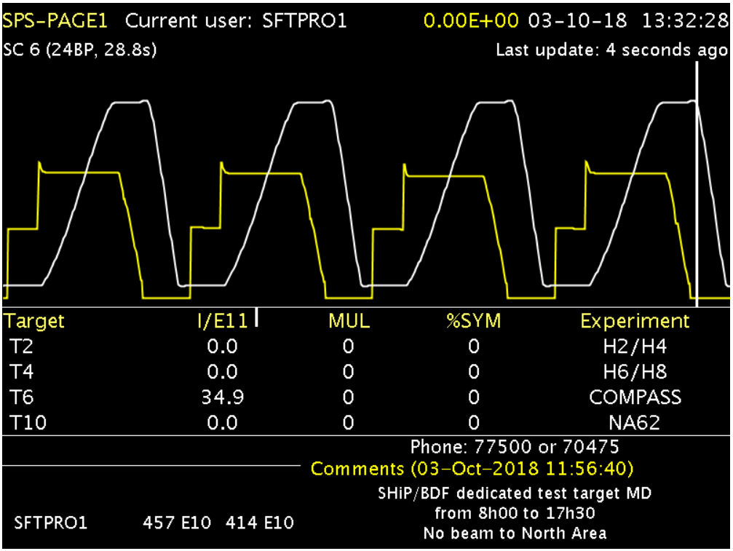
How many protons for BDF / SHiP? (i)
Short 7.2 s SHiP cycles with a 1.2 s FT (~ 1 s spill) vs. 14.4 s SFTPRO period
SPS Page 1 during BDF prototype target test at T6 in 2018

Slide 11
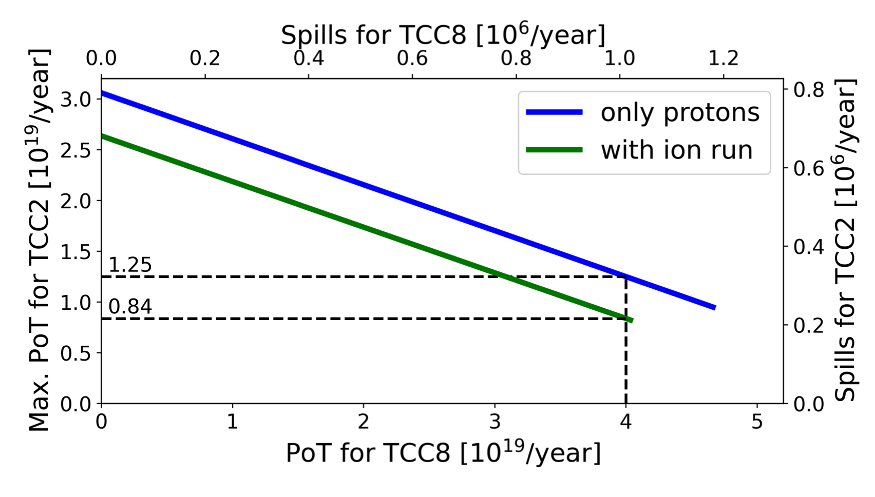
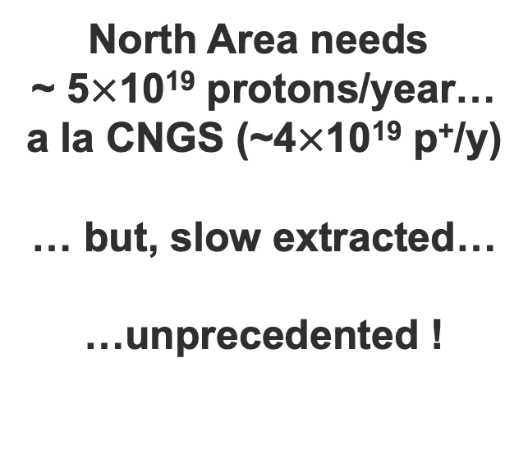
T. Prebibaj et al., SPS Operation and Future Proton Sharing Scenarios for the ECN3 facility, CERN-PBC-Notes-2023-001
How many protons for BDF / SHiP? (ii)
North Area needs
~ 5$×$10¹⁹ protons/year…
a la CNGS (~4$×$10¹⁹ p⁺/y)
… but, slow extracted…
…unprecedented !
Protons to TCC2 (other NA users)
Possible after ~ 10 years of
SX R&D with bent crystals
Protons to ECN3 (BDF/SHiP)

Slide 12
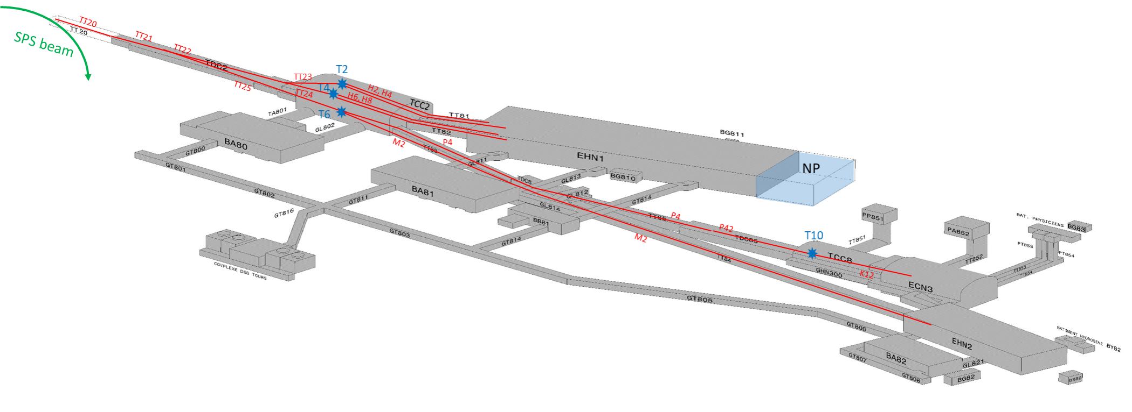
Slow Extraction from LSS2 in SPS

Slide 13
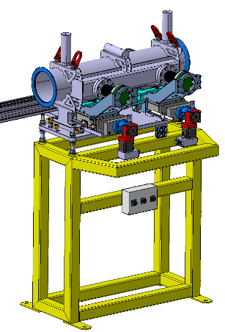
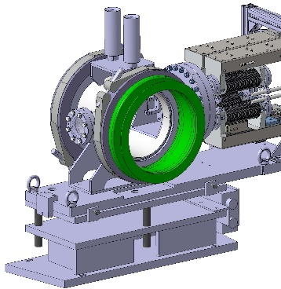
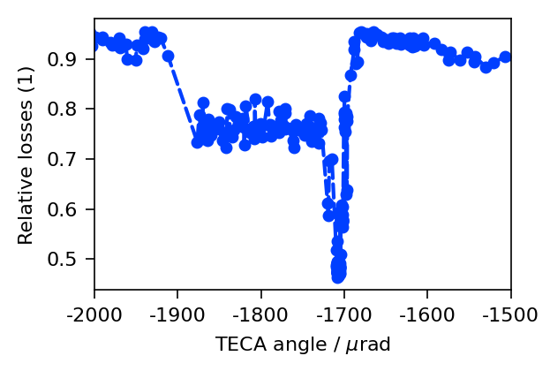


L. Esposito et al., Progress on optimised TECA and MVRA production, SLAWG #76: Crystal shadowing and production, August 2024
F. M. Velotti et al., Phys. Rev. Accel. Beams 22, 093502 (2019)
Crystal Shadowing of electrostatic septa
LSS4 gonio R&D:
~ 55% loss reduction
To be deployed operationally in 2024
LSS2 gonio already operational with 20% loss reduction
TECA (LSS4)
TECS (LSS2)
Unaffected beam
To TT20
deflected
(...)
up
x
Deflected beam
Deflected beam
ZS
circulating
down
s
To SPS
Thin, bent silicon crystal ~ 2 mm thick, 2 mm long

Slide 14
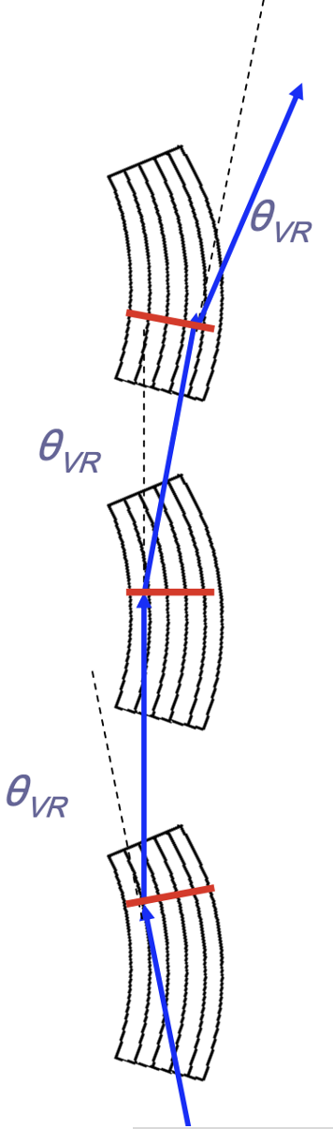
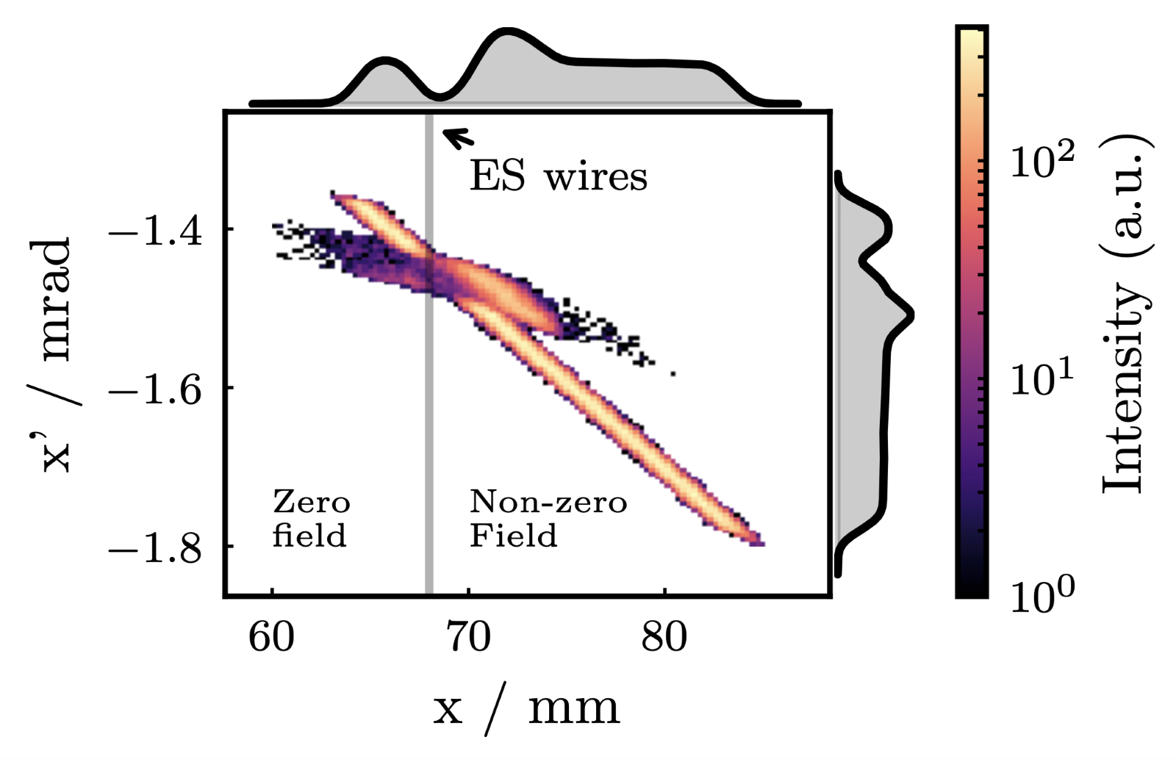
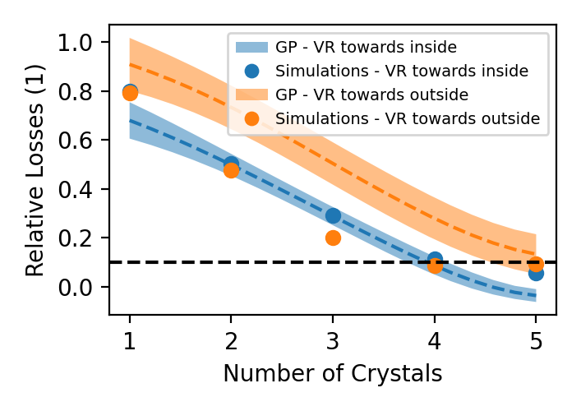
L. Esposito et al., Progress on optimised TECA and MVRA production, SLAWG #76: Crystal shadowing and production, August 2024
F. M. Velotti et al., Phys. Rev. Accel. Beams 22, 093502 (2019)
Crystal Shadowing of electrostatic septa (ii)
Objective: achieve an even higher loss reduction factor (x10?!) with advanced crystal technology (multiple thin, bent crystals aligned for Volume Reflection) installed in SPS

Slide 15
Beam Transfer across the North Area

Slide 16
SFTPRO shared Beam Delivery to ECN3
LSS2
TT21
TT22
TT23
T2
H2
H4
SPS
EHN1
H6
TT24
T4
H8
Shared delivery:
splitting
Field-free region
P4
P41, P61
ECN3
TCC8
P42
NA62
Horizontally deflected by the B-field
TT25
T6
M2
EHN2
Continues straight: no B-field
Losses (~5%)
16

Slide 17
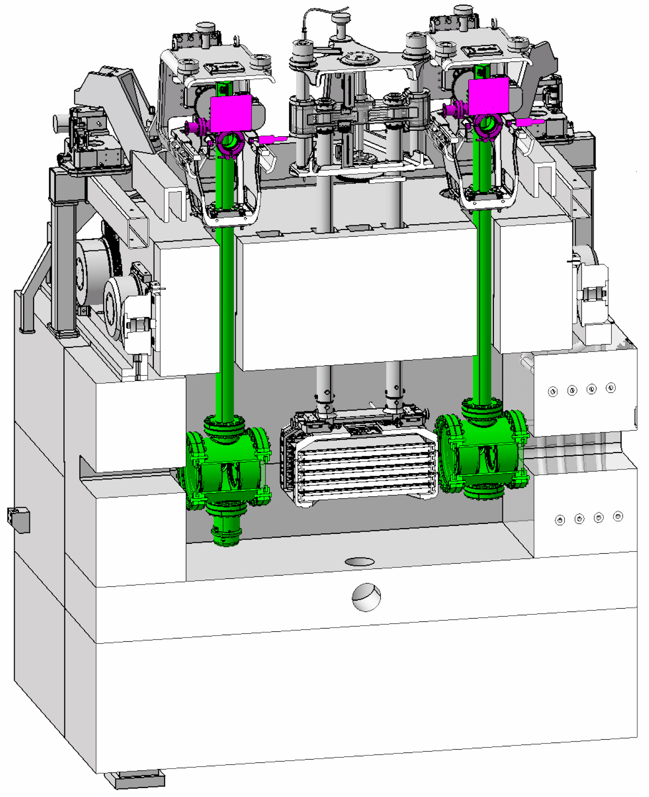

Dedicated Beam Delivery to ECN3: commissioning
LSS2
TT21
TT22
TT23
T2
H2
No splitting
in TDC2
H4
SPS
EHN1
H6
target
T4
TBIU
TBID
TT24
H8
Dedicated delivery:
no splitting
No interaction with TCC2 Target
P4
P4 Beam Dump
ECN3
B
TT25
T6
M2
EHN2

Slide 18
Dedicated Beam Delivery to ECN3
LSS2
TT21
TT22
TT23
T2
H2
No splitting
in TDC2
H4
SPS
EHN1
H6
TT24
T4
H8
No interaction with TCC2 Target
P4
P41, P61
ECN3
TCC8
P42
BDF/SHiP
TT25
T6
M2
EHN2

Slide 19
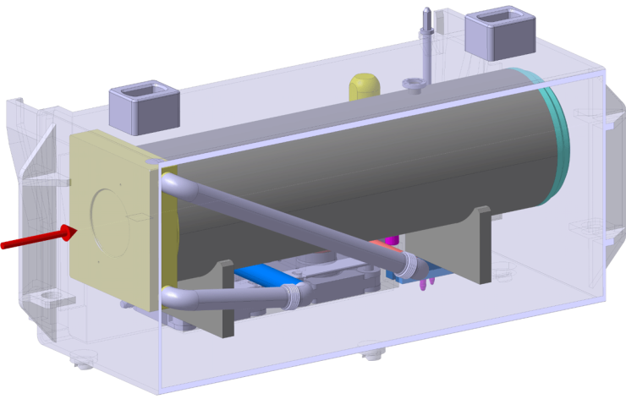
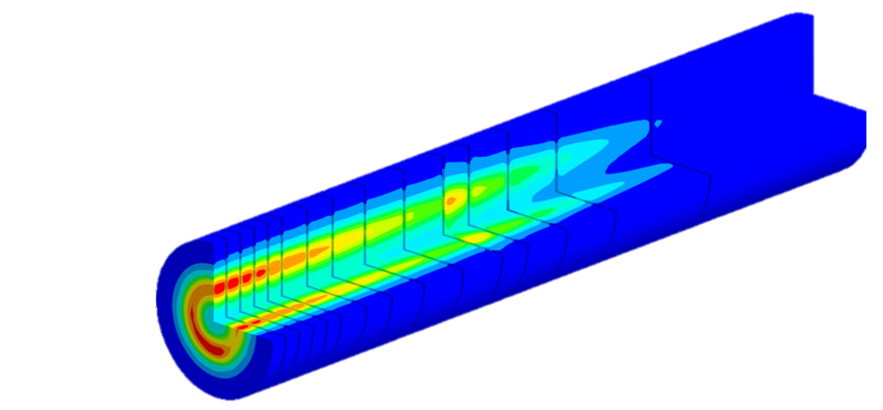
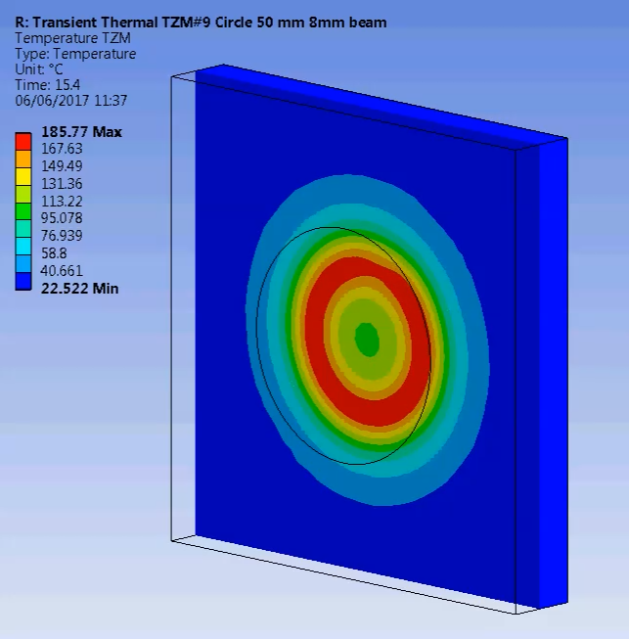
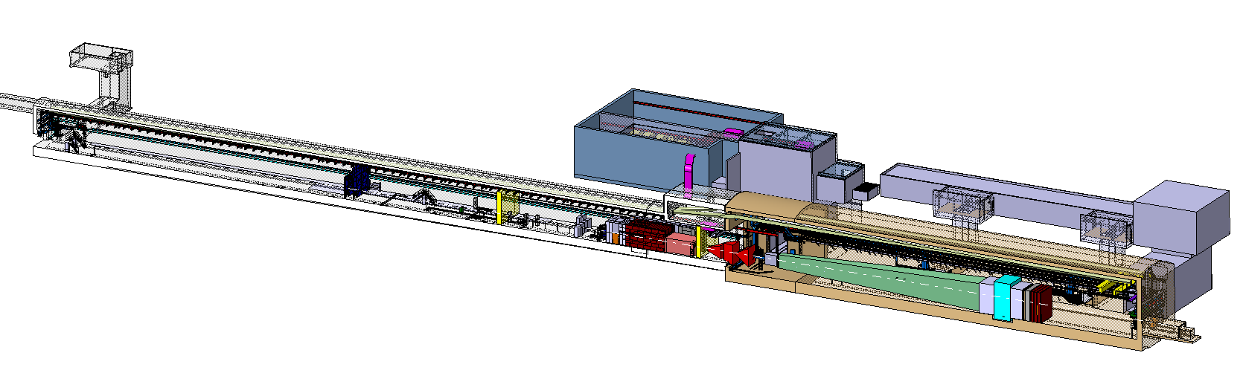
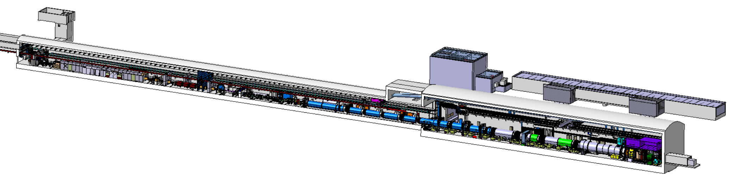
L. Krzempek, BDF-SHiP Integration in ECN3, EDMS #2936008
BDF/SHiP in ECN3
~ 300 kW (avg.)
~ 2.3 MW (spill)
1 second spill
4 Hz sweep
Beam from SPS
New
Access
Shaft
New Target
Service Building
Existing
Access Shaft
B911
B918
Beam Dilution System
TCC8
BDF’s Target Complex
containing a “thick” high-Z target (Mo/W)
ECN3
SHiP experiment

Slide 20
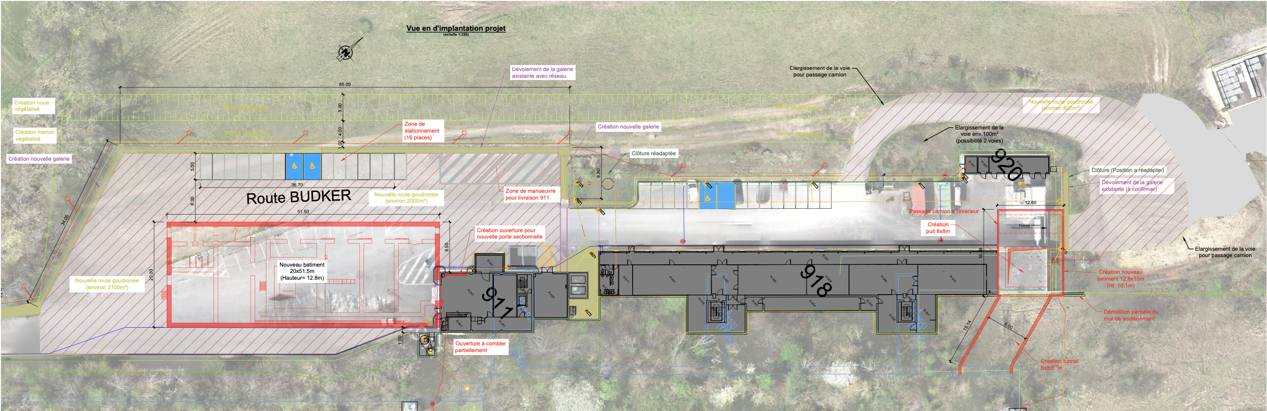
Civil Engineering Scope
New target building: adjacent to building 911 → B. 754 / BB85
New access shaft (PA855), connecting tunnel to ECN3 and access building→ B. 758 / BA85
Underground excavations: in Target complex (TCC8) and Experimental Area (ECN3)

Slide 21
NA62 in ECN3
Dismantling will start immediately in LS3 to allow civil engineering works to get underway ASAP
T10
Target
T10
XTAX
K12 beam line
B911
B918
TCC8
ECN3

Slide 22
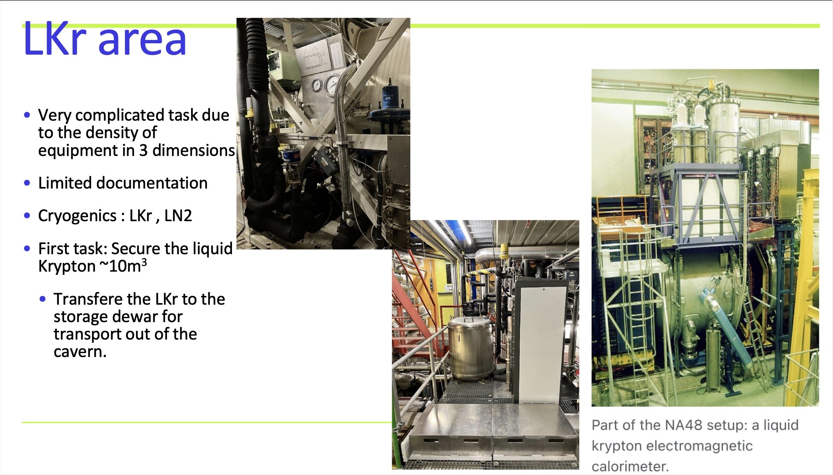
NA62 Dismantling: an example
*F. Duval, Plans for the NA62 dismantling at LS3C#8, 24 July 2024
Expert technical support from Johan BREMER (TE-CRG)

Slide 23
TCC2 Upgrades

Slide 24
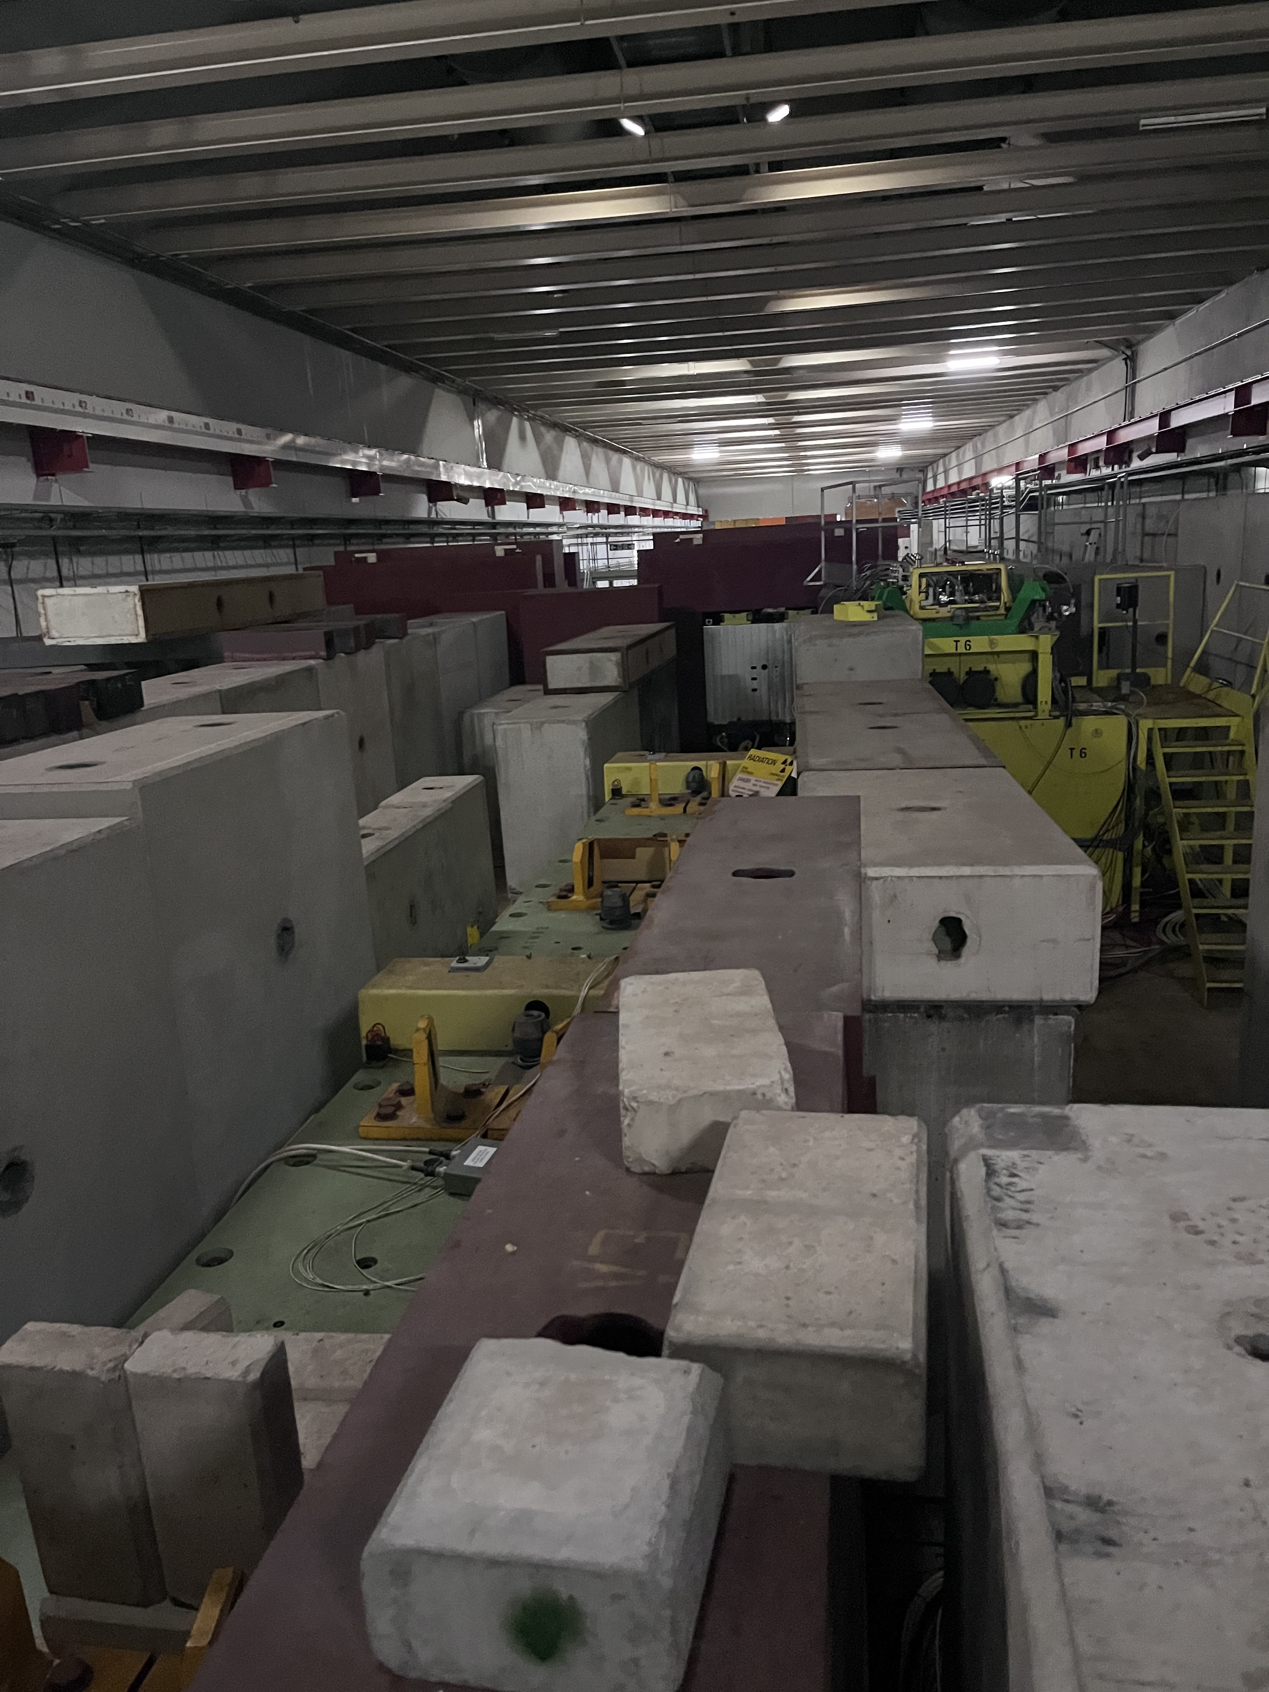
Upgrade of TCC2 T4 Target System for BDF/SHiP (i)
Looking downstream from on top of T4 target
To ECN3
H8
H6
To avoid scattering BDF/SHiP beam on air the ECN3 side of XTAX will be replaced by a fixed absorber with a vacuum chamber
Urgent design effort ongoing !

Slide 25
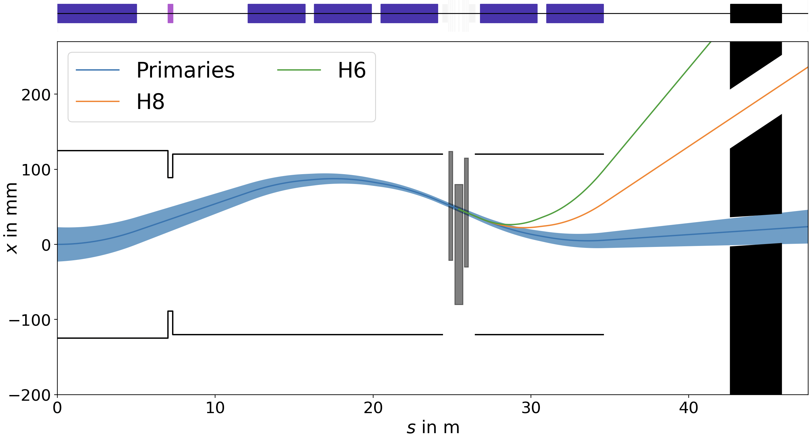

F. Metzger et al, Beam line and parameters, 30th SHiP collaboration meeting, ALU Freiburg, 1 – 4 October 2024
Upgrade of TCC2 T4 Target System for BDF/SHiP (ii)
Today, operation of EHN1 (H6/H8 test beams) is coupled with ECN3 (NA62)
Secondary particles for EHN1 are selected using magnet wobbling system, whilst protons not interacting with the target are transmitted to NA62
To EHN1: H6
To EHN1: H8
To ECN3: NA62
$$μ± 7σ$$
x
T4 Target
s
T4 XTAX

Slide 26
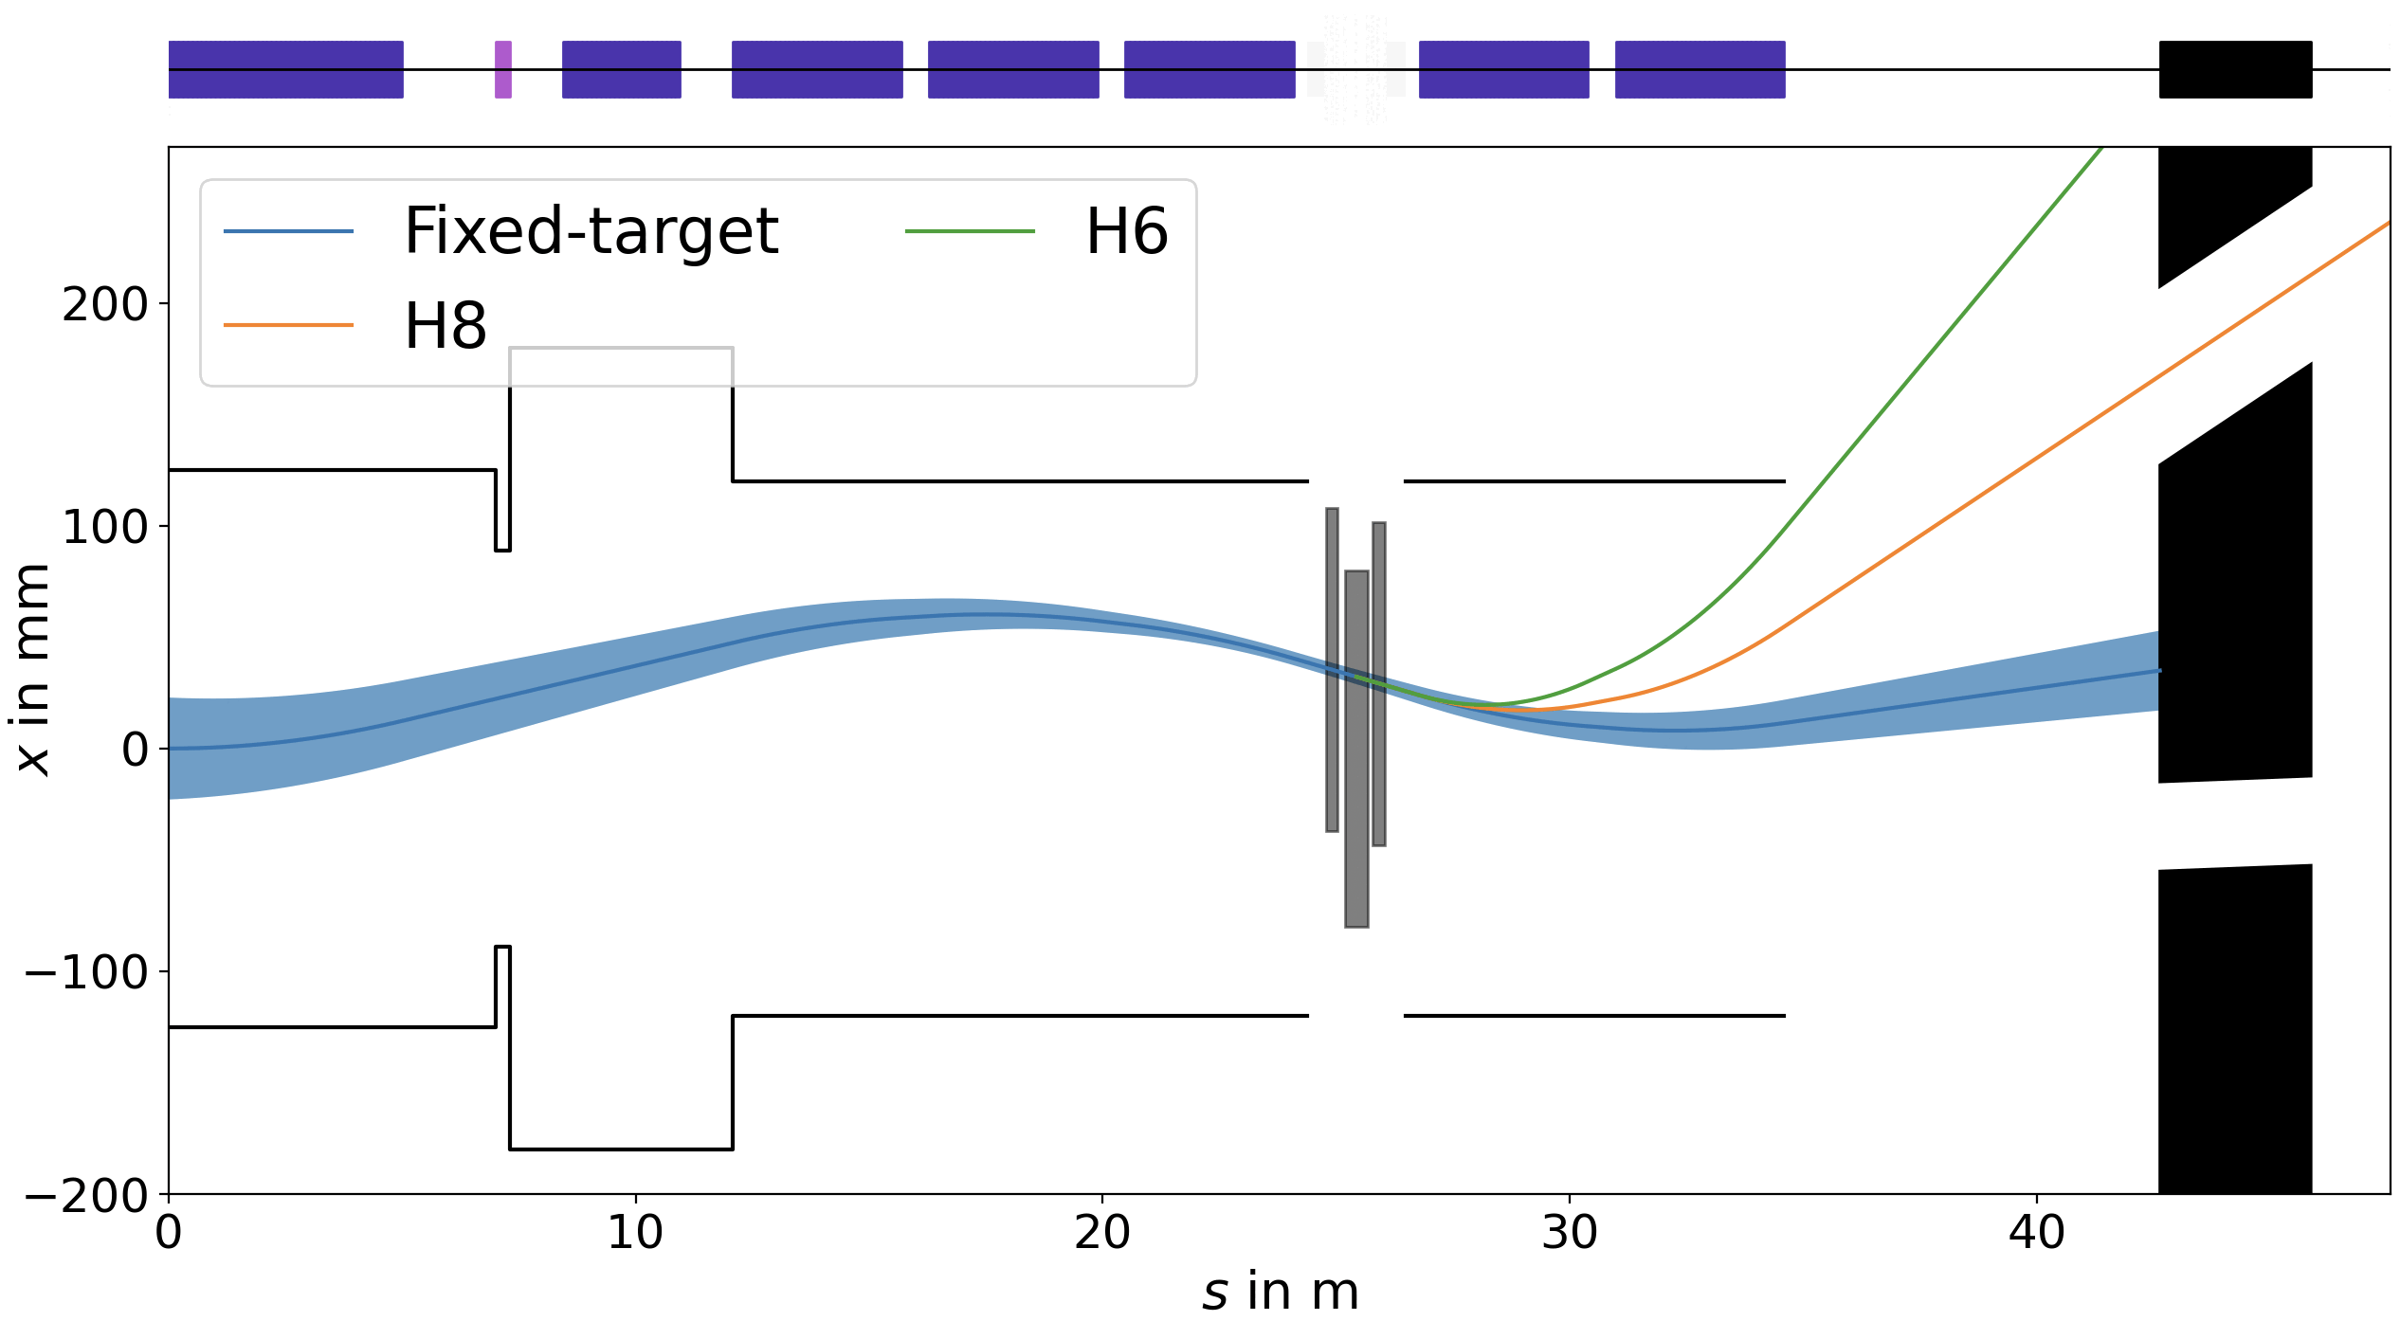
F. Metzger et al, Beam line and parameters, 30th SHiP collaboration meeting, ALU Freiburg, 1 – 4 October 2024
Upgrade of TCC2 T4 Target System for BDF/SHiP (iii)
A pulsed magnet allows us to decouple proton beams on the dedicated HI-ECN3 cycle in the horizontal plane (in addition to vertical separation to avoid target)
To EHN1: H6
To EHN1: H8
T4
To ECN3: NA62

Slide 27
TCC8 / ECN3

Slide 28
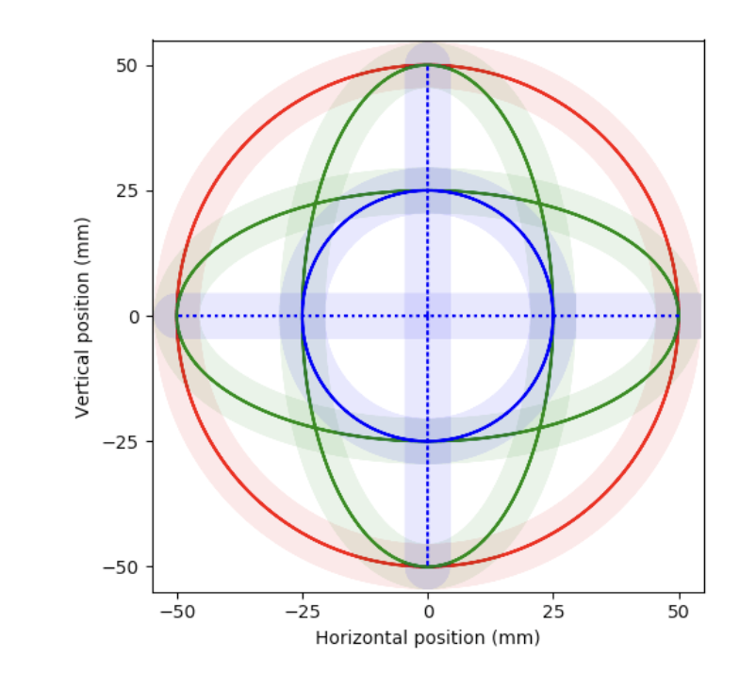
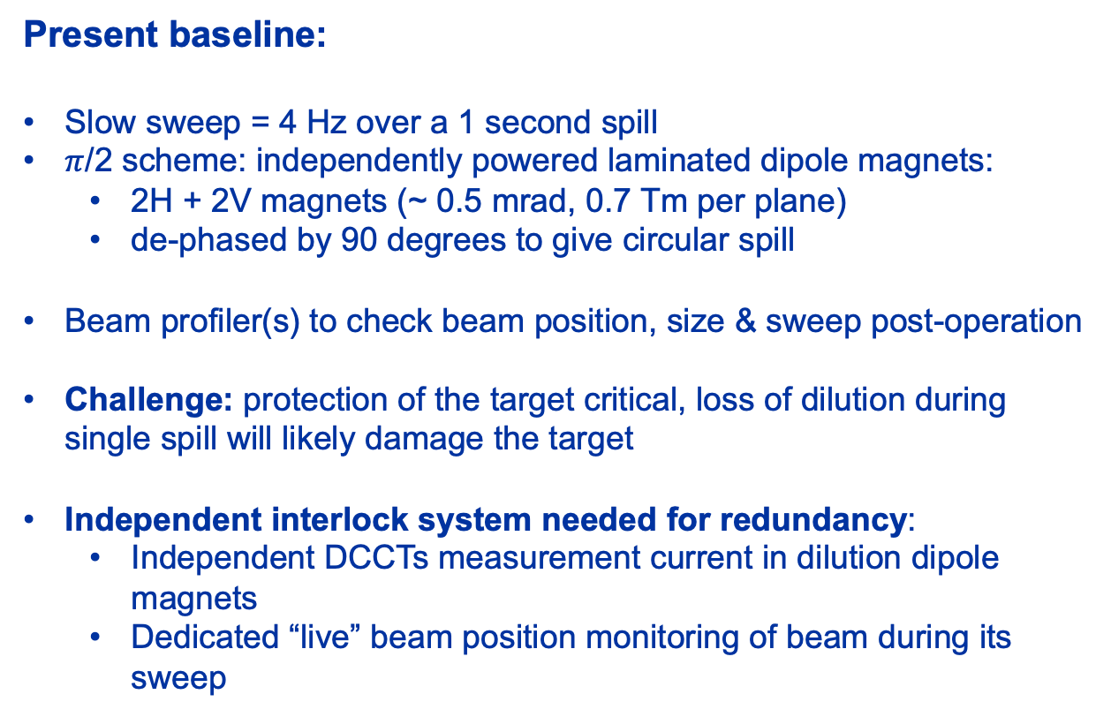
BDF Dilution System
Y. Dutheil, SPS BDF CDS, CERN Yellow Report, CERN-2020-002
Present baseline:
Slow sweep = 4 Hz over a 1 second spill
$π$/2 scheme: independently powered laminated dipole magnets:
  2H + 2V magnets (~ 0.5 mrad, 0.7 Tm per plane)
  de-phased by 90 degrees to give circular spill
Beam profiler(s) to check beam position, size & sweep post-operation
Challenge: protection of the target critical, loss of dilution during single spill will likely damage the target
Independent interlock system needed for redundancy:
  Independent DCCTs measurement current in dilution dipole magnets
  Dedicated “live” beam position monitoring of beam during its sweep
Failure Scenario:
Failure 2H OR 2V
Failure 1H OR 1V
Failure 1H AND 1V

Slide 29
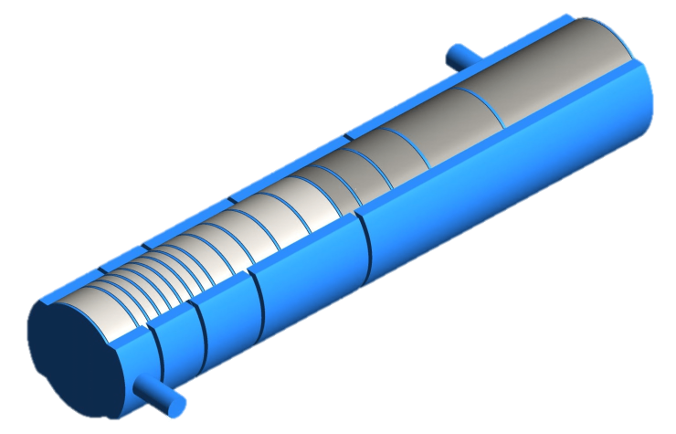
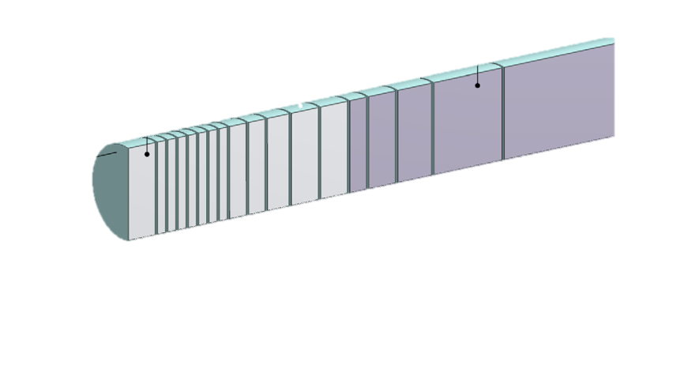
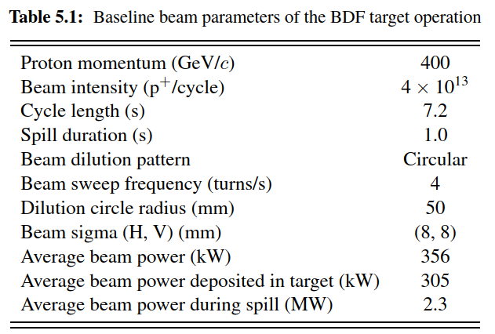
BDF Target Baseline Design
~ 1500 mm
Baseline beam parameters of the BDF Target operation. https://doi.org/10.23731/CYRM-2020-002
~ 4.0×10¹⁹ p⁺/y
D250 mm
5x W blocks (780 mm)
13 x TZM blocks (580 mm)
Baseline design:
Water-cooled, Mo & W blocks (cladded with Ta)
Tested with beam in 2018 & PIE
TDR phase needed to improve CDS design:
Alternatives to water-cooling to avoid cladding and the risk of development of free radicals (hydrogen)
Helium-cooled pure W design now being prototyped: tests in TCC2 planned in 2025 and 2026

Slide 30
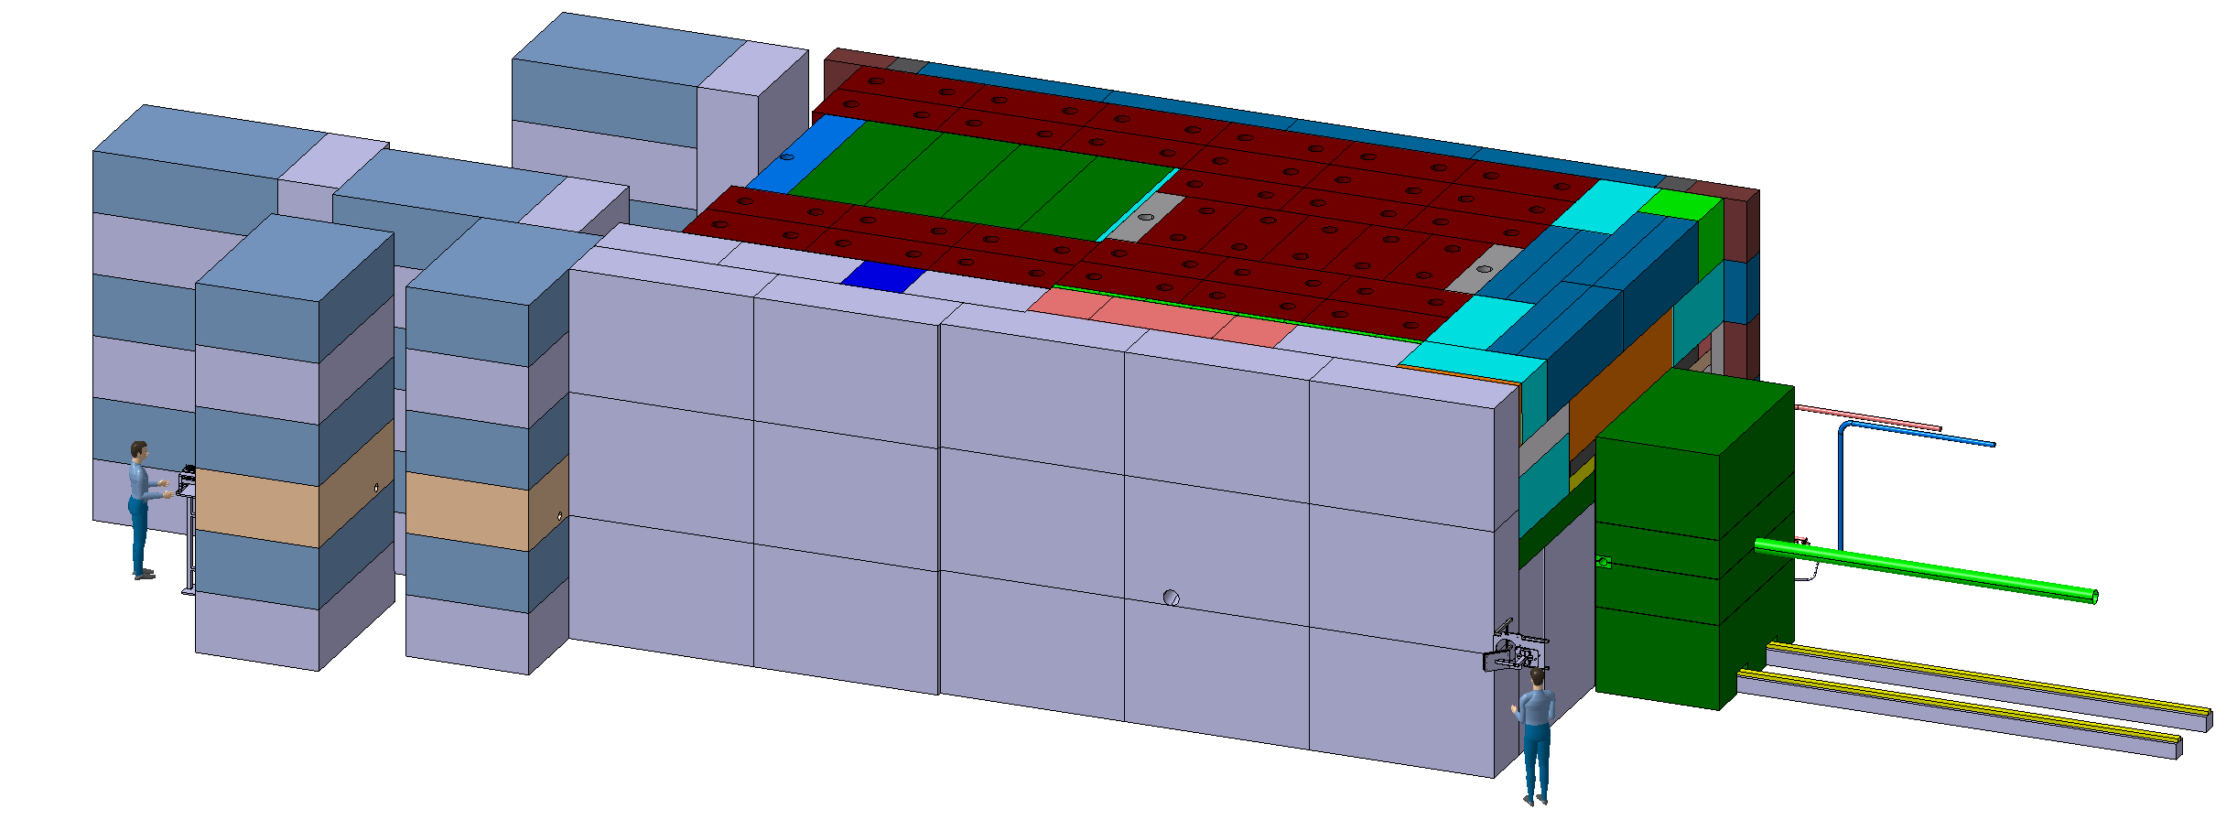
BDF Target Complex in TCC8 (i)
Diluted Proton beam from SPS
~4.8 m
~8 m
~12 m
30

Slide 31
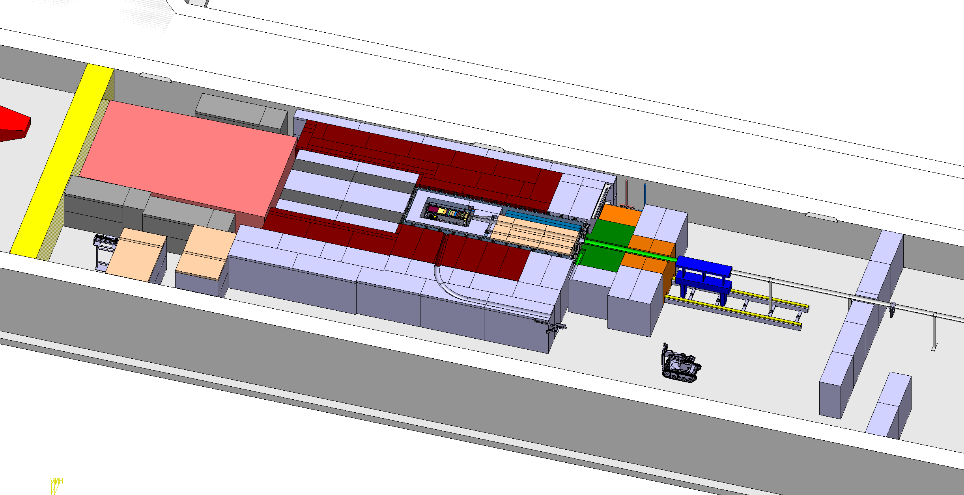
BDF Target Complex in TCC8 (ii)
Target area confinement wall (details under study with FIRIA study)
Magnetised hadron stopper (shielding)
Beam instrumentation ?
Diluted Proton beam from SPS
SHiP muon shield MS1
Access chicane

Slide 32
Summary
BDF/SHiP has been approved to search directly for dark matter at the North Area
CERN has reserved budget in its Medium-Term Plan for the construction of a new facility in ECN3 under the project named HI-ECN3 to fully exploit the investment being made in the North Area Consolidation project
Some ~ 10 years of R&D will converge into a Technical Design Report to realise a slow extracted beam power of 300 kW (avg.) to the North Area
HI-ECN3 TDR will be published in 2026, building on the SPS BDF Comprehensive Design Study published in 2020
First beam on target expected in 2031 to give SHiP at least 2 years of beam before LS4

Slide 34
NA-CONS / HI-ECN3 Synergy
*M.A Fraser & Y. Kadi, ICEA Mandate for the HI-ECN3 Study Project, Memorandum, EDMS#3018359, 25 Jan 2024
CERN Management
Project Management
Project Coordination & Integration
Technical Design Study
Frequency is choice of WPL ~ Biweekly
NA-CONS / HI-ECN3
Steering Committee Meetings
Roberto LOSITO
~ Quarterly
Project Team Meetings
Claudia AHDIDA /
Matthew FRASER
~ Weekly
HI-ECN3 TCC
Claudia AHDIDA /
Matthew FRASER
~ Monthly
Joint with NA-CONS TCC when relevant
WP2 Coordination Meetings
Francesco VELOTTI
WP3 Coordination Meetings
Rui XIMENES
WP4 Coordination Meetings
Jean-Louis GRENARD
IEFC
Brennan GODDARD
when reporting requested
Project Board Meetings
Matthew FRASER
~ Adhoc
ICEA
Francois BUTIN /
Jean-Louis GRENARD
~ Biweekly
Joint with NA-CONS ICEA when relevant
EP ECN3 Experiment Technical Coordinator (TC)
Richard JACOBSSON
WP5 Coordination Meetings
Francois BUTIN
GRAD team supported by CERN STAFF experts
NA62 TC
Decommissioning
Hans DANIELSSON
Adhoc Meetings
ATS-MB
Mike LAMONT
when reporting requested
Reviews:
C&S, Safety, Technical etc.
Joint NA-CONS when relevant
TBC
WP6 Coordination Meetings
Claudia AHDIDA
ICL
(upstream TCC2)
EN-ACE
WP7 Coordination Meetings
= adhoc NA-CONS WC4
Fernando PEDROSA
Joint NA-CONS / HI-ECN3 TCC meeting series: critical for advancement of TCC2 upgrades fro BDF & implicated systems, next items include P42 dump and BA82
HI-ECN3 ICEA:* first dedicated agenda on integration to take place in two weeks (impacted NA-CONS items already discussed in ICEA for many months) co-chaired by Francois Butin and Jean Louis Grenard
WP7.1 NA-CONS Synergism: collecting and documenting impacted systems and NA-CONS WPs key role played by Fernando PEDROSA & Thomas ZICKLER (timing, magnets, power converters, BA82, etc.)

Slide 35
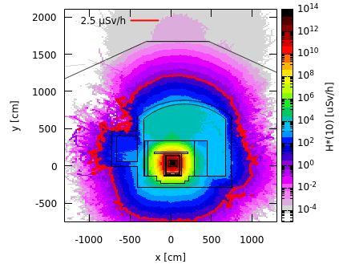
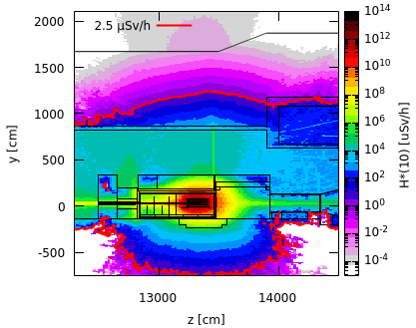
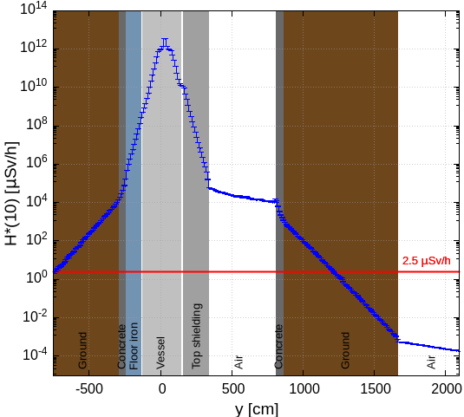
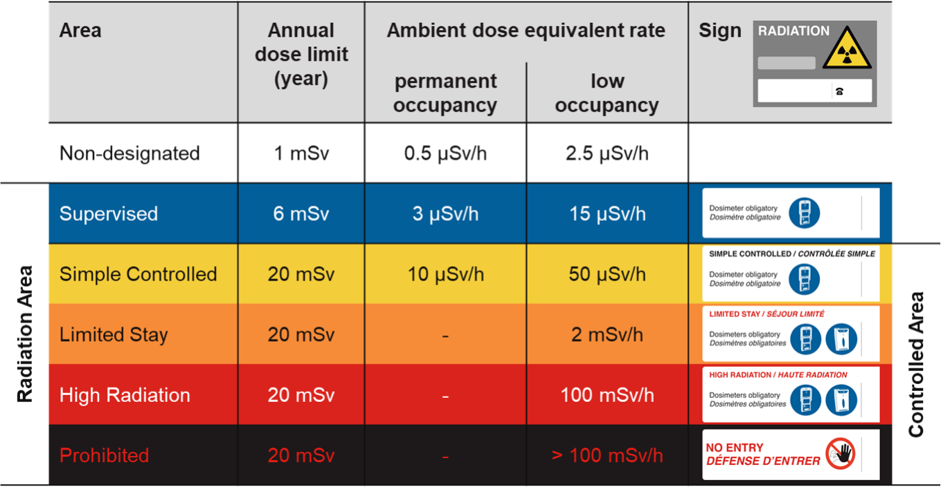
C. Ahdida et al., RP Studies for CERN's HI-ECN3 Facility, presented at SATIF-16, 29 May 2024
Prompt Radiation in TCC8
Avg. intensity of 5.6×10¹² p/s
Cross-sectional view
Side view
(-20 cm < x < 80 cm)
(13260 cm < z < 134380 cm)
(13260 cm < z < 13380 cm)
(-20 cm < x < 80 cm)
Shielding design is well optimized for the prompt radiation

Slide 36
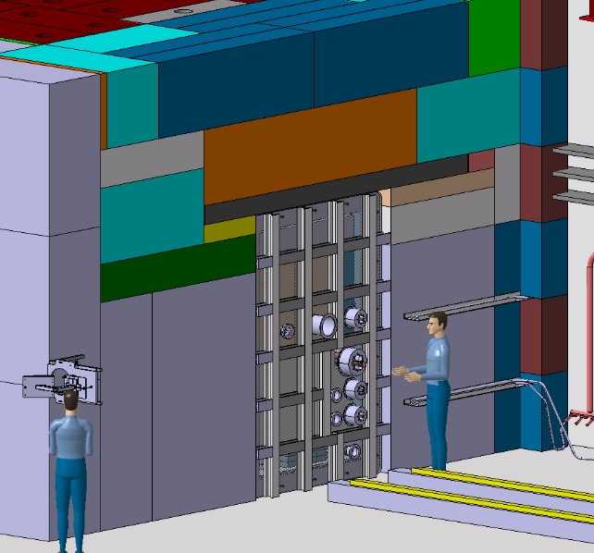
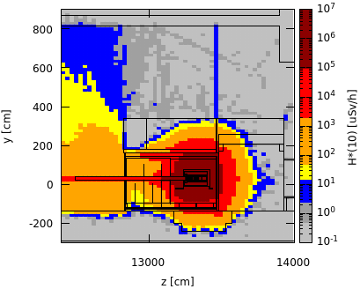
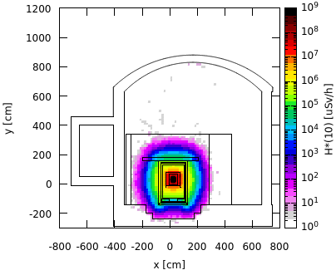
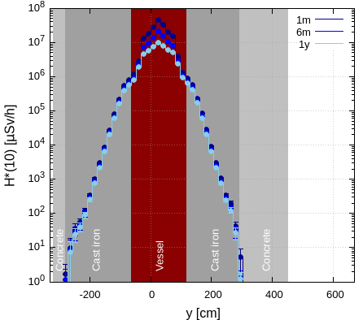
C. Ahdida et al., RP Studies for CERN's HI-ECN3 Facility, presented at SATIF-16, 29 May 2024
Prompt Radiation in TCC8
Upstream of vessel w/o upstream shielding
Preliminary worst case manual intervention scenario
Total POT 6×10²⁰
Cross-sectional view, target level
Along x-axis, working height
1 month cool-down
Shielding removed
(13240 cm < z < 13390 cm)
(15 cm < y < 45 cm)
(13240 cm < z < 13390 cm)
1 month
(-15 cm < x < 80 cm)
After opening vessel & removing shielding, residual dose rates of several 100 µSv/h are expected
Supervised Radiation Area on the sides
Further optimization by movable shielding
x [0,40]
x_beam = 26 cm
The shielding design contains well the high residual dose rates reaching in the central target region several 10 Sv/h after 1 month of cool-down
The residual dose rates outside the shielding are < 1 µSv/h
100 rem = 1Sv

Slide 37
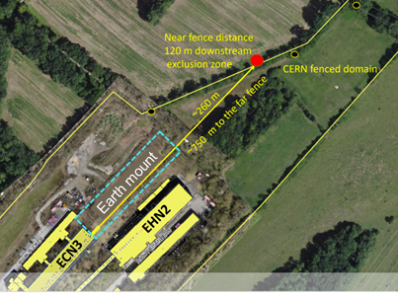
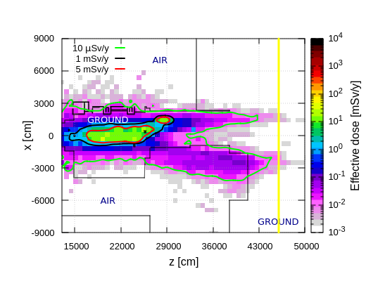
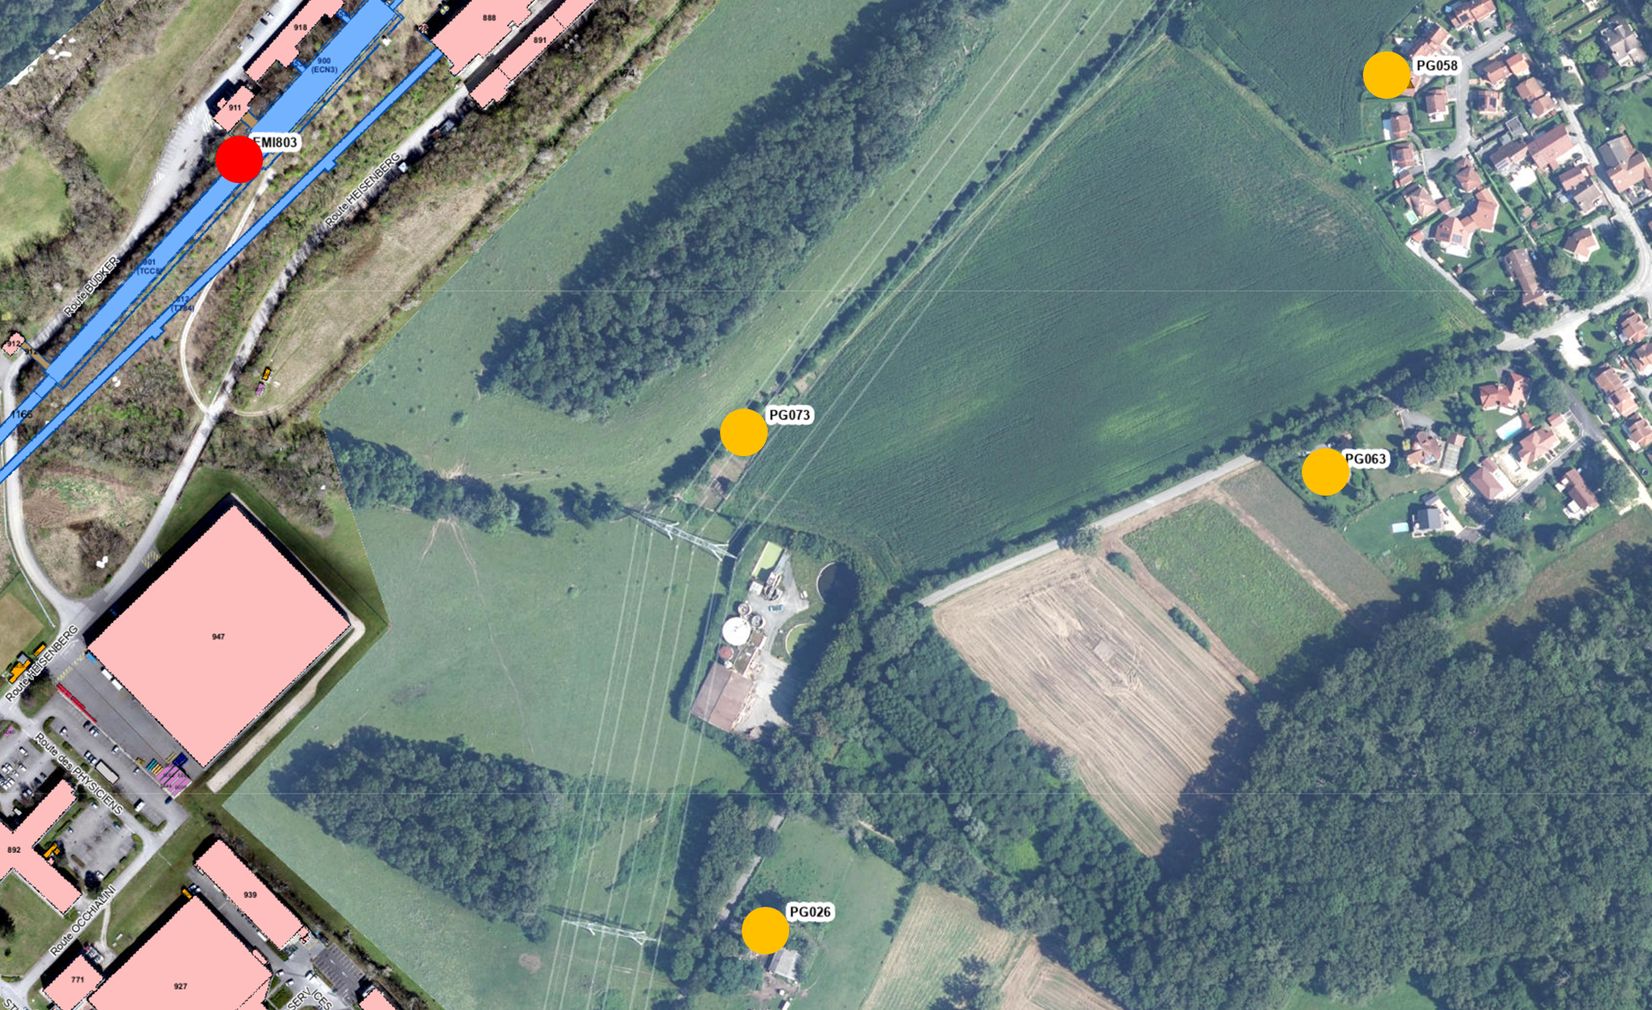
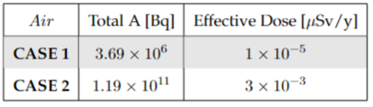
C. Ahdida et al., RP Studies for CERN's HI-ECN3 Facility, presented at SATIF-16, 29 May 2024
Environmental Aspects
POT 4×10¹⁹ per year
Dose from air releases
Dose from stray radiation
Used max. dose coefficients from different age groups
Annual effective dose from muons
Positions of nearby population groups
Effective dose estimates
CERN fence
Release point
Muon prompt radiation aboveground downstream ECN3
H-3 release due to air activation of ~80 kBq
Annual limit of Non-designated Area on CERN domain and at CERN fence (1 mSv/y) as well as dose objective for members of the public (10 uSv/y) is by far met

