Slide 1
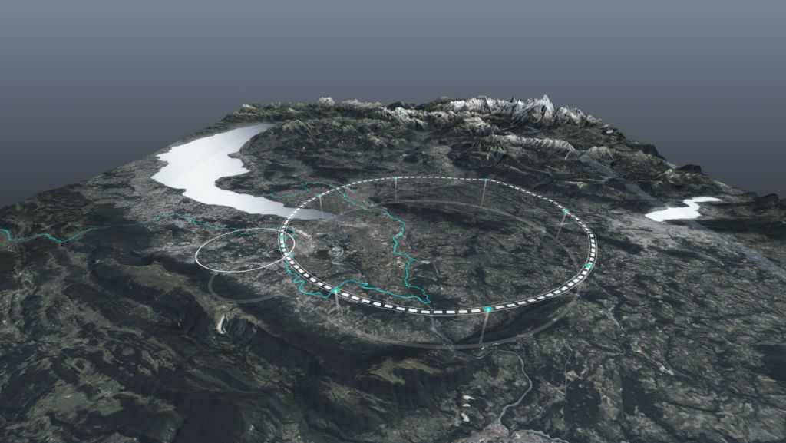









FCC Status
CERN-KEK Committee, meeting #19, 26 November 2024
Michael Benedikt, Frank Zimmermann, CERN
on behalf of FCC collaboration
http://cern.ch/fcc
Work supported by the European Commission under the HORIZON 2020 projects EuroCirCol, grant agreement 654305; EASITrain, grant agreement no. 764879; iFAST, grant agreement 101004730, FCCIS, grant agreement 951754; E-JADE, contract no. 645479; EAJADE, contract number 101086276; and by the Swiss CHART program
photo: J. Wenninger

Slide 2
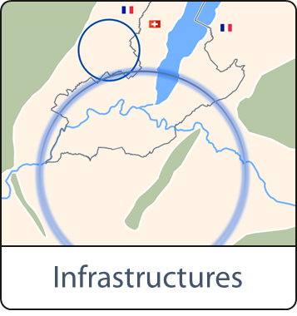

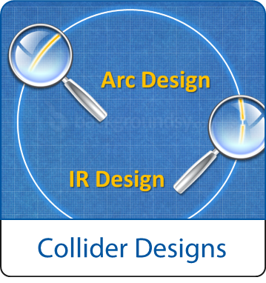
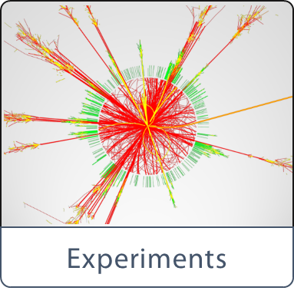
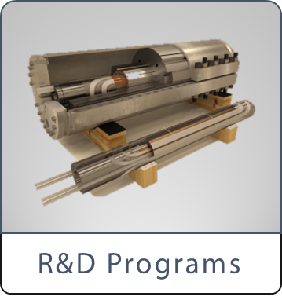

High-level goals of the FCC Feasibility Study
together with the Host States, optimisation of placement and layout of the ring, and demonstration of the geological, technical, environmental and administrative feasibility of the tunnel and surface areas;
consolidation of the physics case and detector concepts, optimisation of the design of the colliders and their injector chains, supported by targeted R&D to develop the needed key technologies;
development of the technical infrastructure concepts and integration with territorial constraints and identification of opportunities for co-construction;
elaboration of a sustainable operational model for the colliders and experiments in terms of human and financial resource needs, environmental aspects and energy efficiency;
identification of substantial resources from outside CERN’s budget for the implementation of the first stage of a possible future project;
final deliverable is a Feasibility Study Report by March 2025.

Slide 3




Feasibility Study Report for March 2025
Structure:Three Volumes
Vol. 1: Physics, Experiments and Detectors (~200 pages)
Vol. 2: Accelerators, Technical Infrastructures, Safety Concepts (~400 pages)
Vol. 3: Civil Engineering, Implementation & Sustainability (~200 pages)
- Executive Summary of the FCC Feasibility Study: ~40 pages
In addition:
a. Documentation on Cost Estimate – Funding Models
b. Environmental Report
Input for Update of European Strategy for Particle Physics
to be prepared with Overleaf & published by EPJ (Springer-Nature) – FCCIS members

Slide 4
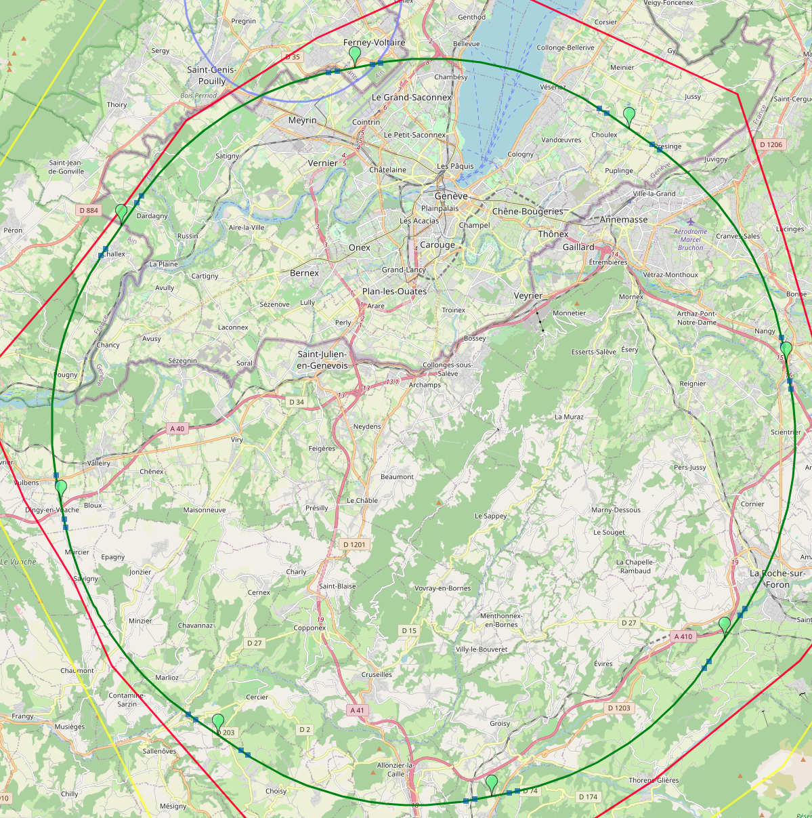
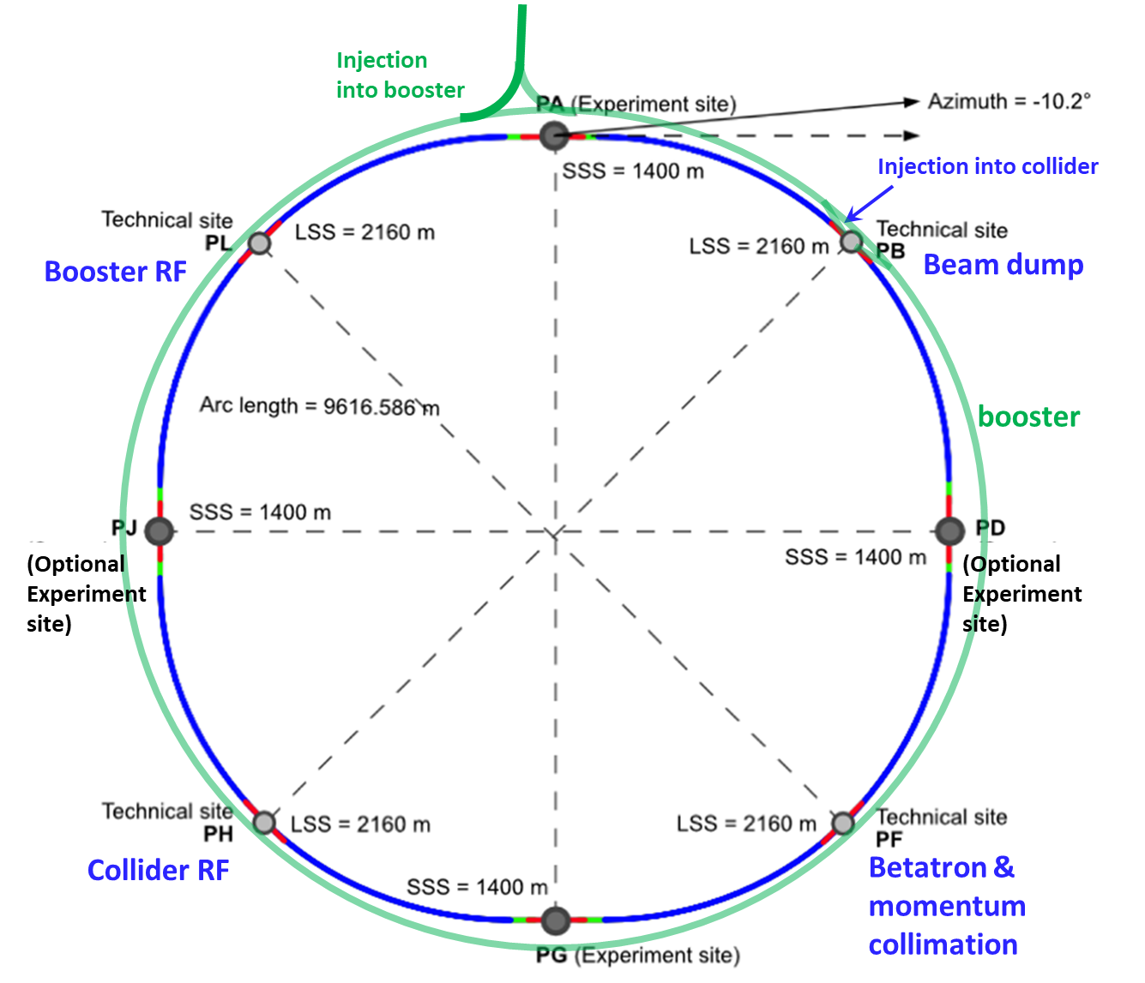
Reference layout and implementation: PA31 - 90.7 km
V. Mertens,
J. Gutleber
Layout chosen out of ~ 100 initial variants, based on geology and
surface constraints (land availability, access to roads, etc.), environment, (protected zones), infrastructure (water, electricity, transport), machine performance etc.
“Avoid-reduce-compensate” principle of EU and French regulations
PA: Experiment
PB: technical
PL: technical
Overall lowest-risk baseline: 90.7 km ring, 8 surface points,
4-fold symmetry
Number of surface sites | 8
Surface requirements | ~40 ha
LSS@IP (PA, PD, PG, PJ) | 1400 m
LSS@TECH (PB, PF, PH, PL) | 2032 m
Arc length | 9.6 km
Sum of arc lengths | 76.9 m
Total length | 90.7 km
PD: experiment
PJ: experiment
4 experiments
PF: technical
PH: technical
4
PG: experiment

Slide 5
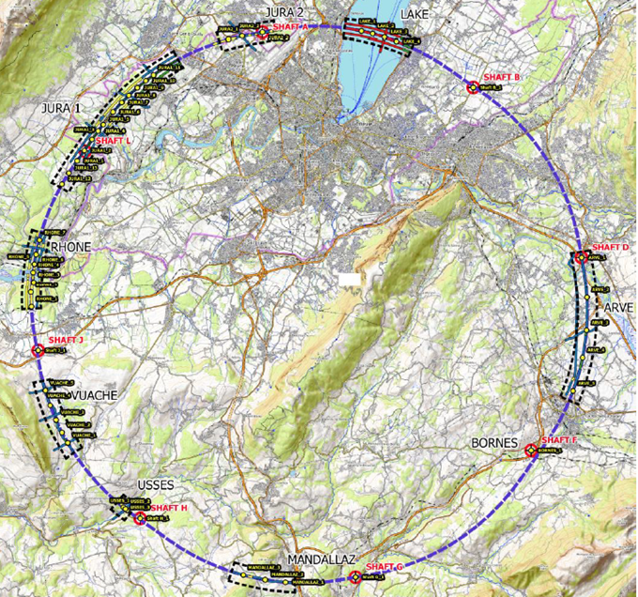
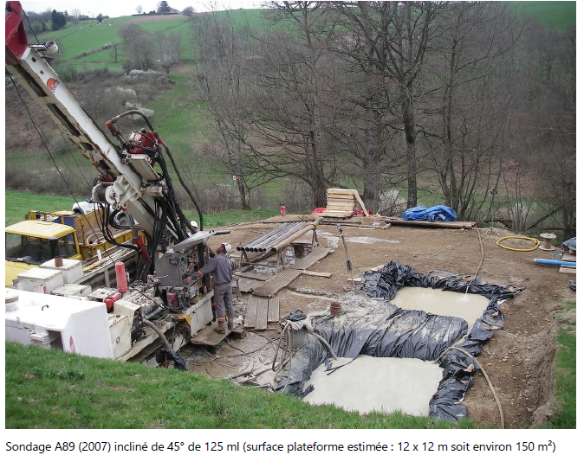
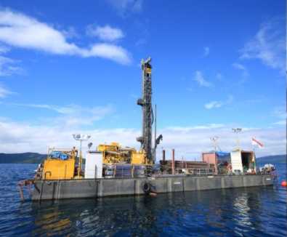
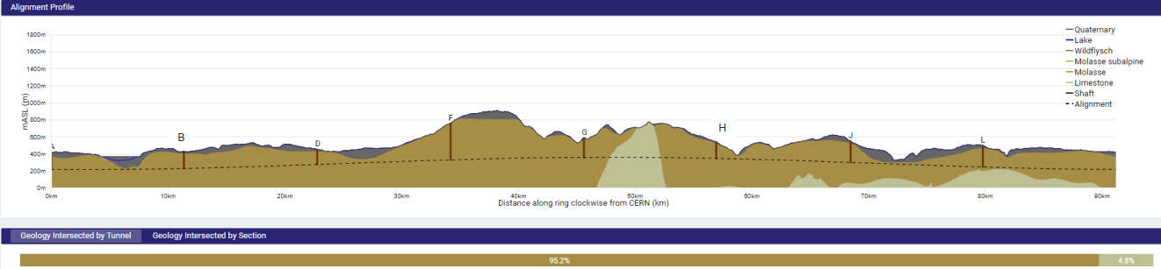
First series of site investigations
Site investigations to identify exact location of geological interfaces:
Molasse layer vs moraines/limestone
~30 drillings and ~90 km seismic lines
→ Vertical position and inclination of tunnel
example of drilling works on a lake the lake

Slide 6
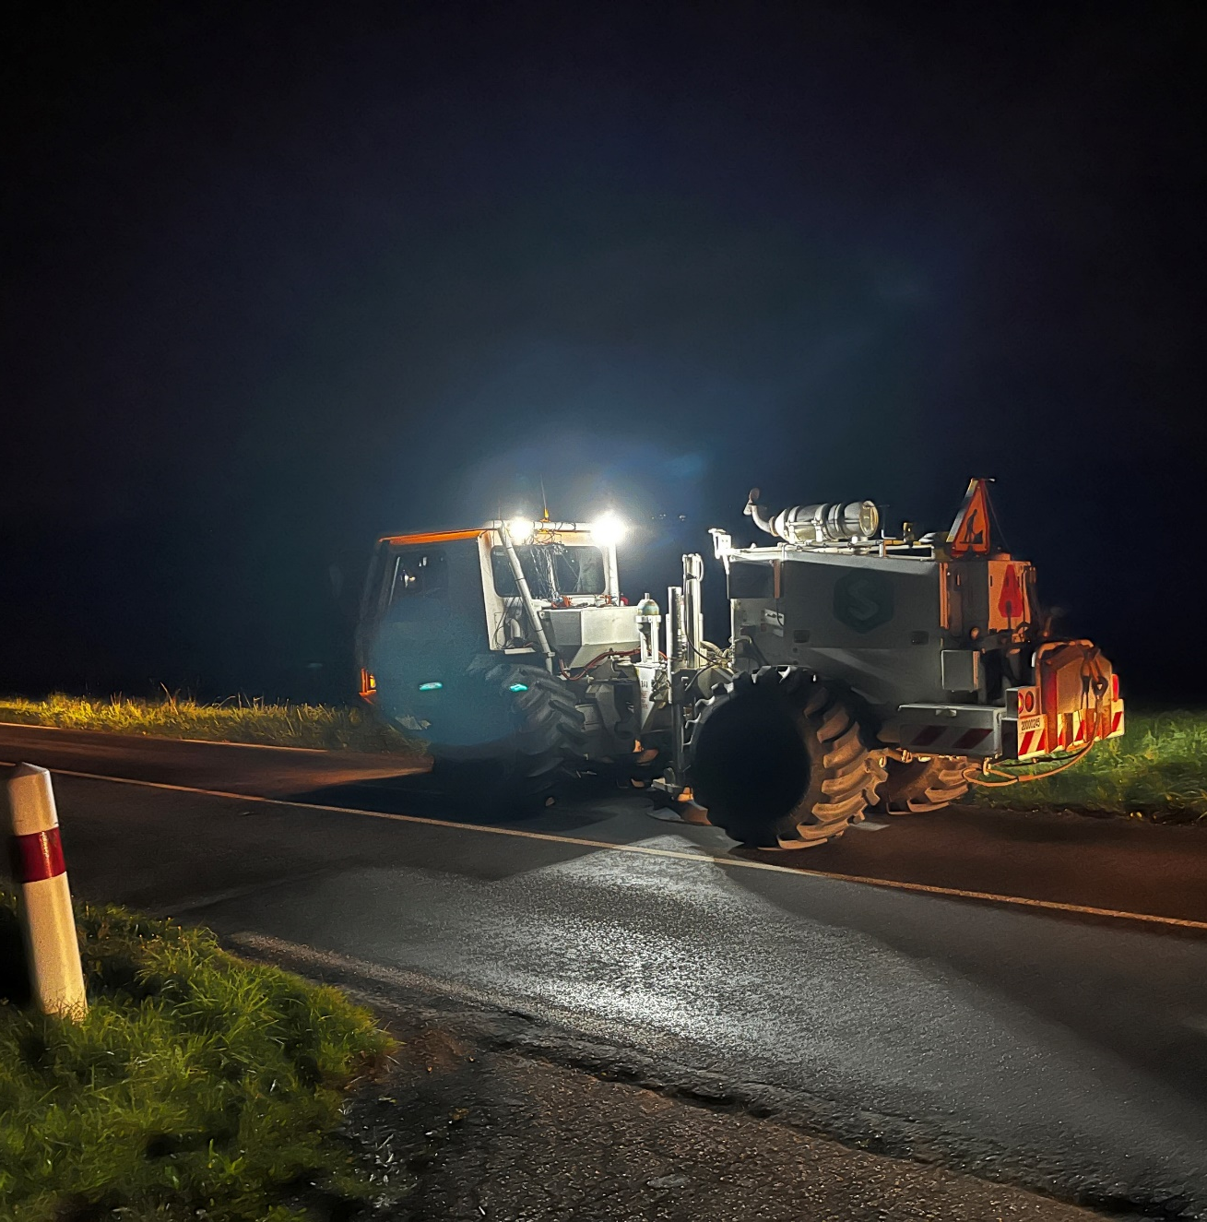
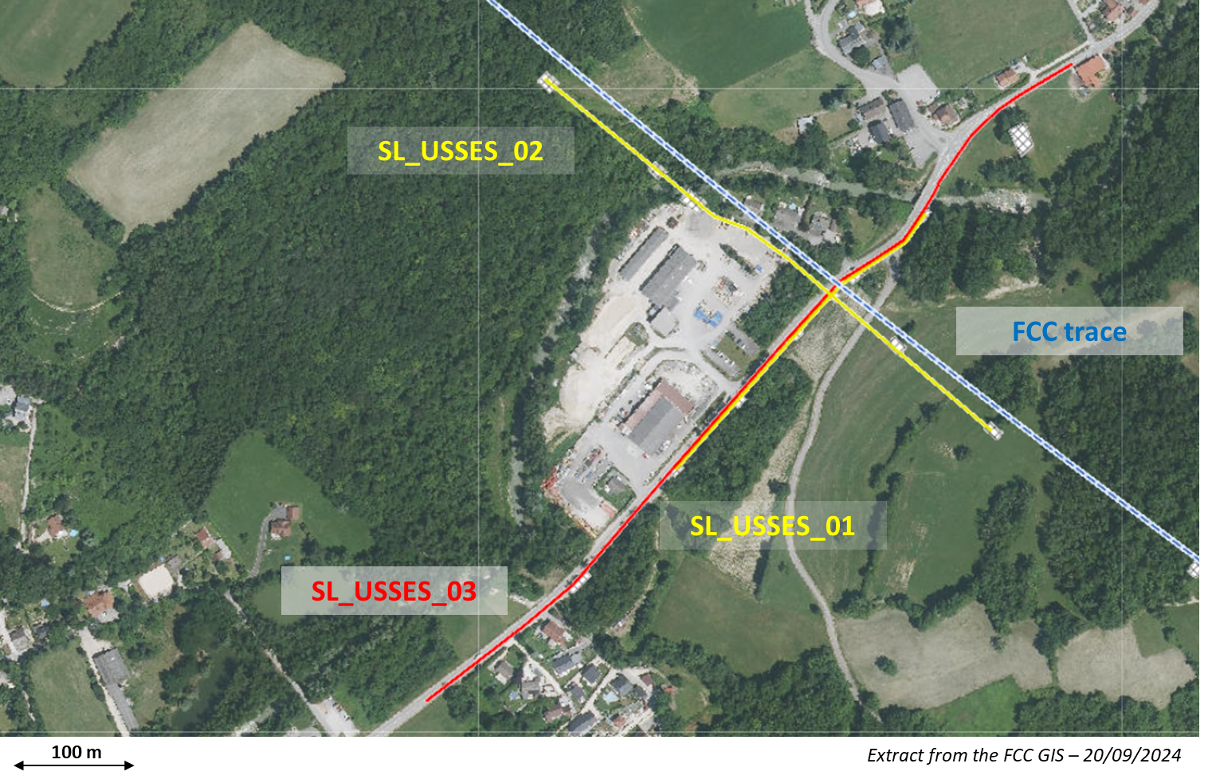
Start of site investigations – seismic investigations
First seismic line :
Second seismic line :
Seismic line SL_USSES_02 :
Acquisition date : 01/10/2024
Length : 480 meters
Method(s) : Explosive and Seismic gun
Geophones : 96 units (5 meters of spacing)
Shot points : 13 shot points in total
Seismic line SL_USSES_01 :
Acquisition date : 02/10/2024
Length : 300 meters
Method(s) : Weight drop
Geophones : 60 units (5 meters of spacing)
Shot points : 15 shot points in total

Slide 7
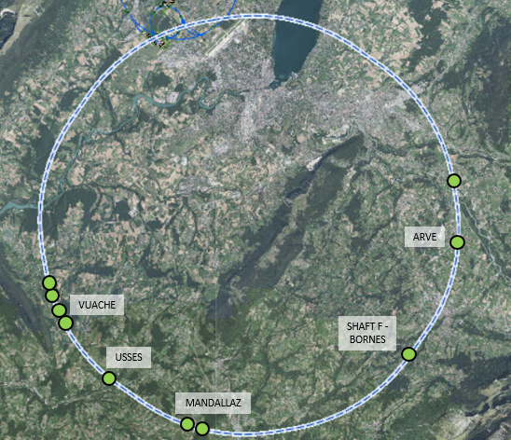
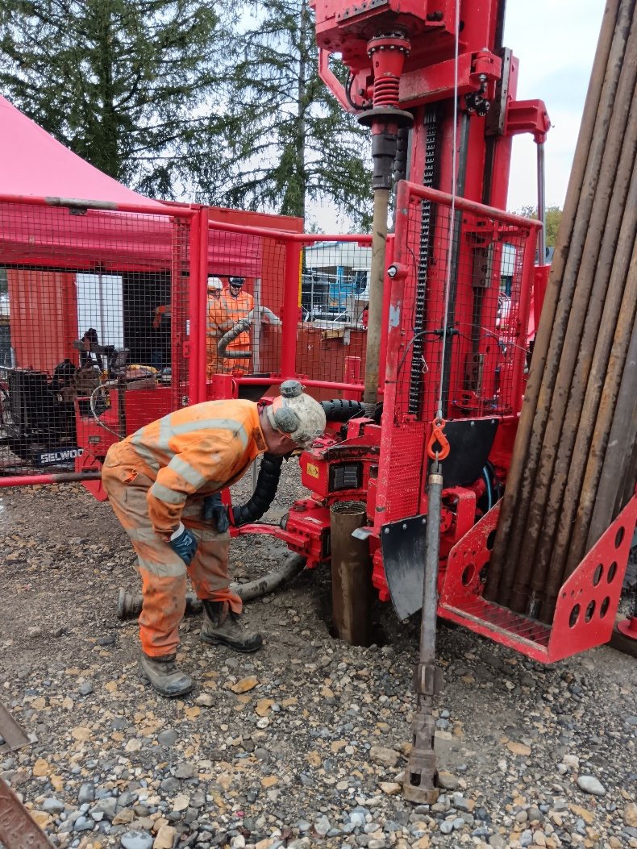
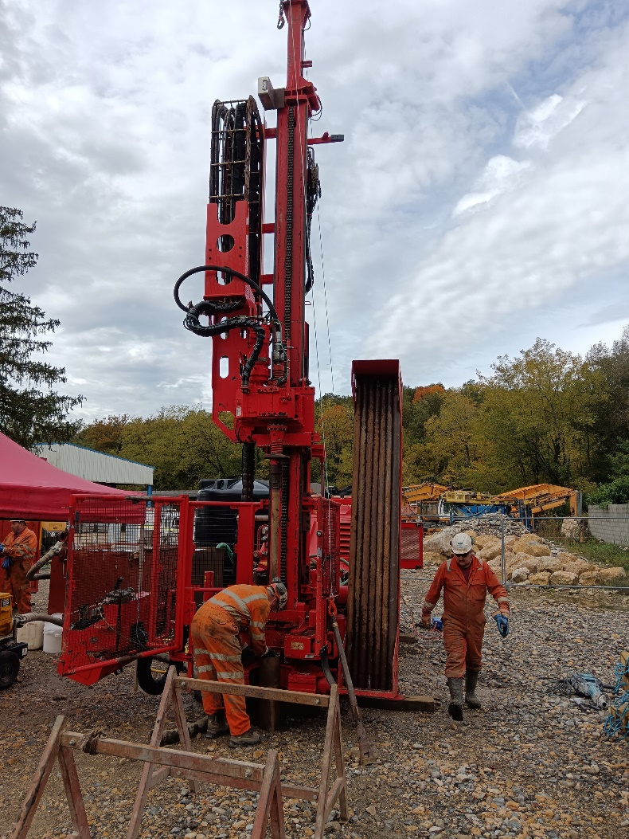
Status of site investigations – drillings
  Drilling for first borehole commenced on 14/10/2024
  The drilling (USSES 2) is within the commune of Marlioz
  The drill site is located within the storage yard of a private construction company (Besson).
  Drilling Depth = 70m
  Fully cored recovery
  Drill time should be about 2 weeks
  Equipped with Piezometer

Slide 8
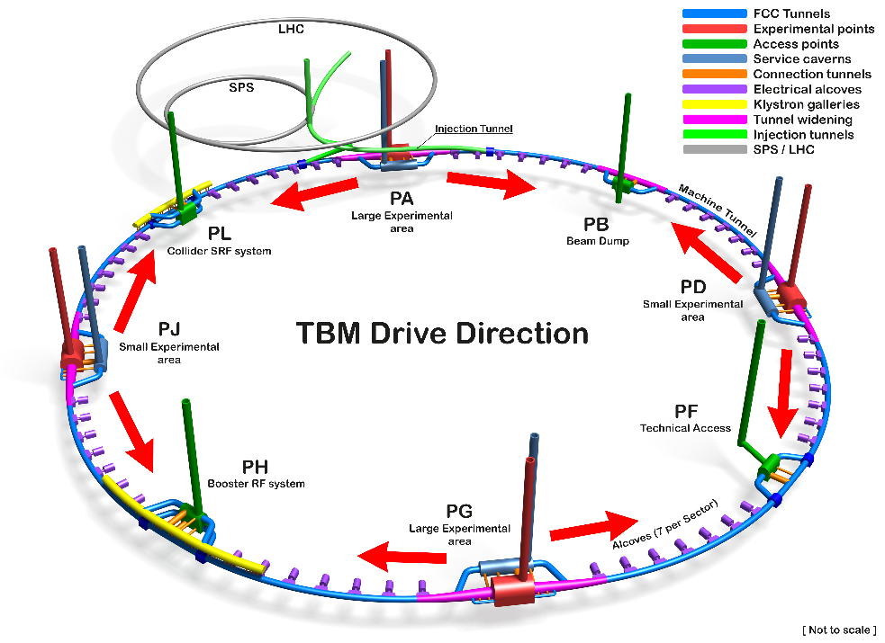
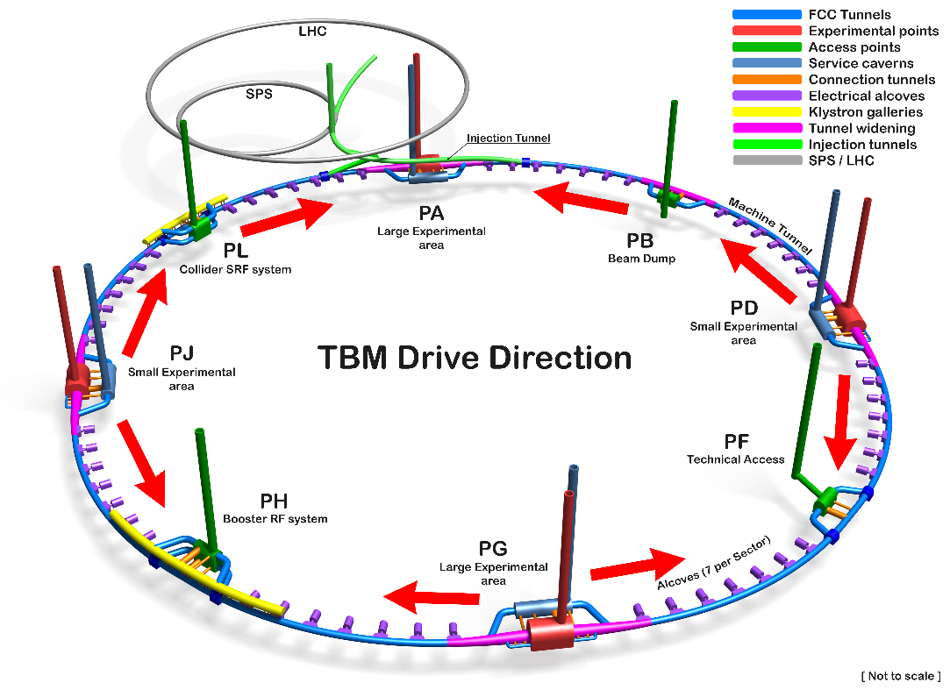
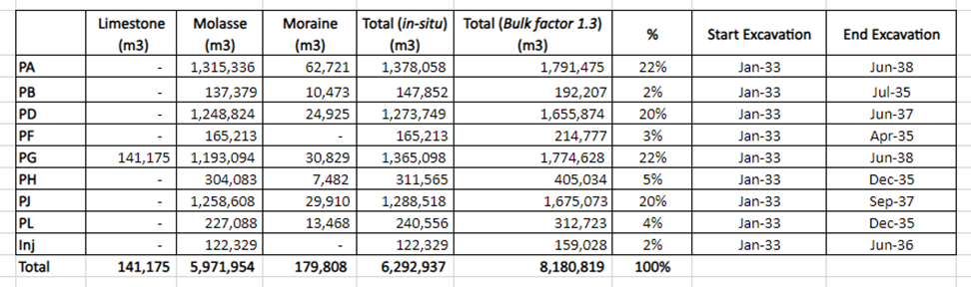
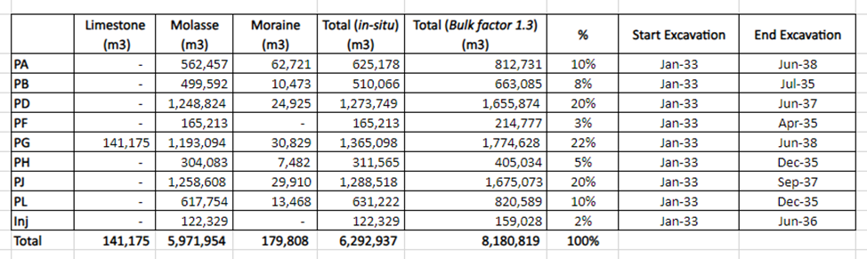
Studies on excavation strategy and material quantities
2 TBMs from each experimental point Alternative with no TBMs from PA

Slide 9
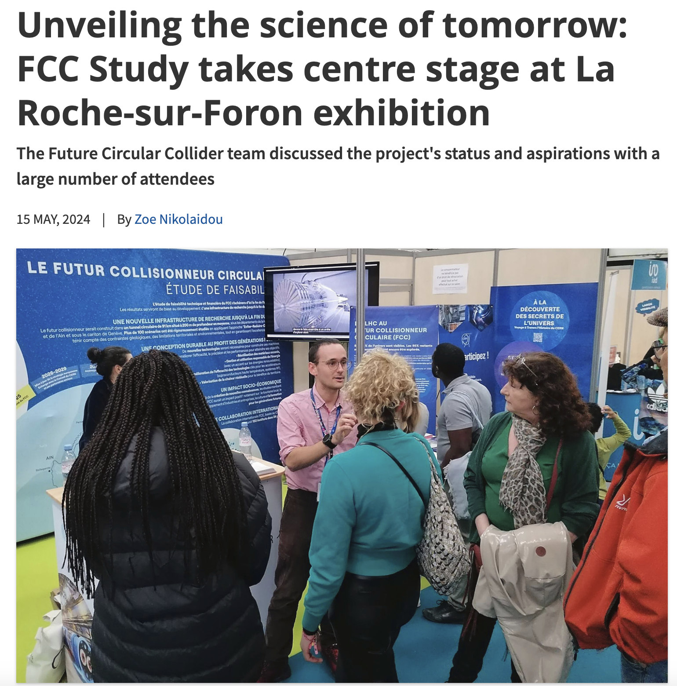
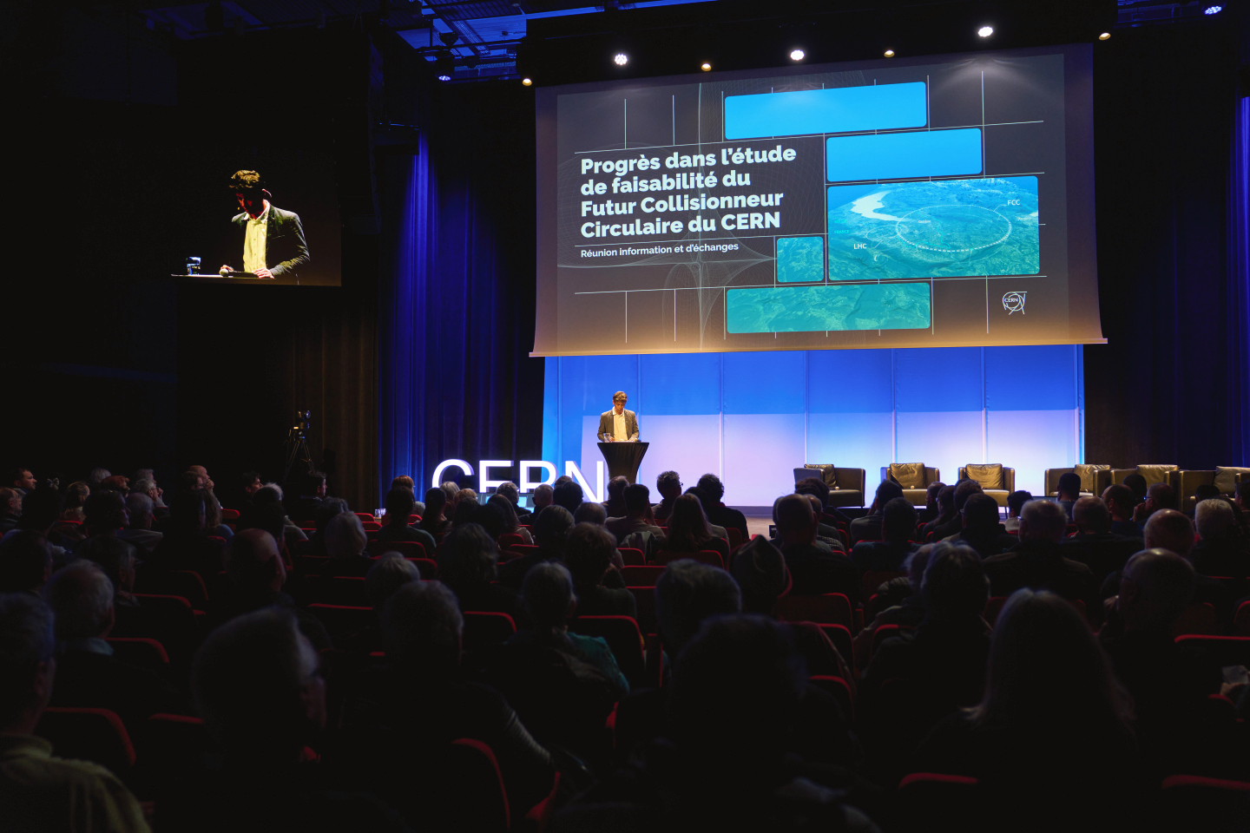
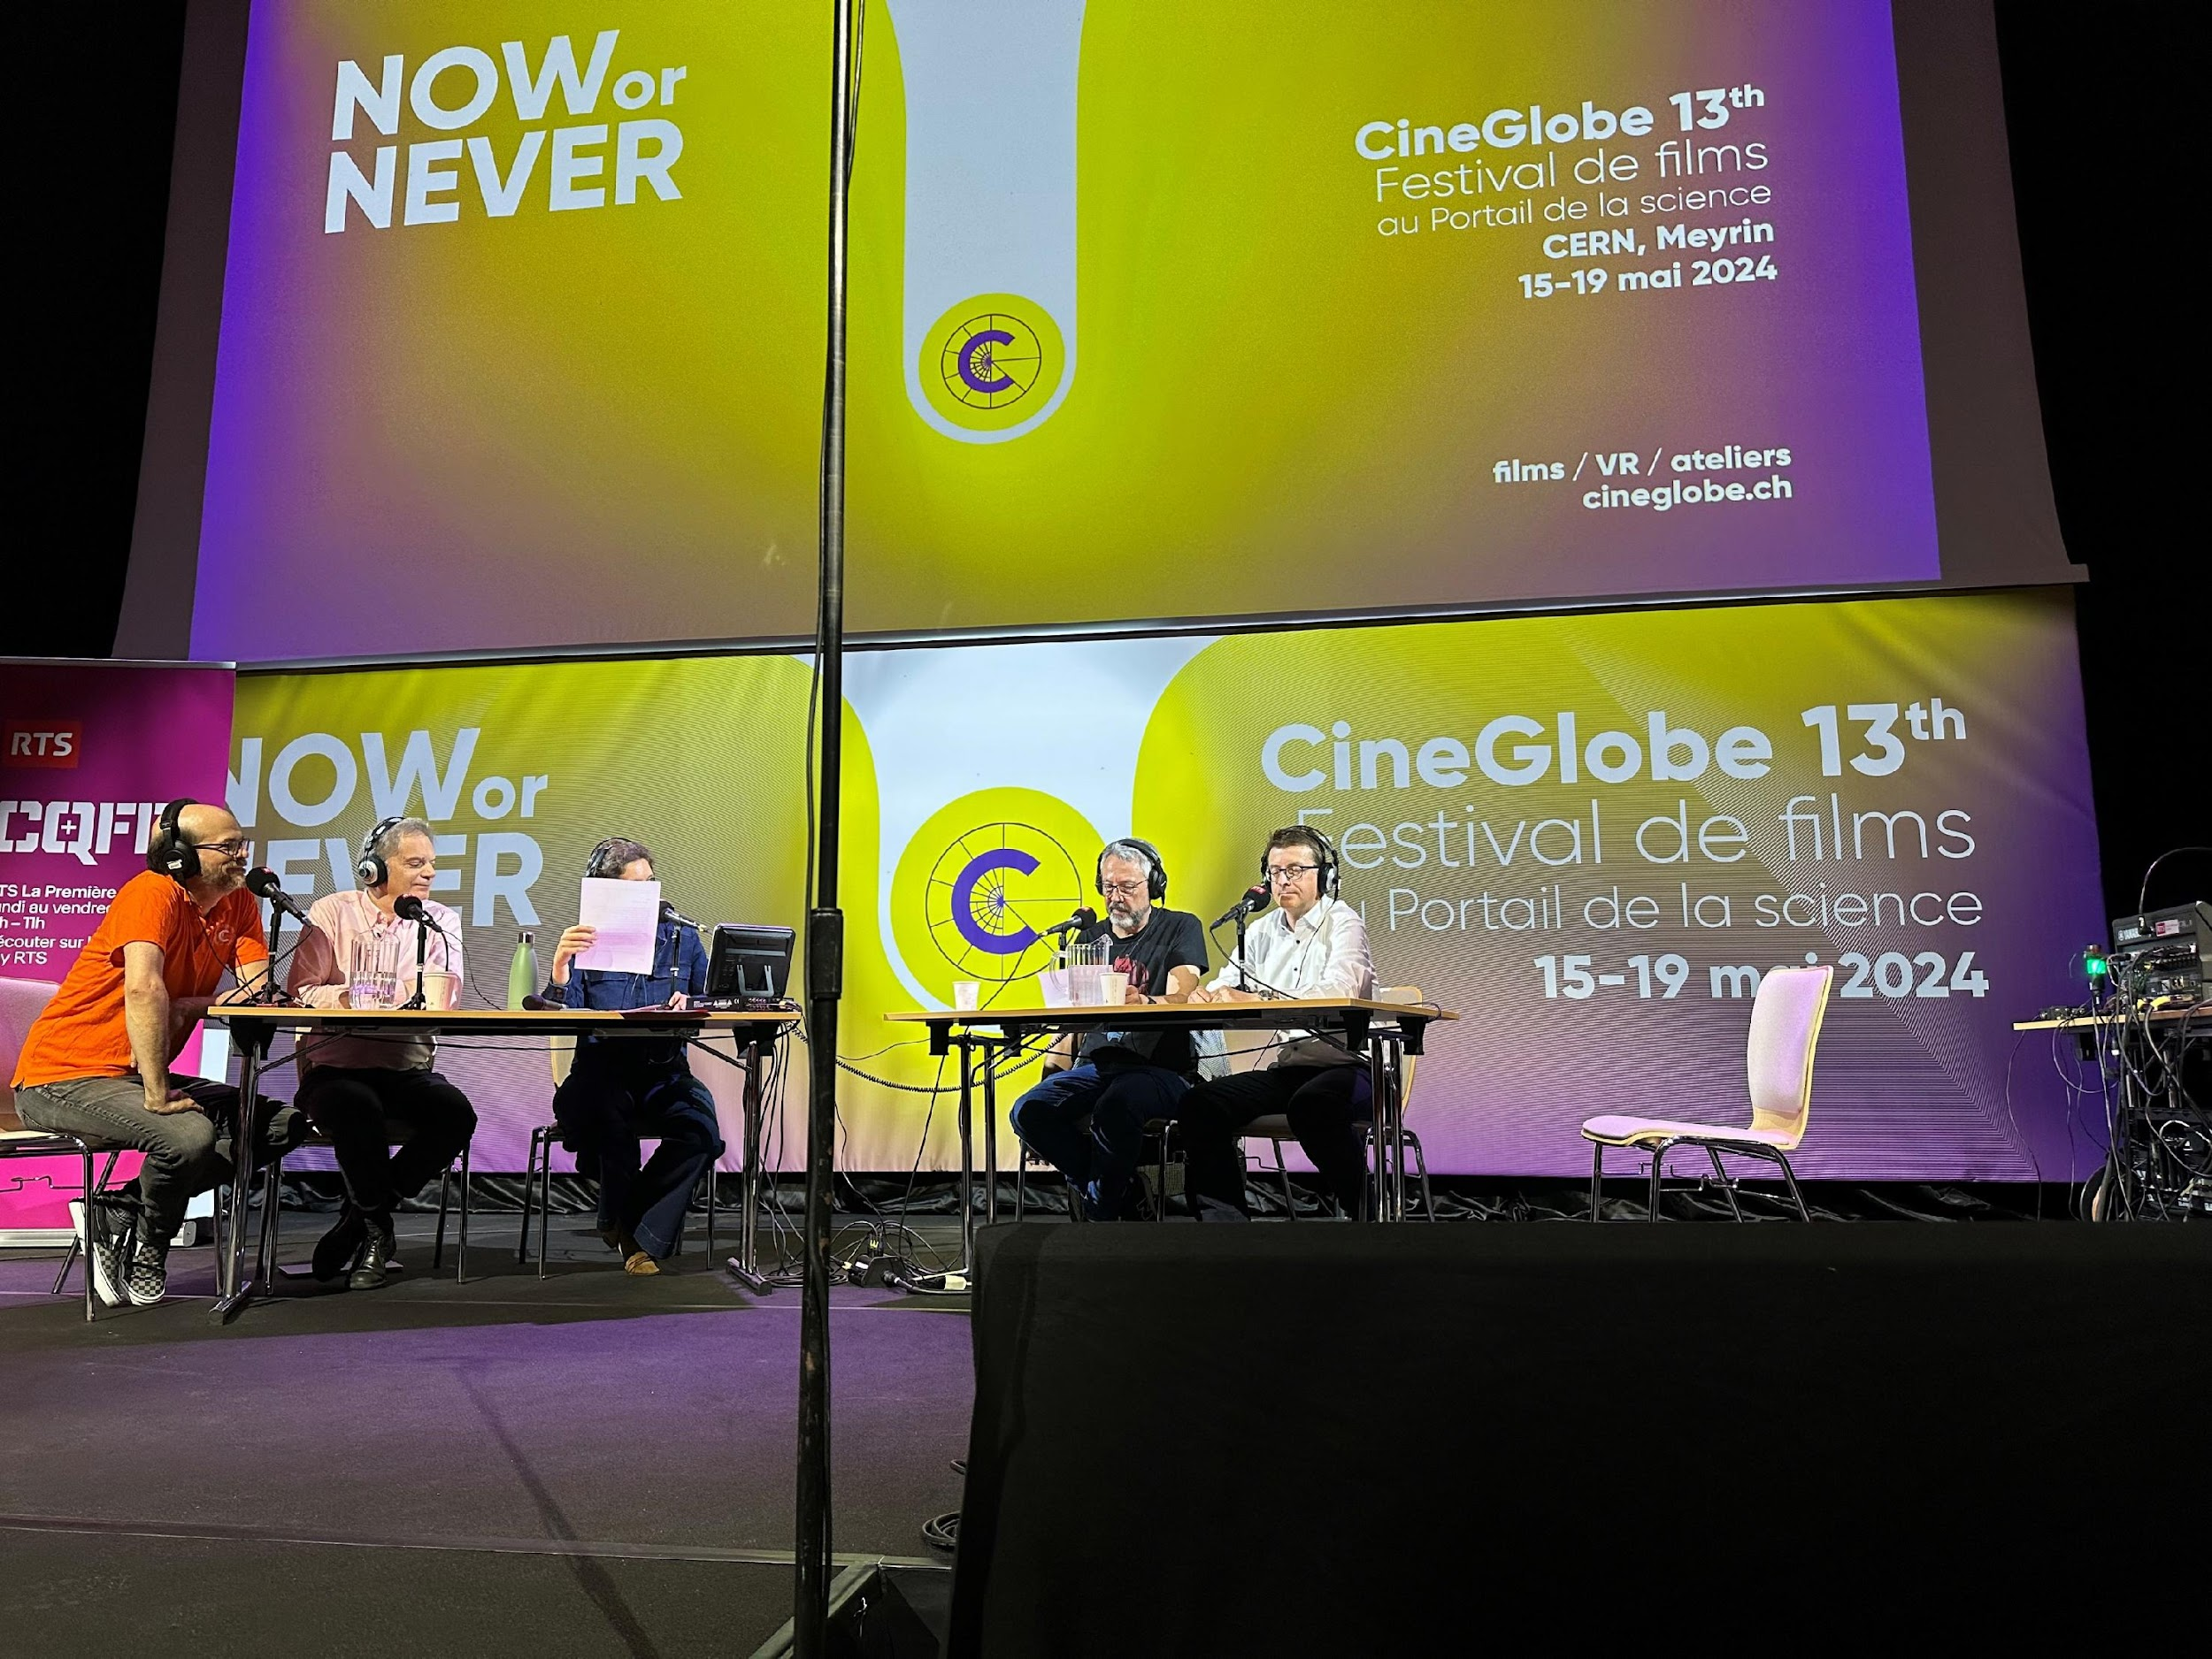
Start of public information & engagement sessions
First public information and discussion meeting at the Science Gateway on the 24th April at CERN.
The meeting was organised for the local community of our Host States, France and Switzerland, in the Science Gateway.
The "Progress of the feasibility study of the Future FCC circular collider" was followed by a discussion with the participants.
La Roche-sur-Foron - Haute Savoie international fare April 27 to May 6
CERN’s participation in the International Fair of Haute-Savoie/Mont Blanc, enhanced by the valuable help of volunteers from the FCC team, resulted in meaningful discussions with more than 2000 members of the local community on topics ranging from the required technological advancements to sustainability measures.
On 15 May, RTS (Radio Télévision Suisse) broadcasted a special program celebrating CERN’s 70th anniversary and hosted at CERN’s Science Gateway.
The event featured a comprehensive look at CERN's illustrious history, groundbreaking achievements, and future ambitions, including the prominently featured Future Circular Collider (FCC) project with study experts interacting with the audience.

Slide 10
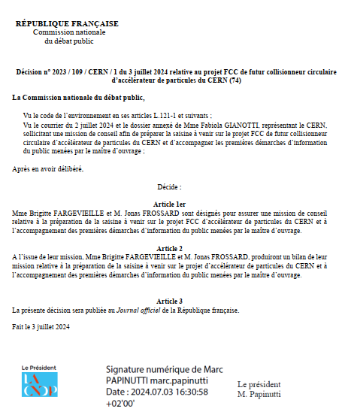
Commission Nationale de Debat Public (CNDP)
mission & public information meetings
The CNDP, created in 1995, is an independent French authority that ensures public participation in the definition and decision process of major projects in France, impacting the environment by providing a neutral and transparent framework for discussions between decision-makers and citizens.
On July 2, 2024, the CERN DG requested the CNDP to undertake an advisory mission on public participation for the FCC. On July 3, the president of the CNDP appointed two guarantors to:
Assist CERN in preparing the first information meetings on the ongoing studies in the region.
Provide non-binding advice to CERN on the next steps for public participation regarding the FCC.
CNDP decision for the Advisory Mission

Slide 11
FCC-ee main machine parameters
Parameter | Z | WW | H (ZH) | ttbar
beam energy [GeV] | 45.6 | 80 | 120 | 182.5
beam current [mA] | 1270 | 137 | 26.7 | 4.9
number bunches/beam | 11200 | 1780 | 440 | 60
bunch intensity [10¹¹] | 2.14 | 1.45 | 1.15 | 1.55
SR energy loss / turn [GeV] | 0.0394 | 0.374 | 1.89 | 10.4
total RF voltage 400/800 MHz [GV] | 0.120/0 | 1.0/0 | 2.1/0 | 2.1/9.4
long. damping time [turns] | 1158 | 215 | 64 | 18
horizontal beta* [m] | 0.11 | 0.2 | 0.24 | 1.0
vertical beta* [mm] | 0.7 | 1.0 | 1.0 | 1.6
horizontal geometric emittance [nm] | 0.71 | 2.17 | 0.71 | 1.59
vertical geom. emittance [pm] | 1.9 | 2.2 | 1.4 | 1.6
vertical rms IP spot size [nm] | 36 | 47 | 40 | 51
beam-beam parameter ξ_{x} / ξ_{y} | 0.002/0.0973 | 0.013/0.128 | 0.010/0.088 | 0.073/0.134
rms bunch length with SR / BS [mm] | 5.6 / 15.5 | 3.5 / 5.4 | 3.4 / 4.7 | 1.8 / 2.2
luminosity per IP [10³⁴ cm⁻²s⁻¹] | 140 | 20 | ≥5.0 | 1.25
total integrated luminosity / IP / year [ab⁻¹/yr] | 17 | 2.4 | 0.6 | 0.15
beam lifetime rad Bhabha + BS [min] | 15 | 12 | 12 | 11
Design and parameters to maximise luminosity at all working points:
allow for 50 MW synchrotron radiation per beam.
Independent vacuum systems for electrons and positrons
full energy booster ring with top-up injection, collider permanent in collision mode
4 years
5 x 10¹² Z
LEP x 10⁵
2 years
> 10⁸ WW
LEP x 10⁴
3 years
2 x 10⁶ H
5 years
2 x 10⁶ tt pairs
x 10-50 improvements on all EW observables
up to x 10 improvement on Higgs coupling (model-indep.) measurements over HL-LHC
x10 Belle II statistics for b, c, τ
indirect discovery potential up to ~ 70 TeV
direct discovery potential for feebly-interacting particles over 5-100 GeV mass range
Up to 4 interaction points → robustness,
statistics, possibility of specialised detectors
to maximise physics output
F. Gianotti

Slide 12
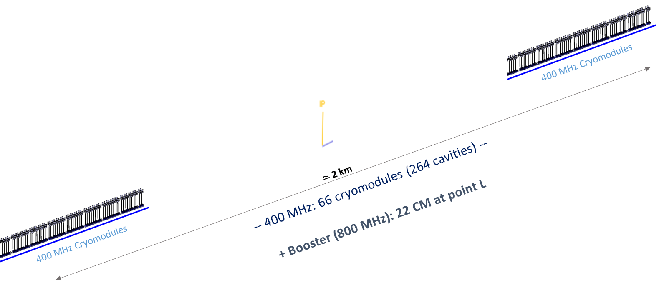
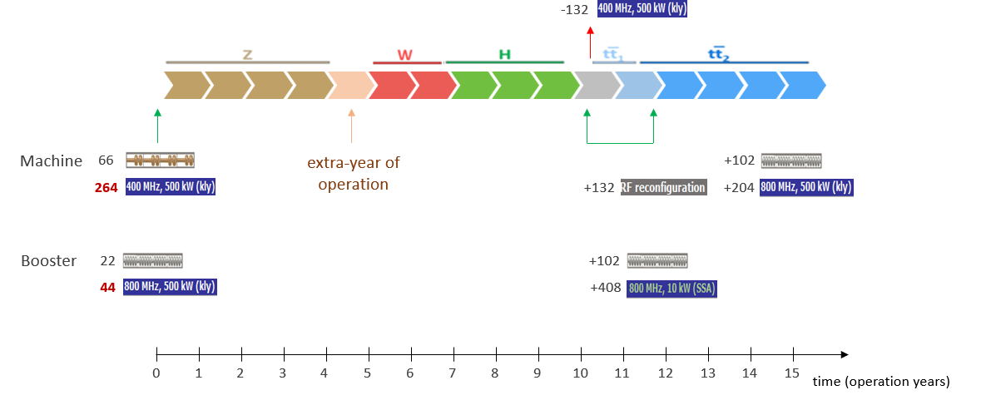
Optimisation for operation: 400 MHz SRF and beam switchyard
Beam switching between (Z, W) and ZH operation
2-cell 400 MHz cavities for all three working points, identical configuration thanks to reverse phase operation: (1) experimentally verified w high beam loading at KEKB (Y. Morita et al., 2009), (2) baseline solution for US EIC
ES separators + magnetic field for switching beams
Allows quasi “instantaneous” switching between Z, W, ZH
 | Energy (GeV) | Current (mA) | RF voltage (GV)
Z | 45.6 | 1280 | 0.08
W | 80 | 135 | 1
H | 120 | 26.7 | 2.08
ttb | 182.5 | 5 | 11.67
Beam crossing and combination
at RF section in point H
Collider RF integration at point H
(Z, WW and ZH operation)
Z, W
ZH
33 CM
33 CM
33 CM
33 CM
Beam 1
400 MHz
400 MHz
400 MHz
400 MHz
Beam 2
E&M
sep.1
E&M
sep. 2a
E& M
sep. 2b
extra year of operation thanks to single RF system

Slide 13
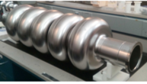
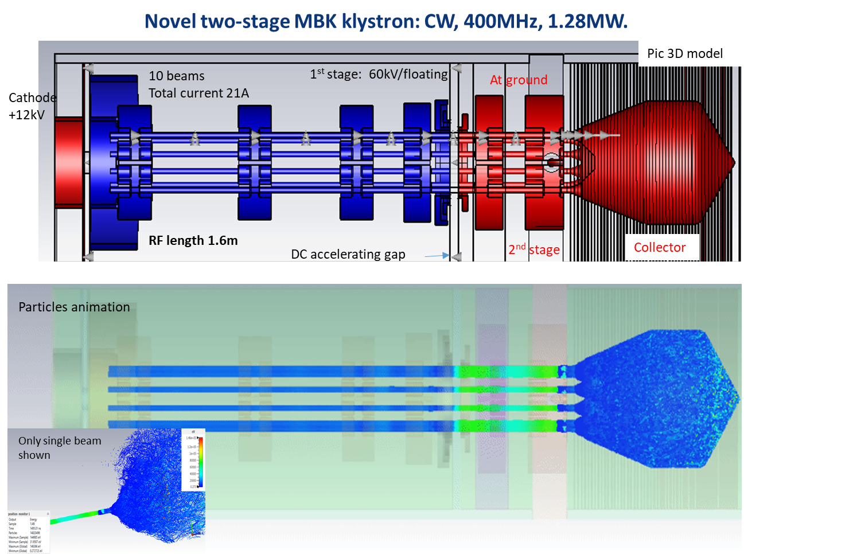
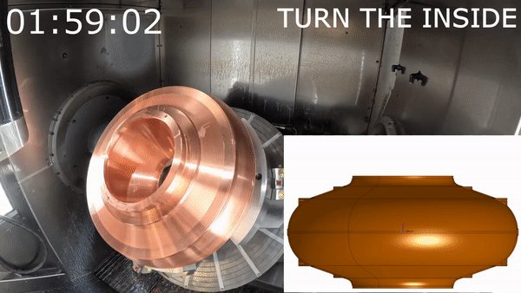
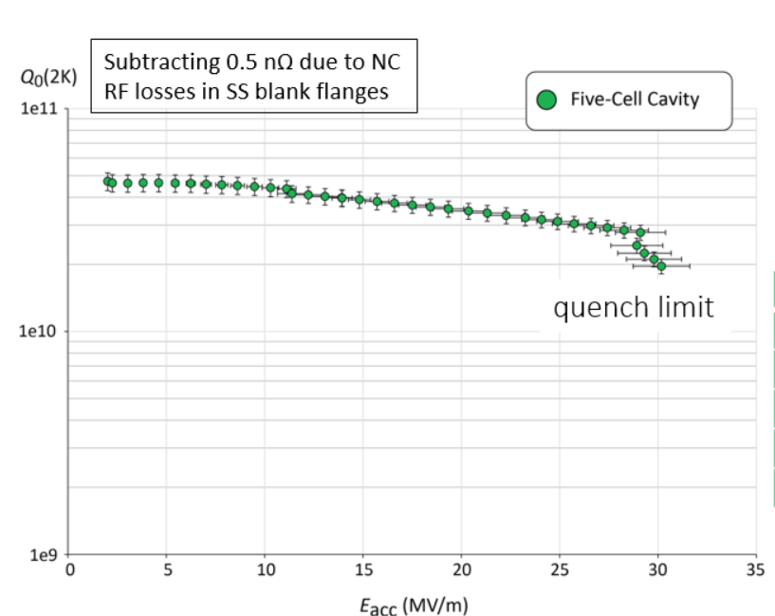
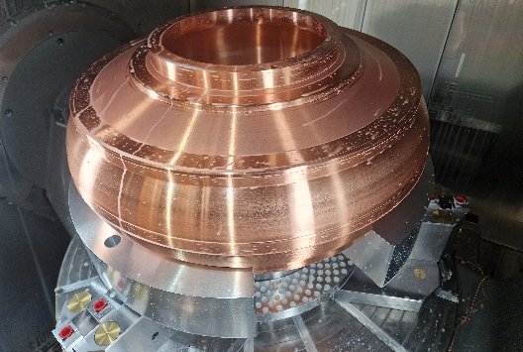
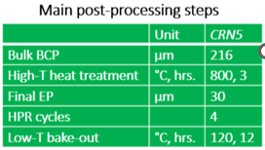
RF R&D activities
RF system R&D is key for increasing energy efficiency of FCC-ee
Nb on Cu 400 MHz cavities (KEK as R&D partner), seamless cavity production, coating techniques
Bulk Nb 800 MHz cavities, surface treatment techniques
RF power source R&D in synergy with HL-LHC.
5/6-cell 800 MHz cavity development collaboration with JLAB
high-efficiency klystron R&D
400 MHz
monoblock prototype

Slide 14
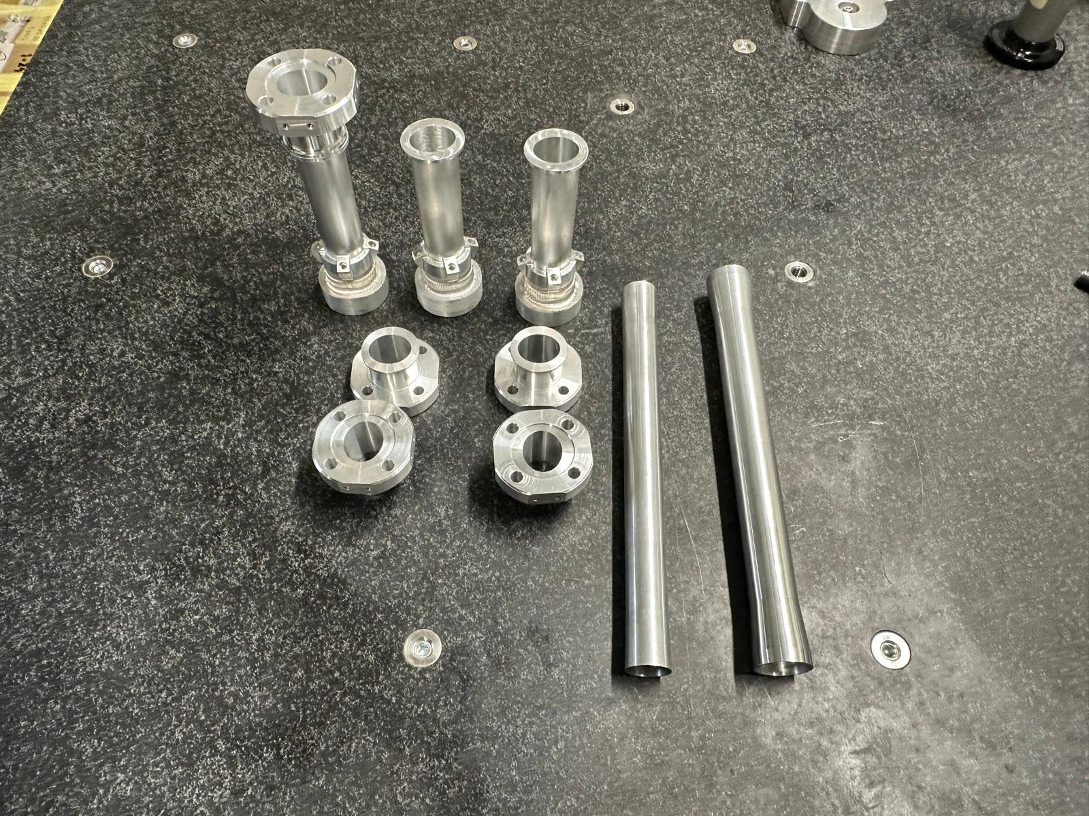
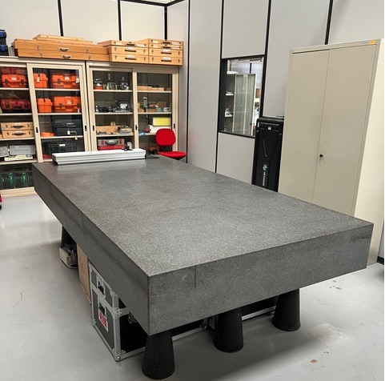
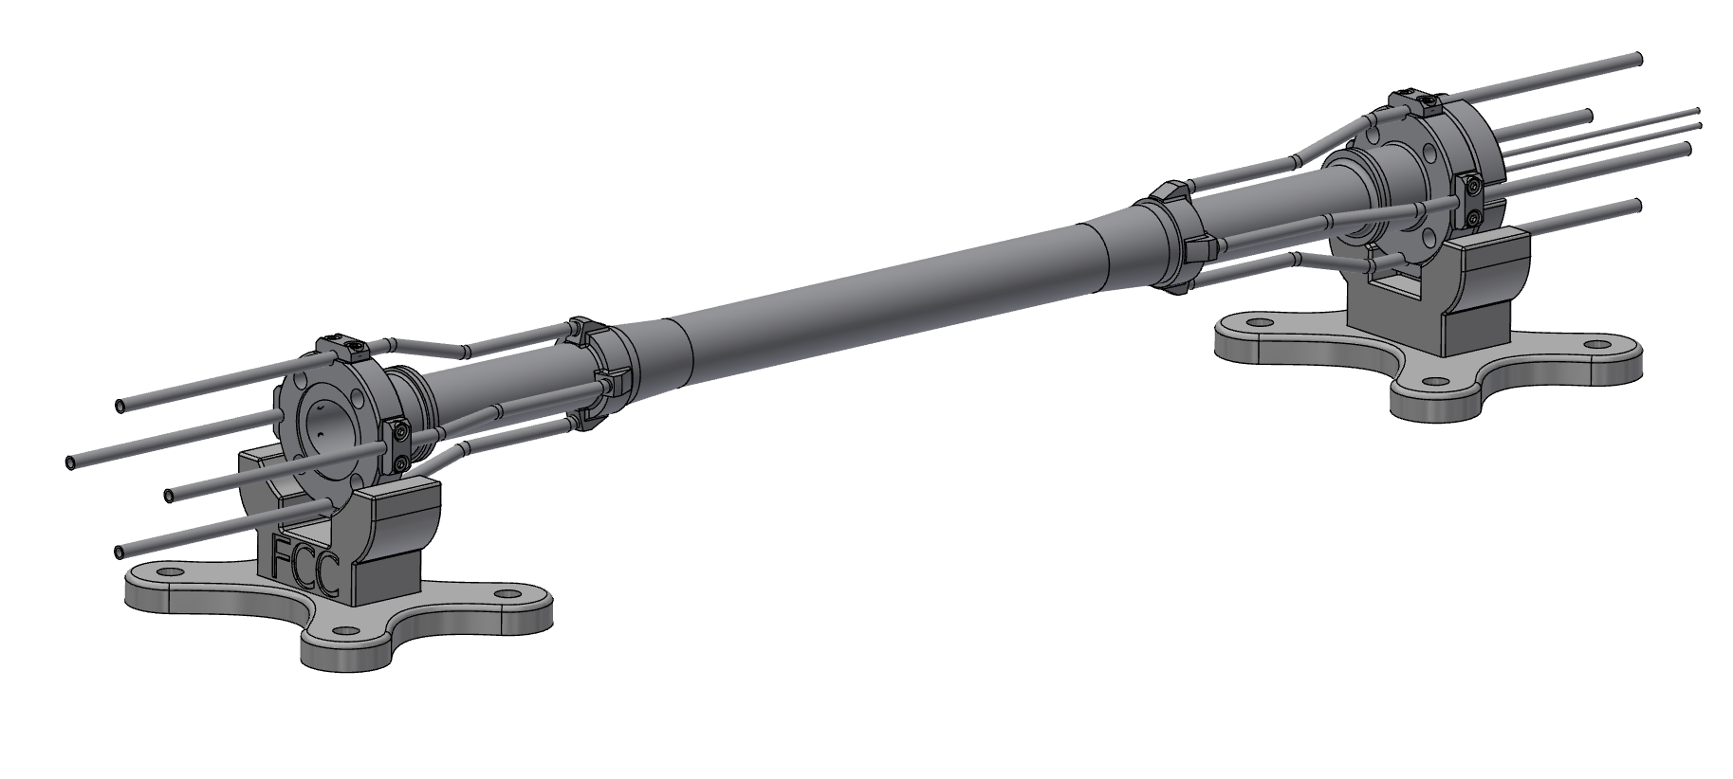
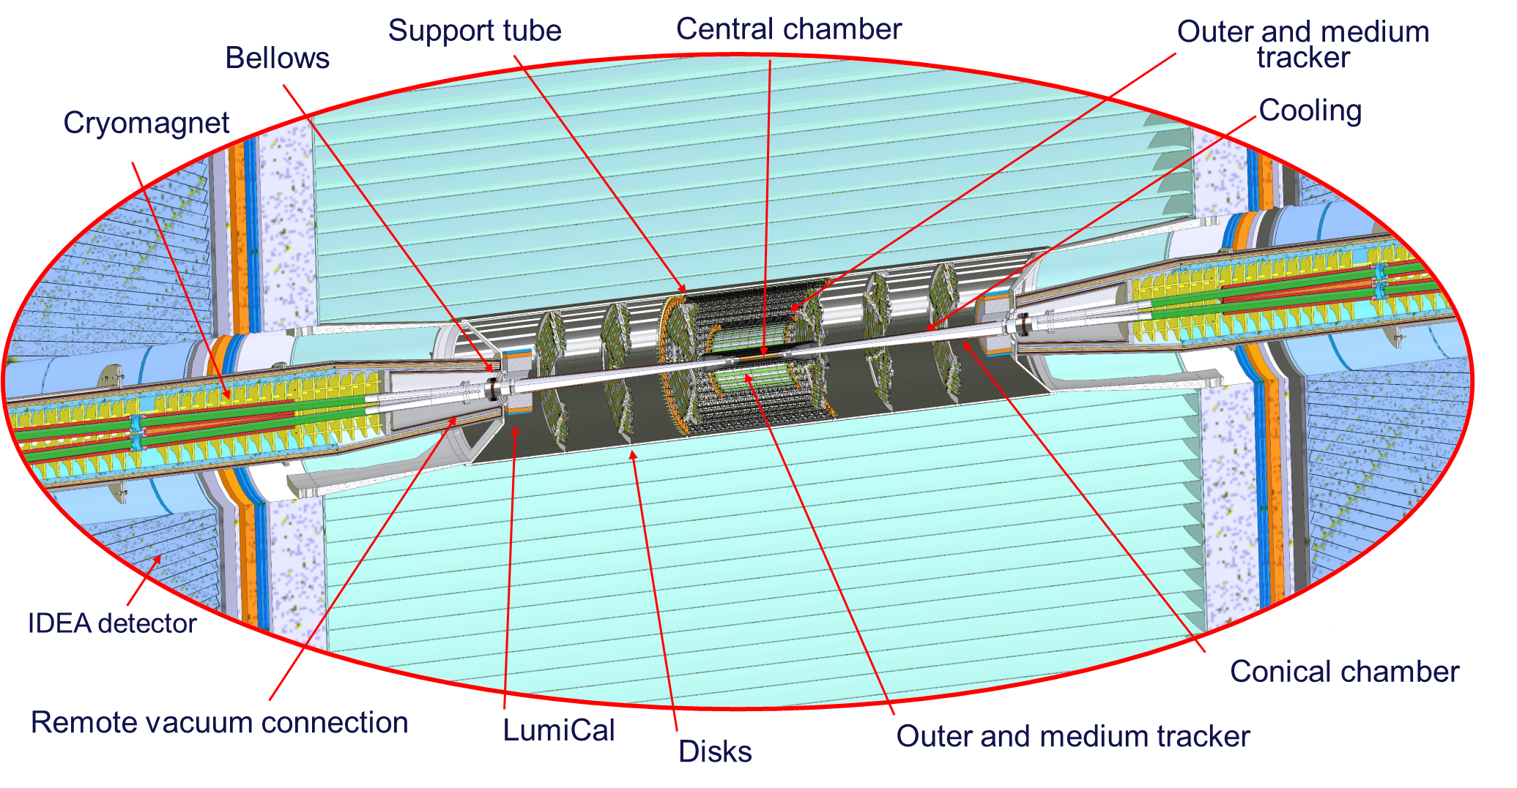
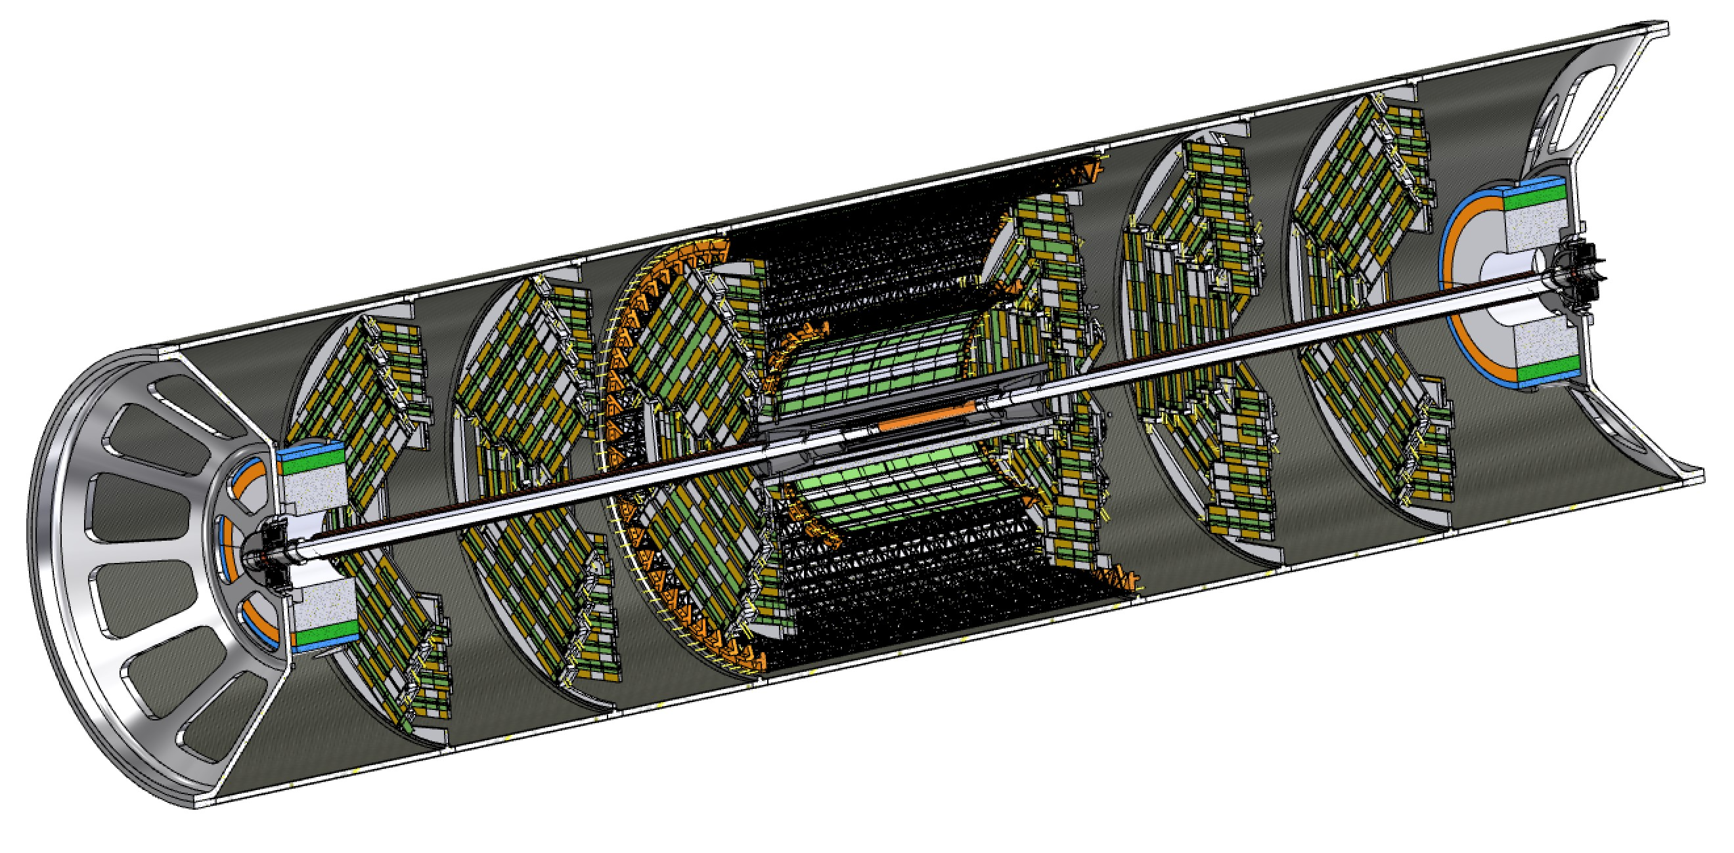
Interaction region mock up at INFN-LNF (Frascati)
INFN-LNF, CERN and INFN-Pisa collaboration
  Central chamber with paraffin cooling in production – Tests starting end of Oct.
  Conical chamber(s) with water cooling ~ to be ordered – Delivery end of the year
  Vertex mechanical structure Carbon fibre foils arriving
Assembly & test lab in Frascati
  Vertex air cooling tunnel – orders placed – assembled Q1 2025
  Support tube - orders expected Q1-2025
  Bellows ~ design almost finished, to be ordered
  Integration & overall assembly Q4-2025
B. 5/a Serv. ing. mecc. (SIM) div.acc.
M. Boscolo, F. Fransesini, F. Palla

Slide 15
Optimized injector concept and parameters (PSI & CERN)
Mid-term review recommendations to reduce gradients and repetition rate → new linac optimization in terms of cost and power density
  Overall power consumption (for linacs) is reduced by more than a factor 3 by means of:
    new accelerating structures with higher shunt impedance;
    lower gradient (29.5 MV/m → 22.5/20.5 MV/m);
    lower repetition rate (200/400 Hz → 100 Hz).
  Repetition rate of 100 Hz with 4 bunches per rf pulse
  New layout: Damping Ring at higher energy 2.86 GeV, no common linac with 2x repetition rate.

Slide 16
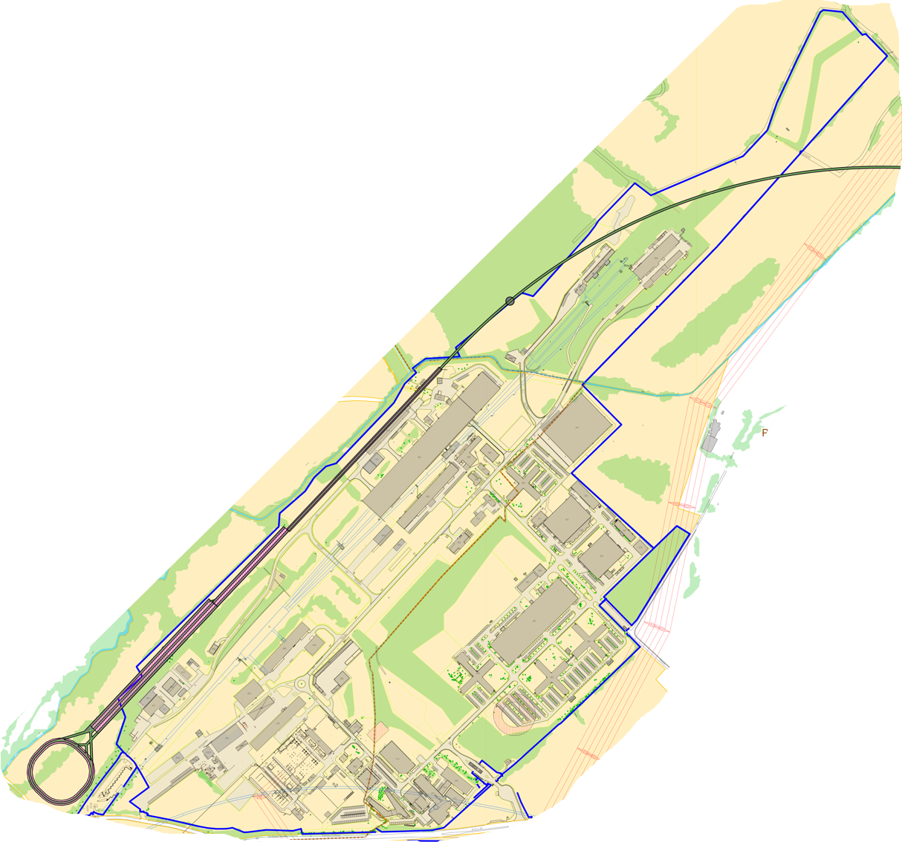
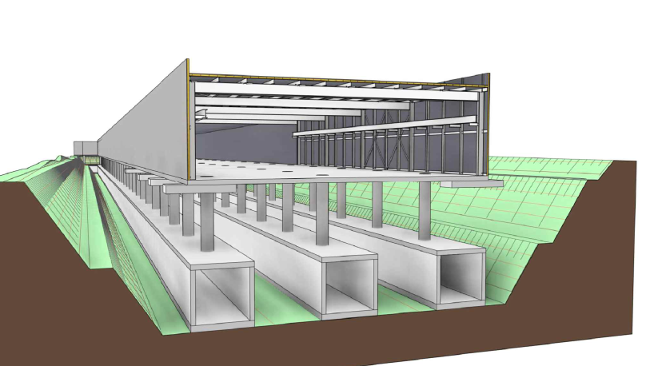
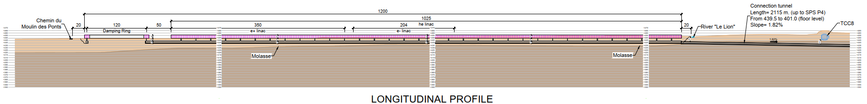
Optimised injector implementation at Prévessin site
Good integration with existing CERN Prevessin Site and strongly reduced visibility from outside.
Ideal connection to existing experimental halls.
Good conditions for construction.
High Energy LINAC
Damping
Ring
CERN Fenced Area
Entrance CERN Prevessin Site

Slide 17
Other FCC-ee science applications under study
→ Workshop on “Other Science Opportunities at the FCC-ee”
28-29 November at CERN, https://indico.cern.ch/event/1454873/
for example:
FCC-ee booster as diffraction limited storage ring with coherent synchrotron radiation down to 0.1 Å
FCC-ee injector as the world’s ultimate positron source for material studies and paving a path towards the first Bose-Einstein condensation of Ps (511-keV gamma-ray laser)
using beamstrahlung for radionuclide production
e⁻ beam driven neutron source
etc.

Slide 18
FCC-hh main machine parameters
parameter | FCC-hh | HL-LHC | LHC
collision energy cms [TeV] | 81 - 115 | 14
dipole field [T] | 14 - 20 | 8.33
circumference [km] | 90.7 | 26.7
arc length [km] | 76.9 | 22.5
beam current [A] | 0.5 | 1.1 | 0.58
bunch intensity [10¹¹] | 1 | 2.2 | 1.15
bunch spacing [ns] | 25 | 25
synchr. rad. power / ring [kW] | 1020 - 4250 | 7.3 | 3.6
SR power / length [W/m/ap.] | 13 - 54 | 0.33 | 0.17
long. emit. damping time [h] | 0.77 – 0.26 | 12.9
peak luminosity [10³⁴ cm⁻²s⁻¹] | ~30 | 5 (lev.) | 1
events/bunch crossing | ~1000 | 132 | 27
stored energy/beam [GJ] | 6.1 - 8.9 | 0.7 | 0.36
Integrated luminosity/main IP [fb⁻¹] | 20000 | 3000 | 300
With FCC-hh after FCC-ee: significant amount of time for high-field magnet R&D,
aiming at highest possible collision energies
Target field range for cryo-magnet R&D
Formidable challenges:
high-field superconducting magnets: 14 - 20 T
power load in arcs from synchrotron radiation: 4 MW → cryogenics, vacuum
stored beam energy: ~ 9 GJ → machine protection
pile-up in the detectors: ~1000 events/xing
optimization of energy consumption: → R&D on cryo, HTS, beam current, …
Formidable physics reach, including:
Direct discovery potential up to ~ 40 TeV
Measurement of Higgs self to ~ 5% and ttH to ~ 1%
High-precision and model-indep (with FCC-ee input)
measurements of rare Higgs decays (𝛄𝛄, Z𝛄, µµ)
Final word about WIMP dark matter
F. Gianotti

Slide 19
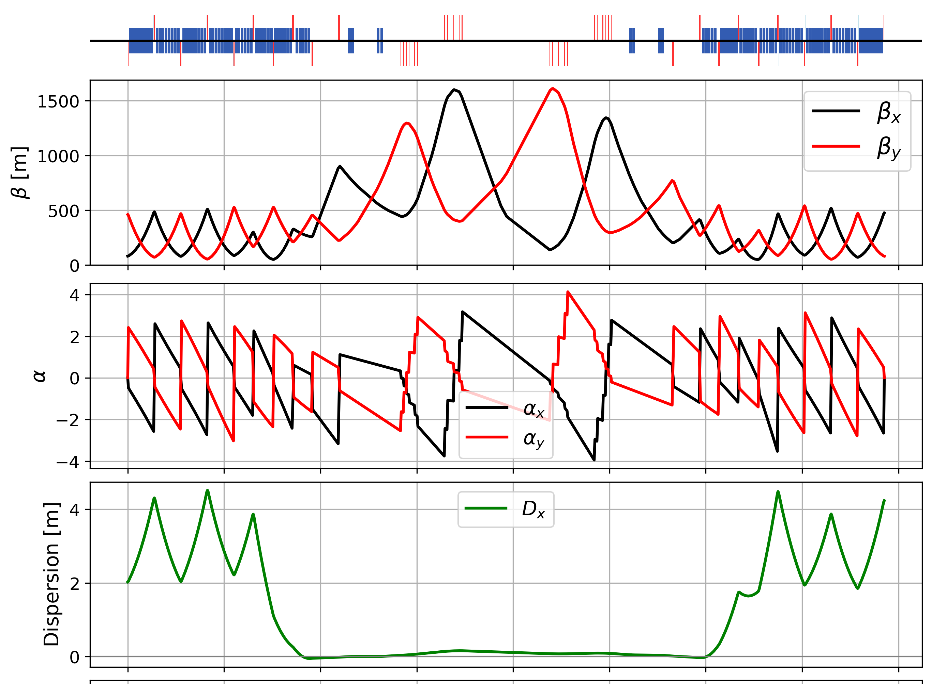
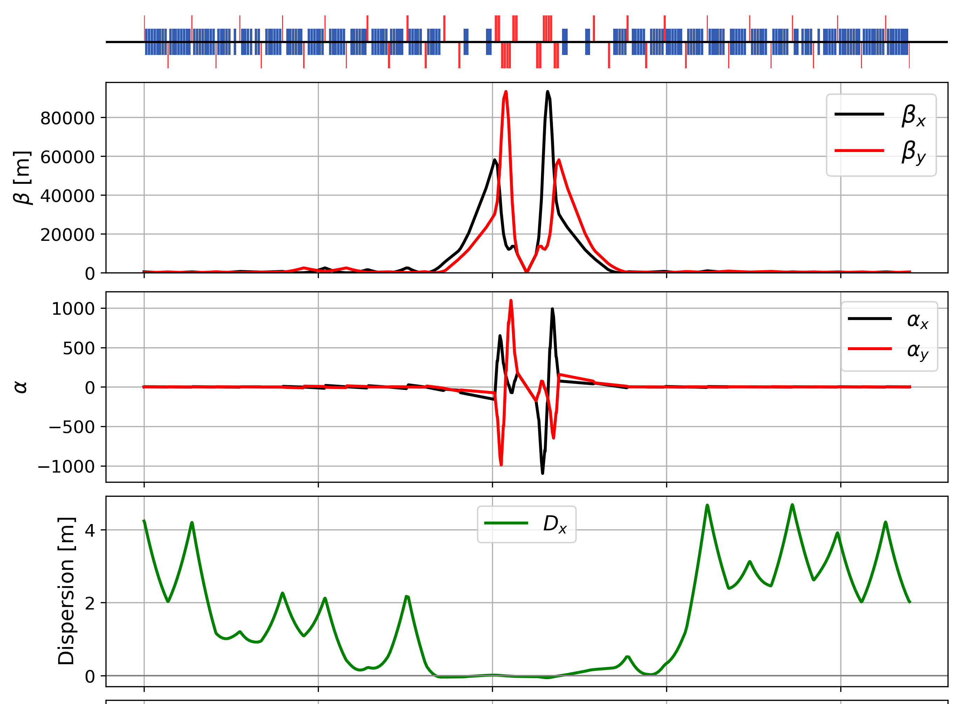
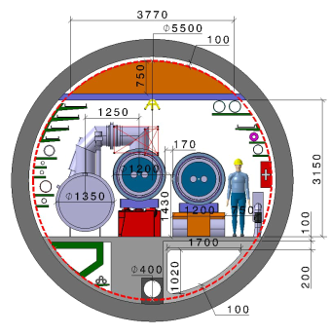
Key activities on FCC-hh: cryo magnet system, optics design
Optics design activities:
adaptation to new layout and geometry
shrink β collimation & extraction by ~30%
optics optimisation (filling factor etc.)
betatron collimation straight
experimental straight
M. Giovannozzi. G. Perez, T. Risselada
High-field cryo-magnet system design
Conceptual study of cryogenics concept and temperature layout for LTS and HTS based magnets, in view of electrical consumption.
Update of integration study for the ongoing HFM designs and scaling to preliminary HTS design.
  → Confirmation of tunnel diameter!
HFM R&D (LTS and HTS) on technology and magnet design, aiming also at bridging the TRL gap between HTS and Nb₃Sn.
Collider Center
F. Valchkova

Slide 20

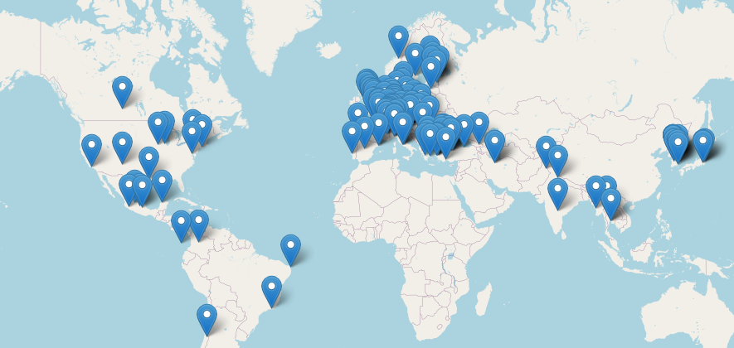


Status of FCC global collaboration
Increasing international collaboration as a prerequisite for success:
→links with science, research & development and high-tech industry will be essential to further advance and prepare the implementation of FCC
FCC Feasibility Study:
Aim is to increase further the collaboration,
on all aspects, in particular on
Accelerator and Particle/Experiments/Detectors
155 Institutes
36 countries
+
CERN

Slide 21
FCC collaboration members in Asia
India
UPES Dehradun
IIT Hyderabad
Iran
University of Tehran
IPM
Japan
The University of Tokyo
Tokyo International University
KEK
Pakistan
PAEC
South Korea
Pusan National University
Hanyang University Seoul
Kyung Hee University Seoul
Pohang Accelerator Laboratory (PAL)
Kyungpook National University Daegu
KAIST Daejeon
Gangneung-Wonju National University
Korea University Seoul
Yonsei University Seoul
Sungkyunkwan University Seoul
University of Seoul
Thailand
Faculty of Science / Chiang Mai University
Thailand Center of Excellence in Physics
Chulalongkorn University Bangkok
Srinakharinwirot University Bangkok
Türkiye
Ege University Bornova-Izmir
TOBB University of Economics
and Technology Ankara
Giresun University
Isik University Sile Istanbul
Izmir University Bakırcay (IBU)
Bursa Uludağ University Nilüfer
Ankara University
Kirikkale University
AIBU Bolu
İstinye UniversityIstanbul
Piri Reis Üniversitesi Tuzla Istanbul
IYTE Urla Izmir
Istanbul Aydin University
Istanbul University
Izmir University of Economics Balcova-Izmir

Slide 22
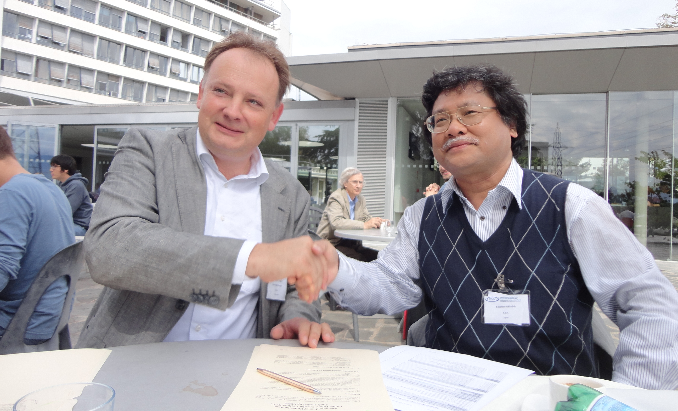
2014: KEK joining FCC collaboration

Slide 23

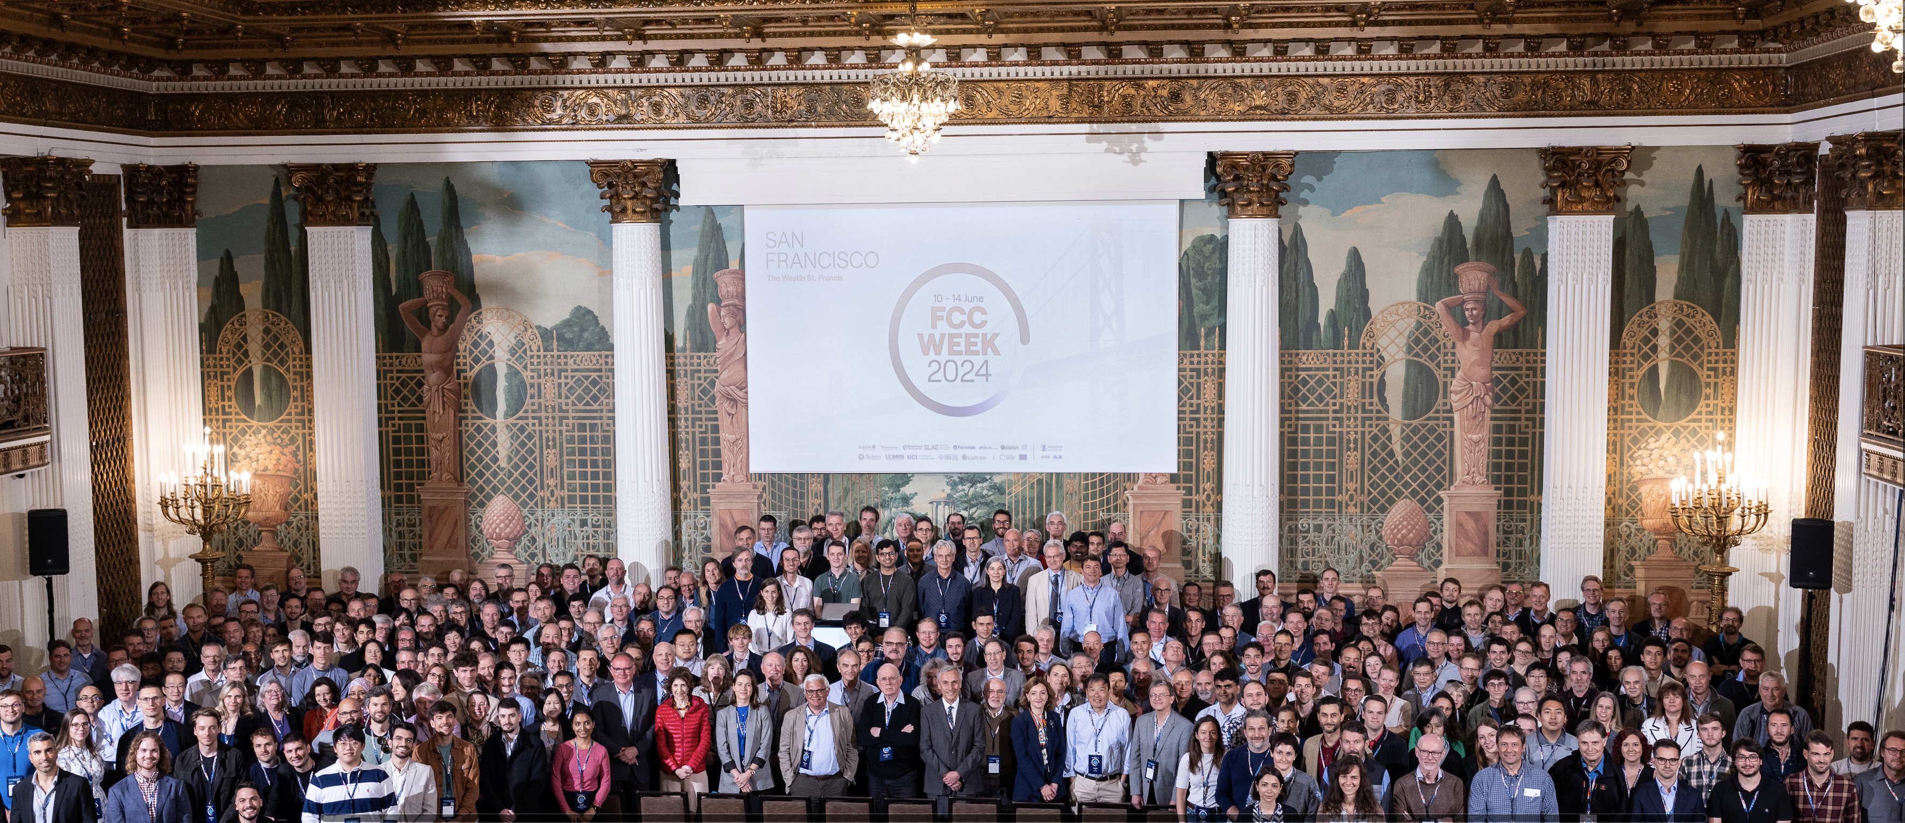
FCC Week 2024
Complete status of the FCC Study and all the latest advancements were presented at the Future Circular Collider Week 2024, in San Francisco, 10-14 June 2024
https://fccweek2024.web.cern.ch/
449 participants : 75 remote, 374 on site

Slide 24
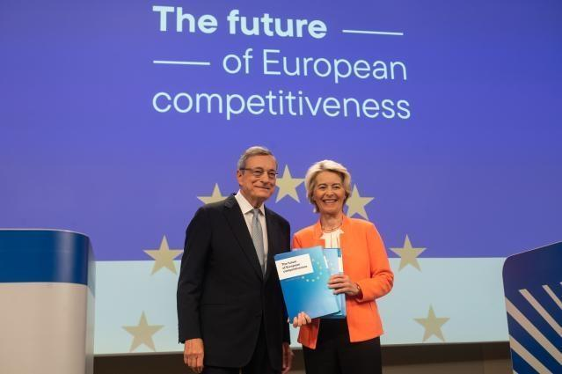
EU Competitiveness Report
edited by Mario Draghi, and officially handed over to Ursula von der Leyen in September 2024
“One of CERN’s most promising current projects, with significant scientific potential, is the construction of the Future Circular Collider (FCC): a 90-km ring designed initially for an electron collider and later for a hadron collider..
Refinancing CERN and ensuring its continued global leadership in frontier research should be regarded as a top EU priority, given the objective of maintaining European prominence in this critical area of fundamental research, which is expected to generate significant business spillovers in the coming years.”
https://commission.europa.eu/topics/strengthening-european-competitiveness/eu-competitiveness-looking-ahead_en

Slide 25
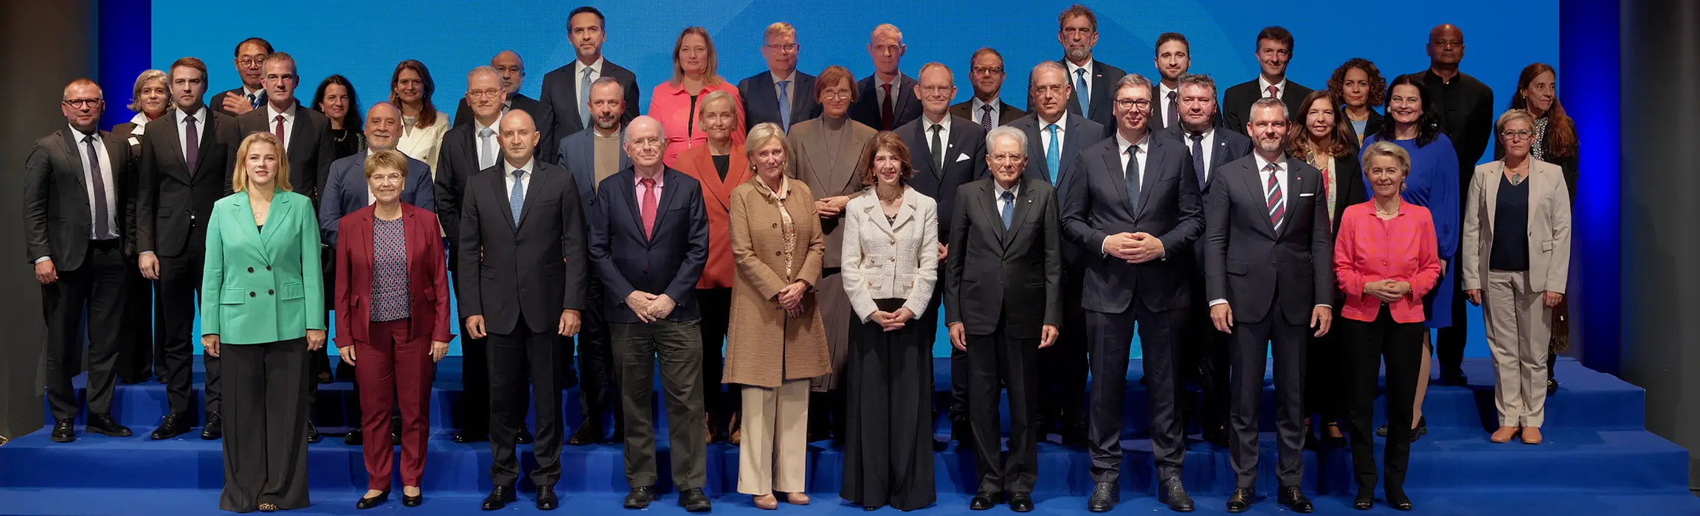
Supporting statements at CERN’s 70th anniversary
“….No European country alone could have built the world’s largest particle collider. CERN has become a global hub because it rallied Europe and this is even more crucial today.
I am proud that we have financed the feasibility study for CERN’s Future Circular Collider (FCC). This could preserve Europe's scientific edge and could push the boundaries of human knowledge even further. And as the global science race is on, I want Europe to switch gears. To do so, European unity is our greatest asset. ….”
Ursula von der Leyen, President of the European Commission

Slide 26
FCC Main Goals for Coming Years
Upcoming milestone for FCC is the completion of the Feasibility Study by March 2025 as input for the Update of the ESPP.
The following pre-TDR phase should prepare for a possible project approval by 2027-2028 and enable the subsequent start of CE design contract:
  Updated cost and schedule studies
  specifications to enable CE tender design by mid 2027
  refined input for environmental evaluation and project authorisation process
  requires overall integration study and designs based on technical pre-design of accelerators, technical infrastructure and detectors
Possible start of CE construction would then be 2032-33:
  CE groundbreaking
  TDR to enable prototyping, industrialization towards component production
Strong international collaboration is essential for success!

Slide 27




Possible timeline till start of construction
2024 |  |  |  | 2025 |  |  |  | 2026 |  |  |  | 2027 |  |  |  | 2028 |  |  |  | 2029 |  |  |  | 2030 |  |  |  | 2031 |  |  |  | 2032 |  |  |  | 2033
Q1 | Q2 | Q3 | Q4 | Q1 | Q2 | Q3 | Q4 | Q1 | Q2 | Q3 | Q4 | Q1 | Q2 | Q3 | Q4 | Q1 | Q2 | Q3 | Q4
Feasibility Study
Pre-TDR Phase
TDR Phase
Construction →→→
FS Report
cost update
ESPPU
2025/26
pre TDR
cost update
TDR
cost update
Project Decision
accelerator design, technical infrastructure design, R&D, towards TDR
engineering design →
Environmental Impact study & Authorization Process
Phase 1 Site Investigations
Phase 2 Site Investigations
CE Concept Design update
CE Tender Design
Construction Design
Start construction
Detector EOI submissions
FC³ formation, call for CDRs
Detector CDRs submitted to FC³

Slide 28
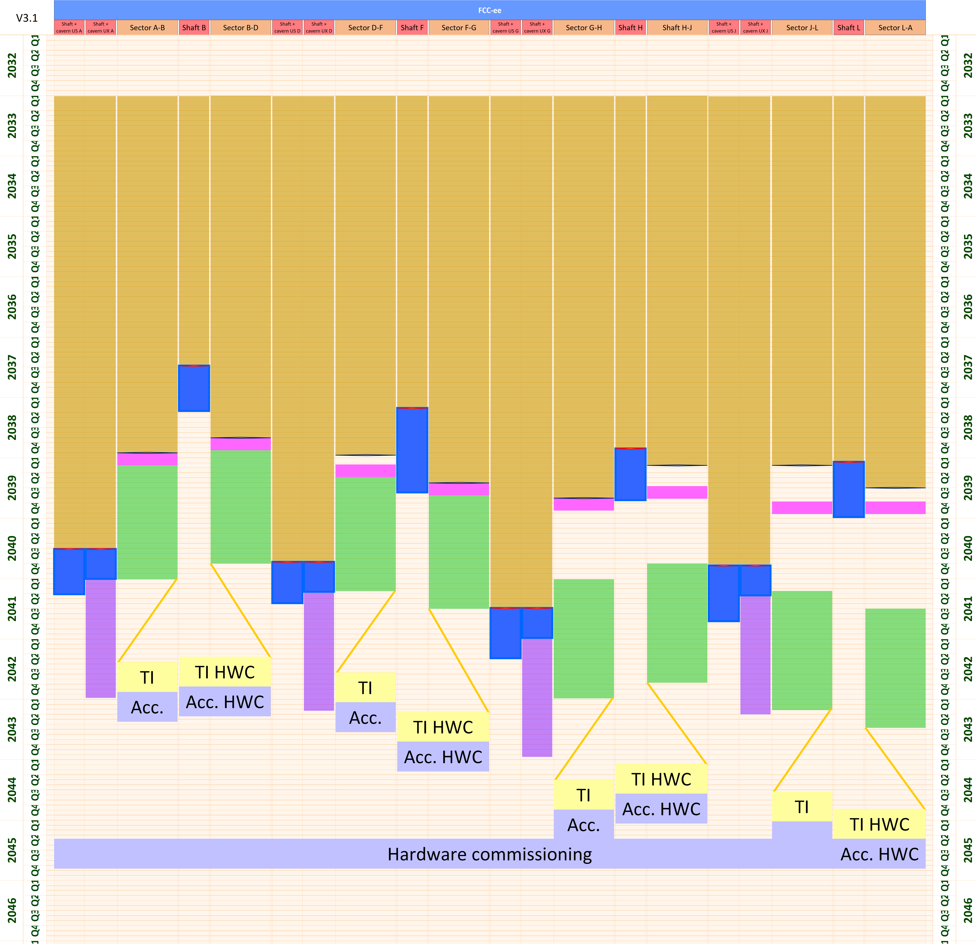
Construction and installation planning
Baseline collider schedule
Q1 2033, Start of CE construction work
Q2 2041, Completion of last lot of CE construction
Q2 2043, Overall completion of TI installation
Q4 2044, Accelerator installation completed
Q4 2045, HW commissioning completed
Q1 2046, First beams
Q1 2048, Start of nominal operation
Q3 2041 – Q3 2044, Experiment installation
Q1 2046, Start beam commissioning
Civil eng. works
Experiment. install.
Accelerator HWC
Shaft works
Geodetic install.
TI HWC
TI installation
Machine install.
Shaft release
First alcove release

Slide 29
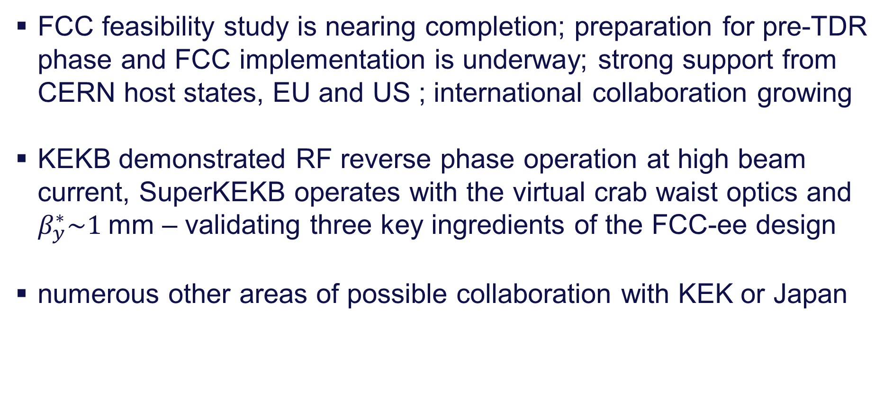
take home messages
FCC feasibility study is nearing completion; preparation for pre-TDR phase and FCC implementation is underway; strong support from CERN host states, EU and US ; international collaboration growing
KEKB demonstrated RF reverse phase operation at high beam current, SuperKEKB operates with the virtual crab waist optics and $β_{y}^{∗}\sim 1$mm – validating three key ingredients of the FCC-ee design
numerous other areas of possible collaboration with KEK or Japan

Slide 30
possible FCC contributions from Japan
accelerators:
expertise from SuperKEKB
FCC-ee virtual crab waist optics successfully implemented, β* smaller than for FCC-ee, etc.
FCC-ee experts participating SuperKEKB in Int’l Task Force
final focus and MDI expertise from Belle II
SRF and RF power sources
expertise from TRISTAN, KEKB, SuperKEKB, ILC, STF
reverse phase operation demonstrated at KEKB (key for FCC-ee and US EIC)
cavity design, optimization & production (e.g. 6-cell 800 MHz bulk Nb cavities)
highly efficient klystrons, IOTs, SSA ….
beam diagnostics, vacuum system, collimators, magnets, …
experiments & detectors:
expertise from Belle II, ATLAS, and ILC efforts
physics:
expertise from ILC and Belle II physics

Slide 31

FCC Week 2025 - Vienna
Event Overview
Venue: Hofburg Palace, a historical and cultural landmark in Vienna, Austria.
Dates: Monday 19 to Friday 23 May 2025
Presentation of the Feasibility Study Report and review of its findings and opportunities for future R&D projects
Please save the date and join us in Vienna
https://indico.cern.ch/event/1408515

