Slide 1
CERN-KEK Collaborative Activities for
Linear Colliders
Steinar Stapnes – with information/slides from many others at KEK and CERN
Today:
ILC-IDT renewed (Appendix 24)
ILC - ITN (Appendix 26 – new annex recently signed)
ATF (collaboration) very active – in the original ICA, also part of the ILC ITN
EAJADE (EU funded exchange programme with Japan (and Americas) for Higgs factories – supports ATF, SuperKEKb, sustainability studies, SCRF, etc)
Normal conducting cavities and test-stands, originally linked to X-band studies, recently used for dielectric studies (Appendix 2)
A few summary lines

Slide 2
The ILC IDT organization – initiated at the ICFA meeting at SLAC February 2020
2020-21: The IDT – created by ICFA and hosted by KEK – was set up to move ILC towards construction. The worldwide structure of the WGs: https://linearcollider.org/team/
A set of key activities were identified in a Preparation Phase Programme.
CERN’s involvement covered by CERN-KEK appendix 24. Just extended by 2 years.
2022-23: A subset of the technical activities of the full ILC preparation phase programme have been identified as critical (next slide). These are being addresses by a ~4 year programme called ITN – the ILC Technology Network. Moving forward with this work is being supported by the MEXT (ministry) providing crucial increased funding.
As of today: With funding from 1.4.2023 ITN is now the main activity in the area of LC studies. CERN-KEK appendix 26. See next slides.
Notes:
Chang eKEK name

Slide 3
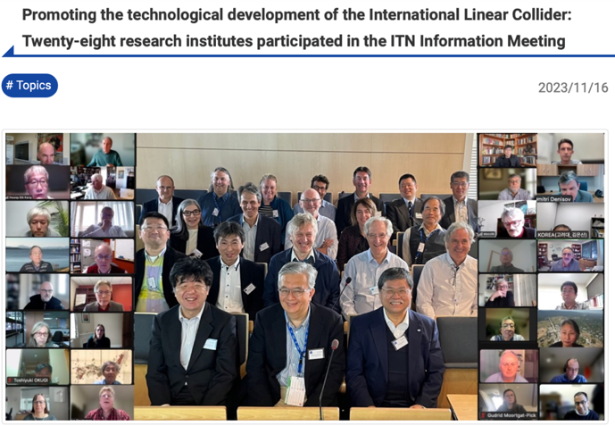
ITN: The International ILC Technology Network ILC
Globally performing high-priority R&D for the IDT in 13 WPPs; based on MEXT funding
WPP | 1 | Cavity production
WPP | 2 | CM design
WPP | 3 | Crab cavity
WPP | 4 | E- source
WPP | 6 | Undulator target
WPP | 7 | Undulator focusing
WPP | 8 | E-driven target
WPP | 9 | E-driven focusing
WPP | 10 | E-driven capture
WPP | 11 | Target replacement
WPP | 12 | DR System design
WPP | 14 | DR Injection/extraction
WPP | 15 | Final focus
WPP | 16 | Final doublet
WPP | 17 | Main dump
Building the ITN activities:
Planning in the IDT WG2 – significant interests and expertise already represented
Information meeting at CERN 16-17.10.2023 jointly organized by KEK and the IDT
Interest matrix for the ITN work-packages (next slide)

Slide 4
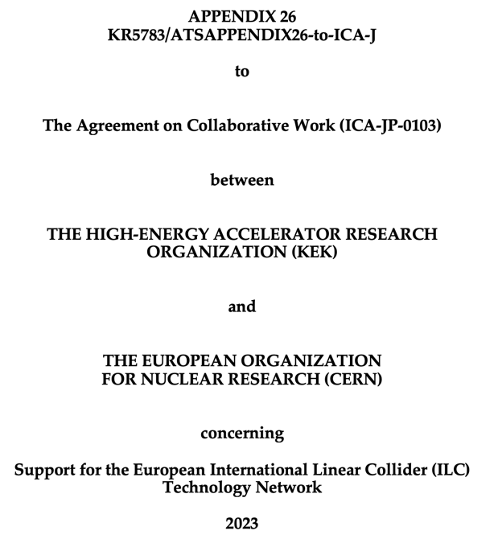
ITN in Europe
Contributing to ITN activities in Europe:
Planning ongoing: significant interests and expertise already represented (see interest & capability matrix)
Formally being implemented; CERN (supported by KEK) facilitates and organises work at European partners

Slide 5
ITN: European Contributions
… concentrate on five main activity areas:
Main linac (ML) related tasks (ITN WPPs 1-3)
SRF and ML elements: cavities and cryo-module, crab cavities,
ML quads and cold BPMs
(INFN, CEA, DESY, CERN, IJCLAB, UK, CIEMAT, IFIC)
Sources (ITN WPPs 4-11)
Pulsed magnet and wheel/target (UHH, DESY, CERN)
Damping ring including kickers (ITN WPPs 12,14)
Low Emittance Rings, fast kicker electronics (UK)
ATF activities, final focus and nanobeams (ITN WPPs 15-17)
ATF and MDI (UK, DESY, IJCLAB, CERN, IFIC)
Implementation
Dump, CE, Cryo – follow-up efforts at CERN
Sustainability, life-cycle assessment (CERN, DESY, CEA, UK groups)
Supported by the European Commission
EAJADE (EU funding for DESY, UK, CEA, CNRS, IFIC, INFN, UHH, CERN)
Infra-structure
Personnel, expertise
EAJADE
LC studies at CERN
Material funds
Notes:
How to map on WPs?
What is ATS (under ATC)?

Slide 6
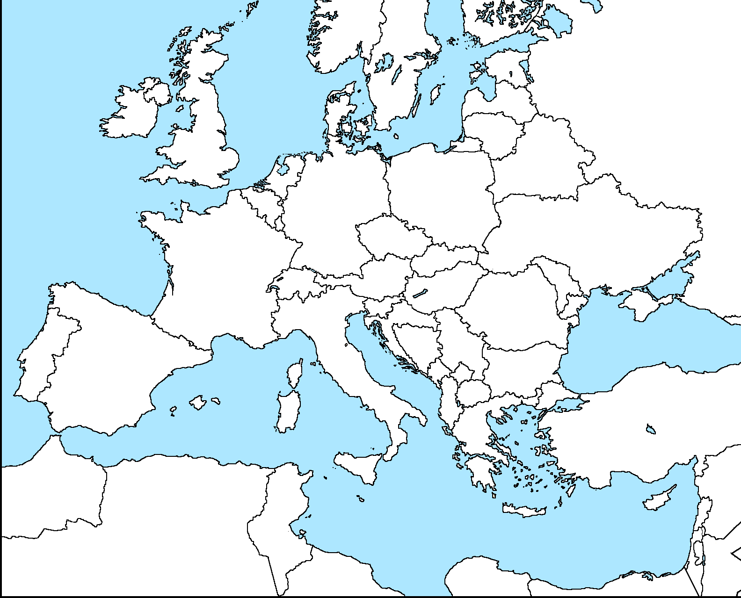
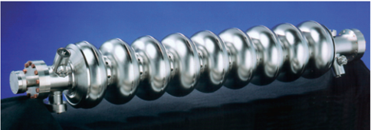

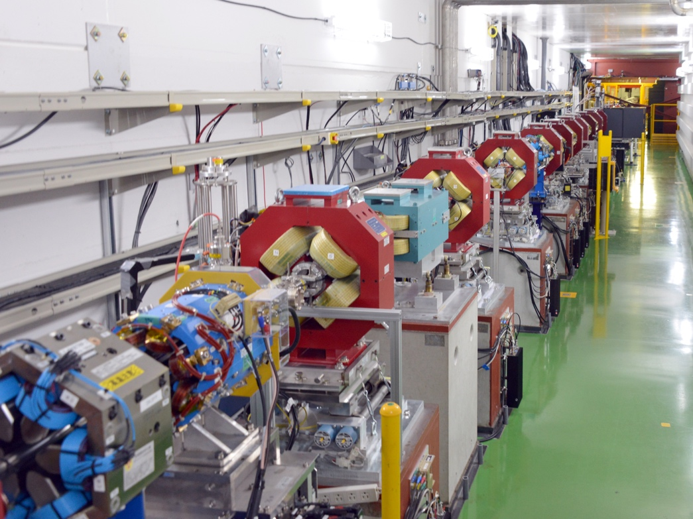
SRF cavities (CERN, CEA, INFN, DESY)
UK groups •
DESY / UHH
CEA •
IJCLab •
CERN •
CIEMAT
INFN
IFIC

Slide 7










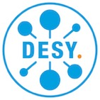












The EAJADE Work Packages
Addressing the most pressing items for Higgs factories
1) R&D&I at currently operating acilities.
2) State-of-the-art high-gradient high-efficiency reduced-cost radio-frequency structures and
power sources
3) Special technologies, devices and systems performance
4) Sustainable technologies for scientific facilities
5) Investigation of potential early applications of novel and advanced technologies for colliders

Slide 8

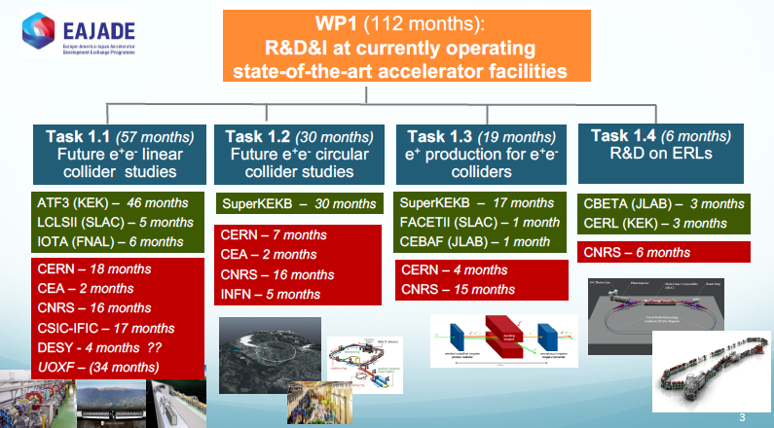
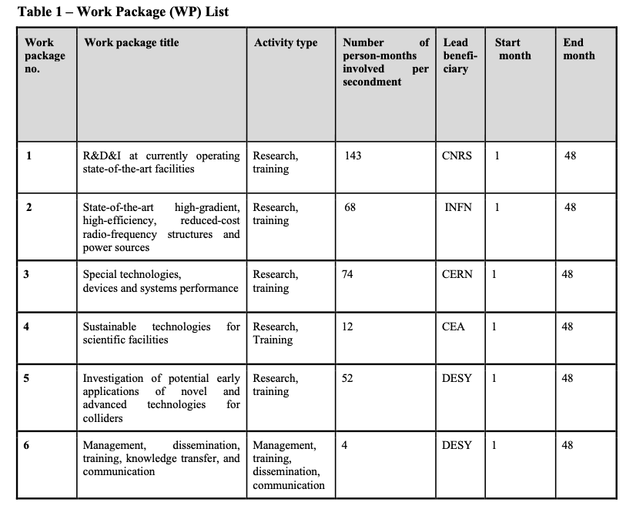
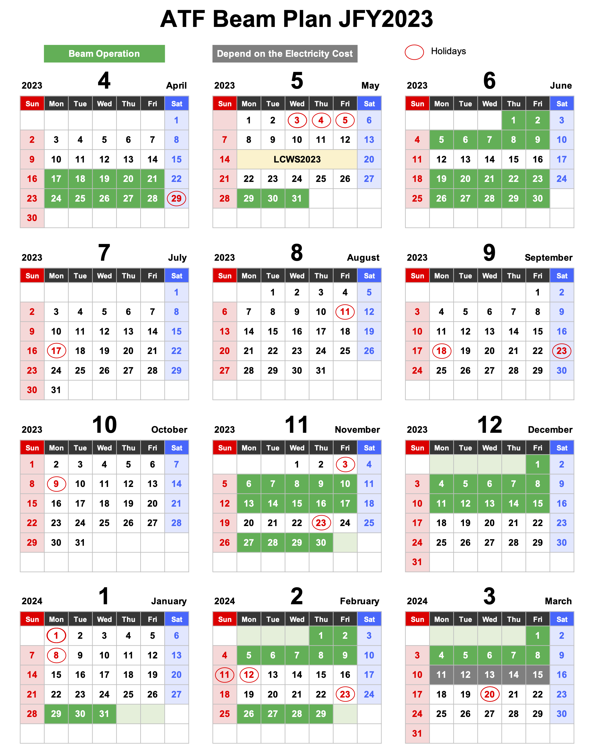
ATF3 in EAJADE project
EAJADE (Europe–America–Japan Accelerator Development and Exchange programme) focused in Higgs Factories, with participation of major EU (CERN, INFN, CEA, DESY, CNRS, CSIC, UOXF), Japan (KEK, Tokyo Univ., Tohoku Univ.) USA (BNL, FNAL, SLAC, JLAB, LBNL, Cornell Univ.) and Canada (VISPA) labs. (2023-2027)

Slide 9
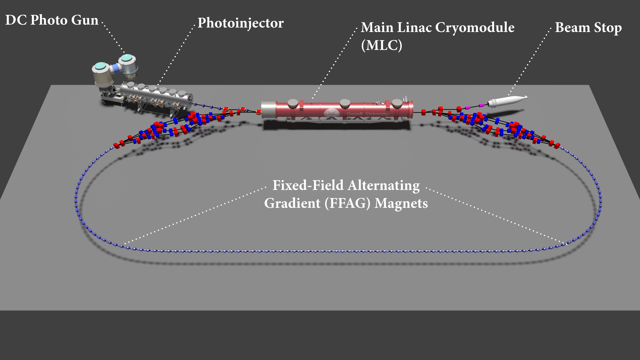
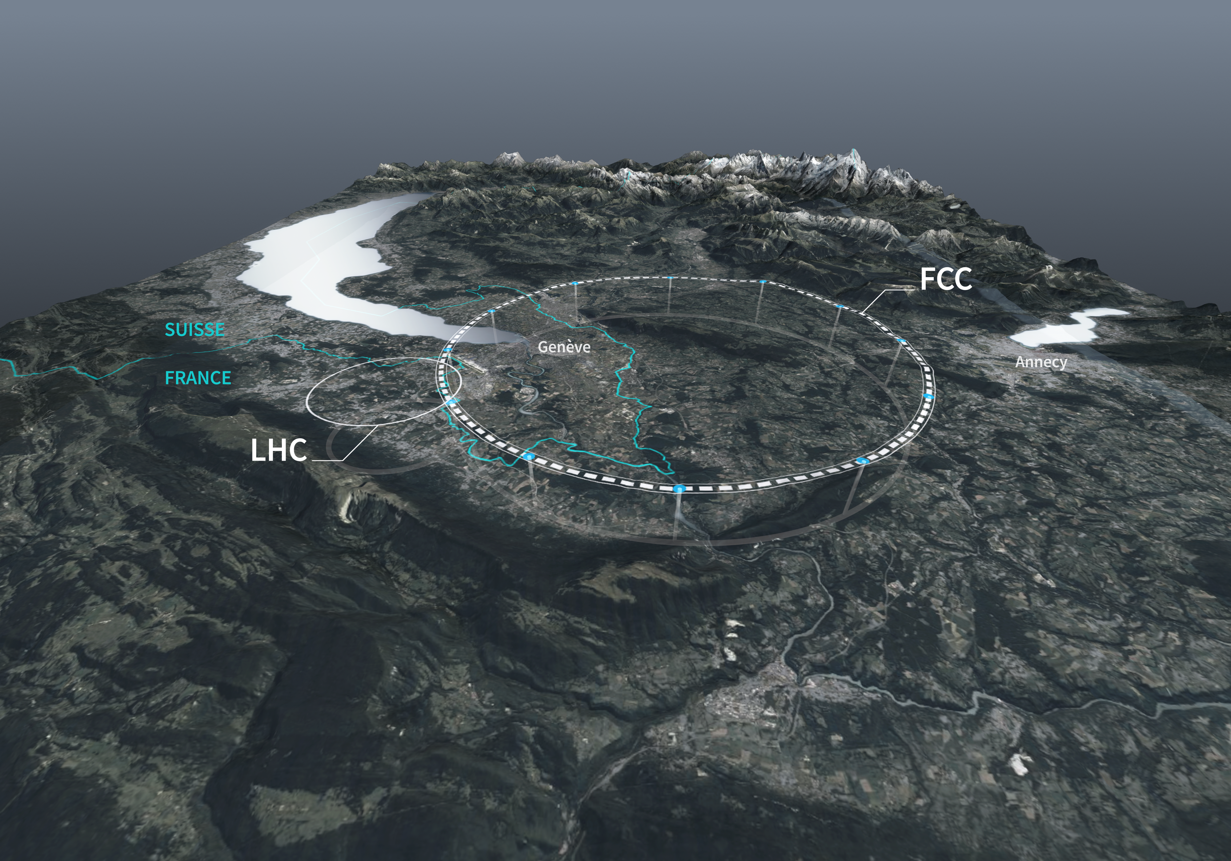
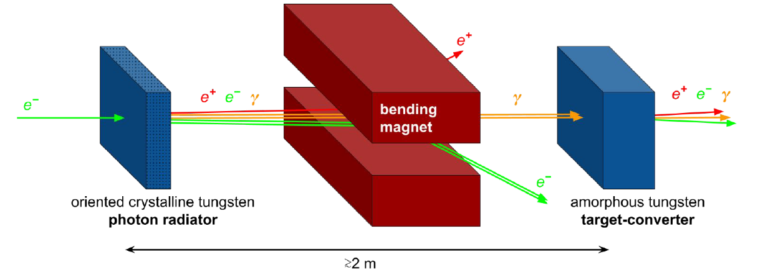
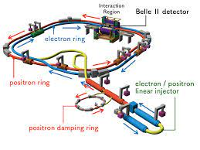
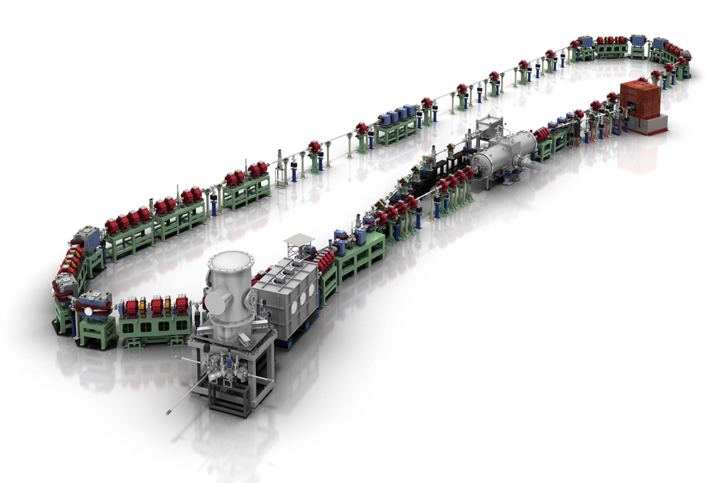
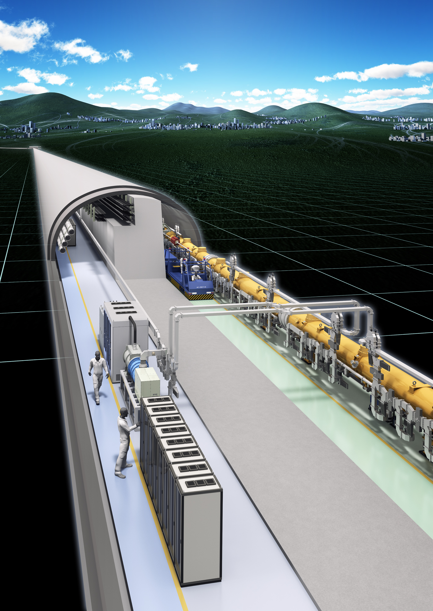
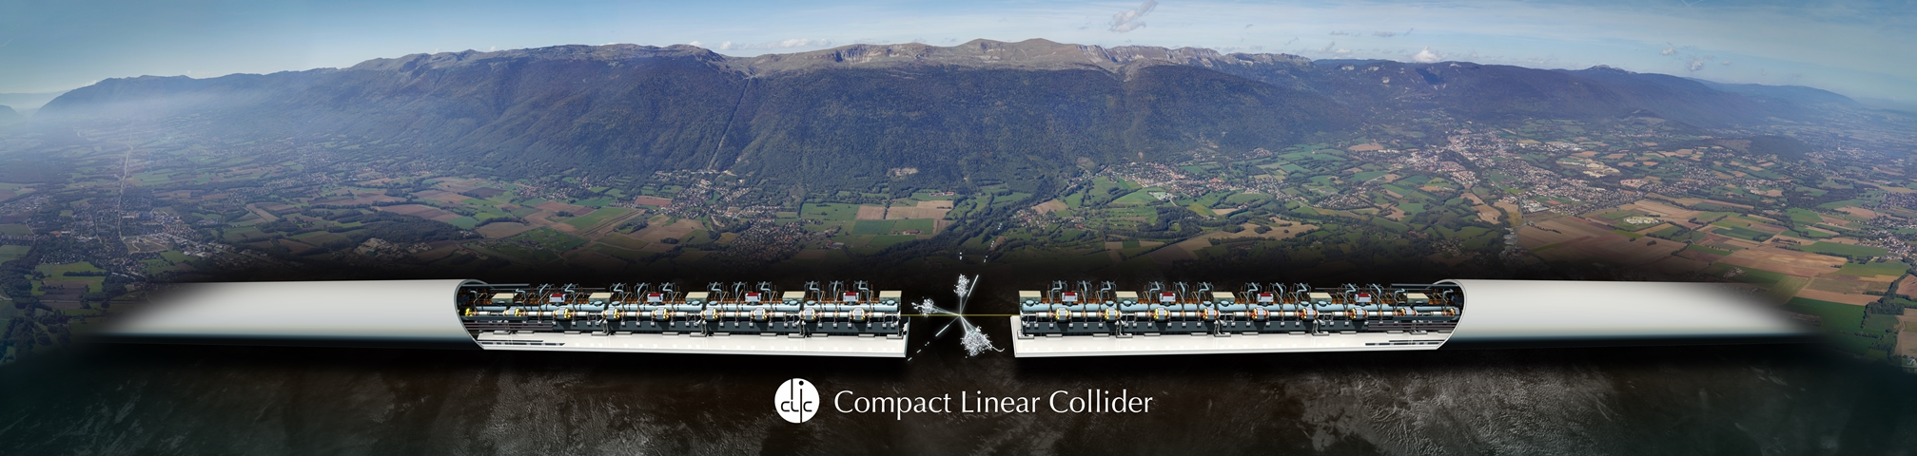
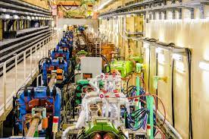
ATF3 in EAJADE project
Next 6 slides from Angeles Faus-Golfe
WP1 (112 months):
R&D&I at currently operating state-of-the-art accelerator facilities
Task 1.1 (57 months)
Future e⁺e⁻ linear collider studies
Task 1.2 (30 months)
Future e⁺e⁻ circular collider studies
Task 1.3 (19 months)
e⁺ production for e⁺e⁻ colliders
Task 1.4 (6 months)
R&D on ERLs
ATF3 (KEK) – 46 months
LCLSII (SLAC) – 5 months
IOTA (FNAL) – 6 months
SuperKEKB – 30 months
SuperKEKB – 17 months
FACETII (SLAC) – 1 month
CEBAF (JLAB) – 1 month
CBETA (JLAB) – 3 months
CERL (KEK) – 3 months
CERN – 7 months
CEA – 2 months
CNRS – 16 months
INFN – 5 months
CNRS – 6 months
CERN – 18 months
CEA – 2 months
CNRS – 16 months
CSIC-IFIC – 17 months
DESY - 4 months
UOXF – (34 months)
CERN – 4 months
CNRS – 15 months
Notes:
WP1 in a nutshell

Slide 10
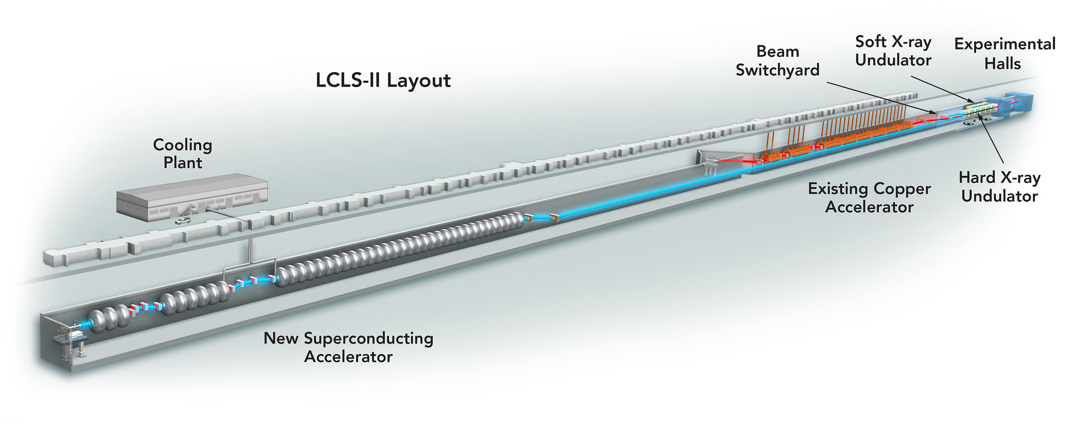
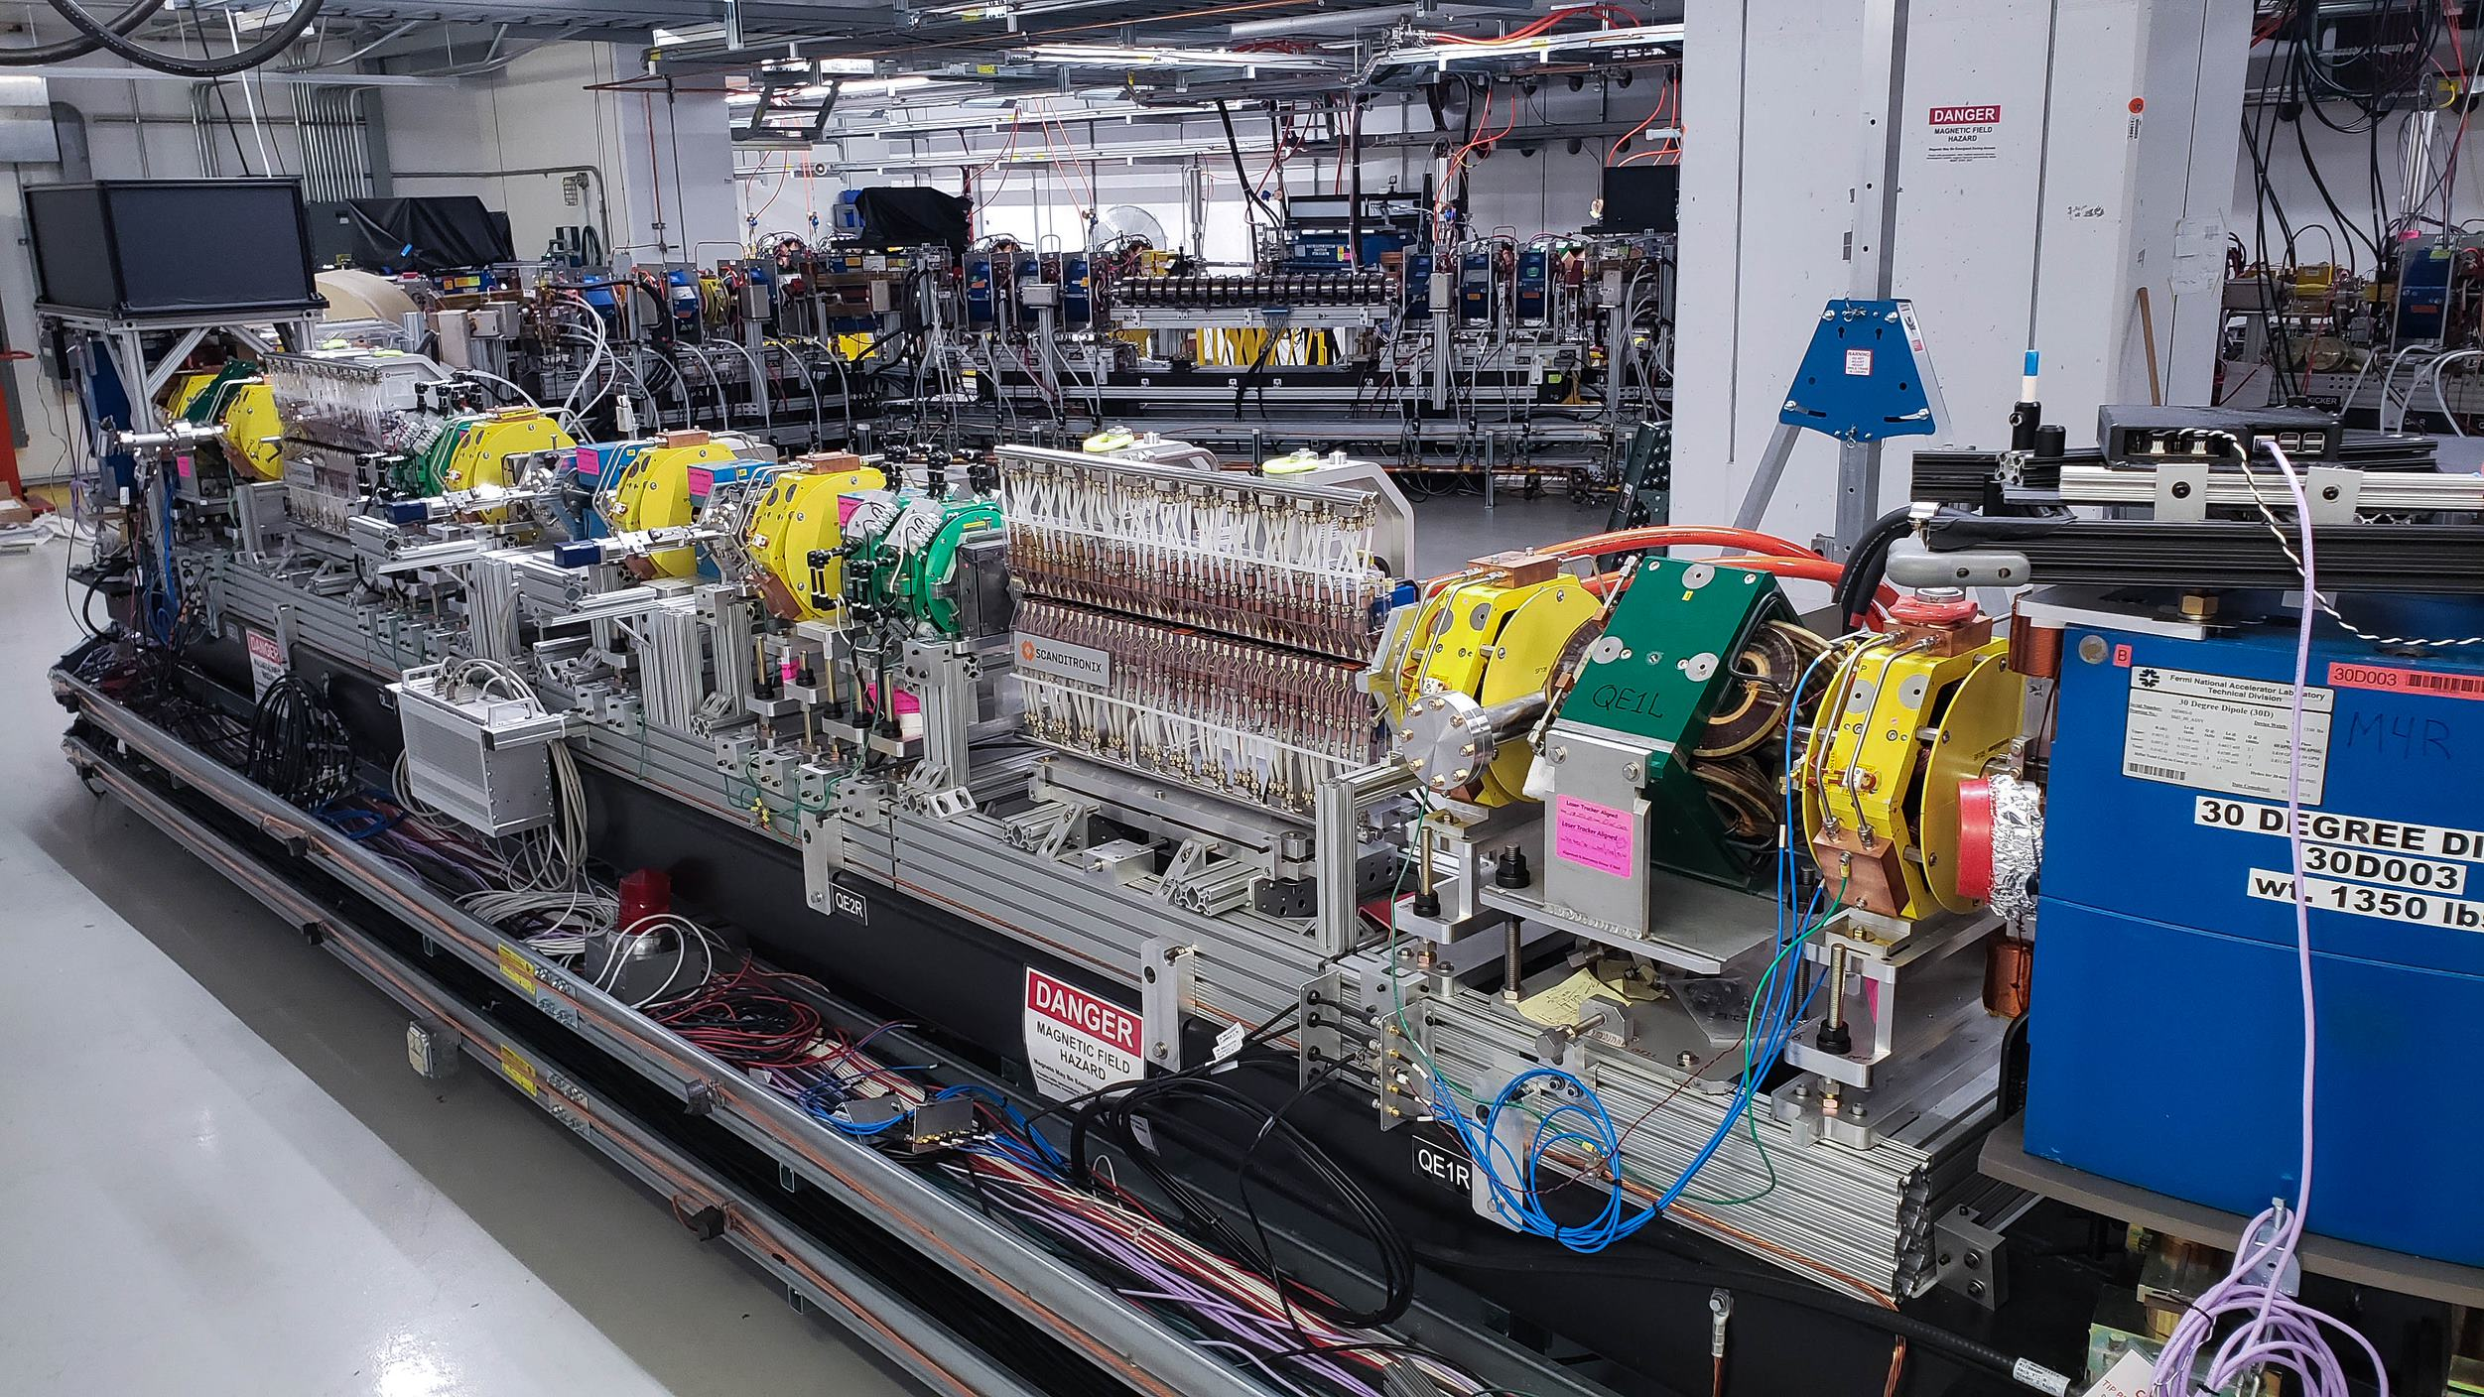
Task 1.1: Future e⁺e⁻ linear collider studies
(CERN, CEA, CNRS, CSIC/IFIC DESY, UOX, 57 (34) person-months)
R&D objectives of the ATF3 linear collider test facility at KEK, to maximize the luminosity potential of the next generation linear-collider-based Higgs factories, focused on ILC and CLIC final focus system (FFS). The main topics are (1) long-term stability and availability in routine operation, (2) vibration monitoring and beam-based feed-back / feed-forward, (3) wakefield mitigation, (4) high-order aberration control and in ultra-low-β_{y}* optics, and (5) AI-based machine learning beam tuning techniques.
Main linac linear collider subsystem: LCLS II at SLAC is ideal to acquire experience with issues specific to operating SC RF linacs, relative to beam dynamics and collective effects as well as to efficiency considerations of the CW RF modules.
High-current and high-gradient superconductive RF linac operation experience at FAST-IOTA at FNAL can be acquired, especially with respect to emittance preservation in the presence of beam loading. Knowledge on non-integrable optics, amplitude detuning techniques, AI based machine-learning tools, including simulation benchmarking, will also be acquired.
ATF2 @ KEK
LCLS II @ SLAC
IOTA @ FNAL

Slide 11
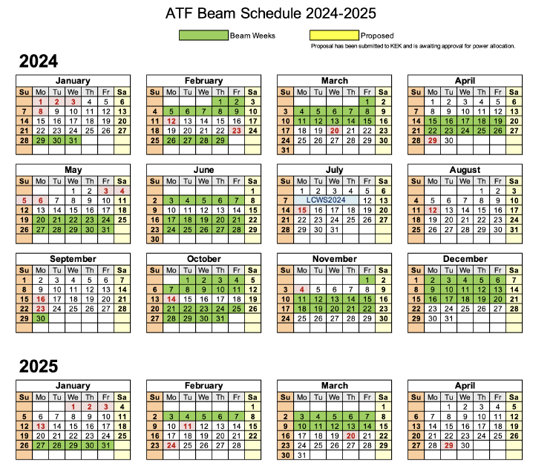
ATF3 operational plan FY2024

Slide 12
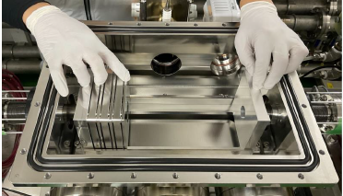
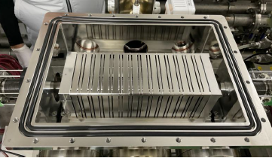
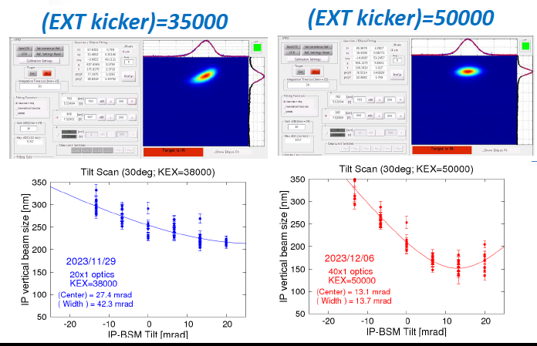
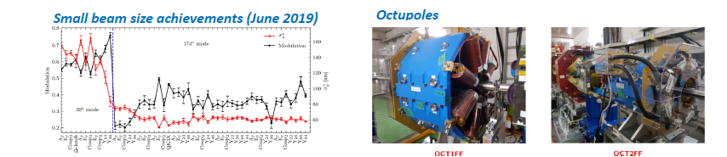
R&D Programs and Experimental Studies
Wakefield mitigation (new wakefield test station)
  Static: mitigation by relocating the sources in lower β-positions: modelling of ATF2 beam line
  Dynamic: FONT feedback (minimization of injection fluctuation)
High-order aberration correction and mitigation
  Measurement of FF quads mutipoles
  Impact of tilt scan (mitigation by beam orbit control)
  Ultra low-β studies
Installation of flange like structure in Abe Chamber
Beam studies of non-linear field at the septum extraction magnet
CERN contribution
Ultra low-β studies with octupoles

Slide 13
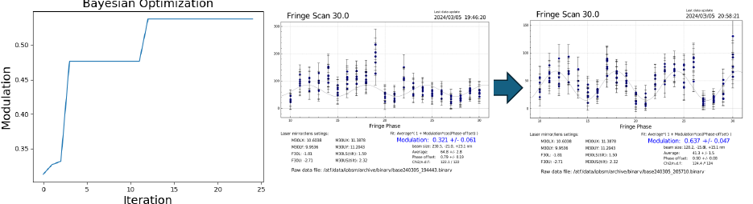
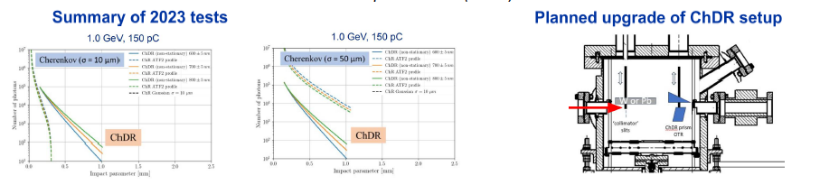
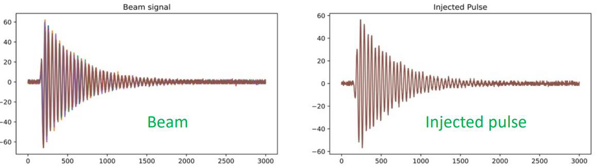
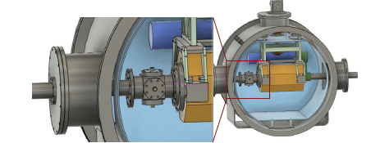
ATF2-3 recent experimental studies
ILC beam tuning (ML)
  Automatic beam tuning
    Minimize the tuning parameters
    Simultaneous optimization
  Beam optimization ( ATF Linac, ATF DR and ATF2)
    “Black-box”
    Bayesian optimization
Incoherent Cherenkov Diffraction Radiation
  Proof of concept validation in progress
Cavity BPM Calibration pulse injection
  Proof of concept validated
  Hardware specifications in progress
ILC Cavity BPM for ILC ML
  Prototype under designs
  First test with re-entrant CBPM FLASH-CEA type
Bayesian optimization of IP-BSM modulation
IChDR tests nad upgrade
CERN contribution
Calibration pulse injection
ML Quadrupole end CBPM

Slide 14
Secondment Task 1.1
Names: Andrii Pastushenko (Postdoc), Enrico Manosperti (PhD)
Institution: CERN
Dates: 03/12/2023 – 16/12/2023
Visiting Lab: ATF2-3 KEK
Results
Objectives
Became familiar with the correction routines and aberrations control techniques at ATF2.
Uploaded and used the ultra-low β*_{y} lattice for the first time since March 2020.
Successfully used the optics matching routines written in MAD-X to match the ultra-low β*_{y} optics.
Train in the small beam size tuning at ATF2-3.
Upload, set up, and verify the ultra-low β*_{y} optics at ATF2-3.

Slide 15
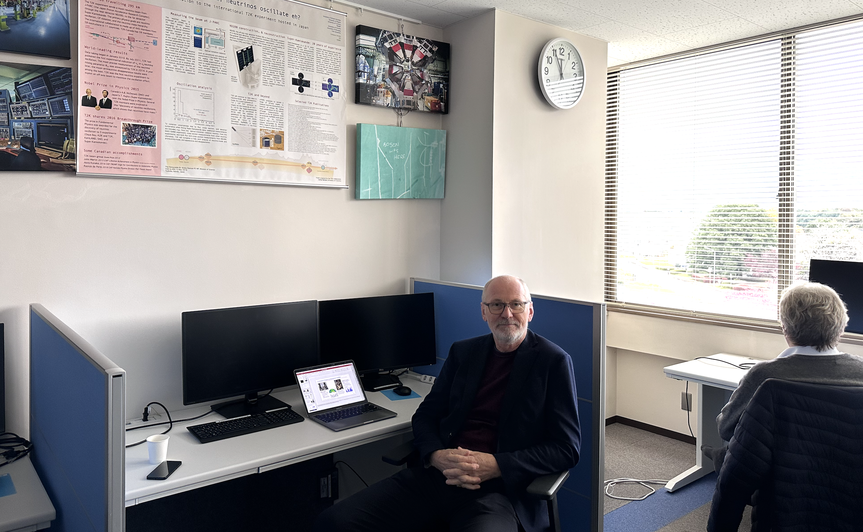
EAJADE WP5
WEB page: https://wsfa2023.huhep.org
“Young” CERN researches in CERN office at KEK last week, LCA studies and common paper on sustainability issues

Slide 16
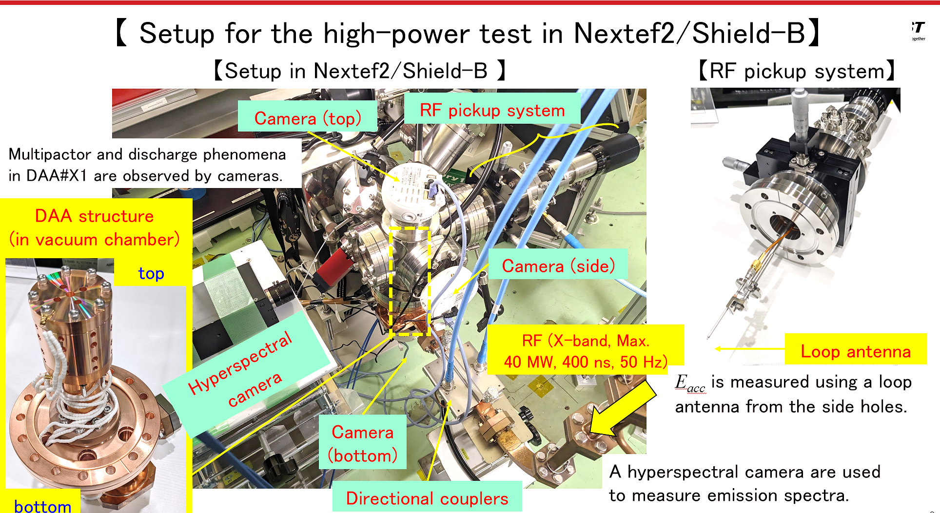
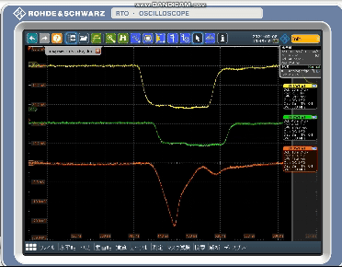
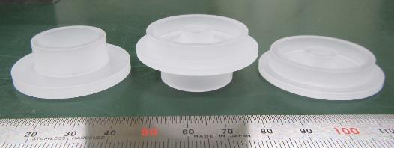
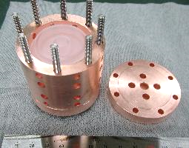
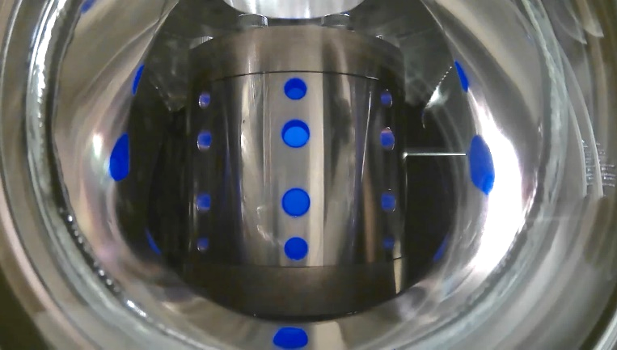
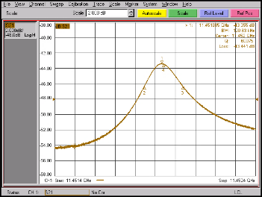
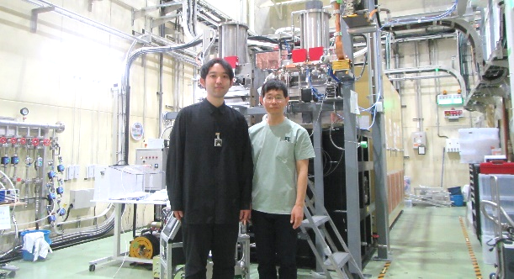
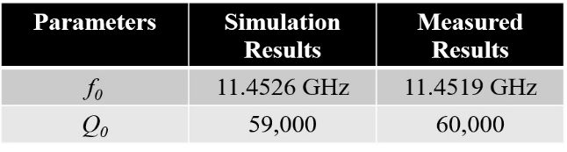
High-power test of the 2nd DAA (Dielectric-Assist Accelerating) test cavity at Nextef2 conducted by Daisuke Satoh (AIST) supported by “MEXT Development of Key Element Technologies to Improve the Performance of Future Accelerators Program” (Japan Grant Number JPMXP1423812204)
DAA has one order of magnitude higher Q₀ than those of conventional metallic cavities due to loaded ultra-low loss dielectrics.
But the accelerating gradient is limited by multipacting (E_{acc} ≲ ~10 MV/m).
This program aims to achieve higher gradients with DAA.
High-power test performed from June to July, 2024
Input
Dielectrics made of single-crystal sapphire for DAA#X1
Regular cell
End cell
Reflection
Pickup
120ns
Hybrid cell
Side-view during the high-power test
Significant fluctuation observed in pickup
indicating multipacting
This time, no DLC (Diamond-Like Carbon) coating in order to highlight the nature of the problems toward higher gradients
(Shown in LCWS2024)
Beautifull blue light during the high-power test!
Spectrum meas. indicating the cathodoluminescence in sapphire
Low-power RF meas.
On-axis E-field from bead-pull meas.
F
Cr
Ti
Input coupler
+ circ. WG
We collected enough data to move to the next step
toward higher gradients with DAA.
← One order of magnitude higher Q₀ than metallic cavities
D. Satoh and collaborator at Nextef2

Slide 17
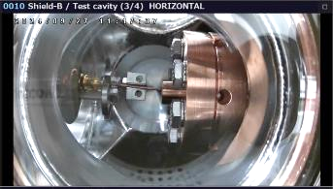
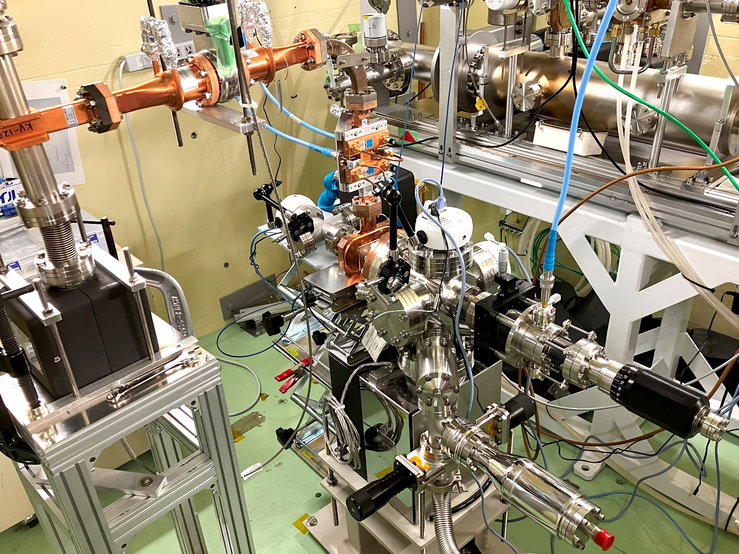
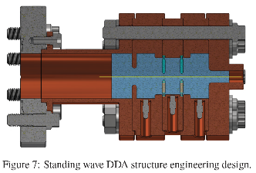
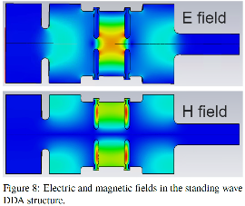
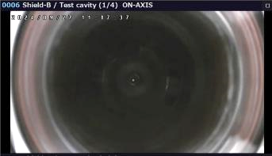
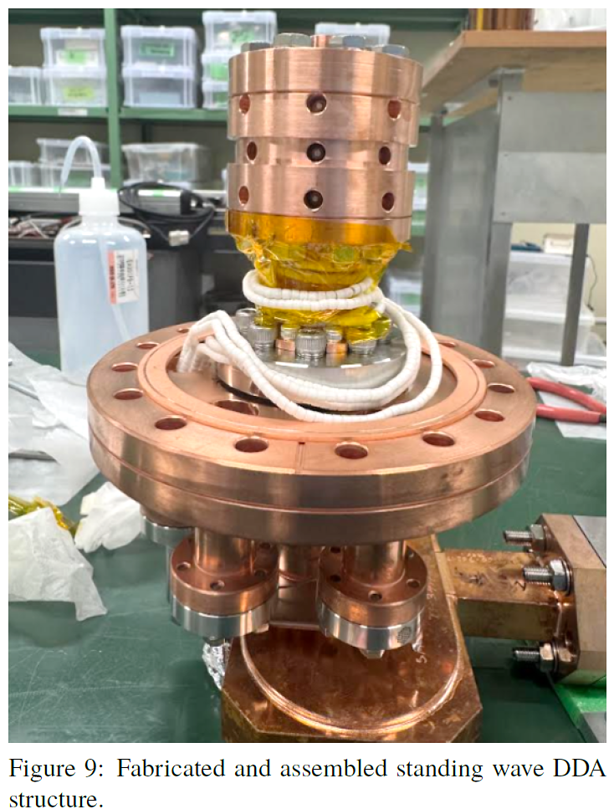
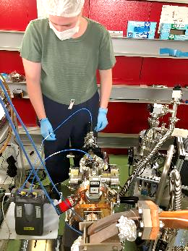
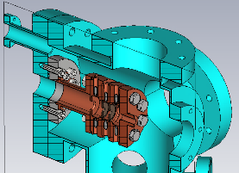
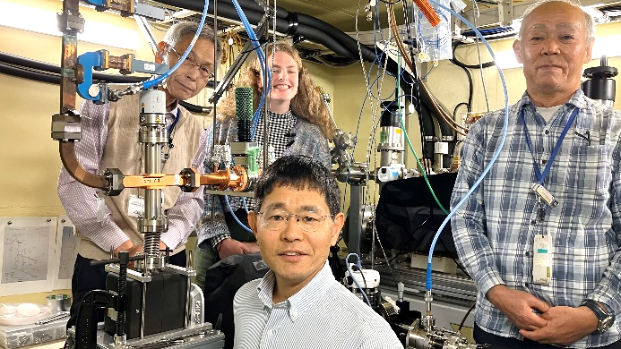
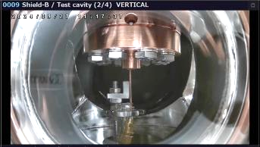
High-power test of the new standing-wave DDA (Dielectric-Disk Accelerating) test cavity at Nextef2 conducted by Sarah Weatherly (Illinois Institute of Technology)
supported by US-Japan Ozaki Exchange Program
DDA has a higher group velocity with maintaining a high shunt impedance compared with conventional metallic cavities due to loaded dielectric disks.
DDA is different from DAA.
The high-power test of the traveling-wave DDA test structure with short RF pulses (~9 ns) at Argonne Wakefield Accelerator (AWA) Complex showed withstanding capability against more than 320 MW RF power that corresponds to an accelerating gradient over 100 MV/m.
This program aims to investigate the performance and characteristics of DDA for longer RF pulses (>> 10 ns) using a newly designed standing-wave DDA test cavity.
The work is also supported by ANL/AWA and Euclid Beamlabs.
High-power test performed in October, 2024
RF
Pickup antenna
↓
Horizontal camera
(Extracted from the AAC paper written by S. Weatherly)
Directional coupler
RF
TM₀₁ mode launcher
(rect.TE₁₀→circ.TM₀₁)
On-axis camera
Low-power RF meas. performed at Nextef2 just before starting the high-power test
DDA test cavity inside this vacuum chamber
Linear manipulator for the pickup antenna
Vertical camera
←Pickup antenna
S. Weatherly and collaborators at Nextef2
Detailed data analysis on-going at ANL (US)

Slide 18
Concluding words
Interesting ongoing collaborative R&D with Japan and KEK with relevance for Linear Colliders (and Higgs factories in general), within a wide range of technologies, including ATF3 and benefitting from EAJADE related exchanges of people.
KEK and CERN works closely with European partners in many cases
Common work on sustainability issues very beneficial to align methodologies in this area
ILC ITN moving ahead well in Europe, financial and material support from KEK very important
In 2025-2026(7) nine cell cavities for ITN will be the largest single ”investments”
Slides/plots and pictures from many colleagues in CLIC and ILC – many thanks

Slide 19
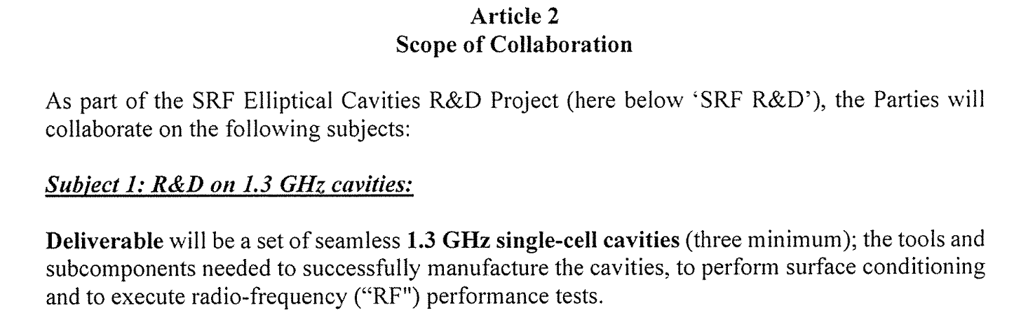
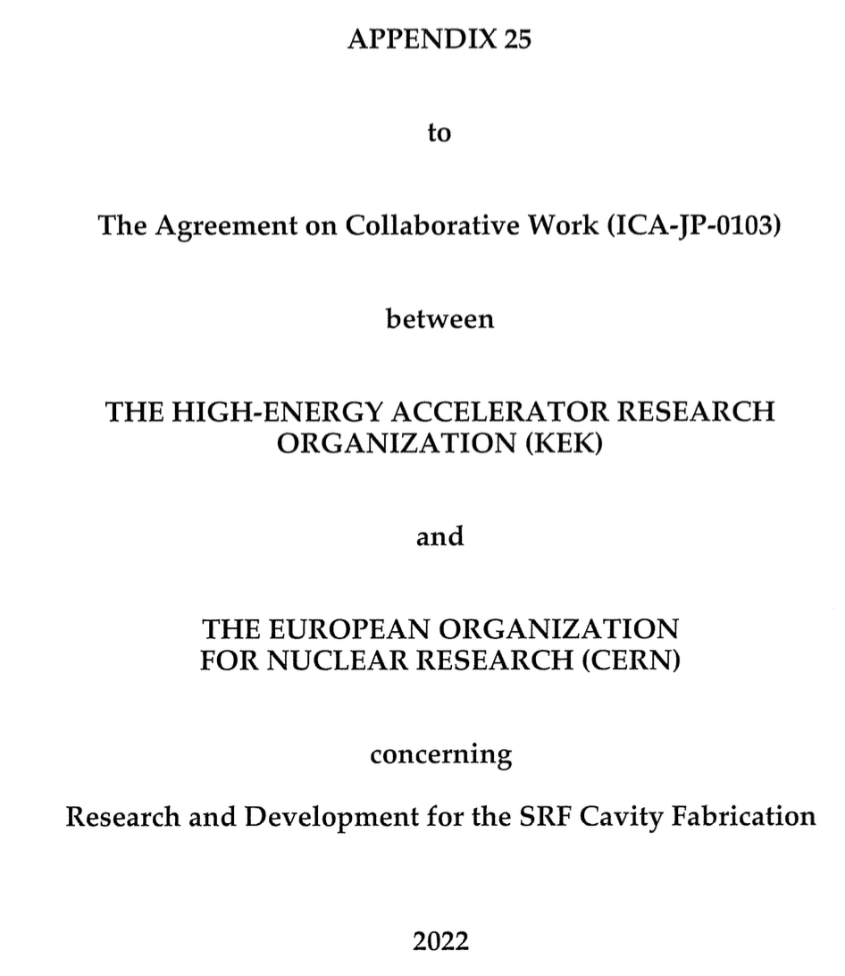
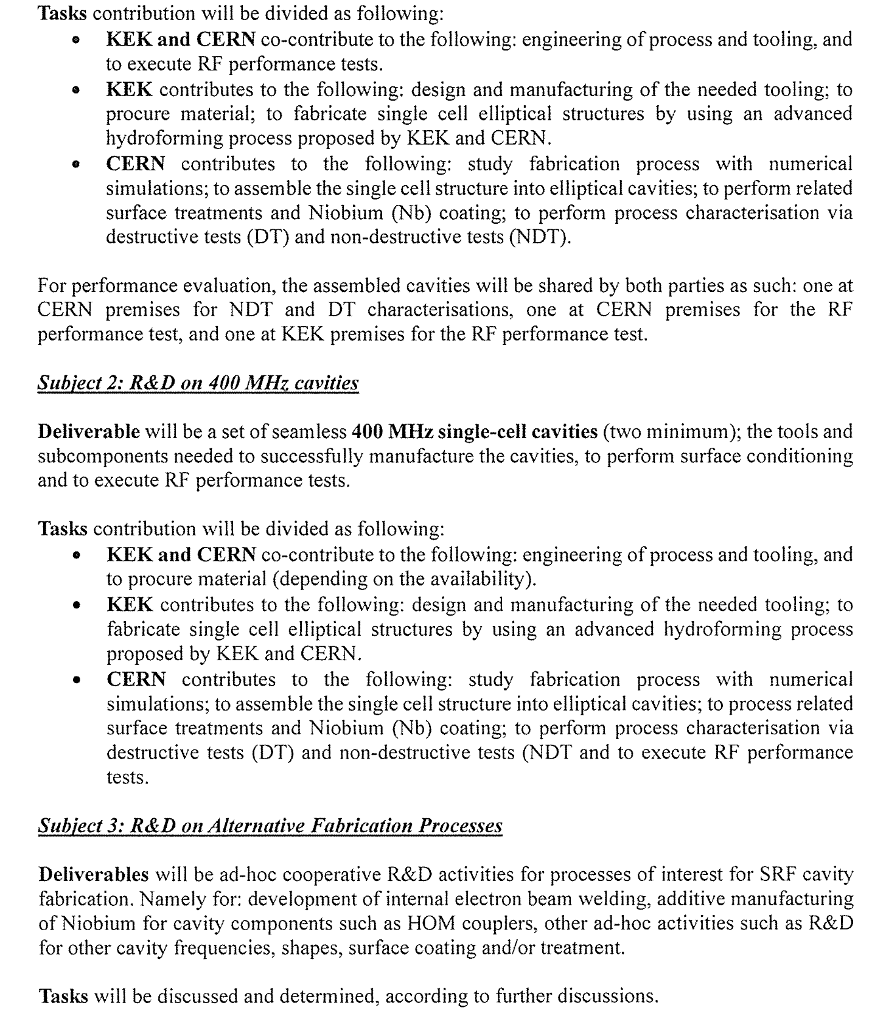
Agreement on SCRF

