Slide 1


D1 / Quench Protection Heater Power Supply Status
Tatsushi NAKAMOTO, KEK
On behalf of CERN-KEK Collaborations for D1 and DQHDS for HL-LHC
CERN-KEK Committee, 19th Meeting, Nov. 26, 2024

Slide 2
Acknowledgement
KEK (in particular)
M. Sugano, K. Suzuki, Y. Arimoto, R. Ueki, Y. Ikemoto, H. Kawamata,
N. Okada, R. Okada, H. Ohhata, A. Terashima, K. Tanaka, N. Ohuchi, T. Ogitsu.
Univ. of Tokyo
N. Kimura.
CERN (in particular)
E. Todesco, J. C. Perez, H. Prin, D. Duarte Ramos, C. Scheuerlein,
H. G. Gavela, G. Willering, F. Mangiarotti, L. Fiscarelli.
D. Carrillo, E. Nowak, M. Pojer, D. Wollmann.
Hitachi
M. Yanagisawa, A. Yokogi, H. Togashi, T. Tahara, T. Chiba.
Fusac Technologies
T. Ichihara.

Slide 3
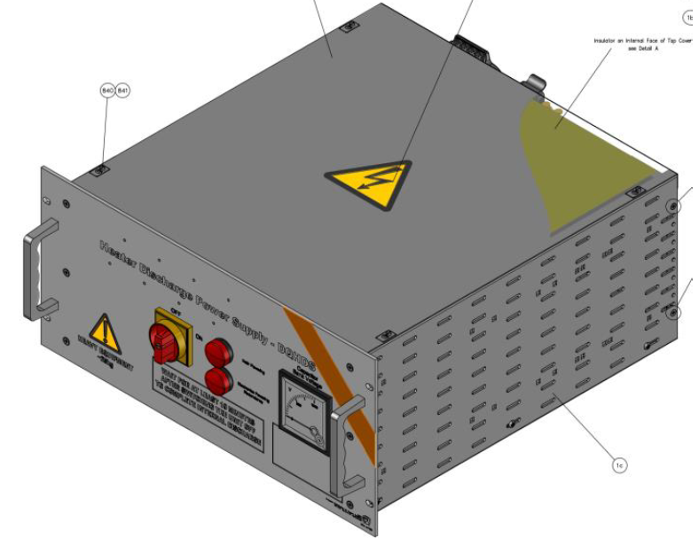
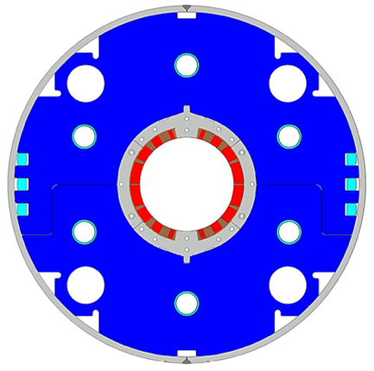
Japanese Contribution to HL-LHC: D1, DQHDS
IP
Beam separation dipole (D1): 7 units x 7m long cold masses
  Design study of D1 for HL-LHC within the framework of the CERN-KEK collaboration since 2011.
  150 mm single aperture, 35 Tm (5.6 T x 6.3 m), Nb-Ti technology.
  Development 2-m long model magnets (3 units) at KEK
  1 full-scale prototype cold mass (LMBXFP)
  6 series cold masses (LMBXF1-6)
Quench heater power supply (DQHDS)
  4 units of pre-series
  626 units of series production

Slide 4
Powering test of D1 series production magnets at KEK

Slide 5
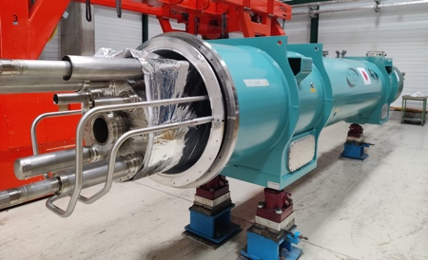
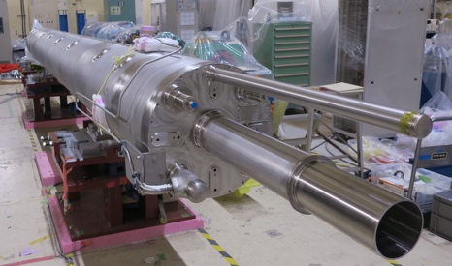
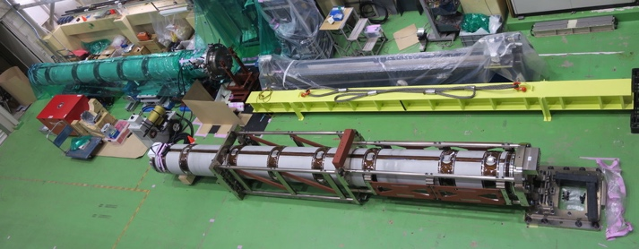
Current status of MBXF / LMBXF
 | Prototype | Series production (in order of production sequence)
 | MBXFP1 | MBXF1 | MBXF5 | MBXF2 | MBXF3 | MBXF6 | MBXF4
Magnet assembly
Cold test at KEK |  |  |  |  | Test is underway
Cold mass assembly
Delivery of completed cold-mass to KEK
Transport to CERN
Horizontal test at CERN
LMBXF1
MBXF5
LMBXFP1
MBXF2

Slide 6
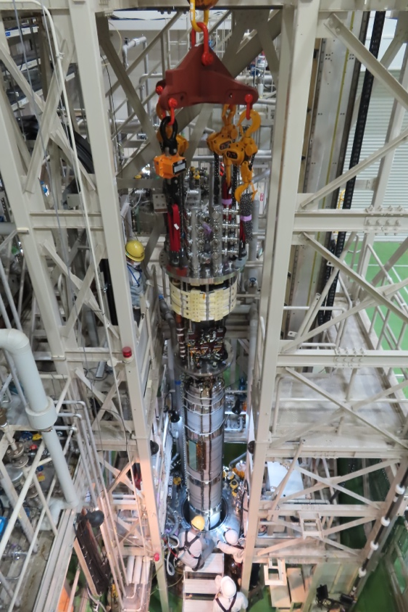
Items of cold powering test at KEK
Check of electrical integrity by a Hi-pot test at cold
Training
  Up to the ultimate current
  Identification of quench start location by quench antennas
  Training memory
  Current-holding test at the ultimate current for 4h
Magnetic field measurement
  Field quality at the magnet center
  Integrated field quality
Joint resistance
RRR measurement

Slide 7
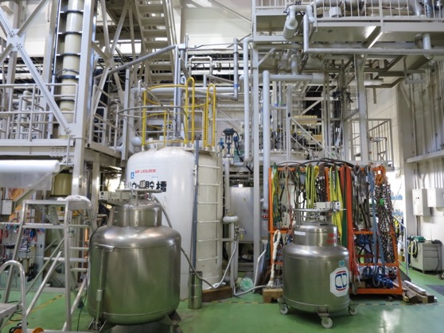
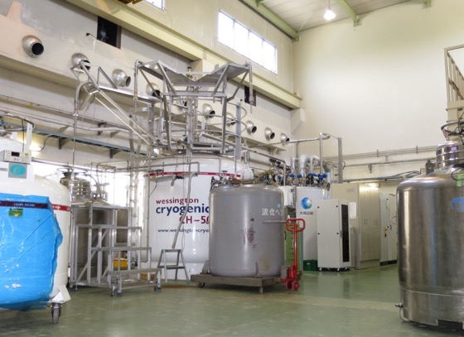
Dual operation of refrigerators
20 m long LHe transfer line connecting #2 and #4 systems.
#4 Refrigerator/Liquefier for Test Stand
180 L/h, 2400 L dewar
Manufactured by Teisan/Air Liquide in 1987
New cold box in 2007
#2 Liquefier (Primary)
400 L/h, 5000 L dewar
LINDE LR280 in 2014
Mandatory to supply LHe to users at KEK.
During CD1 of MBXF5, we had a trouble with the warm turbine of #4 refrigerator.
  CD2 of MBXF5 after TC was postponed.
Cooling test of dual operation of the #4 refrigerator and #2 liquefier was conducted in April 2024. Sufficient total liquefaction ability of 490 L/h was confirmed.
Cooling down of MBXF2 was performed with such a dual operation.

Slide 8
Training Quenches
Due to a trouble of refrigerator
TC: Thermal cycle
Cold mass
4h
4h
4h
at CERN
Number of quenches
All series magnets reached the ultimate current.
The 2nd cycle for MBXF5 was postponed due to malfunction of the test facility of KEK.
Good training memory in MBXF1 and MBXF2.
Successful current-holding for 4h at the ultimate.
→ Stable operation of the magnets
 | 1st cycle |  | 2nd cycle
 | Nominal | Ultimate | Nominal | Ultimate
MBXFP1 | 3 | – | 3 | –
MBXF1 | 2 | 7 | 0 | 0
MBXF5 | 4 | 9 | TBC | TBC
MBXF2 | 10 | 18 | 0 | 1
Acceptable training performance

Slide 9
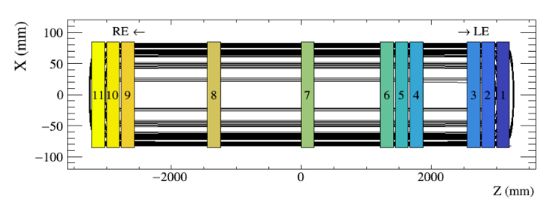
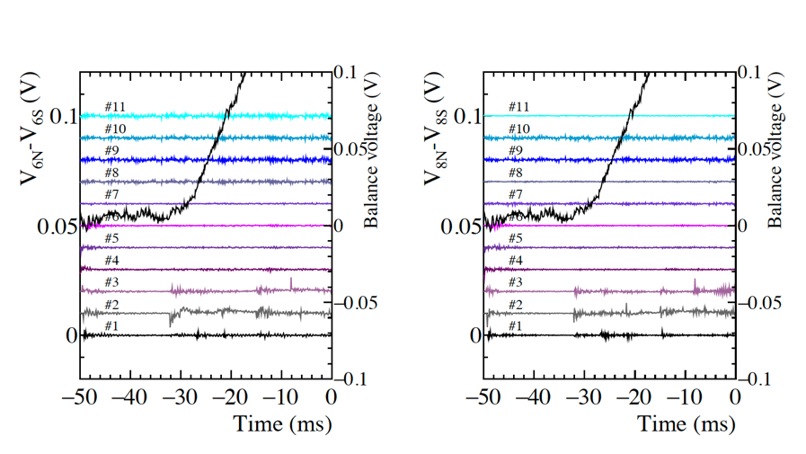
Quench start locations
Top
Bottom
LE
RE
Not identified
Arrangement of quench antennas
Balance voltage
TC
TC
TC
Signals detected by quench antennas
Quench start locations were changed during the training. → No weak point.
All quenches at a low current took place at LE, which is a common nature of MBXF.

Slide 10
Current dependence of integrated multipoles
Ramp-down
Ramp-down
Ramp-up
Ramp-up
The field quality of series production magnets is predictable by OPERA 3D simulations.

Slide 11
Integrated multipoles at the nominal current (I=12.11 kA)
Prototype
Series
0.19
0.54
0.14
0.13
6.44
1.35
1.18
0.53
0.63
0.01
0.23
0.08
0.16
0.77
0.13
0.14
0.08
0.25
0.16
0.10
0.16
0.03
0.38
0.02
0.02
0.010.00
-0.15
-0.14
-0.10
-12.54
-4.13
-5.49
-6.81
-4.72
-0.50
-0.62
-0.65
-0.75
-0.12
-0.20
-0.10
-0.17
-0.14
-0.03
-0.06
-0.00
-0.00
-0.07
-0.01
Fine-tuning by modification
of coil cross-section from prototype
to series magnets
in KEK cryostat
1.97
1.91
2.00
1.89
1.65
0.33
0.40
0.02
0.17
0.33
0.13
0.02
0.18
0.27
0.24
0.19
0.13
0.12
0.04
0.17
0.08
0.00
0.01
0.06
0.02
0.09
0.06
0.08
0.05
0.01
0.05
0.06
0.02
0.03
0.02
-0.12
-0.08
-0.13
-0.20
-0.15
-0.00
-0.03
-0.52
-0.59
-0.08
-2.53
-3.73
-1.11
-1.12
-0.28
in KEK cryostat
Good reproducibility in integrated field quality among the series production magnets.

Slide 12
Flash Report: Cold Test of MBXF3
Cooling of MBXF3 started Nov. 8.
A campaign of training quenches started at the Nov. 20.
The test will continue until the end of Dec. 2024.
CD2 of MBXF5 which was postponed due to malfunction of the refrigerator will be performed in March 2025.

Slide 13
Powering test of prototype at SM18

Slide 14
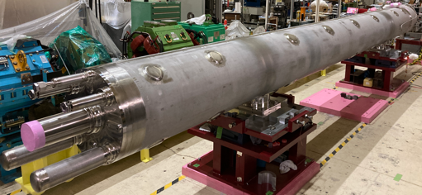
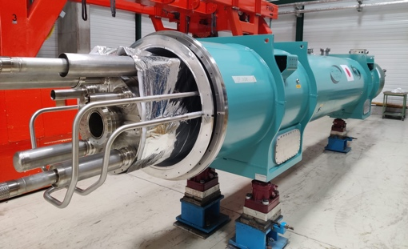
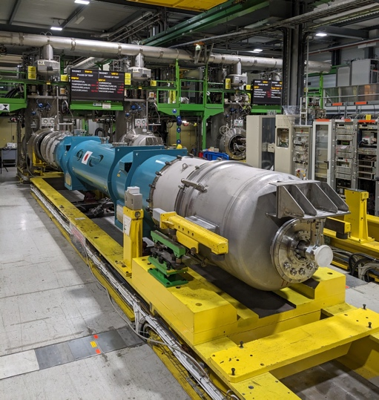
Horizontal powering test of LMBXFP1 at CERN
MBXFP1 cold mass (LMBXFP1) was assembled into a cryostat at CERN.
The first powering test for MBXF cold mass with a horizontal cryostat.
The items to be checked in the horizontal test.
  Training memory for the cold mass including newly designed bus leads.
  Field quality including the influence of the magnetic LHC cryostat.
  Long-time operation: current-holding test at the ultimate for 8 hours.
  Endurance test: 500 powering cycles between 1 kA and 12.11 kA.
G. Willering, Gaëlle Ninet, Franco Mangiarotti, Piotr Rogacki, Lucio Fiscarelli
https://indico.cern.ch/event/1379959/
EDMS 3015584

Slide 15
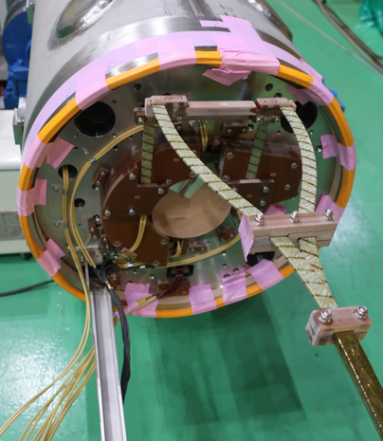
Training Quenches of LMBXFP1
Bus lead
Splice
box
8h
End cover
End plate
Magnet at KEK
Cold mass
at CERN
Bus lead
The quench current reached the ultimate current in the second cycle.
Current-holding at the ultimate current for 8h was also successful.
500 powering cycles between 1 kA and 12.11 kA could be stably completed.
→ The bus leads newly designed by KEK was validated.
Training memory should be checked in the series production magnets.

Slide 16
Magnetic design considering an effect of LHC cryostat
Test at KEK
Test at CERN
Iron pit
LHC cryostat
• Vertical SS cryostat at KEK
• Iron pit surrounding the cryostat
• The magnet is off-centered by 150 mm
• LHC cryostat made of magnetic iron
• The off-center of the magnet with respect to
the cryostat is neglected.
The effect of the LHC cryostat made of magnetic iron was considered in the magnetic design.
The magnet cross-section was optimized so that the field quality was controlled within the target after the cold mass was assembled into the LHC cryostat.
Offset estimated from OPERA 3D simulation: Δb₃=+6.1 units, Δb₅=+0.3 units
The validity of this design strategy was checked in LMBXFP1 for the first time.

Slide 17
Field quality at the nominal current of LMBXFP1
Measurement by KEK KEK cryostat (MBXFP1) |  |  | Measurement by CERN LHC cryostat (LMBXFP1)
Field integral (B₁) |  | 34.935 Tm | Field integral (B₁) |  | 35.188 Tm
n | b_{n} integral (unit) | a_{n} integral (unit) | n | b_{n} integral (unit) | a_{n} integral (unit)
2 | 0.25 | -2.52 | 2 | 0.27 | 0.88
3 | -12.54 | 1.96 | 3 | -5.44 | 1.95
4 | 0.19 | -0.52 | 4 | 0.05 | 0.12
5 | 6.43 | -0.12 | 5 | 6.68 | -0.19
6 | 0.10 | -0.08 | 6 | 0.05 | 0.00
7 | 0.38 | 0.18 | 7 | 0.35 | 0.20
8 | 0.01 | 0.11 | 8 | 0.04 | 0.15
9 | 0.77 | 0.01 | 9 | 0.76 | 0.00
10 | 0.02 | 0.09 | 10 | 0.04 | 0.10
11 | -0.12 | 0.05 | 11 | -0.13 | 0.07
12 | -0.02 | 0.02 | 12 | 0.03 | 0.03
13 | -0.76 | 0.00 | 13 | -0.73 | 0.05
14 | -0.08 | -0.06 | 14 | 0.00 | 0.00
15 | -1.22 | -0.01 | 15 | -1.18 | 0.03
Shift of b_{n} by the LHC cryostat
Integrated b₃
Simulation: +6.1uits
Measurement: +7.1units
Integrated b₅
Simulation: +0.27uits
Measurement: +0.25units
The field quality of LMBXF cold mass
with the LHC cryostat can be well predicted
from the field quality of the magnet measured
at KEK.
The proposed magnetic design is valid.
Note that the cross-section of LMBXFP1 was not fully optimized.
Fine-tuning has been applied to the series production magnets.

Slide 18
Prediction of integrals of b₃ and b₅ for series production cold mass with LHC cryostat
At the nominal current
b₃ integral (unit) | Measurement by KEK with KEK cryostat | Prediction for cold mass with LHC cryostat | Acceptance criteria
MBXF1 | -4.13 | 1.97 | b₃ integral <±2.9 units
MBXF5 | -5.49 | +0.61 | b₃ integral <±2.9 units
MBXF2 | -6.81 | -0.71
Δb₃=+6.1 units
b₅ integral (unit) | Measurement by KEK with KEK cryostat | Prediction for cold mass with LHC cryostat | Acceptance criteria
MBXF1 | 1.35 | 1.62 | b₃ integral <±1.5 units
MBXF5 | 1.18 | 1.45
MBXF2 | 0.53 | 0.80 | b₃ integral <±1.5 units
Δb₅=+0.27 units
The field quality can be expected within the acceptance criteria for the series production cold masses with the LHC cryostat.

Slide 19
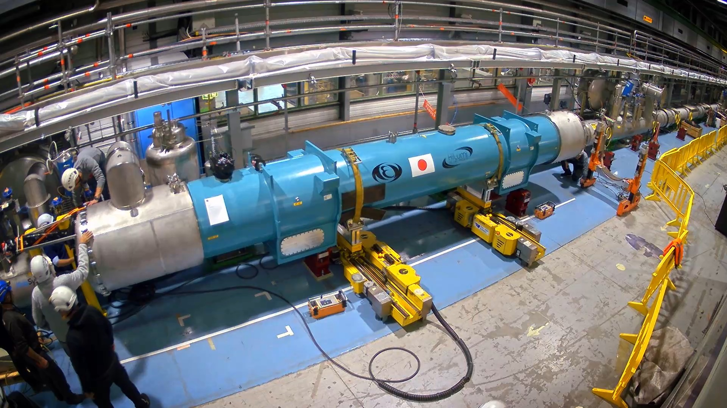
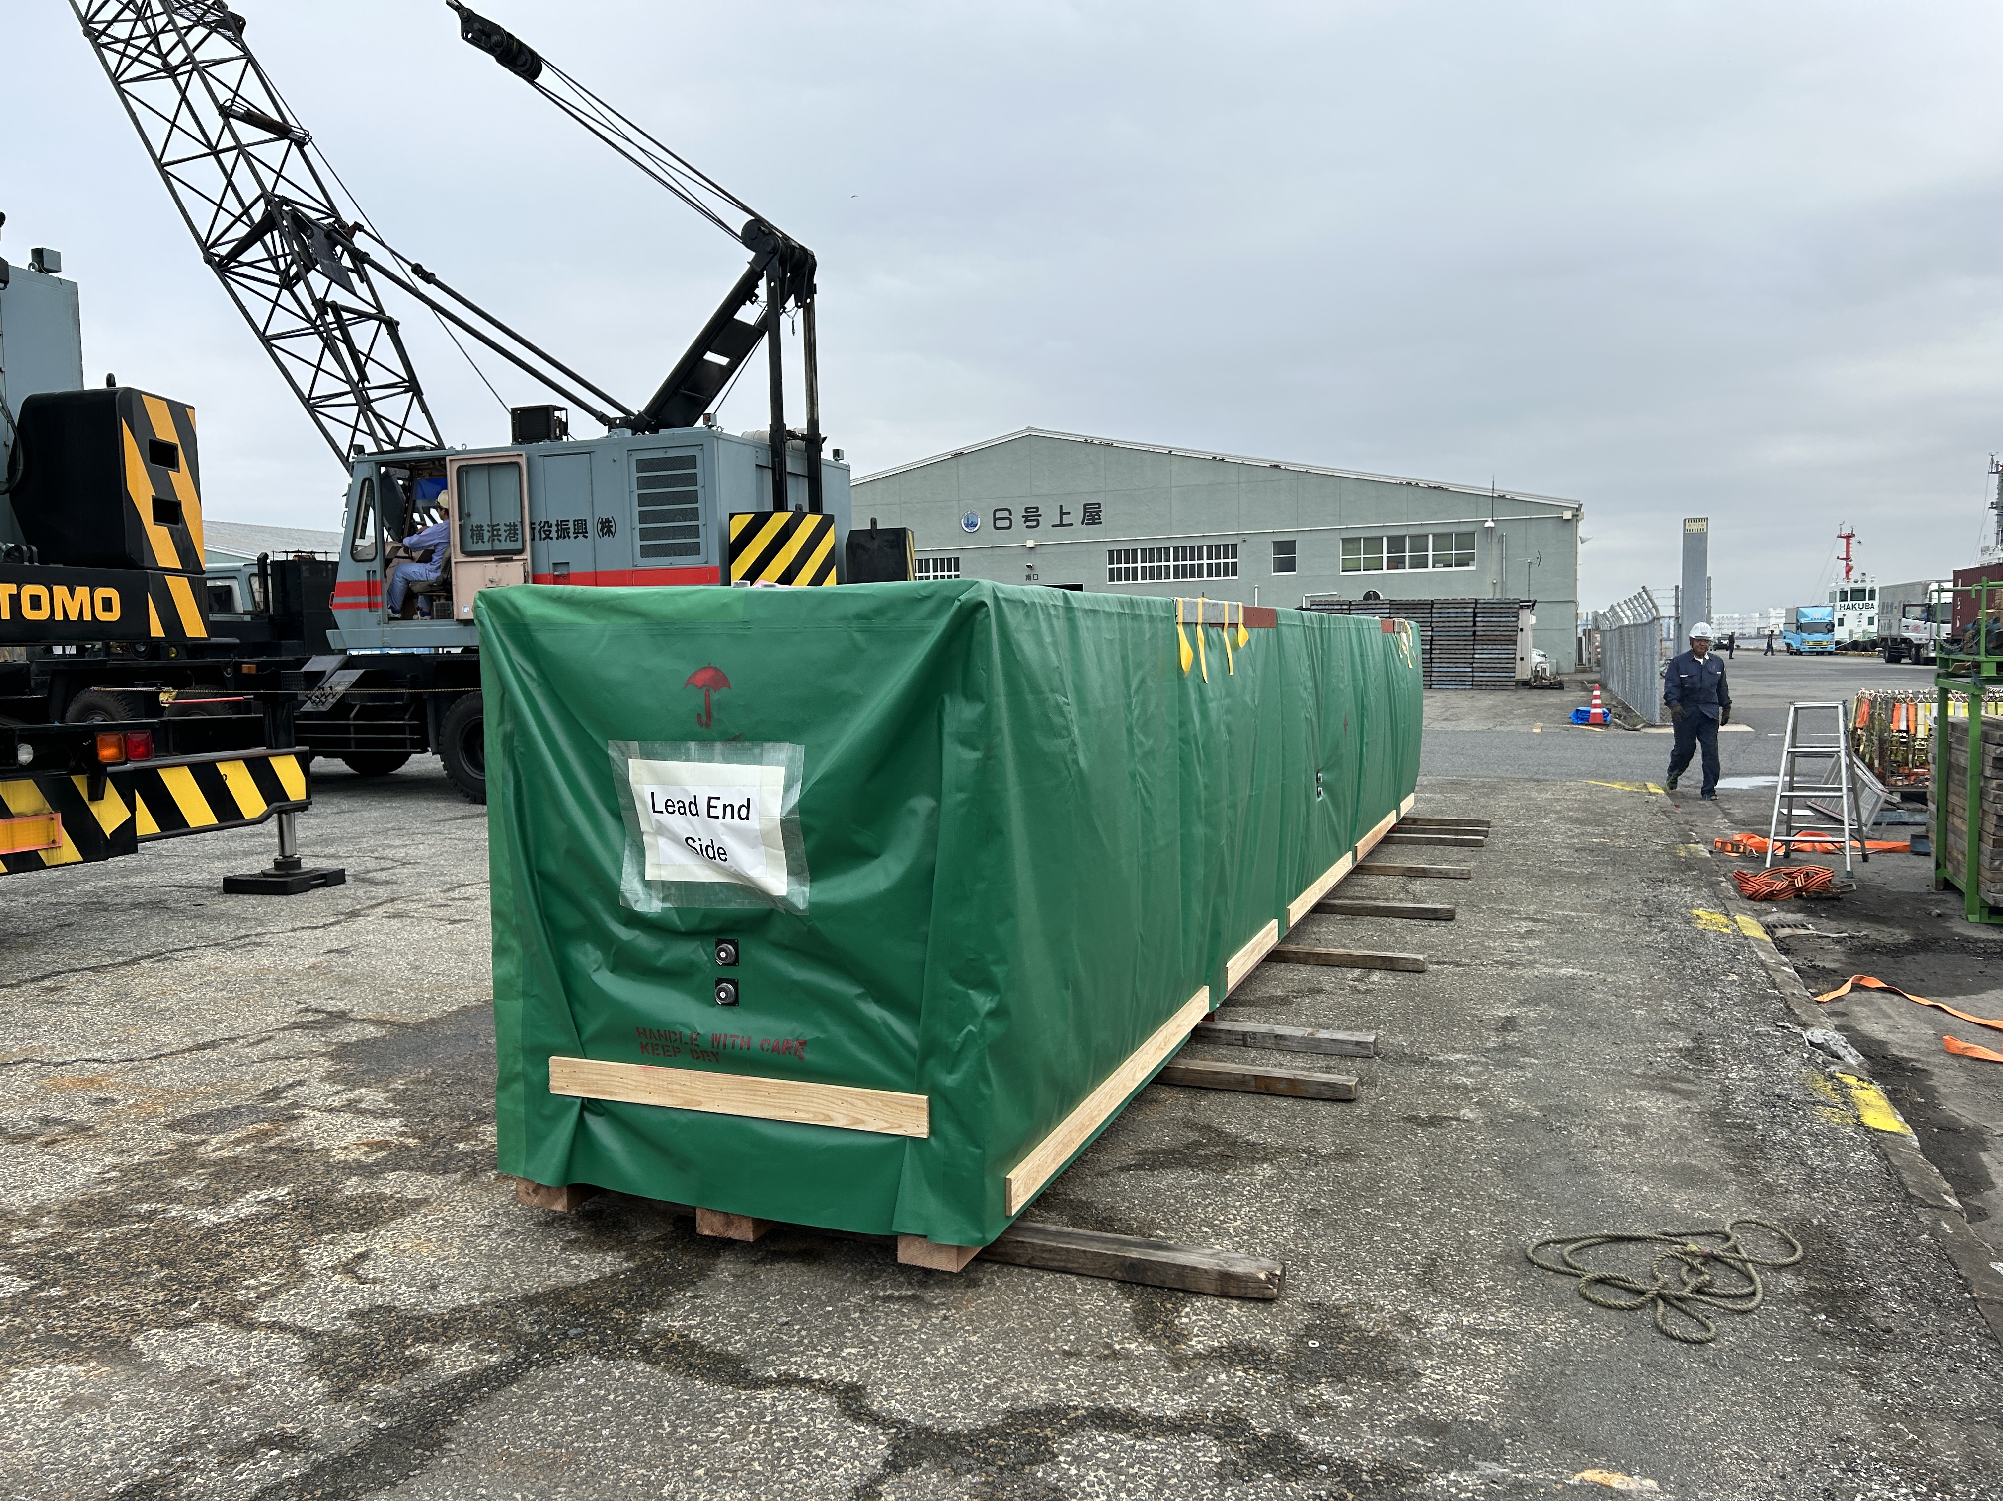
Status of D1 Series Production and Tests
LMBXFP1
  Horizontal powering test at CERN was completed.
  The cold mass was accepted by CERN.
  Installation to IT String was done in Nov, 2024.
LMBXF1
  The cold mass was completed and delivered to KEK at March 2024.
  The cold mass is expected to be delivered to CERN in the week of December 9.
MBXF5
  The trouble of a the refrigerator forced to stop the cold test (CD2) after T.C.
  Plan of CD2 in early 2025, after the cold test of MBXF3.
MBXF2
  Final assembly of the cold mass is underway at Hitachi.
  Completion will be in June 2025.
MBXF3
  The magnet was nearly completed in August, but the delivery to KEK has been delayed due to the NC (cut of voltage tap wires).
  Delivery to KEK was on Oct. 28 and the cold powering test is currently underway.
MBXF6
  Two coils (LT-5, LB-5) were already wound but the collaring will be only possible in December due to an issue of resources in Hitachi.
MBXF4
  Coil winding is planned in early 2025.
LMBXFP1 in IT-String
LMBXF1

Slide 20

Status of D1 Series Production and Tests
LMBXFP1
  Horizontal powering test at CERN was completed.
  The cold mass was accepted by CERN.
  Installation to IT String was done in Nov, 2024.
LMBXF1
  The cold mass was completed and delivered to KEK at March 2024.
  The cold mass is expected to be delivered to CERN in the week of December 9.
MBXF5
  The trouble of a the refrigerator forced to stop the cold test (CD2) after T.C.
  Plan of CD2 in early 2025, after the cold test of MBXF3.
MBXF2
  Final assembly of the cold mass is underway at Hitachi.
  Completion will be in June 2025.
MBXF3
  The magnet was nearly completed in August, but the delivery to KEK has been delayed due to the NC (cut of voltage tap wires).
  Delivery to KEK was on Oct. 28 and the cold powering test is currently underway.
MBXF6
  Two coils (LT-5, LB-5) were already wound but the collaring will be only possible in December due to an issue of resources in Hitachi.
MBXF4
  Coil winding is planned in early 2025.
LMBXFP1 in IT-String
LMBXF1

Slide 21
Status of D1 Series Production and Tests
LMBXFP1
  Horizontal powering test at CERN was completed.
  The cold mass was accepted by CERN.
  Installation to IT String was done in Nov, 2024.
LMBXF1
  The cold mass was completed and delivered to KEK at March 2024.
  The cold mass is expected to be delivered to CERN in the week of December 9.
MBXF5
  The trouble of a the refrigerator forced to stop the cold test (CD2) after T.C.
  Plan of CD2 in early 2025, after the cold test of MBXF3.
MBXF2
  Final assembly of the cold mass is underway at Hitachi.
  Completion will be in June 2025.
MBXF3
  The magnet was nearly completed in August, but the delivery to KEK has been delayed due to the NC (cut of voltage tap wires).
  Delivery to KEK was on Oct. 28 and the cold powering test is currently underway.
MBXF6
  Two coils (LT-5, LB-5) were already wound but the collaring will be only possible in December due to an issue of resources in Hitachi.
MBXF4
  Coil winding is planned in early 2025.
LMBXFP1 in IT-String
LMBXF1

Slide 22
Status of DQHDS

Slide 23
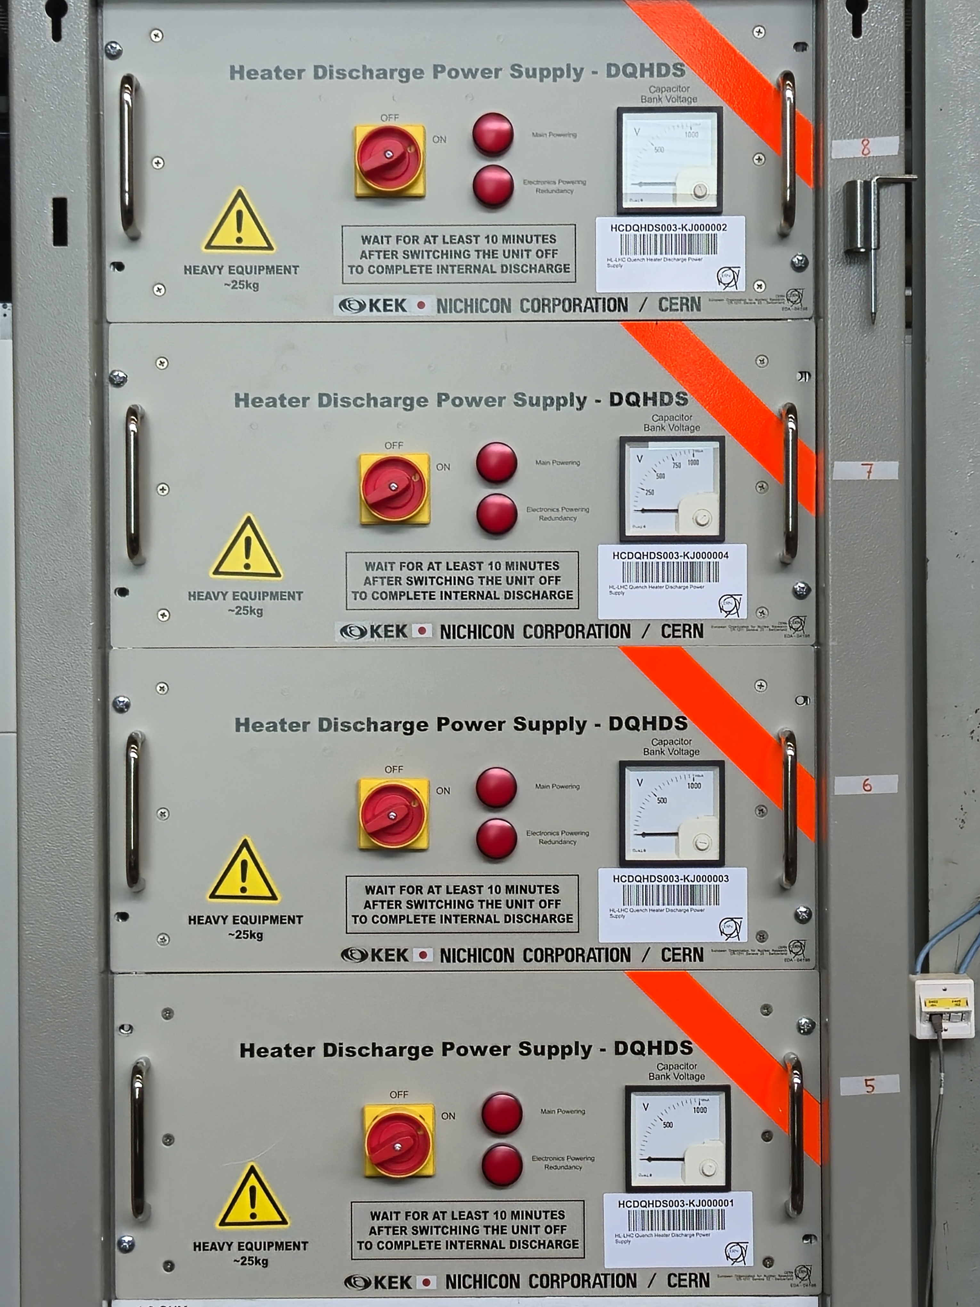
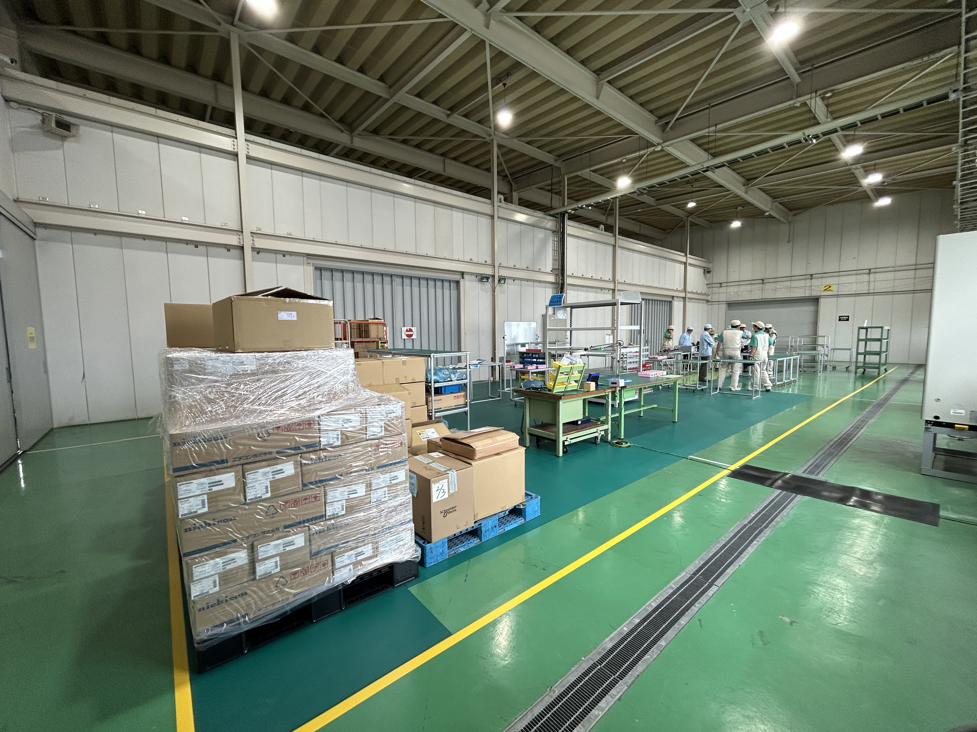
Status of Quench Heater Power Supply (DQHDS)
Pre-series DQHDS
4 unit of DQHDS pre-series were delivered to KEK in March 2024 and sent to CERN for performance qualification. The pre-series units were successfully validated and accepted in July.
Visit of production lines at the producer (Nichicon) by KEK with a remote connection of CERN experts was conducted on Oct. 16.
  The green-light to start the series production was sent to Nichicon.
264 units of the series production will be delivered by March 2025 (JFY2024).
The remaining 362 units will be delivered in JFY 2025.
Visit of production lines

