Slide 1
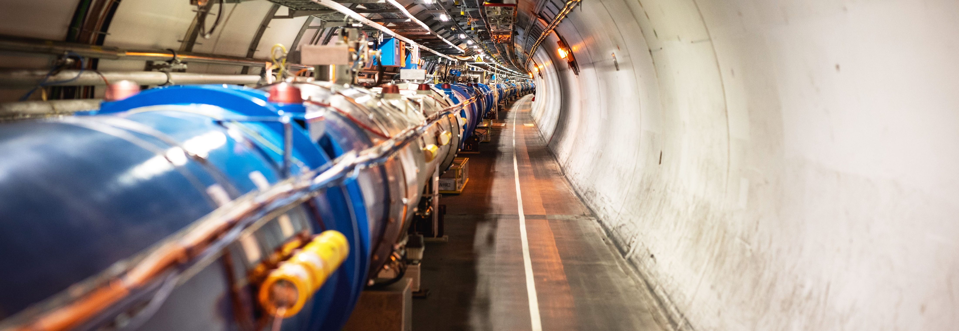
CERN International Relations Update
Emmanuel Tsesmelis
Head of Associate Member State and Non-Member State Relations
CERN
19th Joint CERN-KEK Committee Meeting
26 November 2024
Notes:
THE WELCOME SLIDE
With this slide the speaker:
Introduces him/herself
Describes how this brief presentation aims to give an overview of CERN, as an introduction to the visit that will follow.

Slide 2

COLLABORATION
Notes:
This is the title slide for the section on “International Collaboration”.
It should be shown for just enough time for the speaker to place it in the context of the four pillars mentioned at the start of the presentation (as a form of ”signposting”)
(THIS SECTION HAS 4 SLIDES)

Slide 3

Science for peace
CERN was founded in 1954 with 12 European Member States
24 Member States
Austria – Belgium – Bulgaria – Czech Republic
Denmark – Estonia – Finland – France – Germany
Greece – Hungary – Israel – Italy – Netherlands
Norway – Poland – Portugal – Romania – Serbia
Slovakia – Spain – Sweden – Switzerland – United Kingdom
CERN’s annual budget
is 1200 MCHF (equivalent
to a medium-sized European university)
2 Associate Member States
in the pre-stage to membership
Cyprus – Slovenia
8 Associate Member States
Brazil – Croatia – India – Latvia – Lithuania – Pakistan
Türkiye – Ukraine
6 Observers
Japan – Russia (suspended) – USA
European Union – JINR (suspended) – UNESCO
As of 31 December 2023
Employees:
2666 staff, 1002 graduates
Associates:
12 370 users, 1513 others
Around 50 Cooperation Agreements
with non-Member States and Territories
Albania – Algeria – Argentina – Armenia – Australia – Azerbaijan – Bangladesh – Bolivia – Bosnia and Herzegovina
Canada – Chile – Colombia – Costa Rica – Ecuador – Egypt – Georgia – Honduras – Iceland – Iran – Jordan
Kazakhstan – Lebanon – Malta – Mexico – Mongolia – Montenegro – Morocco – Nepal – New Zealand
North Macedonia – Palestine – Paraguay – People's Republic of China – Peru – Philippines – Qatar – Republic of Korea
Saudi Arabia – Sri Lanka – South Africa – Thailand – Tunisia – United Arab Emirates – Vietnam
The applications of Chile and Ireland
for Associate Membership are being
considered at the CERN Council.
Notes:
The speaker can highlight CERN’s second mission as stated when it was established: to foster peaceful collaborations between nations that had recently been at war.
Additional information (OPTIONAL)
More than 40% of CERN’s budget is returned to industry through materials, utilities and services

Slide 4
A laboratory for people around the world
Distribution of all CERN Users by the country of their home institutes as of 31 December 2023
Geographical & cultural diversity
Users of 110 nationalities
23.7 % women
Member States 7467
Austria 86 – Belgium 129 – Bulgaria 46 – Czech Republic 252
Denmark 47 – Estonia 29 – Finland 88 – France 842 – Germany 1296
Greece 112 – Hungary 80 – Israel 74 – Italy 1609 – Netherlands 167 Norway 77 – Poland 322 – Portugal 105 – Romania 113
Serbia 38 – Slovakia 67 – Spain 413 – Sweden 106
Switzerland 419 – United Kingdom 950
Associate Member States
in the pre-stage to membership 40
Cyprus 14 – Slovenia 26
Associate Member States 541
Brazil 135 – Croatia 37 – India 145 – Latvia 21 – Lithuania 17 – Pakistan 30 Türkiye 129 – Ukraine 27
Observers 3005
Japan 219 – Russia (suspended) 779 – United States of America 2007
Non-Member States and Territories 1317
Algeria 2 – Argentina 16 – Armenia 16 – Australia 26 – Azerbaijan 3 – Bahrain 3 – Belarus 14 – Canada 206
Chile 45 – China 414 – Colombia 24 – Costa Rica 3 – Cuba 3 – Ecuador 4 – Egypt 24 – Georgia 34 – Hong Kong 15 Iceland 3 – Indonesia 7 – Iran 14 – Ireland 4 – Jordan 3 – Kazakhstan 3 – Kuwait 2 – Lebanon 7 – Madagascar 1
Malaysia 4 – Malta 1 – Mexico 56 – Montenegro 3 – Morocco 18 – New Zealand 2 – Nigeria 2 – Oman 1
Palestine 1 – Peru 3 – Philippines 1 – Republic of Korea 168 – Saudi Arabia 6 – South Africa 61 – Sri Lanka 10
Taiwan 52 – Thailand 17 – Tunisia 4 – United Arab Emirates 10 – Vietnam 1
Notes:
THIS SLIDE WILL INCLUDE THE NUMBER OF MEMBERS OF PERSONNEL OF THE VISITORS’ COUNTRY OF ORIGIN

Slide 5
Observer States
At its session in September 2024, Council decided to grant Japan Observer status in respect of the HL-LHC project, for the duration of the construction and operation of the HL-LHC.
Japan joins the United States as an Observer State in respect of the HL-LHC project, in addition to the Observer status that both already held for the LHC.

