Slide 1
RF synchronization and phase recovery using a White Rabbit network for the Large Hadron Collider at CERN
A. Spierer, T. Gingold, G. Hagmann - 28th October 2024 | LLRF Topical Workshop

Slide 2
Overview
Context of the upgrade
Constraints
Solutions
Timeline
Conclusion
& Outlook
Example

Slide 3
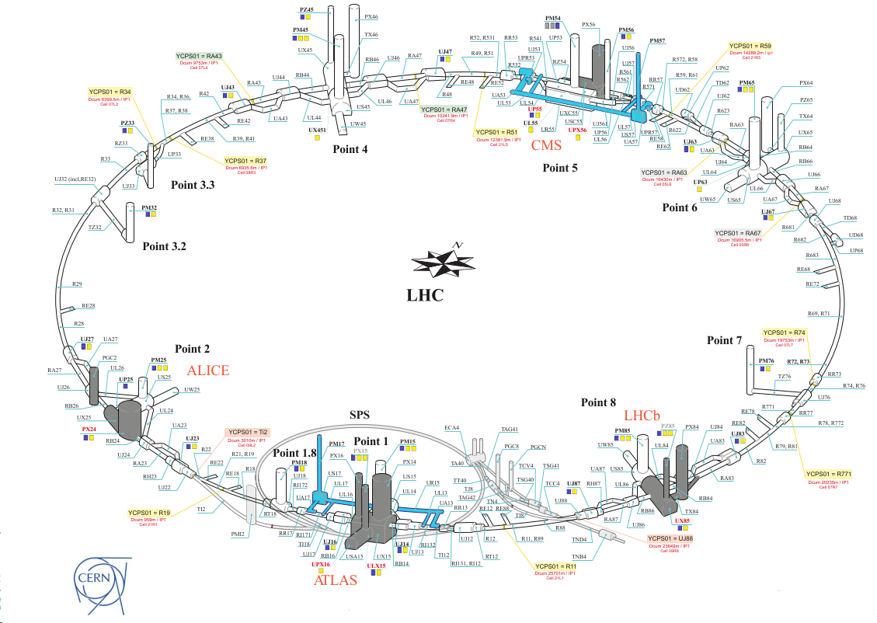
Context of the LLRF upgrade (Phase 0)
High-Luminosity LHC (HL-LHC)
  Increase of the integrated luminosity
    Beam intensity increase : Injectors upgrade
    Increased focusing : New quadrupoles
    Beam orientation : Crab cavities
  Planned for restart in 2030, operation until 2040+
LLRF upgrade motivation
  Obsolescence of the LHC beam control hardware (frequency program, reference RF generators)
  Modernization of the clock distribution, requested by users
  Need for an RF distribution to the Crab cavities
  Parallel upgrade of the machine timing to White Rabbit

Slide 4
Current distribution
Beam Control LLRF
feedbacks
Frequency program
VCXO
Analog RF distribution over fibers (uncompensated): 40-400 MHz, pulses
  To cavity controllers
  To instrumentation
  To experiments
Phase
discri
to optical
to optical
to optical
LLRF
to electr.
to electr.
9 km
to electr.
Starpoint
Pick-ups
Instr
Exper.
Cav. LLRF

Slide 5
Requirements
Providing glitch-free clocks for experiments triggers, FPGAs, …
Phase locked in all locations
Phase recovery after the power cycle of an endpoint
Scalability - Limiting the number of optical fiber links
Phase noise, thermal drift and reproducibility - described in the WR2RF poster
Reliability - 24/7 operation

Slide 6
Solution
RF distributed digitally over a White Rabbit network
Generated locally, at the endpoint

Slide 7
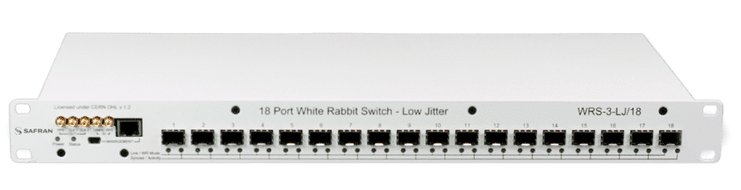
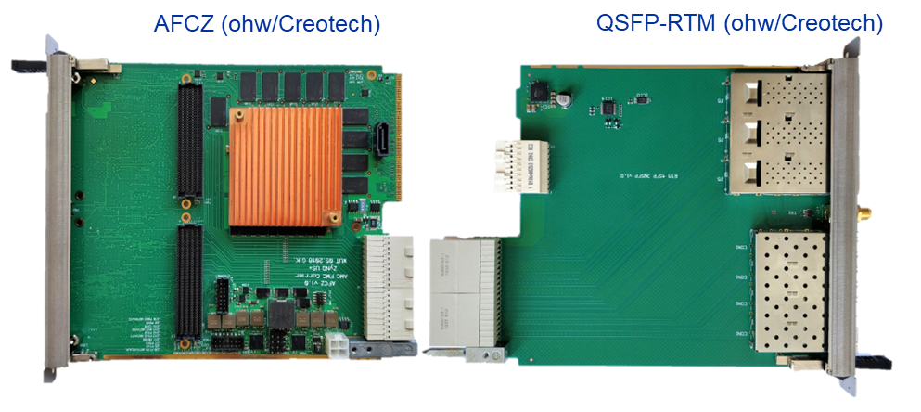
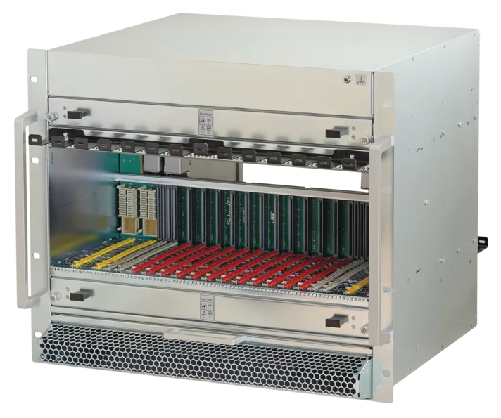
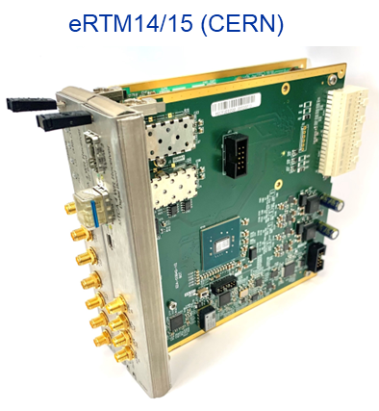
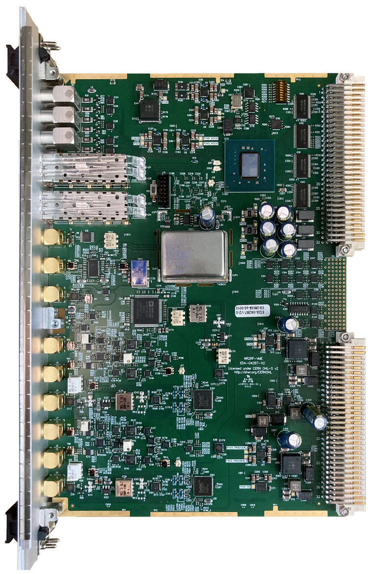
Solution
Based on the Super Proton Synchrotron (SPS) experience
  Same/similar hardware uTCA+VME (eRTM for clocks, WR2RF modified for
  400MHz, AFCZ, WR switches)
  New: RF over ethernet (RoE) instead of streamers, lightweight and generic
  New: Glitch-free operation
Towards a more generic approach
  Shared networks with general timing and other accelerators
  Opportunity to connect and synchronize with the up/downstream machine
WR Switch
WR2RF (VME)

Slide 8
Solution (Phase 0)
feedbacks
NCO
Frequency program
VCXO
RF
WR net.
Replacement of the frequency program
  WR capable
WR2RF to generate reference RF for loops and accelerating cavities
Dedicated low-latency network (~20 us)
  Accelerating cavities LLRF, Beam Control LLRF
Injection of RoE in the machine timing WR network (~200 us)
  For experiments, Crab cavities, instrumentation
NCO
WR2RF
Timing WR net.
Phase
Discri.
to optical
to electr.
NCO
WR2RF
Pick-ups
Acc. Cav. LLRF
NCO
Crab
LLRF
Experi-ments

Slide 9
Solution (Phase 1+)
NCO
NCO
Feedback
Frequency program
RF
WR net.
Update of the cavities and Beam control LLRF
  Long shutdown 4, ~2033
  nodes are all WR-enabled
Timing WR net.
NCO
WR2RF
Pick-ups
NCO
NCO
Acc. Cav. LLRF
Crab
LLRF
Experi-ments

Slide 10
Synchronization example: WR2RF
Recovering the relative phase between two distant nodes

Slide 11
RF generation
WR2RF (VME)
The WR2RF contains two types of oscillators
  The clocks and analog LOs are at constant frequency (in red)
  The digital IF for the modulation sweeps to track the beam
FPGA
~25.788 MHz
~400.788 MHz
375 MHz

Slide 12
RF generation – tracking the sweeping RF
The frame is sent once per beam revolution (~90 microseconds) by the beam control
It is received and applied to the RFNCO with a fixed delay set at the receiver side*
From WR RF frame
~25.788 MHz
~400.788 MHz
375 MHz

Slide 13
RF generation – Locking fixed frequency DDS
The endpoints are locked to the atomic time (TAI) through the WR link
After a power cycle, a pulse locked to the TAI second* is used to synchronize the DDS phase as well as RFNCO LO phase
  These oscillators must have an integer number of periods in N seconds
~25.788 MHz
~400.788 MHz
Reconstructed from WR link
Generated from atomic time
375 MHz

Slide 14
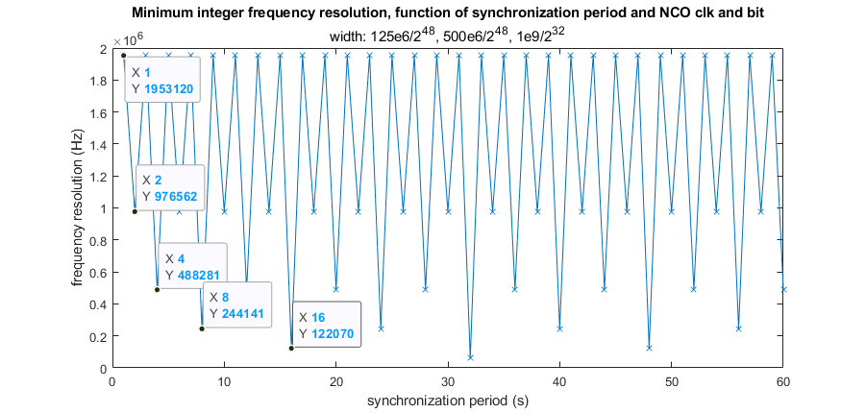
RF generation – Phase recovery
Higher synchronization period N*second => broader choice of LO frequencies
The graph shows how the resolution improves when increasing N
~25.788 MHz
~400.788 MHz
LO FTWs must match without rounding to avoid drift
375 MHz

Slide 15
RF generation – Reference phase recovery
The reference RFNCO phase (Beam Control) is transmitted over WR
It is compared to the local RFNCO phase, if different triggers a re-sync.
In case of re-sync., the phase difference is linearly ramped down
Receiver
Beam Control
RFNCO
Փ_{N}
latch
Loopback
Rx
RFNCO
WR
WR
Rx
FTW_{N}
Փ
latch
Փ_{N}
Փ_{N}
-
FTW_{N}
dՓ_{N}
sync
dFTW
Tx = Trev FTWs
Acc
Փ

Slide 16
Timeline
2024
Hardware installation
2025
Parallel test and comparison with the existing system
2026-29
Long Shutdown 3
Frequency locking
2029
Restart with the new frequency program as reference
Parallel to the existing system
Reproducibility
Replacement of the reference
Stability tests without beam (with users)

Slide 17
Conclusion and outlook
We use a White Rabbit network and distributed NCOs to replace the obsolete RF generation and distribution in the LHC
Based on the successful SPS system
  With a series of updates and modification to fit the LHC constraints
Installation ongoing and the restart with the new system planned in 2029
In collaboration with our controls group, going towards a generalized transmission of the RF information together with the general timing
  Simplifying networks and distribution as well as synchronization between machines
Improvement of the received clock quality (Phase noise, drift)
Easier network extensions/installations

Slide 18
References
Workshop: G. Hagmann & al. Poster
  HL-LHC RF distribution over White-Rabbit, the WR2RF and eRTM modules
Workshop: G. Papotti & al. Presentation
  High-precision clocks and triggers for longitudinal beam measurements in high energy synchrotrons
Phase Stability Compliancy Testing of a White Rabbit Based Solution for the LHC RF and Timing Distribution Backbone Upgrade
  https://indico.cern.ch/event/1381495/contributions/5988793/
RoE
  https://roe-mapping.web.cern.ch/
WR
  http://white-rabbit.web.cern.ch/
SPS beam control
  https://cds.cern.ch/record/2845762?ln=en

Slide 20
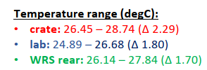
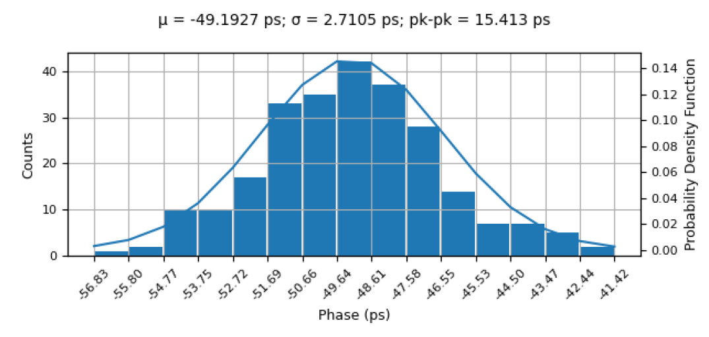
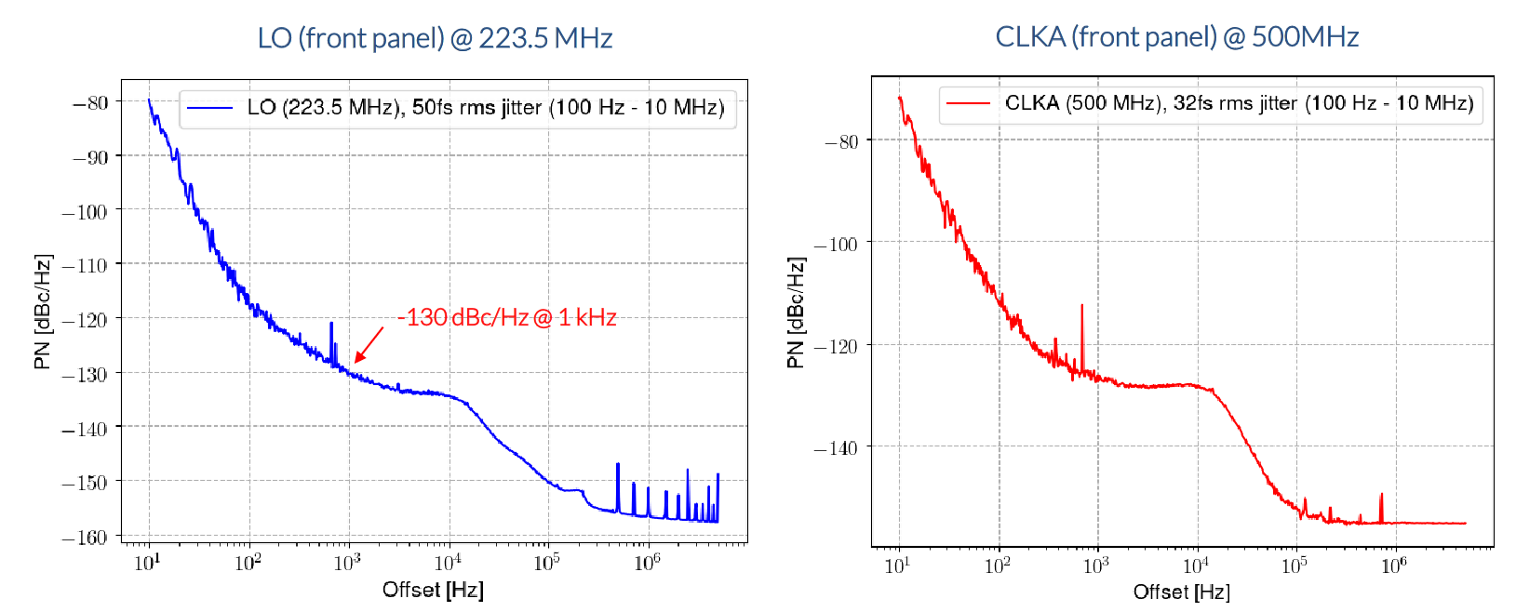
Clock & LO generation
RF Phase variation over time between
two WR clients with resets
  Clock phase reproducibility = WR reproducibility
  Full characterisation ongoing with WR switches in cascade
eRTM 14/15 phase noise
performance

Slide 21
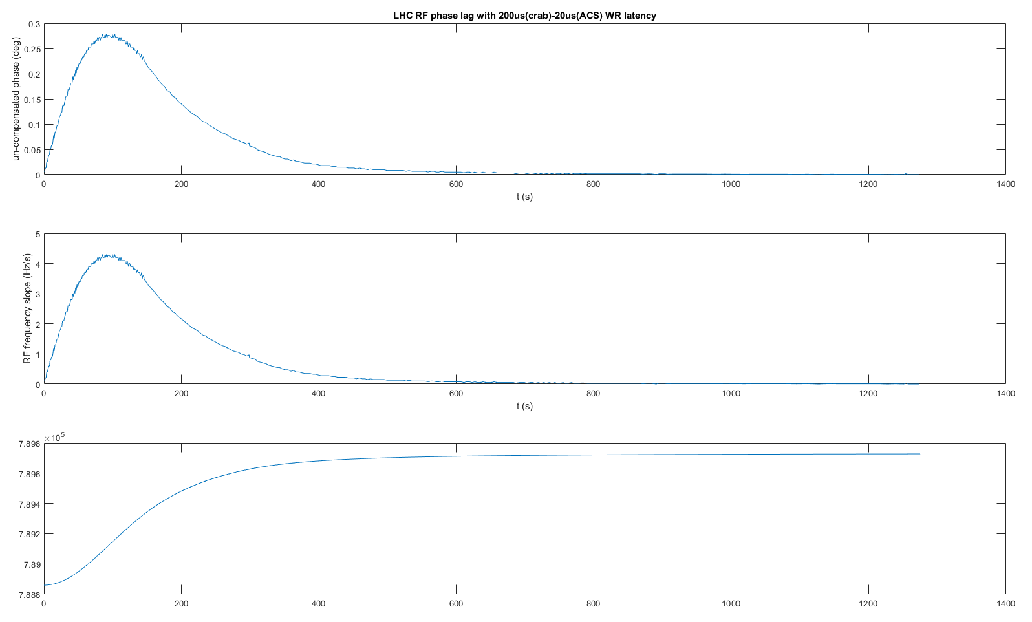
Effect of WR delay
Requires cable length compensation for sweeping frequencies
Introduces a lag in phase for distant devices (200us)
  OK for experiments as they are working only at flat top frequency
  OK for Crab cavities for the same reason

Slide 22
RF generation
Frame content
Field | Type | Size | Comment
FTW_prog_b1 (1) | FTW | 48 (2) | Includes radial_correction_b1 dFTW
FTW_prog_b2 (1) | FTW | 48 (2) | Includes radial_correction_b2 dFTW
FTW_master_b1 (1) | FTW | 48 (2) | FTW_prog_b1 + dFTW phase and synchro loop b1
FTW_master_b2 (1) | FTW | 48 (2) | FTW_prog_b2 + dFTW phase and synchro loop b2
synchro_error_b1 | phase | 16 | For phase 0, if VCXO drifts with temperature, receivers can take this offset in account.
synchro_error_b2 | phase | 16
controls | bits | 16 | NCO_reset
 |  |  | NCO_resync
 |  |  | DDS_resync
resync_phase_prog_b1 | phase | 48 | Used for glitch-free synchronization
resync_phase_prog_b2 | phase | 48
resync_phase_master_b1 | phase | 48
resync_phase_master_b2 | phase | 48
Total Payload |  | 432 | (54 bytes)

Slide 23
WR Network

