Slide 1

High-precision clocks and triggers for longitudinal beam measurements in high energy synchrotrons
LLRF Topical Workshop on Timing, Synchronization, Measurements and Calibrations
Frascati, 29 October 2024
G. Papotti,
H. Damerau, G. Hagmann, T. Levens, A. Spierer
CERN, Geneva, Switzerland

Slide 2

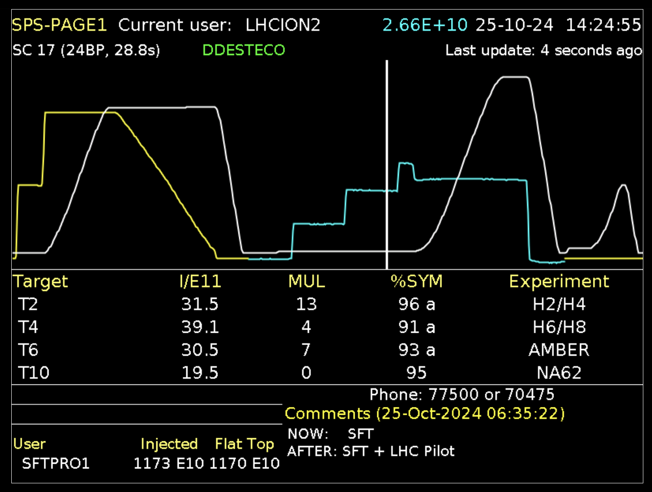
introduction - the SPS
Super Proton Synchrotron (SPS): second largest CERN accelerator
  LHC injector, fixed target program in North Area, AWAKE, HiRadMat
  different “users” served in parallel

Slide 3
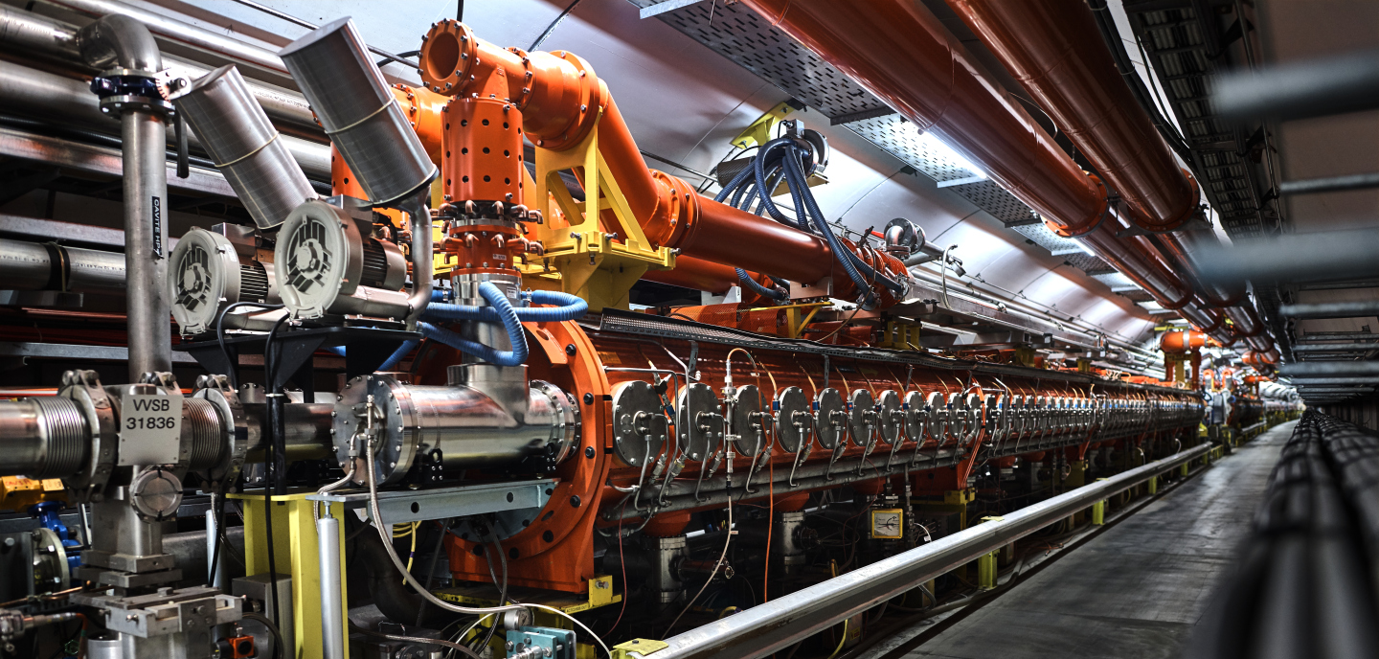
introduction – SPS RF
6x 200 MHz Travelling Wave structures
  designed for 10 - 450 GeV/c protons
  f_{RF} = h f_{rev}
    with harmonic number: h = 4620
  bandwidth: 199.5 - 200.4 MHz
  note: more complex operation with heavy ions detailed later
p [GeV/c] | f_{rev} [kHz] | f_{RF} [MHz] | bucket [ns]
10 | 43.186 | 199.5185 | 5.012
14 | 43.279 | 199.9468 | 5.001
26 | 43.347 | 200.2645 | 4.993
450 | 43.375 | 200.3944 | 4.990

Slide 4
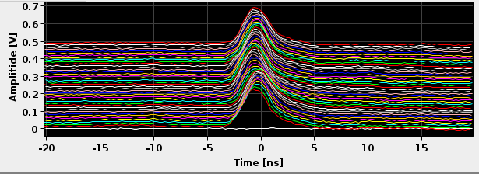
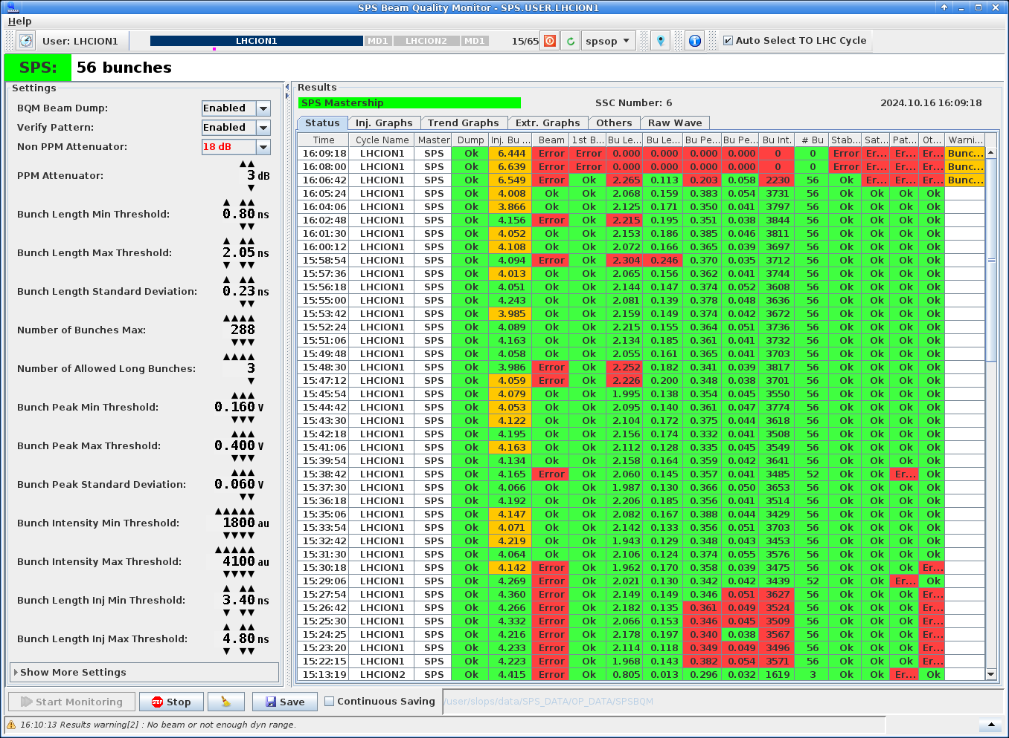
SPS longitudinal beam observation systems
accelerator
tunnel
surface building
(Faraday Cage)
several different l.b.o. systems
  remotely controlled programmable attenuators
  ~100 m on cable or fibre to ADC
  ADC on the surface
  (triggering scheme on next slide)
beam
shielding
wall current monitor
pickup
attn
ADC
(~15m)
cable / fibre
(~100m)
MR
two main systems used in operation
  “Mountain Range” for visual checks (beam structure, inj. phase, …)
    older pickup, transmission on cable
  “Beam Quality Monitor” for automated evaluation of longitudinal beam quality and pattern
    inhibits injection into the LHC if parameters out of spec
    newer pickup, transmission on optical fibre for improved profile quality
BQM

Slide 5
longitudinal observation triggering scheme
General Machine Timing
General Machine Timing (GMT)
  telegram broadcast on cable to synchronize equipment to events like injection, start of ramp, start of flat top, start of fast or slow extraction…
Local Timing event (LTIM)
  pulse by local GMT receiver followed by a counter
  choice of which GMT event triggers, with option of additional delay
    generally ms precision
VME Trigger Unit (VTU)
  RF-synchronous counter, thanks to f_{rev} and f_{RF} inputs
  precise to the bucket + fine alignment down to 20 ps precision
  started by LTIM pulse
    could also be started by e.g. injection or extraction pulse for turn accuracy
  can do single pulse, or pulse burst at chosen spacing
    can repeat several times (triggered by several LTIM pulses)
VTU finally triggers the ADC
  for desired user/cycle, at desired time in the cycle, at desired bucket, with fine alignment
example: for standard MR, acquire bucket 1 for 42 consecutive turns (i.e. 1 ms) at every inj.
Local Timing
event
f_{rev}
VME
Trigger Unit
f_{RF}
ADC

Slide 6
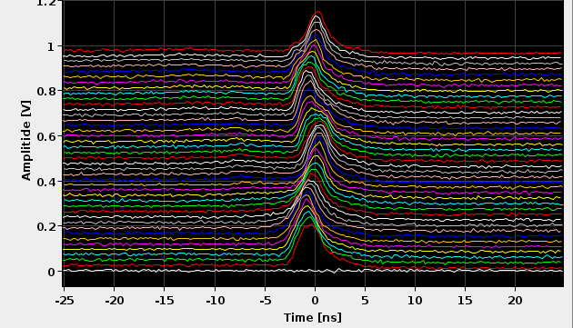
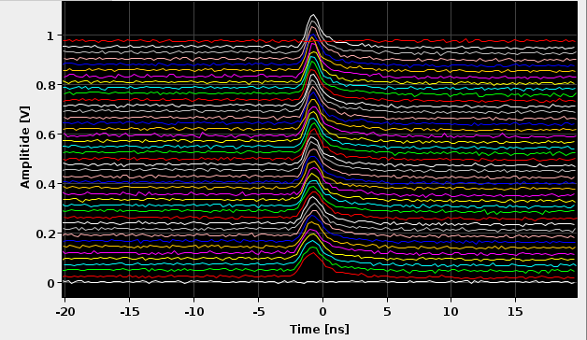
examples of acquisitions - protons
standard use: MR view at injection
non standard example: MR view along a cycle
1 ms, 42 turns
10 s
images to be updated!
injection transients
proton bunch through the cycle

Slide 7
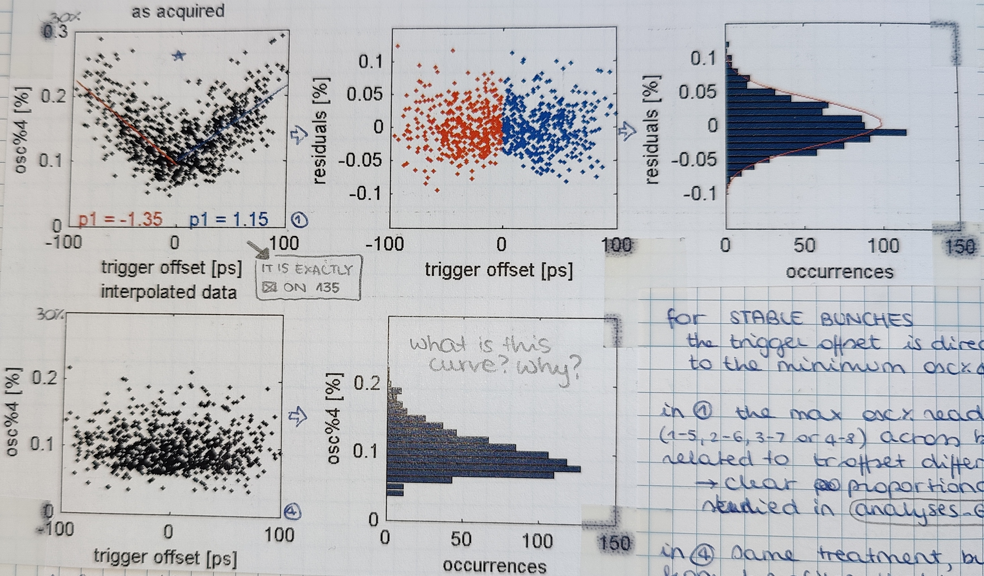
observation jitter
BQM includes beam stability analysis
  comparison of 8 acquisitions at turn spacing of fraction of synch. period
instability measurement includes component proportional to ADC trigger offset
  trigger offset is random for each acquisition, and <125 ps (ADC is 8 GS/s)
  top plots: stable beam is measured as marginally unstable
    instability measurement proportional to trigger offset excursion among acquisitions
  bottom plots: if profiles are interpolated according to trigger jitter, instability measurement is reduced
for the purposes of longitudinal beam observation, the trigger jitter of the observation systems is negligible
30
10
20
5
instability [%]
0
10
-5
-10
0
30
hand-written notes
from my 2009 logbook!
20
20
instability [%]
10
10
0
0

Slide 8
added complexity for ion operation
p [GeV] (Pb) | f_{rev} [kHz] | f_{RF} [MHz]
17.07 | 42.967 | 198.5094
451.15 | 43.375 | 200.3921
f_{RF} = 4620 f_{rev} too low at inj. for ions
  e.g. for lead (Pb)
  (cavity bandwidth: 199.5 – 200.4 MHz)
use Frequency Shift Keying (FSK) and Amplitude Modulation (AM)
  FSK: f_{RF,on} and f_{RF,off} in the same turn
  AM: RF off for half of the time
  choose f_{RF,on} as needed for beam, within cavity bandwidth
    at injection: bunch to bucket transfer from injector (CERN Proton Synchrotron), and capture at SPS (h = 4653, f_{RF,on} = 199.9255 MHz)
  f_{RF,off} in the other half of the ring, such that beam is in bucket 1 and with correct phase after a turn
    f_{RF,avg} = 4620 f_{rev} = (f_{RF,on} + f_{RF,off})/2
in addition, Fixed Frequency Acceleration: accelerate with varying h (f_{RF,cen} = 200.222 MHz)
1 turn
f_{RF,on}
f_{RF,off}

Slide 9
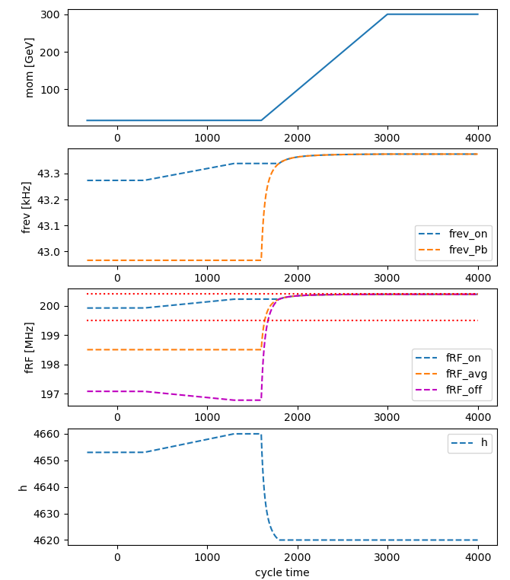
more on ion operation
1.
2.
3.
4.
injection: h = 4653 (AM and FSK)
after inj, before ramp: f_{RF} to f_{RF,cen}
  f_{rev} constant, h varies, f_{RF} varies
during energy ramp: f_{RF} = f_{RF,cen}
  f_{rev} varies, h varies, f_{RF} constant
stop FFA when f_{rev,Pb} 4620 = f_{RF,cen}
  continue with standard: f_{RF} = 4620 f_{rev}
  stop FSK
Notes:
FFA_LSA.py

Slide 10
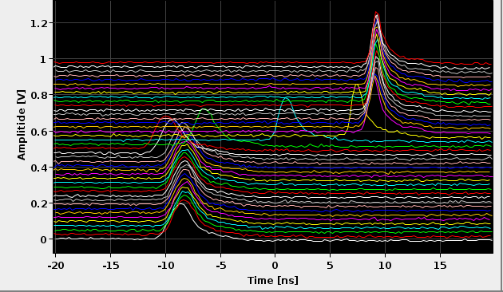
examples of acquisitions - ions
for ions, complex RF operation complicates longitudinal observations
  increased frequency swing from injection to high energy
    (0.06% for protons and 1% for Pb)
  FSK modulation impacts on pattern verification
MR single ion bunch across cycle
  (standard distribution)
10 s

Slide 11
triggering scheme with White Rabbit
in 2024, f_{rev} and f_{RF} synthesized locally by WR2RF
  on WR2RF see A. Spierer and G. Hagmann at this workshop
  delay compensation knob: compensate for cable delays
  FSK offset knob: adjust for counting f_{RF,on} and f_{RF,off}
  trigger unit offset: used for compatibility with previous setup
advantages
  observation does not slip with acceleration
  same bucket 1 reference for different beams
    results also in easier settings management for different users
General Machine Timing
Local Timing
Receiver
WR
network
WR2RF
f_{rev}
VME
Trigger Unit
f_{RF}
ADC

Slide 12
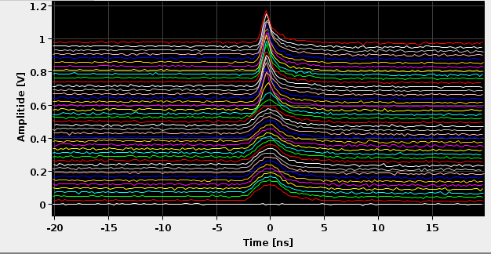
examples of acquisitions with WR2RF - ions
MR of ion bunch through the cycle
10 s

Slide 13
conclusions
several systems used at CERN SPS for longitudinal beam observations
  e.g. Mountain Range for visual checks
  e.g. Beam Quality Monitor for automated analysis of beam pattern, stability, … and inhibition of injection in LHC if parameters are out of spec
improvement in longitudinal beam observations thanks to WR2RF
  no observation slippage throughout acceleration ramp
  single bucket 1 reference for different beam types
  easier setting management
WR2RF settings management to be improved
  ideally, user to input delay and azimuth
  results in cumbersome commissioning at present

Slide 14
references
I. Béjar Alonso, O. Bruning, P. Fessia, M. Lamont, L. Rossi, L. Tavian, M. Zerlauth, "High-Luminosity Large Hadron Collider (HL-LHC): Technical design report", CERN, Geneva, Switzerland, 2020.
J. Coupard et al., "LIU Technical Design Report- Volume I: Protons", CERN, Geneva, Switzerland, Rep. CERN- ACC2014-0337, Dec. 2014.
E. Shaposhnikova, E. Ciapala, E. Montesinos, "Upgrade of the 200 MHz RF system in the CERN SPS", in Proc. 2nd Int. Particle Accelerator Conf. (IPAC’11) IPAC11, San Sebastian, Spain, Sept. 2011, MOPC058.
D. Boussard, T. Bohl, T. Linnecar, U. Wehrle, “Non integer harmonic number acceleration of lead ions in the CERN SPS”, 16th Biennial Particle Accelerator Conference and International Conference on High-Energy Accelerators, Dallas, TX, USA, 1 - 5 May 1995, pp.1506-1508.
information on WR2RF: https://www.white-rabbit.tech/rf-over-wr-cern/
Tomasz Włostowski et al.,“TRIGGER AND RF DISTRIBUTION USING WHITE RABBIT”, ICALEPCS201.

Slide 15
spares

Slide 16
abstract
High energy synchrotrons, like the Super-Proton Synchrotron (SPS) and the Large Hadron Collider (LHC) at CERN, require high-precision beam synchronous triggers for longitudinal measurements, e.g. to acquire bunch profiles from a wall current monitor pickup.
The observation triggering scheme is based on the General Machine Timing (GMT) followed by dedicated trigger units counting the revolution and RF frequency clocks to allow synchronisation to the exact RF bucket.
Combined with a programmable fine delay, accurate triggers can be placed at any azimuthal position with a resolution of about 20 ps.
The SPS installation is described in detail, including its additional flexibility for measurements at injection, extraction and bunch rotation.
The performance and limitations of such an implementation are analysed in terms of jitter with respect to the beam, delay variation due to cable lengths between the clock generation and acquisition with a sweeping revolution frequency.
Such varying delays can be compensated with the White Rabbit (WR) technology, and highlights from the recent upgrade in the SPS are presented.

