Slide 1

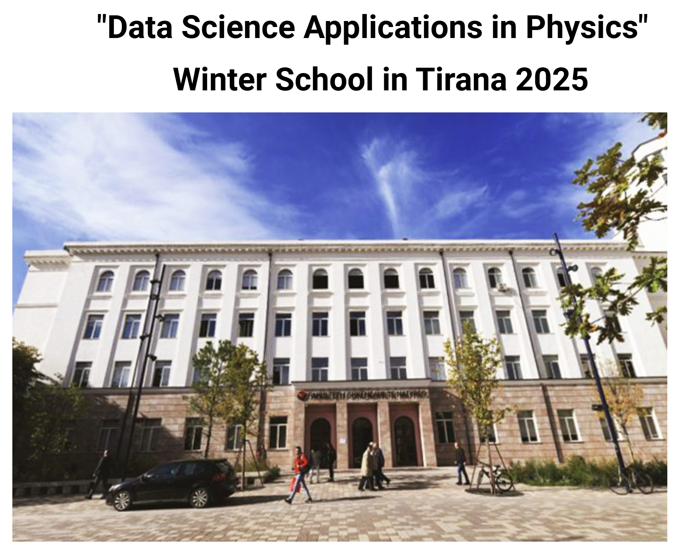
Optical and Interferometric Methods for Material Characterization
and Dimensional Analysis
Faculty of Natural Sciences
Hall 413 B - Tirana
Mon 27th January 2025
Giovanni Pappalettera

Slide 2
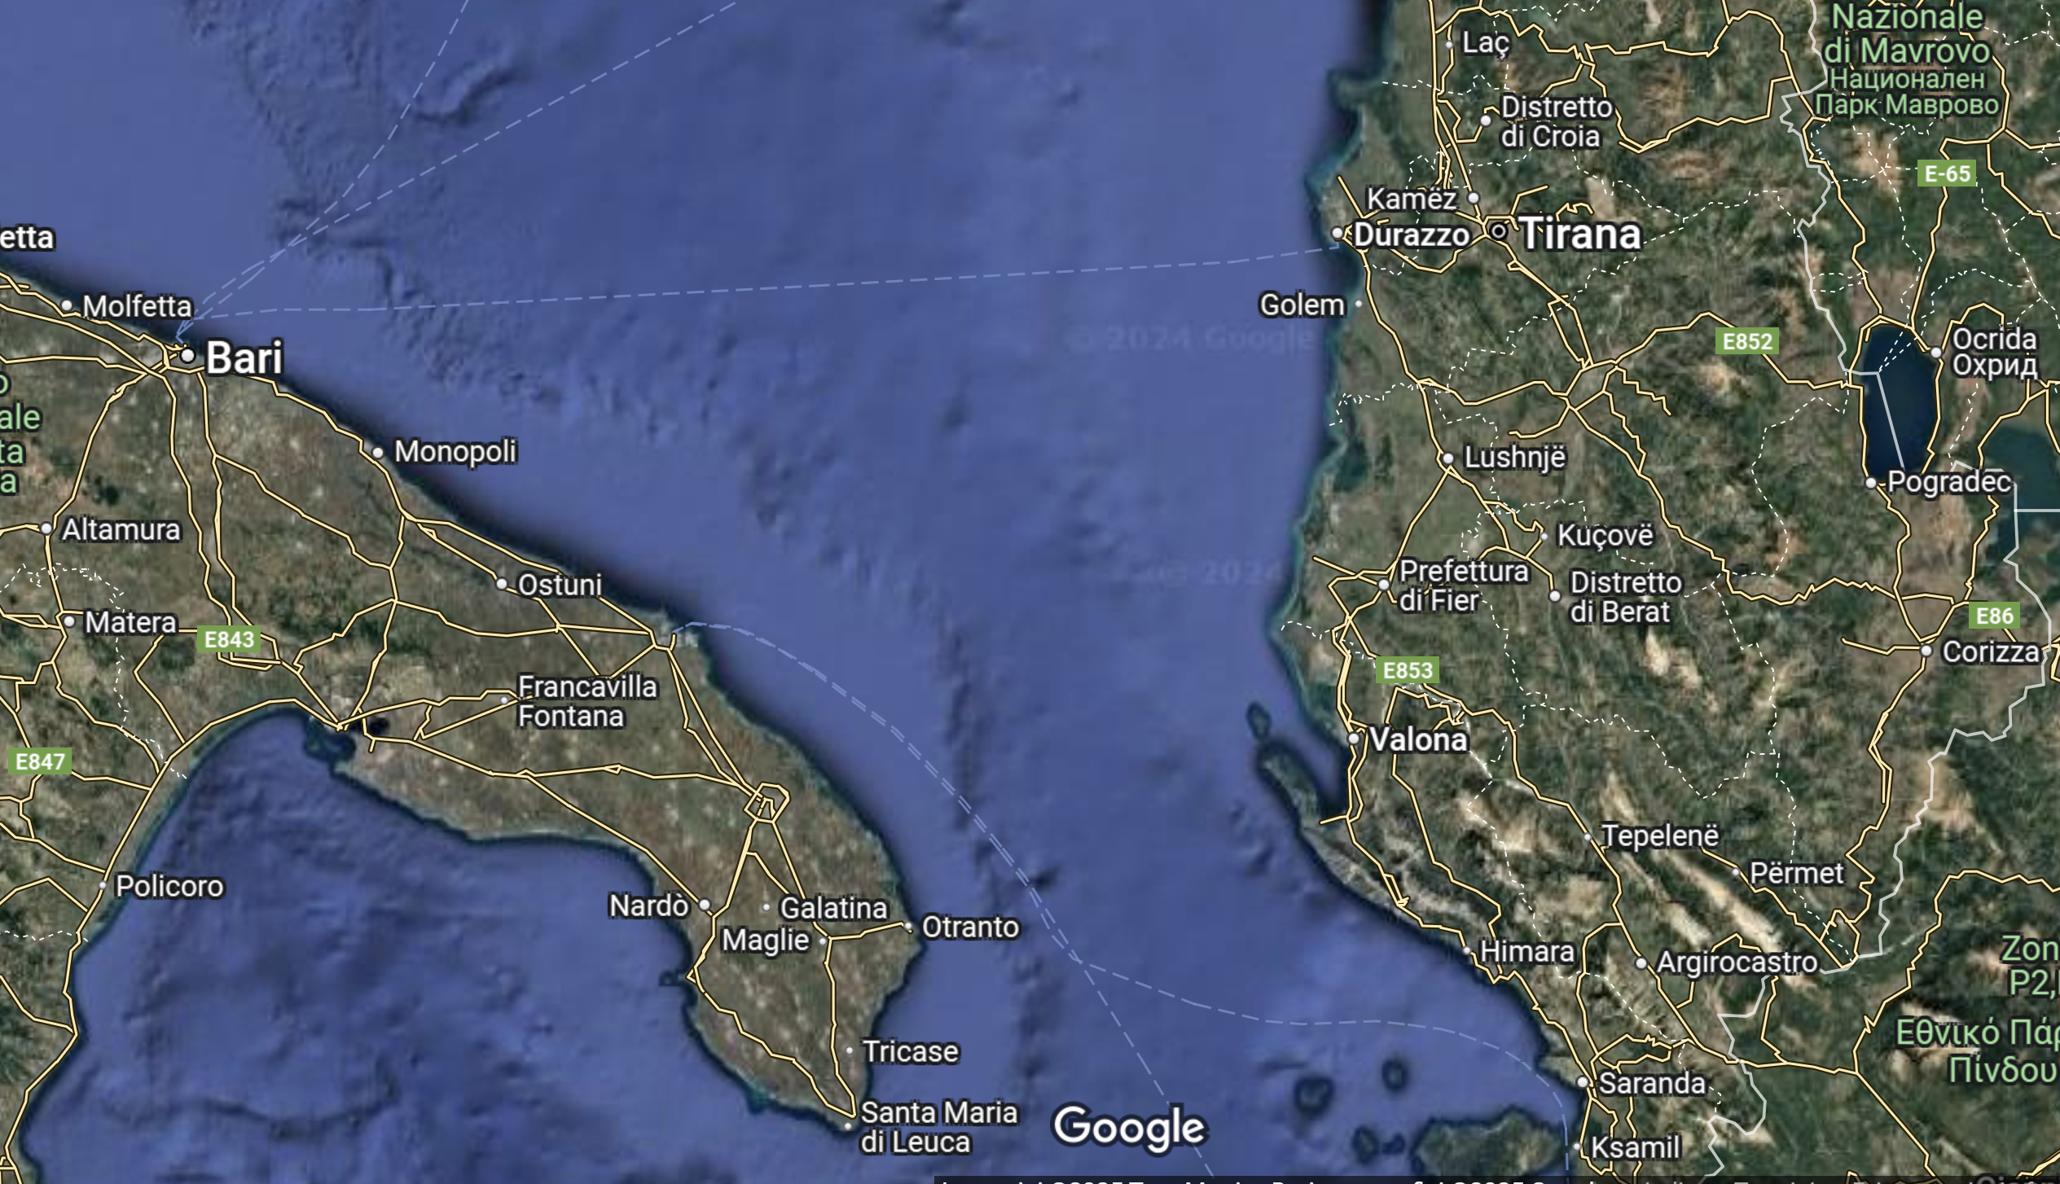

Slide 3
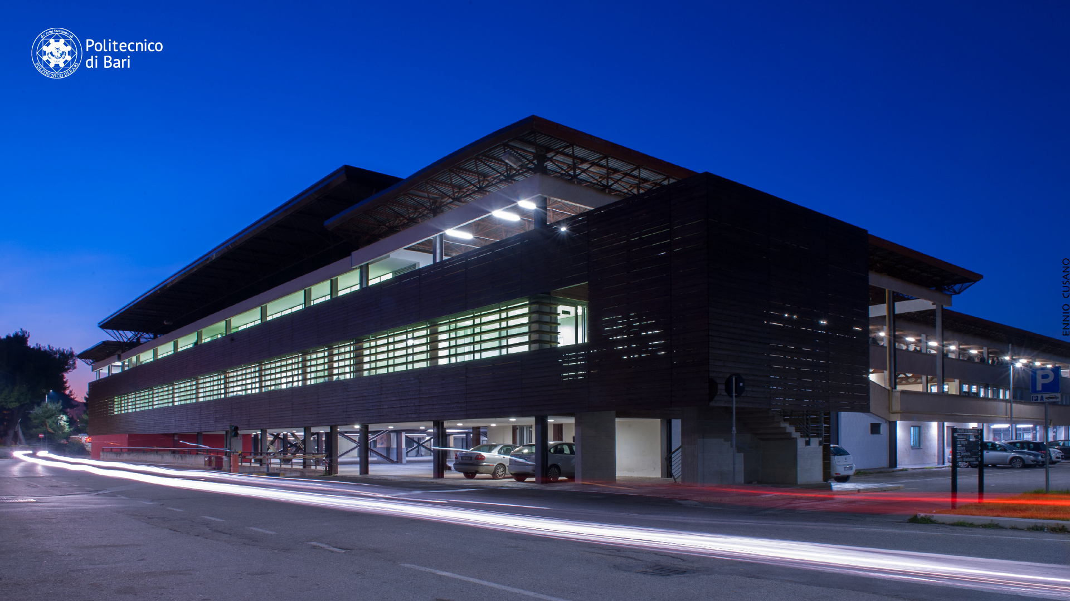

Slide 4
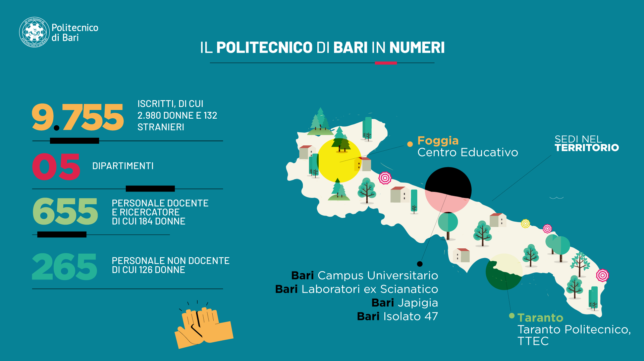
POLITECNICO DI BARI IN NUMBERS
ENROLLED STUDENT WITH
2.980 WOMEN AND 132
FOREIGN STUDENTS
TERRITORIAL
SEATS
DEPARTMENTS
PROFESSORS and RESEARCHERS
184 WOMEN
NON TEACHING STAFF
126 WOMEN

Slide 5
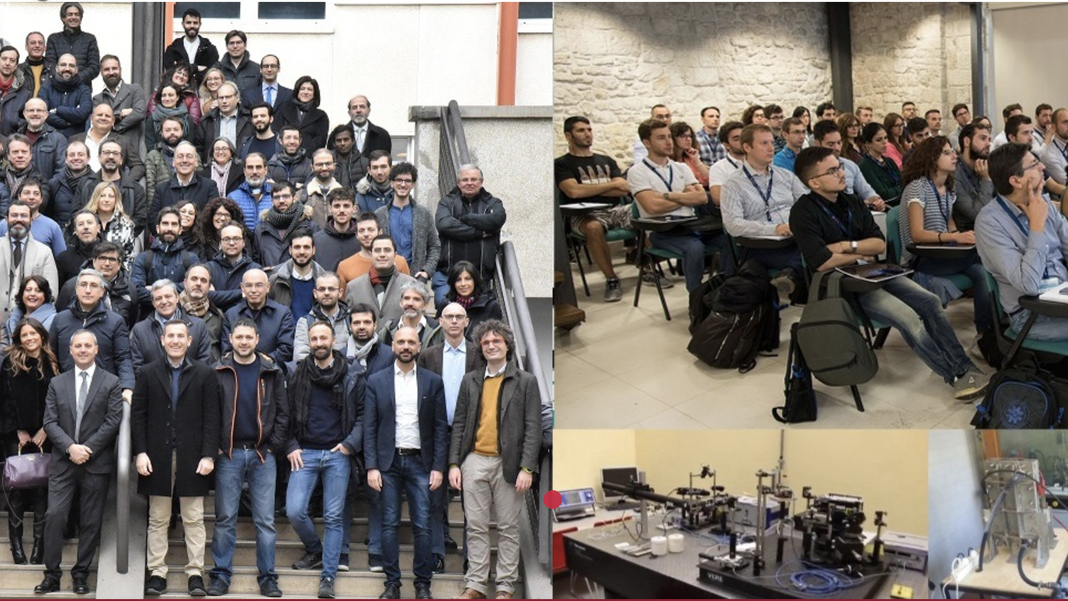
SEAL of EXCELLENCE DEPARTMENT
2018-2022
2023-2027
A recognition given by the Italian
Ministry of University and Research
Selecting among 800 University
Department
Best Ranking in the Industrial Area
MECHANICS, MATHEMATICS and MANAGEMENT DEPARTMENT

Slide 6




Teaching Offer
Bachelor
Mechanical Engineering
Management Engineering
Aerospace Systems Engineering(TA)
Industrial and Naval Systems Engineering
(TA)
Master
Mechanical Engineering
Management Engineering
Energetic Engineering
Mechanical Engineering
PhD
Mechanical and Energetic Engineering (DRIME)
PhD
Management Engineering (DRIG)
PhD
Engineering and Aerospace Systems(DRISA)
Post Lauream

Slide 7
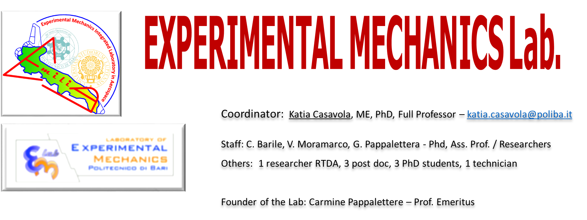
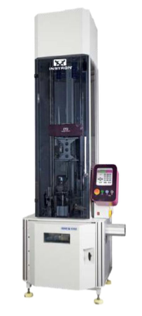
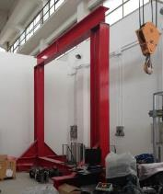
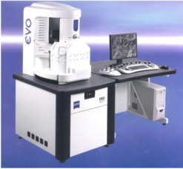
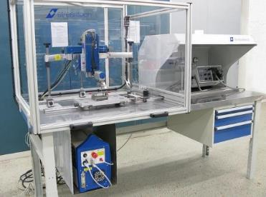
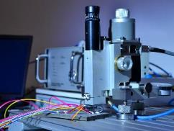

Slide 8
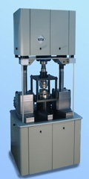
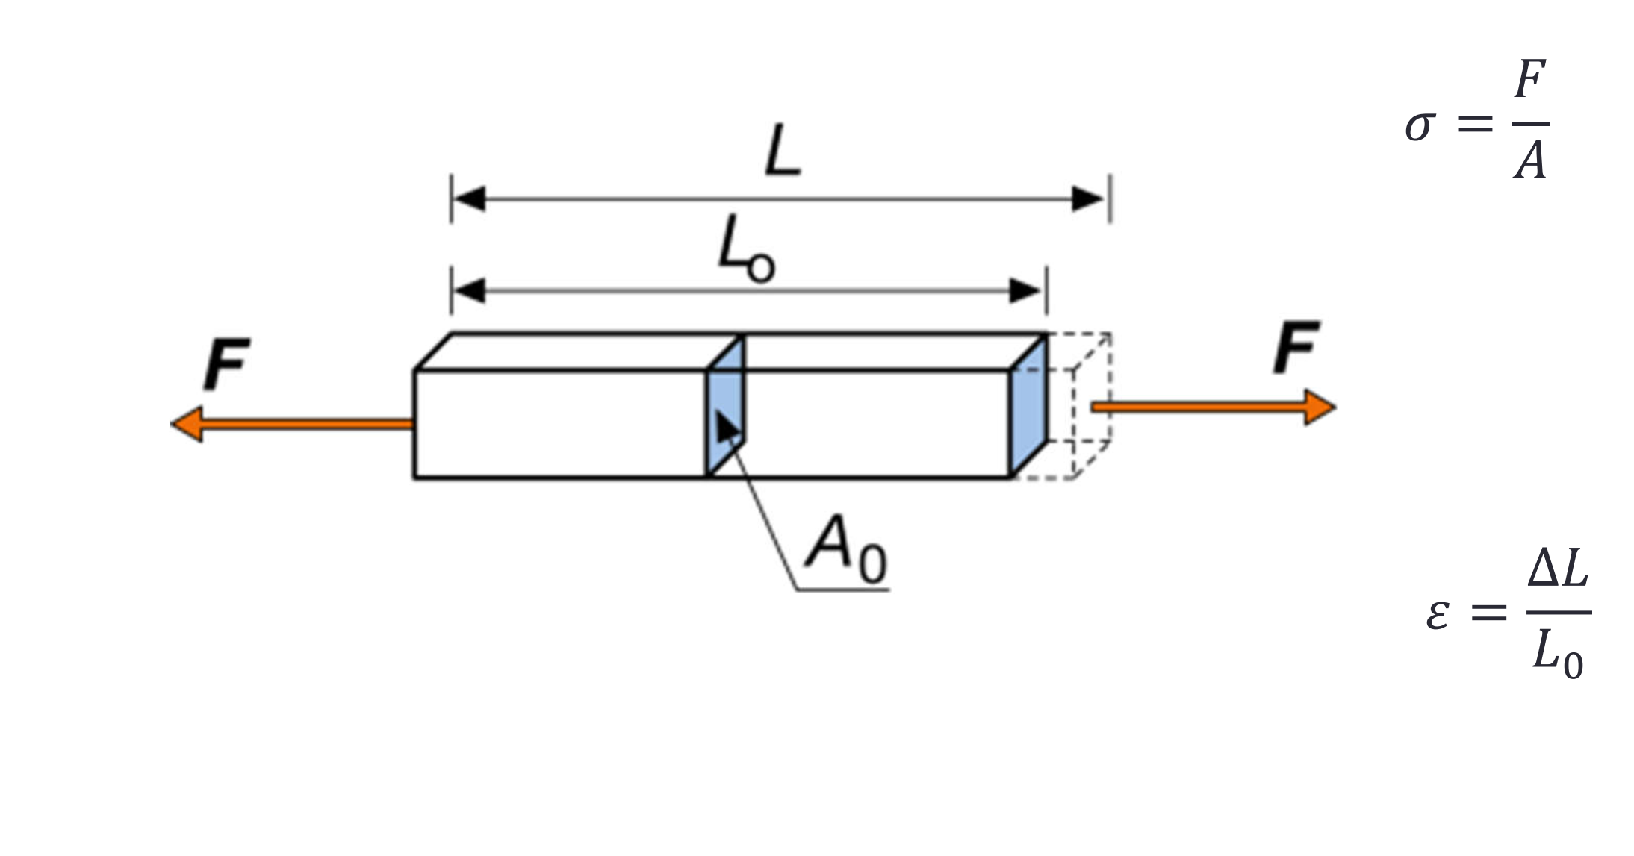
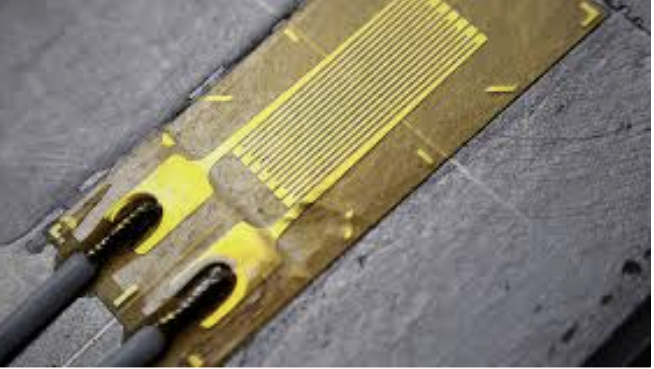
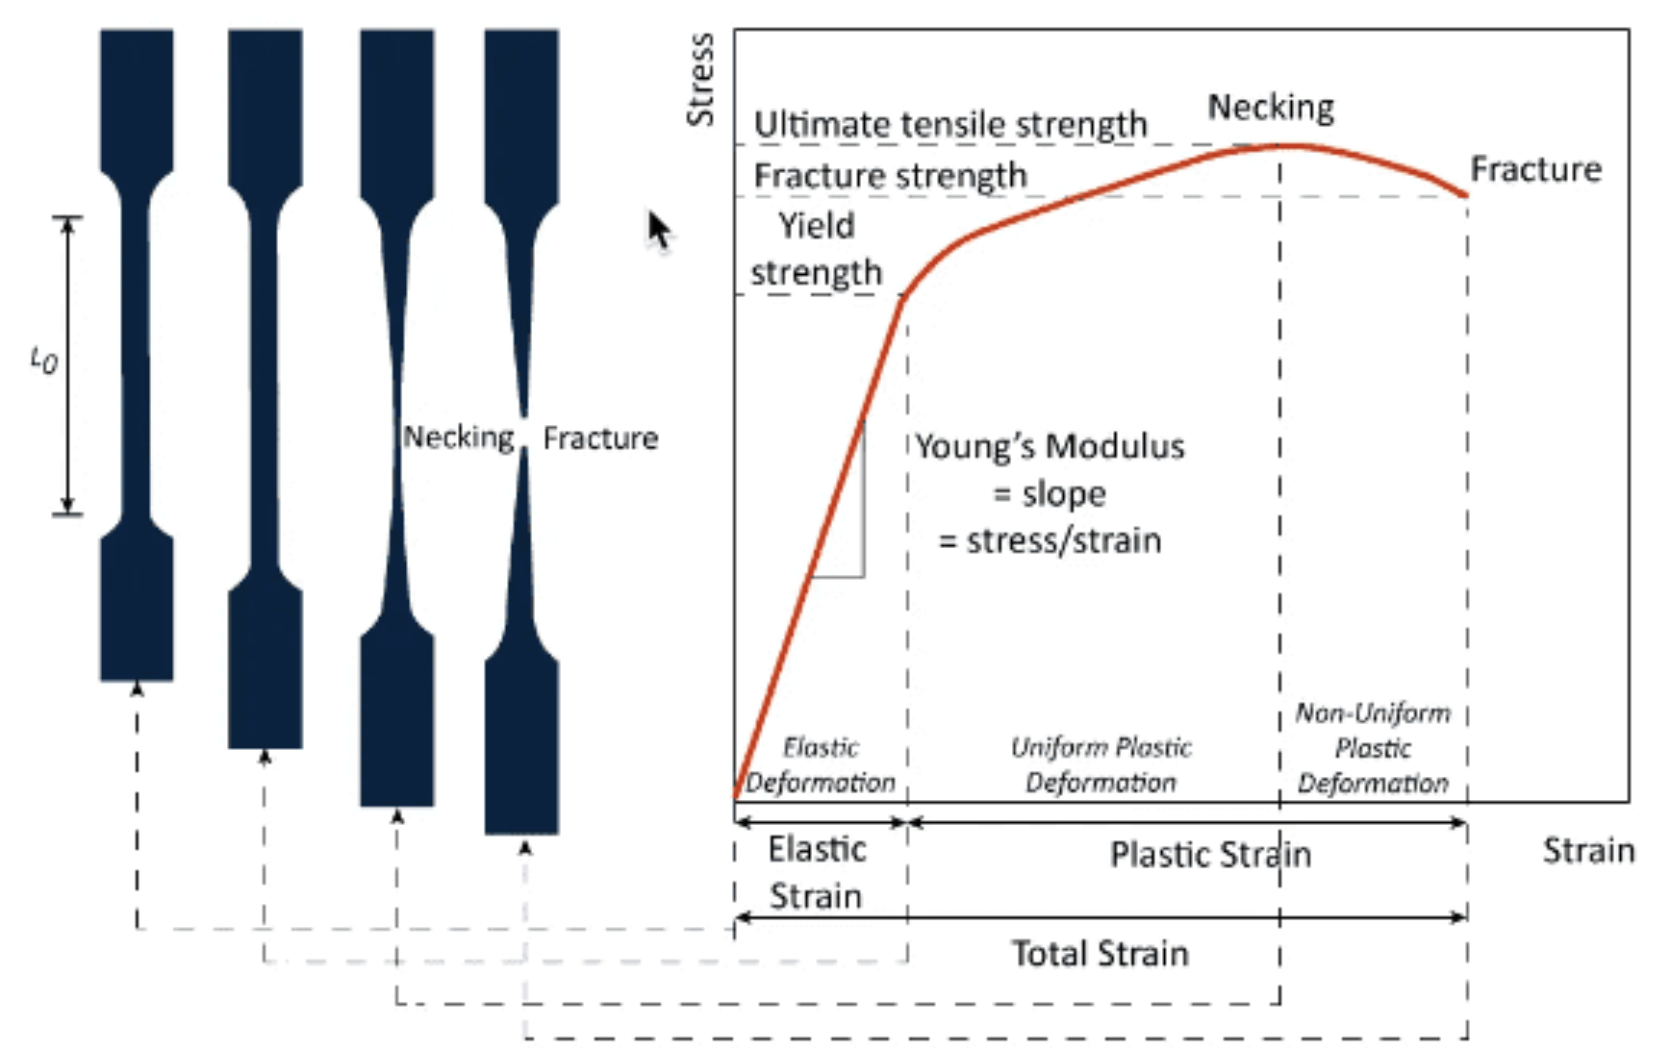
Stress and Strain
Apply Load
Stress
Strain
Measure
Deformation
Get Stress/Strain
Curve

Slide 9
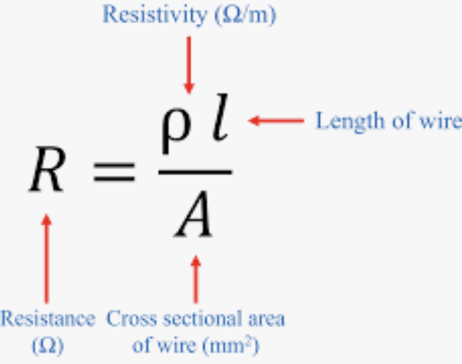
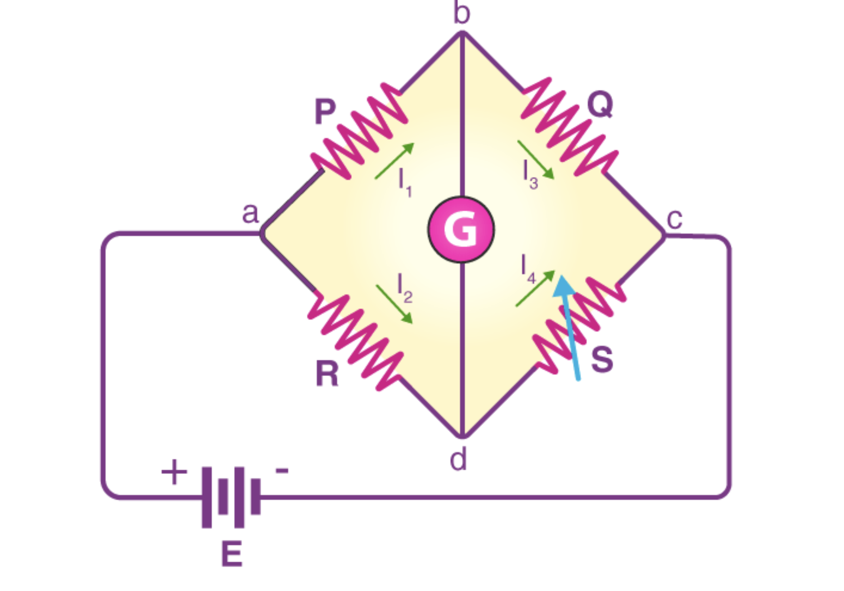

Strain Measurement: Strain Gauge
Dimensional variation of the strain gauge change its resistivity
Wheatstone Bridge
$$ε=\frac{l−l_{0}}{l_{0}}$$

Slide 10
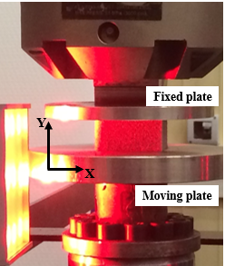
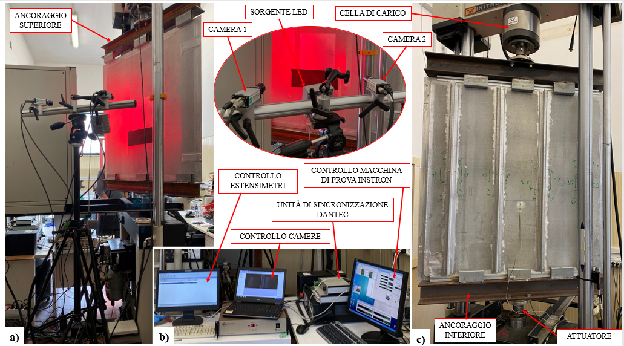
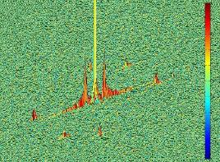

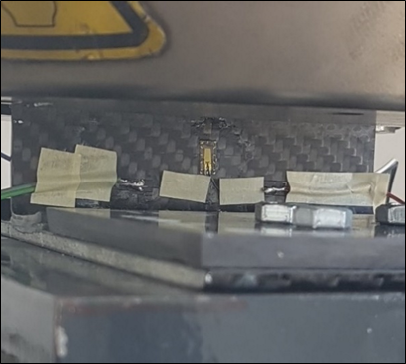
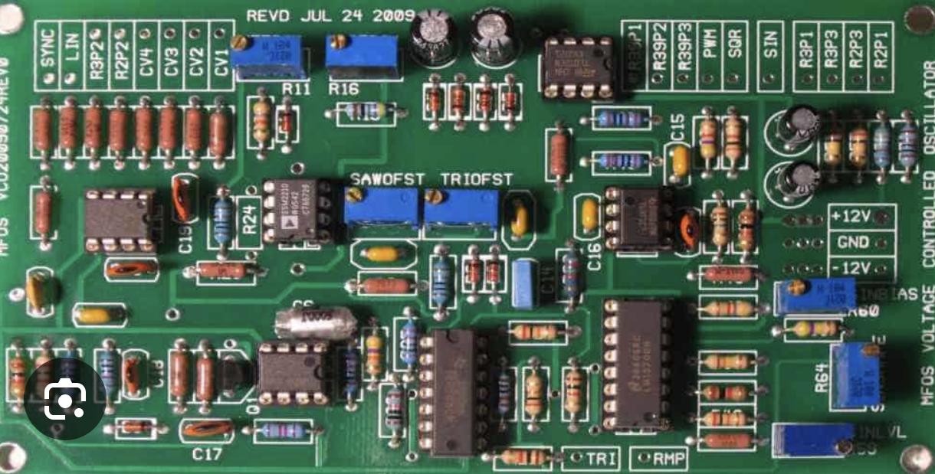
Strain Gauges limitations
Corrosion onset
PU foam
Aluminum foam stringered panel
PCB Board
CFRP Composite

Slide 11

Why optical Methods?
Every time we are looking for:
No contact
No destructive
High resolution
High sensitivity
Which optical Methods?
Speckle Interferometry
Moirè Methods
Fringe Projection Methods
Digital Holography
Shearography
Photoelasticity
DIC
…..
Interferometric Implementation
Non Interferometric Implementation

Slide 12
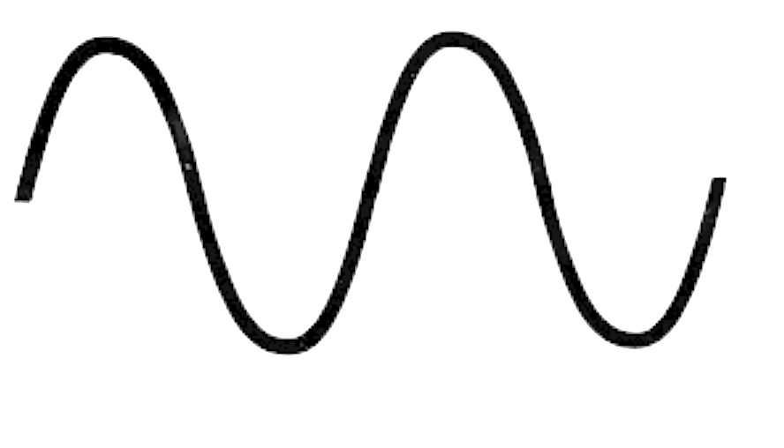
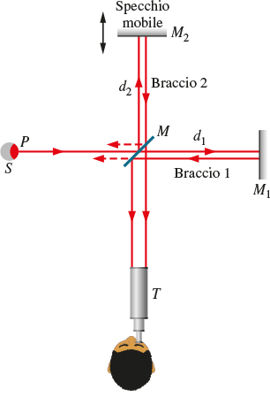
Interferometric Methods
I
Mobile Mirror
I
Arm 1
Mirror
Constructive
Arm 2
I
Destructive
I
Intermediate

Slide 13
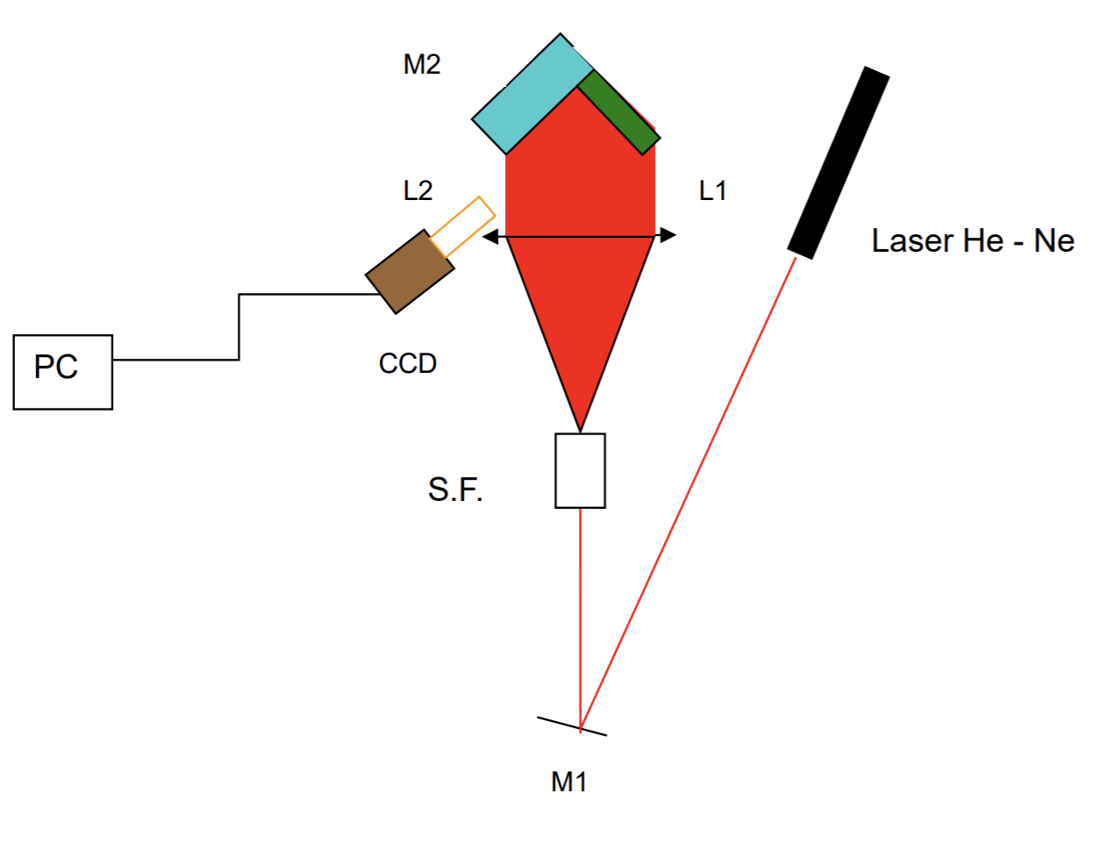
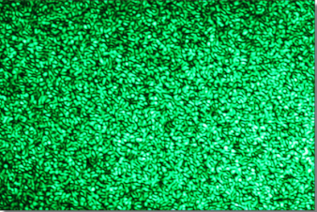
Speckle Methods
2
P
?
P
?
Intensity?
Intensity?
Constructive/Destructive
Randomly determined
Constructive/Destructive
2
2

Slide 14
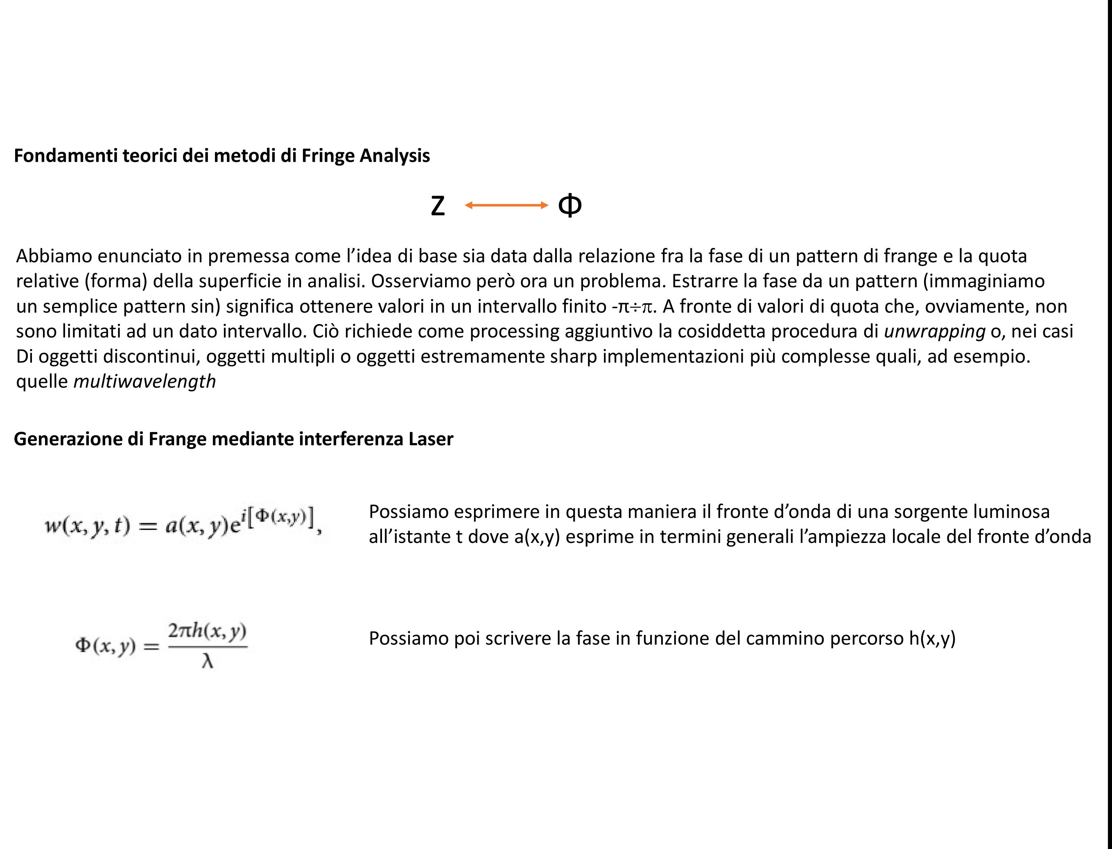
Principle of Fringe Analysis
h
Basic idea is the relationship between phase in the pattern and the quantity to be measured
Fringes Generated by Laser Interference
This express the light wavefront at a given instant t
Phase can be express as a function of the travelled path h(x,y)

Slide 15
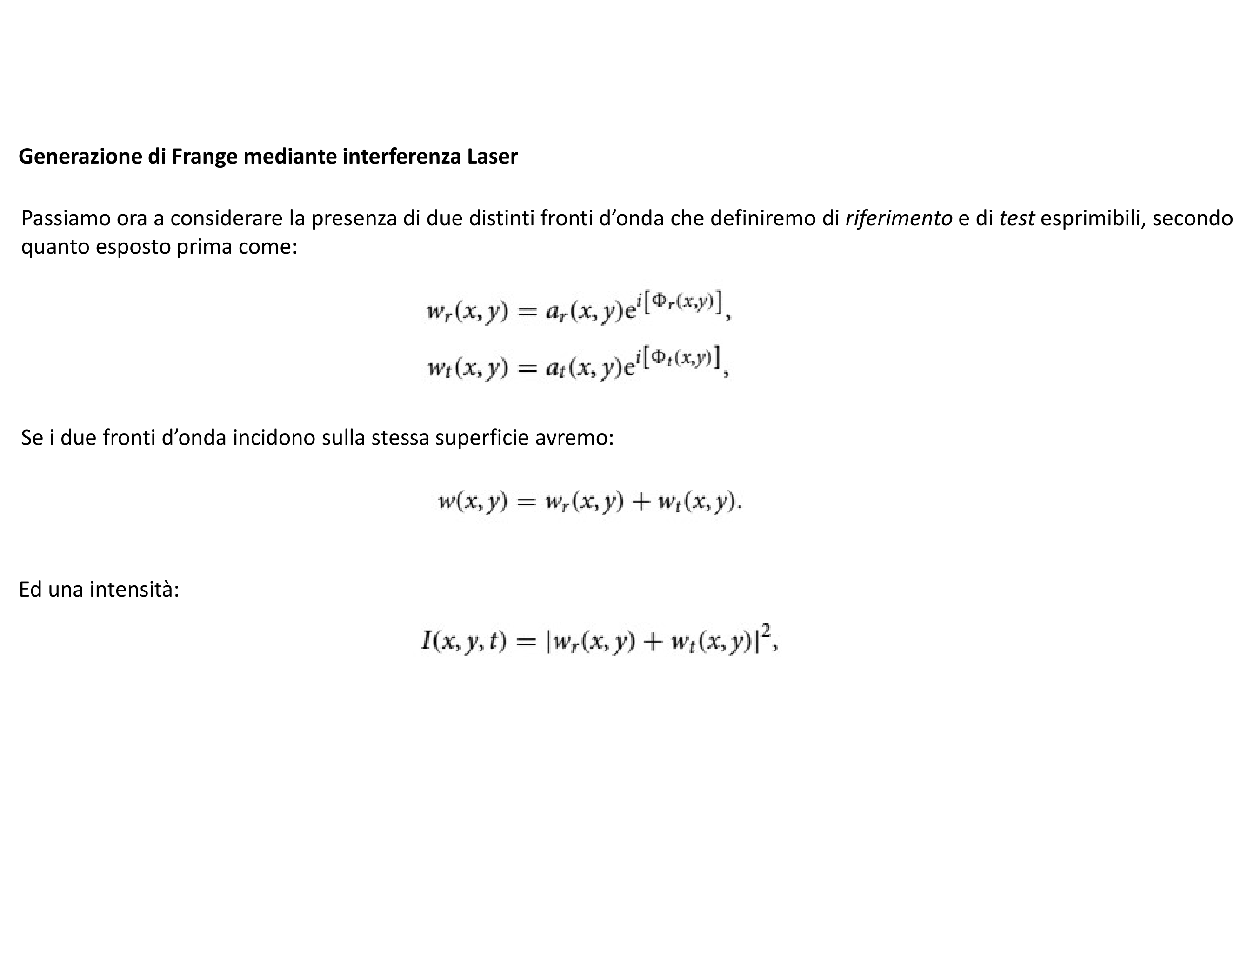
Principle of Fringe Analysis
Fringes Generated by Laser Interference
Let’s suppose now to have two wavefront and let’s call them reference and test
Let’s make them interfere on a surface
Leading to an intensity

Slide 16
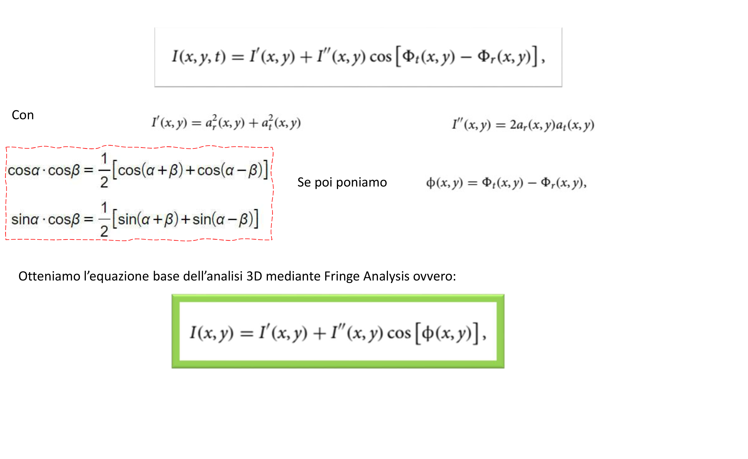
Principle of Fringe Analysis
Where
We can set
We get the fundamental equation of the fringe analysis

Slide 17
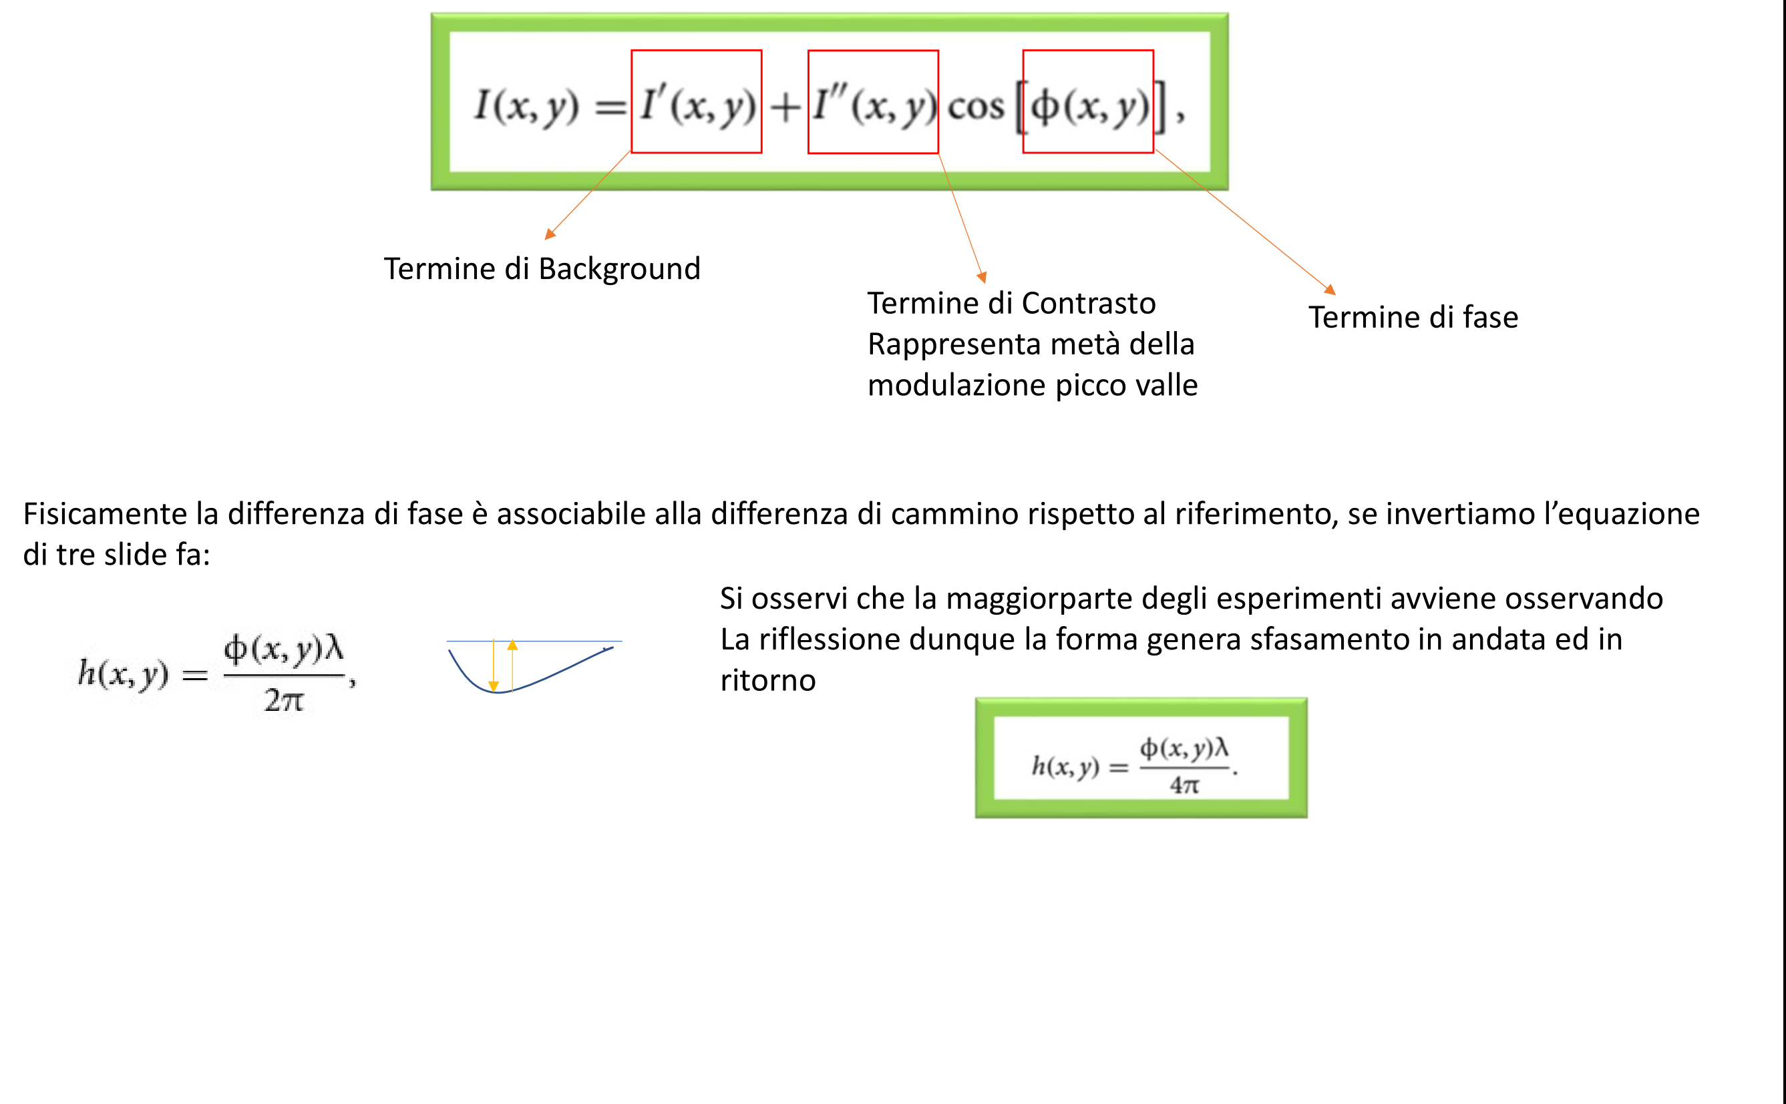
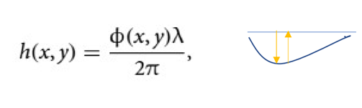
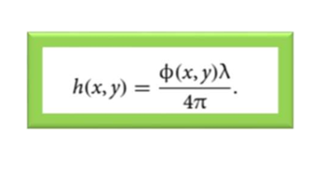
Principle of Fringe Analysis
Background
Contrast
Phase

Slide 18
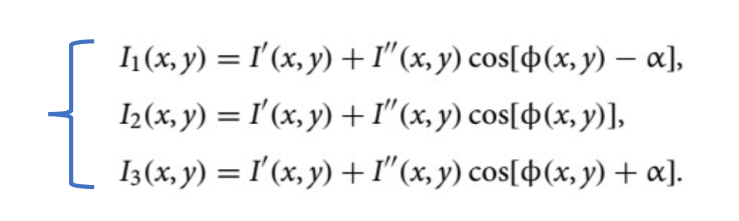
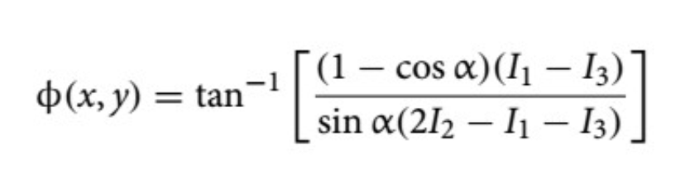
Principle of Fringe Analysis
How I can extract the phase? PHASE SHIFTING
Three Step Phase Shifting

Slide 19
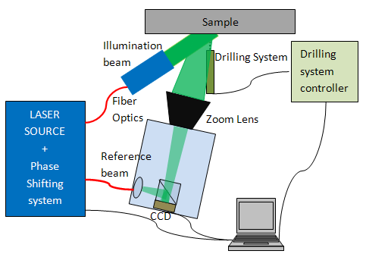
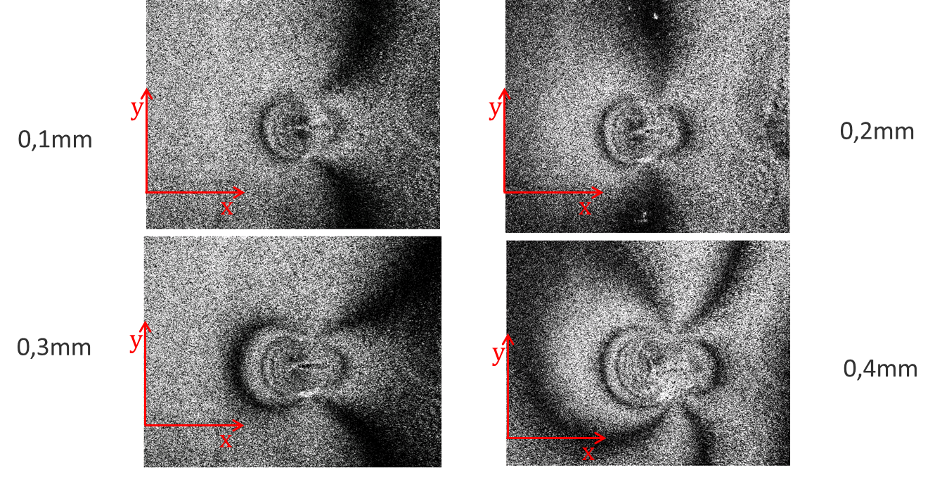
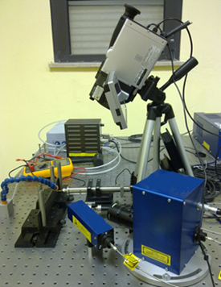
Principle of Fringe Analysis: one application
1 DPSS, λ=532 nm, P=25 mW laser source
1 CCD camera 640x480 ;
1 Electronically controlled cutter
1 Precision Translational stage
1 Compressed air cleaning system
1 PC
Speckle is a noise on the fringe pattern

Slide 20
Moiré Principle
Grid 1
Grid 2
All the methods allowing to exploit this effect, overlapping even electronically these two grids are called
moiré
Notes:
In questa slide mostriamo il principio fondamentale su cui sono basate le tecniche moiré. Sovrapponendo due griglie sfasate si generano delle frange la cui frequenza varia al variare dello spostamento relativo. Questo principio può essere declinato in varie maniere a seconda dello specifico set-up.

Slide 21
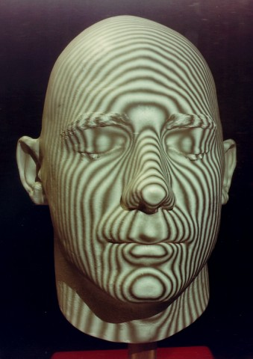
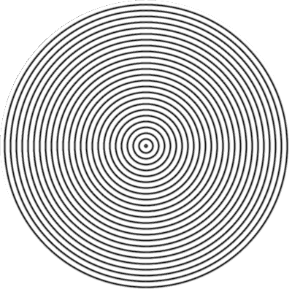
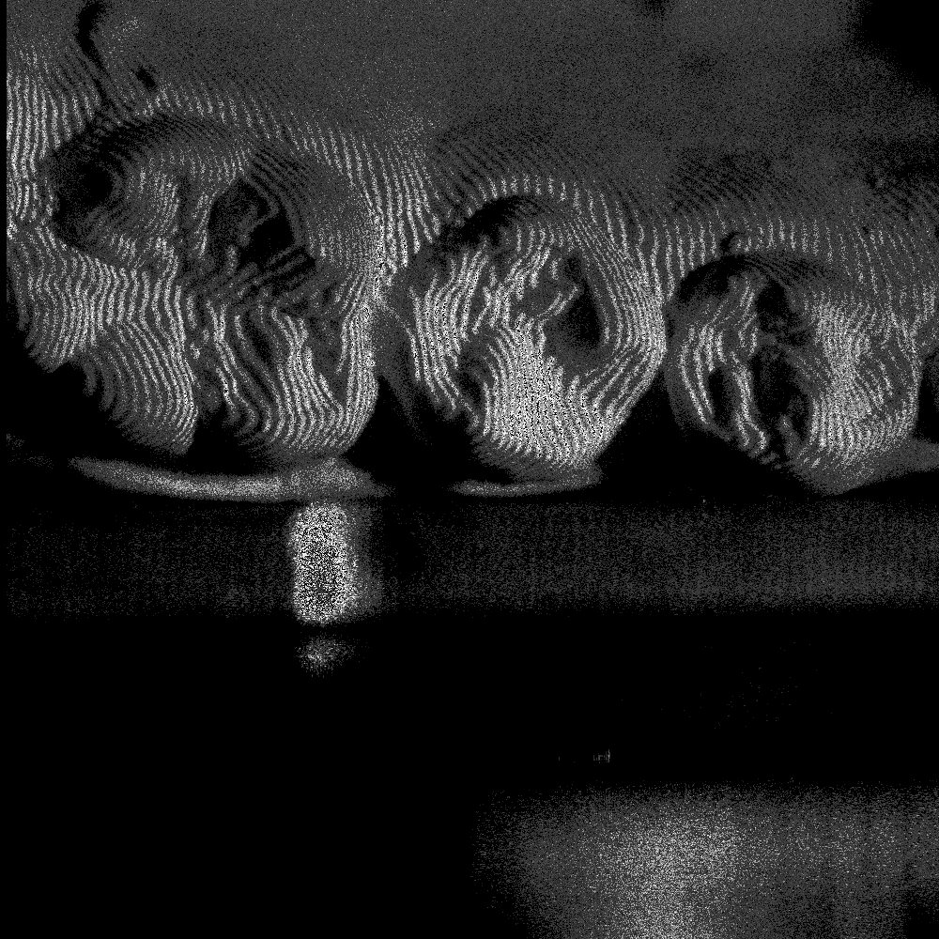
Moiré Principle

Slide 22
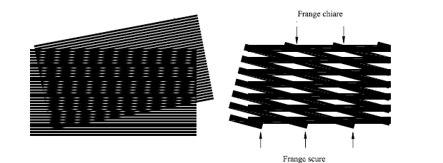
Moiré Method
Geometric Moiré
Interferometric Moiré
Reflection Moiré
Shadow moiré
u=pNx
v=pNy
In plane displacement
w=KpNz
Out of plane displacement

Slide 23


Moiré Method
p
P’
p’=(dp)/(d±p)
d=moiré fringes distance

Slide 24
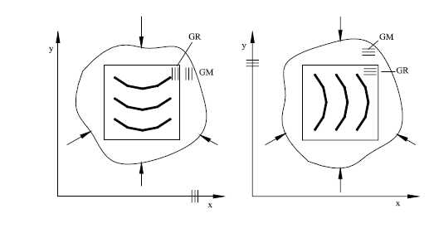
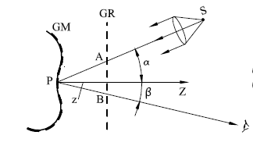

Moiré Method
Plane moiré
Shadow Moiré

Slide 25
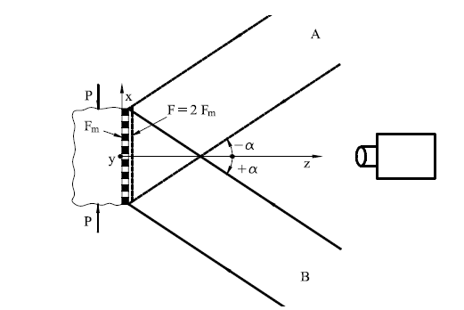
Moiré Method
u=pNx
Interferometric Moiré

Slide 26
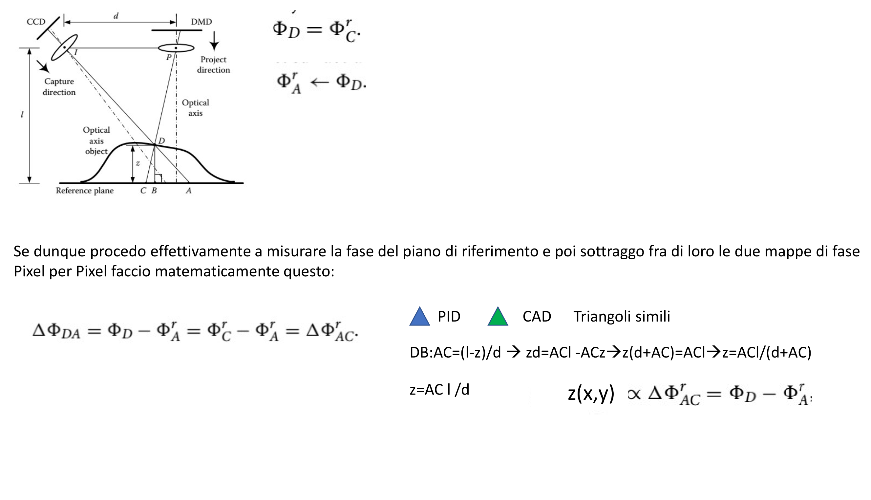
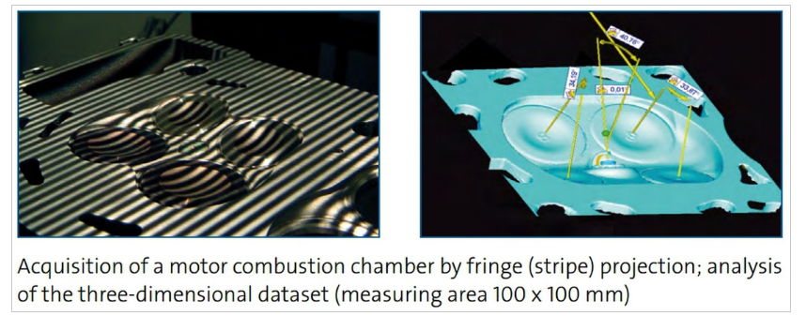
Fringe Projection Methods
If I subtract two phase map on the object and on the phase plane I get this:
Similar Triangles

Slide 27
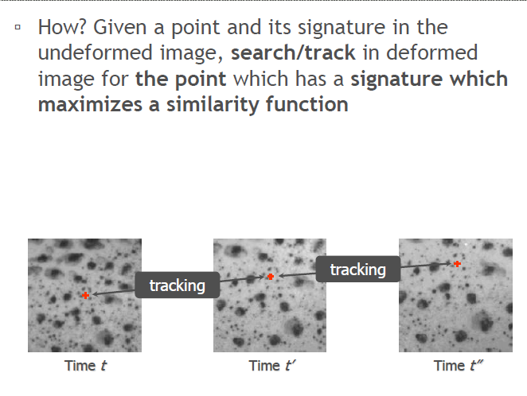
DIC

Slide 28
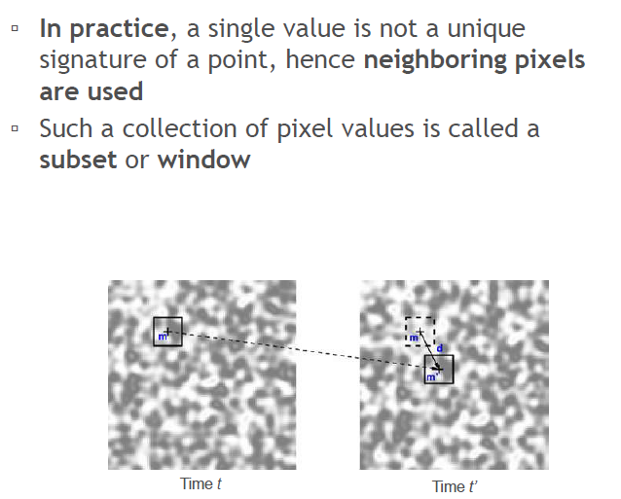
DIC

Slide 29
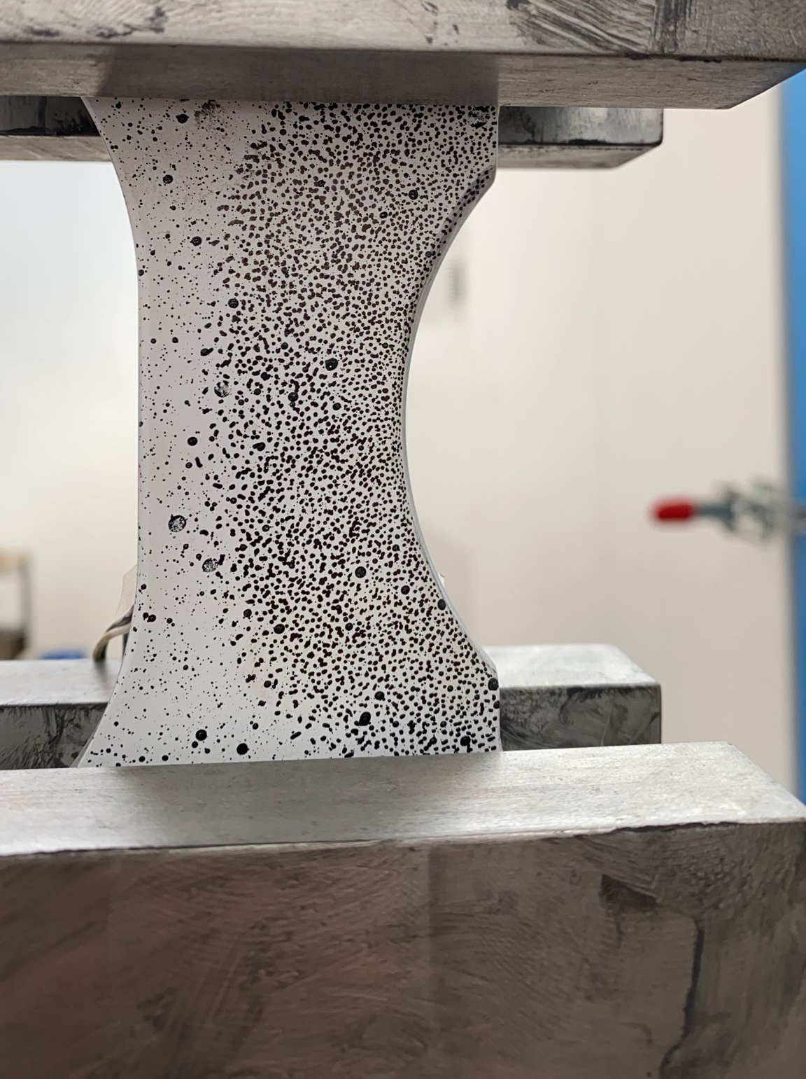
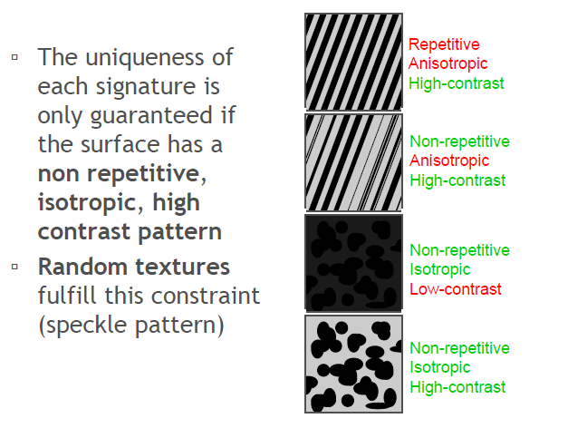


DIC
Stress Concentration Airbus
Clear Aligners
Foam Iosipescu
Iosipescu FOAM

Slide 30


DIC

Slide 31


DIC

Slide 32

DIC

Slide 33

DIC
C(5,5,1,1)=0
Perfect Match!

Slide 34

DIC
C(5,5,1,1)=0
Best Match!

Slide 35


DIC

Slide 36

DIC current challenges and Machine Learning
Improve Computational Time going toward real time evaluation
Reduce error in calculating strain from displacement
Manage with issue at high deformation up to paint breaking
Ru Yang, Yang Li, Danielle Zeng, Ping Guo, Deep DIC: Deep learning-based digital image correlation for end-to-end displacement and strain measurement. Journal of Materials Processing Technology, 302, 2022

Slide 37

DIC current challenges and Machine Learning
Three ideas:
Two separate net for Displacement and Strain
Displacement and Strain Calculated in the incremental way
Accumulated displacement is used to update the ROI

Slide 38

DIC current challenges and Machine Learning
Using an encoder decoder architecture and
Giving two input images (reference and
calculation) you have:
Two displacement fields
Three strain fields

Slide 39



DIC current challenges and Machine Learning
Notes:
Pytorch

Slide 40

DIC current challenges and Machine Learning
Calculated Strain Error
Max: 5.93%
Avg: 0.24 %
Strainnet Error
Max: 0.11 %
Avg: 0.018 %
Error in Strain Determination is reduced
But still not proved to manage large deformation at once

Slide 41

DIC current challenges and Machine Learning
Higher accuracy both on displacement and
Strain with respect to VIC-2D software
Other comparison can be done in terms of
Calculation time
When applied to a sequence of 189 images
The net time for VIC 2D software was 27 s
Time for Deepnet was 2.35 s
https://github.com/RuYangNU/Deep-Dic-deep-learning-based-digital-image-correlation

Slide 42

ESPI current challenges and Machine Learning
Denoising is a process which is slowing
the measurement chain
When dealing with complex fringe pattern
Global optimum denoising can hyde some
Local features
Poor generalization
Wenbo Jiang, Tong Ren, Qianhua Fu Zeng, Deep Learning in the Phase Extraction of Electronic Speckle Pattern Interferometry. Electronics, 13(2), 2024

Slide 43

Ground Truth
SOOPDE
WFF
Higher Contrast
Higher Denoising
Better shape Preservation
BL Hilbert L2
FDD NET
Xu, M.; Tang, C.; Hong, N.; Lei, Z. MDD-Net: A generalized network for speckle removal with structure protection and shape preservation for various kinds of ESPI fringe patterns. Opt. Lasers Eng. 2022, 154, 107017.
MDD NET
Notes:
Windows Frame Fourier
Oriented Partial Differential equation

Slide 44

Thank You For Your Attention!
giovanni.pappalettera@poliba.it

