Slide 1
Active control in Nanophotonics
for
Super-resolution Imaging
Bergin Gjonaj

Slide 2




Acknowledgments
Asaf David
Yochai Blau
Doron Shterman
Guy Bartal
APRL Group
Jochen Aulbach
Patrick Johnson
Allard Mosk
Kobus Kuipers
Ad Lagendijk

Slide 3
Outline
Background
  Microscopy over time
  Nanophotonics promises for microscopy
  Control - shaping optical wavefronts
Proof of concept for new microscopy
  Controlling nanophotonic/plasmonic wavefronts
  Focusing and scanning microscopy
Super-resolution
  Platforms for super-resolution
  Silicon Plasmonics

Slide 4
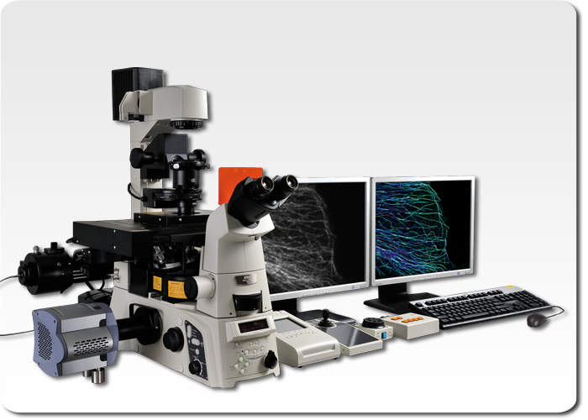
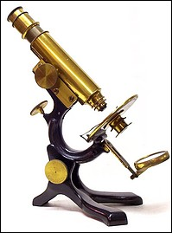
Microscopy
We started like this
Few Nobels later
(Nikon Storm)

Slide 5
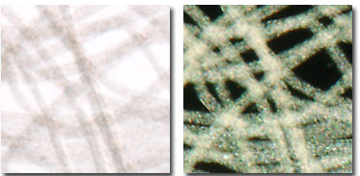
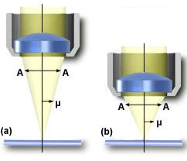
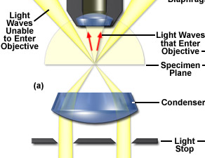
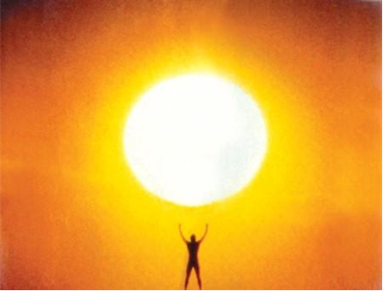
Bright field – Dark field

Slide 6
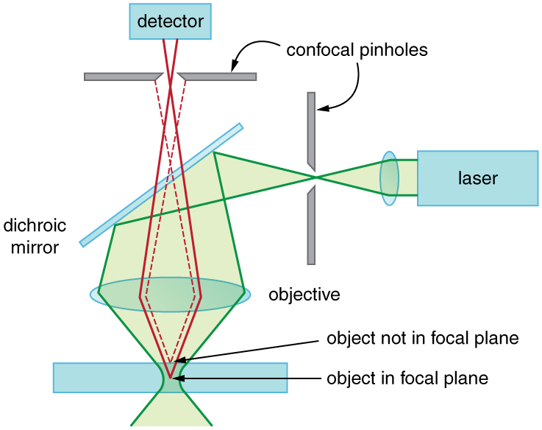
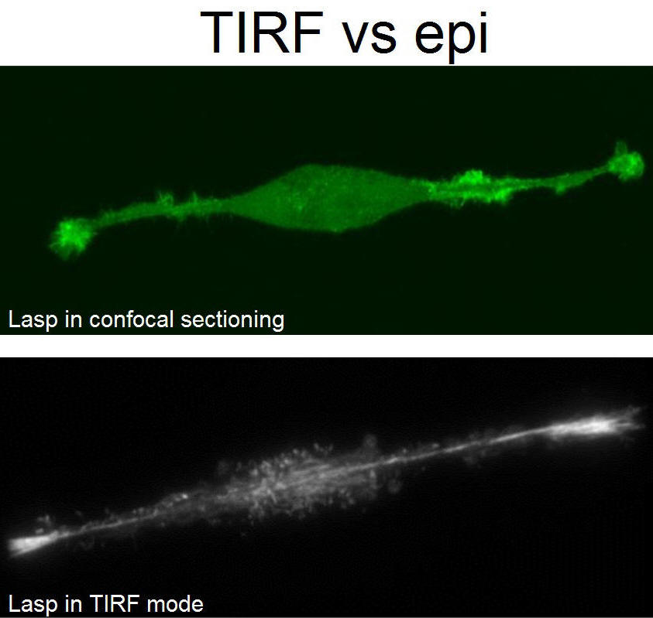
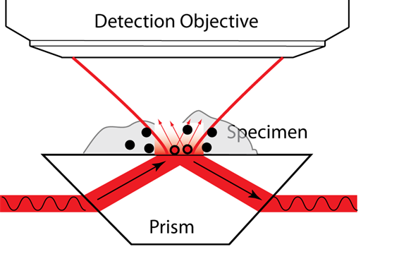
TIRF & Confocal
Total internal reflection
  Evanescent excitation
  Surface specific
Scanning technique
  Focused excitation
  Focused detection

Slide 7

Structured illumination
Two different gratings generate a third one
Sample
Structured illumination
If resolution does not allow to resolve one of the gratings, You can still deduce it from the other two.

Slide 8
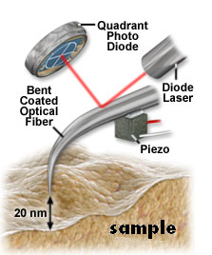
Near field Probes
No more lenses
  Detect with a scanning probe
  Resolution is given by the probe size

Slide 9
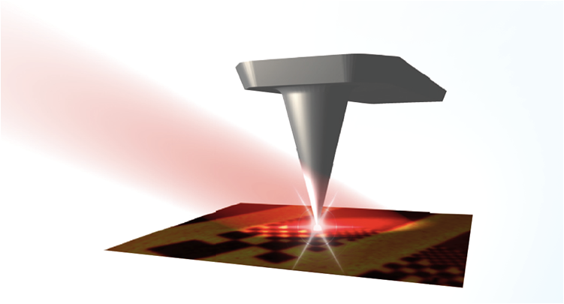
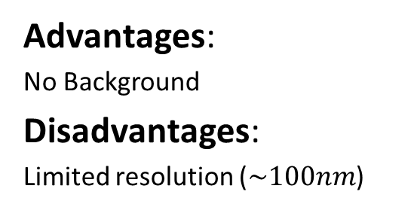
Near – field techniques
Scattering NSOM
Light collected by
lens/parabolic mirror
Aperture NSOM
Light coupled into optical fiber
Advantages:
Resolution (~2-20 nm)
Disadvantages:
Far field |Bacground
Scanning Sample
Advantages:
No Background
Disadvantages:
Limited resolution ($\sim 100nm$)
Notes:
Expand on nearfield

Slide 10
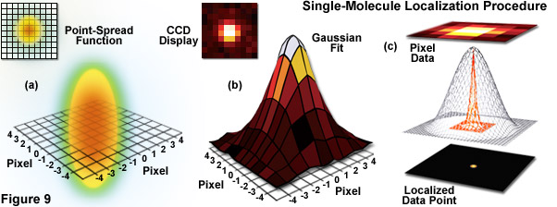
Single molecule localization
If two single molecules are well separated in space
  You can localize them by their center of mass

Slide 11
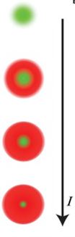
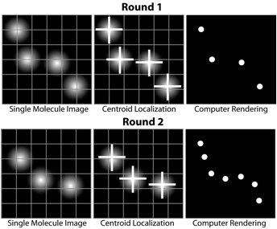
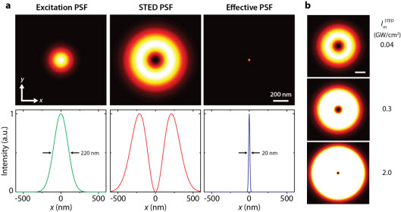
PALM, STORM STED
If molecules are separated
in time or space
  You can sum up an image
  (switching, activating)
If molecules are separated
in energy
  You can scan an image
  (saturation, depletion)
Betzig et al, Science 2006
Hell et al, Optics Letters 1999

Slide 12
Outline
Wavefront shaping in Nanophotonics (spatial resolution)
  Controlling waves in nanophotonic systems
  Focusing and scanning microscopy / Super-resolution
  Goal: towards nanolocalized Raman excitation
Wavefront shaping in scattering media (spatio-temporal)
  Controlling speckle in time
  Spatio-temporal focusing at targets
  Goal: towards burning/imaging targets inside tissue

Slide 13
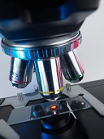
Optical microscopy: optimizations
Optics
  Oil/water immersion objectives
Illumination
  Dark Field, Phase Contrast (DIC)
  Total Internal Reflection (TIRF)
  Optical Coherence Tomography (OCT)
  Structured Illumination (SIM)
Detection
  Fluorescence,
  Confocal, Near-Field
Light-matter interaction
  STED, PALM, STORM
  Nonlinear, Photo-acoustic
The microscope slide

Slide 14
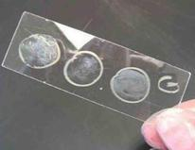
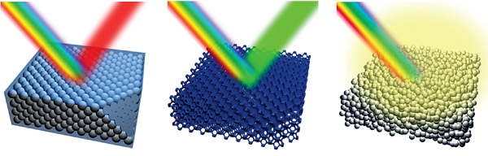
The generalized microscope slide
Conventional
  Passive, compensated
  Cheap and standard
  More Control!
Nanophotonic
  Active, focusing, filtering
  Super, hyper, meta lens
  More Control!
Natural
  Omnipresent, random, light scattering
  Thin slicing ex-vivo, other waves

Slide 15
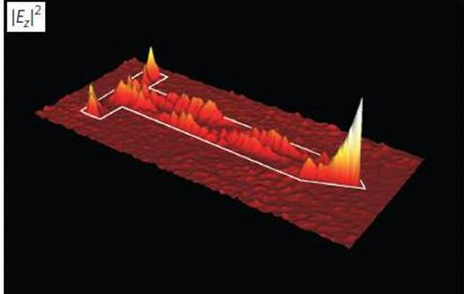
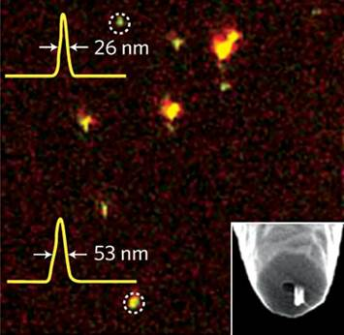

More control in Nanophotonics
Resolution
  Hot spots 10 – 100 nm
  Fixed, No imaging
Required control
  Image formation
Hillenbrand group (Nat Photon, 2012)
Choo, Yablonovitch (Nat Photon, 2012)
Novotny & Van-Hulst (Nat Photon, 2011)

Slide 16
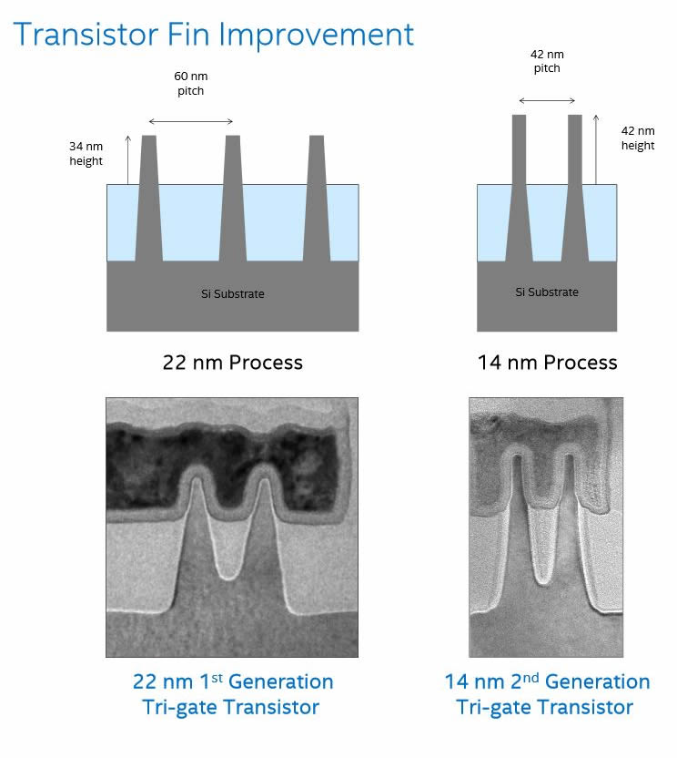
Motivation
Why do you need new microcopies?
  Applied - latest transistors at 20nm
  Cannot be fluorescently labeled
  Fundamental – spectroscopy
  The spatial distribution provides the WHAT
  You need spectroscopy to provide the HOW

Slide 17
The slide is the lens
Metamaterial slide
  Negative refraction materials
  Perfect lens
  Hyperbolic material
  Hyper lens
Plasmonics
  Short wavelengths
  Plasmonic lens
  Little success in bio imaging – We need more control!

Slide 18
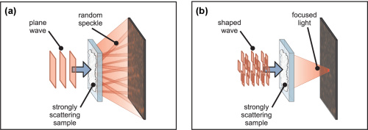
Wavefront Shaping – new control
Control the incident wavefront
  Use a spatial light modulator to shape the front
  Use feedback to find the right wavefront
  Achieve focusing from scattering media (paper)
  Achieve focusing to a different spot
Vellekoop, Opt. Lett. (2007 )

Slide 19
The wavefront control
Spatial Light Modulator (SLM)
Shaped front
(amp & phase)
Planar front
10 000 channels

Slide 20
Nanophotonics wavefront control
Is wavefront control in nanophotonics
applicable for microscopy?

Slide 21
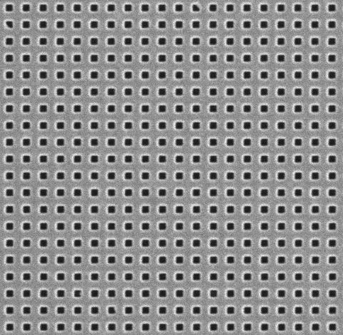
Surface Plasmon Polaritons (SPP)
Dielectric
Surface waves
Evanescent waves
Metal-dielectric interface
Sensing, SERS, Q. optics
Compared to photons:
Metal
SPP
Light
Same energy (color)
Shorter wavelength
Momentum mismatch

Slide 22
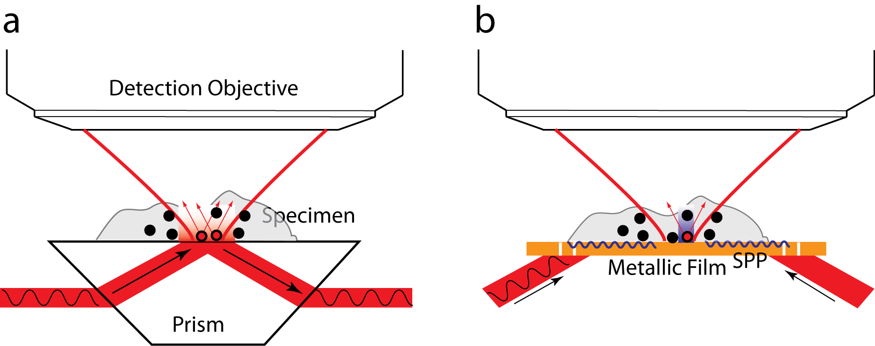
Plasmonics for microscopy
Shorter wavelength
Better focusing
Improved resolution

Slide 23
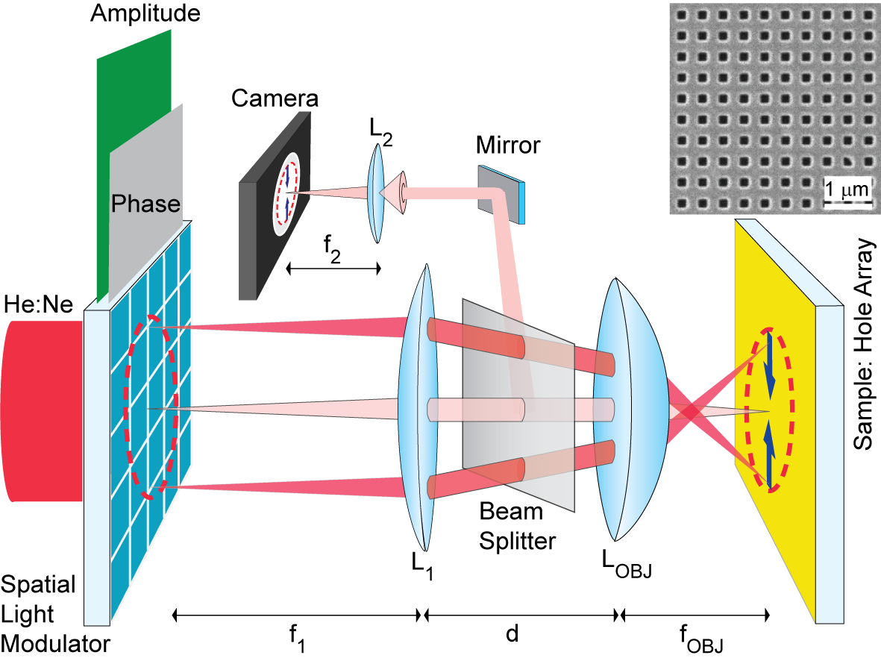
Plasmonic wavefront shaping
Gjonaj, Nature Photonics (2011)

Slide 24
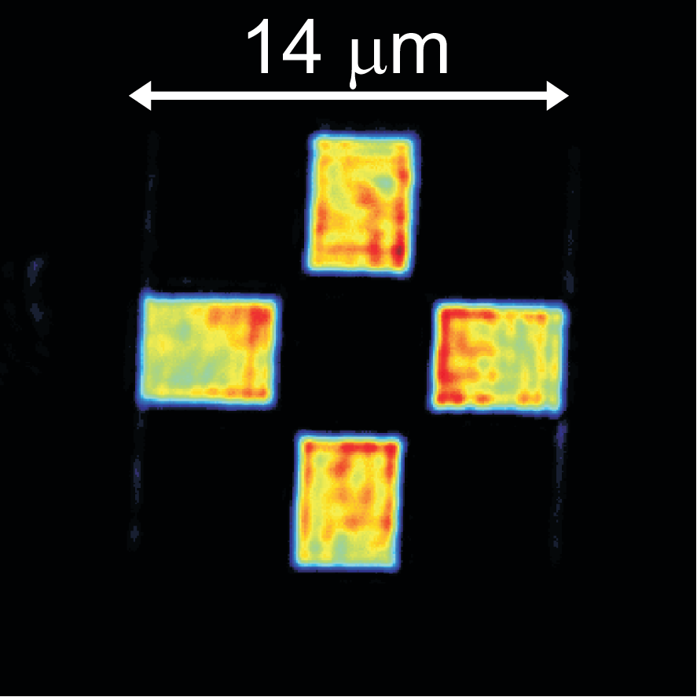
Amplitude design: bare gold
Resolution: 450 nm

Slide 25
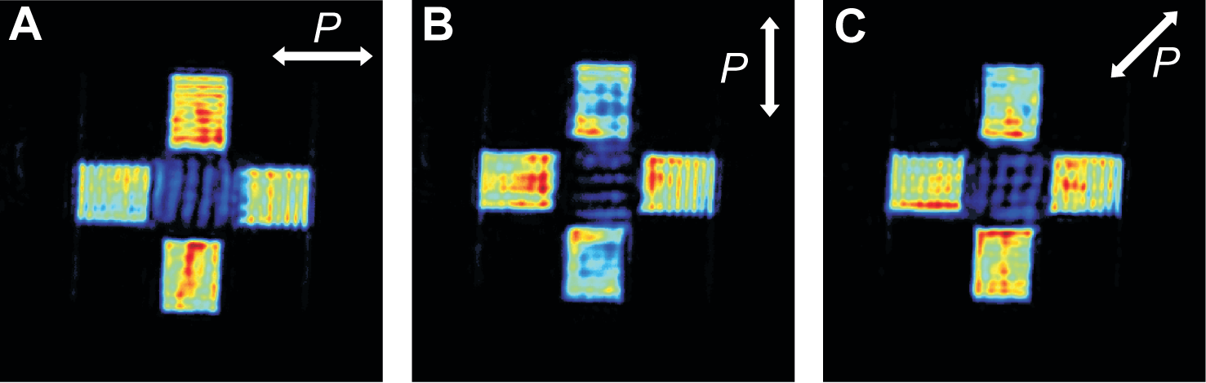
Launching SPPs: hole array
SPP plane waves propagate into the SPP arena
Polarization dependency
Formation of a standing SPP wave

Slide 26
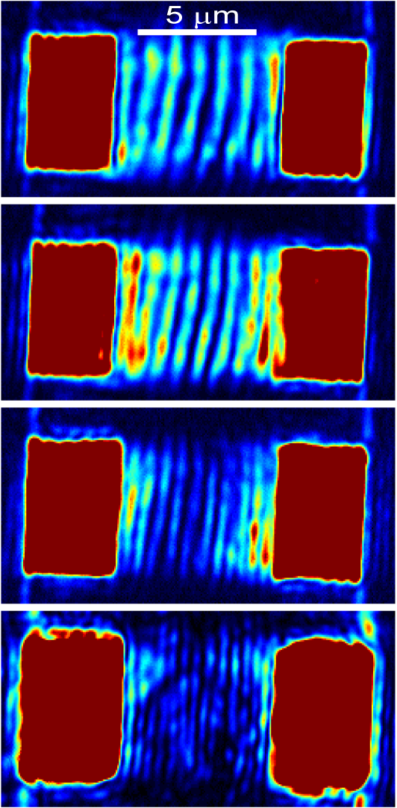
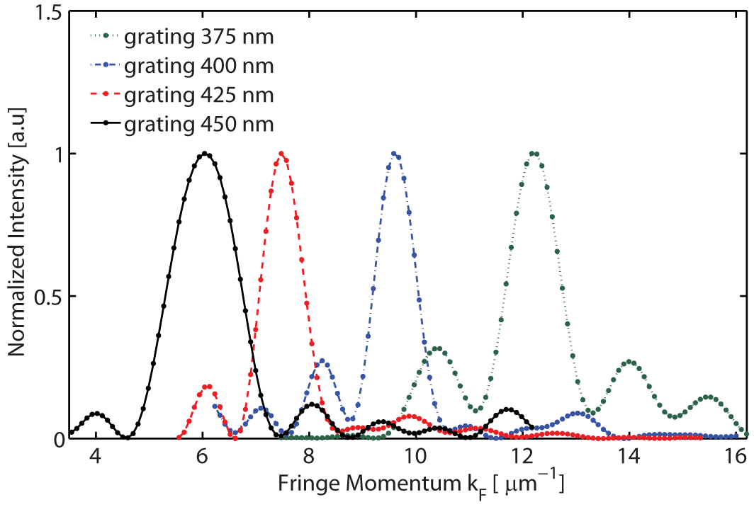
Fringes and gratings
450 nm
Fringe periodicity = 0.5*λ_{SPP} = 300 nm
425 nm
400 nm
375 nm

Slide 27
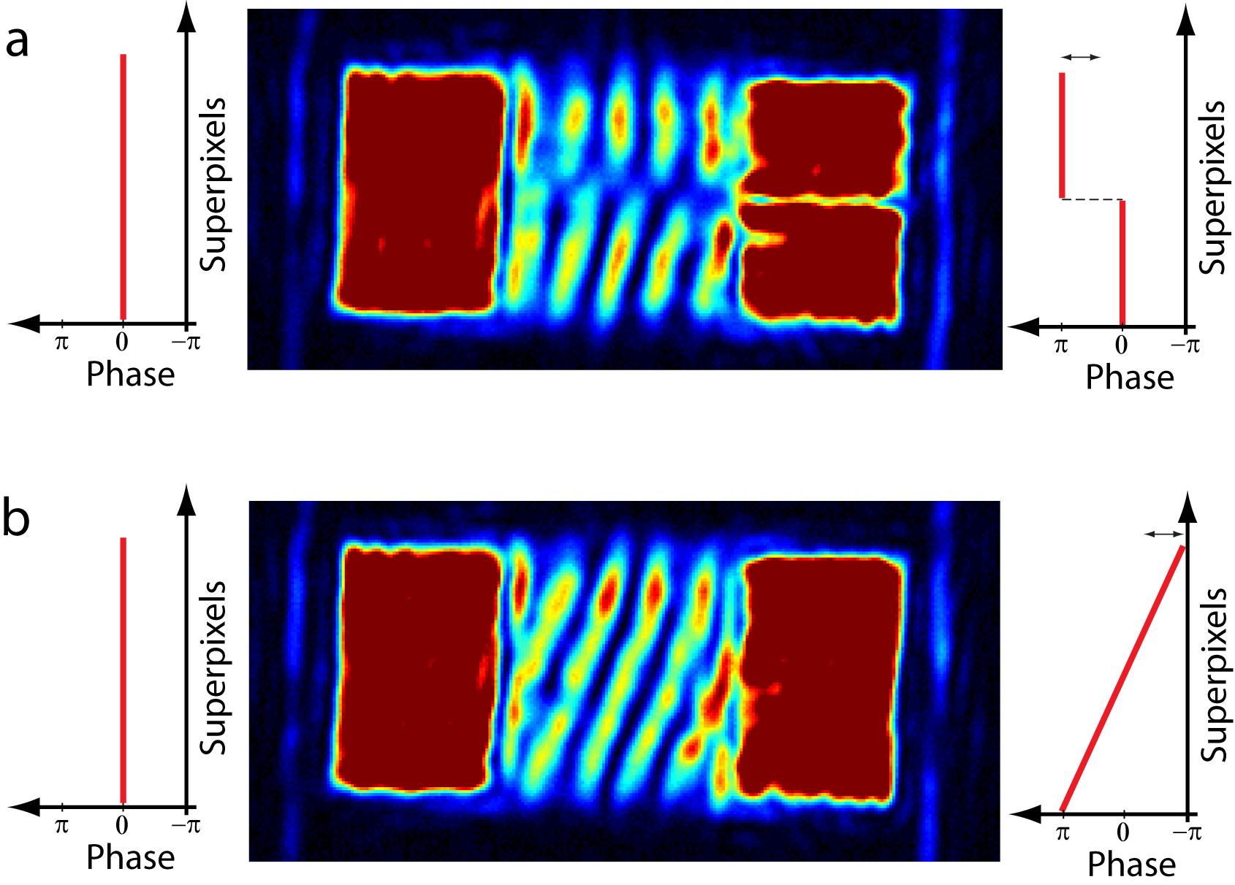
Shift & tilt of the fringes (SSIM)
Gjonaj, Nano Letters (2012)

Slide 28
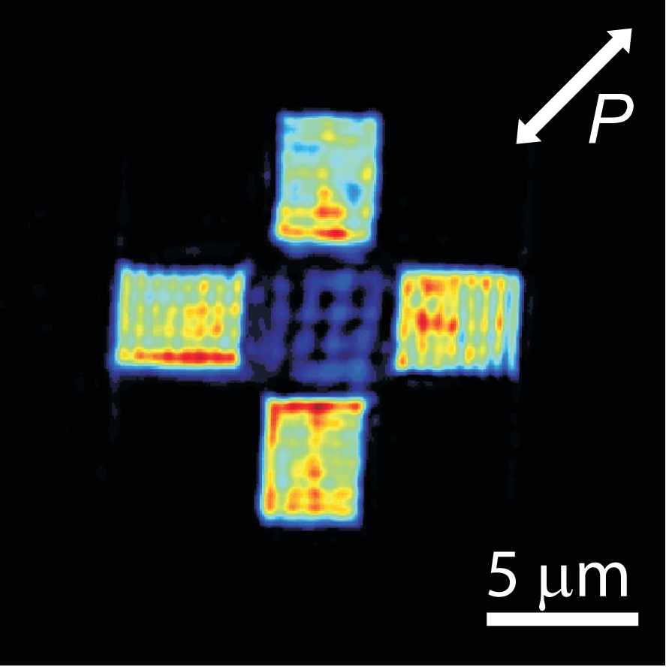
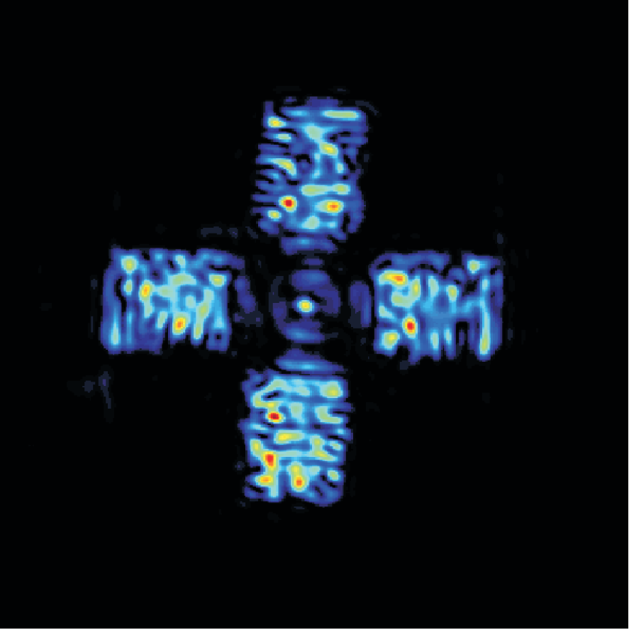
SPP focusing

Slide 29
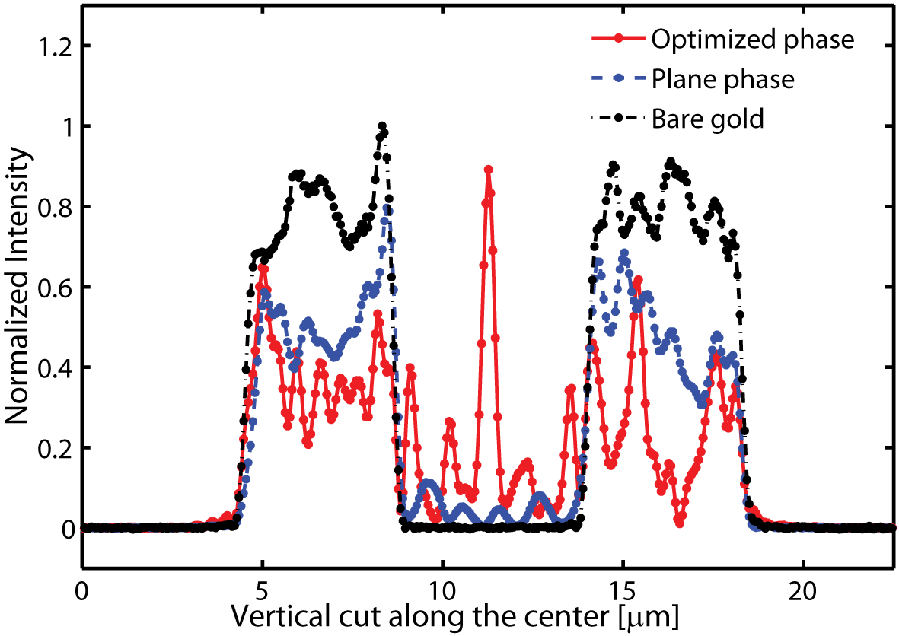
The SPP focus (with feedback)

Slide 30
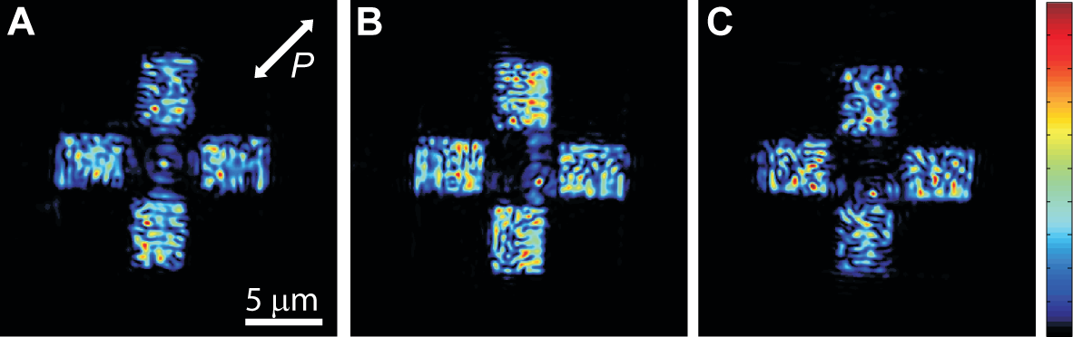
Relocating the focus
Everywhere inside the SPP arena
Gjonaj, Nature Photonics (2011)

Slide 31
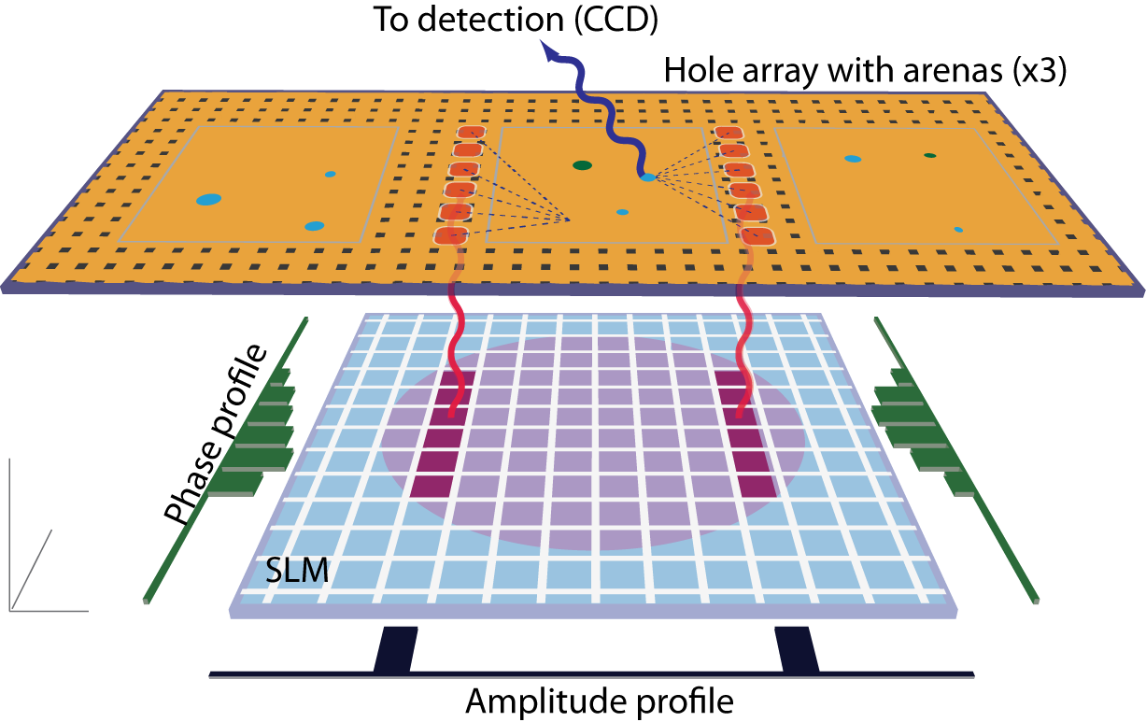
Implementation: microscopy
Gjonaj, PRL (2013)

Slide 32
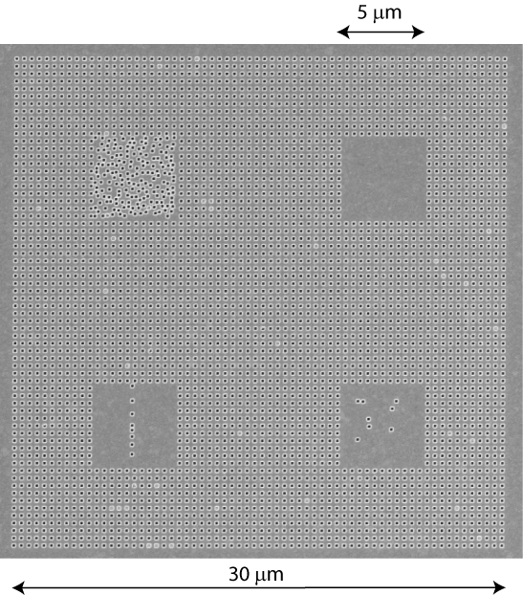
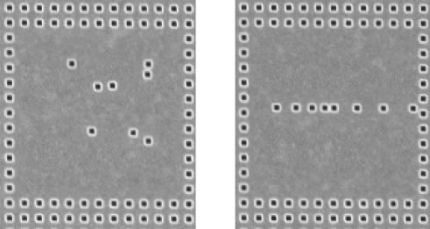
Nanostructered microscope slide
Hole grating : SPP launching
Bare gold arenas : no feedback
Free space GF : calculation
Scatterers : to be imaged
Metal : functionalize

Slide 33
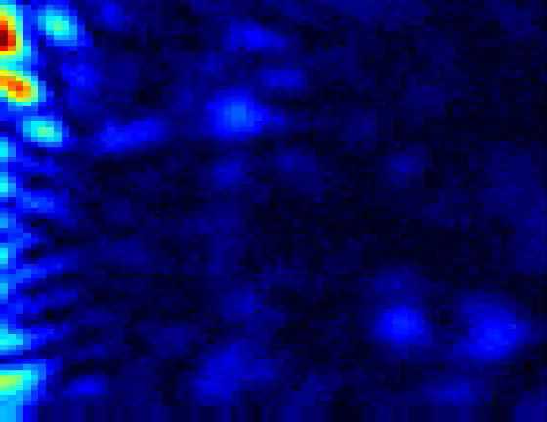
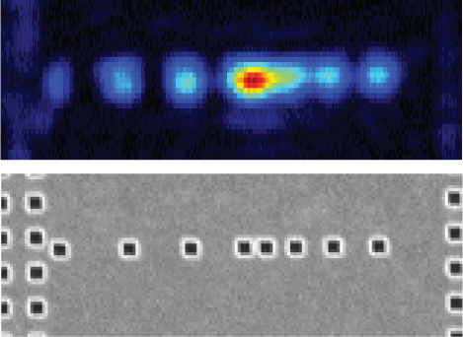
Concept – Scanning the focus

Slide 34
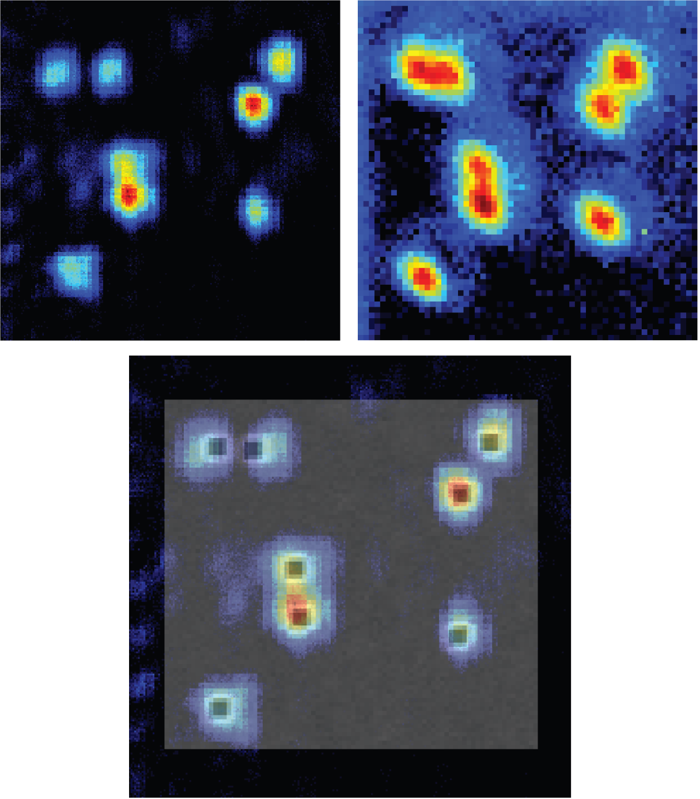
Plasmonic 2D imaging
Focusing
and
scanning
White light
illumination
Overlap with
SEM image

Slide 35
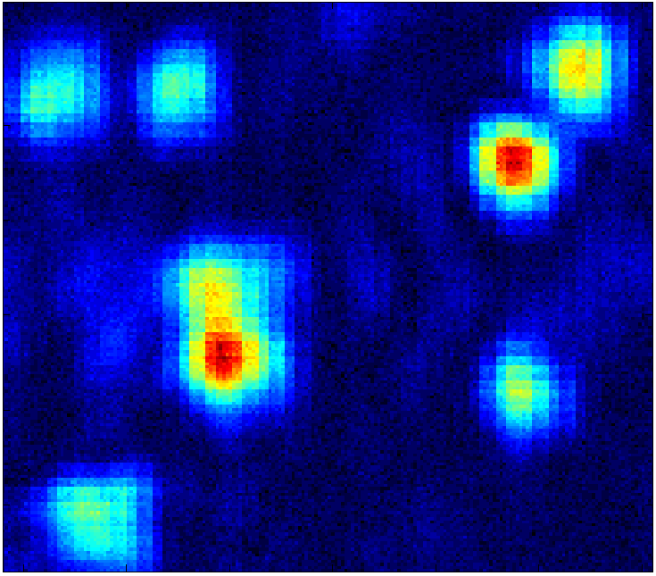
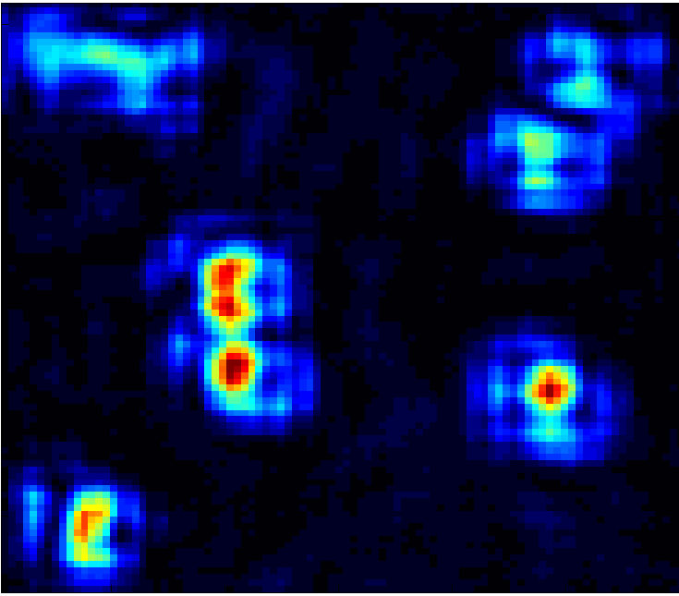
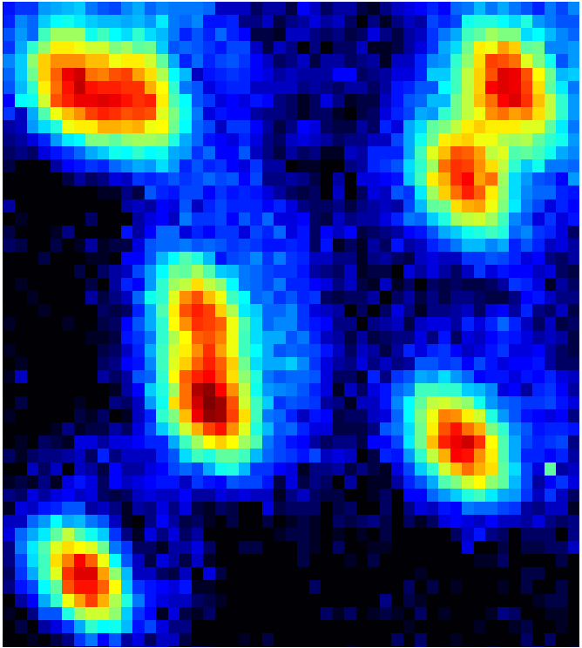
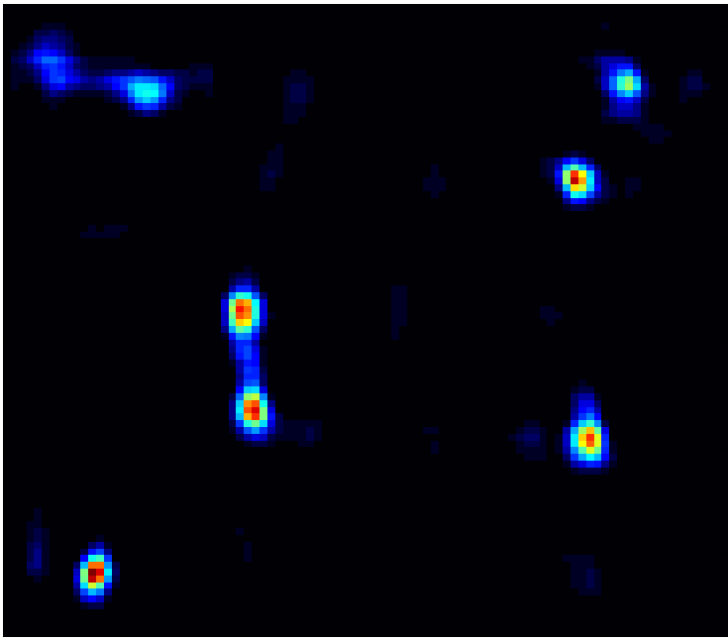
Enhancing the focusing/resolution
Deconvolution
White light
illumination

Slide 36
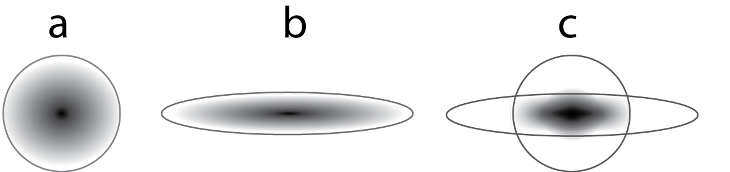
Possible read-outs
Single shot : detection psf
Integrated intensity : excitation psf
Pixel in the focus : confocal psf

Slide 37
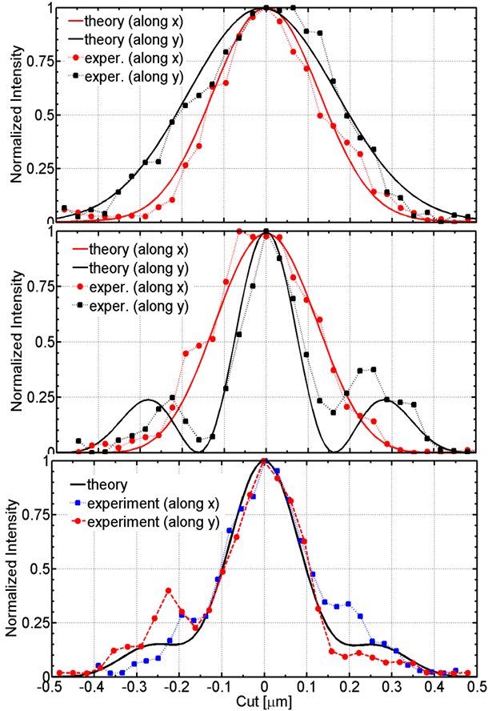
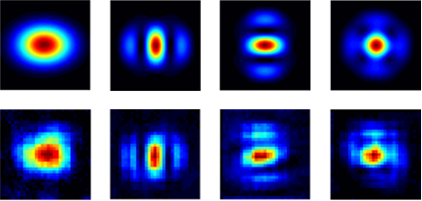
Imaging point spread functions
Gjonaj, PRL (2013)

Slide 38
Reorganizing our thoughts
Concept
  Simple – scanning a focus to achieve imaging
  Nice – does not require labeling
  Competitive – delivers energy locally (nano-spectroscopy)
Resolution
  Lensing – From 450nm objective to ~ 200nm. Great
  Wavelength – From 633nm to ~ 600nm plasmonic. (n=1.1)
  Maturity – STED, PALM, STORM ~ 20nm. Unfit

Slide 39
Improved waveguides – Si Nitrite
Next: New nanophotonics platforms
  Wavelength – From 633nm to ~ 180nm. (n=3.5)
  Losses – Propagation length > 1 micrometer.
  Interaction – Should excite a probe or a bio molecule
Air
Air
SiN
Gold
Silver
SPP (240nm)
SPP (600nm)
Light (633nm)
Light (532nm)

Slide 40
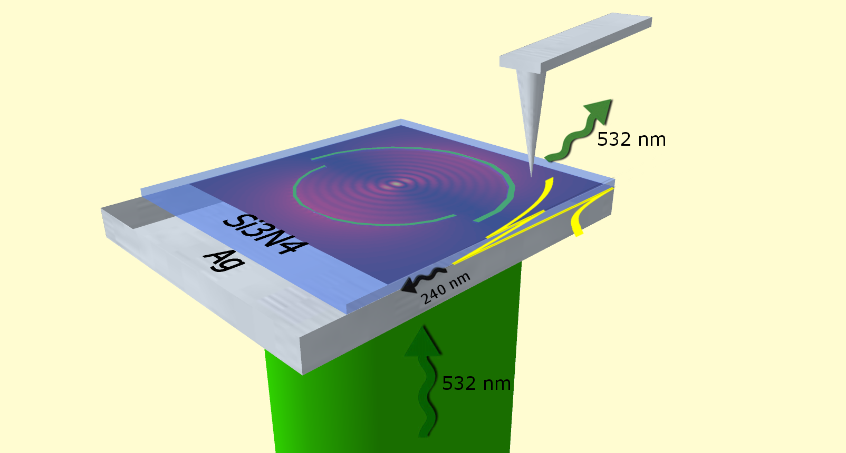
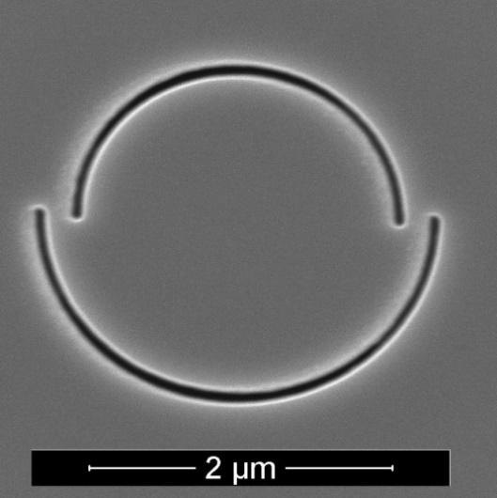
Near field measurements
Static focus due to the shape of the slits
Gjonaj, David et al Nano Letters (2014)

Slide 41



Wavelength 240nm; focus 66 nm
Gjonaj, David et al Nano Letters (2014)

Slide 42





Improved waveguides – Si Nitrite
Air
Air
SiN
Gold
Silver
  Wavelength – From 600nm to ~ 240nm. Almost there
  Losses – Propagation length < 1 micrometer.
  Interaction – Should excite a probe or a bio molecule

Slide 43

Super-resolution in Silicon domain
Bulk Silicon
  Refractive index ~ 3.5
  Connection to Si Photonics
  Connection to lithography
  Absoption in the visible
  Hard to harvest light
IBM Research
Thin Si waveguide
  Transparent
  Guided modes in 2D
  Propagation up to 10 um

Slide 44


Focusing with Silicon
David, Gjonaj et al Optica (2015)

Slide 45



Hybrid photonic plasmonic modes
Si - SiO₂ - Ag
60 - 8 - 300 nm
1D
Si - SiO₂ - Ag
60 - 4 - 300 nm
Air
Si
Metal
Air
Si
Metal
- SiO₂ -
Single hybrid mode
  More photonic
  Wavelength 220 nm
  Propagation 5.3 um
Single hybrid mode
  More plasmonic
  Wavelength 184 nm
  Propagation 3.3 um
Oulton et al Nat Photon (2008)

Slide 46





Resolution: contrast or size?
Intensity
Phase
Si - SiO₂ - Ag
60 - 8 - 300 nm
  Wavelength 220 nm
  Propagation 5.3 um
  Size (FWHM) 78 nm
$$1μm$$
Si - SiO₂ - Ag
60 - 4 - 300 nm
  Wavelength 184 nm
  Propagation 3.3 um
  Size (FWHM) 66 nm
David, Gjonaj et al Optica (2015)

Slide 47







Tunability: better contrast focusing
1
0
−π
π
  Wavelength 220 nm
  Propagation 5.3 um
  Size (FWHM) 78 nm
$$100nm$$
$$1μm$$
Si - SiO₂ - Ag
60 - 8 - 300 nm

Slide 48




Tunability: better size focusing
1
0
−π
π
  Wavelength 184 nm
  Propagation 3.3 um
  Size (FWHM) 66 nm
$$100nm$$
$$1μm$$
Si - SiO₂ - Ag
60 - 4 - 300 nm
David, Gjonaj et al Optica (2015)

Slide 49


Orbital angular momentum (spiral)
Spiral lens & circular polarization
  Angular momentum spiral = -1
  Angular momentum polarization = 1
  Net angular momentum L = 0
1
0
−π
π
$$100nm$$

Slide 50





Orbital angular momentum (circle)
Circular lens & circular polarization
  Angular momentum circle = 0
  Angular momentum polarization = 1
  Net angular momentum L = 1
$$100nm$$
David, Gjonaj, et al PRB (2016)

Slide 51

Nano vortex relevance
Optical vortices are well known and used
    Hasman, et al Nano Letters (2011)
Nano vortices are new
  The size (60 nm) is comparable with quantum systems
  For example Quantum Dots
  Beyond the dipole transition
  Accessing new transitions (dipole prohibited)
$$100nm$$
David, Gjonaj, et al PRB (2016)

Slide 52
Joining efforts
Active wavefront control
  Raster scanning
  (focus or vortex)
  Far field microscopy
  Flexibility
Silicon waveguides
  Wavelength 184 nm
  Propagation 3.3 um
  Resolution 66 nm
  CMOS compatibility Al

Slide 53
Take home messages
  Microscopy is continuously growing
Nanoscopy is an actuality
  Limitations: Fluorecent labelling, invasiveness
  Open questions : Chips, nanospectroscopy (i.e. Raman)
Wavefront shaping is flexible control
  Microscopy by focusing and scanning (label free)
  Deliver energy suitably for spectroscopy
Resolution is enhanced in Photonic 2D waveguides
  Static focusing to ~60 nm with reasonable contrast
  Tunable by material properties (resolution, losses, CMOS)

Slide 54

Upgrading an existing microscope
Multiplexed imaging

Slide 55
How to achieve it
Grating 1 order 1
Grating 2 order 1
Phase
Spatial light modulator: amplitude and phase

Slide 56
The generalized microscope slide
Conventional
  Passive, compensated
  Cheap and standard
  More Control!
Nanophotonic
  Active, focusing, filtering
  Super, hyper, meta lens
  More Control!
Natural
  Omnipresent, random, light scattering
  Thin slicing ex-vivo, other waves

Slide 57

Optical bioimaging – label free
  2 Photon
  fluorescence
  Optoacoustic
  microscopy
  Bright-field
  Principle: Scan a focused laser pulse
  Resolution: Size of the focus (~ 0.2 – 10 um)
  Depth: Mean free path (~ 0.1 – 1 mm )
  SHG THG
  Nonlinear harmonic generation
  Overlaid
  contrast
Ntziachristos group
D. Soliman, et al, Sci. Rep. (2015)

Slide 58



Bypassing diffusion (space – time)
  Acoustics
  M. Fink, IEEE (1992)
  A. Derode, et al, PRL (1995)
  Microwave
  G. Lerosey, et al, PRL (2004)
  G. Lerosey, et al, Science (2007)
  Optics (monochromatic)
  S. M. Popoff, et al, PRL 2010
  Optics (pulsed)
    D. J. McCabe, et al, Nat Com (2011)
    J. Aulbach, et al, PRL (2011)
    O. Katz, et al, Nat Photon (2011)

Slide 59

Acoustics to optics
Fink, et al. Rep. Prog. Phys. (2000)
Johnson, et al. Phys. Rev. E (2003)

Slide 60


Bypassing diffusion (space – time)
Aulbach, Gjonaj, et al, Phys. Rev. Lett. (2011 )

Slide 61


Time focusing
  Laser pulse ~ 64 fs
  SLM segmentation N ~ 300
  Temporal focusing ~ 115 fs
  Intensity enhancement ~ 10² - 10³
Aulbach, Gjonaj, et al, Phys. Rev. Lett. (2011)

Slide 62

Space-time addressing of targets
  Second Harmonic particles (size 200 nm)
Aulbach, Gjonaj, et al, Opt. Exp. (2012 )

Slide 63



Space-time focusing
SH images
(@ 2ω)
Autocorrelation
(@ 2ω)
Aulbach, Gjonaj, et al, Opt. Exp. (2012 )

Slide 64

Reproducibility
Part. # | τ_{pulse}(fs) | η_{exp} | η_{model} | η_{cw}
1 | 110 | 2.5 · 10² | 3.1 · 10² | 1.6 · 10⁴
2 | 102 | 0.7 · 10² | 3.2 · 10² | 1.7 · 10⁴
3 | 111 | 2.7 · 10² | 2.7 · 10² | 1.4 · 10⁴
4 | 104 | 0.7 · 10² | 2.9 · 10² | 1.5 · 10⁴
5 | 109 | 3.0 · 10² | 3.8 · 10² | 2.0 · 10⁴
6 | 109 | 5.5 · 10² | 6.5 · 10² | 2.4 · 10⁴
  The enhancement, η, depends on the SLM segmentation.
  We contained the SLM segmentation to N = 800,
  because above it (N > 1000) the particles are burned and destroyed

Slide 65





Biomedical opportunities
Human brain tumour (dark)
Intra-operational THG image (40 mW)
  Depth ~ 10 - 100 mean free paths
  Tissue equivalent 0.1 - 5 cm
Intra-operational (in depth)
  High tumour density: CUT MORE
  Low tumour density: CLOSE UP
Early stage (in depth)
  Degeneration: YES/NO
65
Can we burn inside?
Nanoparticle labelling ?
Can we image inside (THG)?
Focusing and memory effect?
Kuzmin, et al, Biomed. Opt. Express. (2016 )

Slide 66


The right feedback
Challenges/requisitions:
  Diffusion of light by tissue
  Local power delivery
  Specificity – tumours only
  Photoacoustic contrast
  Multi-sensorial (light, sound)
  Single detector (image-free)
  Only optical diffusion

Slide 67

Ant-burning of tumours
Submitted VIDI proposal

Slide 68
Therapy, imaging & sensing
Photoacoustics space-time focusing:
  Contrast agents: Hemoglobin – brain, eye, breast
          Melanin – skin, lymph nodes, circulating tumor cells
          External – dyes, plasmonic particles
  Imaging : SHG, THG, (memory effect - high res, limited range)
  Sensing: Oxygen saturation of Hemoglobin (sO₂), temperature
One case of success is sufficient!

Slide 69
Conclusions
Generic
  Microscopy is important and is challenging
  ‘SIM is the future’ – Betzig said.
Specific to this work
  High index materials (n>3) are great for SIM
  A double Moire illumination is the way to go
  5x better resolution (down to 45nm)
  Relatively simple and fast
  The required control is feasible

