Slide 1
Beam Gas Curtain – An Overview of 2024 on the LHC
Oliver Stringer
On behalf of the BGC collaboration
H. Zhang, M. Ady, D. Butti, A. R. Churchman, P. Forck, T. Lefevre, S. Mazzoni, C. Pasquino, A. Rossi, A. Salehilashkajani, M. Sameed, G. Schneider, O. Sedlacek, C. C. Sequeiro, S. Sethi, K. Sidorowski, S. Udrea, R. Veness, A. Webber-Date, and C. P. Welsch

Slide 2
Outline
Motivation of work.
Beam Gas Curtain (BGC) working principles.
Accuracy validation against ATLAS and CMS.
2D proton beam profile and emittance measurements.
Highlights as a lead beam diagnostic.
Summary and outlook.

Slide 3
Motivation
It is essential to be able to measure beam size within accelerators to determine emittance, and luminosity.
Current transverse profile diagnostics for the LHC include wire-scanners and the BSRT, both of which have limitations.
The High-Luminosity upgrade will introduce new challenges for existing diagnostics.
We present a non-invasive beam profile monitor that works for all stages of acceleration on the LHC.
  Only instrument able to acquire lead ion beam size measurements at injection energies.
  Only instrument able to acquire proton and ion beam size measurement through the acceleration cycle.

Slide 4
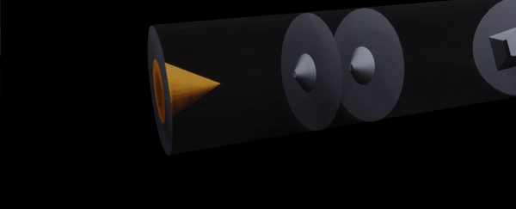
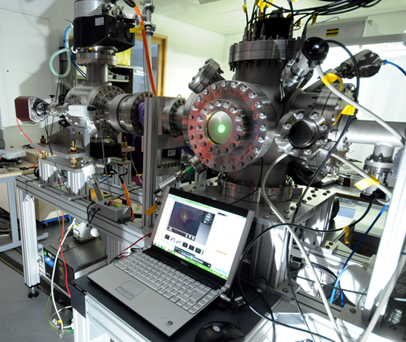
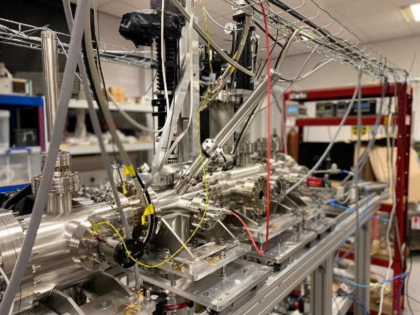
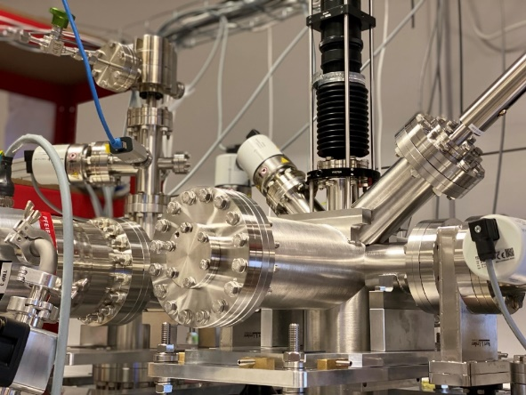
Gas Curtain Generation
Accelerate gas to supersonic speeds.
Collimate the profile using skimmers to a 45 degrees thin curtain.
Credit: Bethany Spear
18 years of research on gas jet technology.
Version 1
Version 2
Version 3

Slide 5
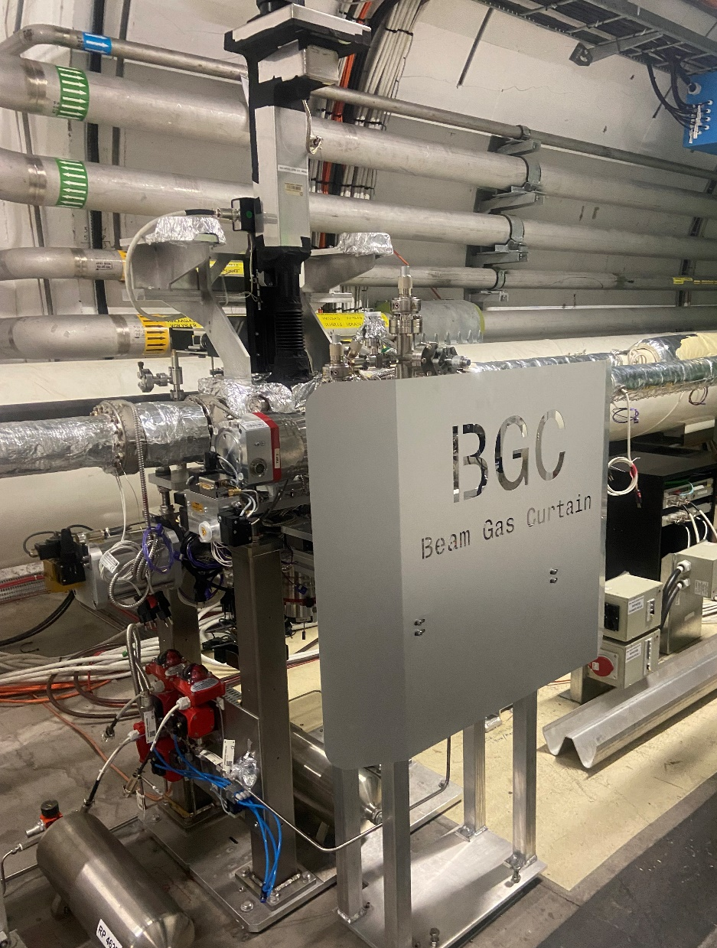
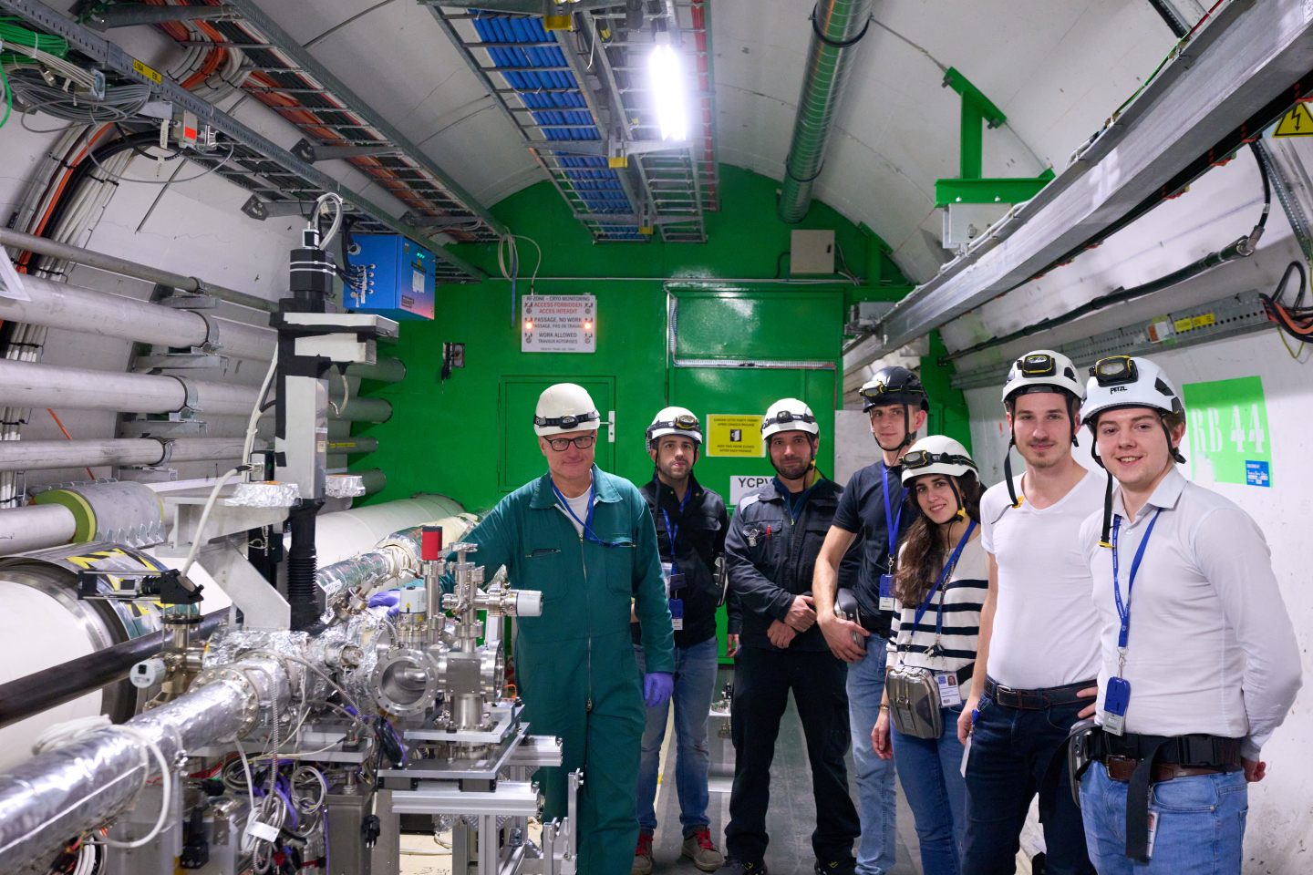
LHC Installation
Optical system
Gas curtain dump
Gas curtain injection
Notes:
Jan 2023
Thanks - the support provided by the BI group, vacuum group and the operation team, technicians at CERN.
3.5x10^16 mol . m^-3 - simulation
2.6x10^16 mol . m^-3 - measurement

Slide 6
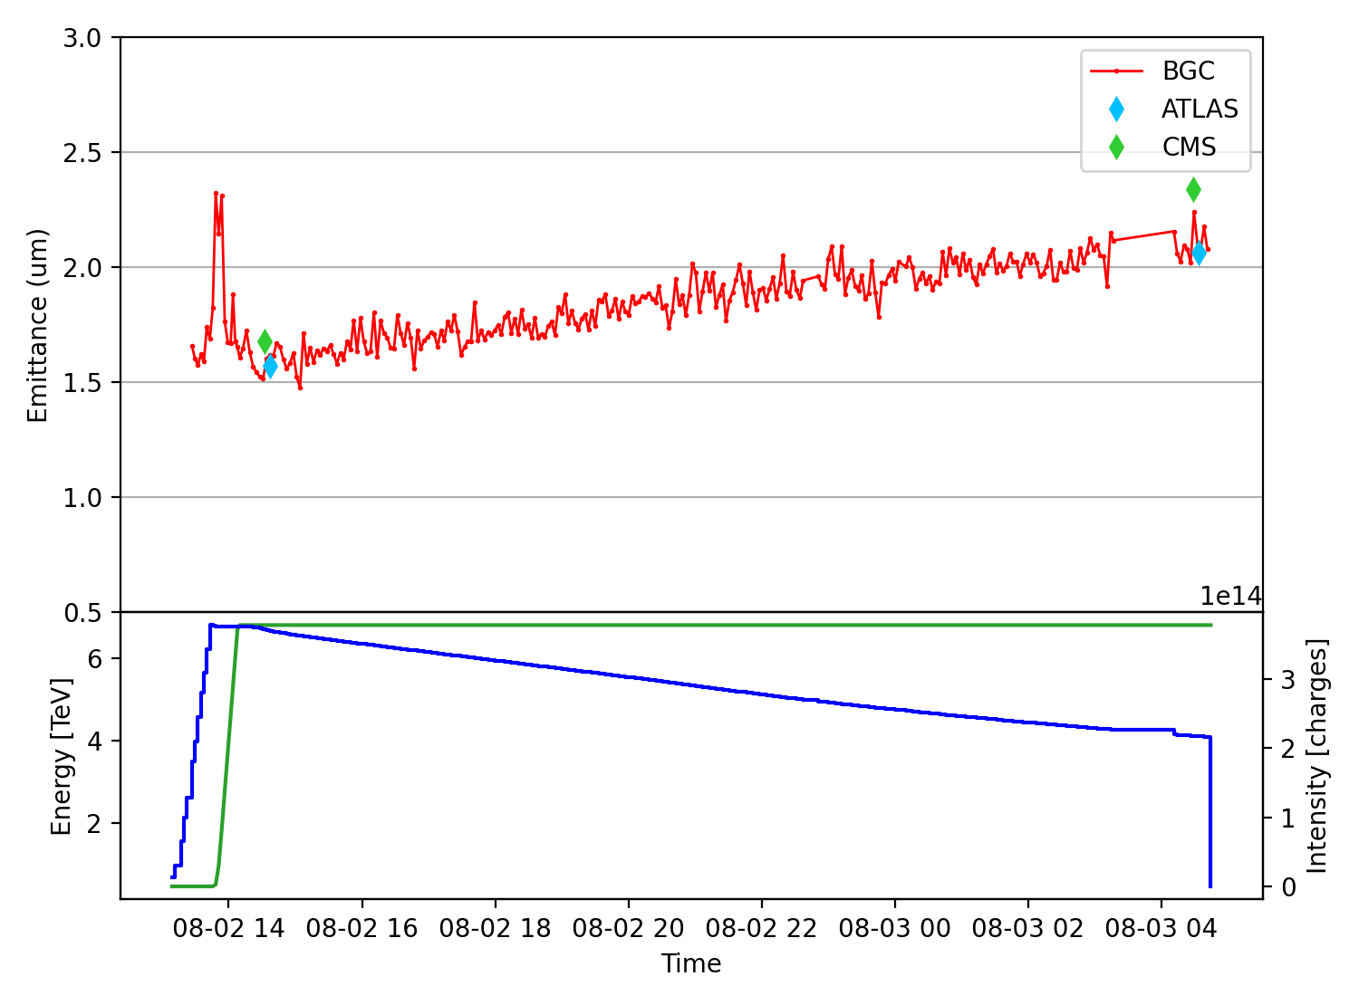
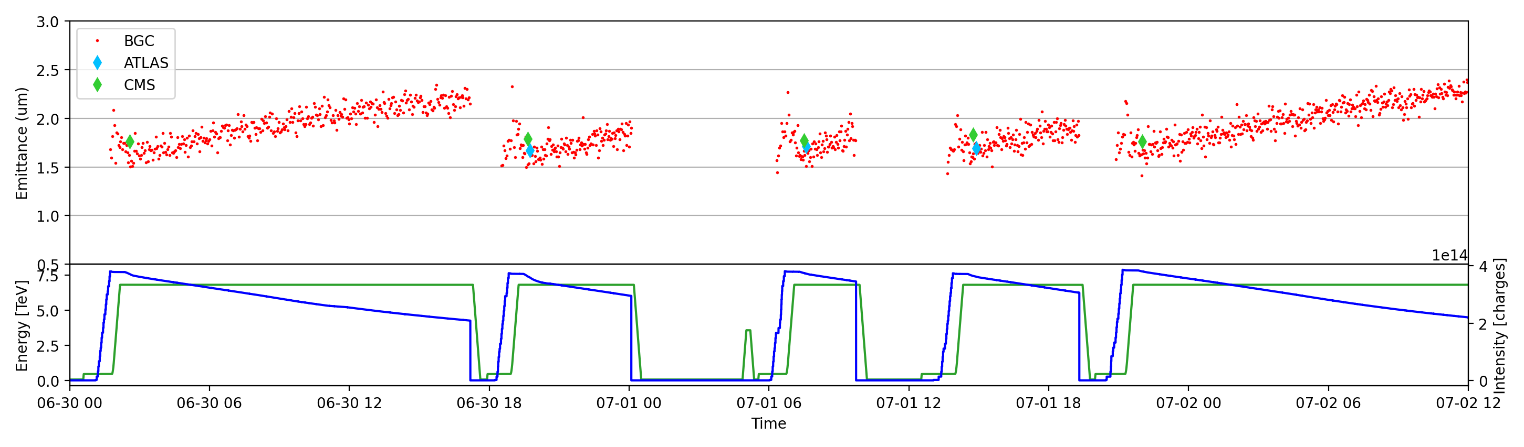


Accuracy Validation
Proton Physics
Noisy measurements (±10% peak-to-peak) but values consistent with emittance scans and reproducible over several fills
Visible neon transition and horizontal emittance
#9969
120 s integration per point
Consistent with both emittance scans
#9842
#9843
#9846
#9848
#9849
Courtesy of D.Butti
Notes:
(No space charge)
(No jet thickness)

Slide 7
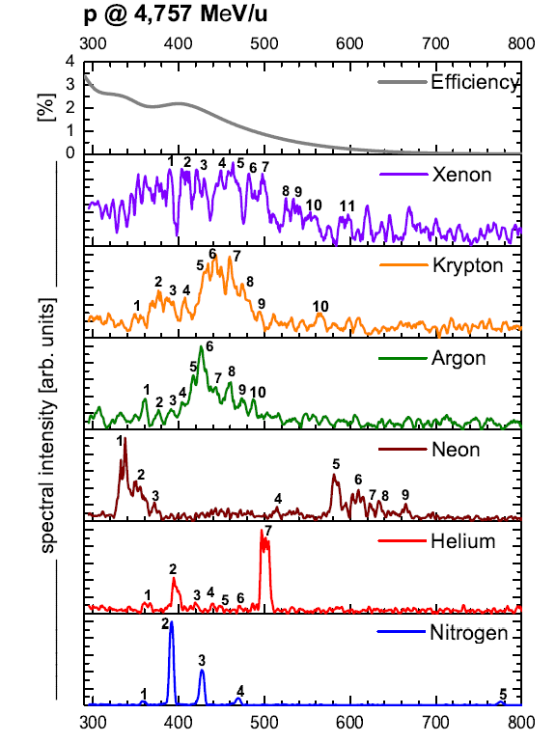
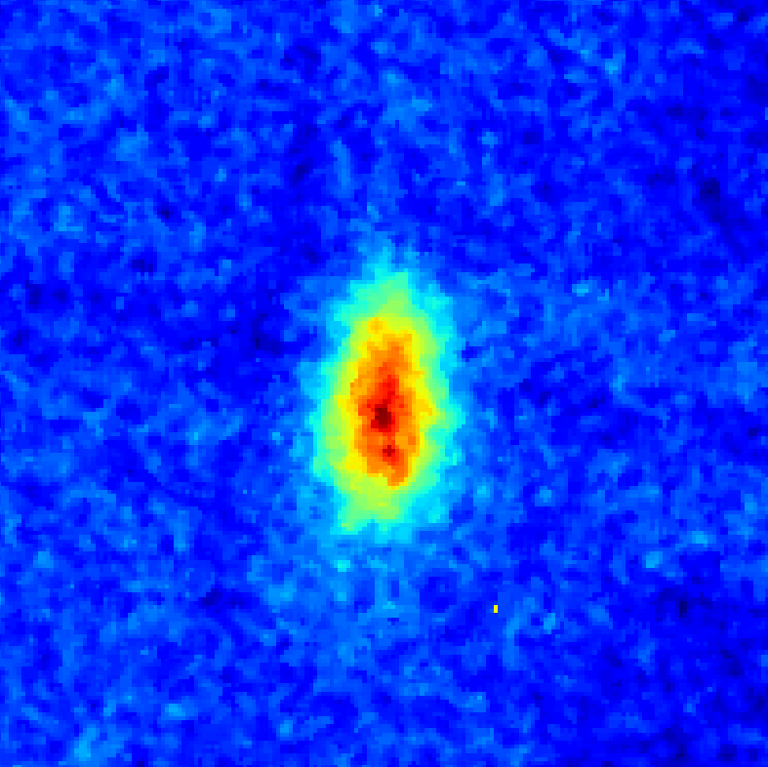
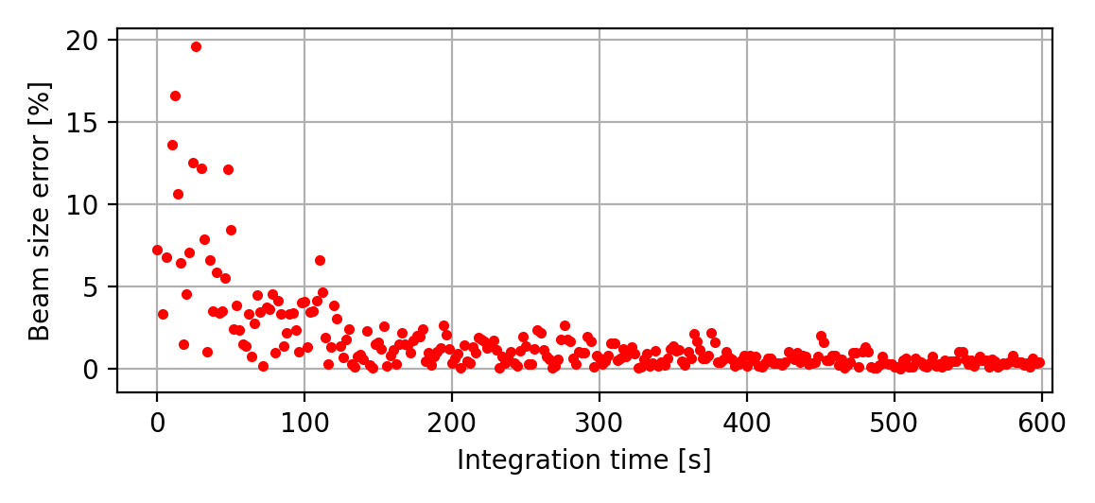
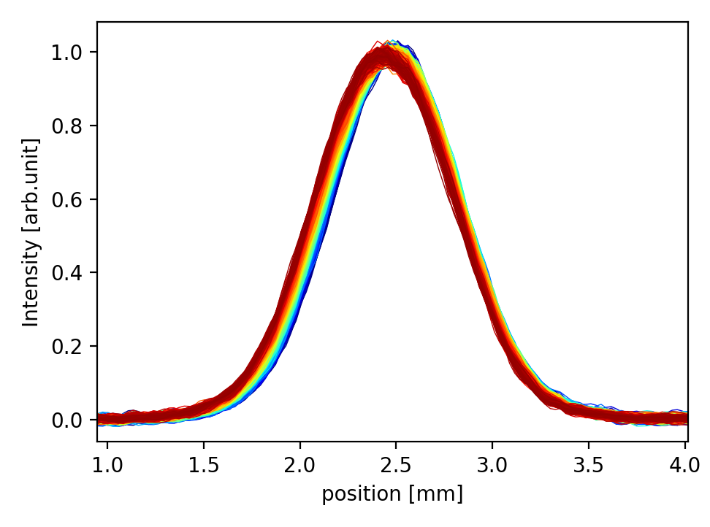
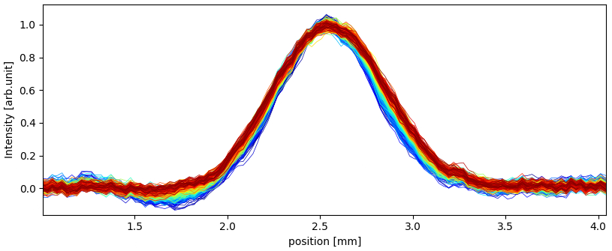
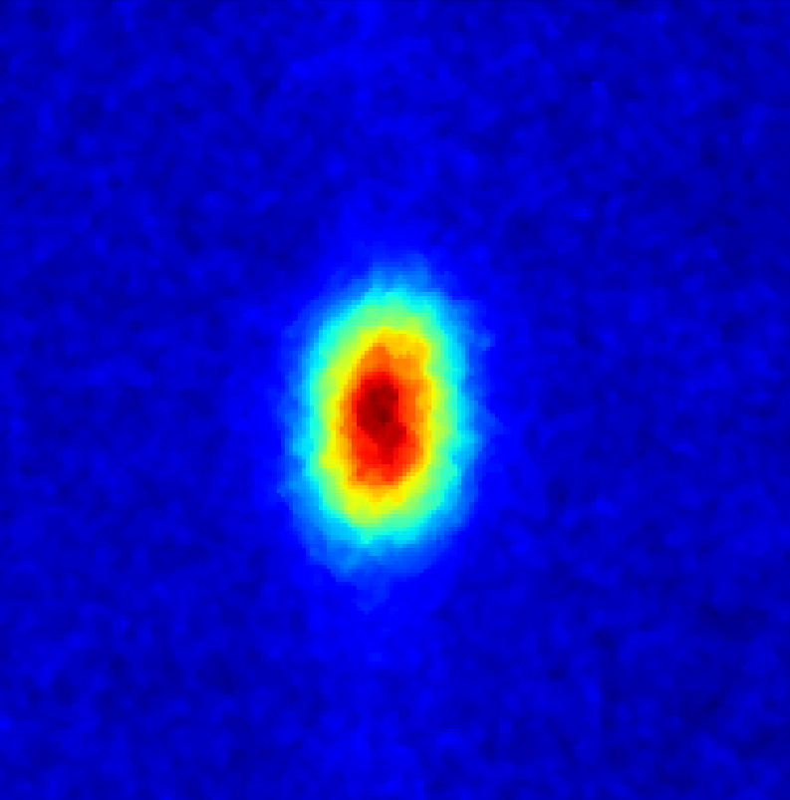
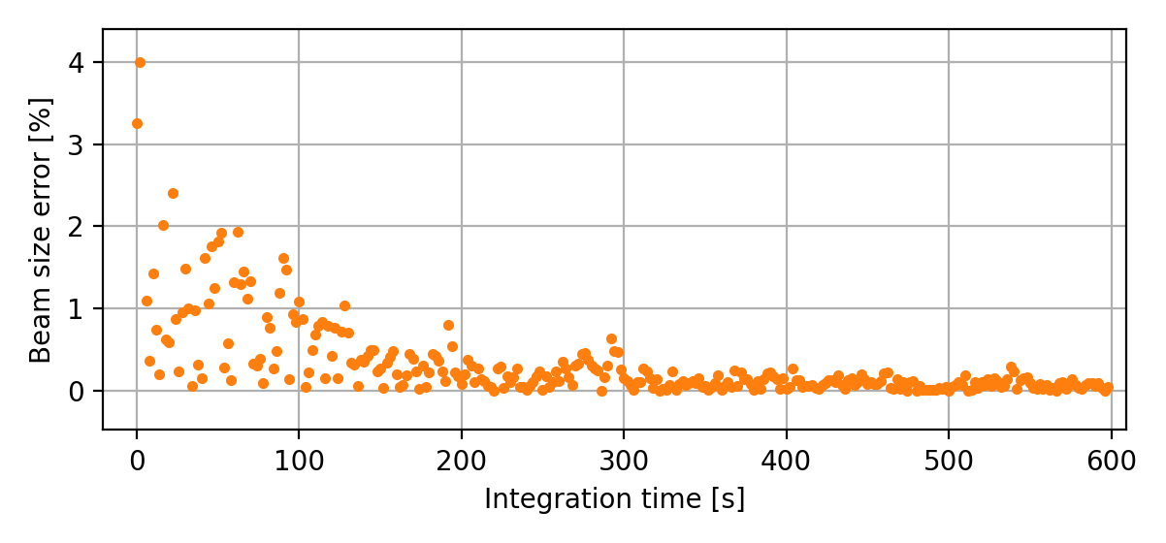
Visible or UV Fluorescence
Proton Physics
wavelength [nm]
Visible wavelength is a reduced signal, but a neutral emitter (independent of space charge).
UV wavelength provides more signal but is a charged emitter.
VIS 120 s
±5% ~ 120s
6.8 TeV
beam
UV 40 s
Visible resolution = ~65 µm
UV resolution = ~200 µm
±2.5% ~ 40s
6.8 TeV
beam
Courtesy of D.Butti
Notes:
UV resolution is poor for stable beams. But good for Injection and Ramp (increased size and higher signal is needed).
Combination

Slide 8
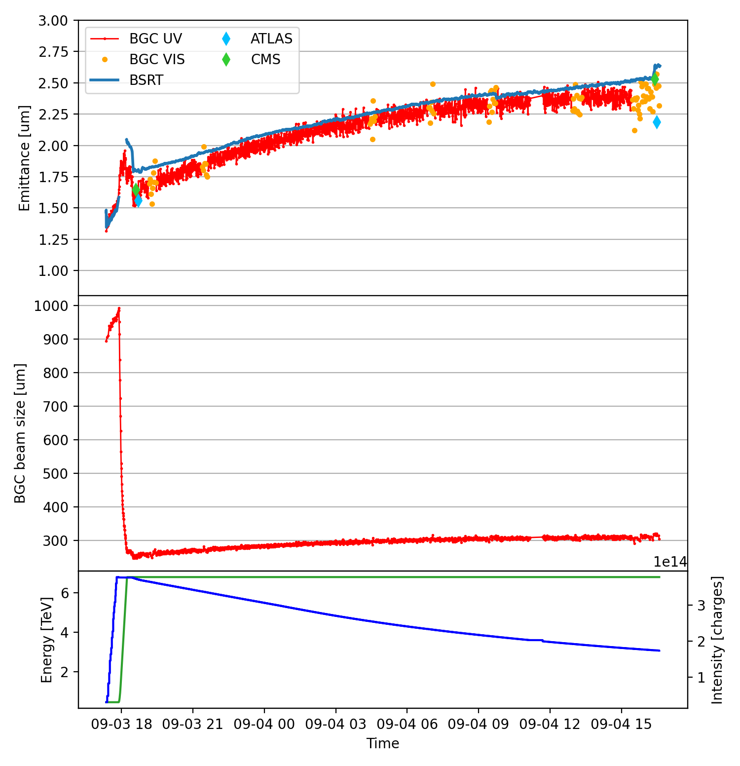




Combining UV and Visible Fluorescence
Proton Physics
Combining UV and visible measurements allows accurate measurements every 40 seconds.
Fluctuations within ±5% in emittance.
#10084
Absolute values still compatible with experiment emittance scans.
>22h SB due to injectors unavailability
Courtesy of D.Butti

Slide 9
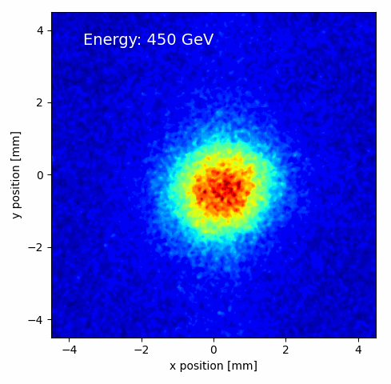
Combining UV and Visible Fluorescence
Proton Physics
Combining UV and visible measurements allows accurate measurements every 40 seconds.
Fluctuations within ±5% in emittance.
#10084
Absolute values still compatible with experiment emittance scans.
>22h SB due to injectors unavailability
Courtesy of D.Butti

Slide 10
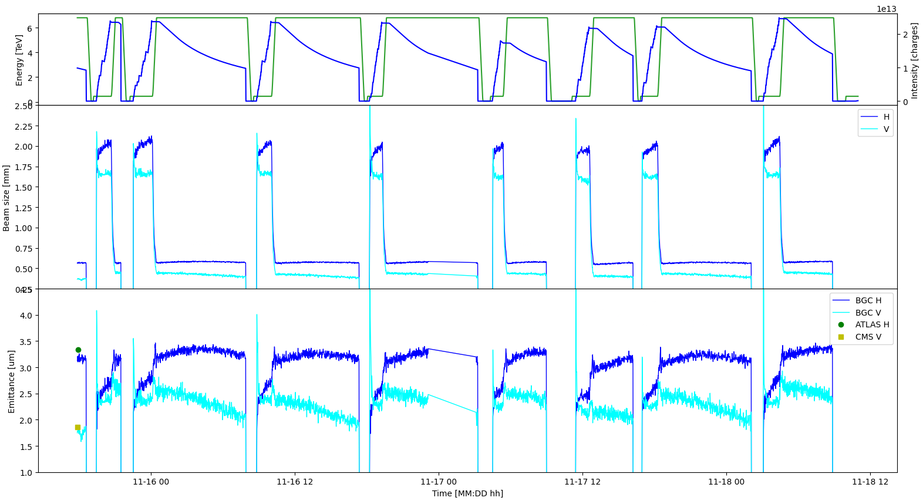
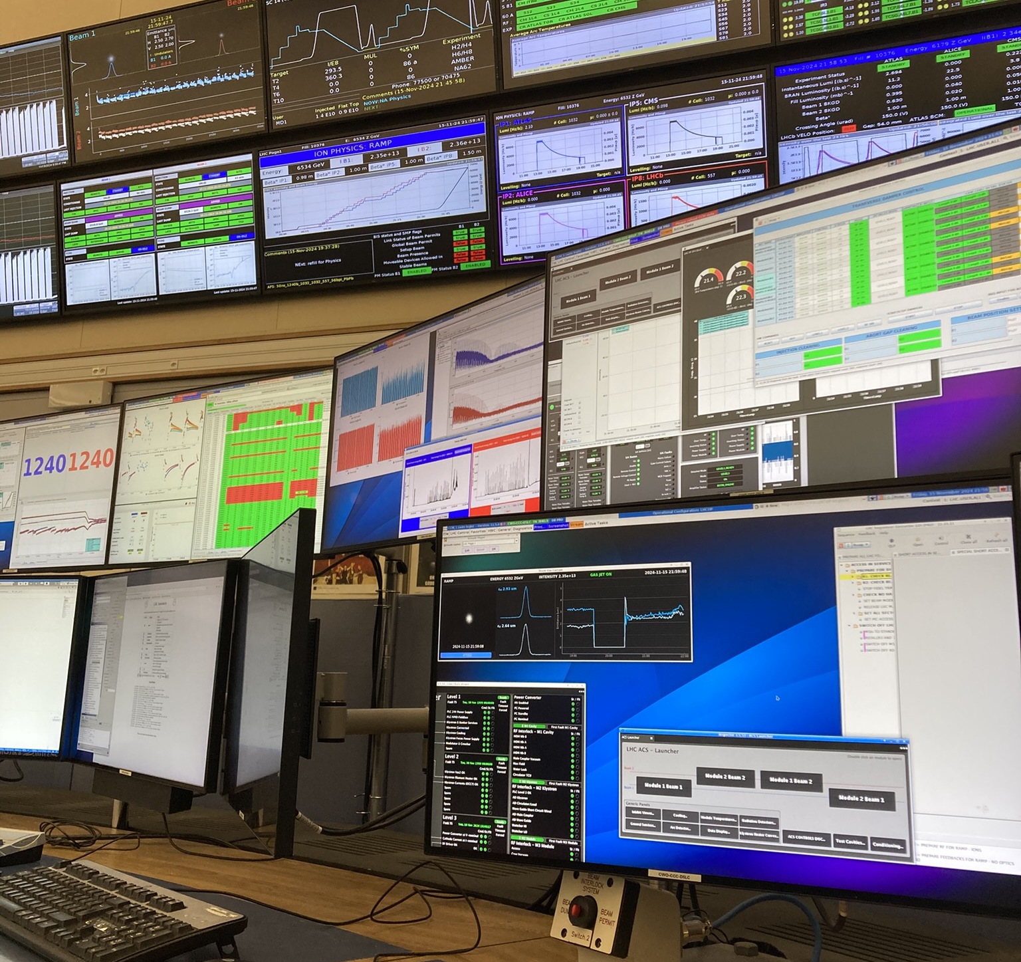
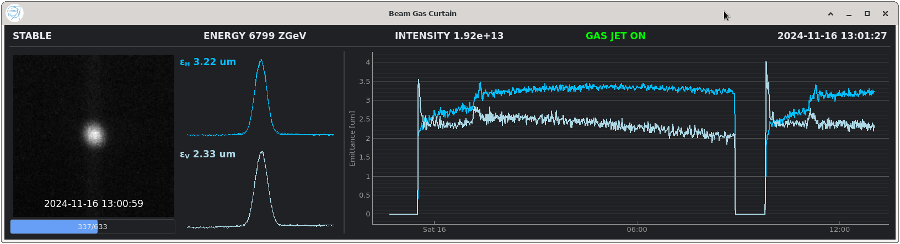
Highlights from 2024 Ion Run
Ion Physics
BGC continuously running throughout ion run, close to operational instrument.
Online average emittance measurements.
Courtesy of D.Butti
Notes:
Larger cross-section and lower SR, even easier than Protons.

Slide 11
Summary
BGC performance as emittance monitor thoroughly assessed in 2024.
Invited talks at IBIC23, IBIC24, and IPAC24.
Achievements with proton beams.
  Accurate and reproducible measurements for horizontal direction in stable beams.
  Combined UV-visible operation provides the best option for entire fill.
Achievements with ion beams.
  Stronger fluorescence and larger sizes simplifies BGC operation.
  Effective online emittance monitoring during ion physics production.

Slide 12
Outlook
Excellent basis for healthcare applications (£340k JetDose award).
Install a EBTS dedicated BGC for potential active halo suppression methods post HL-LHC.
Install a second BGC device for Beam 2 during LS3.
Develop towards an operational instrument and use for machine optimisation.
Measure fluorescence cross-sections - new physics.
Investigating potential future with halo imaging and control.

Slide 13
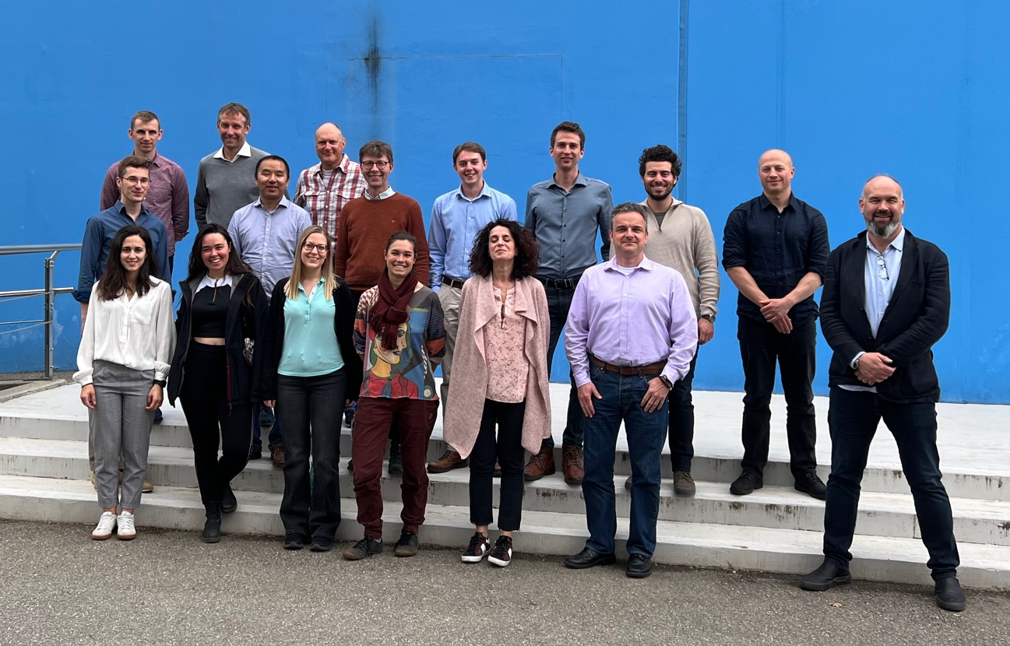


Thank you for your attention
Many thanks to the whole BGC collaboration for their fantastic support and work over the past 10 years.
This work was supported by the HL-LHC-UK phase II project funded by STFC under Grant Ref: ST/T001925/1 and the STFC Cockcroft Institute core grant No. ST/V001612/1.
Notes:
https://www.youtube.com/watch?v=vBd-Loq6U2o&t=0s

Slide 14
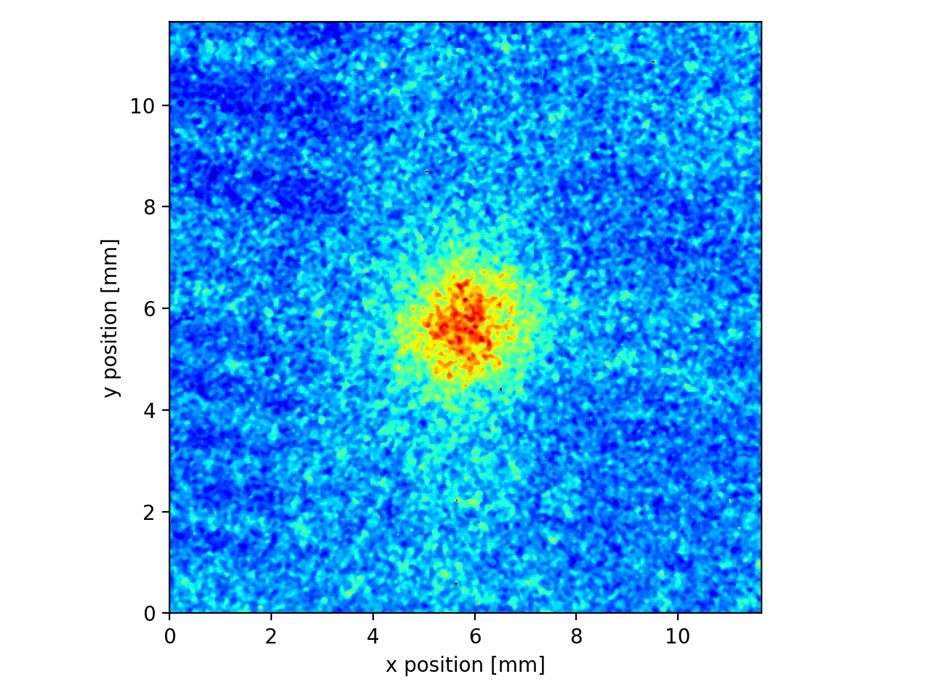
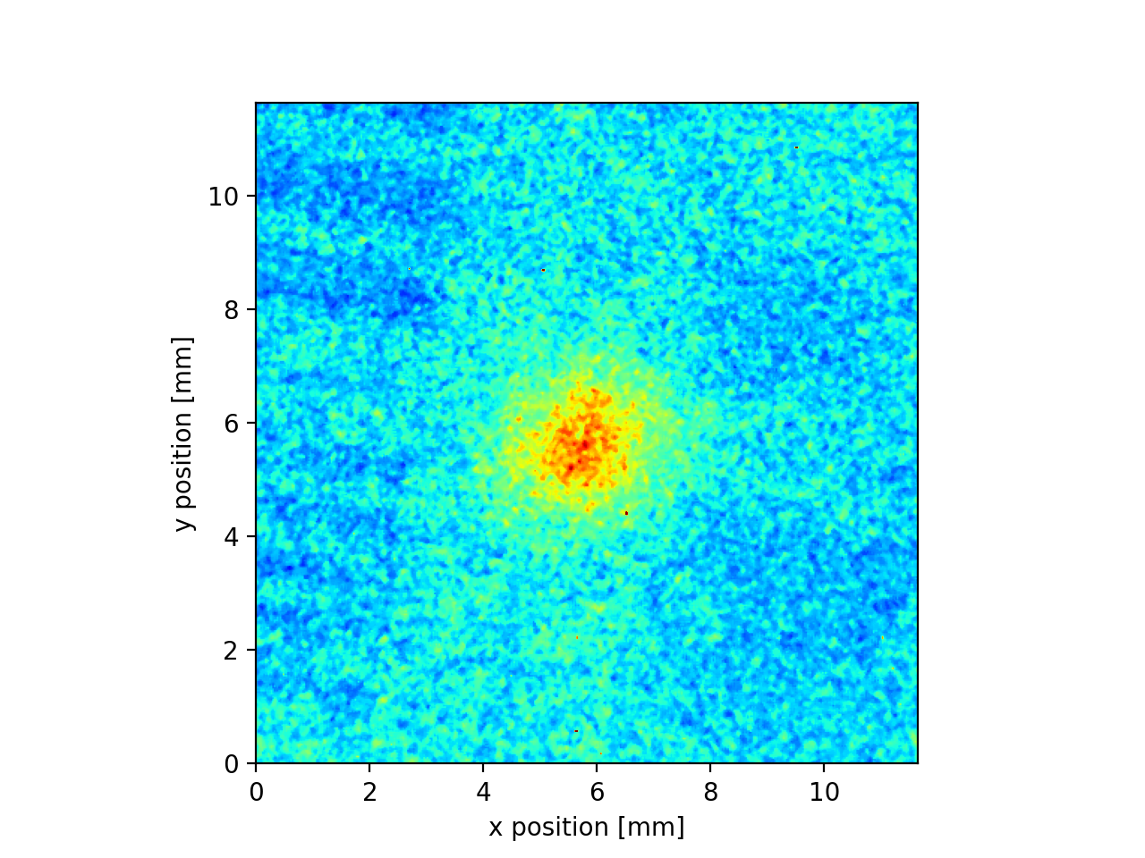
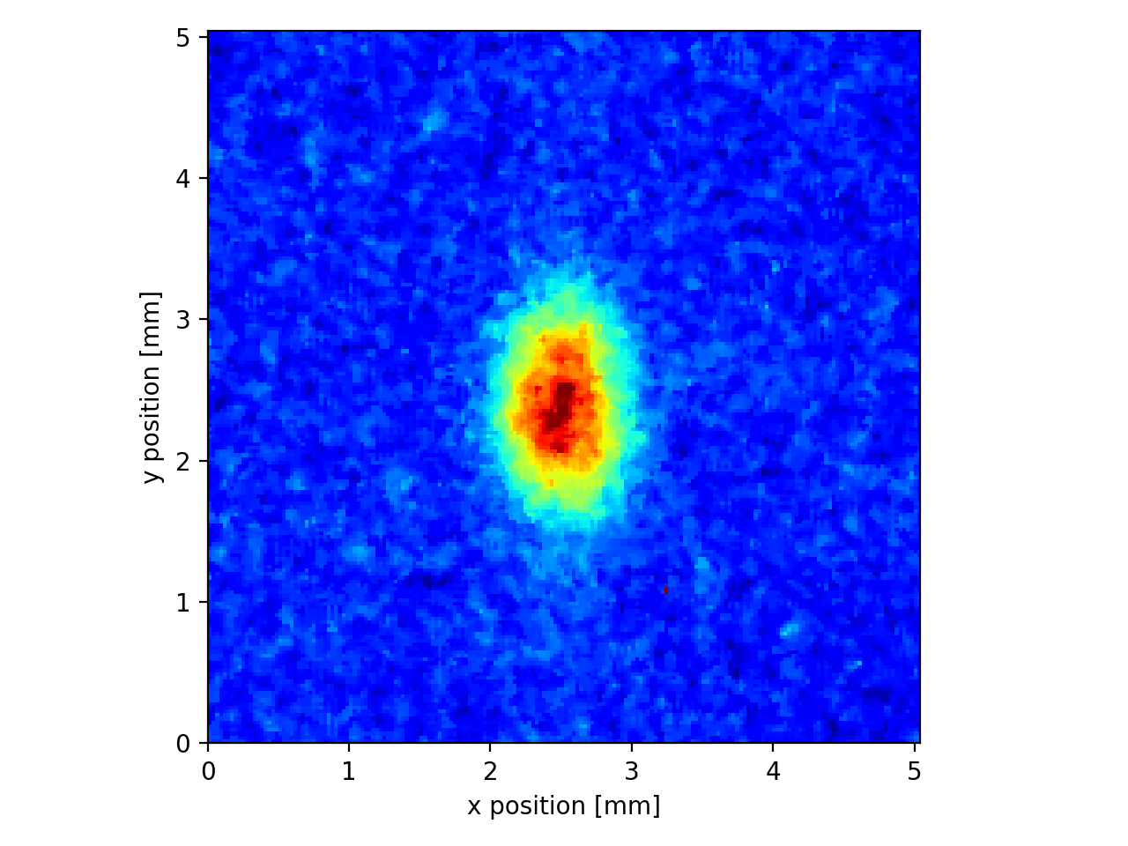
2D Profile Measurements
Proton Physics
Injection
Start of Ramp
Stable Beams
Injection
Start of ramp
Courtesy of D.Butti

Slide 15
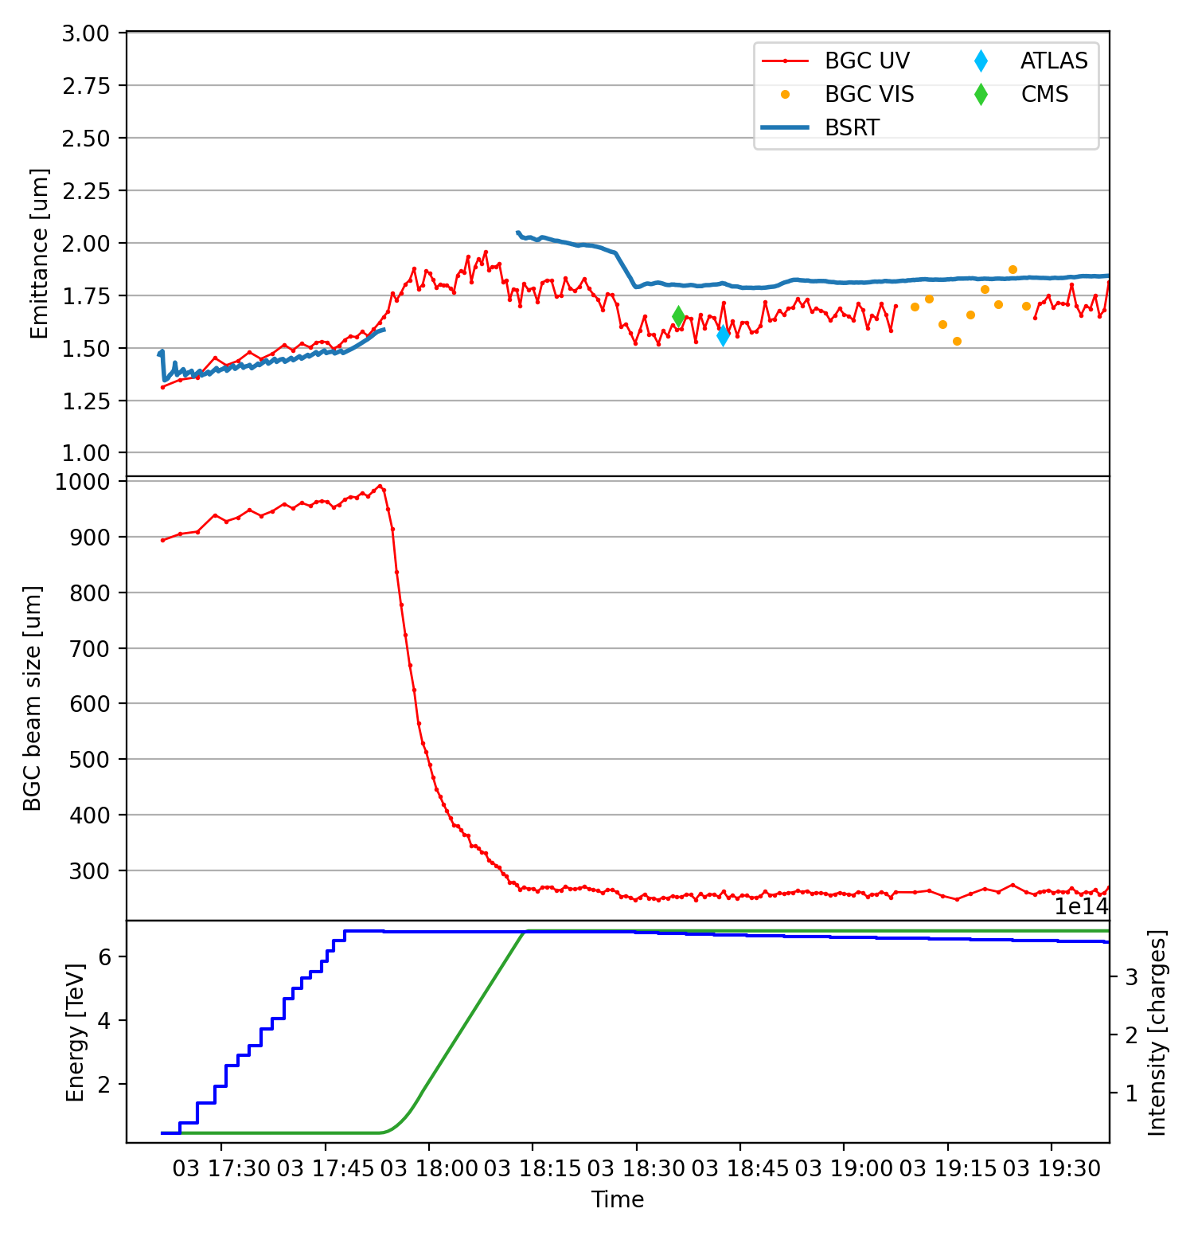
BSRT Ramp Switch
Proton Physics
BSRT Switching during Ramp (from Undulator to Dipole SR).
Offset from experiments.
collision
~30 points in ramp
Courtesy of D.Butti

Slide 16
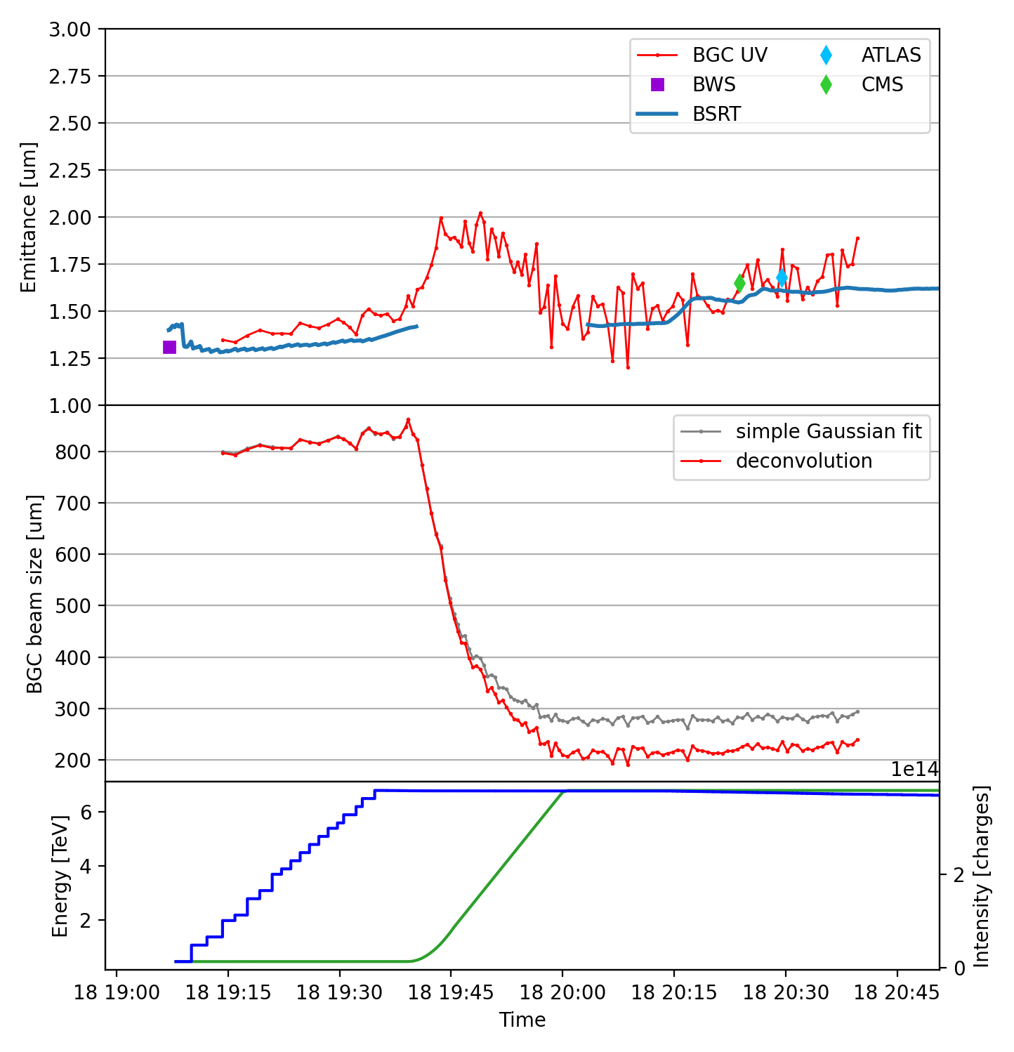
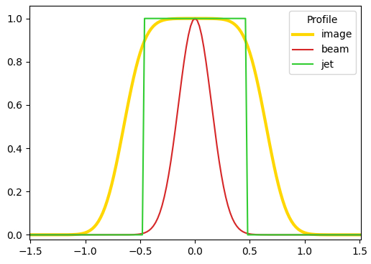
Vertical Profile
Stable Beams
#10127
V profile
collision
deconvolution becomes necessary
Courtesy of D.Butti

Slide 17
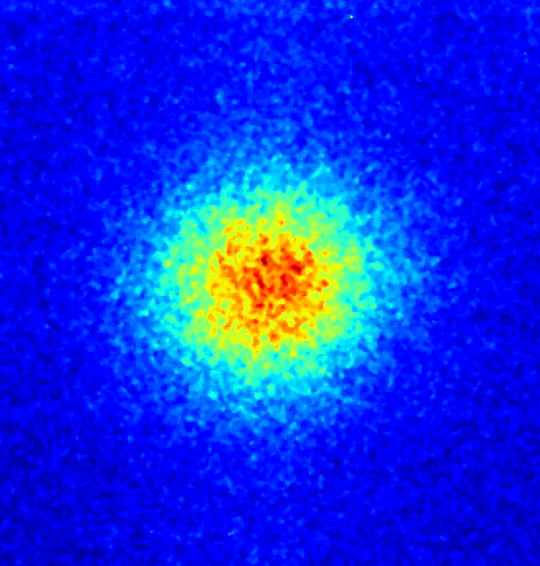
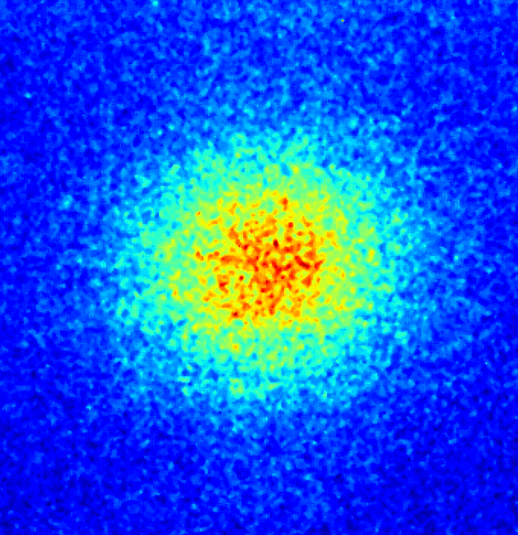
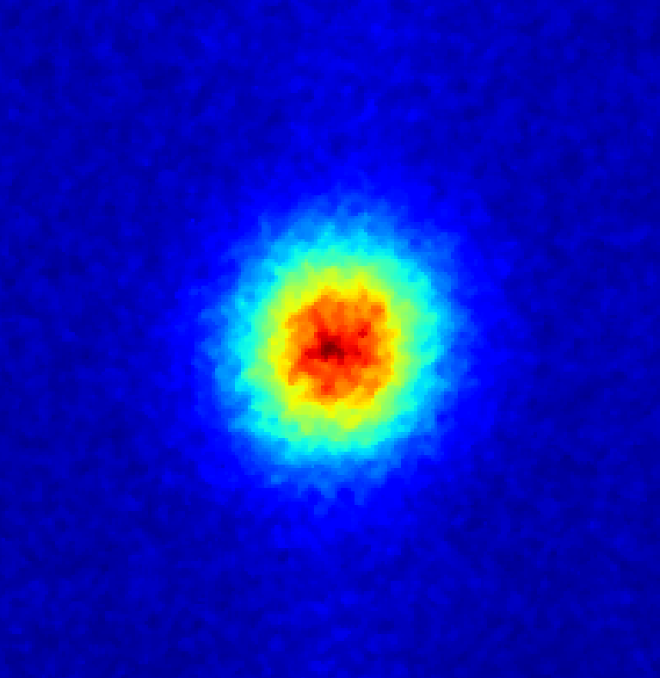
Performance with ion beams
Ion physics
More favorable conditions with ion beams
stronger fluorescence signal
larger beam sizes
sufficient signal with visible configuration, no need to combine UV signal
Protons VIS
Limited availability of BSRT with ions:
no light at injection
rarely calibrated at flat-top
there is already the case for extra diagnostics
Lead ions VIS
Injection
Start of ramp
Stable beams
Courtesy of D.Butti

Slide 18
2023 Proton & Ion Beams
Time: 1 min
Time: 1 min
Time: 1 min
Time: 1 min
PRELIMINARY
PRELIMINARY
PRELIMINARY
PRELIMINARY
Proton beam
Energy: 450 GeV
Intensity: 2.2e14
x
Proton beam
Energy: 6.8 TeV
Intensity: 3.45e14
x
Lead ion beam
Energy: 450 GeV/Z
Intensity: 1.53e13
x
Lead ion beam
Energy: 6.8 TeV/Z
Intensity: 1.5e13
x
y
y
y
y
σ_{x} =0.917mm σ_{y} =0.817 mm
σ_{x} =0.308 mm σ_{y} =0.432 mm
σ_{x} =1.653 mm σ_{y} =1.418 mm.
σ_{x} =0.543 mm σ_{y} =0.589 mm
Notes:
585nm filter +- 10mm
Blackened coating, ~10% reflection
Multi-layer sputtering coating 0.2% reflection
Proton injection beam: 20230524, subfolder(27), Sigma_x =0.9172, Sigma_y =0.8167.
Proton stable beam: 20230705, Sigma_x =0.3079, Sigma_y =0.4324.
Lead ion injection beam: 20231029, subfolder(33), Sigma_x =1.653, Sigma_y =1.418.
Lead ion stable beam: 20231011, subfolder(33), Sigma_x =, Sigma_y =0.563.

Slide 19
Halo Monitor Concept
BGC Profile Monitor
BGC Halo Monitor
camera
photons
BLM
jet
losses
beam
jet
beam
Courtesy of D.Butti

Slide 20


Pressure Profiles
Simulation
Measurement
20 mm
20 mm
C. Castro Sequeiro, PRAB 27, 043201, 2024.
Interaction chamber (VGP.4a.5L4.BGC) | Pressure [mbar]
Ne gas Jet OFF | 2.0e-10
Ne gas Jet ON | 4.00e-8
Eq. Pressure: 1.45x10⁻⁶ mbar
Eq. Pressure: 1.08x10⁻⁶ mbar
H. Zhang et. al, Vacuum 208, 111701, 2023.

Slide 21
Injection Optimisation
0.00
1.00 – 10.00 mm
6.58 – 48.49 mm
174.94 – 241.11 mm
294.94 mm
346.13 – 409.94 mm
Nozzle
1st Skimmer
2nd Skimmer
3rd Skimmer
IP
4th Skimmer
a
a
d
d
b
b
d: 500 – 7,500 um
d: 30 – 10,000 um
a: 50 – 2,000 um
b: 2 – 60 mm
a: 50 – 10,000 um
b: 2 – 100 mm

Slide 22
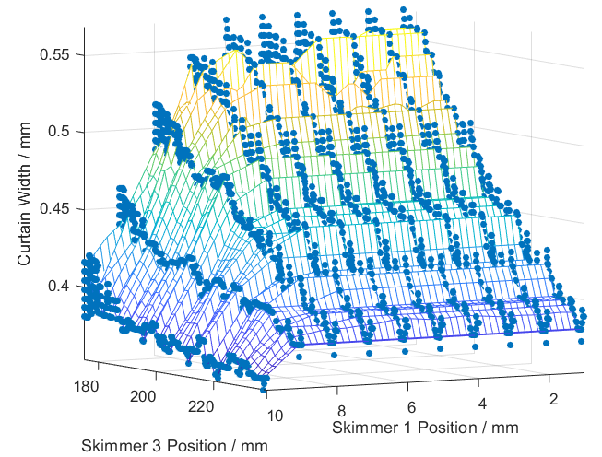
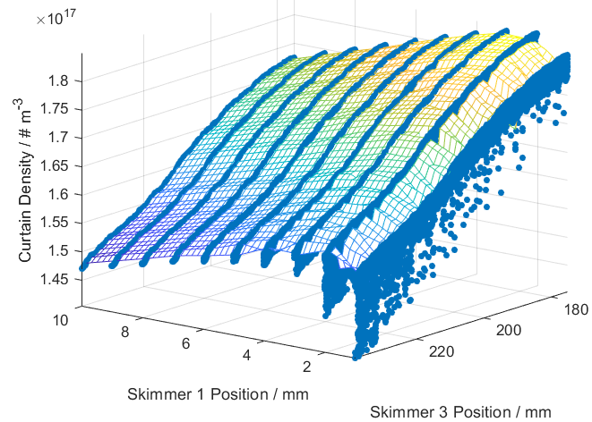
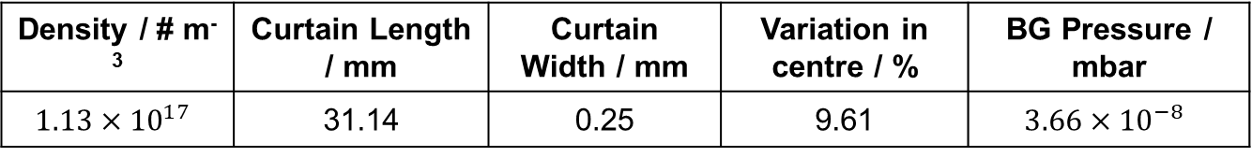
Gas Jet Optimisation Framework
Density / # m⁻³ | Curtain Length / mm | Curtain Width / mm | Variation in centre / % | BG Pressure / mbar
$$1.13×{10}^{17}$$ | 31.14 | 0.25 | 9.61 | $$3.66×{10}^{−8}$$

Slide 23
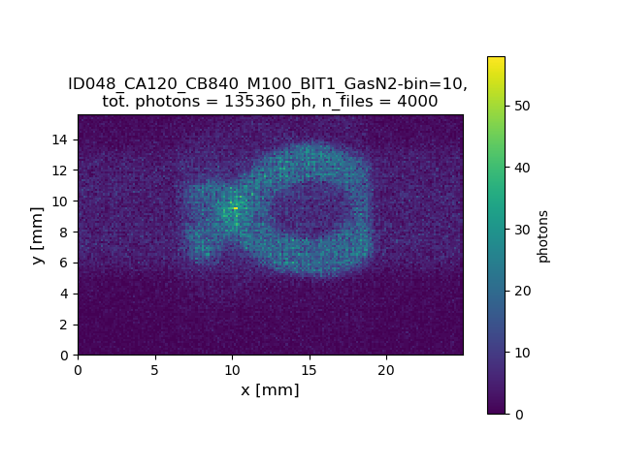
EBTS

