Slide 1
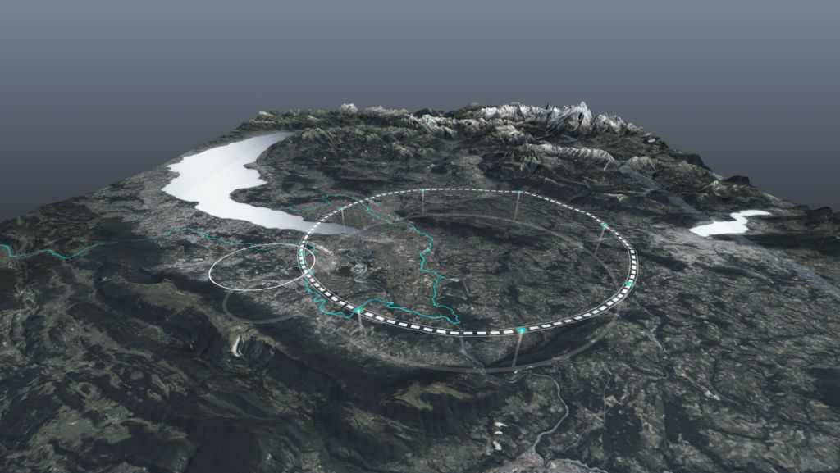









The FCC Integrated Program
HFM Annual Meeting, CERN, 10 February 2025
Michael Benedikt, Frank Zimmermann, CERN
on behalf of FCC collaboration & FCCIS DS team
http://cern.ch/fcc
Work supported by the European Commission under the HORIZON 2020 projects EuroCirCol, grant agreement 654305; EASITrain, grant agreement no. 764879; iFAST, grant agreement 101004730, FCCIS, grant agreement 951754; E-JADE, contract no. 645479; EAJADE, contract number 101086276; and by the Swiss CHART program
photo: J. Wenninger

Slide 2

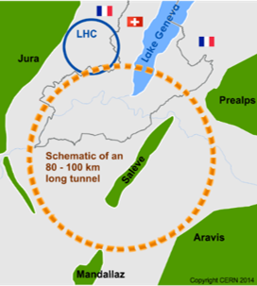
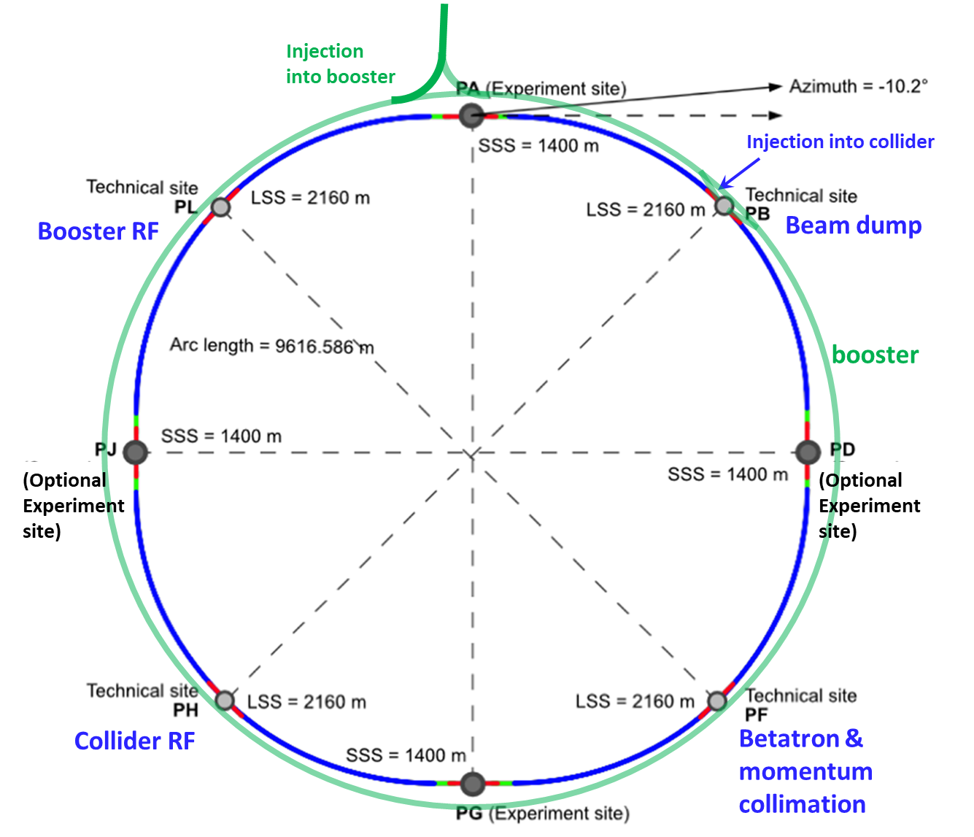
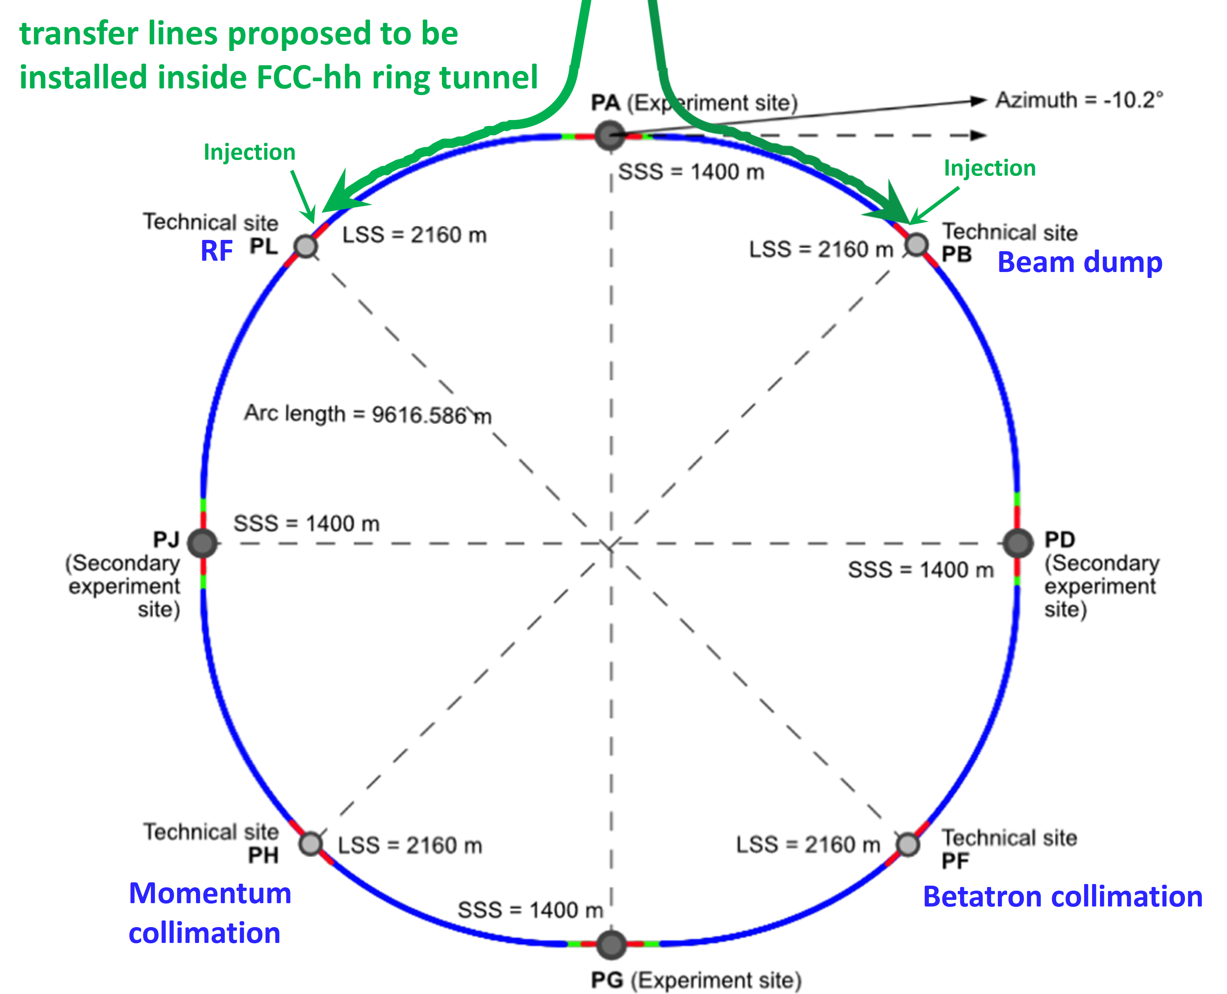
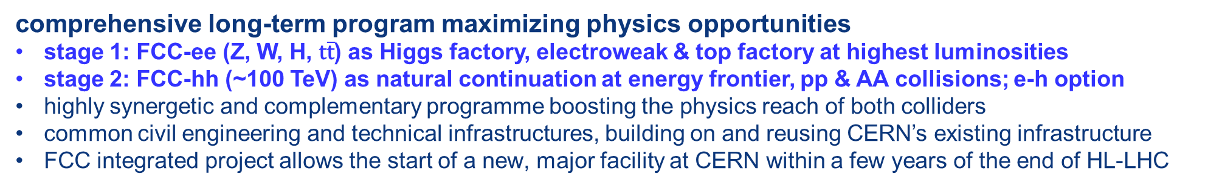
FCC integrated program
comprehensive long-term program maximizing physics opportunities
stage 1: FCC-ee (Z, W, H, $\text{t}\overline{\text{t}}$) as Higgs factory, electroweak & top factory at highest luminosities
stage 2: FCC-hh (~100 TeV) as natural continuation at energy frontier, pp & AA collisions; e-h option
highly synergetic and complementary programme boosting the physics reach of both colliders
common civil engineering and technical infrastructures, building on and reusing CERN’s existing infrastructure
FCC integrated project allows the start of a new, major facility at CERN within a few years of the end of HL-LHC
FCC-ee
FCC-hh
2020 - 2045
2045 - 2065
2070 -

Slide 3
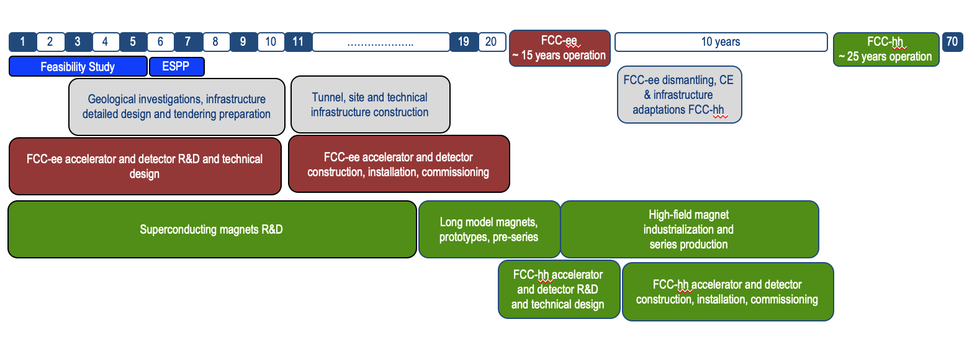
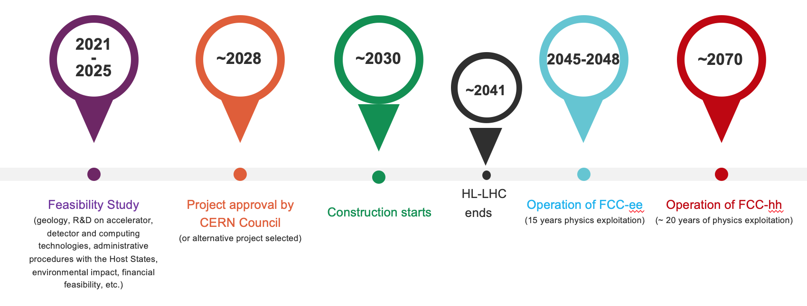
FCC integrated program - timeline
Note: FCC Conceptual Design Study
started in 2014 leading to CDR
in 2018
Ambitious schedule taking into account:
past experience in building colliders at CERN
approval timeline: ESPP, Council decision
that HL-LHC will run until 2041
project preparatory phase with adequate
resources immediately after Feasibility Study
2027/28
~2033
~2046
~2070

Slide 4

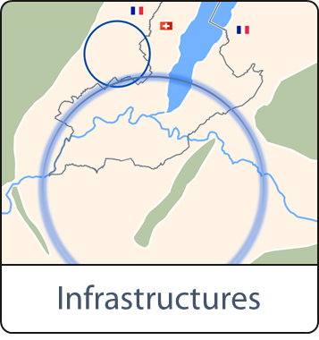

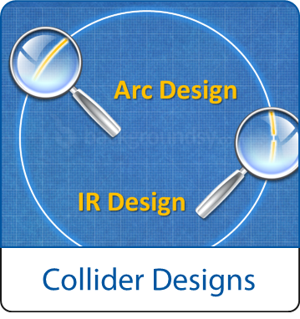
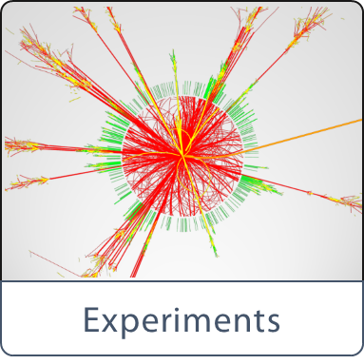
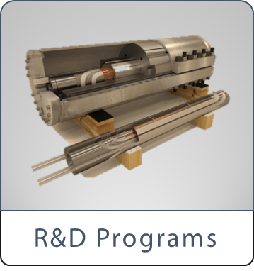

High-level goals of the FCC Feasibility Study
together with the Host States, optimisation of placement and layout of the ring, and demonstration of the geological, technical, environmental and administrative feasibility of the tunnel and surface areas;
consolidation of the physics case and detector concepts, optimisation of the design of the colliders and their injector chains, supported by targeted R&D to develop the needed key technologies;
development of the technical infrastructure concepts and integration with territorial constraints and identification of opportunities for co-construction;
elaboration of a sustainable operational model for the colliders and experiments in terms of human and financial resource needs, environmental aspects and energy efficiency;
identification of substantial resources from outside CERN’s budget for the implementation of the first stage of a possible future project;
Final deliverable is a Feasibility Study Report by March 2025.

Slide 5




Feasibility Study Report for March 2025
Structure:Three Volumes
Vol. 1: Physics, Experiments and Detectors (~200 pages)
Vol. 2: Accelerators, Technical Infrastructures, Safety Concepts (~400 pages)
Vol. 3: Civil Engineering, Implementation & Sustainability (~200 pages)
- Executive Summary of the FCC Feasibility Study: ~40 pages
In addition:
a. Documentation on Cost Estimate – Funding Models
b. Environmental Report
Input for Update of European Strategy for Particle Physics
to be prepared with Overleaf & published by EPJ (Springer-Nature) – FCCIS members

Slide 6
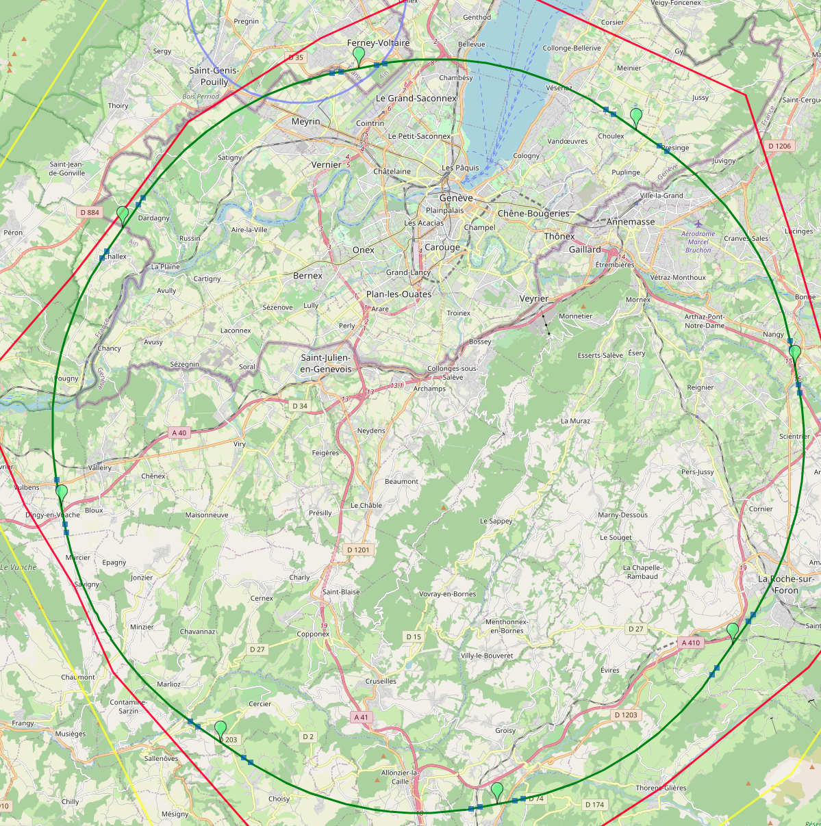
Reference layout and implementation: PA31 - 90.7 km
V. Mertens,
J. Gutleber
Layout chosen out of ~ 100 initial variants, based on geology and
surface constraints (land availability, access to roads, etc.), environment, (protected zones), infrastructure (water, electricity, transport), machine performance etc.
“Avoid-reduce-compensate” principle of EU and French regulations
PA: Experiment
PB: technical
PL: technical
Overall lowest-risk baseline: 90.7 km ring, 8 surface points,
4-fold symmetry
Number of surface sites | 8
Surface requirements | ~40 ha
LSS@IP (PA, PD, PG, PJ) | 1400 m
LSS@TECH (PB, PF, PH, PL) | 2032 m
Arc length | 9.6 km
Sum of arc lengths | 76.9 m
Total length | 90.7 km
PD: experiment
PJ: experiment
4 experiments
PF: technical
PH: technical
6
PG: experiment

Slide 7
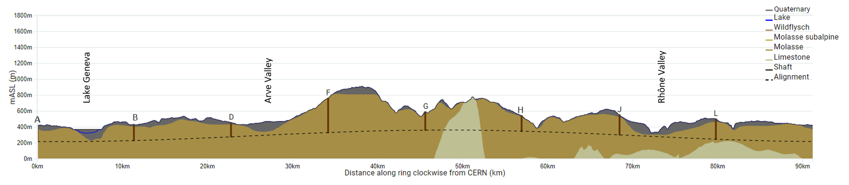
FCC tunnel implementation- geological conditions
FCC inclined at 0.5% gradient to minimise depth of point F
Limestone unavoidable between G-H
FCC above limestone
FCC passes below Lake Geneva moraines
  Tunneling mainly in moraine layer (soft rock), well suited for fast, low-risk TBM construction.
  6 million m³ excavated volume → 8.5 million m³ excavation material on surface
  CE Designs of all underground structures developed
  To fix the vertical position of the tunnel, interfaces between geological layers have to be known

Slide 8
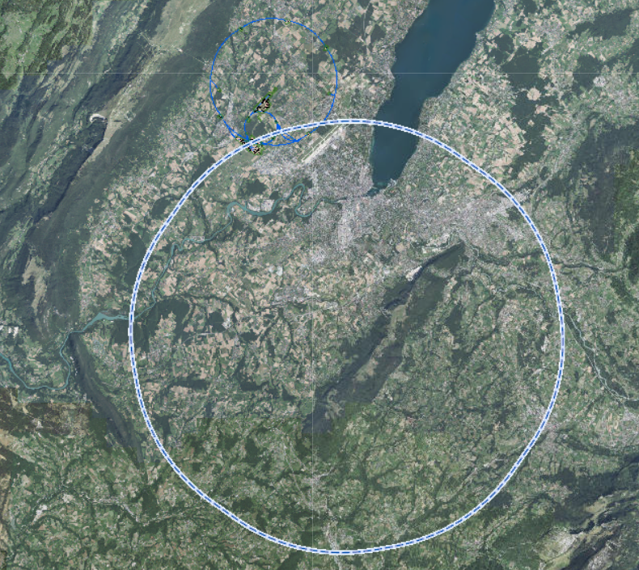
Site Investigations
  28 boreholes and 80 km of geophysics in total between October 2024 and December 2025
  Southern work package completed by March 2025
  All geophysics acquisition and interpretation in sections Arve, Mandallaz, Usses and Vuache is completed
  Drilling progress (including logging and testing) will be 100% complete
  Northern work package completed by end 2025
  Geophysics and drilling activities in the largest section (Jura 1) expected to begin in March 25 (pending permits)
JURA2
LAKE
JURA1
RHONE
ARVE
  Site investigation results provide:
  Locations of geologic interfaces, permitting to fix vertical position and inclination of tunnel
  Engineering properties of deeper Molasse as input data for future design and construction work
  Characteristics of deeper limestone Vuache (karstic structures, unavoidable traversal)
  Characterisation of rock from viewpoint of reuse/disposal
VUACHE
BORNES
Complete
USSES
Ongoing
MANDALLAZ
Starting shortly

Slide 9
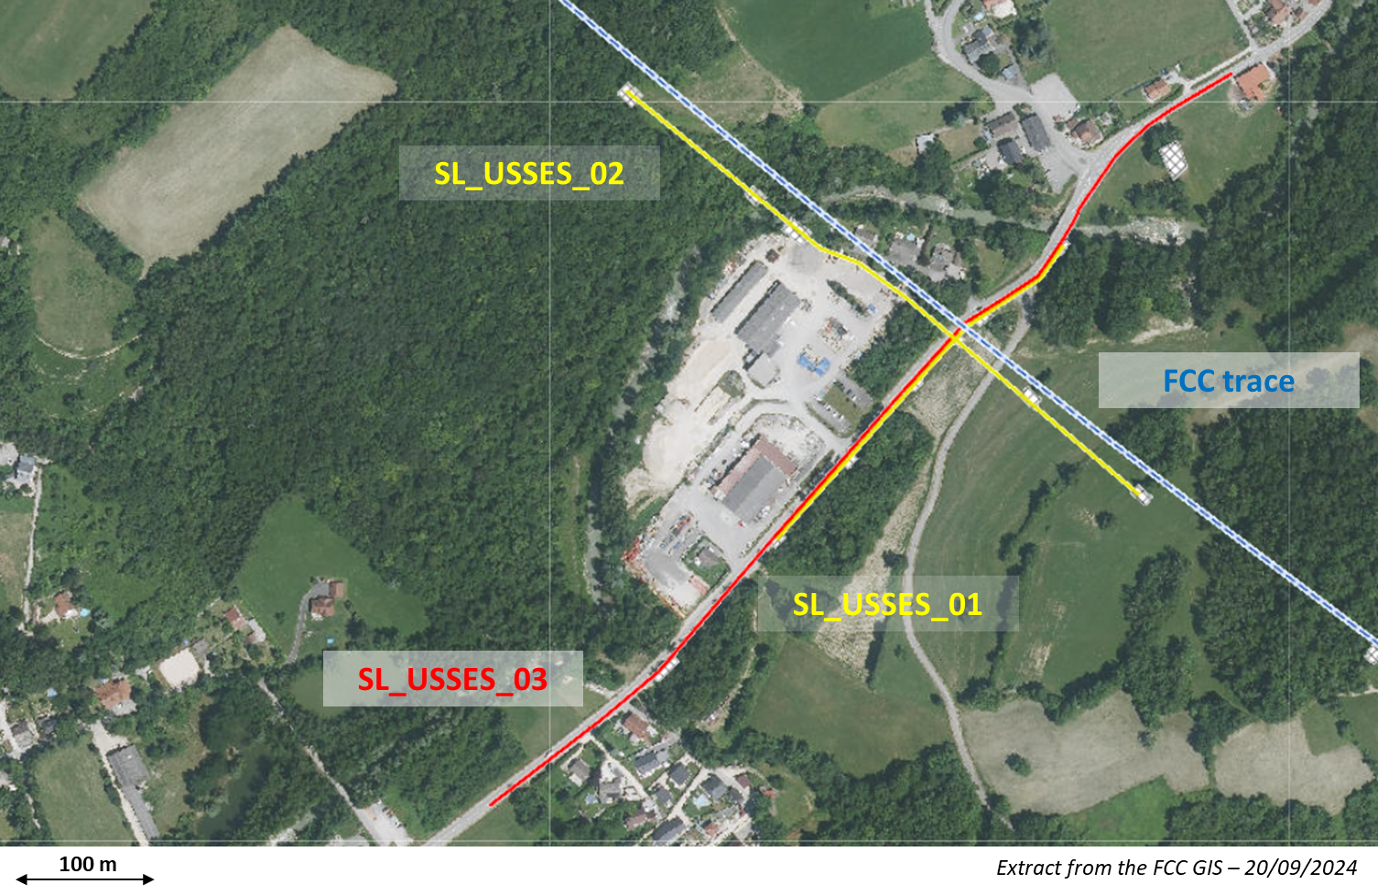
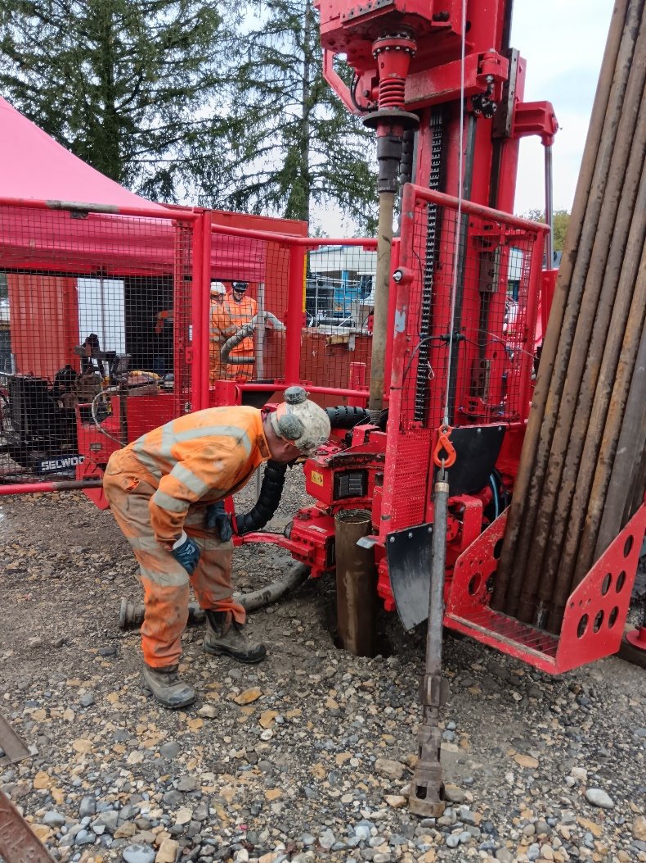
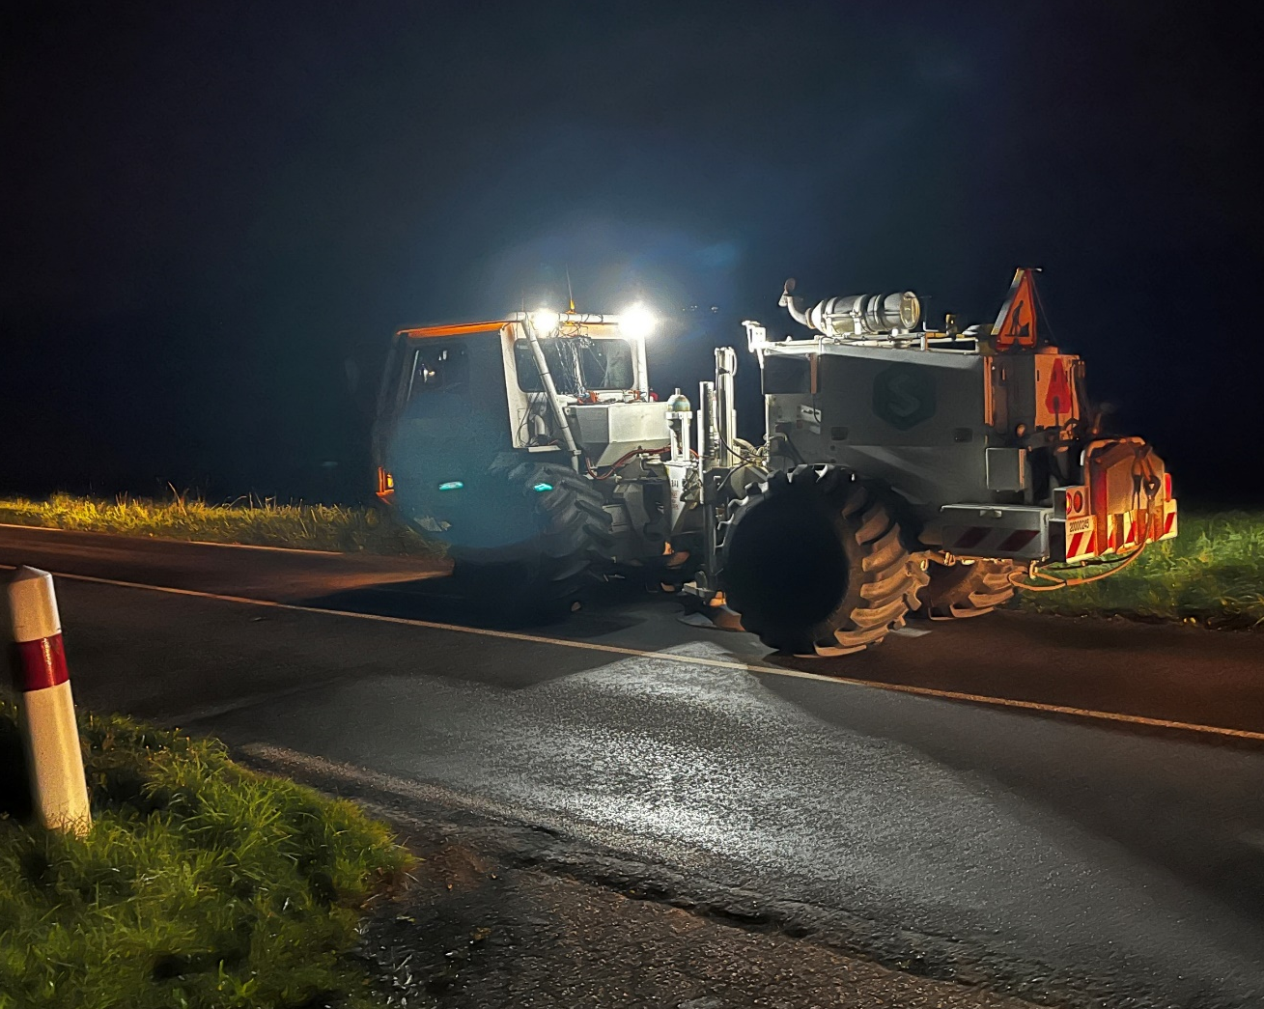
Seismic investigations drilings

Slide 10
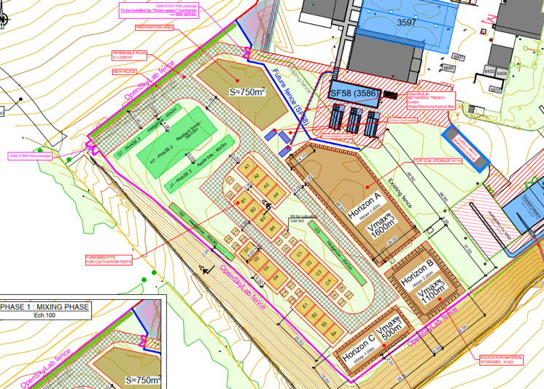









Development of excavation material re-use opportunities
OpenSkyLab: academic and industrial collaboration @LHC P5 CMS
Transformation of Molasse (FCC ~8 Mm³ volume) into fertile soil for agricultural and other uses
Materials: Molasse from the HL-LHC construction
Duration: 4+ years (2024 - )
Trials with 5 000 t molasse
  Soil fertilisation process (micro-organisms, mixing with fertile soil, etc.)
  Development of ferilisation mix products
  Development of quality managed processes
  Experimental phase with scientific protocol and field monitoring and control system support

Slide 11
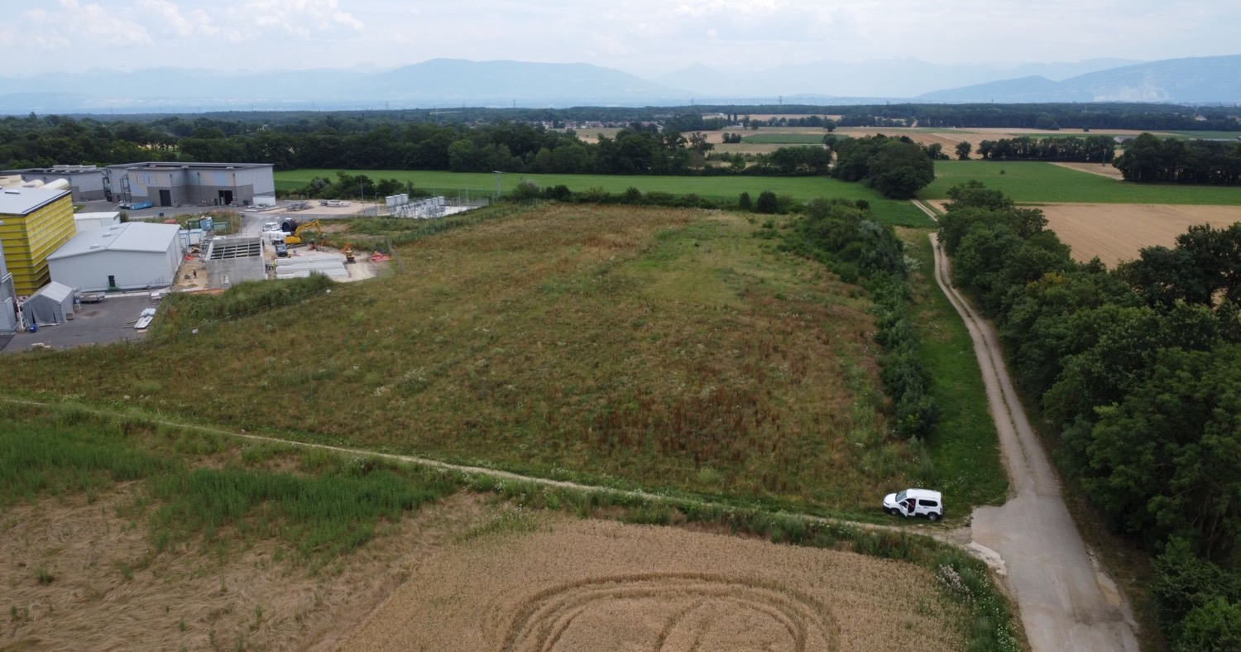
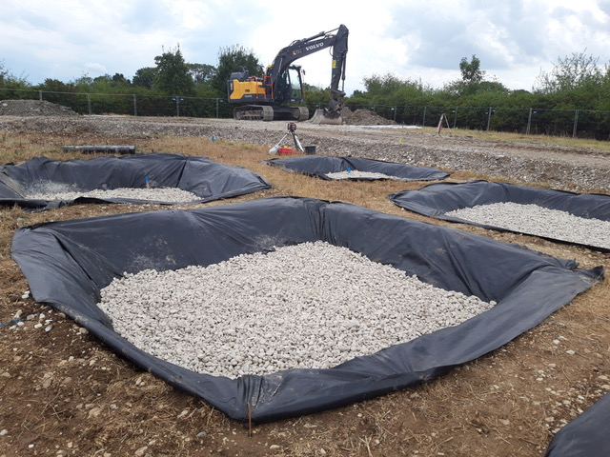
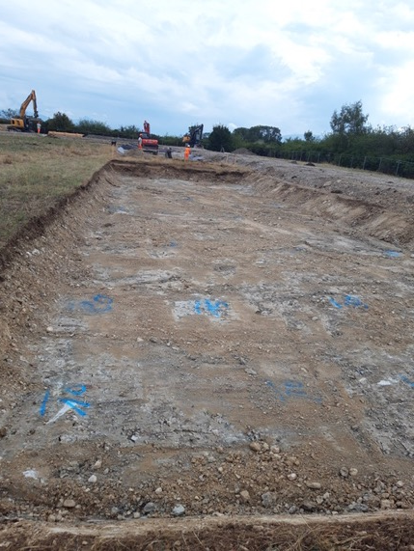
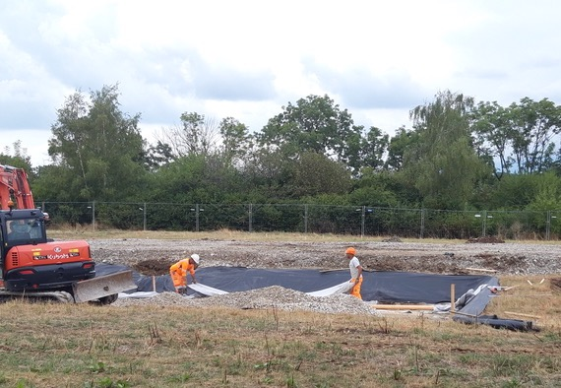
OpenSkyLab status and progress

Slide 12
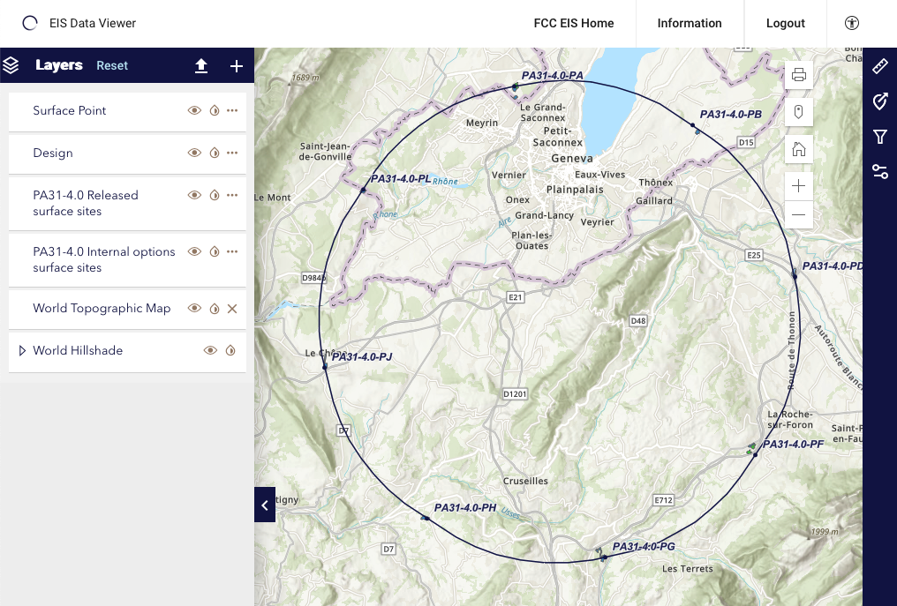
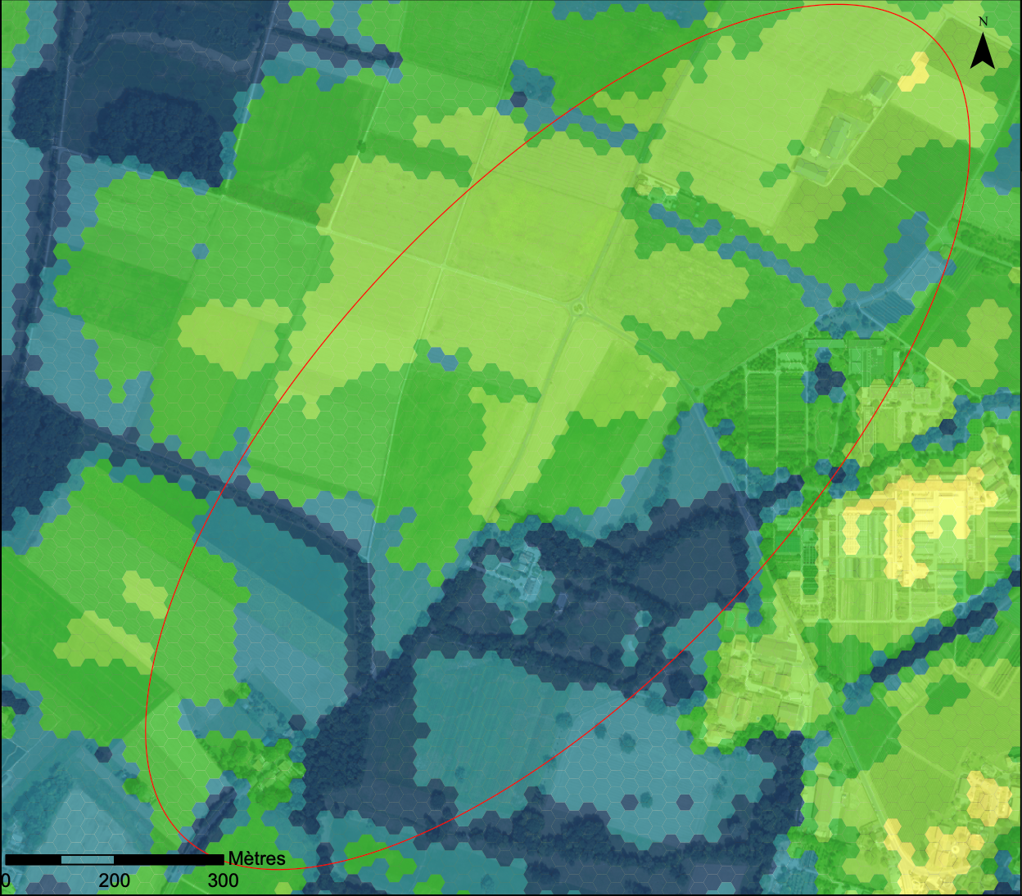
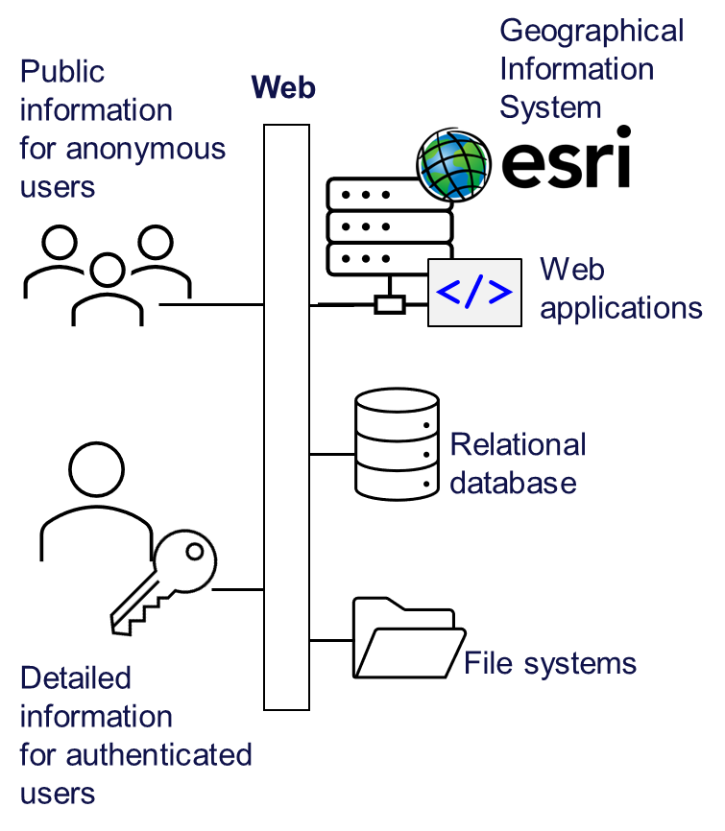
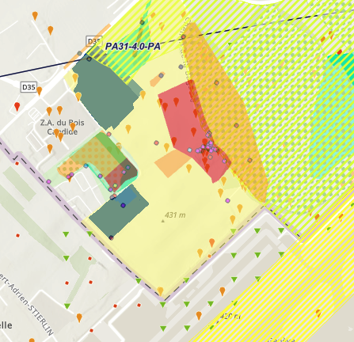

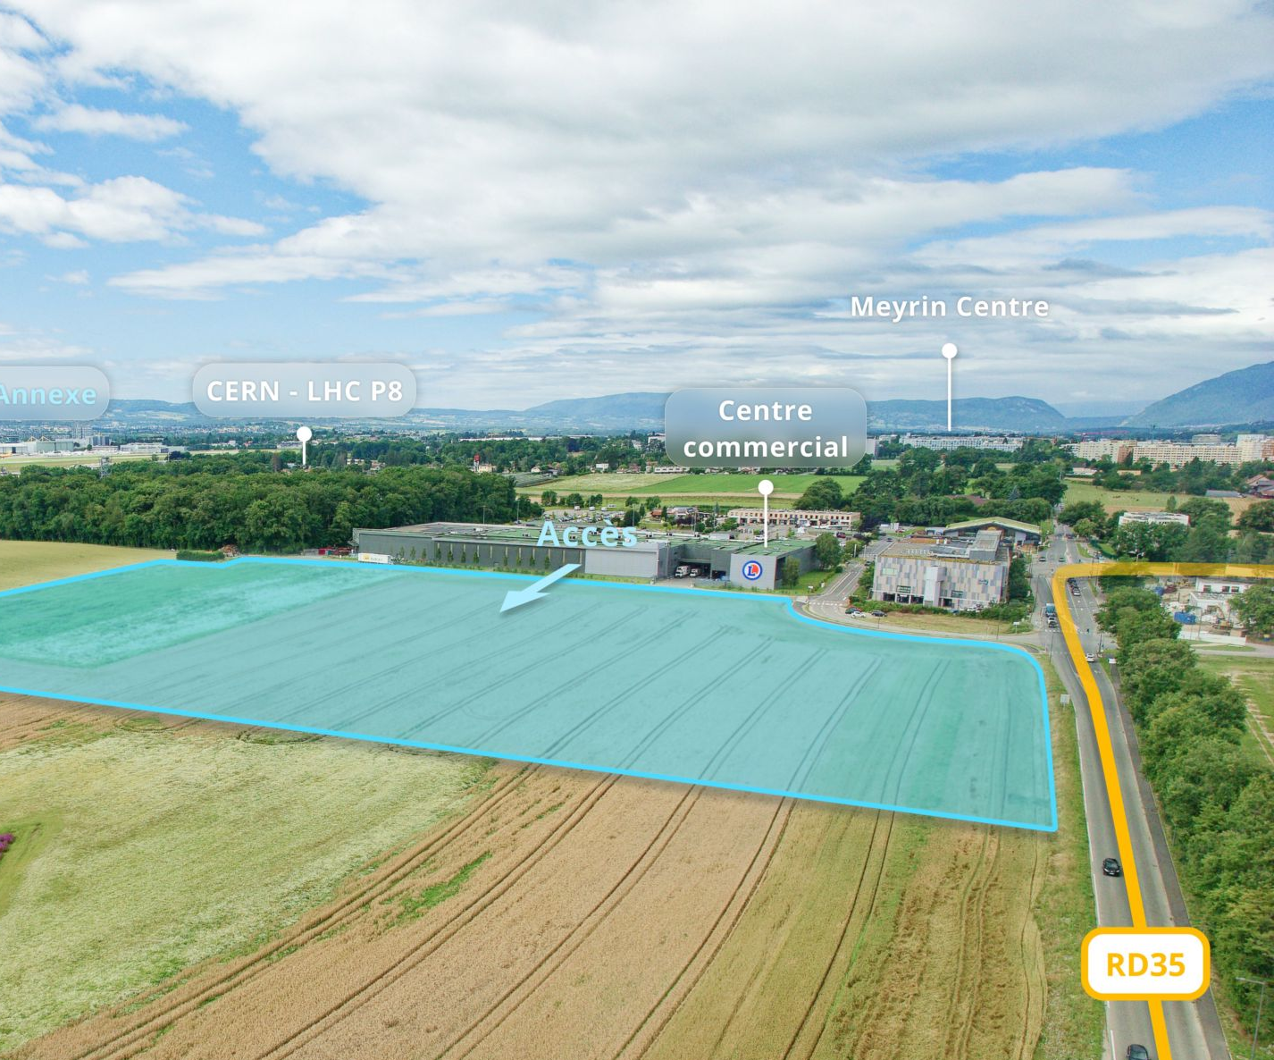
Environmental Initial State Study
Environmental information system
The environmental initial state analysis at the eight surface site locations did not highlight principal showstoppers for the project and identified topics for further environmental optimization.
The environmental information system EIS developed during the FS is a key system for documentation and will be essential for communication with authorities and production of material for environmental impact assessment and project authorization process.

Slide 13
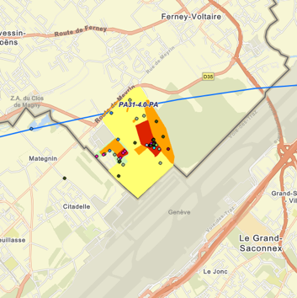
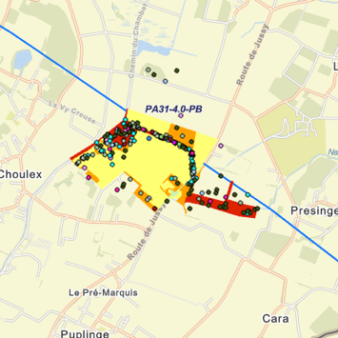
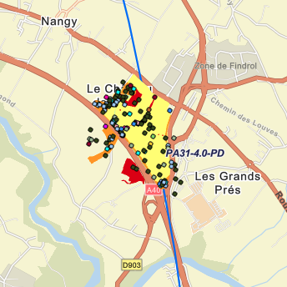
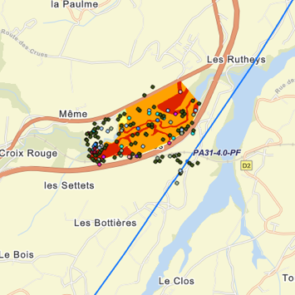
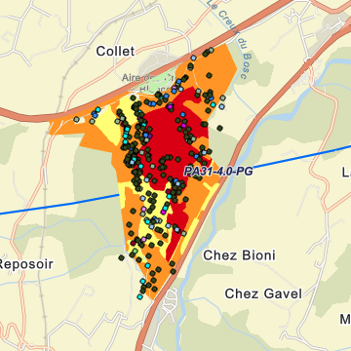
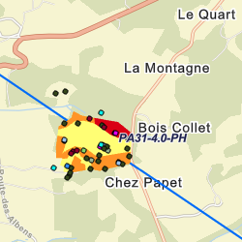
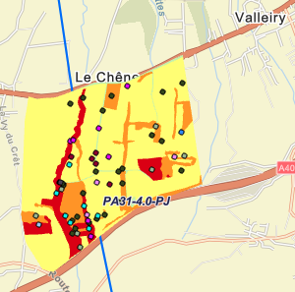
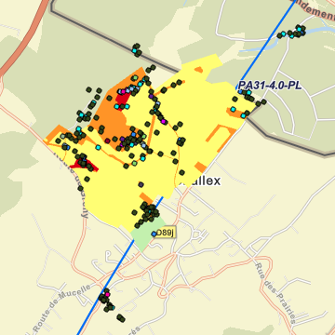
Environmental studies around surface areas
PA
PB
PD
PF
Total area investigated in 2023/24: 585 ha over 4 seasons
PG
PH
PJ
PL

Slide 14
FCC-ee main machine parameters
Parameter | Z | WW | H (ZH) | ttbar
beam energy [GeV] | 45.6 | 80 | 120 | 182.5
beam current [mA] | 1270 | 137 | 26.7 | 4.9
number bunches/beam | 11200 | 1780 | 440 | 60
bunch intensity [10¹¹] | 2.14 | 1.45 | 1.15 | 1.55
SR energy loss / turn [GeV] | 0.0394 | 0.374 | 1.89 | 10.4
total RF voltage 400/800 MHz [GV] | 0.120/0 | 1.0/0 | 2.1/0 | 2.1/9.4
long. damping time [turns] | 1158 | 215 | 64 | 18
horizontal beta* [m] | 0.11 | 0.2 | 0.24 | 1.0
vertical beta* [mm] | 0.7 | 1.0 | 1.0 | 1.6
horizontal geometric emittance [nm] | 0.71 | 2.17 | 0.71 | 1.59
vertical geom. emittance [pm] | 1.9 | 2.2 | 1.4 | 1.6
vertical rms IP spot size [nm] | 36 | 47 | 40 | 51
beam-beam parameter ξ_{x} / ξ_{y} | 0.002/0.0973 | 0.013/0.128 | 0.010/0.088 | 0.073/0.134
rms bunch length with SR / BS [mm] | 5.6 / 15.5 | 3.5 / 5.4 | 3.4 / 4.7 | 1.8 / 2.2
luminosity per IP [10³⁴ cm⁻²s⁻¹] | 140 | 20 | ≥5.0 | 1.25
total integrated luminosity / IP / year [ab⁻¹/yr] | 17 | 2.4 | 0.6 | 0.15
beam lifetime rad Bhabha + BS [min] | 15 | 12 | 12 | 11
Design and parameters to maximise luminosity at all working points:
allow for 50 MW synchrotron radiation per beam.
Independent vacuum systems for electrons and positrons
full energy booster ring with top-up injection, collider permanent in collision mode
4 years
5 x 10¹² Z
LEP x 10⁵
2 years
> 10⁸ WW
LEP x 10⁴
3 years
2 x 10⁶ H
5 years
2 x 10⁶ tt pairs
x 10-50 improvements on all EW observables
up to x 10 improvement on Higgs coupling (model-indep.) measurements over HL-LHC
x10 Belle II statistics for b, c, τ
indirect discovery potential up to ~ 70 TeV
direct discovery potential for feebly-interacting particles over 5-100 GeV mass range
Up to 4 interaction points → robustness,
statistics, possibility of specialised detectors
to maximise physics output
F. Gianotti

Slide 15
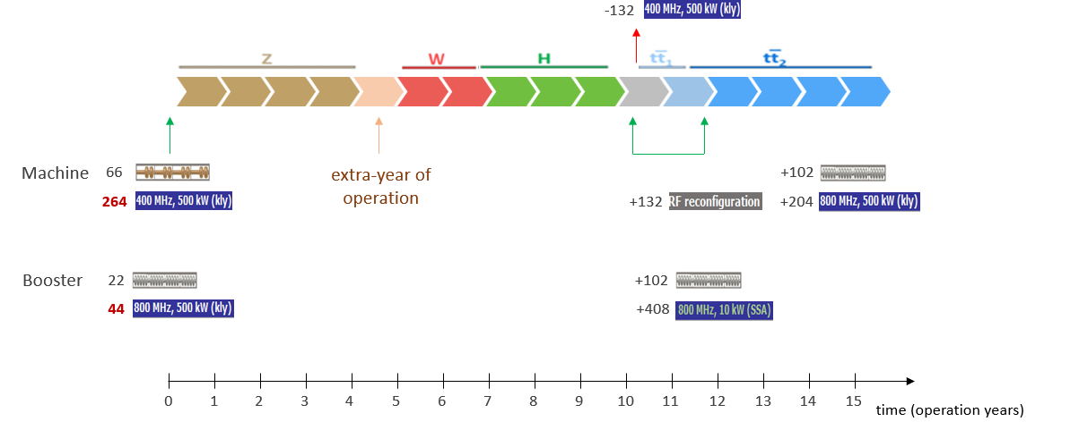
Optimisation for operation: 400 MHz SRF and beam switchyard
Beam switching between (Z, W) and ZH operation
2-cell 400 MHz cavities for all three working points, identical configuration
ES separators + magnetic field for switching beams
Allows quasi “instantaneous” switching between Z, W, ZH
 | Energy (GeV) | Current (mA) | RF voltage (GV)
Z | 45.6 | 1280 | 0.08
W | 80 | 135 | 1
H | 120 | 26.7 | 2.08
ttb | 182.5 | 5 | 11.67
Beam crossing and combination
at RF section in point H
Physics operation planning
Z, W
33 CM
33 CM
Beam 1
400 MHz
400 MHz
Beam 2
ZH
33 CM
33 CM
400 MHz
400 MHz
New 400 MHz approach
Allows flexible choice of and rapid switching between working points Z, W, ZH
Reduces R&D, cost, installation time, operation complexity by avoiding the “old” single cell system only for Z
New 800 MHz approach reduces number of CMs and increases real estate gradient

Slide 16
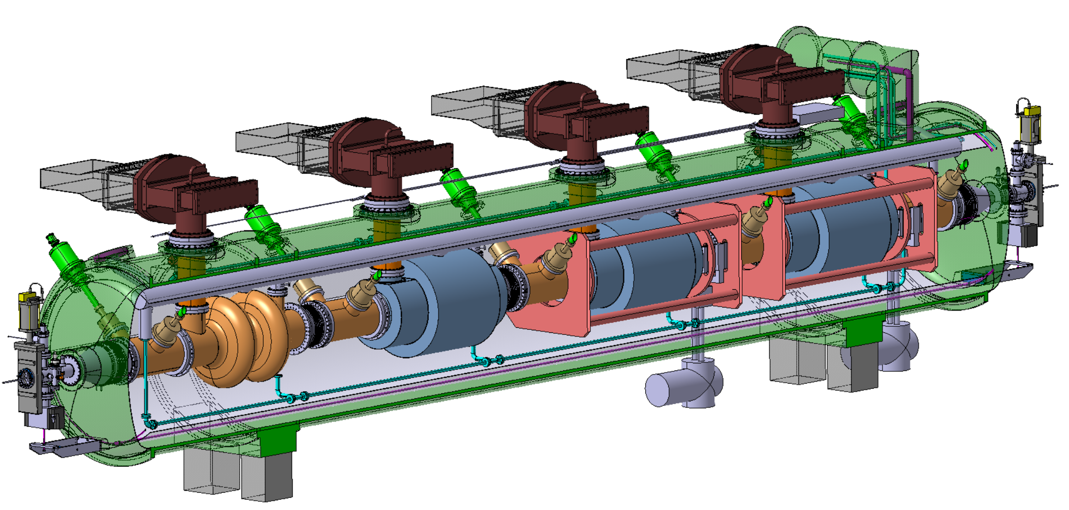
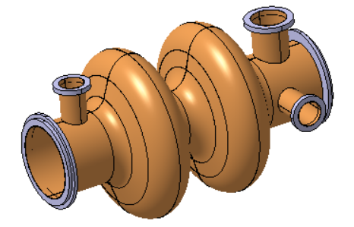
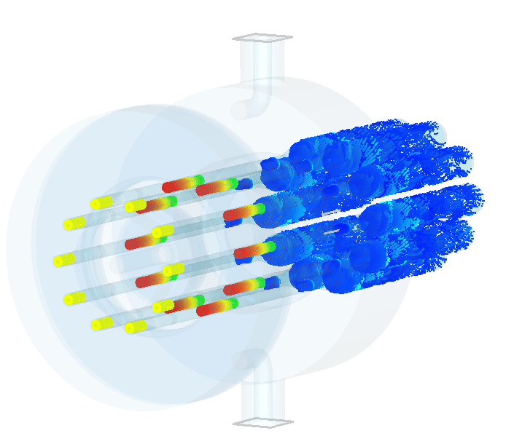
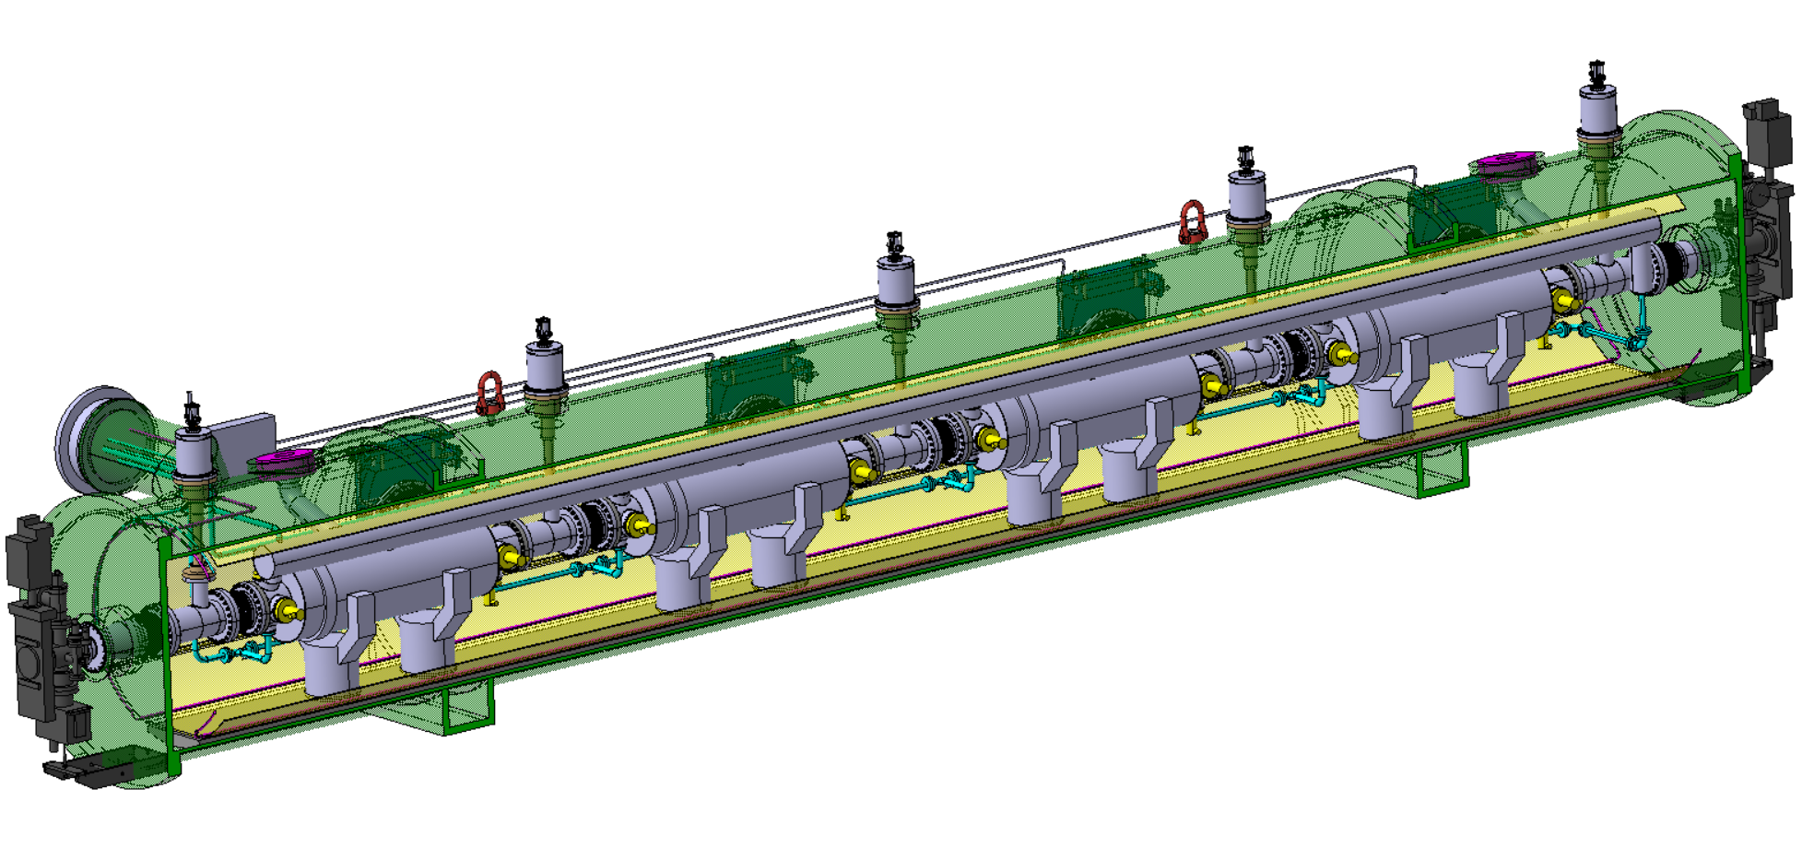
400 MHz system, 800 MHz systems, Power Source
400 MHz Collider
Power source: Multibeam Tristron
Very efficient ~90 % ! <<OPEX
3 m long
50 kV
500 kW, CW
X 264
X 66
Superconducting elliptical cavity
400 MHz, 2-cell, copper Nb coated
1.5 m. long
400 MHz Cryomodule
X 264
800 MHz Collider + Booster
X (408 + 448 booster)
X (102 + 112 booster)
X 204
+ 448 x 10 kW SSA booster
Superconducting elliptical cavity
800 MHz, 6-cell, bulk Nb
Nb₃Sn if R&D is successful
800 MHz Cryomodule

Slide 17
Optimized injector concept and parameters
Mid-term review recommendations to reduce gradients and repetition rate → new linac optimization in terms of cost and power density
  Overall power consumption (for linacs) is reduced by more than a factor 3 by means of:
    new accelerating structures with higher shunt impedance;
    lower gradient (29.5 MV/m → 22.5/20.5 MV/m);
    lower repetition rate (200/400 Hz → 100 Hz).
  Repetition rate of 100 Hz with 4 bunches per rf pulse
  New layout: Damping Ring at higher energy 2.86 GeV, no common linac with 2x repetition rate.

Slide 18
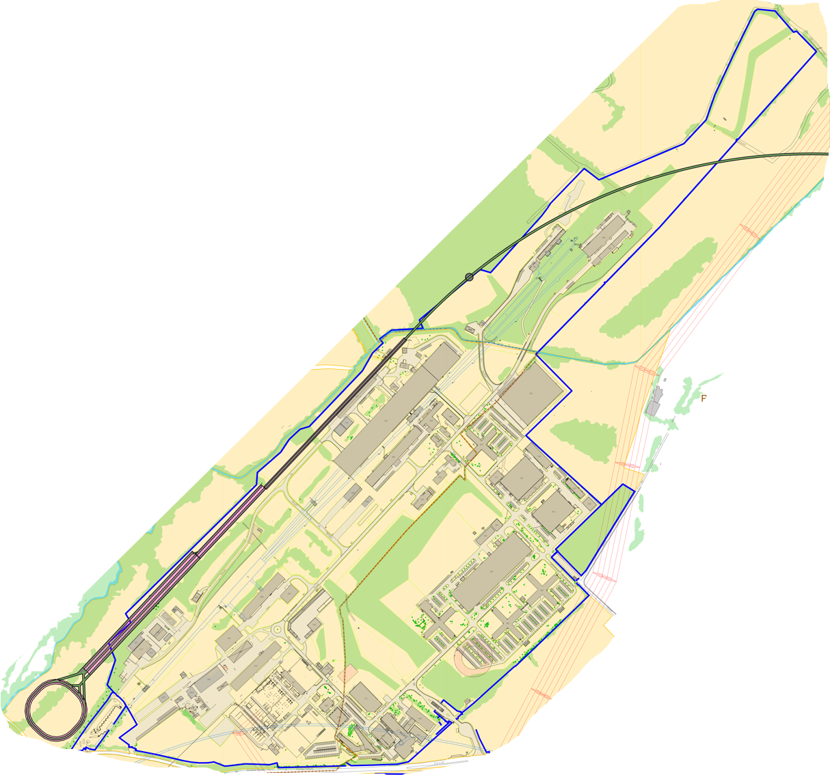
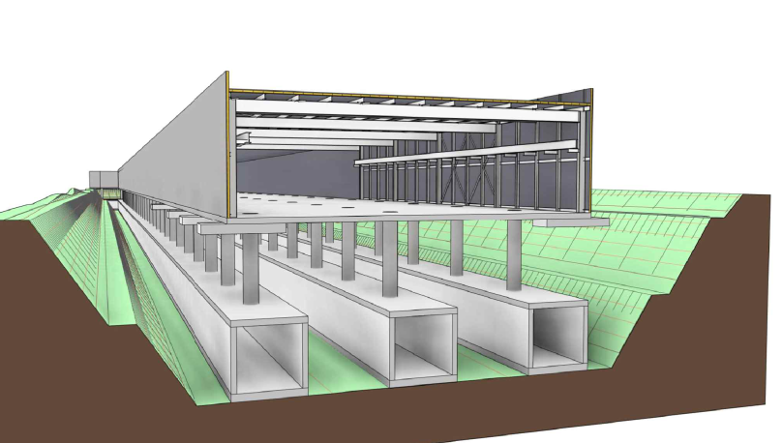
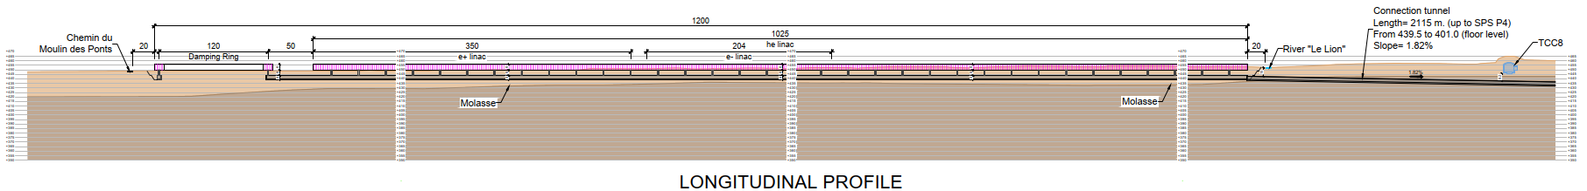
Optimised injector implementation at Prevessin site
Good integration with existing CERN Prevessin Site and strongly reduced visibility from outside.
Ideal connection to existing experimental halls.
Good conditions for construction.
High Energy LINAC
Damping
Ring
CERN Fenced Area
Entrance CERN Prevessin Site

Slide 19
New FCC-hh baseline for feasibility study
Main intentions:
Parameter optimization towards “acceptable power consumption” (~max. consumption of FCC-ee)
Magnetic field considered realistic with today’s technologies (Nb3Sn, ~14T)
Parameter | Unit | FSR (2024) | CDR (2018) | (HL-)LHC
c.m. energy | TeV | 85 | 100 | 14
dipole field | T | 14 | 16 | 8.33
beam current | A | 0.5 | 0.5 | (1.12) 0.58
bunch population | 10¹¹ | 1.0 | 1.0 | (2.2) 1.15
bunches/beam |  | 9500 | 10400 | (2760) 2808
rf voltage | MV | 35 | 20 - 48 | (16) 16
longitudinal emit. | eVs | 8.1 | 9.0 | 2.5
normalized transverse emittance | μm | 2.2 | 2.2 | (2.5) 3.75
IP beta* | m | 0.3 | 0.3 | (0.15) 0.55
initial σ* | μm | 3.8 | 3.5 | (7.1 min) 16.7
Initial luminosity | nb⁻¹s⁻¹ | 170 | 200 | (50, lev’d) 10
initial pile up |  | 590 | 690 | (135) 27
ΔE / turn | MeV | 2.4 | 4.7 | 0.0067
SR power/beam | kW | 1200 | 2400 | (7.3) 3.6

Slide 20
New FCC-hh baseline – preliminary results
Technical system choices and areas for optimisation:
Accelerator optics design to increase arc dipole filling factor and maximize beam energy
Cryo-magnet operation temperature
Cold mass either at 1.9 K with superfluid He (studied in CDR, cf. LHC) or with 4.5 K with forced flow
Cryogenics eco mode during shutdowns
Temperature of beam vacuum system (beam screen)
Impact on power consumption, integration, magnet design, Helium inventory, etc…
 | FCC-hh 90.7km 14T | FCC-hh 90.7km 14T
Magnet temperature | 1.9 K | 4.5 K
Power consumption @ 85 TeV c.m. | < 430 MW | < 330 MW
Yearly electricity consumption | < 2.8 TWh | < 2.2 TWh
Significant reduction of electrical power consumption compared to CDR version
Potential for further reduction, to be addressed with design optimisation and R&D

Slide 21
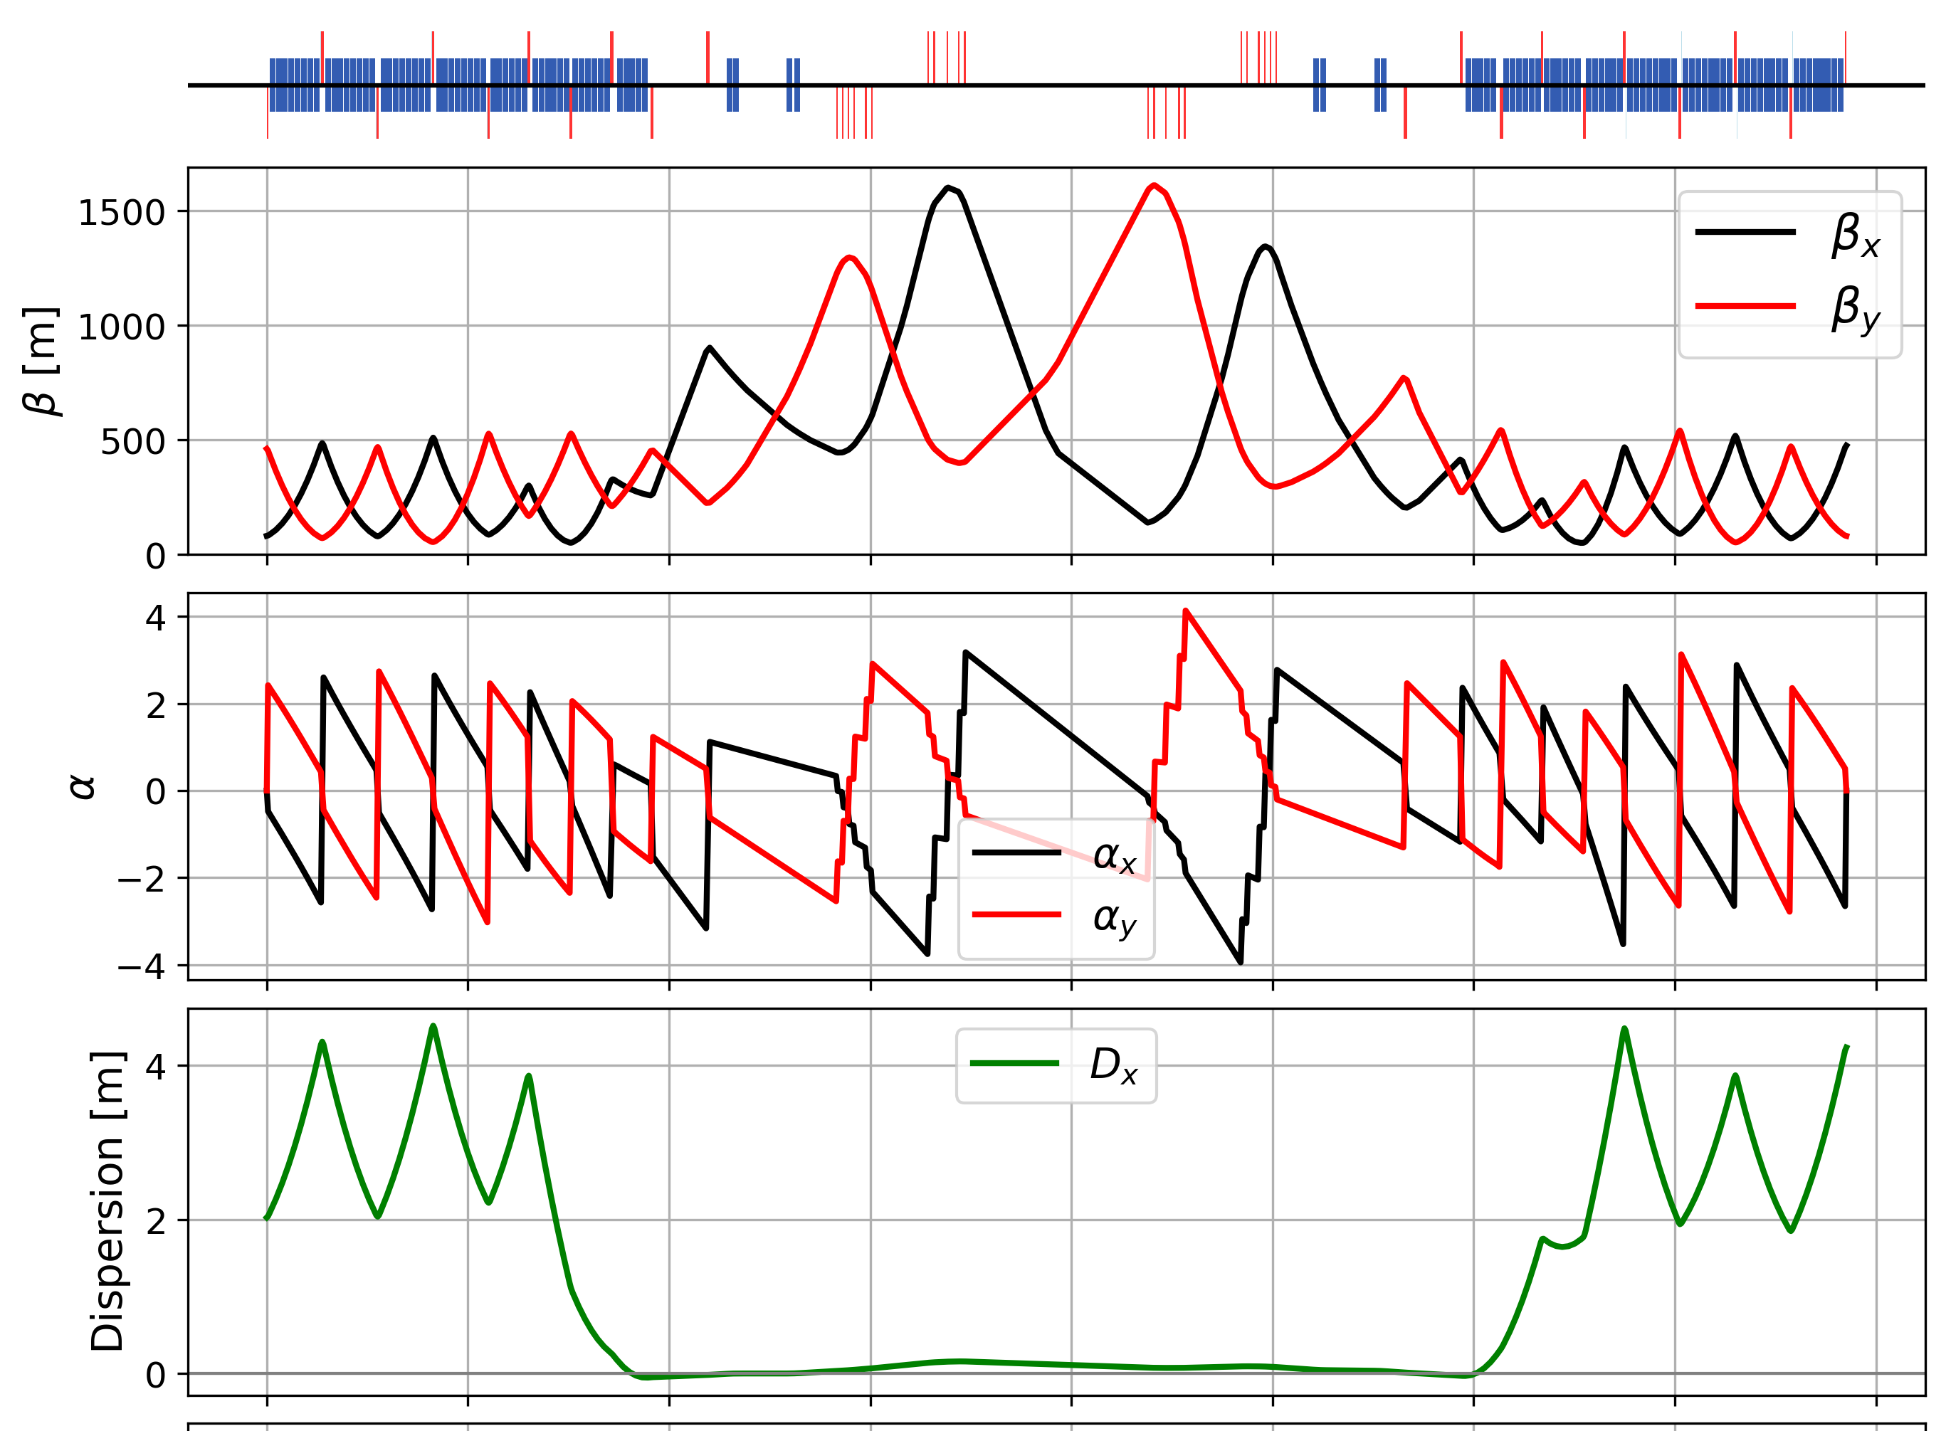
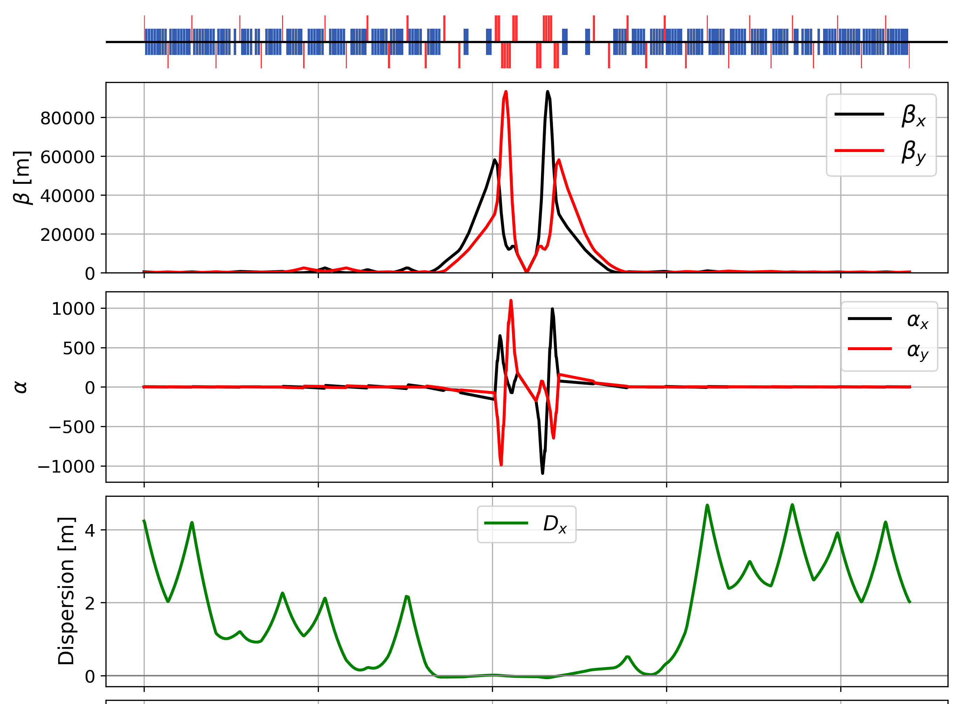
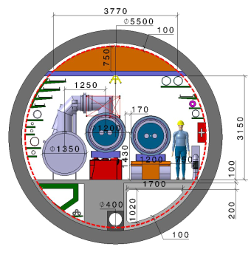
Key activities on FCC-hh: cryo magnet system, optics design
Optics design activities:
adaptation to new layout and geometry
shrink β collimation & extraction by ~30%
optics optimisation (filling factor etc.)
betatron collimation straight
experimental straight
M. Giovannozzi. G. Perez, T. Risselada
High-field cryo-magnet system design
Conceptual study of cryogenics concept and temperature layout for LTS and HTS based magnets, in view of electrical consumption.
Complete comparison of total cost of ownership (CAPEX & OPEX)
Update of integration study for the ongoing HFM designs and scaling to preliminary HTS design.→ Confirmation of tunnel diameter!
HFM R&D (LTS and HTS) on technology and magnet design, aiming also at bridging the TRL gap between HTS and Nb₃Sn.
Collider Center
F. Valchkova

Slide 22




Possible time line till start of construction
2024 |  |  |  | 2025 |  |  |  | 2026 |  |  |  | 2027 |  |  |  | 2028 |  |  |  | 2029 |  |  |  | 2030 |  |  |  | 2031 |  |  |  | 2032 |  |  |  | 2033
Q1 | Q2 | Q3 | Q4 | Q1 | Q2 | Q3 | Q4 | Q1 | Q2 | Q3 | Q4 | Q1 | Q2 | Q3 | Q4 | Q1 | Q2 | Q3 | Q4
Feasibility Study
Pre-TDR Phase
TDR Phase
Construction →→→
FS Report
cost update
ESPPU
2025/26
pre TDR
cost update
TDR
cost update
Project Decision
accelerator design, technical infrastructure design, R&D, towards TDR
engineering design →
Environmental Impact study & Authorization Process
Phase 1 Site Investigations
Phase 2 Site Investigations
CE Concept Design update
CE Tender Design
Construction Design
Start construction
Detector EOI submissions
FC³ formation, call for CDRs
Detector CDRs submitted to FC³

Slide 23
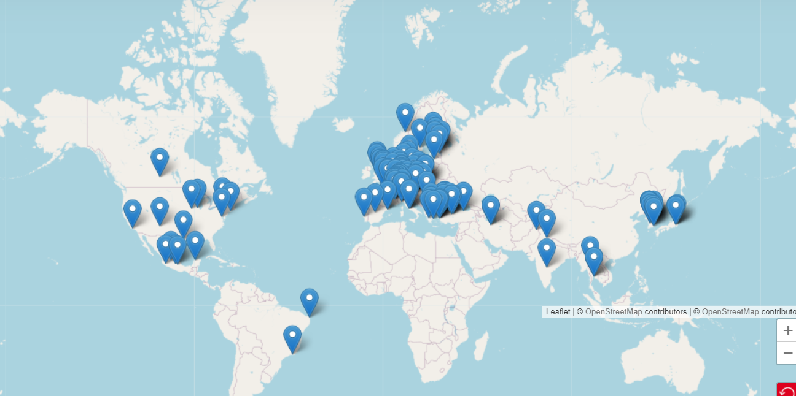
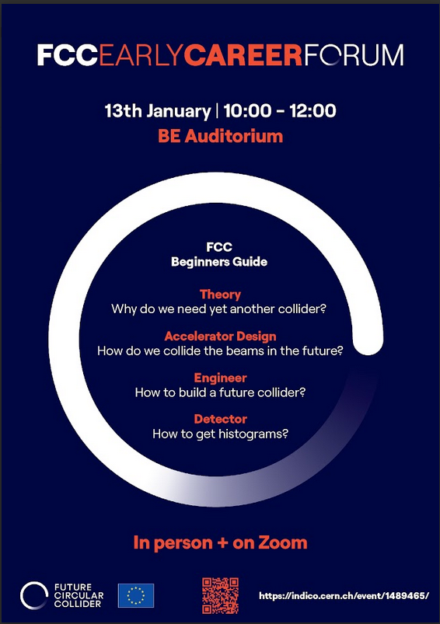
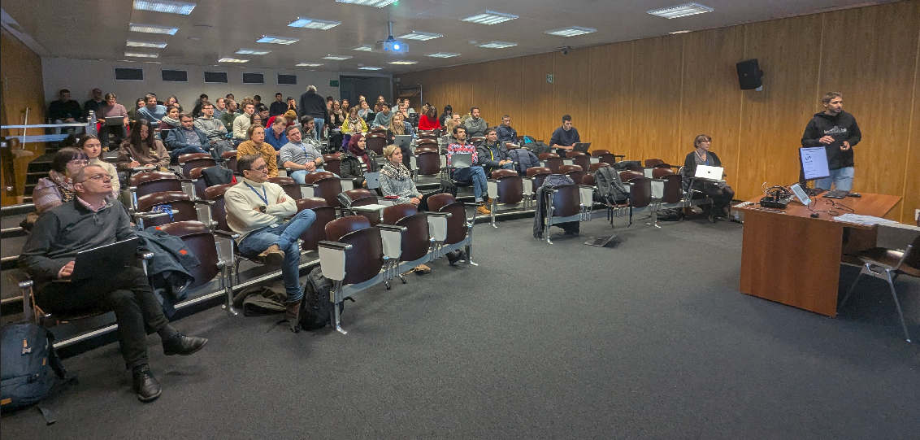


Status of FCC global collaboration and community
Increasing international collaboration as a prerequisite for success:
→links with science, research & development and high-tech industry will be essential to further advance and prepare the implementation of FCC
First FCC Early Career Forum during FCC Physics Workshop
Great interest from young generation Around 150 participants
FCC Feasibility Study:
Aim is to increase further the collaboration,
on all aspects, in particular on
Accelerator and Particle/Experiments/Detectors
141 Institutes
32 countries
+
CERN

Slide 24
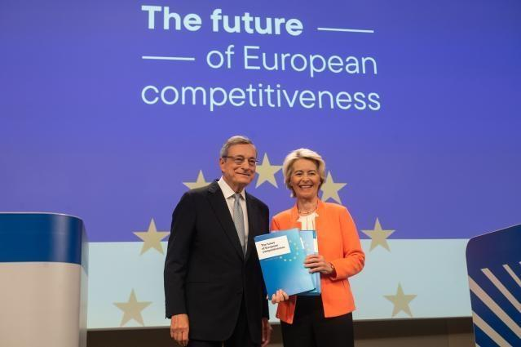
EU Competitiveness Report
edited by Mario Draghi, and officially handed over to Ursula von der Leyen in September 2024
“One of CERN’s most promising current projects, with significant scientific potential, is the construction of the Future Circular Collider (FCC): a 90-km ring designed initially for an electron collider and later for a hadron collider..
Refinancing CERN and ensuring its continued global leadership in frontier research should be regarded as a top EU priority, given the objective of maintaining European prominence in this critical area of fundamental research, which is expected to generate significant business spillovers in the coming years.”
https://commission.europa.eu/topics/strengthening-european-competitiveness/eu-competitiveness-looking-ahead_en

Slide 25
FCC Main Goals for Coming Years
Upcoming milestone for FCC is the completion of the Feasibility Study by March 2025 as input for the Update of the ESPP.
The following pre-TDR phase should prepare for a possible project approval by 2027-2028 and enable the subsequent start of CE design contract:
  Updated cost and schedule studies
  specifications to enable CE tender design by mid 2027
  refined input for environmental evaluation and project authorisation process
  requires overall integration study and designs based on technical pre-design of accelerators, technical infrastructure and detectors
Possible start of CE construction would then be 2032-33:
  CE groundbreaking
  TDR to enable prototyping, industrialization towards component production
Strong international collaboration is essential for success!

Slide 26

FCC Week 2025 - Vienna
Venue: Hofburg Palace, a historical and cultural landmark in Vienna, Austria.
Dates: Monday 19 to Friday 23 May 2025
Presentation of the Feasibility Study Report and review of its findings and opportunities for future R&D projects
Please save the date and join us in Vienna

