Slide 1





Muon Collider
D. Schulte
On behalf of the International Muon Collider Collaboration
CERN, February, 2025
Funded by the European Union (EU). Views and opinions expressed are however those of the author(s) only and do not necessarily reflect those of the EU or European Research Executive Agency (REA). Neither the EU nor the REA can be held responsible for them.

Slide 2

Muon Collider Overview
Would be easy if the muons did not decay
Lifetime is τ = γ x 2.2 μs (e.g. 3100 turns in collider ring)
Protons produce pions which decay into muons which are captured
Short, intense proton bunch
Ionisation cooling of muon in matter
Acceleration to collision energy
Collision
2
D. Schulte Muon Collider, Chamonix, January 2025
2

Slide 3
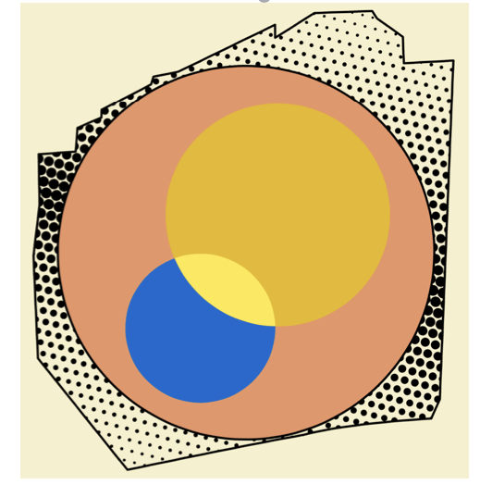
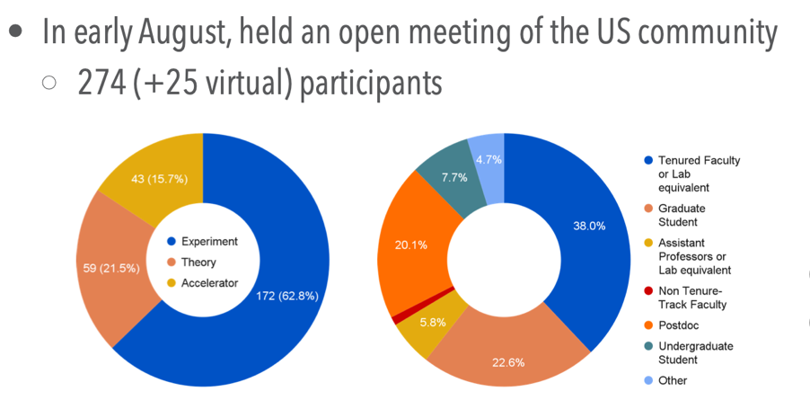
IMCC
International Muon Collider Collaboration
Collaboration currently hosted by CERN
New partners still joining (58 signed, more in the process)
From different regions
EU co-funded design study MuCol started 2023
Strong recommendation from P5 «This is our muon shot»
Interest in hosting at FNAL
US partners are joining/plan to join
Strong interest at US Muon Collider Inauguration Meeting in August at FNAL (about 300 participants)
Addendum to CERN-DoE agreement in preparation
  First resources (RF test stand, demonstrator study)
Strong US contribution to IMCC R&D plan
IMCC will carry out the R&D together and develop options to host the collider at CERN or at FNAL and potentially also other sites

Slide 4
IMCC Partners
IEIO | CERN
FR | CEA-IRFU
 | CNRS-LNCMI
 | Ecoles des Mines St-Etienne
DE | DESY
 | Technical University of Darmstadt
 | University of Rostock
 | KIT
UK | RAL
 | UK Research and Innovation
 | University of Lancaster
 | University of Southampton
 | University of Strathclyde
 | University of Sussex
 | Imperial College London
 | Royal Holloway
 | University of Huddersfield
 | University of Oxford
 | University of Warwick
 | University of Durham
 | University of Birmingham
 | University of Cambridge
NL | University of Twente
IT | INFN
 | INFN, Univ., Polit. Torino
 | INFN, LASA, Univ. Milano
 | INFN, Univ. Padova
 | INFN, Univ. Pavia
 | INFN, Univ. Bologna
 | INFN Trieste
 | INFN, Univ. Bari
 | INFN, Univ. Roma 1
 | ENEA
 | INFN Frascati
 | INFN, Univ. Ferrara
 | INFN, Univ. Roma 3
 | INFN Legnaro
 | INFN, Univ. Milano Bicocca
 | INFN Genova
 | INFN Laboratori del Sud
 | INFN Napoli
Mal | Univ. of Malta
EST | Tartu University
PT | LIP
SE | ESS
 | University of Uppsala
FI | Tampere University
 | HIP, University of Helsinki
LAT | Riga Technical University
CH | PSI
 | University of Geneva
 | EPFL
 | HEIA-FR
BE | Univ. Louvain
AU | HEPHY
 | TU Wien
ES | I3M
 | CIEMAT
 | ICMAB
China | Sun Yat-sen University
 | IHEP
 | Peking University
 | Inst. Of Mod. Physics, CAS
 | University of CAS
KO | Kyungpook National University
 | Yonsei University
 | Seoul National University
India | CHEP
Ty
CA | Université Laval
US | Iowa State University
 | University of Iowa
 | Wisconsin-Madison
 | University of Pittsburgh
 | Old Dominion
 | Chicago University
 | Florida State University
 | RICE University
 | Tennessee University
 | MIT Plasma science center
 | Pittsburgh PAC
 | Yale
 | Princeton
 | Stony Brook
 | Stanford/SLAC
 | …
DoE labs | FNAL
 | LBNL
 | JLAB
 | BNL
Brazil | CNPEM
4
Signed MoC (58), requested MoC, contributor

Slide 5
IMCC Goals
Develop high-energy muon collider as option for particle physics:
Focus on 10 TeV feasibility
Initial stage as option by ~2050 as strongly recommended by Steering Board and Advisory Committee, with required compromises
Could later consider other energies (above 10 TeV, 125 GeV, …)
LDG Accelerator R&D Roadmap
Goal is to motivate investment into CDR
Important resources ramp-up realized with EU co-funding (MuCol)
  Finish early 2027 (original plan for beginning of 2026)
Currently in the middle of ”minimal programme”
  Most important studies, basically no hardware
Goals for ESPPU is to provide document with
Assessment of muon collider concept, technologies and work progress
An R&D plan for the next 5 and 10 years
Implementation considerations (including site, timeline, …)
http://arxiv.org/abs/2201.07895
5

Slide 6
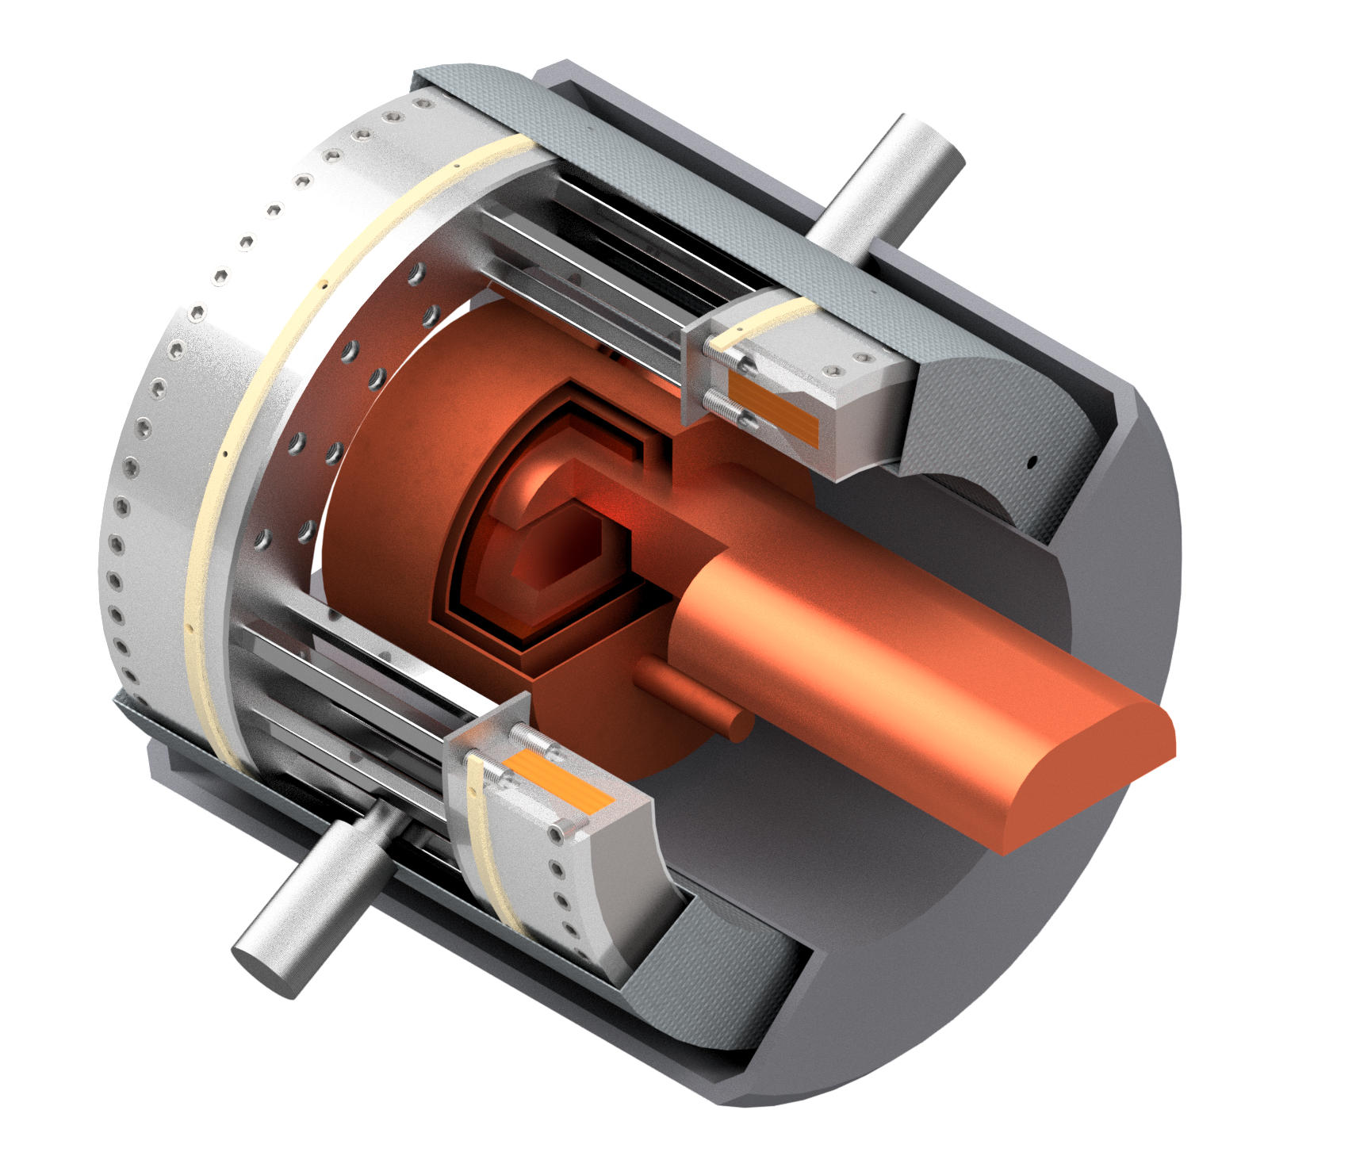
R&D Programme
Muon cooling technology
RF model test stands to test cavity models in magnetic field
Muon cooling cell test infrastructure (700 MHz)
Demonstrator
  At CERN or FNAL, maybe ESS, JPARC, …
Magnet technology
HTS solenoids
Collider ring magnets with NbTi, Nb3Sn or HTS
Detector technology and design
Can do the important physics with near-term technology
But available time will allow to improve further and exploit AI, MI and new technologies
Other technologies are also important to support that the muon collider can be done and perform
Integrated facility design
Environmental impact, lattices, beam dynamics, cost/power optimization, neutrino flux
Site specific studies
Strong synergy with HFM Roadmap and RF efforts

Slide 7
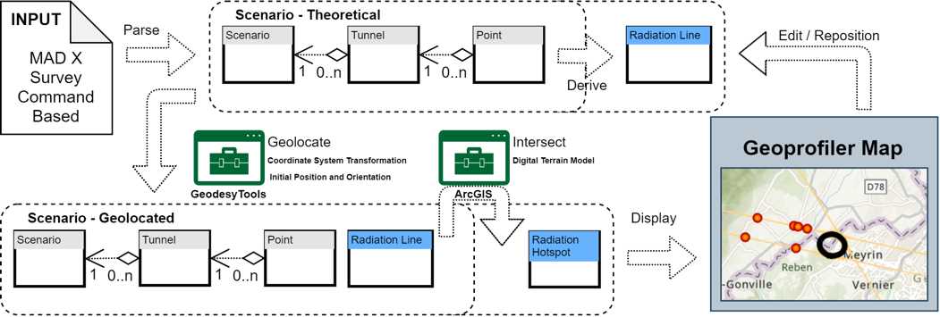
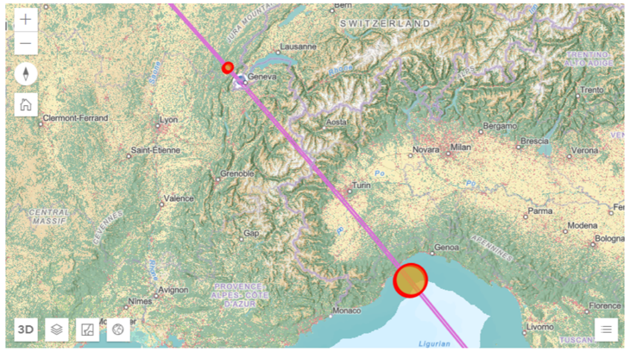
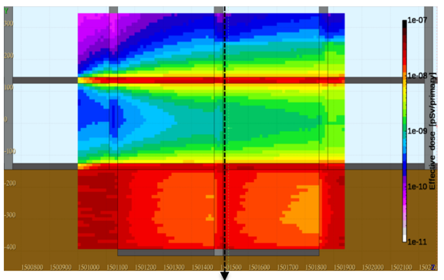
Environmental Impact
Limited study on CO₂ etc. at this moment
Inherent muon collider benefits
Compact size limits material use/CO₂ footprint
Limited power consumption
Limited land use, in particular if existing tunnels are reused
Aim at minimising neutrino flux
Focus on collider ring for now, need to expand later
Working with RP
Improved geoprofiling tool to place collider ring
Mechanical mover system against dense neutrino flux
First promising site and orientation identified
Mitigates flux from experiments
Arc flux likely negligible for 3 TeV
  Acceptable/negligible for 10 TeV
Further site optimization, detailed RP study, study of specific locations, development of technical systems and beam study needed, legal discussions

Slide 8
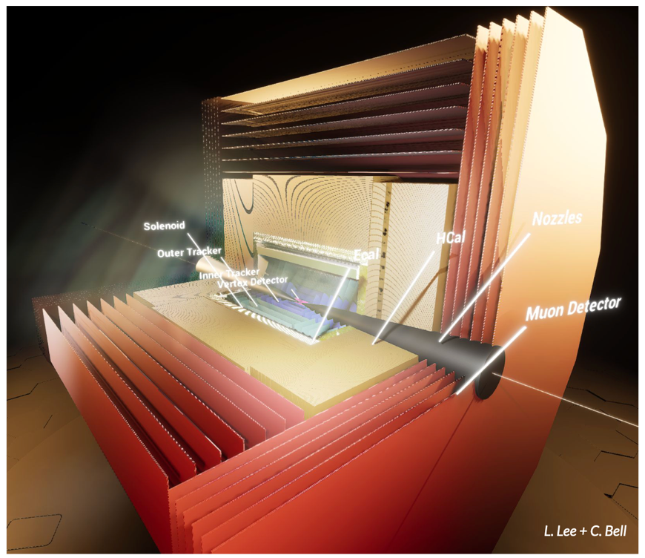
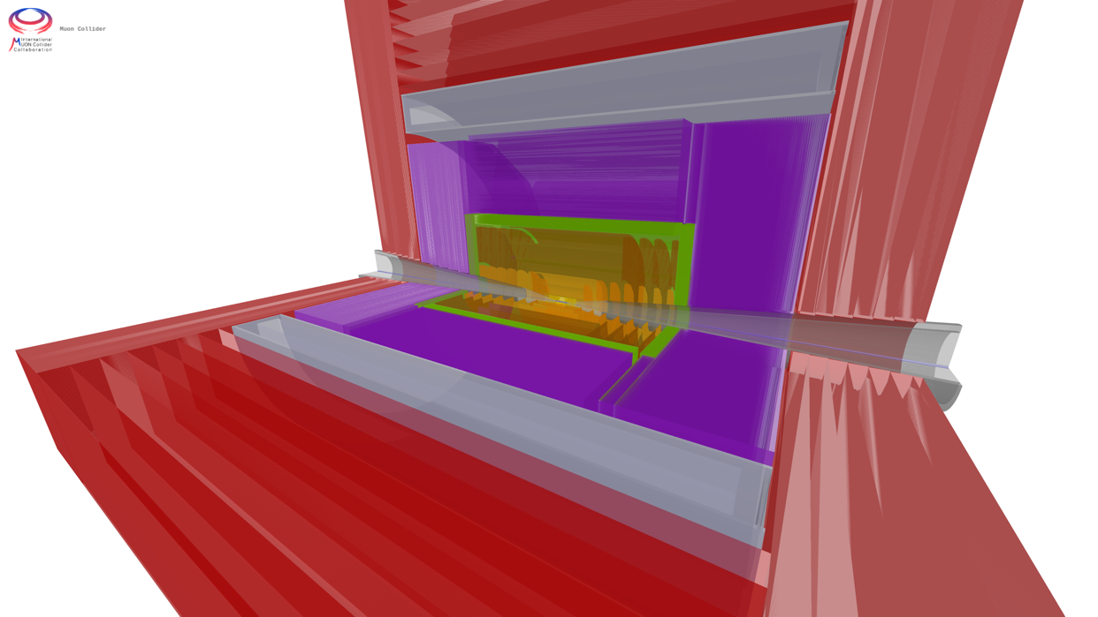
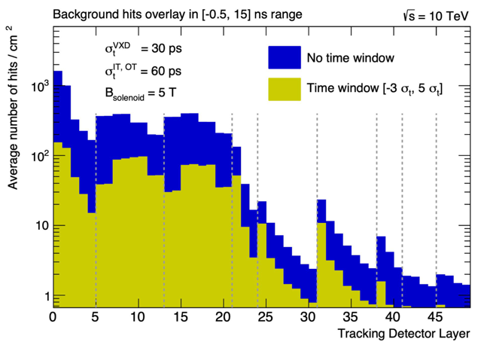
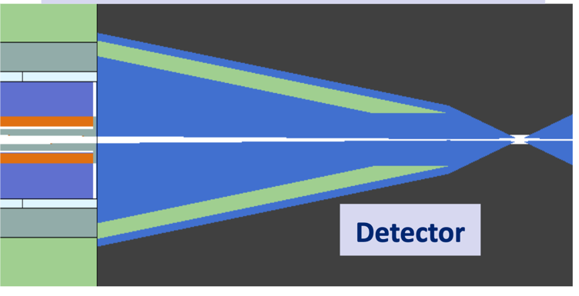
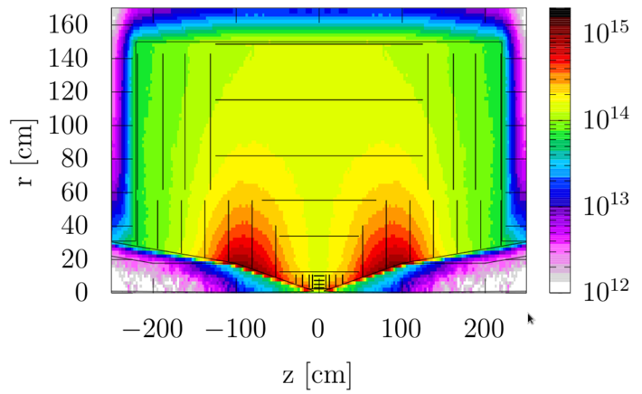
Physics and Detector Concepts
MUSIC
(MUon System for Interesting Collisions)
MAIA
(Muon Accelerator Instrumented Aperatus)
Two detector concepts are being developed
Required resolutions
MDI and background suppression
…
Increasing effort to use available time for further improvements and exploiting AI, ML and new technologies
Closer integration with ECFA detector R&D highly welcome
Can do the important physics with near-term technology also thanks to HL-LHC developments

Slide 9
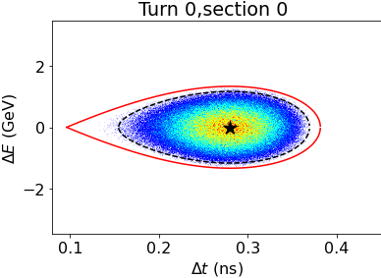
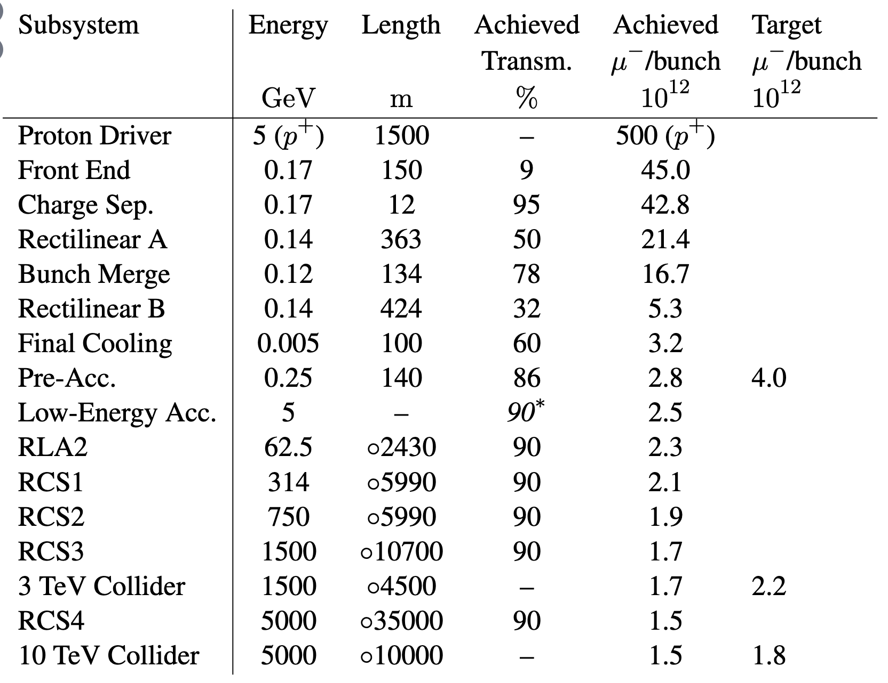
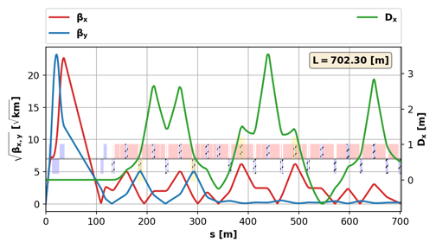
Facility Design
Good progress in the different system designs
Proton complex, muon production and cooling, acceleration and collider ring, collective effects, …
Preliminary design of cooling chain advanced
24 to 30 um transverse emittance
Goal 22.5 um, MAP achieved 55 um
Collider ring lattice design
Achieve beta-function
Need to improve energy acceptance (2-3 x)
Preliminary muon transmission estimate
1.5 x 10¹² muons at IP (goal 1.8 x 10¹²)
Cooling transmission below target
High-energy complex is above (would like to reduce for cost)
Need resources to improve system design
Will study higher power target (graphite or liquid metal)
Time to increase design effort to cover and integrate all systems (“start-to-end simulation”), improve codes, performances and consider alternatives
9

Slide 10
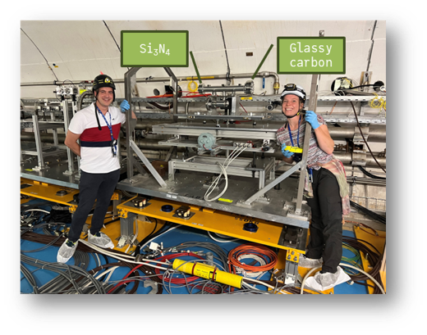
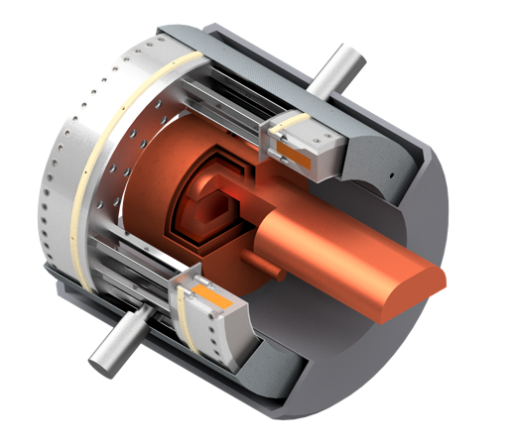
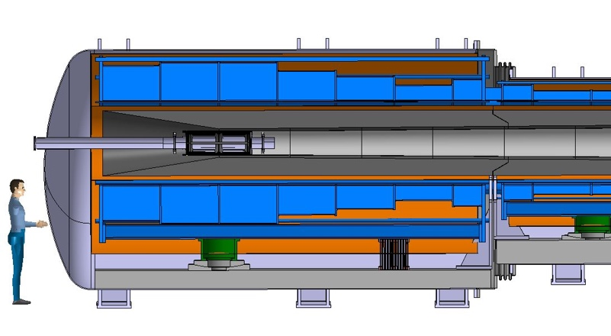
Muon Production and Cooling
Muon cooling technology and demonstrator
Most integrated technology
Operational demonstrator in O(10 years), with enough resources
Allows to perform final optimization of cooling technology
Very bright muon beam challenges absorbers and windows
First tests of absorber windows performed
Strong theoretical and experimental programme required
Engineering module design started
Including solenoid
RF design ongoing
2 MW graphite target looks very promising
Some work on windows remains
Will study alterative higher power (4 MW) target
Graphite, liquid metal, fluidized tungsten
Ready to widen effort, in particular beamdynamics, prototyping and experimental work
10

Slide 11
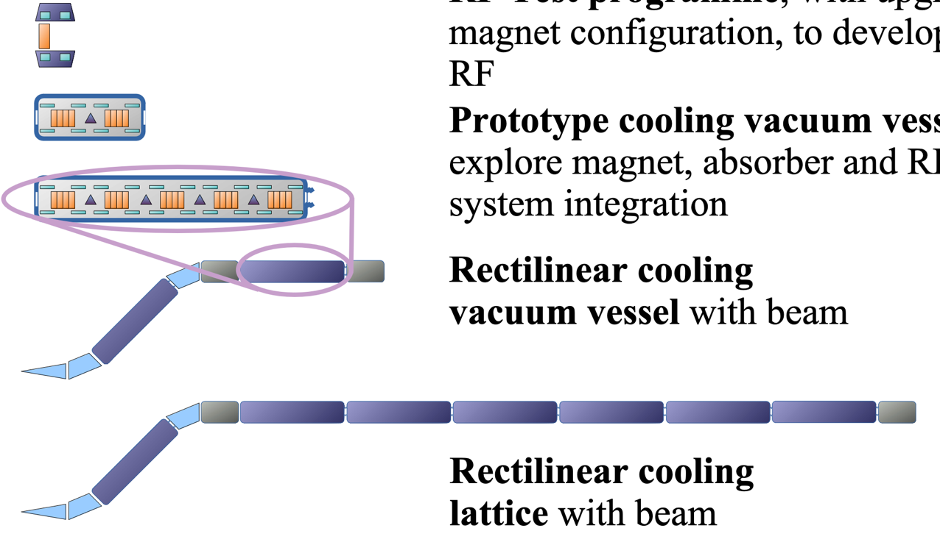
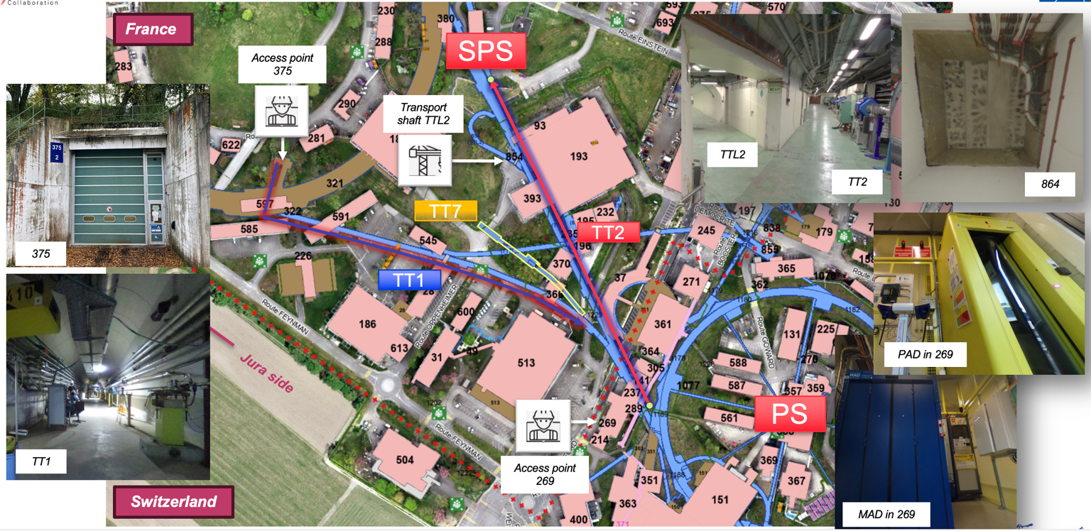
Demonstrator
Ultimate 6D cooling technology integration
Components: Magnets, RF systems, absorbers, vacuum, instrumentation, cryogenics, …
Integration, operation, performance with beam
Gradual upgrades as cell design evolves, confidence grows
Will be important part of commissioning preparation after the decision to build the muon collider
Staged implementation
Components
RF model test stands
700 MHz cell test infrastructure
Module test with beam
Improved module string
Detailed studies of site at CERN ongoing, considering TT7 tunnel or CTF3 building
US plan to start detailed study at FNAL
Effort ramp-up in several stages
Modular plan will allow quickly moving forward
adjust to developments in Europe and the US

Slide 12
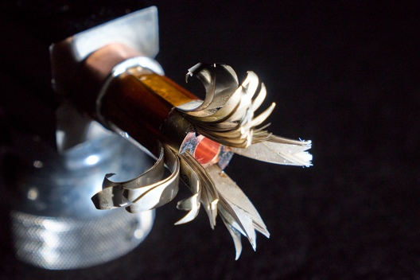
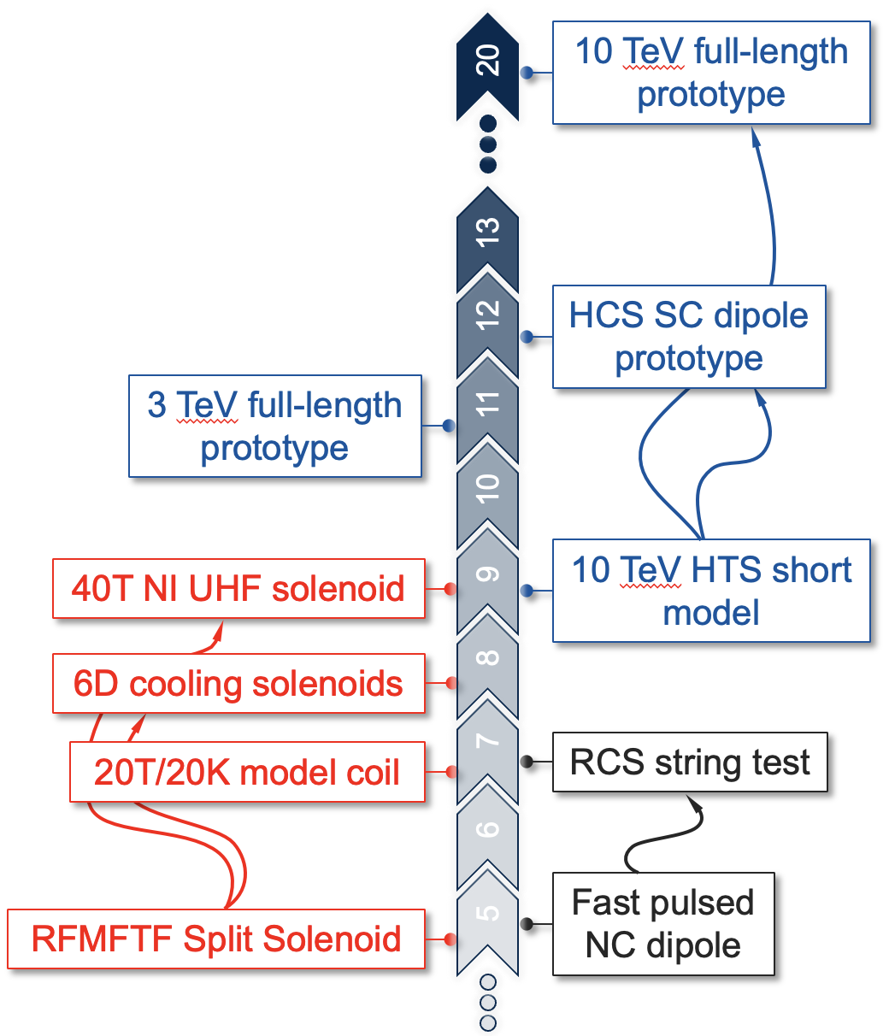
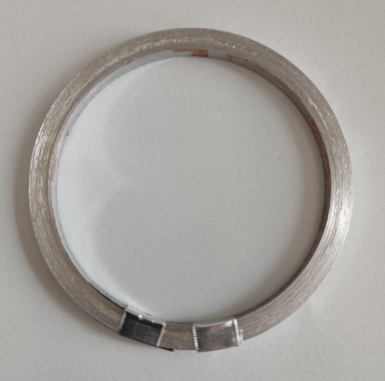
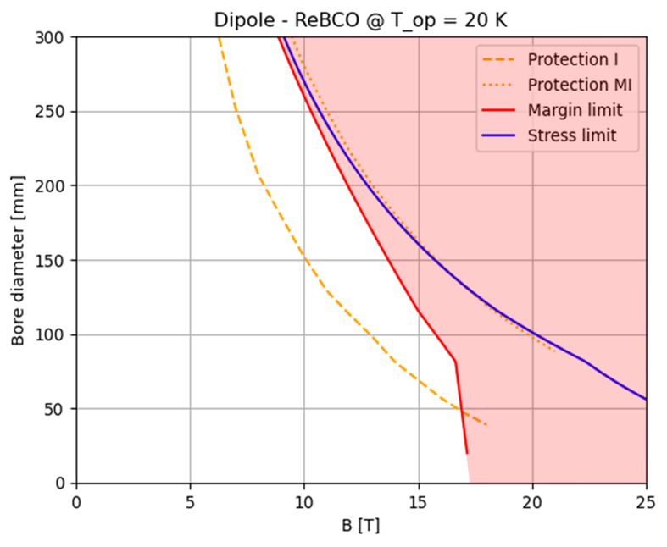
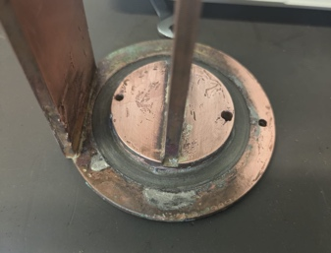
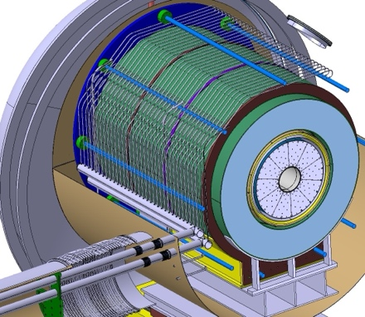
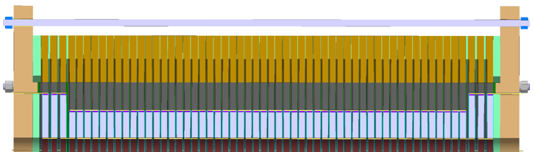
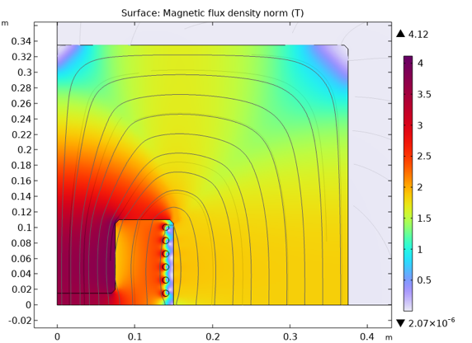
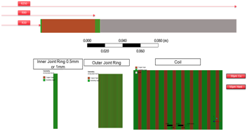
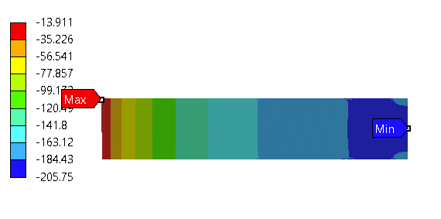
Magnets
Progress:
Systematic dipole performance prediction for LTS and HTS
Aperture, field, cost, stress, loadline, protection, …
HTS solenoid designs (6D cooling, final cooling, target)
Normal-conducting fast-pulsed dipoles (HTS as alternative) and power converter
MuCol HTS conductor
Operating current: 61 kA
Will slightly adjust collider ring field for cost
HTS final cooling solenoid mechanical design
REBCO, 20 K
First HTS winding tests
Target HTS solenoid
Opportunity to ramp up effort
Engineering designs
Tests of cables, building models, …
With sufficient resources HTS solenoids and Nb₃Sn dipoles could be ready for decision in 10-15 years
HTS dipoles likely take longer
HTS pancakes 4 mm tape
Normal-conducting RCS pulsed magnets
12

Slide 13
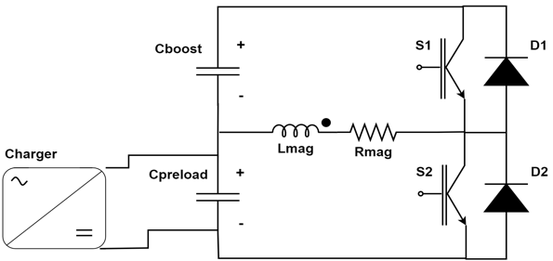
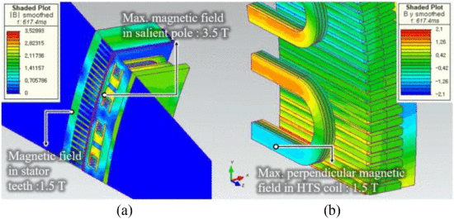
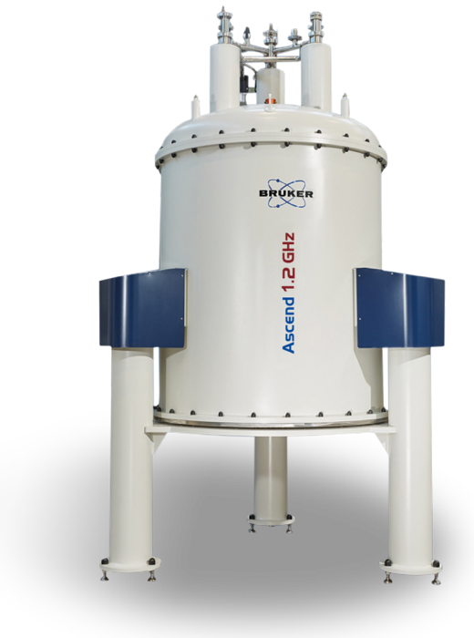
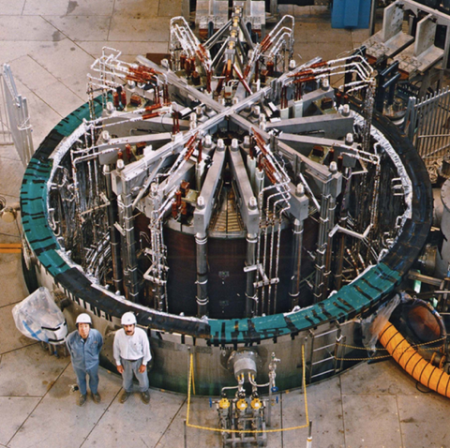
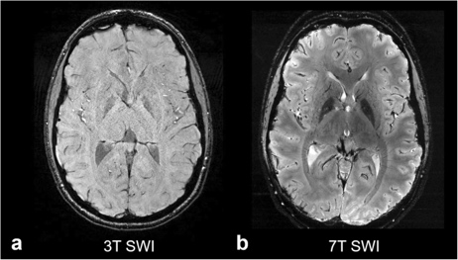
Other R&D Programme
R&D on other technologies also needed
Power converter, high-field superconducting cavities, efficient RF power sources, cryogenics (e.g. liquid hydrogen), instrumentation, …
RCS power converter
Synergy with MMC
For high-power transfer
e.g. off-shore windmills
Most important is training of young people
Most important resource
Strong interest by early career experts
  e.g. https://indico.cern.ch/event/1422393/
Motivating challenges
Design of 10 MW HTS wind generator
ITER Central Solenoid Model Coil
13 T at 4.5 K, 1.7 m (LTS)
Exploit synergies with other fields (technology and physics)
Strong synergy with LDG HFM and RF
HTS solenoids have important potential
Fusion
Power generators for windmills and motors
Life sciences
Important step toward FCC-hh HTS dipoles
…
Detector technology development
AI, ML, …
28.2 T LTS+HTS, 54 mm
Opportunities to profit from synergies
Attract young generation
R&D programme can be distributed world-wide

Slide 14
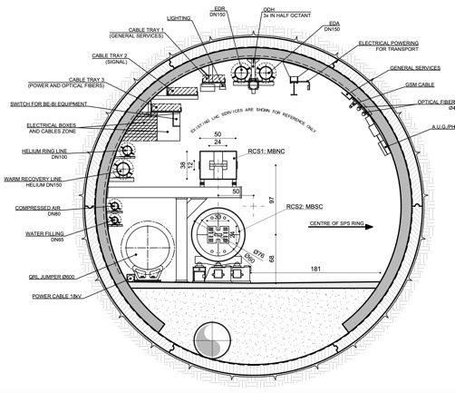
Exploratory Site Studies at CERN
First potential collider ring site identified that mitigates neutrino flux from experiments
More work required for arcs
RCSs:
SPS-1 (normal conducting) normal RCS
LHC-1 1.6 TeV, normal RCS
LHC-2 3.8 TeV, hybrid RCS
Or LHC-2 5 TeV, hybrid RCS with HTS ramping magnets
Most construction on CERN land
Detailed study required!
J. Osborne et al.
Muon production, cooling, initial acceleration
Example as discussion basis
numbers will change
Collider ring (10 TeV)
Two RCS in LHC tunnel
Transferline maximum slope 6%
Injector similar to SPL
SPS and LHC used for RCSs
Motivates detailed study

Slide 15
Staging (CERN-specific)
Expect to be ready for implementation in 15 years
Detector
Muon cooling technology
HTS solenoid technology
NbTi or Nb3Sn collider ring magnets
Parameter | Unit | 3 TeV (GF) | 10 TeV (GF) | 3.2 TeV (1) | 10 TeV (1) | 7.6 TeV (2)
L | 10³⁴ cm⁻²s⁻¹ | 1.8 | 18.75 | 0.74 | 18 | 7.9
N | 10¹² | 2.2 | 1.8 | 2.2 | 1.8 | 1.8
f_{r} | Hz | 5 | 5 | 5 | 5 | 5
P_{beam} | MW | 5.3 | 14.4 | 5.3 | 14.4 | 11
C | km | 4.5 | 10.7 | 11 | 11 | 11
B_{dipole} | T | 11 | 15 | 4.8 | 14.5 | 11
Collider techn. |  | Nb3Sn | HTS | NbTi | HTS | Nb3Sn
Last RCS techn. |  | normal | normal | normal | HTS | normal
Likely need longer for
HTS collider ring magnets
Fast-ramping HTS RCS magnets
Aim for 3.2 TeV and later 10 TeV
Or 7.6 TeV in one step
Take with a grain of salt, this is to motivate the studies
15

Slide 16
Technically Limited Timeline for Development Phase
R&D required to prepare approval and launch of project
Decision process and further optimization/project preparation
Initial programme to keep potential for ambitious starting point
As requested by ESPPU
All budget available
Full commitment
All R&D successful

Slide 17
Potential Implementation Timeline
Initial stage at lower energy using CERN infrastructure
Green field or higher energy will be slower
As requested by ESPPU
All budget available
Full commitment
All R&D successful
Iterative decision process
5 years
Detailed studies required
Assume most important timeline driver is removal of HL-LHC and installation of RCSs in LHC tunnel
17

Slide 18
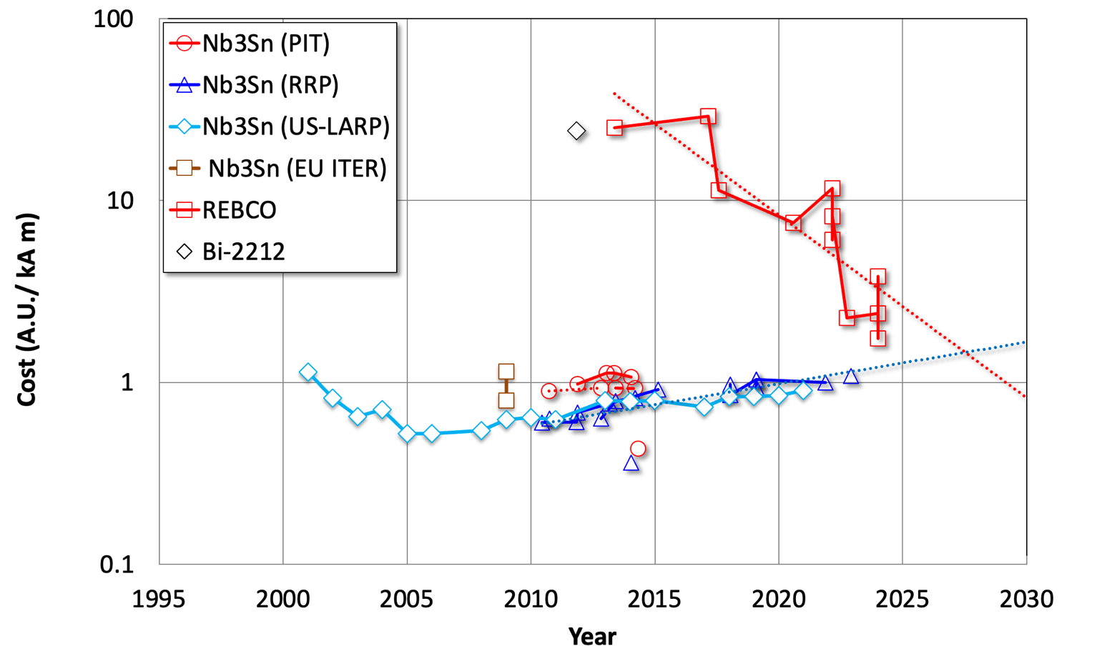
Maturity, Cost, Power, Land Use
Maturity
The moment to commit depends on many factors
Important for society
Willingness to take risk
…
Feel that we need a decade more R&D
Further and optimize overall design
Address challenges
HTS cost is coming down
How much depends on the overall use of HTS
Cost and Power
Are collecting cost and power information (Carlo Rossi is also leading the CLIC costing), at this moment
Remaining uncertainties exist
Important magnet cost uncertainty
Are asked to adjust to FCC-hh costing methodology
Land Use looks promising
Nb3Sn cost slowly increasing
We may be the only users
Industry would have to ramp up just for us

Slide 19
Conclusion
The Muon collider is a potentially important option for particle physics
For Europe after HL-LHC, if the Higgs factory is built elsewhere
To bring the US back into the high-energy frontier of particle physics
As a project in Europe or elsewhere after a Higgs factory
Good progress has been made in its design and the relevant technologies
A further, important R&D over a decade is required to arrive at sufficient maturity to commit to a collider
An initial stage of the project by around 2050 is used to define the R&D and implementation plans
Making the required compromises
With strong commitment
Provided the funding is available
Provided the R&D is successful
Many thanks to the collaboration for all the work

Slide 20
Reserve

Slide 21
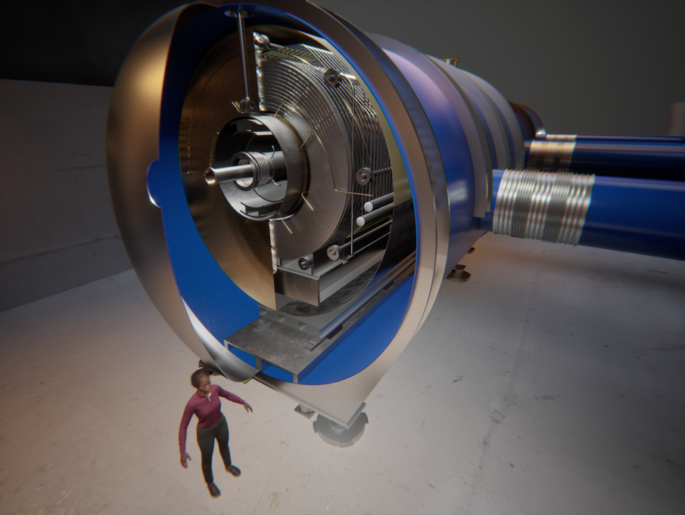
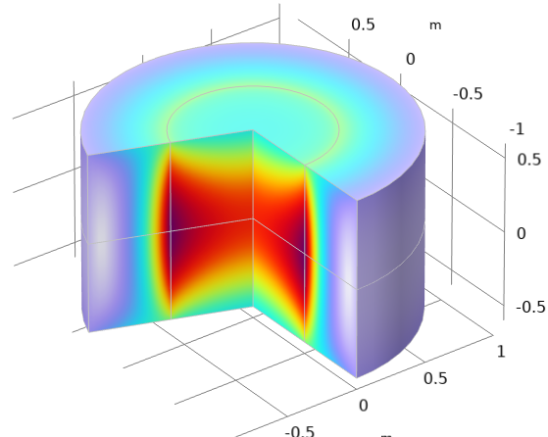
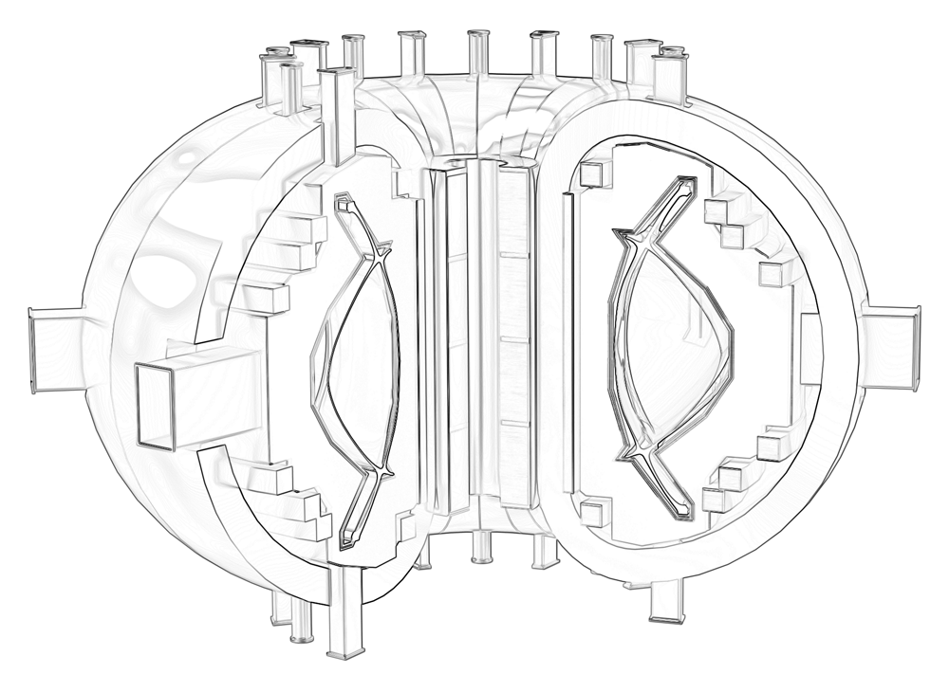

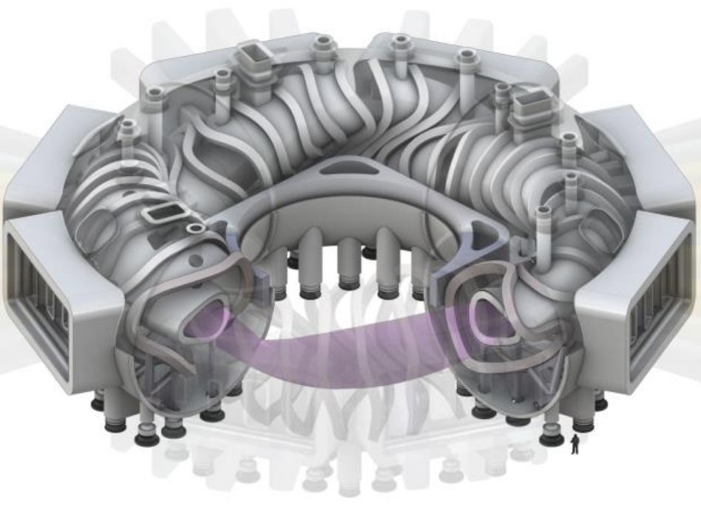

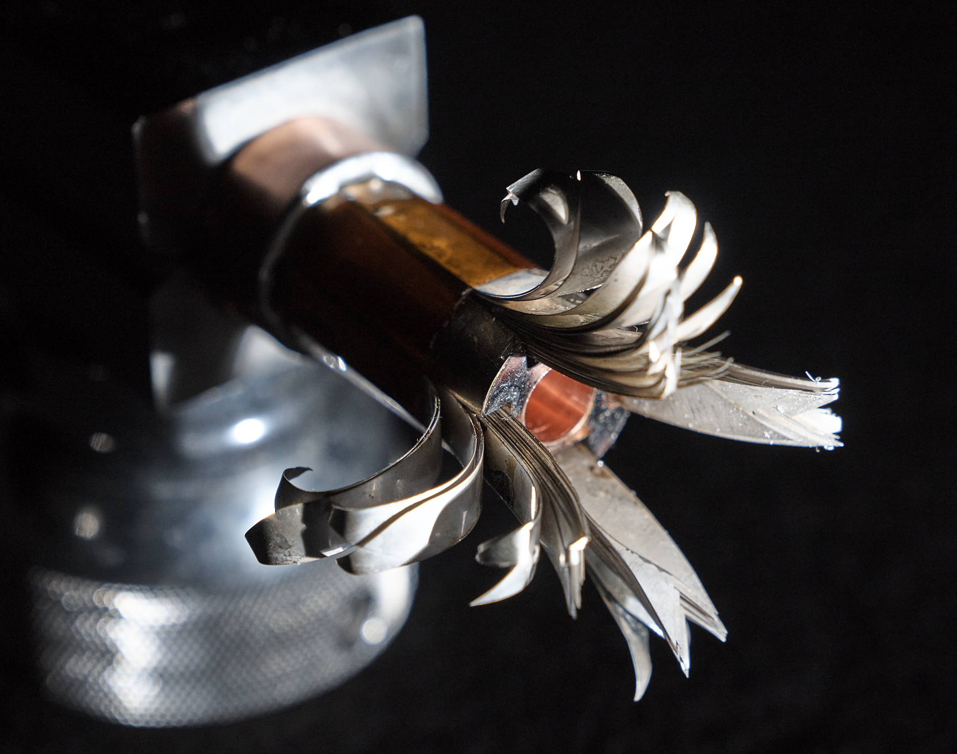

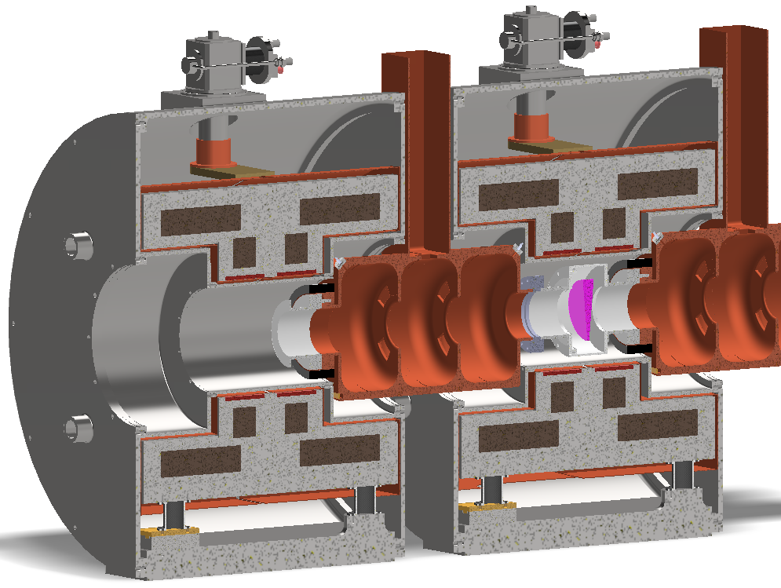

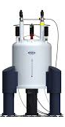
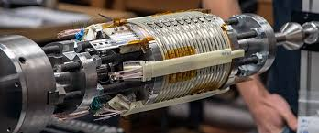
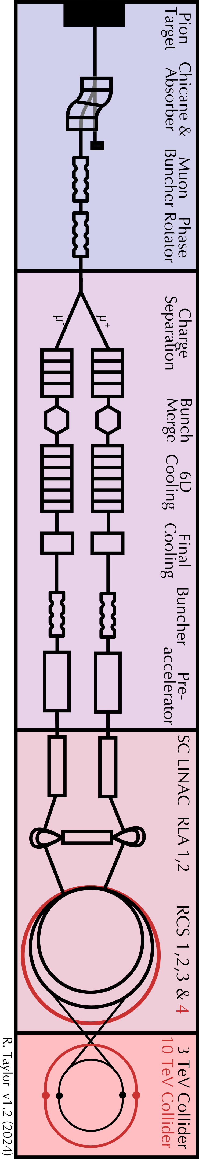


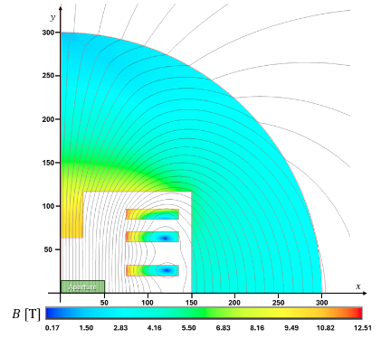
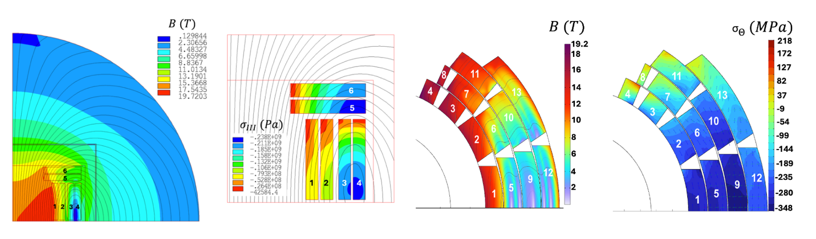
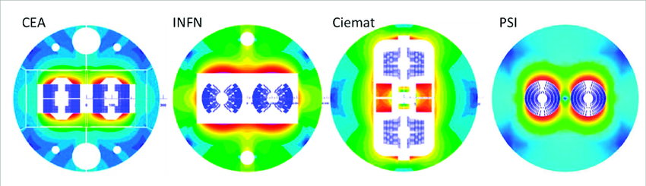

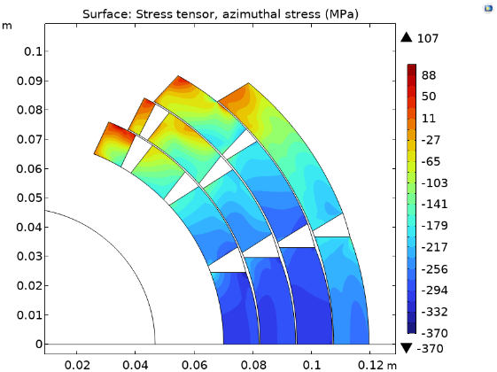
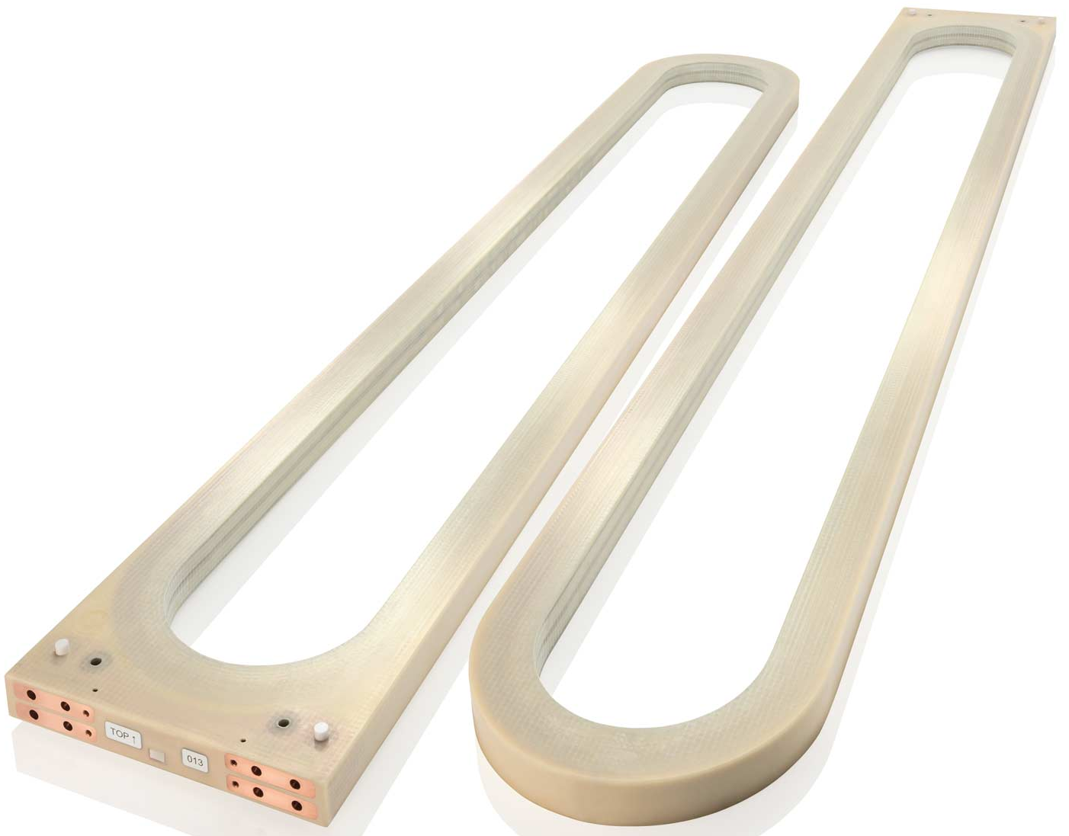


F4E
EUROFusion
Gauss Fusion
ENI
Target and capture solenoid
Magnetically confined fusion
Muon beam cooling solenoids
LNCMI
NHMFL
UHF science, NMR and MRI
Accelerator and collider magnets
HEP and power applications
HFM
FCC-hh

Slide 22
Benefits of R&D on muon collider magnets
Technological Innovations
  Advances in HTS magnet science and technology will benefit HEP and high-field applications beyond accelerators.
  Novel HTS technology can accelerate fusion energy research (e.g. towards compact fusion machines), as well as materials and life science (e.g. UHF analytics and NMR with better diagnostic power).
  Operation at temperature above liquid He will improve energy-efficiency of cryogenics systems for broader industrial use.
Societal Applications
  Energy: widespread introduction of HTS materials would lead to simpler and more efficient fusion plants, aeolic generators and motors, reduced electricity distribution losses, enhancing energy efficiency and cost savings.
  Healthcare: Enhanced NMR and MRI technology would improve diagnostics, reduce healthcare expenses and facilitate market penetration.
  Cryo-free energy efficient HTS magnets would reduce the size of particle therapy accelerators and gantries, facilitating diffusion of particle-based cancer therapy.
Economic Impact
  Potential to generate technological spin-offs, industrial applications, and job creation.
  Promotion of innovation ecosystems, driving high-tech economic growth and sustainability initiatives.

Slide 23


Staging
Expect to be ready for implementation in 15 years
Detector
Muon cooling technology
HTS solenoid technology
Nb₃Sn dipoles (11T) for collider ring
High-field HTS dipoles for second stage are likely later
Energy staging
3 TeV design takes lower dipole performance into account
  HL-LHC type performances
Cost split over two stages, little increase in integrated cost
Luminosity staging
Longer collider ring arcs and less performant interaction region lead to less luminosity in first stage
Can later upgrade interaction region (as in HL-LHC), remain at 2/3 of luminosity because of arcs
Full cost at first stage
23

Slide 24

Key Challenges
Environmental impact
Neutrino flux mitigation
Power, cost, CO₂, …
0) Physics case
2) Beam-induced background
Key technologies for timeline
Magnet technology
Muon cooling technology
Detector
Other technologies are instrumental for performance, cost, power consumption and risk mitigation, decision making
  Accelerator physics, cryogenics, superconducting cavities, ….
4) Muon production and cooling drives the beam quality
MAP put much effort in design
optimise as much as possible
1) Dense neutrino flux
mitigated by mover system and site selection
Other important timeline considerations are
Civil engineering
Decision making
3) Cost and power consumption limit energy reach
e.g. 35 km accelerator for 10 TeV, 10 km collider ring
Also impacts beam quality
24

Slide 25
Technically Limited Timeline
Decision process and further optimization/project preparation
R&D required for to prepare approval and launch of project
Construction/installation
Removal of equipment in existing tunnels
Initial programme to keep potential for ambitious starting point
As requested by ESPPU
All budget available
Full commitment
All R&D successful

Slide 26
Muon Collider Physics Case
A. Wulzer

Slide 27
A. Wulzer
Muon Collider Physics Potential

Slide 28

A. Wulzer
Muon Collider Physics Potential

Slide 29

A. Wulzer
Muon Collider Physics Potential

Slide 30

A. Wulzer
Muon Collider Physics Potential

Slide 31

A. Wulzer
Muon Collider Physics Potential

Slide 32

A. Wulzer
Muon Collider Physics Potential

Slide 33

A. Wulzer
Muon Collider Physics Potential

Slide 34
Muon Collider Experiment Status
D. Lucchesi, F. Meloni

Slide 47
Local pile-up substraction -> BIB subtraction

