Slide 2
High Field Magnet
Programme Developments
E. Todesco, HFM programme leader
B. Auchmann, HFM programme co-leader
On behalf of HFM collaboration
With feedbacks from A. Milanese, A. Ballarino, S. Izquierdo Bermudez
10 February 2025, CERN

Slide 3
Contents
What’s new
Baseline for FCC and options
Nb₃Sn activities
HTS activities

Slide 4
A brief summary of 2024 main actions
Update of the mandate, with 14 T as baseline for FCC-hh
  Preparation of a revised chapter for FCC-hh feasibility study, with baseline and options
  Update of the timeline for the Nb₃Sn dipole magnets for FCC-hh
    Main element: selection of one (max two) design during LS3 (by 2028), FCC-hh commissioning in 2050-55 [see talk B. Auchmann and appendix]
  Update of cost estimate for Nb₃Sn dipole, preparation of the ESPP-HFM
Fine tuning of the structure
  Reduction of WPs (from 38 to 33) and transformation of RDline4 (modeling) to integration and sustainability
Enhancing communication and synergies
  Merging the RDline fora in one unique forum “a la carte”, where also US-MDP is invited, https://indico.cern.ch/event/1510468/ 13 meetings in 2024, plus 4 joint with US-MDP - attendance rised from initial 25-30 to 50-70
  Activation of working groups

Slide 5
HFM steering board
M. Lamont (chair)
P. Vedrine (co-chair)
HFM collaboration board
C. Senatore (chair)
TBD (deputy)
High Field Magnet Programme
E. Todesco (Leader), B. Auchmann (Co-leader)
Programme office
G. Riddone
RD2:HTS conductor+magnets
RD2 coord: A. Ballarino (CERN)
RD3: Nb₃Sn magnets
RD3 line coordinators:
F. Toral (CIEMAT)
Haziot, A. Foussat (CERN)
RD4: Integration,
sustainability
RD4 line coordinator:
P. Borges de Sousa (CERN)
RD5: Infrastructures
2.1 REBCO development
B. Holzapfel (KIT)
3.1 12 T cosθ CERN
A. Foussat (CERN)
5.1 Test
F. Mangiarotti (CERN)
4.3 Insulation and HV
R. Piccin (CERN)
RD1: Nb₃Sn conductor
RD1 line coordinators:
T. Boutboul (CERN)
C. Senatore (UniGe)
2.2 REBCO conductor
A. Ballarino (CERN)
3.2 12 T cosθ INFN
S. Farinon (INFN)
5.2 Conductors, cables
J. Fleiter (CERN)
1.1 Nb₃Sn wire and cable
T. Boutboul (CERN)
4.5 Quench D+P
M. Wozniak (CERN)
2.5 Demonstrator DI coils
A. Baskys (CERN)
3.4 Technology development
A. Haziot (CERN)
5.4 Manufacturing
J. Axensalva (CERN)
1.3 Internal oxidation wires
C. Senatore (UniGe)
4.6 Cryogenics, thermal
P. Borges de Sousa (CERN)
2.6 Solenoids and MuC
L. Bottura (CERN)
3.5 14 T Block dipole BOND
J. C. Perez (CERN)
5.5 MM, modelling
L. Fiscarelli (CERN)
1.15 Nb₃Sn development
M. Sugano (KEK)
2.11 Demonstrator MI coil
T. Lecrevisse (CEA)
3.3 5-m-long block
J. Ferradas Troitino (CERN)
5.7 CIEMAT lab
C. Martins (CIEMAT)
1.18 Internal oxid. studies
A. Leineweber (BAF)
2.15 IBS development
A. Malagoli (CNR-SPIN)
3.6, 3.12 Block dipole F2D2
E. Rochepault (CEA)
2.16 HTS laboratory
C. Barth (CERN)
2.17 REBCO development
Y. Yang (SOTON)
3.7 Common coil DAISY
F. Toral (CIEMAT)
1.19 Nb₃Sn characterization
C. Senatore (UniGe)
2.18 HTS 10 T dipole
M. Statera (INFN)
3.11 14 T Cosθ
M. Sorbi (INFN)
6.1 Societal impact
E. Chesta (CERN)
2.19 REBCO racetrack
D. M. Araujo (PSI)
3.14 CC stress managed
D. M. Araujo (PSI)
2.20 REBCO characteriz.
M. Eisterer (TUWien)
Collaboration WPs
January 2025
Note: completed WP
not shown
CERN WPs

Slide 6
A selection of some 2024 technical achievements
Order of about 1 ton of Nb₃Sn conductor has been placed
  Deliveries expected in 2026, insulated cable for collaborations in 2027
  We are in a condition of shortage of conductor for Nb₃Sn models in the next two years – make good use of conductor, and do not waste …
Nb₃Sn magnets
  Second assembly of RMM, 16.9 T reached, 15.7 T stable
  Winding tests in ASG and CERN for 12 T program
  First winding of R2D2 coils in CEA (12 T demonstrator)
  DAISY design in CIEMAT, with revamping of the hybrid option Nb₃Sn/Nb-Ti
  Successful test of the PSI small scale Stress Managed Common Coil, 6 T reached, CDR for 12 T

Slide 7
A selection of some 2024 technical achievements
Integration and sustainability
  Ongoing studies on 4.5 K cooling options
  Revision of budget for hysteresis losses during ramp
  Two novel protection schemes tested in small model coils: ESC and eCLIQ
HTS
  31 km of conductor procured and being qualified, QA facilities …
  Commissioning of ReBCO line in KIT and first deliveries
  First winding and test of MI racetracks in CEA
  First winding and test of DI racetracks at CERN
Testing, testing and testing …
  Proposal to retest HD2 from LBNL, the cosθ eucard2 ReBCO dipole from CEA, …
  Special emphasis on memory, hysteresis losses, reproducibility, temperature margin at 4.5 K, …

Slide 8
Contents
What’s new in 2024
Baseline for FCC and options
Nb₃Sn activities
HTS activities

Slide 9
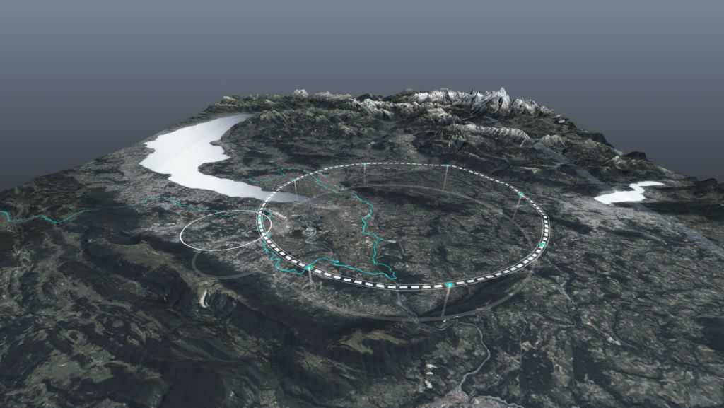
FCC-hh baseline
FCC-hh updated baseline : 14 T dipole operational field, 85 TeV
  14 T reached with 20% loadline margin,
  14 T reached with improved HL-LHC conductor, available today
  14 T rather than 16 T allows stress limits set at 150 MPa rather than 200 MPa, as proved by EuroCirCol
  Operational temperature stays at 1.9 K
FCC-hh parameters | CDR 2019 | 2024-Nb₃Sn | 2024-HTS
Dipole field (T) | 16.0 | 14.0 | 14-20
Temperature (K) | 1.9 | 1.9 | 4.5-20
Tunnel length (km) | 100 | 90.7 | 90.7
Arc length (km) | 82.0 | 76.9 | 76.9
Arc filling factor (adim) | 0.80 | 0.83 | 0.83
Energy c.o.m (TeV) | 100 | 85 | 85-120
Non Cu jc 16 T 4.2 K | 1500 | 1200 | TBD
Loadline margin | 86% | 80% | TBD
FCC layout and evolution of parameters

Slide 10
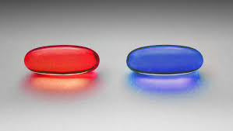
Options to the FCC baseline
HTS opens the path above 15 T and much more
  We have as a goal an HTS dipole for FCC-hh at 14-20 T, giving 85-120 TeV
  Note that 20 T/120 TeV has twice synchrotron radiation than 100 TeV, and 4 times more than 85 TeV - but we keep it as a generic R&D target
FCC-hh parameters | CDR 2019 | 2024-Nb₃Sn | 2024-HTS
Dipole field (T) | 16.0 | 14.0 | 14-20
Temperature (K) | 1.9 | 1.9 | 4.5-20
Tunnel length (km) | 100 | 90.7 | 90.7
Arc length (km) | 82.0 | 76.9 | 76.9
Arc filling factor (adim) | 0.80 | 0.83 | 0.83
Energy c.o.m (TeV) | 100 | 85 | 85-120
Non Cu jc 16 T 4.2 K | 1500 | 1200 | TBD
Loadline margin | 86% | 80% | TBD
    Nb₃Sn and HTS are not in competition - they are on different time scale
    We want to eat both pills !♭
HTS
Nb₃Sn
Inspired by Wachowski broth.,
“Matrix” (1999, Warner Bros.)
    ♭This is a totally different thesis from S. Zizek “I want a third pill!”, see link

Slide 11
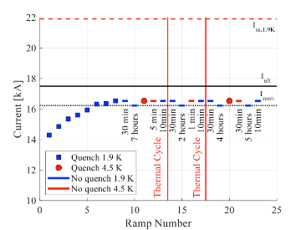
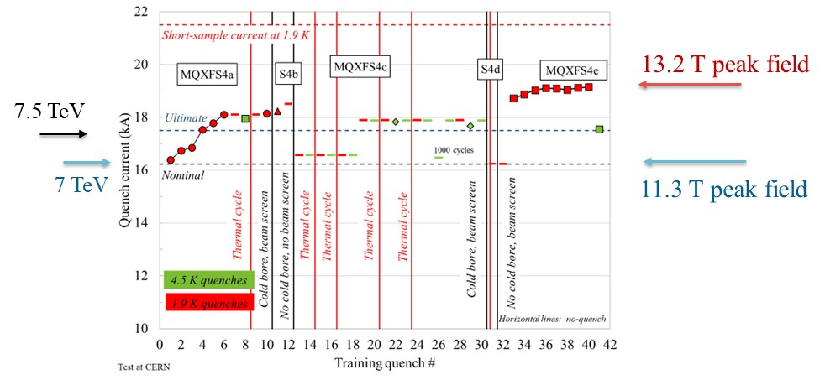
Nb₃Sn margin targets
14 T operational field → short models shall reach 15-15.5 T
  Do not make confusion between operational and achieved field: LHC dipoles reached 9.5 T, but they operate in the LHC slightly above 8.0 T
14 T shall be reached also at 4.5 K
    In HL-LHC MQXF operational field is also achieved at 4.5 K, without retraining
    [See talk by S. Izquierdo Bermudez]
MQXFS4 and MQXFB03 test results [S. Izquierdo Bermudez, J. C. Perez, P. Ferracin, F. Mangiarotti, et al.]

Slide 12
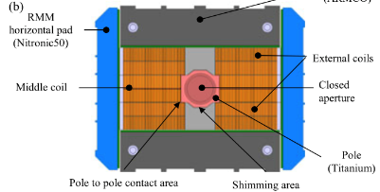
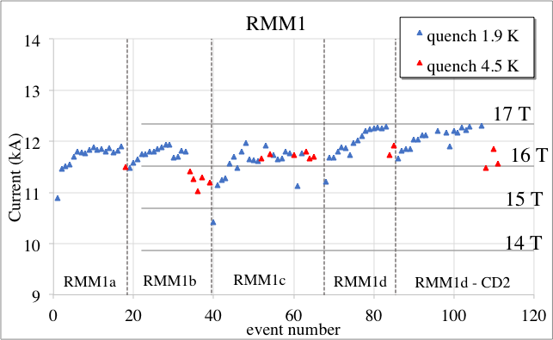
Where we stand
Are we already at dipoles with 14 T operational field ? Not far, but not yet:
    HD2, 2005: 13.8 T at 4.5 K (never tested at 1.9 K, we will at CERN) but in 35 mm aperture
    Fresca2, 2019: 14.5 T at 1.9 K, 13.8 T at 4.5 K in 100 mm aperture but very large coil
    MDPCT1, 2020: 14.1 T at 4.5 K in 60 mm aperture but followed by degradation
    11 T, proving two-in-one aperture in short models but issues with scaling in length
    Plus the RMM demonstrator, giving field well above 15 T but very large coil and no flared ends: test of reproducibility of the assembly in 2024: 16.9 T achieved, and 15.7 T for long flattops [see talk by J. C. Perez]
Cross-section of RMM [J. C. Perez, et al.]
RMM power tests [G. Willering, J. C. Perez, et al.]

Slide 13
Options to the FCC baseline
12 T magnet and 77 TeV
  Why ? 15-20% cheaper magnet (less conductor), for 10% less energy – INFN and CERN are working on a cosθ [talk by S. Farinon, A. Foussat, M. Sorbi]
Operation at 4.5 K reducing the margin [talk by P. Borges de Sousa]
  HL-LHC magnets can operate at 4.5 K … but with how much margin? It would be good to be able to measure [talk by F. Mangiarotti]
  Significant reduction of power consumption of cryogenics at 4.5 K
  Within this option, dry magnets cooled with capillaries able to reduce He?
Hybrid Nb₃Sn/Nb-Ti
  Initially considered and discarded, becomes interesting for 14 T and 12 T: large reduction in the mass of Nb₃Sn conductor – but not trivial, see D19H experience
  IHEP reached 12.5 T bore field with hybrid, CIEMAT is planning a 12 T hybrid [talk by F. Toral, and Q. Xu]

Slide 14

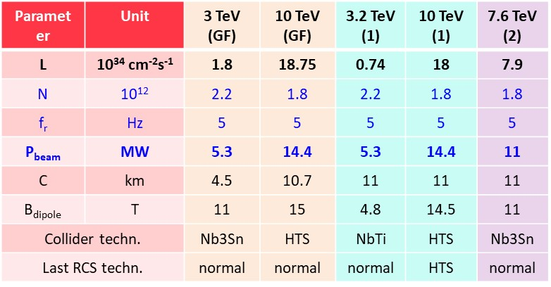
MuCol
We have a WP dedicated to Muon collider solenoids [talk by L. Bottura]
  To develop this technology, several synergies with HTS dipoles
  Conductor characterization, degradation, winding techniques, test, protection …
Muon collider also needs large aperture dipoles [talk by D. Schulte]
  We are presently not working on this, but WPs could be activated according to the management choices
  Lot of experience in HL-LHC with large aperture magnets

Slide 15
Table of contents
What’s new in 2024
Baseline for FCC and options
Nb₃Sn activities
HTS activities

Slide 16
Nb₃Sn conductor guidelines
Conductor development for Nb₃Sn follows two main guidelines
  Have more providers (today there is only one fully qualifed industry)
  Decrease the cost: this is only possible with prolonged investements on a mid term plan as done in the US with CDP at the beginning of the 00’s
Plus
  Increase the performance: FCC targets fixed in 2015 (1500 A/mm² at 16 T 4.22 K [A. Ballarino, et al. IEEE TAS 29, 2019] reached in laboratories, but not in industrial production – this would allow to have 30% reduction of conductor [see talk of S. Hopkins]
  Improve resilience to stress (efforts within HFM ongoing in KEK, JASTEC, NIMS) [see talk of M. Sugano]
APC (artificial pinning center) opportunities: more j_{c}, less hysteresis losses
  Works in HFM on going in University of Geneva, BAF [see talk of C. Senatore]
  Synergies with activities in FNAL (X. Xu et al, SUST ) [see talk of S. Prestemon]
In fall 2024 we made an order to have a strategic reserve of Nb₃Sn

Slide 17


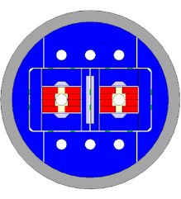


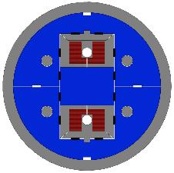
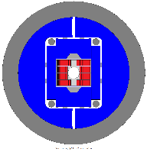
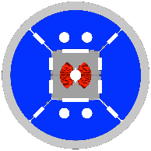
Nb₃Sn magnet design
The block option: this design has the world record
  HD2 reached 13.8 T at 4.2 K, Fresca2 reached 14.6 T at 1.9 K
  BOND (no grading) test in 2026, F2D2 (grading) test in 2028 [J. C. Perez and E. Rochepault]
The common coil design: a simpler path ?
  The IHEP program reached 12.5 T at 4.5 K (LFP1) [see talk of Q. Xu]
  CIEMAT is planning to build a common coil, test in 2027/8 [see talk of F. Toral]
Cosθ option: MDPCT1 reached 14 T at 4.5 K in the US, 11 T reached 12.5 T at 1.9 K
  2layer magnet in INFN and CERN, test in 2026/7 [see talks of Farinon and Foussat]
FalconD cross-section
[S. Farinon, M .Sorbi,
A. Foussat et al.]
14 T block dipole
[J. C. Perez, et al.]
14 T block dipole F2D2
[E. Rochepault, et al.]
DAISY cross-section
[F. Toral, et al.]

Slide 18

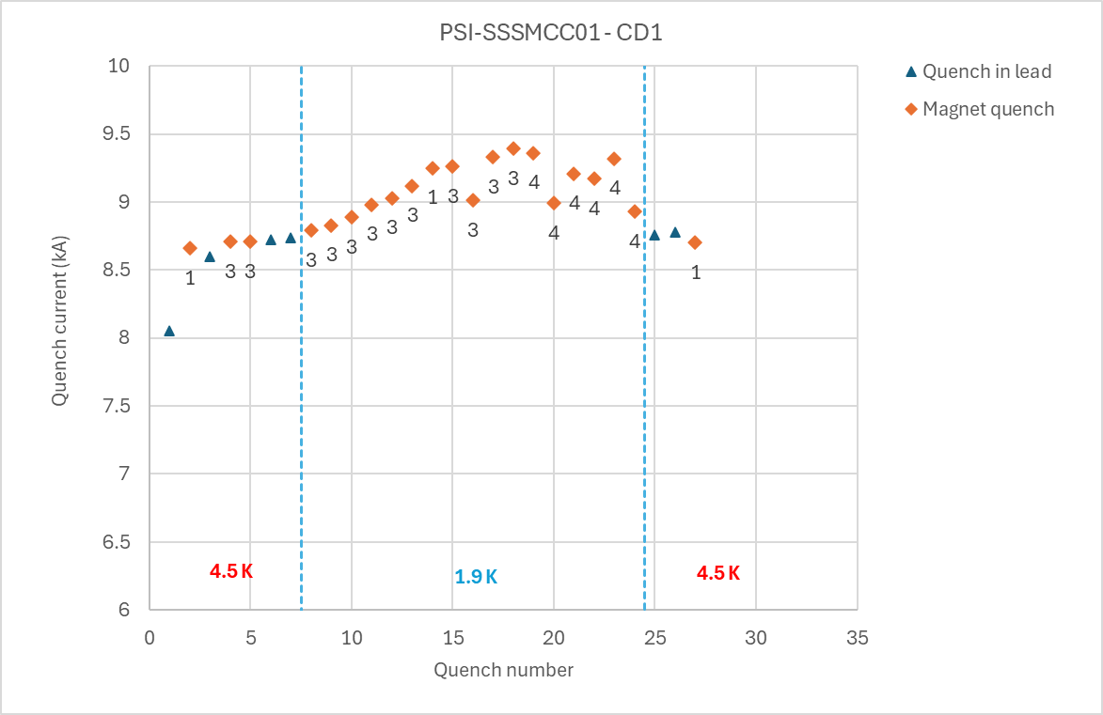
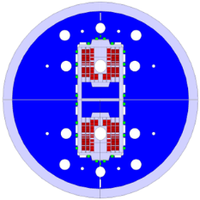

Nb₃Sn program: stress management
Stress management consists in mixing the structure and the coil
  Mandatory for 20 T, and MDP is investing only in this direction
    CCT5: 8 T reached (LBNL), CD1: 10 T (PSI) reached with 17 mm width coil
PSI manufactured a subscale stress managed common coil, with CERN support for parts of coil manufacturing and test [D. Araujo et al.]
  Peak field in the coil of 6.5 T reached >5 T in in the centre (June 2024)
SMACC1 is a common coil stress managed, 12 T target, test in 2026
Short sample 1.9 K
Short sample 4.5 K
Design of 12 T SMACC1
(D. Araujo, B. Auchmann, et al.)
Test of SSSMCC in SM18 (D. Araujo, G. Willering, et al.)

Slide 19
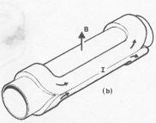
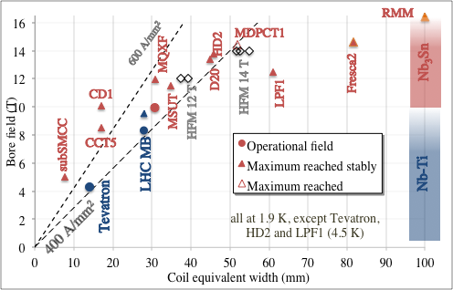
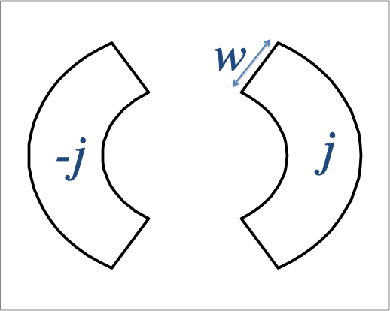
What are we building
Demonstrators
μ₀/2

Slide 20
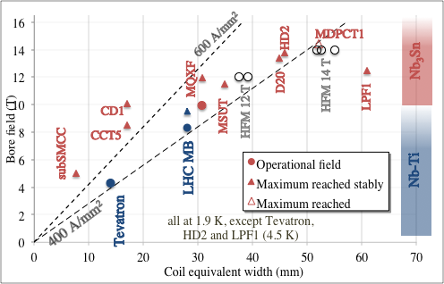
What are we building
Stress managed
μ₀/2

Slide 21
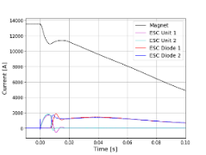
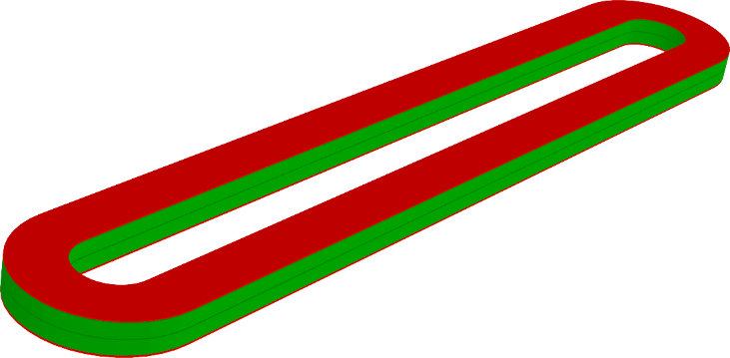
Protection guidelines
Once SC properties are not a bottleneck for performance, and stress is intercepted, the last obstacle to have more efficient coils is protection
Targets:
  Getting rid of QH and have a fully redundant CLIQ
  Studying alternative systems to allow larger current density → more compact and cheaper magnets
  Novel method proposed [E. Ravaioli et al. ] and has been tested at CERN on a SMC to allow a part of energy extraction, and fast quenching
  Second novel method (eCLIQ) is under test, first promising results
  [see talk by M. Wozniak]
Copper coil and SC coil in ESC, and quench protection (E. Ravaioli, J. C. Perez, et al.)

Slide 22
Table of contents
Baseline for FCC and options
Nb₃Sn activities
HTS activities

Slide 23
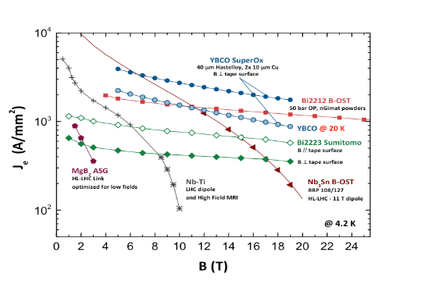
HTS: a brave new world
Critical current weakly decreases with field: the path is open well beyond 20 T …
Large temperature margin
Material | Temp margin
Nb-Ti at 1.9 K, 80% on the loadline | 2 K
Nb₃Sn at 1.9 K, 80% on the loadline | 5 K
ReBCO at 20 K, 80% on the loadline | 10 K
Jeng vs B, all at 4.2 K (courtesy of A. Ballarino)

Slide 24
HTS conductors
BSSCO (commercially available, mainly used in the US)
    Available in round strand, dipoles reaching 1.5 T have been done (LBNL)
    No activities foreseen in HFM
REBCO (commercially available, strong impluse from fusion)
    Recently, large reduction of cost, thanks to large interest from fusion: Can we use this tape for our needs ? It could be neccessary to renegotiate requirements
    Available in tape, cable geometries being considered (Roebel, Corc®, Star ®)
    Hysteresis losses can be a showstopper: the filament is the tape width
    Workhorse for HFM [see talks A. Ballarino, B. Holzapfel, C. Senatore, L. Bottura, T. Lecrevisse, L. Rossi]
    Procurement and characterization of order of 50 km of tapes
    IBS (not comercially available, strong impulse from China)
    Critical current is improving, but not as expected
    Potentially cheaper than REBCO
    One WP in HFM [see talk by A. Malagoli]

Slide 25
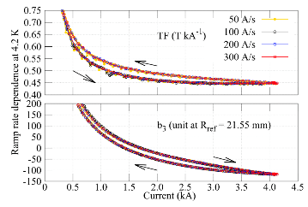
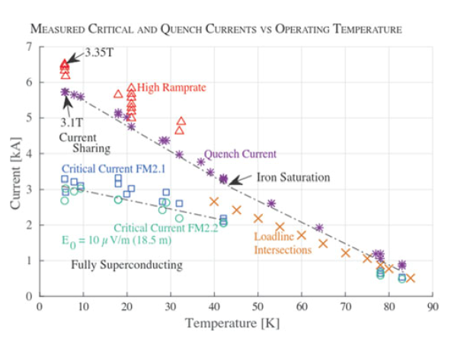
Where we stand
EuroCirCol activities: HTS inserts to boost Nb₃Sn field by 5 T
  CEA racetrack with ReBCO tapes: 4.3 T reached M. Durante, et al, IEEE 28 (2018)
  CEA cosθ: 1.6 Τ reached, to be retested
  CERN aligned block (Roebel®): 4.5 T reached L. Rossi, et al, Instruments 5 (2021)
US MDP:
  Bin5: CCT with BSCCO, 1.6 T reached T. Shen, et al, PRSTAB 25 (2022)
  C2: CCT with CORC ® 2.9 T reached W. Wang, et al, SUST 34 (2021)
TF and b3 in C2 magnet (X. Wang, et al.)
Power test of Feather2 (G. Kirby, J. van Nugteren, et al.)

Slide 26
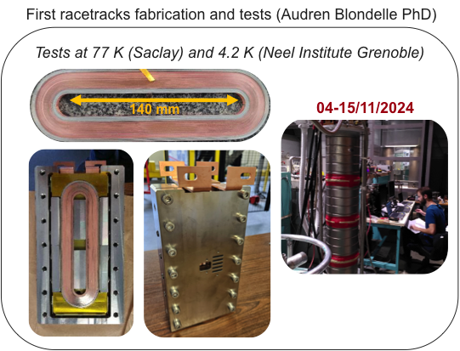
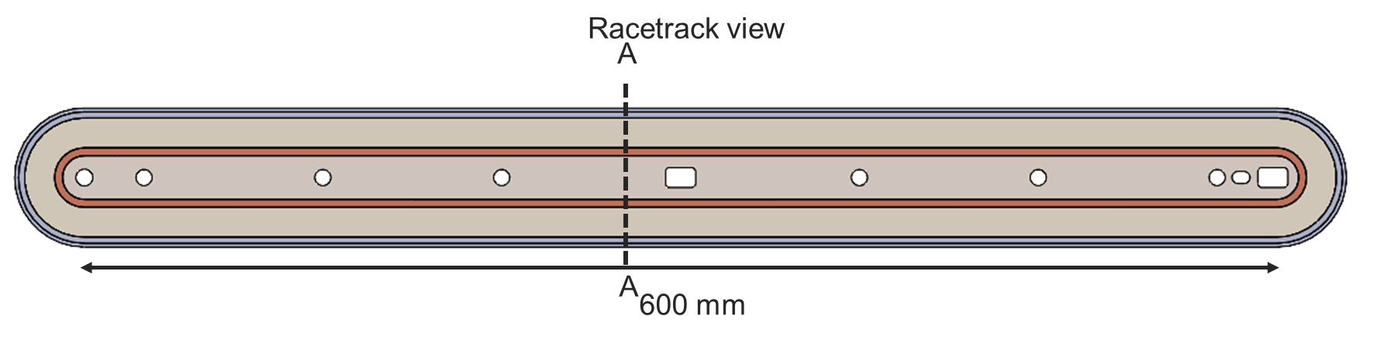
The metal insulation path
A research line of MI (Metal Insulated) is also active in HFM (CEA) – 2.7 T at 4.2 K reached in fall 2024 [see talk by T. Lecrevisse, et al. ]
  Many racetracks are being built and will be tested, scaling in length is also ongoing
  Efforts for modeling this complex
  physics are also ongoing
MI long racetrack coils [T. Lecrevisse, et al. ]
MI racetrack coils [T. Lecrevisse, et al. ]

Slide 27
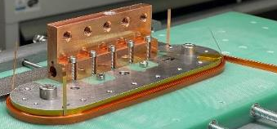
The dielectric insulation path
At CERN, racetrack wound with dielectric insulated (DI) REBCO are ongoing, and went through preliminary test at 77 K and one coil was tested at 4.5 K reaching 2.7 T central field
  These are double pancake coils
Structure able to test stacks of racetrack see talk by A. Ballarino
[A. Ballarino, et al., HFM TE day https://indico.cern.ch/event/1425262/ ]

Slide 28
Never forget the specificity of accelerator magnets
First: An accelerator dipole is not a solenoid !!
  Field is not parallel to the wire, forces are not perpendicular to the wire, stresses are about 50% larger than magnet pressure
Second: Overall current densities of ∼500 A/mm² are a peculiar feature/challenge for accelerator magnets
  One order of magnitude above HEP detector magnets or fusion magnets
Third: magnet operational range is not a single point, but a whole set of currents (from injection to high field)
 | Overall current density (A/mm²) | Non-Cu current density (A/mm²) | Ramp rate (mT/s) | Field in conductor (T)
Tevatron dipole | 360 | 1550 | ∼4 | 4.7
LHC dipole | 360/440 | 1260/1820 | ∼8 | 8.6
ATLAS BCT | 30 | 950 | ∼0.8 | 3.9
ITER (TF & CS) | 20 to 40 | 150 | ∼400 | 5 to 13
HL-LHC SC link | 17 | 1450 | ∼8 | Self field (<1 T)

Slide 29

Some final personal remarks
There is no free lunch: every tesla is gained with lot of coherent effort, time, and technical advancements
Collaboration in space is in place … visits, exchanges are a must
Collaboration in time is needed: we build on the results of previous colleagues (some times of previous generations)
Be pragmatic and do not fall in religion war …
It takes time to make the sauce, be patient
To handle information between generations and between labs, journals (and conferences) are fundamental: (i) write, even about setbacks (ii) travel (iii) read, read, read … and forget, and then read again
E. Kusturica «Black cat, white cat», 1998

Slide 30
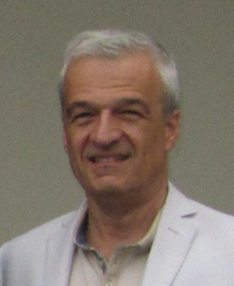
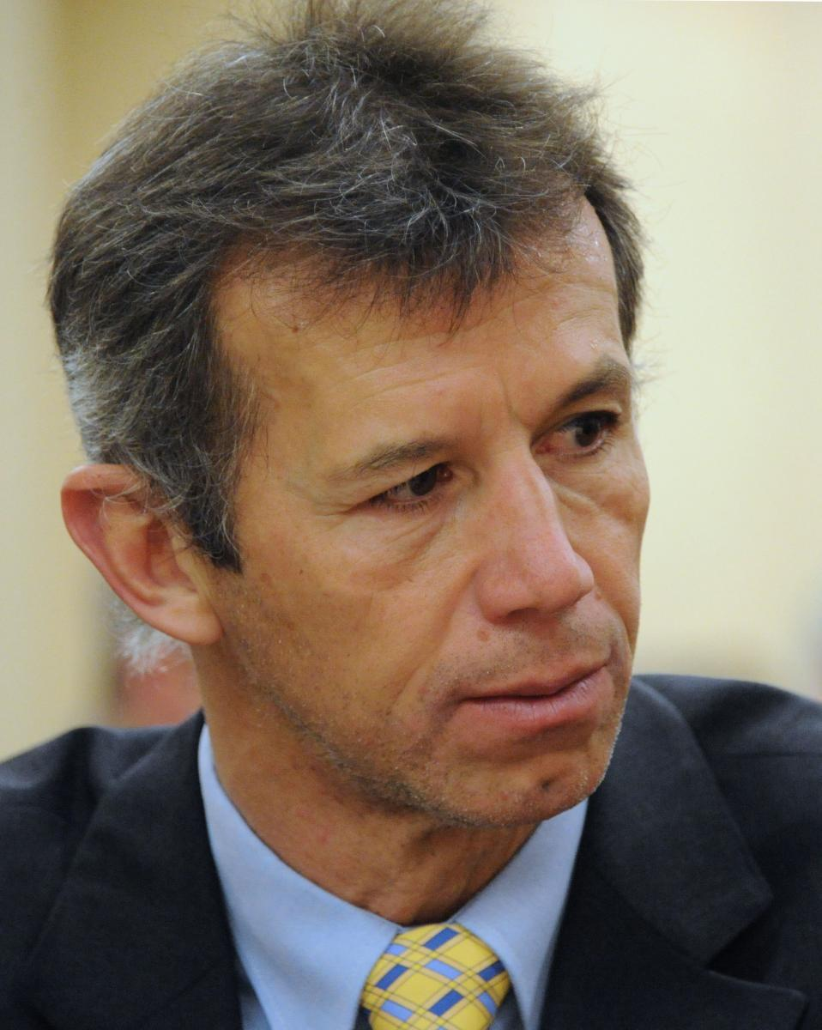
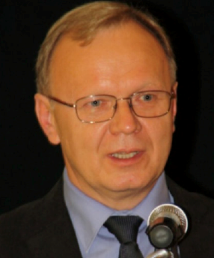
A big thanks to our predecessors
D. Tommasini, leading
EuroCirCol studies 2014-2020
Luca Bottura, leading
HFM program 2020-2021
Andrzej Siemko, leading
HFM program 2022-2023

Slide 32
Timeline for FCC-hh baseline
Select the design by the end of LS3 (we should start having some indications from tests in 2026-2027)
Have a full short model program as MQXF during RunIV
Scaling in length in two steps
(but we are already anticipating)
15 m long prototypes (>5 of each type)
5 m long prototypes of one selected design
(>5 of each type)
Short model program on two selected designs
(>5 of each type)
Ongoing 12 T and 14 T short models (seven designs, 1 or 2 of each type)
Selection of final design
to start long magnets
2024
2025
2026
2027
2028
2029
2030
2031
2032
2033
2034
2035
2036
2037
2038
2039
2040
2041
LHC RunIII
HL-LHC RunIV
HL-LHC RunV

Slide 33
Roadmap for Nb₃Sn
This is rather a conservative roadmap, and could be shortened by 5-10 years (with more risk and cost) having less staggered phases and with earlier involvement of the industry
Installation and commissioning
Production and test
Industrialization (pre-series magnets)
Tender for the series
2040
2041
2042
2043
2044
2045
2046
2047
2048
2049
2050
2051
2052
2053
2054
2055
2056
2057
LHC RunV

