Slide 1
US-MDP LTS and HTS Magnets
Soren Prestemon
US Magnet Development Program
Lawrence Berkeley National Laboratory
On behalf of the US MDP Collaboration

Slide 2




Outline
The US Magnet Development Program – status of updated roadmap following P5
The MDP Nb₃Sn magnet program
The MDP HTS program
  Bi2212 magnet developments
  REBCO magnet developments
Next major milestones for the program
Opportunities to join forces: initiatives in HEP, FES, and High-Field Magnets

Slide 3
Our program has been reviewed and revised to align with P5 recommendations
Central focus: develop and test high field magnets for HEP
Improve integration for hybrid magnets
Investigate HEP-motivated solenoid designs
Support magnets with critical materials, expertise & dev. of new enabling technologies
Strengthen linkage between technologies and magnets
Forward looking – what is enabled by our advances, and what is achievable for colliders
Align with, and support, collider design efforts
Further build collaborations, leverage synergies with fusion and with the NHMFL

Slide 4
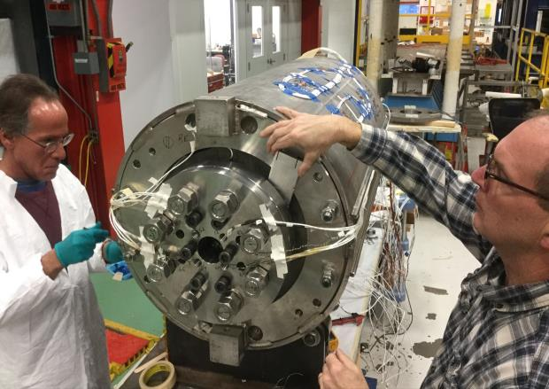
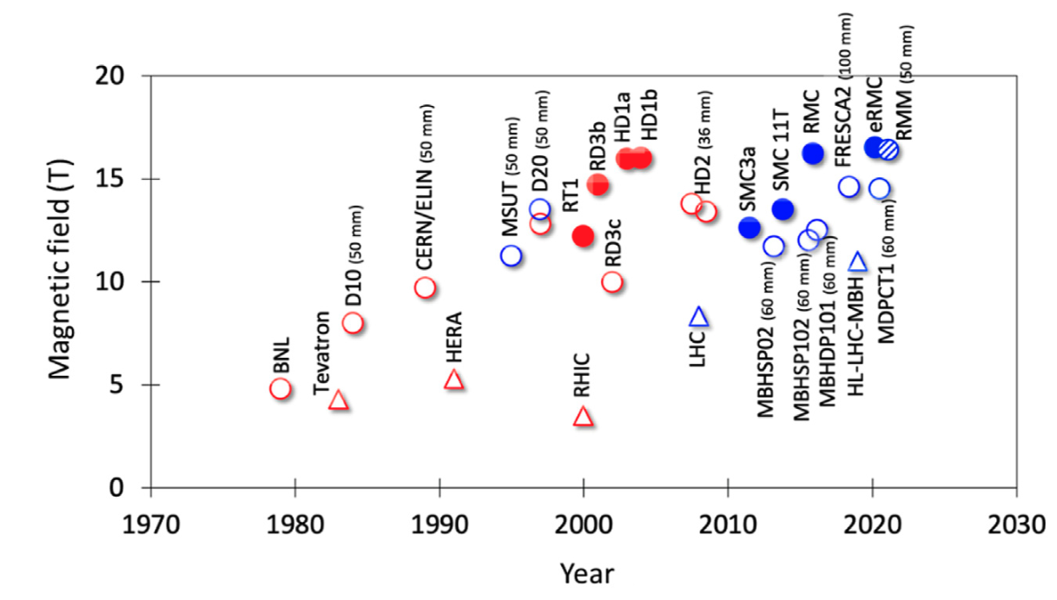
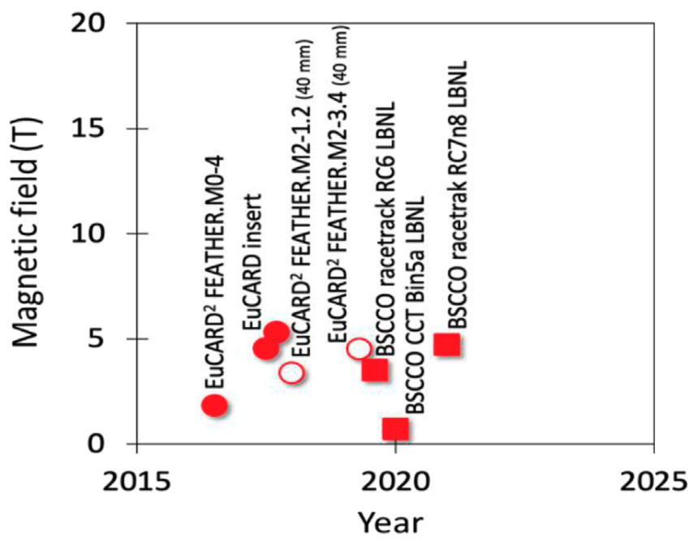
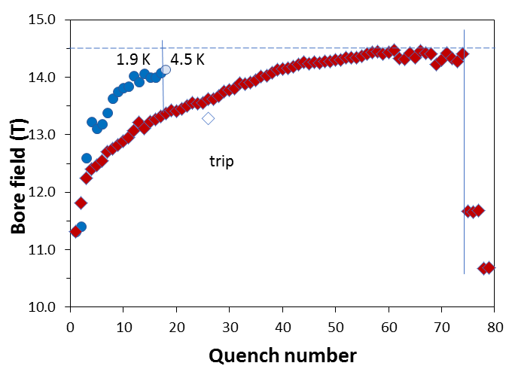

A key early MDP result was the 14.5T “MDPCT1” dipole
FNAL 14.5T “MDPCT1”
Bottura, Prestemon, Rossi, & Zlobin, Front. Phys., 12 October 2022
MDP Perspective:
[I]: Highest priority issue: degradation mechanisms; design mitigation
[II]: Second priority: Initial quench current and memory after thermal cycle
[III]: Third priority: Training rate
II
III
I

Slide 5
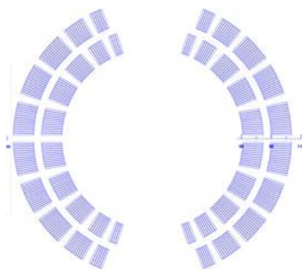
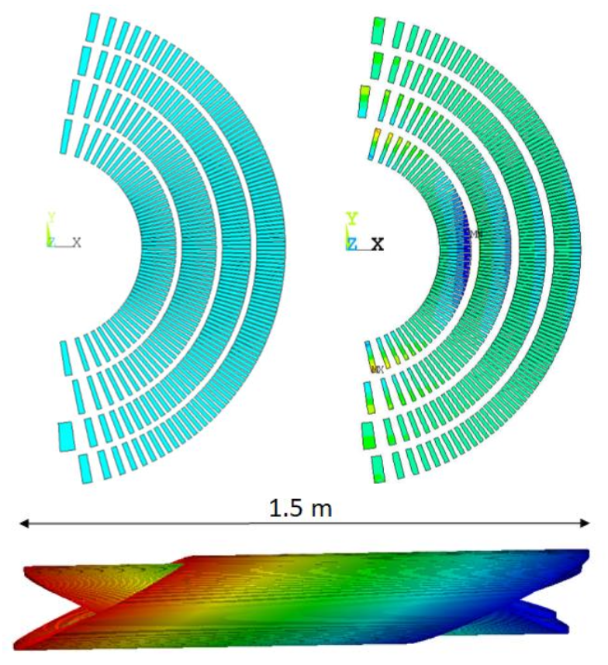
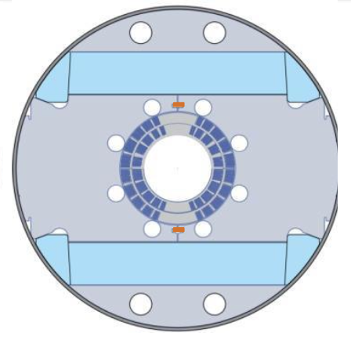
A priority now is to build the Nb₃Sn outserts
Canted Cosine theta:
  4 layers
    Bore field of ~12 T / 13 T for standalone operation
    Bore diameter: 120 mm
Stress-managed Cosine Theta:
  2 layers
    Bore field of ~12 T
    Bore diameter: 120mm
SMCT
CCT
30+ % current margin at target fields of 12 T, 4.2 K and 13 T, 1.9 K
These are two variants on stress-management
CCT is a “limiting case” of maximal SM
SMCT is a more efficient design

Slide 6
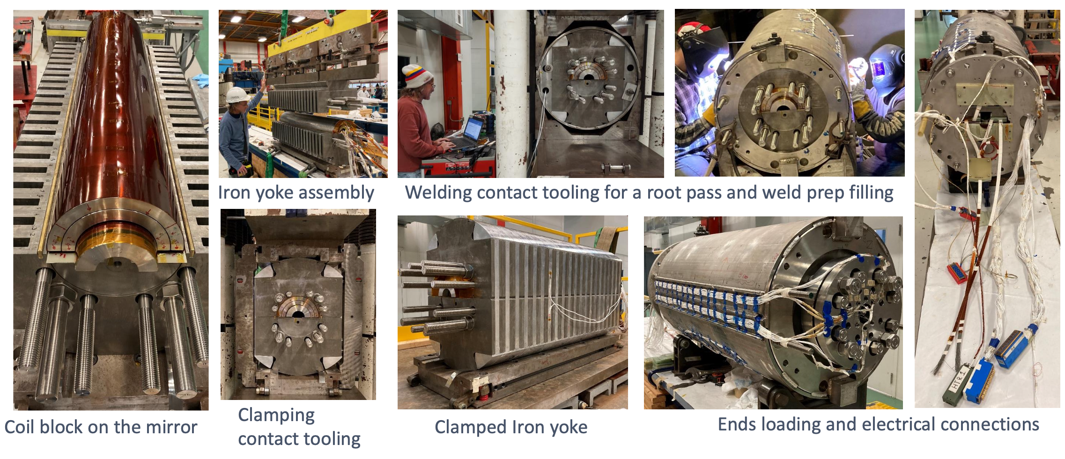
Assembly steps for the SMCT mirror test
Sasha Zlobin => Igor Novitski

Slide 7
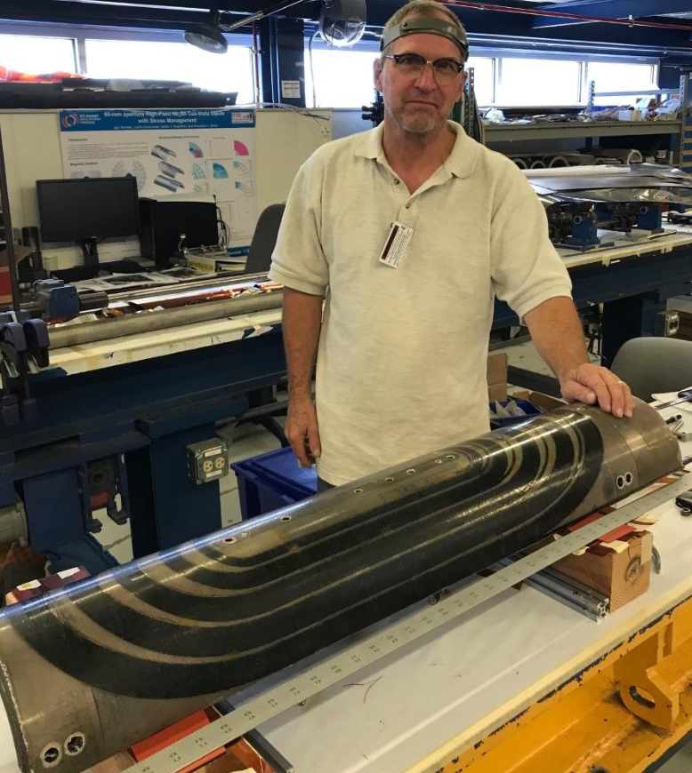
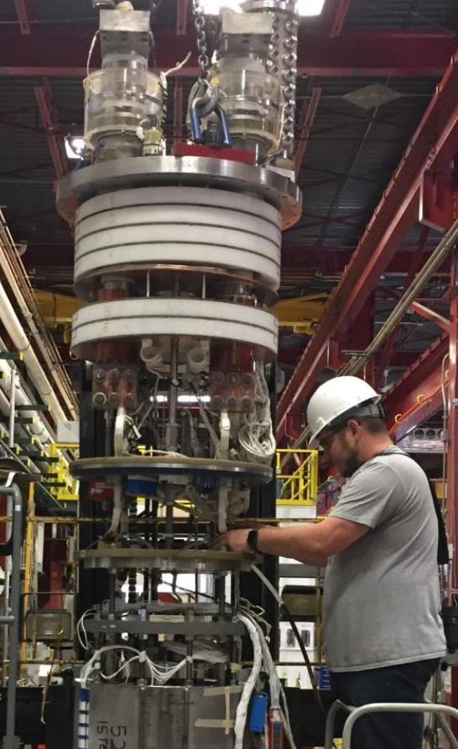
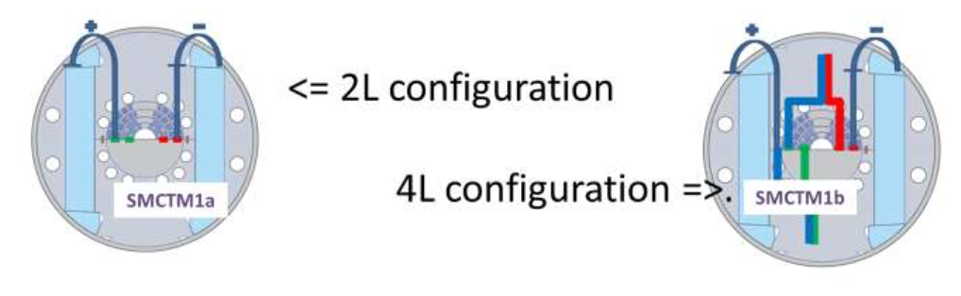
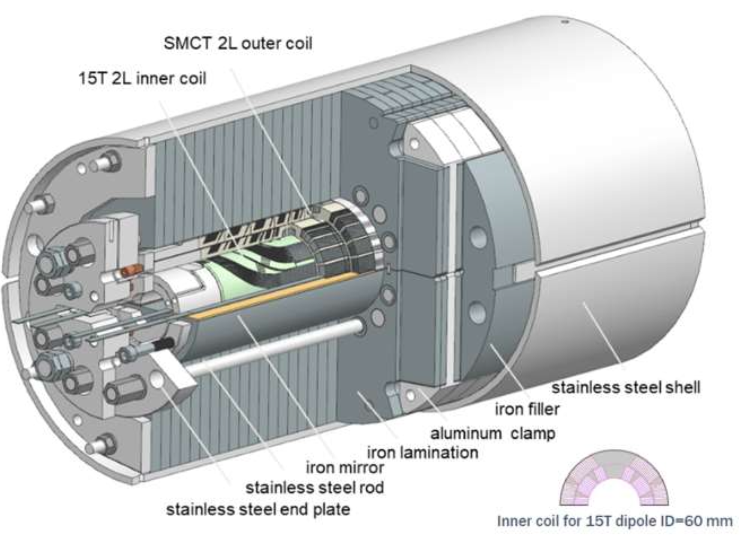
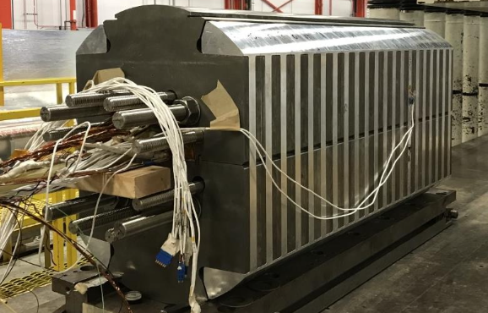
Stress managed cos-theta development is progressing
First mirror test performed
Zlobin et al., IPAC’24

Slide 8
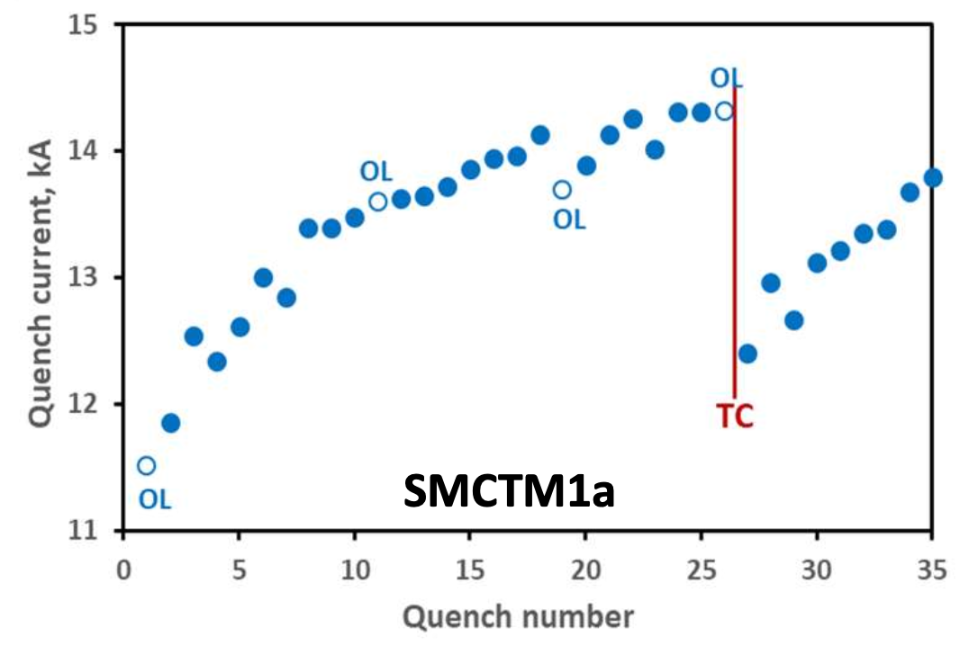
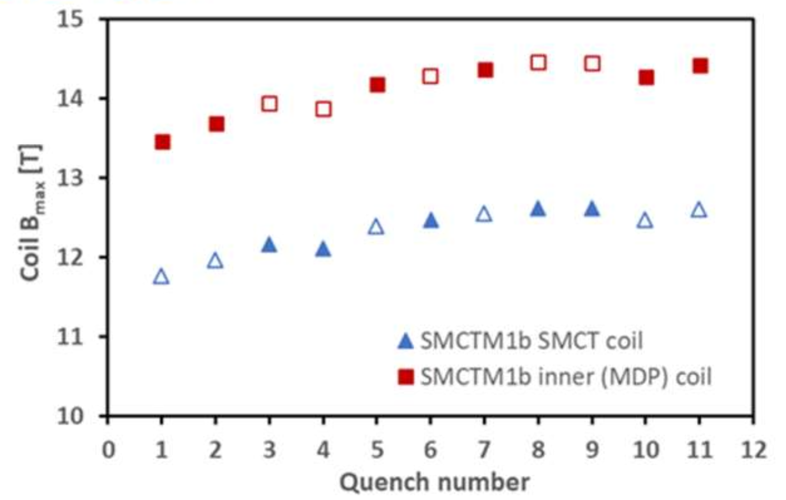
SMCT mirror test demonstrated concept
Next: SMCTD1 - fabrication of coils and impregnation with Telene
Plan:
  New SMCT coils, impreg with Telene
  Test envisioned mid 2026
Trained to >90% I_{SS} in 2-layer SMCT mode
Training limited by inner (CT) coils in 4-layer mode
No degradation apparent from test, but poor memory

Slide 9
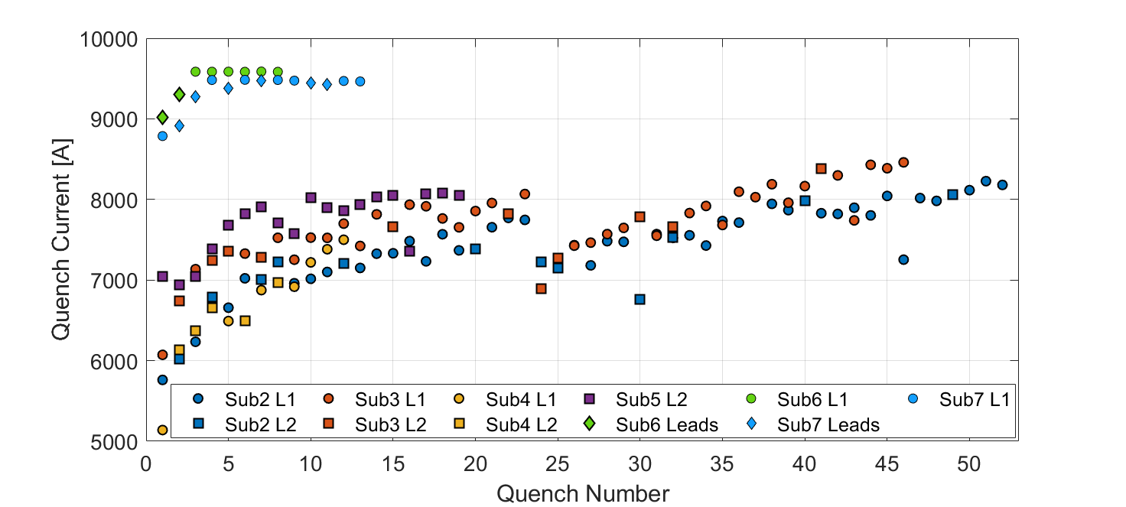
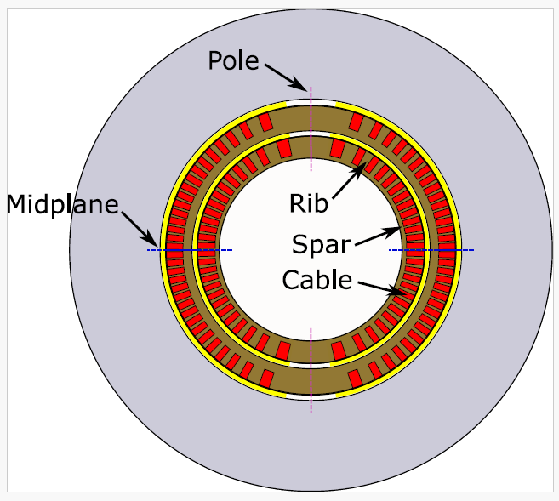
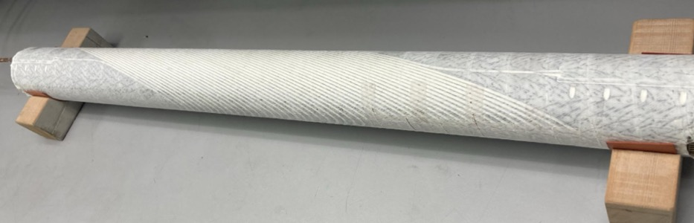
Subscale magnets are used to evaluate impregnation materials – the return of Paraffin Wax!
Diego Arbelaez
    Daly et al 2022 ,SUST 35 055014
    D. Arbelaez, IEEE TAS, Vol. 32, No. 6, Sep. 2022, 4003207.
    D Arbelaez et al., SUST, 37 065015, 2024
    E. Barzi et al 2024 SUST. 37 045008
Subscale CCT’s built with Paraffin wax (sub-6), then filled-wax (sub-7)
Subscale with Telene is being fabricated
Very promising – is it a lasting breakthrough?

Slide 10
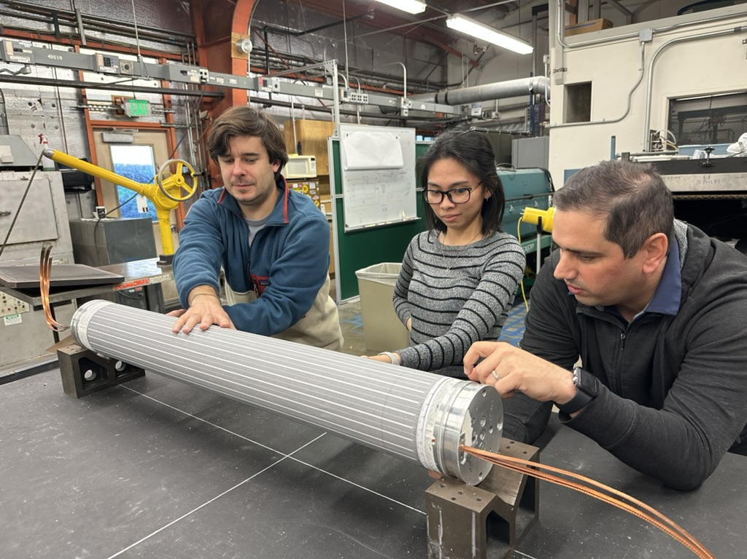
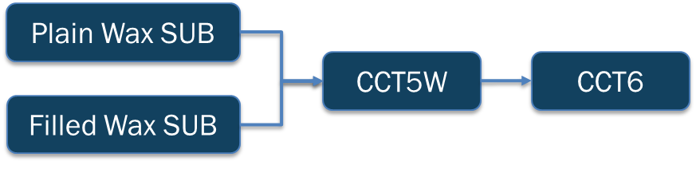
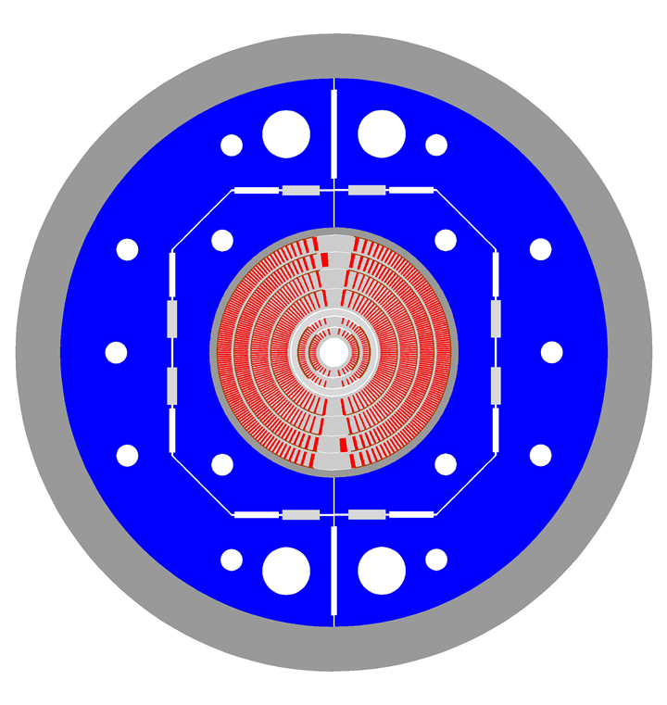
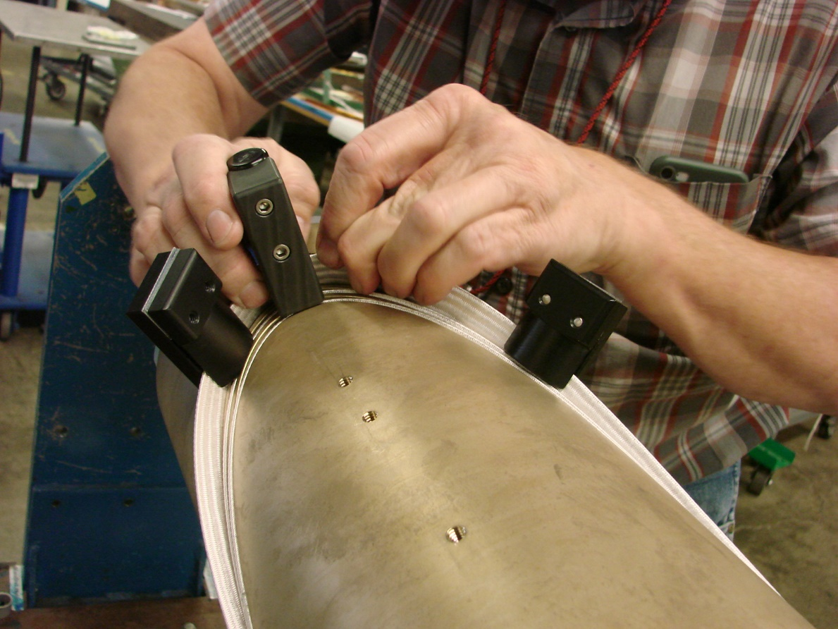
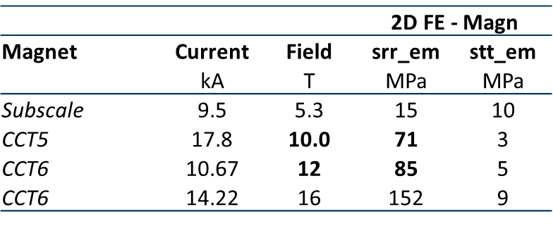
Need to demonstrate technology at relevant stress levels
✔️
CCT5w coils completed
✔️
Under fabrication at LBNL; test planned at FNAL in late March
“Flagship” ~14T large bore dipole construction beginning; highly relevant to muon collider storage ring and FCC-hh
Stress on Turn from Lorentz Force
Practice winding of CCT6

Slide 11
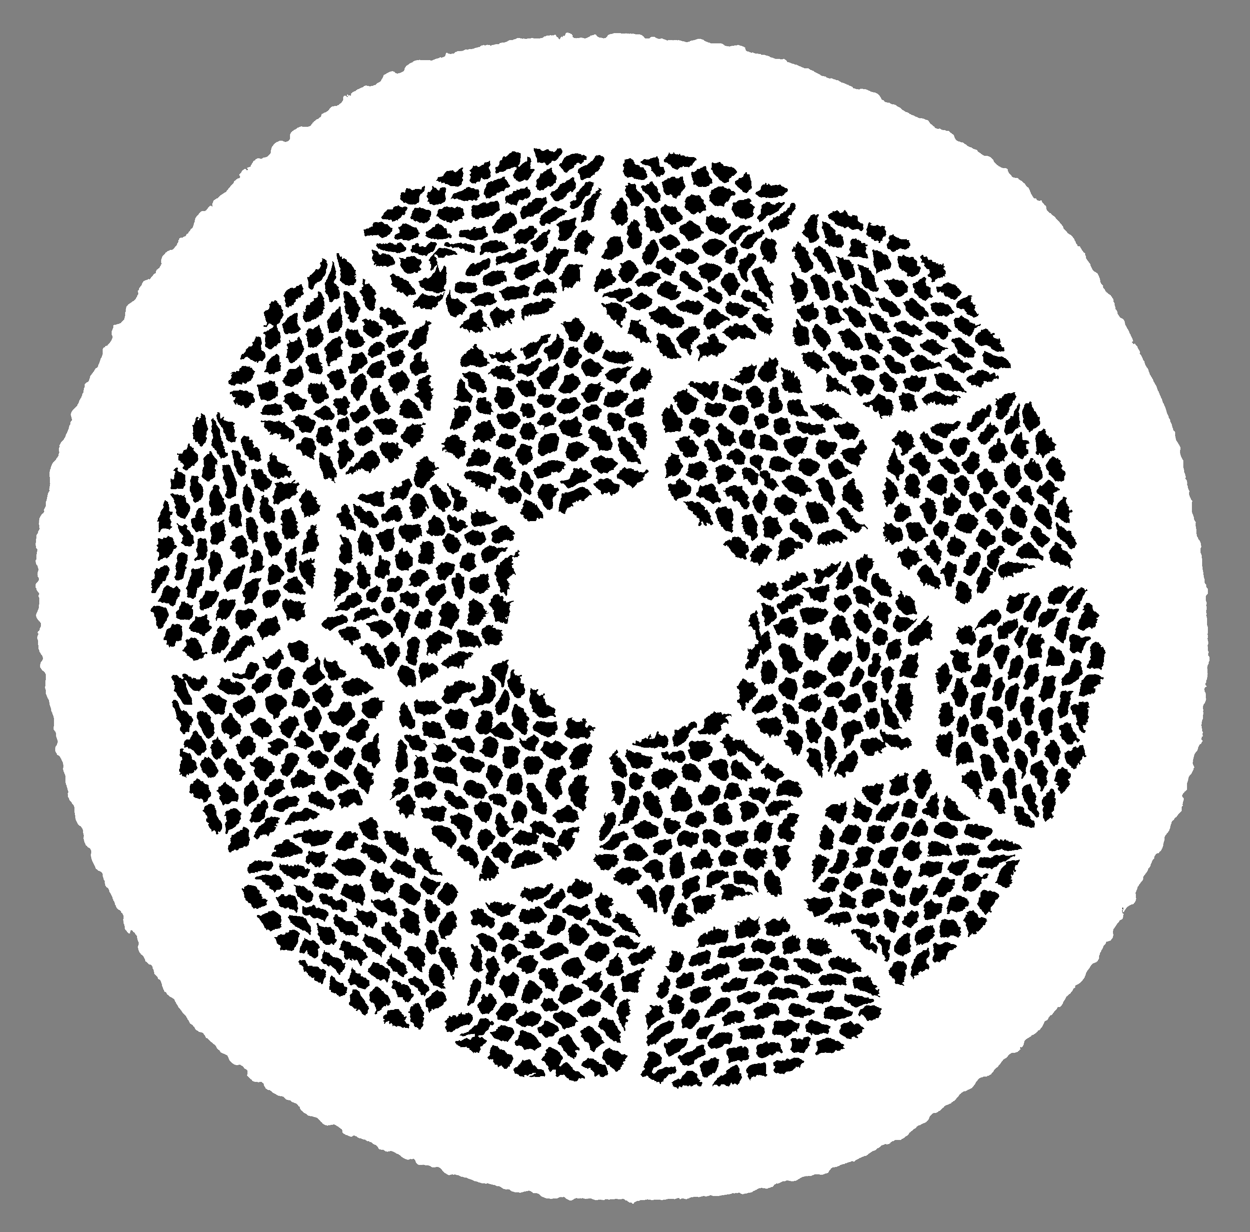
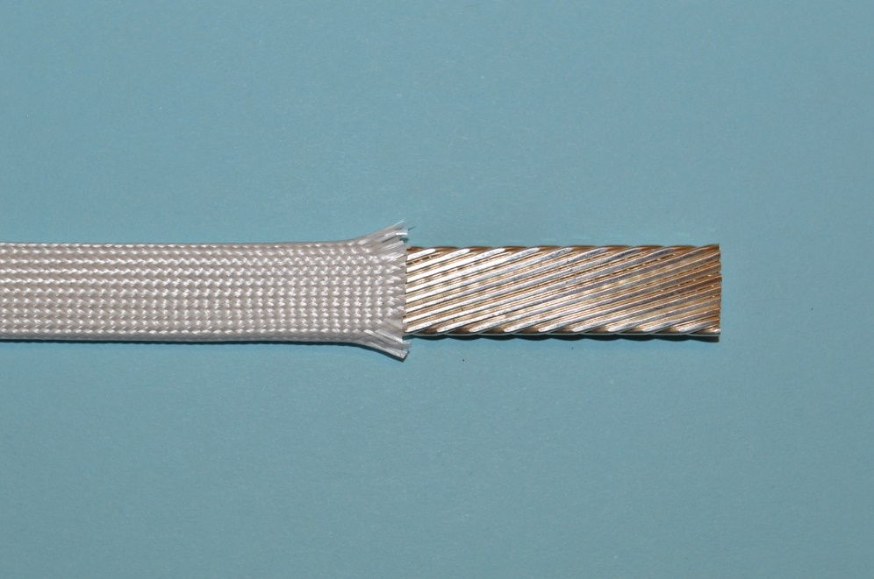
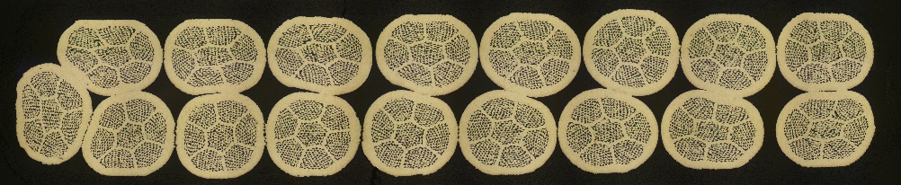
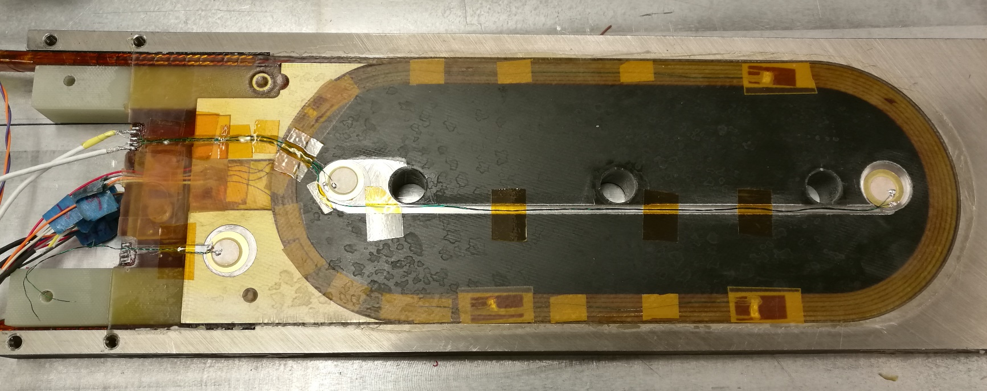
Bi-2212 wires => Rutherford cables => racetrack coils to verify heat treatment, materials compatibility, insulation, cable parameters
PMM170123, 55x18,
nGimat power
LXB-52
PMM101111, 36x18,
Nexans powder
77
LBNL 17-strand Rutherford cable
PMM130411, 19x36,
Nexans powder
77
Mullite braided insulation
Bi-2212
11
Jiang et al., TAS, Vol. 33, No. 5, August 2023
Shen et al., Scientific Reports Vol. 9, Art. No.: 10170 (2019) ​
Zhang et al Supercond. Sci. Technol. 31 105009 (2018)
RC3

Slide 12




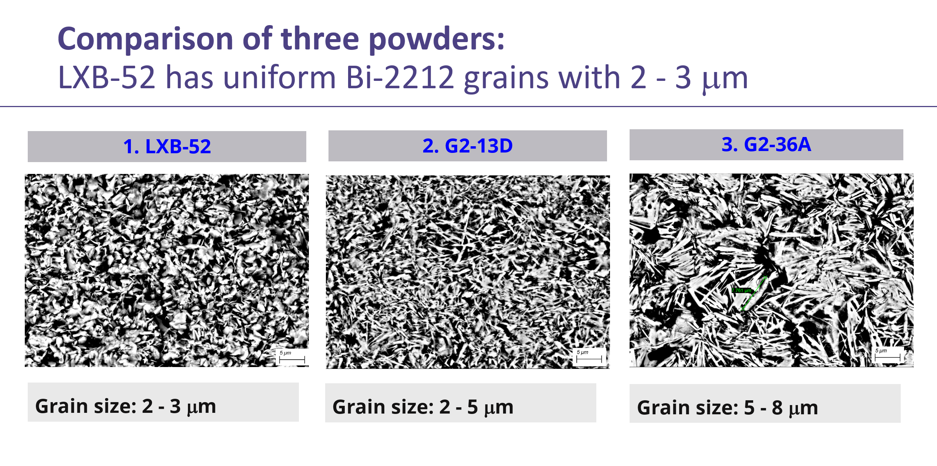
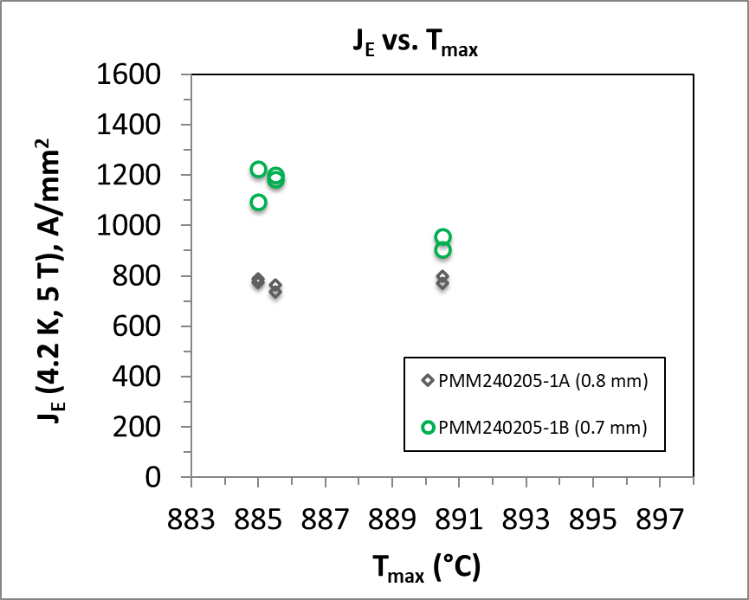
Recent progress on Bi2212 focused on conductor development, effects of cabling, and insulation
Tengming Shen
Dedicated project:
“Enhancing Domestic Production of High Temperature Superconducting Bi₂Sr₂CaCu₂O_{x}/Ag wires for High Field Magnets“
Series produced 2-kg billets yield regressed performance.
Scaled up 10-kg billets have lower performance than 2-kg billets.
Lack of understanding why and how.
Champion
Now
(Data by Jianyi Jiang, NHMFL)

Slide 13
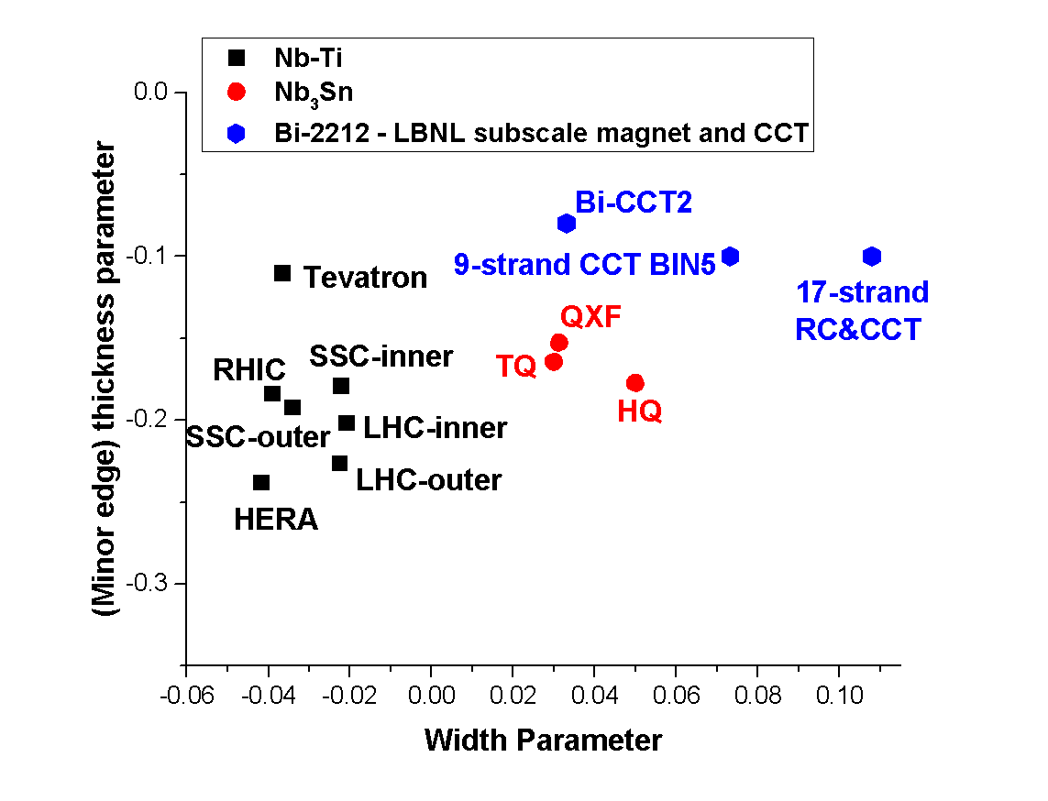
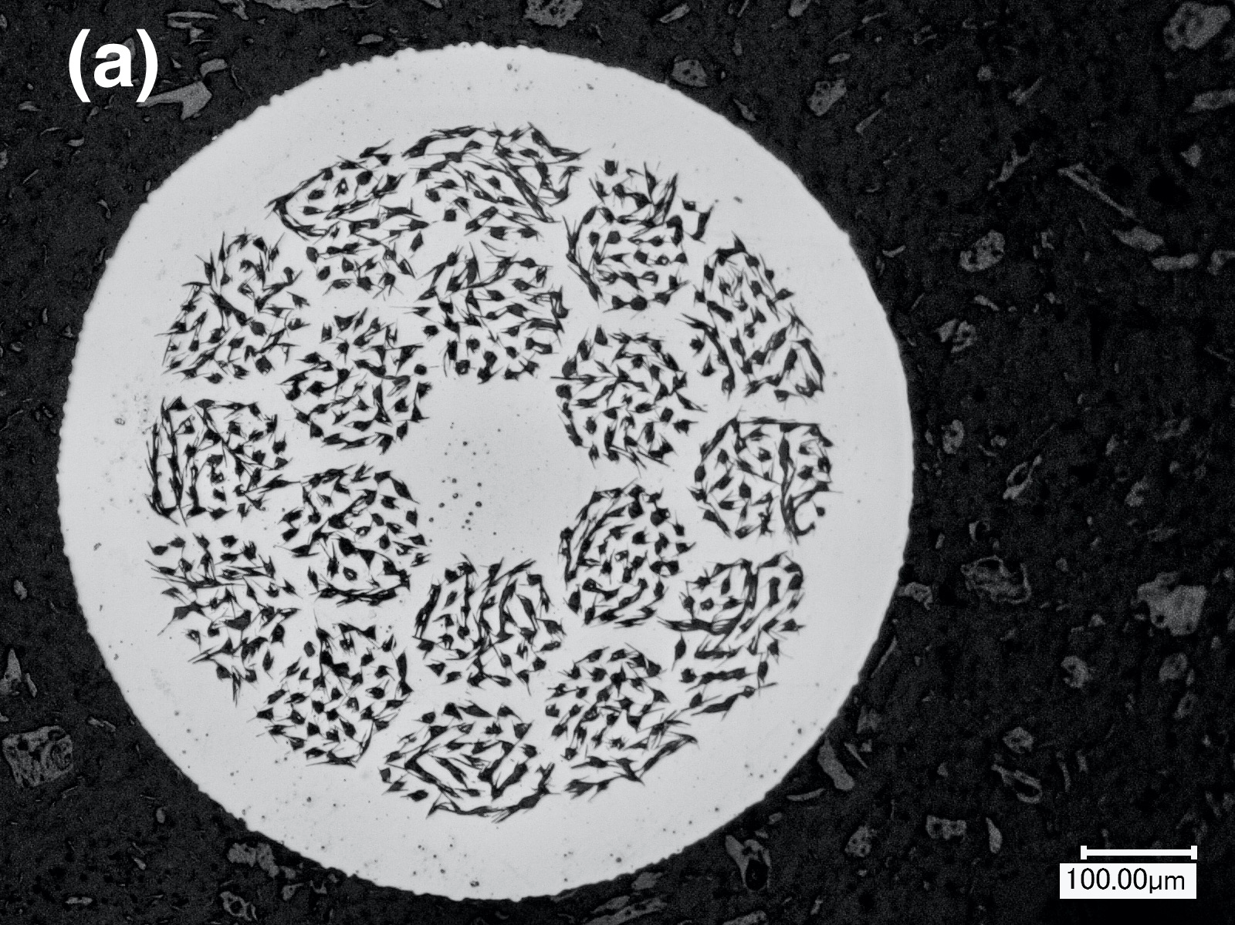
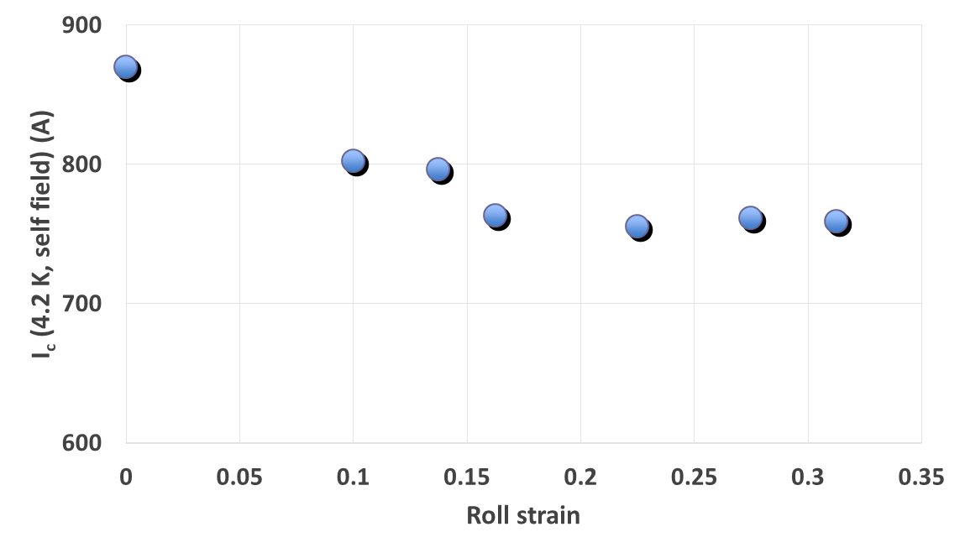
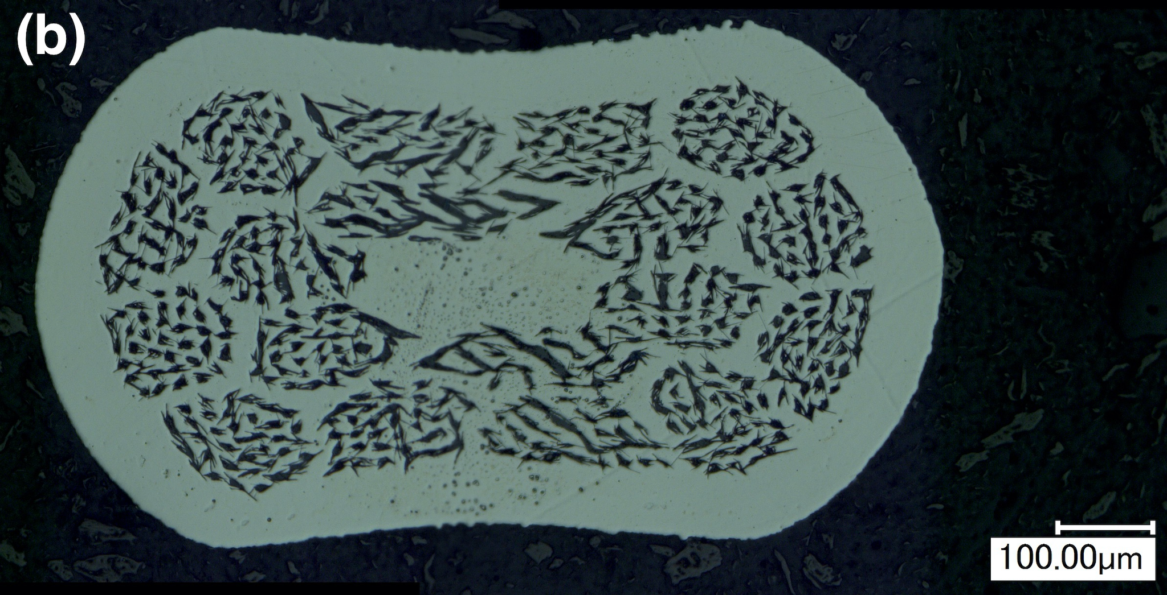
Effects of Rutherford cabling under investigation

Slide 14
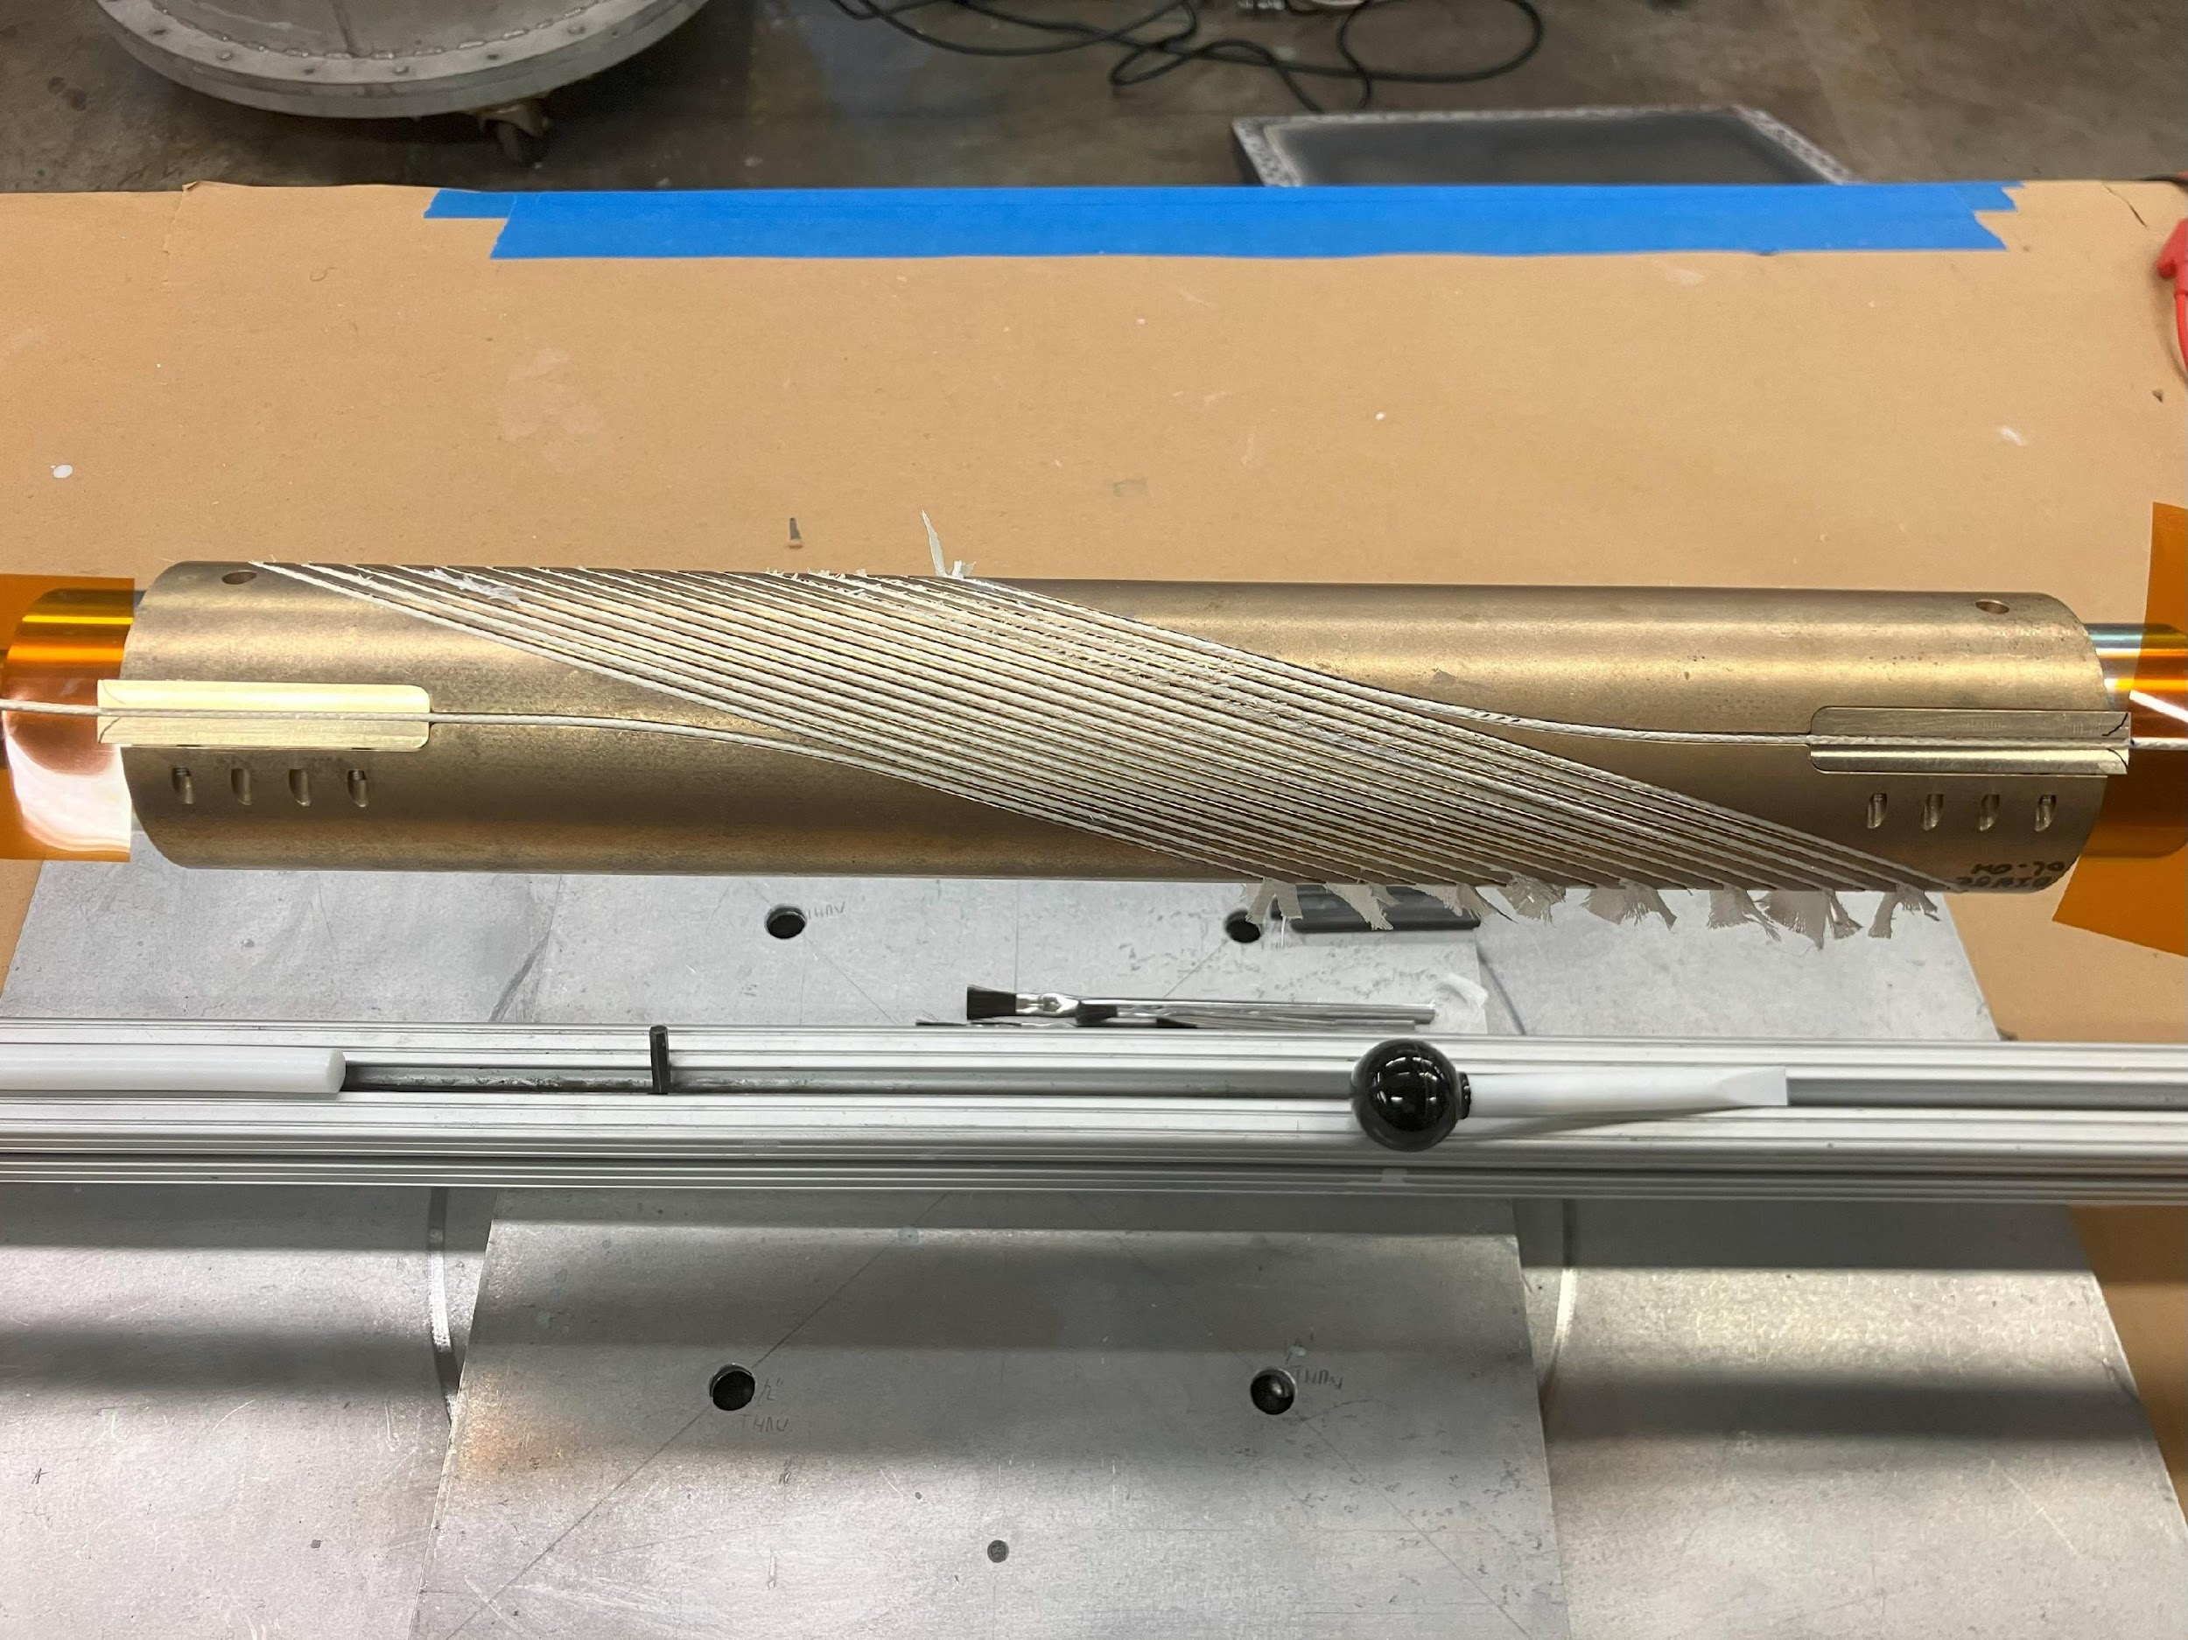
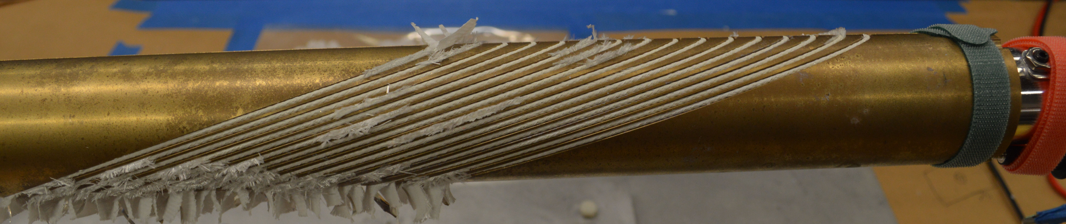
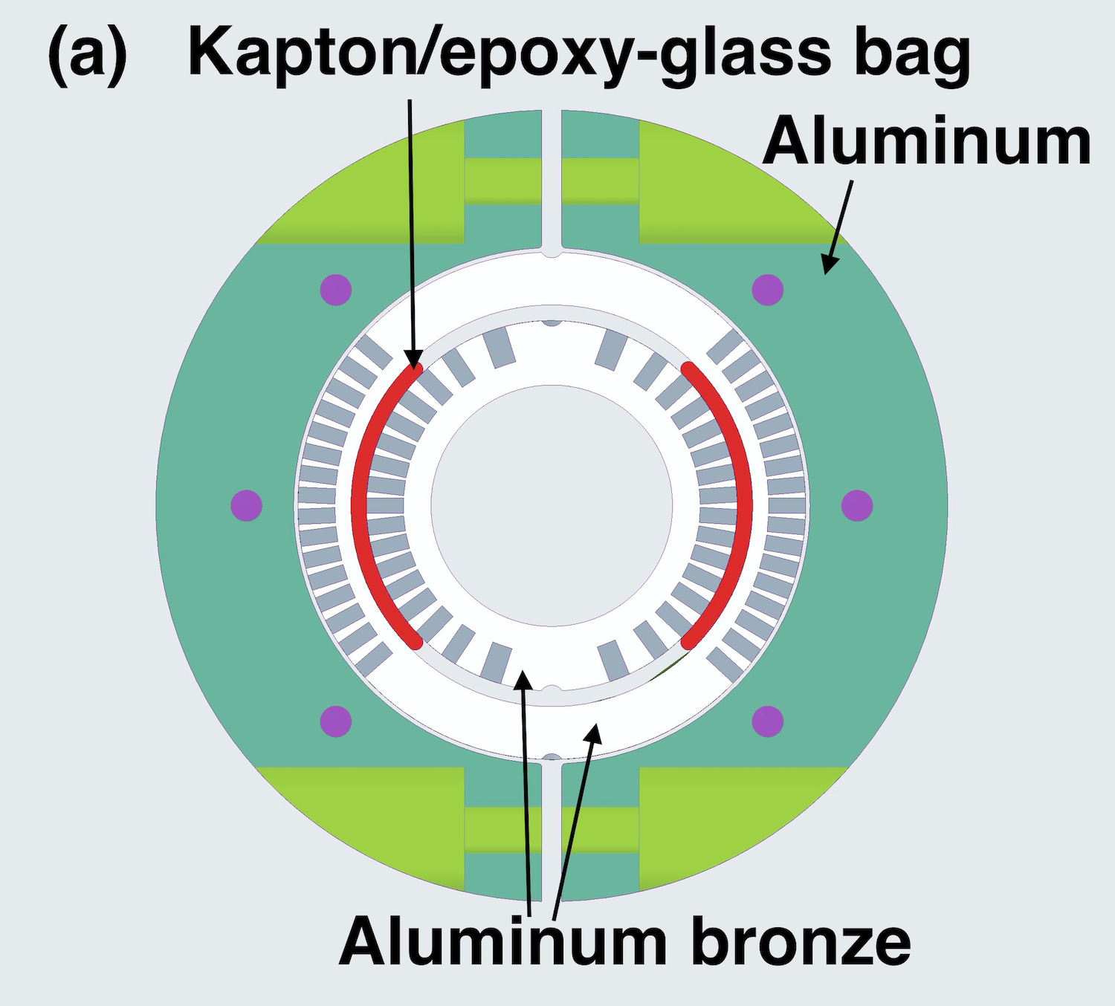
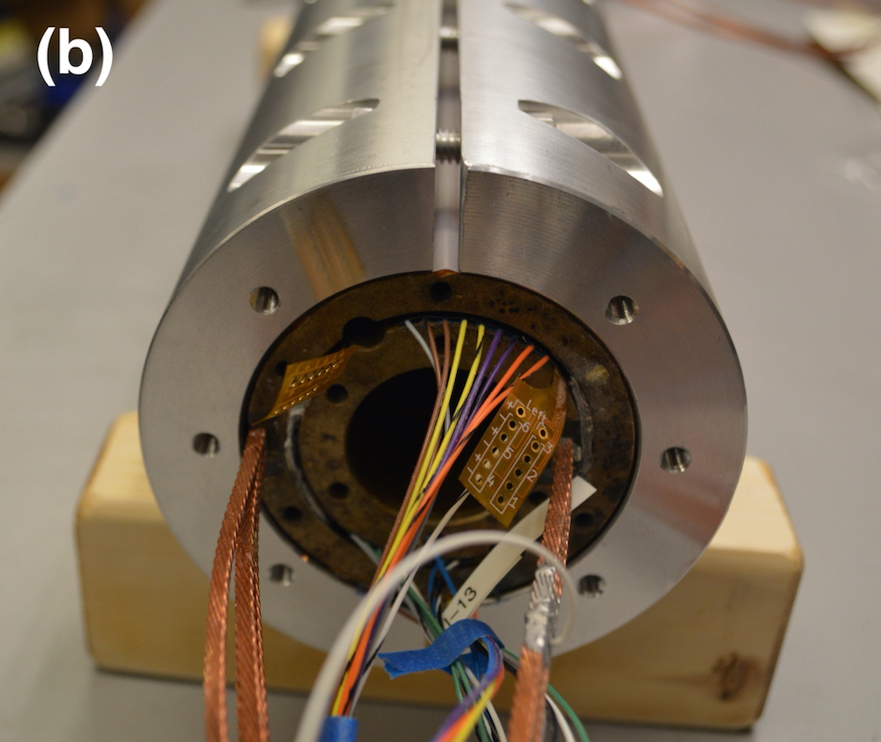
Insulation of Bi2212 cables being tackled on multiple fronts
Dedicated pure alumina braid insulation system (ASC)
Al₂O₃ slurry process
CCT ARDAP coil BIN5E:
  Inner and outer layer coils wound. No electrical shorts.
  NEW: Use Al₂O₃ slurry to “repair, reinforce and lubricate” alumina fibers. (courtesy of Dr. Jun Lu, NHMFL)

Slide 15
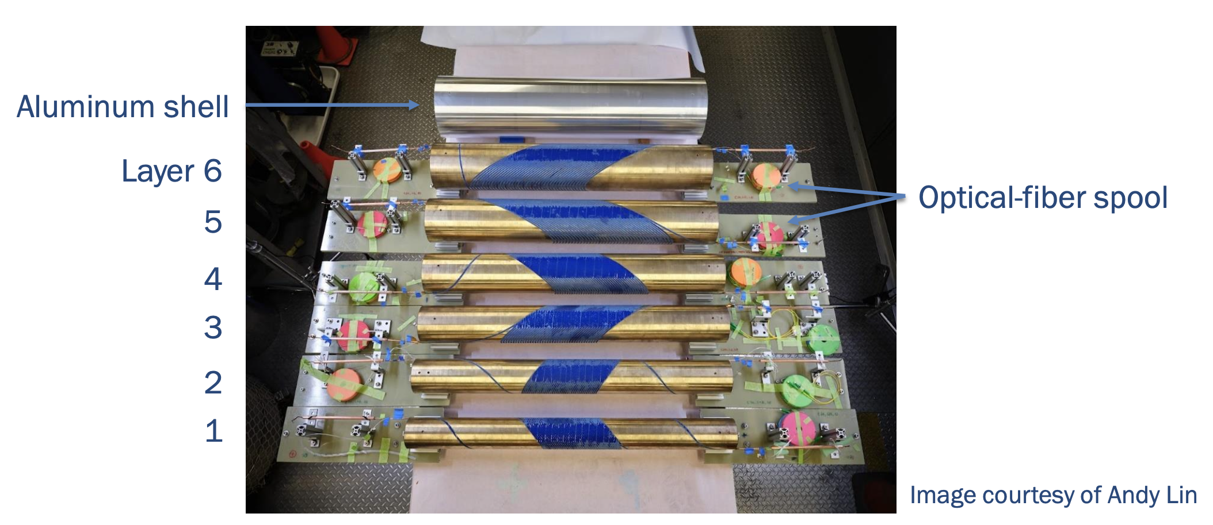
C3 is a 6-layer CCT magnet using CORC conductor
Xiaorong Wang
145 m of CORC® wires in six pieces, maximum piece length 35 m
Specified the minimum tape Ic for HM tapes

Slide 16
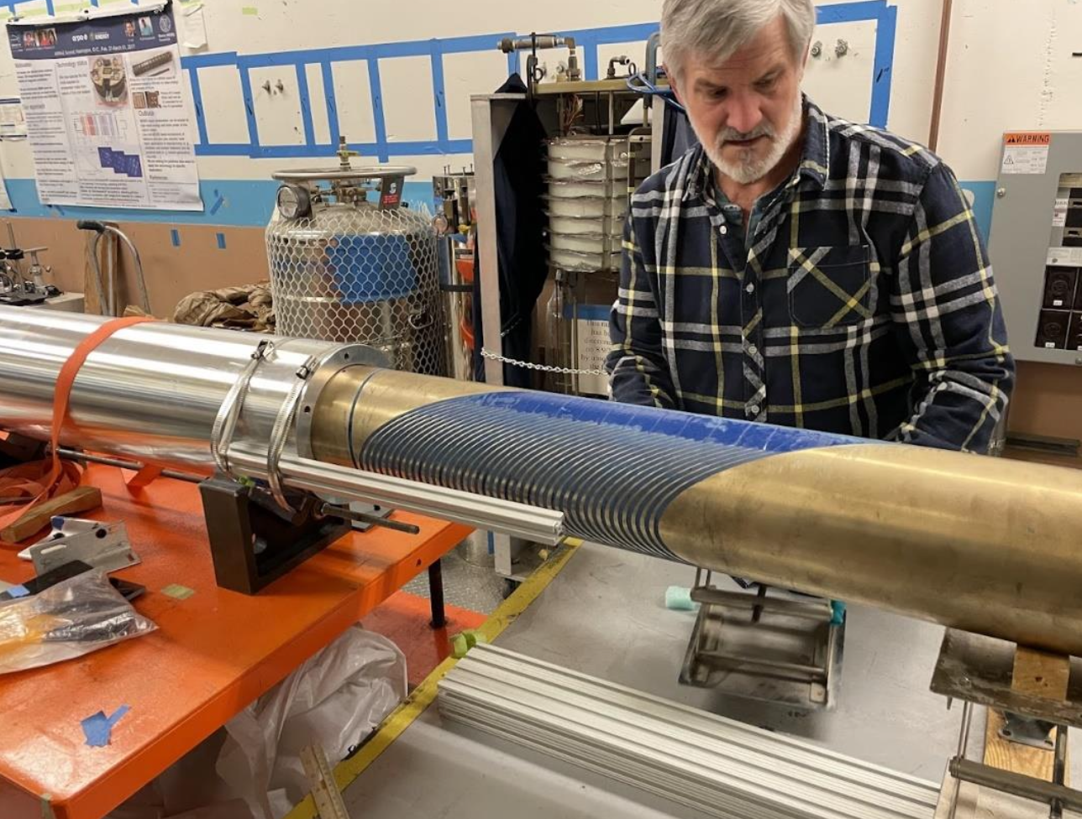
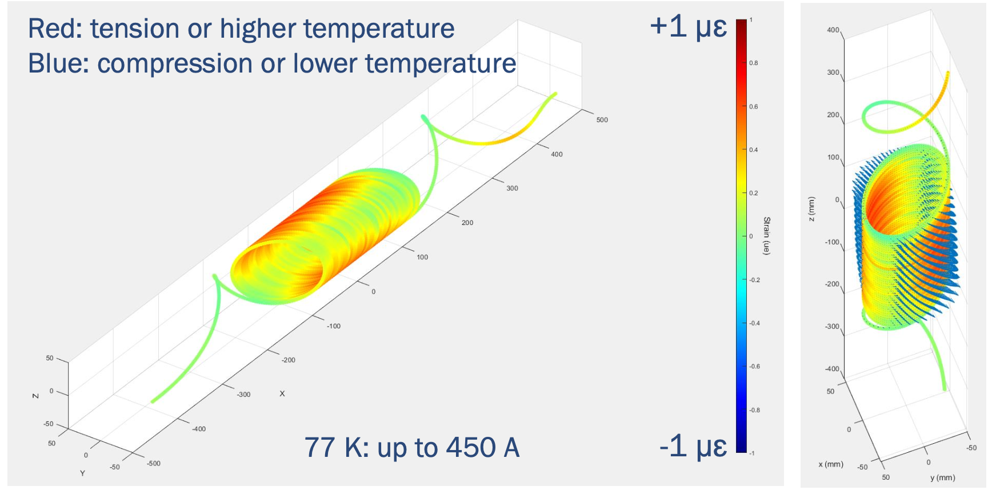
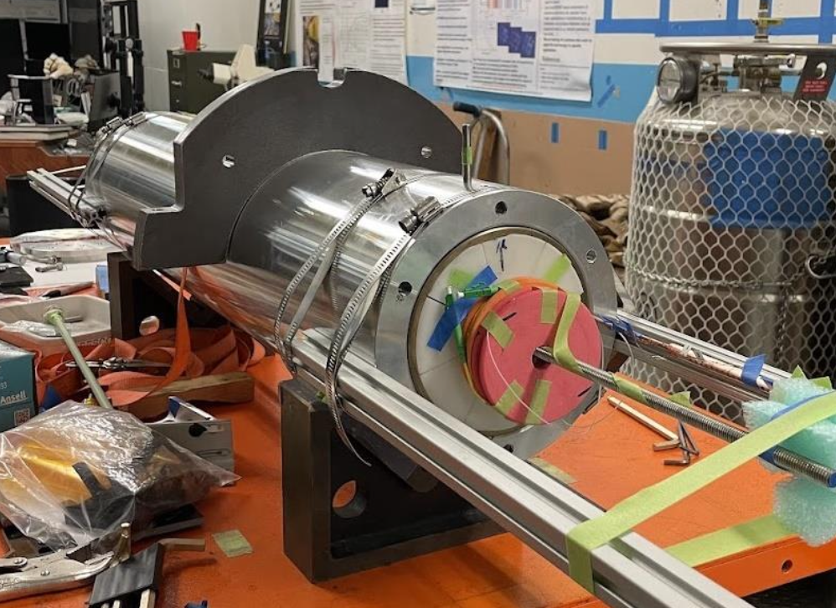
C3 should achieve 4-5T=> major goal of the 2020 MDP roadmap
Assembly complete, being put on header now
Test anticipated in the next few weeks
Strain measured via distributed optical fiber – test at 77K already showing interesting results (Linqing Luo, LBNL)

Slide 17
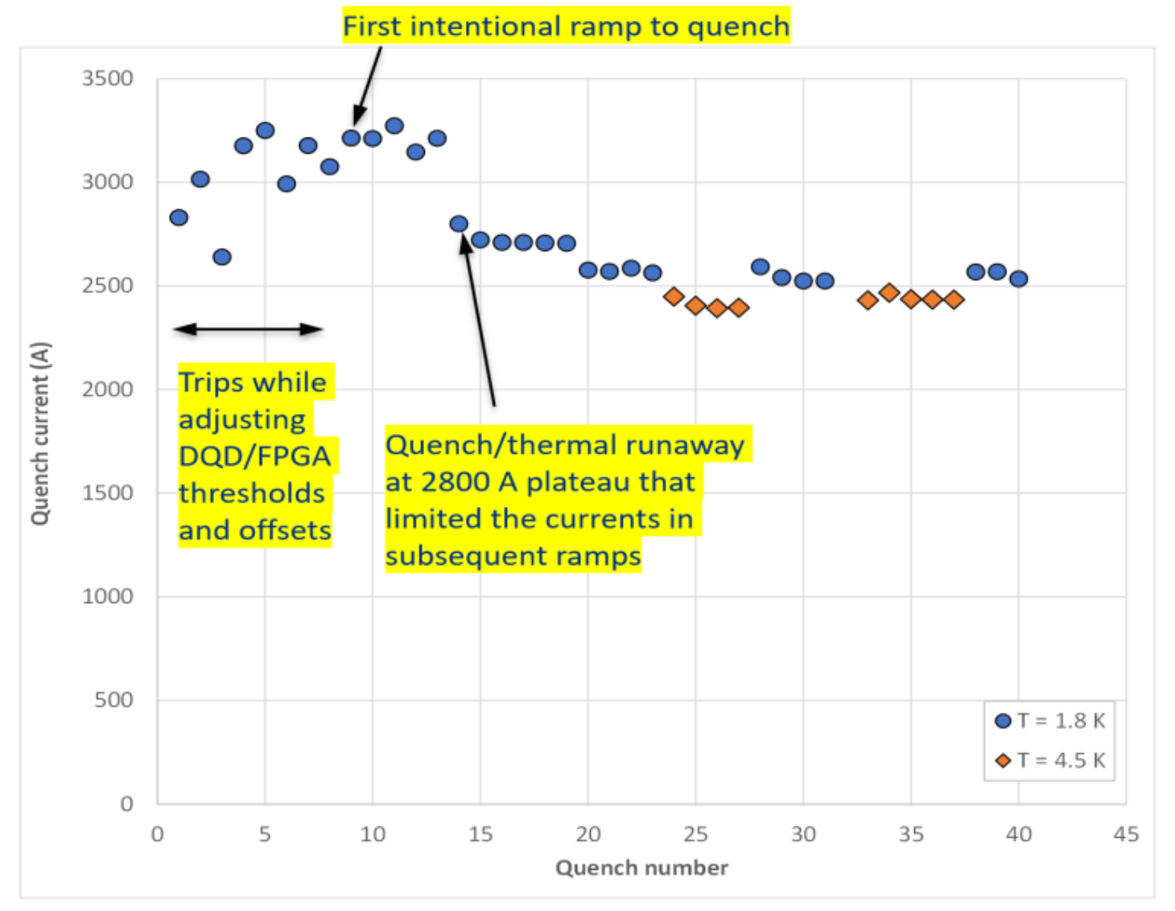
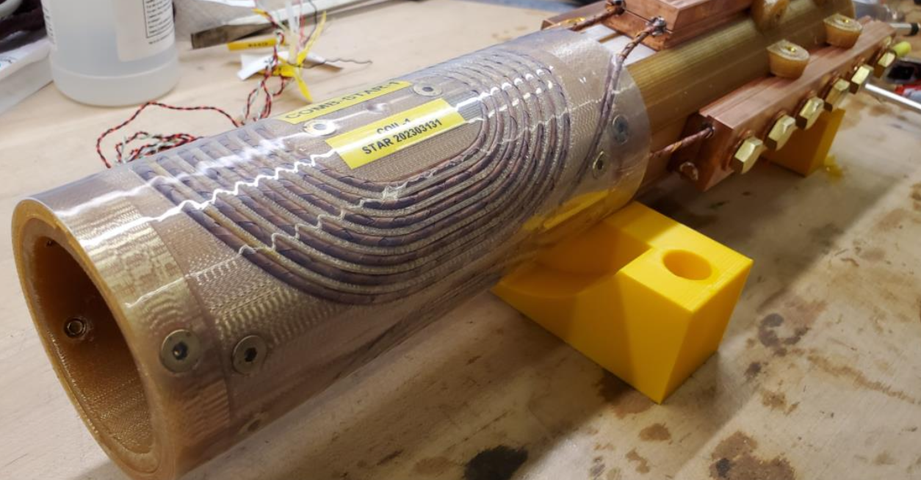
COMB concept yielding results
Vadim Kashikhin
COMB-STAR-1 magnet (2023-24) Achieved 1.5 T bore field @ 3.3 kA in LHe
  Degradation in one coil explored vi micro-CT scan

Slide 18
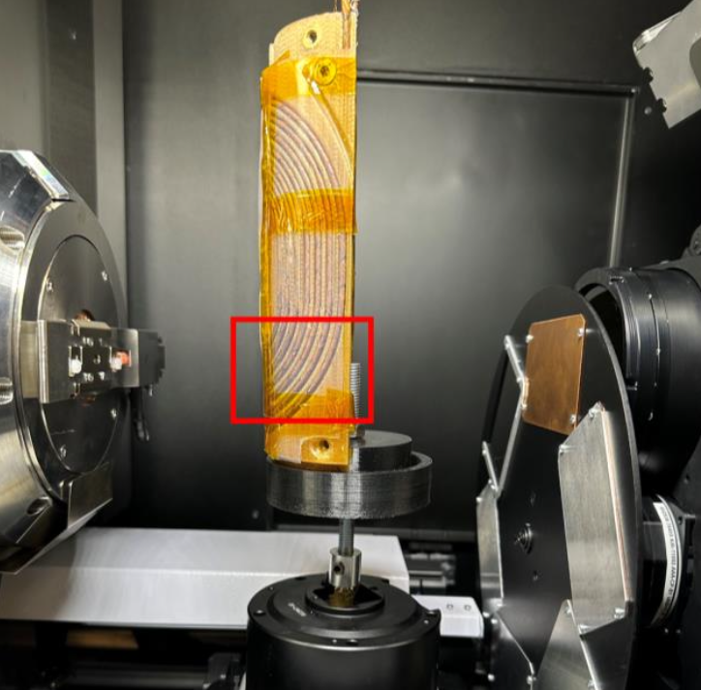
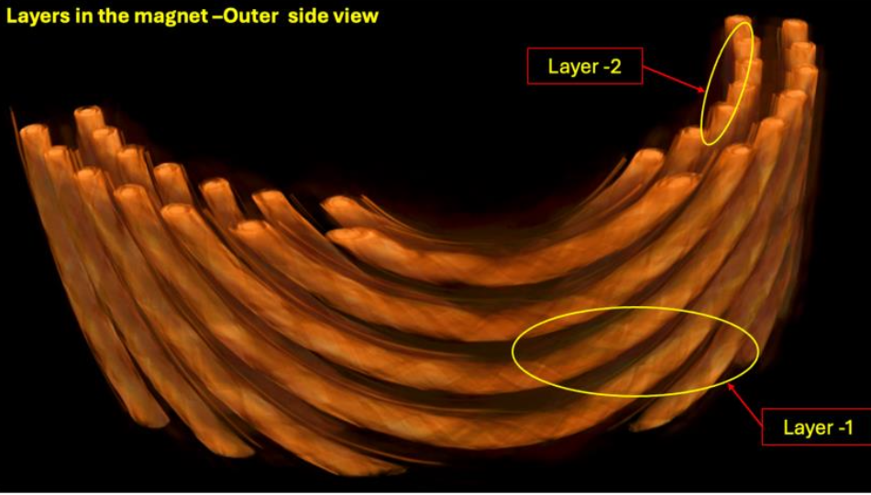
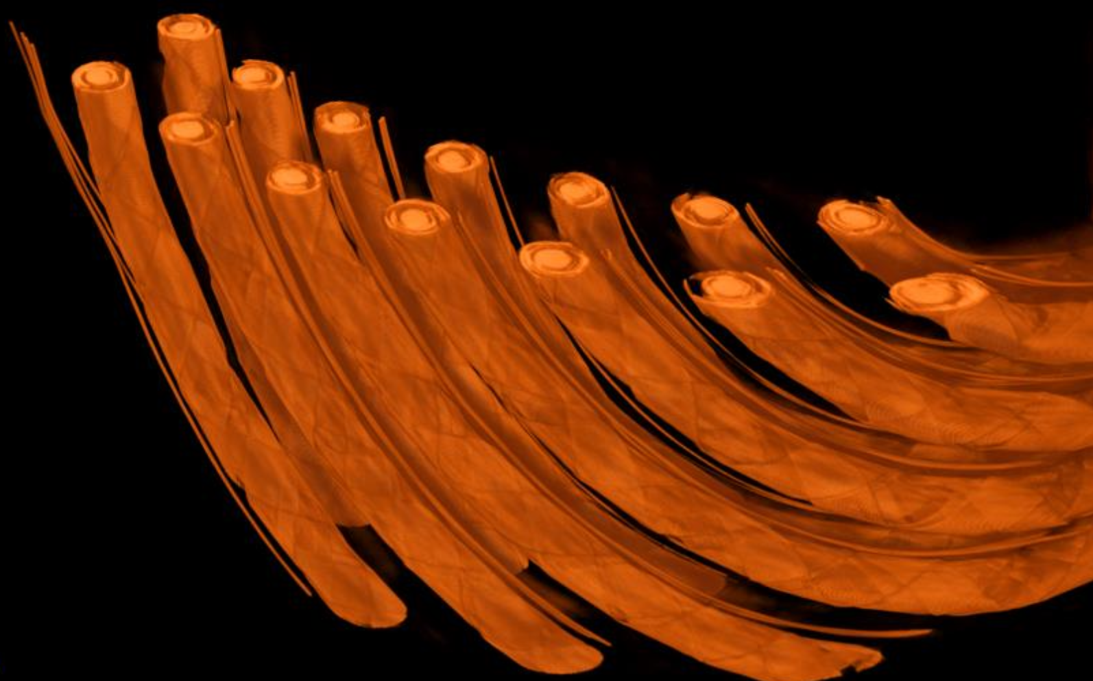
Disassembly/autopsy/micro-CT scan performed on the half-coil
The technique shows promise, but resolution cannot distinguish fine details in the wire
No evidence of wire damage apparent

Slide 19
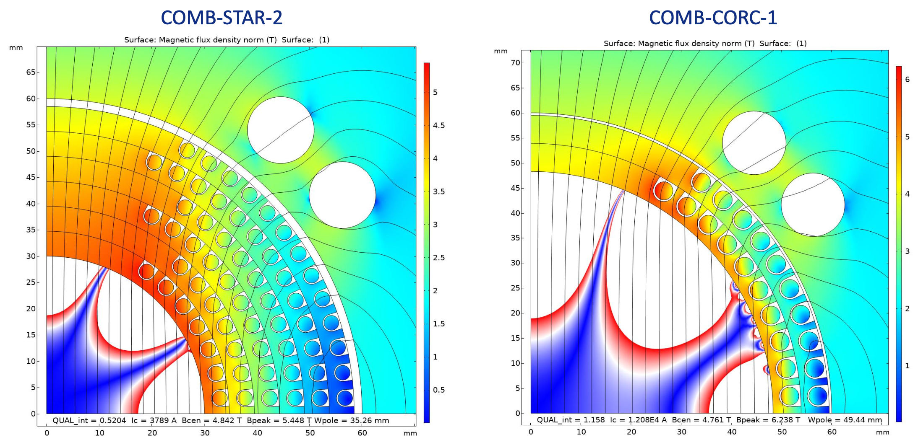
Designs for the next STAR and CORC COMB magnets are progressing
STAR™ allows for smaller bend radius => 60mm bore, 6 layers, may consider grading
CORC™ allows higher current but limited bending => ~97mm bore, 2 layers
STAR wire: 12 layers of AMPEER tape, 1 tape/layer; wire OD 2.6mm
CORC: 24 Superpower HM tapes, 2 tapes/layer; wire OD 3.8mm
4.8T bore field with 120mm OD

Slide 20
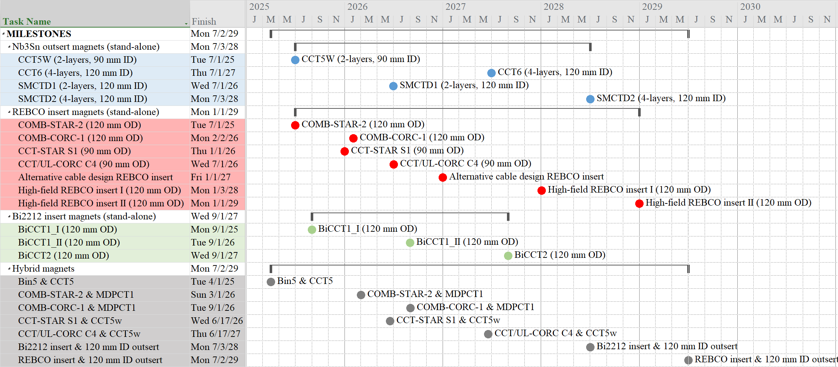
Major push now is to integrate HTS and LTS in hybrid magnets
Paolo Ferracin
Tentative – dates still being revised

Slide 21
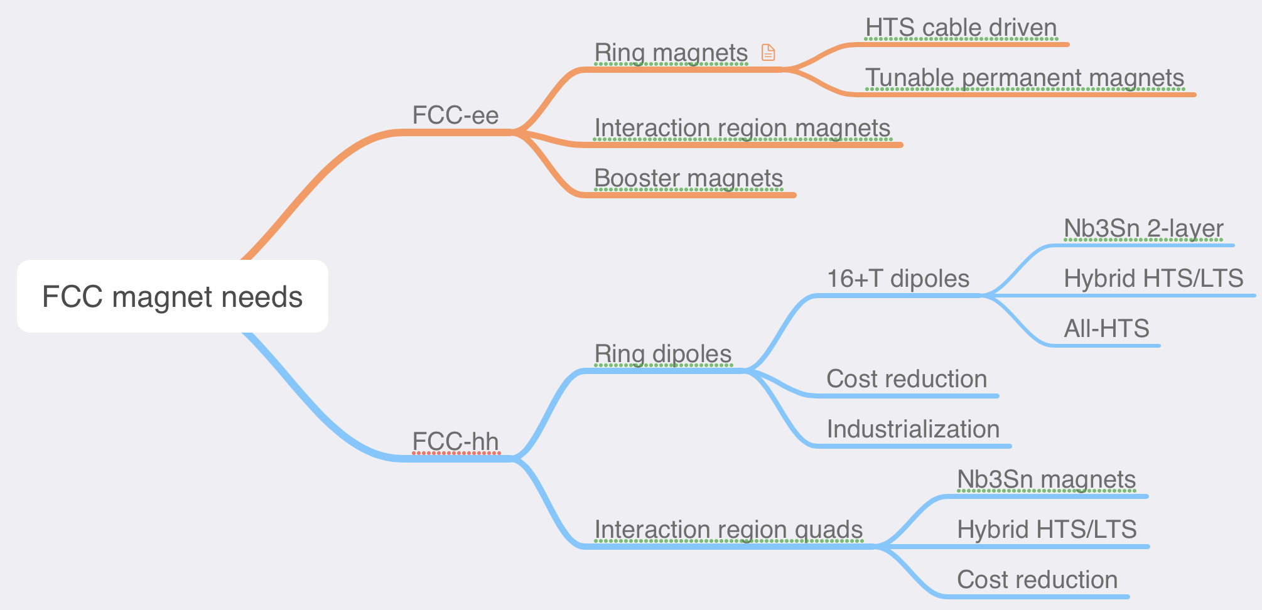
The US MDP currently pursues research addressing a– critical – subset of the magnet needs for a future FCC hadron collider
Current MDP is highly relevant
xx T

Slide 22
A muon collider will require critical advances in magnet technology – ripe for synergies with other applications
Radiation is a major consideration:
  Study tradeoff in aperture/bore+shielding vs magnet radiation hardness
  Further advance understanding of radiation hardness of superconductors and magnet materials
Rapid acceleration is critical:
  Study fixed-field booster options where applicable
  Further investigate high dB/dt magnet concepts
  Evaluate acceleration (particularly low-energy) schemes in an integrated approach
Large thermal loads suggest higher-temperature operation
  Explore all-HTS option
  Explore facility and operational cost models
Leverage strong synergies with fusion and High-Field magnets (e.g. condensed matter):
  Fastest development path for very challenging target and cooling magnets
New P5-aligned MDP roadmap focuses on these areas

Slide 23
Thank you!
We are at a critical period, where innovation and progress in magnet technology is essential to enable the next generation of colliders – the opportunity and challenge is shared with Fusion and other applications!

Slide 24
Central themes of MDP magnet R&D
Use fast turn-around platforms (subscale magnets, mirror magnets, etc)
Develop and apply advanced diagnostics, modeling
Explore “Quench Current-boosting”, high-Cp concepts, etc.
Understanding the disturbance spectrum and its control
  Study training, operating margin, and means to mitigate/reduce
Develop stress-management concepts to enable high-field accelerator magnets with strain-sensitive materials (Nb3Sn, HTS)
Develop and demonstrate REBCO and Bi2212 magnet technologies
Explore the viability of hybrid HTS/LTS magnets for efficient high-field accelerator magnets
Work with industry to advance superconductors tailored to HEP needs
Focus on developing conductor / cable / coil / magnet processes, identifying key issues
Leverage elements above to design optimized high-field configurations
Longstanding nexus between Labs, Universities, and industry in the US
  Example: Annual Low Temperature Superconductor Workshop >40+ years!

Slide 25
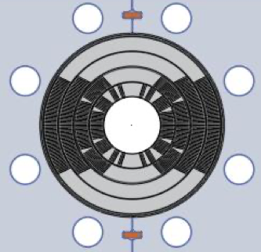


Managing mechanical stresses is key to higher fields – exploring stress-managed structures
“Traditional” Cos-theta
- Midplane stress due to azimuthal force accumulation
“Stress-managed” Cos-theta
- Groups of turns, azimuthal forces intercepted by support
MDP stress-managed hybrid magnets are under development
Critical for strain sensitive Nb₃Sn & HTS conductors
Characterized by significant interfaces
Nb₃Sn outsert
These “stress-managed” structures may enable combined function high-field accelerator magnets, which are subject to complex force distributions
HTS insert
Serves as good candidate for muon collider ring dipole

Slide 26







Strong synergies with Fusion REBCO research are leveraged
No sign of degradation seen in high field & low-cycle fatigue testing - IC>80% sum of tapes
Demonstrate feasibility of direct dry wound (non-VPI) coil design
DOE Offices of HEP & FES jointly funding a large-bore cable test facility
Will provide 15T dipole field over 750mm good-field, 1.9-50K on-sample
Cryostat will enable testing of high-field hybrid magnets
Being located at FNAL
A two layer Cable Model Coil to test for cyclic degradation

Slide 27





Bi2212 shows strong promise – being readied for hybrids
CCT6-Bi-CCT1
ID 40mm
OD 95mm
SSL 5T
17-strand
0.8mm diameter
3 coils at FSU, ready for reaction
CCT6-Bi-CCT2
ID 40mm
OD 115mm
SSL 6.8T
23-strand
1.0mm diameter
Renegade furnace

Slide 28



New paradigms: quench-free HTS magnet designs?
Traditional superconducting magnet design ensures magnet can survive quenches
  Motivation:
    spontaneous quenches => lack of reliable precursor, not controllable
    Training => potential for improved performance after quenching
Can we contemplate a new paradigm for HTS?
Higher MQE => not (?) susceptible to spontaneous quenches => no “random” behavior
So far no indication that HTS magnets exhibit training => no performance enhancement
Design to eliminate run-away quenching !?
“Typical” Nb₃Sn CCT magnet training
T. Shen et al., PHYS. REV. ACCEL. BEAMS 25, 122401 (2022)
“Rapid” training to ~75% short-sample, then rate changes
“Fair” memory after thermal cycle
Sub 2/3 thermal cycle

Slide 29
New paradigms: Liquid hydrogen cooled collider?
Hydrogen has critical advantages:
  Plentiful => not supply limited
  Carnot + liquefaction efficiency => dramatic improvement in ”wall-plug efficiency”
  Strong investments from other societal uses => cost, storage/shipping evolving rapidly
But there are concerns/issues:
  Safety => highly combustible in presence of oxygen
  Materials compatibility => some restrictions due to embrittlement/corrosion
  Limits superconductor option => only REBCO maintains significant transport current at 20K
Sustainability will be a driving consideration in any future international physics experiment - our community needs to make a strong, dedicated effort to explore liquid hydrogen for future colliders

Slide 30
DOE-OHEP has an excellent record of developing advanced technology
Long term investments in general accelerator R&D set the stage for dedicated readiness programs, which in turn enable successful delivery of advanced technology for colliders
The programs strive to coordinate efforts to more rapidly advance technology development
General R&D - programmatic
(ex: US MDP)
Directed R&D
(Technology readiness)
(ex: LARP)
Directed R&D
(Technology readiness)
Project
Project
(ex: HL-LHC AUP)
The US DOE approach balances long-range R&D and project preparation

Slide 31



Nb3Sn accelerator magnet technology is - for the 1st time - being installed in a collider
S. Prestemon, Workshop on Advanced Superconducting Materials and Magnets, KEK January 22 2019
S. Prestemon, Workshop on Advanced Superconducting Materials and Magnets, KEK January 22 2019
HiLumi magnet production is arguably “boutique production”
First implementation of Nb₃Sn superconductor in a collider
What are the risks and benefits of full-scale industrial production of Nb₃Sn magnets?
What elements of the design are “robust”, and what elements generate risk/performance limitations?
There is significant value-engineering that can be performed

