Slide 1
HFM Input to ESPP
B. Auchmann, E. Todesco
for the editorial team:
B. Auchmann, A. Ballarino, N. Bagrets, A. Milanese,
E. Rochepault, L. Rossi, C. Senatore, E. Todesco, F. Toral
February 10, 2025

Slide 2

Process towards final document
Formation of editorial team
PLs prepare document structure
1st Editorial team discusses bullet-point style input
(Discussion may continue offline via eMail or shared doc)
Drafting by HFM PLs, sharing of draft
2nd editorial meeting to discuss draft end of January
PLs revise document
SB discusses draft in January SB on 5 February
Community presentation and discussion at Annual Meeting, 10-12 February
3rd editorial meeting, discuss final draft
Possibly one additional dedicated SB
Submission before end of March

Slide 3
HFM Input to ESPP Update - Outline
Introduction
Updated baseline and R&D directions beyond the baseline
HFM R&D in context
Synergies with other fields and societal Impact
Conclusions
Annex
  Program Structure
  LTS R&D Timeline
  HTS R&D Timeline
  TRL and resource estimates

Slide 4
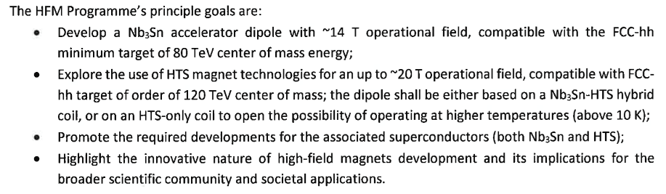
Introduction
HFM is a directed research program – see HFM PL mandate
Synergies and societal impact intended and welcomed – see Sec. 4.
HFM context: ESPP 2020, LDG Roadmap
Link with US-MDP
From the PL mandate:

Slide 5
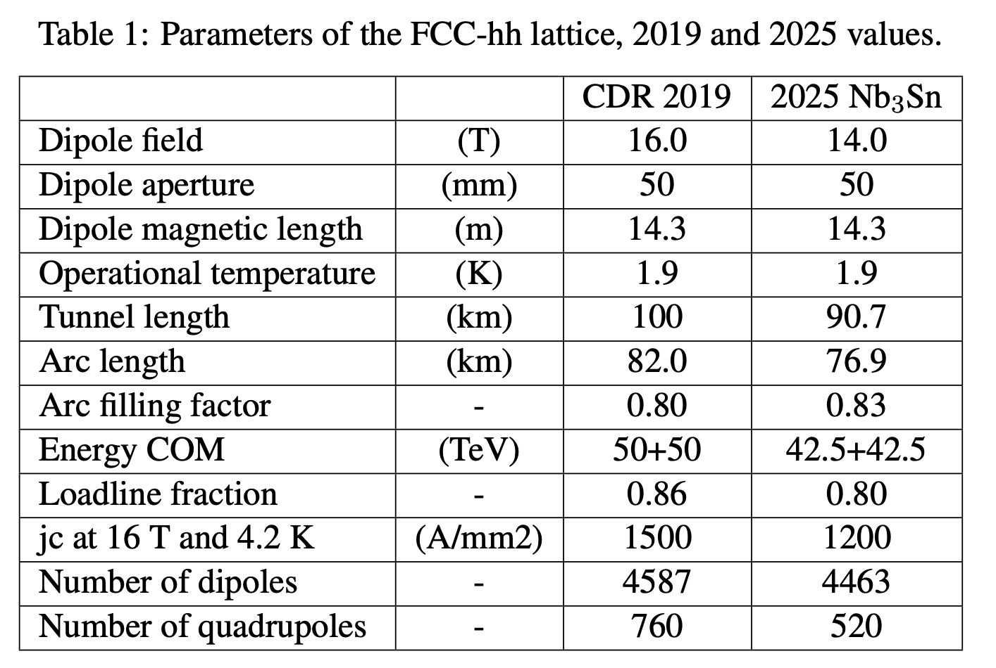
Sec. 2, Baseline and R&D Directions (LTS)
2. Updated Baseline Parameters and R&D directions beyond the baseline
RD: R&D directions for the next ESPP period (5-7 yr).
2.1 Baseline parameters
with an eye on cost, length scaling, and industrializable processes:
  RD: Demonstrate the baseline parameters with short magnets reaching 15-15.5 T.
  RD: Down-select to one or two designs for further optimization and demonstration of reproducibility.

Slide 6
Sec. 2, Baseline and R&D Directions (LTS)
2.2 LTS options and R&D directions
A. Improved conductor performance:
  RD: Demonstrate increased Nb₃Sn non-copper J_{c} and steps twoards industrial production.
  RD: Enlarge the supply base for high-performance Nb₃Sn wire to reduce the reliance on a single supplier; demonstrate baseline performance or better.
B. 4.5 K operation:
  RD: Determine the appropriate operational margins for 4.5 K cooling; Quantify the increase in amount of SC required to meet the 4.5 K-operation requirements.
  RD: Experimentally determine whether the option of a dry magnet cooled via capillaries is viable.

Slide 7
Sec. 2, Baseline and R&D Directions (LTS)
2.2 LTS options and R&D directions
C. 12 T magnets:
  RD: Demonstrate 13-13.5 T in a short magnet, following the above baseline for all other parameters.
D. Nb₃Sn/Nb-Ti hybrid magnets at 1.9 K :
  RD: Explore the challenges of a hybrid design using Nb-Ti in low field regions and aimed at 12 -14 T operational field.

Slide 8
Sec. 2, Baseline and R&D Directions (HTS)
2.3 HTS potential and R&D directions
A. Conductor Choice:
  RD: Develop REBCO tape technology in view of accelerator needs.
  RD: Monitor developments in BSCCO technology closely in cooperation with US-MDP.
  RD: Study potential of IBS round wire conductor in view of competitive specifications and timeline.
B. HTS magnet specifications and requirements
with cryo, powering/protection, beam dynamics, feedback systems, instrumentation, vacuum, beam-induced losses, etc.:
  RD: In an iterative process that involves all relevant subsystems, determine HTS magnet specifications and requirements.

Slide 9
Sec. 2, Baseline and R&D Directions (HTS)
2.3 HTS potential and R&D directions
C. HTS technology stack:
  RD: Develop and validate a cable for REBCO accelerator magnets.
  RD: Determine how to wind and insulate, mechanically load, cool, and protect REBCO dipoles.
  RD: Demonstrate accelerator quality at an intermediate field level and short length, before scaling up to nominal field.
D. HTS/LTS hybrid technology:
  RD: Quantify potential gains of hybrid HTS/LTS technology for accelerators and evaluate how they measure up against the drawbacks and risks.

Slide 10
Sec. 3, HFM R&D, LTS
3. HFM R&D
3.1 Nb₃Sn Conductor
3.2 Nb₃Sn magnets: classical preloaded structures
3.3 Nb₃Sn magnets: stress managed structures
 |  | FalconD | SMACC1 | BOND | F2D2 | DAISY
Design type |  | Cosθ | Stress-managed common coil | Block | Block graded | Common coil
Field | (T) | 12.0 | 12.0 | 14.0 | 14.0 | 14.0
Current | (kA) | 20.2 | 12.7 | 20.04 | 9.2 | 16.41
Peak field | (T) | 12.5 | 12.5 | 14.85 | 14.58 | 14.87
Loadline margin | (%) | 25 | 23 | 18 | 24 | 19.4
Equivalent coil width | (mm) | 37.5 | 20.1+19.1 | 53.5 | 24.0+27.7 | 29.2+25.6
J overall | (A/mm²) | 441 | 411 / 603 | 360 | 299 / 438 | 298/402
J superconductor | (A/mm²) | 1270 | 1205 / 2129 | 1002 | 837/1870 | 864/1172
J copper | (A/mm²) | 1357 | 1339 / 1774 | 1113 | 930/1039 | 960/1302
Stored energy | (MJ) | 13.1 | 22.9 | 29.6 | 31.8 | 32.9
Inductance | (mH) | 62.9 | 266 | 135 | 740 | 229
Coil energy density | (J/mm³) | 0.133 | 0.151 | 0.089 | 0.130 | 0.096

Slide 11
Sec. 3, HFM R&D, HTS
3.4 HTS conductors
3.5 HTS Magnets: partially and fully transposed cables in
EUCARD, EUCARD2, and US-MDP
3.6 HTS Magnets: metal- and no-insulation coils
3.7 HTS Magnets: dielectrically insulated, non-transposed cables
3.8 FCC integration and sustainability

Slide 12
Sec. 4, Synergies with Other Fields & Societal Impact
4. Synergies with Other Fields and Societal Impact
Collection of concrete examples from CERN, national labs, and institutes.
4.1 HEP (MuCol, FCC-ee)
4.2 Light sources and accelerator-based physics
4.3 Transportation
4.4 Energy
4.5 NMR spectroscopy
4.6 Medical applications
5. Conclusions

Slide 13
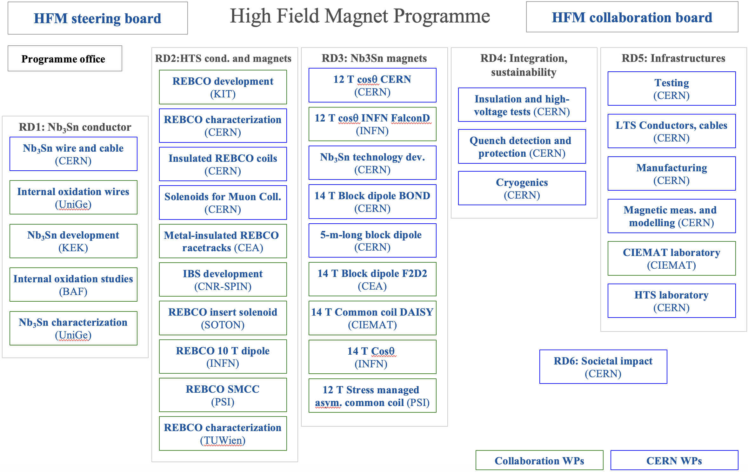
Annexes: program structure

Slide 14
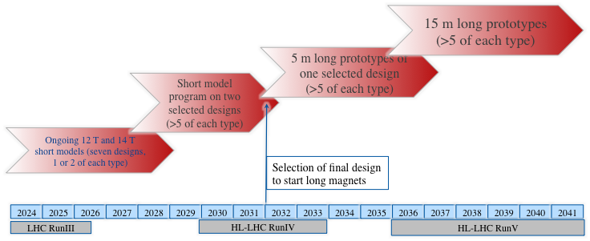
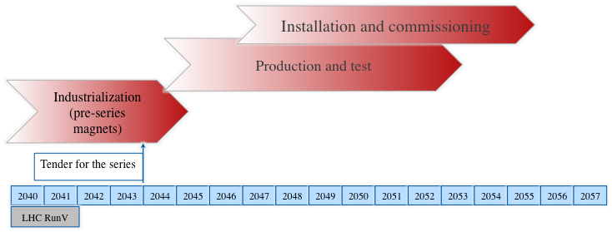
Annexes: LTS timeline

Slide 15
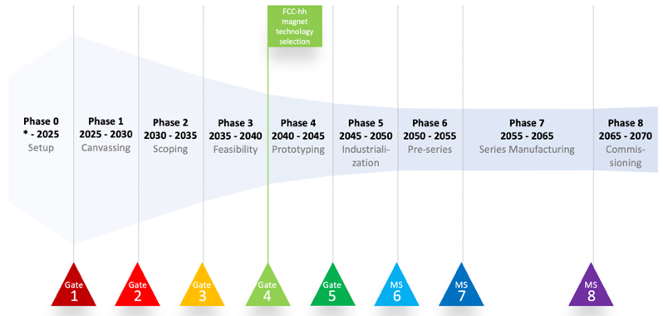
Annexes: HTS timeline
Published in FCC Feasibility Study Midterm Report under the assumption of the FCC integrated program.

Slide 16
Annexes: TRL and resources
Ongoing exercise with CERN WG and LDG.

