Slide 2
WP 3.4
Nb₃Sn Magnet Technology Development Program (TDP)
HFM Annual Meeting
11-02-2025
Ariel Haziot (TE-MSC-SMT)

Slide 3
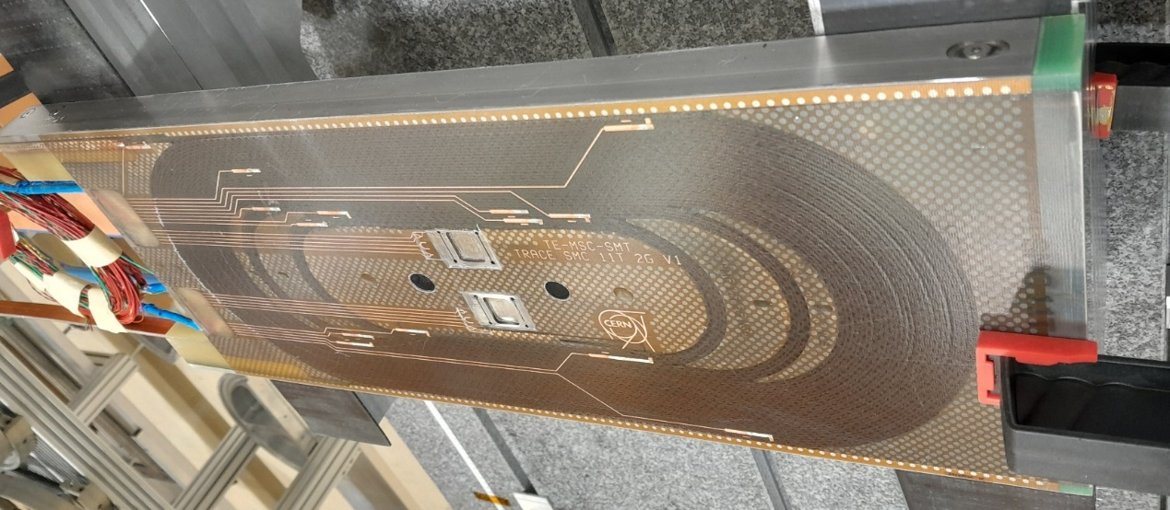
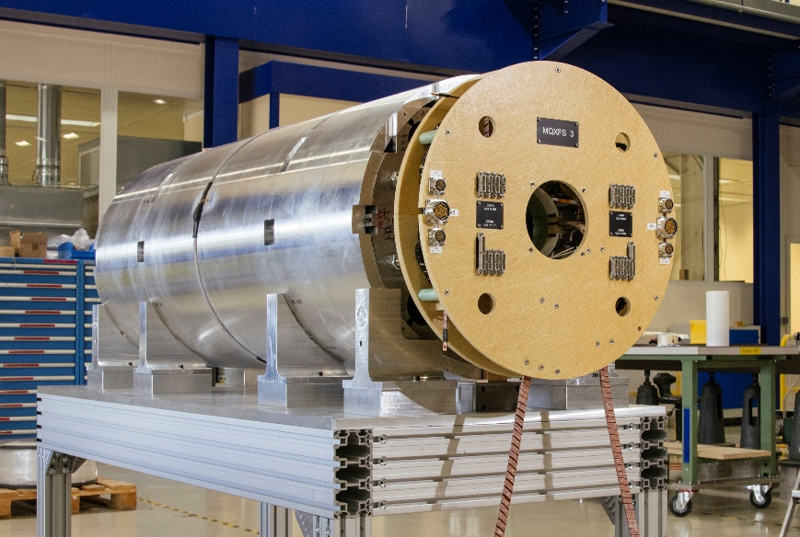
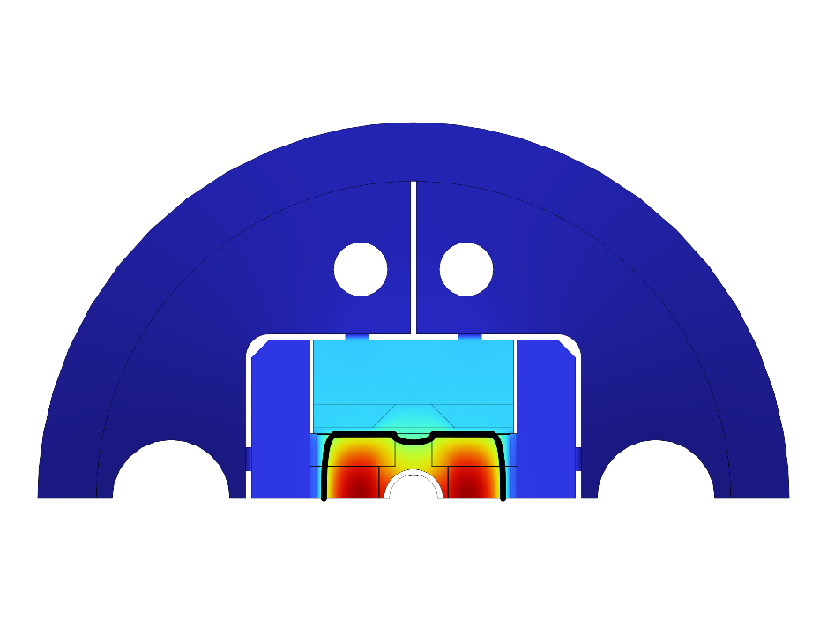
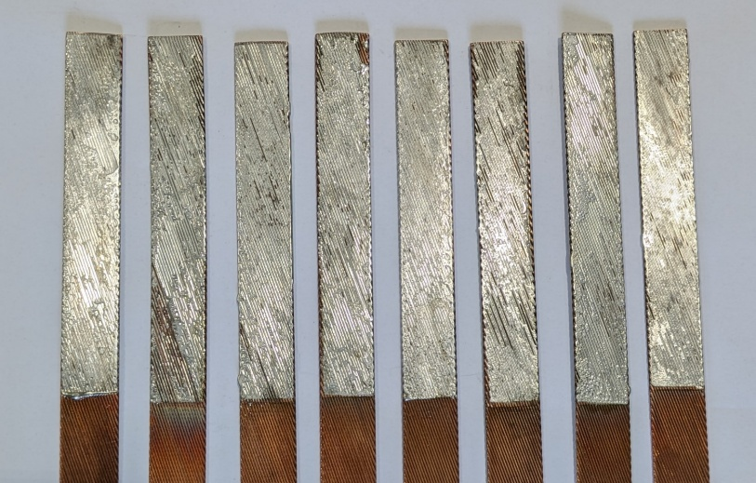
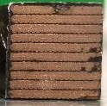
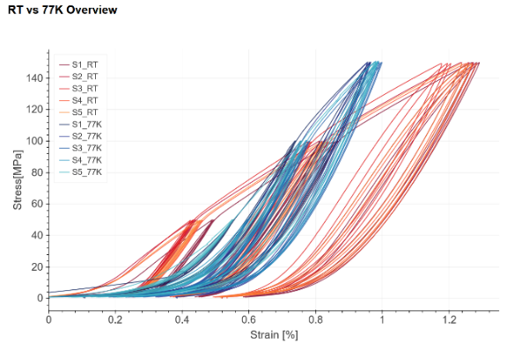
Table of content
TDP main axis
SMC racetrack magnets
development program
Quadrupole short model program (MQXFS)
Thermomechanical properties of
coil composite material
Nb₃Sn/Nb₃Sn- Nb₃Sn/NbTi internal splice
Technology towards
4.5K channel/dry cooling
3

Slide 4
Table of content
TDP main axis
SMC racetrack magnets
development program
Quadrupole short model program (MQXFS)
Thermomechanical properties of
coil composite material
Nb₃Sn/Nb₃Sn- Nb₃Sn/NbTi internal splice
Technology towards
4.5K channel/dry cooling
See Coil Composite WG
this afternoon

Slide 5
SMC racetrack magnets
development program

Slide 6
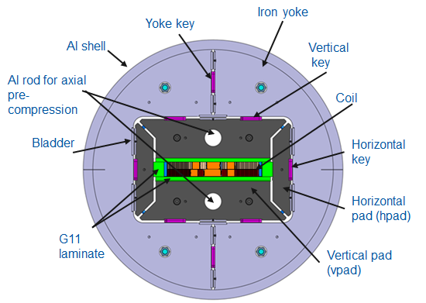
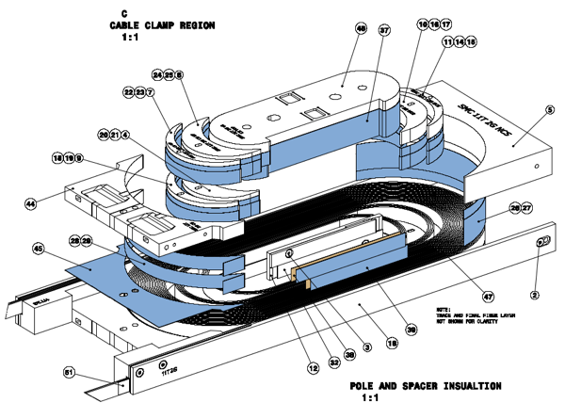
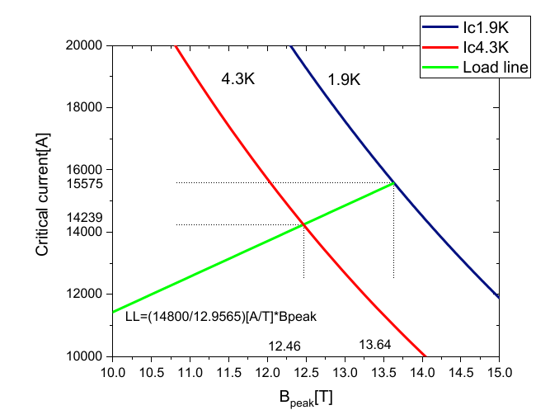
SMC racetrack magnets program
Description of the scope
The Short Model Coil (SMC) assembly has been designed as a test bench for short racetrack coils wound with Nb₃Sn cable.
A double pancake racetrack coil.
An assembly relying on a key & bladder structure and hosting 1 coil.
A fast turnover time compared to larger magnets.
The SMC program led by J.C. Perez since 2009 is now in TDP.
The most recent is the SMC 11T 2nd Generation (2G) that features:
  A conductor with 40x0.7 mm Nb₃Sn strands
  A layer jump in the straight section
Short sample current (4.3K) | 14.24 kA
Short sample current (1.9K) | 15.58 kA
Short sample Field (4.3K) | 12.46 T
Short sample Field (1.9K) | 13.64 T

Slide 7
SMC racetrack magnets program
Overview of the program
2021: 3 coil windings
2022: 3 coil windings, 3 magnets assemblies, 3 cold tests
2023: 1 coil winding, 8 magnet assemblies, 7 cold tests
2024: 2 coil windings, 4 magnet assemblies, 3 cold tests
Acknowledgment (2024)
Winding & assembly: S. Clement, C. Fernandes,
E. Fernandez Mora, B. Fornes, F. Garnier, G. Maury, S. Menu, N. Peray, J.C. Perez, F.O. Pincot, P. Rizzo, 927 team
Mechanical measurement: M. Guinchard, S. Mugnier
Cold test: J. Feuvrier, G. Willering, SM18 team
SMC2G 105
Disassembling
SMC2G 109
Loading
SMC2G 109
Winding
SMC1G 101g
Cold test
SMC1G 101g
Disassembly
SMC2G 108
Loading
SMC2G 107
Loading
SMC2G 107b
Cold test
SMC2G 105
Cold test
SMC2G 108
Winding
SMC2G 107
Cold test
SMC2G 107
Disassembling
SMC2G 107b
Loading
SMC2G 107b
Disassembling
2024
Jan.
Feb.
Mar.
Apr.
May
Jun.
Jul.
Aug.
Sep.
Oct.
Nov.
Dec.
An important objective of the program for the SMC 11T 2G is training reduction by exploring different impregnation systems. (in collaboration with WP 4.3)
The SMC assembly is also used as a test bench for new quench protection systems.
(in collaboration with WP 4.5)

Slide 8
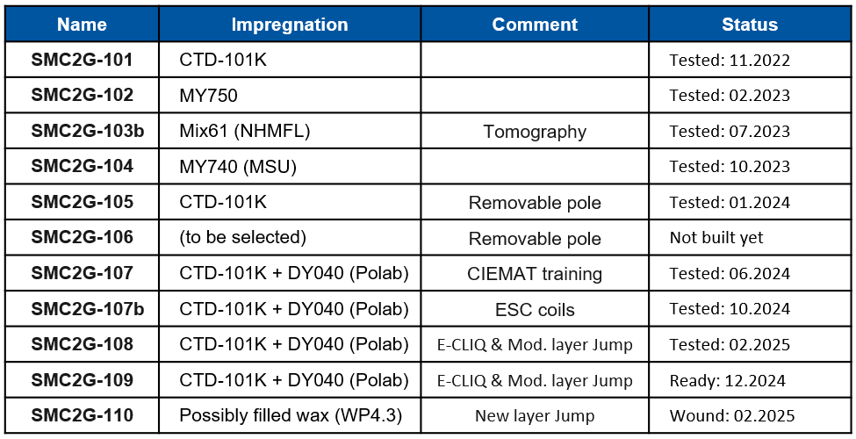
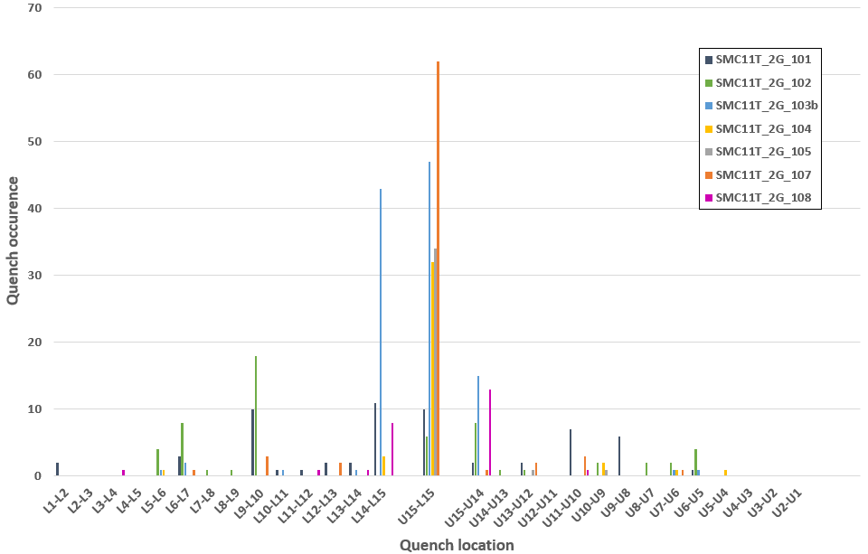
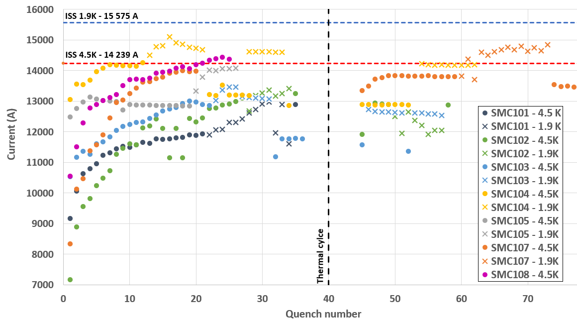
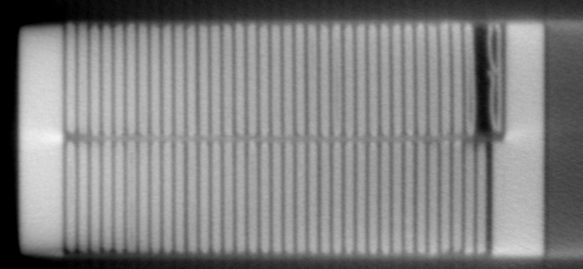
SMC racetrack magnets program
Overview of the results from SMC 11T 2G
Coils exhibit limitation around 90% I_{SS} at 4.5K
Performances degrade permanently at 1.9K.
The weak point is in the layer jump.
Tomography studies confirmed a degradation of the cable in this area.
It is difficult to state any strong conclusion on the influence of the resin.
The layer jump area has been modified since #108.
M. Celuch,
EDMS 3063899
Cold tests: G. Willering and collaborators at SM18

Slide 9
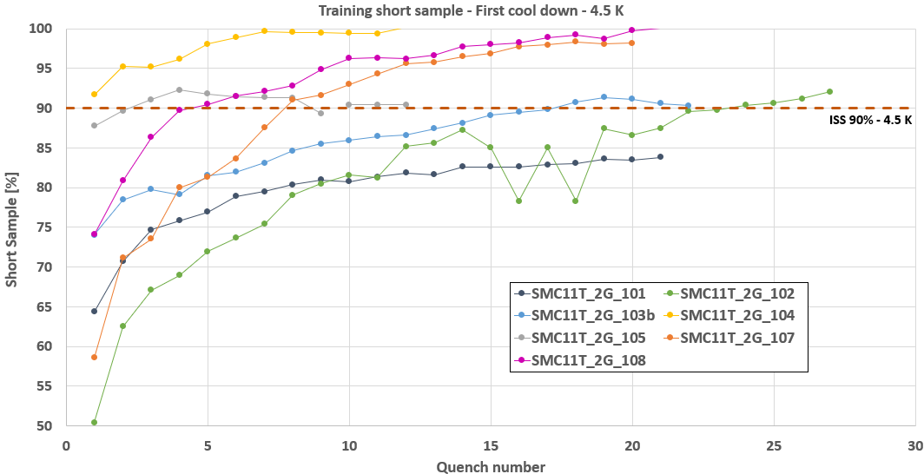
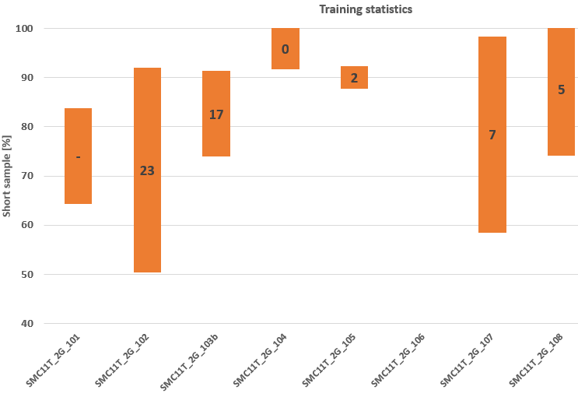
SMC racetrack magnets program
Overview of the results from SMC 11T 2G
If we focus on 4.5K virgin training:
Training range, and length are reduced with Mix61, MY740 or Polab mix compared to CTD-101K.
Low friction pole improves significantly the training.
(removing training quenches in the coil, only limited at layer jump)
CTD-101K
MY 750
Mix 61
MY 740
CTD-101K
Low friction pole
Polab mix
Polab mix

Slide 10
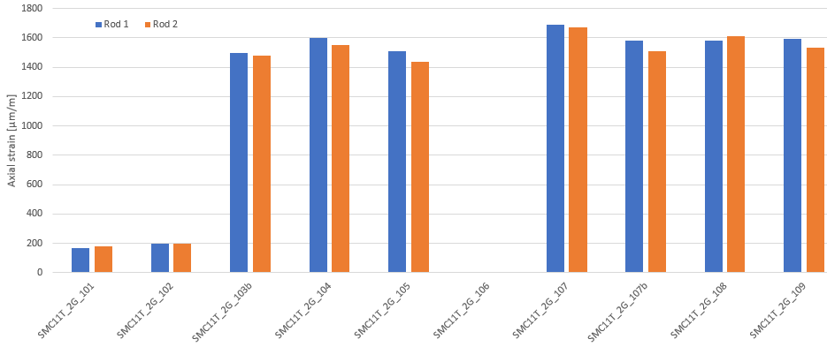
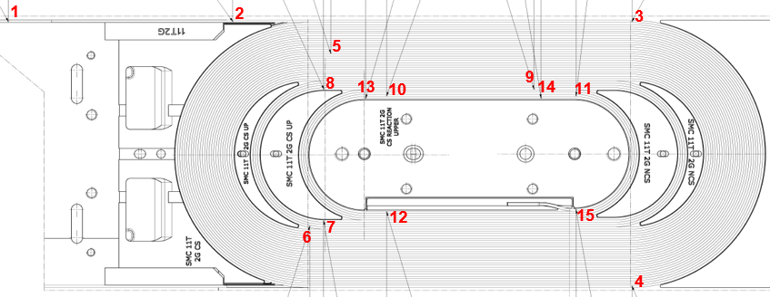
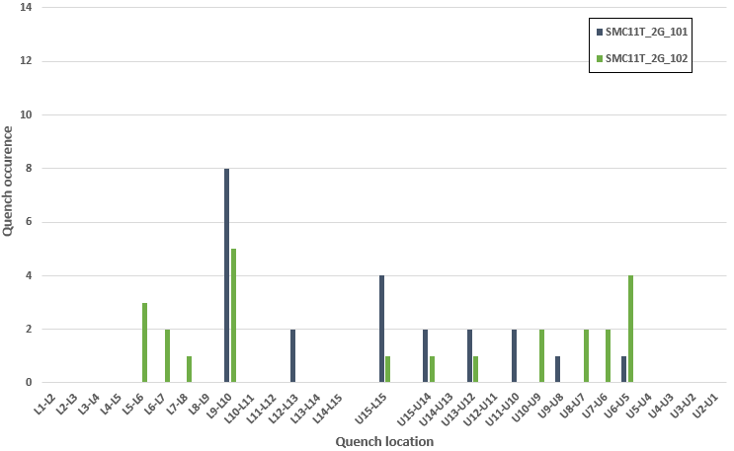
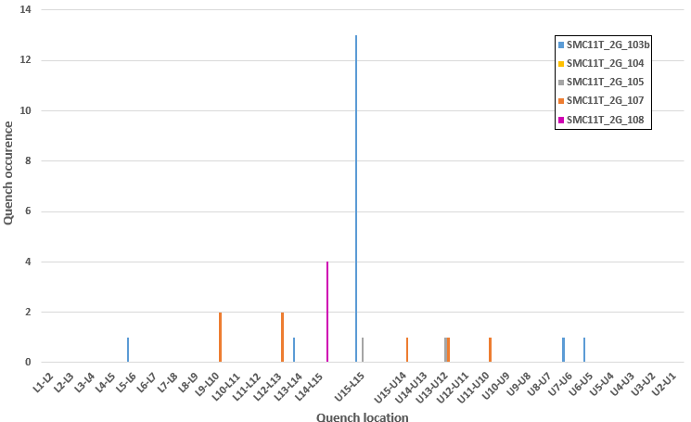
SMC racetrack magnets program
Overview of the results from SMC 11T 2G
Effect of longitudinal loading on virgin training at 4.5 K
With low loading, training quench are spread in the coil.
At higher loading, they reduces
Rods deformation for SMC11T 2G magnets

Slide 11
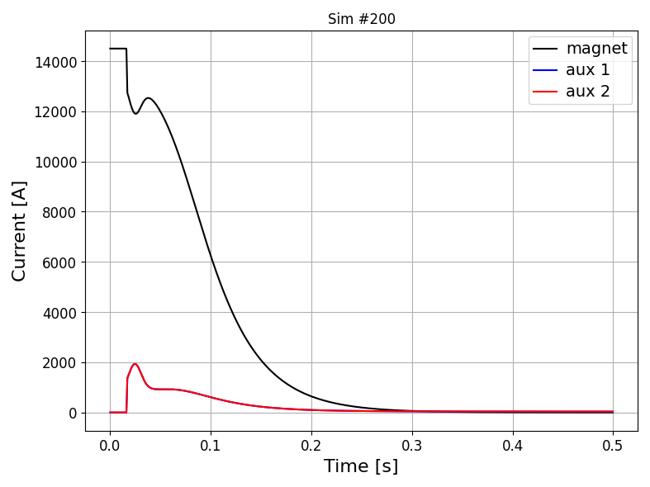
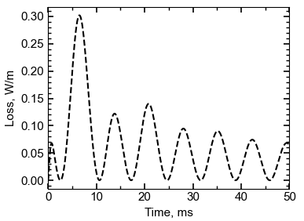
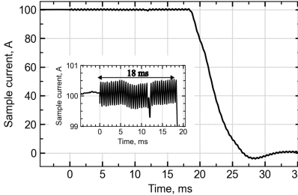

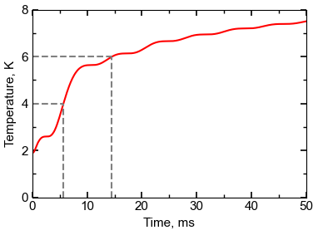
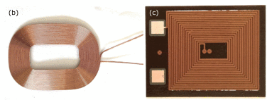
SMC racetrack magnets program
A test bench for new quench protection systems (in collaboration with WP 4.5)
ESC (Energy Shift with Coupling)
E-CLIQ
As fast as CLIQ or faster
Extracts part of the magnet energy
Sudden current drop → lower ohmic loss
Electrically insulated from coil
Easier redundancy
E-CLIQ coils are inductive quench heaters: AC current → AC magnetic field → AC loss in the conductor.
Potential to initiate a quench within some milliseconds.
Acts also as a small Joule based quench heater
0
1
2
3
Auxiliary coil 1
Magnet coils
auxiliary coil 2
0. Powering
1. Unit discharge
2. Diode conduction
3. Magnet discharge
E. Ravaioli et al., Energy shift with coupling (ESC): a new quench protection method, Supercond. Sci. Technol. (2025)
T. Mulder et al., External Coil Coupled Loss Induced Quench (E-CLIQ) System for the Protection of LTS Magnets, IEEE Trans. Appl. Supercond. 33, 3258912 (2023)
For more details, see talk by M. Wozniak

Slide 12
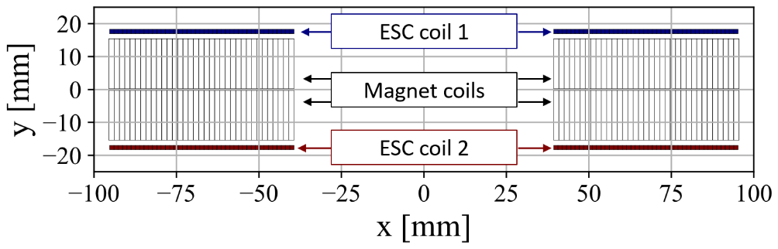
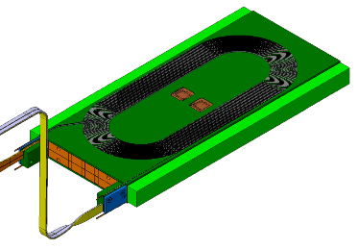
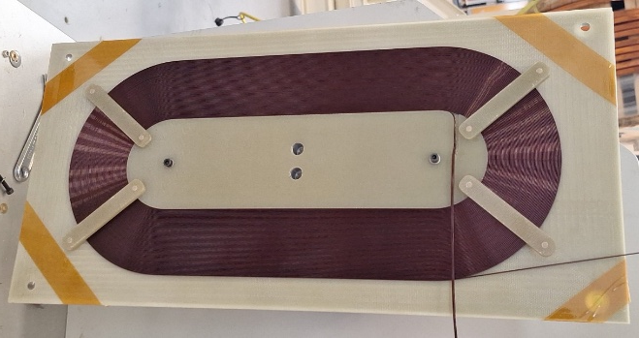
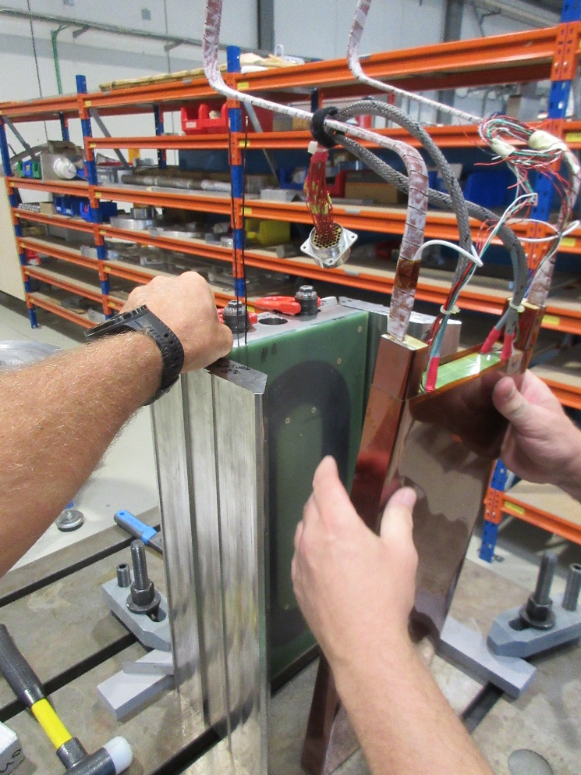
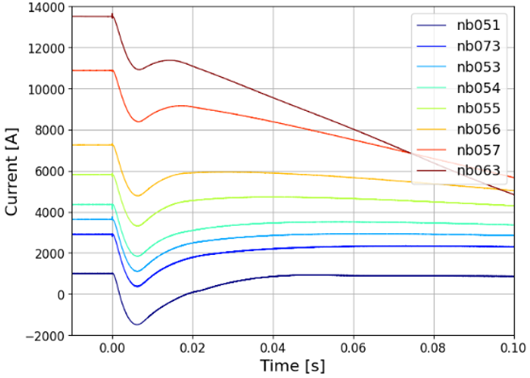
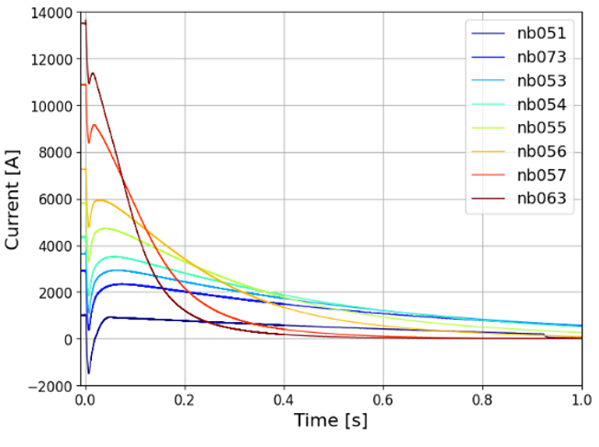
SMC racetrack magnets program
First demonstration of the Energy Shift with Coupling (ESC) in SMC
2 ESC Cu coils (2x0.8 mm², 59 turns).
Assembled in the coil pack around the SMC coil in epoxy casing.
Demonstrated quench protection at all current levels at 1.9K and 4.5K.
1 ESC coil is enough for protection.
Reproducible and transparent on magnet.
Coil fabricaiton: J. Bauche, M. Dumas, 181 team
1.9K - 200 V
1.9K - 200 V
Courtesy of E. Ravaioli and G. Willering
For more details, see talk by M. Wozniak

Slide 13
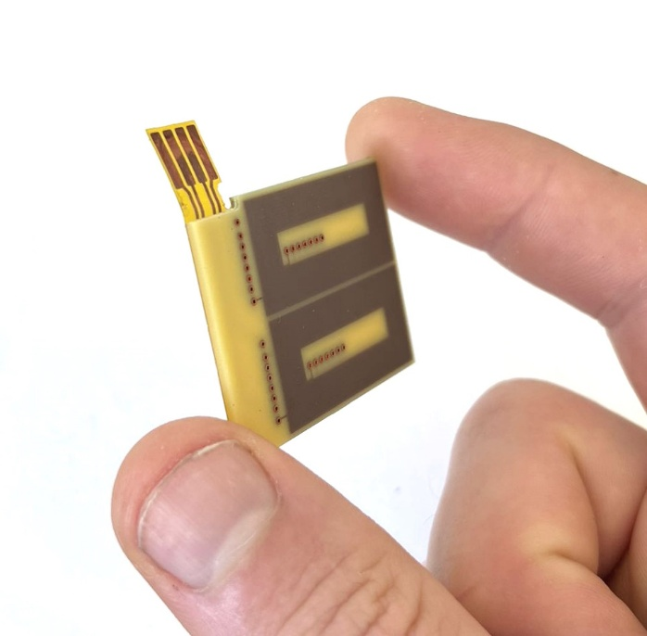
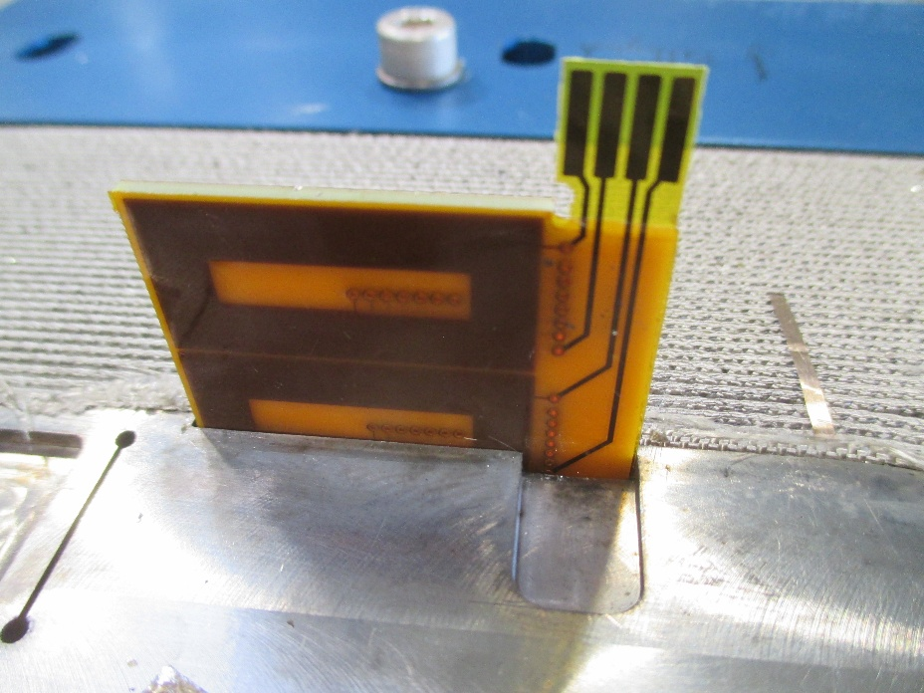
SMC racetrack magnets program
First demonstration of E-CLIQ in SMC
New E-CLIQ coils designed and produced for SMC.
Two coils on 1 PCB → 1 for each layer of the SMC.
Each coil has 14 layers and an inductance of 3 mH.
Coils were inserted between the pole and the 1st turn and impregnated with the coil.
Tests are on-going with results better as expected.
Tests with E-CLIQ coils in top plane to be foreseen.
For more details, see talk by M. Wozniak

Slide 14
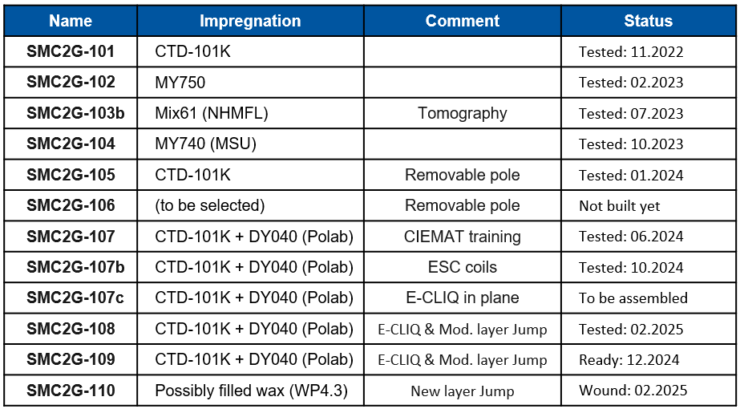
SMC racetrack magnets program
Coming in 2025 on SMC 11T 2nd Generation
Test of #108 and #109 (Q1 2025)
  Modified layer jump
  E-CLIQ
Assembly of #110 (Q1 2025)
  New layer jump geometry
  Possibly impregnated with filled wax
  (collaboration with WP4.3)
Assembly of #106 (Q2 2025)
  Removable pole
  Best impregnation system
Assembly of #107c/108b (Q2 2025)
  E-CLIQ on top of the coil
Test of #110 and #106 (Q2 2025)
Test of #107c (Q3 2025)
No more 11T cable available for building SMC 11T 2G.

Slide 15
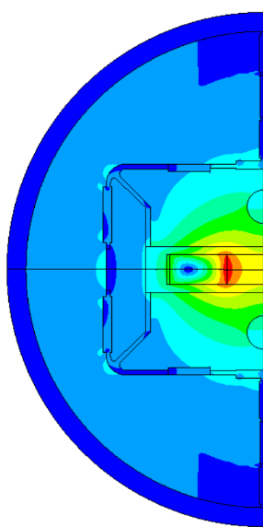
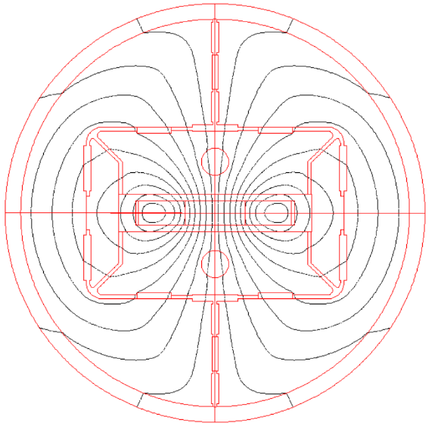
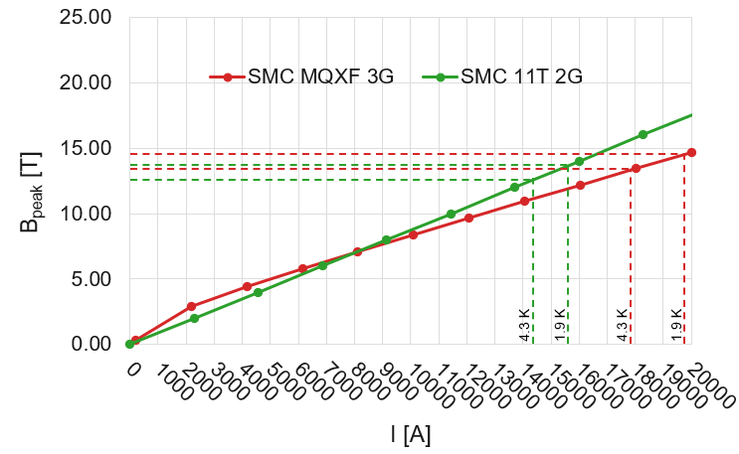
SMC racetrack magnets program
SMC MQXF 3rd Generation
A SMC coil using available MQXF strand has been designed:
(J. Ferradas, J.C. Perez)
It is compatible with the actual tooling (used for SMC 11T 2G).
It can be assembled in the existing 2 SMC structures.
Cable |  |  | 2nd Gen. | 3rd Gen.
No. strand |  | 40 |  | 32
Strand diam. | [mm] | 0.700 |  | 0.850
Cu/NonCu |  | 1.2 |  | 1.0
Bare cable thickness (R) | [mm] | 1.31 |  | 1.59
Bare cable width (R) | [mm] | 14.89 |  | 14.88
Coil |  | 2nd Gen. |  | 3rd Gen.
No. of turns per pole |  | 35 | 31
Number of layer |  | 2 | 2
Magnet |  | 2nd Gen. | 3rd Gen.
Short sample current (4.3K) | [kA] | 14.24 | 17.84
Short sample current (1.9K) | [kA] | 15.58 | 19.80
Short sample Field (4.3K) | [T] | 12.46 | 13.30
Short sample Field (1.9K) | [T] | 13.64 | 14.53
Design completed in September 2024
Parts procured for 3/10 for March 2025
1st coil for Q2 2025

Slide 16
SMC racetrack magnets program
Test plan for SMC MQXF 3G under discsussion
Exploration of new impregnation systems (see WP 4.3 talk by R. Piccin)
  Polab Mix as baseline
  Filled wax
  Though epoxy
  Low friction epoxies
Validation of new electrical insulation strategies (see WP 4.3 talk by R. Piccin)
  De-sizing
  Ceramic coating
Test conduction cooling at 4.5K with closed helium circuits.
  Modified yoke structure
  Validation of thermal models
Test material grading in block coil design
  Engineering design of a hybrid Nb₃Sn/NbTi.

Slide 17
Quadrupole short model
program (MQXFS)

Slide 18
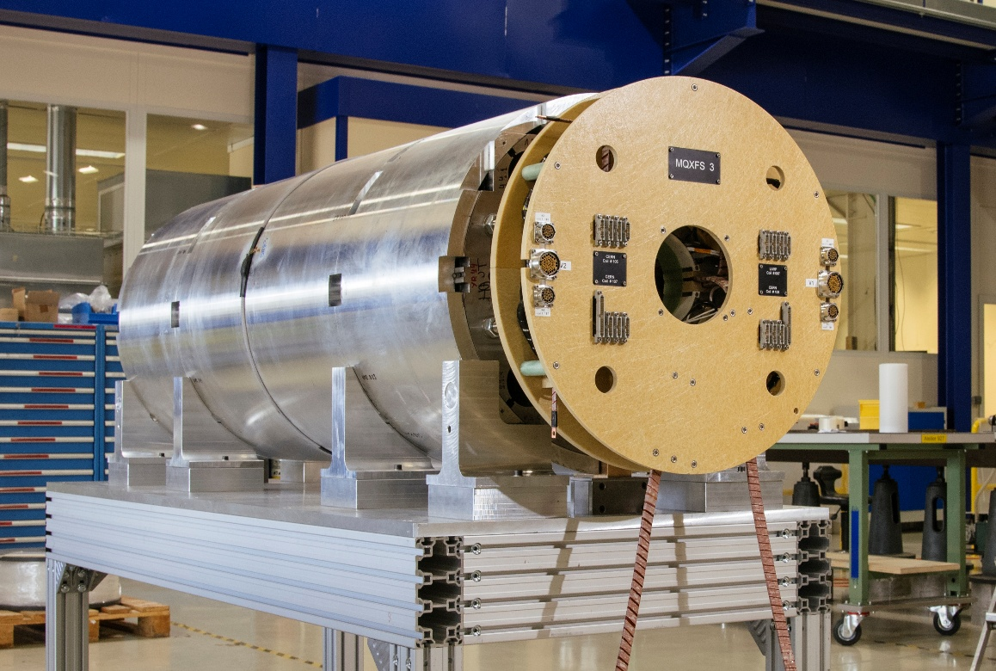
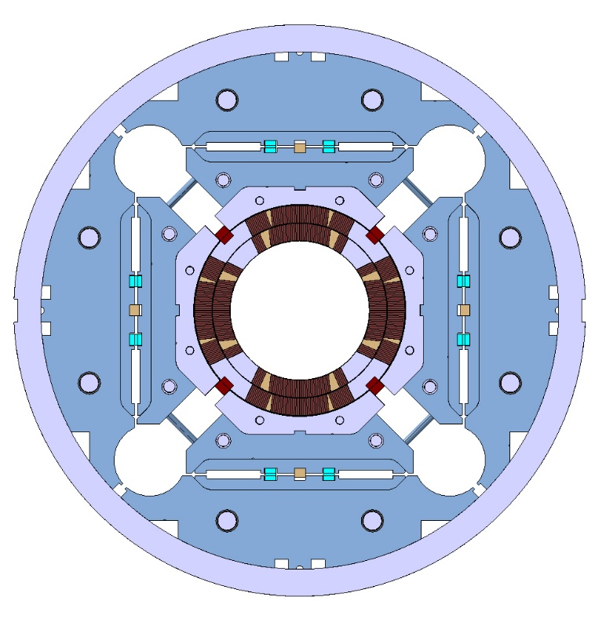


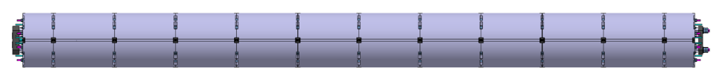
Quadrupole short model program (MQXFS)
Description of the scope
The quadrupole short model (MQXFS) is a 1.2 m long magnet with the same design as MQXFA/MQXFB, and very similar manufacturing and assembly procedure.
Initially, used for design and parameter validation
Then, used as a tool to validate new measures implemented in full length magnets
Now, used for technological studies
MQXFS
(1.2 m)
MQXFA
(4.2 m)
MQXFB
(7.2 m)
Main persons involved:
S. Izquierdo Bermudez, R. Diaz Vez, P. Ferracin, J. Ferradas, S. Ferradas Troitino, J. Feuvrier, L. Fiscarelli, M. Guinchard, F.J. Mangiarotti, J.C. Perez, P. Quassolo, E. Ravaioli, P. Rogacki, E. Todesco, G. Willering, M. Wozniak, 927 and SM18 teams

Slide 19
Quadrupole short model program (MQXFS)
Overview of MQXFS
Since the first tests of MQXFS1 at Fermilab in 2016:
7 magnets fabricated and tested
27 coils tested
4 different conductors
11 pre-load configurations
2 test stations commissioned at CERN
2 beam screens tested
4 protection systems tested
MQXFS1a
MQXFS7a
MQXFS8a
MQXFS1b
MQXFS7b
MQXFS1c
MQXFS7c
MQXFS3a
MQXFS3c
MQXFS6a
MQXFS7d
MQXFS3b
MQXFS4a
MQXFS6b
MQXFS7e
MQXFS7f
MQXFS7j
MQXFS5a
MQXFS4b
MQXFS6c
MQXFS4c
MQXFS6d
MQXFS7g
MQXFS7h
MQXFS8b
MQXFS4d
MQXFS7i
2016
2017
2018
2019
2020
2021
2022
2023
2024
2025
2026

Slide 20
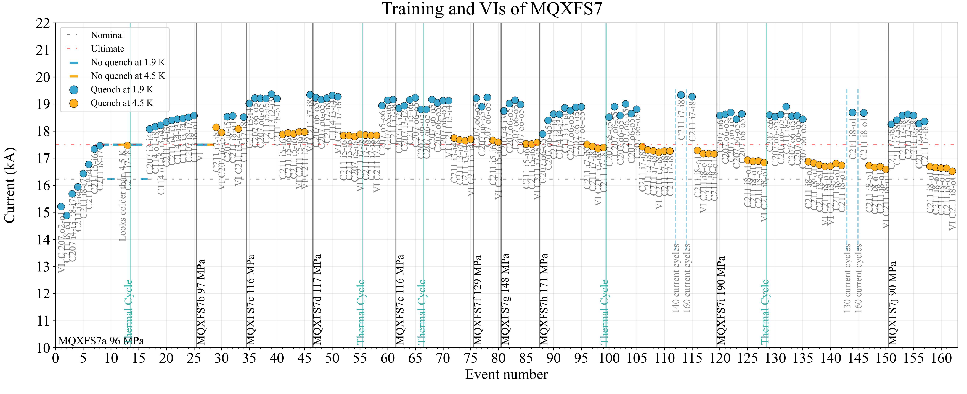
Quadrupole short model program (MQXFS)
MQXFS 7: 2 RRP coils and 2 PIT coils tested up to 190 MPa
Gradual increase of the loading interference key to assess the stress limit that induces a reduction of the magnet performance (∆σ_{θ} = 20 MPa/0.1mm)
  13.7 mm (S7) → 13.8 mm (S7c) → 13.9 mm (S7f) → 14.0 mm (S7g) → 14.1 mm (S7h) → 14.2 mm (S7i)
To verify if the change on performance is reversible or irreversible, last step with 13.8 mm (S7j)
Nominal preload
Gradual preload increase
Back to nominal
F. Mangiarotti et al., Performance of a HL-LHC Nb3Sn Quadrupole Magnet in the 100–200 MPa Range of Azimuthal Stress, IEEE Trans. Appl. Supercond. 35, 4000307 (2025)

Slide 21
Quadrupole short model program (MQXFS)
MQXFS 7: 2 RRP coils and 2 PIT coils tested up to 190 MPa
No quench in the RRP coils up to 190 MPa and up to 85% of I_{ss}.
The quench limitation was on the PIT coil with bundle barrier (98% and 84-88% of I_{ss} at 100 Mpa and 190 Mpa)
Quenches were in the inner pole turn area (HF region).
At high pre-stress levels (170-190 MPa), the performance of the magnet reduces after thermal cycles.
The induced degradation at 190 MPa is permanent.
Nominal preload
Gradual preload increase
Back to nominal
F. Mangiarotti et al., Performance of a HL-LHC Nb3Sn Quadrupole Magnet in the 100–200 MPa Range of Azimuthal Stress, IEEE Trans. Appl. Supercond. 35, 4000307 (2025)

Slide 22
Quadrupole short model program (MQXFS)
Coming next on MQXFS
Re-assembly of MQXFS4 to test the stress limit on 4 RRP Nb₃Sn coils
  Gradual increase of azimuthal pre-load
  Fast iteration using experience from MQXFS7
Iterations on MQXFS8, exploring toward lower axial pre-load and possibly azimuthal
  Investigate the role of axial pre-load and the inter-play between axial and azimuthal
  Test the robustness of the mini-swap heaters (baseline configuration for MQXFB)
Test of ESC protection system in a Cos Theta configuration with key & bladder structure
  Test to be carried on MQXFS 4 or 8 depending on planning

Slide 23
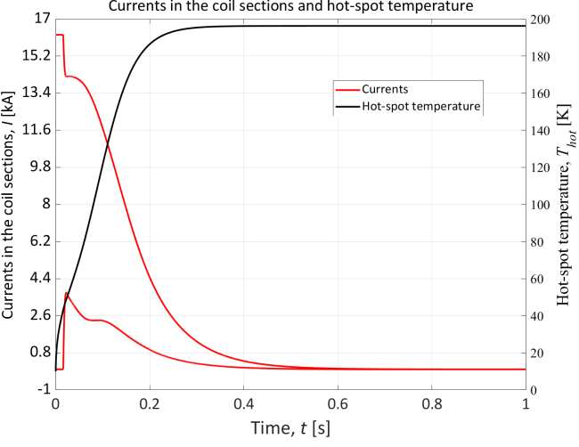
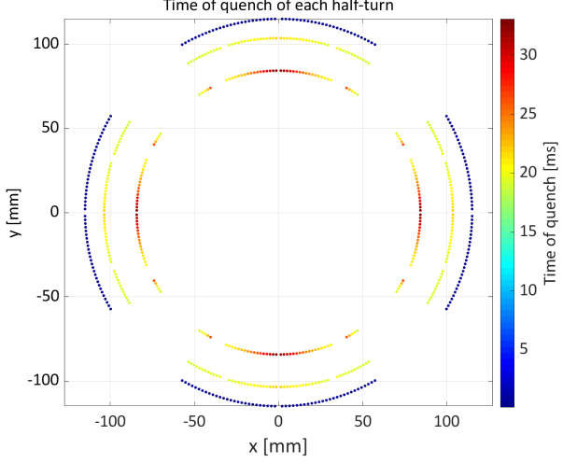
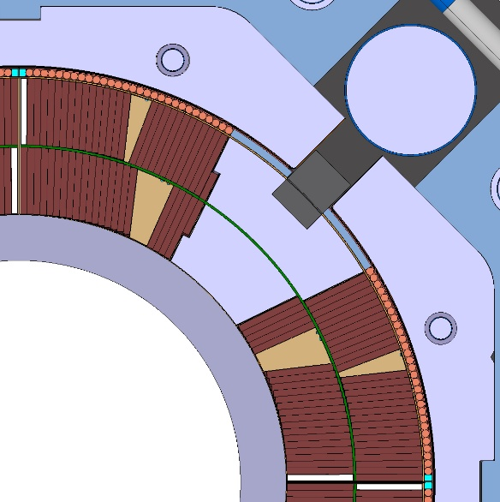
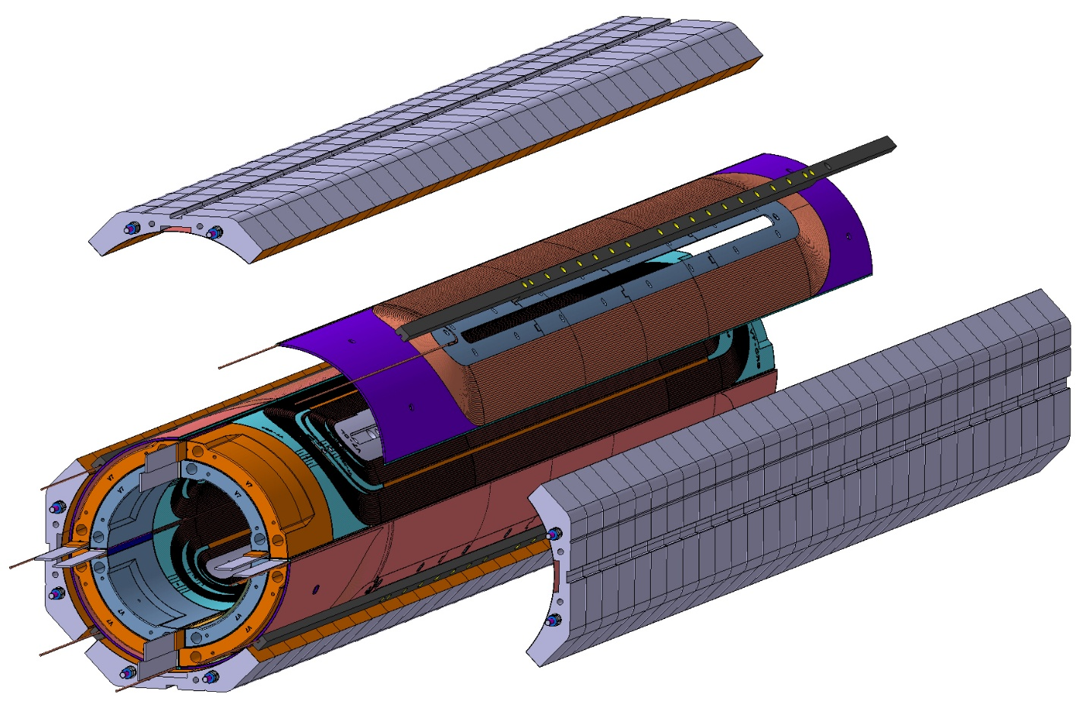
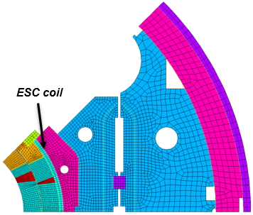
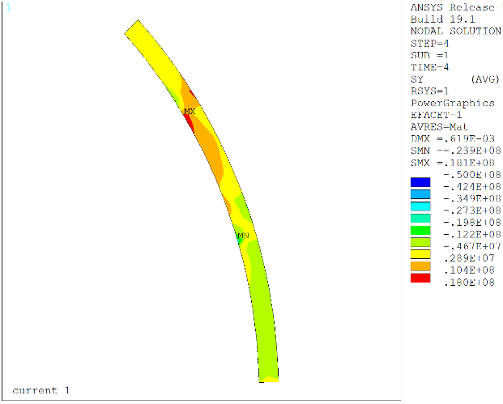
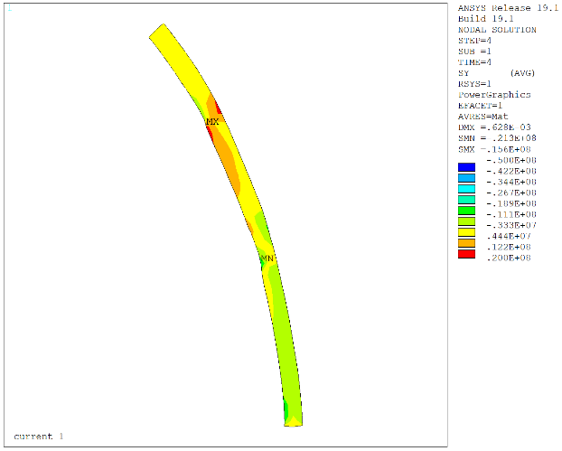
Quadrupole short model program (MQXFS)
Conceptual and engineering design of ESC coils in MQXFS
Transient simulations (Steam-Ledet) have shown that both MQXFS and MQXFB could be protected by 4 ESC coils using 29 turns of
2 mm diameter Cu wire.
ESC coils are wound and potted separately.
They are inserted between the SC coil and the collar. FEA has shown:
  minor disturbance during magnet loading
  no damage on the coil at quench
Planning
Wind the 1st coil in spring 2025
Assemble them in MQXFS8
Courtesy of E. Ravaioli
P. Quassolo, EDMS 3220427
ESC at nominal
ESC at quench
Courtesy of M. Bottollier Curtet

Slide 24
Conclusion
The Technological Development Program provides 2 platforms to test and to validate new technologies toward future high field magnets:
  Impregnation
  Electrical insulation
  Quench protection system
  Cooling
  Hybrid concepts
SMC is a short racetrack working in the 13T range with easy implementation of new features.
  2nd Gen.: 4 more magnets to be tested (E-CLIQ, Filled Wax, removable pole)
  3rd Gen.: 3 new coils and subsequent tests
  Nb₃Sn/ NbTi hybrid engineering design
MQXFS is accelerator magnet representative. It has a structure very well known with the series production of MQXFA/B.
  Performance under stress of RRP coils
  Test of ESC protection system

Slide 25
Conclusion
Planning for 2025
SMC 2G 109
SMC 2G 108
SMC 2G 110
SMC 3G 201
SMC 3G 202
SMC 3G 203
MQXFS8b
SMC 2G 106
SMC 2G 107c
MQXFS4f
MQXFS4g
MQXFS4h
MQXFS4i
MQXFS8c
Cold Test
Feb.
Mar.
Apr.
May
Jun.
Jul.
Aug.
Sept.
Oct.
Nov.
Dec.
Design &
Assembly
Winding 1st ESC coil for MQXFS
Assembling
MQXFS
with ESC
Conceptual design of SMC NbTi hybrid
Winding
1st SMC 3G
Winding
2nd SMC 3G
Engineering design of SMC NbTi hybrid
Winding
3rd SMC 3G
Assembling SMC with plane E-CLIQ

Slide 27
SMC racetrack magnets program
Overview of the results from SMC 11T 2nd Generation
Name | Impregnation | Comment | Status
SMC2G-101 | CTD-101K |  | Tested: 11.2022
SMC2G-102 | MY750 |  | Tested: 02.2023
SMC2G-103b | Mix61 (NHMFL) | Tomography | Tested: 07.2023
SMC2G-104 | MY740 (MSU) |  | Tested: 10.2023
SMC2G-105 | CTD-101K | Removable pole | Tested: 01.2024
SMC2G-106 | (to be selected) | Removable pole | Not built yet
SMC2G-107 | CTD-101K + DY040 (Polab) | CIEMAT training | Tested: 06.2024
SMC2G-107b | CTD-101K + DY040 (Polab) | ESC coils | Tested: 10.2024
SMC2G-107c | CTD-101K + DY040 (Polab) | E-CLIQ in plane | To be assembled
SMC2G-108 | CTD-101K + DY040 (Polab) | E-CLIQ & Mod. layer Jump | Tested: 02.2025
SMC2G-109 | CTD-101K + DY040 (Polab) | E-CLIQ & Mod. layer Jump | Ready: 12.2024
SMC2G-110 | Possibly filled wax (WP4.3) | New layer Jump | Wound: 02.2025

Slide 28
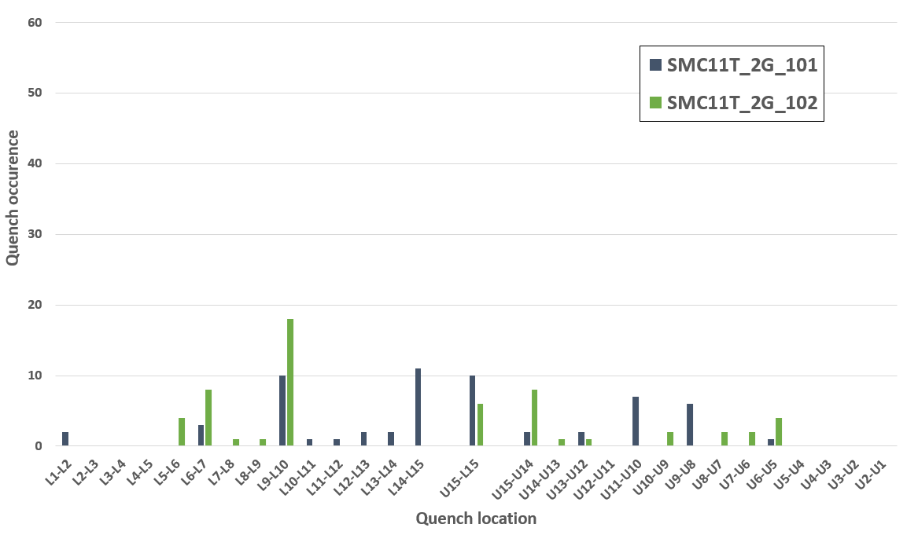
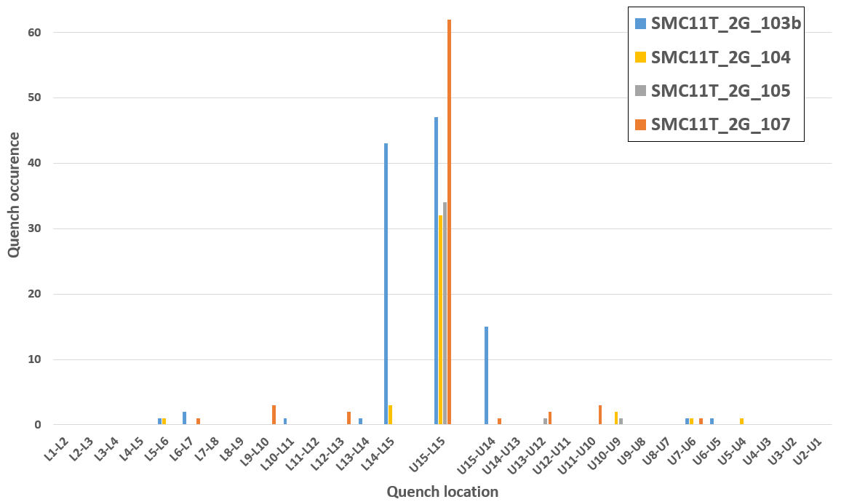
SMC racetrack magnets program
Overview of the results from SMC 11T 2nd Generation

Slide 29
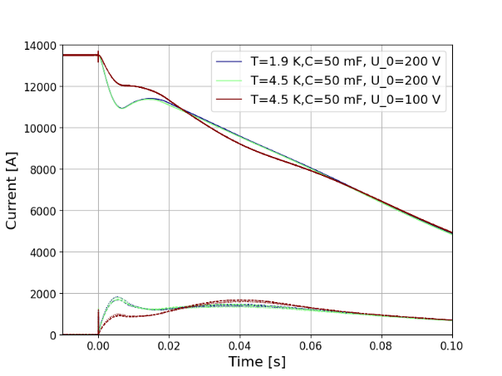



SMC racetrack magnets program
First demonstration of the Energy Shift with Coupling (ESC) in SMC

