Slide 2
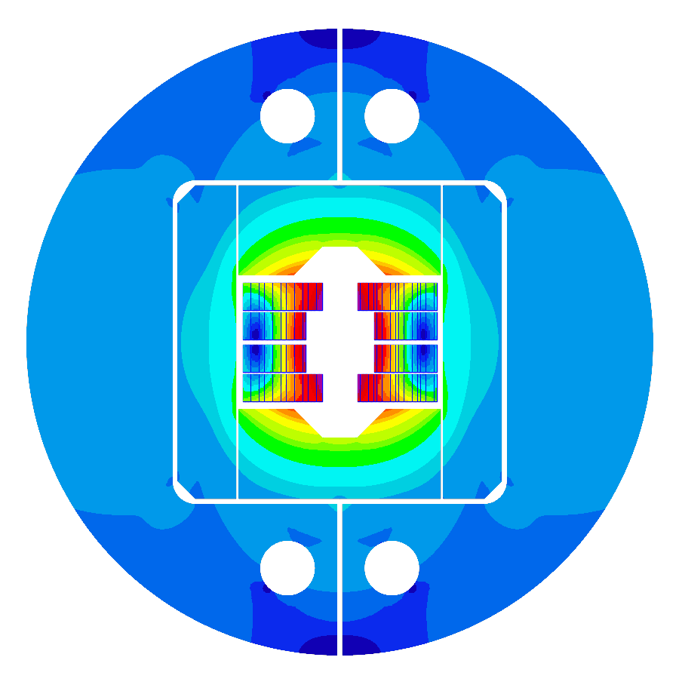
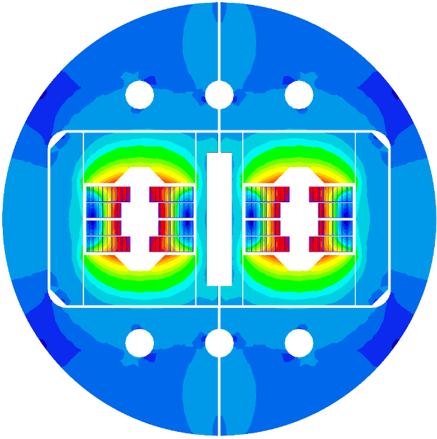
WP3.5
Nb₃Sn 14 T Block dipole BOND
HFM Annual Meeting 2025
J. C. Pérez, N. Bourcey, E. Fernandez, J. Ferradas, A. Haziot, N. Lusa, S. Izquierdo, N. Peray and E. Todesco
https://indico.cern.ch/event/1471305/

Slide 3
Table of contents
Scope of the Work Package 3.5
14 T BOND design
Overview on tooling & components design
Overview on manufacturing mock-ups
Cooling strategies
eRMC & RMM activities update
14 T BOND development plan & schedule
Summary

Slide 4
Table of contents
Scope of the Work Package 3.5
14 T BOND design
Overview on tooling & components design
Overview on manufacturing mock-ups
Cooling strategies
eRMC & RMM activities update
14 T BOND development plan & schedule
Summary

Slide 5
Scope of the Work Package
WP3.5: Nb₃Sn 14 T Block dipole BOND
Demonstrate Nb₃Sn performance in a 14 T block-type dipole at 1.9 K
Design and construction of a 14 T accelerator quality dipole model magnet
  The short model magnet should reach 15-15.5 T field
Explore alternatives and develop design and technology for Nb₃Sn accelerator dipoles

Slide 6
Table of contents
Scope of the Work Package 3.5
14 T BOND design
Overview on tooling & components design
Overview on manufacturing mock-ups
Cooling strategies
eRMC & RMM activities update
14 T BOND development plan & schedule
Summary

Slide 7
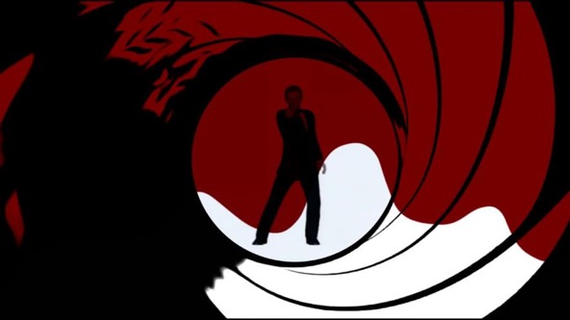
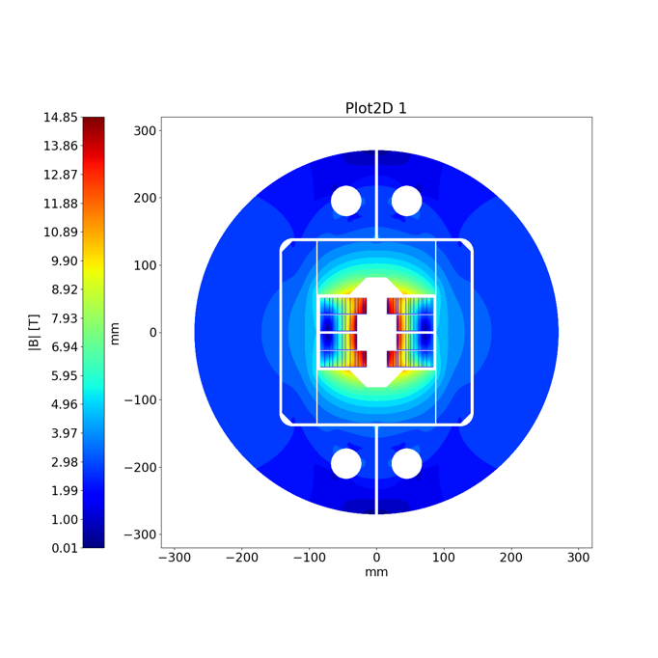
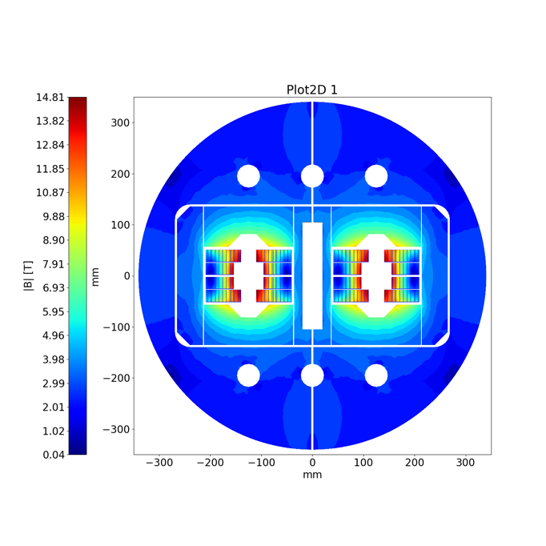
14 T Block dipole BOND
BOND
BOND stands for BlOck coil Nb₃Sn Dipole

Slide 8
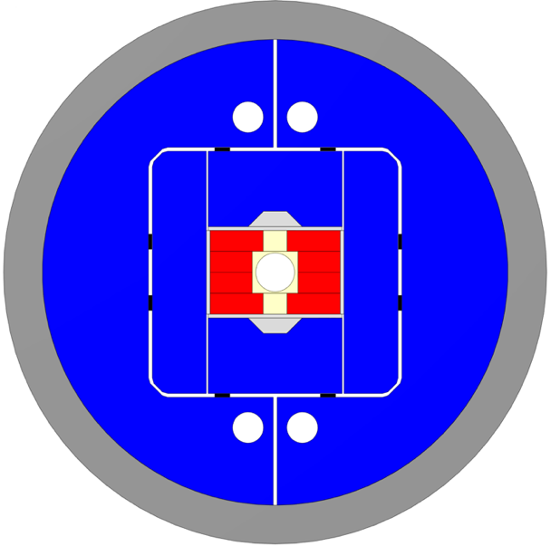
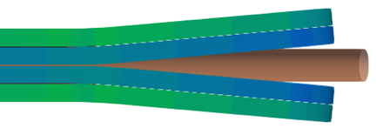
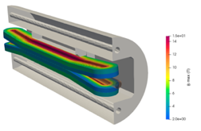
14 T Block dipole BOND
Design requirements:
14 T bore field with ≈ 20 % load line margin
(1.9 K using HFM specs).
Protection time margin*¹ > 40 ms.
Aperture = 50 mm.
Eq. coil width*² < 60 mm → “accelerator coil size”.
Field quality within 10 units at all current levels (excluding PC effects).
Magnet OD:
  Double aperture, inter-beam distance: 250 mm.
  Cold mass OD: 800 mm and Magnet OD: 760 mm.
  For the 1 in 1, we will scale down.
Coil
Vertical pad
Al shell
Horizontal pad
Key
Ti post
Iron yoke
Courtesy of A. Haziot, J. Ferradas & E. Fernandez

Slide 9

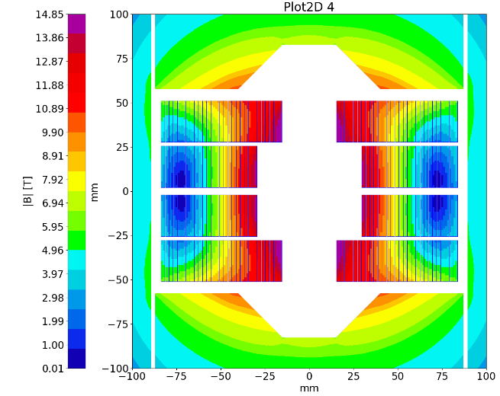
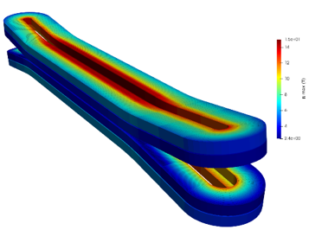
14 T Block dipole BOND
A first BOND conceptual design (2024) was investigated accounting for the use of a large cable made of 44 strands of 1.1 mm diameter. The cable would be the same as the Test Facility Dipole (TFD), manufactured at LBNL since the strand number exceeds the current capability of CERN’s Rutherford cabling machine.
In parallel, a second design based on a 40 strands cable (which can be manufactured at CERN) was also considered and initially kept as an alternative.
BOND – 40 strands cable
Courtesy of J. Fleiter & A. Bonasia
In December 2024, a decision was made to change the baseline for BOND design and proceed with the 40 strands (1.1 mm diam.) option, allowing for the internalization of the cable production.

Slide 10
40 strands cable design

Slide 11
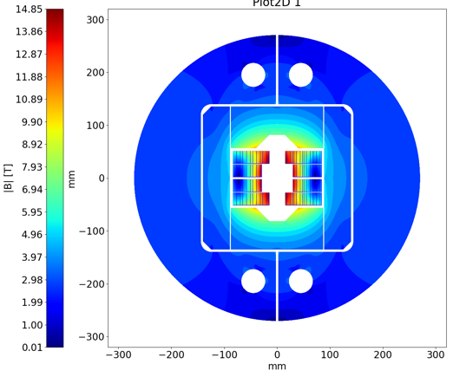
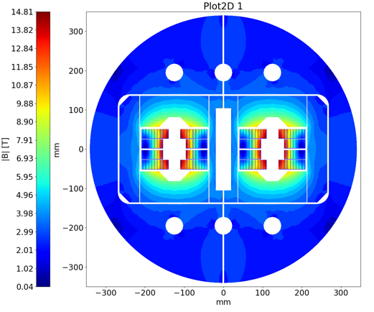
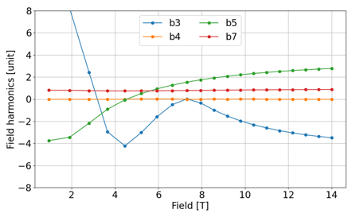
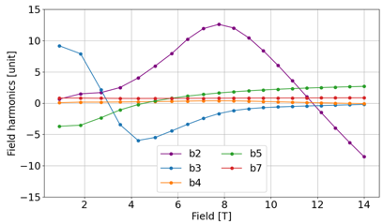
BOND Design Parameters
The 2D & 3D electromagnetic design for the single aperture configuration was completed in January 2025.
Magnet |  | Single | Double
Aperture | [mm] | 50 | 50
Intra-beam distance | [mm] | - | 250
Yoke diameter | [mm] | 540 | 680
Shell diameter | [mm] | 640 | 780
Nominal current | [kA] | 20.005 | 19.340
J overall | [A/mm2] | 360 | 348
J strand (eng.) | [A/mm2] | 526 | 509
Nominal field | [T] | 14.00 | 14.00
Peak field | [T] | 14.85 | 14.81
Ap. to peak field ratio | [%] | 6.0 | 5.7
Load line fraction @1.9 K | [%] | 82.7 | 81.7
Load line fraction @4.2 K | [%] | 92.6 | 91.2
Temperature margin | [K] | 3.99 | 4.11
Inductance | [mH/m] | 4.72 | 10.24
Stored energy | [MJ/m] | 1.031 | 2.064
Coil |  | Single | Double
No. of turns per pole |  | 52
Insulated cable surface | [mm²] | 11572
Equivalent coil width | [mm] | 53.4
Coil efficiency *¹ | [T.mm/A] | 0.00073 | 0.00075
Courtesy of A. Haziot

Slide 12
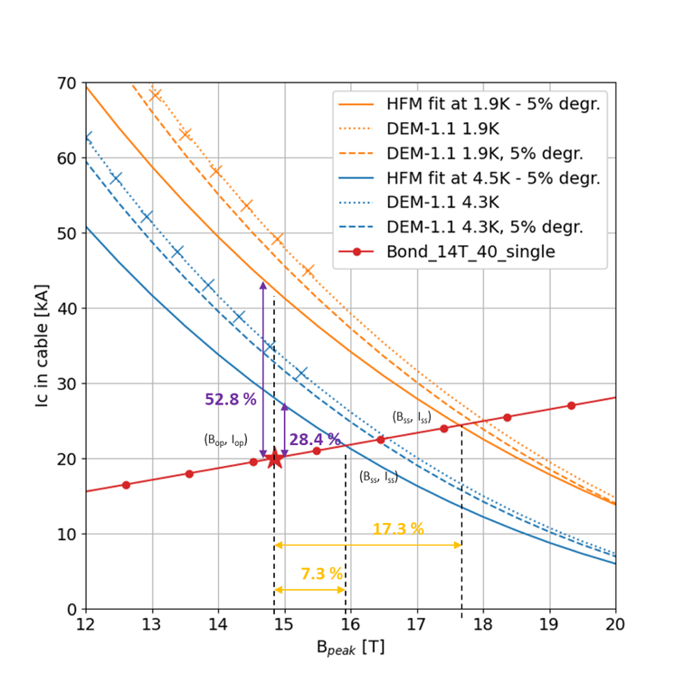
BOND Loadline
Loadline and critical surface margins for single aperture design

Slide 13
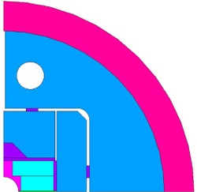
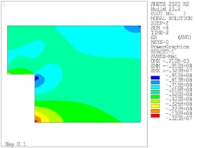
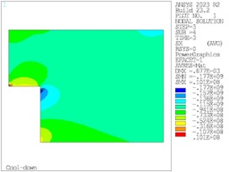
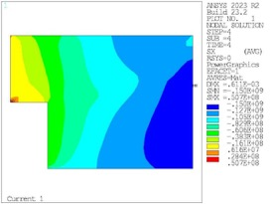
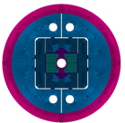
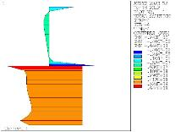
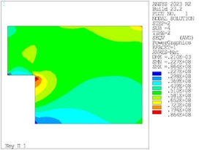
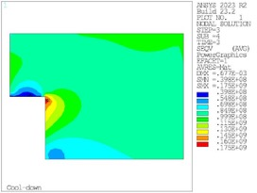
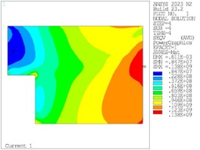
BOND Mechanical Design
Peak at RT = 91 MPa
Peak at CD = 177 MPa
Peak at 14 T = 150 MPa
X-component of stress (MPa) during assembly (left), cool down (centre), and at 14 T (right).
Coil to pole contact pressure at 14 T
Peak at RT = 86 MPa
Peak at CD = 175 MPa
Peak at 14 T = 140 MPa
Von Mises stresses (MPa) during assembly (left), cool down (centre), and at 14 T (right).
Magnet structure designed with enough margin to operate at 15.5 T.
Courtesy of J. Ferradas

Slide 14
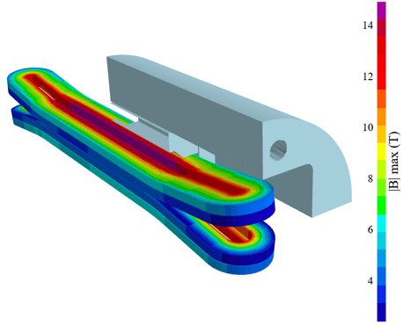
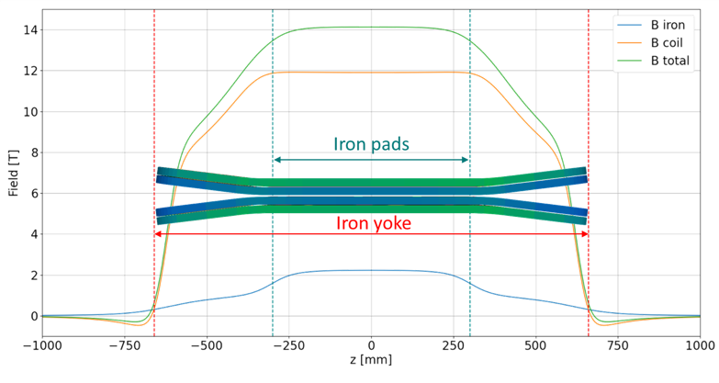
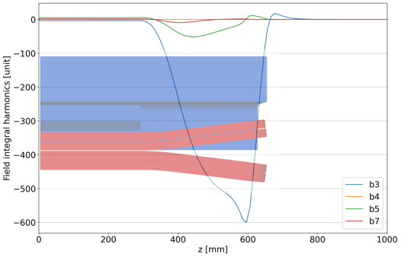
BOND Coils Configuration and Field Profile
Flared end curvature radius | mm | 750
Flared end angle | º | 7
Flared end straight section | mm | 178.4

Slide 15
Table of contents
Scope of the Work Package 3.5
14 T BOND design
Overview on tooling & components design
Overview on manufacturing mock-ups
Cooling strategies
eRMC & RMM activities update
14 T BOND development plan & schedule
Summary

Slide 16
Tooling & components design
Coil components and coil fabrication tooling design is well on track.
The 3D design will be completed by end of April.
First tooling delivered is expected by late summer 2025.
Impregnation
Winding
Reaction
* Technical discussions organized in “Sharing experience on Nb₃Sn Magnet & Tooling engineering WG”
Courtesy of N. Peray

Slide 17
Table of contents
Scope of the Work Package 3.5
14 T BOND design
Overview on tooling & components design
Overview on manufacturing mock-ups
Cooling strategies
eRMC & RMM activities update
14 T BOND development plan & schedule
Summary

Slide 18
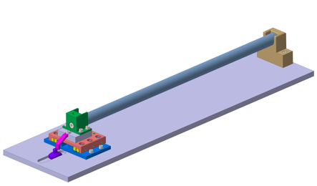
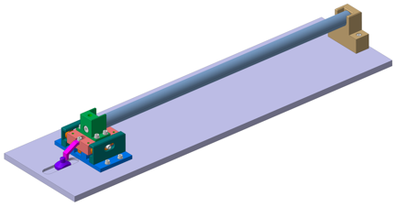
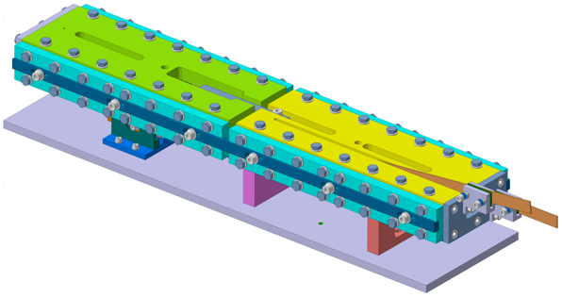
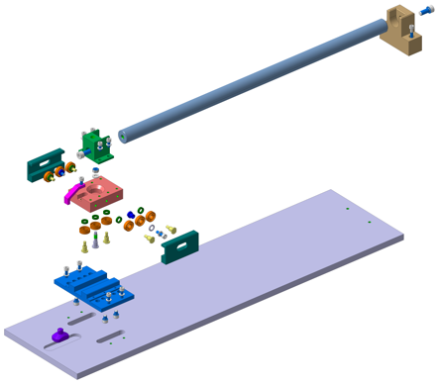
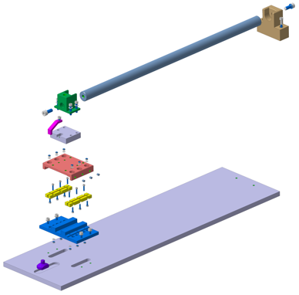
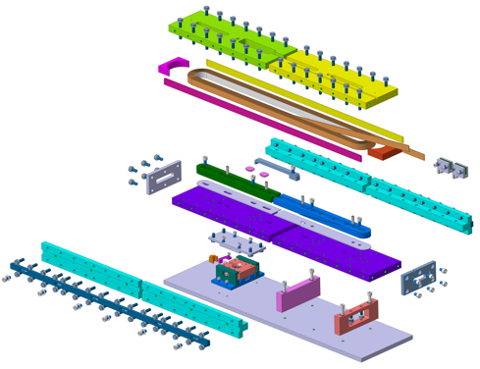
Mock-up design of sliding reaction tooling
Thanks to the experience gained during the construction of the Race-tracks, FRESCA2 and MQXF magnets, BOND tooling designed to compensate for dimensional variations during heat treatments is currently in the design phase.
Racetrack coil mock-up with integrated sliding system
Linear ceramic bearing
Circular ceramic bearing
The basic concepts will be validated using simplified mock-ups that replicate conditions close as possible to those that will be used during coil manufacturing.
Courtesy of N. Lusa, J. Ferradas & B. Pellet

Slide 19
Table of contents
Scope of the Work Package 3.5
14 T BOND design
Overview on tooling & components design
Overview on manufacturing mock-ups
Cooling strategies
eRMC & RMM activities update
14 T BOND development plan & schedule
Summary

Slide 20
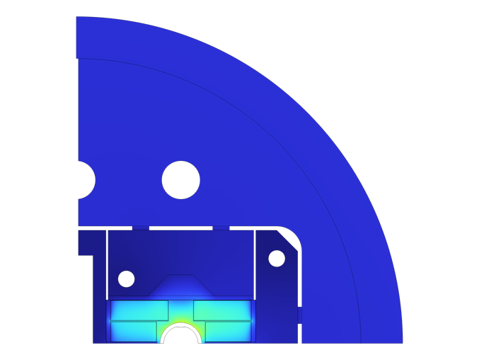
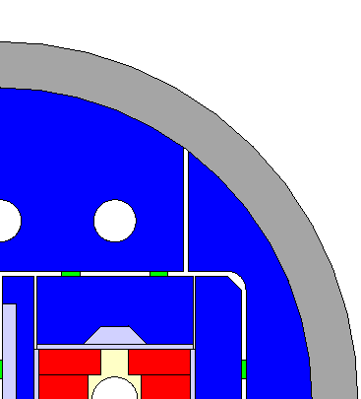
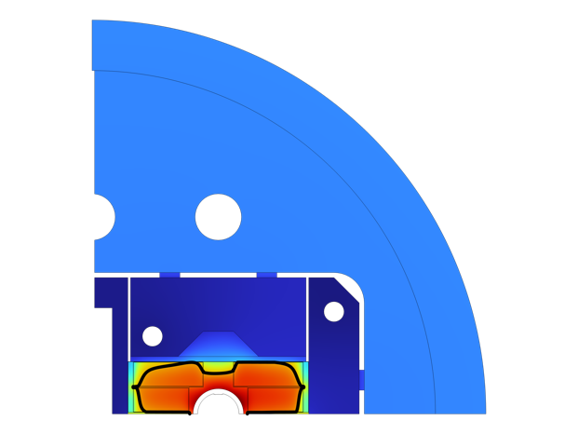
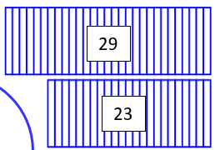


Cooling strategies
Heat loads: static + dynamic + magnetization
BOND cross-section thermal modelling started
Studies based on latest BOND coil configuration using 40 strands cable
Helium thermal contact (He at 4.5 K)
$$T_{max} =4.83 K$$
$$T_{max} =5.13 K$$
Interlayer: 2 mm
Cu: 1 mm
PRELIMINARY!
Midplane: 3 mm
Cu: 1.425 mm
See Patricia’s presentation on
“Progress on cryogenic studies at CERN”
Courtesy of P. Borges de Sousa & X. Gallud

Slide 21
Table of contents
Scope of the Work Package 3.5
14 T BOND design
Overview on tooling & components design
Overview on manufacturing mock-ups
Cooling strategies
eRMC & RMM activities update
14 T BOND development plan & schedule
Summary

Slide 22
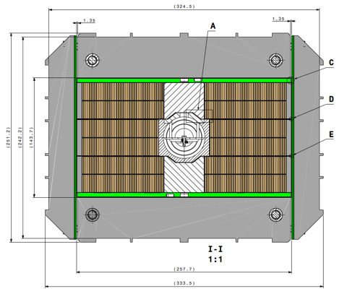
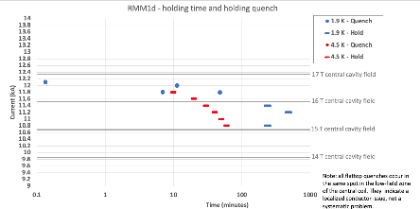
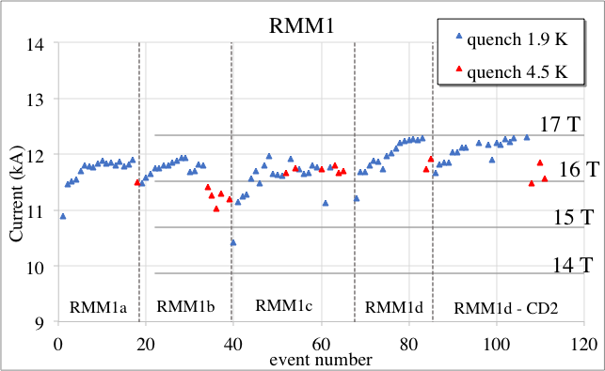
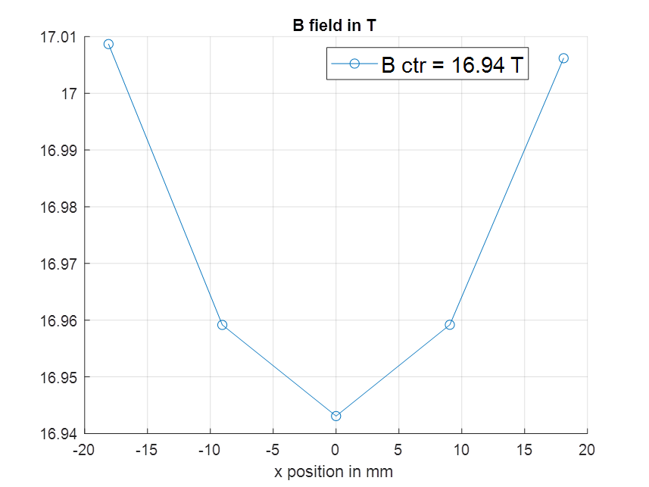
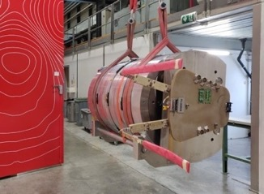
RMM activities
RMM is a Racetrack Model Magnet, with a 50 mm closed cavity made of 2 eRMC coils & 1 RMM coil in the middle.
The objective is to explore high field straight section region of a 16+ T dipole, focusing on mechanical aspects.
4 RMM assemblies have already successfully been tested.
The last magnet reached 16.94 T corresponding to 90% of Iss in the 50 mm diameter and 431 mm long closed cavity.
The magnet was powered during 4 h at 15.75 T without quenching.
RMM1d reached 16.5T central cavity field at 4.5 K corresponding to 98% of Iss
(HFMMHRMM0080)
RMM1d has been assembled with increased preload w.r.t. RMM1c and tested in September 2024.
RMM1a | I (kA) | Bp (T) | Bo (T)
Short Sample @4.3 K | 12.26 | 17.07 | 16.85
Short Sample @1.9 K | 13.64 | 18.77 | 18.51
Courtesy of G. Willering

Slide 23
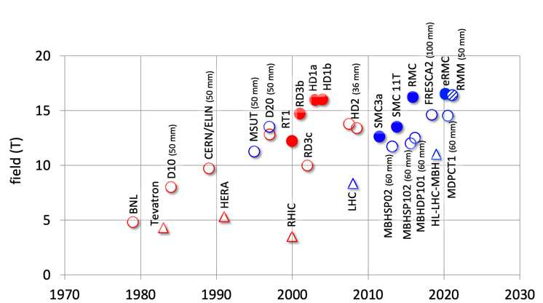
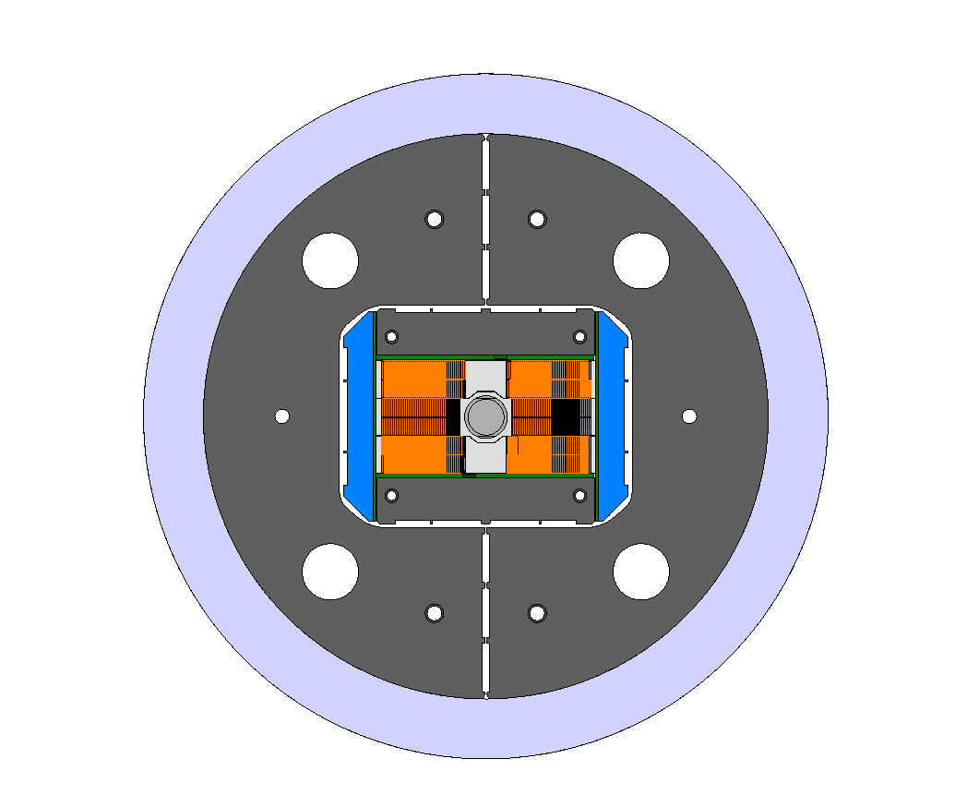
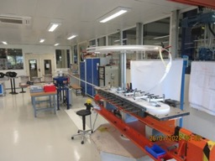
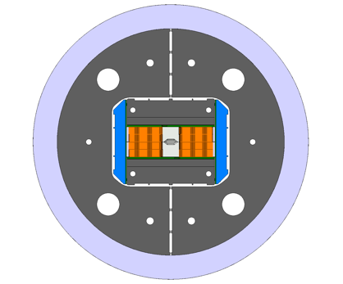
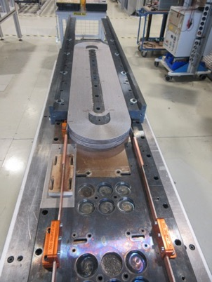
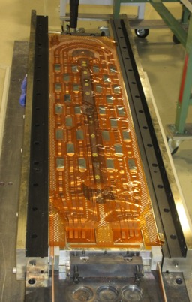
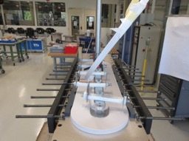
eRMC/RMM
The production of 3 eRMC coils has been completed to prove the repeatability of the results obtained with the first set of coils
  eRMC coil #104
  eRMC coil #105
  eRMC coil #106
The assembly of RMM2 is scheduled Q3-2025.
eRMC
(enhanced Racetrack Model Coil)
RMM
(Racetrack Model Magnet)

Slide 24
Table of contents
Scope of the Work Package 3.5
14 T BOND design
Overview on tooling & components design
Overview on manufacturing mock-ups
Cooling strategies
eRMC & RMM activities update
14 T BOND development plan & schedule
Summary

Slide 25
BOND Magnet development plan
Analysis
Iterative engineering design
First Single Aperture Magnet #1 assembly
Trial Copper Coil
Powering tests Magnet #2
1st Nb₃Sn Coil Winding
Double Aperture Magnet #1 assembly
Q1_2025
Q2_2025
Q3_2025
Q4_2025
Q1_2026
Q2_2026
Q3_2026
Q4_2026
Double Aperture Magnet Magnet #1 powering tests
Today
Insulated Nb₃Sn Cable delivery
Single Aperture Magnet #2 assembly
First dummy copper cable at CERN
Coil 3D CAD Design
3D CAD Winding, reaction & splicing tooling
Cold Powering Tests Magnet #1

Slide 26
Table of contents
Scope of the Work Package 3.5
14 T BOND design
Overview on tooling & components design
Overview on manufacturing mock-ups
Cooling strategies
eRMC & RMM activities update
14 T BOND development plan & schedule
Summary

Slide 27
Summary
The electromagnetic and mechanical 3D design of BOND single aperture magnet is well advanced
The 3D design of the double aperture is progressing in parallel
The CAD design of components and tooling is underway, and the first components are expected in Q2-2025
The chosen design incorporates lessons learned from the construction of magnets previously tested and validated
The design, using two coils capable of producing 14 T, simplifies construction and reduces costs associated with tooling and the amount of cable used
The reproducibility of the results obtained during the various assemblies carried out with the RMM magnet proves that the Nb₃Sn conductor technology allows for consistently achieving fields close to 17 T without any apparent signs of conductor degradation
RMM has also demonstrated the ability to be powered for four hours at a stable regime while producing a field of 15.75 T in its 50 mm cavity
The winding operation of BOND coils is scheduled to start during Q3-2025 and the first powering tests of a single aperture magnet are foreseen by early 2026
The assembly of the first double aperture configuration is foreseen in Q4_2026

Slide 28
Thank you for your attention

Slide 29
Glossary
*1 Defined as the time available to react and to quench all the coil before the magnet reaches Tmax
E. Todesco, “Quench limits in the next generation of magnets,” in Proc.Workshop Accel. Magn. Supercond. Des. Optim.
*2 Width of a 60° sector coil whose area is the same of the area of the layout that we are considering.
E.Todesco, ”Masterclass - Design of superconducting magnets for parti-cle accelerators. Chapter 4,” Available at https://indico.cern.ch/category/12408/.
*3 Coil efficiency: Ratio between the field and the current times the coil width, given in [T.mm/A].
E.Todesco, ”Masterclass - Design of superconducting magnets for parti-cle accelerators. Chapter 4,” Available at https://indico.cern.ch/category/12408/.

Slide 30
Backup slides

Slide 31
44 strands cable design

Slide 32
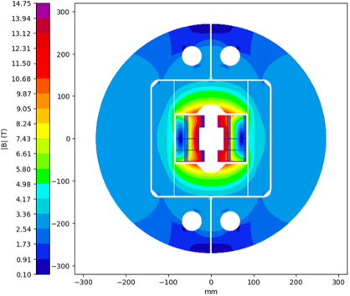



14 T Block dipole BOND – 44 strands cable
The 2D & 3D electromagnetic design for the single aperture configuration was completed in 2024.
Magnet |  | Single | Double
Aperture | [mm] | 50 | 50
Intra-beam distance | [mm] | - | 250
Yoke diameter | [mm] | 540 | 680
Shell diameter | [mm] | 640 | 780
Nominal current | [kA] | 20.255 | 19.590
J overall | [A/mm2] | 331 | 320
J strand (eng.) | [A/mm2] | 484 | 468
Nominal field | [T] | 14.00 | 14.00
Peak field | [T] | 14.75 | 14.53
Ap. to peak field ratio | [%] | 5.4 | 3.8
Load line fraction @1.9 K | [%] | 80.1 | 79.7
Load line fraction @4.2 K | [%] | 89.8 | 89.4
Temperature margin | [K] | 4.13 | 4.25
Inductance | [mH/m] | 4.60 | 10.00
Stored energy | [MJ/m] | 1.030 | 2.064
Coil |  | Single | Double
No. of turns per pole |  | 52
Insulated cable surface | [mm²] | 12746
Equivalent coil width | [mm] | 56.9
Coil efficiency *¹ | [T.mm/A] | 0.00074 | 0.00077

Slide 33


14 T Block dipole BOND – 44 strands cable
Flared end curvature radius | mm | 750
Flared end angle | º | 5
Flared end straight section | mm | 250

Slide 34
44 vs 40 strands cable designs

Slide 35


14 T Block dipole BOND
BOND – 44 strands cable
The new 40 strand baseline allows for:
  Save in coil area of 9.2 %.
  Save in conductor volume of 20 % (shorter coil with the new flared end design).
  Increased midplane distance between coils (4 mm between insulated conductors) - potentially opening the possibility for improved cooling, see next slides.
  Internalization of the cable production at CERN.
At the expense of :
  9 % larger J_{overall}
  Decrease of loadline margin by 2.6 % in the single aperture and 2 % in the double aperture.
  Increased peak stresses in the homogenized coil block by 15 MPa
BOND – 40 strands cable

Slide 36







Winding tests at CERN
44 strands x 1.1 mm
Initial tests performed
Final tests
  Easy-way bending tests
  Experimental validation and consolidation of the new baseline
  Additional winding test to explore the impact of the winding tension.
    R_{easy-way} = 12 mm
    R_{easy-way} = 13 mm
    R_{easy-way} = 14.8 mm
    For our baseline cable architecture (44 strands x 1.1 mm), all tests were successfully completed.
  Combined easy-way and hard-way bending tests → Focus on 44 strands x 1.1 mm
    R_{easy-way} = 13 mm & R_{hard-way} from 275 to 450 mm
      Strand instabilities and pop-outs identified.
    R_{easy-way} = 15 mm & R_{hard-way} 350 and 450 mm
      For 450 mm → feasible. In general, cable stable.
      No pop-outs identified.
    Decision made to take a safety margin and to align with previous experience (FRESCA2) → increase the R_{hard-way} to 750 mm (small impact in coil length, ~52 mm)
Courtesy of D. Pulikowski, PhD. Thesis
[https://cds.cern.ch/record/2641140/files/CERN-THESIS-2018-181.pdf]
    New design baseline: R_{easy-way} = 15 mm & R_{hard-way} = 750 mm
Courtesy of E. Fernandez Mora

