Slide 2



FALCON-D CERN – INFN
12T (cos θ) dipole status
HFM RD3 WP3.1, WP3.2
CERN, February 10-11st, 2025
CERN - Arnaud Foussat, Nicola Sala, Sachin Gowrishankar, Carlos Fernandes, Ariel Haziot, Elena Fernandez Mora, Juan Carlos Perez, Thierry Boutboul, Matthias Bonora, Oussama Id’ Bahmane, Luca Gentini, Oscar Sacristan De Frutos, Nikolina Vejnovic, Ezio Todesco
INFN - Stefania Farinon, Massimo Sorbi, Andrea Bersani, Barbara Caiffi, Andrea Gagno, Alessandra Pampaloni, Riccardo Valente

Slide 3
Outline
FALCON-D scope update, motivations
Cable and winding challenges, trials & outcomes
WP3.1 CERN magnet development status.
WP3.2 INFN magnet development status.
2025-2027 Schedule
Summary
Notes:
As an outline, I will start with a brief introduction of the context of this work and give an update of the Wp3.1 technical scope related to the development of Cos theta 12T dipole . Then I will summarize the related achievements, agreements within the INFN – CERN collaboration with the updated deliverables of WP3.1. In the end I will present the deliverables and development plan focusing over 2024 2026 and summarise.

Slide 4
Outline
FALCON-D scope, update, motivations
Cable and winding challenges, trials & outcomes
WP3.1 CERN magnet development status
WP3.2 INFN magnet development status
2025-2027 Schedule
Summary

Slide 5
Scope, motivations
HFM program entrusted CERN WP3.1 & INFN WP3.2 to develop 12 T Nb₃Sn Cos-theta dipole models (< 2m) by 2028. (indico/1430998/)
Strategic cos ϴ dipoles accelerator technology in 10-13T range with optimised minimal superconductor amount versus shape factor γ ( J. v. Nugteren IEEE TAS 28 (2017) 4000205,)
Re-alignment since mid 2024 of Falcon D coils design between CERN (WP3.1) with INFN (WP3.2) one using FalconD cable: gain in I_{SS} margin, enhanced technical development synergy;
Focus on key winding findings at CERN and ASG for INFN using Falcon cable and the baseline design impacts;
Develop integrated design for manufacturability features from lessons learnt from HL and fit-to-purpose Nb₃Sn cos θ coil tooling production
Based on past and recent HL magnet’s ROE, to keep design in view of long magnet production.
Notes:
Shape factor as relation between useful field and both operating current density, size of the winding.
Watchword of design choice as function of long magnet assembly production

Slide 6
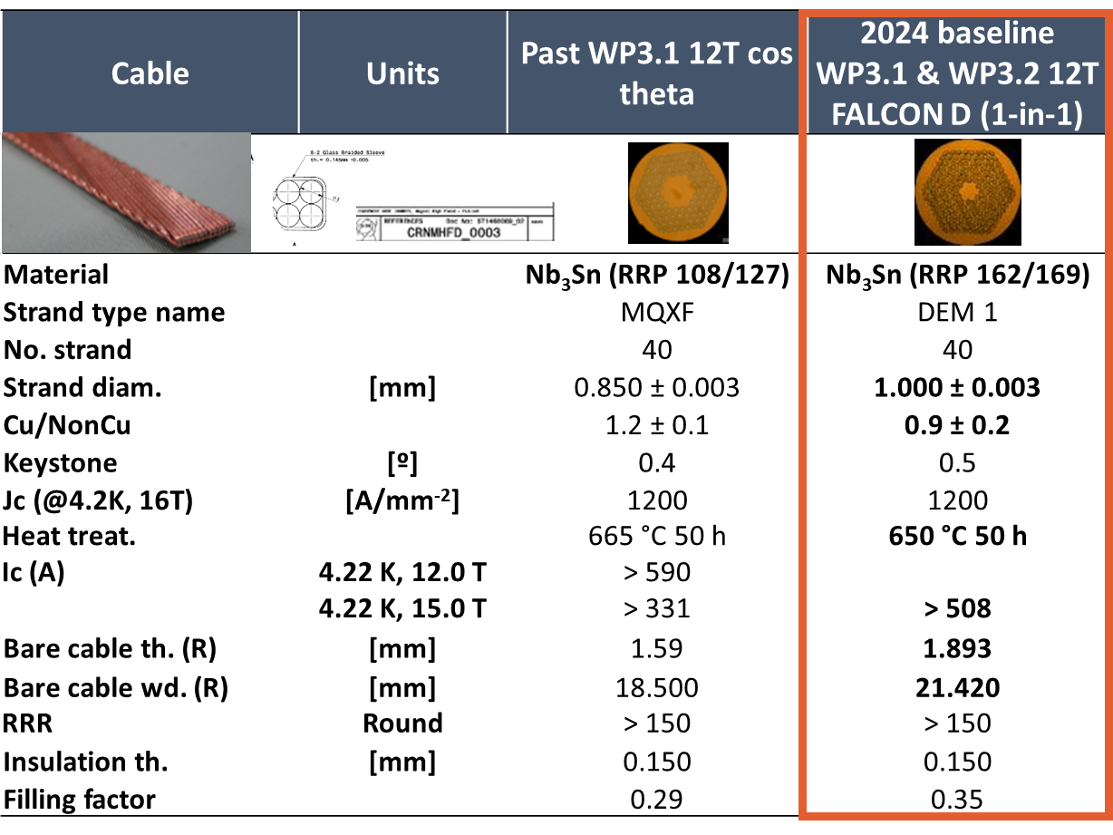
Nb₃Sn RRP wire for FALCON D dipole
Reference S Hopkins et al. : doi: 10.1109/TASC.2023.3254497
Past QXF cable with 40 x 0.85 mm strands allowed 17% Iss margin @ 1.9K
Falcon D cable baseline, 40 x 1.0 mm strands allows 25% Iss @ 1.9K
Notes:
New strand 162/160 with 1 m diameter and 0.9 cu ncu ratio offering a design at 76 %ISS

Slide 7
Cos-ϴ dipole development plan
CERN-MSC and INFN-Ge, LASA proposed from 2024 the synergetic plan below towards a twin-aperture 12 T, 1.5 m long Nb₃Sn dipole design by 2028.
Date | Description | Length | Scope | Goals | Institute
Q2-2025 Q3 2026 | 1 mechanical Mock-up 1-in-1 demonstrator Magnet | < 0.5 m 1.5 m | INFN B&K magnet model | Novel dipole b&k 45deg quadrant structure design validation | INFN WP3.2
Q3-Q4 2025 | Mechanical mock ups LMK1/2 | < 0.5 m | CERN B&K & collars coils section mock up assembly ( use 11T coils) | Benchmarked concepts of mechanical cross section structures at RT and cold. Measurement of residual stress | CERN WP3.1
Q3- 2026 Q4 - 2027 | Two 1-in-1 demonstrator magnets M1, M2 | 1.5 m | CERN B&K magnet models | M1: Novel dipole b&k structure design validation M2 Optimization of b&k structure design. ESC coil protection test Reproducibility Structure pro’s & con’s assessment | CERN WP3.1
Q2-2028 | 2-in-1 demonstrator magnet M3 | 1.5 m | CERN B&K 2-in-1 magnet assembly | New 2-in-1 structure, Field optimization, fabrication process, scale-up design inputs for 14T design | CERN WP3.1
Notes:
Series of mock up both at CERN and INFN during 2025 to validate concepts of structure

Slide 8
Outline
FALCON-D scope, update, motivations
Cable and winding challenges, trials & outcomes
WP3.1 CERN magnet development status
WP3.2 INFN magnet development status
2025-2027 Schedule
Summary

Slide 9
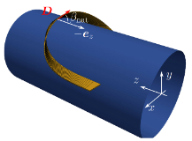
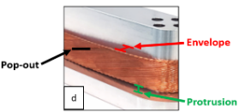
Cable and winding challenges & outcomes
CERN performed in Q4-2024 winding trials to experience final SC Falcon D cable behavior in heads on 50 mm OD mandrel.
  (i) to wind a complete inner layer with dummy large Falcon cable (multiple turns, stacking behavior on last INFN end spacers)
  (ii) Check SC cable natural inclination β angle (fig1)
  in critical midplane block [ψ: 0-180deg] in free, then clamped state
  Findings :
    CERN observed all defects categories (fig.2) and issue with hard way bending in natural inclination.
    Only off-standard extended head geometry allows lay fitting of mid-plane block through high hard bending
      Quantified strain energy density enhancement factor ( see Appendix) in Roxie in both extreme cases: torsion τ : x 5 or hard way bending κg : x 8
(fig.1)
(fig.2)

Slide 10
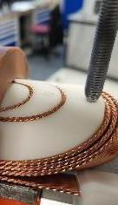
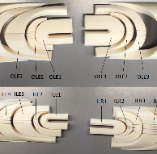
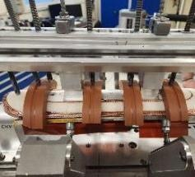
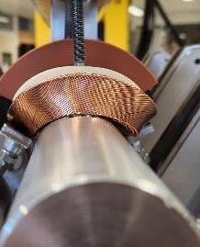
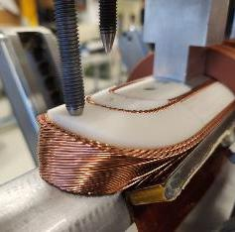
(i) Winding trials on inner layer coil
Inner coil layer winding trials on 50 mm OD in 2024 using copper dummy 40 strands, 21 mm-wide cable with ss core
Large protrusion gaps ( > 4 mm), pop outs instabilities.
Blocks deformation during winding from IL3,
Large dummy cable stiffness observed and low stability
Notes:
Pictures of layer winding illustrate the protrusion gap, the pop outs instability

Slide 11
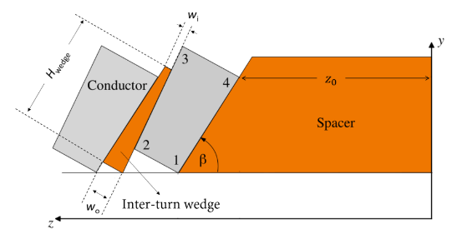
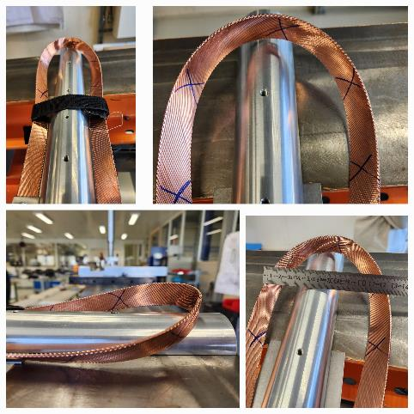
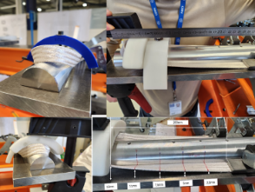
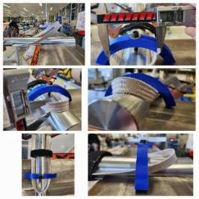
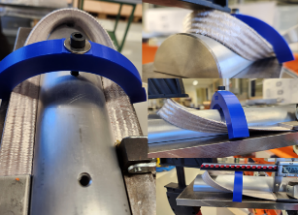




(ii) Single turn natural inclination
ID | Cable | AP OD | F =B/A | Z0 (mm) | β (deg) | Note
⓪ | Cu Falcon D bare | 50 | 3 | 160 | - | No possible natural shape, unstable, collapse
① | SC Falcon D bare | 50 | 3 | 160 | 65 | Natural inclination ok but clamping not possible unless collapse
② | SC Falcon D insulated | 50 | 9 | 270 | 60 | Possible clamped fit only with large hard bending force. Risk of deformation, block winding, curing, strand damage
③ | SC Falcon D insulated | 56 | 3.5 | 160 | 65 | Clamped fit by hand, low hardway bend ( per roxie parameters), good fit
④ | SC QXF insulated | 50 | 1.8 | 160 | 65 | Clamped fit by hand, low hardway bend ( per roxie parameters), good fit
①
②
③
④

Slide 12
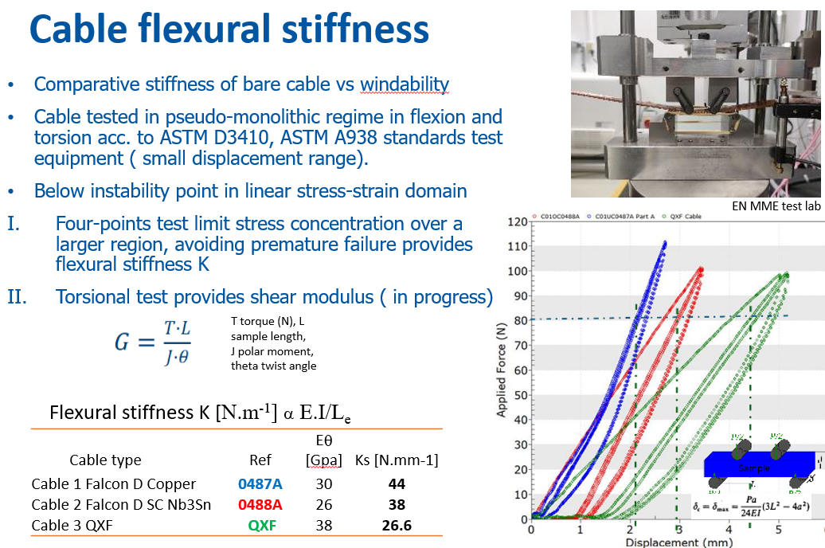
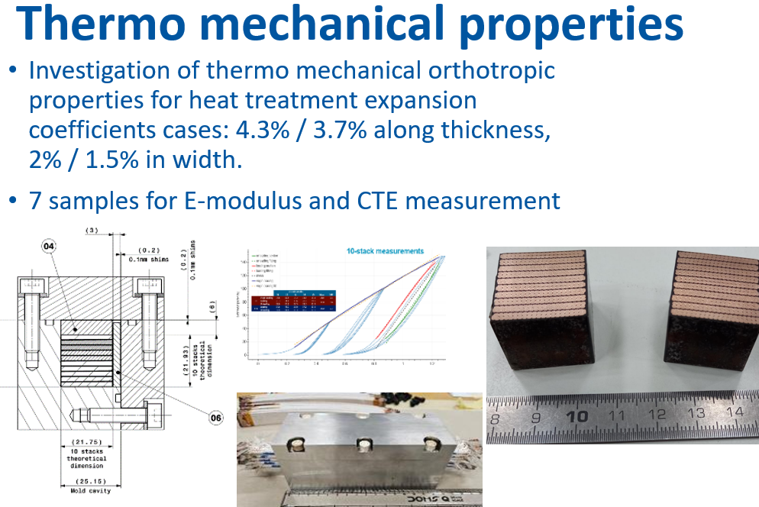
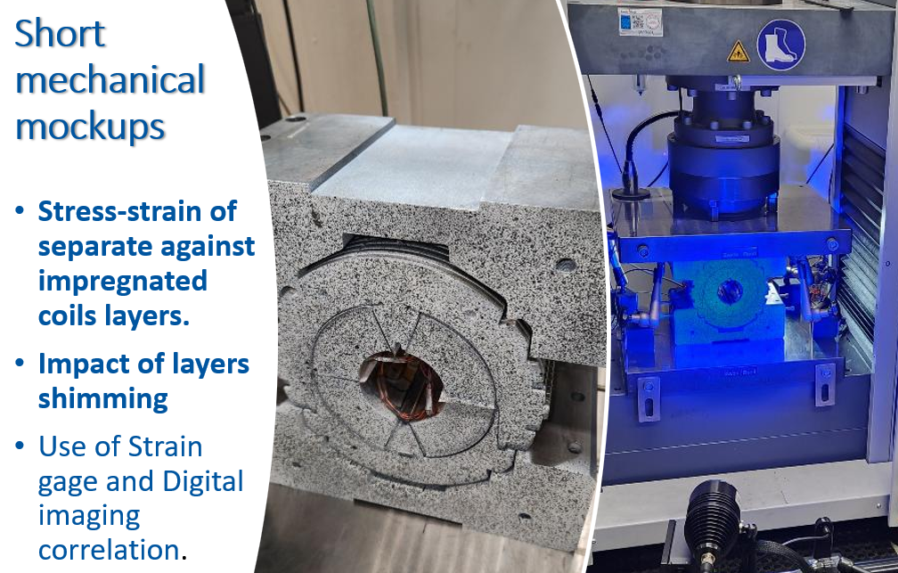
Cable properties measurement
Mutualization of measurement of cable stack thermo mechanical properties (CTEs_{x,y,z}, E_{x,y,z}) as model benchmarking inputs.
Impacts of separate layers, individual layers shimming on coil stress.
Cable flexural, torsion properties for winding support
Work in progress
Courtesy EN MMe test lab

Slide 13
Outline
FALCON-D scope, update, motivations
Cable and winding challenges, trials & outcomes
WP3.1 CERN magnet development status
WP3.2 INFN magnet development status
2025-2027 Schedule
Summary

Slide 14
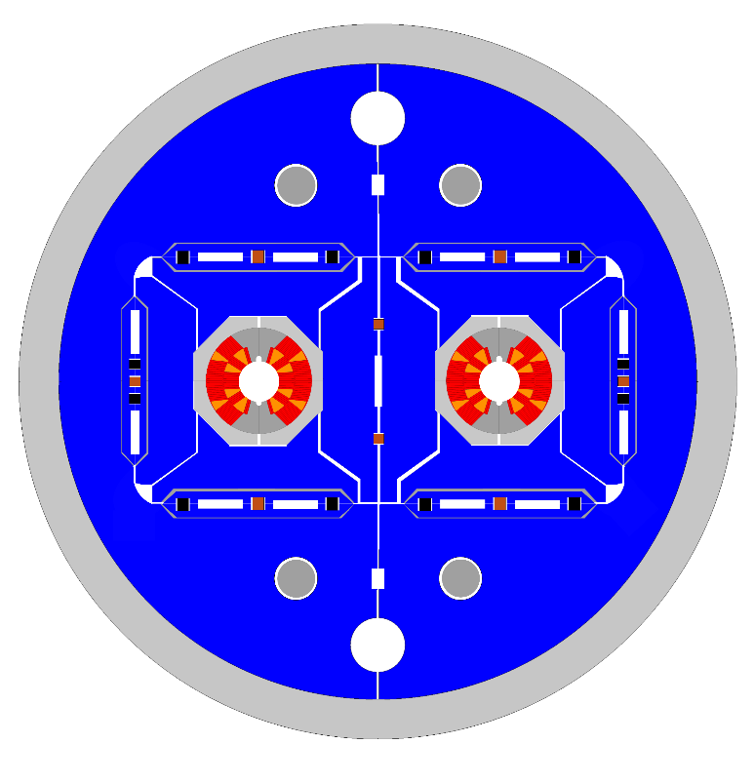
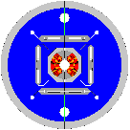
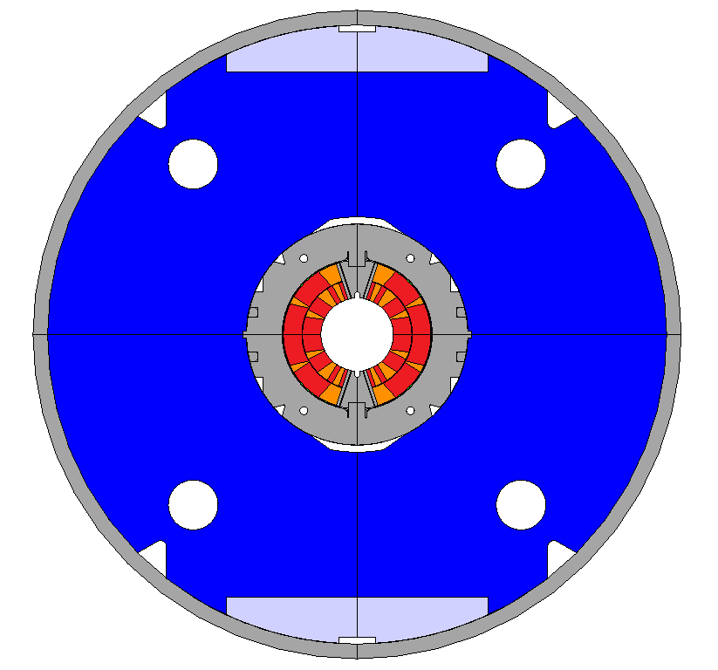
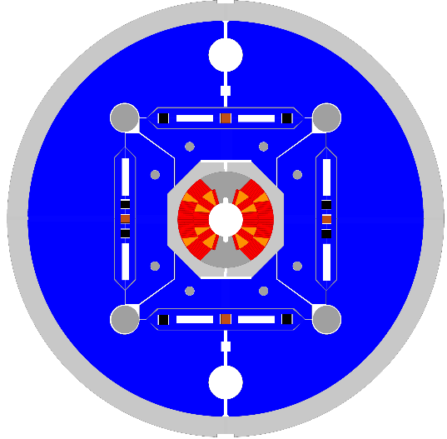
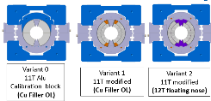
WP3.1 FalconD 12T dipole roadmap
Structure dipole with novel b&k structure and Alu ring (per QXF, US-AUP experience)
Mechanical mock ups measurement platform ( structure, cable stacks)
1-in-1 magnet models design and construction towards 2-in-1 dipole.
Long mechanical mock ups
Single Aperture
B&K magnet models
Double aperture B&K 12T cos theta dipole magnet
LMK1,2
M1,2
M3
2025
2026
2027-2028
SMKs
Short mechanical mock up

Slide 15
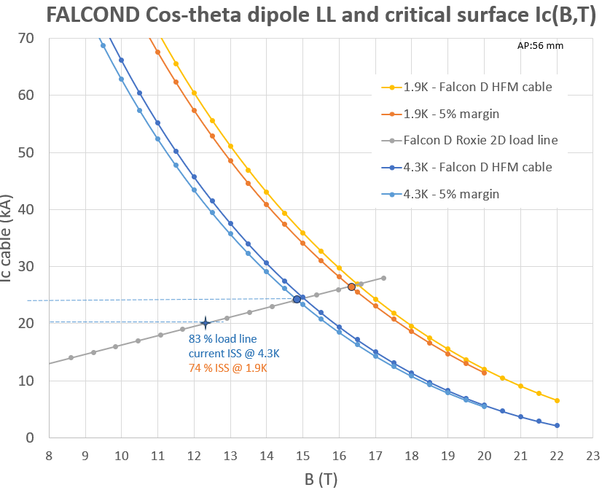
FALCOND WP3.1 12T design parameters
Coil |  | Falcon D 1-in-1 | Falcon D 1-in-1 (v6)
Aperture | [mm] | 50 | 56
No. of turns per pole |  | 12+24 = 36 | 15+22 = 37
No. Blocks |  | 5 | 6
Insulated cable surface | [mm²] | 6859 | 7040
Equivalent coil width | [mm] | 35.5 | 36.4
Filling factor k |  |  | 0.385
Physical length | [m] | 1.5 | 1.5
Coil efficiency | [T.mm/A] | 0.00074 | 0.00078
Magnet |  | Falcon 12T b&k (2024) | Falcon 12T b&k v6 (2025) | 2-in1 Falcon D 12T
Aperture | [mm] | 50 | 56 | 50
Operating temperature | [K] | 1.9 | 1.9 | 1.9
Outer diameter | [mm] | 640 | 640 | 720
Nominal current | [kA] | 19900 | 20.200 | 20.400
Strand eng. Je | [A/mm²] | 924 | 881 | 650
Overall Je | [A/mm²] | 454 | 420 | 454
Nominal field | [T] | 12.00 | 12.00 | 12.1
Peak field | [T] | 12.53 | 12.38 | 12.4
Ap. to peak field ratio | [%] | 4.4 | 3.0 | 4.5
Load line fraction | [%] | 74.4 | 74.8 | 76.1
Temperature margin | [K] | 5.11 | 5.0 | 5.14
Inductance | [mH/m] | 2.24 | 2.48
Stored energy | [MJ/m] | 0.543 | 0.557 | 1.04
Hot spot temp. adia. | [K] | < 150 K | < 150 K | < 150 K
Horizontal force (per quadr) | [MN/m] | 3.57 | 3.68 | 3.7
Vertical force (per quadr) | [MN/m] | -1.78 | -1.94 | -1.9
Axial e.m loads (@14T) | kN |  | 432 | 864
Hot spot temperature (@ 105% I_{nom}) | [K] | < 350 | < 350 | < 350
Voltage to ground | [kV] | < 1.2 | < 1.2 | < 1.2
Notes:
New version 56 mm allows to fit more conductor in inner layer, and reduce in version v7 b to 35 turns

Slide 16
Mechanical CERN design
CERN Falcon-D 1-in- 1 alternative model structure based on B&K designed and under optimization: keys interference level & position, fine tuning on part dimension, tolerance sensitivity, cable material properties in progress
Take benefit from experimental coils section mock-ups as fast mechanical design validation turn around: optimization of magnet models. (incl. variant of Alu stopper with collared coil.)
Mechanical bladder & keys mockup under CAD parts design completion, procurement start.
Objectives to minimize pole peak stress at RT, eq coil stress & mid plane stress at cold within allowable. Keep min contact in pole under power.

Slide 17
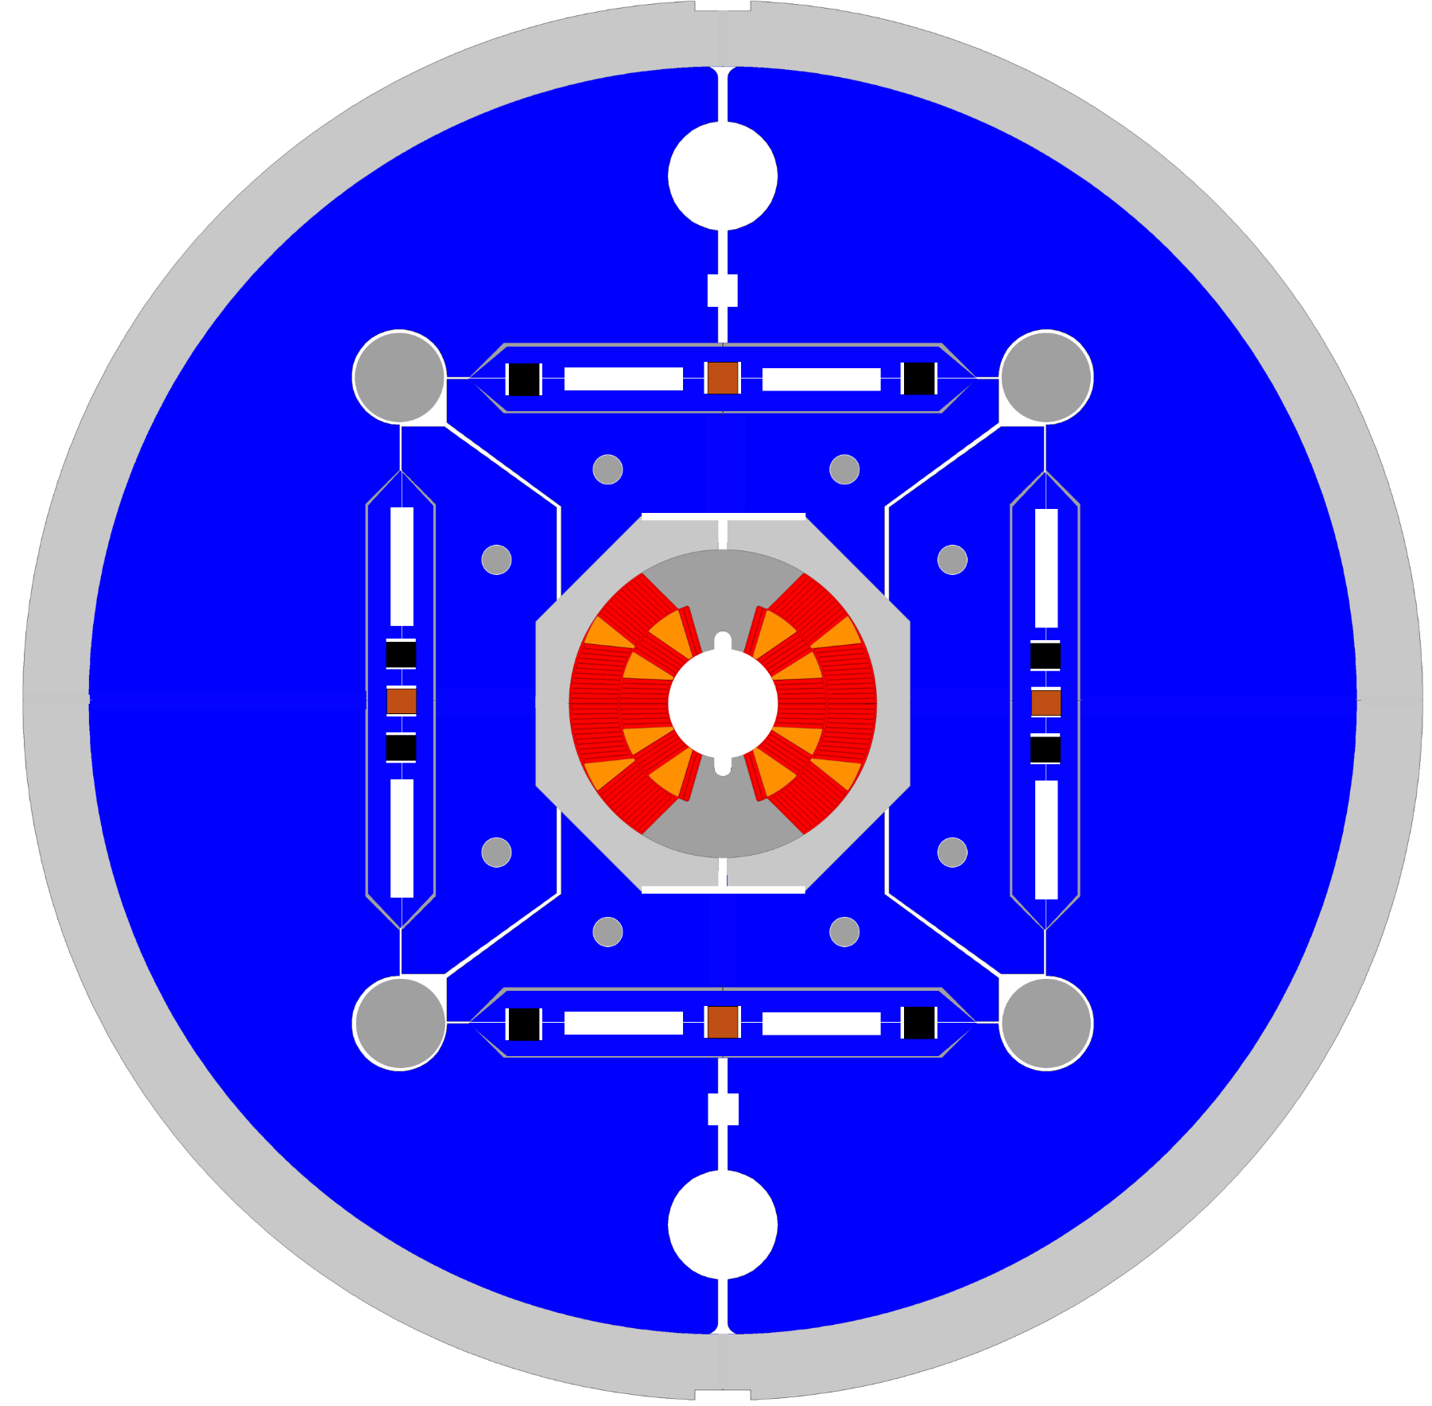

FalconD Cos theta Dipole (CERN)
Top vertical keys in masters
Top pad loading on 45° inclined plane with vertical gap.
Collar pad made of Al-6082 material
Midplane lateral interference keys
Al-6086 Alu structural ring OD630mm
Tailored iron yoke stiffness
MSC-SMT N.Sala, A.Foussat

Slide 18


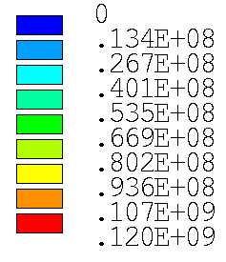

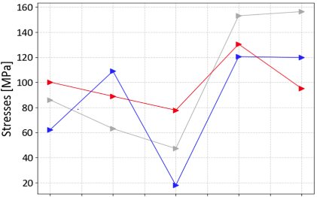
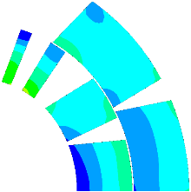

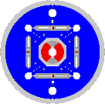

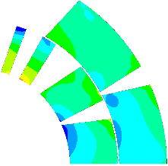
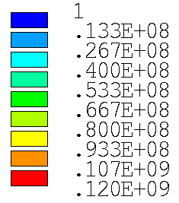
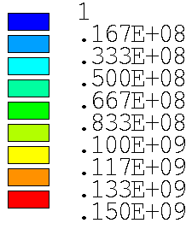
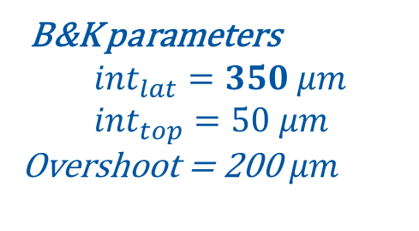
LMK1 mock up structural FEA (1/2)
B&K parameters
$${int}_{lat}=350 μm \\ {int}_{top}=50 μm$$
Overshoot = 200$μm$
Increased lateral interference (with fixed shell thickness), higher assembly
repeatability.
Azimuthal stress in the Al Shell at the end of assembly around 50 Mpa (similar target value of MQXF).
VM peak stress in the coils below limits (120 MPa at RT, 150 Mpa at 4K).
lateral
overshoot
top
overshoot
nominal
assembly
Annual HFM meeting, FALCOND project, CERN
TE-MSC-SMT – Arnaud Foussat/ INFN-Ge Stefania Farinon

Slide 19
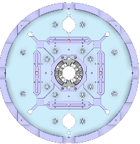
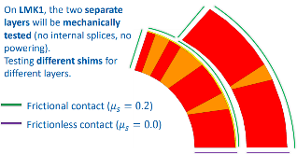
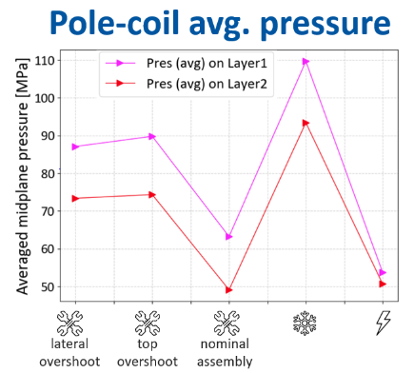
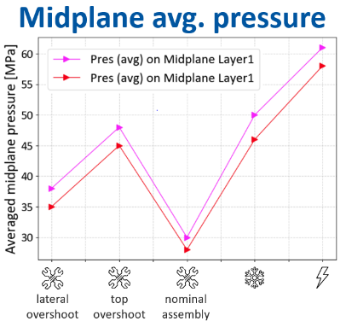
LMK1 mock up structural FEA (2/2)
LMK1 CAD model view - R. Ferriere
Annual HFM meeting, FALCOND project, CERN
TE-MSC-SMT – Arnaud Foussat/ INFN-Ge Stefania Farinon

Slide 20
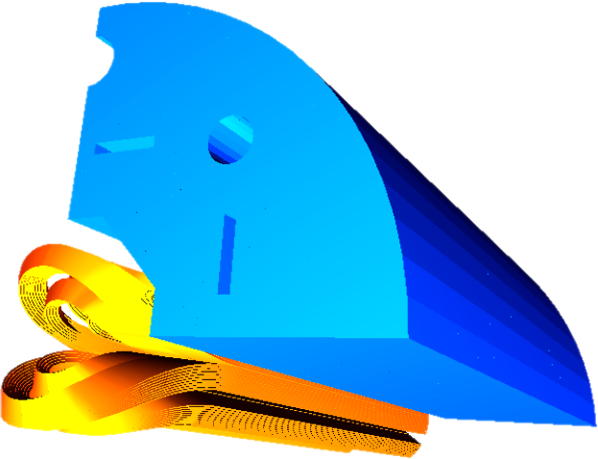
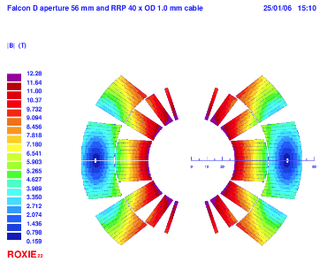
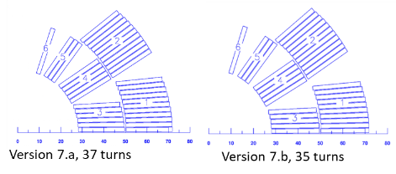
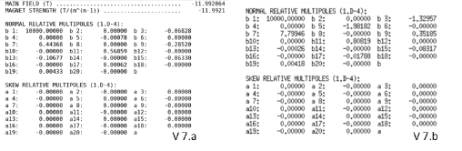
Magnetic design
  Development of 6-blocks CERN design reference section v.7 with a φ 56 mm aperture, 3D model optimization in progress.
Fig. 1 3D magnetic model v7.b
15+22
Fig. 2 6-blocks magnetic flux coil contour v7.a, Bp/Bo =3%
14+21
Fig.1 2D 6-blocks cross sections, φ 56 mm with Falcon D cable (21 x 1.8 mm)
V7.a: UL:105 m, 20200 A, 24.5 %I_{SS} margin
V7.b: UL:100 m / 21900 A, 23.5 %I_{SS}
  Cu wedges size optimized, preferred option
|b₃|,|b₅|< 2 units, |b₇|< 7 units
Annual HFM meeting, FALCOND project, CERN
TE-MSC-SMT – Arnaud Foussat/ INFN-Ge Stefania Farinon

Slide 21
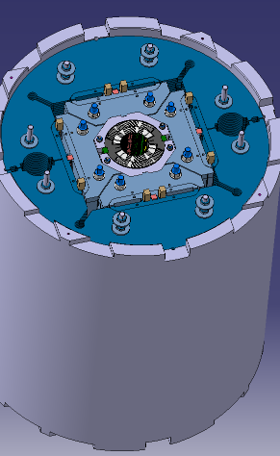
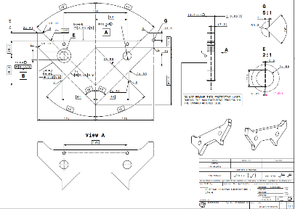
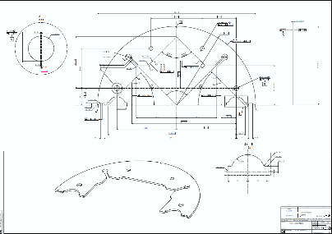
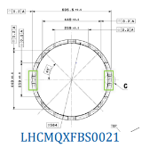
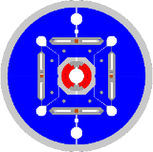
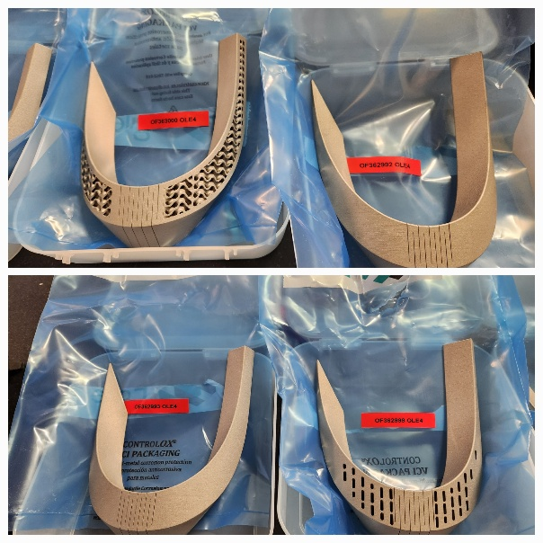
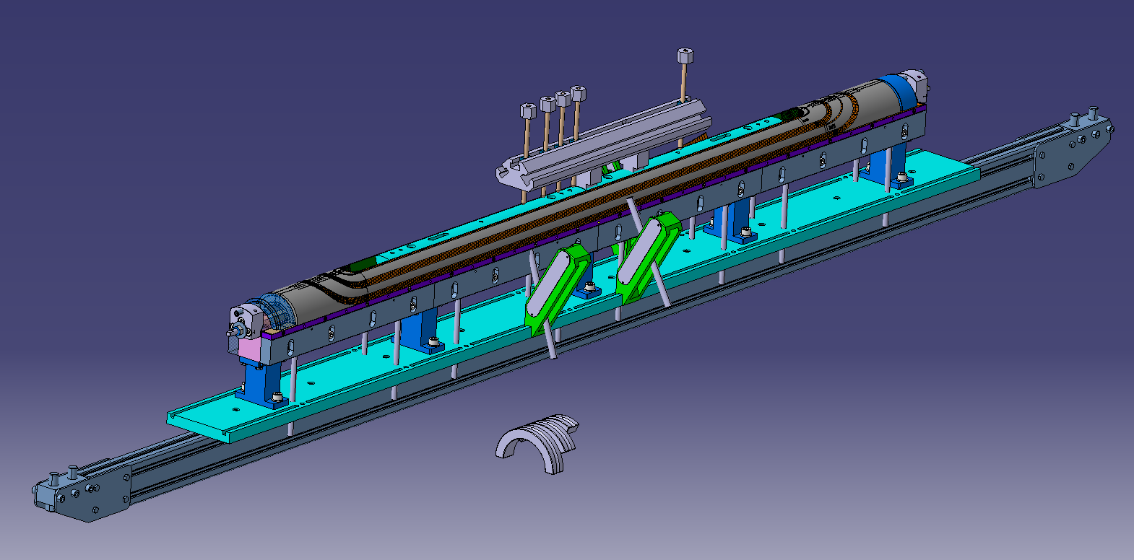
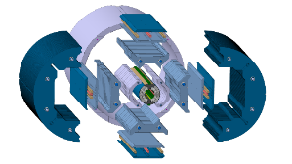
Components procurement
WP3.1 mock up manufacture drawings released for procurement
All coils components fabricated by CERN for WP3.2 ( except spacers)
Recent prototyping of both 3D printed and machined SS falconD spacers evaluated
Main SC coils parts and tooling under CAD design, procurement from Q2-2025 over 7-8 months
LMK1
3D printed SS spacers
WP3.1 winding mandrel
Annual HFM meeting, FALCOND project, CERN
TE-MSC-SMT – Arnaud Foussat/ INFN-Ge Stefania Farinon

Slide 22
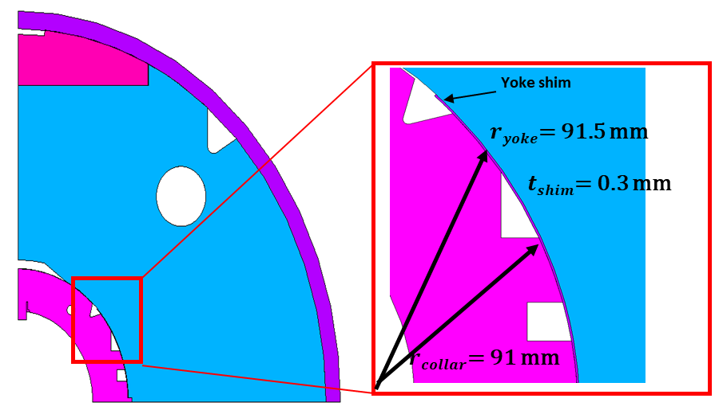
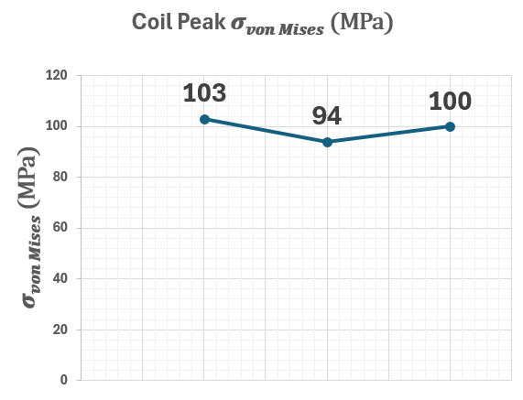
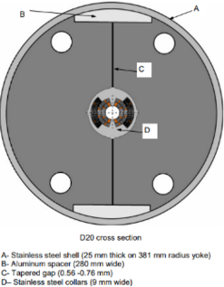







LMK2 mock up
Second mechanical mock up as proof of principle to test structure concept of collared coils with aluminium stoppers in SS shell - Design in progress.
Reference of last high-field record Nb3Sn cosine-theta magnet LBNL’s D20, which reached 13.5 T at 1.9 K in 1997.¹
LMK2 FE model - Courtesy Sachin Gowrishankar
1 D. Dell’Orco, R. Scanlan, and C.E. Taylor, “Design of the Nb3Sn Dipole D20,” IEEE Applied Superconductivity 3, 1 (February 1993), pp. 82-86.
//edms.cern.ch/document/3231780/1
Annual HFM meeting, FALCOND project, CERN
TE-MSC-SMT – Arnaud Foussat/ INFN-Ge Stefania Farinon
Notes:
Proof of principle mock up to test the use of alu safety stopper at RT and reduced decrease of coil stress at cold.

Slide 23
Outline
FALCON-D scope, update, motivations
Cable and winding challenges, trials & outcomes
WP3.1 CERN magnet development status
WP3.2 INFN magnet development status
2025-2027 Schedule
Summary

Slide 24




WP3.2 INFN organization
This program is being developed in accordance with the CERN/INFN KE 4102 agreement.
The FalconD project includes the following activities:
  At ASG-Superconductors, the manufacturing of:
    1 dummy pole wound with copper cable
    2 practice poles wound with Nb₃Sn cable
    3 + 2 poles wound with Nb₃Sn cable
    for the single aperture dipole
  At INFN-LASA Lab, the assembly and testing
  @ 4.2 K of the FalconD magnet
CERN supplies the magnet components, including the cable, spacers, and other necessary items)
ASG Superconductors is responsible for manufacturing the coils, which include 7 Nb₃Sn coils and 1 dummy copper coil.
INFN is responsible of the magnet design, assembly, and preliminary test @ 4.2 K
at LASA laboratory in Milan.
Annual HFM meeting, FALCOND project, CERN
TE-MSC-SMT – Arnaud Foussat/ INFN-Ge Stefania Farinon

Slide 25




Electromagnetic design
The coils were optimized using Roxie, and three promising test campaigns have been carried out at CERN in recent years, although none of them utilized the FalconD conductor.
21.42 mm
Reacted cable
Width +2%
Mid-thick +4.5%
1.89 mm
40 strand Ø 1 mm
Courtesy of R.Valente
INFN-LASA
1.98 mm
1.17 mm
9.85 mm
1.38 mm
Annual HFM meeting, FALCOND project, CERN
TE-MSC-SMT – Arnaud Foussat/ INFN-Ge Stefania Farinon

Slide 26


Coil development status @ ASG
The tooling for winding and curing the coils has been already procured and installed by ASG.
Currently, the tooling for heat treatment and impregnation is on hold due to the outcomes of the latest winding tests.
Annual HFM meeting, FALCOND project, CERN
TE-MSC-SMT – Arnaud Foussat/ INFN-Ge Stefania Farinon

Slide 27




Winding test outcomes (1/2)
Winding tests have been performed using bare Cu cable, insulated Cu cable, and insulated Nb₃Sn, revealing significant differences in the results.
Key findings include:
  Turns closer to the pole are less critical, as most of the bending occurs in the easy way.
  The most critical turns are those near the midplane, where significant hard-way bending is combined with pronounced twisting.
  The natural turn angles deviate from those anticipated by the end spacers.
  A significant detachment (protrusion) of the accumulated
  turns from the mandrel has been observed.
Annual HFM meeting, FALCOND project, CERN
TE-MSC-SMT – Arnaud Foussat/ INFN-Ge Stefania Farinon

Slide 28



Winding test outcomes (2/2)
Free bending tests of the midplane turn
have been performed using both 50 mm and
56 mm mandrel diameters.
These tests confirmed the challenges,
particularly for short coil ends (~100 mm). However, extending the coil end to ~200 mm appears to mitigate or resolve the issue.
Our findings suggest that increasing the aperture from 50 mm to 56 mm provides some improvement but does not fully address the problems.
To further refine the design, we plan to extend the end spacers and align them with the natural conductor angles observed during the winding tests.
Once the new spacers are implemented, we will conduct another winding test. If the results are satisfactory, we will proceed with the development of the dummy coil.
Annual HFM meeting, FALCOND project, CERN
TE-MSC-SMT – Arnaud Foussat/ INFN-Ge Stefania Farinon

Slide 29



Mechanics
The 2D mechanical design has been finalized.
The 3D mechanical design will be updated with the newly optimized coil ends as soon as they become available.
ASG is in charge of producing engineering drawings of mechanical components
Courtesy of N.Sala
Annual HFM meeting, FALCOND project, CERN
TE-MSC-SMT – Arnaud Foussat/ INFN-Ge Stefania Farinon

Slide 30


Mock-up
The mock-up is designed according to the specifications presented in the TDR and is a 500 mm long model of the central part of the magnet (~1 tons of weight)
  https://indico.cern.ch/event/1086175/
It will be beneficial for:
  consolidating the mechanical finite element analysis to predict stress and strain conditions during the B&K assembly and cooling (at 77 K).
  studying the influence of mechanical tolerances on the mechanical system
  determining the most efficient assembly sequence
  providing training for personnel in B&K assembly procedures.
The assembly activities are ongoing at our laboratory in Genoa.
Annual HFM meeting, FALCOND project, CERN
TE-MSC-SMT – Arnaud Foussat/ INFN-Ge Stefania Farinon

Slide 31



Mock-up assembly
The mock-up will be
instrumented with several
strain gauges located at the
following positions:
  2 below the flat pole
  1 on the pole cross-sectional
  face
  2 on the pad cross-sectional
  face
  3 on the outer shell
  (at 0°, 45°, and 90°)
  2 on the outer shell cross-sectional face
  (at 0° and 90°)
The warm assembly is expected to be completed by February 25.
The feasibility of a cold test at 77 K is currently under evaluation.
Courtesy of A.Bersani
and A.Gagno
Annual HFM meeting, FALCOND project, CERN
TE-MSC-SMT – Arnaud Foussat/ INFN-Ge Stefania Farinon

Slide 32
WP3.2 concluding remarks
The FalconD-I project is making steady progress, with thorough testing and iterative design refinements.
Challenges in coil winding are being addressed, but potential design modifications could impact scheduling.
Further validation through mock-up testing will be crucial for ensuring reliability before full-scale assembly, with the mock-up expected to be tested by Feb. 25.
Annual HFM meeting, FALCOND project, CERN
TE-MSC-SMT – Arnaud Foussat/ INFN-Ge Stefania Farinon

Slide 33
Outline
FALCON-D scope, update, motivations
Cable and winding challenges, trials & outcomes
WP3.1 CERN magnet development status
WP3.2 INFN magnet development status
2025-2027 Schedule
Summary

Slide 34
INFN WP3.2 FalconD timeline
The latest issue with the coil end winding could involve significant design changes (i.e. change to the mandrel diameter) that will require a contingency in the planning, which is not currently accounted for.
Feb. 2025
Dec. 2025
Dec. 2026
Dec 2027
Coil manufacturing
Coil end design
Cu coil
2 Nb3Sn practice coil
5 Nb3Sn series coils
Magnet assembly
Mechanical eng. design
Mech. comp. procurement
1st Magnet assembly
2nd Magnet assembly
Annual HFM meeting, FALCOND project, CERN
TE-MSC-SMT – Arnaud Foussat/ INFN-Ge Stefania Farinon

Slide 35
CERN WP3.1 Falcon D timeline (2025 – 2027)
Jan 2025
Dec. 2025
Dec. 2026
Dec 2027
Phase 0 – Design
Manufacture coil tooling
Magnetic 2D design 3D ends
Winding & curing tooling procurement
HT & impregnation moulds procurement
Assembly tooling
Mechanical design
Assembly tooling procurement
Phase 1 – Mechanical mockups LMK1, LMK2
CAD drawings
Manufacturing, Instrumentation
Assembly
Test LMK1
Test LMK2
Phase 2 – Nb₃Sn dipole Magnet Models M1, M2
Coils Manufacturing (3)
CMM
Instrumentation
Assembly
Cold Test M1
Test M2
Phase 3 – Nb₃Sn 2-in-1 model
Coils Manufacturing (4)
CMM
Instrumentation
Assembly
Annual HFM meeting, FALCOND project, CERN
TE-MSC-SMT – Arnaud Foussat/ INFN-Ge Stefania Farinon
Notes:
Coil tooling from Q3 25 to end 2026. start coil winding practice from q4 25. cold test model from mid 27.

Slide 36
Summary
Good progress in last 6 months in understanding hard limits on use of large Falcon cable, setting consolidated INFN and CERN WPs roadmap
Windability of Falcon D cable remains biggest challenge, further test on practice coils layouts in 2025 on both sites
  INFN investigates with ASG industrial partner up to curing the extended coil ends on 50 mm AP
  CERN proposes to complete tooling design, procure an 56 mm aperture to wind coils and mitigate geometrical deviations risk in subsequent steps
2D-3D magnetic and mechanical design of 1-in-1 CERN FalconD magnet model under completion. Protection test options on models to be selected.
Large scope of magnet tooling CAD design and procurement, Q1-Q4 2025.
Plan for model magnets cold tests both at CERN and INFN in 2027.
Annual HFM meeting, FALCOND project, CERN
TE-MSC-SMT – Arnaud Foussat/ INFN-Ge Stefania Farinon

Slide 37





Thank you for your attention
Any Questions ?
Annual HFM meeting, FALCOND project, CERN
TE-MSC-SMT – Arnaud Foussat/ INFN-Ge Stefania Farinon

Slide 38
APPENDIX
Annual HFM meeting, FALCOND project, CERN
TE-MSC-SMT – Arnaud Foussat/ INFN-Ge Stefania Farinon

Slide 39





Rutherford Cable Parameters
t
w
Cable geometry
  Width w
  Thickness t
  Twist pitch L_{p}
  Keystone angle α
  “Lay” angle θ
Compaction
  Width compaction
  Thickness compaction
  Total compaction

Slide 40

Compaction vs. Degradation
A clearer picture can be obtained compiling data from
  FRESCA2 cable R&D (width compaction)
  VLHC cable R&D at FNAL (thickness compaction)
Lowest degradation is obtained when the total compaction is in the range 85%...86%
FRESCA2
VLHC
Data by courtesy L. Oberli (CERN) and E. Barzi (FNAL)
L. Oberli, Development of the Nb3Sn Rutherford Cable for the EucCard High Field Dipole Magnet FRESCA2, IEEE-TAS, 23, 2013
E. Barzi, et al., Strand Critical Current Degradation in Nb3Sn Rutherford Cables, IEEE-TAS, 11, 2001

Slide 41



Falcon D cable compaction
Compaction rate in Rutherford-type Nb₃Sn Falcon D cables with SS core
With high keystoning angle over-compact the width of the cable, concentrates the deformation at the thin edge and could produce strand damage. 90.3 % compaction in thin edge
The degradation of I_{C} (as well as RRR and D_{eff}) induced by cabling deformation can be limited by using small width compaction (3%...4%) and moderate total compaction (85%...86%)
Cw | Ct | Ctotal
-9% | -5% | 86 %
Selected strands in a small-scale RRP Nb₃Sn Rutherford cable

Slide 42


Width compaction
Best results are obtained by a width compaction of 3%…4%
As a general rule:
  More width compaction causes degradation at the cable edge
  Less width compaction results in degradation for lack of lateral support, and a cable that is not mechanically stable
L. Oberli, Development of the Nb3Sn Rutherford Cable for the EuCard High Field Dipole Magnet FRESCA2, IEEE TAS, 23, 2013

Slide 43



Falcon D Cable compaction parameters
Compaction rate has influence on cable stiffness and windability
Falcon D cable parameters are limiting degradation of I_{C} (as well as RRR and D_{eff}) induced by cabling deformation by using small width compaction (3%...4%) and moderate total compaction (85%...86%)
Falcon D cable compaction
Data by courtesy of R. Scanlan, D. Dietderich, H, Highley (LBNL, Berkeley) and L. Oberli (CERN)

Slide 44




FalconD cable features
Non reacted conductor dimensions
Table 1: FalconD DEM-1 conductor parameters
Annual HFM meeting, FALCOND project, CERN
TE-MSC-SMT – Arnaud Foussat/ INFN-Ge Stefania Farinon

Slide 45




Cable flexural stiffness
Comparative stiffness of bare cable vs windability
Cable tested in pseudo-monolithic regime in flexion and torsion acc. to ASTM D3410, ASTM A938 standards test equipment ( small displacement range).
Below instability point in linear stress-strain domain
Four-points test limit stress concentration over a larger region, avoiding premature failure provides flexural stiffness K
Torsional test provides shear modulus ( in progress)
EN MME test lab
T torque (N), L sample length,
J polar moment, theta twist angle
Flexural stiffness K [N.m⁻¹] α E.I/L_{e}
 | Cable type | Ref | Eθ [Gpa] | Ks [N.mm-1]
Cable 1 Falcon D Copper |  | 0487A | 30 | 44
Cable 2 Falcon D SC Nb3Sn |  | 0488A | 26 | 38
Cable 3 QXF |  | QXF | 38 | 26.6
Annual HFM meeting, FALCOND project, CERN
TE-MSC-SMT – Arnaud Foussat/ INFN-Ge Stefania Farinon

Slide 46


Equivalent coil width, equations for electrodipoles
Equivalent coil width: width of a 60° sector coil with the same surface
  This concept allow to compare different designs (block, cos theta, common coil …)
Equations for a dipole, without iron:
γ_{c} order of μ₀/2, ranging from 0.007 (most effective layouts) to 0.006 – for sector or block coils one has
w_{eq}
Equivalent coil width for MDPCT1 (left) and HD2 (right)
E.Todesco
Annual HFM meeting, FALCOND project, CERN
TE-MSC-SMT – Arnaud Foussat/ INFN-Ge Stefania Farinon

Slide 47

Cable material properties update
Unified Falcon D material properties based on measurement campaign used for FE inputs and 3D smeared calculation
Coming Falcon D cable ten stack measurement ( E, CTE)

Slide 48




Strain energy
Strain energy in a block is defined as
where fτ,fn,fg, are the flexural rigidities, and τ, κn, κg are the torsion, normal curvature and geodesic curvature.
Quantification of energy density in configurations with AP 50mm
  Extended head, B > 250 mm, Low torsion, maximized Hard bending (x 5, fig.2)
  Roxie standard differential geometry head, B:160 mm, maximised torsion (instability risk, x 8, fig.1), low hard way bending
  QXF cable in standard head, low torsion, low geodesic bending, optimum beta 65 deg
Fig.1
Fig.2

Slide 49

HFM Nb3Sn magnets critical current density
Magnet main specifications
Cable
Material |  | Nb₃Sn (RRP)
No. strand |  | < 60
Strand diam. | [mm] | < 1.2
Cu/NonCu |  | > 0.8
FIT | T_{c0}(K) | B_{c20}(T) | α | C₀ [A/mm²T] | Jc at 4.22K
 |  |  |  |  | 12 T | 16 T
Hi-Lumi | 16 | 29.38 | 0.96 | 188870 | 2450 | 1058
HFM | 16 | 29.38 | 0.96 | 214462 | 2800 | 1200
Magnet
Operating temperature | [K] | 1.9
Aperture | [mm] | 50
Intra-beam distance | [mm] | 250
Outer diameter | [mm] | 800
Nominal field | [T] | 12
Load line fraction | [%] | < 80
Critical current density | [A/mm²] | 1800
Temperature margin | [K] | < 4.2
Stress on cond. - warm | [MPa] | < 150
Stress on cond. - power | [MPa] | < 200
Harmonic b3 (@ I_{nom}) | [10⁻⁴] | < 3
Harmonic b5 (@ I_{nom}) | [10⁻⁴] | < 5
Harmonic b7 (@ I_{nom}) | [10⁻⁴] | < 3
Harmonic b2 (@ I_{nom}) | [10⁻⁴] | < 20
Harmonic b3 (@ I_{inj}) | [10⁻⁴] | < 10
$$J_{c}\left(T,B\right)=\frac{C\left(t\right)}{B}b^{0.5}{\left(1−b\right)}^{2}$$
t$= \frac{T}{T_{c0}}$
$b= \frac{B}{B_{c2}}$with $B_{c2}\left(T\right)=B_{c20}\left(1−t^{1.52}\right)$
$C\left(T\right)=C_{0}{\left(1−t^{1.52}\right)}^{α}{\left(1−t^{2}\right)}^{α}$
Protection
Hot spot temperature (@ 105% I_{nom}) | [K] | < 350
Voltage to ground | [kV] | < 1.2
Annual HFM meeting, FALCOND project, CERN
TE-MSC-SMT – Arnaud Foussat/ INFN-Ge Stefania Farinon

Slide 50



Comaprison of effectiveness for coil layouts versus idealized coil
Cost minimization constraining the |b3|, |b5|, |b7| and |b9|
below 2 units
Fig.1 effectiveness for all layouts as a function of magnetic field, current density and aperture size into
a single shape factor γ= π B1/(2μ0 Jo Ra)
J. van Nugteren et al., "Idealized Coil Cross Sections With Minimized Conductor Area for High Field Dipoles," doi: 10.1109/TASC.2018.2795536.
Fig.2 Conductor cost optimized cross-sectional coil as a function of the unitless shape factor γ
Annual HFM meeting, FALCOND project, CERN
TE-MSC-SMT – Arnaud Foussat/ INFN-Ge Stefania Farinon

Slide 51

Equivalent sector coil width
Equivalent coil width: width of a 60° sector coil whose area is the same of the area of the layout that we are considering. ≡ ability of a given quantity of conductor to produce field given an overall current density; the equivalent coil width concept also allows to compute coil efficiencies for other coil layouts
$w_{eq}=r\left(\sqrt{1+\frac{3A}{2πr^{2}}}−1\right)$
where r is the aperture radius and A the area of the insulated cable.
Coil efficiency: Ratio between the field and the current times the coil width, given in [T.mm/A].
$$γ=\frac{B}{jw_{eq}}$$
Can be compared with $γ_{0}=6.625×{10}^{4}$ T.mm/A (found for a 60° 2-sector coil cancelling b3 and b5 [0 °,48 °], [60 °,72 °] case.
Peak field ratio: The ratio λ between peak field and central field can be used as a marker for good optimization. It is a function of the coil shape and can fit with the function:
$$λ=1+a\frac{w_{eq}}{r}$$
E. Todesco, Masterclass – Design of superconducting magnet for particle accelerator – Unit 4
L. Rossi and E. Todesco, Electromagnetic design of superconducting dipoles based on sector coils, Phys. Rev. STAB, 10 (11), 2007
Annual HFM meeting, FALCOND project, CERN
TE-MSC-SMT – Arnaud Foussat/ INFN-Ge Stefania Farinon

Slide 52
References
2023 TE-MSC Strategy & Implementation Update for High Field Magnet (HFM) Part 1: LTS, EDMS 2816918 3-0
12 T VE Preliminary Design Review report , July 5, 2023, CERN : https://indico.cern.ch/event/1294868/
12-14T cos theta HFM WP3.1 Working indico directory: //indico.cern.ch/category/15243/
Technical Design Report of the FalconD Nb3Sn Cos-Theta Dipole Model for the FCC-hh at CERN, INFN/Code-19/001, Indico1086175
2024 update HFM program structure. https://hfm.web.cern.ch/
INFN CERN collaboration ADDENDUM FCC-GOV-CC-CC-0004/17.10.2014 (KE4102/FCC) : Design and manufacturing of a single-aperture, 12 T short model superconducting Nb3Sn dipole magnet, designed and assembled according to the bladder-and-key technology
Publications:
R. Valente et al., Status on the Development of the NbSn 12 T Falcon Dipole for the FCC-hh, IEEE trans. Appl. Supercond., 34 (3), 2024
R. Valente et al., Optimization of Electromagnetic Design After Winding Tests for the Nb3Sn Cos-Theta Dipole Model for FCC-hh, IEEE trans. Appl. Supercond., 33 (5), 2023
F. Levi et al., Updates on the Mechanical Design of FalconD, a Nb3Sn Cosθ Short Model Dipole for FCC-hh, IEEE trans. Appl. Supercond., 33 (5), 2023
A. Pampaloni et al., Mechanical Design of FalconD, a Nb3Sn Cosθ Short Model Dipole for the FCC, IEEE trans. Appl. Supercond., 32 (6), 2022
A. Pampaloni et al., Preliminary Design of the Nb3Sn cosθ Short Model for the FCC, IEEE trans. Appl. Supercond., 31 (5), 2021
Annual HFM meeting, FALCOND project, CERN
TE-MSC-SMT – Arnaud Foussat/ INFN-Ge Stefania Farinon

