Slide 1


Slide 2
CIEMAT Common Coil design
J. García Matos, C. Martins, F. Toral (CIEMAT)
J.C. Pérez, E. Todesco (CERN)

Slide 3
Outline
Introduction
ISAAC: a common coil model magnet with existing coils
DAISY: a 14 T common coil magnet demonstrator
Conclusions

Slide 4
HFM plans at CIEMAT
CIEMAT is contributing to the High Field Magnet (HFM) program led by CERN.
CIEMAT is working on high field magnets based on common coil topology, profiting from the lessons learned from EuroCirCol collaboration.
The target is to develop a prototype magnet able to provide 14 T at the aperture.
In a first step, CIEMAT is working on a model magnet (ISAAC) using existing coils produced by CERN. The aim is to learn about mechanics of high field magnets in common coil configuration. ISAAC means Investigating Superconducting Assembly to Address Common coil mechanics.
In a second step, we are developing DAISY: Demonstrator for Assembly Innovations in Superconducting common coil technologY. It honours Margarita Salas, an outstanding Spanish biologist (daisy is translated into Spanish as margarita).
DAISY coils will be the first ones made with Nb₃Sn cable in the new CIEMAT magnet laboratory (SMART-Lab: Superconducting MAgnet Research and Technology Laboratory).

Slide 5
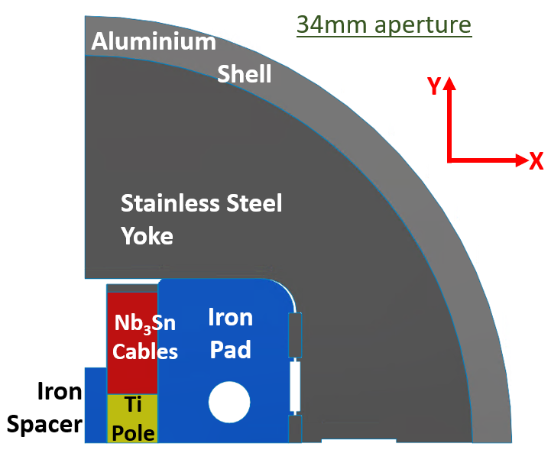
ISAAC design baselines
Main goal: learn for the 14 T demonstrator (DAISY) with existing coils, mostly on mechanics
  Existing RMC coils made at CERN with MQXF strand
  Provide ≈14 T in the 34-mm aperture (100% load). 50-mm aperture is possible to test insert HTS coils.
  No horizontal preload: coils are close to the aperture
Horizontally-split iron to hold large horizontal EM forces. Assembly with bladder and keys, slight preload just to keep contact between parts (@RT). In a second step, we could not use any shell.
Goal: To have a horizontal coil displacement due to the EMF below 0.5 mm to reduce:
  The impact on field quality and magnitude (0.5 mm -> 1% less field in the aperture)
  The possibility of sudden coil movements (quench)

Slide 6
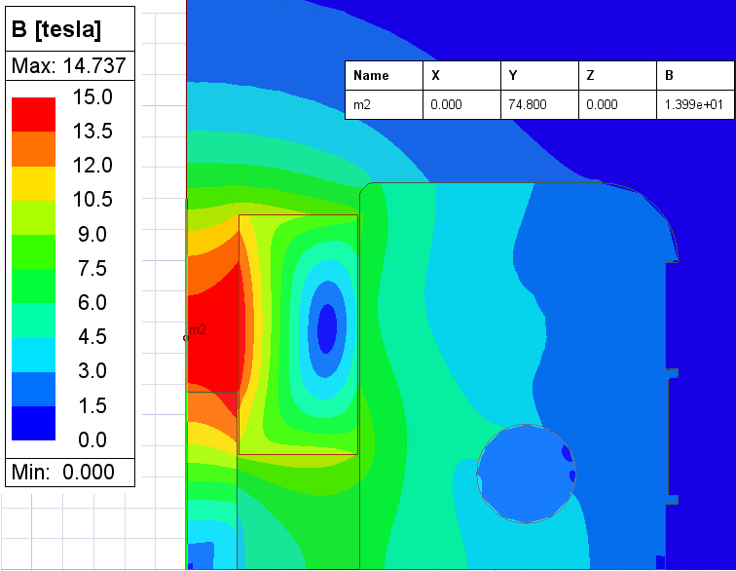
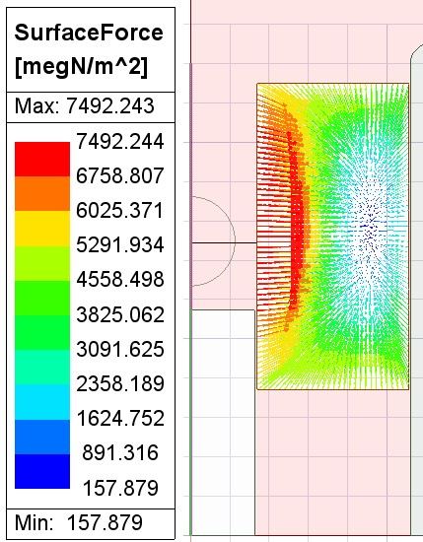
ISAAC 2D Magnetic Design
Field (B)
34mm aperture
Parameter | Conf.#1 |  | Conf.#2 |  | Units
Aperture | 34 |  | 50 |  | mm
Nominal current | 19340 |  | 20728 |  | A
 | Roxie | Maxwell | Roxie | Maxwell
Magnetic length | 0.55 | - | 0.55 | - | m
WorkPoint on LoadLine | 100.6 | - | 100.4 | - | %
Stored energy | 1049 | - | 1357 | - | kJ/m
Aperture Field | 14.04 | 13.99 | 12.74 | 12.70 | T
Peak Field | 14.85 | 14.74 | 14.45 | 14.32 | T
Field ratio | 1.06 | 1.05 | 1.13 | 1.13 | -
F_{x} (Q1) | 6.56 | 6.40 | 5.98 | 5.83 | MN/m
F_{y} (Q1) | 0.45 | 0.44 | 0.85 | 0.83 | MN/m
Coil Cable EMF
34mm aperture
Parameter | Conf.#1 | Conf.#2 | Units
Aperture | 34 | 50 | mm
Nominal current | 16264 | 19410 | A
Aperture Field | 12 | 12 | T
WorkPoint on LoadLine | 85.5 | 94.3 | %
Protection with dump resistor (30 ms delay + Vmax 1000 V): hot spot temperature:
  201 K for 34 mm aperture
  291 K for 50 mm aperture

Slide 7
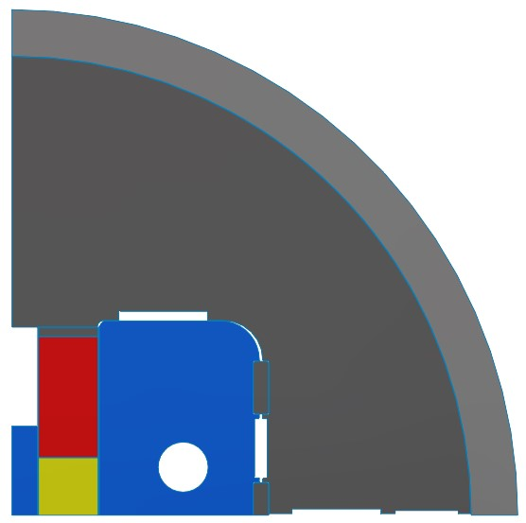
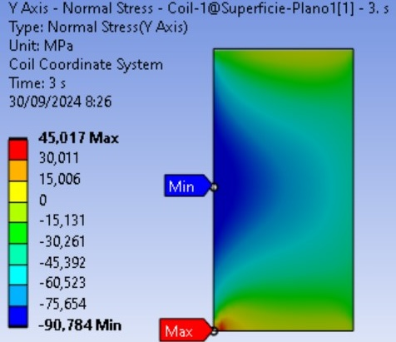
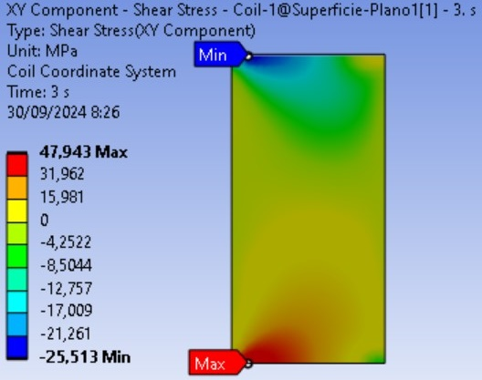
ISAAC 2D Mechanical Design
Components without preload @ RT
 | Coil Stress
 | X stress | Y stress | Shear Stress | VM stress
Max | 30,0 MPa | 14,1 MPa | 14,0 MPa | 36,8 MPa | Cooling
Min | -14,0 MPa | -24,9 MPa | -16,4 MPa | 0,6 MPa
Max | 95,1 MPa | 45,0 MPa | 47,9 MPa | 113,9 MPa | Cooling + EMF
Min | -101,3 MPa | -90,8 MPa | -25,5 MPa | 4,1 MPa
Vertical preload @ RT
Vertical interference @RT: 0.2mm
(this is NOT our original target: free horizontal movement of the coil)
 | Coil Stress
 | X stress | Y stress | Shear Stress | VM stress
Max | 29,7 MPa | -36,6 MPa | 16,3 MPa | 81,5 MPa | Cooling
Min | -18,8 MPa | -82,2 MPa | -17,3 MPa | 43,6 MPa
Max | 56,2 MPa | -1,8 MPa | 43,3 MPa | 132,7 MPa | Cooling + EMF
Min | -98,2 MPa | -136,3 MPa | -34,2 MPa | 30,0 MPa
Main concern: Pole turn detaching due to Vertical (Y) and Shear Stress
More info @ "Mechanical Design of a Common Coil Magnet with RMC Coils (ISAAC)" doi: 10.1109/TASC.2025.3537063
Only compressive vertical stress (no tension)
Maximum shear stress is slightly reduced
Horizontal tension stress is reduced
VM equivalent stress is 133MPa (below the limit of 150MPa)

Slide 8
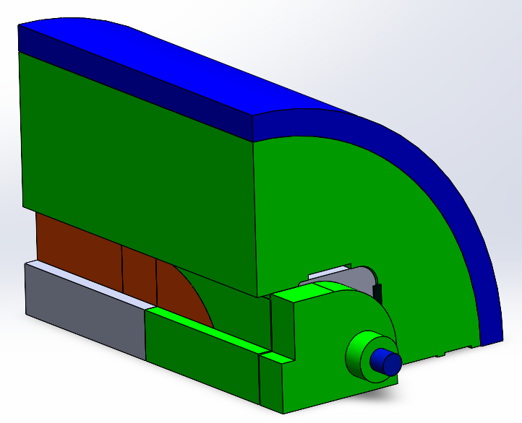
ISAAC 3D Design: Iron
The spacer and the pad can be made of iron. Which length?
If the spacer is made of iron, it should not be longer than the pad. When the peak field is at the straight section, the margin on the load-line increases.
The stored magnetic energy decreases with more iron volume.
A full iron pad provides better support to the large outwards horizontal EMF.
The best-balanced design option is Case #6.
Pad entirely made of iron
Short spacer made of iron (SS+S1)
More info @ "Mechanical Design of a Common Coil Magnet with RMC Coils (ISAAC)" doi: 10.1109/TASC.2025.3537063

Slide 9
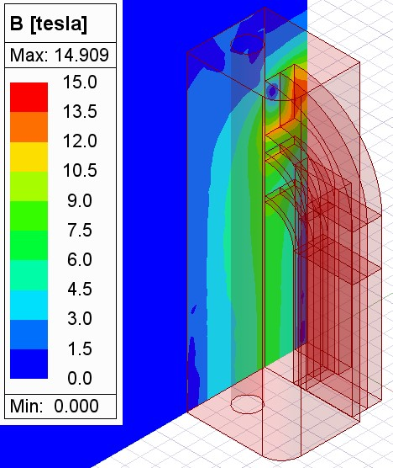
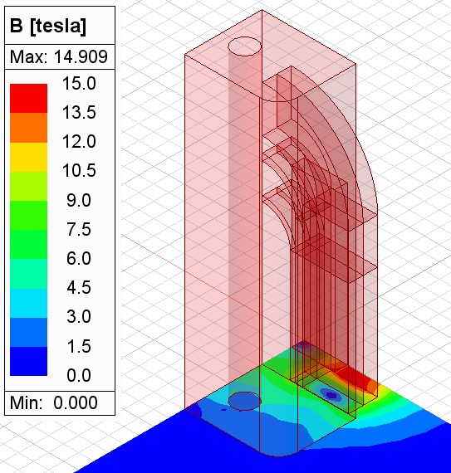
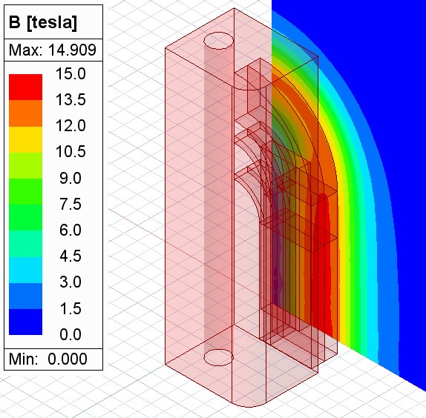
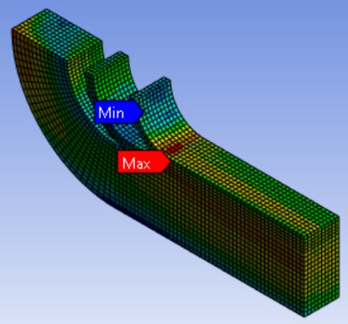
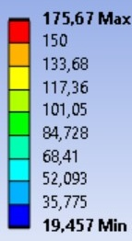
ISAAC 3D Design: coil stress
XZ
XY
YZ
Nominal current: 19340 A
 | Coil | Spacer | Pad
Fx | 2,02 MN | -28,63 MN | -36,99 MN
Fy | 0,42 MN | 58,30 MN | -13,26 MN
Fz | 0,30 MN | -24,15 MN | -64,92 MN
Total F | 2,08 MN | 29,32 MN | 39,83 MN
Vertical preload: 0.2 mm interference
Aluminium rods with 25kN pretension each
EMF per quadrant
@RT: -120 MPa <-> 20 MPa
@Cold: -150 MPa <-> 20 MPa
 | COIL
 | X stress | Y stress | Z stress | VM stress
Max | 2,7 MPa | -5,0 MPa | -0,5 MPa | 20,1 MPa | RT Assembly with Rod Pretension
Min | -14,7 MPa | -26,4 MPa | -10,6 MPa | 3,3 MPa
Max | 50,1 MPa | -2,7 MPa | 54,2 MPa | 133,2 MPa | Cooling
Min | -8,6 MPa | -131,4 MPa | -75,6 MPa | 22,1 MPa
Max | 68,6 MPa | 64,5 MPa | 141,1 MPa | 175,7 MPa | Cooling + EMF
Min | -104,3 MPa | -167,3 MPa | -73,5 MPa | 19,5 MPa
Coil Stresses over limits only in some located areas (bonded to coil parts)
 | COIL SHEAR STRESS
 | Planar surfaces |  | 1st Block surfaces |  | 2nd Block surfaces |  | 3rd Block surfaces
 | XY | XZ | XY | XZ | XY | XZ | XY | XZ
Max | 2,1 MPa | 1,9 MPa | 2,0 MPa | 0,3 MPa | 2,3 MPa | 0,2 MPa | 4,7 MPa | 2,0 MPa | RT Assembly with Rod Pretension
Min | -0,7 MPa | -1,0 MPa | -0,5 MPa | -0,2 MPa | -0,1 MPa | -0,4 MPa | -0,2 MPa | -1,2 MPa
Max | 0,4 MPa | 28,0 MPa | 22,5 MPa | 31,4 MPa | 10,9 MPa | 7,3 MPa | 32,2 MPa | 7,1 MPa | Cooling
Min | -43,2 MPa | -28,1 MPa | -15,5 MPa | -31,8 MPa | -13,2 MPa | -10,7 MPa | -14,5 MPa | -8,6 MPa
Max | 0,4 MPa | 44,2 MPa | 44,3 MPa | 42,0 MPa | 29,6 MPa | 25,3 MPa | 54,9 MPa | 52,5 MPa | Cooling + EMF
Min | -64,9 MPa | -32,3 MPa | -18,9 MPa | -22,8 MPa | -16,9 MPa | -29,3 MPa | -26,0 MPa | -36,6 MPa
@RT & Cold:
-45 MPa <-> 45 MPa
Equivalent VM (MPa)
 | COIL DISPLACEMENT DUE TO EMF
 | X | Y | Z
Max | 0,27 mm | 0,03 mm | 0,21 mm
Min | 0,14 mm | -0,05 mm | 0,00 mm

Slide 10
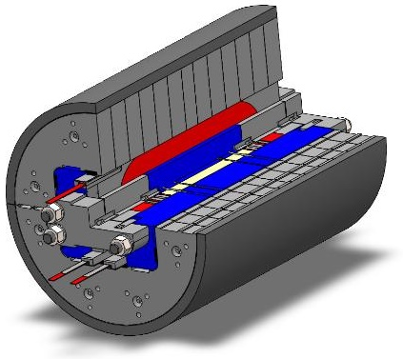
ISAAC Engineering design
Off-centering EM forces on the spacer, which is made of iron and stainless steel
Sliced stainless steel pad
One single shell
Position of strain gauges under evaluation
Connection plate design adapted to existing coil leads
Next steps:
Manufacturing drawings: February 2025
Detailed calculations: February 2025
Manufacturing: May 2025
Assembly: June 2025
Power test: Summer 2025

Slide 11
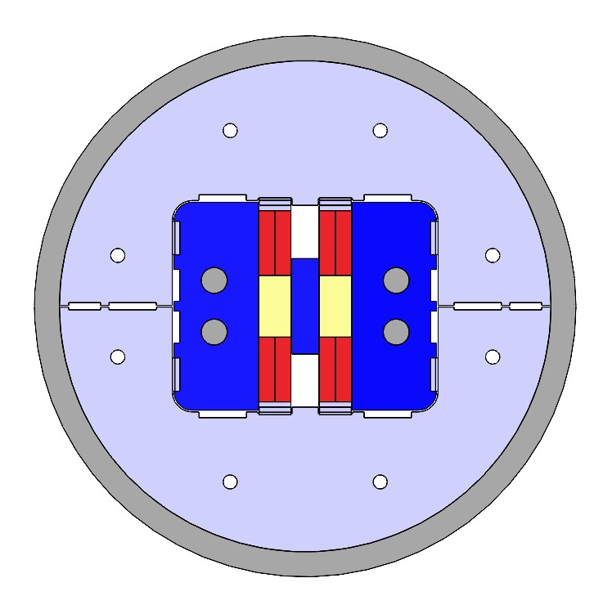
ISAAC Learned lessons (up to now)
Horizontal preload over the coil is difficult to apply, but a stiff support structure allows small coil displacement.
Glued titanium pole induces large shear and horizontal stresses at pole turn. No simple way to reduce them.
Short intrabeam distance decreases superconductor efficiency and induces repulsive vertical forces, that is, tensile stress at pole turn.
Off-centering forces on central spacer are difficult to hold.
Axial preload without contact at coil loading plate induces large shear stresses at glued pole turn.

Slide 13
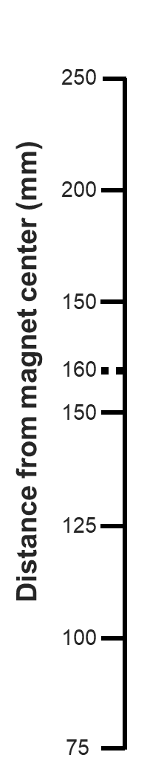
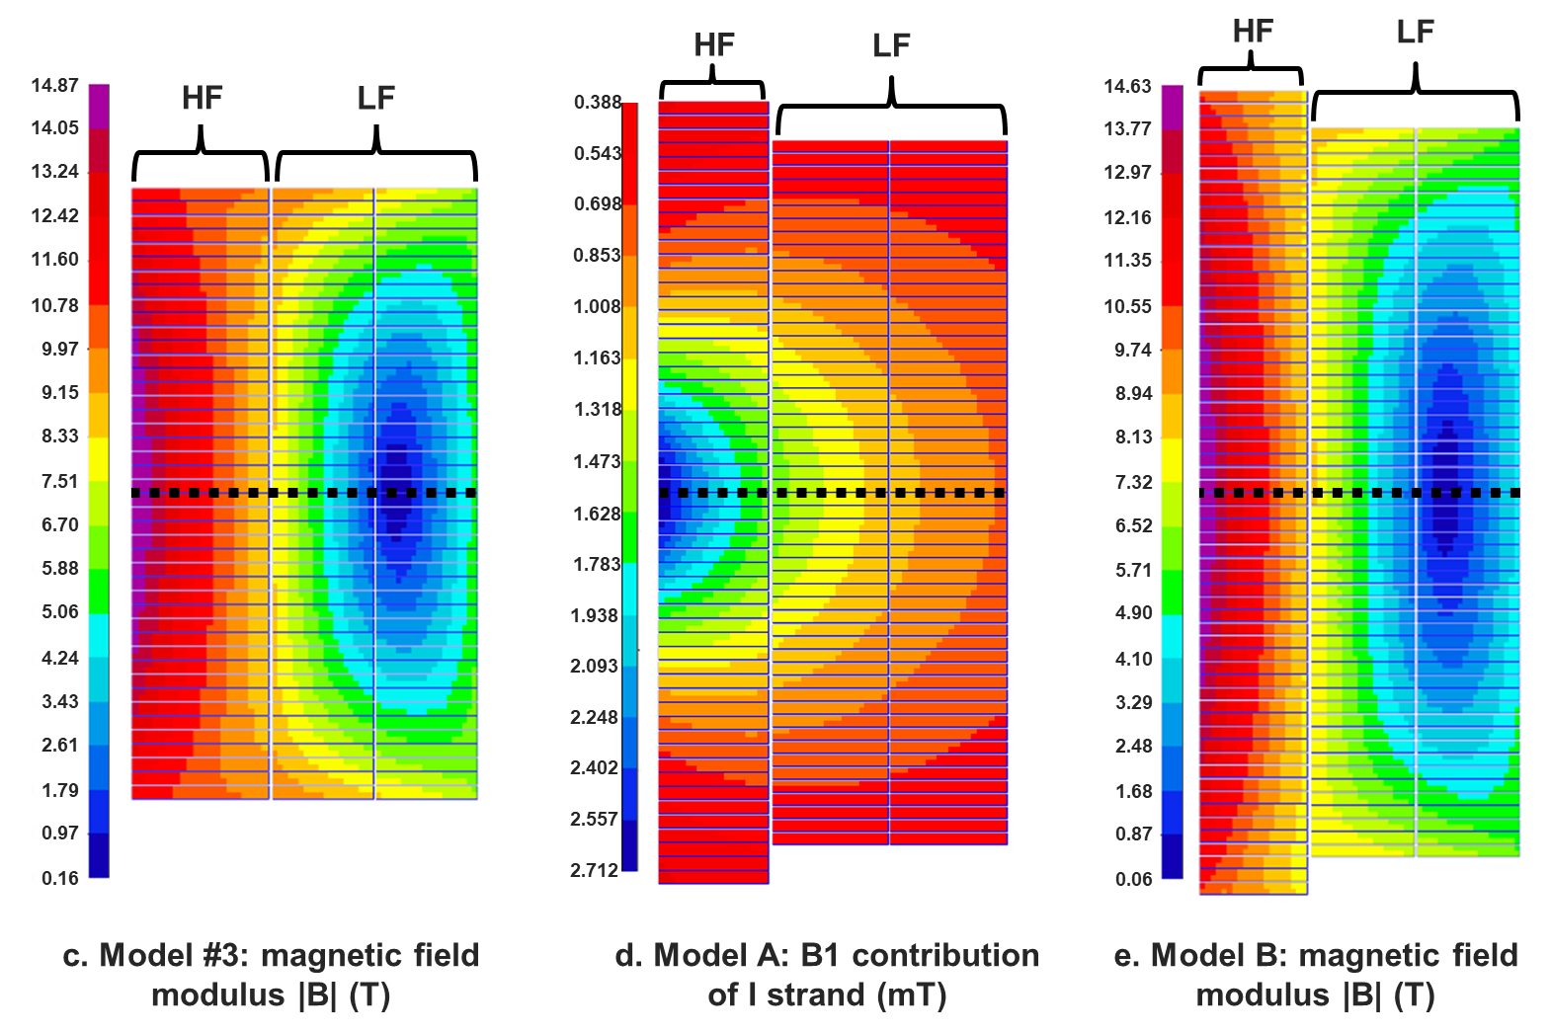
Previously in DAISY…
Nb₃Sn
NbTi
Nb₃Sn
NbTi
Nb₃Sn
Nb₃Sn
Sept’24 (ASC24): Several common coil designs evaluated with a fixed iron at 1.9 K. The use of NbTi for the low field region showed promising results.
Dec’24 (HFM Forum): The use of NbTi could be also an option at 4.5K assuming 1K temperature margin, saving around 30% of Nb₃Sn.
…. But those designs had not good field quality.
Strands | ERMC-1 | MBINL
Material | NB₃Sn | NbTi
Diameter [mm] | 1 | 1.2
Cu / Non Cu ratio | 0.9 | 1
Cu Area per strand [mm²] | 0.37 | 0.57
NbTi strand hypothesis (Suppliers consults ongoing)

Slide 14
The interest of a hybrid approach
Decrease superconductor cost
Reduce coil fabrication complexity
Reduce AC losses
Reduce magnetic instabilities
Mechanically, NbTi is not so easy to be degraded
Goals pursued since Dec’24
  Obtain two accelerator-like designs: field quality, low multipole variation with the current and efficient:
      All Nb3Sn using ERMC-1 strand
      Hybrid using ERMC-1 strand + NbTi (hypothetic strand)
  Working temperature 1.9 K (4.5 K will be studied later if required)
  Compare both designs to assess the hybrid approach.
  Easy to manufacture: try to avoid pole coils if possible.

Slide 15
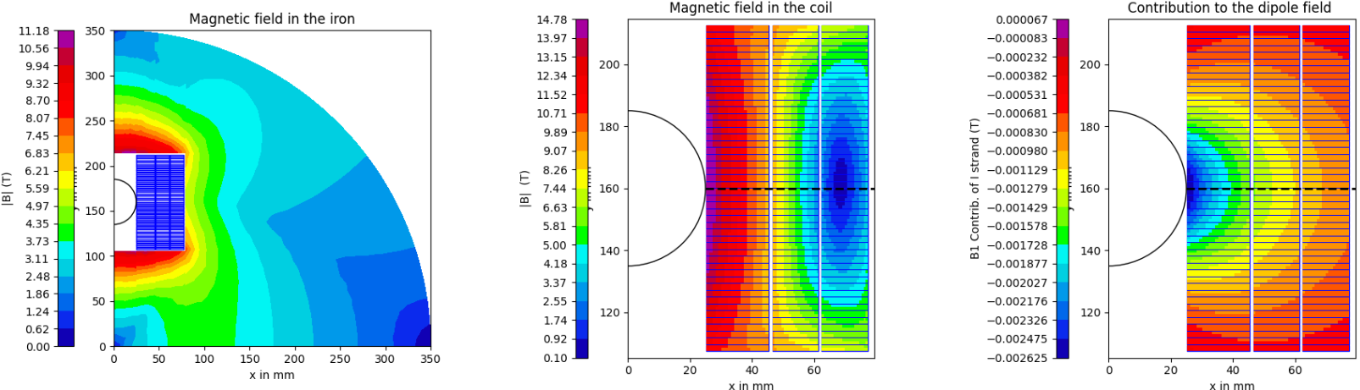
Minimum amount of superconductor
REF01 will be our reference model:
No field quality: solid coil blocks
Large multipole variation with the current: iron is close to aperture
But… Maximum superconductor efficiency
*All models for 320 mm of intrabeam distance and 14T in a 50 mm aperture. Maximum hot spot temperature below 270 K.

Slide 16
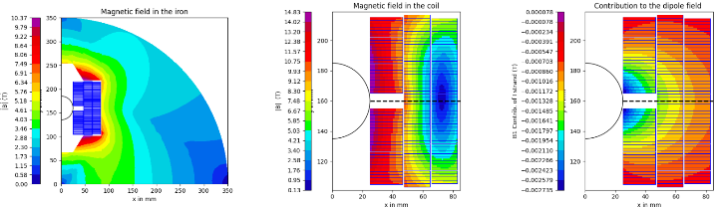
Field quality without pole coils
REF02 is an intermediate step:
Better field quality, but not good enough: 10 mm gap at midplane of HF coil
Multipole variation with the current is decreased
55-mm coil equivalent width: 13% more Nb₃Sn
Next step is to improve field quality
*All models for 320 mm of intrabeam distance and 14T in a 50 mm aperture.
Maximum hot spot temperature below 270 K.

Slide 17
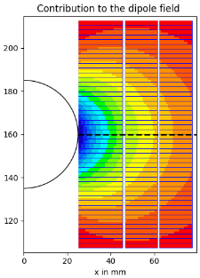
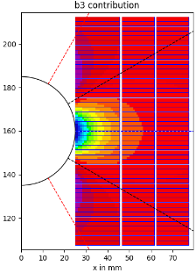

Field quality in a common coil magnet: dealing with a large sextupole
Midplane region is the cause of the large b₃ in the common coil, but removing those cables has a strong impact on efficiency.
Contribution of cables to b₃ decreases sharply with radial distance.
Another option is to place cables in the highlighted areas by means of ancillary coils.
To avoid non-planar ancillary coils the upper region should be discarded.

Slide 18
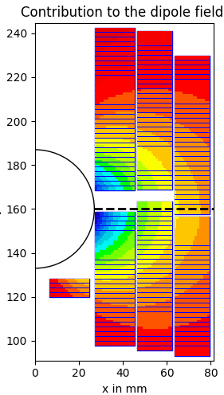
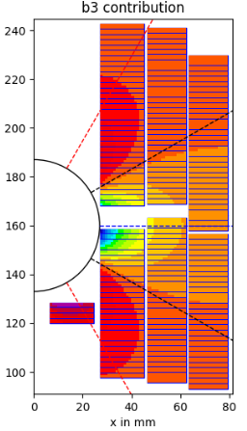
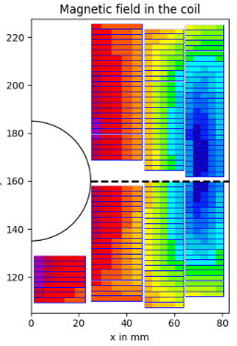
Field quality in a common coil: exploring the asymmetric field quality coil
D. Araujo, B. Auchmann, A. Brem, T. Michlmayr, A. Haziot and E. Ravaioli, "Electromechanical Design of Nb3Sn Stress Managed Asymmetric Common-Coils". Article DOI: 10.1109/TASC.2025.3532906.
Mechanics!! This additional coil feels a force towards the aperture. Some support structure is required.
The sextupole can be compensated with this coil but the midplane gap is still large, losing efficiency.
F_{y}
F_{y}
F_{y}
If the cable needs to be wide, it is very near the vertical axis where all the magnetic flux is concentrated, leading to high peak field/load and low efficiency.
Only few strands hit the maximum b₃ contribution region and the block has a low contribution to the main field

Slide 19
Field quality in a common coil: What if…?
…we move the lower turns towards the aperture?
Sextupole compensation should be more efficient

Slide 20
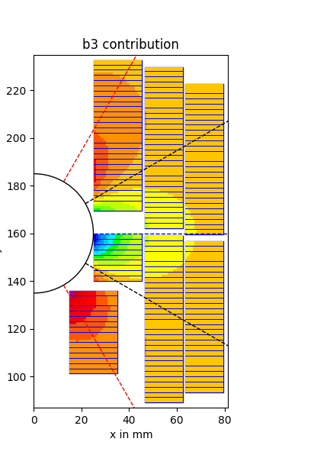
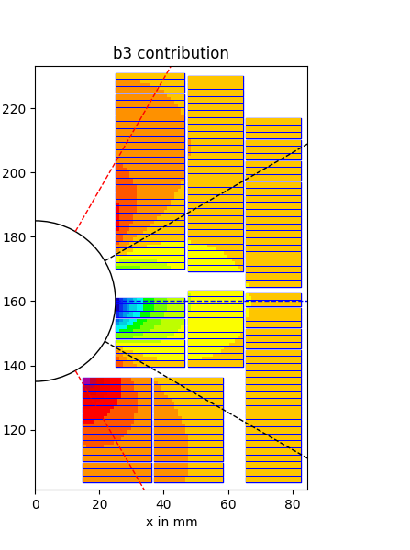
Field quality in a common coil: What if…?
…we move the lower turns towards the aperture?
Sextupole compensation should be more efficient
Main field efficiency is lost in the gap around the pole coil, but it is further from the aperture.
SN_1
SN_2

Slide 21
Field quality in a common coil: What if…?
…we move the lower turns towards the aperture?
Sextupole compensation should be more efficient
Main field efficiency is lost in the gap around the pole coil, but it is further from the aperture.
A casing could hold the EM forces.
SN_1
SN_2

Slide 22

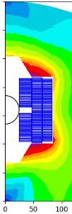
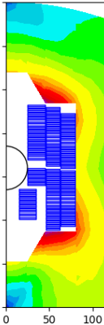
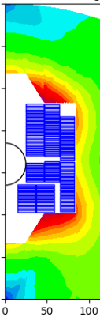
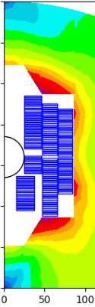
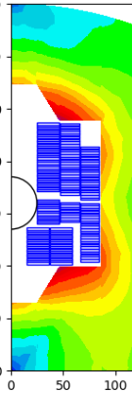
Comparing these models with the previous ones
NbTi
NbTi
Good field quality
Low multipole variation with current
The hybrid options save a significant amount of Nb₃Sn!!!
Temperature margin at NbTi is around 2K, more than current LHC main dipoles (1.3K)
*All models for 320 mm of intrabeam distance and 14T in a 50 mm aperture

Slide 23
DAISY: design guidelines
DAISY will be our first common coil magnet demonstrator:
  We propose not featuring accelerator field quality, but addressing the mechanics of a hybrid magnet.
  It will have a high field coil with a single layer of Nb₃Sn cables and a double pancake coil with NbTi cables.
Schedule:
  Calculations: June 2025
  Cable orders: May 2025
  Manufacturing drawings: October 2025
  Tooling: March 2026
  Coil fabrication: September 2026
  Magnet assembly: November 2026
  Magnet test: January 2027
In a second step, we would target a hybrid common coil magnet performing accelerator field quality.

Slide 24
Conclusions
CIEMAT is contributing to HFM Programme by means of common coil magnets.
ISAAC is a model magnet made using existing RMC coils. Mechanics is based on a low preload concept. Magnet test is foreseen for next summer.
We have explored the space design of common coil magnets providing 14 T in a 50 mm aperture at 1.9 K.
We have found very promising results for hybrid magnets using Nb₃Sn and NbTi coils.
DAISY will be our first common coil magnet demonstrator. We propose not featuring accelerator field quality, but addressing the mechanics of a hybrid magnet. Calculations will be finished by June.
In a second step, we would target a hybrid common coil magnet performing accelerator field quality.

Slide 25
Extra slides

Slide 26



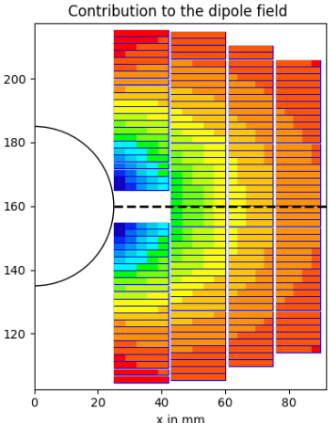



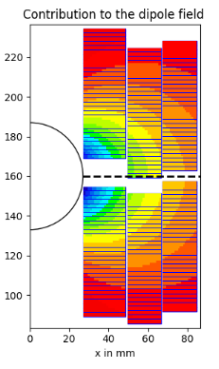


Tuning the GA fitness function
Script #1
Roxie23 environment
Start
Optimal design
Input data
QH
EQW
FQ
LOAD
Genetic Algorithm
(in-house development)
Roxie23
(RoxieAPI [1])
Optimal design results & plots
Equivalent width (EQW): Tends to adapt the coil shape for the better contribution of each strand to the main field, decreasing turns and strands per cable.
Field quality (FQ): Tends to use a lot of superconductor and makes the coils tall (less strands, more turns).
Quench performance (QH): Penalizing J_{cu} avoid using fewer strands than necessary, therefore, controlling hot spot temperature.
Load requirement (LOAD): Usually tends to use more strands than necessary. It is the easier to manually tune later.
Manual tuning of the model
model.output
Coherent
cable libraries
model_induc.output
Script #2
Compute quench and retrieve results
Quench computation [2]
Model
comparison
Results
Stop
[1] M. Bonora, ‘Interfacing with ROXIE: Scripting, Python, and Model Based Design’, presented at the ROXIE Users Workshop: ROXIE 23 Launch Event, Accessed: Jan. 23, 2024. [Online]. Available: https://indico.cern.ch/event/1318061/contributions/5574693/attachments/2711597/4708647/interfacing_roxie.pdf
[2] T. Salmi et al., ‘Quench protection analysis integrated in the design of dipoles for the Future Circular Collider’, Phys. Rev. Accel. Beams, vol. 20, no. 3, p. 032401, Mar. 2017, doi: 10.1103/PhysRevAccelBeams.20.032401.

Slide 27
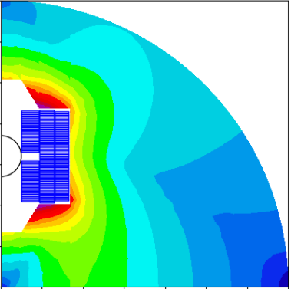
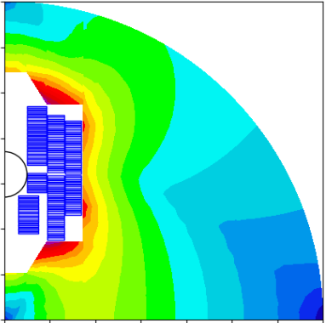
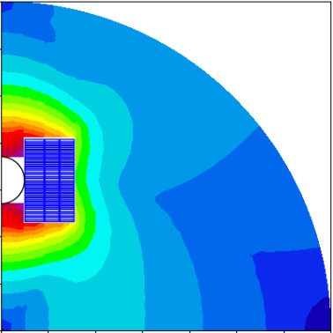
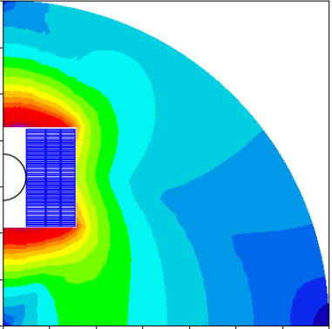
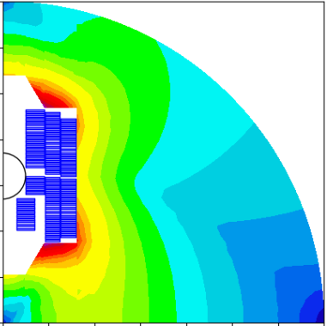
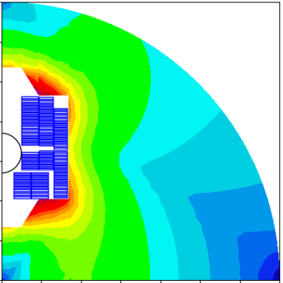
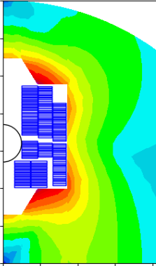
*All models for 320 mm of intrabeam distance and 14T in a 50 mm aperture

Slide 28
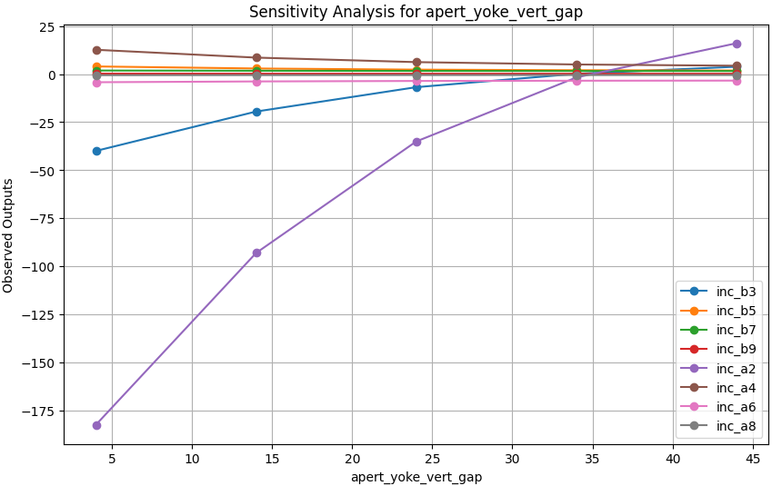
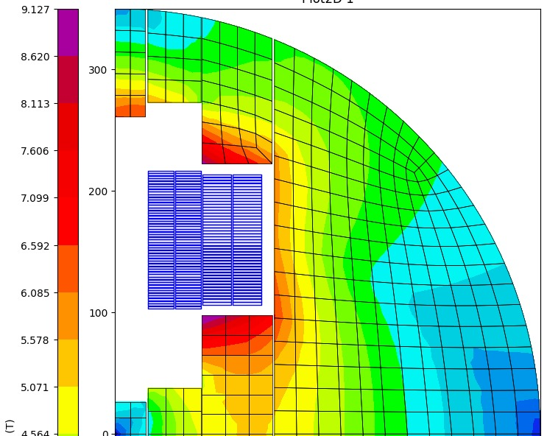
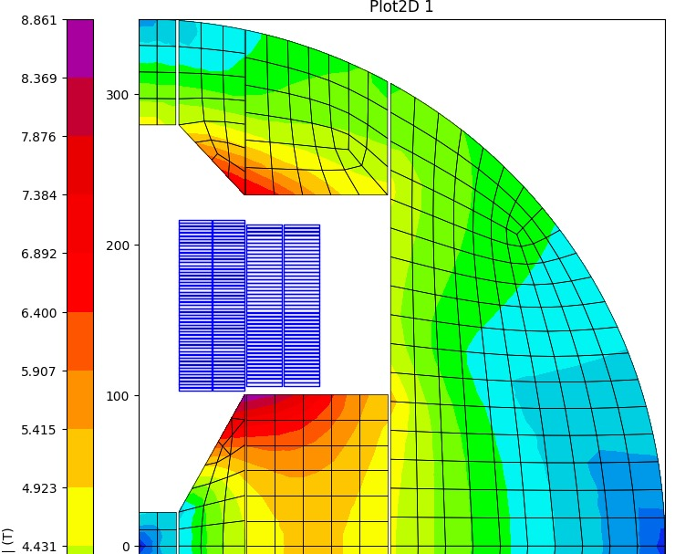
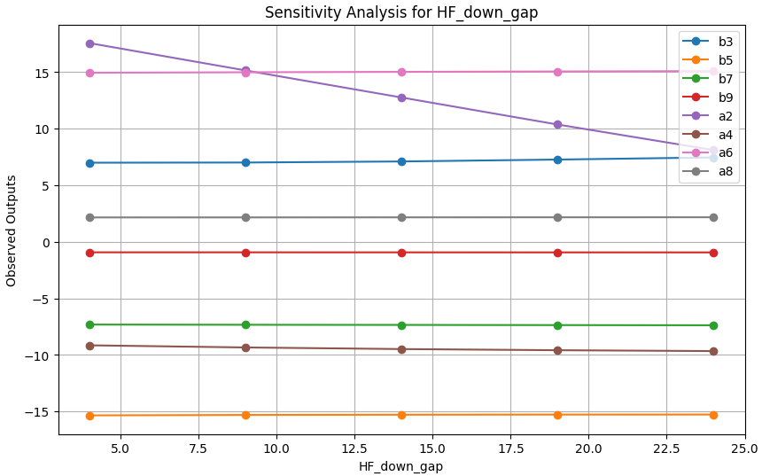
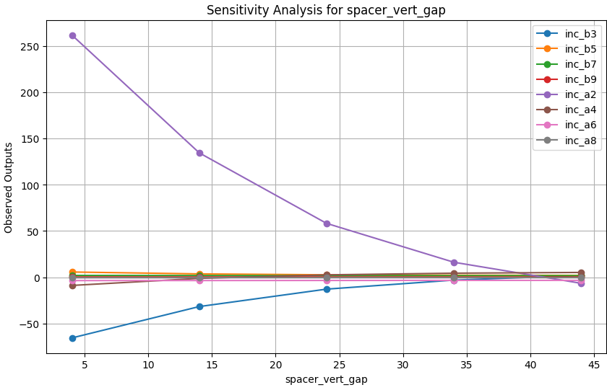
Reducing multipoles variation (GA + Sensitivity analisis)
Determined by iron gaps: around 30 mm gap between coil and aperture is recommended.
These gaps modify also a₂: They should be tuned together with the field quality as a final optimization step.

