Slide 1
PSI Roadmap towards High-Field Magnets
HFM Annual Meeting 2025
D. Araujo, B. Auchmann, A. Brem, T. Michlmayr, A. Stampfli and C. Müller
A. Haziot and E. Ravaioli (CERN)
This work was performed under the auspices of and with support from the Swiss Accelerator Research and Technology (CHART) program.
February 11, 2025

Slide 2


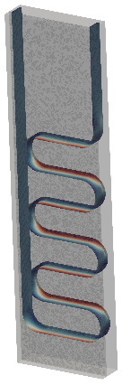
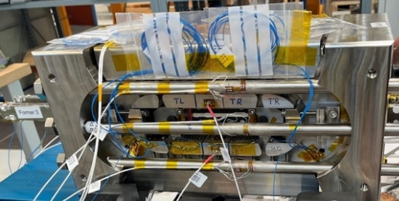
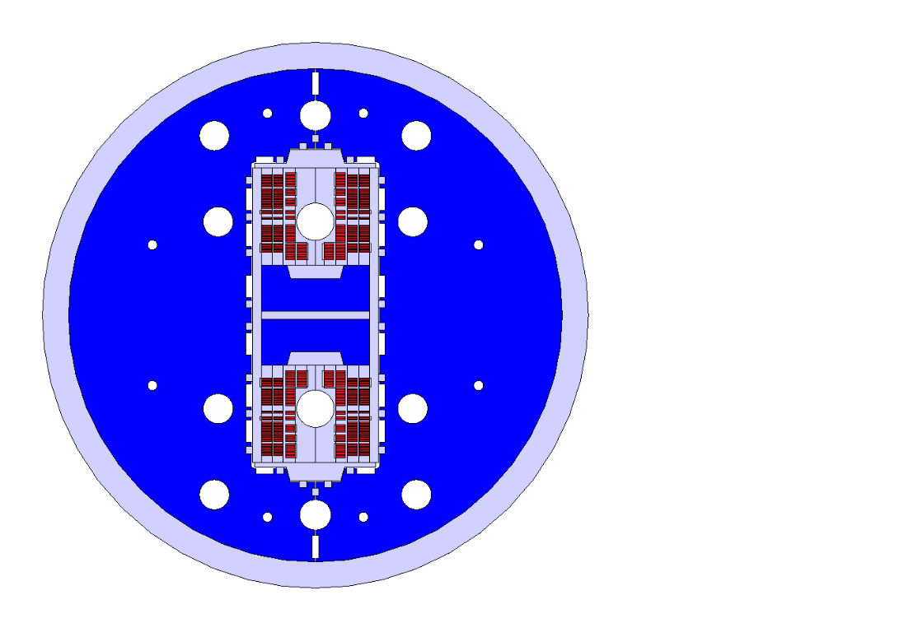
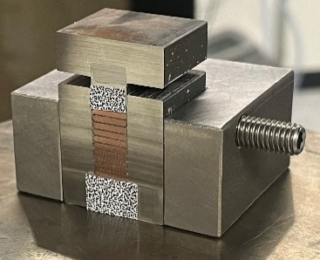
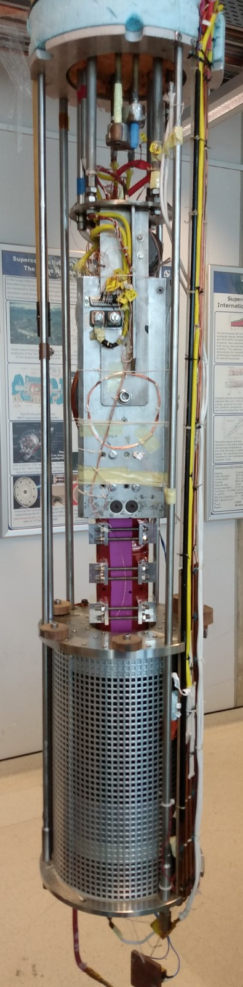
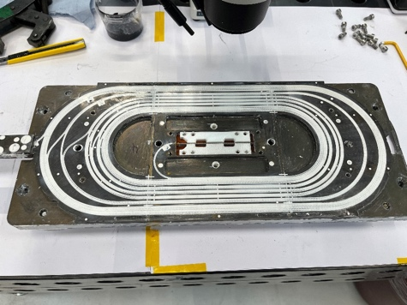
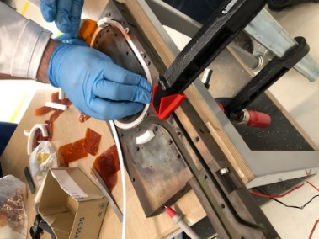
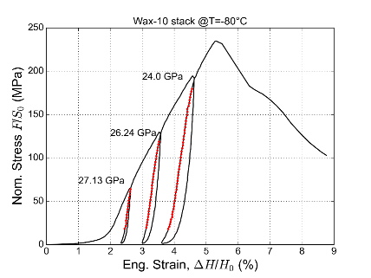

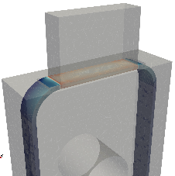
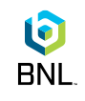

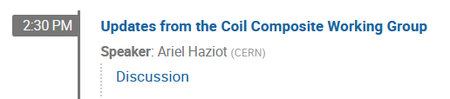
CHART2 Stress-Management R&D
Composite
Characterization
and Modeling
Intermediate Field
Demonstrator
Powered Samples
Coil Demonstrator
Subscale Magnets
Courtesy, X. Kong,
Prof. Tervoort and J. Eijnden
Courtesy, R. Gupta
subscale stress-managed
common coil 1
BigBOX2: Stress-Managed
Coil Demonstrator Under
High-Magnet Field
subscale stress-managed
common coil 2 - ESC
Stress-managed asymmetric
common coil 1 – SMACC1
Courtesy, S. Otten and J. Eijnden

Slide 3
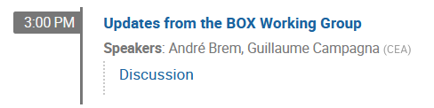
CHART2 Stress-Management R&D
Composite
Characterization
and Modeling
Intermediate Field
Demonstrator
Powered Samples
Coil Demonstrator
Subscale Magnets
Courtesy, X. Kong and
J. Eijnden
Courtesy, R. Gupta
subscale stress-managed
common coil 1
BigBOX2: Stress-Managed
Coil Demonstrator Under
High-Magnet Field
subscale stress-managed
common coil 2 - ESC
Stress-managed asymmetric
common coil 1 – SMACC1
Courtesy, S. Otten and J. Eijnden

Slide 4
CHART2 Stress-Management R&D
Composite
Characterization
and Modeling
Intermediate Field
Demonstrator
Powered Samples
Coil Demonstrator
Subscale Magnets
Courtesy, X. Kong and
J. Eijnden
Courtesy, R. Gupta
subscale stress-managed
common coil 1
BigBOX2: Stress-Managed
Coil Demonstrator Under
High-Magnet Field
subscale stress-managed
common coil 2 - ESC
Stress-managed asymmetric
common coil 1 – SMACC1
Courtesy, S. Otten and J. Eijnden
This Presentation

Slide 5
Agenda
Stress-managed coil demonstrator under high-magnet field (BigBOX2)
Subscale Stress-Managed Common Coil Magnet (subscale SMCC1)
Validation of ESC protection system (subscale SMCC2)
Stress-Managed Asymmetric Common Coil Magnet (SMACC1)
Outlook for CHART2 2025 developments and tests

Slide 6
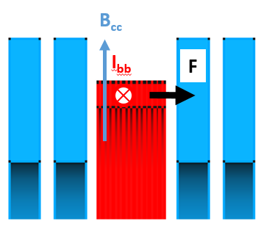
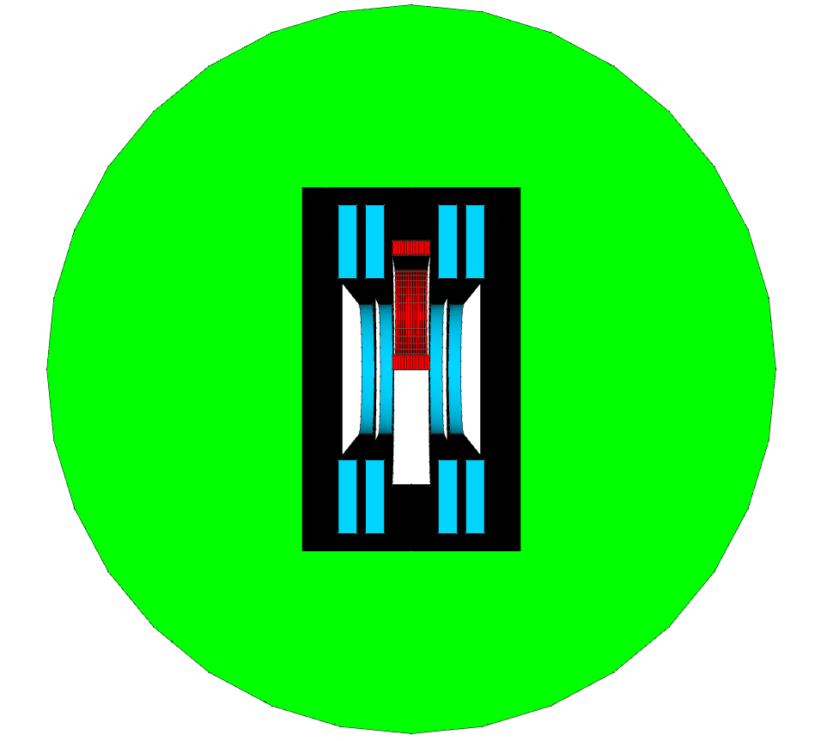

BigBOX: Stress-Managed Coil
Demonstrator Under High-Magnet Field
Assessing coil performance: Nb₃Sn degradation, load line fraction and coil training behavior
Validating technologies: pre-load free coil, interface conditions, impregnation systems, stress-managed structure and ceramic insulation coating
Stress-Managed Coil and DCC Integration designed and manufactured at PSI
DCC17 Magnet
BigBOX and DCC17
Testing campaign
Cable manufactured at LBNL

Slide 7
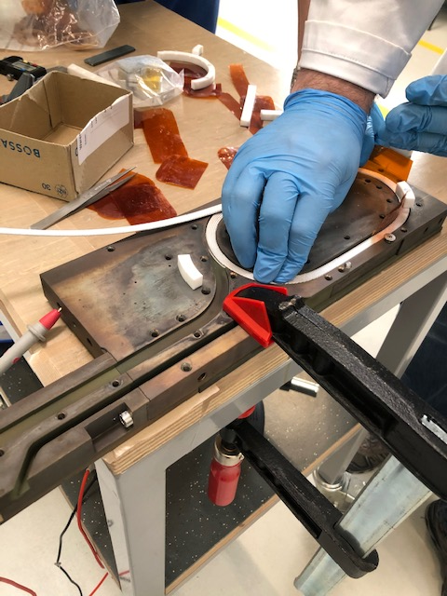
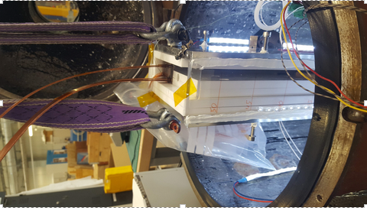
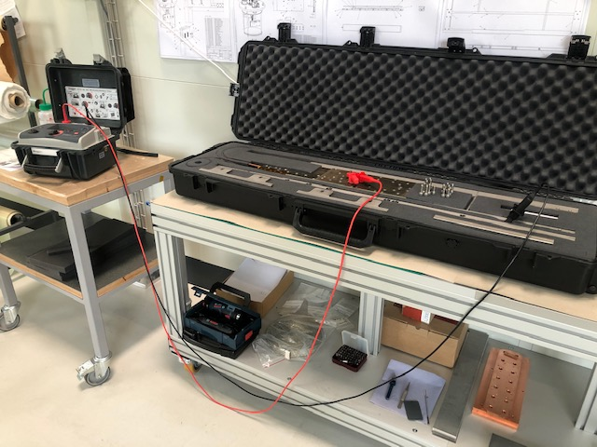
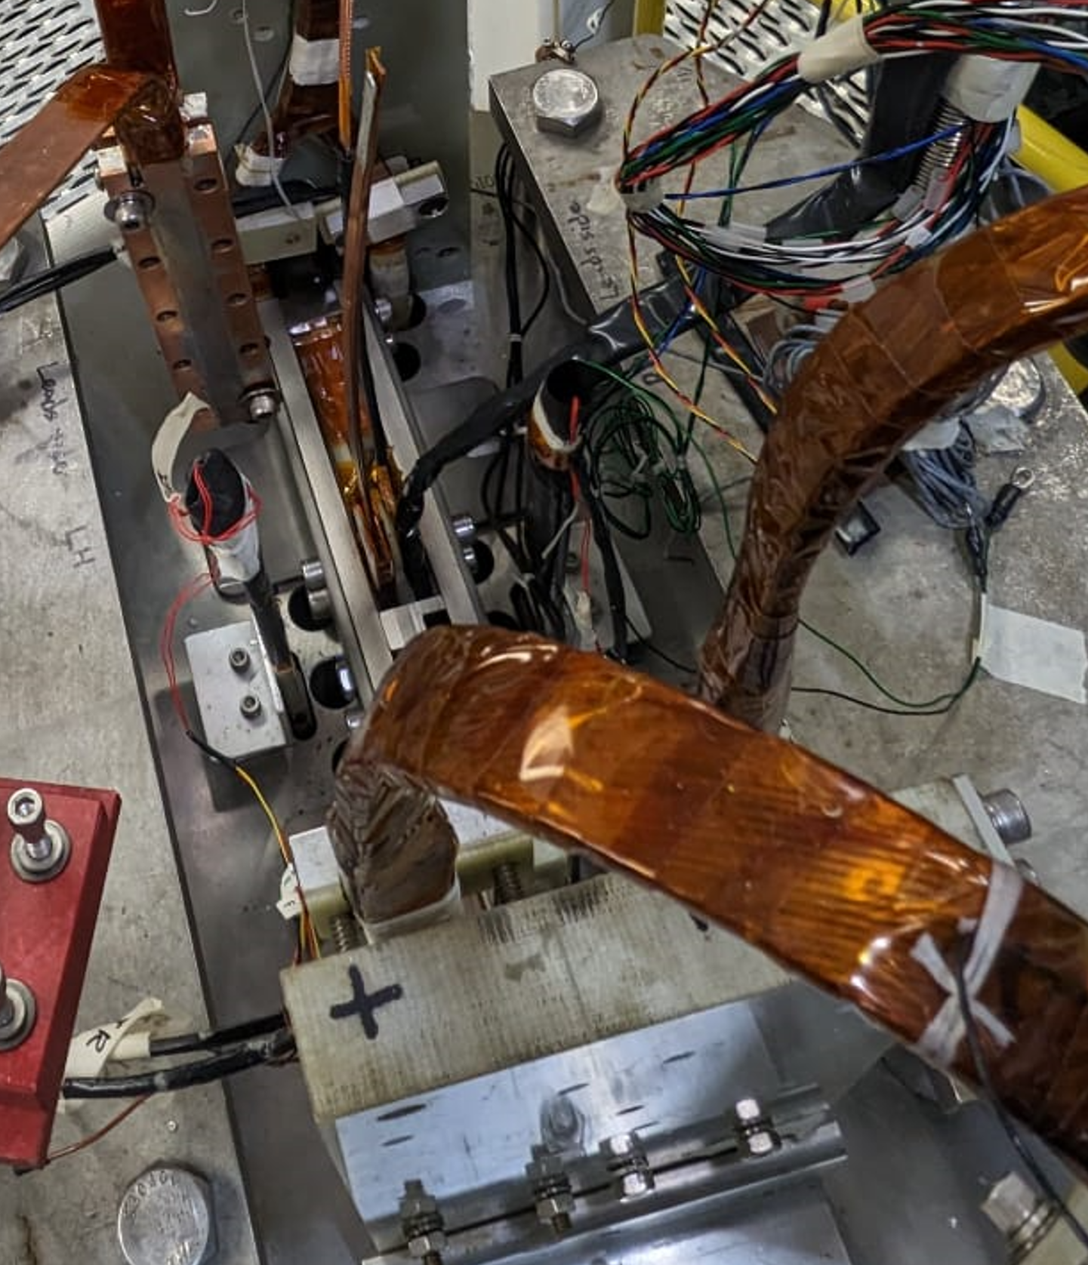
BigBOX1: Manufacturing Steps and Results
Winding Impregnation (Wax)
6 times power-up to short sample limit without training
Electrical Tests Integration
Test Results: courtesy R. Gupta, P. Joshi and M. Kumar
D. M. Araujo et al., “Assessment of Training Performance, Degradation and Robustness of Paraffin-Wax Impregnated Nb₃Sn Demonstrator Under High Magnetic Field,” IEEE Trans. Appl. Supercond., vol. 34, no. 5, pp. 1–8, Aug. 2024, doi: 10.1109/TASC.2024.3368995.

Slide 8
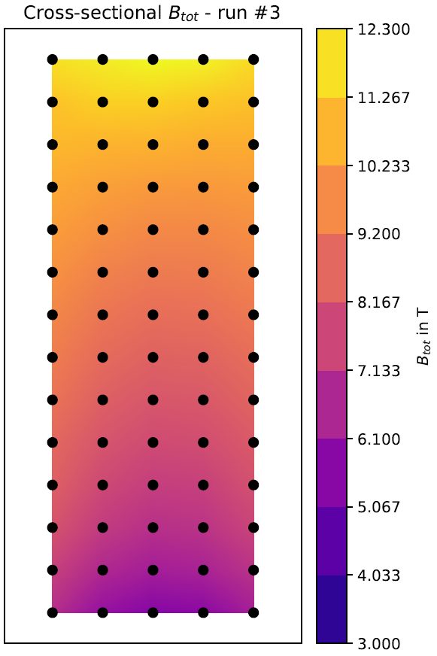
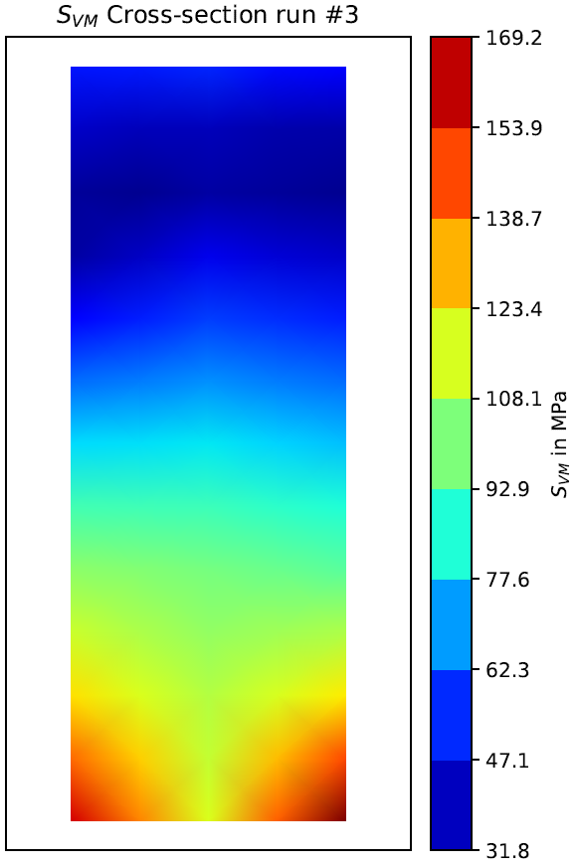
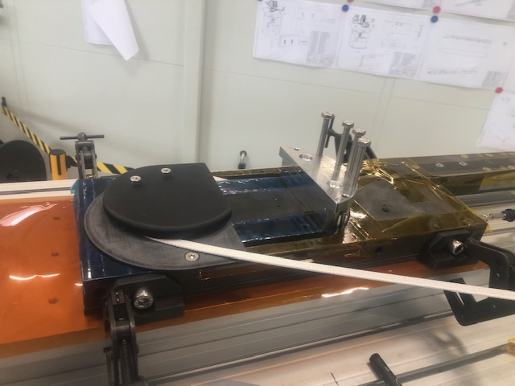
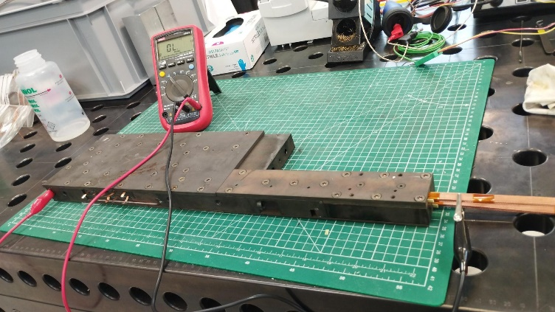
From BigBOX1 to BigBOX2
BigBOX1: powered in a single direction
Impregnation system: paraffin wax
BigBOX2: powering in two direction (assessment of degradation) and Impregnation System: filled paraffin Wax comparable to BOX 7 and 8.
BigBOX2 was manufactured and delivered to BNL in 2024
BigBOX2 is scheduled to be tested in March 2025
Peak field of 12.3 T
Peak of Stress of 170 MPa

Slide 10
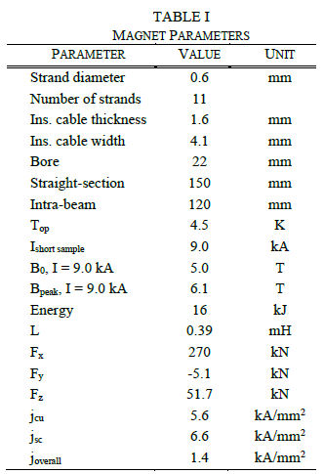
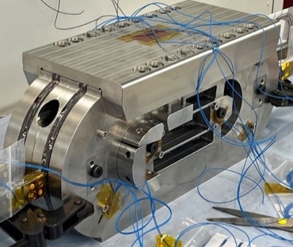
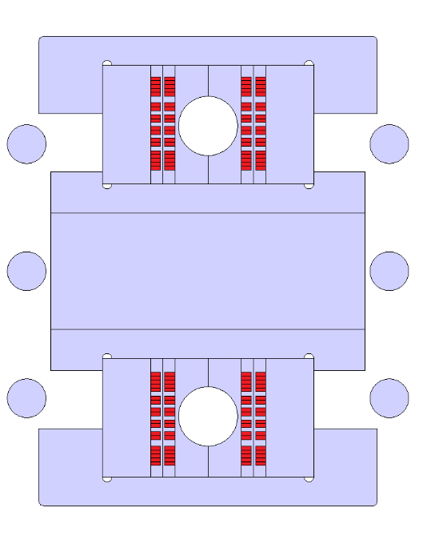
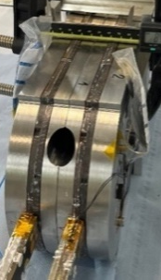


Subscale Stress-Managed Common Coil Magnet (subscale SMCC1)
Stress-managed common coil concept
Validating manufacturing processes and technologies: re-use of tooling from winding to the final assembly, layer to layer splicing, impregnation system, ceramic coating
Outer
pad
Magnet Concept, design and manufacturing by PSI
Inner
pad
Cable manufactured at LBNL
Coils
End
plate
Heat Treatment of 2 of 4 coils and testing campaign
Rods

Slide 11
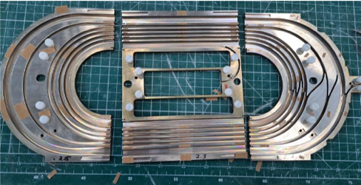
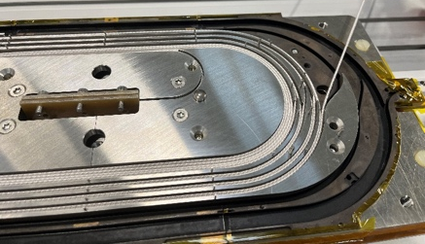
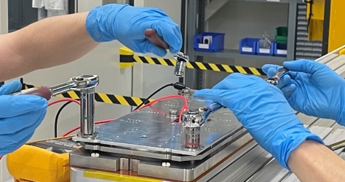
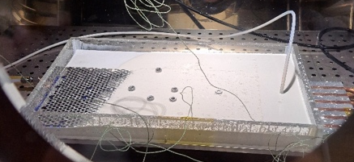
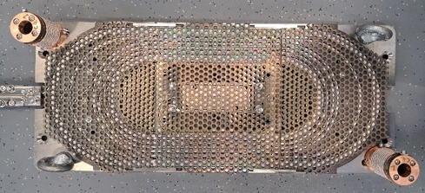
Subscale Stress-Managed Common Coil Magnet (subscale SMCC1)
Stress-managed coil: Nb₃Sn manufacturing steps
D. Araujo et al., “Subscale Stress-Managed Common Coil Design,” IEEE Transactions on Applied Superconductivity, vol. 34, no. 5, pp. 1–5, Aug. 2024, doi: 10.1109/TASC.2024.3360220.

Slide 12
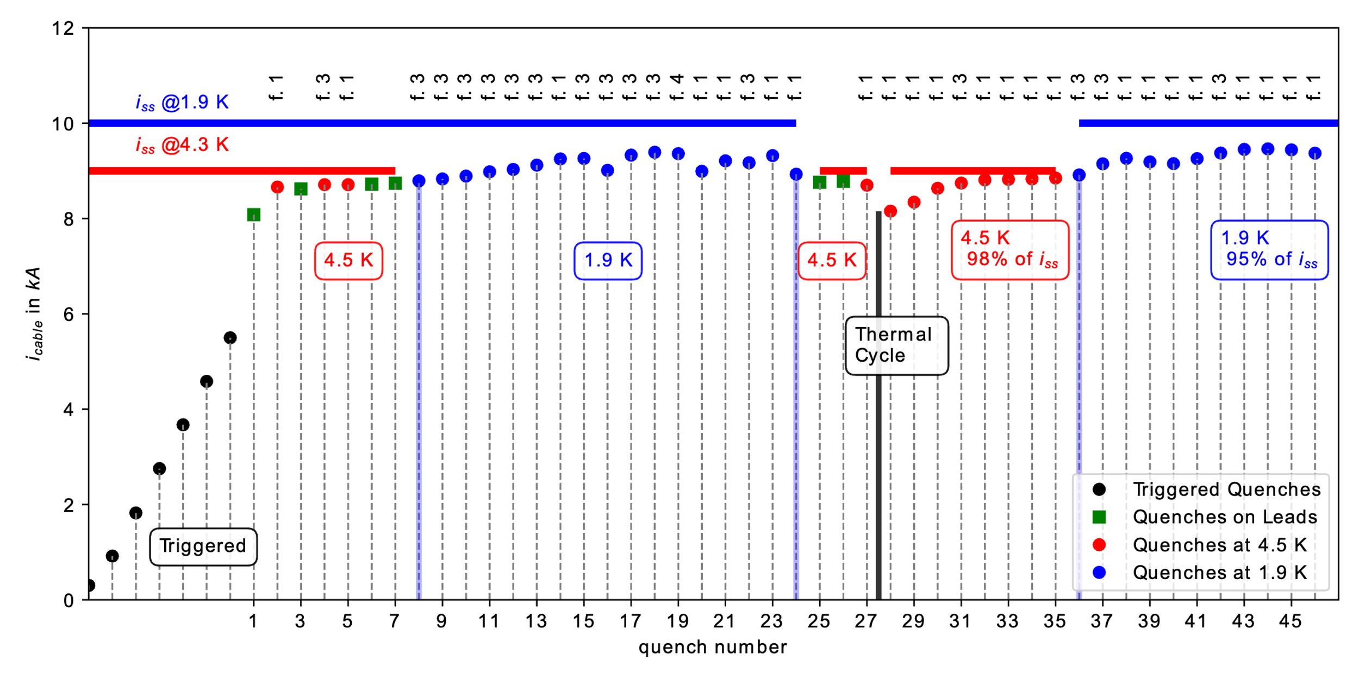
Subscale Stress-Managed Common Coil Magnet
(subscale SMCC1)
Test Results courtesy G. Willering, et al.
Test campaign started in May 2024
D. Araujo et al., “Manufacturing and Testing of the First Nb3Sn Subscale Stress-Managed Common Coil: 2-in-1 Dipole Magnet Developed at the Paul Scherrer Intitute,” IEEE Transactions on Applied Superconductivity, 2025.

Slide 14
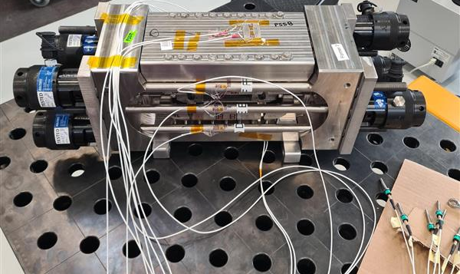
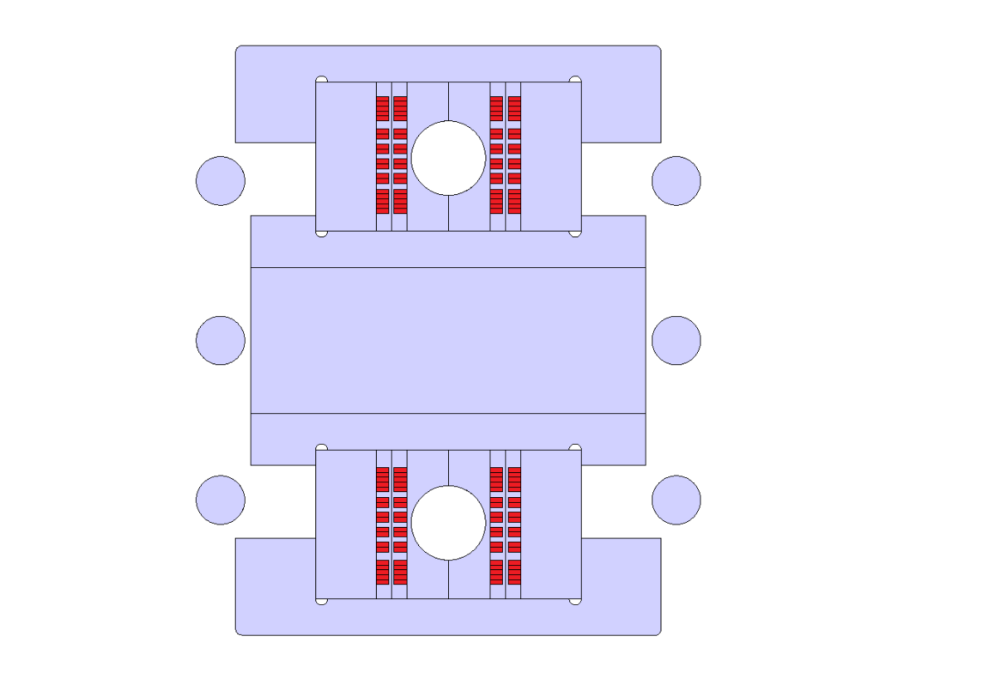
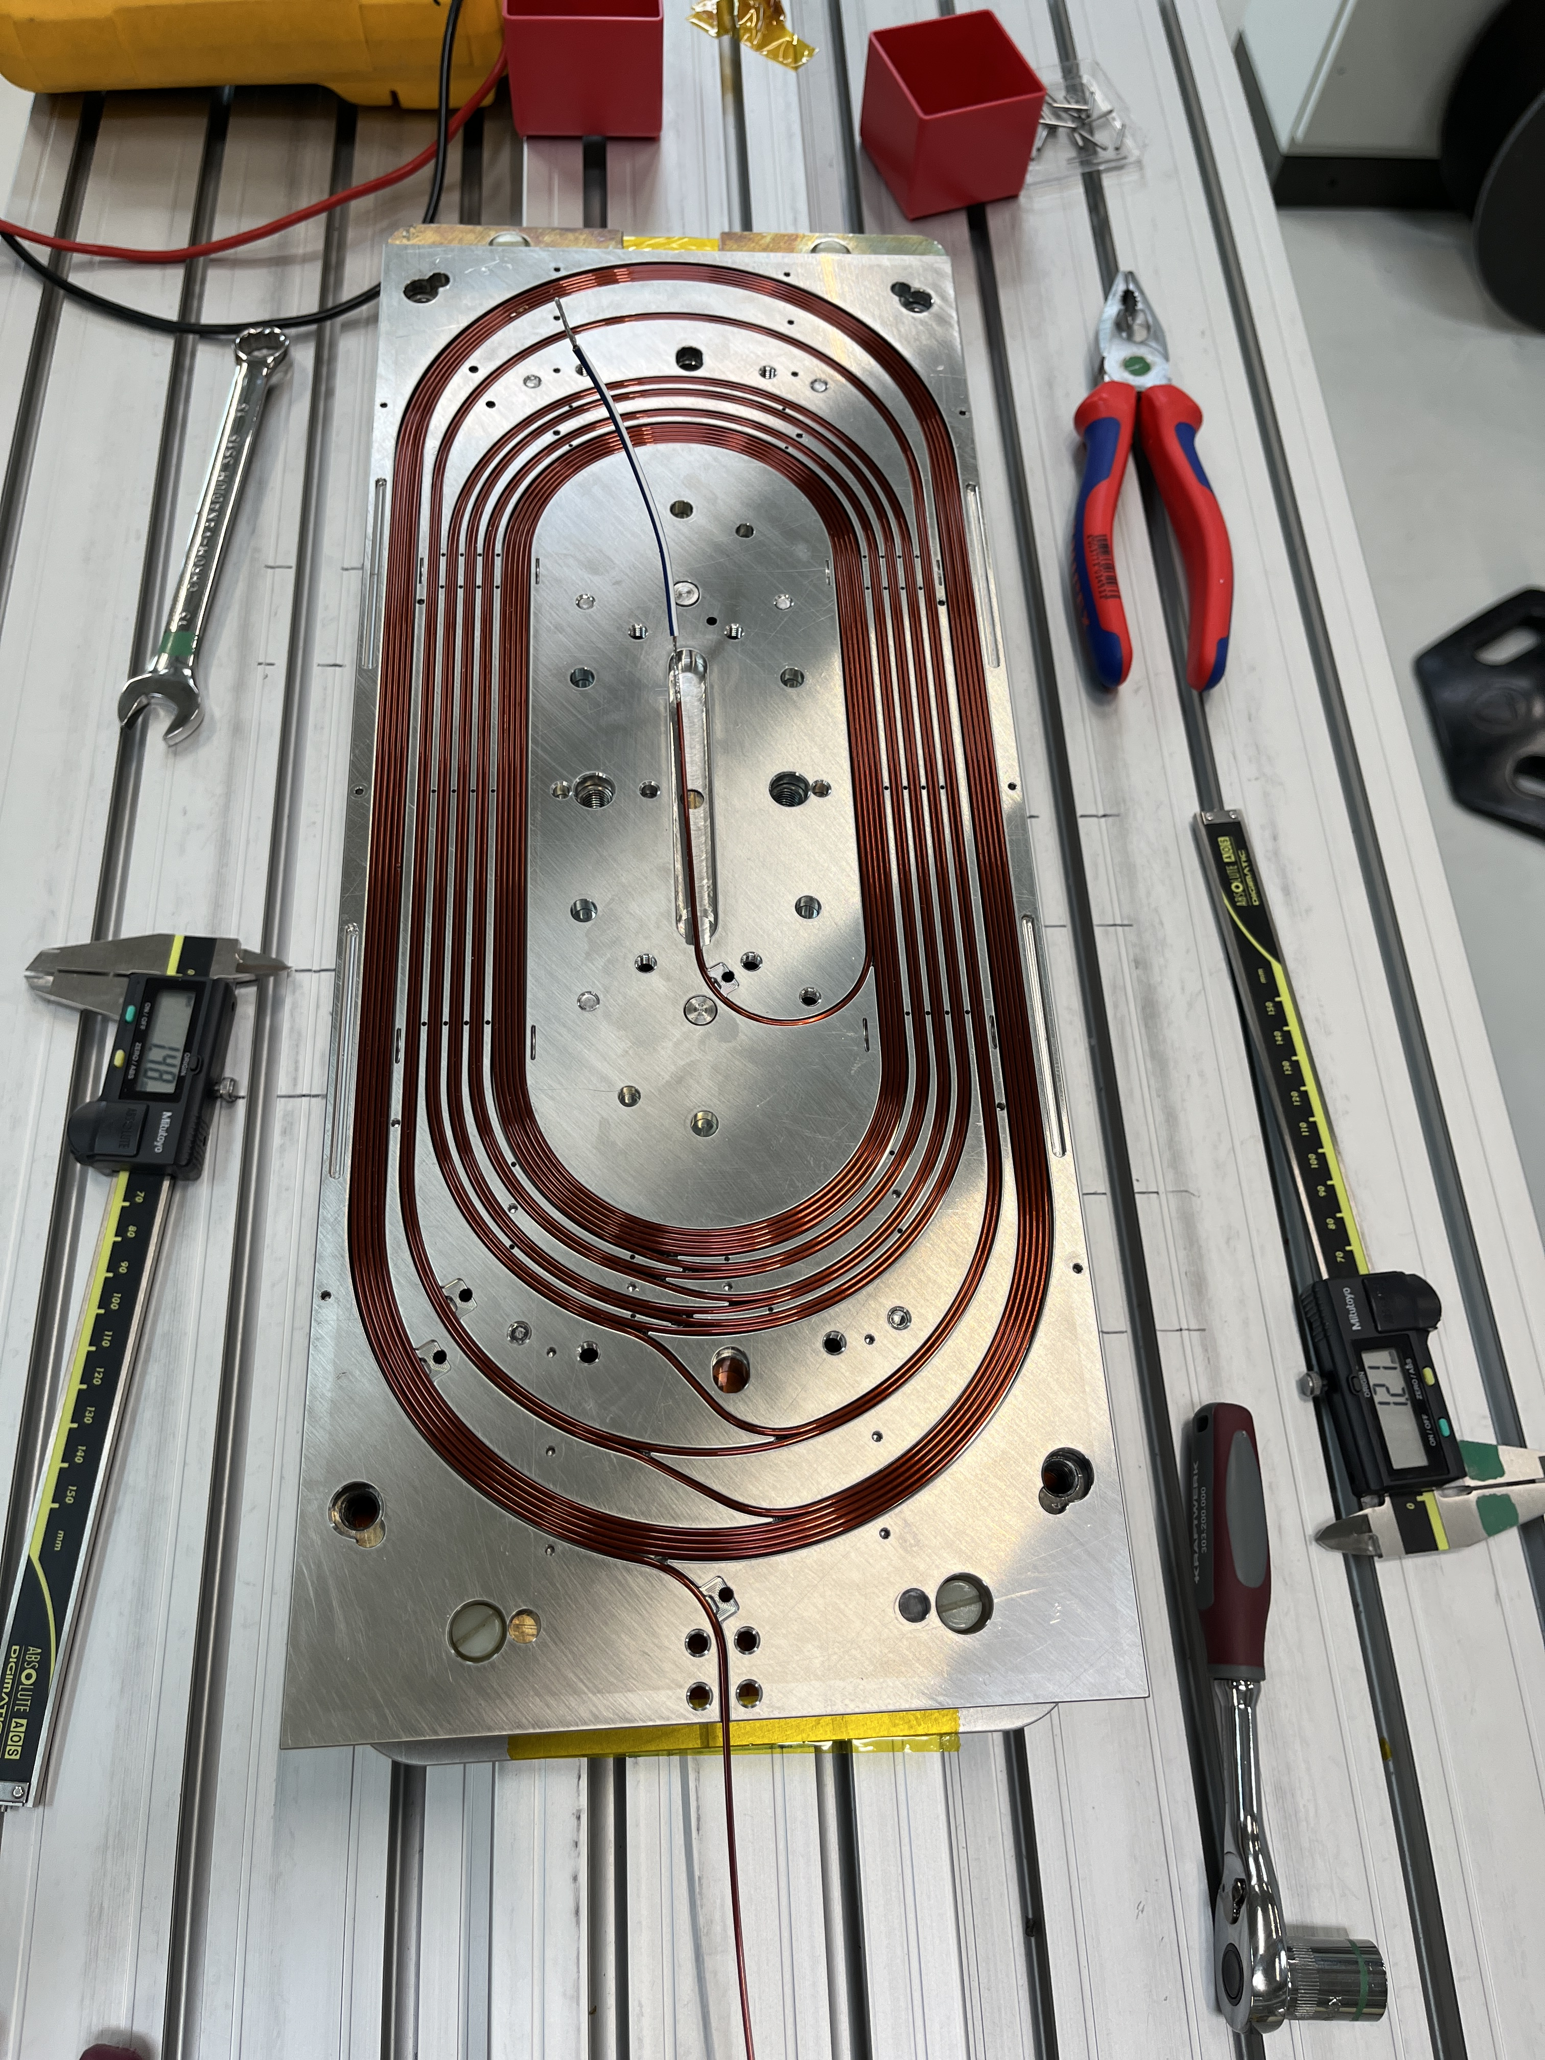
Validation of ESC protection system
(subscale SMCC2)
Subscale SMCC1
4 x stress-managed Nb₃Sn coils
Energy Extraction
Subscale SMCC2
+ 4 x stress-managed Cu coils
Energy Shift Coupling (ESC)
Blank assembly of subscale SMCC2
Copper coils winding trials
E. Ravaioli, A. Verweij, and M. Wozniak, “Energy shift with coupling (ESC): a new quench protection method,” Supercond. Sci. Technol., Jan. 2025, doi: 10.1088/1361-6668/ada833.

Slide 16
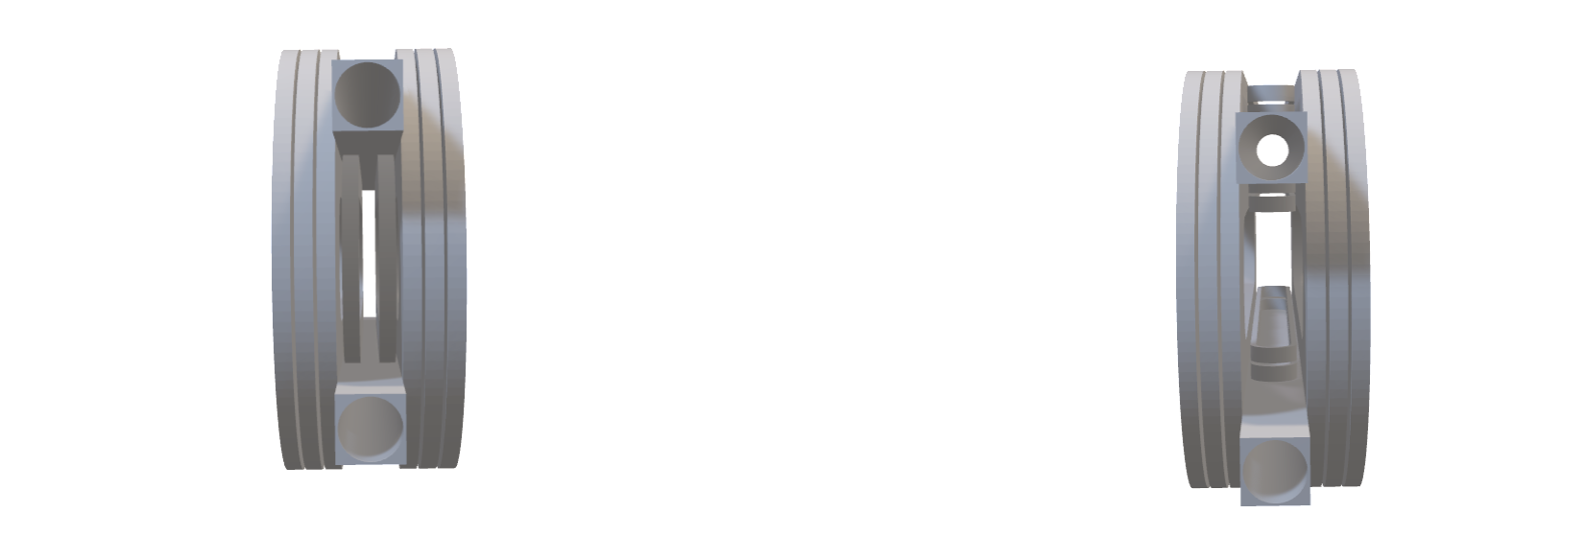
Stress-Managed Asymmetric Common Coil Magnet (SMACC1)
Asymmetric Common Coil concept
Double
pancake
racetracks
Apertures
Common-coils
Combined with stress-managed common coil concept
D. Araujo et al., “Electromechanical Design of Nb₃Sn Stress-Managed Asymmetric Common-Coils,” IEEE Transactions on Applied Superconductivity, 2025.

Slide 17
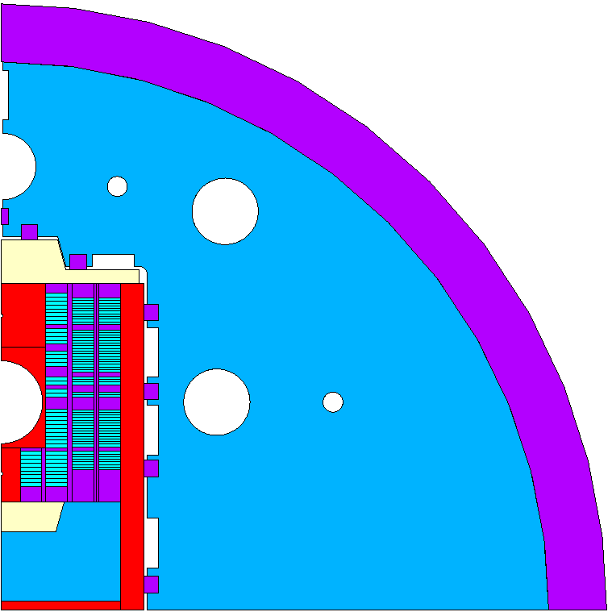
Cable, Magnet Parameters and Cross-section
Type | High-Field | Low-Field
Wire type | Nb₃Sn RRP® 162/169 | Nb₃Sn RRP® 78/91
CERN Wire Denomination | DEM-1.1 | ERMC-0.7
N wire x dia in mm | 21 x 1.1 | 34 x 0.7
Cu/nCu | 0.9 | 1.2
Bare Cable dimensions in mm | 12.74 x 2.06 | 12.74 x 1.31
Insulation thickness in mm | 0.155 | 0.155
Length Availability | - | 400 m
Cable Originally Designed for | R2D2 | -
B₀ in T | B_{peak} in T | T_{op} in K | % Margin | I_{op} in kA
12.0 | 12.6 (+5%) | 1.9 | 24.1 | 12.9
13.0 | 13.7 | 1.9 | 17.1 | 14.1
14.0 | 14.7 | 1.9 | 10.0 | 15.3
15.4 | 16.2 | 1.9 | 0 | 17.0
List of parameters provided in the annex
Field quality: -10 to + 15 units on the cross-section from 1 to 12 T
Dext shell = 740 mm
Shell thickness = 35 mm
Cooling channels and rod holes d = 40 mm
Horizontal pad and non-magnetic pole
iron pole and yoke
Shell, keys and coil formers
Outer vertical pad
Design based on existent cable

Slide 18
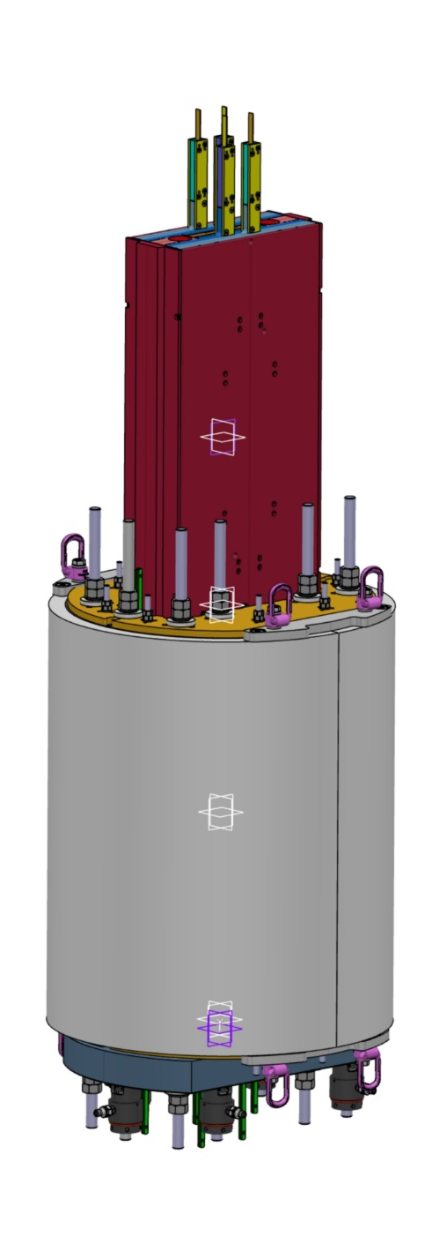
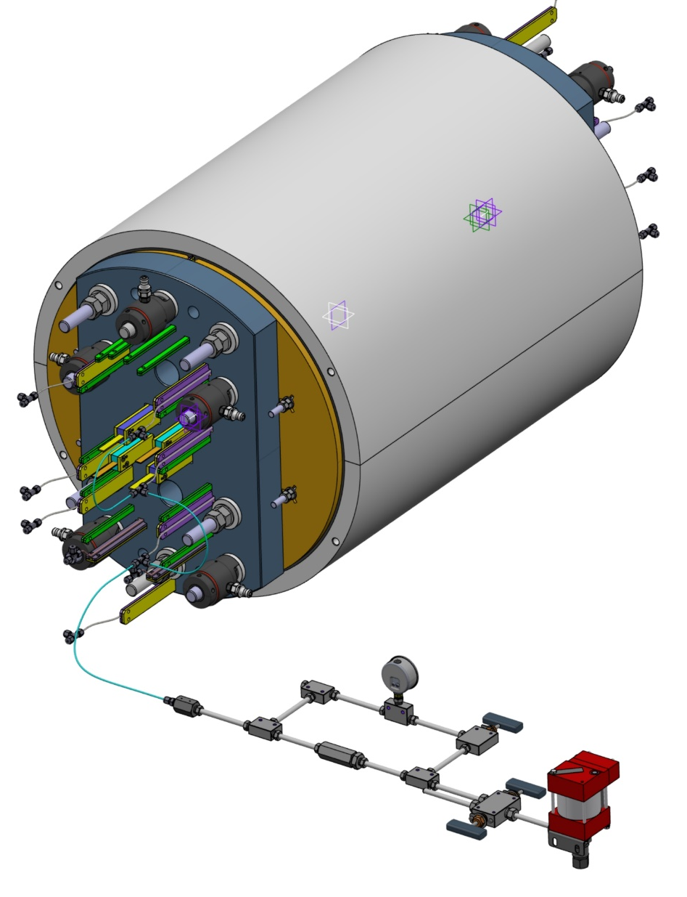
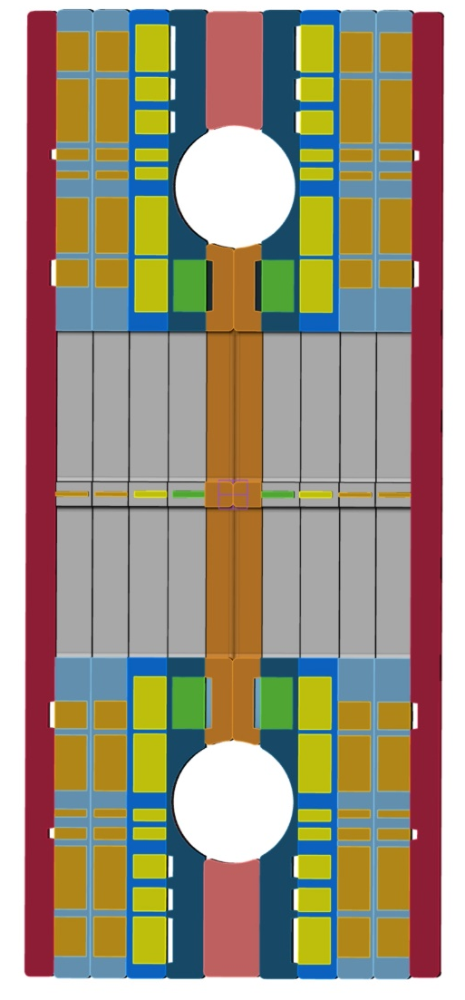
Stress-Managed Asymmetric Common Coil Magnet (SMACC1)
Progress on the engineering design, courtesy T. Michlmayr

Slide 19
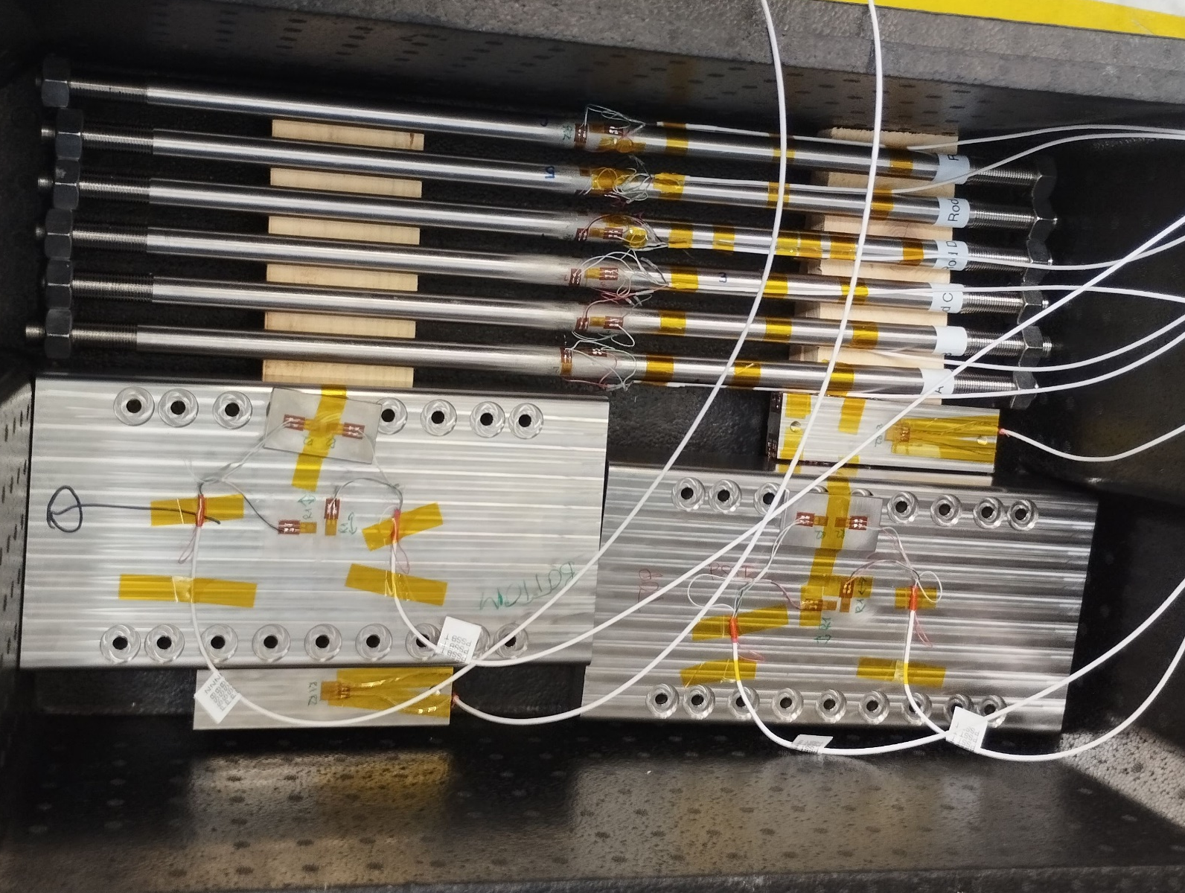
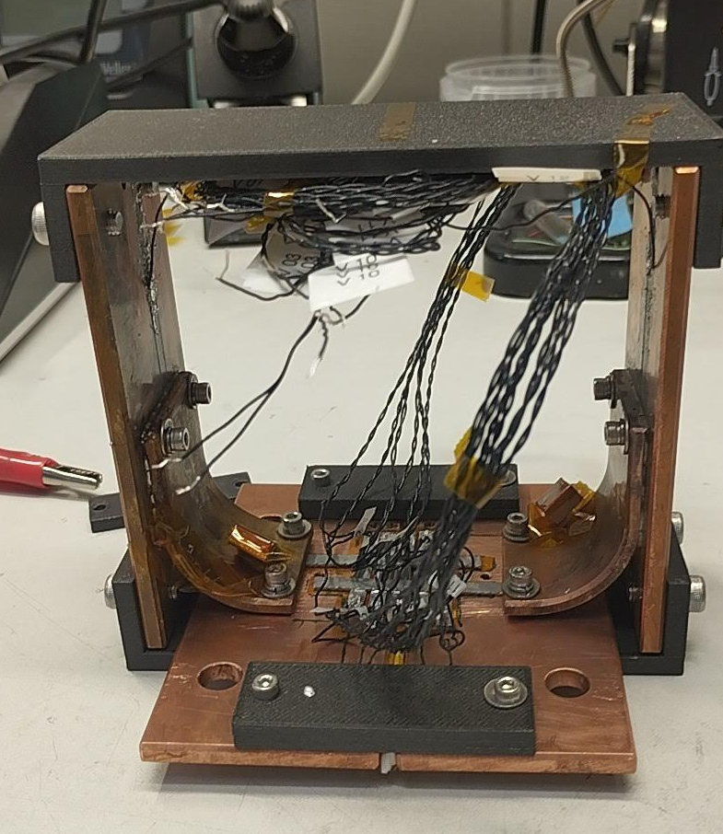
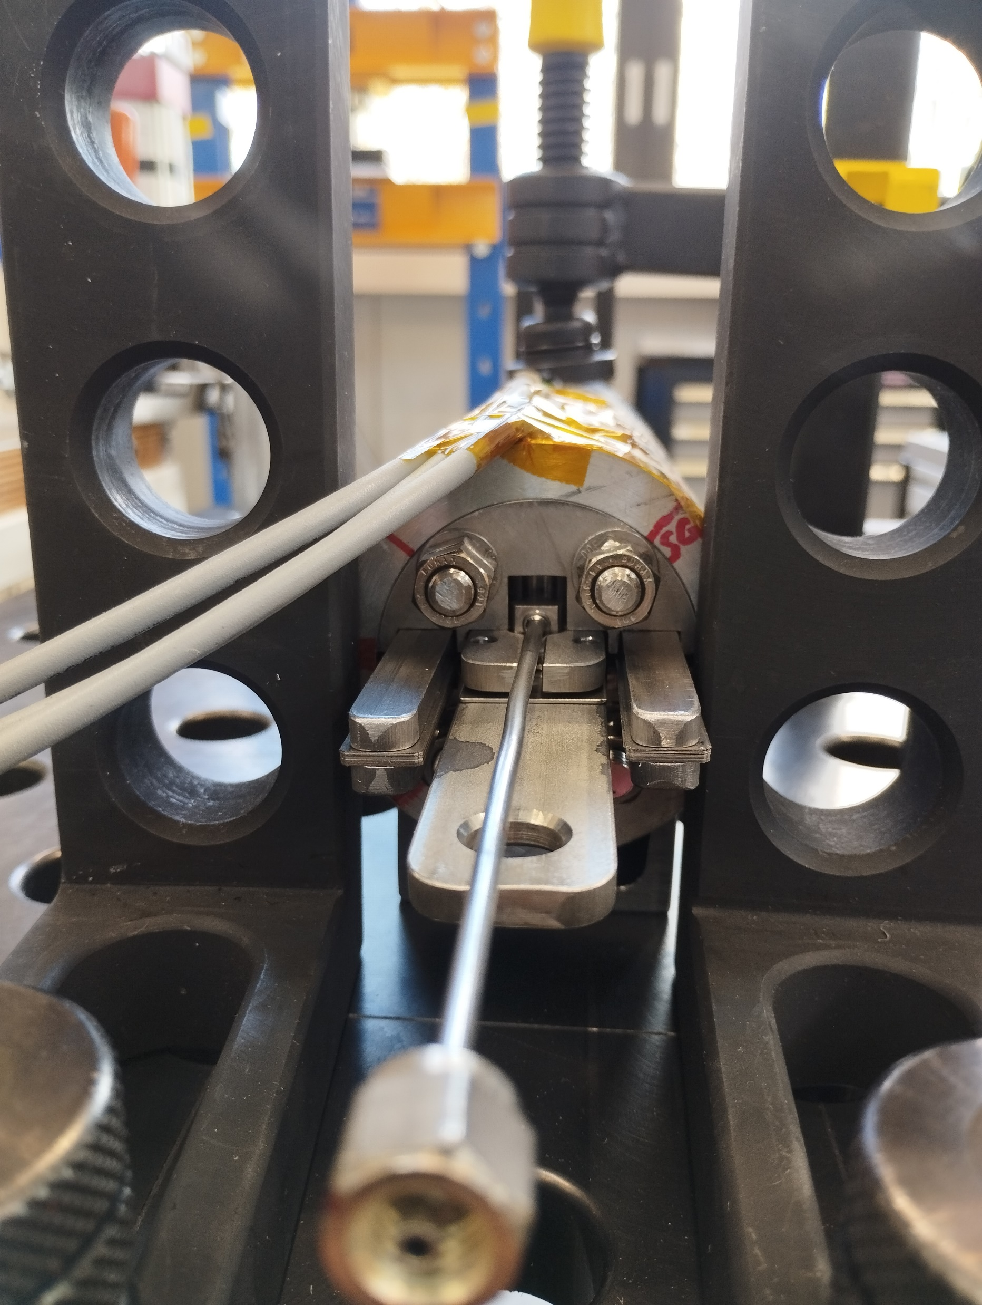
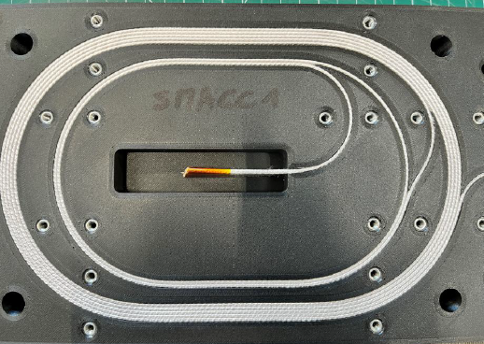
Stress-Managed Asymmetric Common Coil Magnet (SMACC1)
keys
bladder
& support plates
Strain-gauges validation on the subscale SMCC1 magnet. Trials, validation through thermal cycles and measurements during the test campaign at CERN performed by PSI
Nb₃Sn – ReBCO tapes Splices trials, cold measurements performed at PSI
Design and Tests of SMACC1 bladders at PSI
SMACC1 Winding trials
+ Impregnation Trials
+ Electrical Integrity Studies
+ …
Progress on R&D: A. Stampfli, C. Müller, T. Michlmayr, A. Brem and D. Araujo

Slide 21
Outlook for CHART2 2025 Developments and Tests
Test and analysis of BigBOX2 (in collaboration with BNL/US-MDP)
Complete the manufacturing of 4 subscale SMCC copper coils and assembly of subscale SMCC2
Subscale SMCC2 test at CERN
SMACC1 Engineering Design (conceptual design review took place in January 2025)
Manufacturing of SMACC1 Coils

Slide 23
CHART2 Stress-Management R&D
Composite
Characterization
and Modeling
Intermediate Field
Demonstrator
Powered Samples
Coil Demonstrator
Subscale Magnets
Courtesy, X. Kong and
J. Eijnden
Courtesy, R. Gupta
subscale stress-managed
common coil 1
BigBOX2: Stress-Managed
Coil Demonstrator Under
High-Magnet Field
subscale stress-managed
common coil 2 - ESC
Stress-managed asymmetric
common coil 1 – SMACC1
Courtesy, S. Otten and J. Eijnden

Slide 24
SMACC1 2D Magnetic Parameters
SMACC1 2D | Mag length of 1 m | Mag length of 14.3 m |  | High field layers | Low field layers
B₀ in T | 12.0 |  | Insulated reacted conductor area in mm² | 2954 | 4367
B_{peak 12 T} in T* it includes the self-field contribution | 12.8 |  | W_{eq} in mm² | 20.1 | 19.1
I_{12 T} in kA | 12.66 |  | J_{sc12 T} in A/mm² | 1205 | 2129
E_{mag 12 T} in M | 1.6 | 22.9 | J_{cu 12 T} in A/mm² | 1339 | 1774
L in mH Differential self inductance | 18.6 | 266 | J_{overall 12 T} in A/mm² includes insulation | 411 | 603
Loadline margin in % at 1.9 K | 23.1
Fx_{mag 12 T} in MN/m | 8.66
Fy_{mag 12 T} in MN/m | 0.56

Slide 25
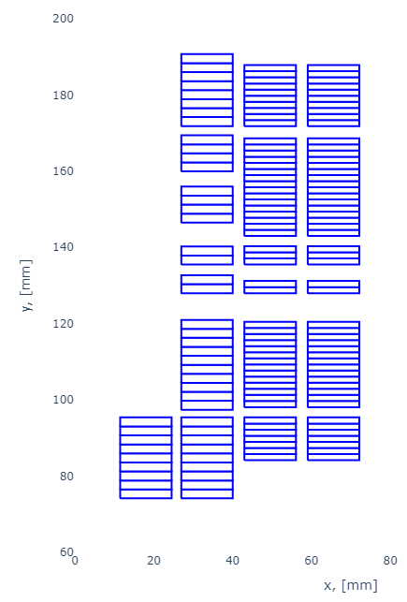
Magnet Parameters: number of turns and coil unit length
Layers | 1 | 2 | 3/4
Cable Type | High-field | High-field | Low-field
Number of turns | 9 | 39 | 52/52
*Coil unit length in m | ~15 | ~75 | ~95
*Computed with a straight section of **446.6 mm
**Max possible straight-section given the cable available.
SMACC1 cross-section
1 2 3 4

Slide 26
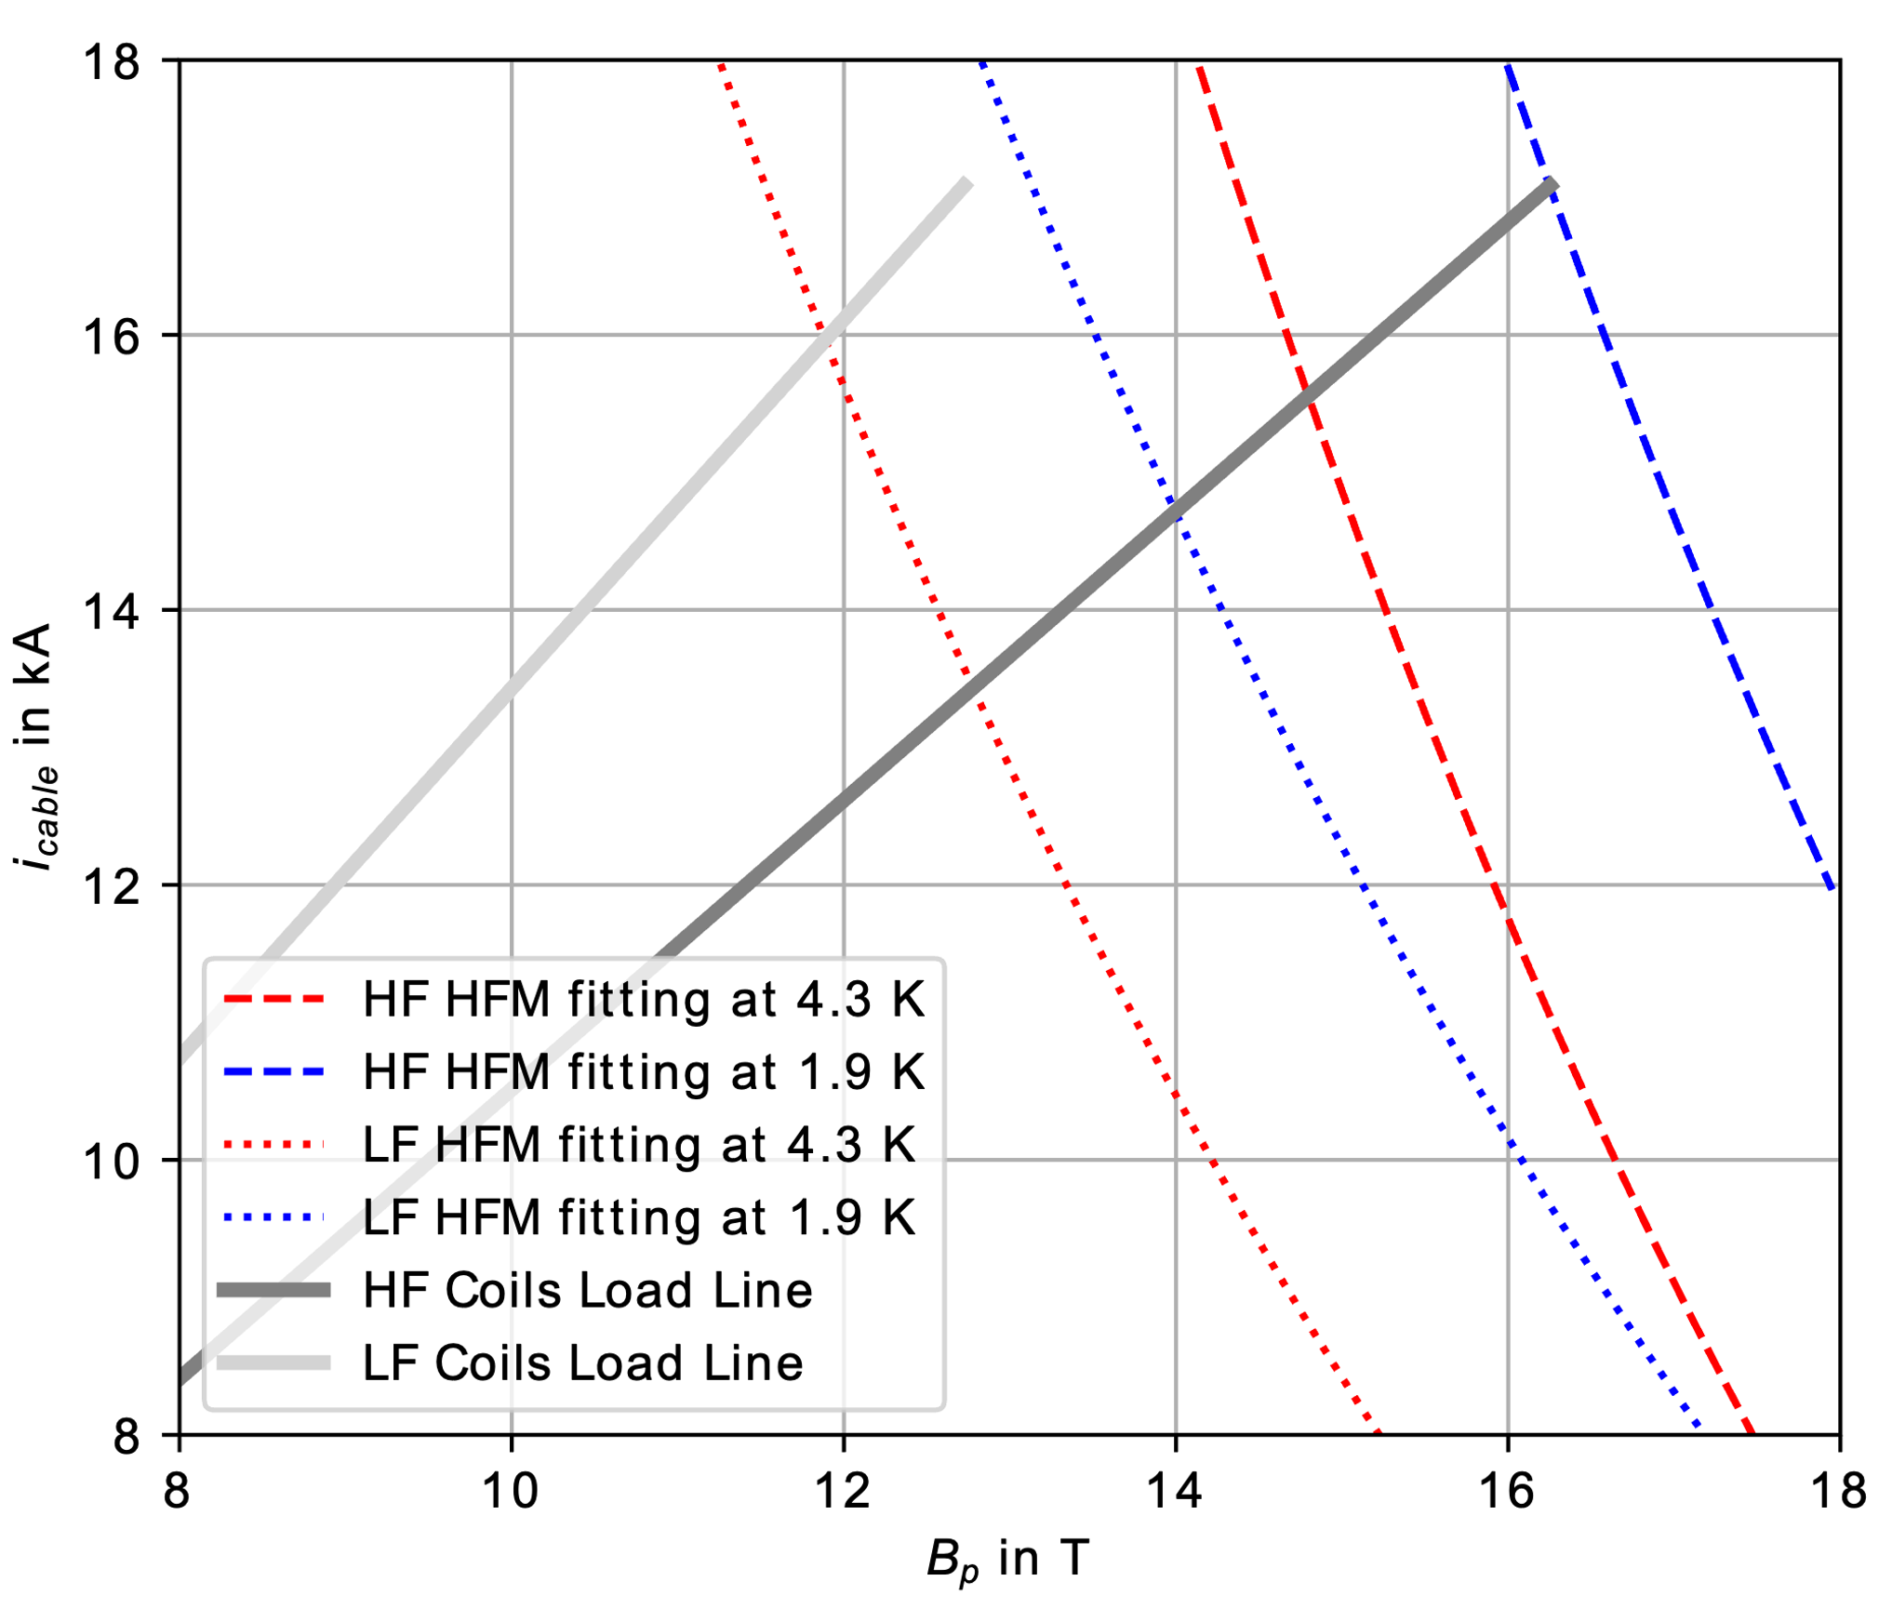
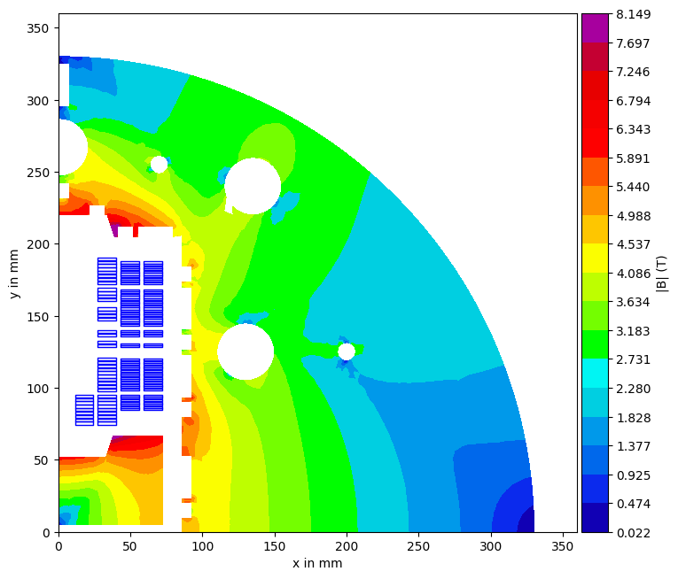
Magnet Parameters: Load line and yoke field map

Slide 27
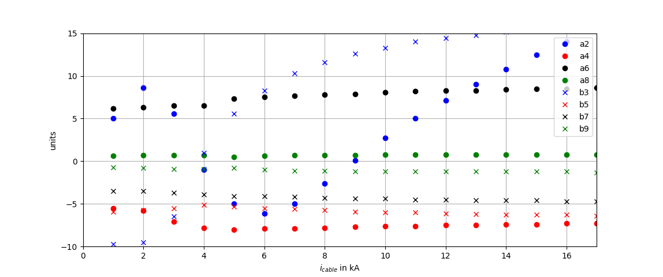
3D Magnetic Analysis Field Quality
2D x 3D
12-T

