Slide 1
Updates from the HFM Insulation WG
HFM Annual Meeting 2025
Roland Piccin (TE-MSC-SMT)

Slide 2
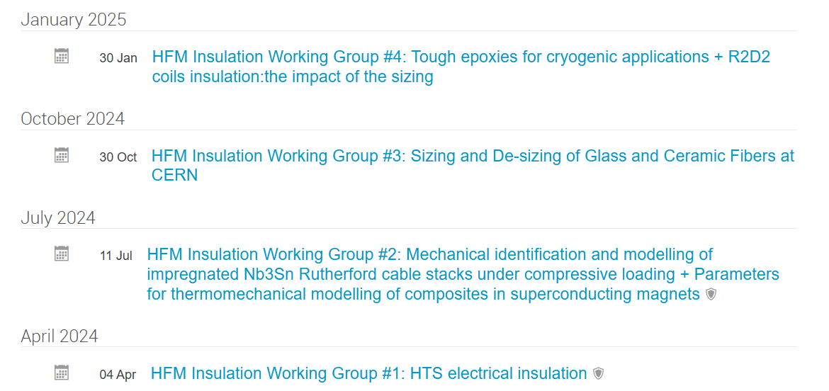
HFM Insulation Working Group
This WG is the former Collaboration meeting KE4738 with CERN – ETHZ – PSI
The meetings are now extended to experts from other institutes within the HFM
Insulation systems for LTS and HTS magnets have to fulfill a number of requirements […]. The "Insulation Materials" working group brings together materials experts to develop and test various aspects of soft materials (epoxies, polyolefin, waxes, etc) and composites (fibre-reinforced, nanocomposites, etc.). The WGs participants optimize systems and processing techniques for use in specific contexts […] and share their respective results and insights. Other topics within the scope of this working group include tribology on coil/structure interfaces (sliding planes) and bonding to structural components.
https://hfm.web.cern.ch/hfm-working-groups
https://indico.cern.ch/category/18081/
Following slides based on activities HFM WP 4.3 (Insulation) and WP 4.4 (ETHZ - Tough Epoxy)

Slide 3
Content
HFM WG Insulation
Selected technologies and processes
- Sizing and de-sizing
- Cable insulation layout
- Impregnation systems
Polymer Radiation Program
HV Challenges at 4.5 K
Conclusions

Slide 4
Selected technologies and processes

Slide 5
Sizing – de-sizing
J. Osuna, F.O. Pincot, R. Piccin - WP4.3 (CERN)

Slide 6
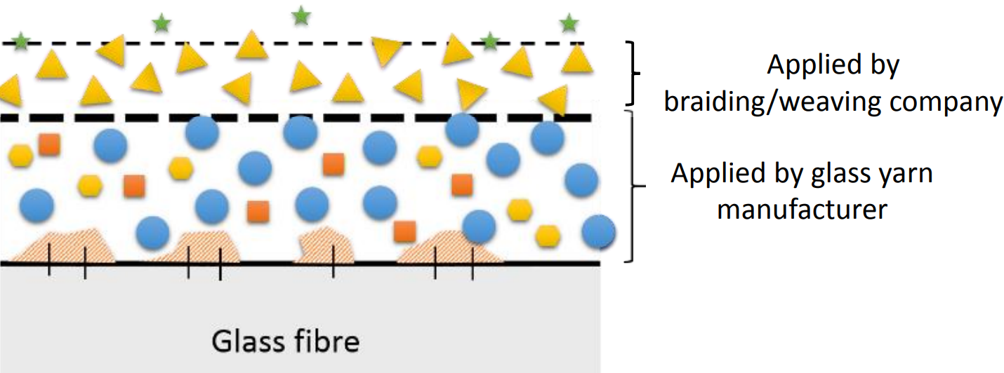
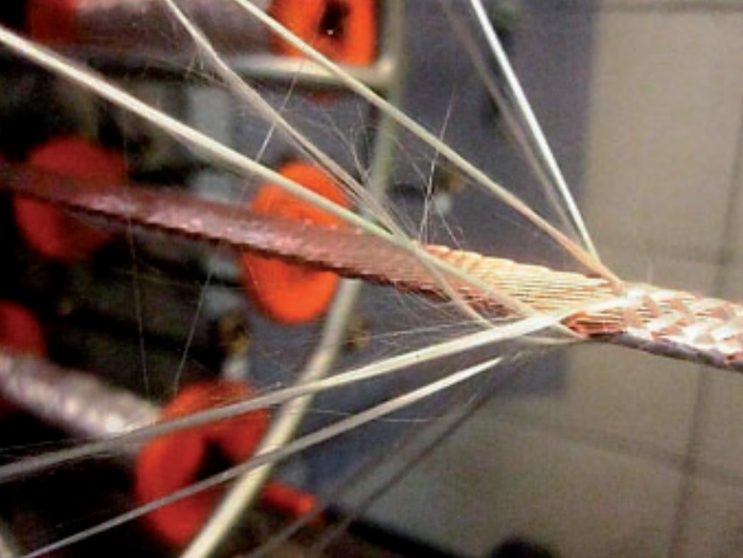
Sizing
The sizing on the fibres is necessary for the braiding process.
Sizing cannot be removed before braiding the fibers onto the cable

Slide 7
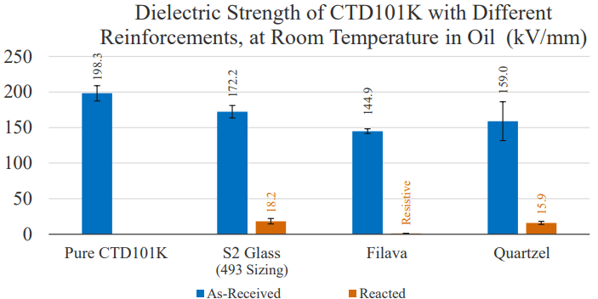
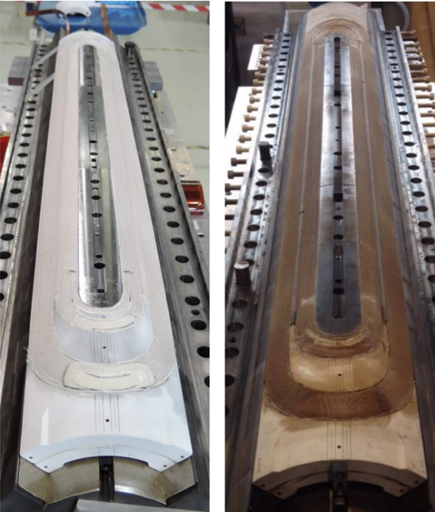
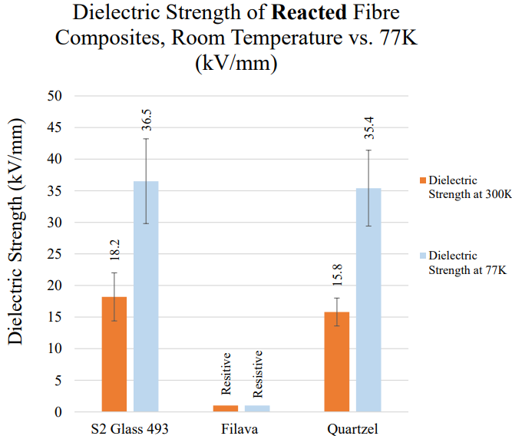
Sizing and Nb3Sn Reaction Treatment
Conductive products from the pyrolysis of sizing
Carbon resistivity increases at low temperatures…
J. Osuna, https://indico.cern.ch/event/1397152/

Slide 8
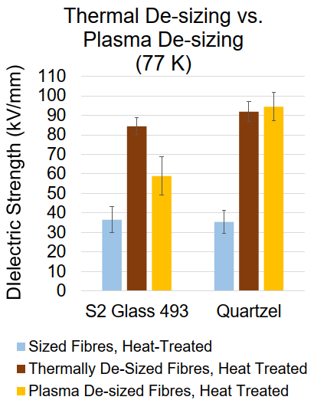
Benefit of de-sizing are proven at laboratory scale: at least double dielectric strength
Possible reduction of cable insulation thickness while keeping high dielectric strength
J. Osuna et al. – Proceedings ICEC/ICMC 2024

Slide 9
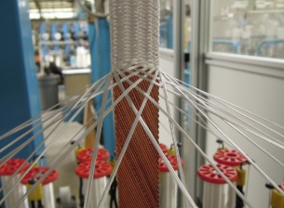
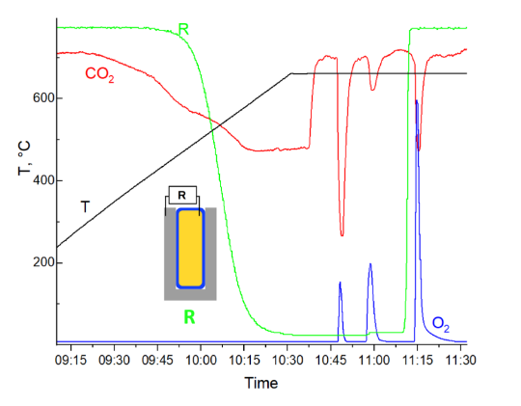
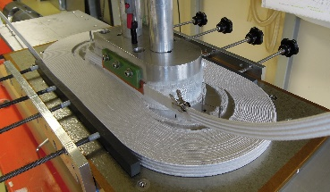
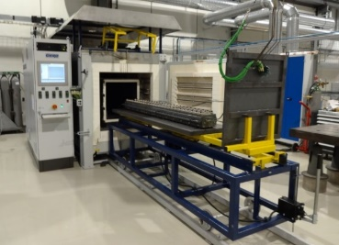
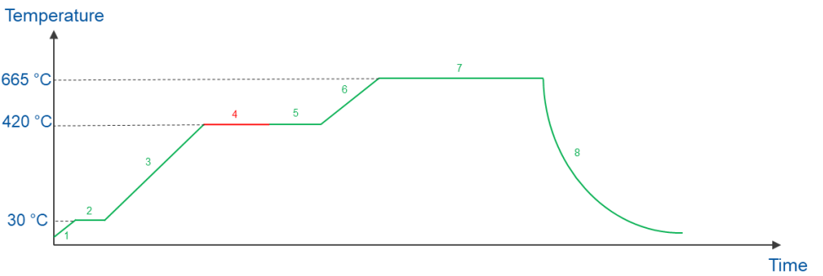
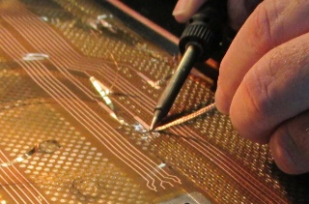
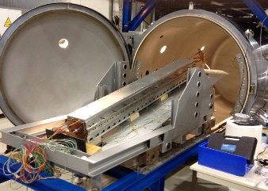
Thermal De-sizing
1. Braiding
2. Winding
3. Reaction
5. Impregnation
4. Instrumentation
Thermal
A. Brem et al. https://doi.org/10.1109/TASC.2023.3338588 (2024)
J. Osuna, EDMS 3175024 (2024)

Slide 10
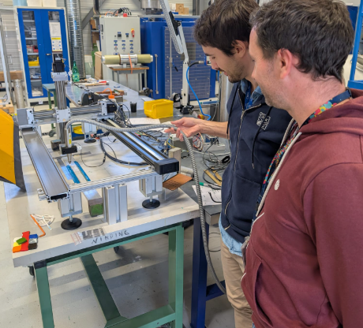
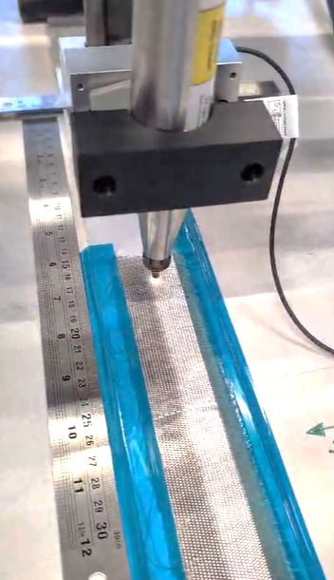
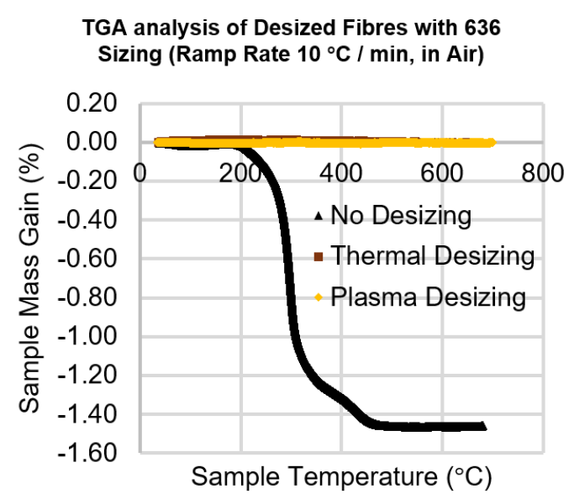
Plasma de-sizing
1. Braiding
2. Winding
3. Reaction
5. Impregnation
4. Instrumentation
Plasma

Slide 11
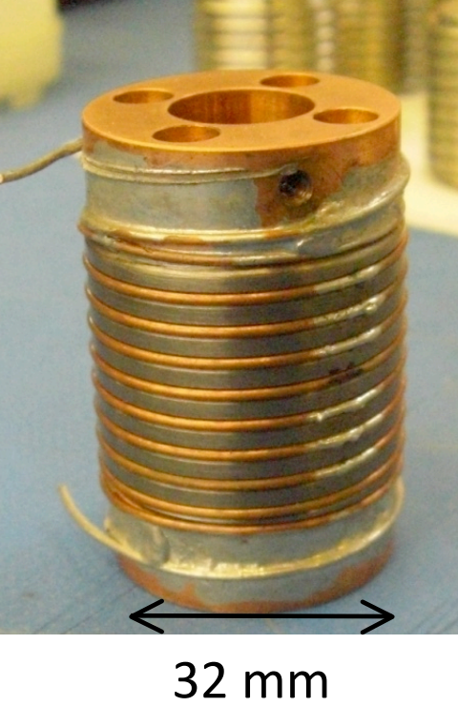
Next steps 2025:
  Effect of the de-sizing process on the conductor (i.e. RRR and Jc)
  Validate the process in small-scale tool (e.g. box) and SMC (see A. Haziot WP3.4 TDP)

Slide 12
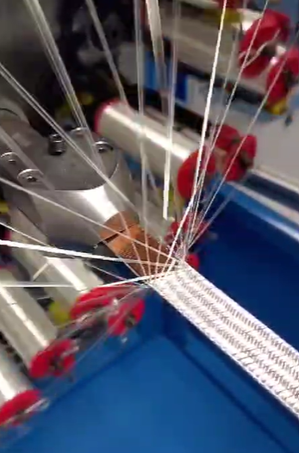
Cable Insulation
F.O. Pincot, R. Piccin - WP4.3 (CERN)

Slide 13
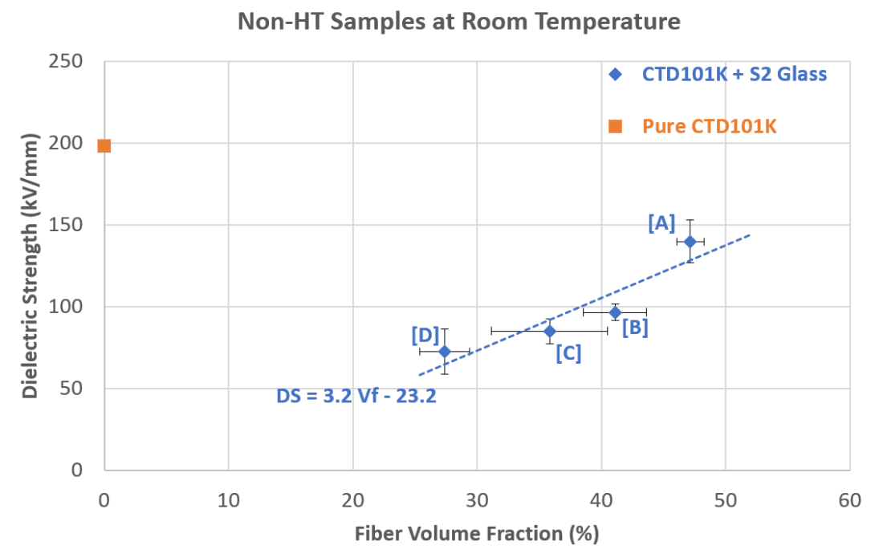
Fiber fraction
Improving cable insulation robustness (electrical and mechanical) increasing the fiber volume fraction and use alternative HT resistant fibers.
Benefits:
- Higher dielectric strength
- Higher mechanical strength
- Higher thermal conductivity
- Lower CTE of the composite
D. Polvani EDMS 3168202 (2024)

Slide 14
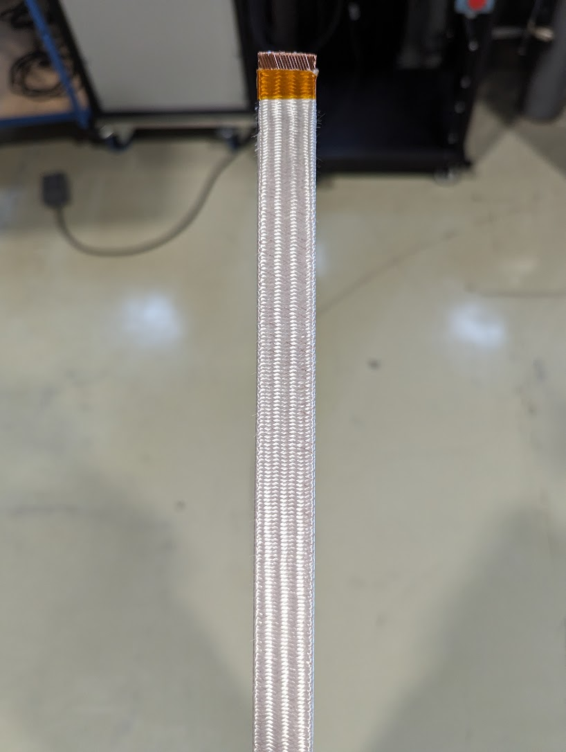
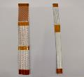
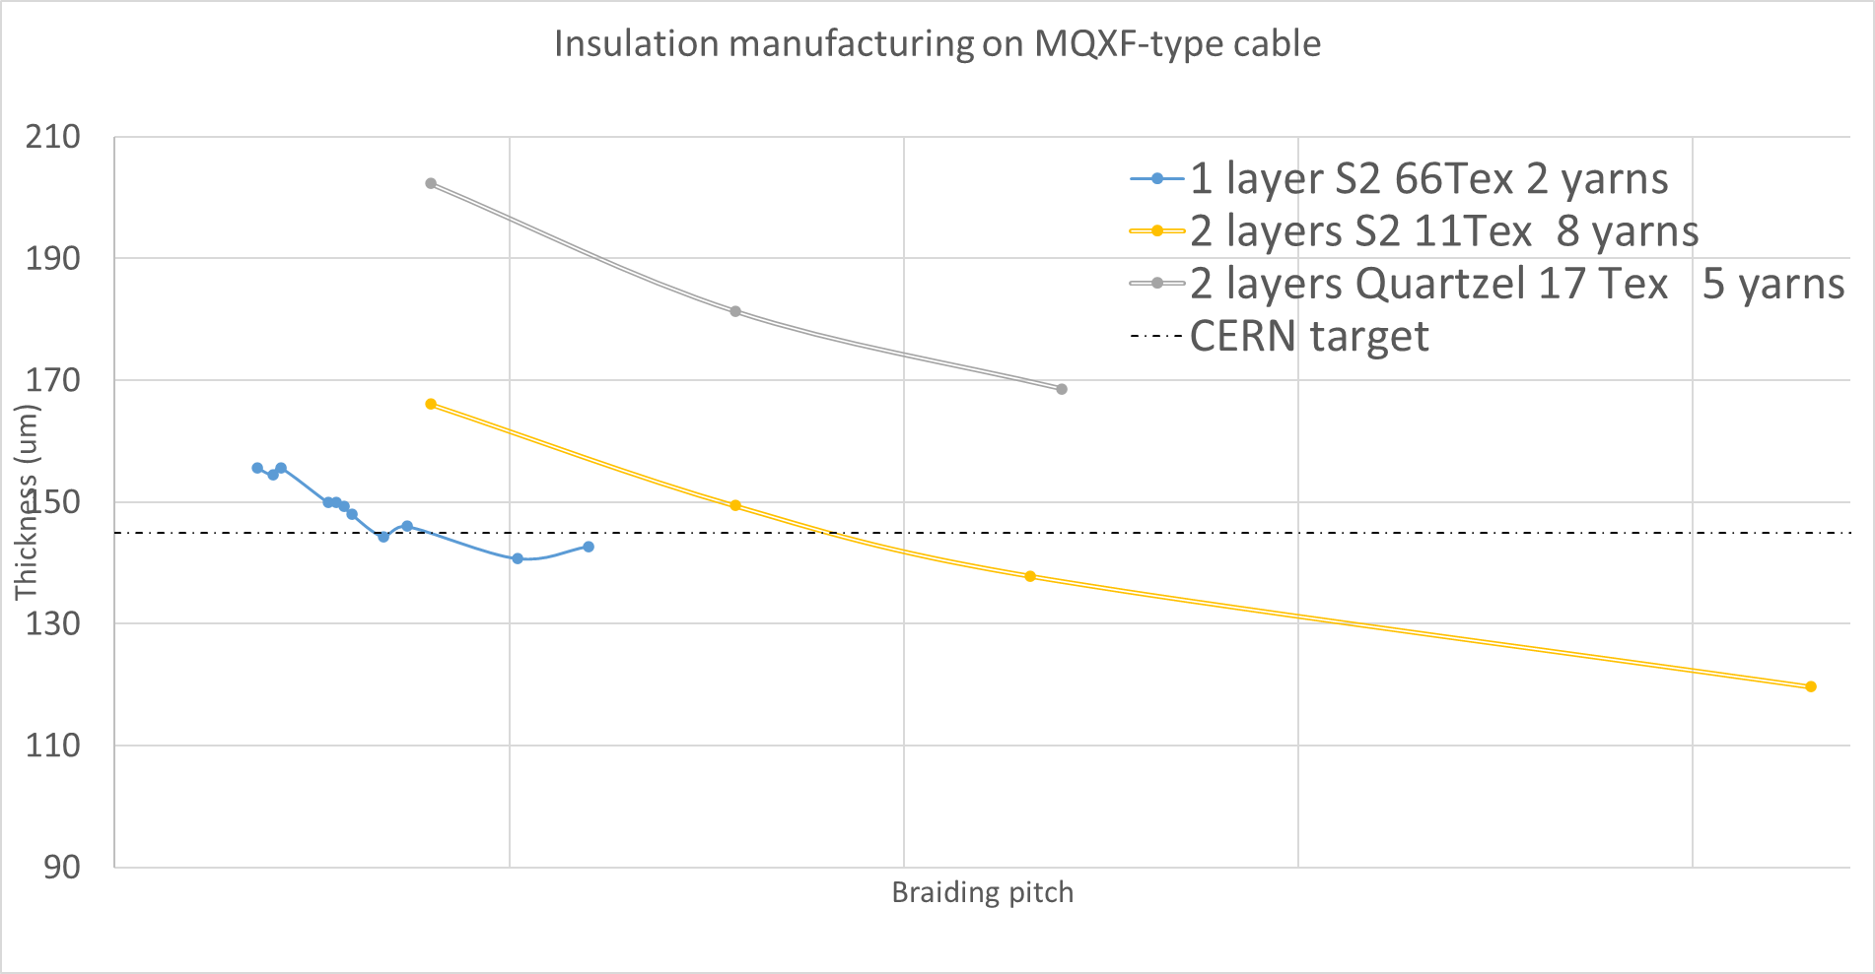
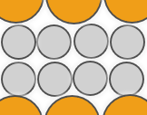
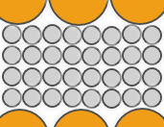
Cable insulation layout
Thinner yearns available:
S2 glass 11 Tex – sizing 636
Quartzel 17 Tex – newly developed sizing
145 µm
Manufacturing trials 2024 (Courtesy of F.O. Pincot)
resin-rich area

Slide 15

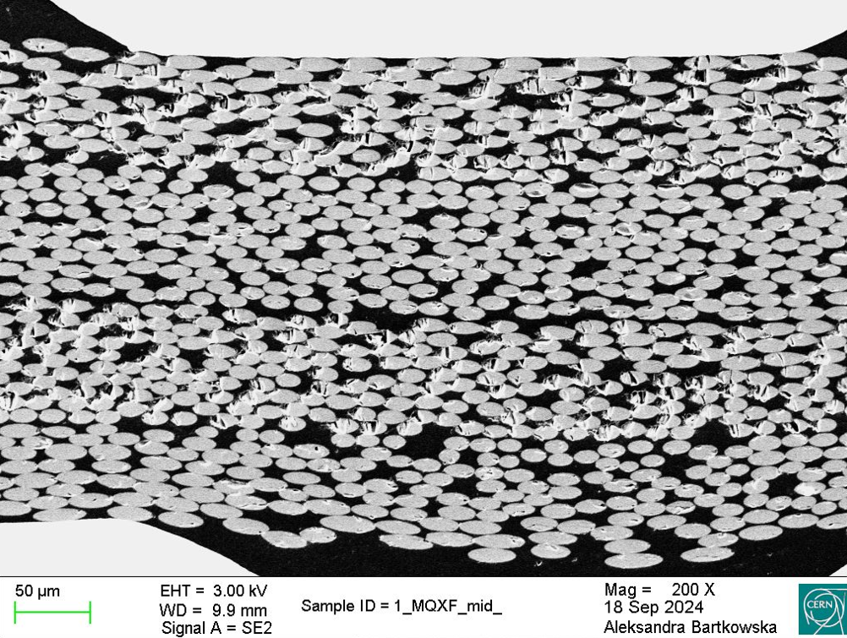
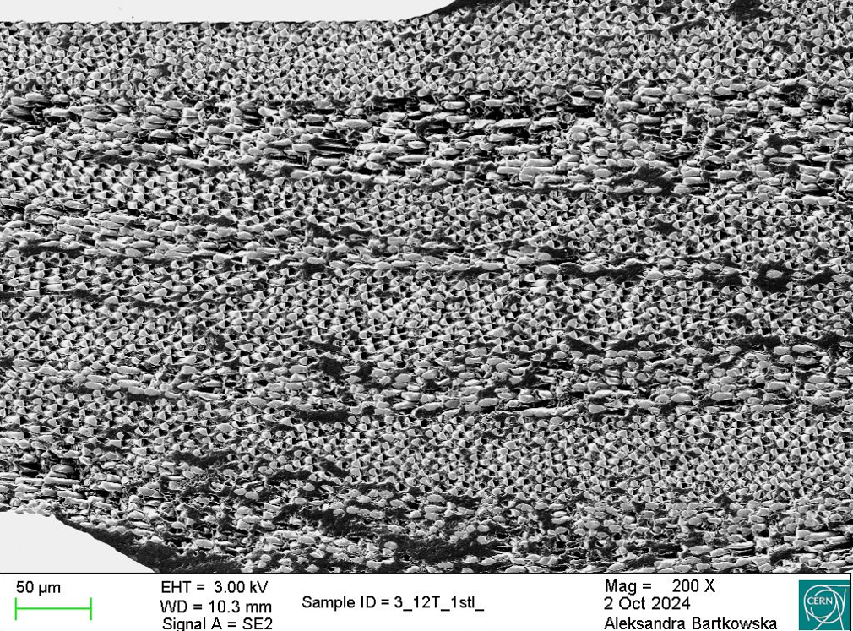
Cable insulation layout
For both insulation layouts fiber fraction area is approximately ~60%

Slide 16
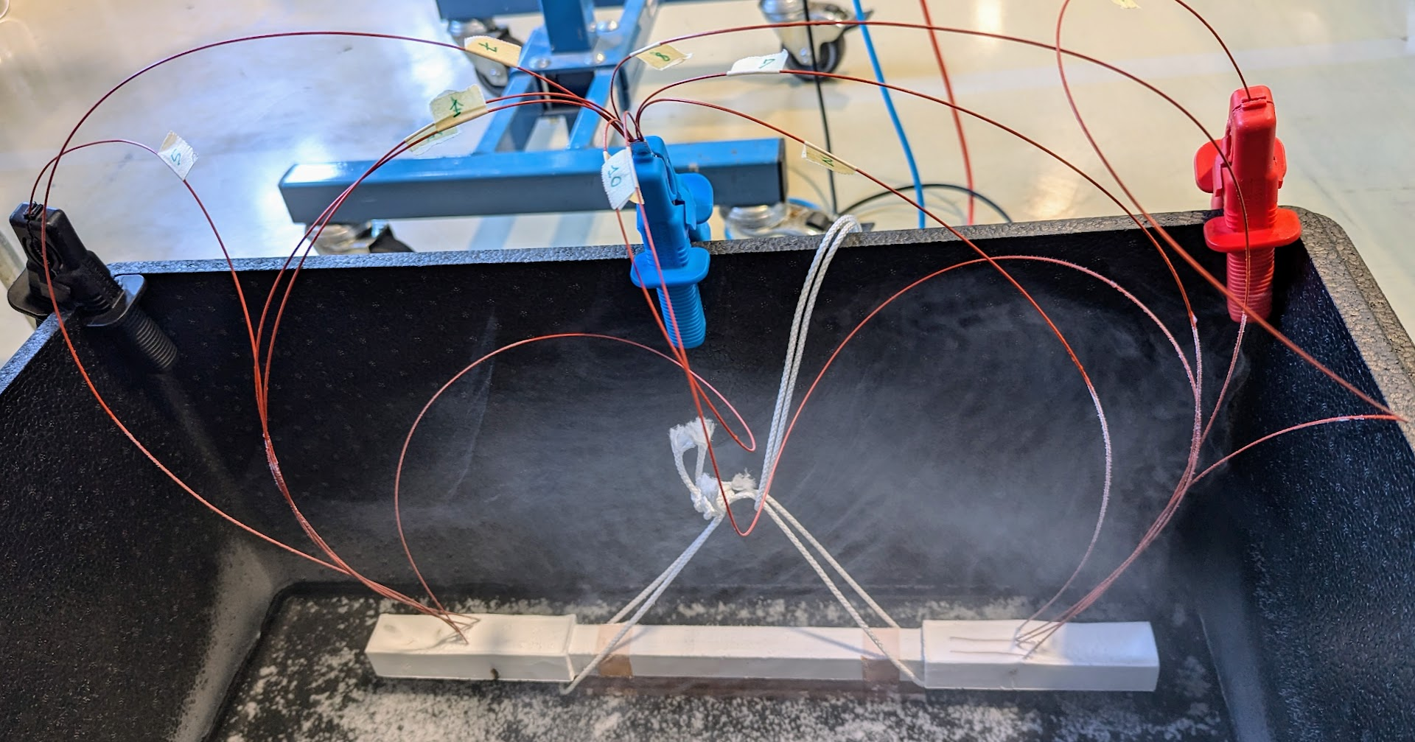
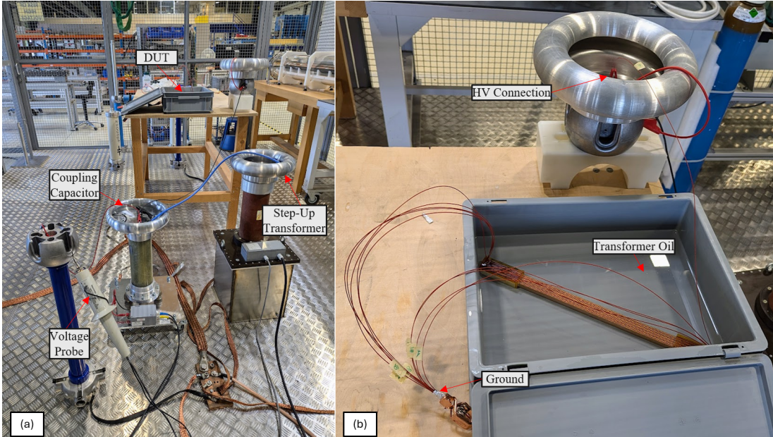
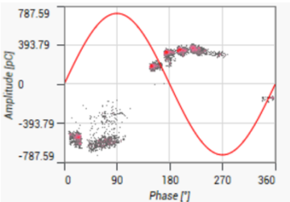
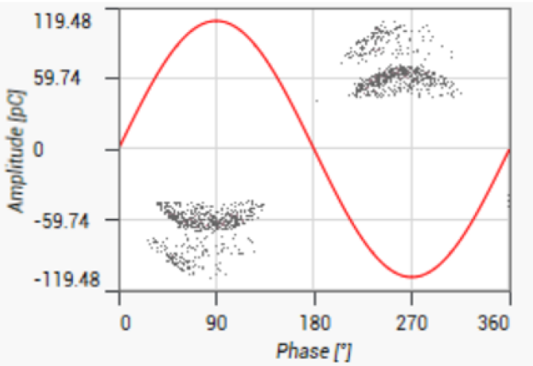
Electrical performance
  Different layouts (still with same fiber fraction) did not show appreciable difference in electrical performance (non-destructive tests):
  Insulation Resistance (IR) up to 2.5 kV DC
  Partial Discharge (PD) up to 6 kV rms AC
D. Polvani EDMS 3168202

Slide 17
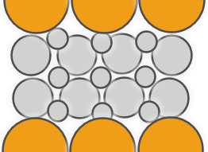
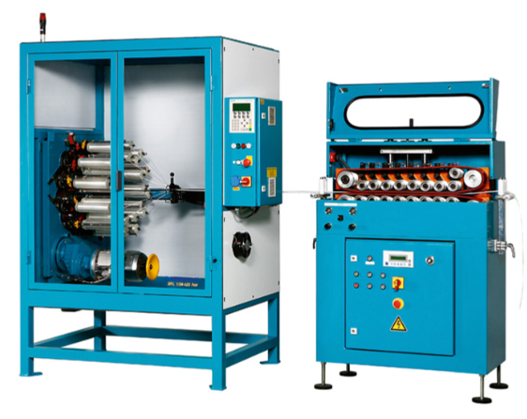
To increase fiber volume fraction we should mix yarn size
On-going procurement of a fiber braiding machine to carry out R&D and production of short lengths for HFM needs. (estimated delivery end 2025/begging 2026)
Example of braiding machine

Slide 18
Impregnation systems
P. Studer and T. Tervoort - WP4.4 and CHART MagRes (ETH Zurich)

Slide 19
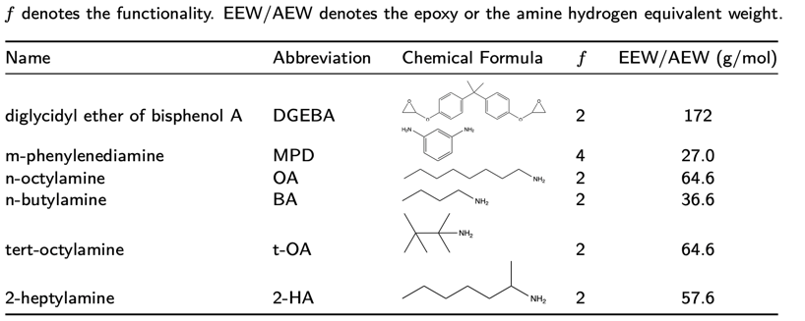
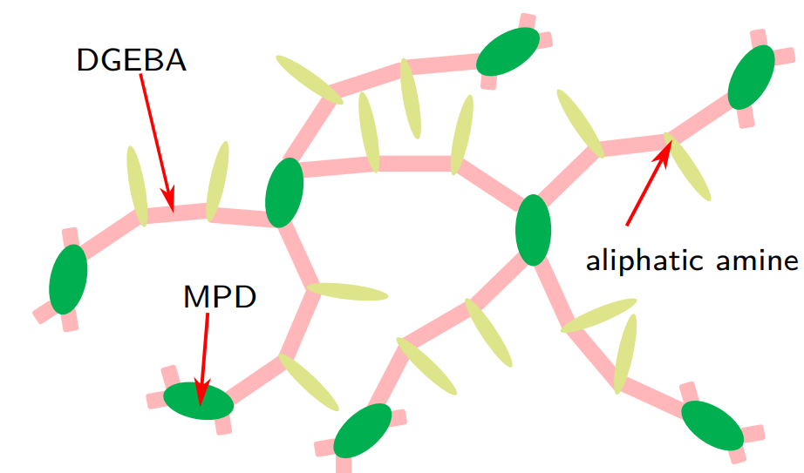
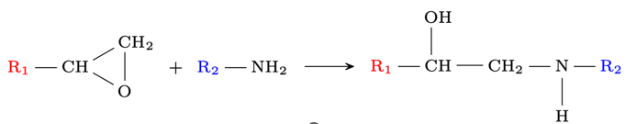
Tough Epoxies for Cryogenic Applications
Primary goal was the design of tough epoxy system
Monomers used for the synthesis of new epoxy resins
Reaction of an epoxide group with an amine group

Slide 20
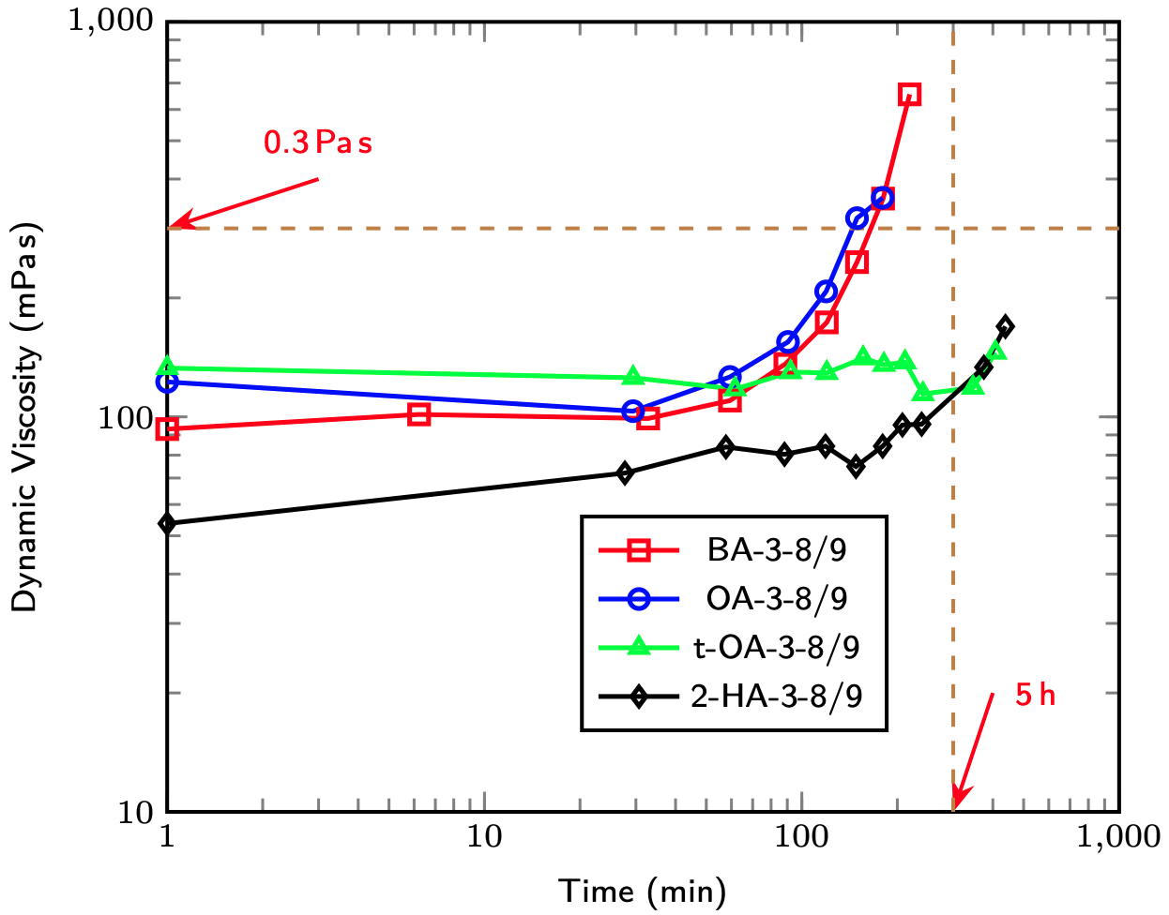
Tough Epoxies for Cryogenic Applications
Influence of chemical structure on potlife
Steric hinderance of the methyl group in the β-position lowers the reactivity, which was used to design epoxide resins with significantly increased potlife

Slide 21
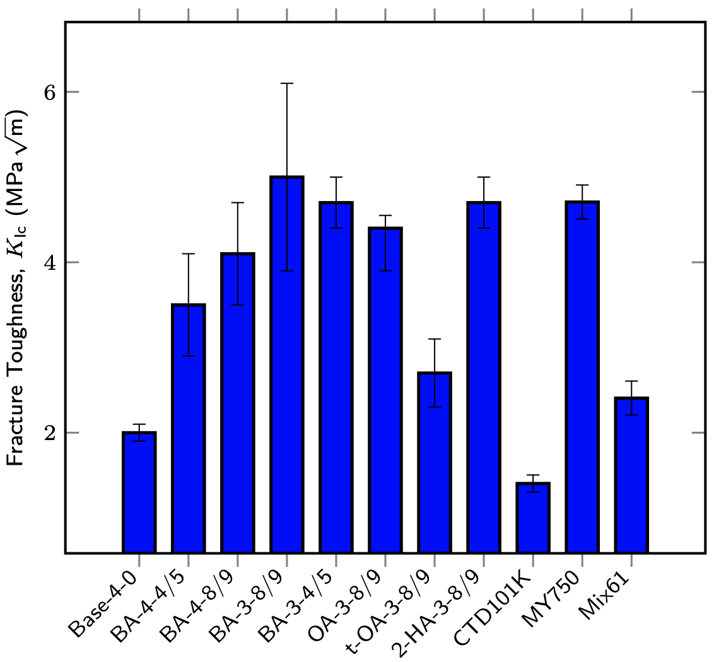
Tough Epoxies for Cryogenic Applications
Cryogenic fracture toughness of all systems
The system 2-HA-3-8/9, based on 2-heptylamine combines a high fracture toughness at -196 °C with a long potlife and a Tg of 72 °C.

Slide 22
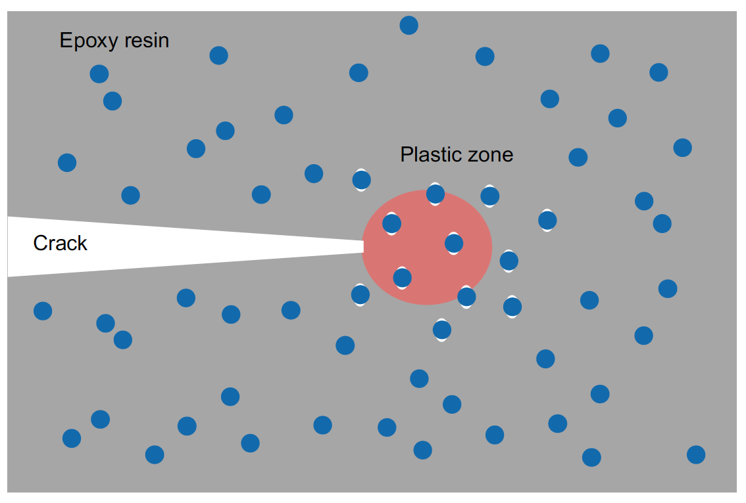
Tough Epoxies for Cryogenic Applications
For non-stress managed magnets, epoxy strength and toughness are needed:
However, high toughness means more heat dissipation at the crack tip and thus might also promote quenching, even in the absence of macroscopic cracks
Particles can improve toughness even further by localized yielding
Ultimate goal: use of gadolinium nanoparticles with high cp at cryogenic temperatures

Slide 23
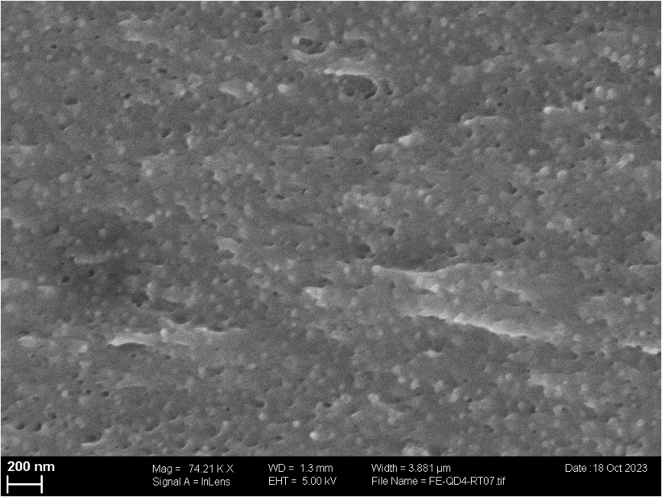
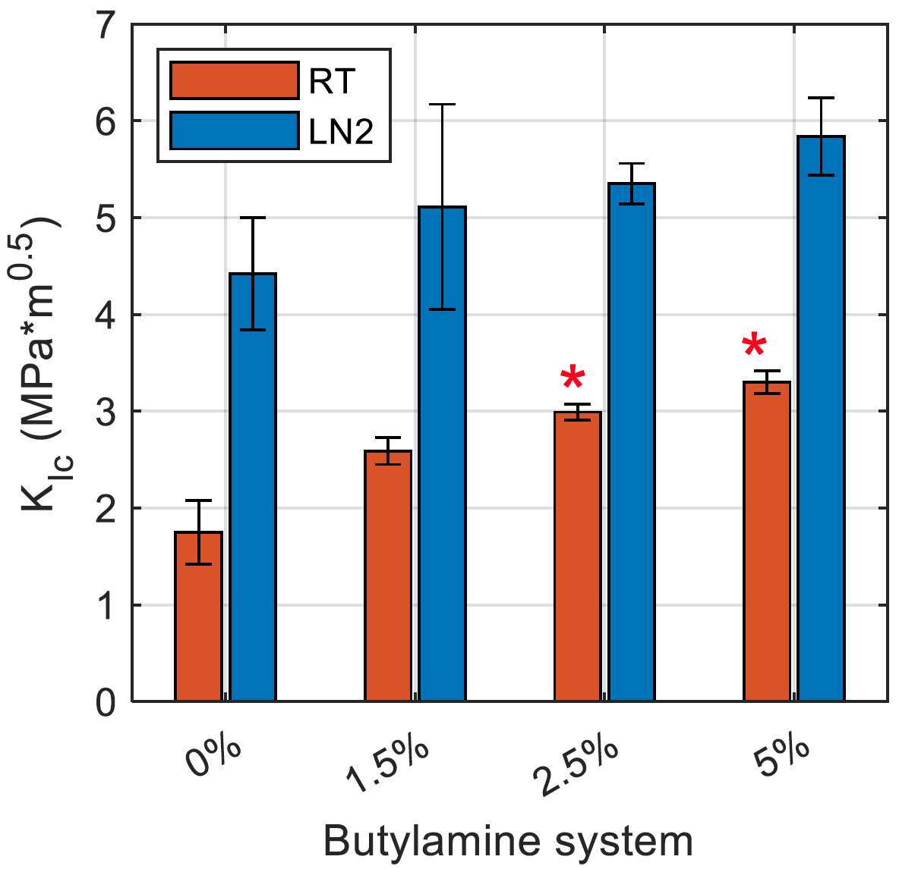
Tough Epoxies for Cryogenic Applications
SEM fracture surface of the butylamine-based system with 5% nano-silica particles.
The well-known toughening effect of nano-silica also works at cryogenic temperatures

Slide 24
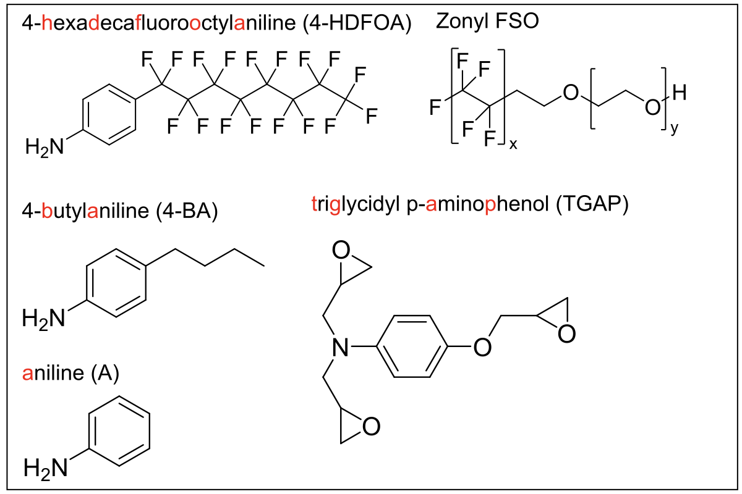
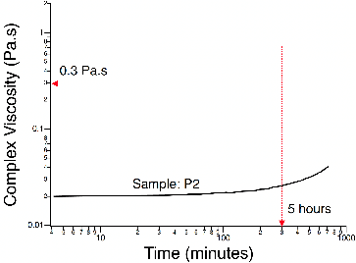
Low Surface-Energy Epoxies for Cryogenics
good potlife
Resin | Tg (°C) | Kic @ 20 °C (MPa⎷m) | Kic @ -196 °C (MPa⎷m) | γ (mN/m)
Reference Epoxide | 180 | 0.8 | 2 | 46
Wax | 60 (Tm) | very low | very low | 20
4-HDFOA (5%) + 4-BA+TGAP | 100 | 0.5 | 1.1 | 21

Slide 25
Polymer Radiation Program
C. Scheuerlein, D. Parragh, L. Wolf - WP4.3 (CERN)

Slide 26
Polymer Radiation Program
To meet FCC-hh focusing magnets requirements, acceptable functional properties (dielectric strength, mechanical strength, thermal properties) of the organic materials used for coil insulation and spacers need to be maintained up to a dose of 80 MGy (4 cm-thick internal tungsten shielding is required to reduce the dose to 80 MGy).
The presently assumed dose limit of organic insulation in the HL-LHC final focusing magnets is 30 MGy (tungsten shielding integrated in the beam screen limits the dose integrated over the magnet lifetime to <30 MGy).
The dose limit will be increased to 80 MGy by:
  Choice of most radiation hard insulation materials
  Consider the effect of different irradiation sources, irradiation environment, dose rates and the irradiation temperature to determine the dose limit of the insulation system
  Refine dielectric and mechanical requirements of superconducting magnet insulation systems
The main magnets in the FCC-hh arcs will be exposed to much lower doses. Alternative impregnation materials, including wax are being tested.
A. Lechner, “Radiation challenges for magnets in present and future colliders (HL-LHC, FCC, Muon Collider)”, presentation at the topical workshop on Radiation effects in Superconducting Magnets (RADSUM25), 15 Jan 2025,
https://indico.cern.ch/event/1450988/contributions/6259348/
C. Scheuerlein, “How can we increase the dose limits of organic insulation materials in superconducting accelerator magnets?”, presentation at RADSUM25, 17 Jan 2025, https://indico.cern.ch/event/1450988/contributions/6259757/

Slide 27
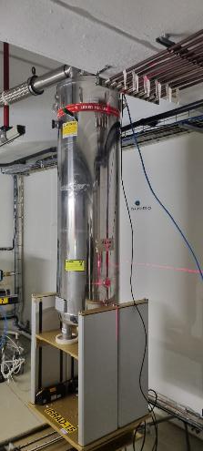
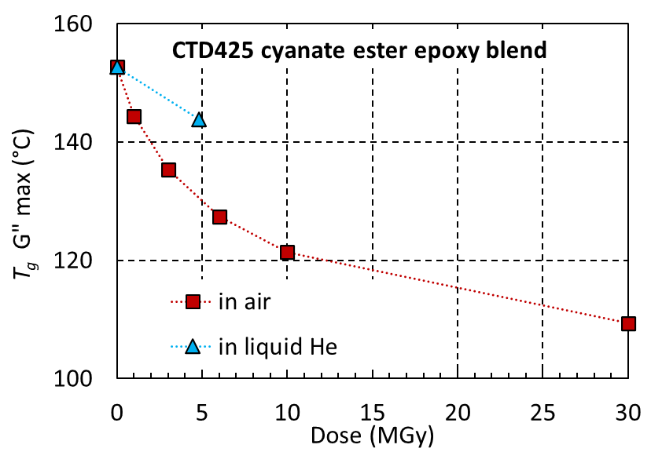
Influence of irradiation environment and temperature
Compared to ambient air irradiation typically:
  More cross-linking and less chain scission in inert gas
  Less cross-linking and less chain scission in liquid He
To predict the dose limits of organic materials in superconducting magnets, irradiations need to be performed at cold.
Liquid helium cryostat in the IRRAD proton irradiation facility
T_{g} G’’_{max} of (a) MSUT epoxy resin and (b) CTD425 cyanate ester epoxy blend as a function of proton dose absorbed in ambient air, inert gas and in liquid He.
D.M. Parragh et al., https://doi.org/10.3390/polym16030407, Polymers 2024

Slide 28
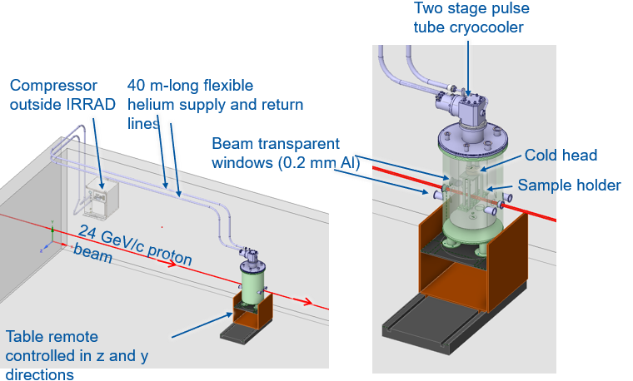
Next Set-up for cold 24 GeV/c proton irradiations in the CERN IRRAD facility
Cold irradiations set-up is being built in collaboration with Polymerlab, IRRAD, Cryolab and MBE-CB teams.
  Peak doses up to about 40 MGy per year will be achieved.
  Samples for dielectric, tensile and thermal tests of different materials will be irradiated simultaneously to different dose steps.
First cold irradiations are planned by mid 2025.
Conceptual design of pulse tube cryocooler cooled sample holder for 24 GeV/c proton irradiations at <30 K in vacuum. Courtesy Lukas Wolf.

Slide 29
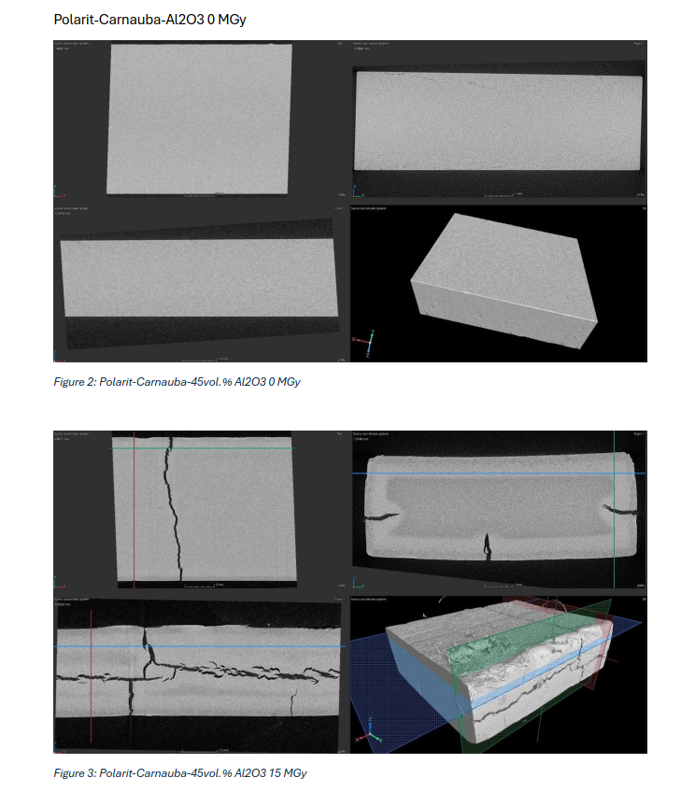
What is the ionising dose limit of wax?
Irradiation hardness of different wax types is studied in collaboration with PSI.
Irradiation with 60Co gamma rays in ambient air – ongoing
Radiation effects (chain scission) monitored by measuring changes of the melting enthalpy using DSC.
Effect of oxygen is confirmed by FTIR microscopy
On-going characterization of samples after irradiation in liquid He to about 10 MGy
Melting enthalpy of different wax samples as a function of gamma dose absorbed in ambient air.
µ-CT images of Paraffin/Carnauba wax mixture with Al₂O₃ particles (A. Brem et al. formulation) before and after 15 MGy absorbed in ambient air.

Slide 30
Insulation & HV Challenges at 4.5 K

Slide 31
Insulation & HV Challenges at 4.5 K
The insulation performance of Nb3Sn relies (also) on the dielectric strength of Superfluid He -> dual function of coolant and insulator
From the presentation of P. Borges de Sousa (link), during a quench He transits in the gas phase at roughly 5 K and p = 4 -13 bar where it shows still high dielectric strength.
Cracks in the insulation must be avoided but the operating conditions (LHe and pressurized GHe) are forgiving

Slide 32
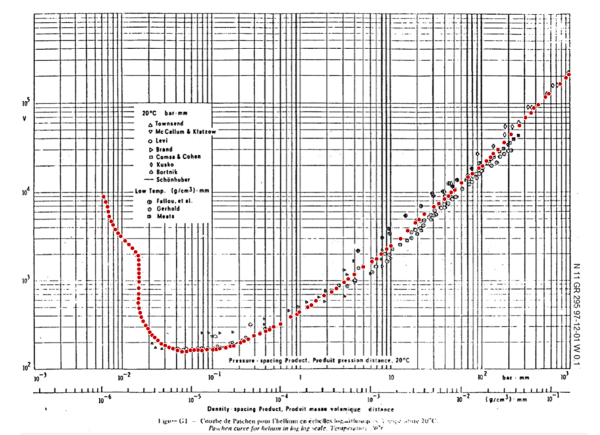
Insulation & HV Challenges at 4.5 K
A supercritical forced flow cooled magnet system (i.e. “drycooled) is one of the option for FCC-hh machine. See next presentation Progress on Cryogenics Studies at CERN (P. Borges de Sousa)
Vacuum is a non-forgiving medium: He leaks and gas desorption (during quench) can increase the pressure and cause Paschen discharges (long list of failure events experienced in Fusion magnets).
Call for new electrical design criteria:
“Paschen-tight” insulation -> no live parts exposed to vacuum (coil, busbars, HV instrumentation, etc.)
Paschen test included in the magnet acceptance testing
New design and validation of insulation design

Slide 33
Conclusions

Slide 34
Conclusions
We gain up to three times higher dielectric strength at cold by de-sizing the fibers. Different methods are validated at laboratory scale. RRR and Jc measurements pending. Aiming to apply the process on a model/prototype coil.
Electrical and mechanical performance of insulation increases with the fiber volume fraction. The type of fiber can determine also thermal properties of the composite. Different layouts will be investigated after commissioning of braiding machine end 2025/early 2026
Engineered epoxy systems for cryogenic systems have been developed at ETHZ. Toughness of the impregnation system is not the only property to look at. Low surface energy (non-sticky) and low toughness systems (e.g. wax) shows low trainings in stress-managed designs. Are these applicable to other designs (e.g. SMC)? See presentation WP 3.4 TDP
Dose limits of organic materials are one of the factors limiting lifetime of magnets (focusing magnets) of present and future machines. The dose limits shall be determined considering actual operating conditions (i.e. at cryogenic temperature). An efficient cold-irradiation set-up will be commissioned by mid-2025.
Magnets operated in insulating vacuum (dry-cooled) are exposed to the risk of Paschen discharge. This needs to be addressed in the electrical design of magnets and cold powering circuit.

Slide 35
Appendix

Slide 36
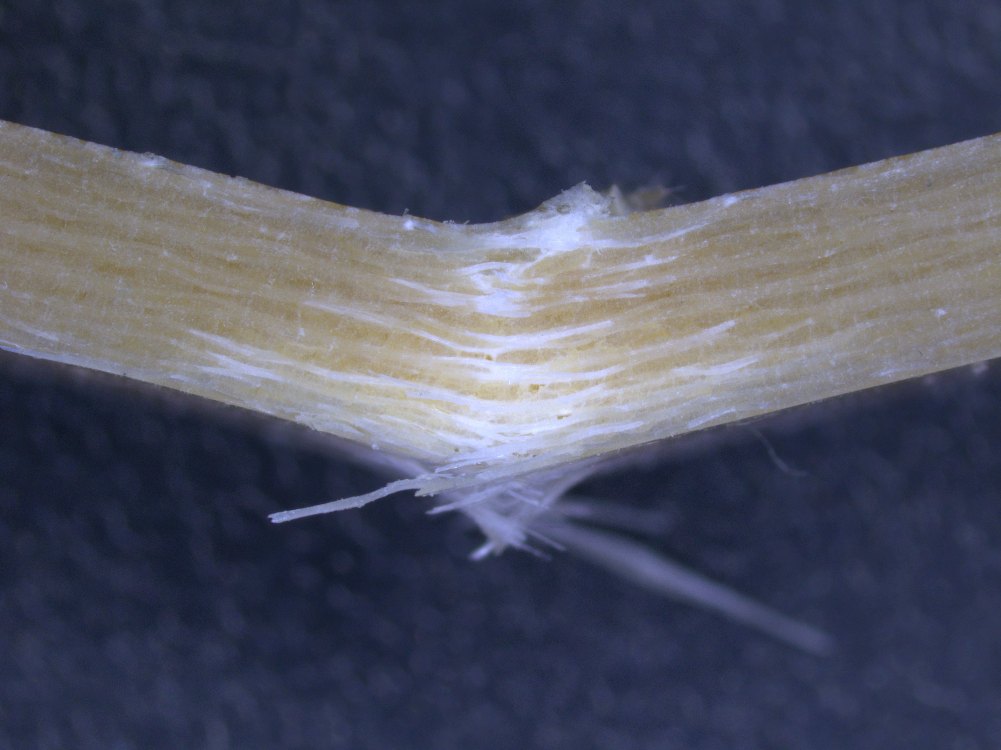
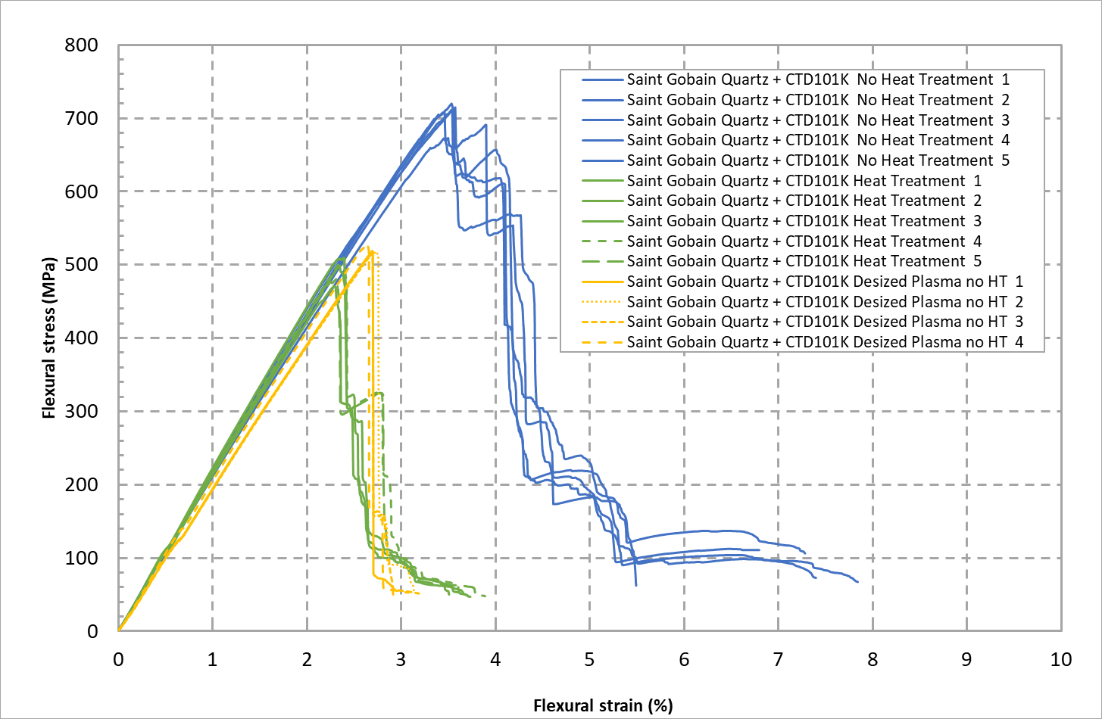


No Heat Treatment
Heat Treatment
Courtesy J. Osuna
Desized Plasma no HT

Slide 37


Towards impregnation of SMC Nb₃Sn coil with wax
Temperature dependent elastic properties of different wax types are compared based on DMA measurements.
At -150 °C very high shear modulus of 18 GPa of wax with 45 vol.% Al₂O₃ [i].
G’(T) of Paraffin/Carnauba wax mixture with Al₂O₃ particles [i].
Courtesy D. Parragh
J. Bertsch, C. Scheuerlein, P. Wiker, D.M. Parragh, A. Echtermeyer, R. Piccin, “Thermomechanical properties of epoxy and wax matrix composites for superconducting magnets”, accepted for ICEC/ICMC 2024 proceedings
[i] A. Brem et al, 10.1109/TASC.2023.3338588 (2024)

Slide 38
Insulation Technologies Validation Levels
Proof-of-concept LEVEL
Performance LEVEL
Prototype LEVEL
Model Coil LEVEL
Laboratory-scale
Mock-ups/material testing, etc.
Relevant Environment
Benchmark tool (e.g. Box)
Relevant Environment
Prototype coil
(e.g. SMC)
Operational Environment
Short Model coil
(e.g. MQXFS,14T, etc.)
2025
DE-SIZING
CABLE INSULATION
IMPREGNATION SYSTEMS
See presentations WP3.4 and WG Box

