Slide 1



deBOX: effect of transverse stress on the training of Nb₃Sn Rutherford cable
G. Campagna¹⁻², A. Kario³⁻⁴, K. Lavernhe², S. Otten⁵, E. Rochepault¹, W.A.J. Wessel³
¹ CEA Paris Saclay, ² LMPS, ³ University of Twente, ⁴CERN, ⁵Foundation SuperACT

Slide 2
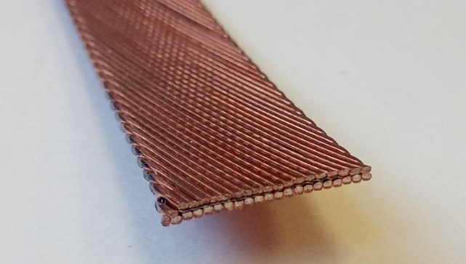
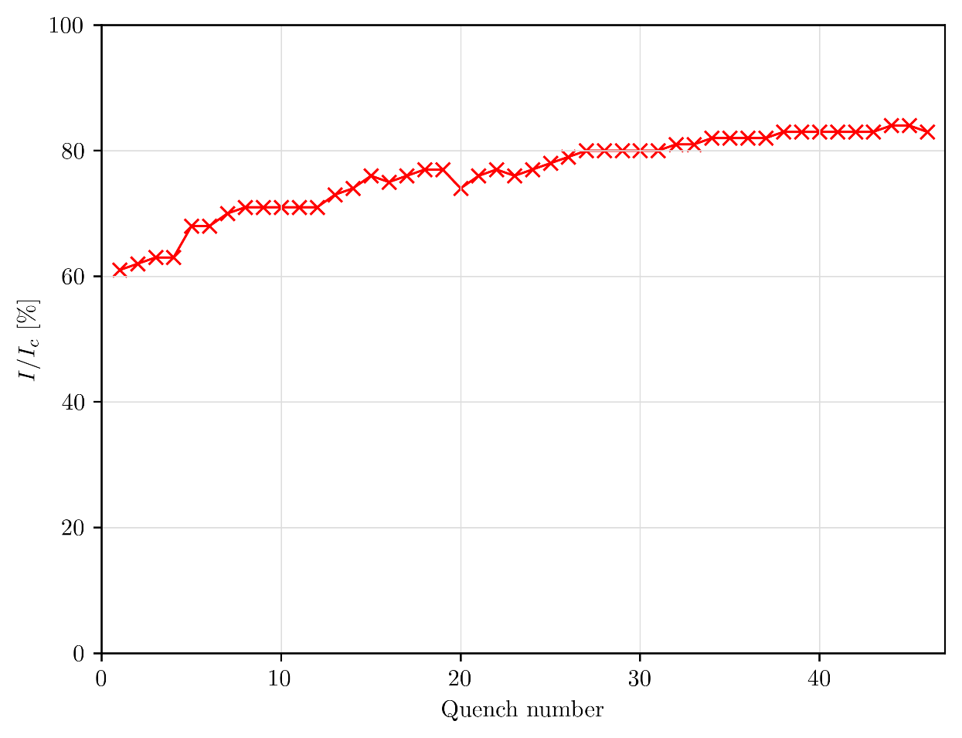
Context : training in Nb₃Sn magnets
Nb₃Sn rectangular Rutherford cable (so called “SMC-11T”)
Training is costly and magnet’s performances are not guarantied. So it must be limited.
According to the literature, there are various “mechanical causes” of training:
Cracking of the impregnation resin. [Daly et al, 2022]
Cable displacement and friction phenomenon. [Wallin & Willering, 2022] [Maeda et al, 1982]
Debonding of the epoxy-metal interface. [Maeda & Iwasa, 1982]
Training curve of HD2d dipole, adapted from [Ferracin et al, 2010]

Slide 3
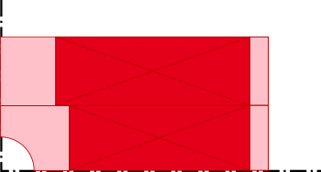
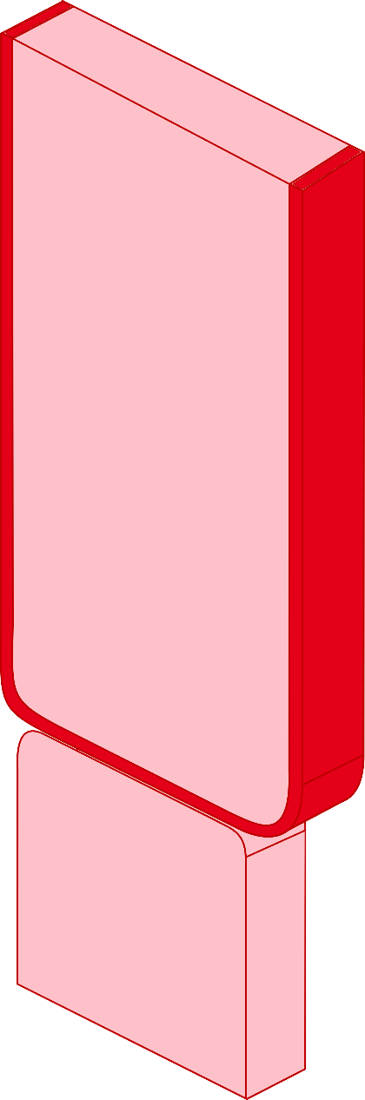






From the magnet to cable scale
Schematic of forces in a superconducting magnet
The deBOnding eXperiment (deBOX): training in conditions of superconducting magnet
$$F_{press}$$
Symmetry plan
$$i$$
$$i$$
$$\vec{B}$$
$$F_{press}$$
$$\vec{B}$$
$$i$$
$$τ_{result}$$
Symmetry plan
$$F_{Lorentz}$$
$$τ_{result}$$
Our goal:
What is the effect of the interfacial shear and transverse compressive stress on the training in Nb₃Sn magnets?
$$F_{Lorentz}$$
$$τ_{result}$$
$$F_{press}$$

Slide 4
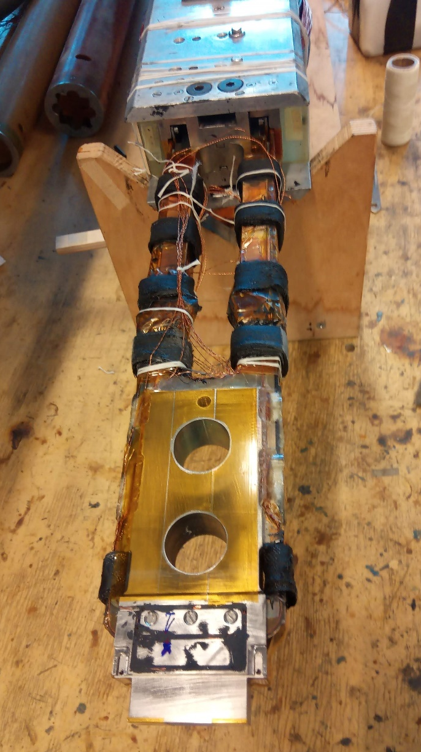
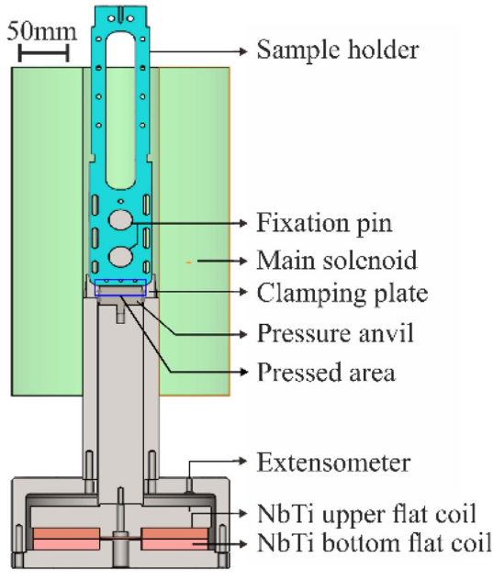
deBOnding eXperiment - deBOX
Our goal:
What is the effect of the interfacial shear and transverse compressive stress on the training in Nb₃Sn magnets?
deBOX1 | deBOX2 | deBOX3 | deBOX4
Scratched (paper grit 180) | Smooth (machined) | Very rough (sand blasted) | Teflon covered
970 L in He (~1,3 T eqCO2 ) | 281 L in He (~0,3 T eqCO2) | 295 L in He (~0,3 T eqCO2) | 560 L in He (~0,75 T eqCO2)
Compression system of a cable in a soleinoid [Gao et al, 2019]

Slide 5
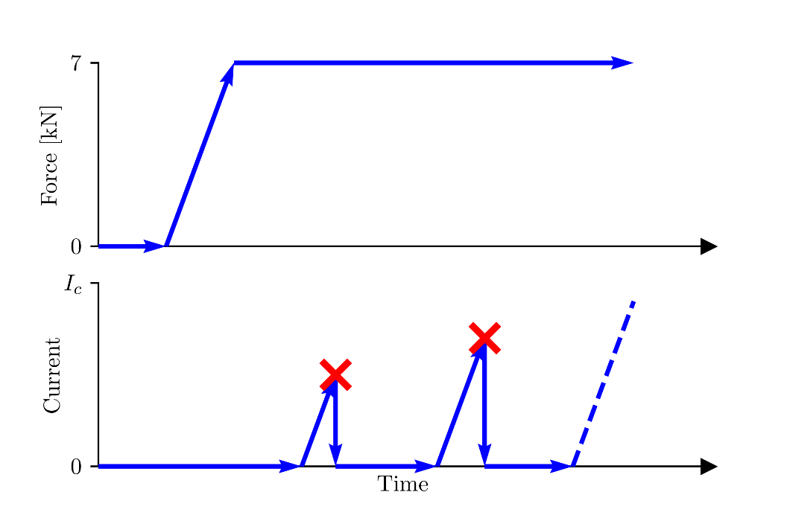
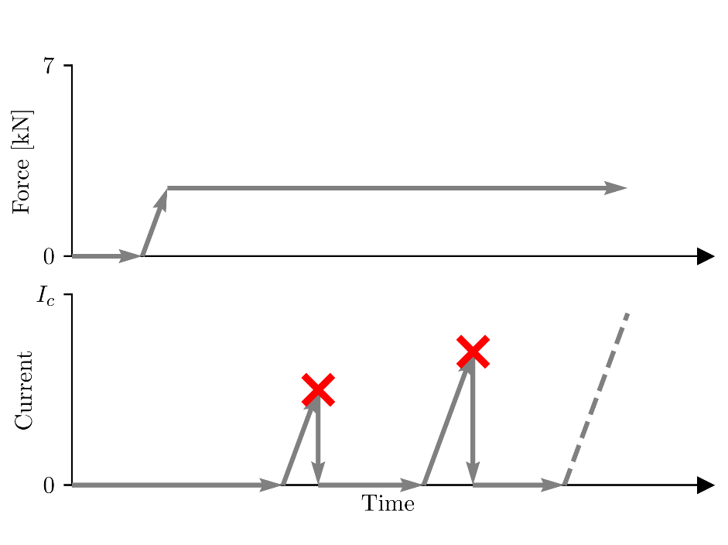
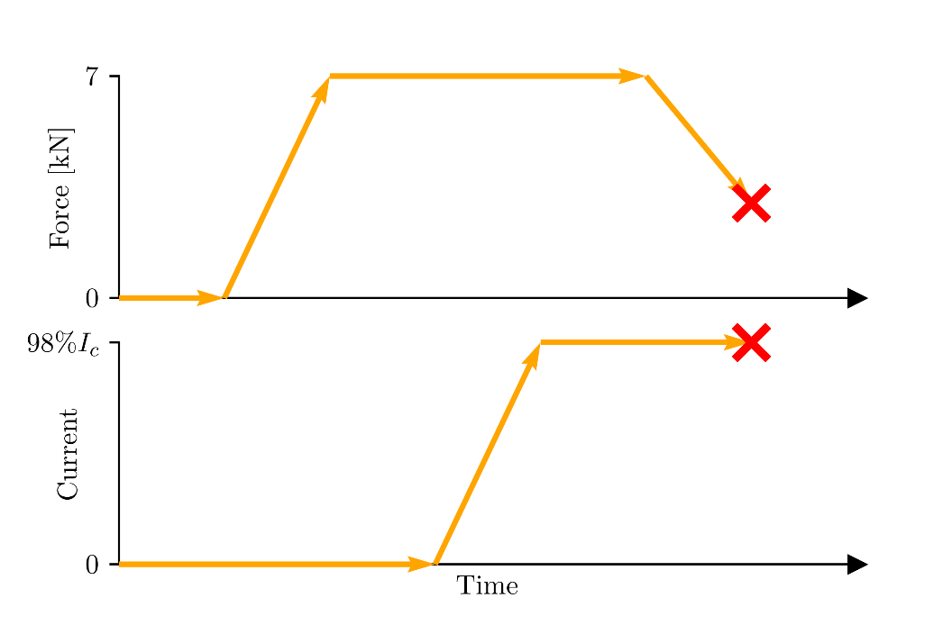
Test methods for deBOX samples
Training at 7 kN (10 MPa)
Training at low compression
« Unloading » quench
Constant transverse force, changing current
Constant current, changing transverse force

Slide 6
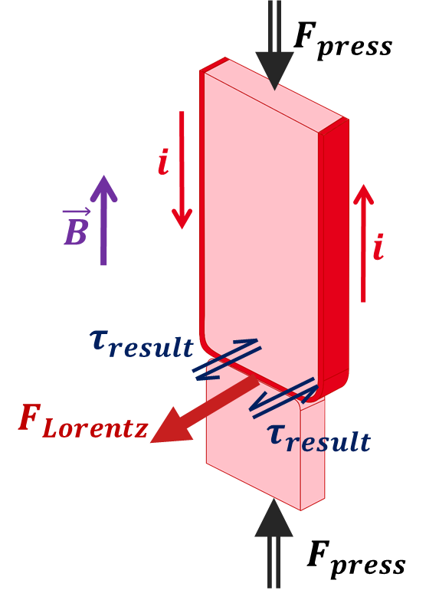
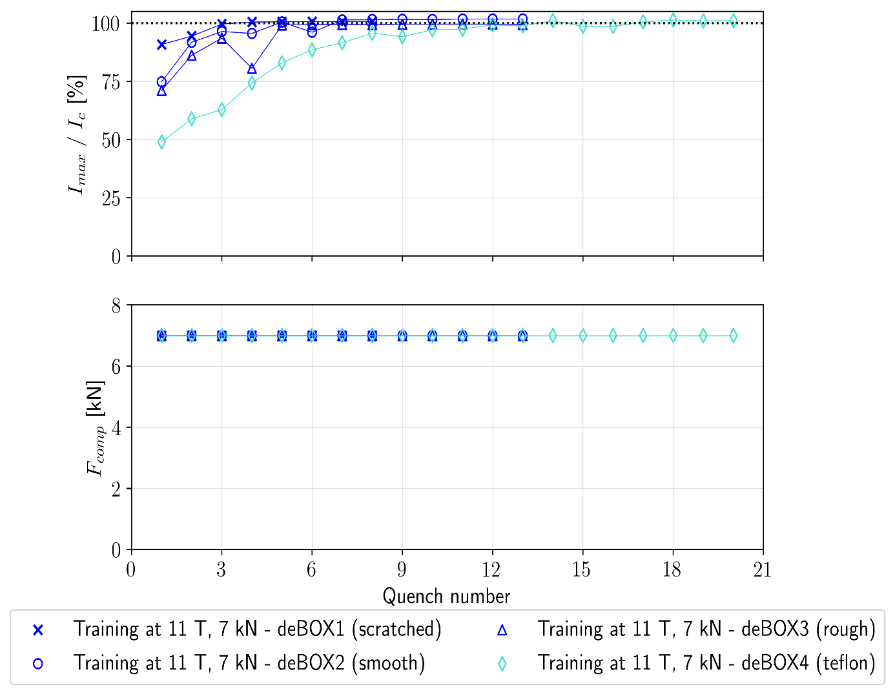
Initial training of deBOX samples (at 7 kN)
Test set-up:
Compress the cable at 10 MPa (~7 kN),
Ramp up the current in the sample until it quenches.

Slide 7
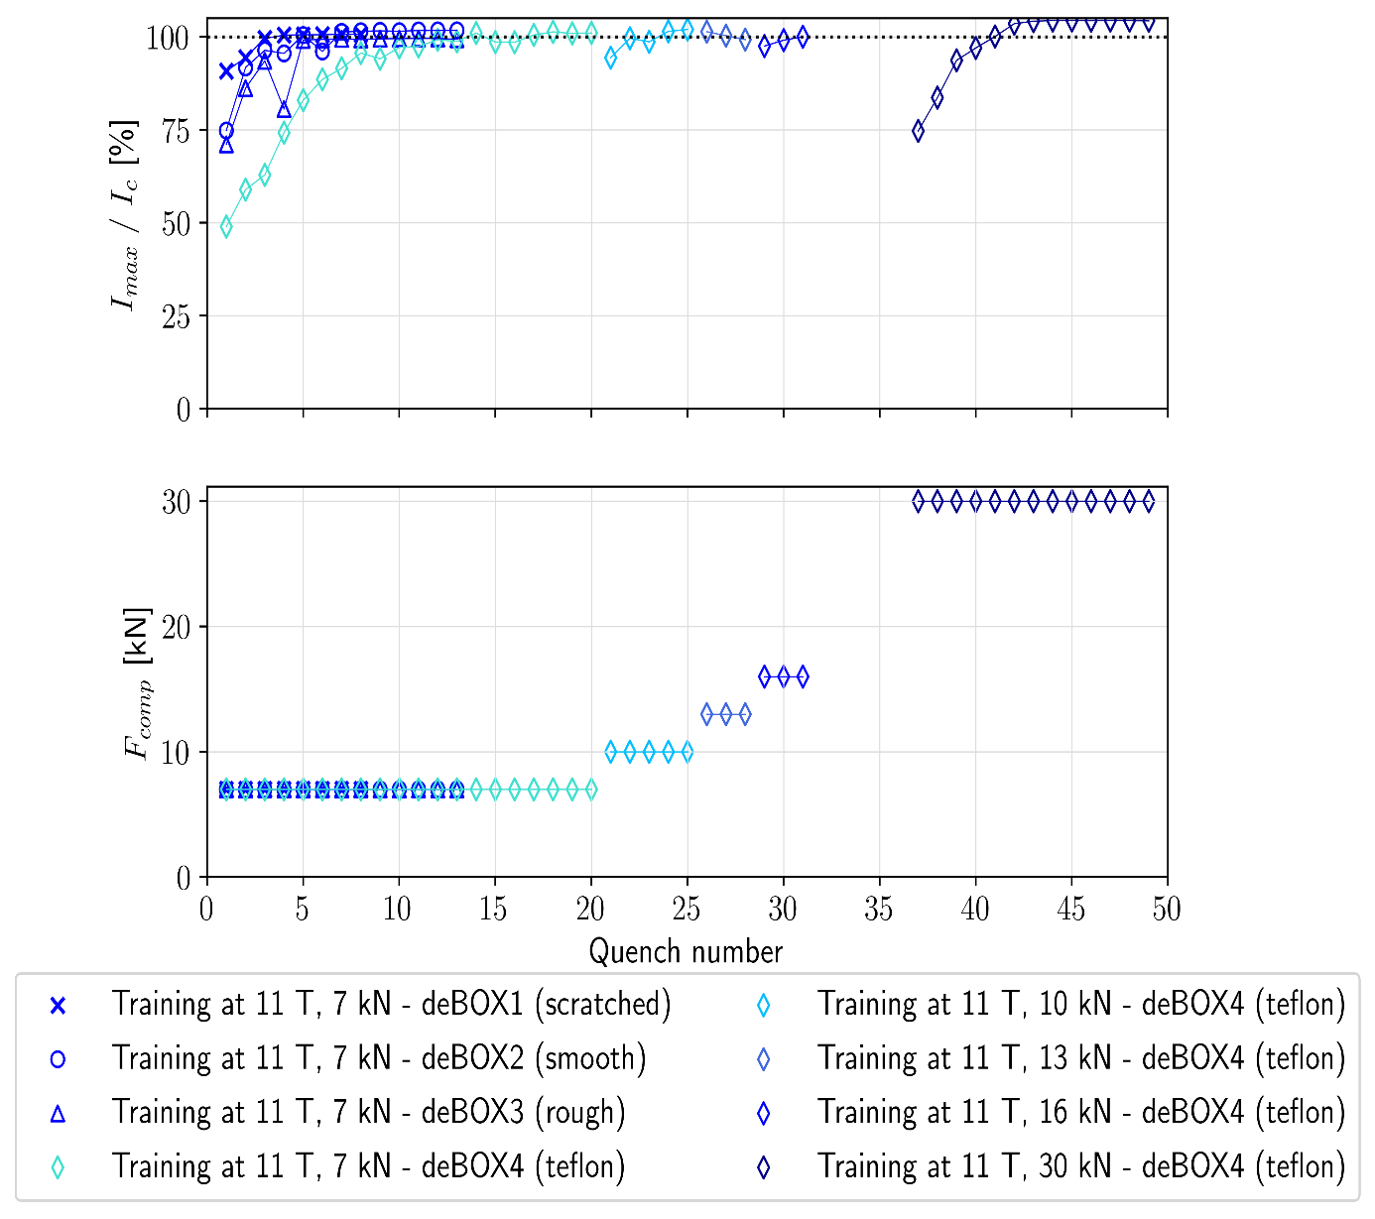
Initial training of deBOX samples
Observations:
For an interface with low adhesive properties (Teflon), a larger force is needed to finish the training.
A minimum compression force seems to be necessary to reach stable quench current.

Slide 8
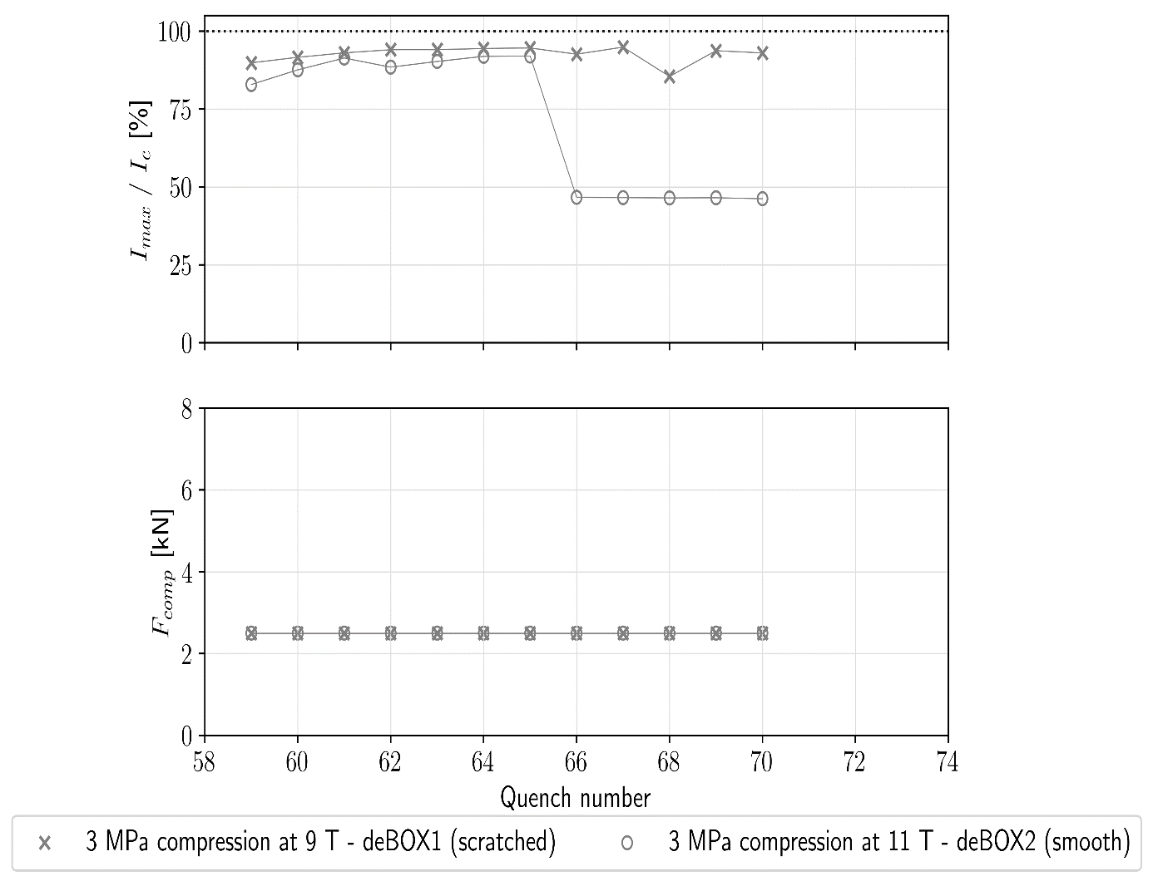
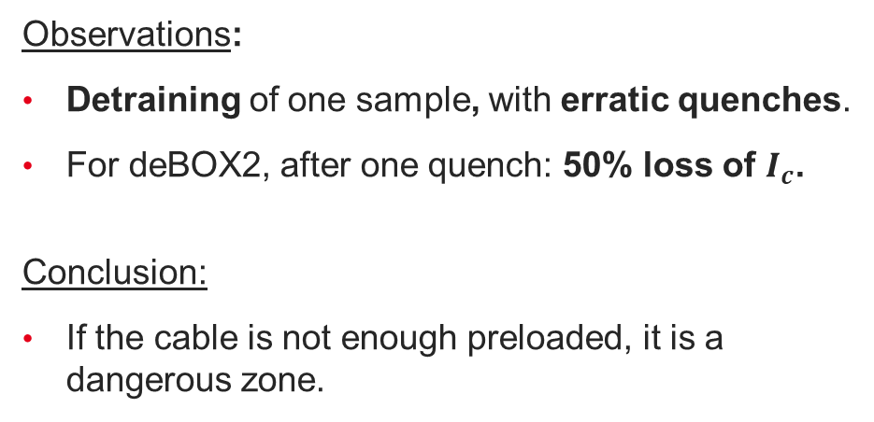
Training at low compression force
~ 3 MPa
Observations:
Detraining of one sample, with erratic quenches.
For deBOX2, after one quench: 50% loss of $I_{c}$.
Conclusion:
If the cable is not enough preloaded, it is a dangerous zone.

Slide 9
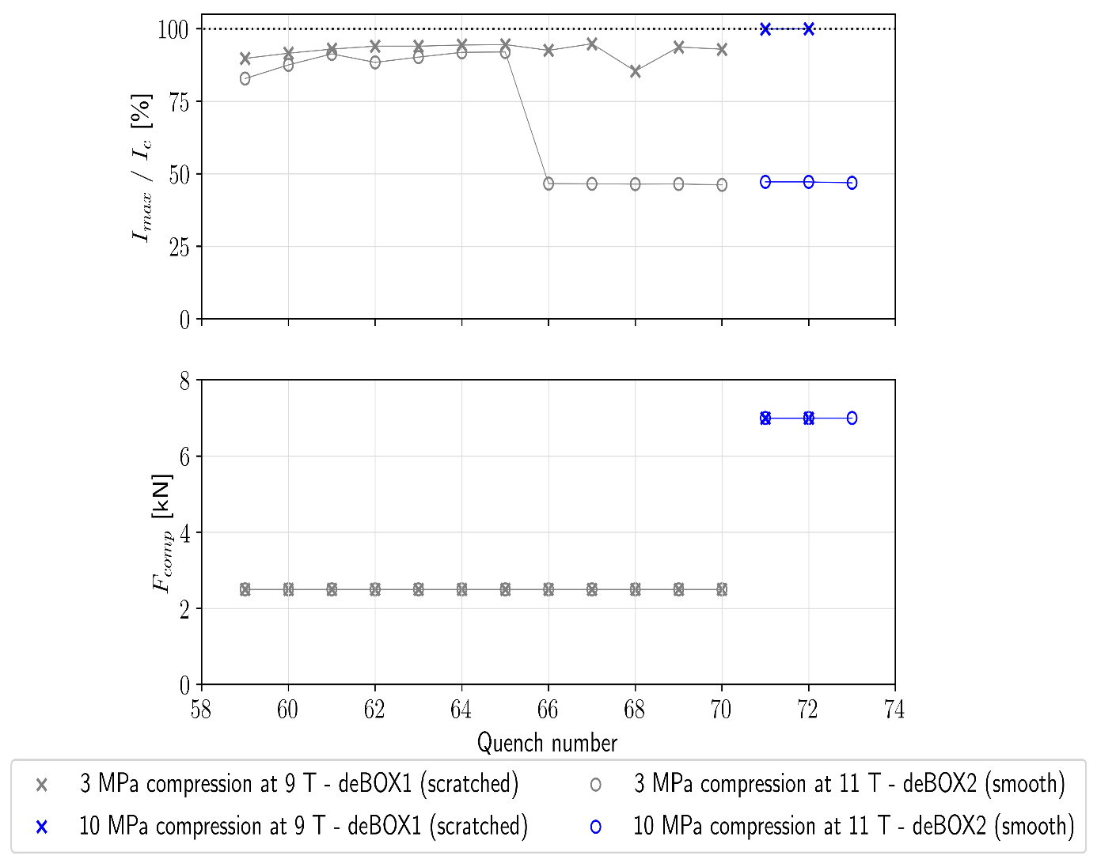
Training at low compression force
~ 3 MPa
10 MPa
Observations:
A small detraining can be reversible.
A large degradation is not reversible.
Conclusion:
The training and the ability to reach performances seems to be very dependent on the compression force!

Slide 10
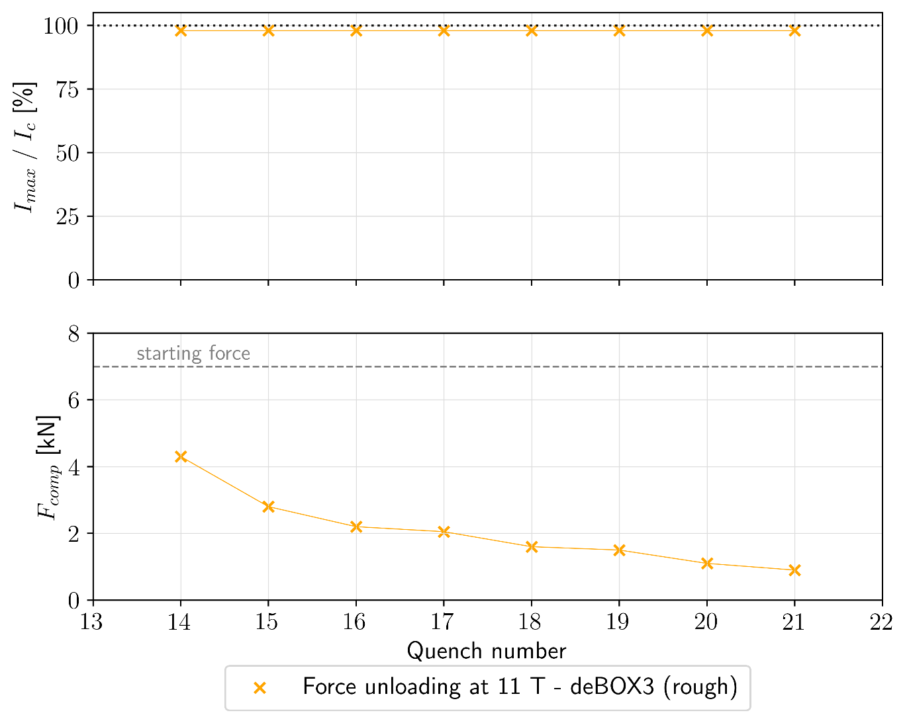

“Unloading” quenches – deBOX3
Quench!
Observation:
A quench can be triggered just by changing the compression force!
For high sticking properties (deBOX3): “training of force” is observed, and degradation occurred if the cable is not maintained anymore.
For low sticking properties (all other deBOX): random force at quench.

Slide 11
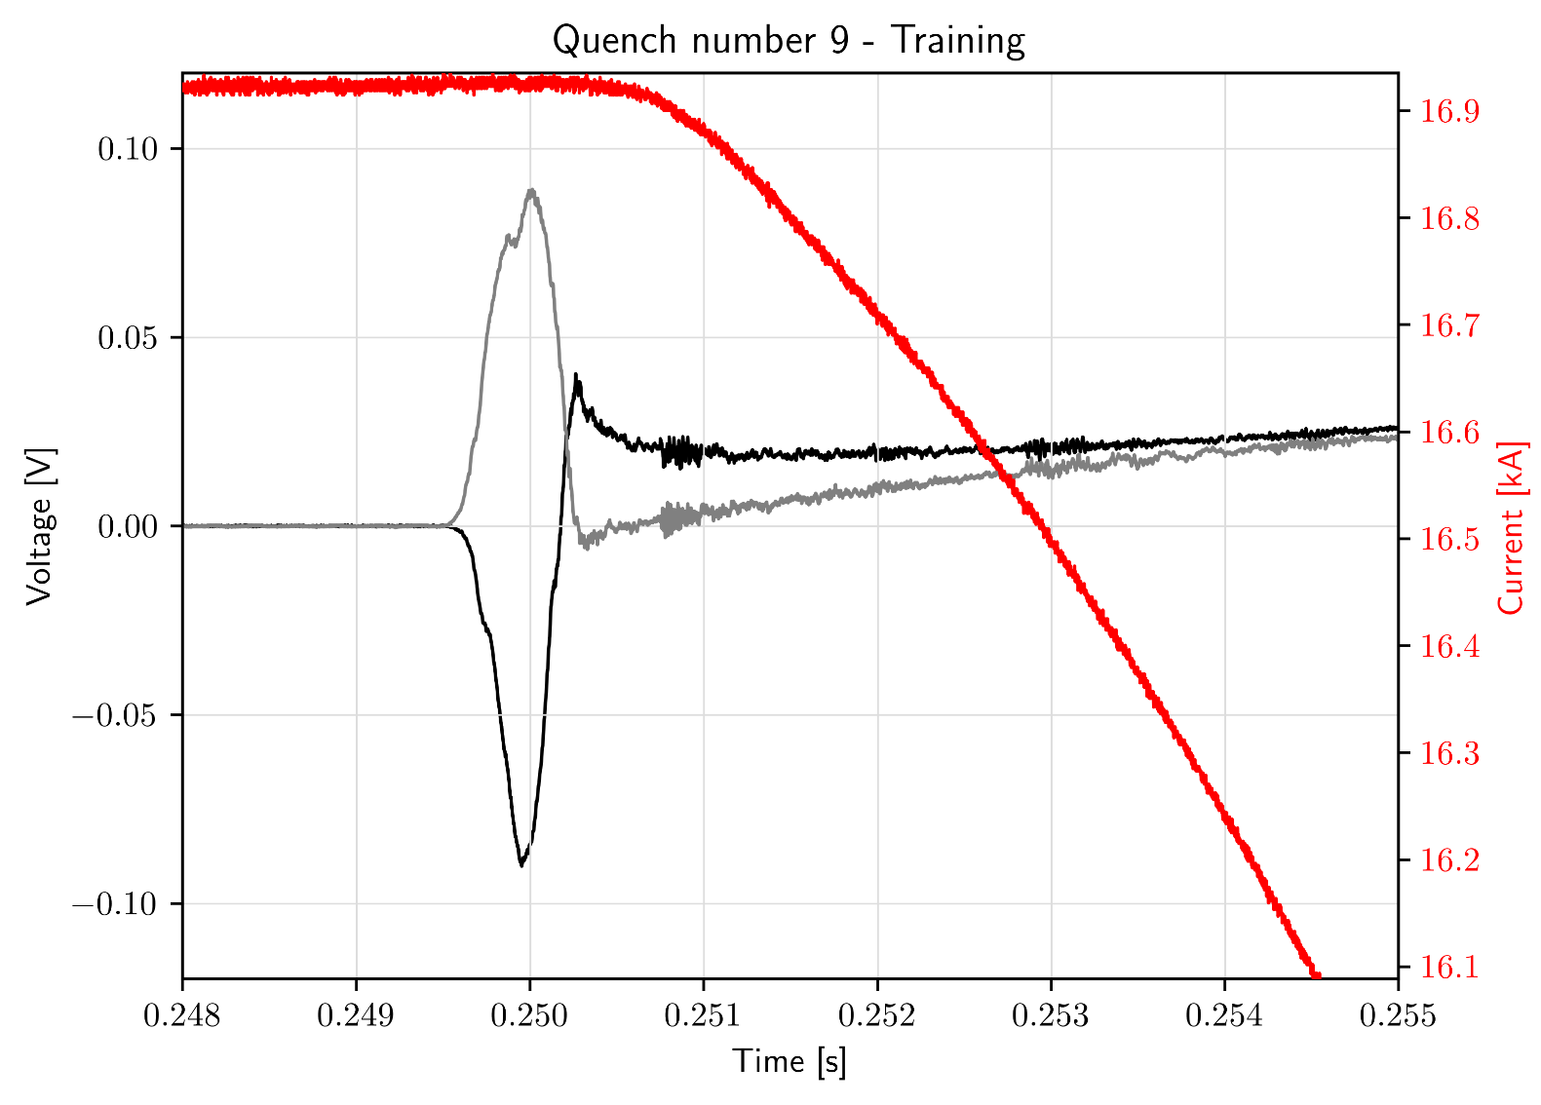
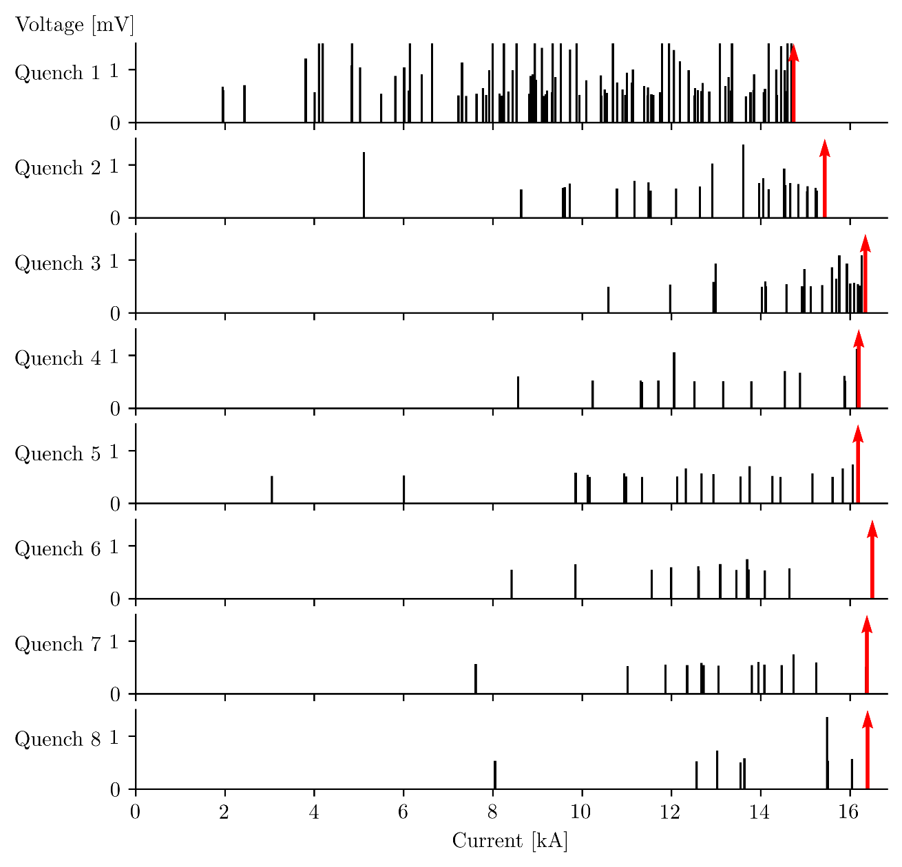
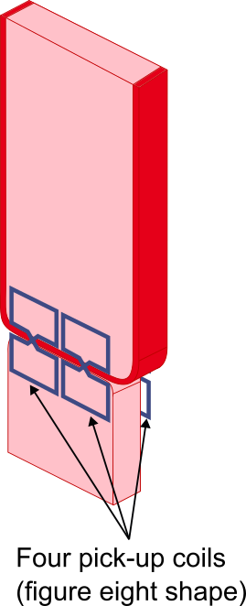

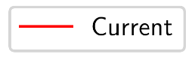
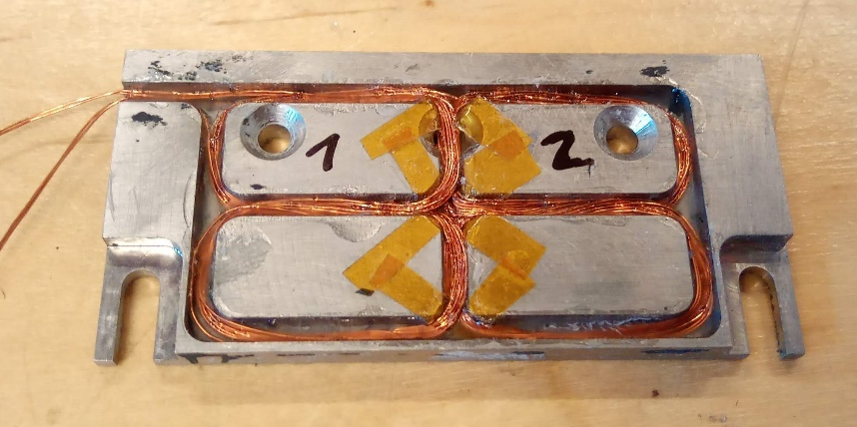
Signal analysis on deBOX samples
Pick-up coils for quench localisation
Votlage transient events analysis for training
History effect on transient events during training of deBOX1

Slide 12
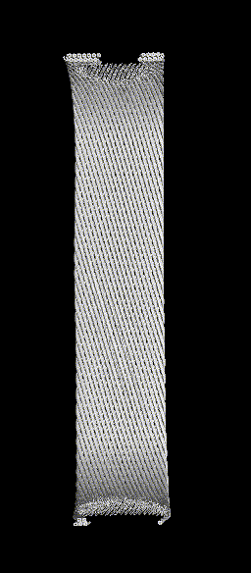
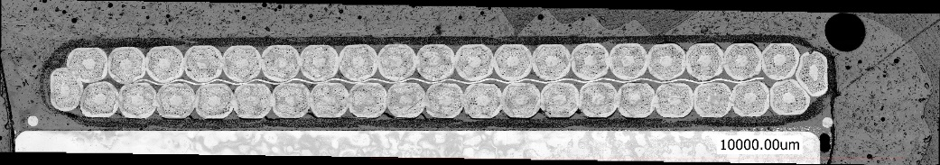
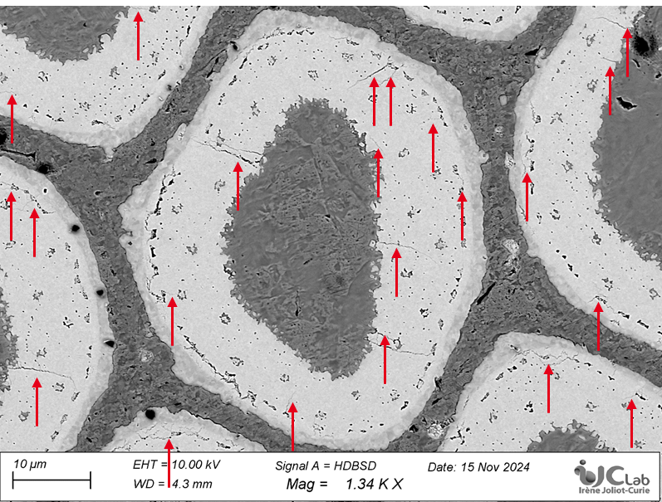
Summary
Conclusion:
Four deBOX samples tested with different epoxy/metal interfaces.
The length of the training and the ability to reach performances seems to be very dependent on the compression force.
If the compression force changes, a quench can be triggered.
Outlook:
Analysis of the data for pick-up coil and voltage transient events is still ongoing.
Post mortem analysis will be conducted to understand where the samples got damaged.

Slide 13
Merci / Thank you!
[Daly et al, 2022] Daly, M., Auchmann, B., Brem, A., Hug, C., Sidorov, S., Otten, S., ... & Ten Kate, H. (2022). Improved training in paraffin-wax impregnated Nb3Sn Rutherford cables demonstrated in BOX samples. Superconductor Science and Technology, 35(5), 055014.
[Ferracin et al, 2010] Ferracin, P., Bingham, et al, 2010. Recent Test Results of the High Field Nb3Sn Dipole Magnet HD2. IEEE Transactions on Applied Superconductivity 20, 292–295.
[Gao et al, 2019] Gao, P., Wessel, W.A.J., Dhallé, M., Otten, S., Kario, A., Nugteren, J.V., Kirby, G., Bottura, L., Kate, H.H.J. ten, 2019. Effect of resin impregnation on the transverse pressure dependence of the critical current in ReBCO Roebel cables. Supercond. Sci. Technol. 32, 055006.
[Maeda et al, 1982] Maeda, H., Tsukamoto, O., & Iwasa, Y. (1982). The mechanism of frictional motion and its effects at 4.2 K in superconducting magnet winding models. Cryogenics, 22(6), 287-295.
[Maeda & Iwasa, 1982] Maeda, H., & Iwasa, Y. (1982). Heat generation from epoxy cracks and bond failures. Cryogenics, 22(9), 473-476.
[Wallin & Willering, 2022] Wallin M., Willering G., (2022) Transients and Coil Displacement in Accelerator Magnets, CERN TE-MSC seminar.
CEA SACLAY
91191 Gif-sur-Yvette Cedex
France
guillaume.campagna@cea.fr
guillaume.campagna@ens-paris-saclay.fr
A big thanks to technical teams of CEA and UT for their help!!

Slide 14
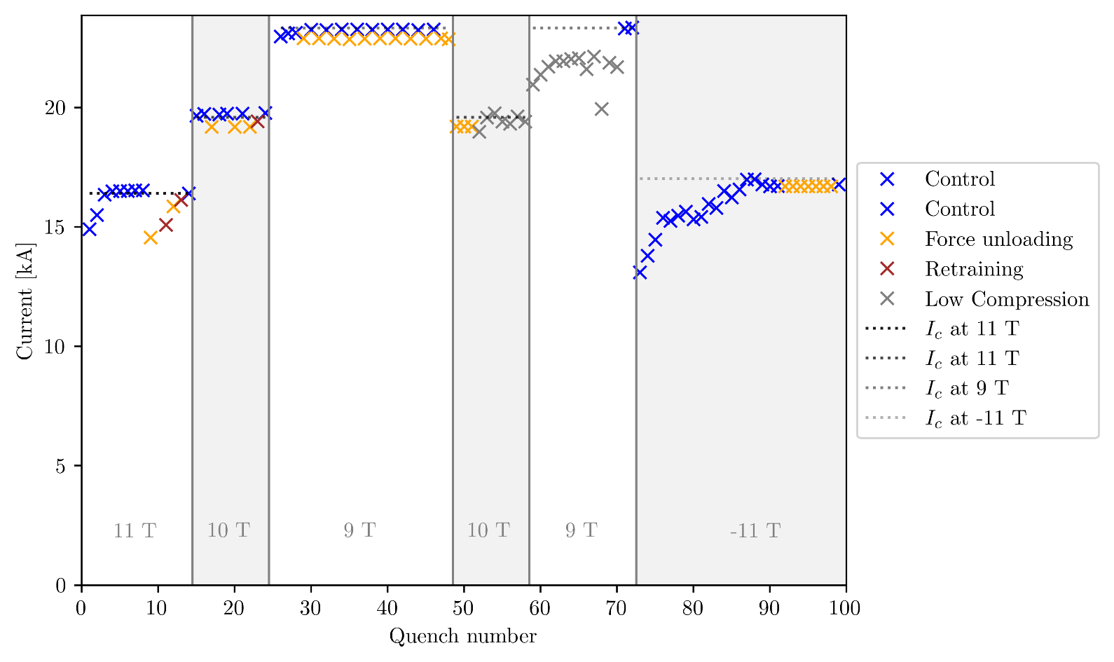
Quenches deBOX1

Slide 15
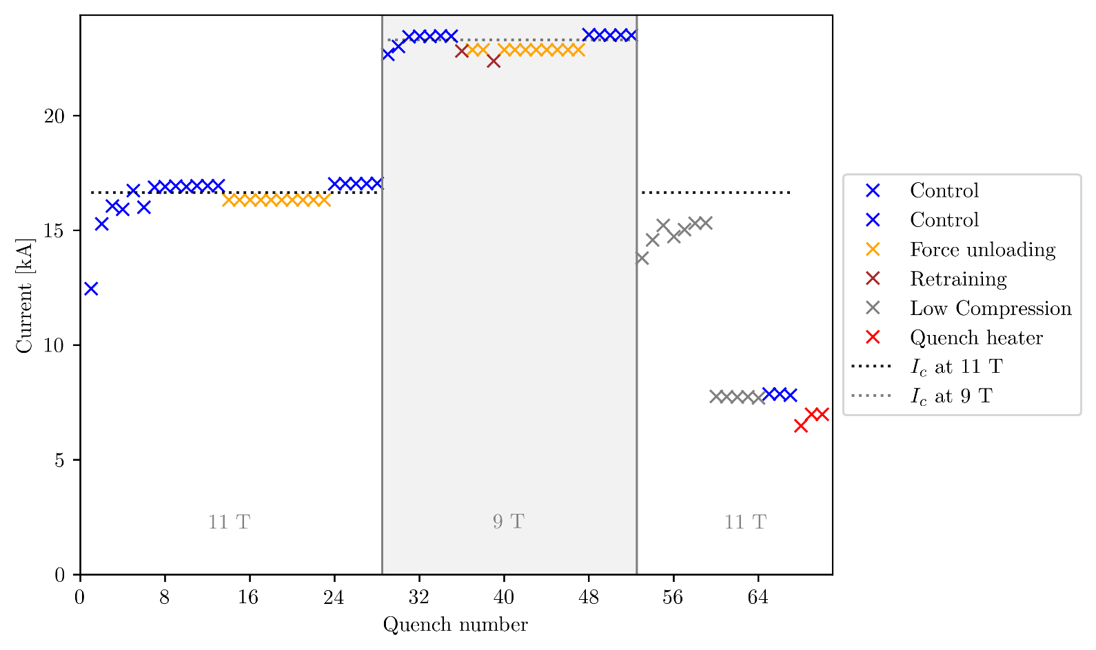
Quenches deBOX2

Slide 16
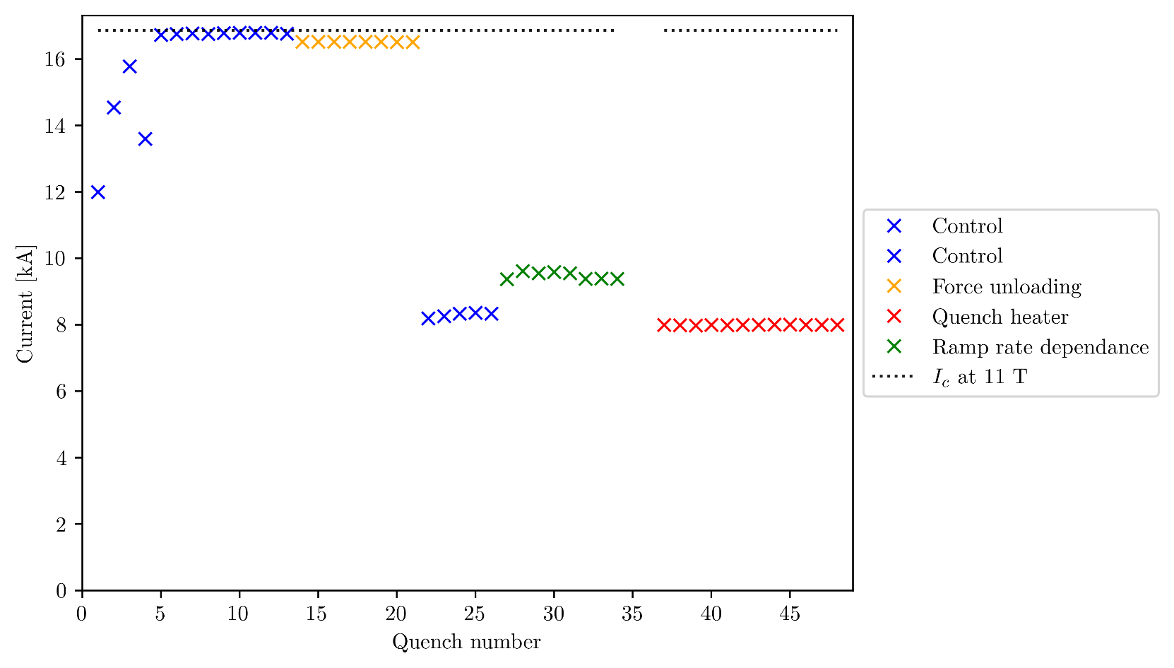
Quenches deBOX3

Slide 17
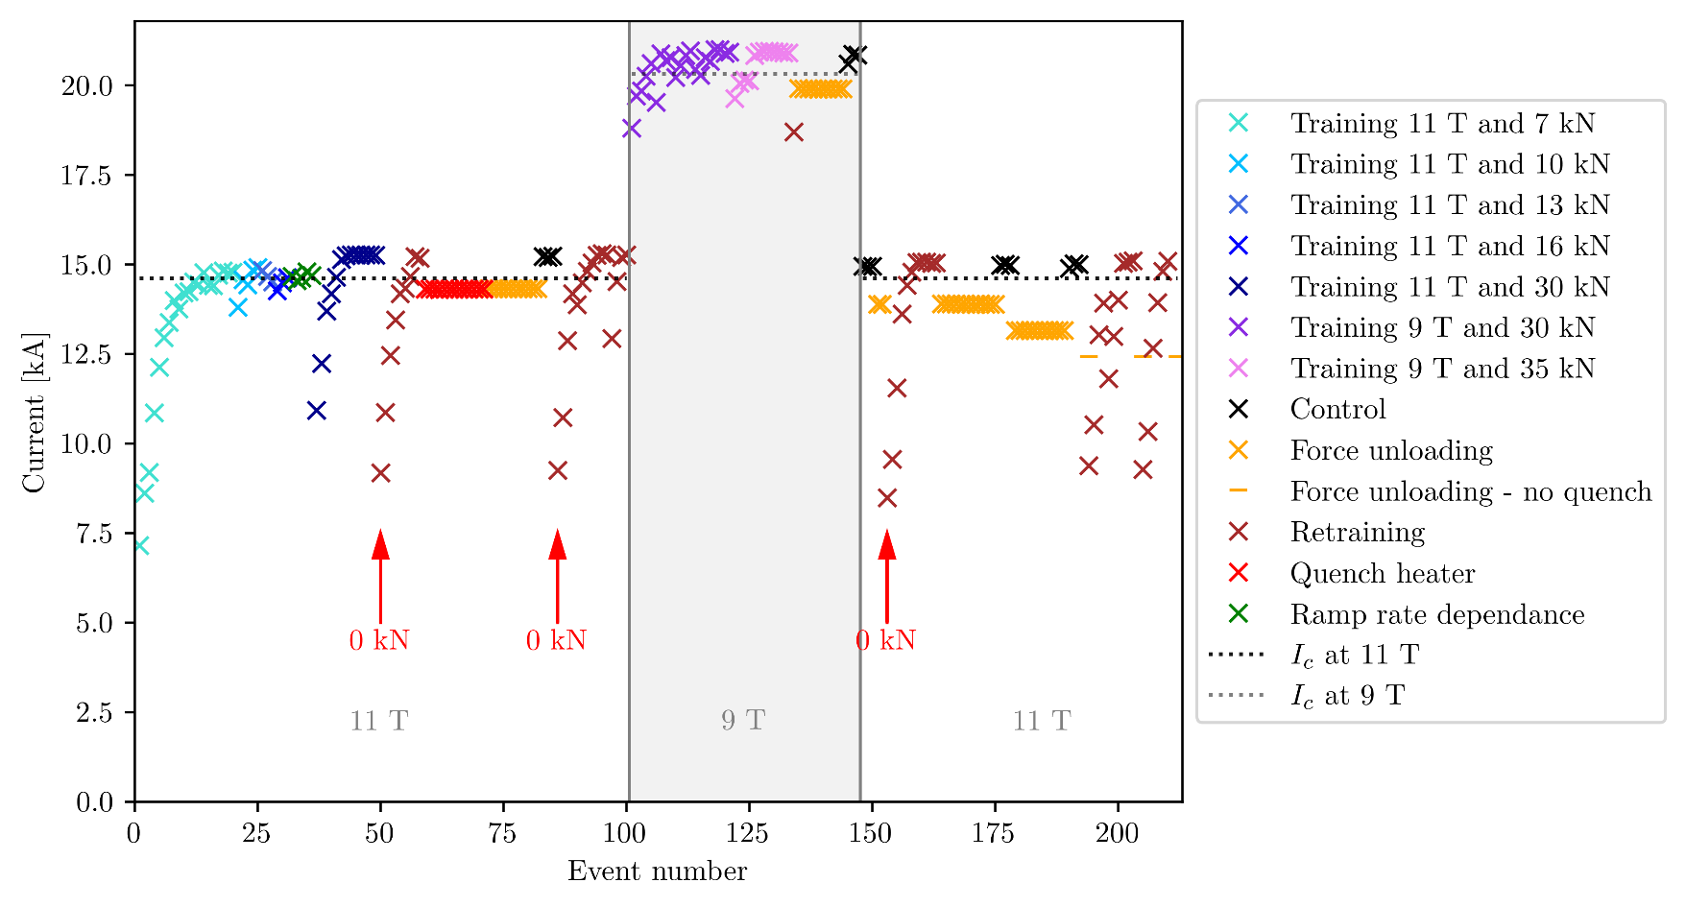
Quenches deBOX4

