Slide 1

Compression BOX
Cable degradation under transverse stress
"This work was performed under the auspices of and with support from the Swiss Accelerator Research and Technology (CHART) program."
A. Brem, M. Duda, M. Daly, J. Van den Eijnden ,D. M. Araujo, C. Müller, H. Garcia, C. Hug, A. Milanese S. Sidorov,
S. Otten, M. Dhallé, Z. Guo, A. Kario, A. Haziot, H. ten Kate and B. Auchmann

Slide 2
Acknowledgment
Many thanks to the US Magnet Development Program and the Lawrence Berkeley National Laboratory for providing the Nb₃Sn cable.

Slide 3
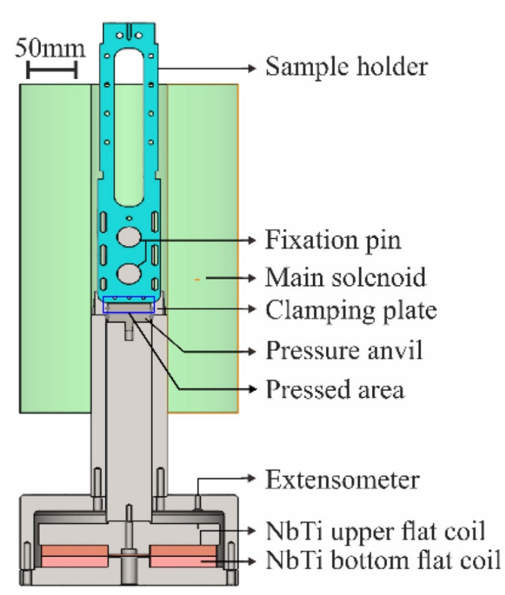
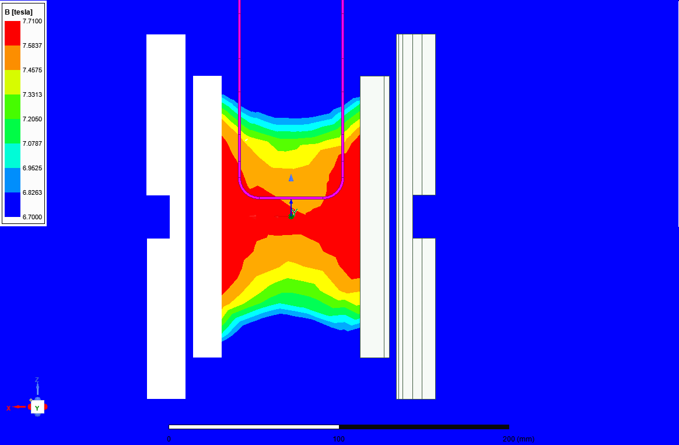
Compression BOX setup at UTwente
Typical UTwente
Transverse Pressure Setup
Background Field: 7.5 T
Unpowered cable
Properties | Values
Material | 316 L
Overall dimensions L x W x H | 365 x 72 x 24 (mm)
Compressed cable length | 38 mm
Background field | 11 T
Expected Current | < 15 kA
Expected stress on cable | 200 MPa

Slide 4
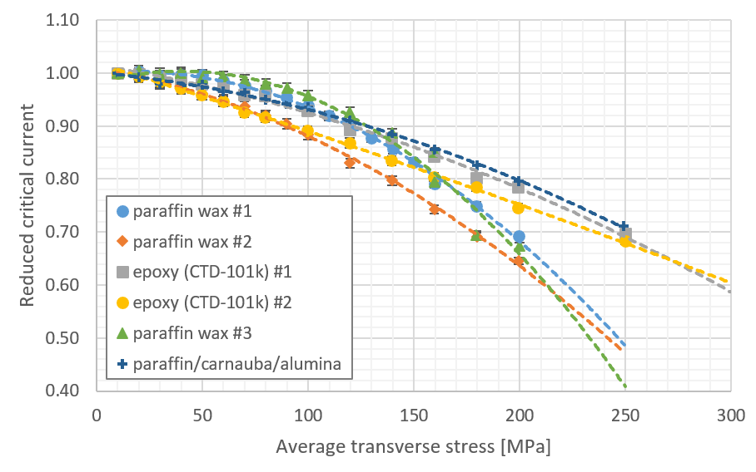
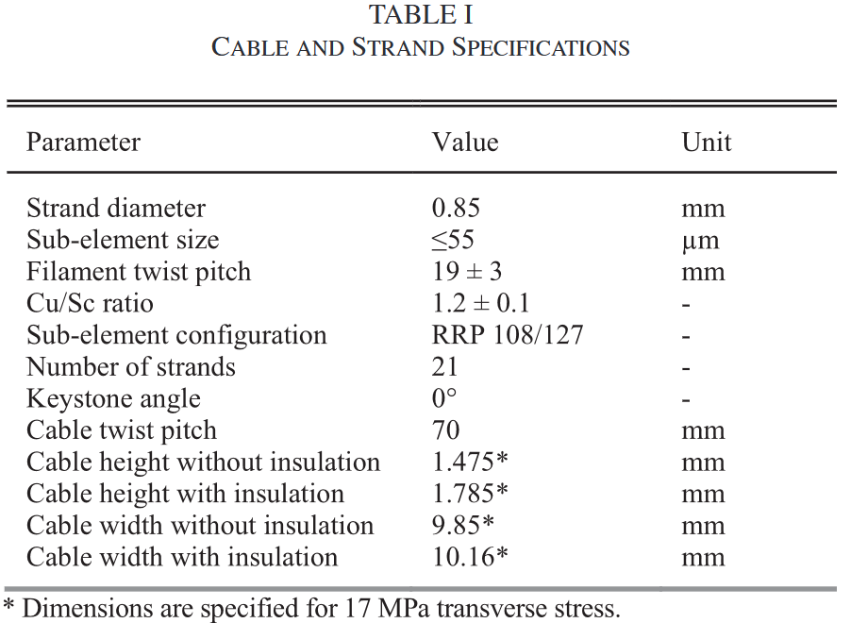
Last time
CD1 cable
filled paraffin wax
or epoxy
pure paraffin wax
S. Otten et al., 2023, 10.1109/TASC.2023.3267051
tests with cable dimensions of approx. 1.5 mm x 10 mm with 11 T background field

Slide 5
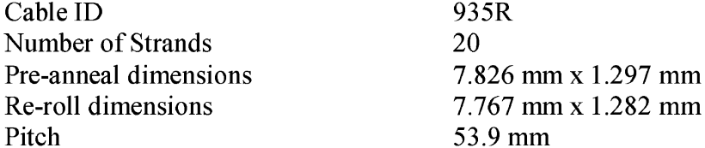

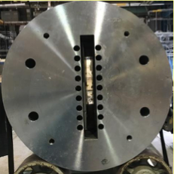
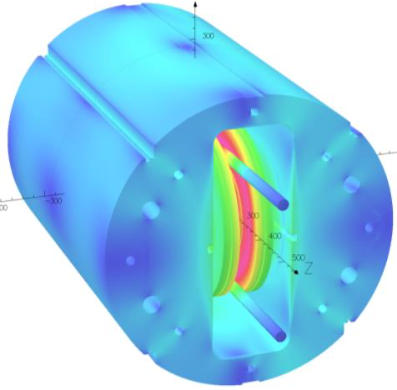
Compression Box with new type of cable cross-check and validation experiments
BigBox cable
Big Box experiment
- coil insert – 14 turns in and external field (10T)
P. Wanderer et al., 2007, 10.1109/TASC.2007.899984.
same cable in Compression BOX experiment to cross-check and validate the experiments
common-coil dipole magnet DCC017 at BNL
D. M. Araujo et al., 2024, 10.1109/TASC.2024.3368995

Slide 6
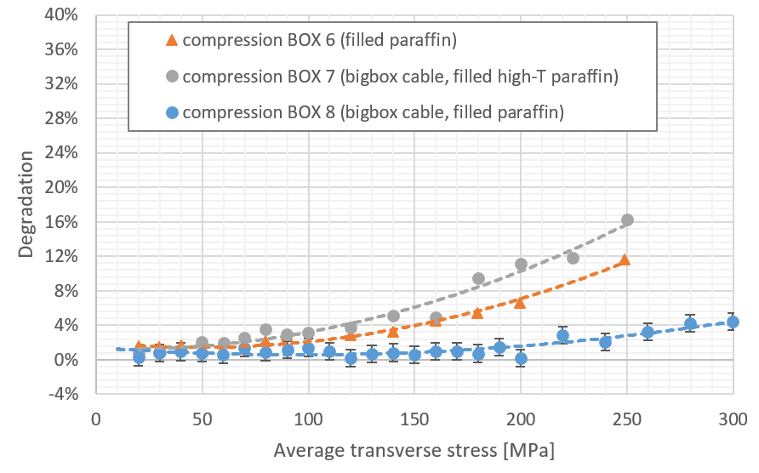
Latest Results
CD1 cable
filled high melting point wax
T_{m} 105 °C
filled paraffin wax
“standard”
T_{m} 57 °C
inconclusive results with the new cable
to be continued...

Slide 7
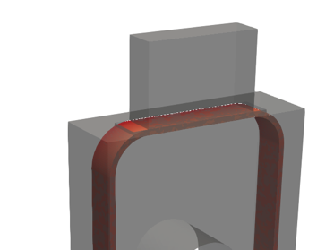
Improvements on Compression BOX better strain monitoring
- average stress is known by a single strain gauge on the pusher block
- the current on the pushing solenoids is also known, correlelates with strain on pusher block
! friction, blockage or uneven loading is not measured/detected
better strain monitoring is required, ideally on both sides
pusher and former
pusher
former
courtesy of J. Van den Eijnden

Slide 8
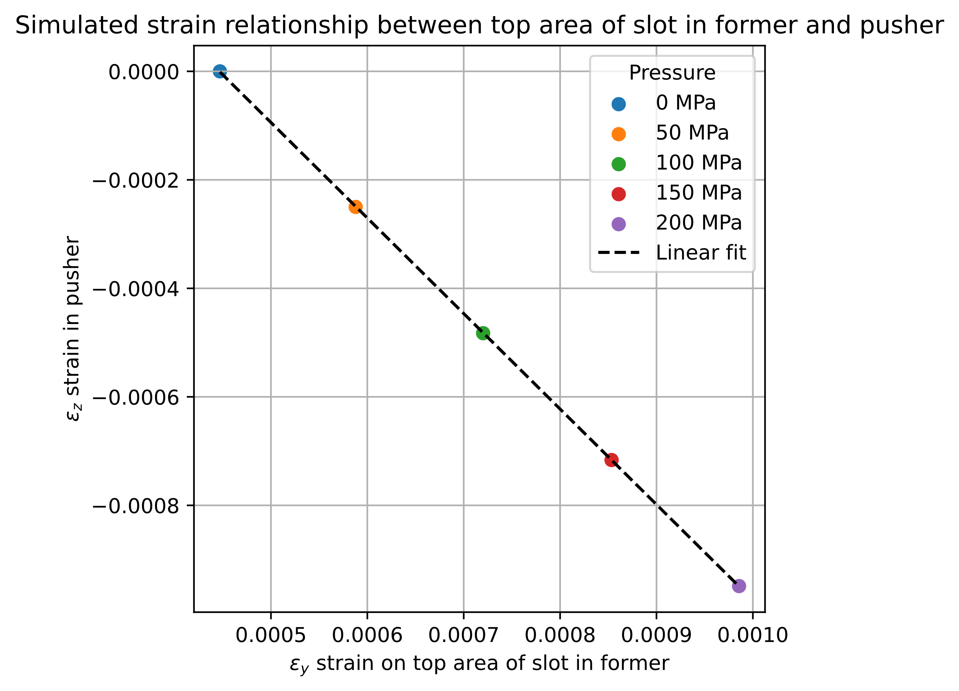
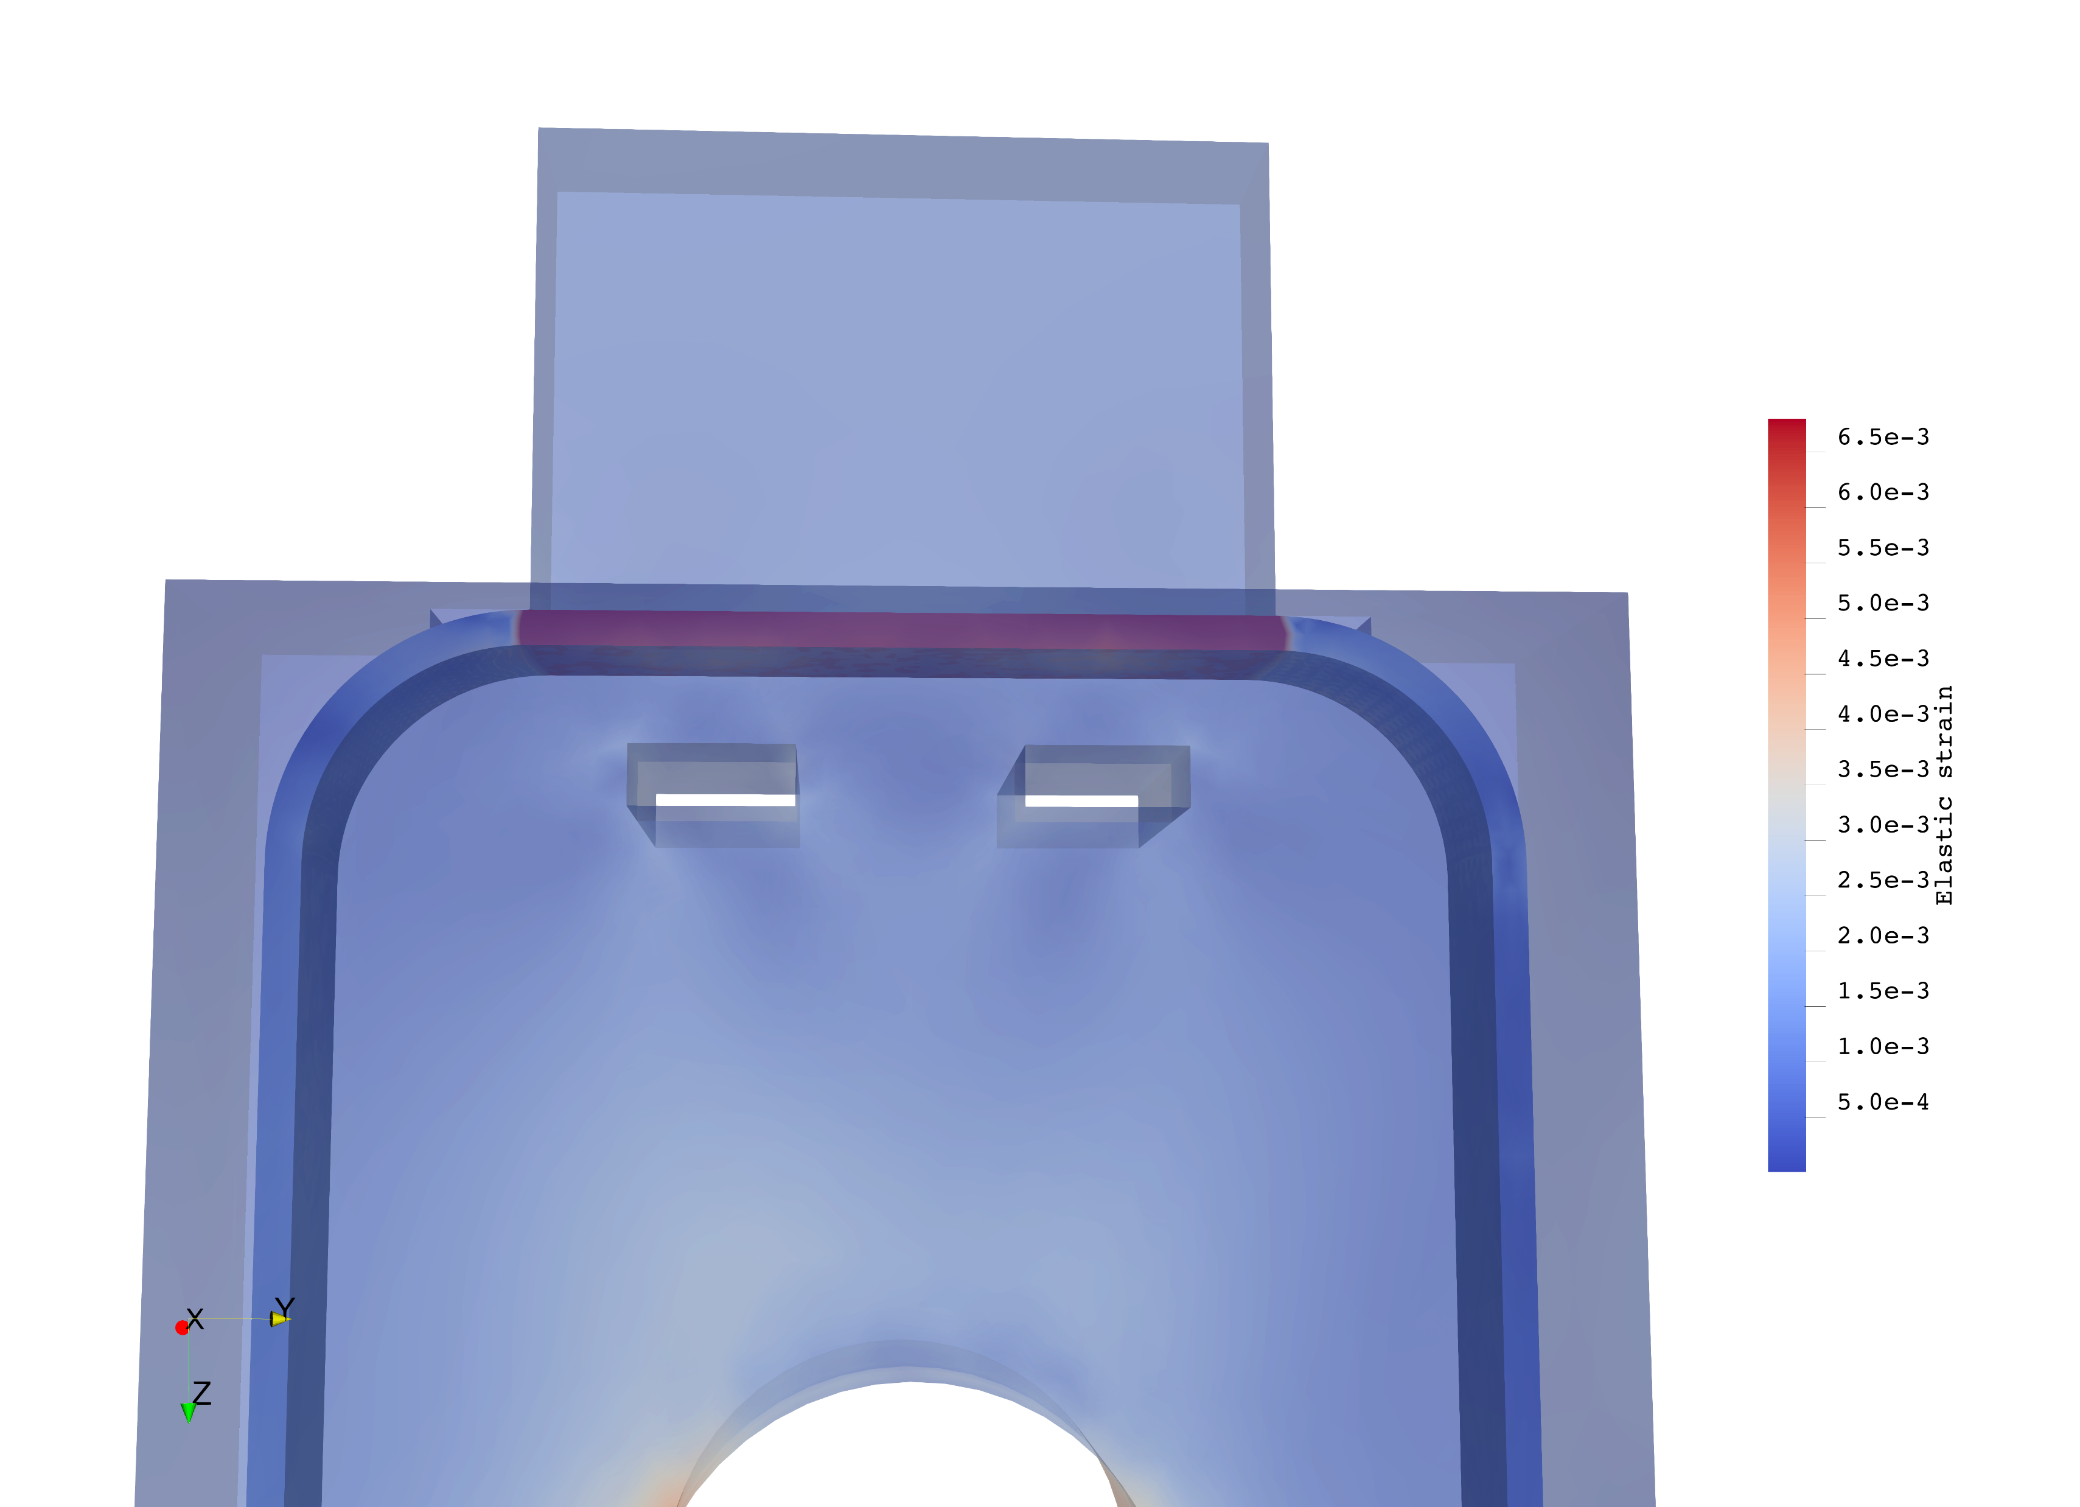
Improvements on Compression BOX better strain monitoring
Possible cause: not all force transferred from pusher to the cable.
Idea: add holes and strain gauges to the former and pusher to measure force transferred
Measure z-component of strain in pusher
Measure y-component of strain in hole
Correlation should show if all force is transferred

Slide 9
Conclusion and Outlook
Compression BOX was adapted to a new type of cable
A filled high melting point wax was tested
- Compression BOX tests with cables which are going to be used in SMACC
- Adaptation of the compression BOX former to accommodate more strain gauges
- Continue the evaluation of filled high melting point wax as impregnation media

Slide 10
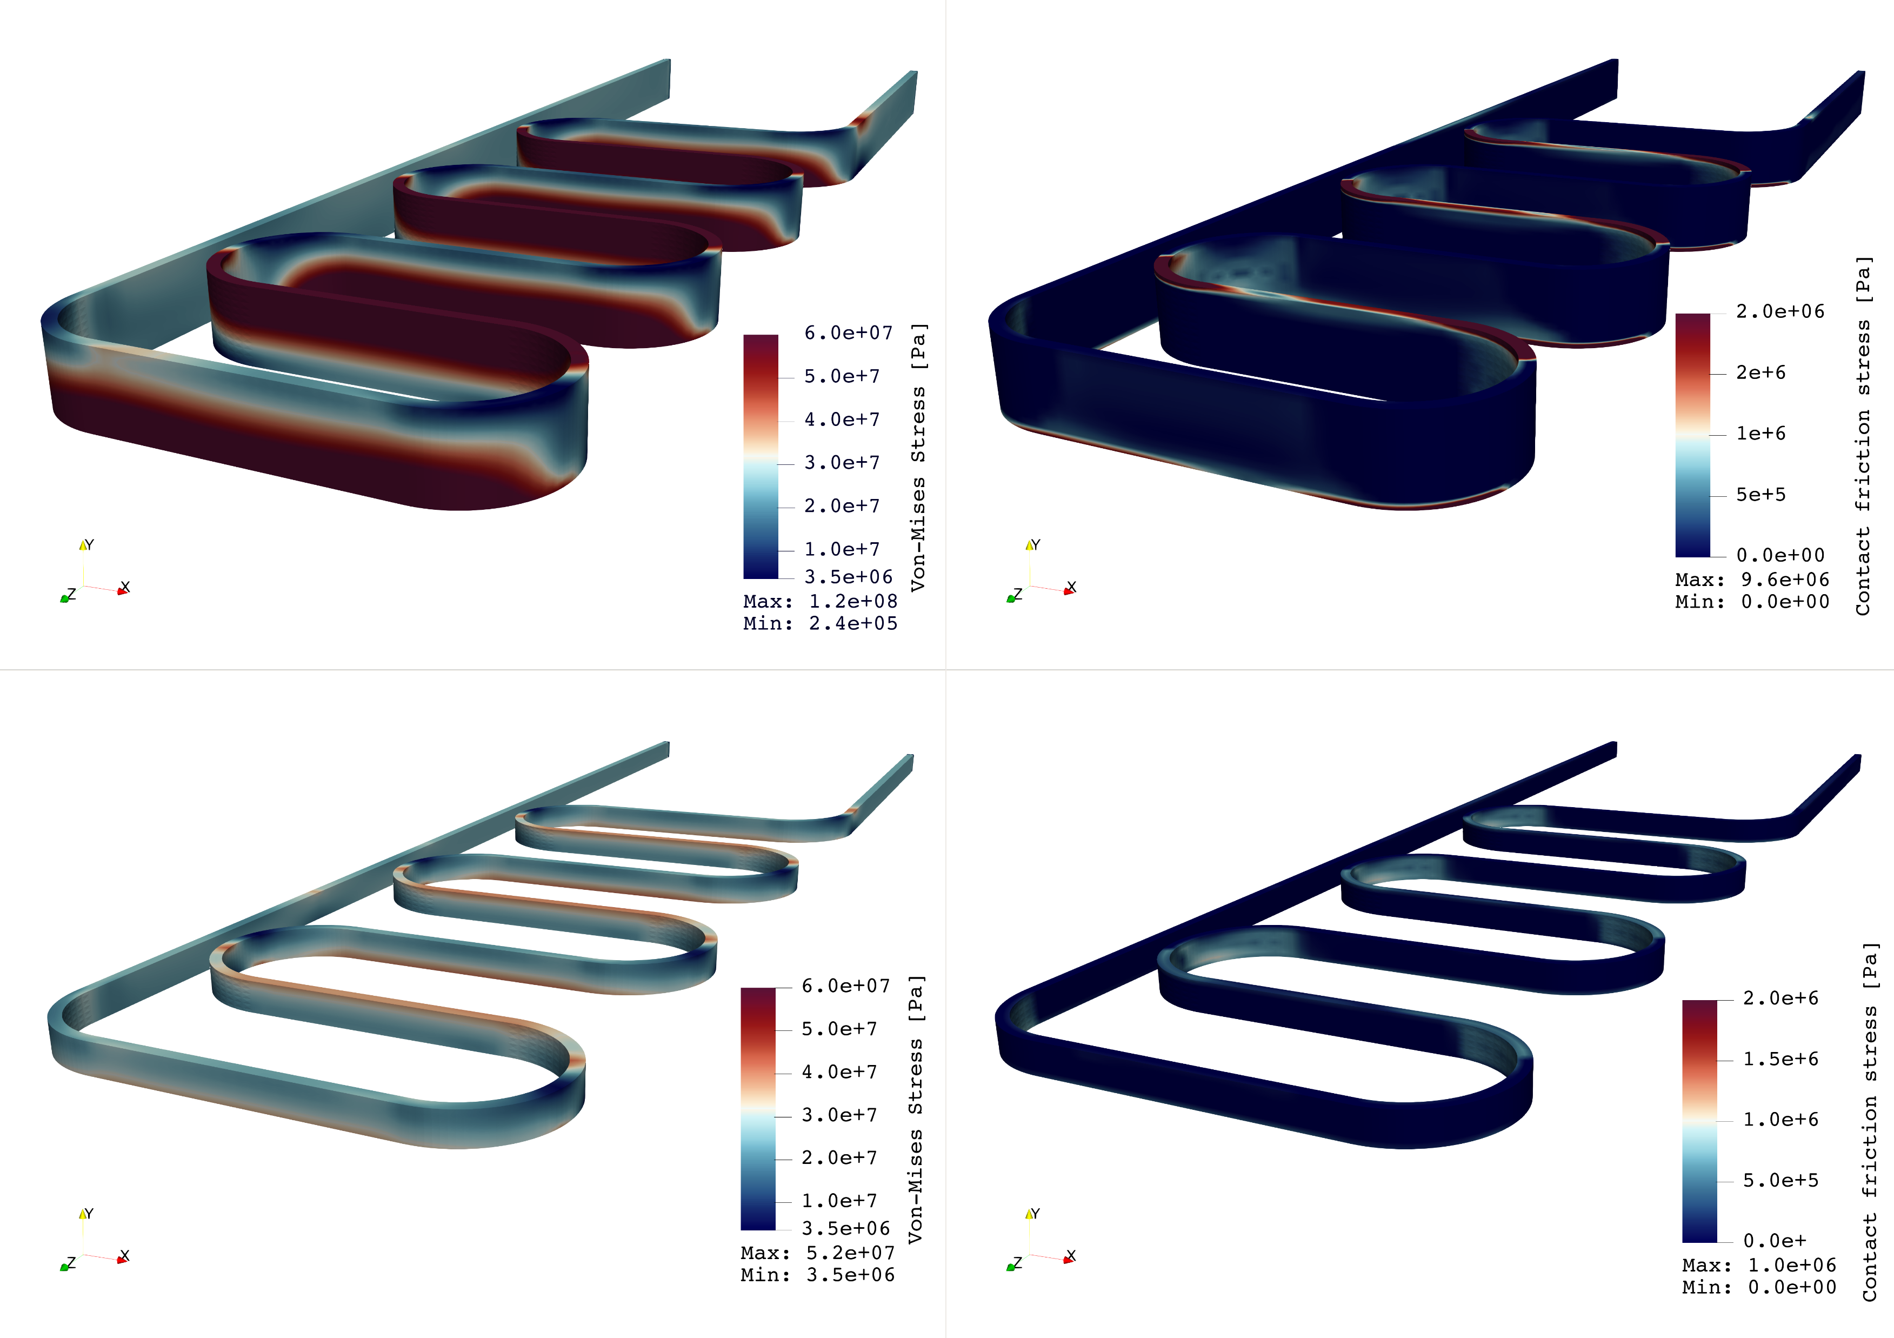
Von-Mises Stress Contract Friction
Outlook - Box with Subscale cable
CD1 cable
20 kA
11 T background field
Subscale cable
10 kA
6 T background field
and also for compression BOX experiments

Slide 11
Questions!

Slide 12
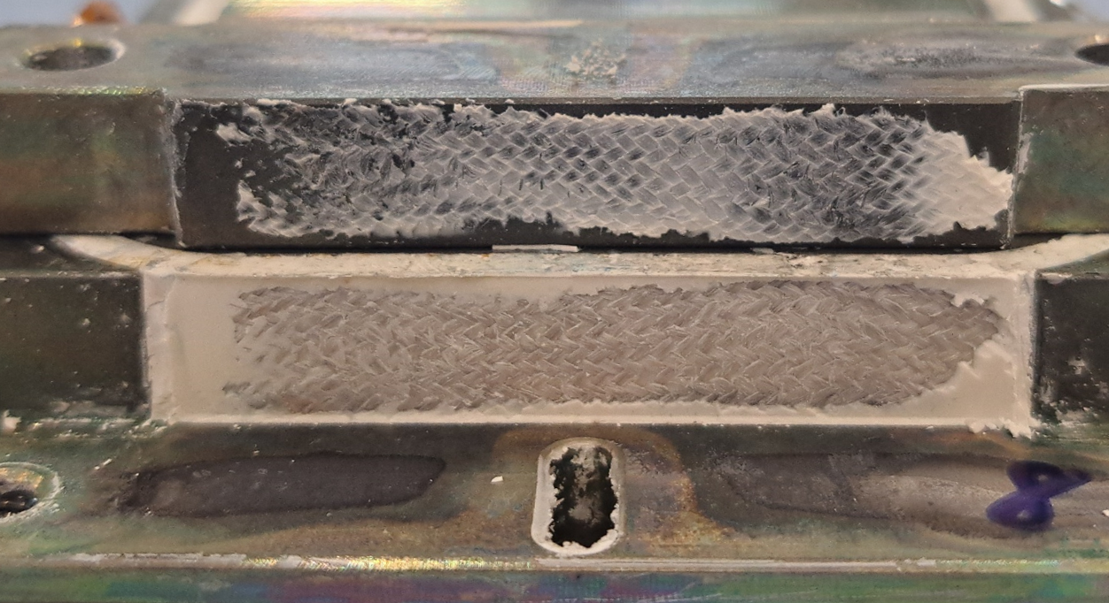
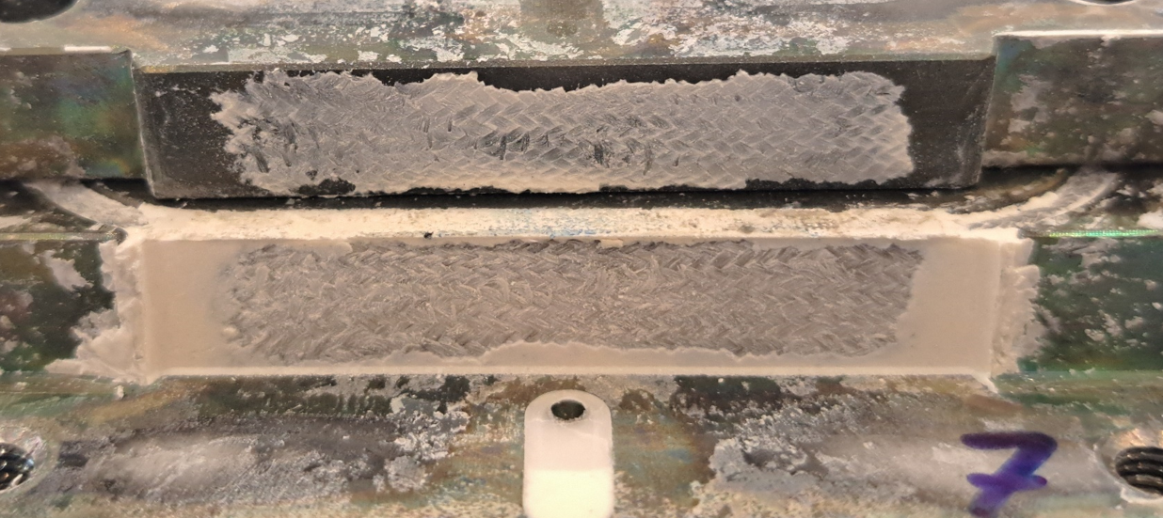

Slide 13
