Slide 1
Progress on Quench Protection and Transient Modelling at CERN
HFM WP4.5
Mariusz Wozniak
HFM Annual Meeting, 11th February 2025
Related presentations
HFM annual meeting, November 2023
https://indico.cern.ch/event/1302031
STEAM – E. Ravaioli & M. Wozniak
WP4.5 – M. Wozniak
TE-HFM Day, September 2024
https://indico.cern.ch/event/1425262
WP4.5 – A. Verweij

Slide 2
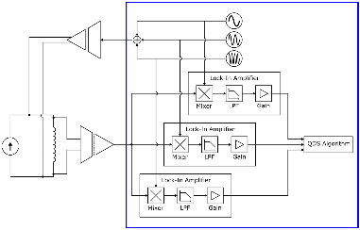
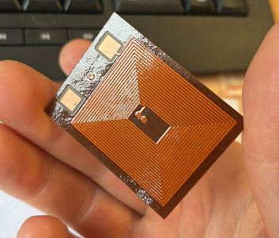
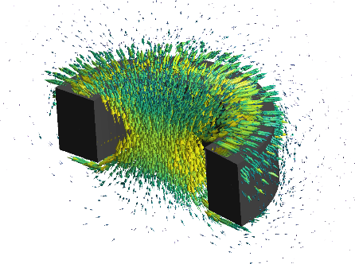

Outline
Detection Technology
Quench Detection Through Electrical Stimuli
Protection Technology
ESC (Energy Shift with Coupling) Results
E-CLIQ (External CLIQ) Results
STEAM & Material Library
Quench protection of PSI SMACC magnet
Quench protection of 20 T hybrid magnets
2D transient thermal simulations in FE
AC loss and homogenization of LTS conductors
High Performance Computing
HTS modelling tools update
Transient Simulations

Slide 3
Outline
Detection Technology
Quench Detection Through Electrical Stimuli
Protection Technology
ESC (Energy Shift with Coupling) Results
E-CLIQ (External CLIQ) Results
STEAM & Material Library
Quench protection of PSI SMACC magnet
Quench protection of 20 T hybrid magnets
2D transient thermal simulations in FE
AC loss and homogenization of LTS conductors
High Performance Computing
HTS modelling tools update
Transient Simulations

Slide 4
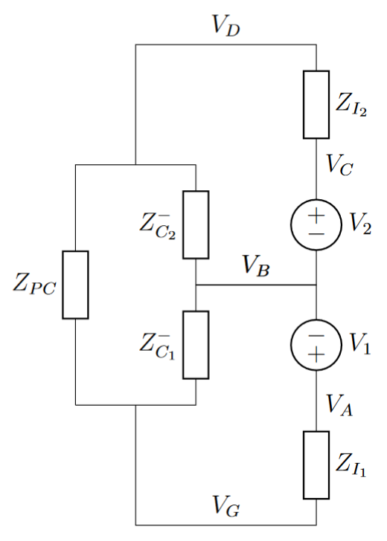
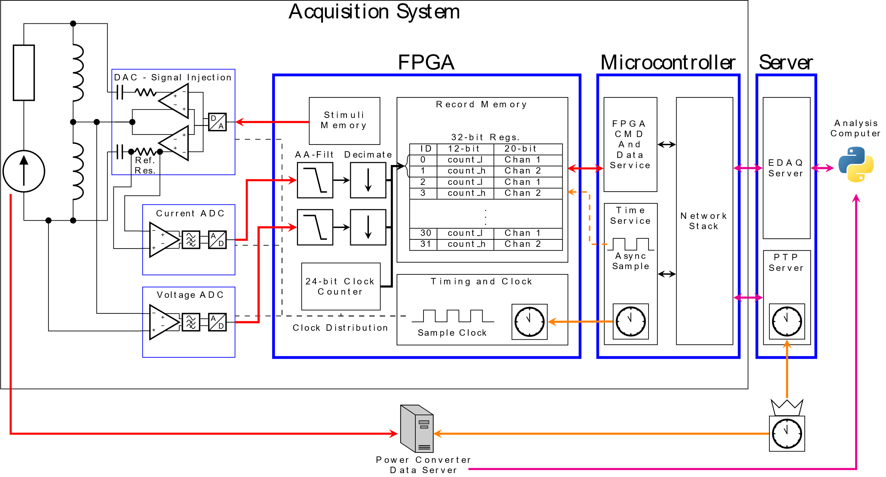
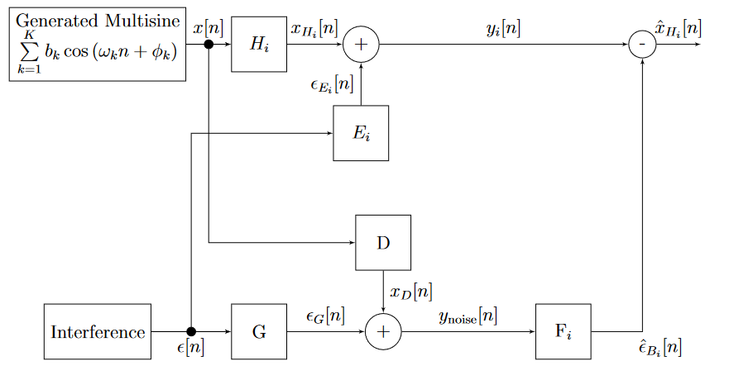
Quench Detection Through Electrical Stimuli
Ph.D. project has come to an end
Stimuli voltage of small amplitude (a few mV) has been injected into LTS magnets
A few mV stimuli is sufficient for impedance measurement as averaging can be applied to improve signal to noise ratio
Larger than a few mV signal needs to be injected for a fast detection of quench
A novel method for impedance measurement of powered superconducting magnet has been developed that is immune to the impedance of the power converter
Courtesy of M. Christensen

Slide 5
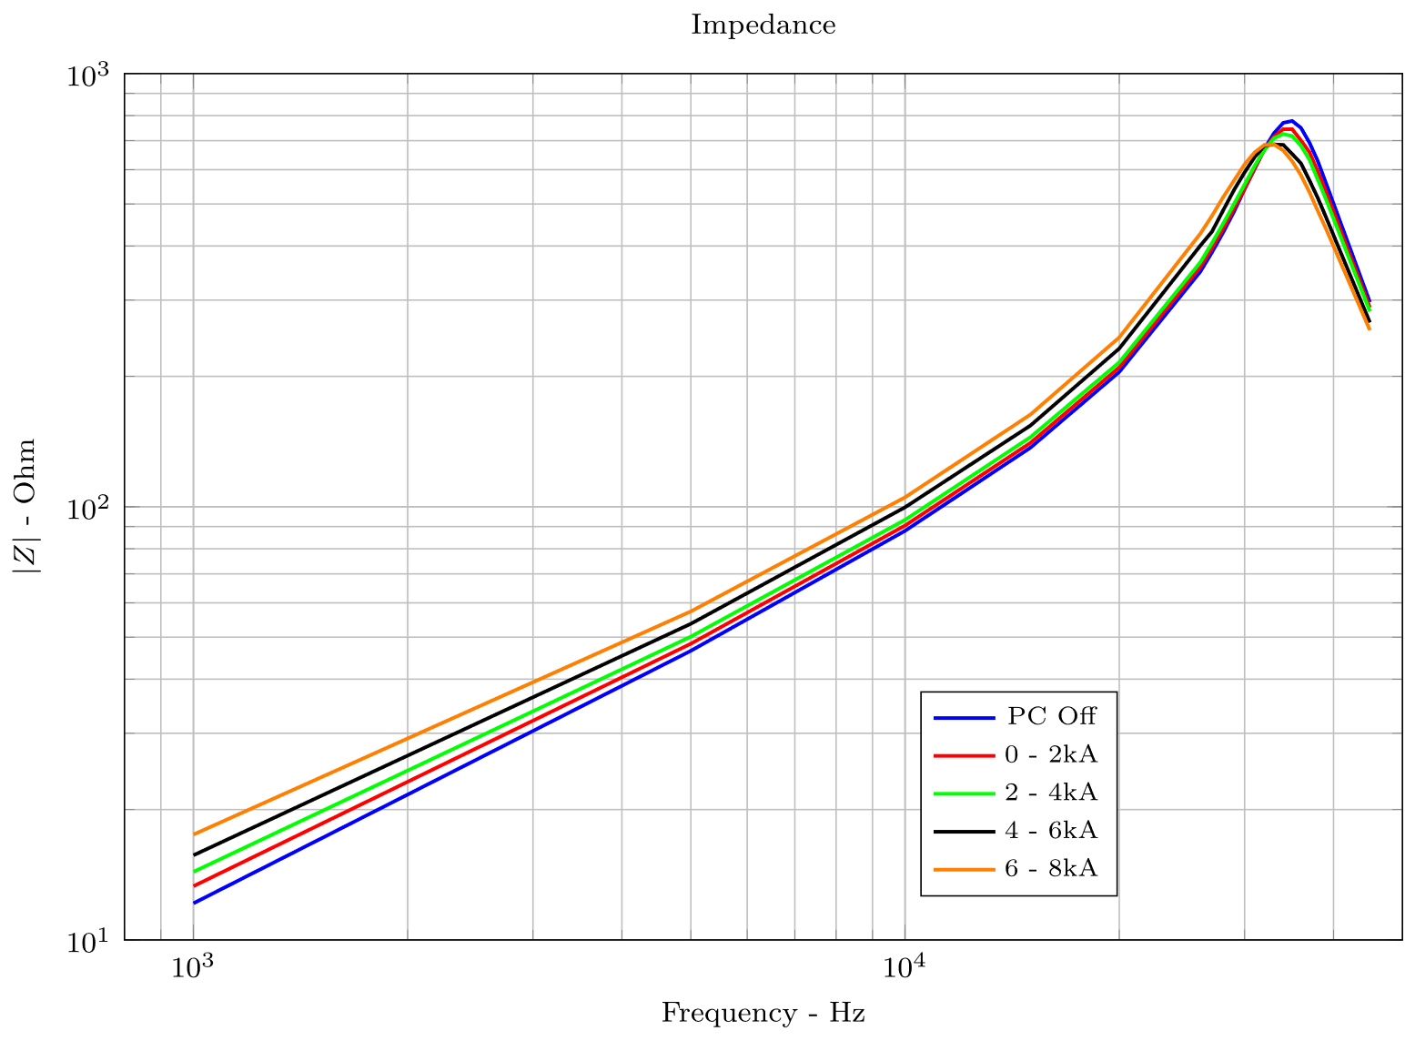
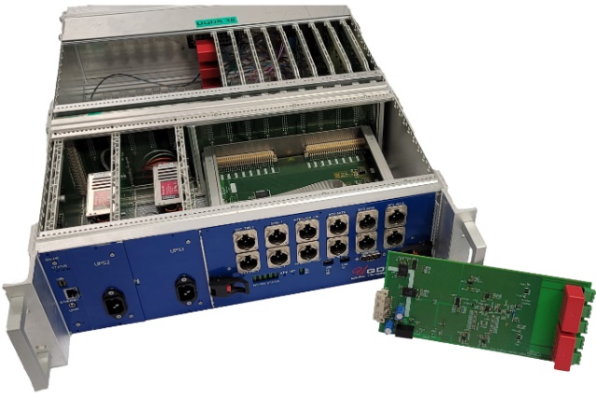


Impedance measurement of powered circuits
Platform based on the UQDS was developed. It:
  Injects low voltage stimuli (to not interfere with QDS).
  Injects it differentially to not interfere with power converter.
  Uses multisine stimuli to simultaneously probe multiple frequencies.
  Can measure continuously.
  Uses offline algorithms for noise suppression of power converter interference.
Impedance measurements were performed:
  On SMC and MQXFS magnets
  With a powered magnet up to 16kA
  And validated against ELQA measurements
Work resulted in several publications:
  Enabling Real-Time Impedance Measurements of Operational Superconducting Circuits of Accelerator Magnets (Conference)
  Continuous Diagnostics for Powered Superconducting Circuits (Conference)
  Enabling Impedance Measurements of Energised Superconducting Circuits Through Differential Probing (Journal, In review)
Courtesy of M. Christensen

Slide 6
Outline
Detection Technology
Quench Detection Through Electrical Stimuli
Protection Technology
ESC (Energy Shift with Coupling) Results
E-CLIQ (External CLIQ) Results
STEAM & Material Library
Quench protection of PSI SMACC magnet
Quench protection of 20 T hybrid magnets
2D transient thermal simulations in FE
AC loss and homogenization of LTS conductors
High Performance Computing
HTS modelling tools update
Transient Simulations

Slide 7
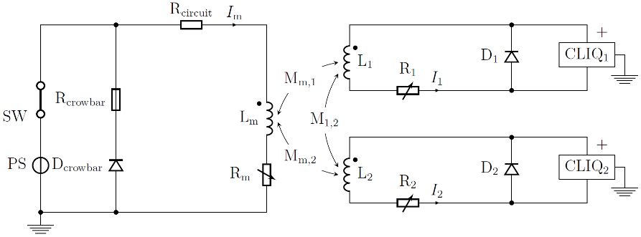
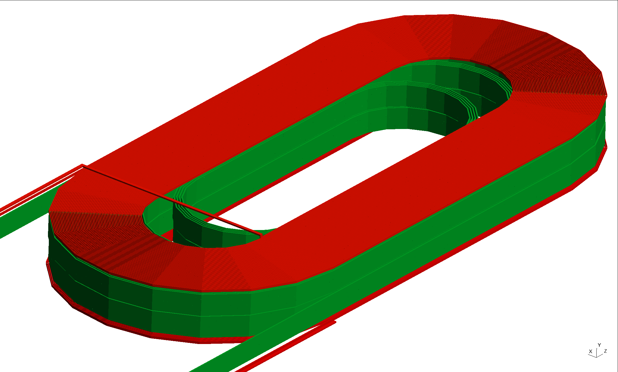
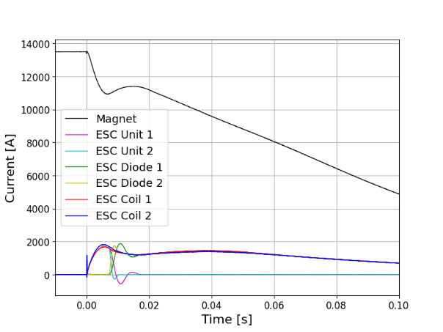
First demonstration of ESC protection on the SMC magnet
ESC (Energy Shift with Coupling) was successfully tested on a 40 cm long Nb₃Sn racetrack coil
100% of the magnet conductor quenched in 1-3 ms and 15% energy extracted without applying high voltage across the magnet
https://iopscience.iop.org/article/10.1088/1361-6668/ada833
https://indico.cern.ch/event/1468340
ESC coil 1
(copper)
Magnet coil
(SC)
ESC coil 2
Thick insulation between auxiliary and magnet coils
Two coils/ESC units provide protection redundancy
Thanks to J. Bauche, M. Dumas, J. Feuvrier, I. Garcia-Aguirrebeitia Sanchez, M.M. Gawedzki, J-L. Guyon, F. Mangiarotti,
M. Masci, J.C. Perez, P.A. Thonet, A. Verweij, P. Wachal, G. Willering, M. Wozniak
Courtesy of E. Ravaioli

Slide 8
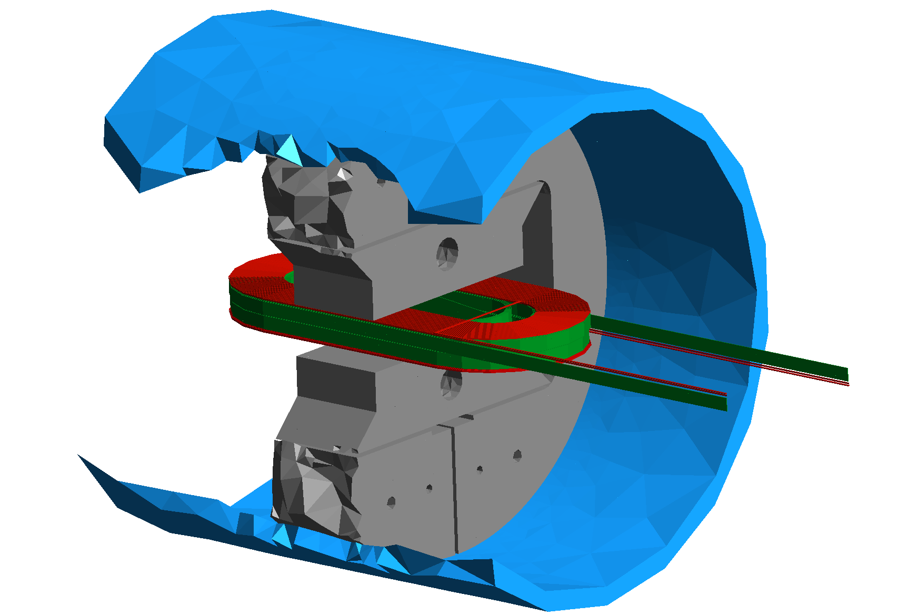
ESC SMC – Next steps – match experimental data with sim.
3D quench simulations of SMC with ESC coils to match measurements
Aluminium Shell
(eddy currents during transients)
ESC coil 1
(Cu)
Magnet winding
(Nb₃Sn)
Iron Yoke
(nonlinear,
shorter than
the magnet)
ESC coil 2
(Cu)
In addition:
Refine the simulations (optimize the ESC coil design, study failure cases, etc)
Assist the design teams to integrate ESC coils in the new magnet designs (next slide)
Courtesy of E. Ravaioli & M. Wozniak

Slide 9
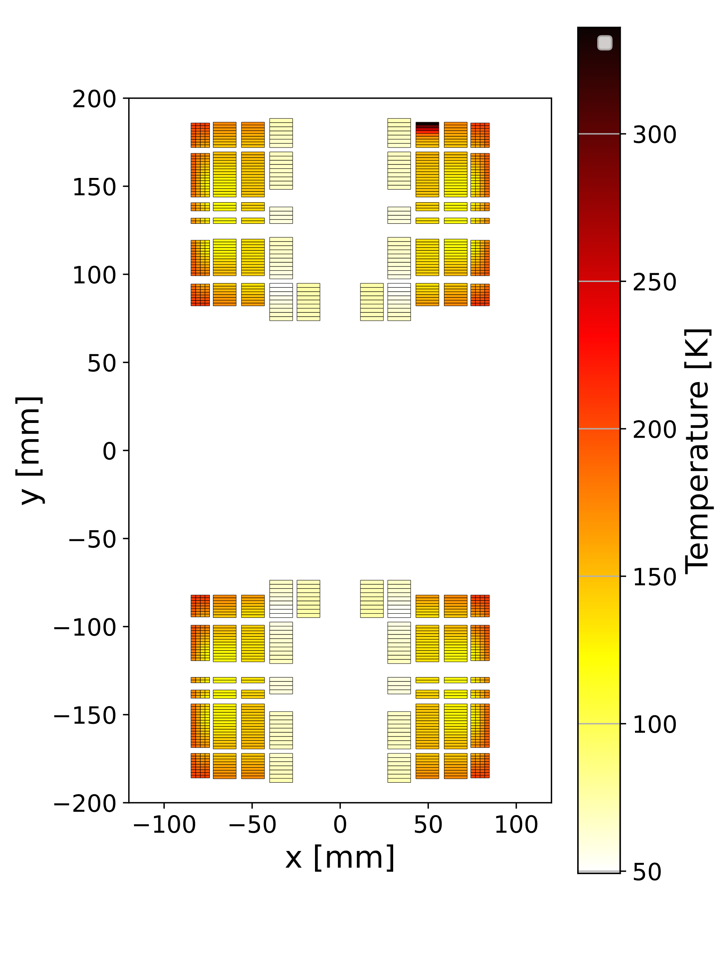
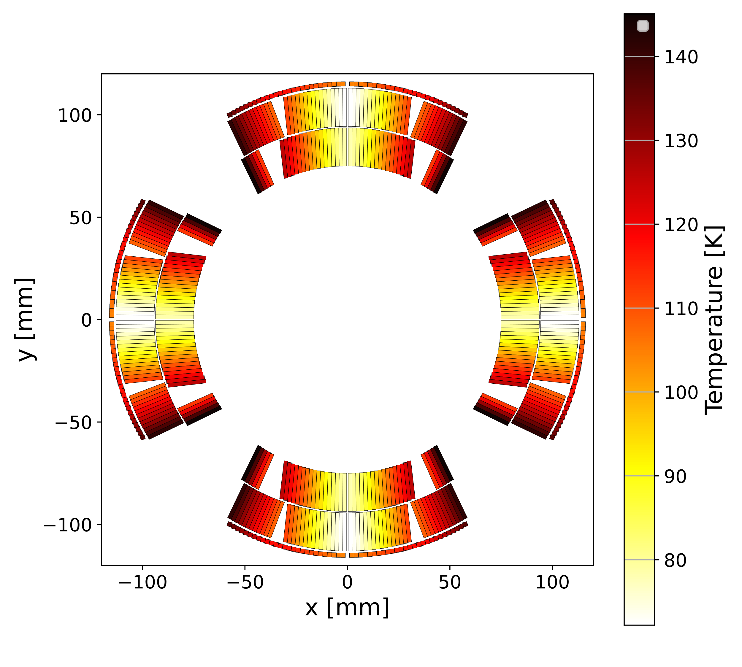
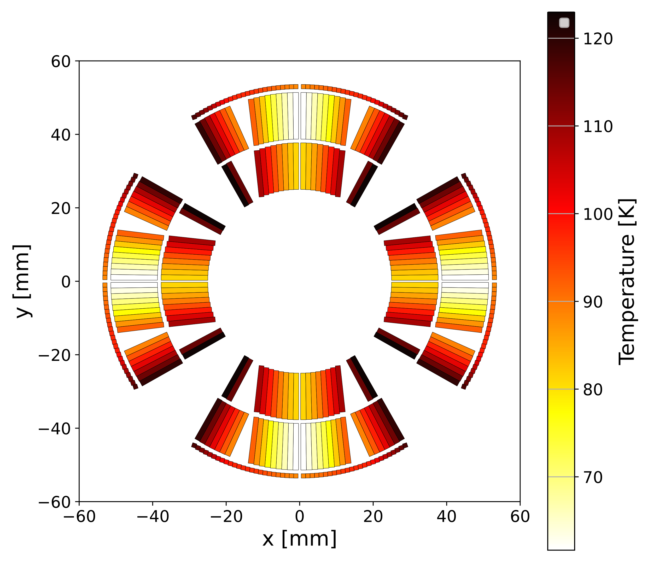
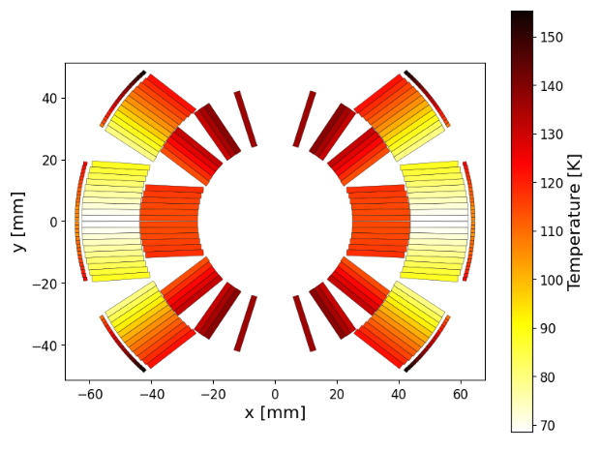
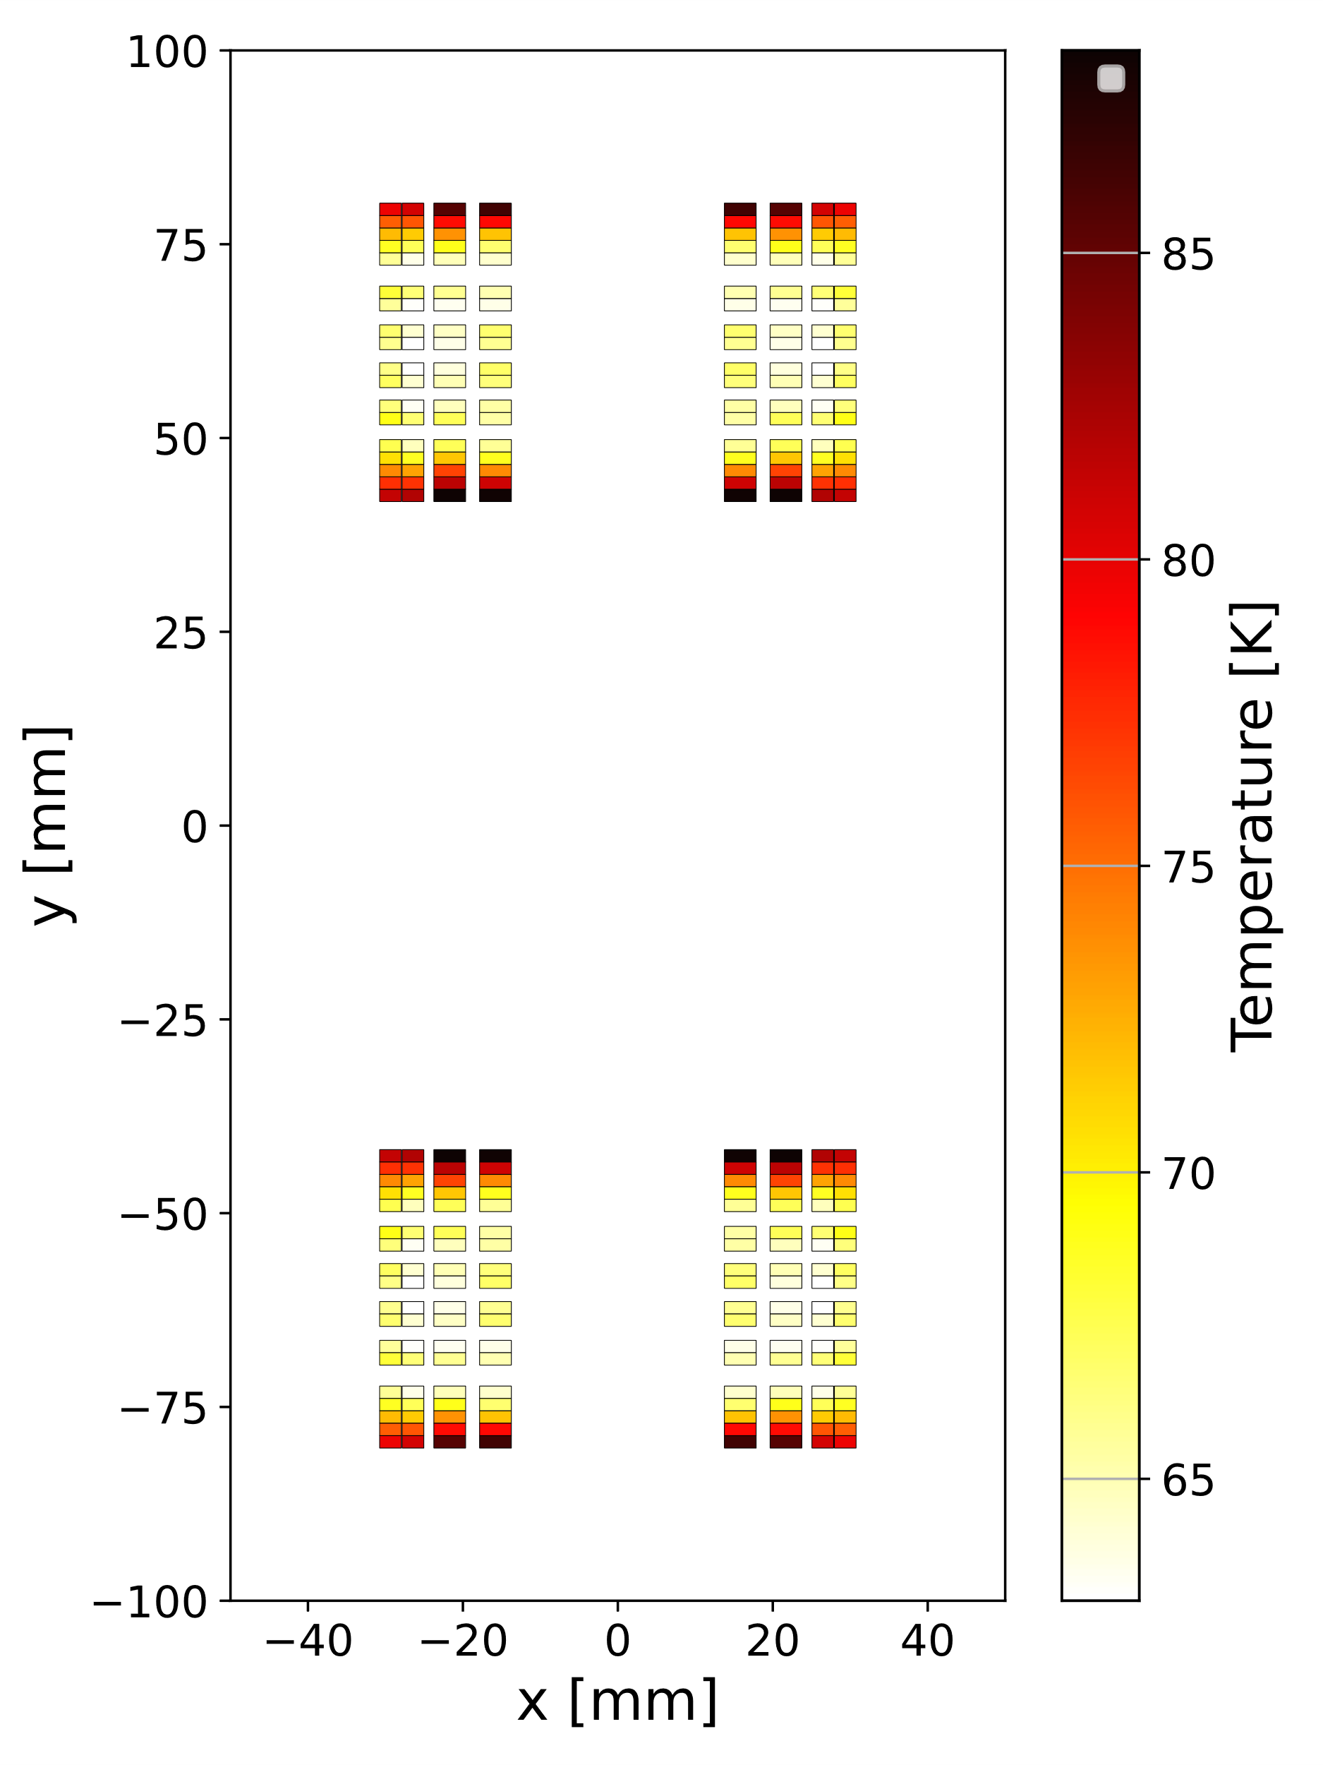
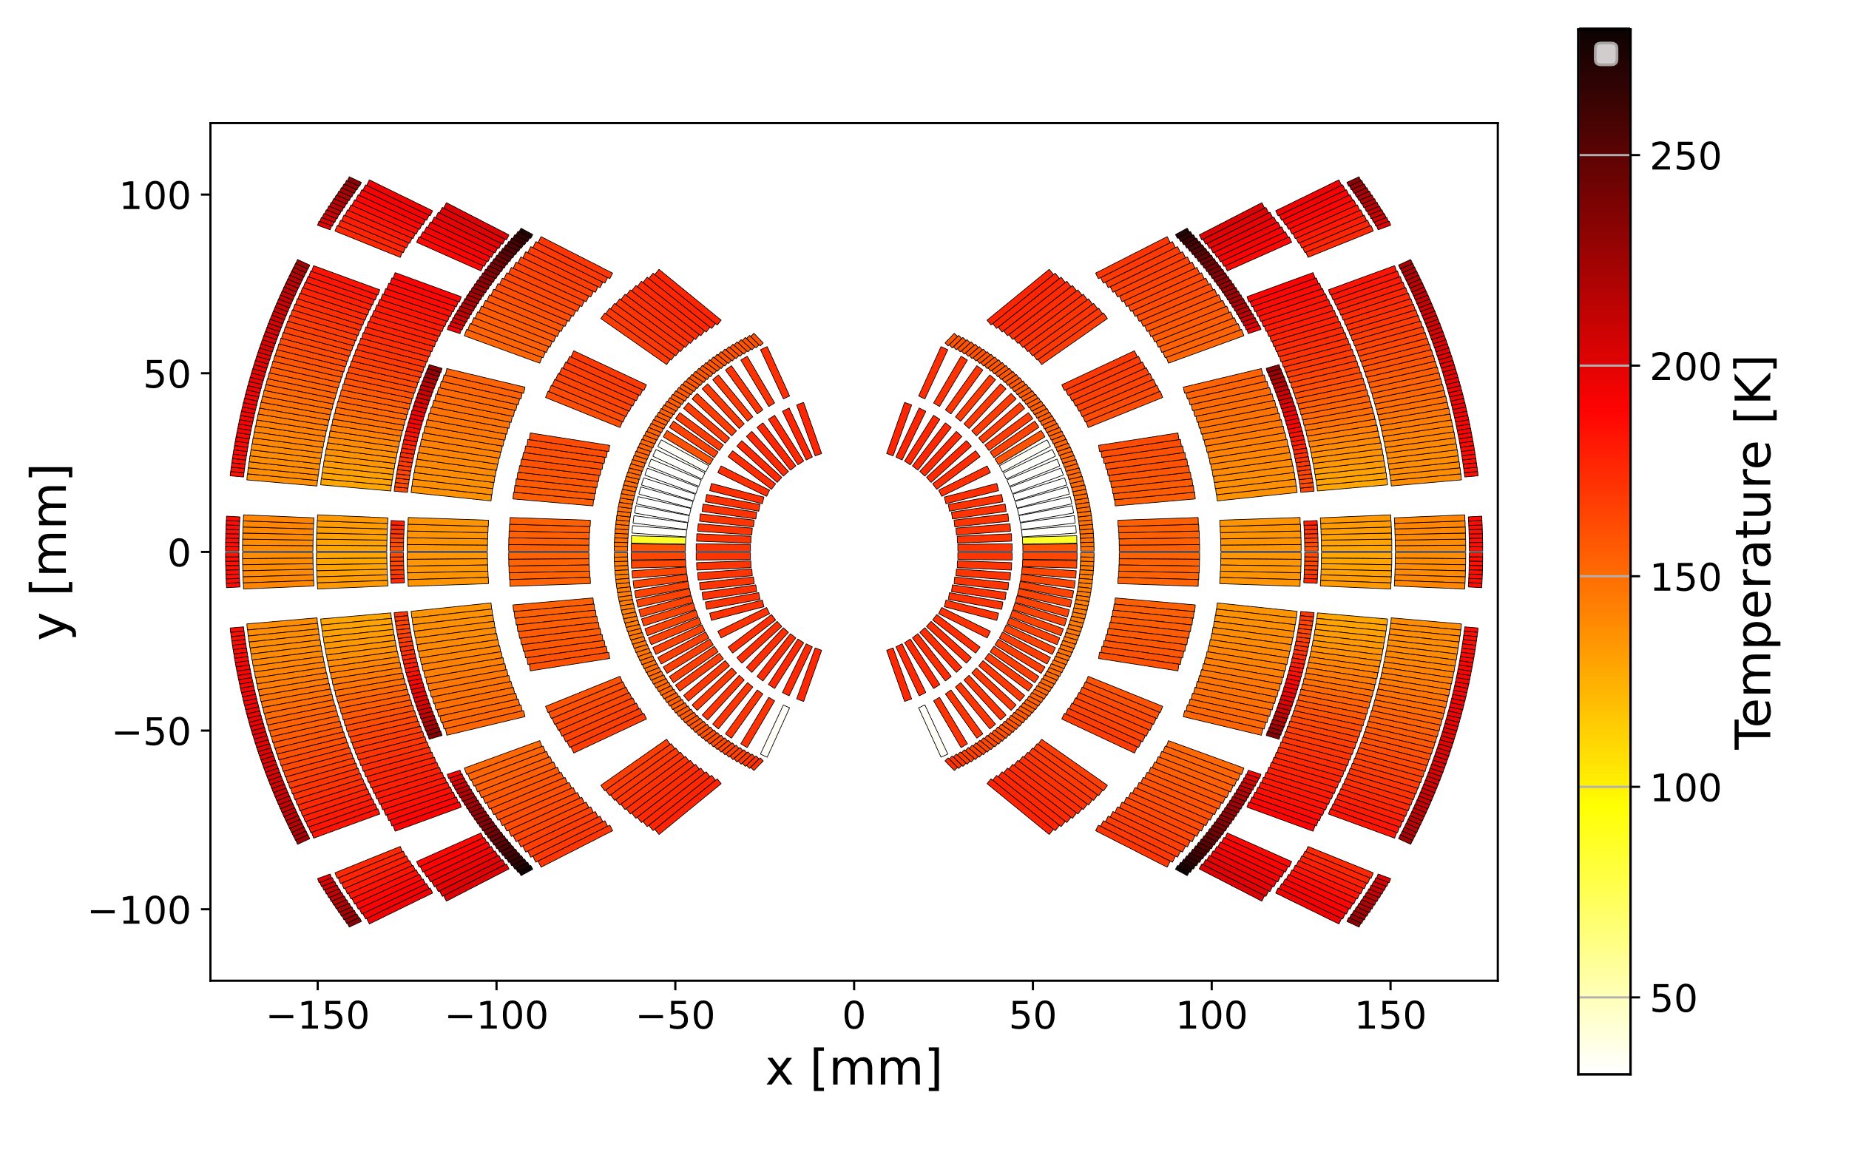
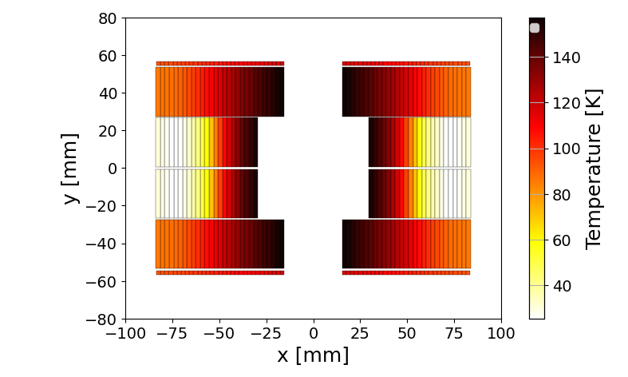
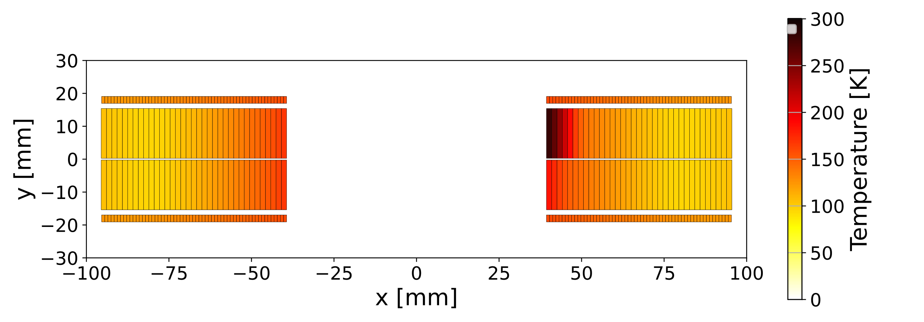
Design ESC-based quench protection for new magnets
ESC-based protection appears very promising for many new magnets (here not in scale)
3
5
7
1
8
4
6
2
1 - SMACC2 (D. Araujo, PSI), 2 - SMC (J.C. Perez, CERN), 3 - FCC MQ (M. Karppinen, CERN),
4 - BOND (A. Haziot, J.C. Perez, CERN), 5 - HFM 12 T (L. Fiscarelli, CERN), 6 - SMCC (D. Araujo, PSI),
7 - MQXF (P. Ferracin, S. Izquierdo Bermudez, et al., CERN, US HL-LHC AUP),
8 - US MDP 20 T cos-theta (M. D’Addazio (LBN), V. Marinozzi (FNAL), E. Ravaioli (CERN), G. Vallone (LBNL))
Courtesy of E. Ravaioli

Slide 10
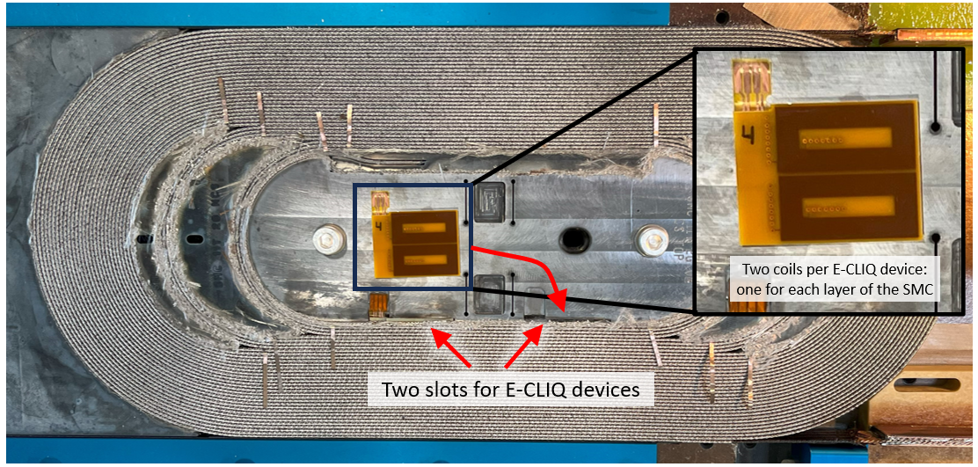
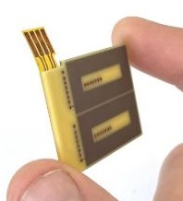
E-CLIQ: External Coupling Loss Induced Quench system
E-CLIQ is a potential alternative to Quench Heaters, but with robust insulation
E-CLIQ uses a multilayer PCB coil powered by AC current (PSU or C dis.)
AC in the E-CLIQ coil generates a large dB/dt and thus AC loss in a SC cable.
This increases the cable temperature within milliseconds after activation
Two E-CLIQ devices embedded in SMC108, each device has two coils
Thank you!
J.C. Perez and
the SMC magnet team
Courtesy of T. Mulder

Slide 11
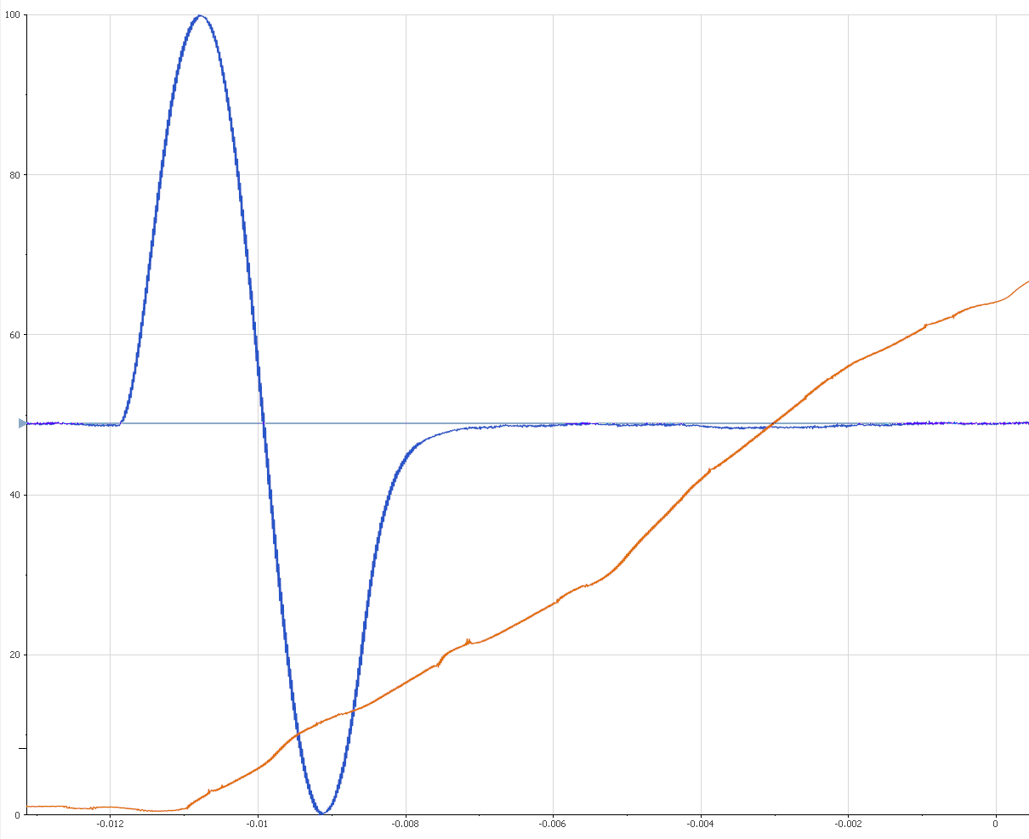
E-CLIQ Demonstration on an SMC
Magnet + E-CLIQ are currently cold in the vertical test station in SM18.
Test plan includes ~60 E-CLIQ activations across 12 different connection configurations and several different magnet operating conditions.
First glimpse of the results:
Big thanks to the teams of 927 and SM18!
  First tests performed at 4.5 K, 1.9 K later this week.
  Some ms between activation and V observation.
  Effective in a frequency range of 70-4000 Hz.
  Effective down to 9 kA of magnet current with a single E-CLIQ pulse.
  At lower magnet currents (2-8 kA), E-CLIQ still works,
  however multiple pulses are needed and time to
  quench increases.
  Better coupling between E-CLIQ coils and the cable
  than expected -> higher loss at higher frequencies
  than expected.
  Low input energy needed, often less than 1 J/coil.
Pulse of current
(5.4 A peak, 300 Hz) through E-CLIQ
Magnet differential voltage signal
~1 ms
Courtesy of T. Mulder

Slide 12
Outline
Detection Technology
Quench Detection Through Electrical Stimuli
Protection Technology
ESC (Energy Shift with Coupling) Results
E-CLIQ (External CLIQ) Results
STEAM & Material Library
Quench protection of PSI SMACC magnet
Quench protection of 20 T hybrid magnets
2D transient thermal simulations in FE
AC loss and homogenization of LTS conductors
High Performance Computing
HTS modelling tools update
Transient Simulations

Slide 13

STEAM tools and libraries
Collection of tools, with possibility of co-simulation, for the analysis of transient (and steady-state) behaviour of superconducting magnets and circuits.
Tools: (py)BBQ, LEDET, ProteCCT, FiQuS, NICQS, HETS, SIGMA, Comsol and SPice models
Electro-magnetic-thermal simulations. Co-simulation (COSIM, PyCoSim) with ANSYS possible.
Development and maintenance by MPE-PE, also in collaboration with other institutes
All types of AC behaviour (coupling currents, magnetisation, eddy currents, quench, quench-back, …)
All types of magnet geometries (CosTheta, CCT, block, common coil, racetrack, solenoid, pancake, …)
All types of conductors (LTS, HTS, strands, cables, tapes, …)
Various types of protection devices (quench heaters, EE, CLIQ, e-CLIQ, s-CLIQ, ESC, cap. discharge, …)
Material properties library for use in simulations: https://cern.ch/smali
Including:
Other circuit components (power converter, bypass diode, …)
Failure scenarios
Parametric analysis & optimisation of protection efficiency
Courtesy of E. Ravaioli & M. Wozniak and STEAM team

Slide 14
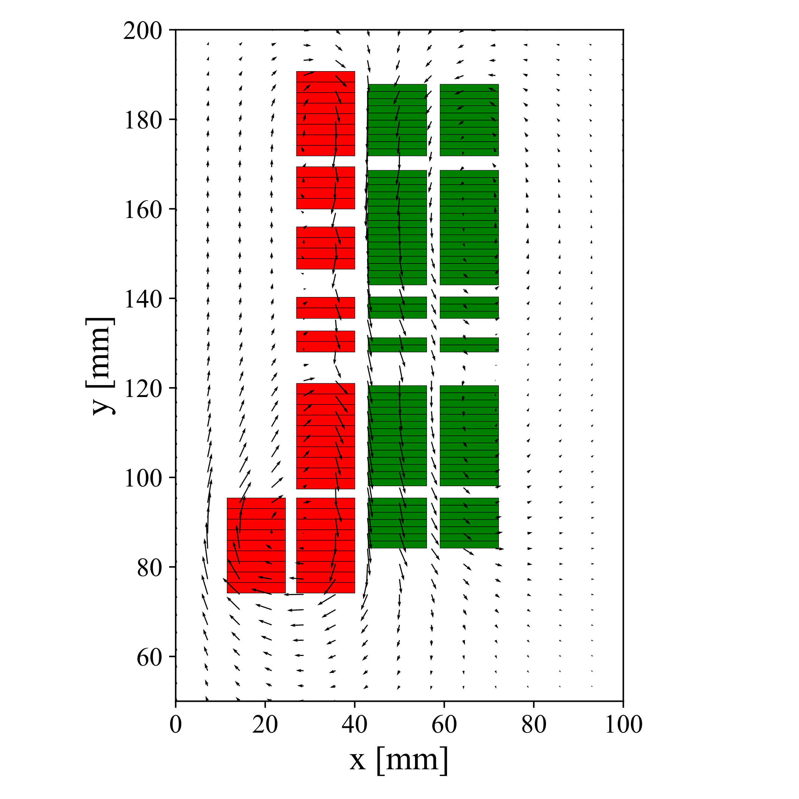
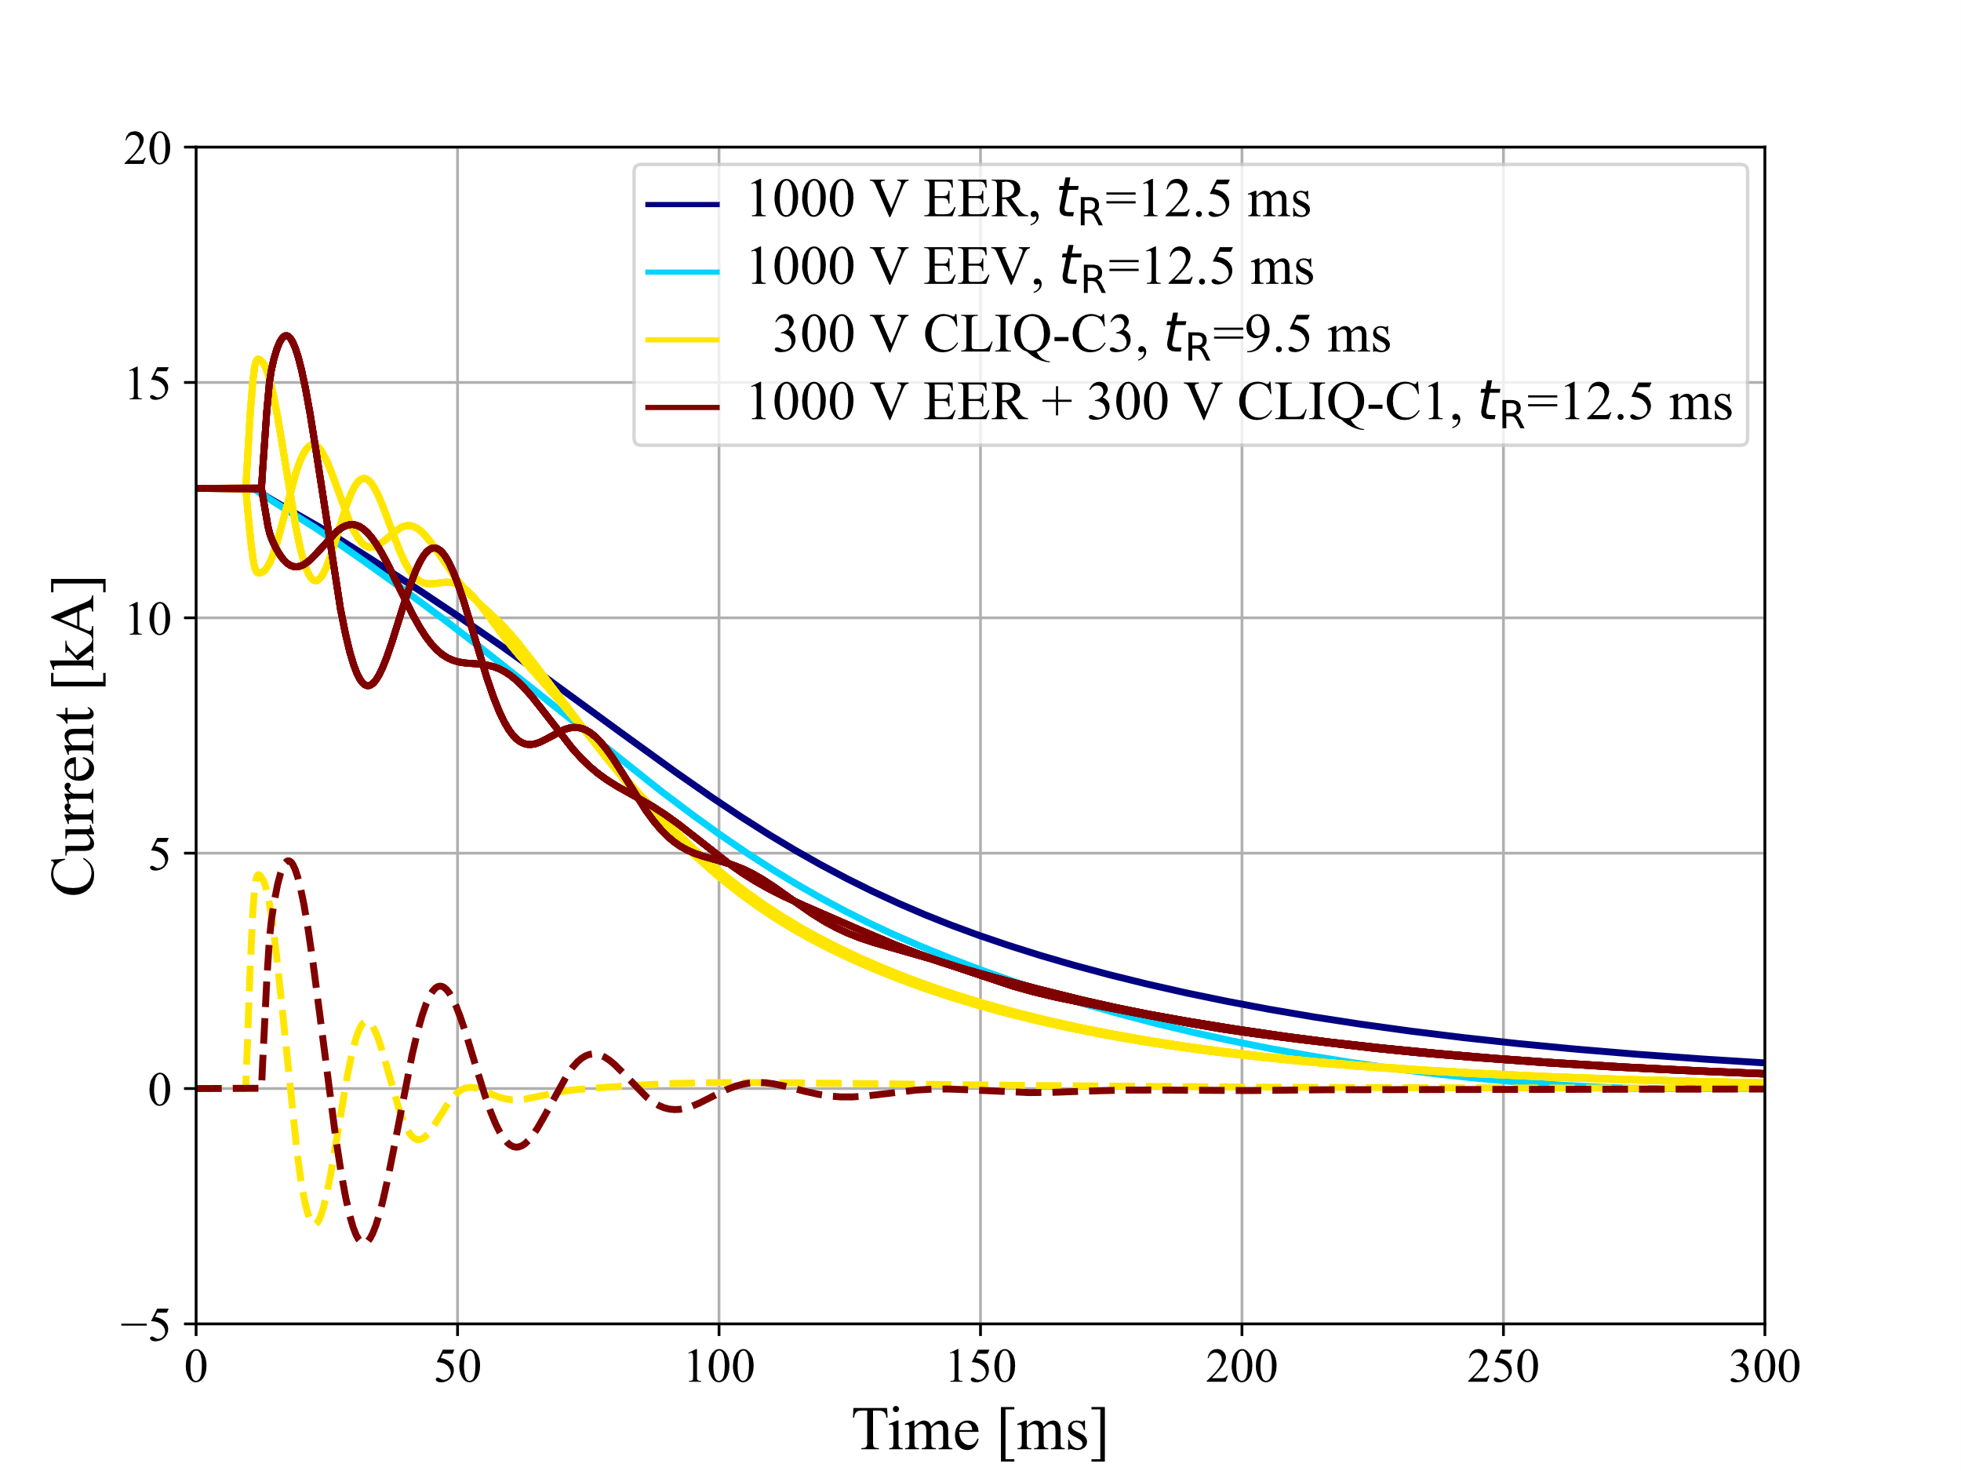
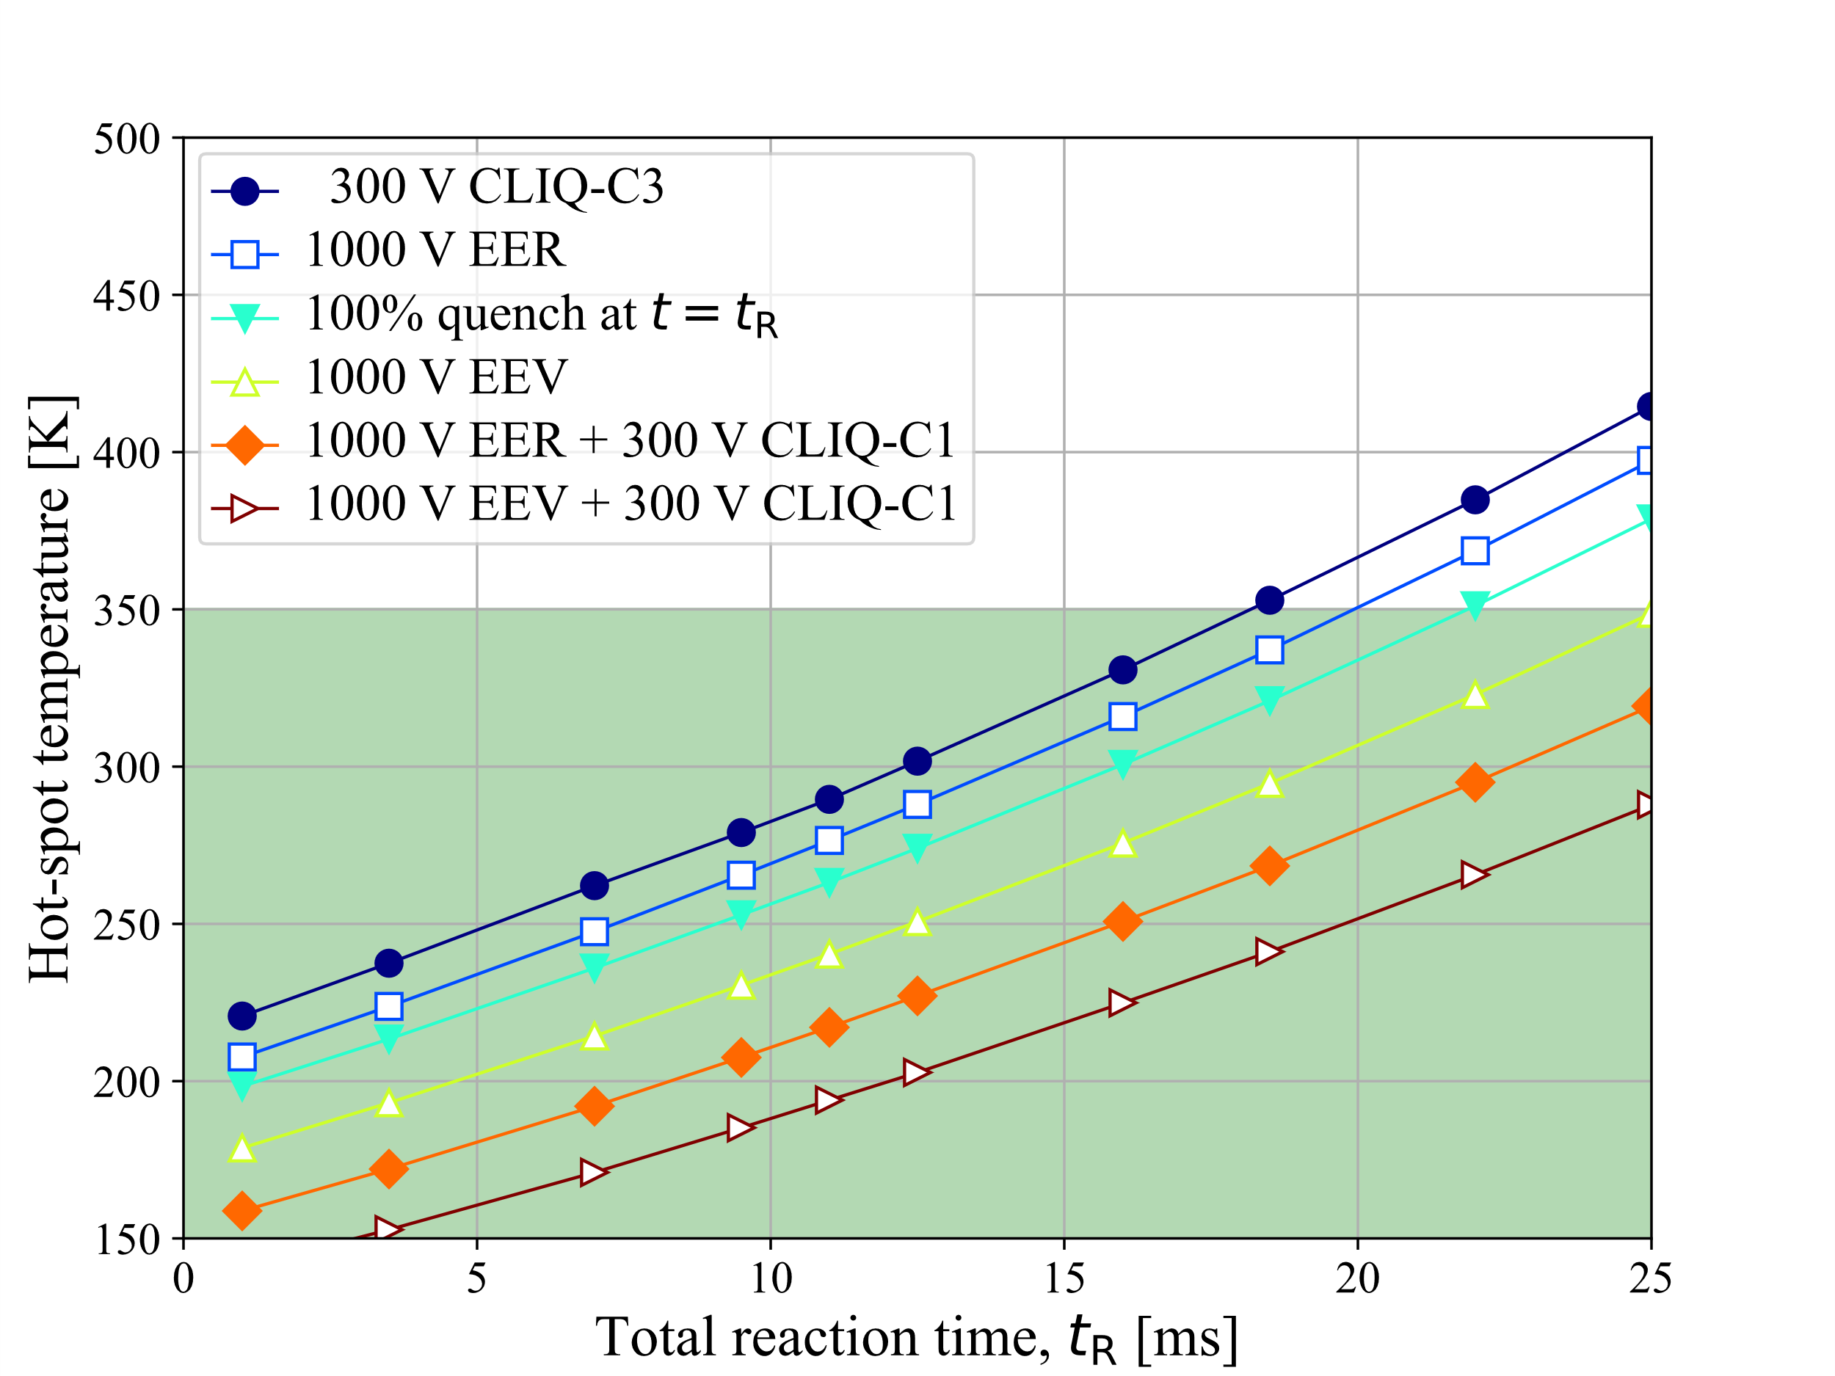
Quench protection of PSI SMACC magnet
Quench protection of SMACC1 12 T magnet presented at the SMACC1 review
Next steps:
Assist the design of SMACC2 (14 T) with quench protection targeting a full-size, 15 m long magnet
Protection study using the new ESC system
Thanks to D. Araujo, B. Auchmann (PSI)
Courtesy of E. Ravaioli

Slide 15
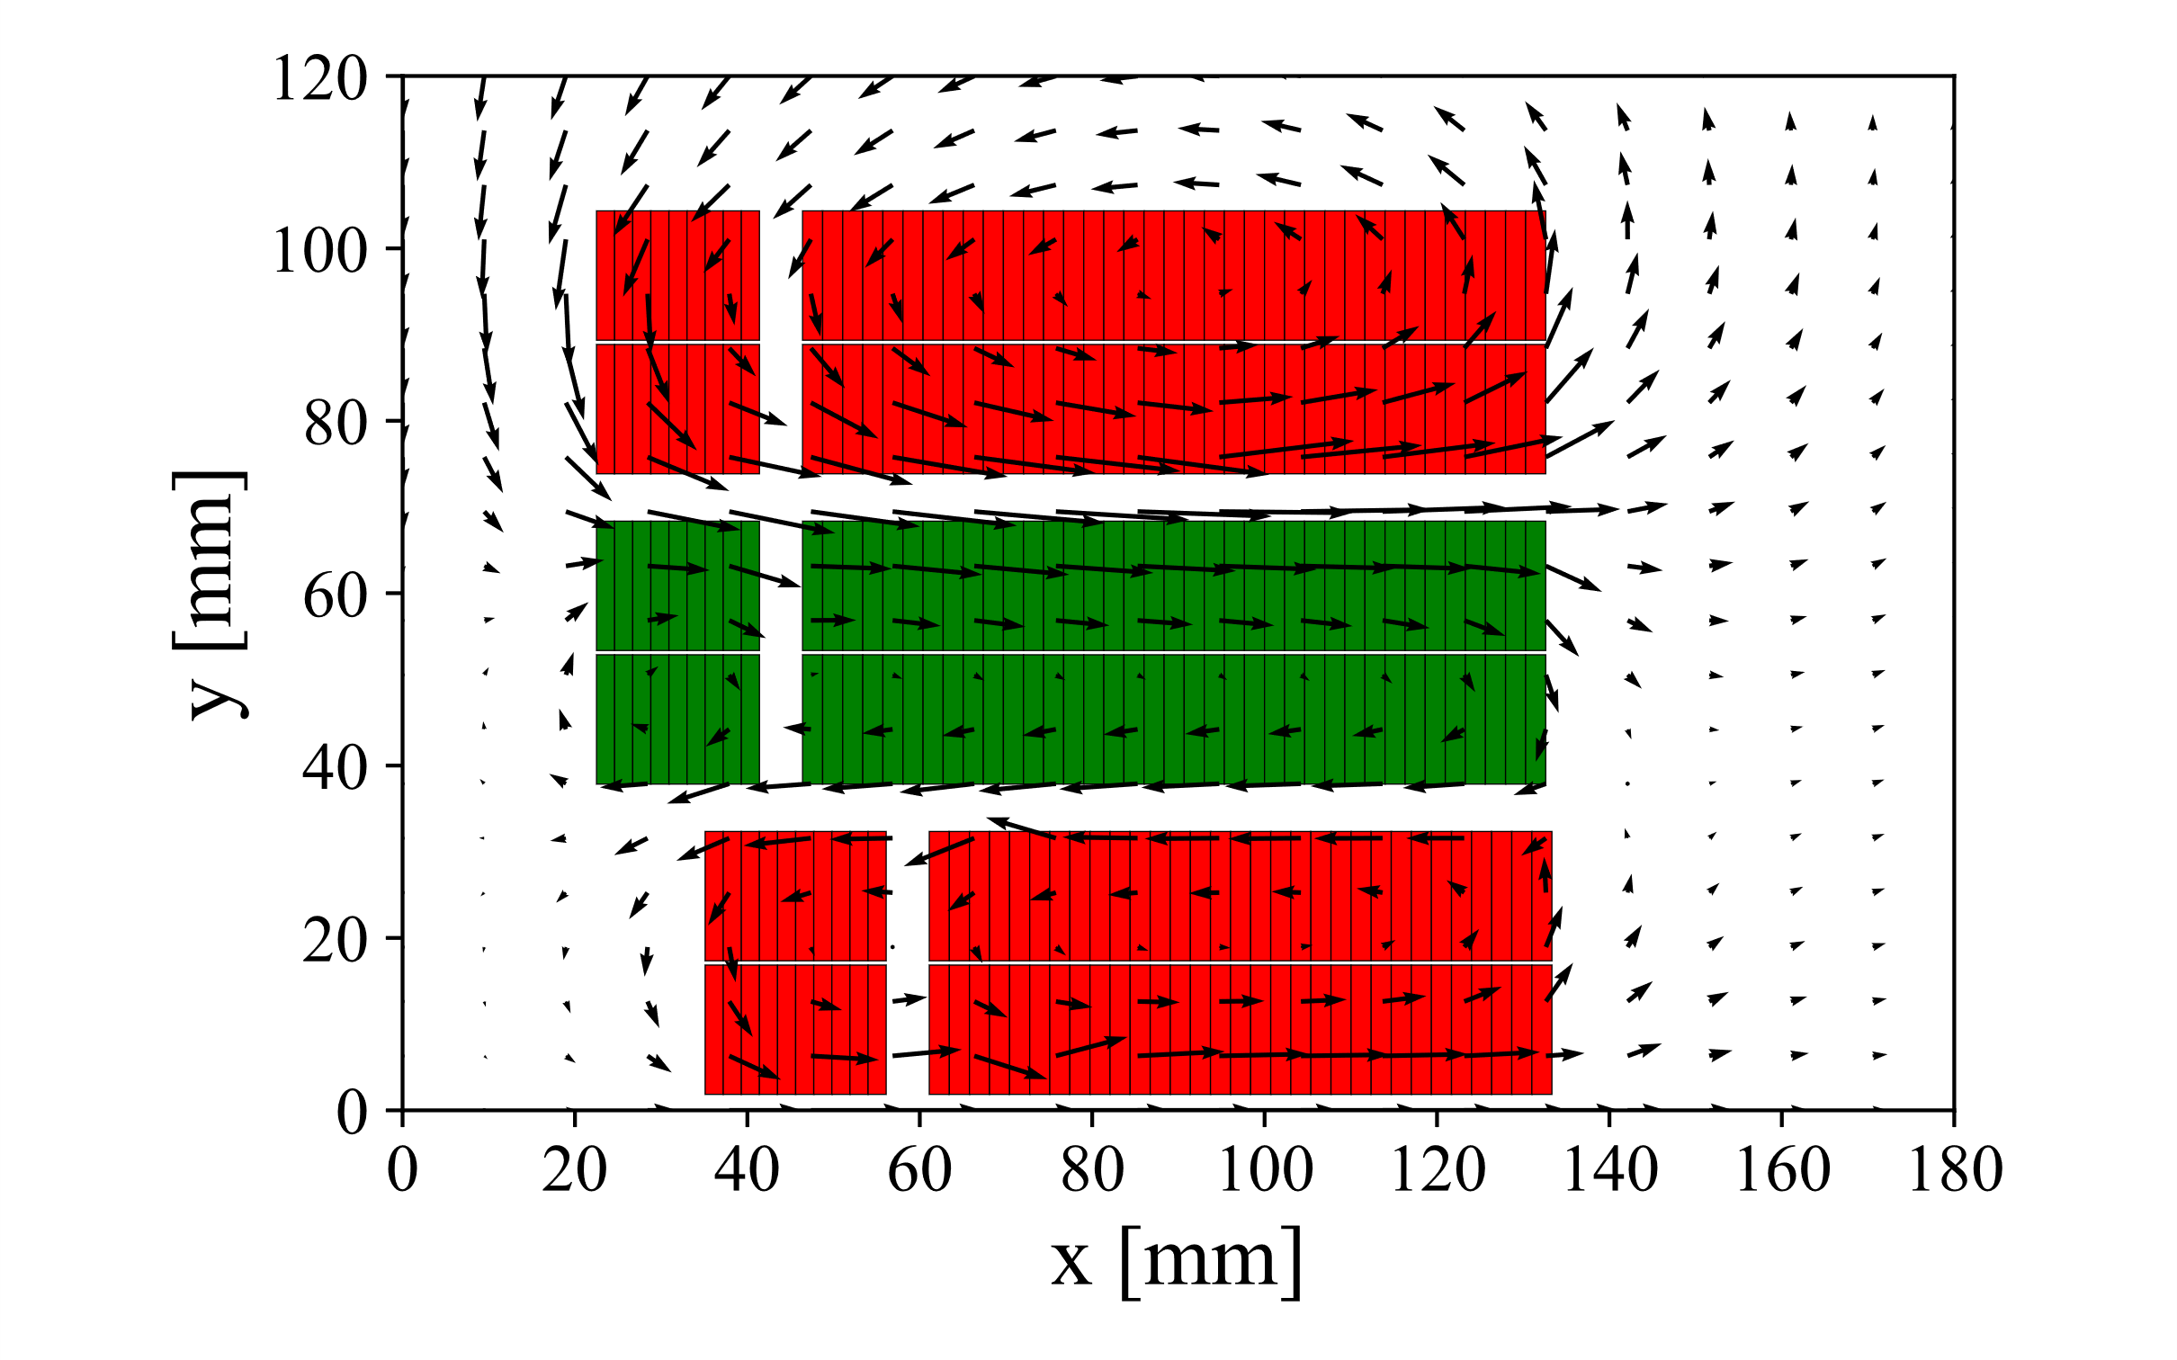
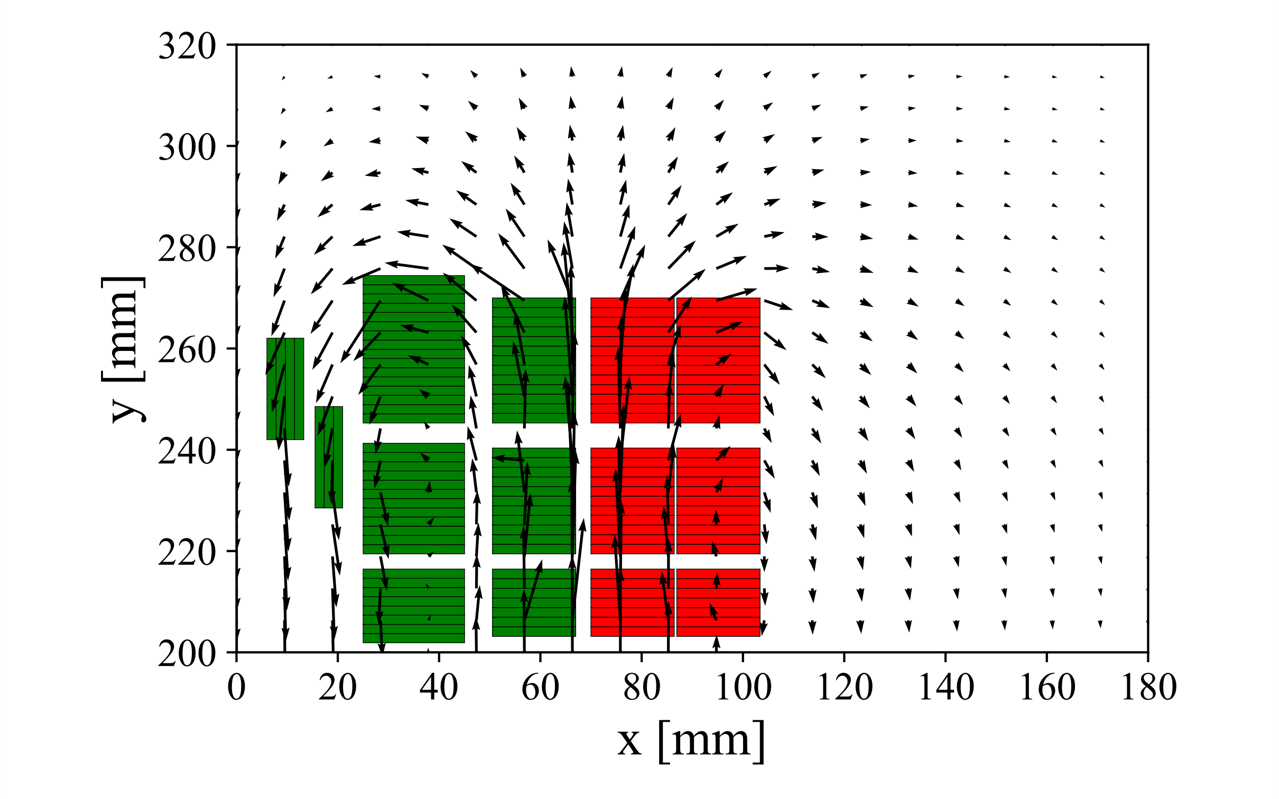
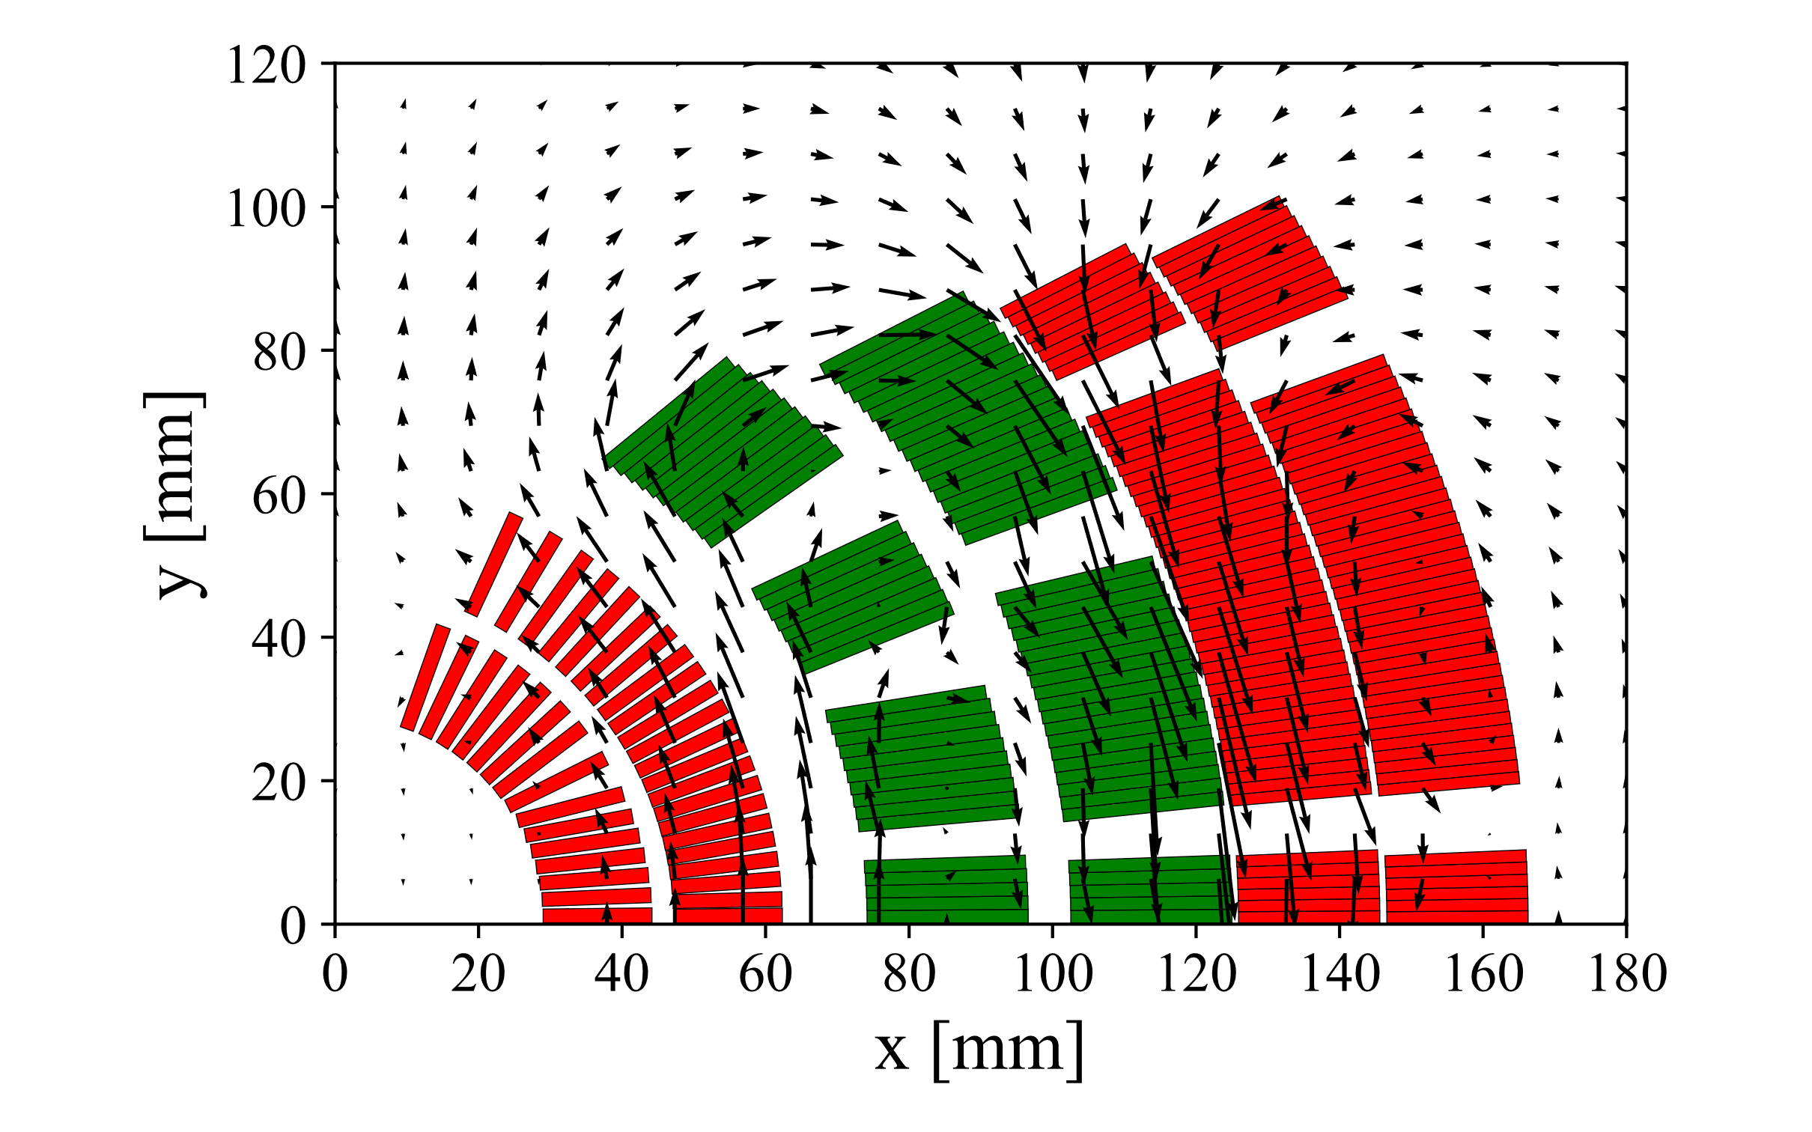
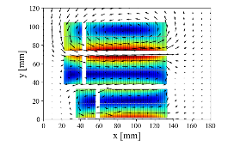
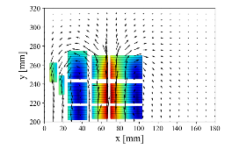
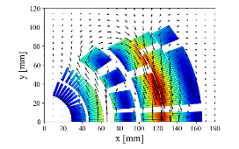
Quench protection of 20 T hybrid magnets
Quench protection of three 20 T LTS+HTS hybrid magnets (block, common-coil, cos-θ)
Next steps:
Collaborate to simulate mechanical stresses in the cos-θ magnet including thermal stress after a quench
Protection study using the new ESC system, targeting a full-size, 15 m long magnet
Thanks to R. Gupta (BNL), E. Rochepault (CEA), V. Marinozzi (FNAL), M. D'Addazio, P. Ferracin, G. Vallone (LBNL),
D. Araujo (PSI)
Courtesy of E. Ravaioli

Slide 16

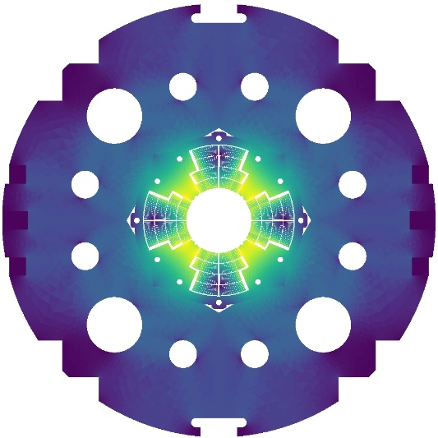
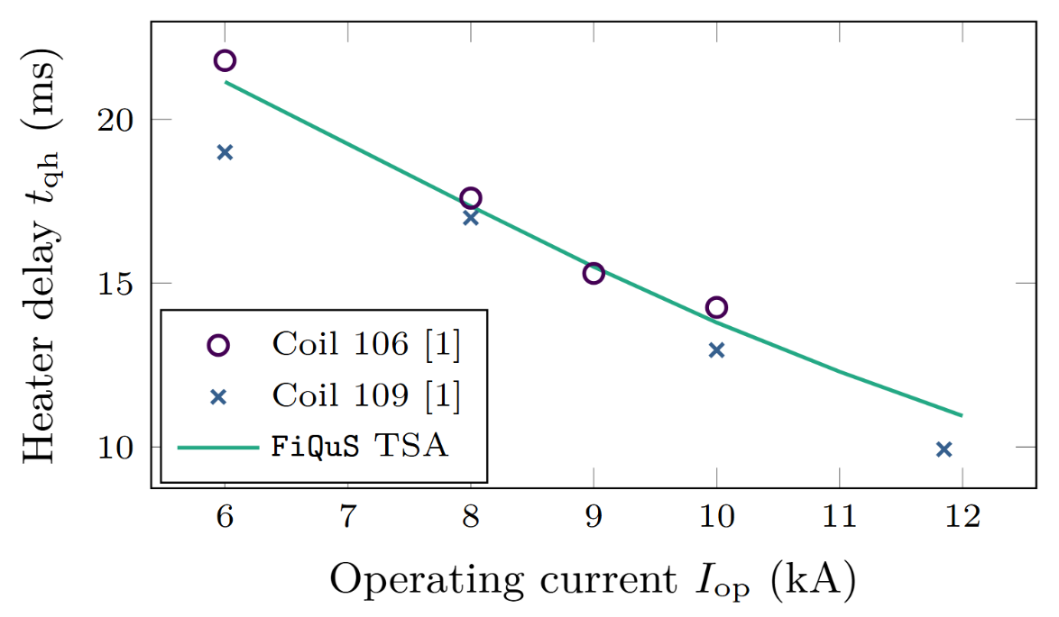
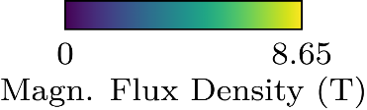
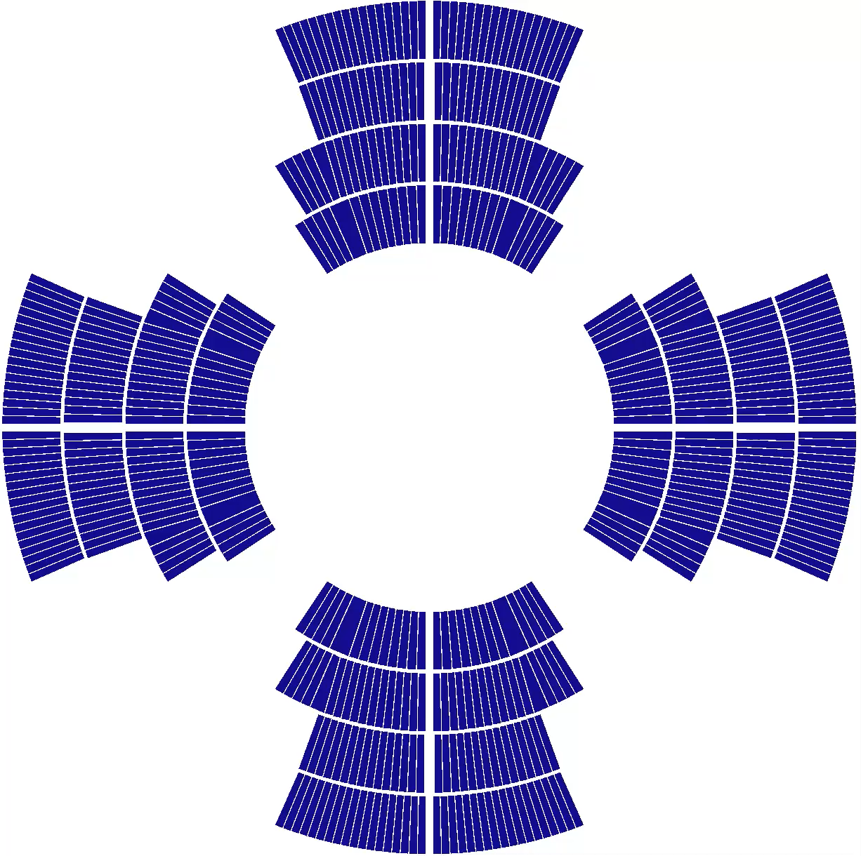
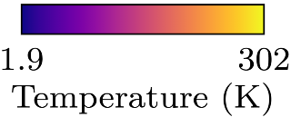
2D Transient Thermal Simulations - LTS Multipole Magnets
Automated generation of coupled magnetostatic and thermal transient
2D full-magnet FE models of LTS multipole magnets in FiQuS (http://cern.ch/fiqus)
  Efficient through thin shell approximations (TSAs), full transient in FE in minutes
  E.g., for MBH: 40 times faster than classical FE with hotspot error < 1 %
  Quench heaters (QHs) enabled by TSA, infeasible for classical FE
Fully open-source, text-based input files aid traceability and repeatability
More details on this work
E. Schnaubelt et. al, “Transient Finite Element Simulation of Accelerator Magnets Using Thermal Thin Shell Approximation”, https://arxiv.org/abs/2501.15871,
submitted to SUST (2025)
< Measured data from: S. Izquierdo Bermudez et al., IEEE TAS (2016), DOI: 10.1109/TASC.2016.2536653
Next steps:
Add homogenization to include small-scale AC loss and magnetization
Implement quench detection and protection circuits for EE, CLIQ, and ESC
Validate this extended model against experimental data
Courtesy of E. Schnaubelt

Slide 17
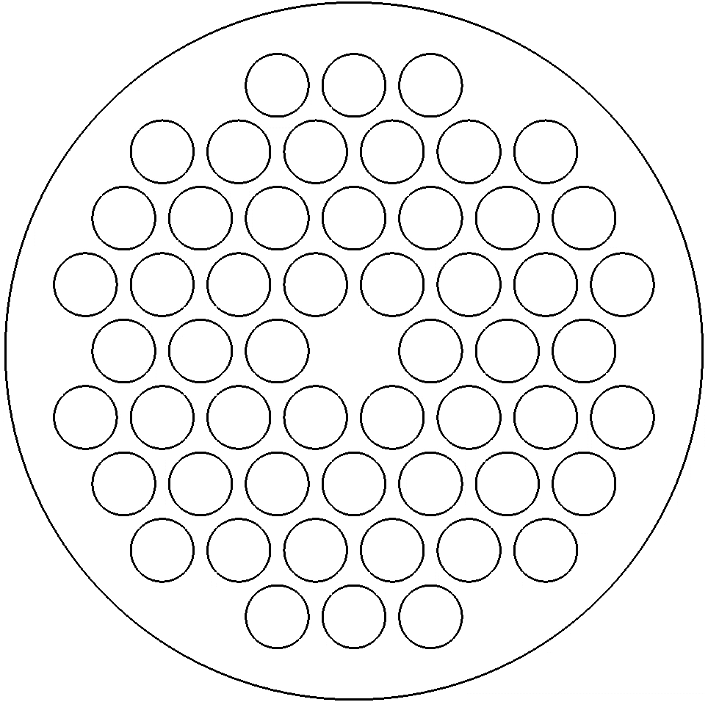
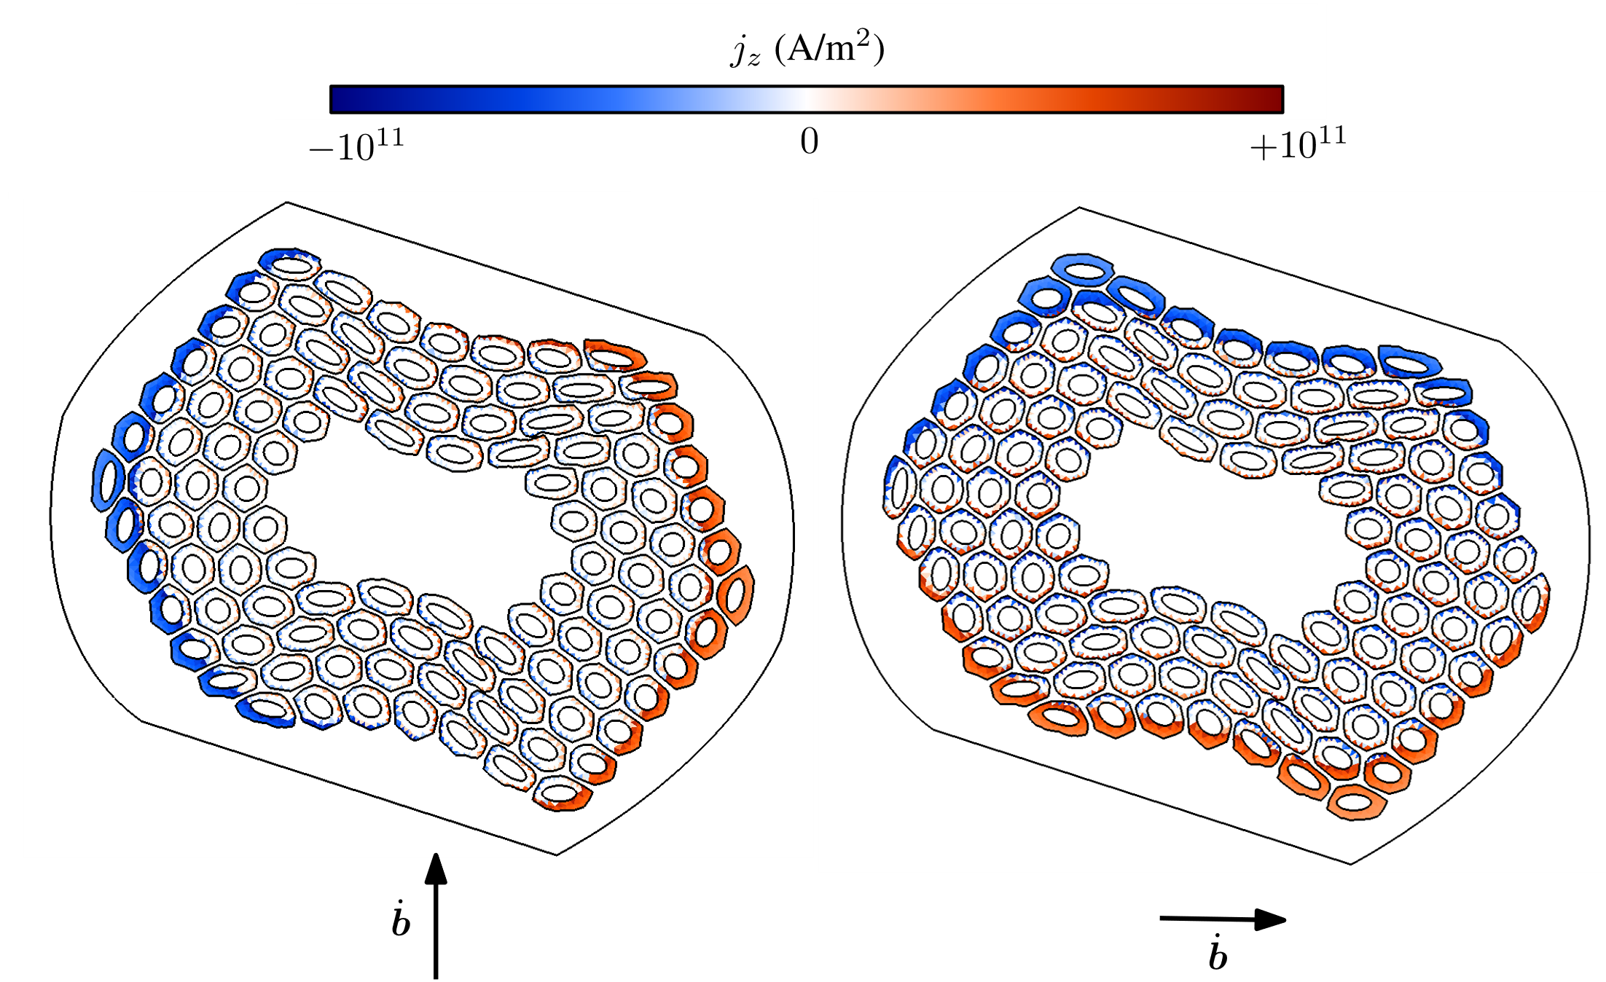
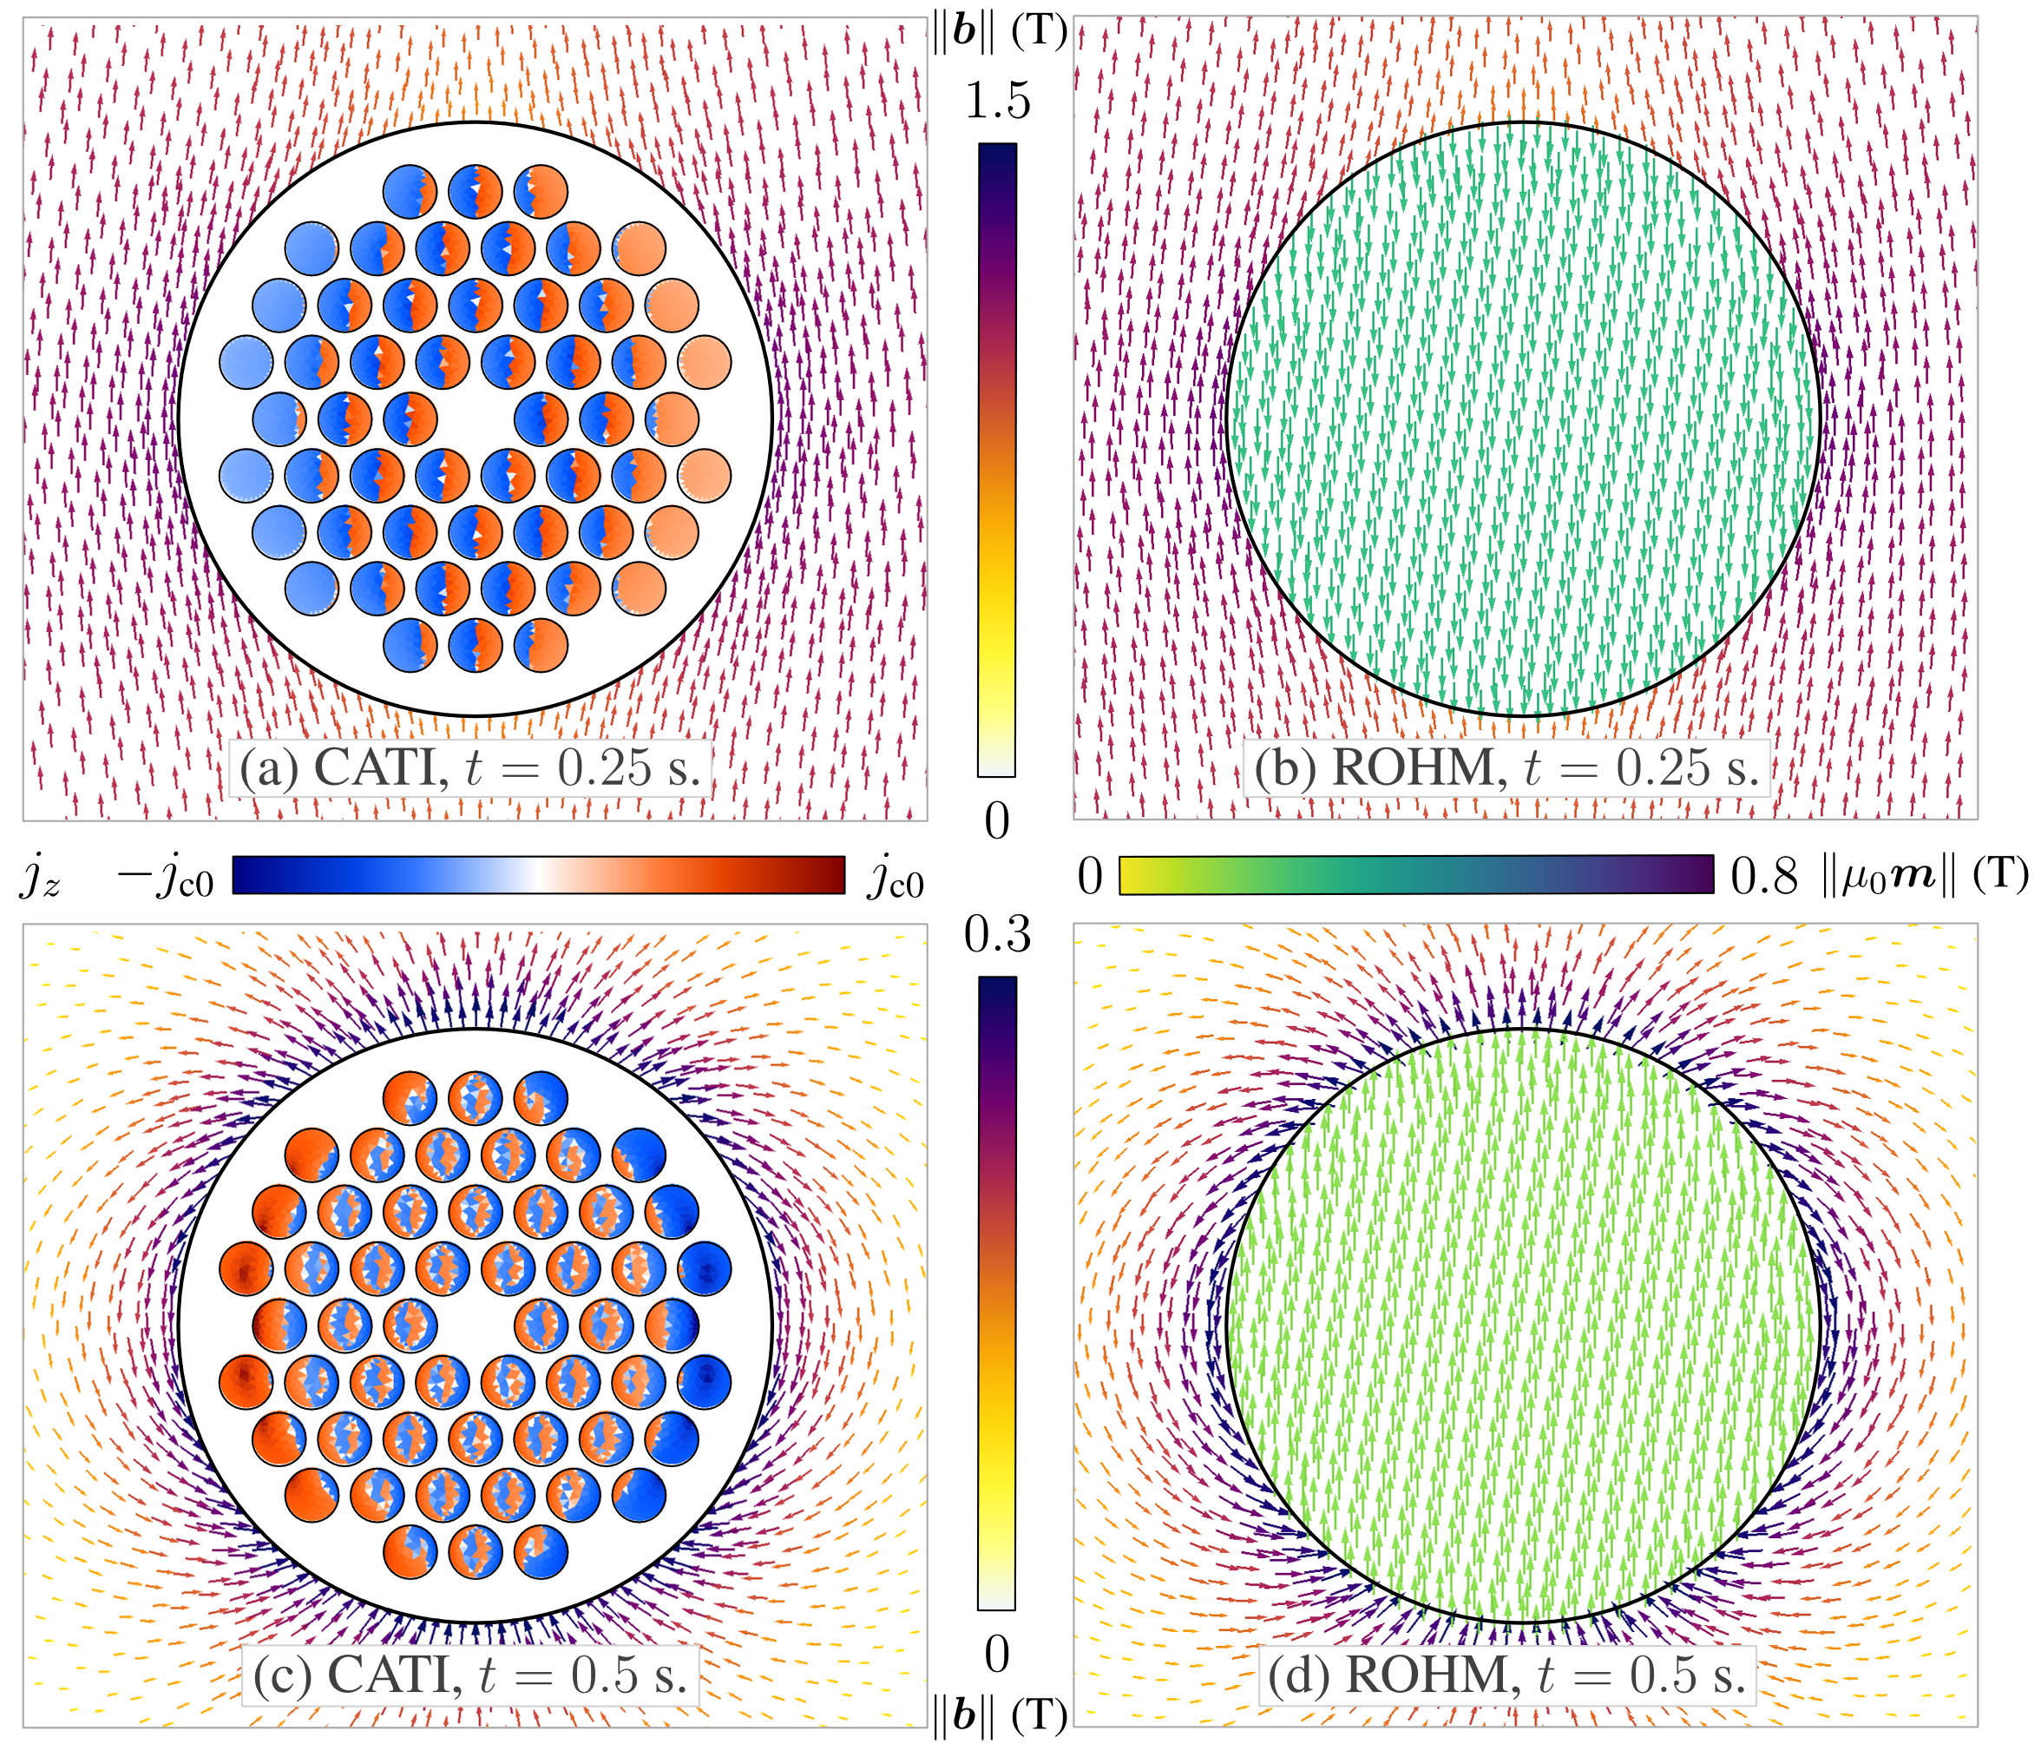
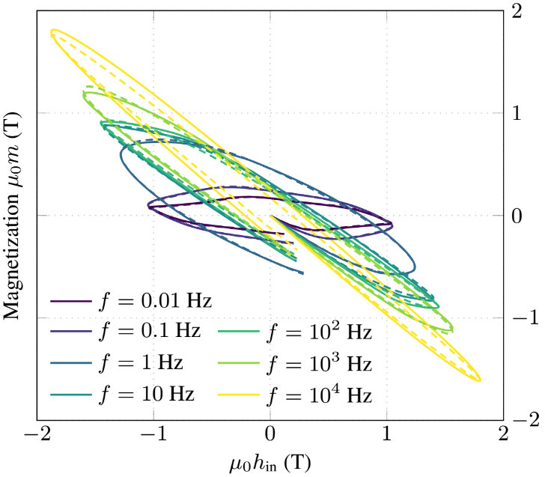
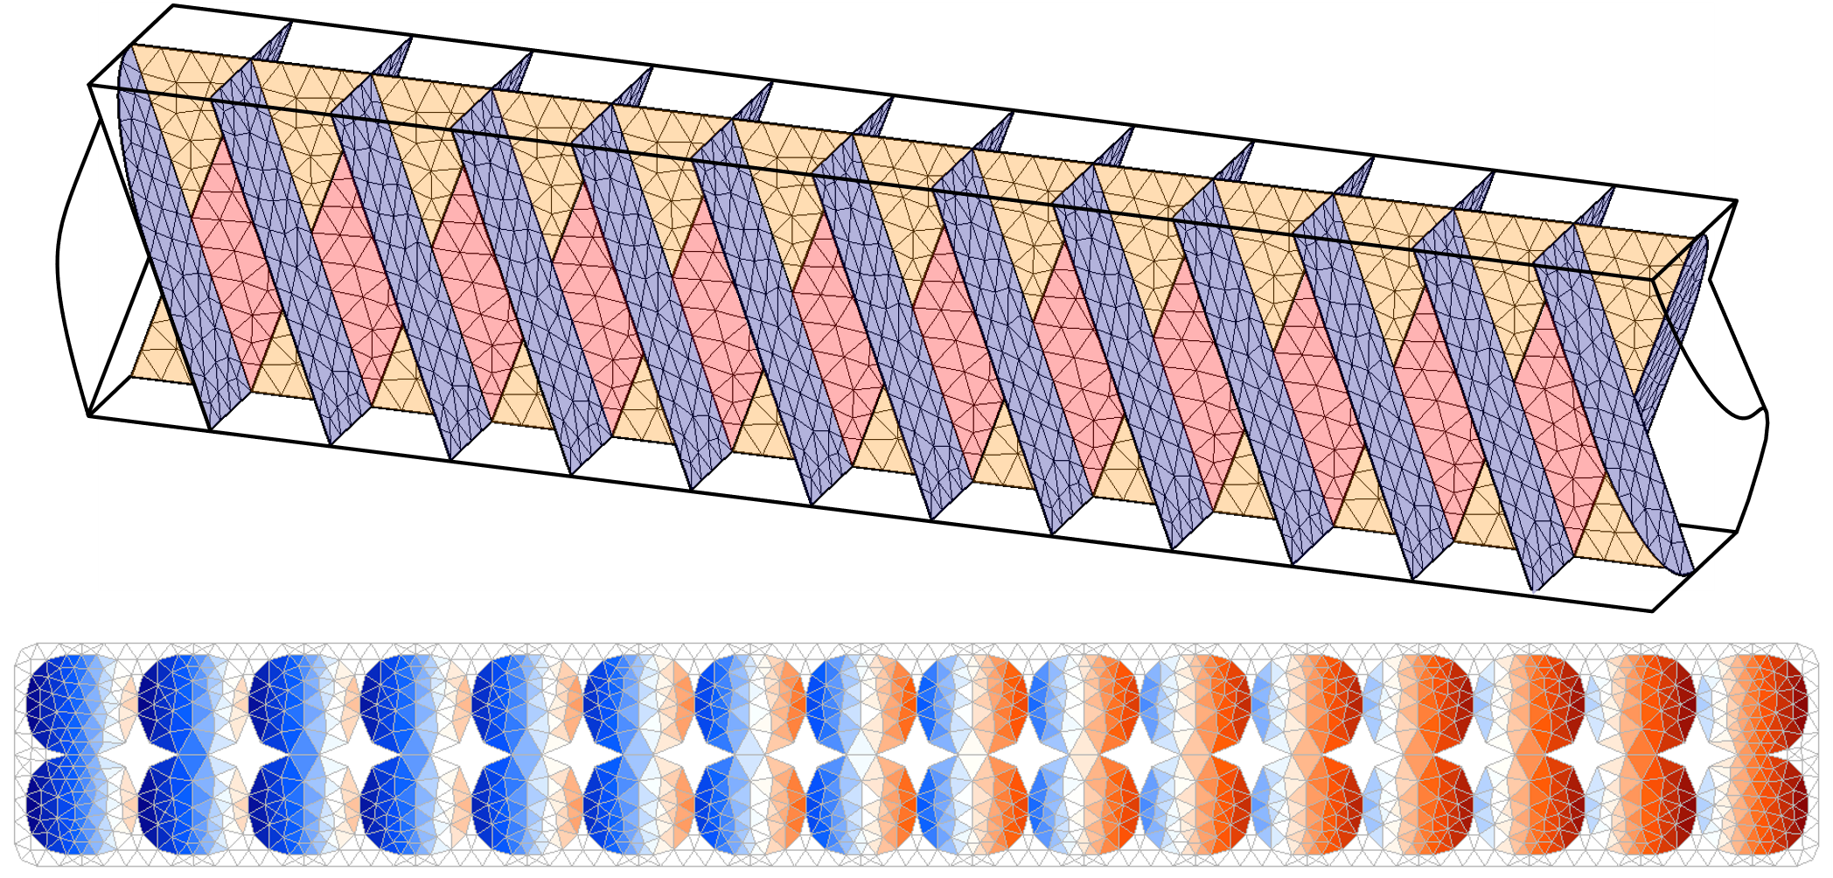
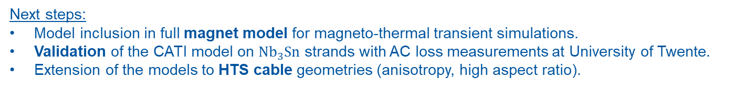
AC Loss and Magnetization in LTS Conductors
Phase 1 – Detailed 2D-based models:
  Magnetic transients in superconducting strands and Rutherford cables.
  Coupled Axial and Transverse currents (CATI) method, 2D Finite Element (FE)
Phase 2 – Homogenized model:
  Reduced Order Hysteretic Magnetization and Flux (ROHM and ROHF) models:
    Describes AC loss, magnetization and inductance.
    Includes hysteresis effects.
    Includes rate-dependent effects.
J. Dular et al. 2024 https://arxiv.org/abs/2409.13653
Deformed geometries from
MSC-LSC (S. Hopkins, J. Baumann, et al.)
Multifilamentary strand
J. Dular et al. 2024 DOI: 10.1088/1361-6668/ad650d
Rutherford cable
J. Dular et al. 2024 DOI: 10.1109/TASC.2024.3520941
Next steps:
Model inclusion in full magnet model for magneto-thermal transient simulations.
Validation of the CATI model on $Nb_{3}Sn$ strands with AC loss measurements at University of Twente.
Extension of the models to HTS cable geometries (anisotropy, high aspect ratio).
Courtesy of J. Dular, A. Glock

Slide 18





FiQuS: HTCondor and SLURM Integration
FiQuS runs on high-throughput (e.g., HTCondor batch system) and high-performance (e.g., SLURM Linux HPC) clusters
  Portability enabled by containerization (Docker/Singularity)
  EOS integration and SSH remote development allows running FiQuS parametric sweeps on HTCondor like on a local machine
HTCondor offers around 300,000 cores for CERN
HPC offers nodes with up to 48 physical cores and 512 GB RAM per node, distributed memory algorithms can use multiple nodes
Preliminary parallelization results are promising but require dedicated research
Next steps:
Integrate Sandia Lab’s Dakota software for state-of-the-art optimization and uncertainty quantification
Run advanced parametric studies using Dakota, e.g., for pancake coils with non-uniform J_{c} distribution
Investigate parallel algorithms to make use of HPC cluster for significantly reduced run times
Courtesy of E. Schnaubelt

Slide 19
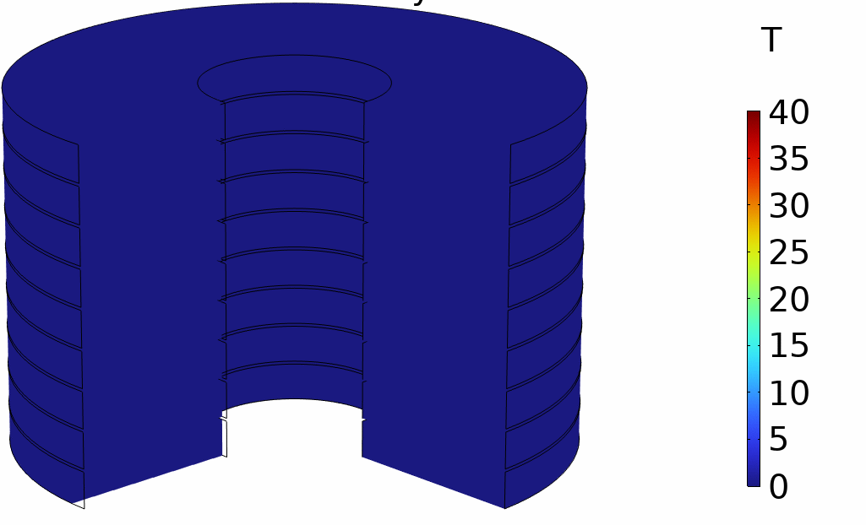
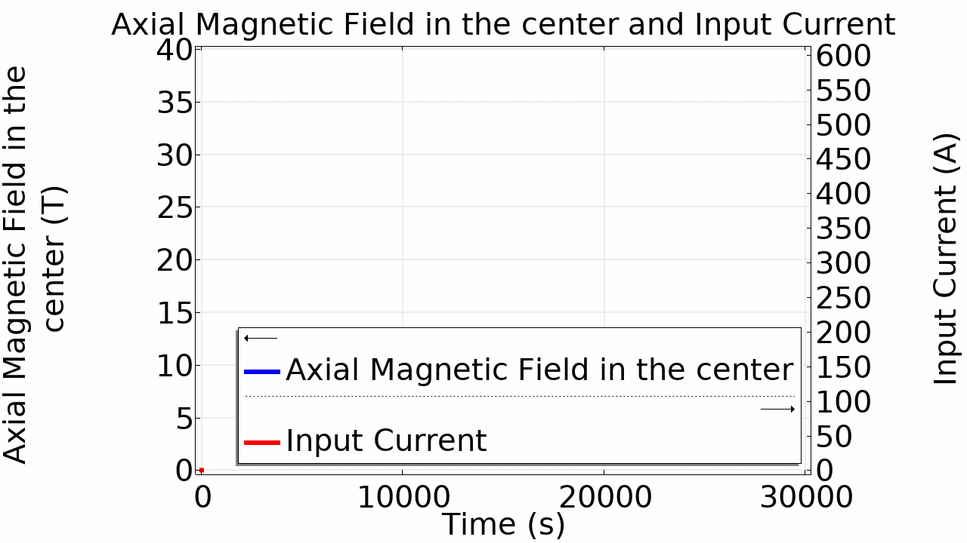
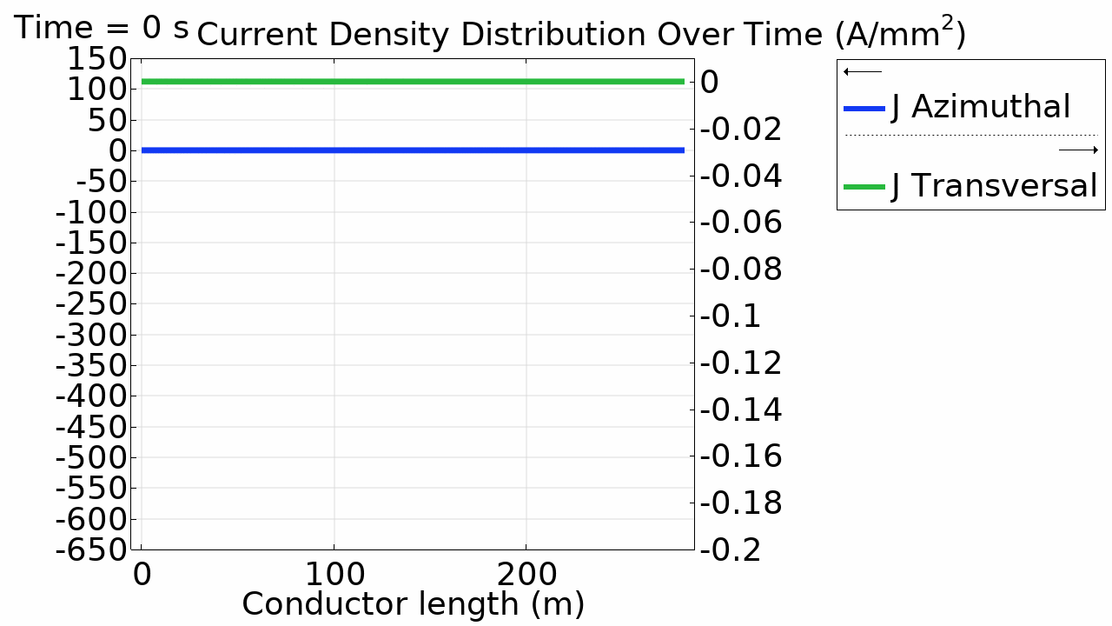
3D Electrodynamic model of NI coils
Only 1-hour computational time on a regular PC!
A COMSOL model based on a novel mathematical formulation was developed to simulate the electro-dynamics of HTS NI Coils
Example of application: the Muon Collider 40 T Solenoid
Infinite number of identical 3D pancakes
Coil winding thickness 6 cm
750 layers of superconductor (each layer simulated)
12 mm x 80 µm tape
Turn-to-turn contact resistance 10 µΩ cm²
2 mm of air between coils
Azimuthal → current parallel to the tape
Transversal → current perpendicular to the tape (turn-to-turn)
Courtesy of D. Rinaldoni & B. Bordini

Slide 20
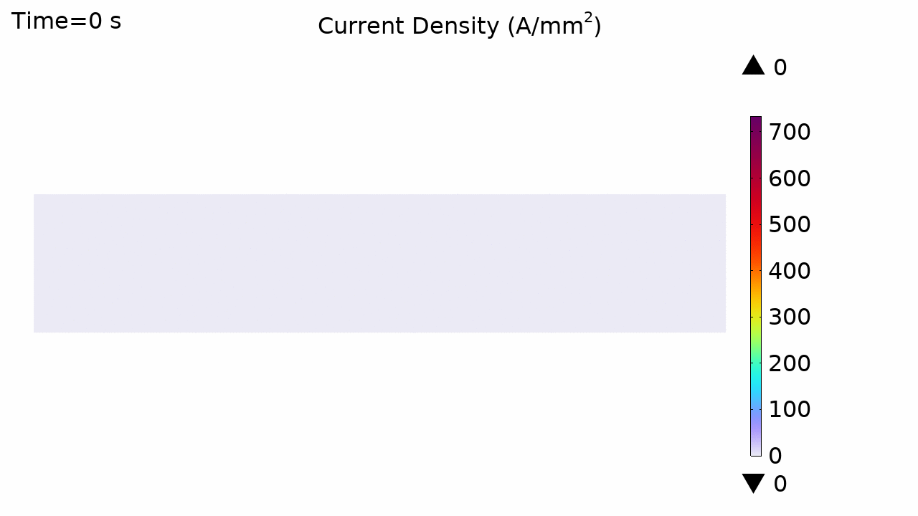
3D Electrodynamic model of NI coils – Ongoing Work
Ongoing work to implement several features to the model:
Screening Currents
Electrical Joints
Thermal effects
Next steps:
Study effect of turn-to-turn resistance on protectability
Cross-check results with NICQS and FiQuS
Validate results on real HTS coils
Courtesy of D. Rinaldoni & B. Bordini

Slide 21


Introducing HETS: 3D Quench Modeling tool for HTS Magnets
HETS – Homogenized, Electrothermal Transients of Superconductors
New 3D thermo-electromagnetic modeling of HTS insulated and non-insulated pancake/racetrack coils.
Uses several simulation techniques from NICQS (2D), optimized for 3D.
It uses a discrete implicit circuit solver for both the electrical and thermal system.
Smart homogenization of the conductor allows simulation of large magnet systems.
Features fast simulation of the ramp, its associated loss, and screening currents.
It includes thermal and inductive quench propagation. As well as quench protection:
self-discharge (for NI coils), quench heaters and energy extraction.
Early design phase, further validation required.
Courtesy of T. Mulder & L. Teichrob

Slide 22
Summary
A method for measuring the impedance of powered magnets has been developed. Experiments on HTS magnets are needed to investigate if the signal-to-noise ratio of the method can be adequate for quench detection.
Protection: ESC and e-CLIQ have been demonstrated on magnets. The methods work very well and could offer improved efficiency and reliability of quench protection. Extension to more magnets and scaling-up to larger magnets is a way forward to gain more experience on designing for protection with these.
Modeling:
  LTS quench simulations are in a mature state. Some work on AC loss and thermal simulations is ongoing to improve simulations of E-CLIQ and thermal transients.
  HTS quench simulations are the bulk of the work. A smart way of homogenisation is of key importance to 3D with affordable computing time.
  Test results are needed to validate the models further.

