Slide 2
Progress on Cryogenics Studies at CERN
Patricia Borges de Sousa on behalf of WP 4.6
11th February 2025 – HFM Annual Meeting

Slide 3
Table of contents
General status of activities
Test stands for HFM materials
HFM Cryogenics laboratory
Development of current leads for ‘dry’ magnets
Studies for magnet cooling at 4.5 K

Slide 4
General status of activities
WP 4.6 | Cryogenic and thermal management studies | Progress up to start of 2025 |  |  |  |  |  | Highlights
T1 | Cooling solutions towards reduced He content and energy consumption |  |  |  |  |  |  | Investigation of supercritical He cooling at 4.5 K for accel. magnets
T2 | Thermal properties of magnet components |  |  |  |  |  |  | Campaign for HTS tape and tape stack measurement to start in 2025
T3 | Thermal design and modelling of coils |  |  |  |  |  |  | Thermal modelling of first BOND double-aperture cross-sections
T4 | Thermal modelling of full cold mass assemblies
T5 | Small-scale HTS coils characterization
T6 | Thermal aspects of quench protection (w/ WP4.5)
T7 | Test stands for HFM |  |  |  |  |  |  | All small test stands operational Dry-cooling demons. to build in 2025

Slide 5
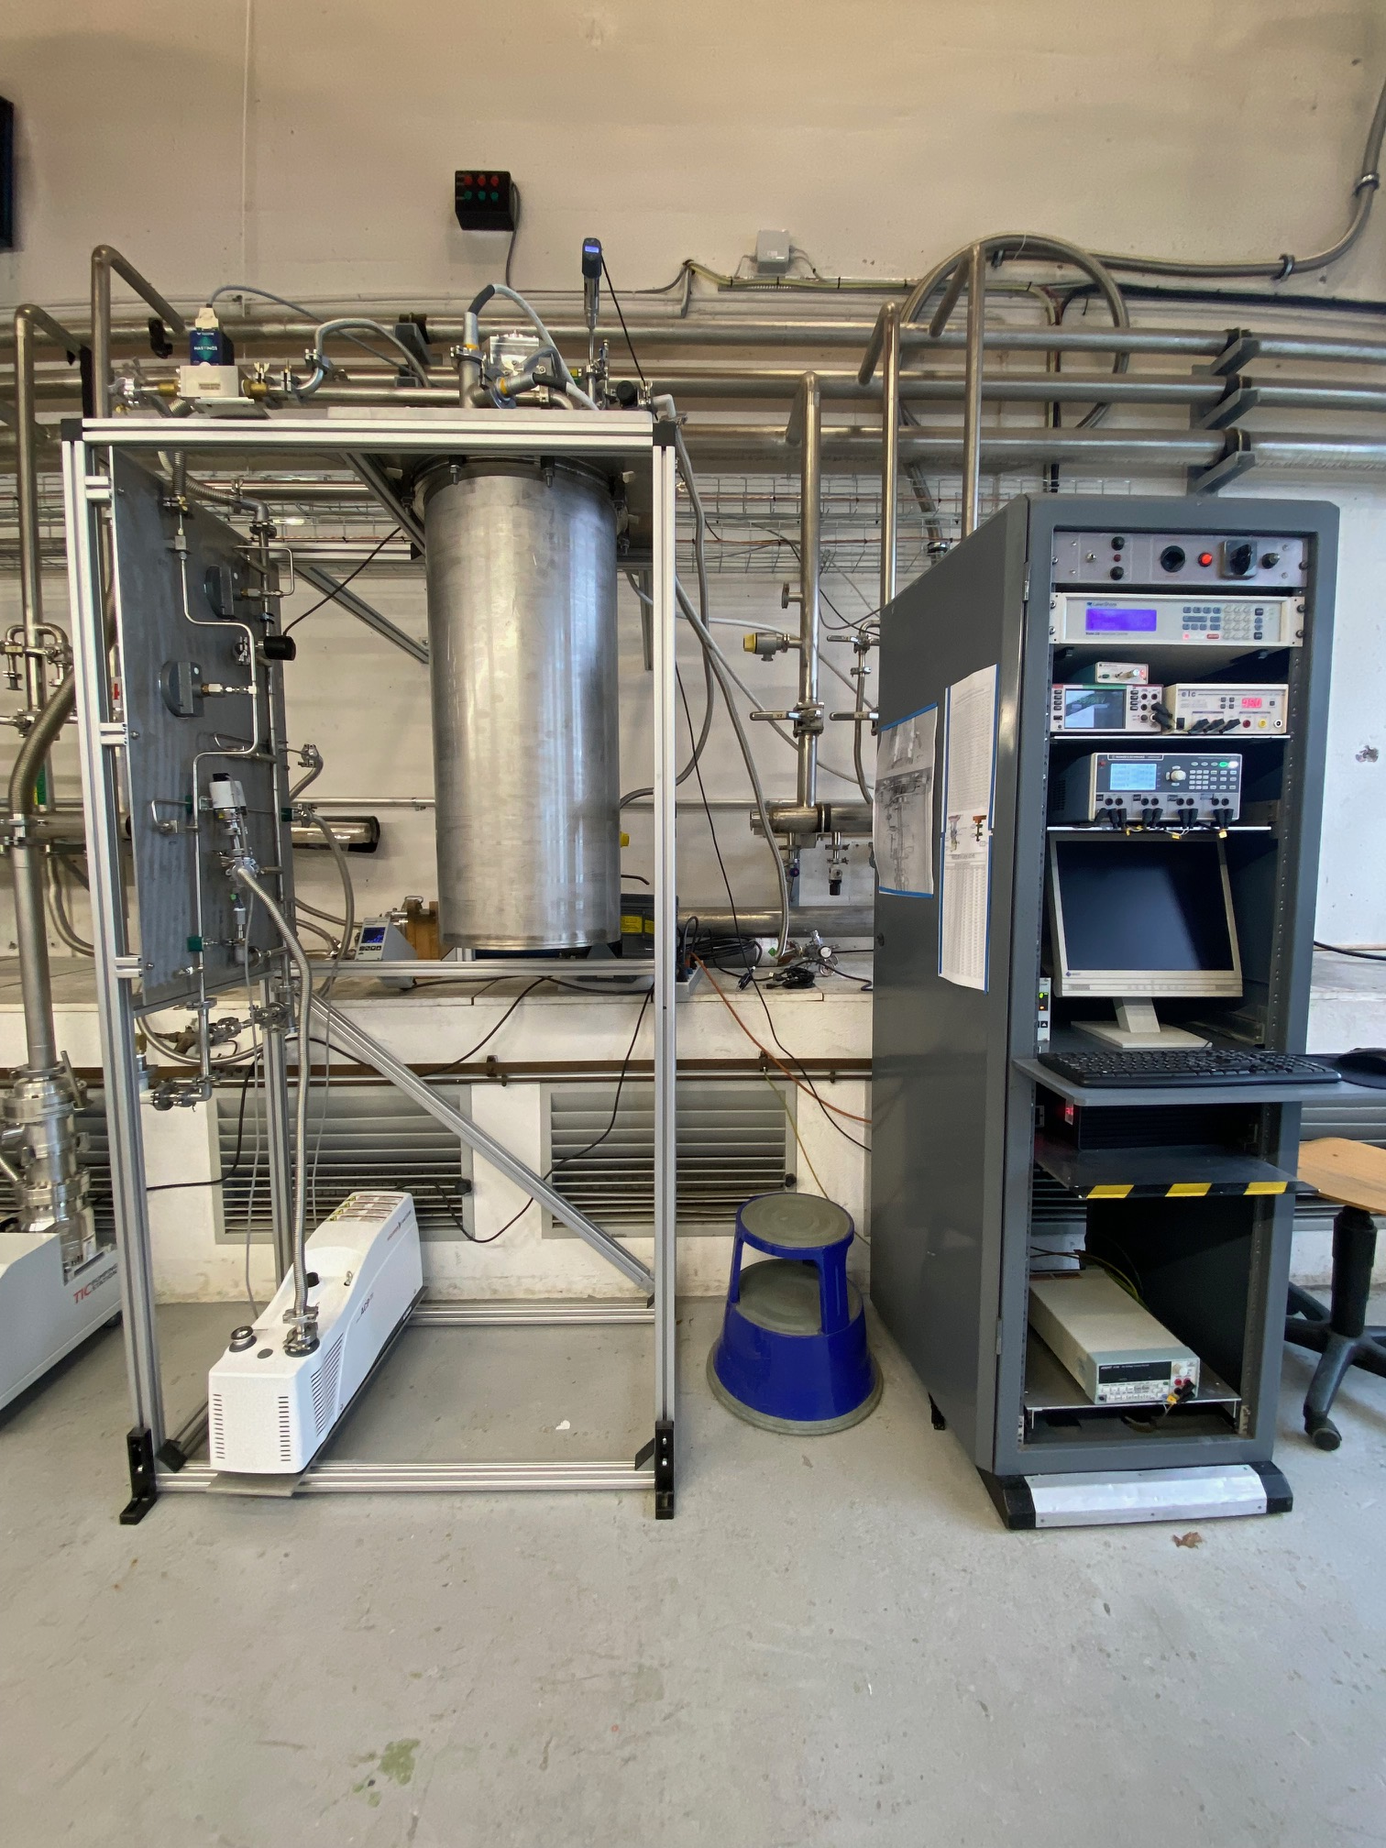
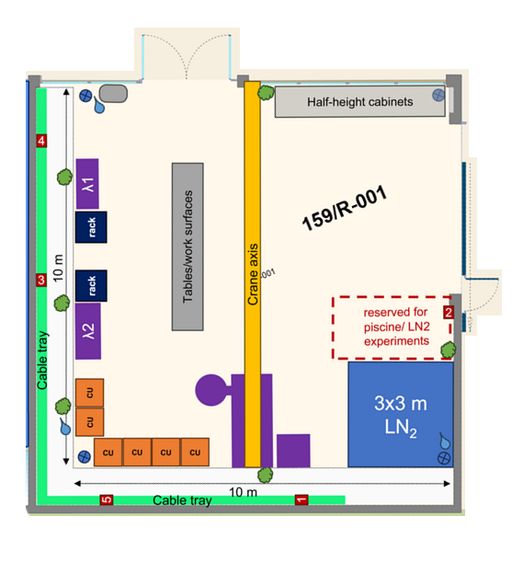
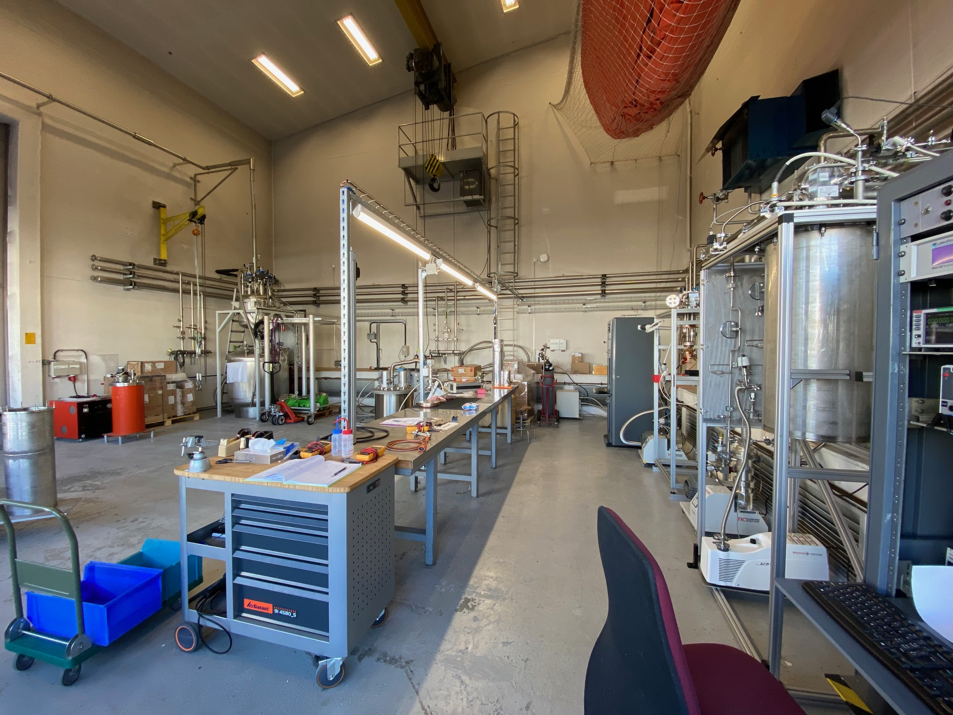
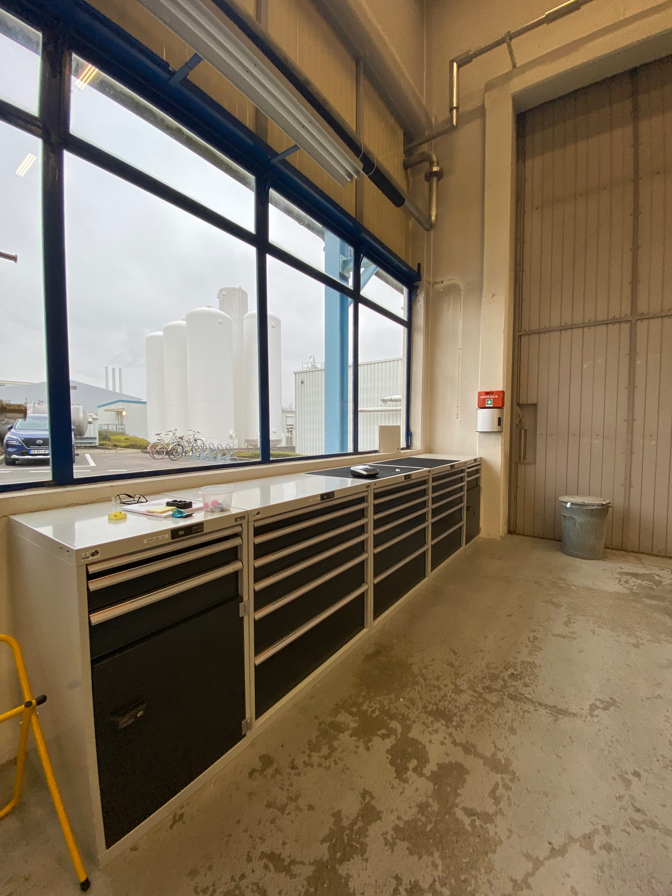
“HFM-Lab” at the Cryolab
Allocation of dedicated 100 m² laboratory space for HFM-related activities
Electrical network upgraded to latest standards, lighting redone, work surfaces and storage installed
Material property test stations + reduced He cooling demonstrator
Most material for supercritical “dry-cooling” demonstrator test stand has been procured and received
New graduate coming in March 2025 for demonstrator test stand development
Refurbishment of bld. 159 for HFM-lab

Slide 6
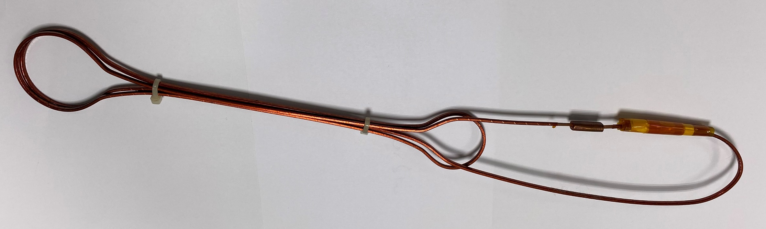
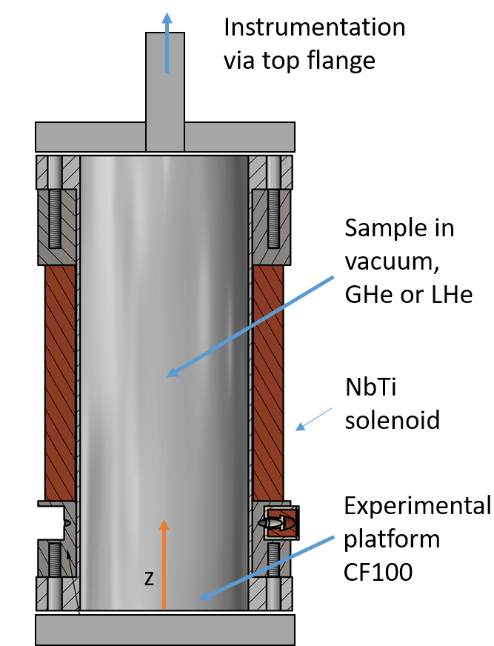
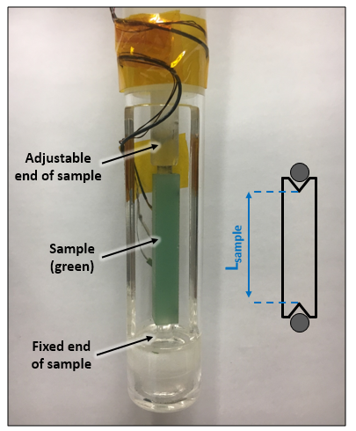
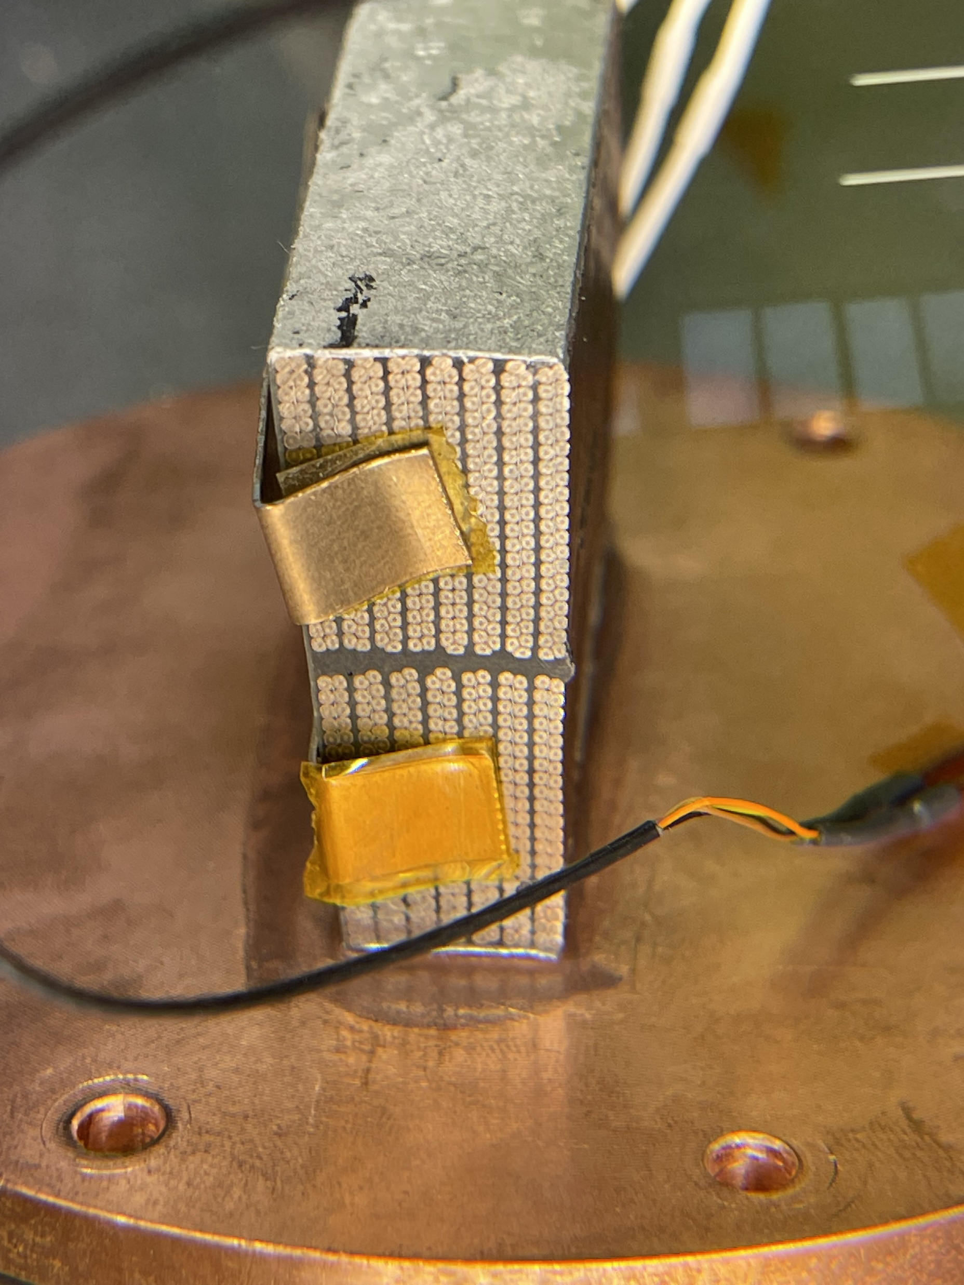
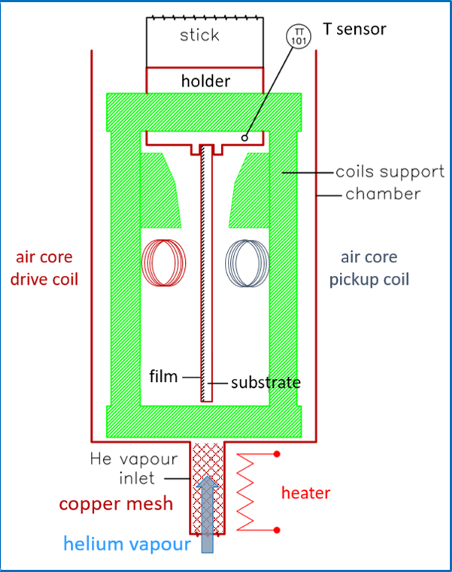
Test stands for HFM – refresher
Small components in variable T field
RRR measurements
SC splice resistance
 | Thin films on substrate | Bulk samples
Capabilities | RRR between 4.2 K and 293 K Can log R throughout cooldown | RRR between ≈7 K and 293 K Can log R throughout cooldown
Temp. range | 4.2 K and 293 K | 7 K and 293 K
Sample dimensions | 50 x 10 mm² flat plates | 120 x 2 x 2 mm³
Environment | Liquid He | In vacuum
Capabilities | Solenoid with 100 mm bore and max. 5 T background field Current leads up to 4 kA exist for sample
Temp. range | 4.2 K – 30 K
Sample dimensions | Ø 90 mm, max. length ≈ 200 mm
Environment | In vacuum, He exchange gas, or LHe
Capabilities | Splice resistance calculated using the time constant and the inductance of the splice (magnetic field decay measured via a Hall probe)
Temp. range | 4.2 K
Sample dimensions | Specific loop geometry; LHC-type cables and larger (e.g. MQXF) fit
Environment | In liquid Helium
T_{C} of SC films on substrate
Heat extraction of coil packs
Capabilities | Measurement of effective thermal conductivity of coil stacks, and heat transfer coefficient of bonded contacts
Temp. range | 1.7 K – 4.2 K base T, ≈10 K on heated side
Sample dimensions | Coil samples or stacks, max. ≈ 70 mm long
Environment | In vacuum
Thermal
contraction
Capabilities | AC contactless method, drive and pick-up coil separated by sample, temperature sweep scanning sample response – T_{C} is max. slope of transition
Temp. range | 4.2 K – 30 K
Sample dimensions | 35 x 13 x 1.5 mm³ flat plates
Environment | In He vapours
Capabilities | Length change measurement by inductive displacement sensor in quartz sample holder
Temp. range | Points at 77 K (LN₂) and 4.2 K (LHe)
Sample dimensions | strictly 8 x 8 x 50 mm³
Environment | In LN₂/LHe vapours

Slide 7
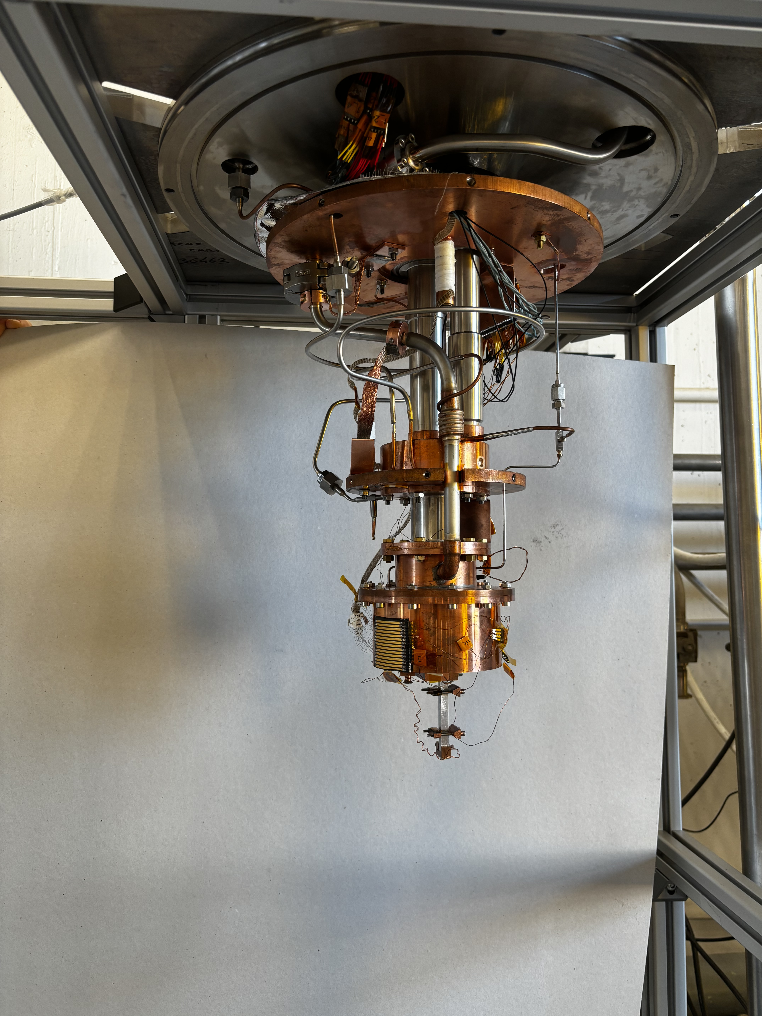
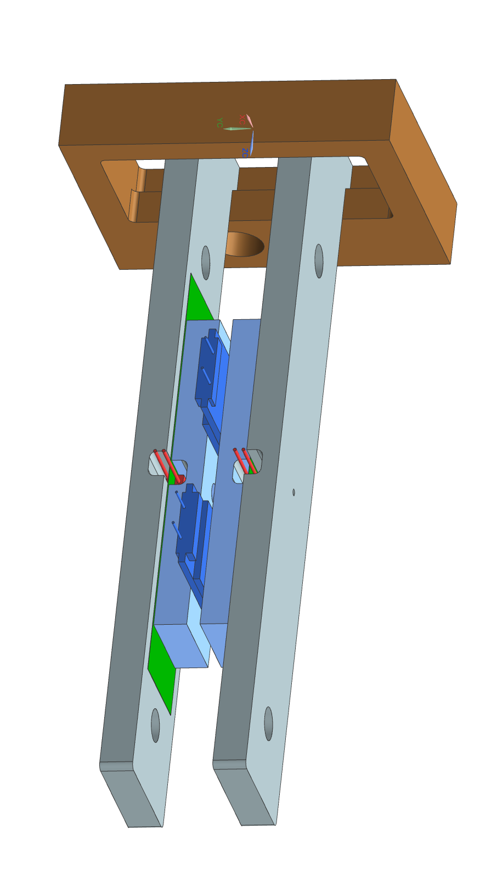
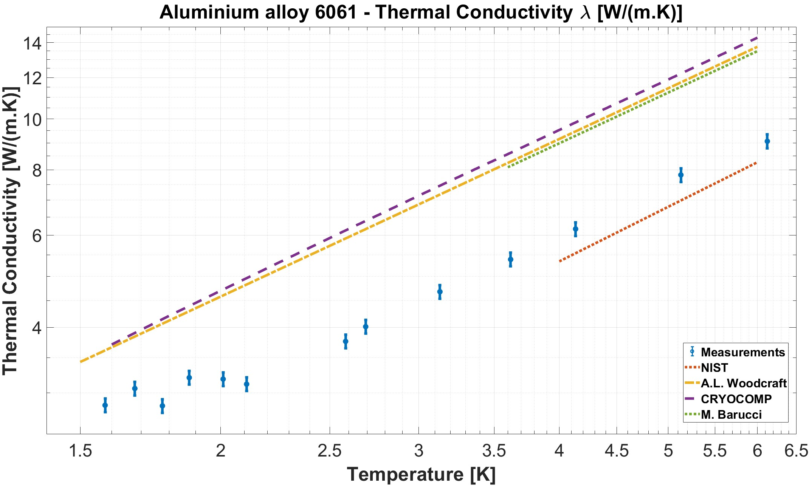
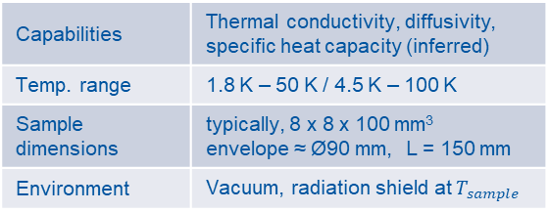
Thermal conductivity test stand
Test station first commissioned summer 2024, presented at ICEC, reached < 1.5 K
Work ongoing in automatization of measurement steps
Still having issues with He circuit for measurements < 3.5 K → advice on multistage roots?
Capabilities | Thermal conductivity, diffusivity, specific heat capacity (inferred)
Temp. range | 1.8 K – 50 K / 4.5 K – 100 K
Sample dimensions | typically, 8 x 8 x 100 mm³ envelope ≈ Ø90 mm, L = 150 mm
Environment | Vacuum, radiation shield at $T_{sample}$
Holder for th. cond. meas. normal to tape broad face
In 2025: measurement of thermal properties of HTS tapes and tape stacks in collaboration with WP 2.2
EH
TT
Thermal conductivity test stand
HTS tape

Slide 8
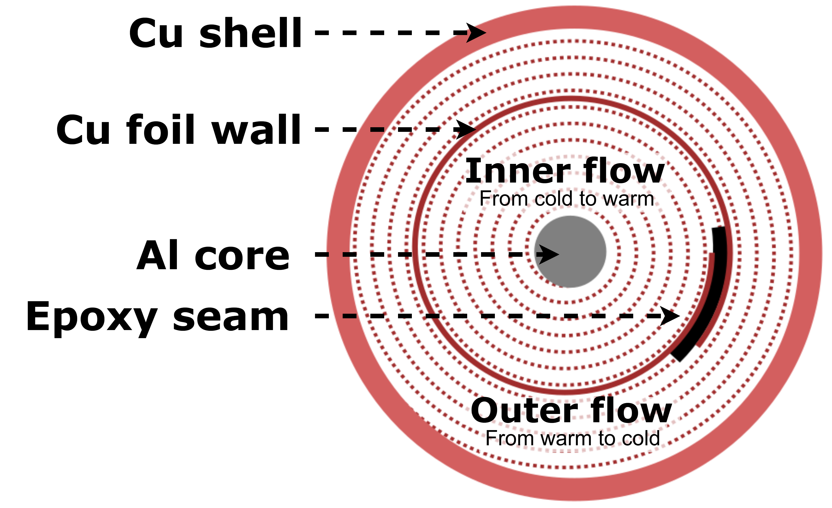
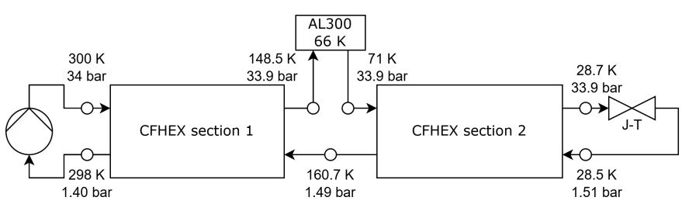
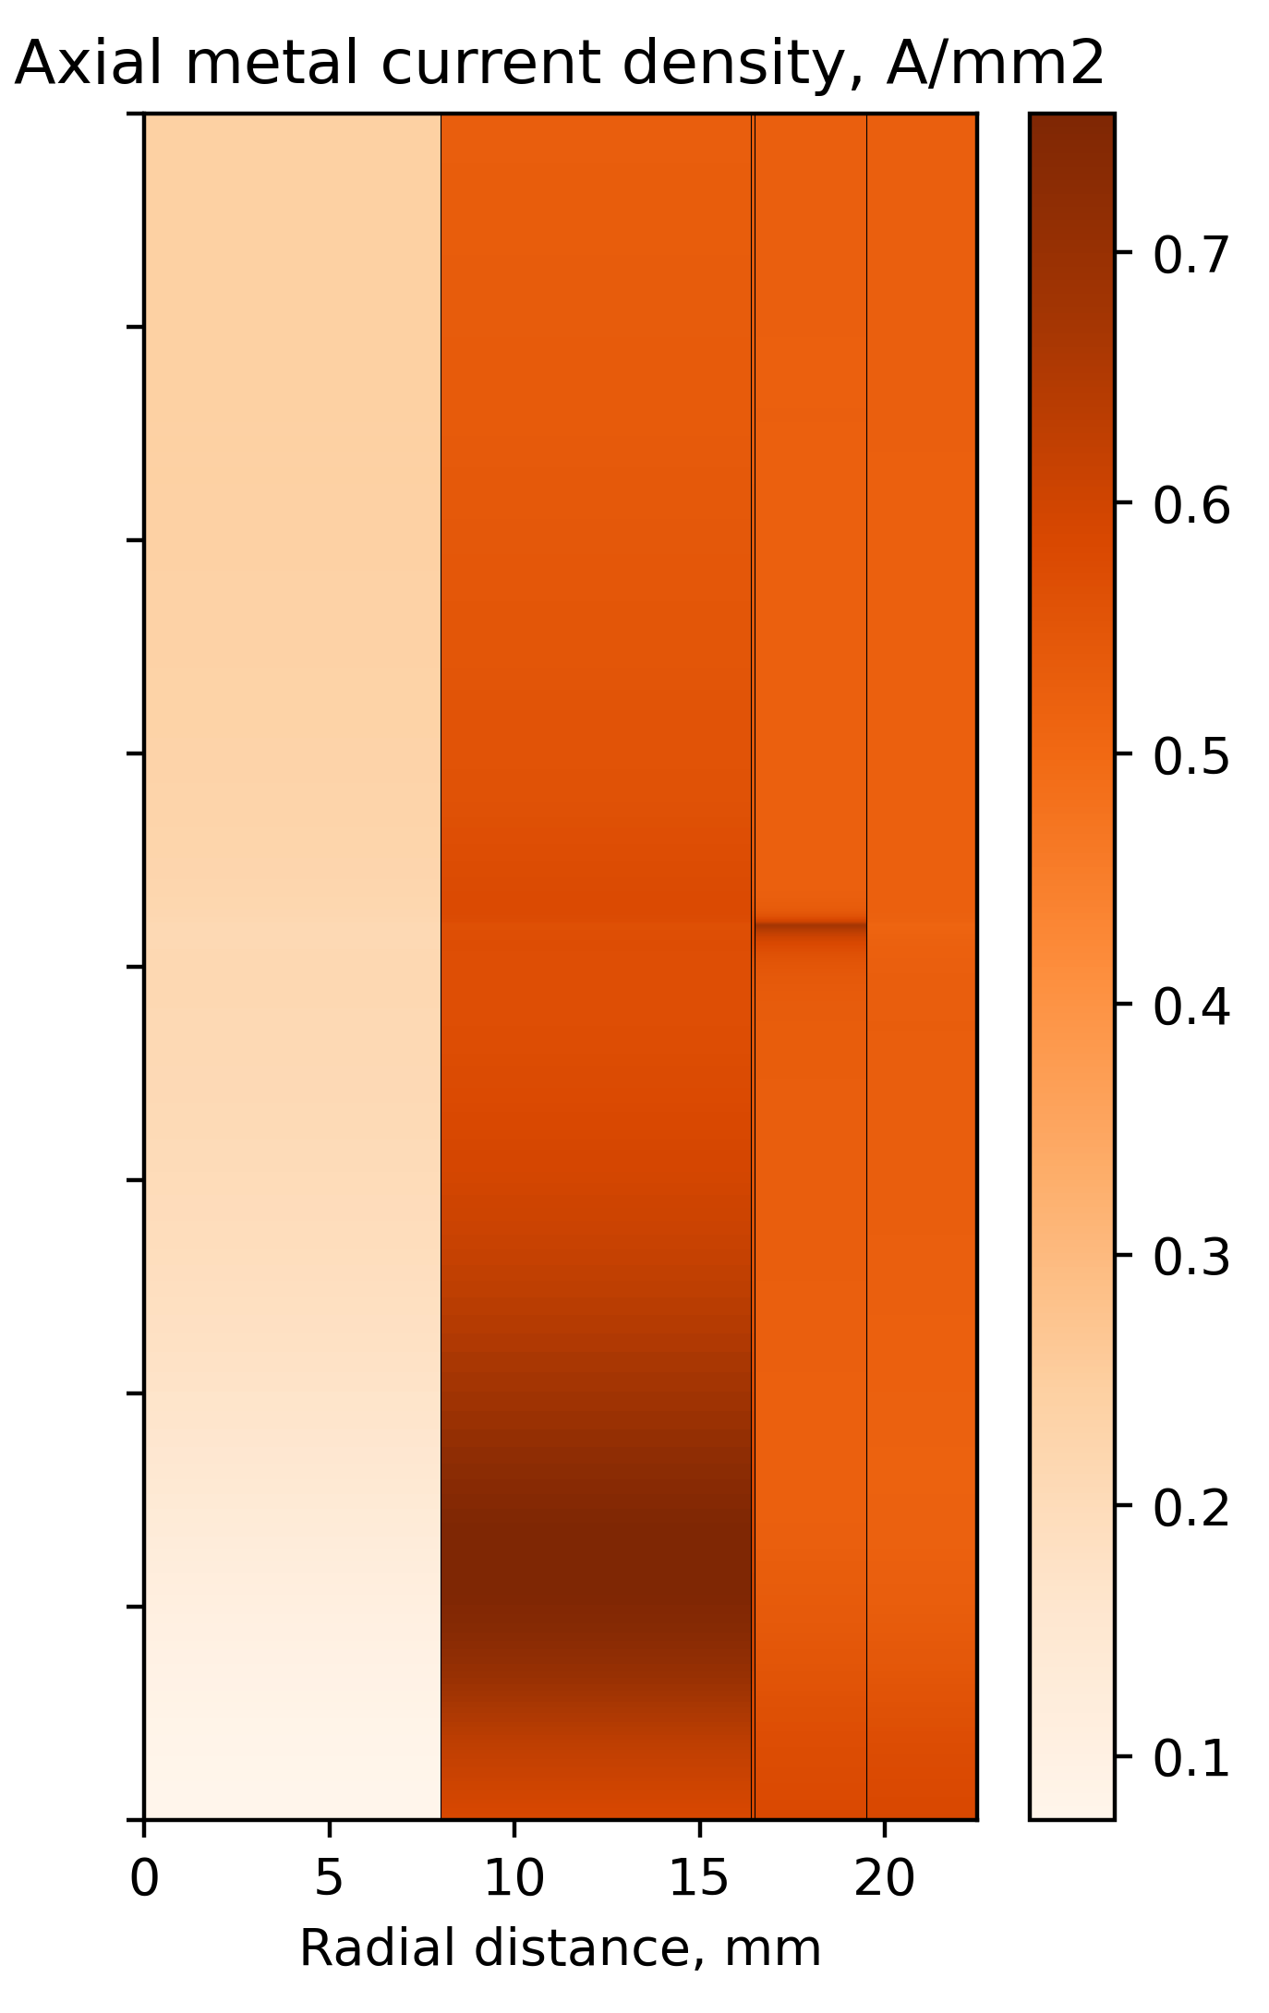
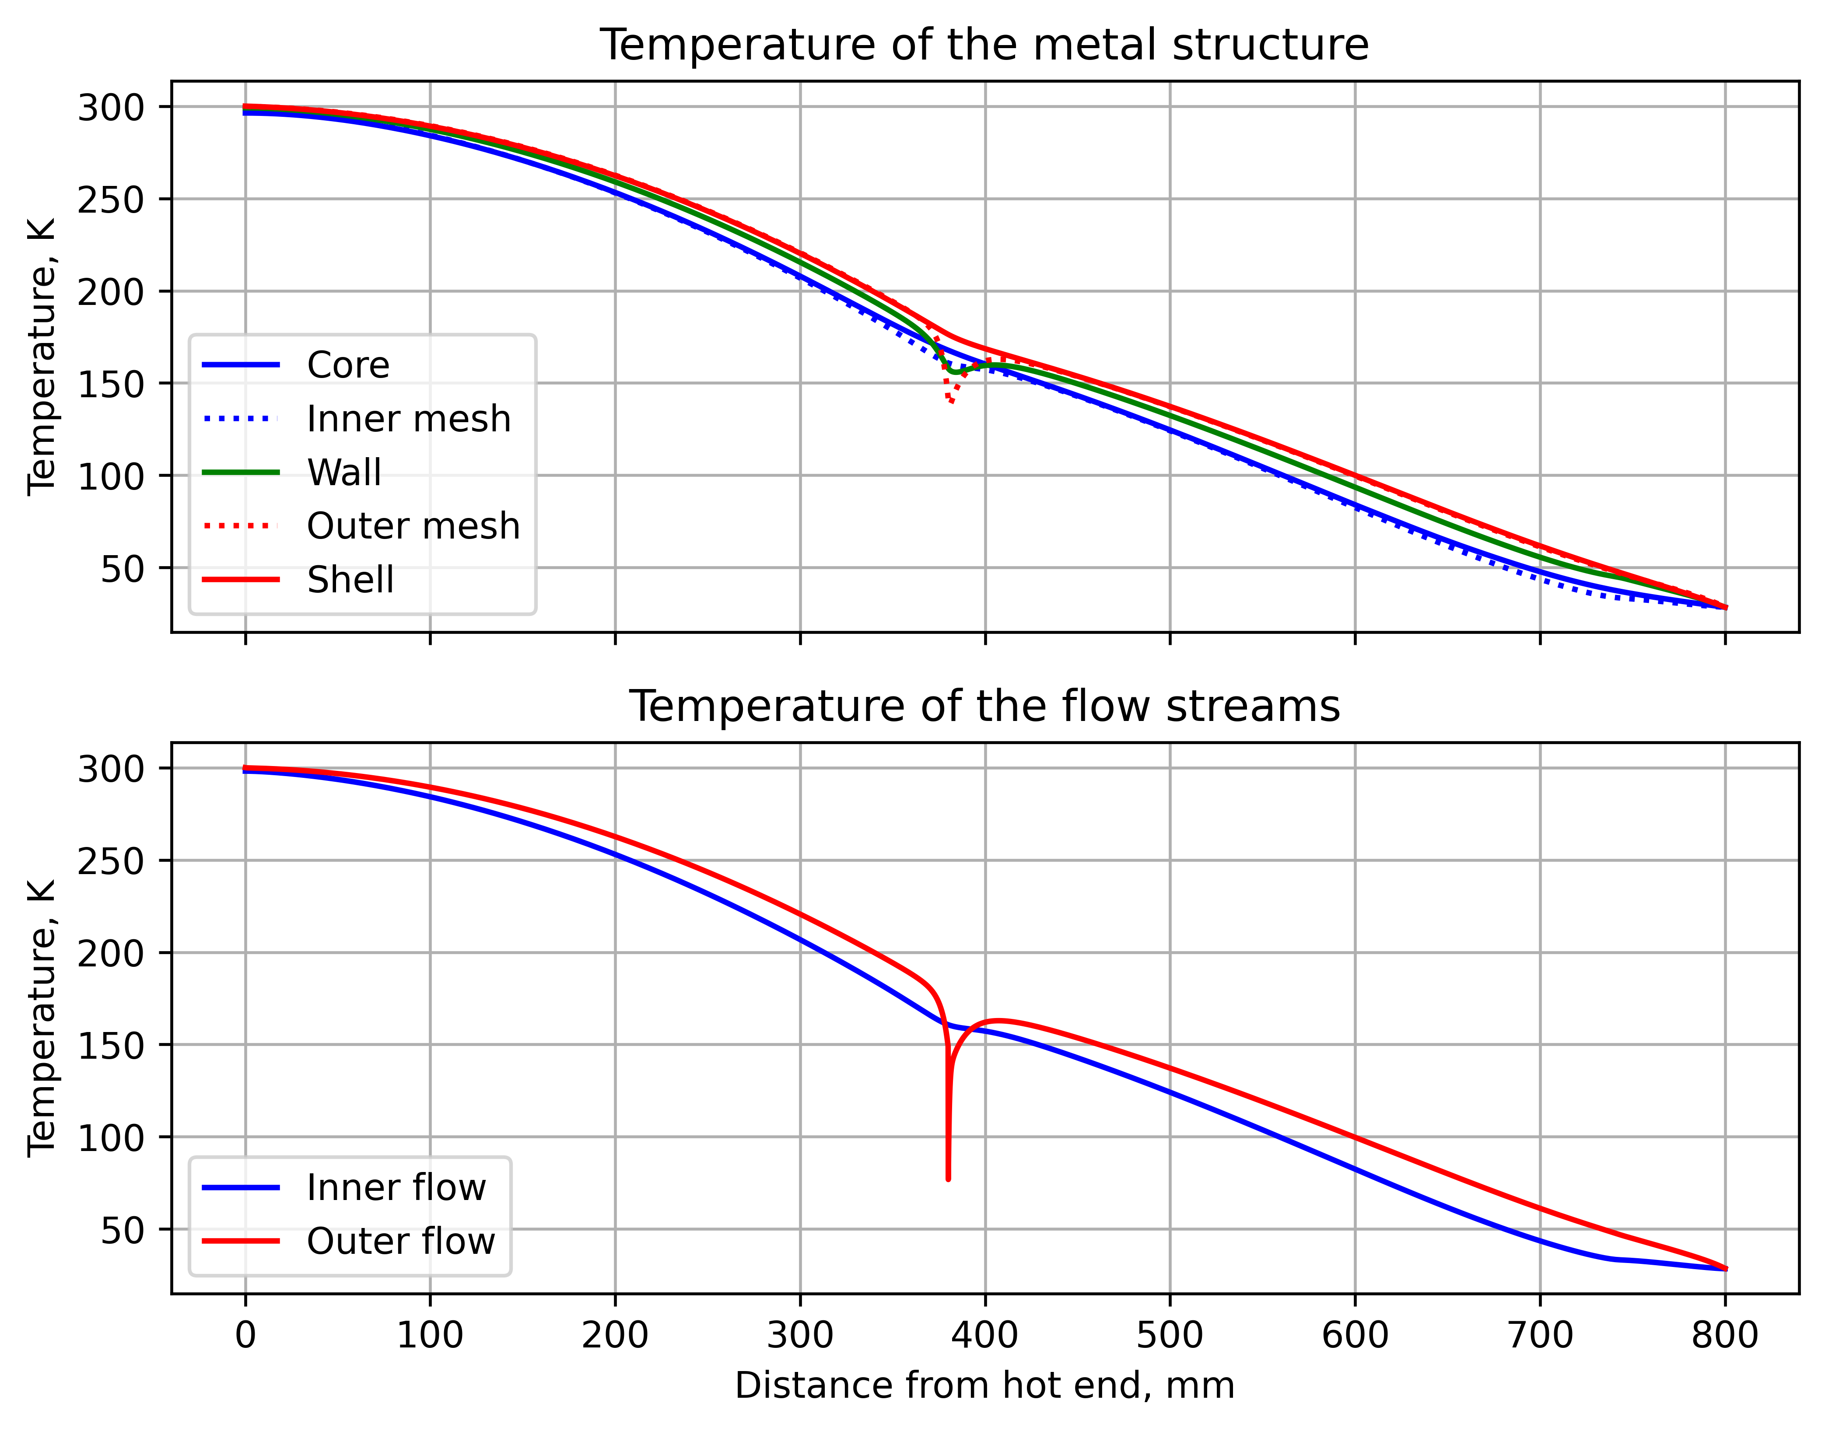
Dry-HFM: CFHEX Current Leads (I)
With advent of ‘dry’-cooled magnets, He boil-off no longer available for vapour-cooled current leads
Need to find low heat inleak option (critical for standalone magnets!) → He-cooled (not vapour cooled!)
Rolled mesh CFHEX current lead idea:
radial (azimuthal) wires for heat transfer between flow streams
axial wires for current transport (+ core and outer shell)
Warm end
Cold end
Student: Ott SALLA
Simulated results of current density and temperature profile for a neon J-T CFHEX CL

Slide 9
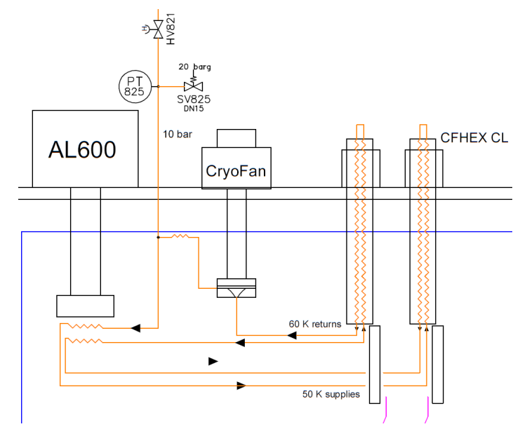
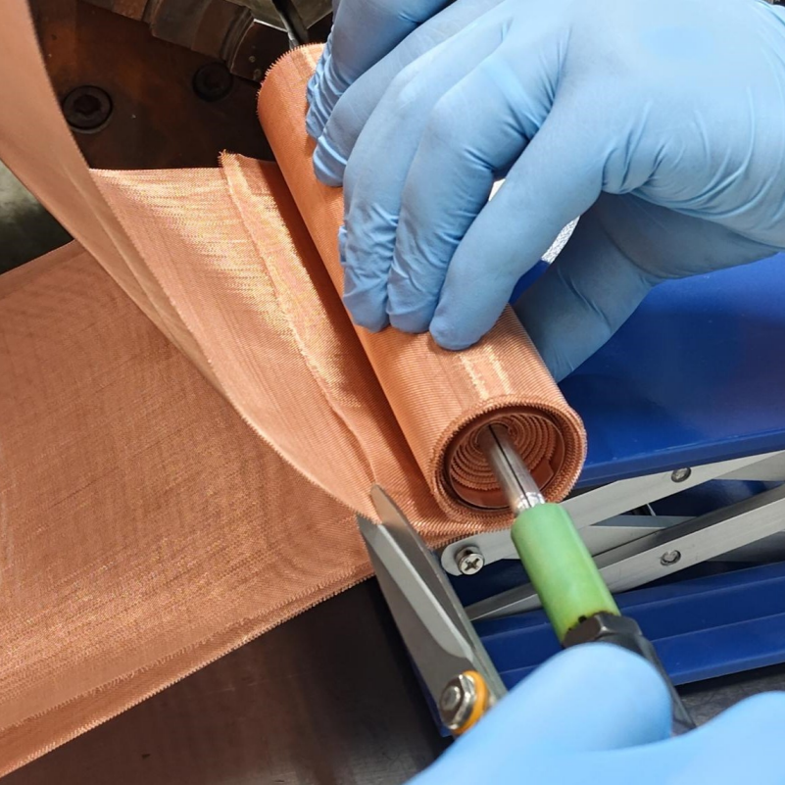
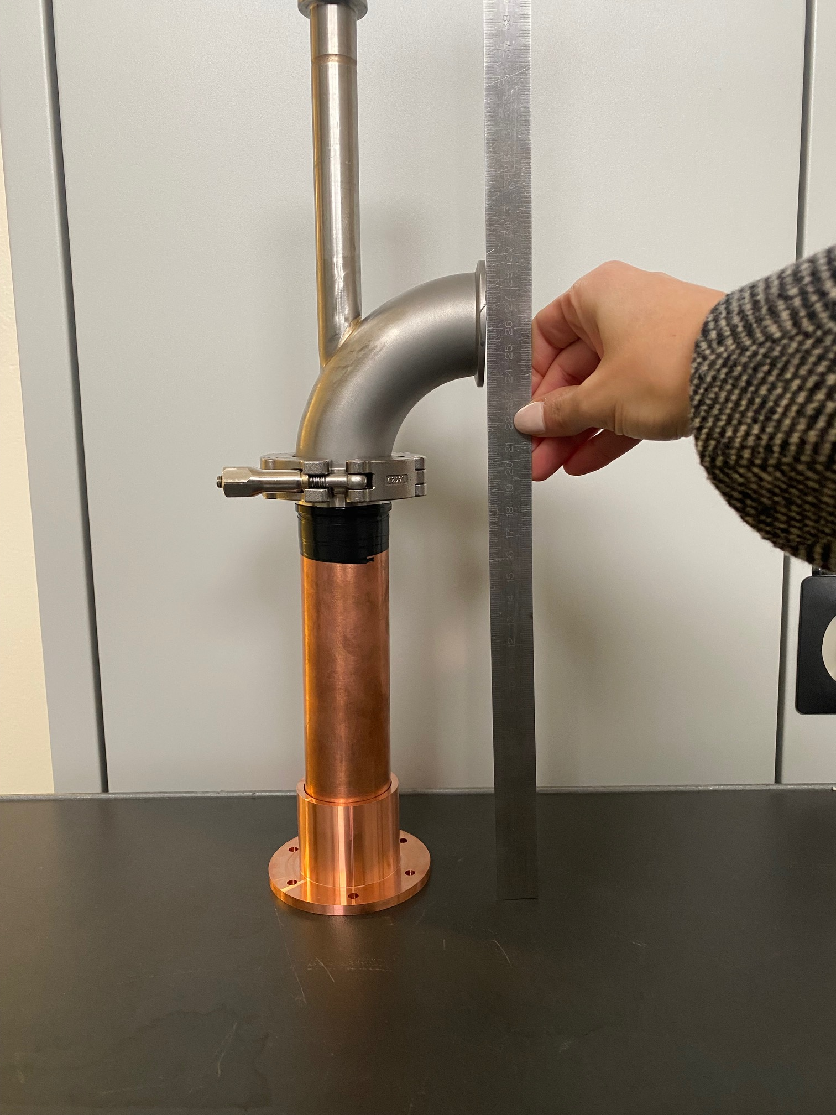
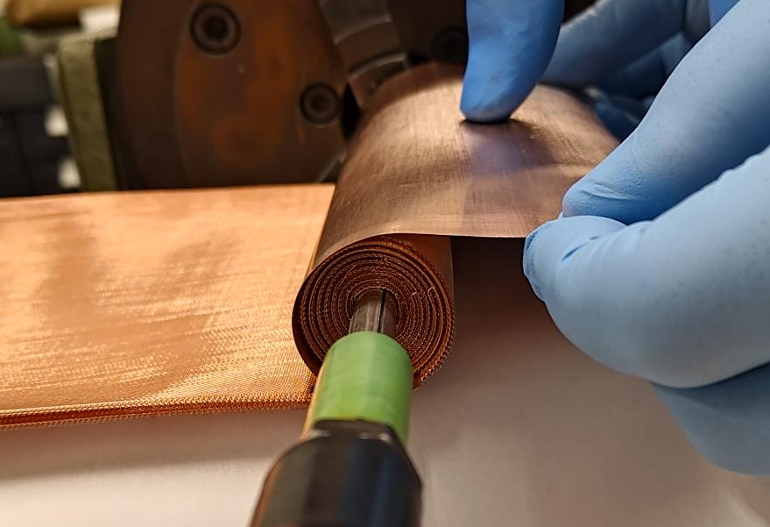
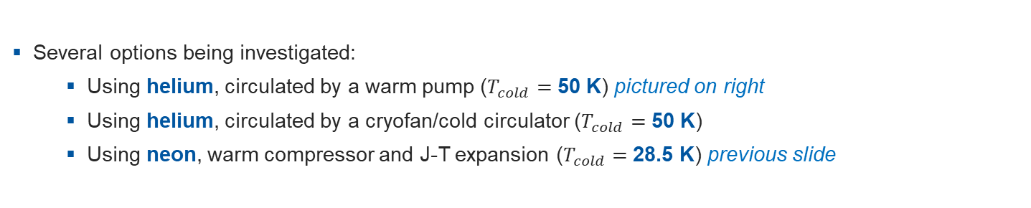
Dry-HFM: CFHEX Current Leads (II)
Several options being investigated:
  Using helium, circulated by a warm pump ($T_{cold}=$ 50 K) pictured on right
  Using helium, circulated by a cryofan/cold circulator ($T_{cold}=$ 50 K)
  Using neon, warm compressor and J-T expansion ($T_{cold}=$ 28.5 K) previous slide
CL option using He + cryofan
Optimisation code developed for CFHEX-type current leads
Construction method optimised w.r.t. bonding materials, flow distribution
Experimental validation of the concept ongoing
Exchange with MSC for possible applications/needs (e.g., SHiP spectrometer magnet)
Current flow
Short prototype assembly
Manufacturing trials for short prototype

Slide 10
Baseline FCC-hh cooling strategy + alternative
New baseline!
FCC-hh parameters | CDR (2019) | F14 Scenario (2024) | 4.5 K option (2024)
Circumference [km] | 97.75 | 90.7 | 90.7
Dipole field [T] | 16 | 14 | 14
Centre-of-mass energy [TeV] | 100 | 85 | 85
SR for 2 beams [MW] | 4.8 | 2.4 | 2.4
Magnet Temperature [K] | 1.9 | 1.9 | 4.5
Beam screen Temperature [K] | 40-60 | 40-60 | 60-80 (tbc)
He Cryogenic capacity at 4.5 K_{eq} [kW] | 1200 | 950 | 650
Electrical consumption [MW] | 266 | 208 | 143
He inventory [tons] | 880 | 820 | 390
Cooling scheme identical to CDR; figures updated to reflect change in SR and arc length
Change T level, different cooling strategy for magnets

Slide 11
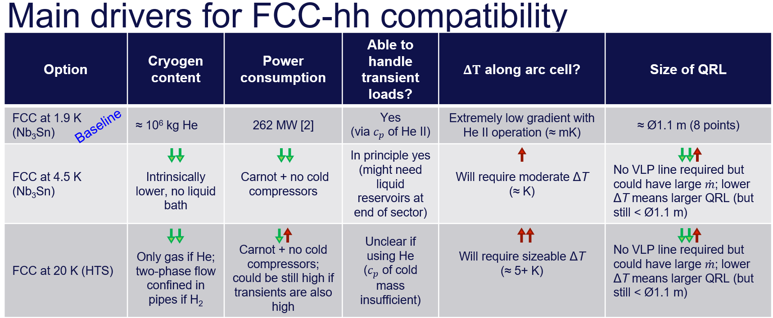
Dry-HFM: Magnet cooling beyond the baseline
Preliminary evaluation of FCC-hh scenario at 4.5 K using 14 T Nb₃Sn magnets and compatibility with FCC-ee machine infrastructure and civil engineering.
Updated heat load assessment w.r.t. the CDR scenario → now compatible with 14 T, 4.5 K
Proposal borrows from SSC design, relies on supercritical He flow at 4 K, 3 bar, periodically re-cooled in phase separators → potential for lower He inventory and energy consumption

Slide 12
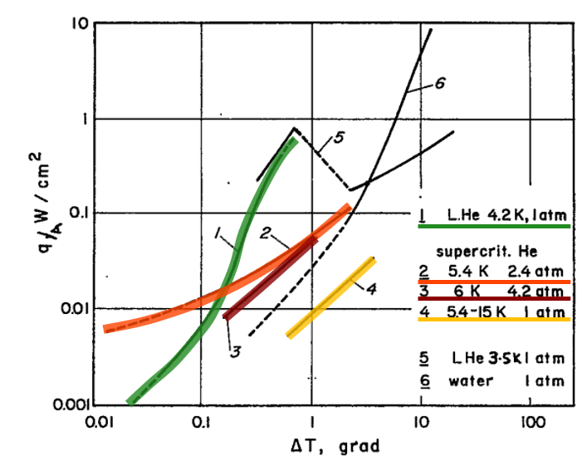


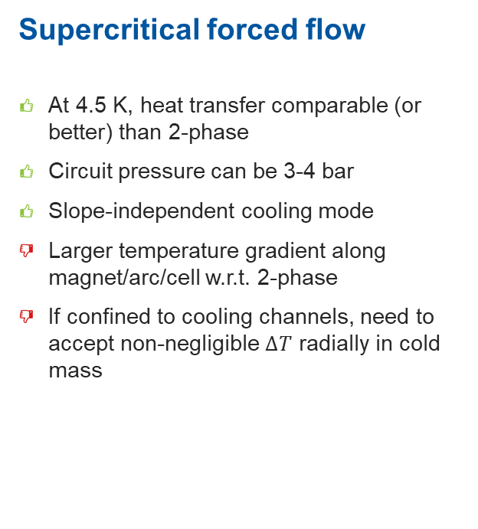
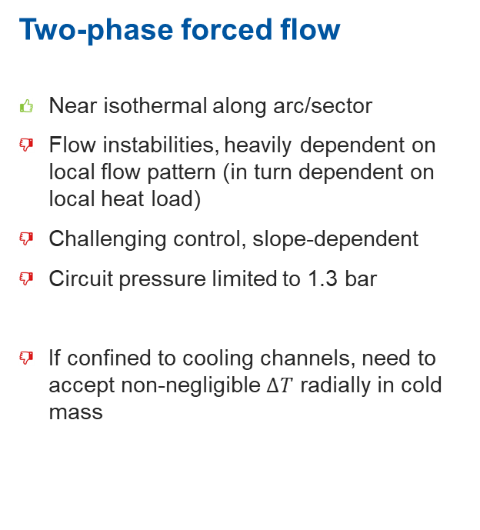
Cooling at 4.5 K – how?
Pool boiling
Near isothermal along arc/sector
Large He inventory in contact with cold mass
(some) penetration of He close to coils if immersed
Bubbles can form and be trapped
Heat transfer of He I
Two-phase forced flow
Near isothermal along arc/sector
Flow instabilities, heavily dependent on local flow pattern (in turn dependent on local heat load)
Challenging control, slope-dependent
Circuit pressure limited to 1.3 bar
If confined to cooling channels, need to accept non-negligible $∆T$ radially in cold mass
Supercritical forced flow
At 4.5 K, heat transfer comparable (or better) than 2-phase
Circuit pressure can be 3-4 bar
Slope-independent cooling mode
Larger temperature gradient along magnet/arc/cell w.r.t. 2-phase
If confined to cooling channels, need to accept non-negligible $∆T$ radially in cold mass
Smith, Review of heat transfer to helium I (link)
Free
convection!

Slide 13
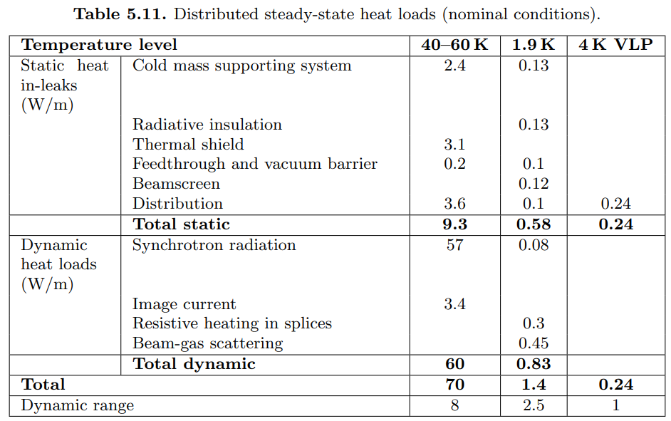

Heat loads to cold mass
Total heat load
We are assuming the same steady-state heat loads (static + dynamic) as stated in CDR for 1.9 K (1.4 W/m) but at around 4 K
${\dot{Q}}_{CM}$ = ${\dot{Q}}_{static}$ + ${\dot{Q}}_{dynamic}$ + ${\dot{Q}}_{transient}$
Steady-state loads
(from CDR table)
Magnet ramp down/up cycle
10 kJ/m over 3200 s (tbc)
Transient loads (hysteresis losses from ramping) are assumed to be 10 kJ/m for a full ramp-up/down cycle for a double-aperture coil (E. Todesco)
This means an added 3.1 W/m to the steady-state loads if considering powering schedule of CDR (3200 s for full cycle)
From original 2019 FCC-hh CDR

Slide 14
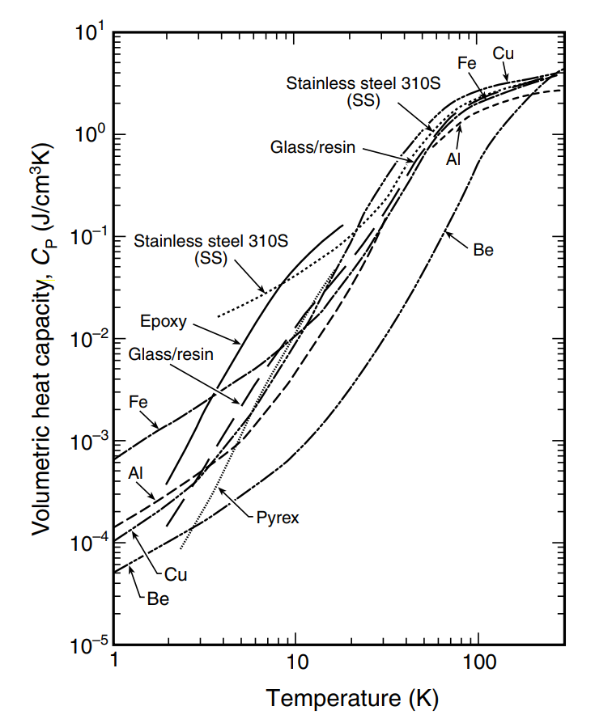
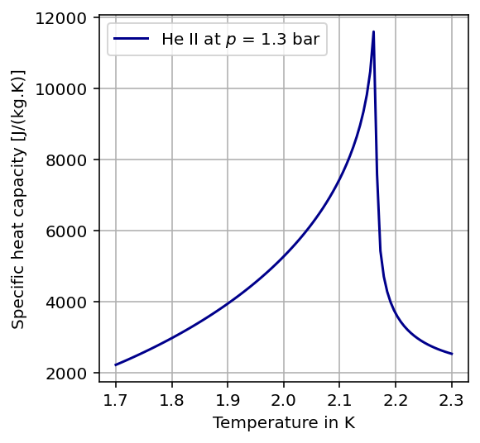
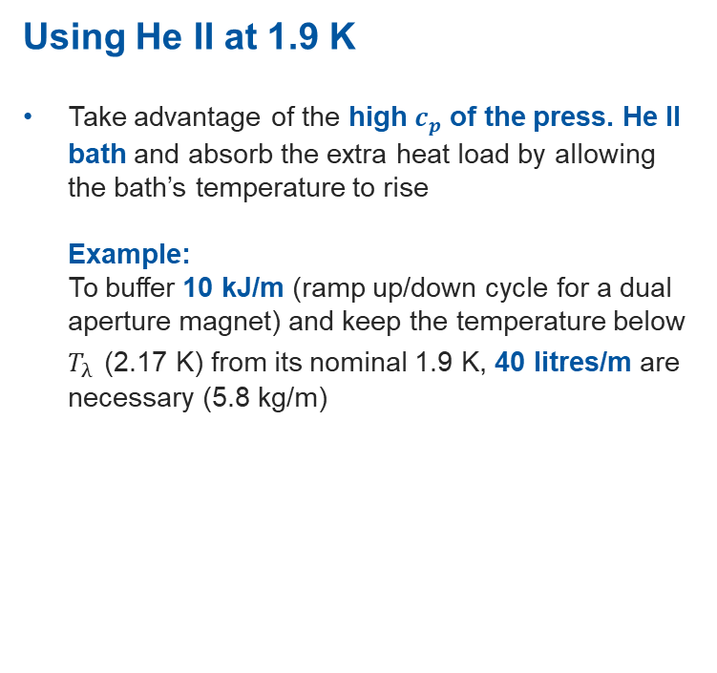
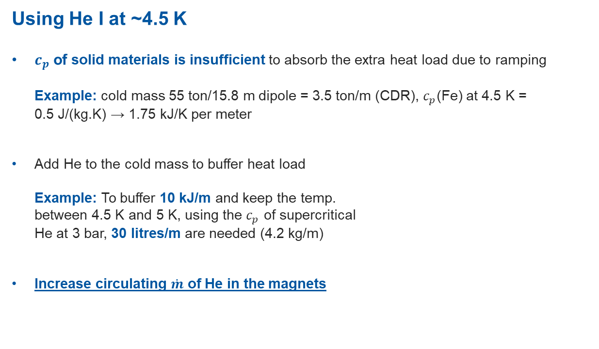
How to buffer hysteresis losses?
Using He II at 1.9 K
Take advantage of the high $c_{p}$ of the press. He II bath and absorb the extra heat load by allowing the bath’s temperature to rise
Example:
To buffer 10 kJ/m (ramp up/down cycle for a dual aperture magnet) and keep the temperature below $T_{λ}$ (2.17 K) from its nominal 1.9 K, 40 litres/m are necessary (5.8 kg/m)
Using He I at ~4.5 K
$c_{p}$ of solid materials is insufficient to absorb the extra heat load due to ramping
Example: cold mass 55 ton/15.8 m dipole = 3.5 ton/m (CDR), $c_{p}$(Fe) at 4.5 K =
0.5 J/(kg.K) → 1.75 kJ/K per meter
Add He to the cold mass to buffer heat load
Example: To buffer 10 kJ/m and keep the temp.
between 4.5 K and 5 K, using the $c_{p}$ of supercritical
He at 3 bar, 30 litres/m are needed (4.2 kg/m)
Increase circulating $\dot{m}$ of He in the magnets
J.W. Ekin, Experimental Techniques for Low-Temperature Measurements
Over 6.5x LHC inventory!
(incl. QRL)

Slide 15
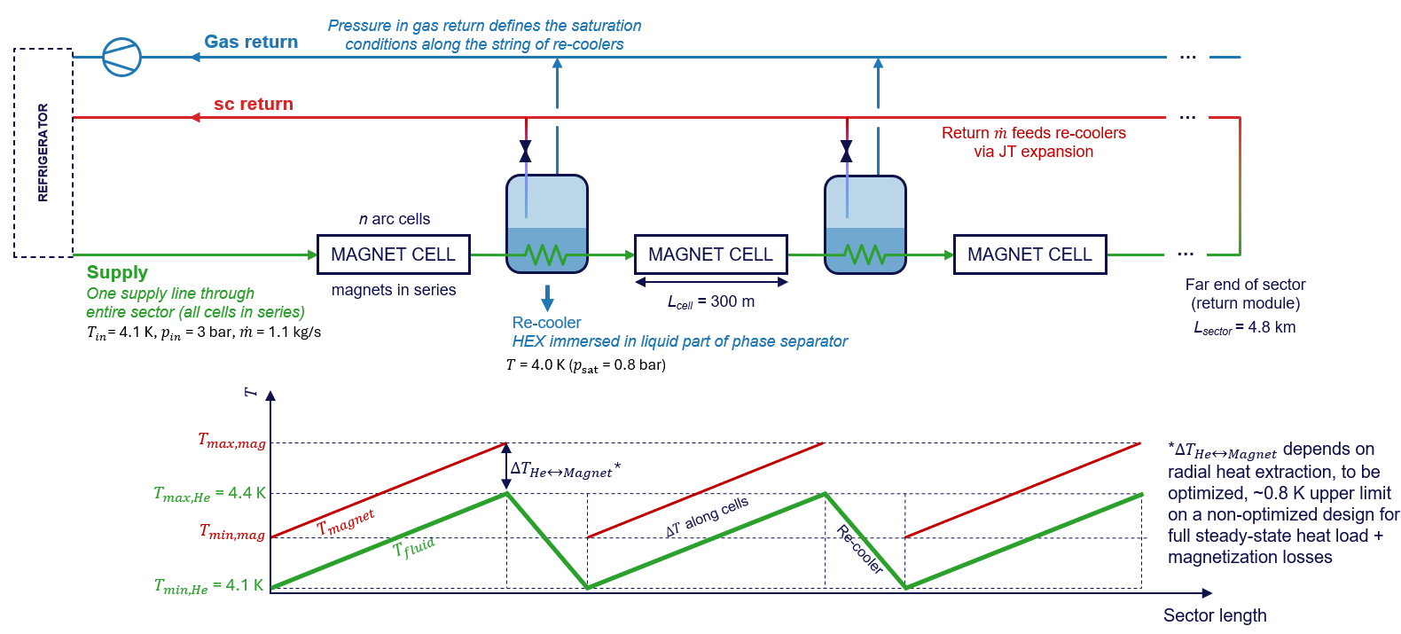
Dry-HFM: Studies for magnet cooling at 4.5 K (I)

Slide 16
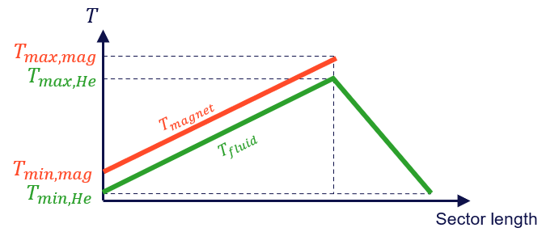
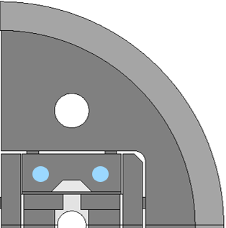
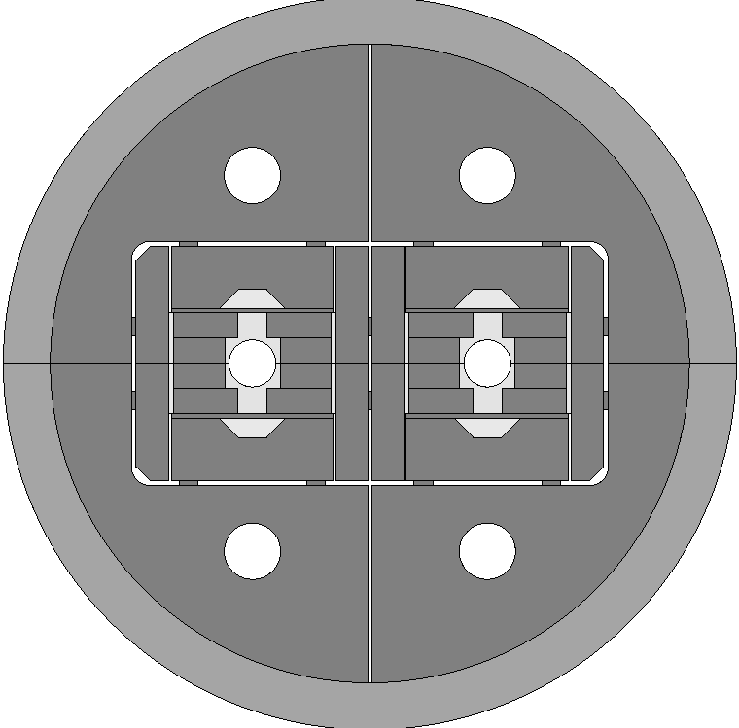

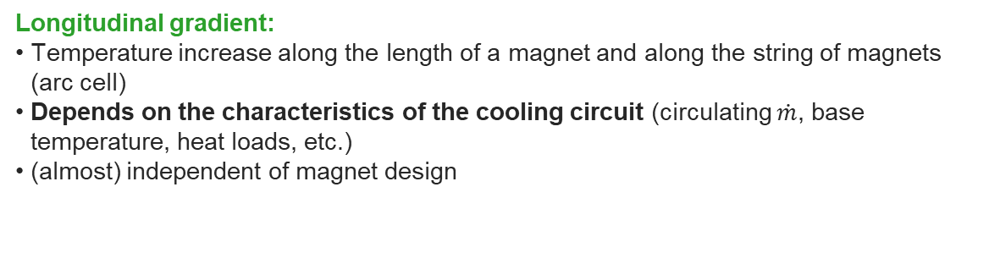
Dry-HFM: Studies for magnet cooling at 4.5 K (II)
Unlike the baseline cooling scheme at 1.9 K, where there are virtually no temperature differences along an entire sector, cooling at around 4.5 K intrinsically involves both radial and longitudinal temperature gradients
Radial gradient:
Between the heat sink (e.g. He inside cooling channel) and the magnet coil/cold mass
Depends on the solid materials between the coil and the heat sink, contact forces and thermal contact resistance
Heavily dependent on the magnet design
14 T block coil design, courtesy TE/MSC-SMT
Longitudinal gradient:
Temperature increase along the length of a magnet and along the string of magnets (arc cell)
Depends on the characteristics of the cooling circuit (circulating $\dot{m}$, base temperature, heat loads, etc.)
(almost) independent of magnet design
Design parameter:
$T_{max,mag}$= 5 K
He channel
(arbitrary position)
Coil blocks

Slide 17
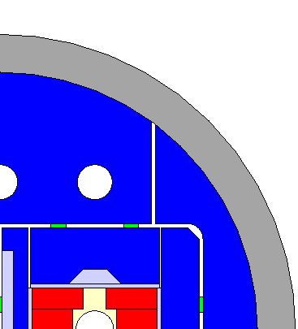
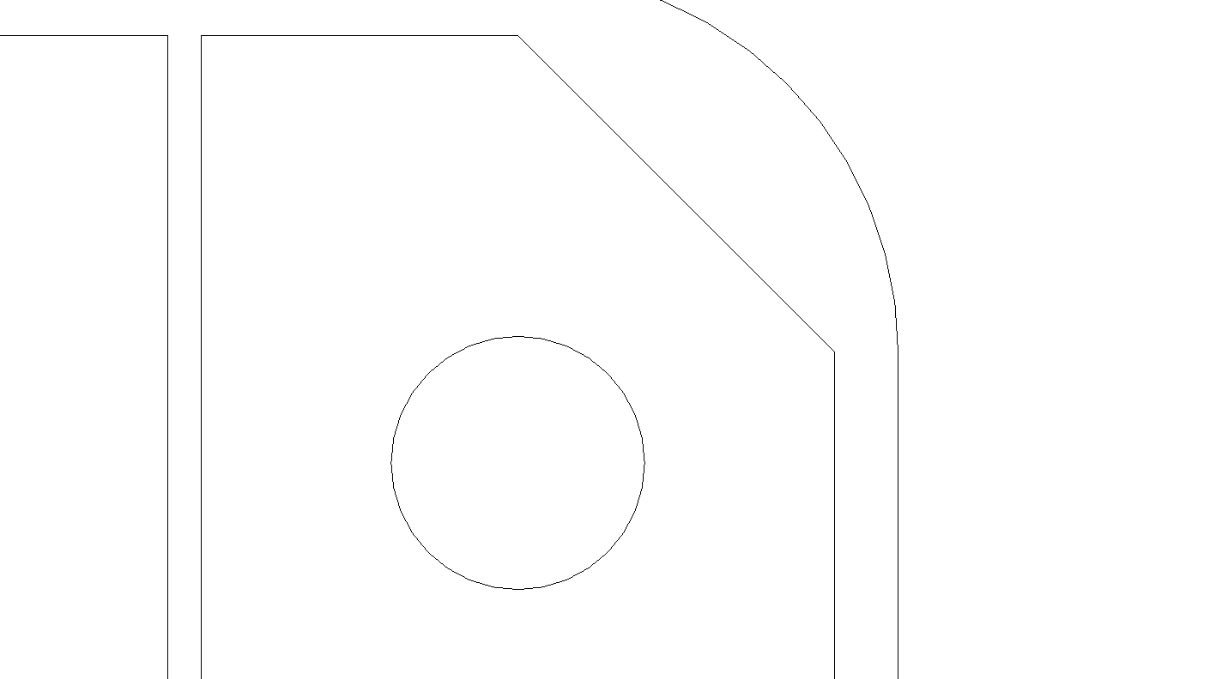
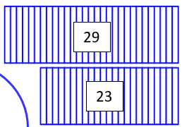
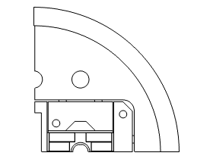
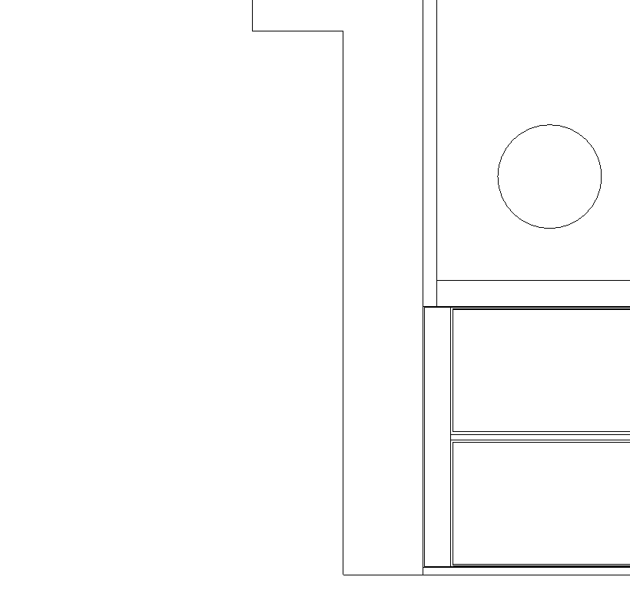



BOND cross-section thermal modelling (I)
Studies based on latest BOND coil configuration using 40 strands cable
Added Cu (RRR10) heat sinks to both midplane and interlayer – insulation ≥ 150 µm to coil
Upgraded thermal contact geometry: Helium thermal contact (He at 4.5 K)
BOND 14 T block coil, courtesy TE/MSC-SMT
$$q=α\left(T\right)\left(T−T_{ext}\right)$$
Interlayer: 2 mm
Cu: 1 mm
$$d=20 mm$$
$$d=20 mm$$
Midplane: 3 mm
Cu: 1.425 mm
Heat sink, provisional before availability of bladder geometry.

Slide 18
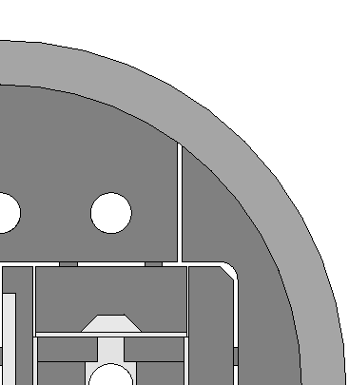
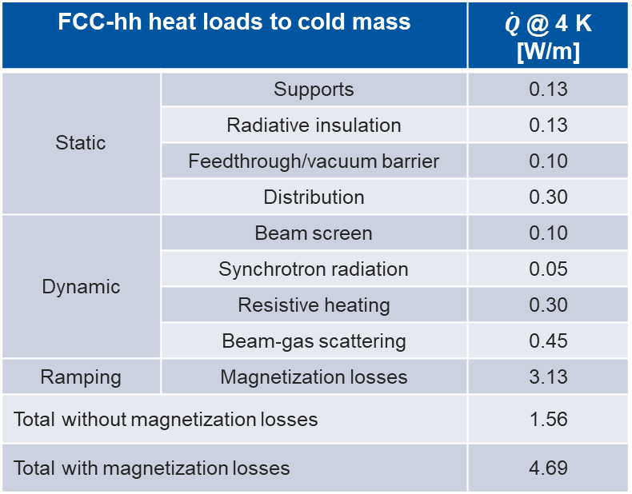
BOND cross-section thermal modelling (II)
Heat loads on the cold mass applied to the cross-section model:
FCC-hh heat loads to cold mass |  | $\dot{Q}$@ 4 K [W/m]
Static | Supports | 0.13
 | Radiative insulation | 0.13
 | Feedthrough/vacuum barrier | 0.10
 | Distribution | 0.30
Dynamic | Beam screen | 0.10
 | Synchrotron radiation | 0.05
 | Resistive heating | 0.30
 | Beam-gas scattering | 0.45
Ramping | Magnetization losses | 3.13
Total without magnetization losses |  | 1.56
Total with magnetization losses |  | 4.69
Homogeneously distributed on cold mass outer surface
BOND 14 T block coil, courtesy TE/MSC-SMT
Volumetrically distributed in the coil
Homogeneously distributed on cold mass inner surface (cold bore/beam pipe)

Slide 19

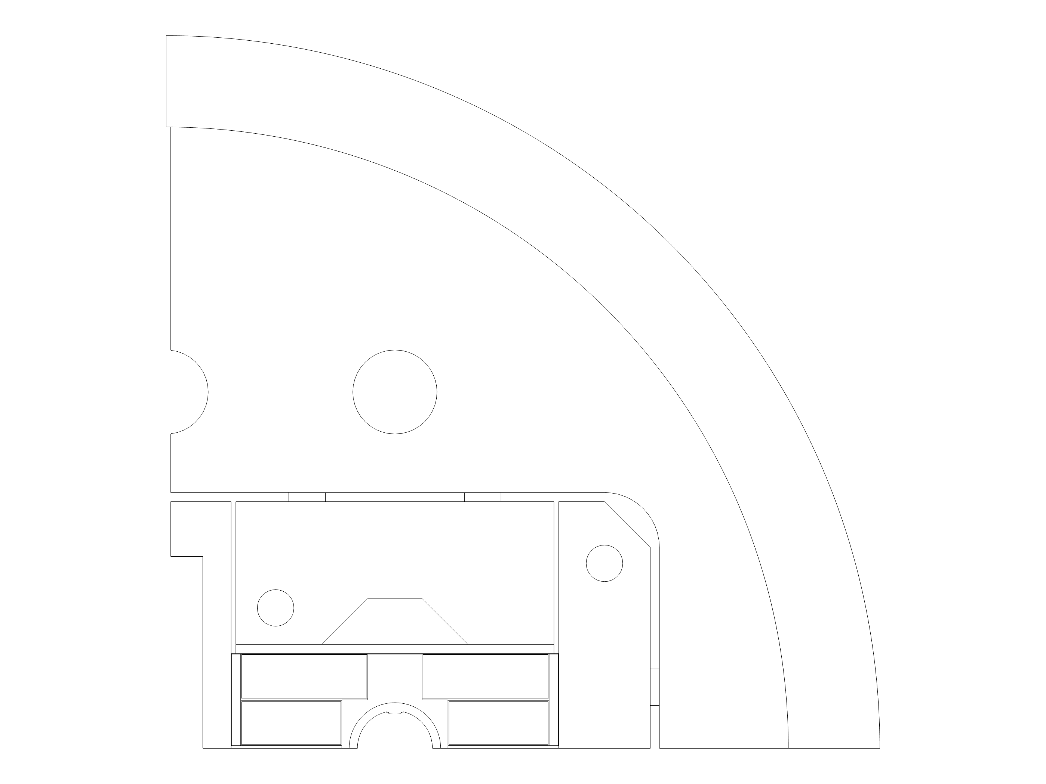
BOND cross-section thermal modelling (III)
19
Preliminary evaluation adding thermal contact resistance to the model
Thermal contact resistance data spans wide range and appropriate combination of materials is often missing.
Thermal contact materials |  | Value (W/m²K) | Remarks
Ti | G-10 | 50 | Extrapolated to 4.5 K from [30-300 K] data. [1]
Cu | G-10/dielectric/kapton | 500 | Interp. to 4.5 K from Cu/Epoxy data. [2]
Stainless Steel | G-10/dielectric/kapton | 15 | Interp. to 4.5 K from SS/SS data. [2]
Al | Fe | 200 | Interp. 4.5 K from Al/Al data. [2]
SS | Fe | 40 | Similar order of magnitude. From SS/SS data at 20 K [2]
Ti | Cu | 200 | Extrapolated to 4.5 K from Cu/C data at 20 K [2]
Cu | Fe | 200 | Extrapolated to 4.5 K from Cu/C data at 20 K [2]
[1] De Bellis, L., Phelan, P.E., Drake, P., Kroebig, W. (2000). Measurement of The Thermal Properties of Epoxied Titanium Contacts at Cryogenic Temperatures.
[2] E Gmelin et al. (1999) J. Phys. D: Appl. Phys. 32 R19

Slide 20
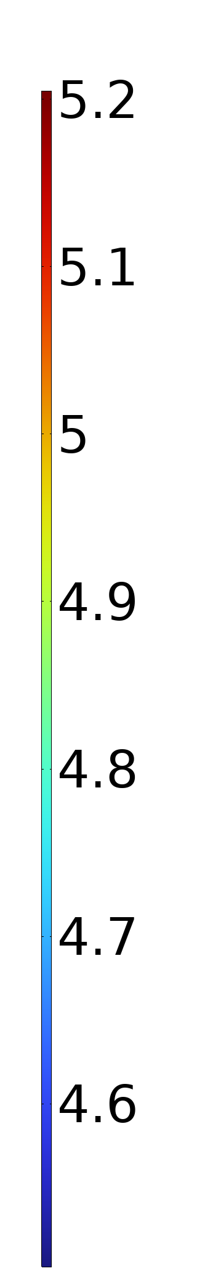
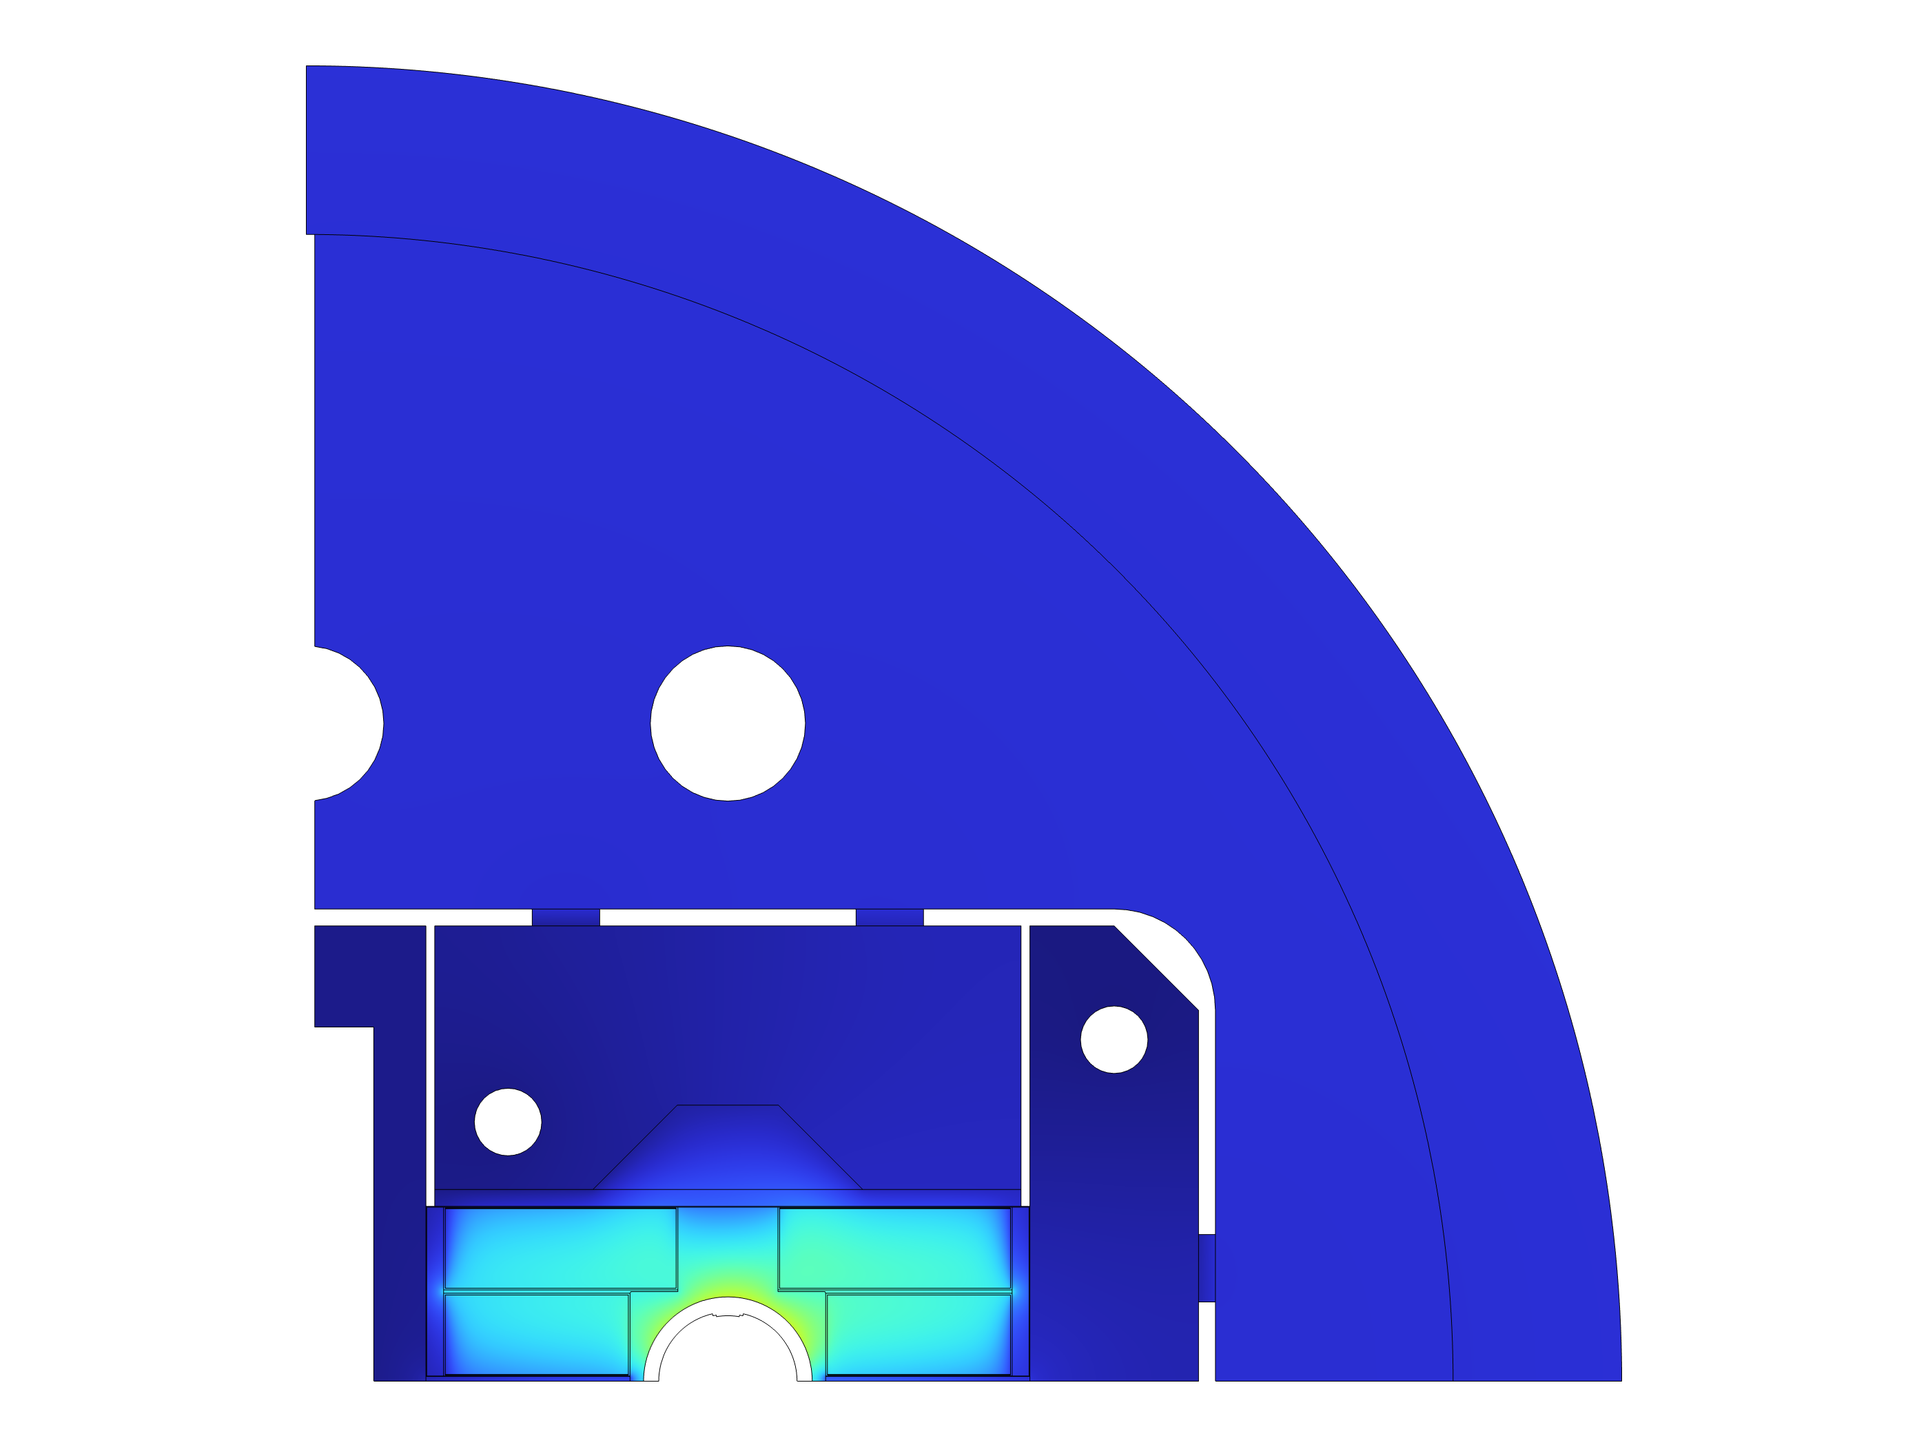
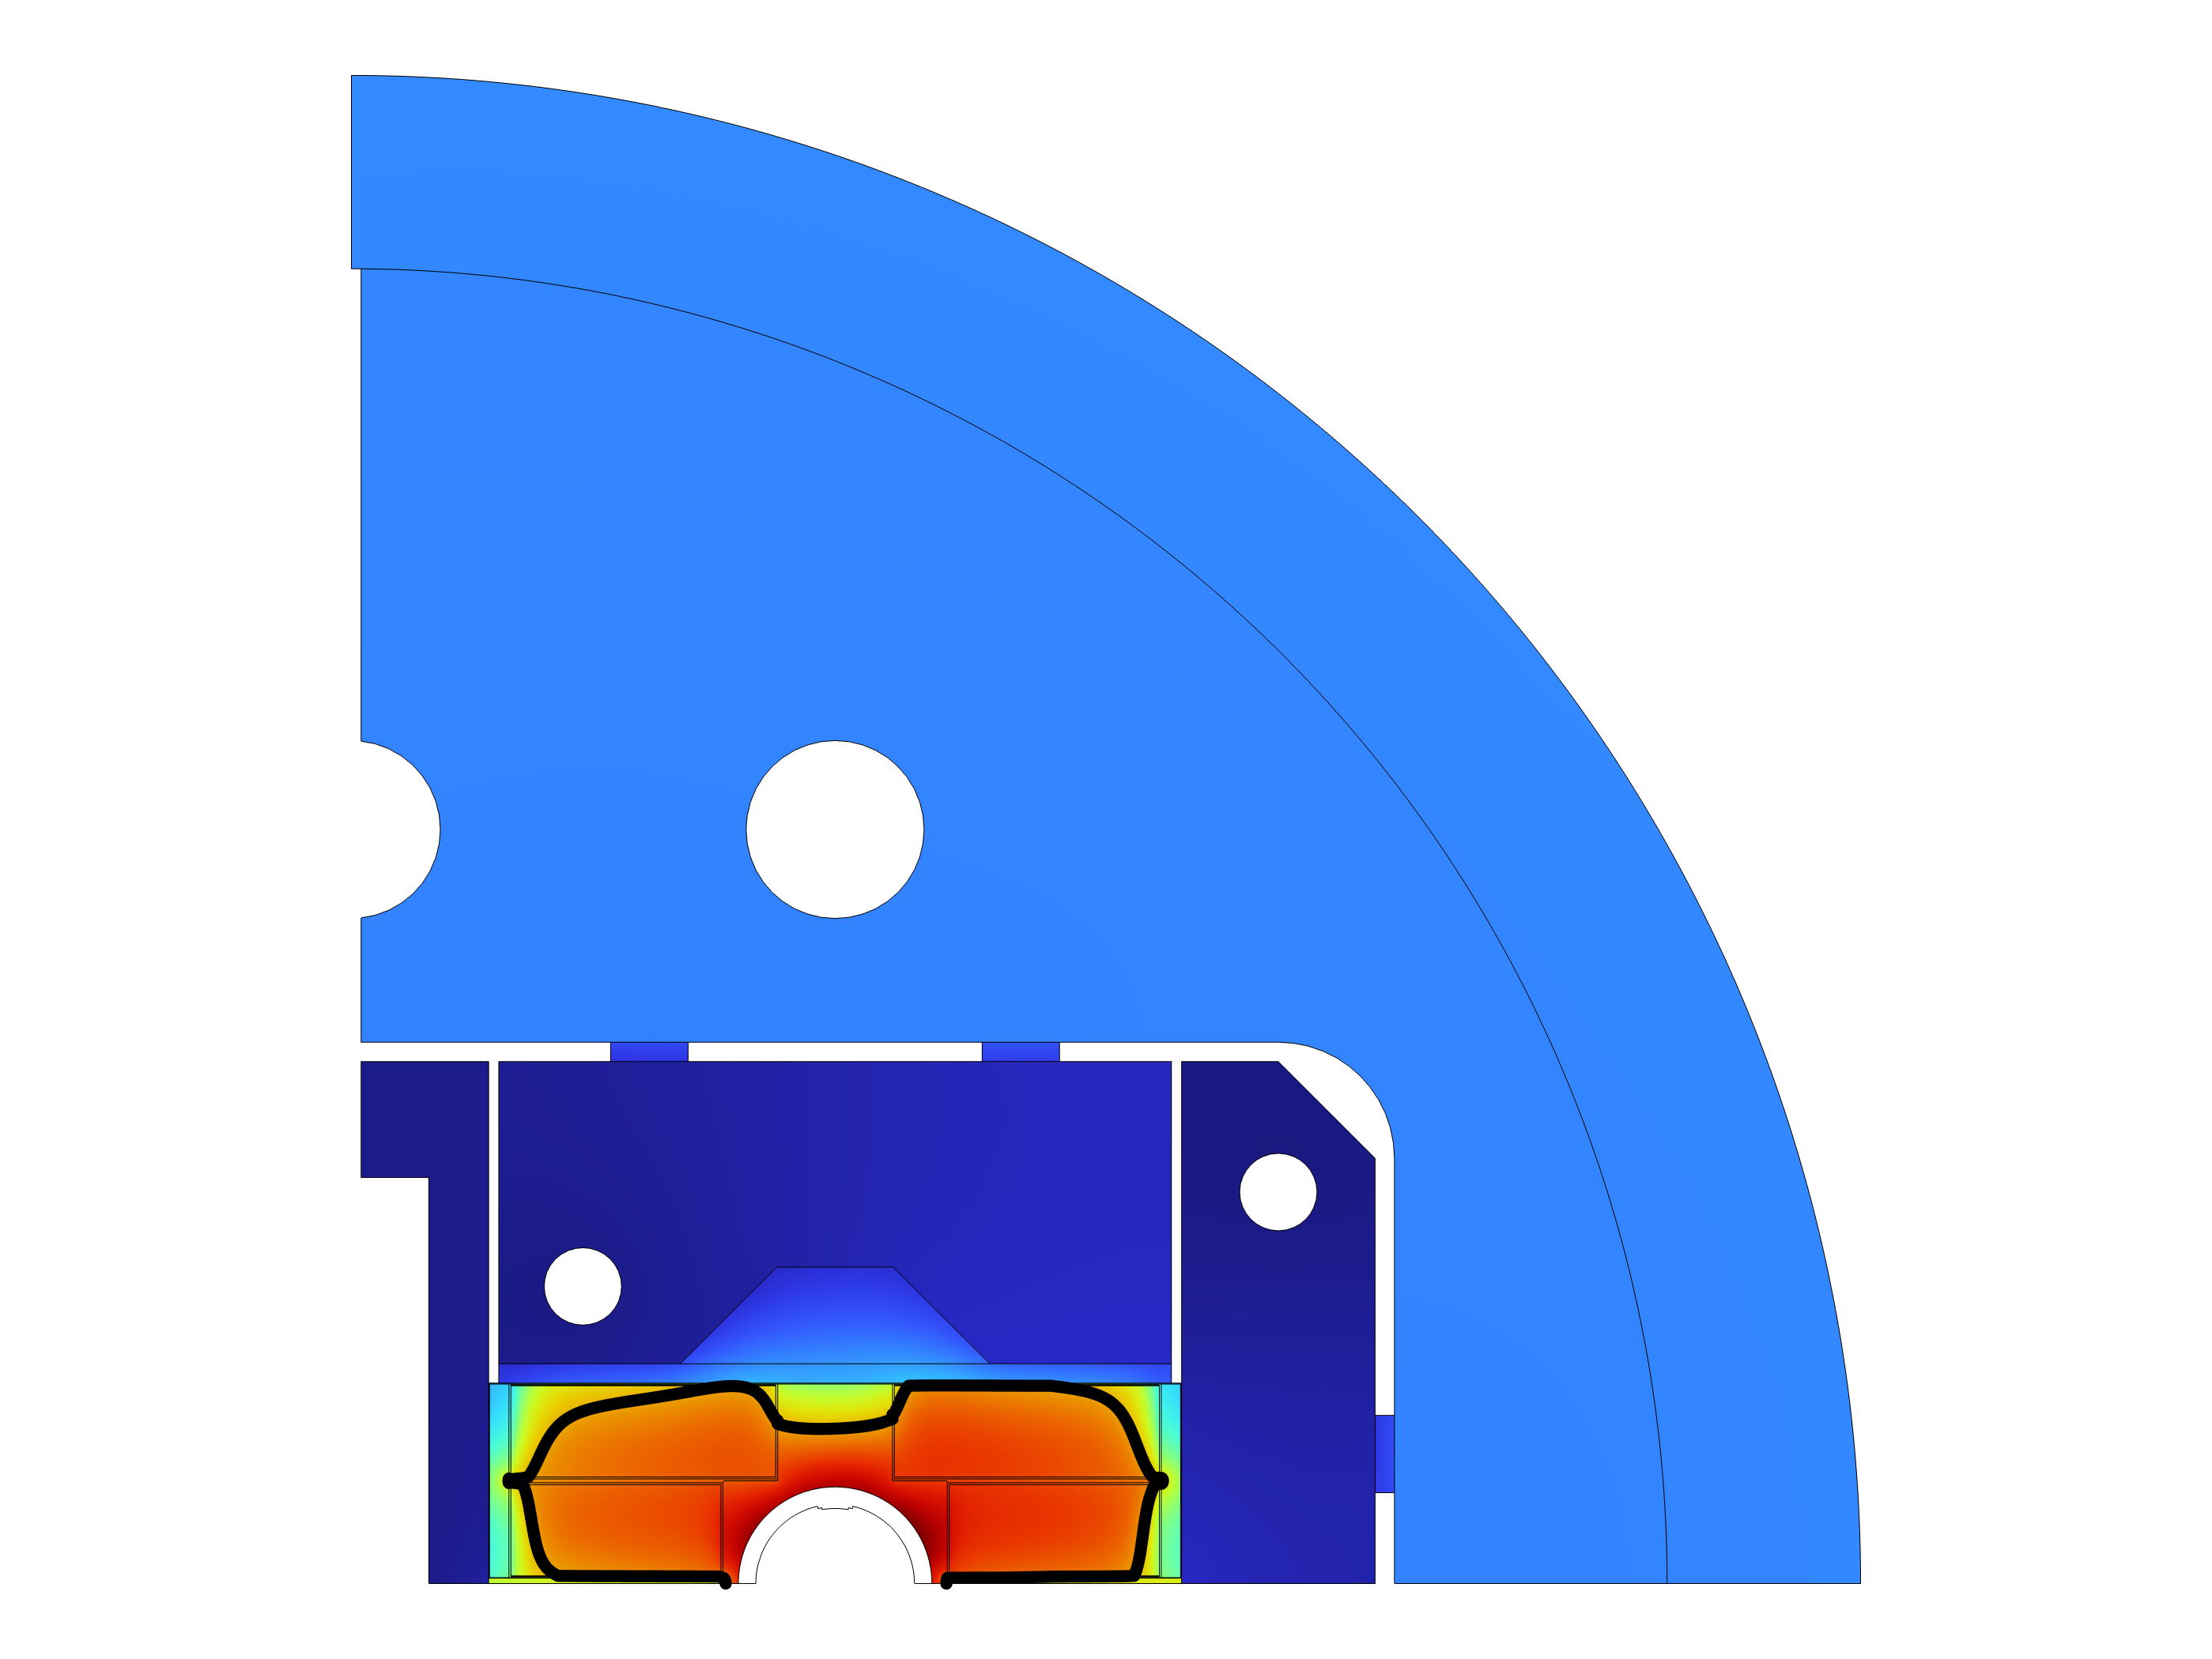



BOND cross-section thermal modelling (IV)
Heat loads: static + dynamic + magnetization
No thermal contact resistance (perfect contact)
Heat loads: static + dynamic + magnetization
Estimated thermal contact resistance as per previous table
$$T(K)$$
$$T_{max} =4.83 K$$
$$T_{max} = 5.13 K$$
PRELIMINARY!

Slide 21
Consequences of change of cooling paradigm
Forced flow in confined channels means the cold mass no longer needs to be a pressure vessel; simplification of geometry and requirements
Working point at 4.5 K instead of 1.9 K allows for intrinsic (Carnot) and technological (cold compressors) improvement in the cryogenic COP
Proposed cooling scheme allows for a reduction of ~40% in energy consumption and ~50% in He inventory
By limiting the contact between He and coil to the cooling channels, impact of quench energy on cooling circuit limited
By avoiding the He I ↔ He II transition, recovery time after a quench event potentially reduced
Intrinsic longitudinal temperature gradient along the length of the magnet/sector
Enthalpy reservoir provided by large mass of LHe is no longer available
Radial temperature gradient inside the cold mass is more significant than when using He II
Dependence of electrical insulation with insulation vacuum needs to be assessed, including during/after quench
?

Slide 22
Outlook for 2025
Optimisation of cooling features for local heat extraction in the magnet structure, collaborating closely with TE/MSC
Investigation of transient modes of an accelerator operated at 4.5 K using single-phase He forced flow: cooldown, behaviour during quench, recovery after quench event…
Construction of demonstrator test stand for dry magnet cooling at 4.5 K: supercritical He circuit at 3-4 bar for magnet cooling loop, CFHEX-based current leads using He or Ne in a separate loop. Cold source provided by standalone cryocoolers. Idea of providing a re-cooler (< 4 K) environment under study.
Impact of dry cooling methods in accelerator magnets: electrical insulation, quench protection
Campaign on thermal properties of HTS tape and tape stack materials
Study of cooling scheme options at 20 K might be pushed to a later date if no immediate urgency

Slide 23
Thank you for your attention!

