Slide 2
CERN Progress on LTS Conductors
HFM Annual Meeting 2025
Author: Simon C. Hopkins, Jerome Fleiter, Thierry Boutboul
Date: 12 February 2025

Slide 3
Nb₃Sn Conductors for HFM
Nb₃Sn Conductor for Magnet Development Activities
  Current wire designs
  Current cable designs and production
  Characterisation and heat treatment optimisation
    J_{c}(B,T), RRR and stability
    Cabling degradation, witness samples
Nb₃Sn Wire Selection, Specification and Procurement
  Characterisation and comparison of wire designs
    J_{c}(B,T), RRR and stability
    Cabling behaviour and electromechanical characteristics
  Current wire procurement
Nb₃Sn Wire Development and Analysis – Collaborations
  Internal oxidation for increased J_{c}
  Next presentations: KEK (with Japanese industry) and UNIGE

Slide 4
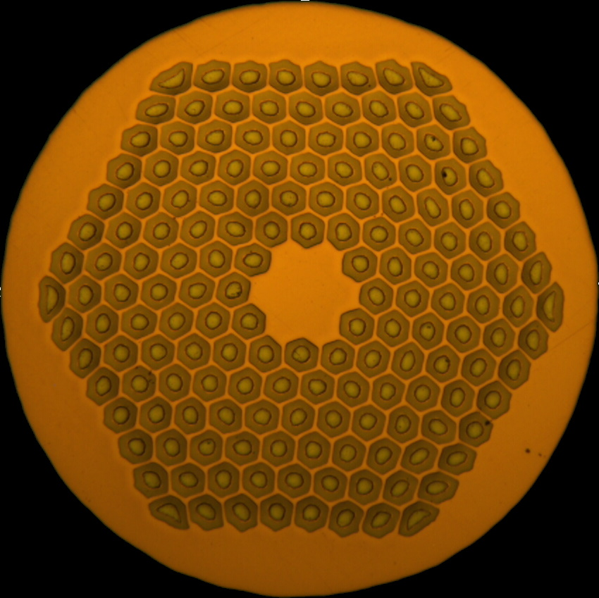
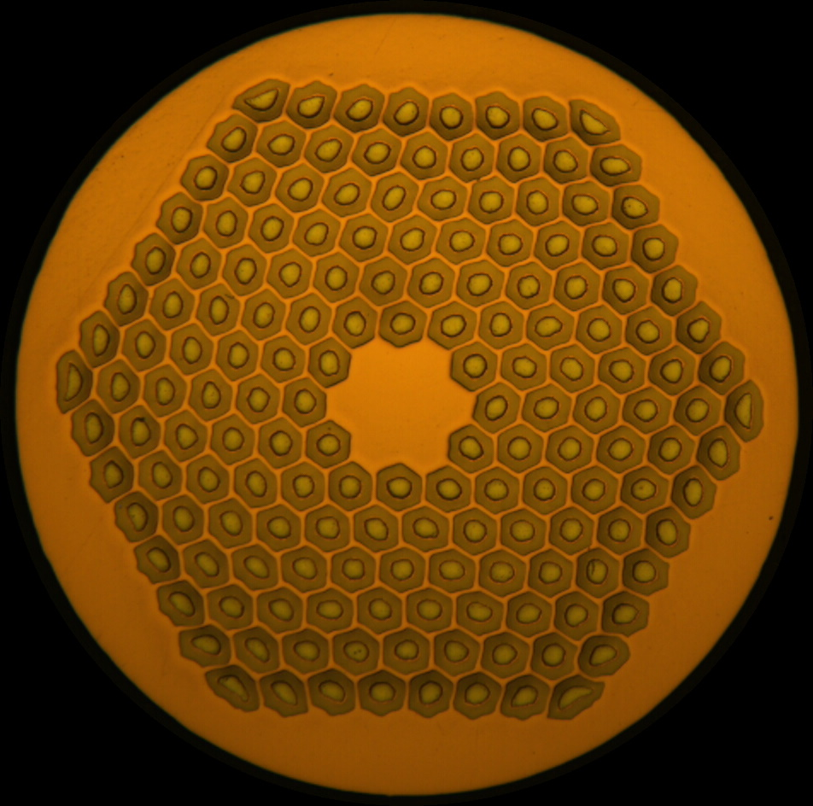
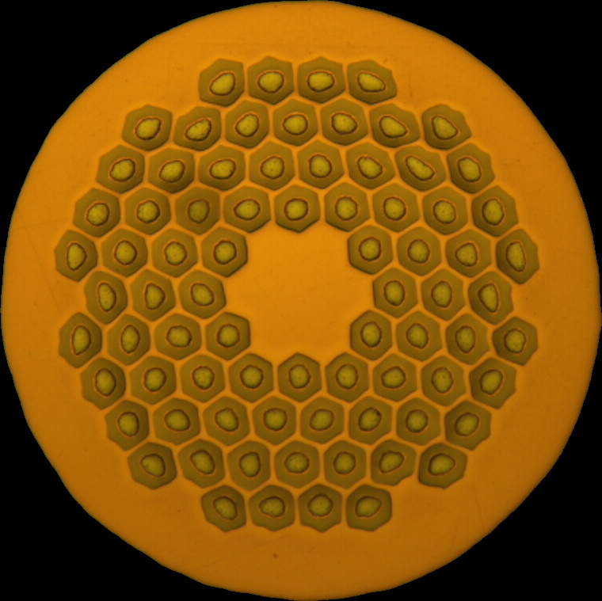
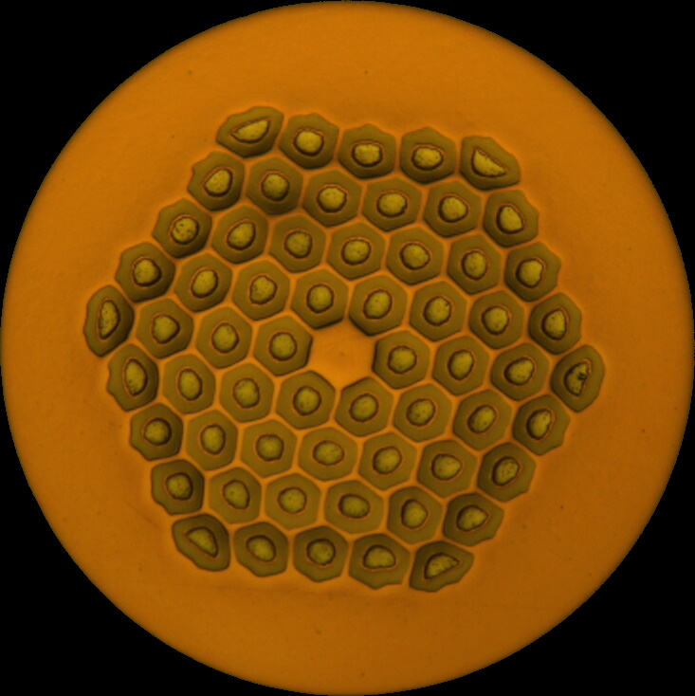
Nb₃Sn Wire Designs: Current Inventory
Current industrial state-of-the-art Nb₃Sn wire is Bruker RRP®
5 designs in active use for HFM magnet development activities:
  108/127 at 0.85 mm procured for HL-LHC MQXF
  Four designs (0.7–1.1 mm) ordered for FCC magnet development in 2019
HFM low field coils
HL-LHC ref.
HFM high field coils (or ungraded)
 | DEM-0.7 | ERMC-0.7 | MQXF | ERMC-1 | DEM-1.1
d (mm) | 0.7 |  | 0.85 | 1.0 | 1.1
Layout | 60/91 | 78/91 | 108/127 | 162/169
d_{s} (µm) | 54 |  |  | 58 | 64
Cu/non-Cu | 1.8 (≥ 1.6) | 1.2 ± 0.2 | 1.2 ± 0.1 | 0.9 ± 0.2
Nb:Sn | 3.6 (reduced Sn) |  |  | 3.4 (standard Sn)
Supplier heat treatment | 665 °C 50 h |  |  | 650 °C 50 h | 665 °C 50 h
Colour code by restack
/91
/127
/169

Slide 5
Cable Development and Production (1)
Cable development and production for the needs of the Nb₃Sn magnet programme (RD3)
  Currently 5 wire designs → 8 cable designs (Nb₃Sn), plus:
    Copper cabling trials and dummy cable for winding trials
    Nb-Ti bus-bars as needed
    Not presented here: development and production proceeding in parallel for HL-LHC and for other R&D activities
  Produced in significant lengths and delivered for insulation
  Qualification (I_{c}, RRR, dimensional characterisation) and witness samples (I_{c} and RRR from coil heat treatments) prepared and tested
 | DEM-0.7 | ERMC-0.7 | MQXF | ERMC-1 | DEM-1.1
d (mm) | 0.7 |  | 0.85 | 1.0 | 1.1
Layout | 60/91 | 78/91 | 108/127 | 162/169
Cu/non-Cu | 1.8 (≥ 1.6) | 1.2 ± 0.2 | 1.2 ± 0.1 | 0.9 ± 0.2
R2D2 (LF)
SMACC1
BOX
SMC-QXF
12T VE
FalconD (12 T)
R2D2 (HF)
BOND

Slide 6
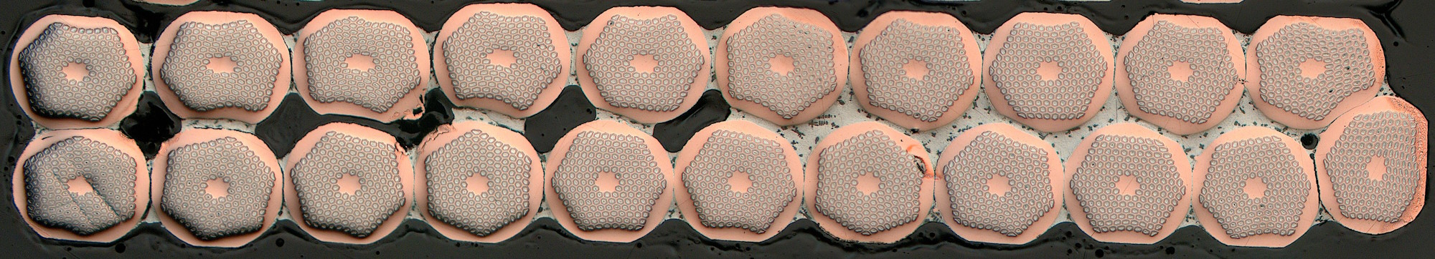
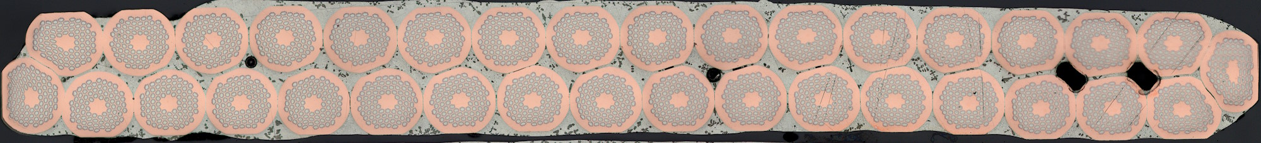
Cable Development and Production (2)
SMACC1
Cable to R2D2 HF and LF designs produced in 2023, also assigned more recently to several activities:
  HF: C02OC0442A → PSI
  LF: C03OC0448A
  LF with ERMC-0.7 strand: C03OC0446A → PSI: SMACC1
R2D2 witness samples tested in 2024
Strands | 34 × ERMC-0.7 (0.7 mm 78/91)
Width (mm) | 12.579
Mid-thickness (mm) | 1.253
Keystone | None
Core | None
Pitch (mm) | 79
R2D2 HF
R2D2 LF
Strands | 21 × DEM-1.1 (1.1 mm 162/169)
Width (mm) | 12.579
Mid-thickness (mm) | 1.969
Keystone | None
Core | None
Pitch (mm) | 84
Strands | 34 × DEM-0.7 (0.7 mm 60/91)
Width (mm) | 12.579
Mid-thickness (mm) | 1.253
Keystone | None
Core | None
Pitch (mm) | 79
R2D2 HF: C02OC0442A
R2D2 LF: C03OC0446A

Slide 7
Cable Development and Production (3)
Cable produced for 12 T programmes in 2024:
  FalconD (INFN):
    4 × 140 m Nb₃Sn (C01OC0466A-E)
    3 × 140 m Nb₃Sn (C01OC0488A-C)
  FalconD (CERN)
    328 m Cu (C01UC0487A)
  9 × 200 m of MQXF design for formerly planned 12 T VE activity
FalconD: C01OC0488A
FalconD
12 T VE (MQXF)
Strands | 40 × ERMC-1 (1.0 mm 162/169)
Width (mm) | 20.95
Mid-thickness (mm) | 1.800
Keystone | 0.5
Core | 14 mm × 0.025 mm 316L
Pitch (mm) | 110
Strands | 40 × MQXF (0.85 mm 108/127)
Width (mm) | 18.15
Mid-thickness (mm) | 1.525
Keystone | 0.4
Core | 12 mm × 0.025 mm 316L
Pitch (mm) | 109

Slide 8
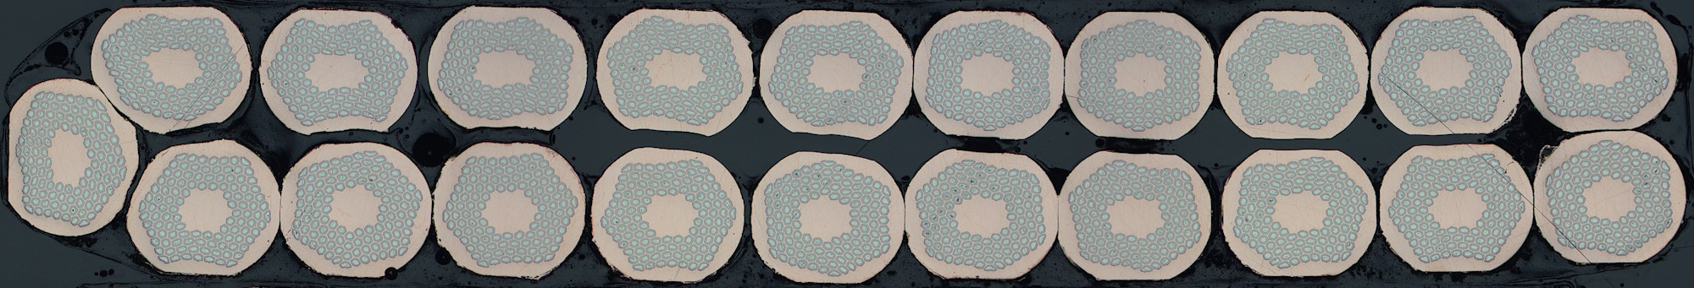
Cable Development and Production (4)
BOX:
  90 m + 120 m (C06OC0492A) produced in December 2024
  Pitch revised in production from 64 → 60 mm
  Qualification samples in heat treatment
BOX
Strands | 21 × MQXF (0.85 mm 108/127)
Width (mm) | 9.89
Mid-thickness (mm) | 1.495
Keystone | None
Core | None
Pitch (mm) | 60
BOX: C06OC0492A

Slide 9
Cable Development and Production (5): Planned
SMC QXF
Production is planned in the coming months for:
  SMC QXF:
    ~200 m copper
    2 × 70 m Nb₃Sn
    Later, 8 × 70 m Nb₃Sn
  BOND:
    ~3 × 200 m copper
    15 m Nb₃Sn
    Later, Nb₃Sn (length TBC)
Strands | 32 × MQXF (0.85 mm 108/127)
Width (mm) | 14.70
Mid-thickness (mm) | 1.525
Keystone | None
Core | 12 mm × 0.025 mm 316L
Pitch (mm) | 90
BOND
Strands | 40 × DEM-1.1 (1.1 mm 162/169)
Width (mm) | 23.045
Mid-thickness (mm) | 1.980
Keystone | None
Core | 14 mm × 0.025 mm 316L
Pitch (mm) | 121

Slide 10
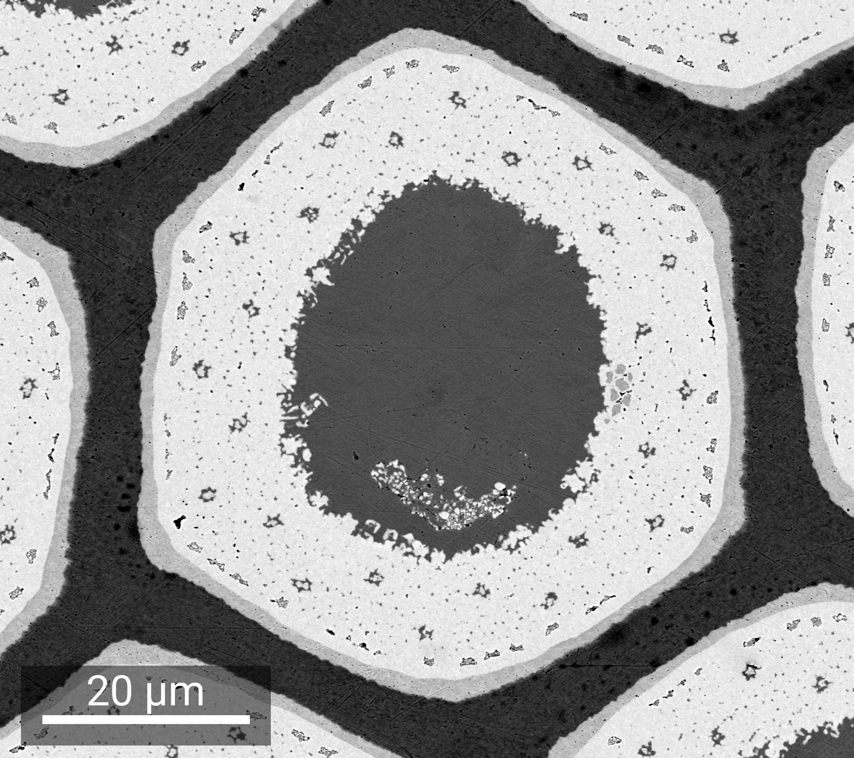
Heat Treatment and Stability Optimisation: ERMC-1
For the ERMC-1 wire (162/169 at 1.0 mm), early V-I tests for magnetothermal stability found significant stability limitations for performance after the reference heat treatment (650 °C 50 h):
  Quench current significantly below I_{c} even at high field, especially for extracted strands at 1.9 K
  Intersection of 1.9 K and 4.3 K curves at ~10 T round, ~12.5 T extracted
…and this stability was much improved by a reduction of the heat treatment duration from 50 to 30 h
  Dramatic increase in RRR (~50 %) for modest reduction (~9 %) in I_{c}
3_650_A
650 °C 50 h
3_650_I
650 °C 30 h
Unreacted Nb barrier
Nb₃Sn
S.C. Hopkins et al.,
IEEE Trans. Appl. Supercond.
33 (5) 6000609 (2023)
50 h

Slide 11
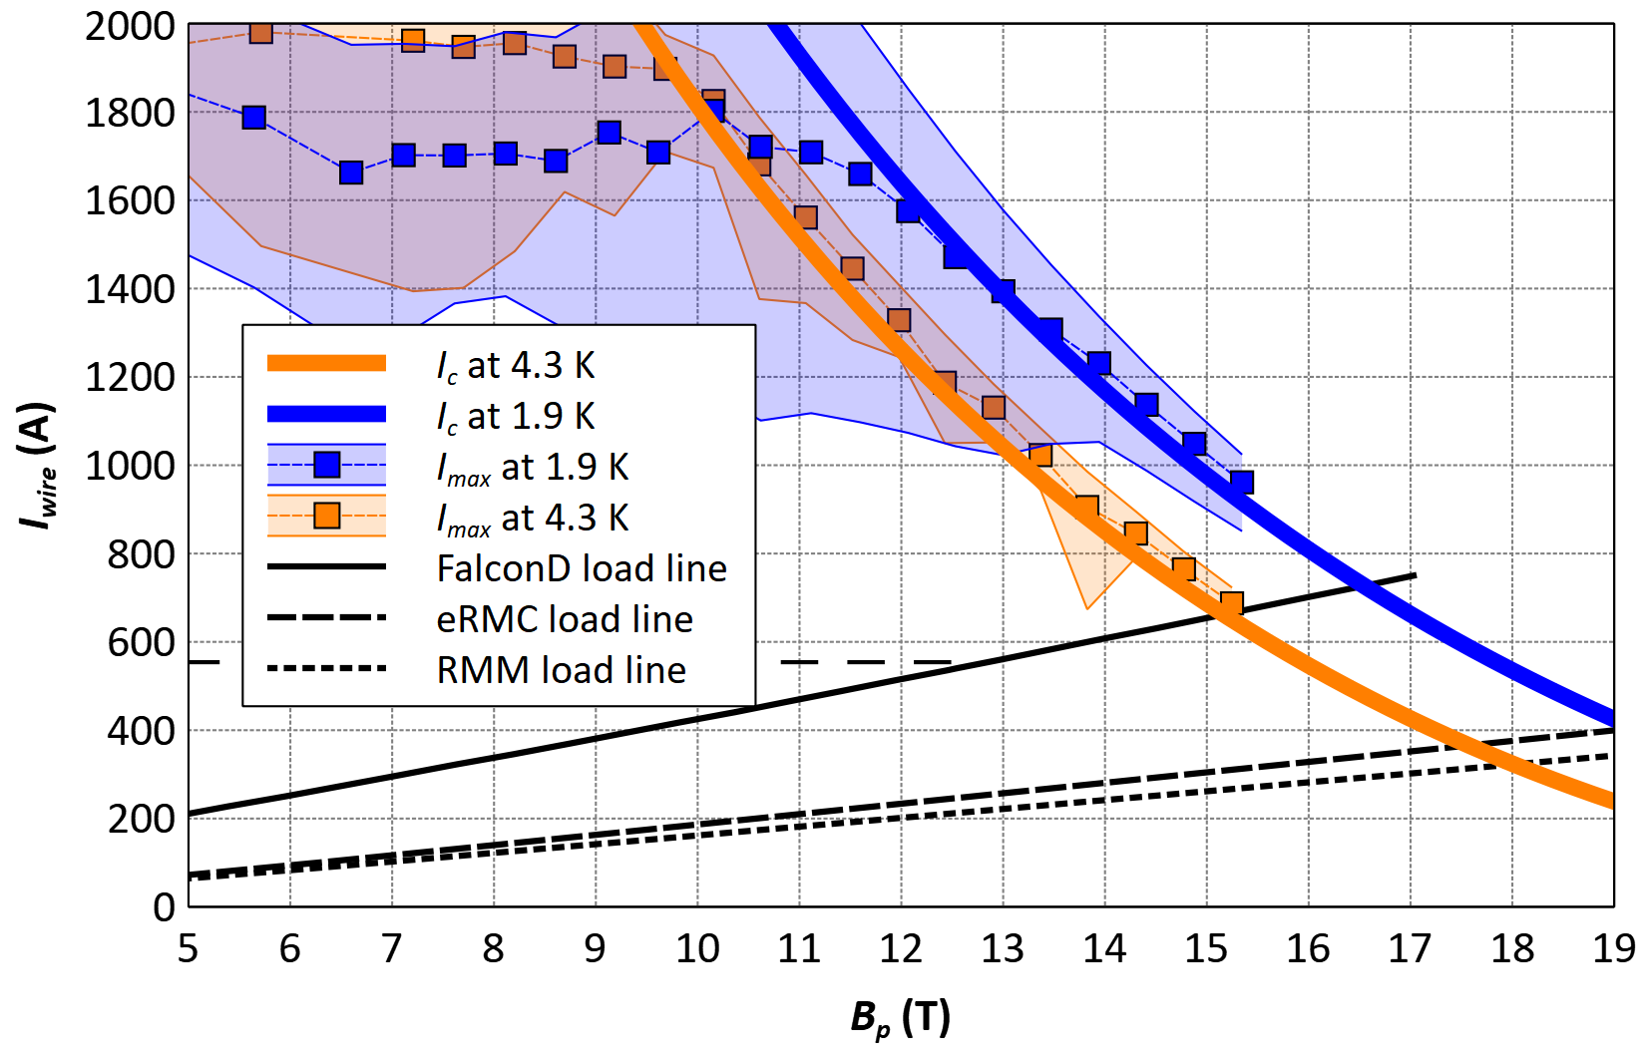
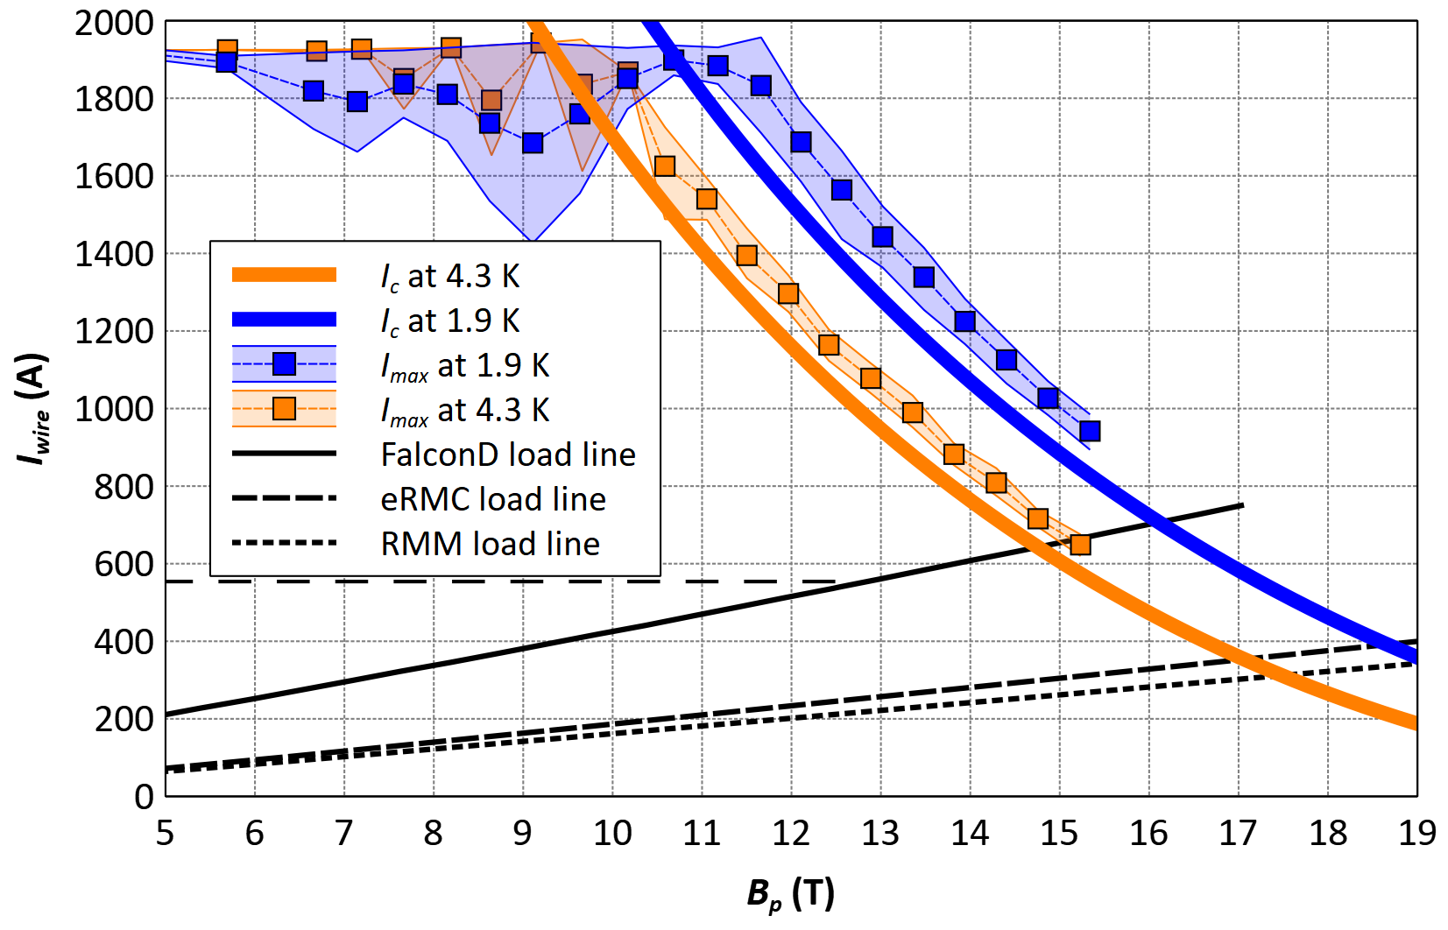
Heat Treatment and Stability Optimisation: ERMC-1
Many more samples now tested for FalconD, both virgin and extracted strands
Significant variability between samples/tests – plots below show the range of quench currents (filled bands) over all measured samples
Relative to load lines for activities using ERMC-1 wire, gain in stability (and cost in I_{c}) is clear
  650 °C 30 h (3_650_I) selected for current RMM and FalconD coils
650 °C 50 h
(3_650_A)
650 °C 30 h
(3_650_I)

Slide 12
Heat Treatment and Stability Optimisation: R2D2
Similar analysis for R2D2 – selected examples below, but significant variability between samples
  For R2D2 HF (162/169 1.1 mm wire), cases with and without significant stability limitations after reference 665 °C heat treatment
  …but no examples to date with significant limitations after 650 °C 30 h cycle
Note that both HF and LF coils must share the same heat treatment cycle
  R2D2 LF (60/91 0.7 mm wire) not expected to be sensitive to self-field stability issues – but applications requiring high low-field current density may still approach stability limits, or be impacted by reduced J_{c} from HT optimisation
3_650_I
650 °C 30 h
LF
60/91
HF
162/169
HF
162/169
HF
162/169
3_665_B
665 °C 50 h
3_650_A
650 °C 50 h
3_650_I
650 °C 30 h

Slide 13
Heat Treatment and Stability Optimisation: R2D2
The effect of the heat treatment cycle on I_{c} (650–665 °C, 30–50 h) is within ~5 %
  Field-dependent, due to effect on B_{c2}
  Comparable in magnitude to cabling degradation (which may also be HT dependent)
For R2D2, 3_650_A heat treatment cycle was selected
Heat Treatment |  |  | I_{c} degradation with HT (4.25 K) |  |  | Cabling degradation of I_{c} (4.25 K)
 |  |  | R2D2 HF 162/169 1.1 mm | R2D2 LF 60/91 0.7 mm |  | R2D2 HF 162/169 1.1 mm | R2D2 LF 60/91 0.7 mm
 | At B_{p} (T) |  | 12.37 | 8.09 | 12
3_665_B | 665 °C | 50 h | (ref.) | (ref.) | (ref. | 2.5 % | 2.1 %
3_650_A | 650 °C |  | 2.6 % | 2.0 % |  | 2.5 % | 0.5 %
3_650_I |  | 30 h | 4.2 % | 0.4 % | 5.1 %

Slide 14
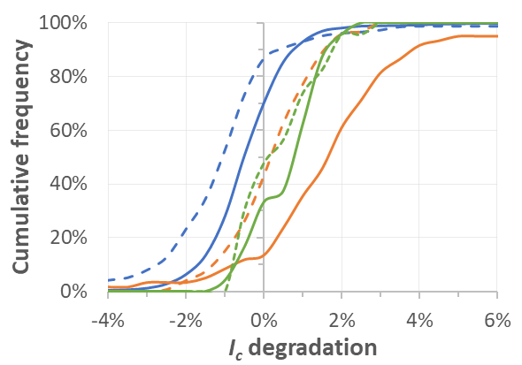
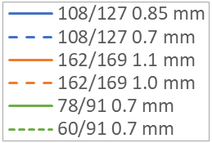
Nb₃Sn Wire Design Selection
.
RRP® wires of many different layouts have been
purchased over time, and differences in average
rolling and cabling degradation have been observed
If some layouts are more robust against cabling degradation, and/or in electromechanical characteristics, may be preferred for future procurement…
…but it is difficult to distinguish effects of layout from differences in other wire and cable characteristics
  Wires differ in Cu/non-Cu, Sn stoichiometry, selected heat treatment cycle etc.
  Cables differ in compaction etc.
108/127
120/127
132/169
150/169
162/169
15 % rolling
Wire Type |  | Cable Geometry |  |  | HT plateau (50 h) | I_{c} Degradation (%) Mean ± std. dev.
 |  | Cable Type | Packing Factor | Thin Edge Compact.
 |  | Cable Type | Packing Factor | Thin Edge Compaction |  | By HT | By cable | By wire
DEM-0.7 | 78/91 0.7 mm | R2D2 LF | 84.1 % | 10.5 % | 665 °C | 2.7 ± 1.2 | 2.2 ± 1.9 | 2.2 ± 1.9
 |  |  |  |  | 650 °C | 0.5 ± 3.4
ERMC-0.7 | 60/91 0.7 mm |  |  |  | 665 °C | 2.7 ± 0.7
ERMC-1 | 162/169 1.0 mm | FalconD | 85.6 % | 14.6 % | 650 °C |  | 5.8 ± 0.8 | 4.8 ± 1.4
 |  | eRMC | 83.8 % | 9.0 % |  |  | 4.3 ± 1.4
DEM-1.1 | 162/169 1.1 mm | R2D2 HF | 81.5 % | 10.5 % | 665 °C | 3.3 ± 1.4 |  | 3.1 ± 1.3
 |  |  |  |  | 650 °C | 2.5 ± 1.1
108/127
162/169
-0.6 %
1.5 %

Slide 15
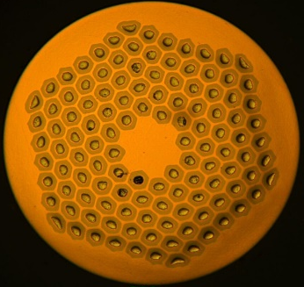
Studies of RRP® Designs at 1 mm (1)
Ideally would compare samples differing in fewer characteristics
In the meantime, compare available wire samples all at 1 mm diameter and for the same heat treatment cycle
  I_{c} and stability measurements at CERN
  Effect of axial and transverse stress (at cold) measured at UNIGE
  Tests with toom temperature application of transverse stress planned at CERN – tooling is in preparation
 | 108/127 | 120/127 | 132/169 | 150/169 | 162/169
d (mm) | 1.0
d_{s} (µm) | 65 | 64 | 58 | 57 | 58
Cu/non-Cu | 1.2 ± 0.1 | 1.06 ± 0.1 | 1.25 ± 0.1 | 1.08 ± 0.1 | 0.9 ± 0.2
Nb:Sn | 3.6 (red. Sn) | M-grade | 3.4 (std. Sn) | 3.6 (red. Sn) | 3.4 (std. Sn)
Ref. heat treatment | 665 °C 50 h | 665 °C 50 h | 650 °C 50 h | 665 °C 50 h | 650 °C 50 h
Test heat treatment | 665 °C 50 h
Colour code by restack
/91
/127
/169

Slide 16
Studies of RRP® Designs at 1 mm (2): J_{c}(B)
Non-Cu J_{c} differences dominated by Sn stoichiometry (for this heat treatment)
  I_{c} then varies with Cu/non-Cu (of course)
I_{c}, 4.3 K
I_{c}, 1.9 K
J_{c}, 4.3 K
J_{c}, 1.9 K
Std. Sn
Red. Sn
 | 108/127 | 120/127 | 132/169 | 150/169 | 162/169
Nb:Sn | 3.6 | M-grade | 3.4 | 3.6 | 3.4
665 °C 50 h

Slide 17
Studies of RRP® Designs at 1 mm (3): Stability
For this heat treatment (665 °C 50 h):
  Reduced tin (108/127, 150/169) – limiting at 1.9 K below ~9 T, for currents > 1600 A
  132/169 (standard tin), 120/127 – limiting at 1.9 K below ~11 T, for currents ~1000 A
  (cf. previous study of 162/169, ERMC-1)
108/127
132/169
d_{s} (µm) | 65
Cu/non-Cu | 1.2
Stoich. | Red. Sn
RRR | 300
d_{s} (µm) | 58
Cu/non-Cu | 1.25
Stoich. | St. Sn
RRR | 168
665 °C 50 h

Slide 18
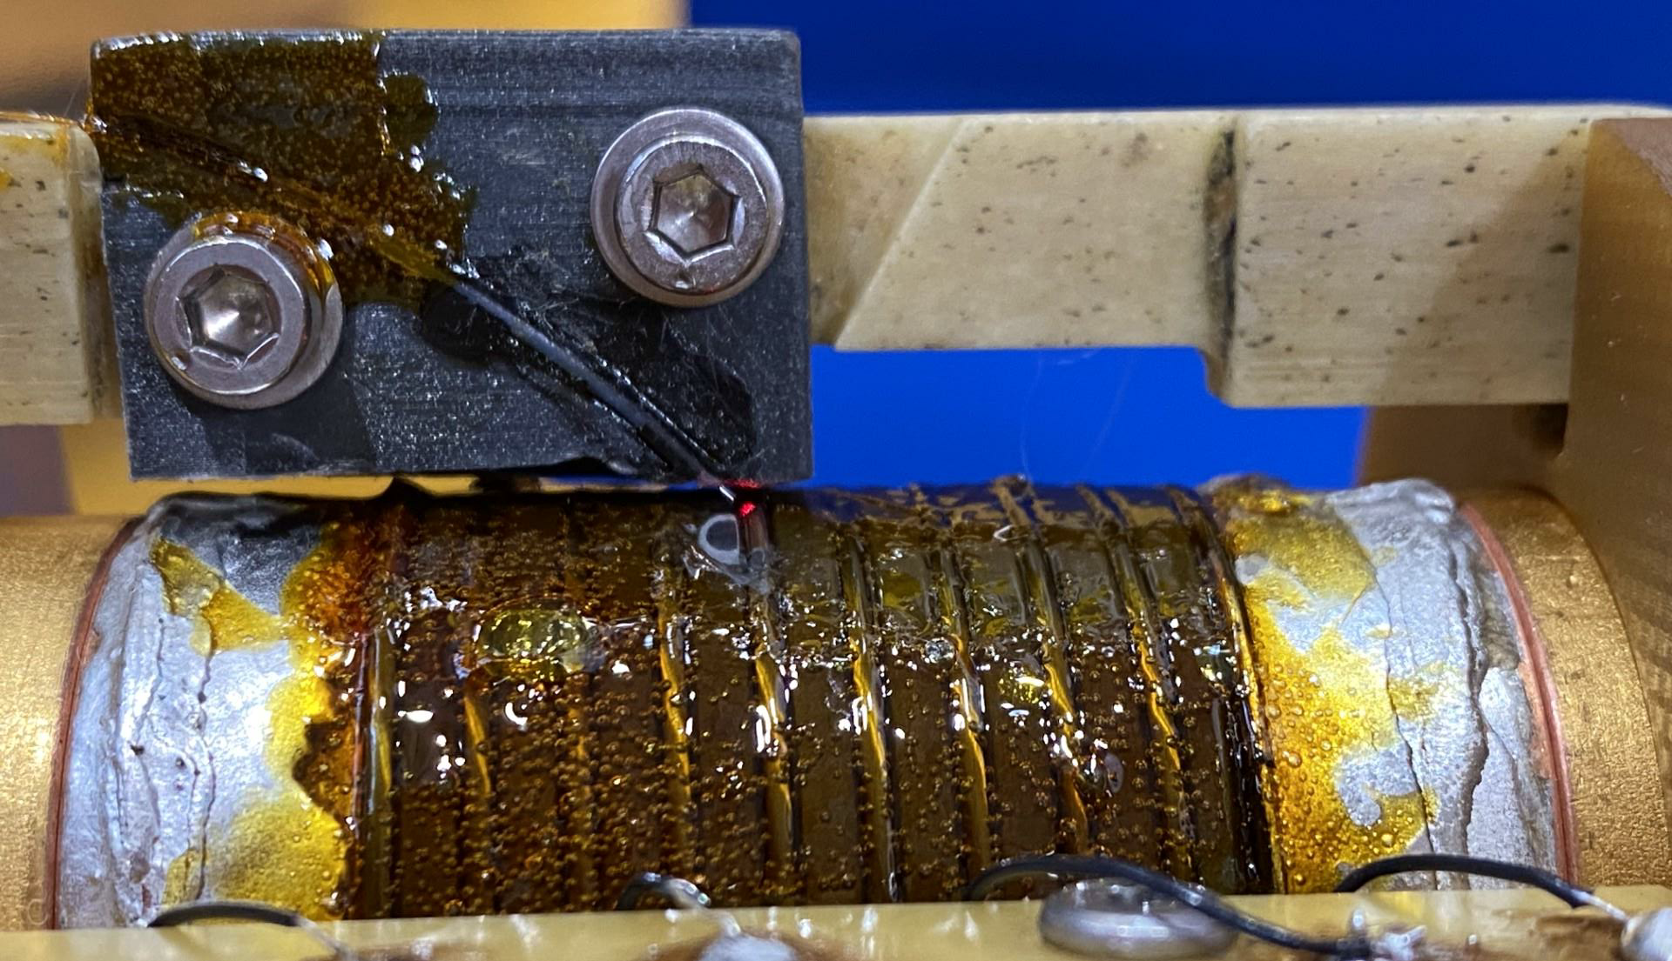
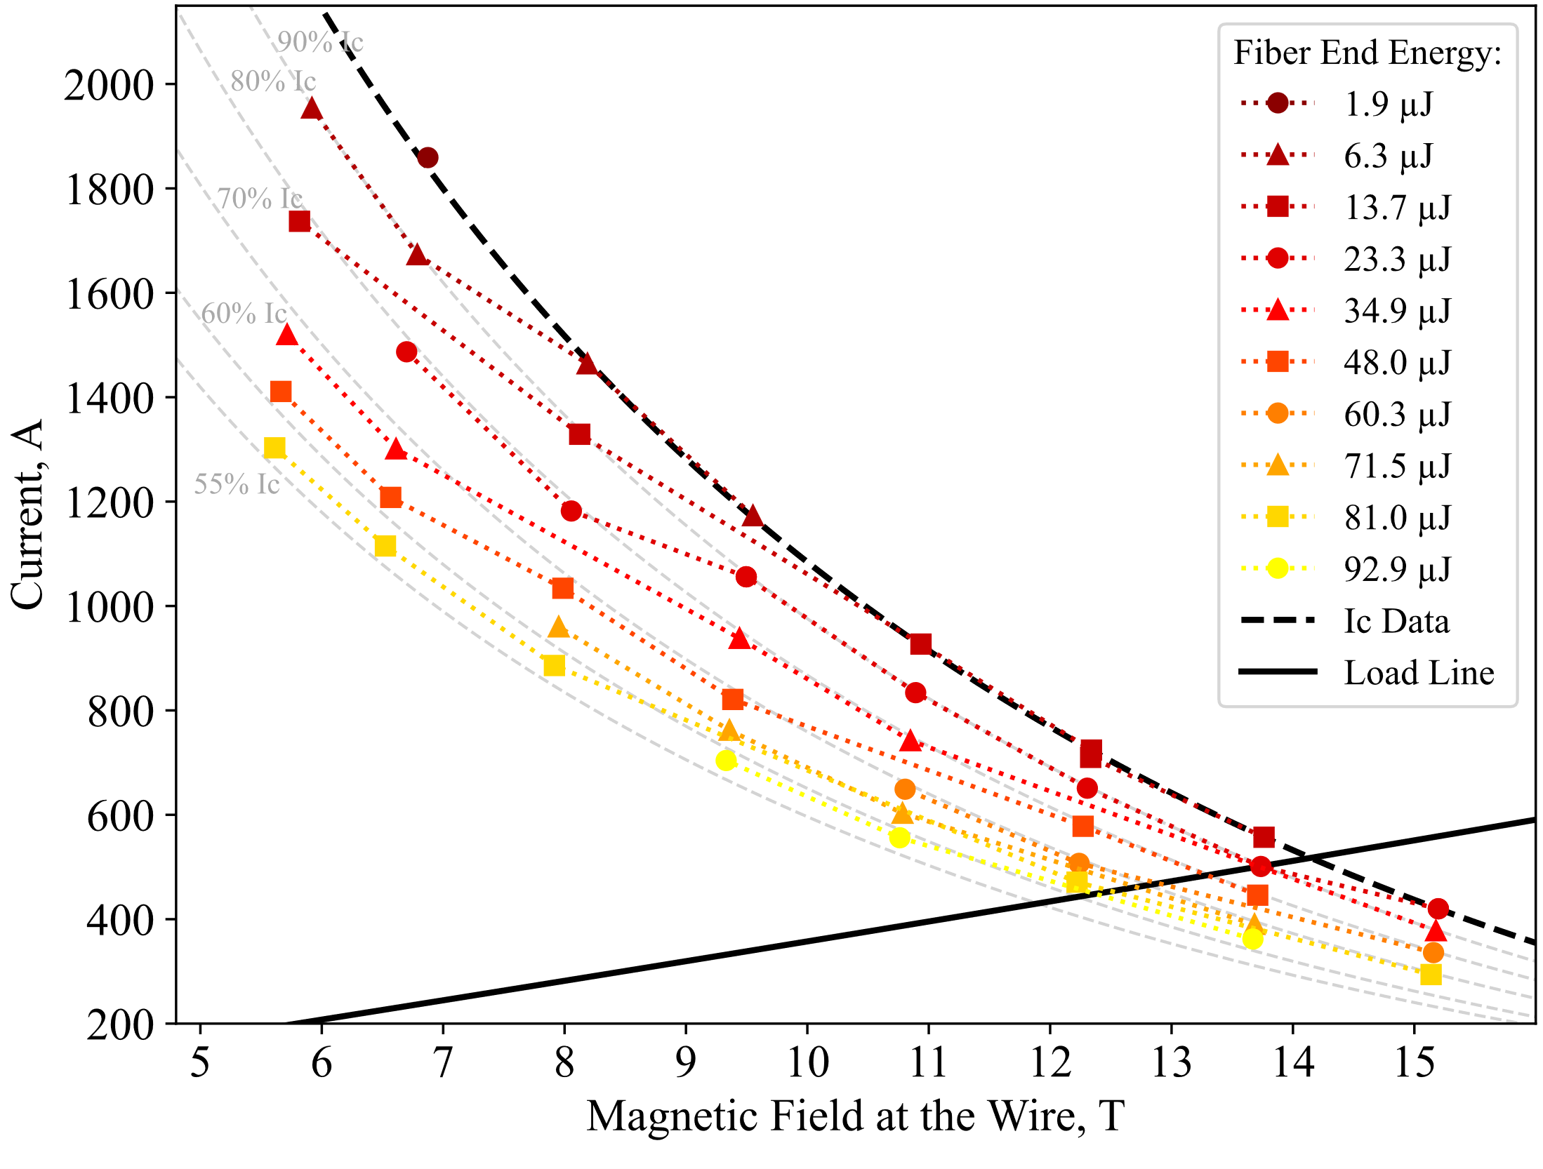
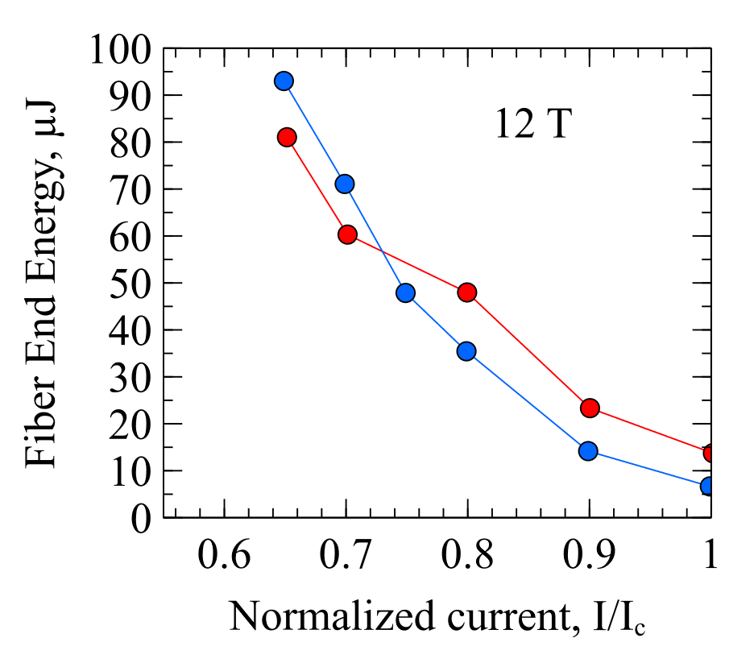
Stability and Minimum Quench Energy: Laser Tests
Contributions from J. Kuczynska
Equipment for triggering quenches with a UV laser has been redesigned
  Energy (<90 µJ) delivered in 1.8 ns pulse → faster than temperature transport in sample
  Measure MQE vs. applied field and current
Should enable a systematic, quantitative comparison of:
  Different wires (technologies, layout, Cu/non-Cu)
  The effect of RRR, stabiliser distribution etc.
Initial results presented at ASC 2024 for MQXF (108/127) wire
Work in progress to calibrate energy delivered for an absolute MQE and to ensure robustness and reproducibility of sample mounting
Site of laser exposure on wire surface
Optical fibre
Wire on barrel
Voltage taps (60 cm)
4.3 K
12 T
4.3 K
1.9 K
MQXF (108/127 0.85 mm) wire: energies triggering quenches vs. B and T

Slide 19
Nb₃Sn Wire Designs: Procurement
Wire ordered:
  Primarily for magnet development activities – strategic reserve of selected designs, with flexibility to adjust the mixture before production begins
  Smaller quantities to compare alternative layouts and take first steps towards production up-scaling
Order placed November 2024; deliveries of wire for magnet activities from mid-2026
Wire for magnet development activities
Wire development/design selection
 | 169-stack |  | 150/169 | 60/91
Length (km) | 85 (1.1 mm eq.) Option to select mixture by diameter 1.0/1.1mm and design (162 vs. 150/169) |  | 20 | 110
Layout | 162/169 DEM-1.1 | 150/169 |  | 60/91 DEM-0.7
d (mm) | 1.1 | 1.0 |  | 0.7
Cu/non-Cu | 0.9 ± 0.2 | 1.05 ± 0.1 |  | ≥ 1.6
Nb:Sn | 3.4 |  |  | 3.6
 | 108/127 |  |  |  | 180/217
Length (km) | 2 | 2 | 2 | 2 | 60 kg Billet upscaling
d (mm) | 1.0 |  | 1.1 |  | 0.85
Nb:Sn | 3.6 | 3.4 | 3.6 | 3.4 | 3.6
Cu/non-Cu | 1.2 ± 0.2
+ short samples of other layouts

Slide 20
Nb₃Sn Wire Development
Wire development activities currently seek to address three topics:
  Industrialisation
    New manufacturers capable of HL-LHC level wire performance (non-Cu J_{c} ~1100 A/mm² at 4.2 K 16 T) in practical unit lengths
    Increase in billet size and piece lengths
  Critical current density – increase towards FCC targets (1500 A/mm² at 4.2 K 16 T)
  Stress tolerance – characterise in axial strain and transverse stress, and develop wire designs with improved stress tolerance
Addressed at laboratory scale and with wire manufacturers
  Collaboration with KEK (signed August 2024) covers all three aspects for distributed tin wires, contracting Japanese industry → Michinaka Sugano’s talk
  Collaborations with UNIGE concerning both (a) electromechanical characterisation and (b) development of internal oxidation/APC wires → Carmine Senatore’s talk
  Fundamental laboratory studies to support this development

Slide 21
Internal Oxidation
Internal oxidation is a promising route to substantially increase J_{c}
Flux pinning in conventional Nb₃Sn wires is mostly on grain boundaries:
  Enhancing grain boundary pinning → refining grain size
  (compromise with Nb₃Sn area, B_{c2}, heat treatment duration)
  Adding point pinning → adding or growing precipitates
  (hardening may impede wire drawing)
‘Internal oxidation’ has been proposed as the solution (Xu et al. 2014):
  Add a readily oxidised solute element (Hf or Zr) to the Nb alloy (e.g. Nb-Ta-Hf)
  Embed a source of oxygen (e.g. SnO₂)
  Precipitates (e.g. HfO₂) form only on heat treatment, in Nb₃Sn, and:
    Impede Nb₃Sn grain growth and/or
    Provide point pinning – with a corresponding shift in the pinning peak in F_{p}(b)
Implemented in short lengths at Hyper Tech, with promising J_{c} comparable to the original FCC target
Challenges:
  Understanding the mechanisms → optimise wire design and processing
  Implementing the method in internal tin wire designs more comparable to our established conductors
X. Xu et al., Supercond. Sci. Technol.
36 035012 (2023)
J. Rochester et al., IEEE Trans. Appl. Supercond. 31 (5) 8000205 (2021)

Slide 22

BAF: Studies of Internal Oxidation Processes
Collaboration agreement KE5963 with BAF (signed March 2024) benefits from previous studies of phase transformations in Cu-Nb-Sn ternary system (and with additions)
The project aims to:
  Use diffusion couples to decouple processes and better understand their mechanisms
  (SnO₂ decomposition, O transport, HfO₂ precipitation, influence of Hf/Ta/O on Cu-Nb-Sn, Nb₃Sn formation and grain coarsening)
  Analyse wire samples to identify relevant model systems and validate applicability of conclusions
Some novel diffusion couple configurations address challenges found in previous studies:
  Sn dewetting mitigated by use of Cu-Sn alloy substrates and patterned SnO₂ films
  Internal reference with/without oxide contact
  Nb alloys both as substrates and sputtered films:
    Control of nominal oxygen content
    Control of microstructure (deformation processing and deposition conditions)
Sn
W
Cu
SnO₂
Nb-X
Nb-X
Cu-Sn
W
SnO₂
Schematic diffusion couple configurations
SnO₂
Reference
Cu-Sn
Nb-X
Internal oxidation
Inert

Slide 23
BAF: Progress of Method Development
Single phase δ substrate
Contributions from S. Waschull and A. Leineweber
Method development
  Cu-Sn substrates prepared and characterised from 16–24.5 at% Sn (α, δ and ε phases):
    Intermetallics are brittle, but δ can be cut to usable pieces
  Inert Y₂O₃ substrates produced and coated with Cu, Sn
  Shadow masks (0.5 and 1.0 mm scale) used to pattern sputtered coatings
    Trials with Nb coatings confirm separate tracks, further optimisation in progress to achieve sharp edges
    Patterned SnO₂ coatings planned soon, of Cu-Sn and Y₂O₃ + Nb
  Nb-Ta-Hf and rolled Nb substrates also available
Model ternary diffusion couples successfully produced with Cu-Sn on Nb
  200 °C step achieves Cu-Sn mixing without Sn dewetting
  Phase transformations examined at 400–700 °C
Key methods established to enable systematic study in the coming months
Y₂O₃ substrate
Before coating
After coating
Masked sputtered coatings
Shadow mask
Trial patterned coating
Model ternary diffusion couples
700 °C
Nb₃Sn
Nb₃Sn
Nb

Slide 25
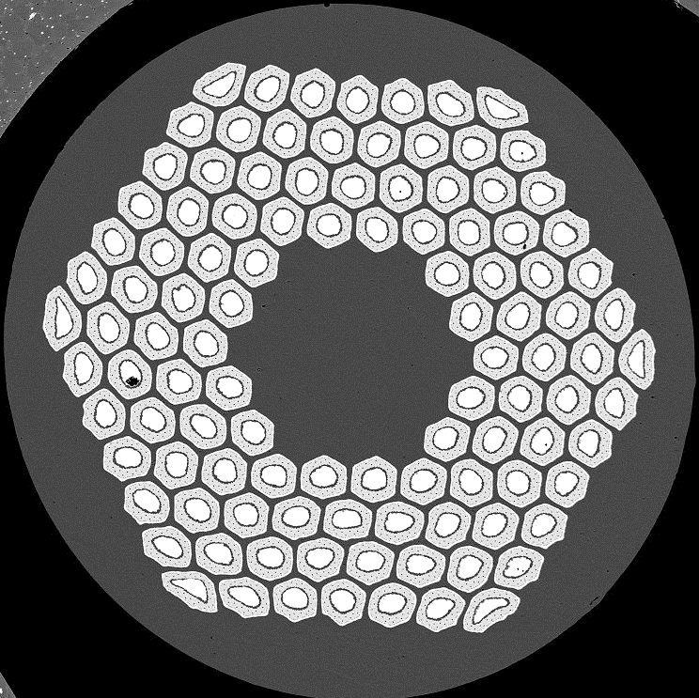
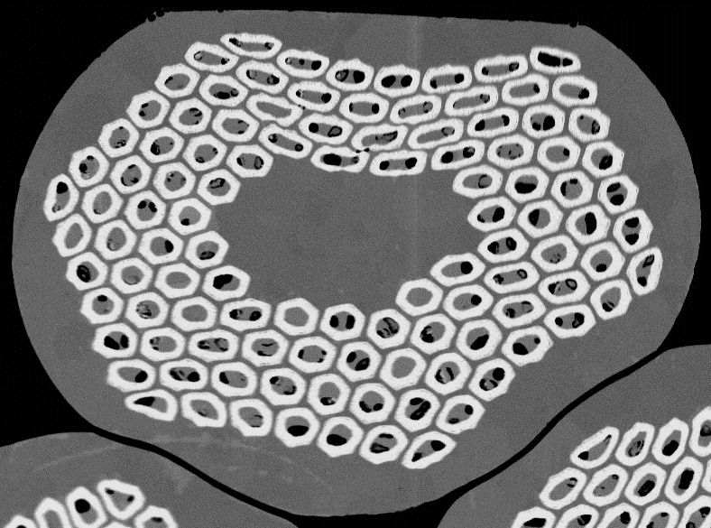
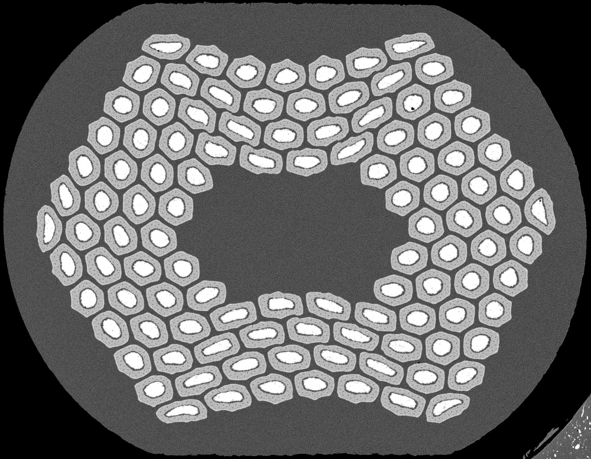
Methods
Samples in three conditions:
  Round/virgin – as received
  Rolled – uniaxially rolled with 15 % reduction
  (i.e. to 0.85 d) to approximate effect of cabling
  Extracted – strand extracted from a cable
Conventional transport I_{c} and RRR measurements
  I_{c} criterion 0.1 µV/cm
  Tested at nominally 1.9 K and 4.3 K
Magnetothermal stability:
  V-I transport measurements as for I_{c}
  Starting with an applied field of 15 T, and decreasing in 0.5 T steps,
  with multiple repetitions at each field
  Plotted here with:
    Extrapolated virgin wire I_{c}
    Mean (marker) and range (error bars) of I_{max}
      Current at which V threshold of protection reached
      = quench current I_{q} if quenching below I_{c}
Round
Rolled
Extracted
Illustration of I_{max} for a V-I test with and without premature quench

Slide 26
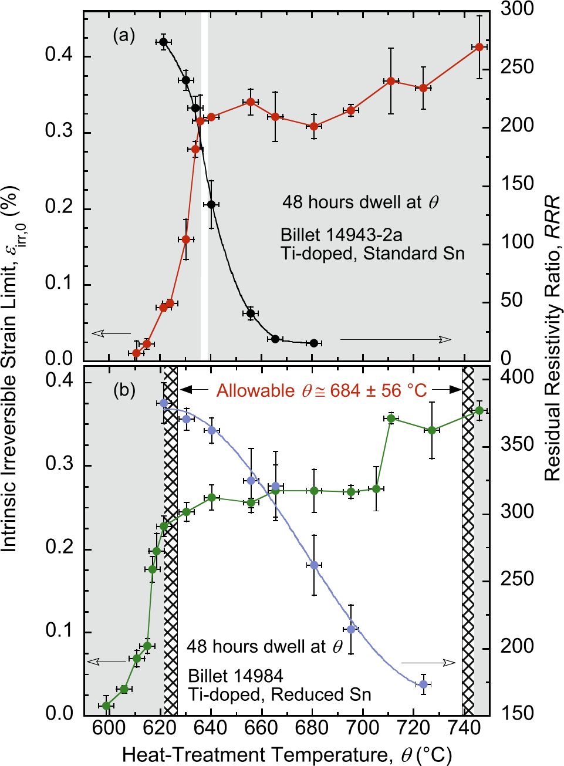
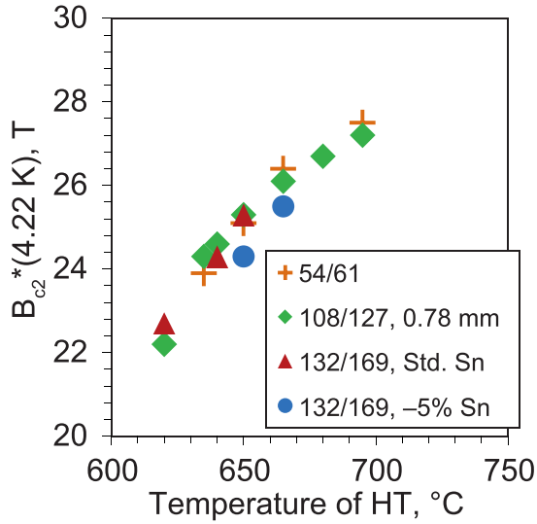
Heat Treatment Cycles and Strain Irreversibility Cliff
‘Strain irreversibility cliff’ (N. Cheggour): an abrupt reduction in the irreversible strain limit as a function of HT temperature
  Associated with δ Cu-Sn
  Cliff temperature dependent on doping (Ti, Ta) and Sn stoichiometry (due to influence on Nb₃Sn growth rate and residual Sn concentration)
  Heat treatment optimisation must also consider I_{c} and RRR
  Much broader acceptable range for reduced Sn than standard Sn
ERMC-1 wire has a manufacturer’s recommended HT temperature of 650 °C
  Reducing temperature to 640 °C could reduce B_{c2} by ~1 T, and
  Approach the ‘strain irreversibility cliff’ (standard Sn stoichiometry)
  First tests for standard Sn 162/169 RRP® suggest similar behaviour to previous reports
Standard Sn
Reduced Sn
Dependence of B_{c2} on heat treatment temperature comparing 132/169 with standard and reduced Sn
Cooley et al. 2017,
IEEE Trans. Appl. Supercond. 27 6000505
Dependence of irreversible strain limit and RRR on heat treatment temperature for Ti-doped 108/127
Cheggour et al. 2019, Scientific Reports 9 5466

Slide 27
R2D2 J_{c}(B): Effect of Heat Treatment Cycle
Comparison of heat treatment cycles: 665 °C 50 h (manufacturer recommendation) and 650 °C 30 h (for improved stability)
  HF and LF coils are reacted together with the same cycle
HF
LF
162/169
60/91

