Slide 2
HFM Annual Meeting 2025
CERN Progress on HTS Conductors
A. Ballarino
A. Ballarino, A. Baskys, C. Barth, S. Hopkins, J. Mazet, D. Perini
CERN, 12/02/2025

Slide 3
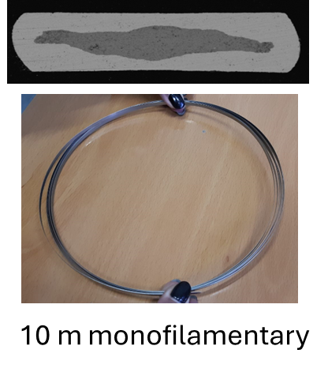
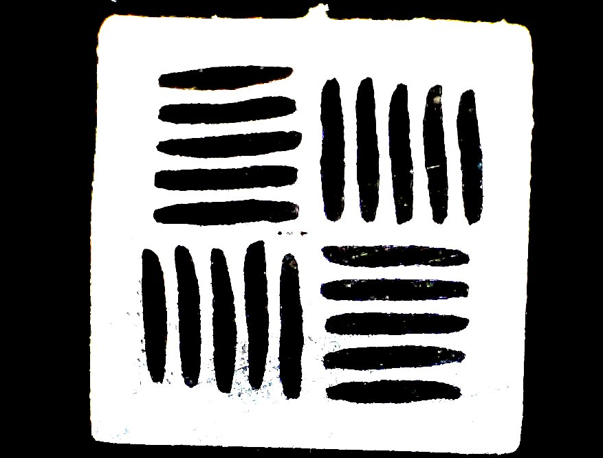
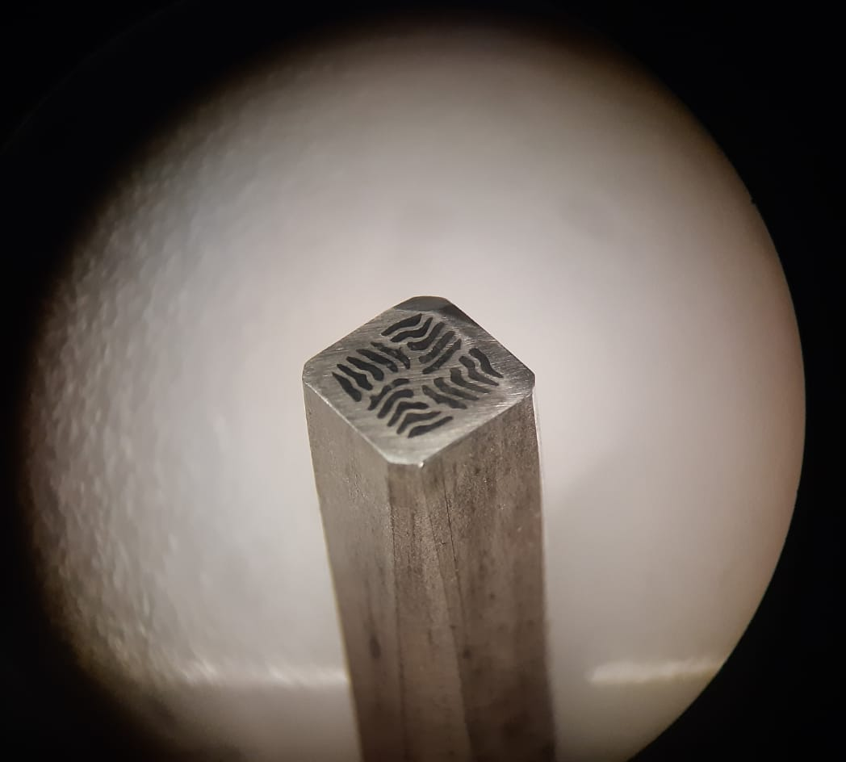
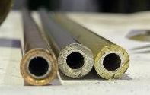
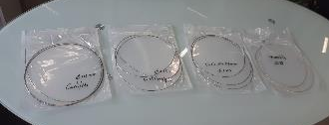
Iron Based Superconductors
Activity at SPIN, Genova (see presentation by A. Malagoli)
Goal: multi-filamentary Powder In Tube Ba-122 round wire
Try wire layouts for React & Wind technology
Target Jc: 10⁵ A/cm² @ 4.5 K and 16 T,
10⁴ A/cm² @ 20 K, 10 T
Prototype wire ready to be delivered to CERN for qualification
Development of innovative multi-filamentary architecture
New sheaths for higher densification and texturing

Slide 4
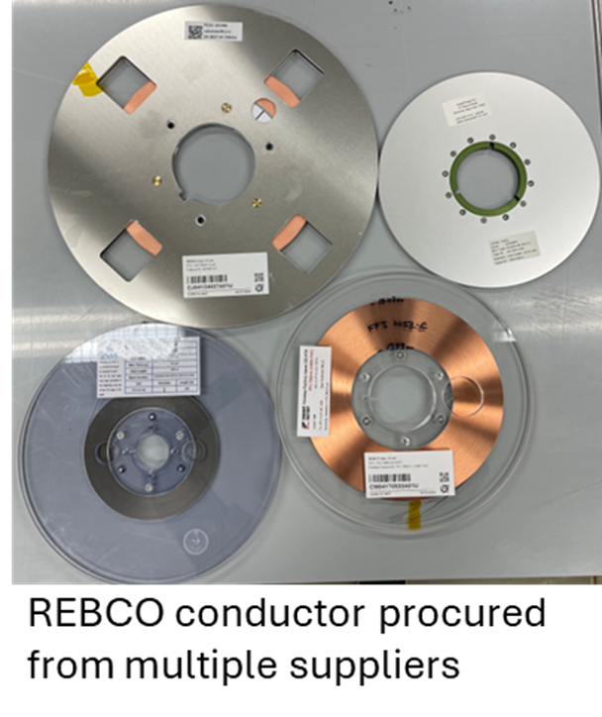
REBCO Tape - Procurement
Procured ∼ 33 km of REBCO tape (2 mm, 4 mm and 12 mm width). Four manufacturers: SST/Marphil, Furukawa, Faraday Factory, Fujikura
Technical specification
Ic (A/cm-width) ≥ 800 A (4.2 K, 20 T)
Je ≥ 1500 A/mm² (4.2 K, 20 T)
Ic (A/cm-width) ≥ 375 A (20 K, 20 T)
Je ≥ 700 A/mm² (20 K, 20 T)
Unit Length ≥ 100 m (Target ≥ 200 m)
RB ≤ 20 mm (Target ≤ 10 mm)
Rlayers ≤ 100 nΩ⋅cm²
Cost (Euro/m) reduced by a factor of ∼ 3 in the last couple of years (relatively small quantity of conductor procured)

Slide 5
REBCO Tape - Procurement
Different widths, different Cu thicknesses, w/wo coating – good sampling of current industrial capabilities. Full delivery (33 km) over a period of 7 months

Slide 6
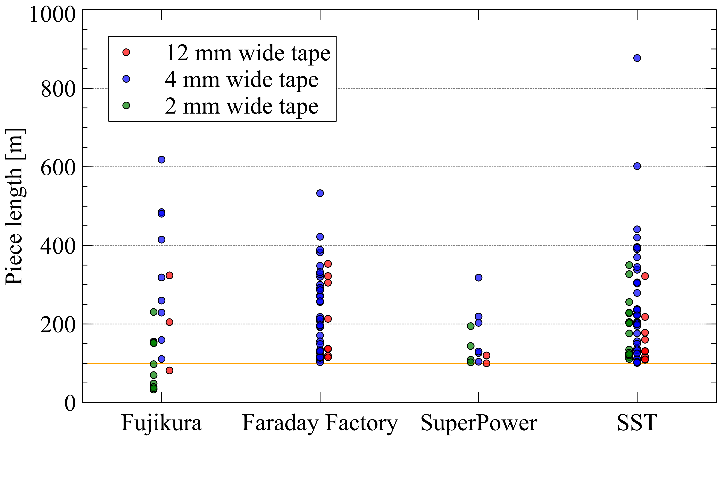
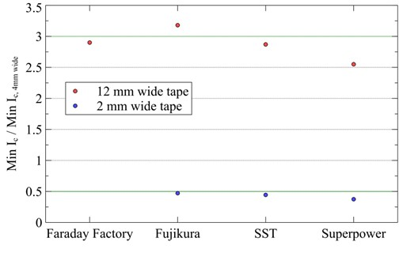
REBCO Tape - Procurement
12 mm width
2 mm width
Piece lengths delivered for different tape widths
Scaling of I_{c} based on width
12 mm width: UL < 400 m
4 mm width: UL from 10 m up to ∼ 850 m

Slide 7
Extensive QC at CERN
Acceptance measurements
  Direct transport Ic @ 77 K
  Indirect reel-to-reel Ic @ 77 K
  Internal resistance (resistance in between layers of tape)
  Minimum bending radius
  Dimensional measurements
Additional measurements
  Direct transport Ic @ 4.2 K, 0-15 T
  Indirect transport Ic @ variable temperature, 0-10 T
  Metallographic analysis
  Mechanical properties
  Thermal degradation
  Launching thermal conductivity measurements in the Cryolab (see presentation of Patricia Tavares)

Slide 8
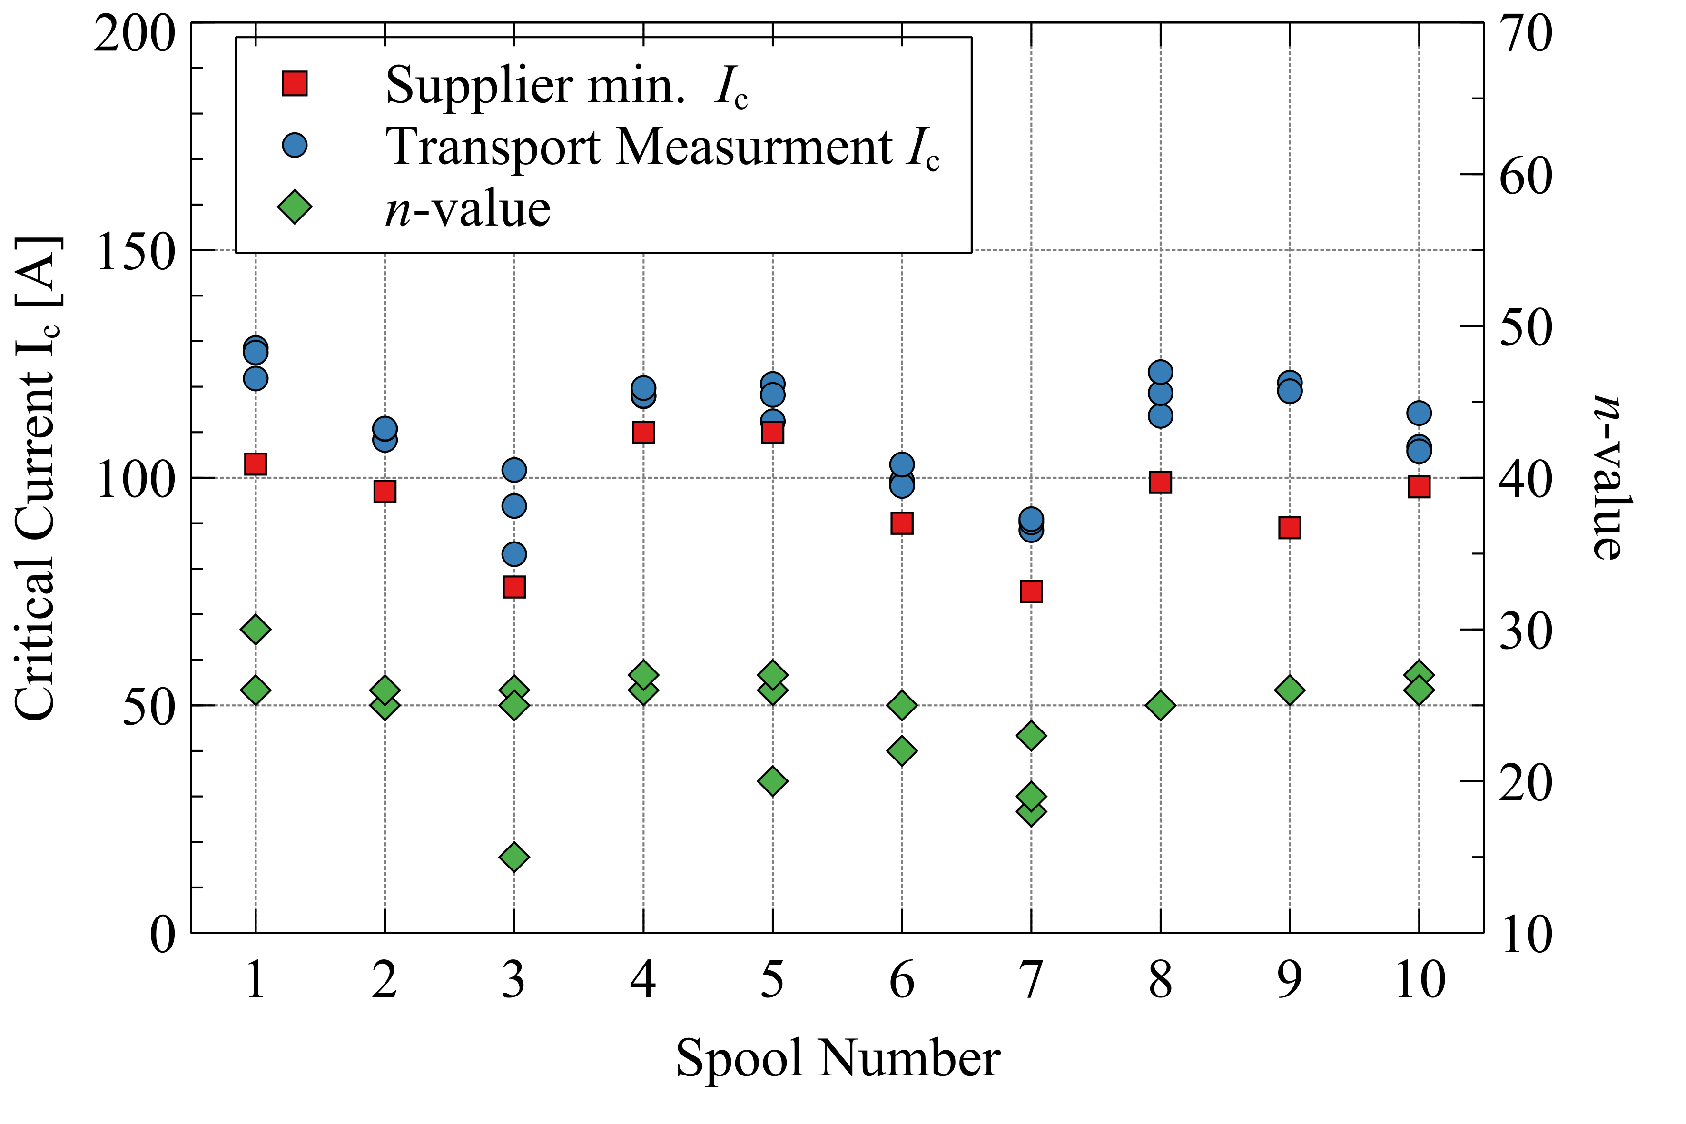
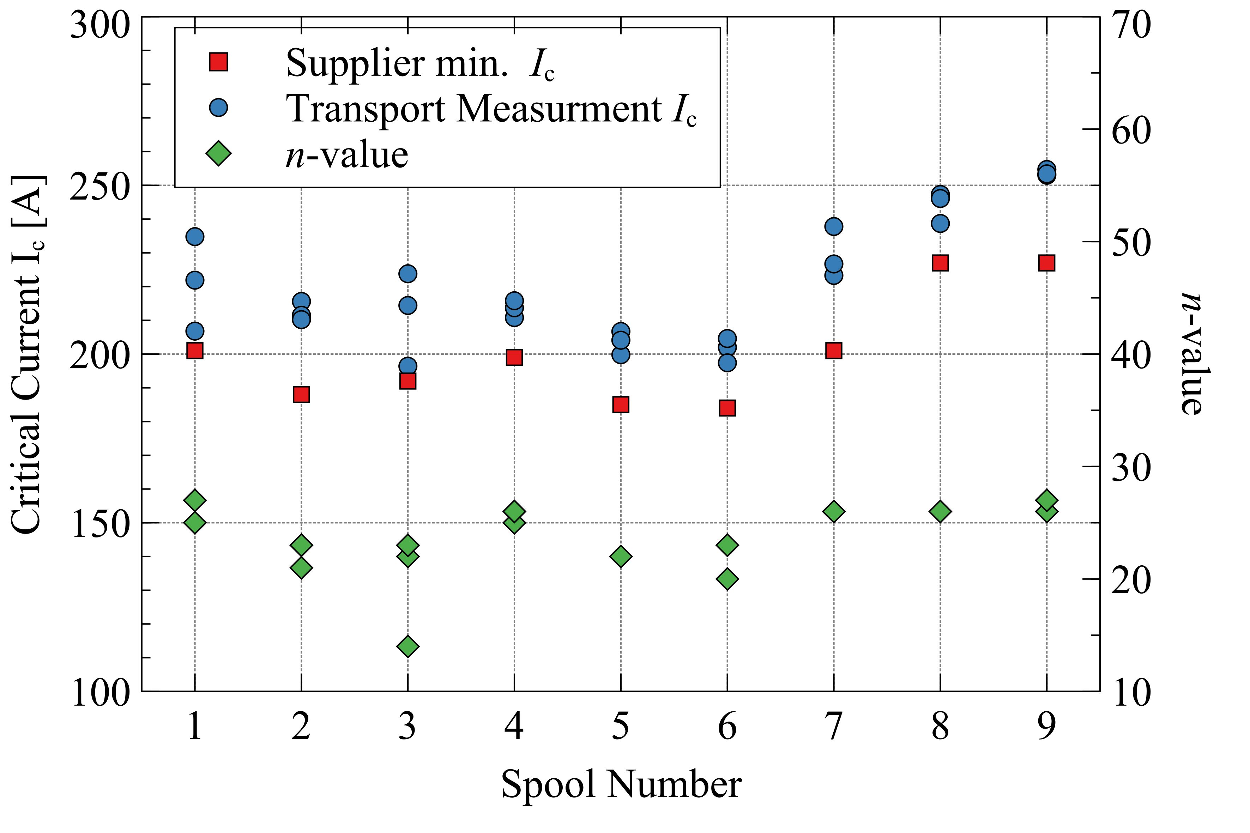
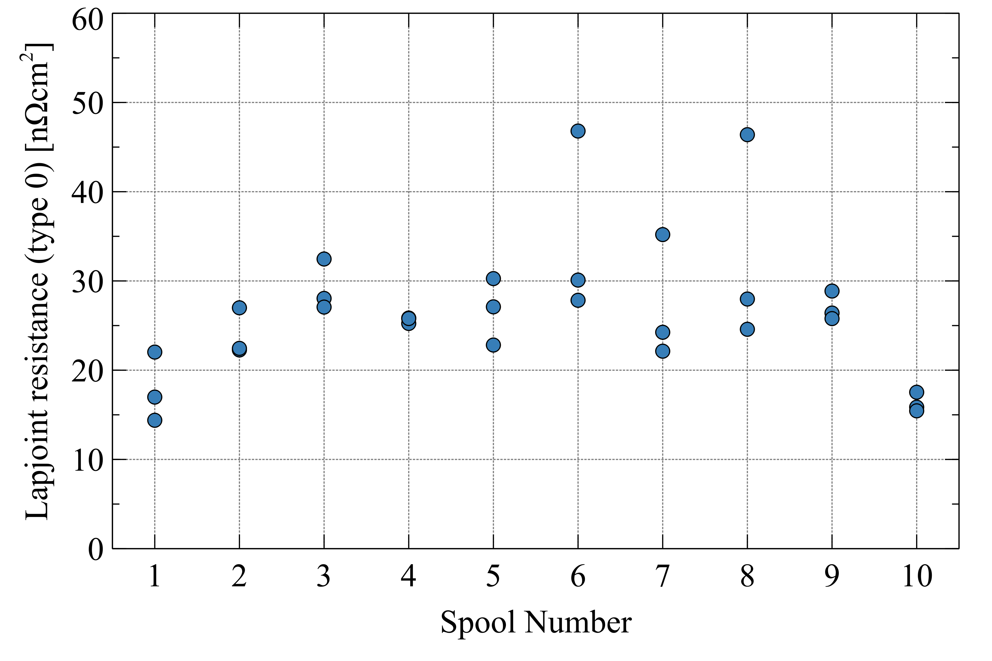
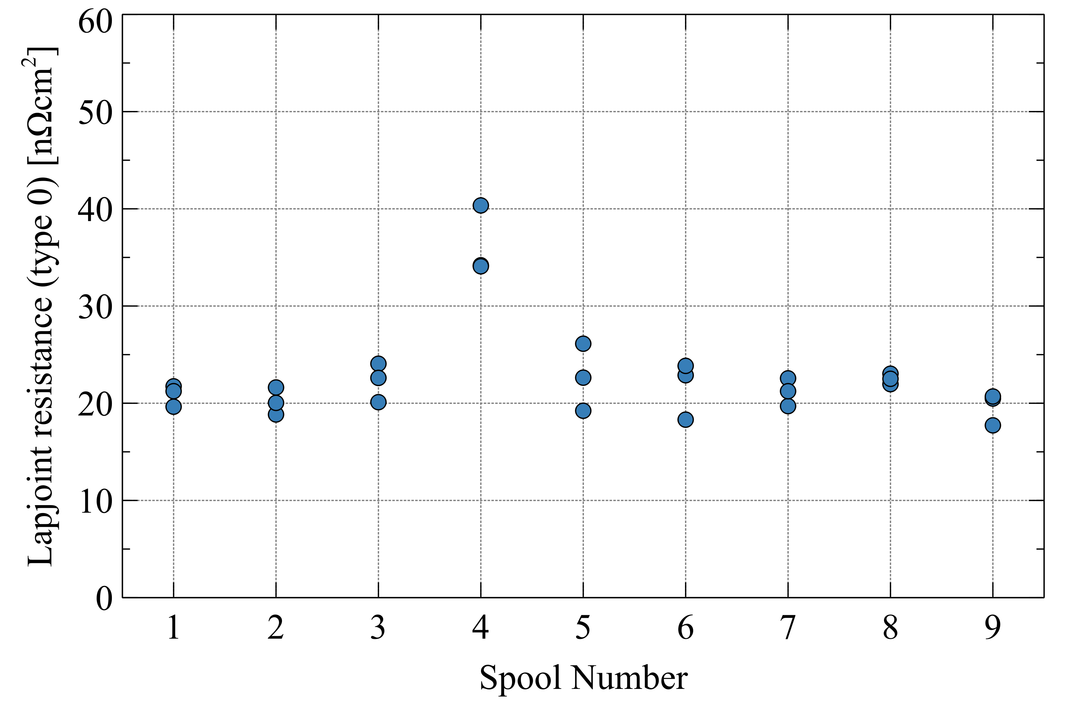
Direct Transport Measurements – 77 K
Ex: REBCO tape from Fujikura (self-field)
2 mm wide tape
4 mm wide tape
∼ 30 %

Slide 9
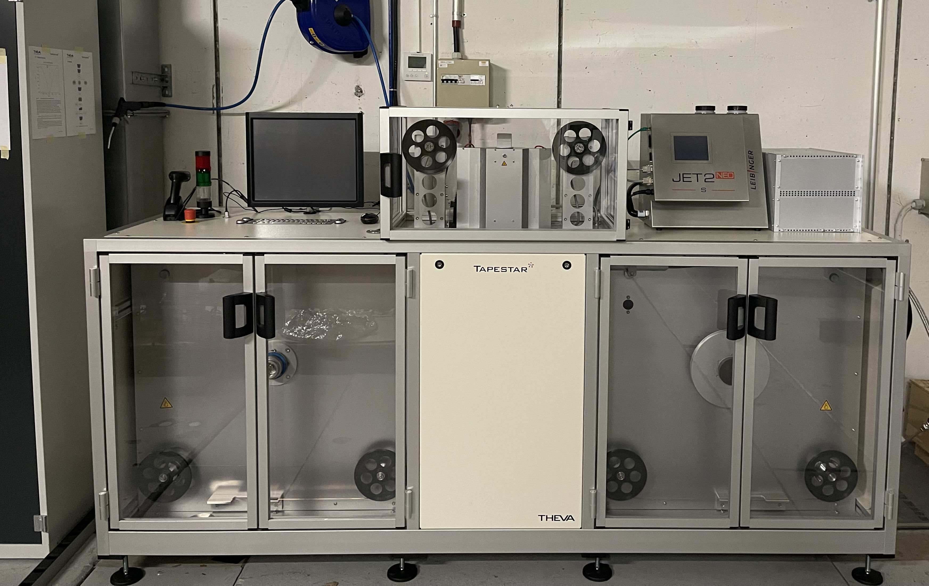
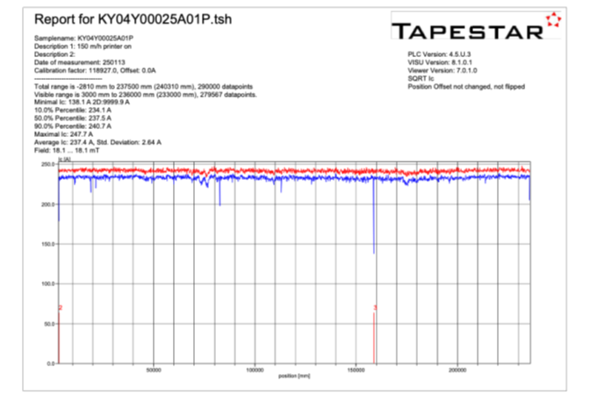
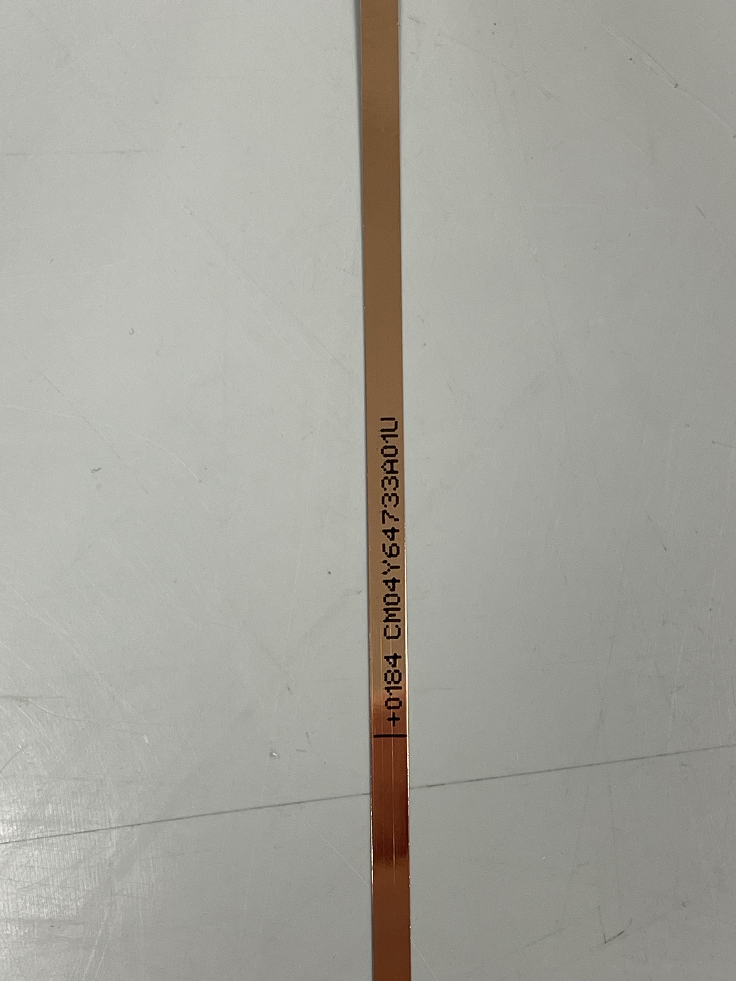
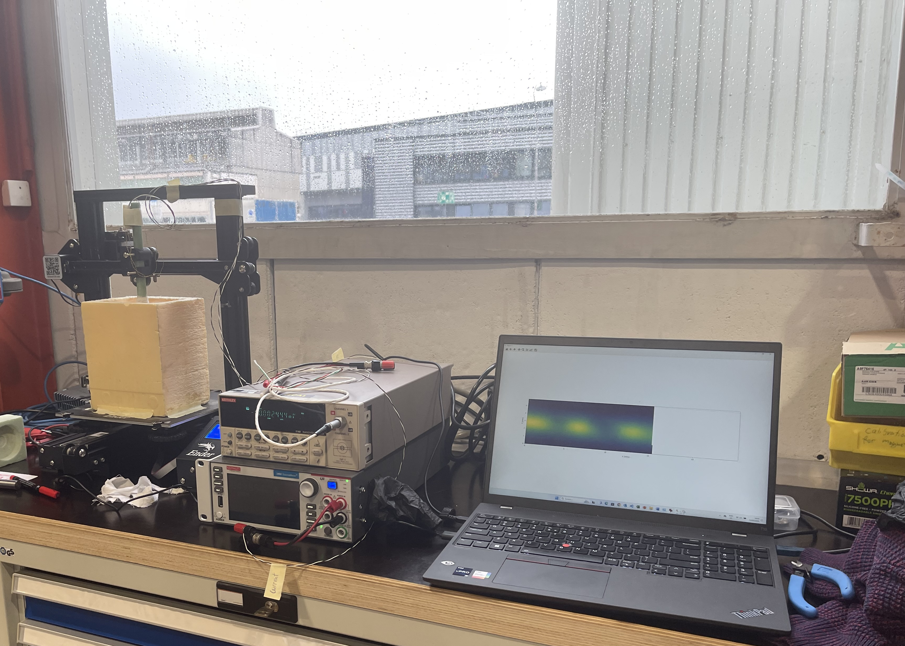
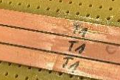
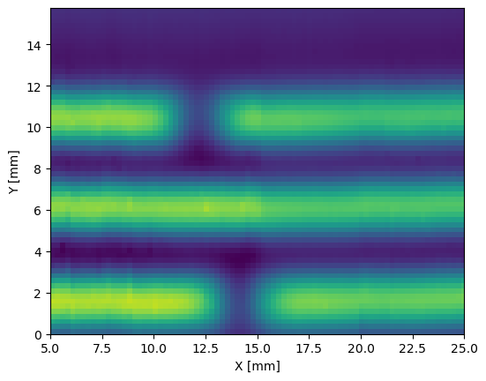
Indirect Transport Measurements
Procured, installed and commissioned TAPESTAR™ (reel-to reel critical current measurement at 67-77 K , s.f. and 1 T). Used now routinely for QC of tape and for defect analysis/identification after winding of coils
67 K- 77 K
Up to 1 T
Received in September 2024
Up to 200 m/h
Tape marking and width/thickness measurement
Defect identification along tape length using TapestarTM for material qualification and extracted strand testing
2D Hall scans for defect/damage characterization
2D Hall scans for defect/damage characterization
Notes:
For determining if the degradation is localized to the tape, high resolution scans of the field from persistent currents above the tape, can localize defects of sub-milimeter size

Slide 10
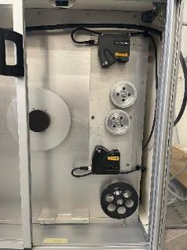
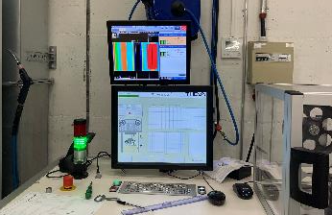
Geometrical and Mechanical Measurements
Reel-to-reel measurement of tape width and thickness
Addition of laser profilometer in TAPESTARTM:
  Tape width and thickness measurement;
  Geometric defect identification - ex: copper stabilizer
Mechanical properties, e.g. minimum bending diameter
REBCO tape dimension measurement now integrated in reel-to-reel I_{c} measurement machine
Minimum bending diameter measurements
Minimum bending radius measurements

Slide 11
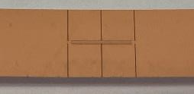
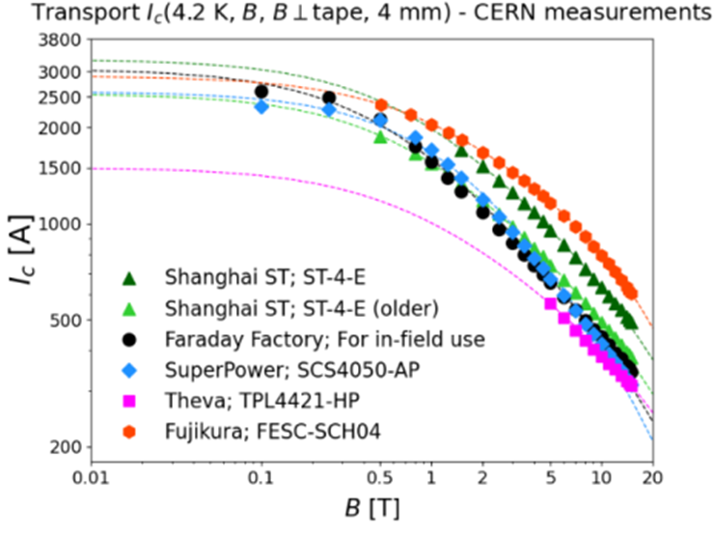
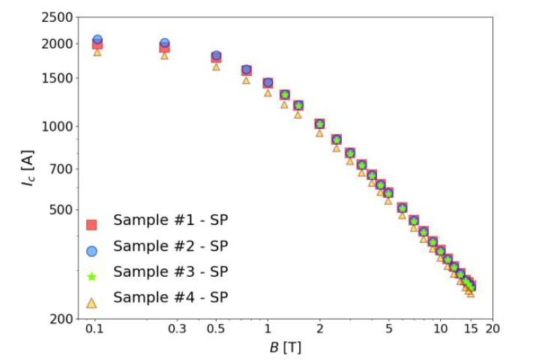
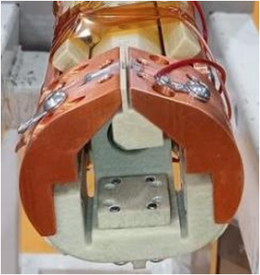
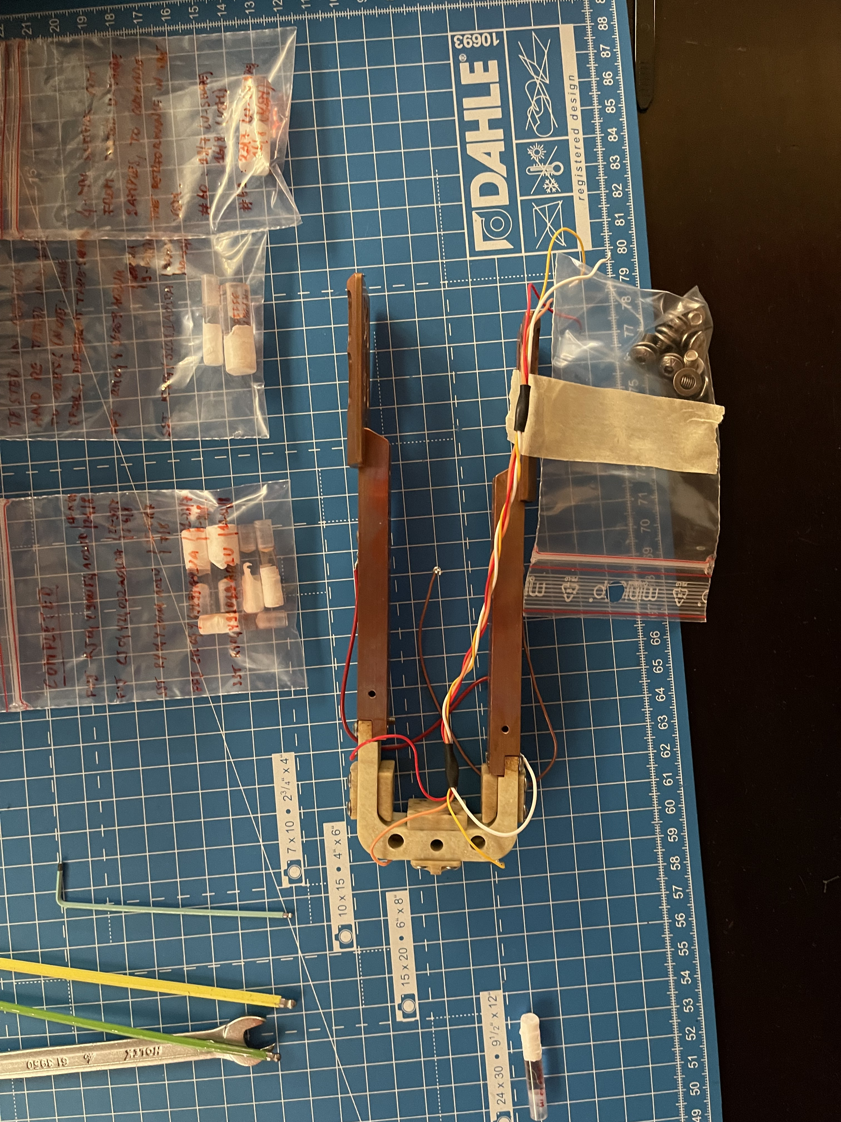
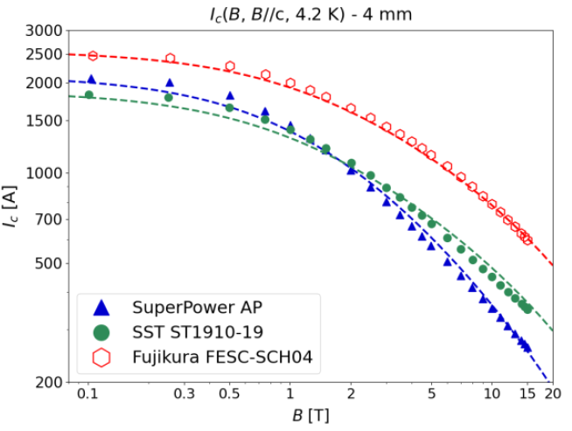
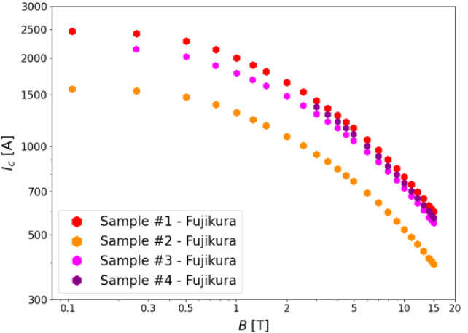
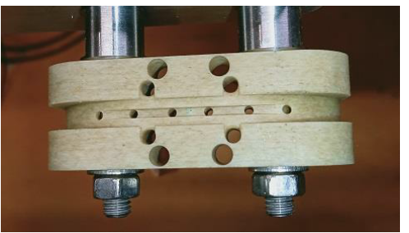
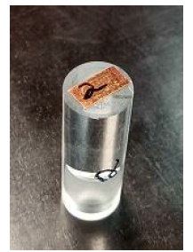
Transport Measurements at 4.2 K
Ic @ 4.2 K, 4 mm width, B⊥
SuperPower
Laser cut bridge on REBCO at KIT
Holders for in-field (// and ⊥) I_{c} measurements
Low
field
Fujikura
Performed hundreds of measurements
G. Succi et al, Proceedings of ASC 2024
Transport (Ic)
VSM

Slide 12
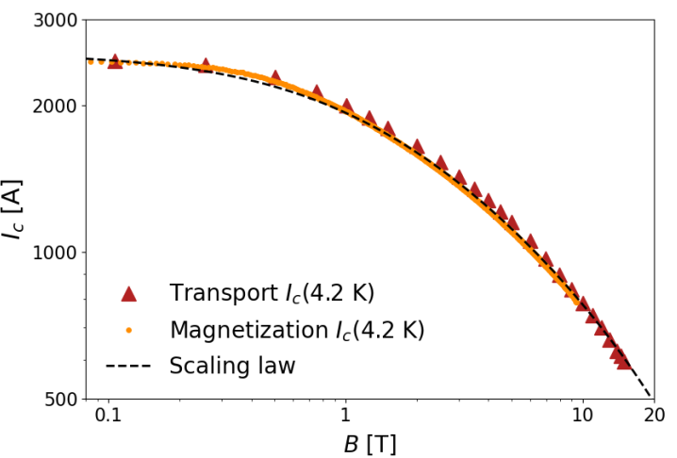
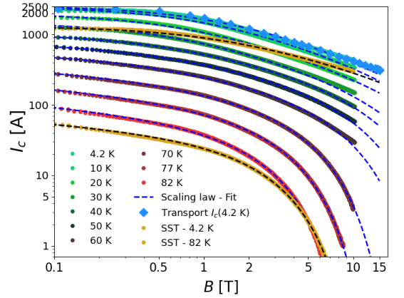
Measurements at Variable Temperature
Ic vs T, 4 mm width, B⊥
Transport vs magnetization
G. Succi et al, Proceedings of ASC 2024

Slide 13
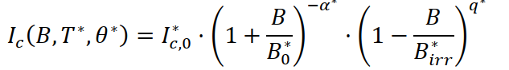
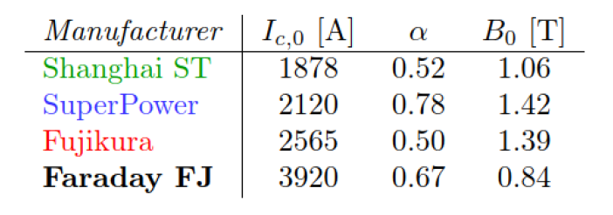
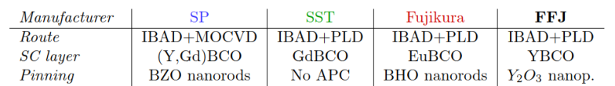
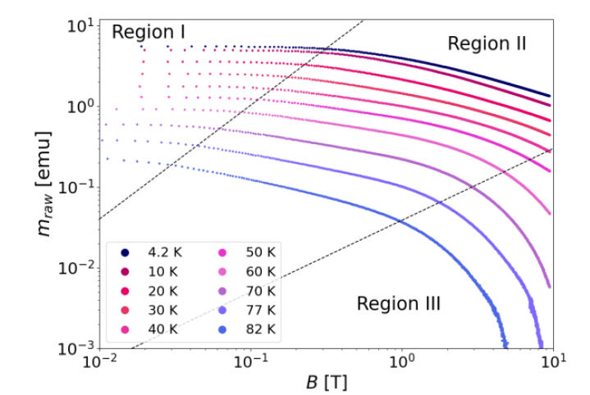
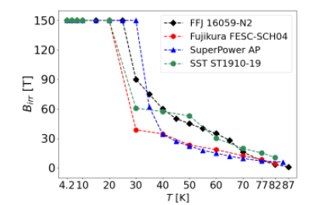
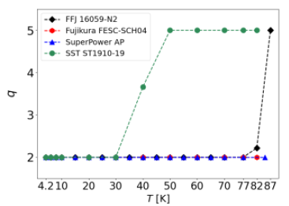
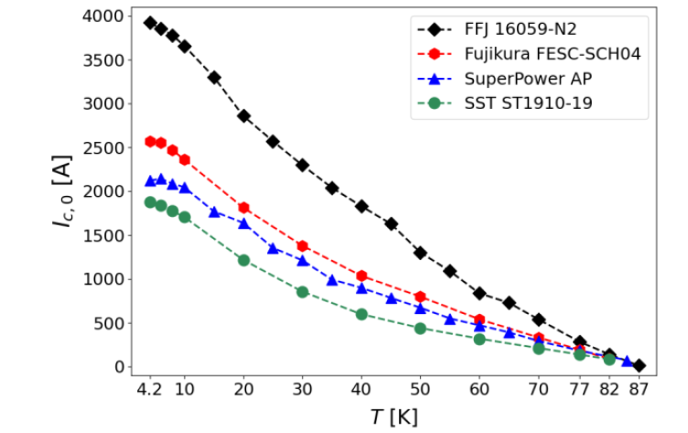
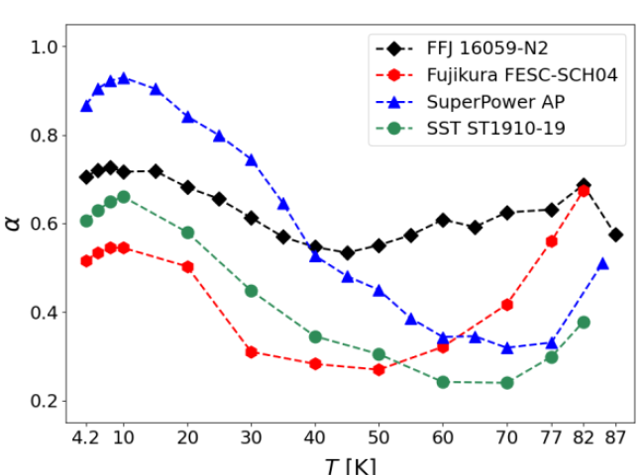
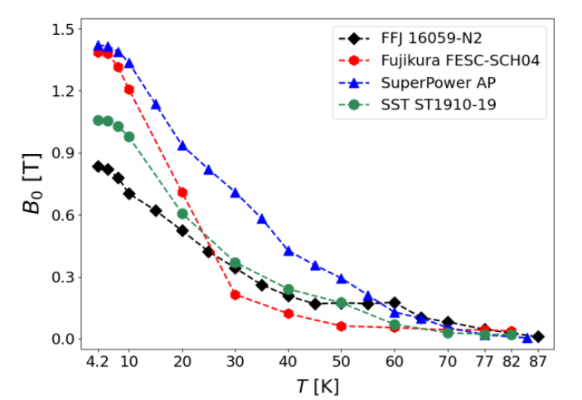
Scaling Law for HFM Tapes
G. Succi et al, Proceedings of ASC 2024

Slide 14
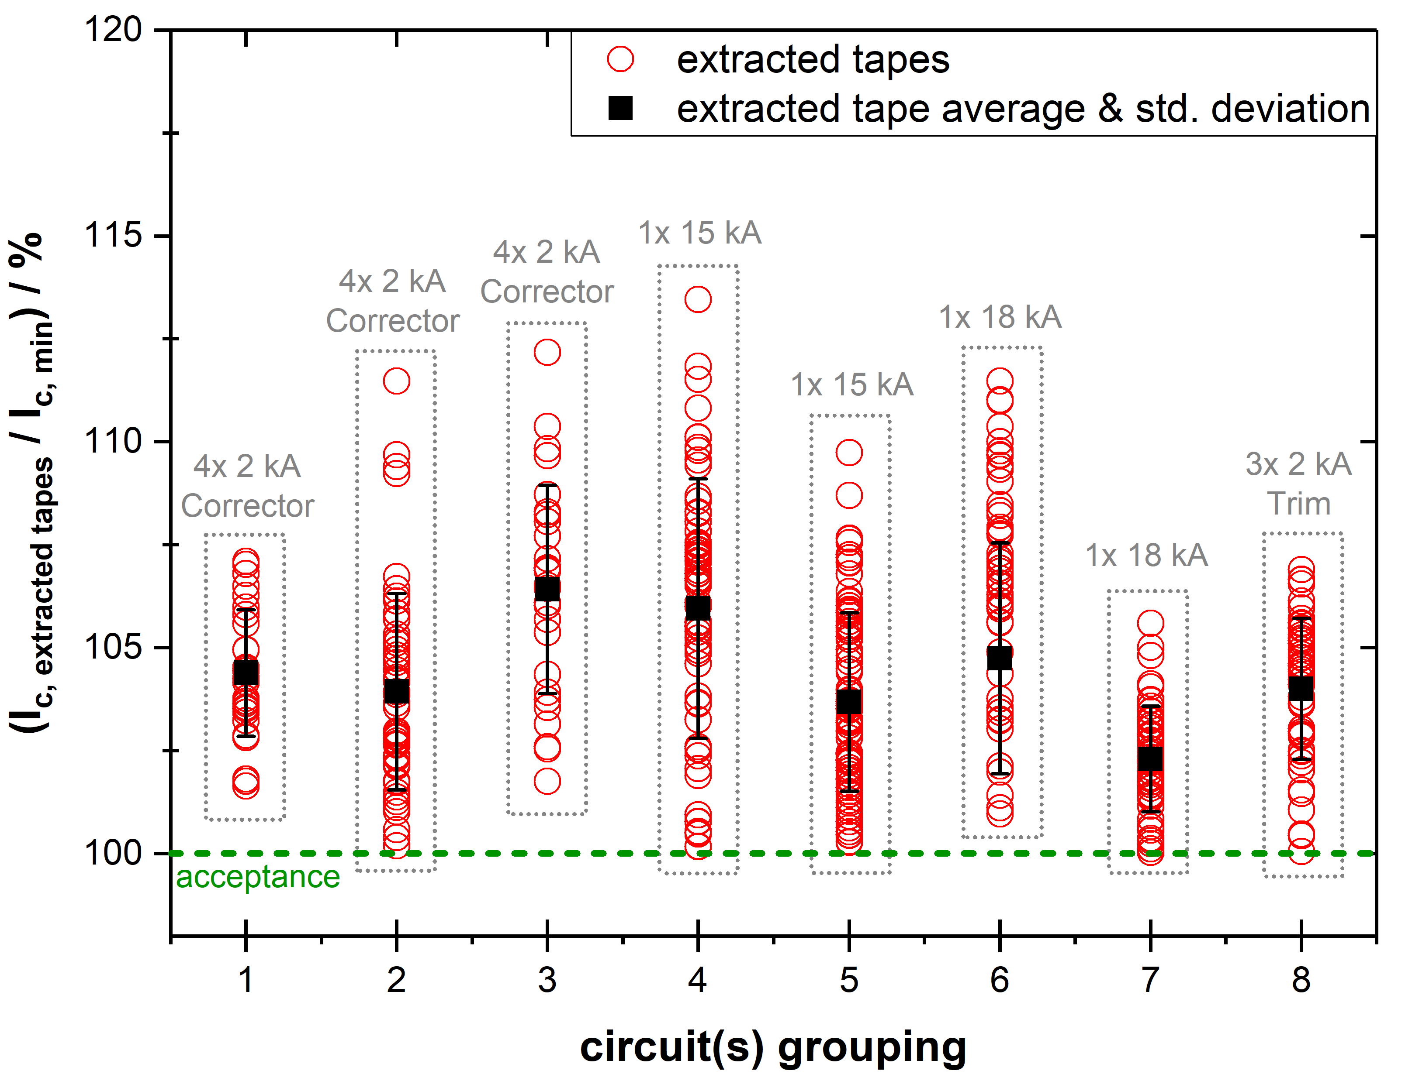
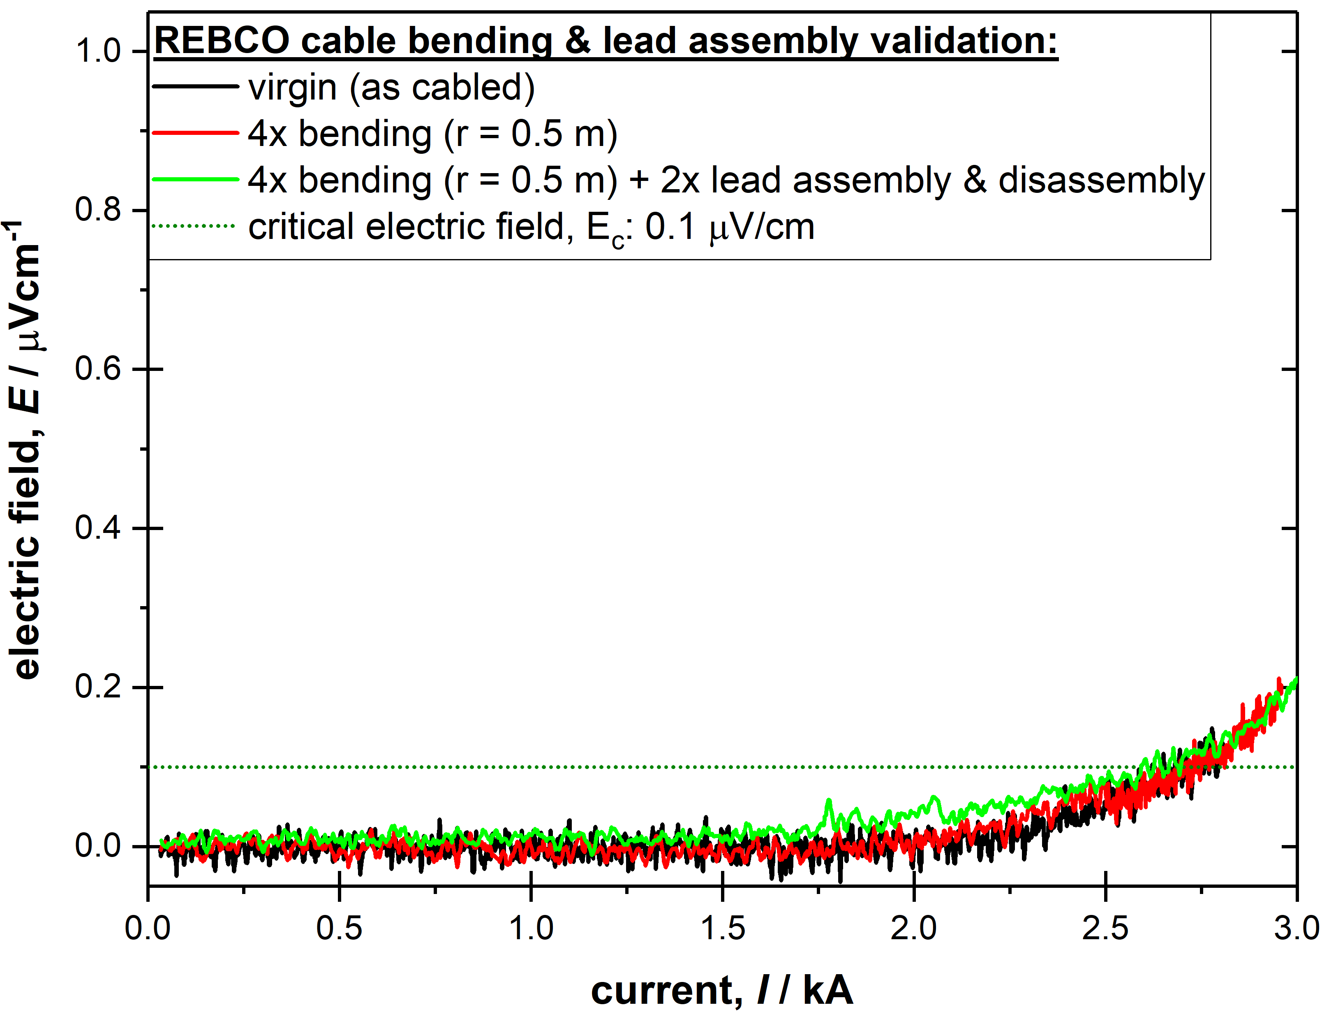
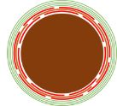
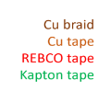
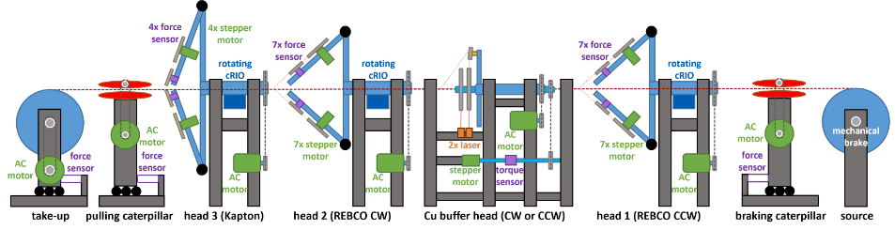
REBCO Round cables- Zero I_{c} Degradation
REBCO in HL-LHC
No cabling degradation
No bending degradation
CERN Cabling Machine

Slide 15
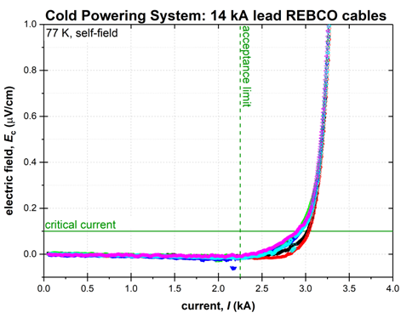
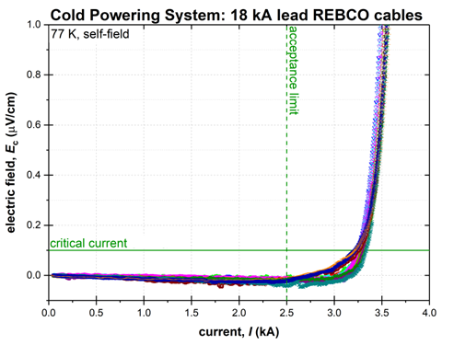
REBCO Round Cables – Reliable Production
REBCO in HL-LHC
Qualification using 0.1 µV/cm electric field criterion (as for LTS)
  No resistive slope subtracted
94 out of 310 cables produced (∼ 350 m out of 1.2 km)
REBCO joints (up to 18 kA) routinely reproduced with controlled resistance
Plan to upgrade the machine for reel-to-reel production of cables with smaller Φ for magnets

Slide 16
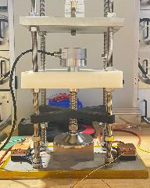
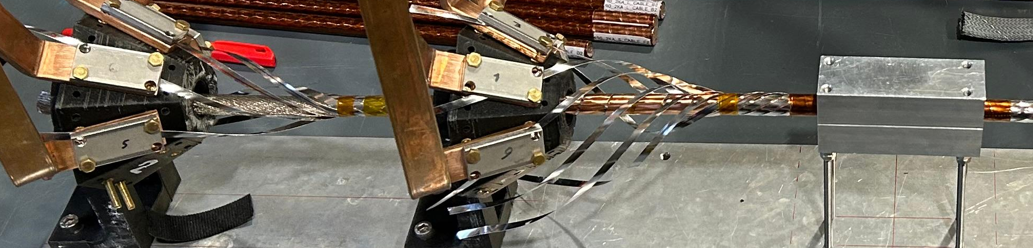
Inter-Tape Resistance Measurements
Measurements of resistance among tapes in a cable
Dependence on pressure, cable layout, type of external layer/deposition
Key parameter for mastering quench protection and current sharing among tapes
REBCO tape contact resistance vs pressure
F. W. Van Ingen
Cable interstrand resistance measurements (A. Saba)

Slide 17
Electrically Insulated Cable
Stack-cable presently used for coil winding
Red: copper
Gray/black: REBCO tape
Orange: electrical insulation
Iop = 2000 A @ 4.2 K, 10 T
Je ∼ 650 A/mm² @ 4.2 K, 10 T
4 REBCO Tapes (4 mm width)
Cu Stabilizer
Kapton® Insulation
Using 4 mm wide tape (SC_4)
Working on development of coils using stack cables with identical geometry but 12 mm wide tapes (SC_12)
One of the key question being addressed: can we protect an electrically insulated cable in a coil geometry

Slide 18
New Cable and Tape Concepts
Developed concepts of fully transposed cables (Je > 600 A/mm² @ 20 T and 20 K). Presently at an early stage of validation. The concepts address:
  Lack of transposition in the stack cable
  Field quality and AC losses issues due to wide REBCO tape layer
  Discussed with KIT and launching at KIT development of new REBCO tape layouts:
      Deposition of REBCO on both sides of the substrate
      Incorporation of patterns in REBCO layer
      University of Southampton interested in joining the effort

Slide 19
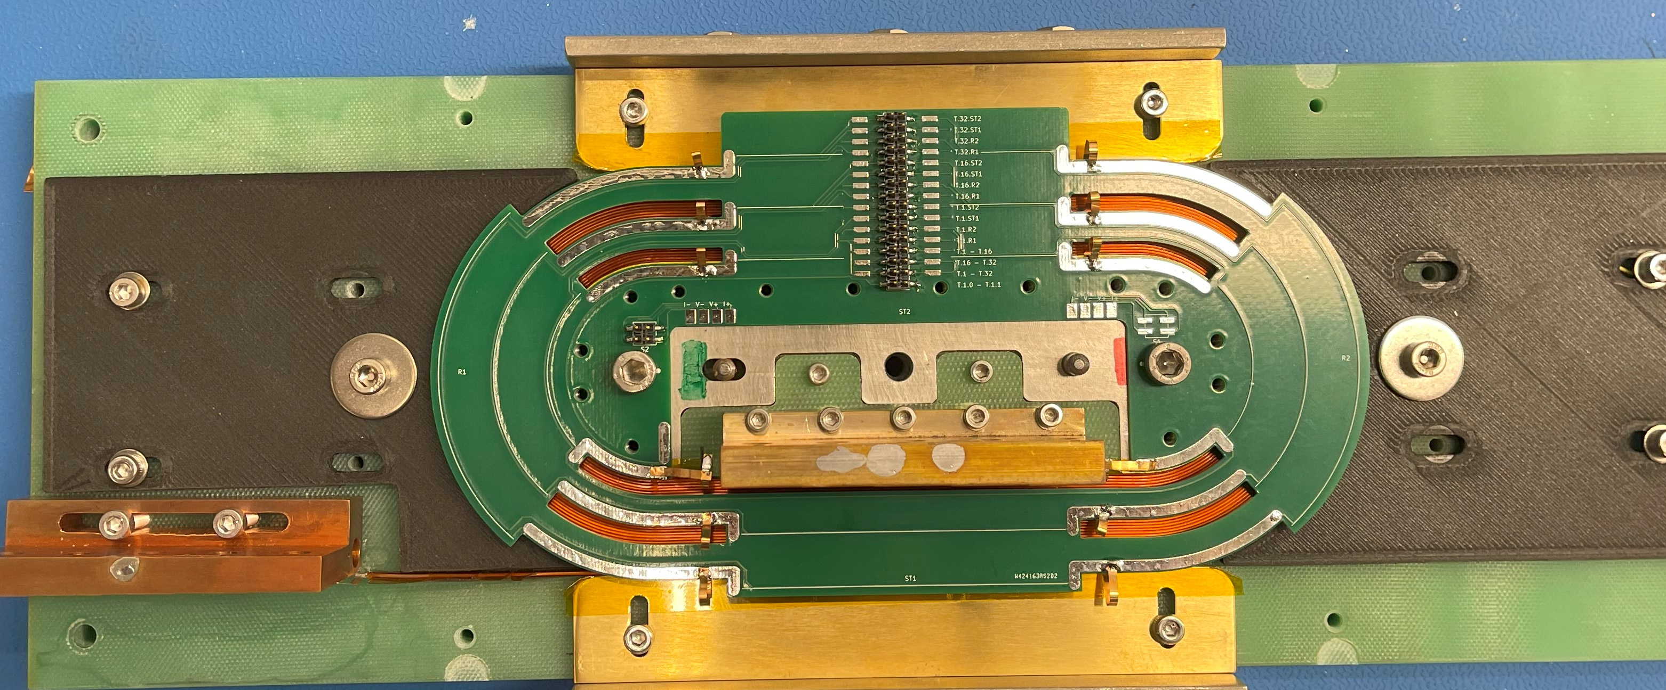


Test of Cables in Coils
Stack-cable now used to develop technology for inter-turn electrically insulated REBCO coils (winding, layer jump, insulation technique, instrumentation…). Scope: identify potentials and limit, e.g. feasibility of protection, losses, field quality,…
Produced several single-layer and double-layer racetracks and qualified them in liquid nitrogen and one in liquid helium. In-house made winding machine
Single racetrack
Double racetrack
See presentation of A. Baskys racetrack coils activity and test results

Slide 20
Global Activity (from Racetracks to Magnet)
Done with stack cable.
Program used also for validating different cable geometries
Coils available.
Components being manufactured
Design on-going
Qualification also at T > 4.2 K (10 K – 20 K)
Φ_{BORE}
20 mm
Φ_{BORE}
50 mm

Slide 21

Common Coil Dipole
Development of double pancake made with stack cable made from 12 mm wide tape started
Preliminary design of a 10 T, common coil double aperture, 50 mm aperture dipole done. Final design by Q4 2025. Construction as from Q1 2026
Parametric studies of 15 T and 20 T configurations (scaled from the 10 T design) in 2025
Preliminary mechanical design of
10 T Common Coil prototype

Slide 22



HTS Laboratory at CERN
New laboratory for
HTS activities in building 180
Adaption work defined and civil engineering on-going
Planned to be available in summer this year
Ground floor
LN2 Tests
Magnet assembly lines
First floor
Elec. lab, cable lab.
Winding shop

Slide 23
Conclusions
Significant progress on qualification of REBCO tape at CERN – methodology and sample holders. Collecting data on performance of industrial tapes
Qualified electrically insulated stack cable in a double racetrack configuration (∼ 5 T peak field in the conductor). Working on new concepts of fully transposed cables
Double racetrack model coil progressing well. Winding methodology optimized and coils with reproducible quality assembled. This is the test bed for new cable concepts
Moving toward higher fields (9 T – 10 T) in double pancakes coils and common coil configurations

