Slide 1

WP2.1 - Progress on ReBCO Tape Research at KIT
Bernhard Holzapfel, Nadja Bagrets, Ruslan Popov
Institute for Technical Physics, Karlsruhe Institute of Technology,
HFM annual meeting 2024,
12.02.2025

Slide 2
Content
WP2.1- R&D on accelerator grade HTS REBCO conductors
Motivation
KC⁴ Equipment Status
Coated Conductor Depositions and Characterization
Next steps

Slide 3
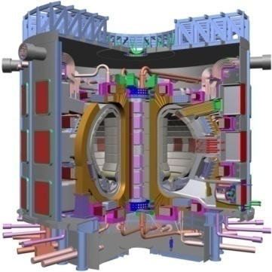
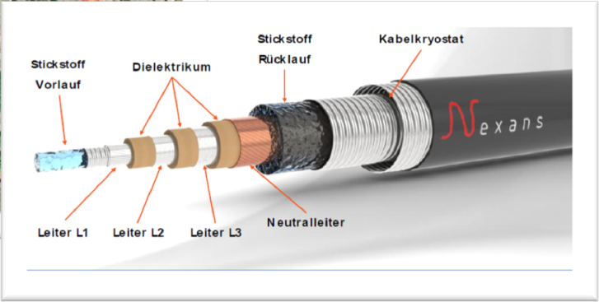
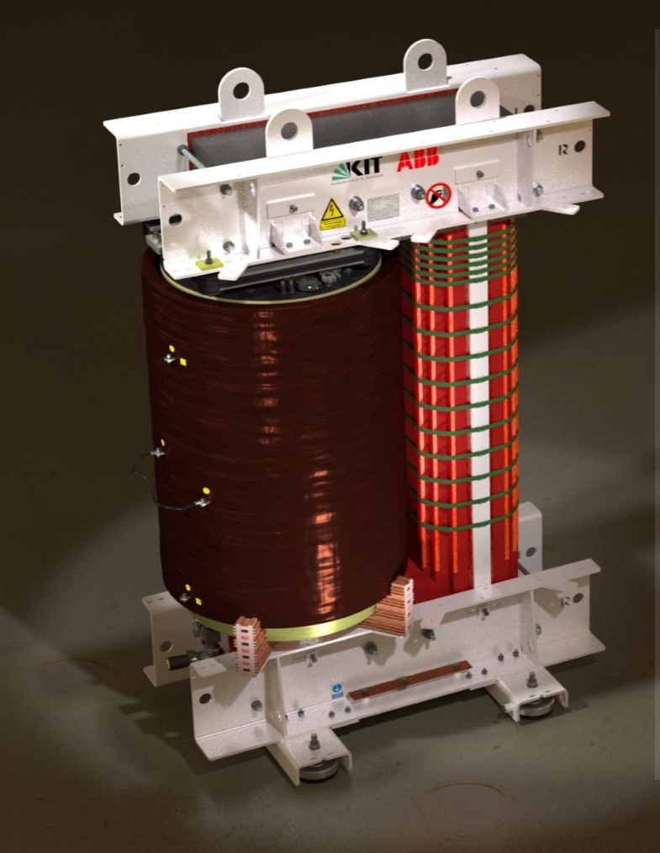
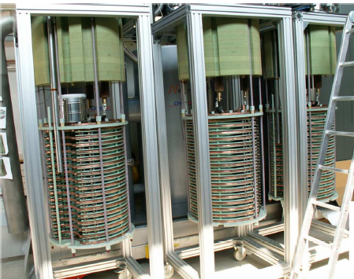
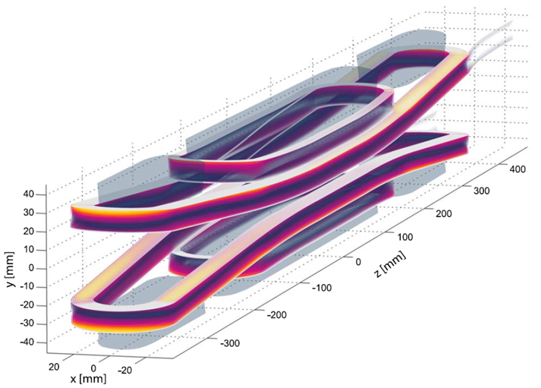
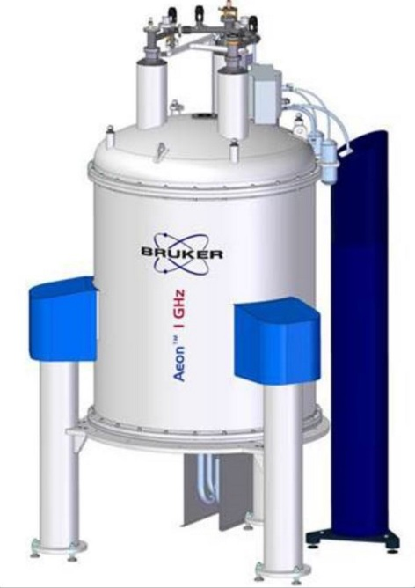
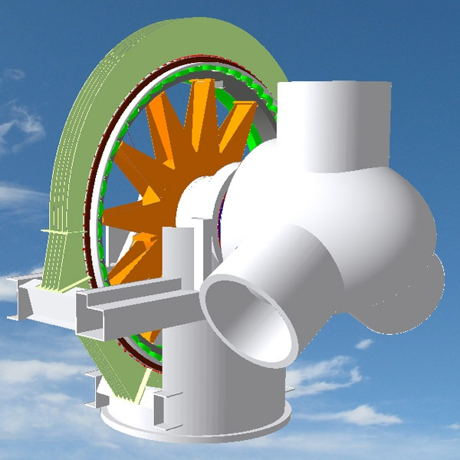
REBCO Coated Conductor Application Areas
Power Applications
Fusion
AC/DC
cables
Transformer
FCC
FCL
Magnets
Rotating Machines
Rotating machines
NMR/MRI
Notes:
Due to their outstanding properties, coated conductors are promising candidates for many application areas: magnets, fusion, accelerator and others, power applications, rotating machines.

Slide 4

Current Status and Challenges of Coated Conductors
Coated Conductors are available on an industrial scale, but costs remain an issue
Beyond J_{c} there exist a number of open development areas, which need to be improved (yield, mechanical issues, thin conductors, electromechanical properties of full conductor, ac losses) and combined
Each application requires different and specific CC properties/architectures
(e.g. magnetic field, temperature, ac-properties, stabilization, mechanical properties, insulation)
New scientific ideas often require just a few 100 m of very specific CC, not easily available from commercial vendors, since industry needs to focus on just a few CC variants to enable economic production
There exists currently no company independent public research institution in Europe, which is able to bridge the gap between small scale basic materials research on PLD-based CC and larger scale industrial synthesis, being able to deliver 100 m+ class, tailored, high quality Coated Conductors on demand

Slide 5

KC⁴: KIT-CERN Collaboration on Coated Conductor
KIT and CERN established a joint, open HTS CC synthesis Lab, which will bridge the gap between small scale materials research on CC and larger scale component requirement of tailored, high quality full Coated Conductor architectures in sufficiently long length
Both power applications as well as magnet applications are targeted
Focus on R&D CC issues, not on low cost CC production
KC⁴ is part of the Helmholtz R&D Programm „Materials and Technologies for the Energy Transition“ at KIT
KC⁴ is part of the High Field Accelerator Magnets R&D Programm at CERN
Third party R&D projects towards tailored CC synthesis for specific applications will be become possible based on an HTS CC open foundry concept
Long length filamentization and ROEBEL cable fabrication will be feasible

Slide 6

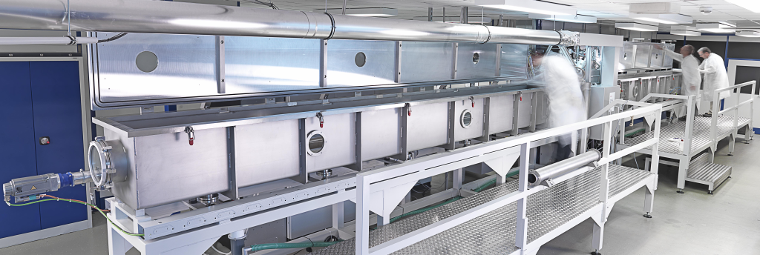
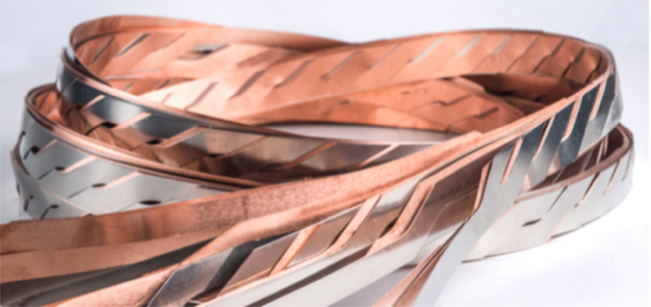
Timeline of KIT-CERN Collaboration
Third Parties
HTS CC Open Lab/Foundry
CERN
KIT
ITEP
Tailored R&D and
demonstration operation
CERN
KIT/ITEP
Baseline R&D Operation
(< 25% capacity use)
KIT/ITEP
CERN
t.b.c
I-A
Installation
I-B
Commissioning
I-C
Performance demonstration
I-D
Baseline R&D operation
Intermediate 20 m length scale
Extension to 100m+ length scale
2022
2023
2024
2027

Slide 7
KC⁴: Baseline R&D Topics
Investigate scaling laws to transfer small scale PLD materials development results towards larger scale Coated Conductor production systems
Address specific Coated Conductor architectures needed for the R&D program at CERN and KIT
Investigate and improve electromechanical properties of full coated conductor architectures (mechanical stability, interface resistance, thermal properties,….)
Evaluate in-line quality control systems
Establish accelerated materials development concepts

Slide 8
KC⁴ Coated Conductor Synthesis Steps
A
B
C
D
E
F
G
180µm
b > 12mm
(foils)
b < 12mm
(tapes)
(
)
A : substrate cleaning/polishing USP/USR-F/USR-B/POL
B : IBAD Buffer deposition ABAD
C : PLD Buffer deposition HEX600+PLD300/600
D : PLD SC deposition HEX600+PLD300/600
E : Ag- coating Tacoma–M/MET-F
F : O₂- loading Tacoma-O/BEL-F
G : Cu-plating PLA
e.g. TapeStar
+ characterization
(structural, electrical, mechanical)

Slide 9

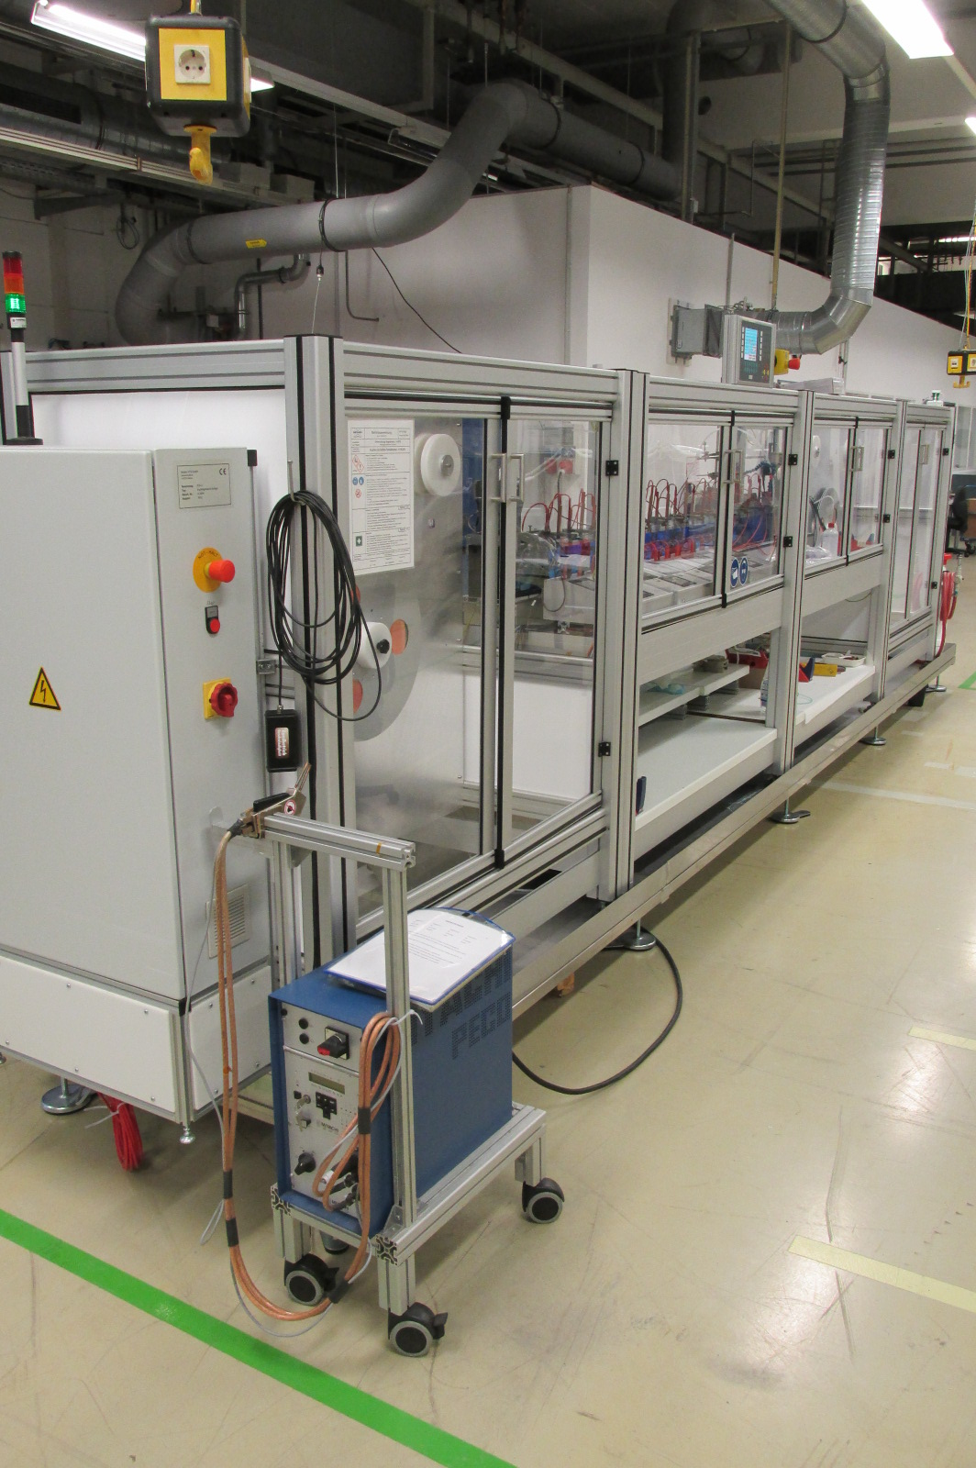
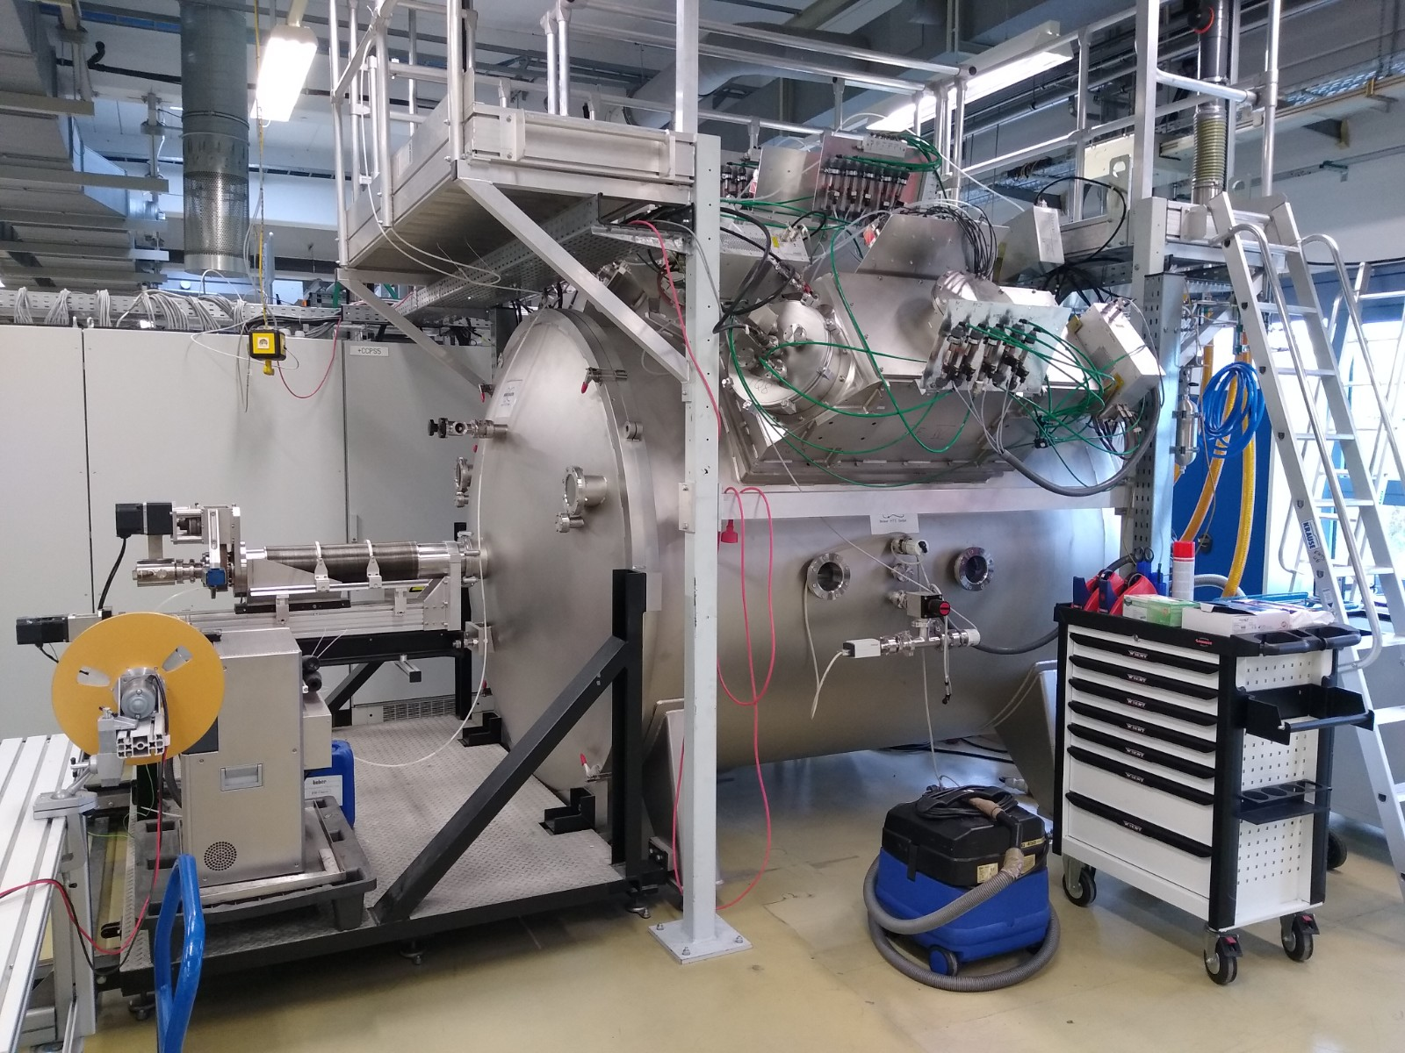
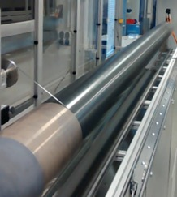
BRUKER HTS R&D-line equipment
Transferred to KIT:
Tape processing equipment with different substrate handling concepts (batch and reel-to-reel R2R processes) including stabilization
PLD600
Batch vacuum coating
R2R electroplating
PLD600
substrate drum
ABAD vacuum coater

Slide 10
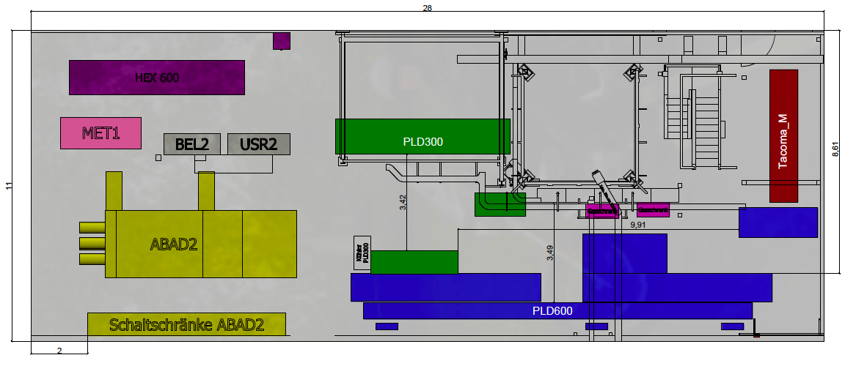
Core KC⁴ Lab space
Transfered Bruker equipment list
USR-F* substrate cleaning
USP* tape spooling
USR-B* reel-to-reel
substrate cleaning
POL* substrate polishing
ABAD IBAD deposition
HEX 600 tape handling
PLD300 PLD
PLD600 long length PLD
Takoma-M Ag-coating
Takoma-O O-loading
MET-F Ag-coating
BEL-F O-loading
PLA* Cu-plating
TapeStar* J_{c}-characterization
*: equipment located in other ITEP labs
ITEP wide > 500 m² lab space dedicated to KC⁴

Slide 11


Current Project Status
(intermediate 20 m length scale)
Cleaning
ABAD
Buffer
SC
Ag
O
Cu
180µm

Slide 12
Status Deposition Runs
Short length (0,5 m; 0,5, 1, 2 µm) experiments to optimize/check deposition conditions for regular Y123 coatings, and coatings with artificial pinning centres are processing routinely
Intermediate length depositions (15 m) with lateral movement. Good I_{c} homogeneity over the length is demonstrated
IBAD MgO tapes from Faraday, SUNAM, HTS and Shanghai SC under investigation
- LMO and CeO buffer layer termination of IBAD MgO tapes
Establishment of (routine) characterization procedures
  - 77 K, sf full width I_{c} characterization
  CryoScan homogeneity check
  Tapestar I_{c} characterization
  Optional mechanical characterization, interlayer resistance measurements
  Optical characterization
  - X-ray characterization (PhD Kai Walter)
  - fast LT, high field J_{c} measurement so far missing
  (request for collaboration)

Slide 13
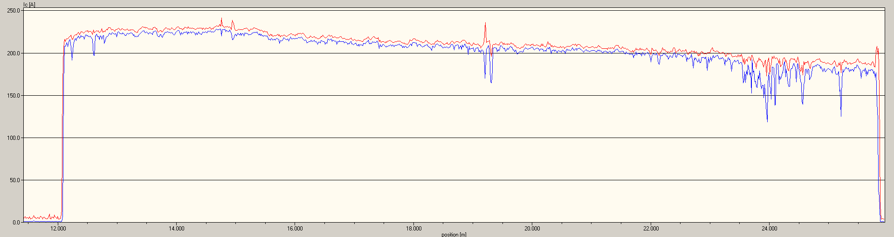
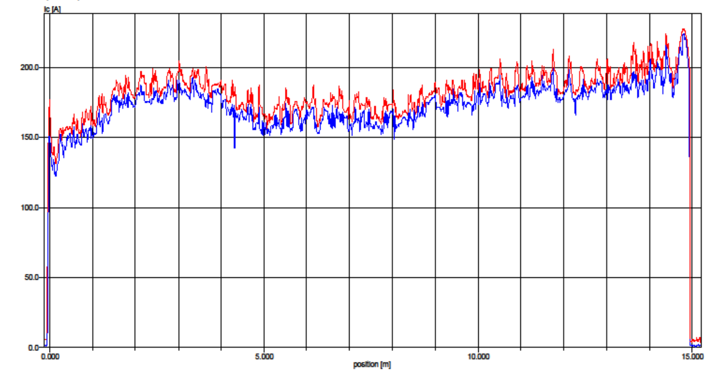
Intermediate lengths:
I_{c} homogeneity over the length
Using the transport calibration factor of 1,6 these I_{c} values correspond to an I_{c} > 300 A over the first, quite defect free 10 m tape length, and I_{c} > 240 A for 15 m tape length

Slide 14
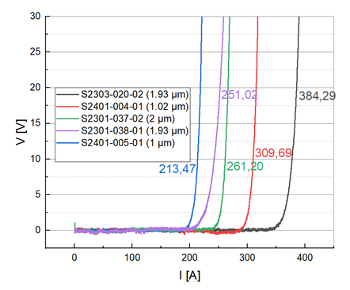
Short samples:
I_{c} for 1-2 μm HTS thickness, 12 mm width

Slide 15
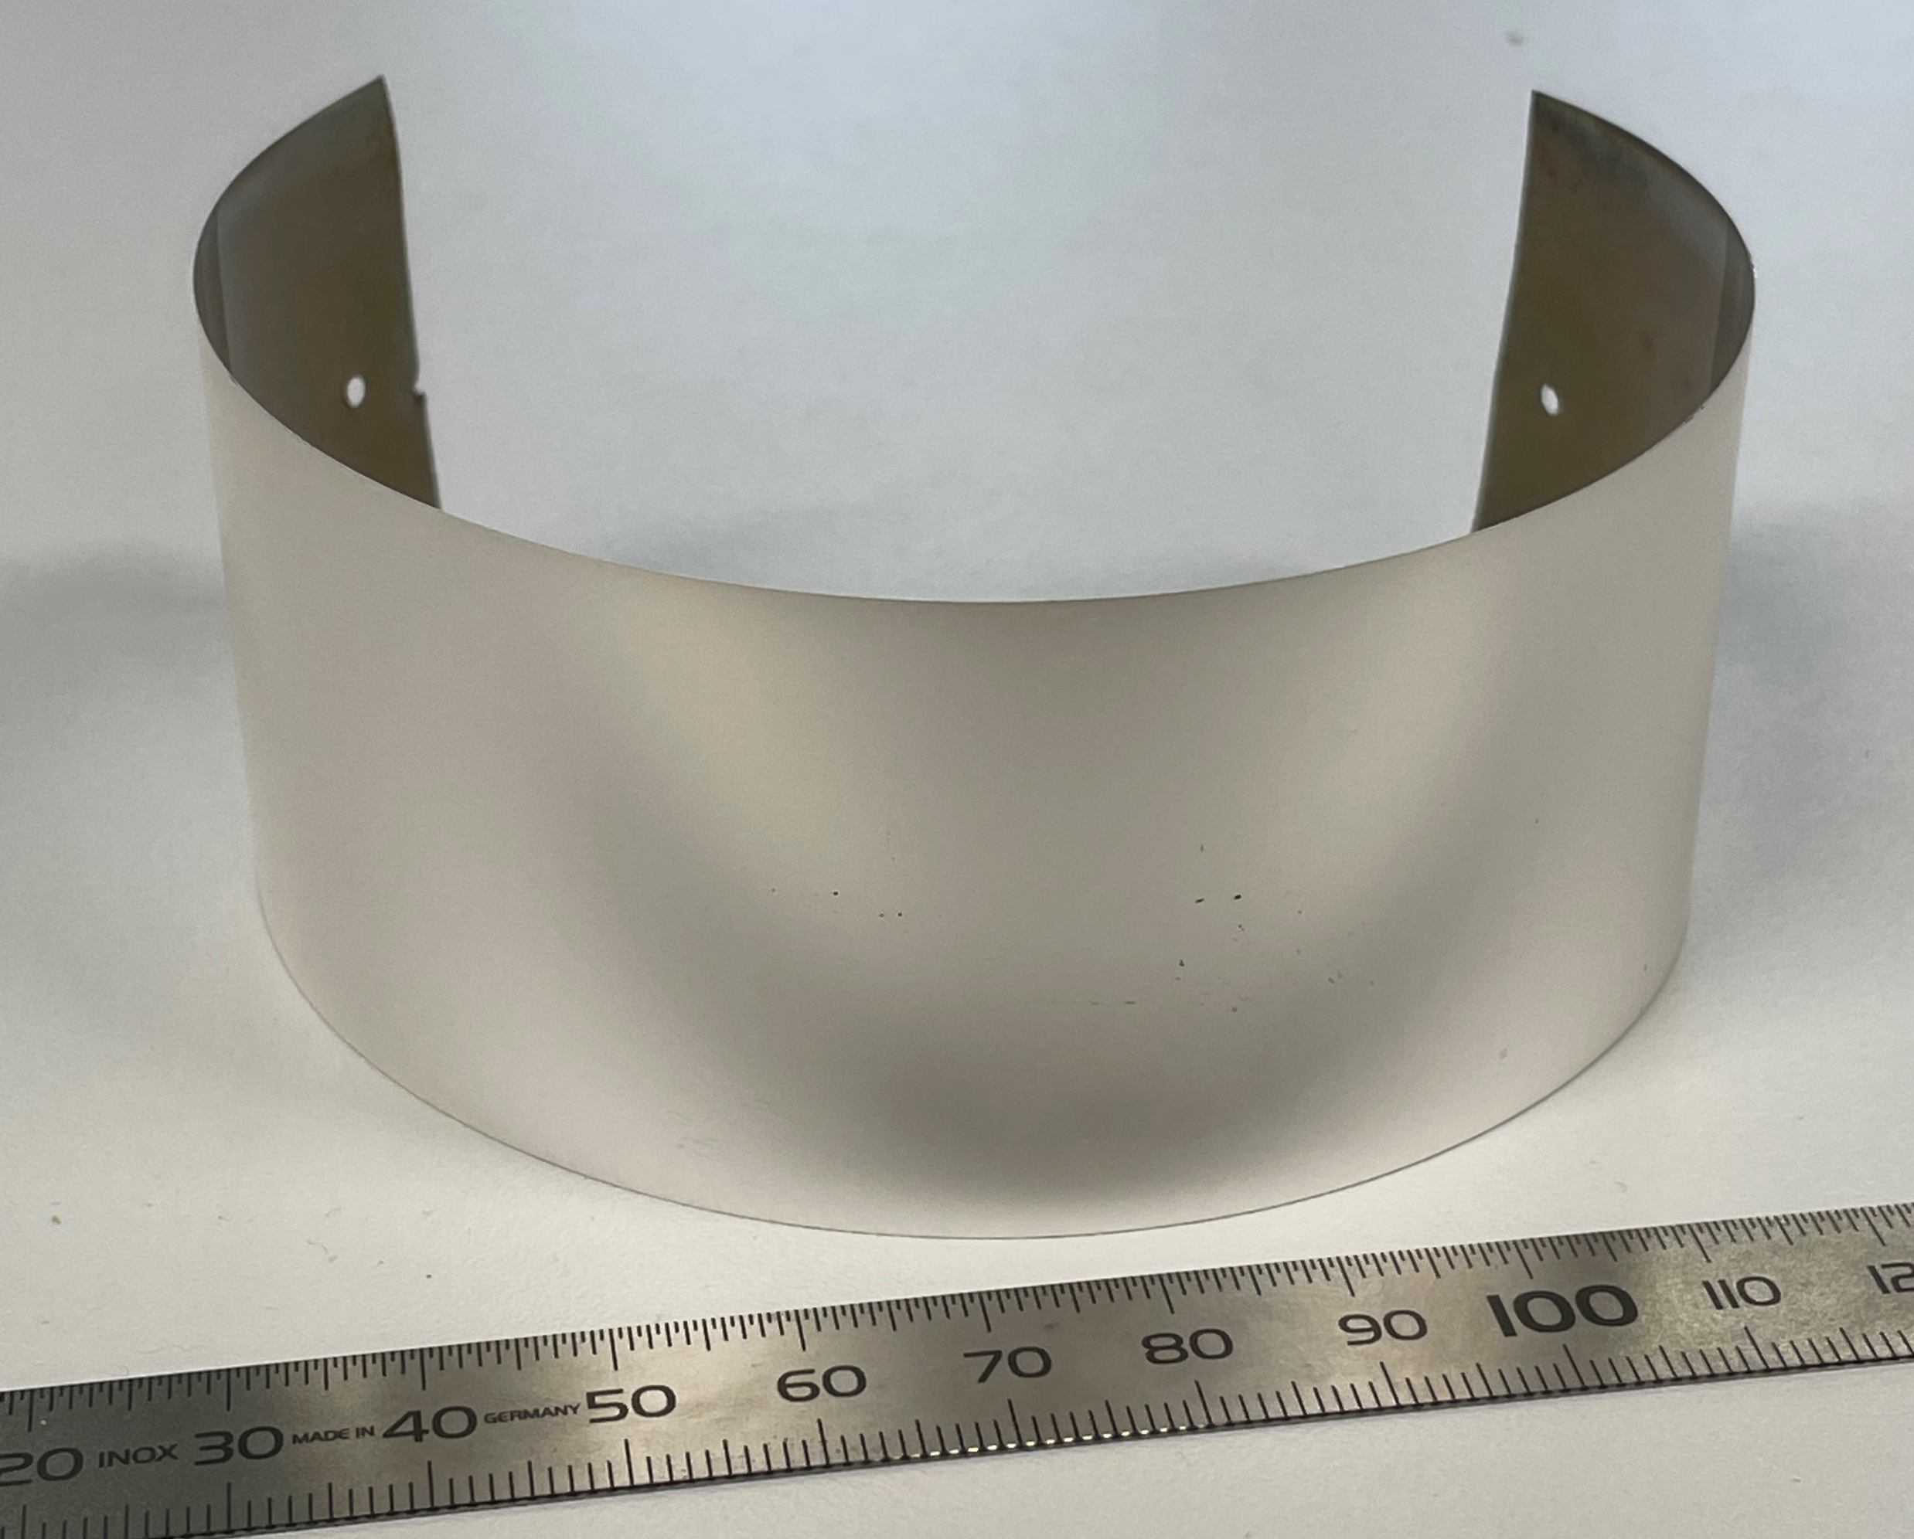
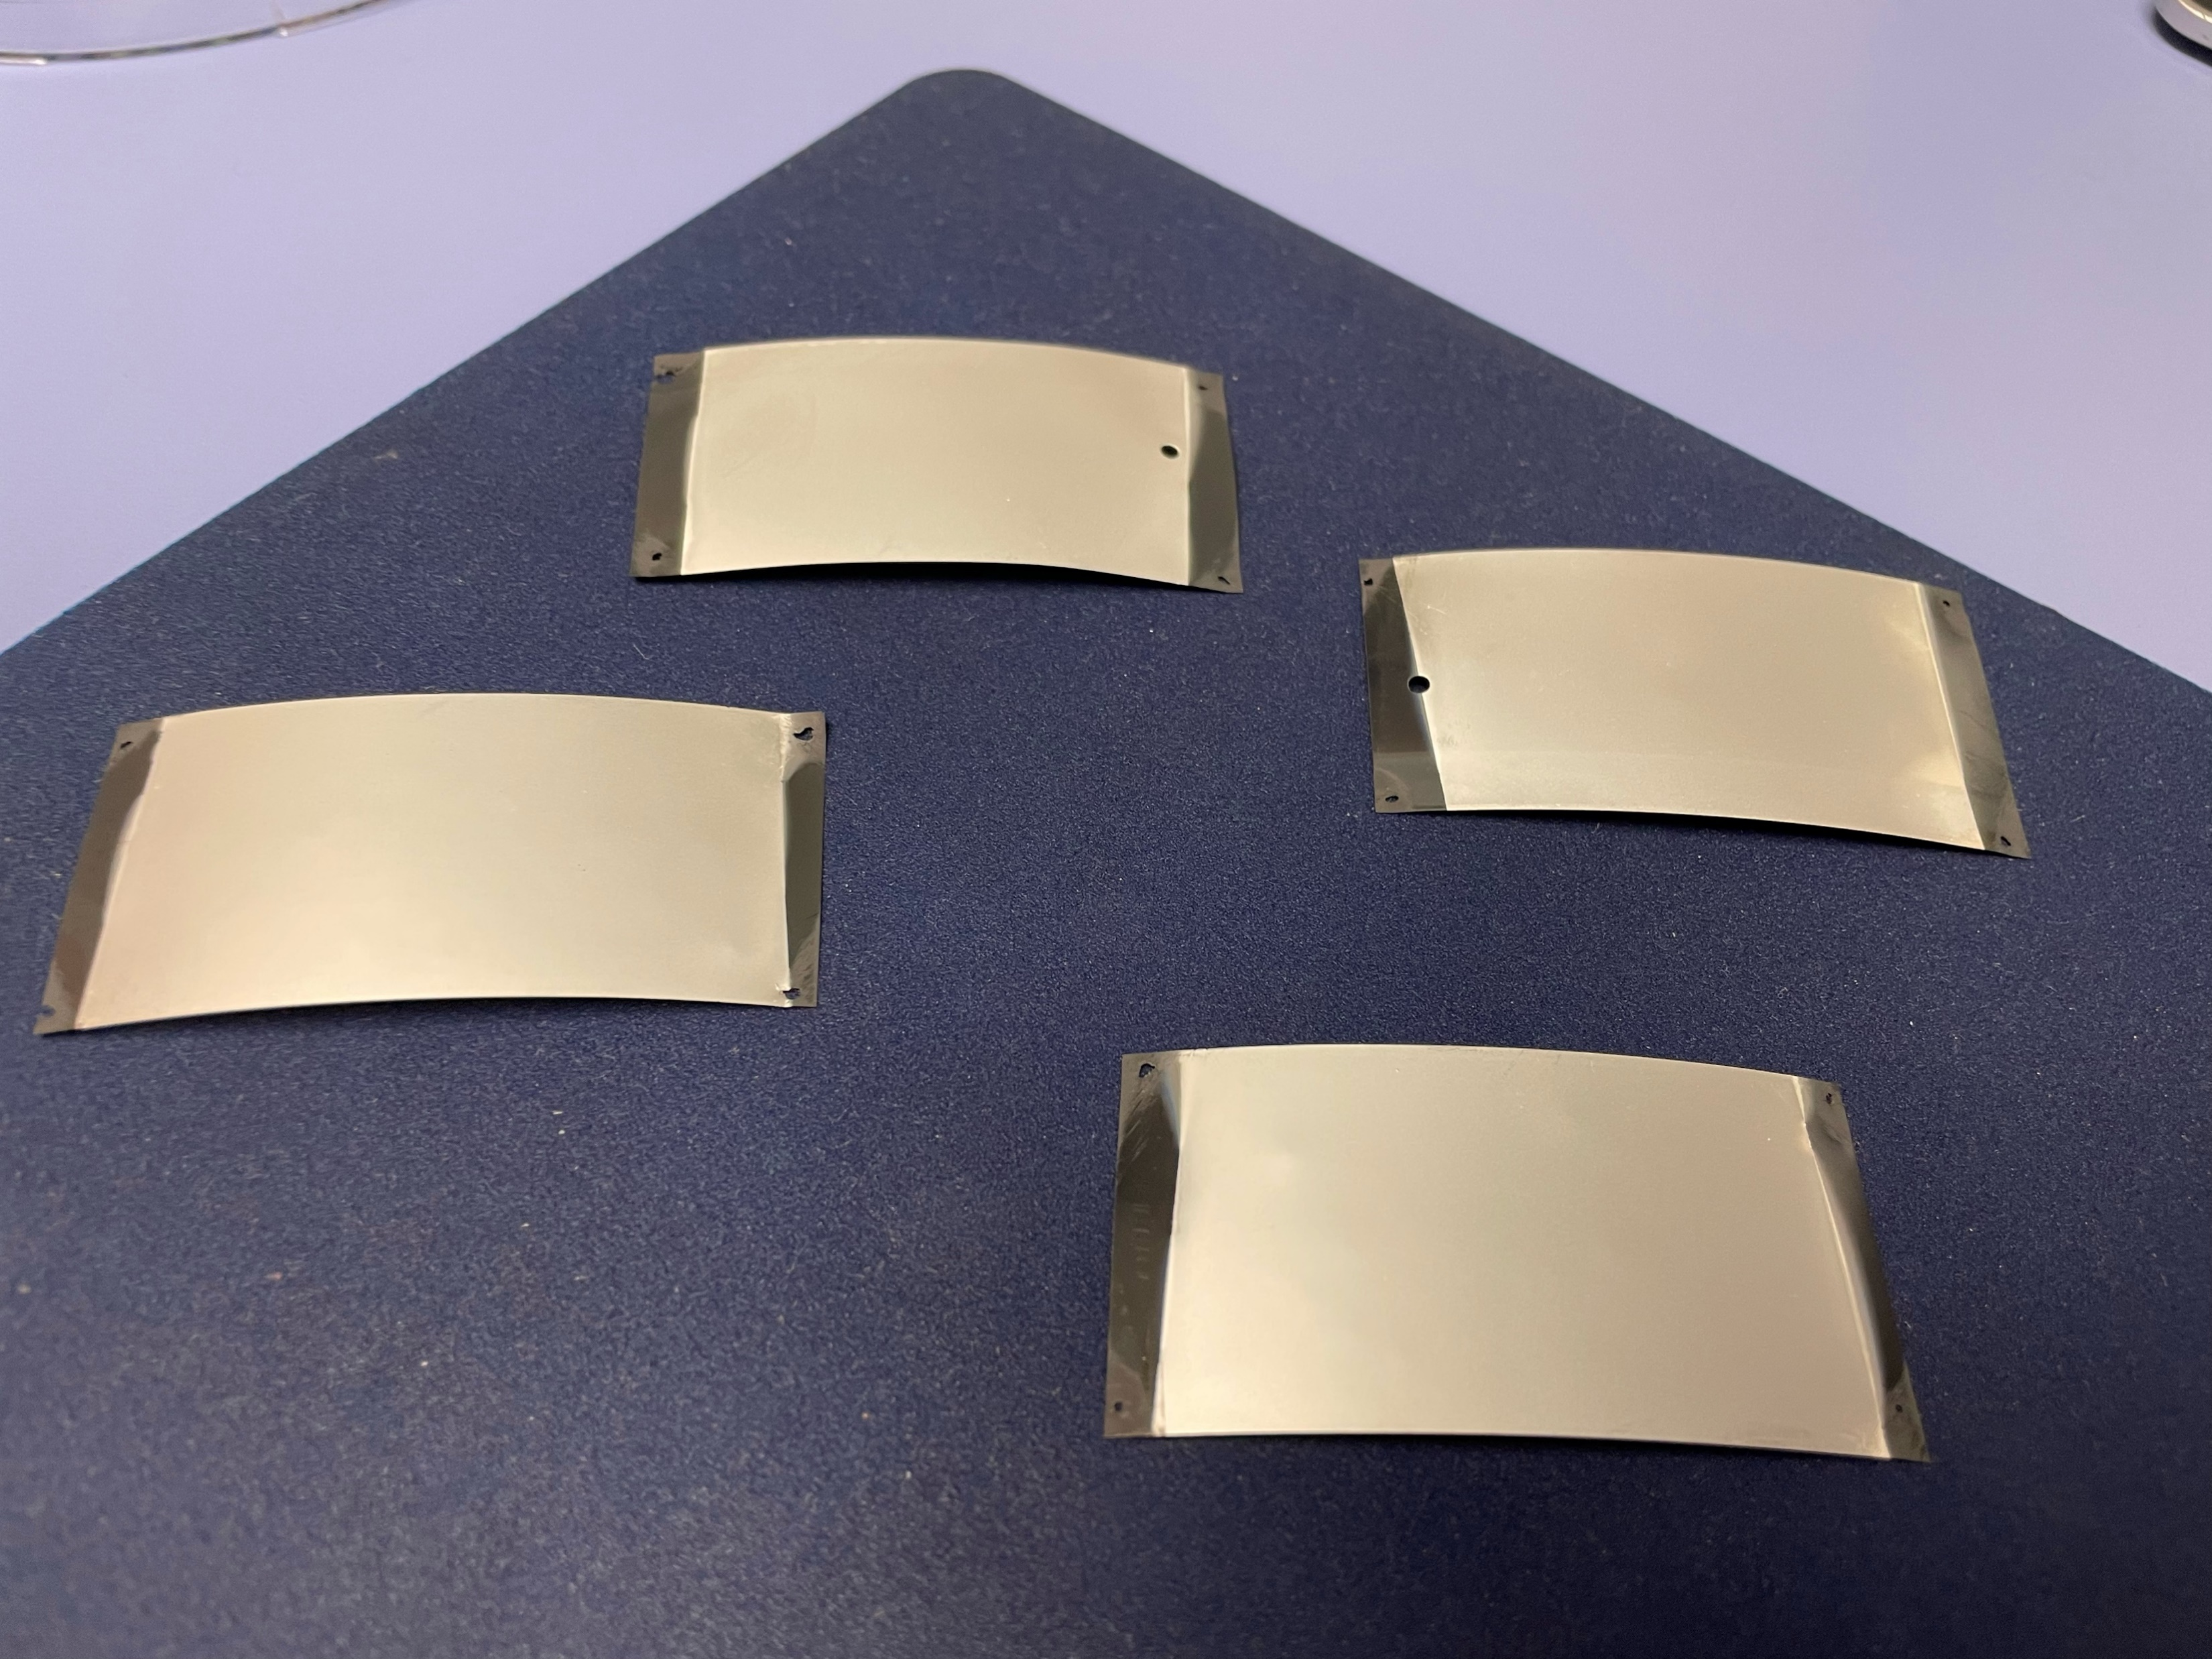
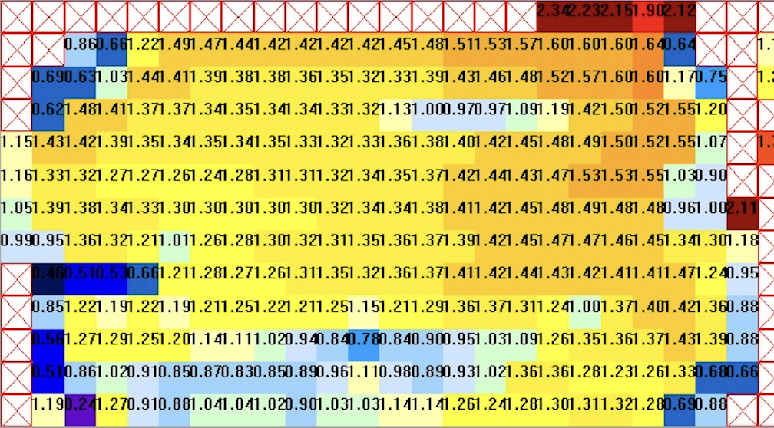
Wider tapes (Joint CERN project „HIGHEST“ - I.FAST Innovative Fund)
40 mm wide
ABAD YSZ CC
30 mm wide
IBAD MgO CC
J_{c} distribution across 4 cm wide CC
Worldwide first realization of 30 and 40 mm wide Coated Conductors within Highest project
4cm tape width

Slide 16
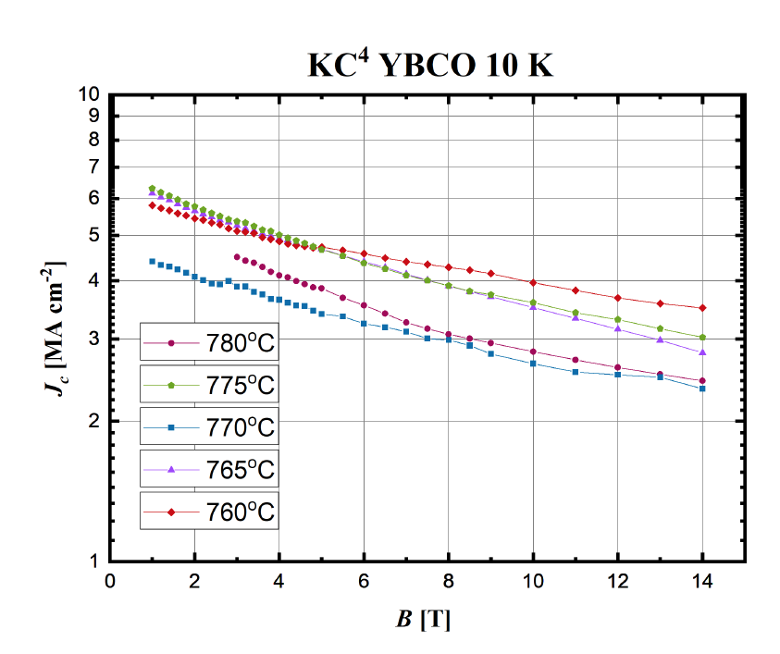
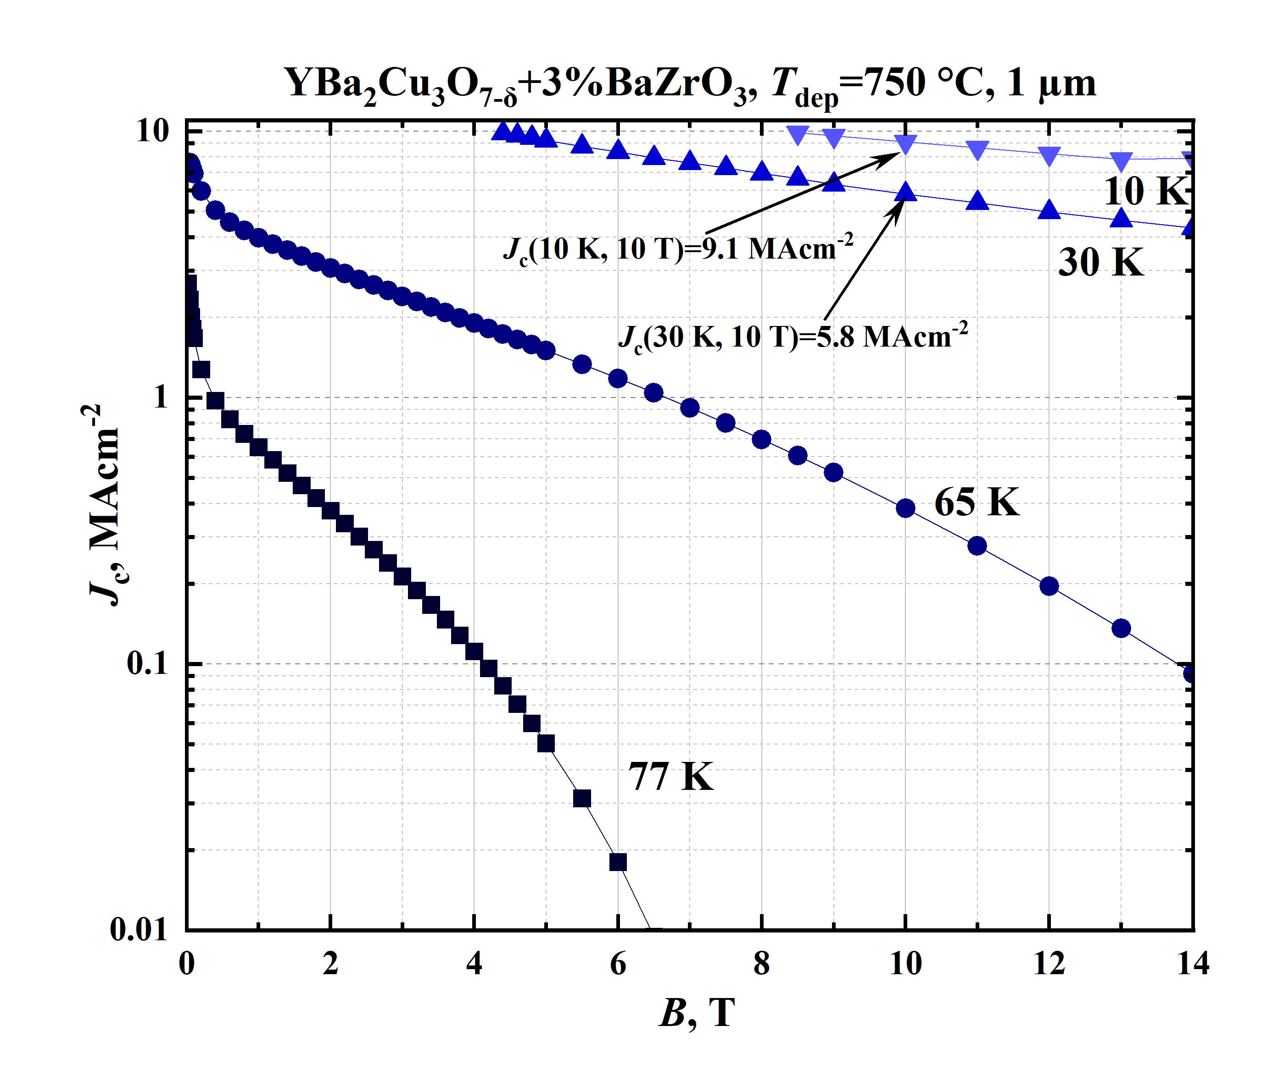
High field, low temperature J_{c} characterization tests for YBCO and YBCO with BZO
Correlation with small scale PLD experiments
High field, low temperature J_{c} characterization tests on small patterned bridges for PPMS setup
BZO nanocolumns can pin the vortices along their entire length, therefore, compared to pristine YBCO, 2-3-fold increase in the low-temperature and high-field J_{c} is achieved for these tapes. This result is in line with best laboratory results worldwide.

Slide 17
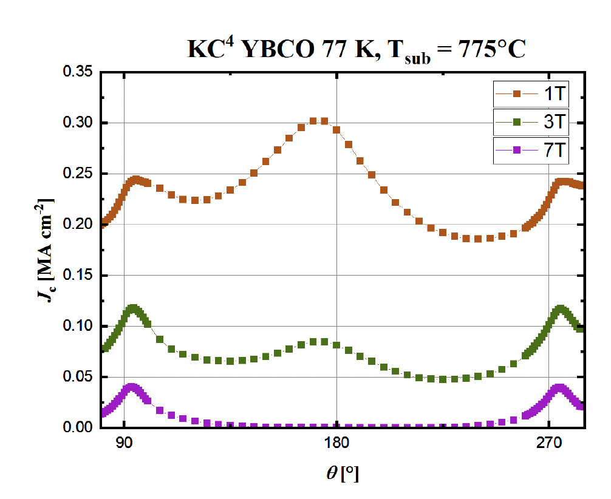
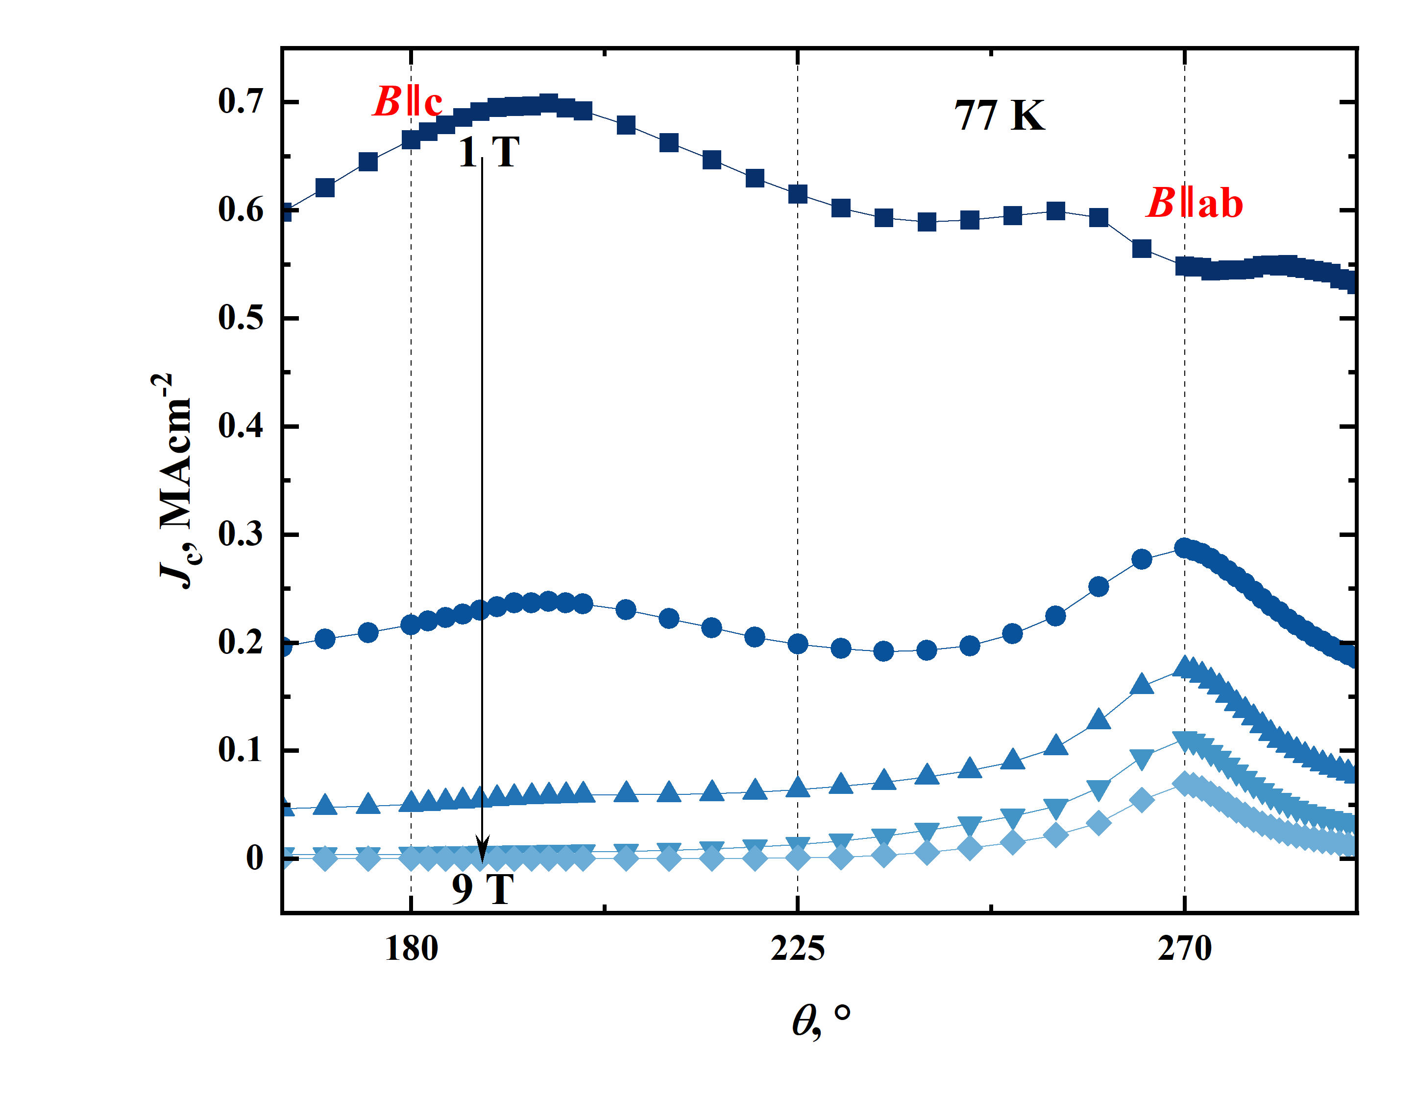
Characterization examples
J_{c} anisotropy characterization for YBCO and BZO doped YBCO
B ‖ c
B ‖ ab

Slide 18
Interfacial resistance studies
Tape ID | CTL (mm) | R_{b} (nΩ*cm²)
S2303_016 (variation over the width) | 0,109 0,106 0,108 | 12,45 11,83 12,21
S2401_001 (variation along the length) | 0,090 0,105 | 16,39 22,28
S2401_002 (variation along the length) | 0,113 0,121 0,104 0,111 | 18,93 21,88 15,99 18,47
S2303_019 A | 0,660 | 606
S2303_019 B | 0,185 | 44
KC4 tapes show low variation in CTL and barrier resistance along the length and over the width. Compared to commercial HTS tapes, these parameters are relatively low
Further experiments are running to investigate the influence of humidity and hydrogen on the barrier resistance value

Slide 19
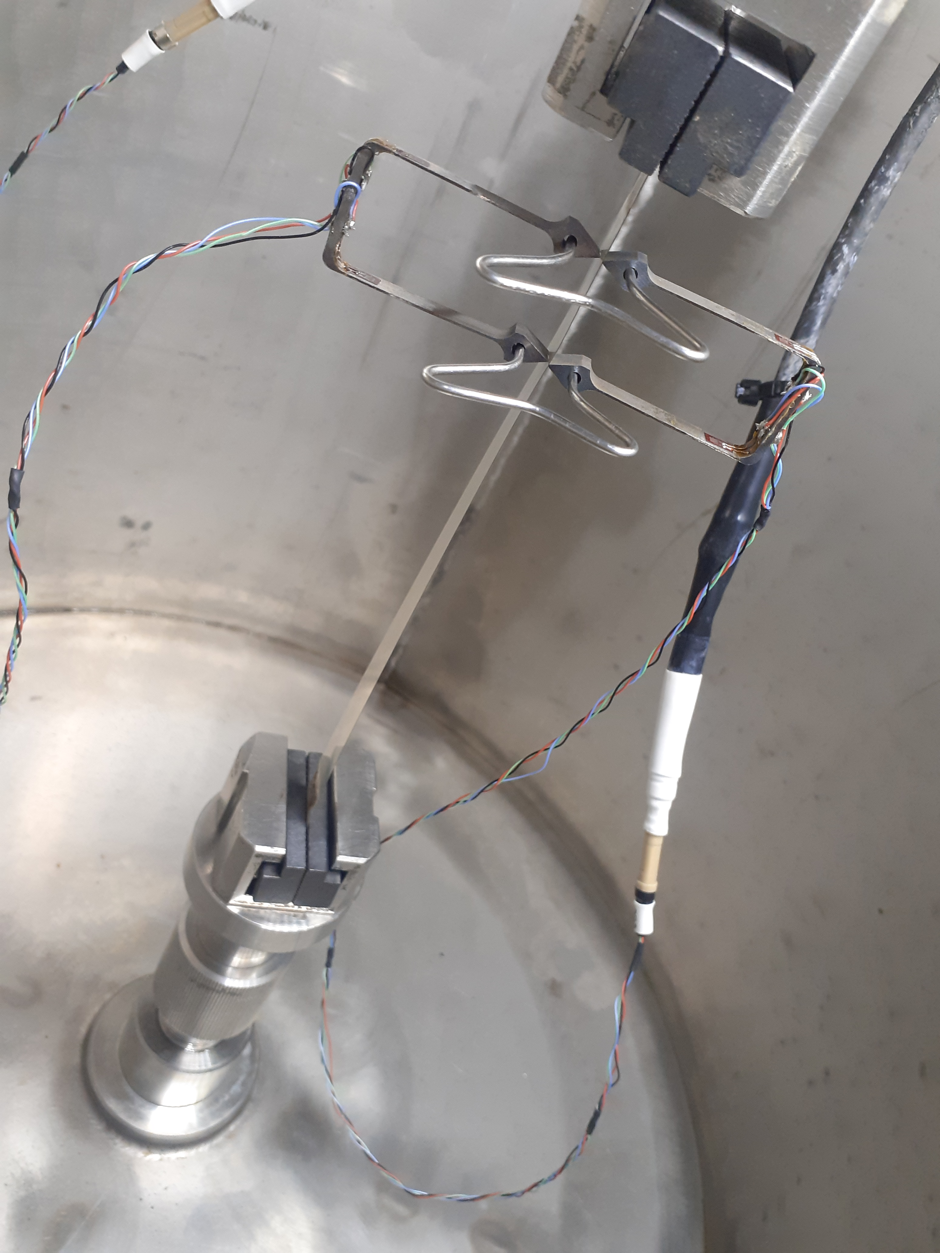
Mechanical characterization – tensile load
I_{c} after application of 0.1% tensile strain
I_{c}-values are measured on two short samples of same tape
Tensile strain of 0.1% applied at 77 K
Samples are cut to remove damage from extensometer tips
I_{c}-values measurement repeated for shortened samples
Result: I_{c} change is within 1%: 195.64 A to 194.68 A and 200.62 A to 198.8 A (that can be within measurement uncertainty and scattering along the length)

Slide 20
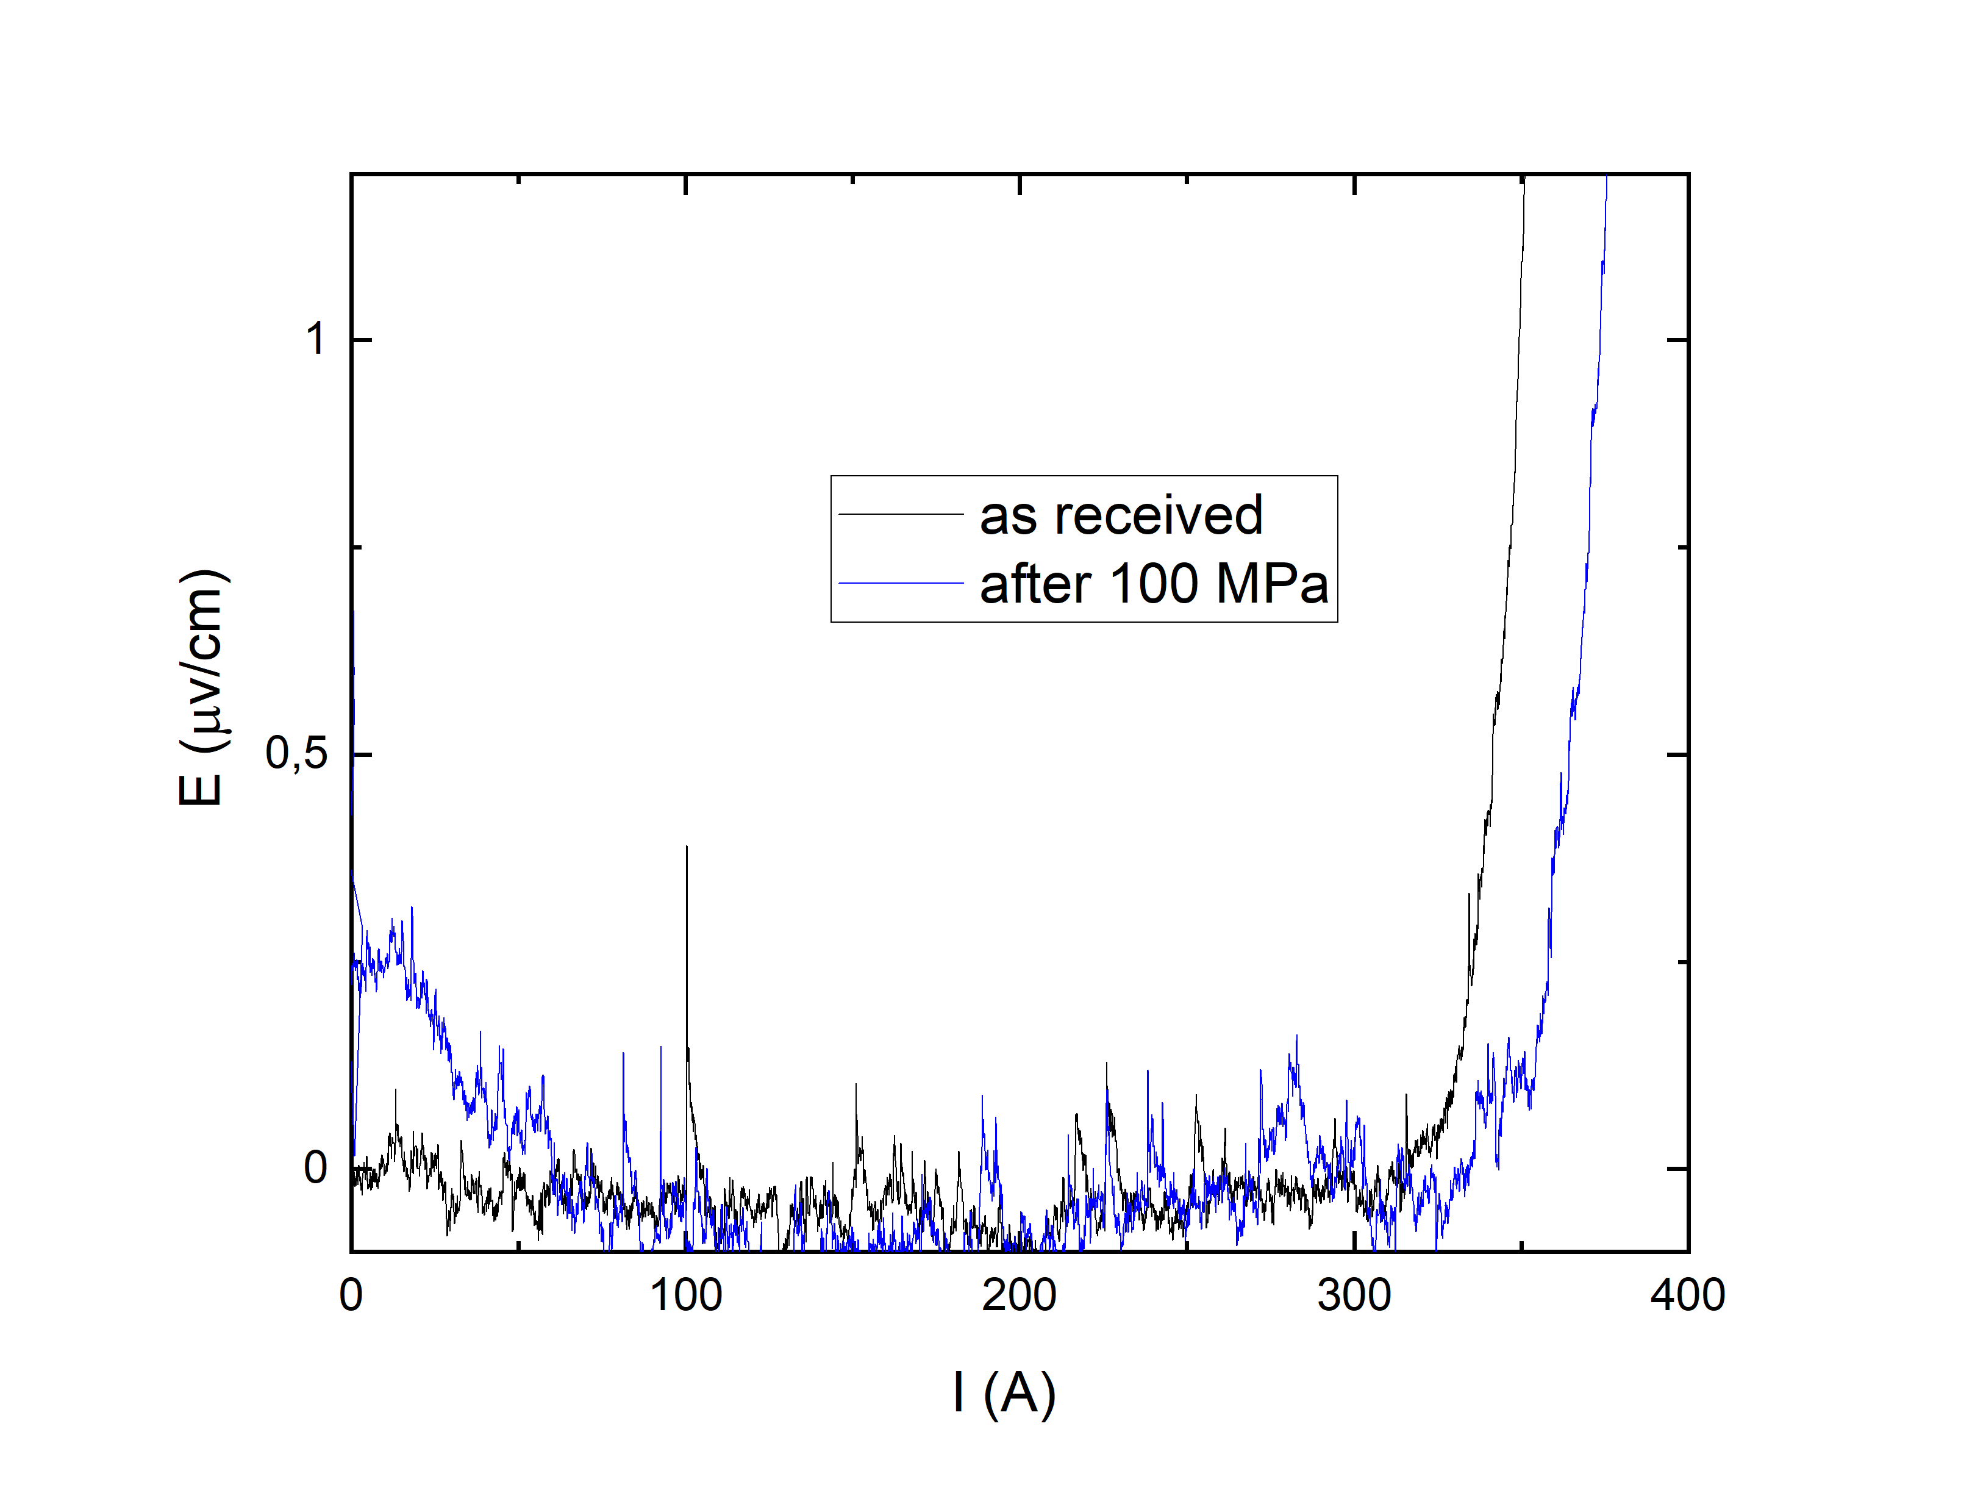
Characterization examples – compressive load
Pressure punch
I-V curves of the sample S2303-014_1 before and after applying a compressive transversal load of 100 MPA over an area of 180 mm² at RT

Slide 21
Further mechanical characterization steps:
J_{c} under tensile stress/strain
J_{c} under delaminating stress
Tensile machine gripping
Voltage contacts
Current joints
J_{c} under compressive stress
Pressure punch
Voltage contacts
Current joints

Slide 22
Next steps
Discussion and decision of joint characterization efforts
- required repeat of deposition parameter tests for
various buffers, SC stoichiometries
- increasing tape lengths >100 m
- electro-mechanical properties measurements
- achievement RfO for second PLD system PLD300 (The laser system is operational and currently the final steps are under way to finish the commissioning phase)
- further transfer small scale PLD experiments on production of tapes
- investigation of factors influencing intrinsic electrical properties

Slide 23
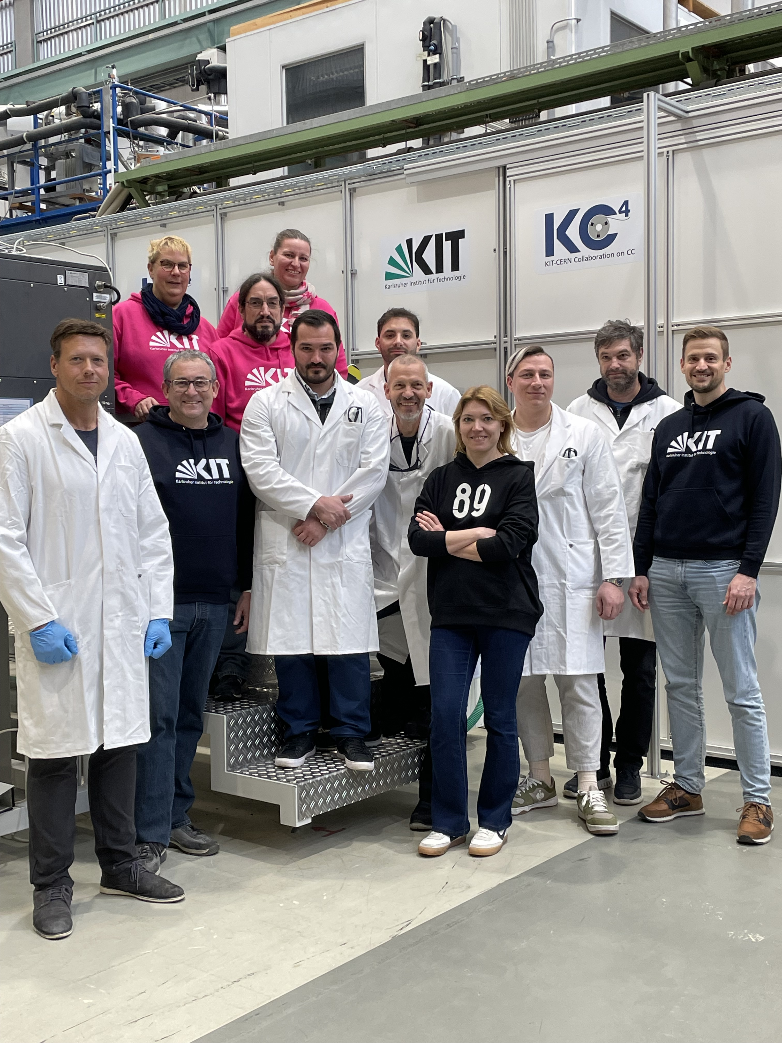
KIT KC4 Team

Slide 24
BRUKER HTS
BHTS’s process chain
The standard processing route for the BHTS coated conductors consists of …
  … stainless steel substrate polishing and cleaning
  … YSZ buffer layer coating by vacuum deposition (ABAD)
  … Ceria and YBCO layer coating by vacuum deposition (PLD)
  … Ag shunt layer coating by vacuum deposition (evaporation) and Ag layer annealing in O2 atmosphere
  … Cu encapsulation by plating
  … final inspection and quality check of the HTS tapes
Typical HTS layer stack
Idealized sketch of the BHTS process chain
180µm

Slide 25
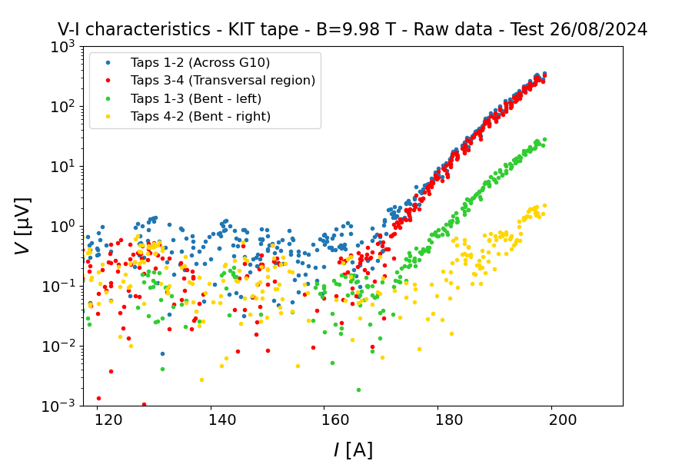
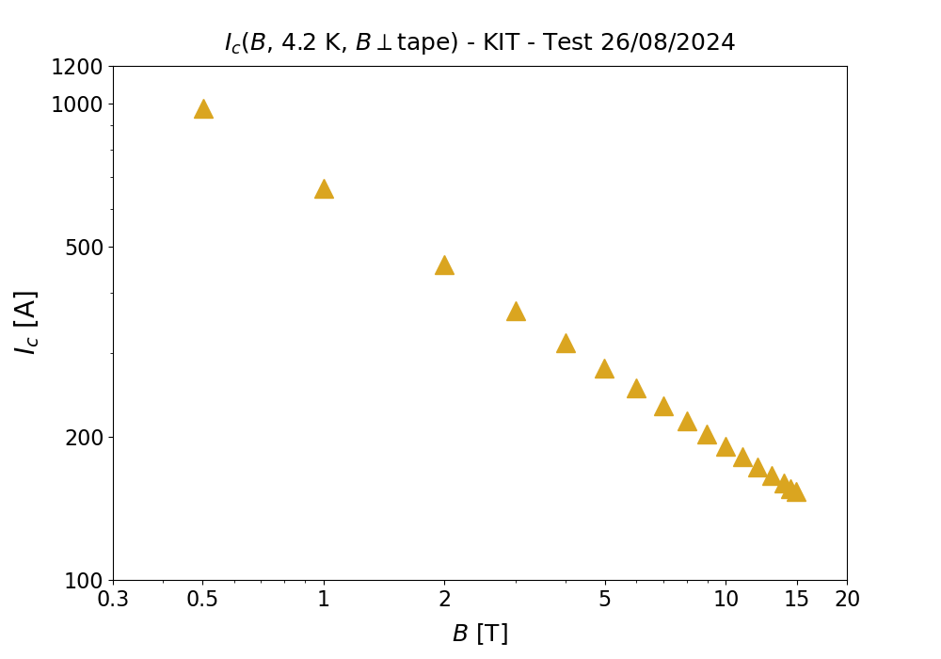
Critical Current Density characterization at low T, high field
I_{c}-measurements at low temperatures and high fields were performed at CERN by Aisha Saba and Giovanni Succi on 4 mm wide tapes which were laser cut at KIT.
B ‖ c
B ‖ c
the IV-curves of the sample at 10 T for different contacted tape areas
The I_{c} value for the relevant BIIc sample is 170 A, which corresponds to an engineering critical current density of J_{E} = 850 A/mm², which meets the deliverable threshold.
The measured field dependence of I_{c} at 4,2 K
I_{c} value >1000 A at zero field, and engineering critical current density of 937 A/mm² at 10 T and 4 K

