Slide 1


KE5814 – CNR-SPIN collaboration on HTS
Progress on development of iron based superconducting wire
Andrea Malagoli
CNR - SPIN
Co-authors:
A. Leveratto, A. Traverso, E. Bellingeri, C. Bernini, F. Loria, V. Braccini CNR-SPIN
M. Bordonaro, H. M. Hassan, UniGe
A. Ballarino CERN
Andrea Malagoli HFM meeting February 12th, 2025

Slide 2
KE5814 – CNR-SPIN collaboration on HTS
HFM Work Package 2.15: Development of iron based superconducting wire
The project consists in carrying out preliminary research and development works related to the development of Iron Based Superconducting wire (IBS) produced with the Powder In Tube (PIT) technology
The programme aims at developing a practical wire produced with a technology that could enable a large-scale production at an affordable cost.
The Objectives are:
  - The definition of a scalable process to produce high quality powders in terms of critical temperature and homogeneity;
  - The development of PIT wires via the ex-situ method through a mechanical process optimized to reach a high densification and texture in the powder core;
  - The fabrication of multifilamentary wires with Jc at least 10⁵ A/cm² at 16 T at the temperature of interest
Andrea Malagoli HFM meeting February 12th, 2025

Slide 3
The development steps …
… and the issues to face
Powder
P.I.T. wire
Oxygen
contamination
Purity and
homogeneity
Scalable processes
Andrea Malagoli HFM meeting February 12th, 2025

Slide 4
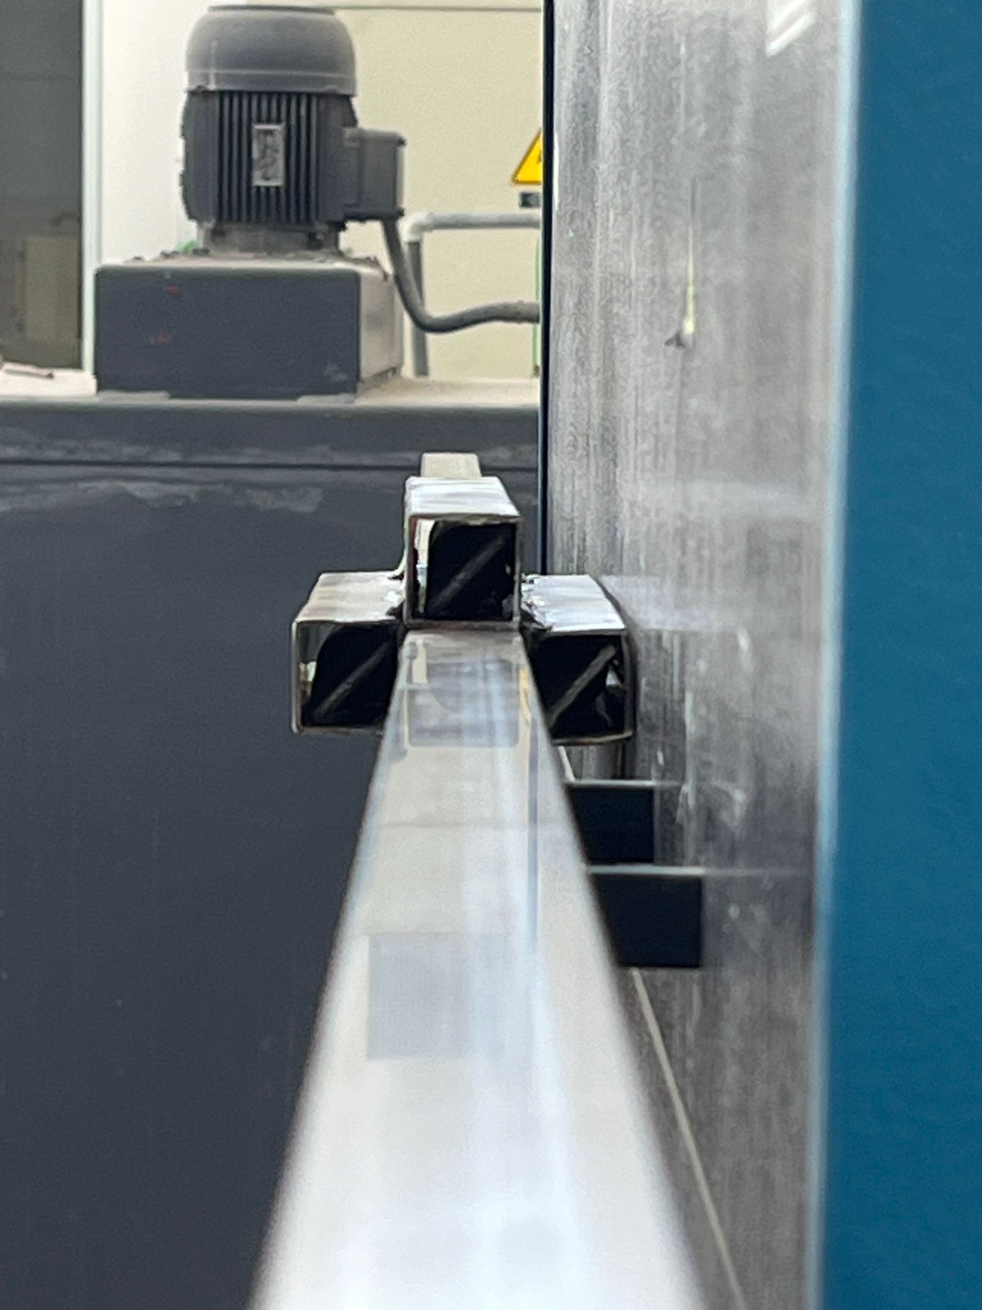
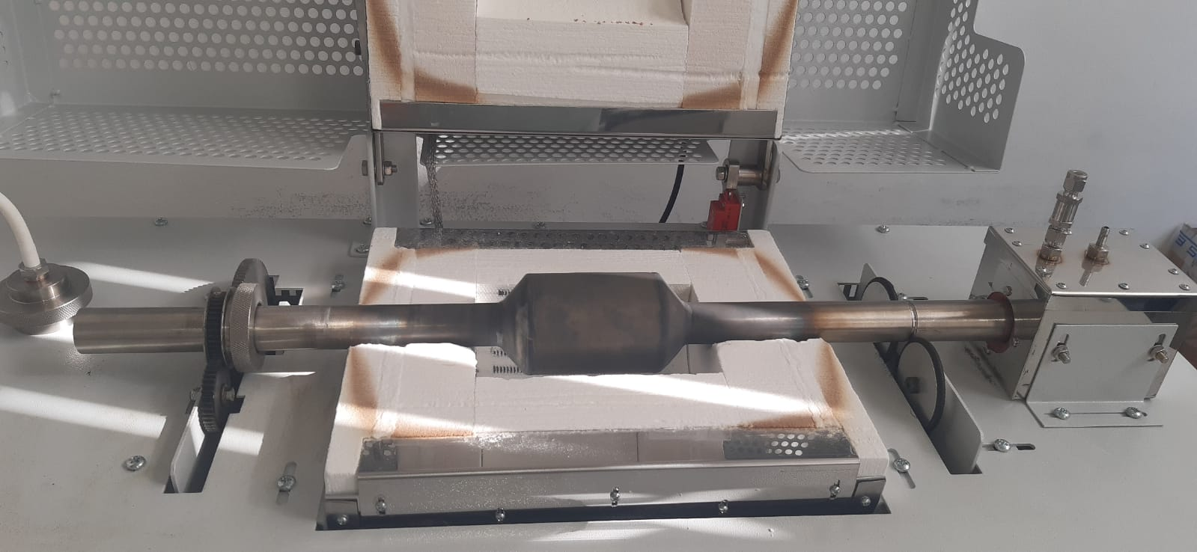
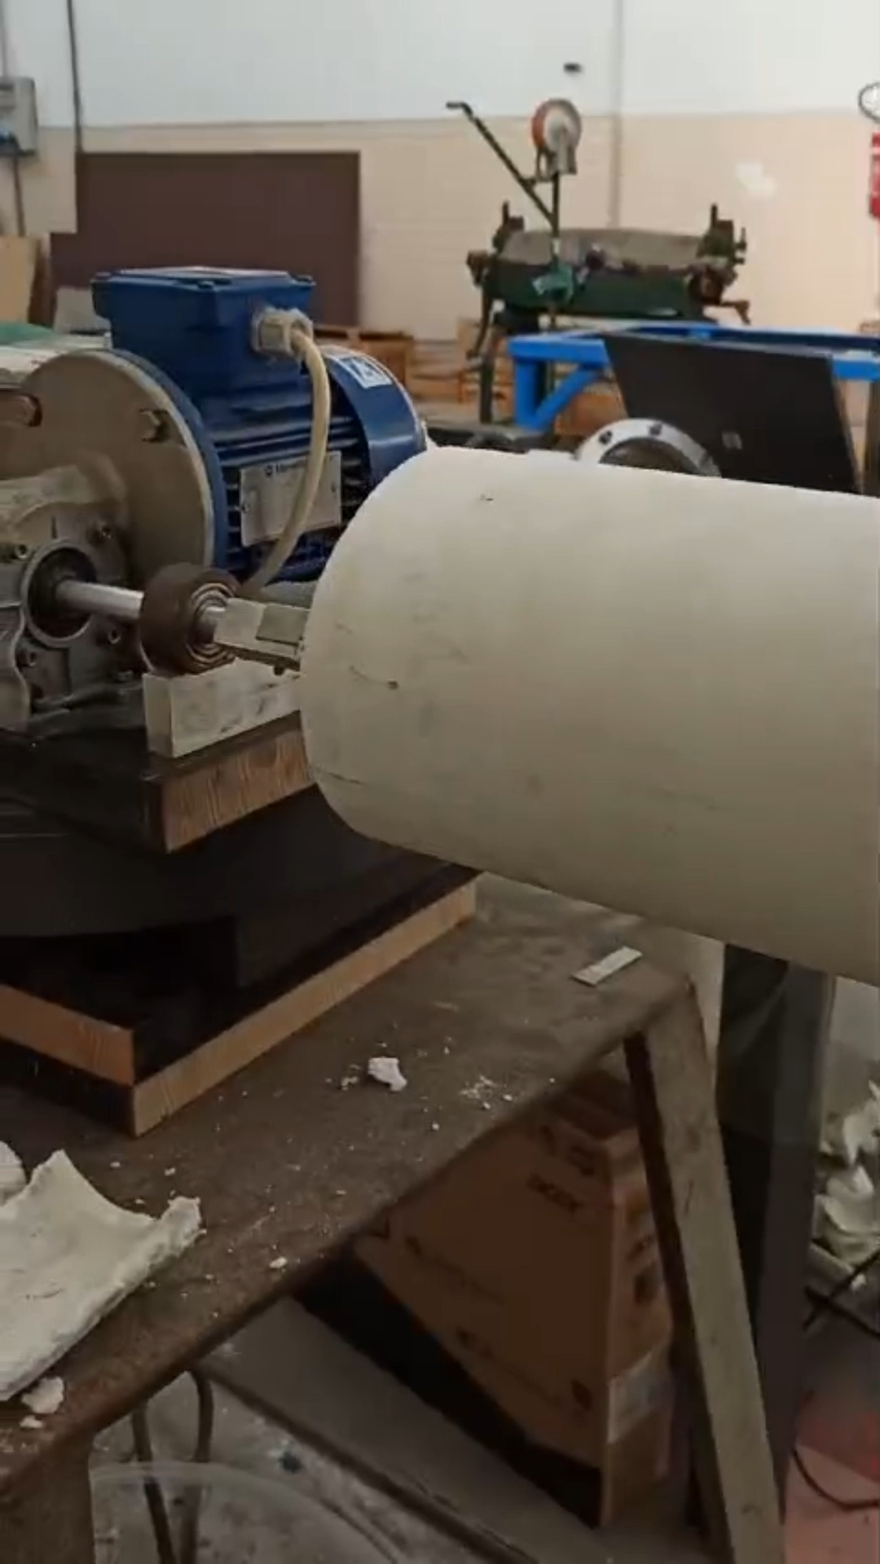
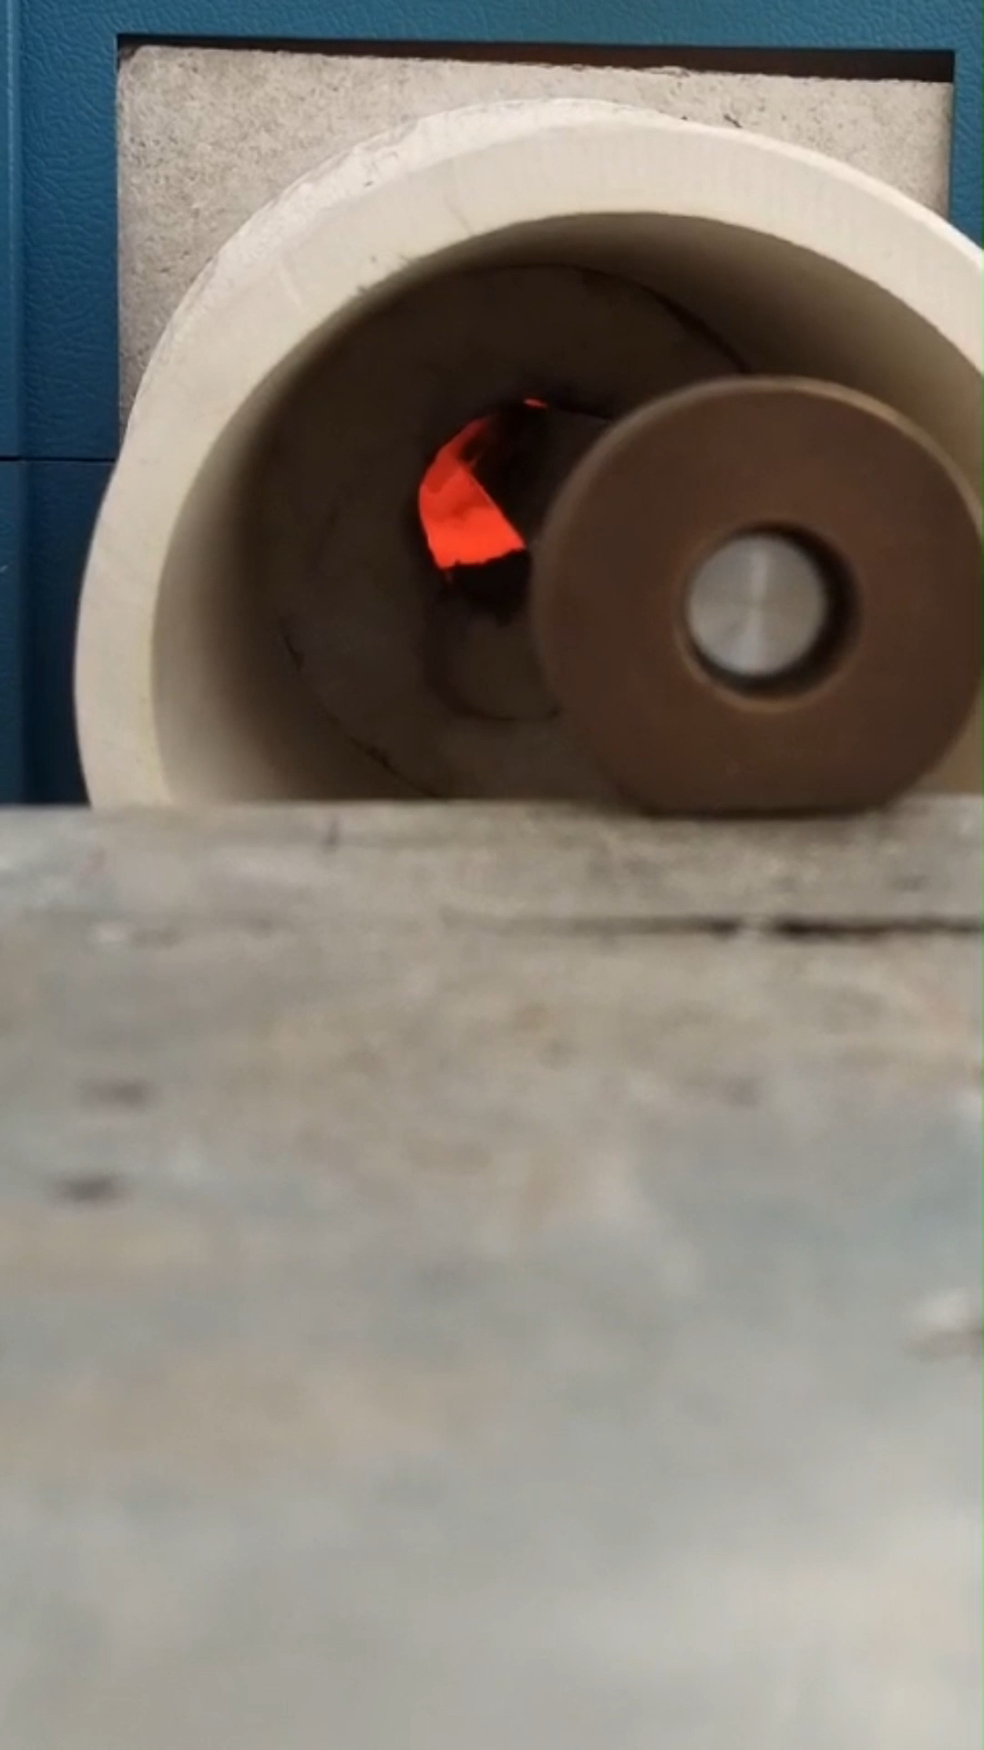
Powders preparation optimization
1 Static Furnace (2 g) 2. Oscillating Furnace (6 g) 3. Rotating Furnace (25 g)
850 °C, 20h
50 °C/h
Temperature
Time
Element | Purity | Form
Iron | 99.99% | Powder
Potassium | 99.99% | Solid
Barium | 99.25%+ (0.75%Sr) | Chunks/filings
Arsenic | 99.99% | Nuggets/Powder
Andrea Malagoli HFM meeting February 12th, 2025

Slide 5
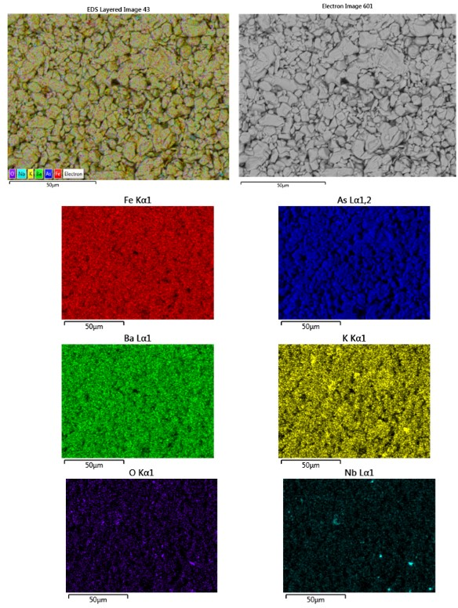
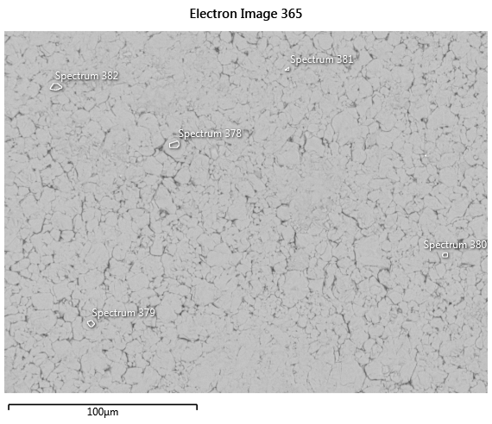
Powders preparation optimization
1 Static Furnace (2 g) 2. Oscillating Furnace (6 g) 3. Rotating Furnace (25 g)
°
e
°
d
°
a
°
c
°
b
Spectrum label | Ba | K | Fe | As | total
a | 13.17 | 7.63 | 40.38 | 38.81 | 100.00
b | 13.26 | 7.85 | 39.69 | 39.20 | 100.00
c | 13.27 | 7.76 | 40.19 | 38.78 | 100.00
d | 13.43 | 7.92 | 39.96 | 38.69 | 100.00
e | 13.11 | 7.65 | 39.97 | 39.27 | 100.00
A. Malagoli et al. IEEE-TAS, vol.35, 5, 2025, D.O.I.:10.1109/TASC.2025.3530897
Andrea Malagoli HFM meeting February 12th, 2025

Slide 6
Powders preparation optimization
Static
Oscillating
Rotating
Estimation
100 g/7 days ∼ 100 m of wire
Andrea Malagoli HFM meeting February 12th, 2025

Slide 7
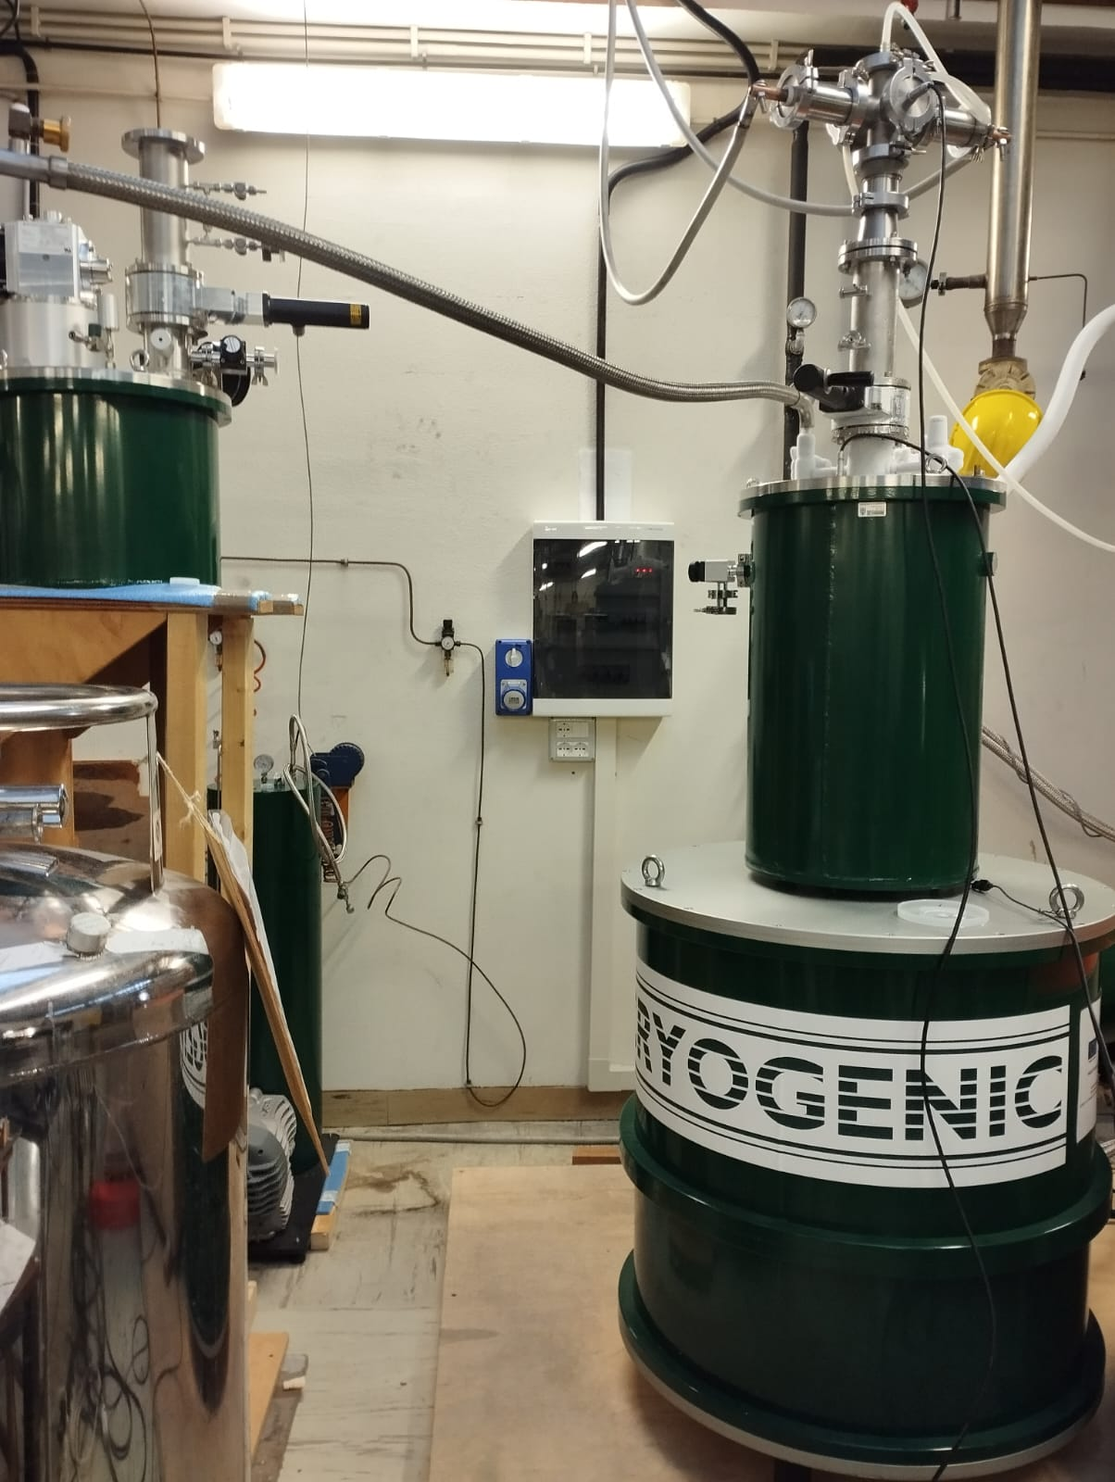
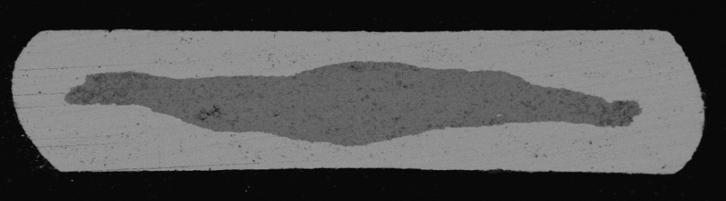
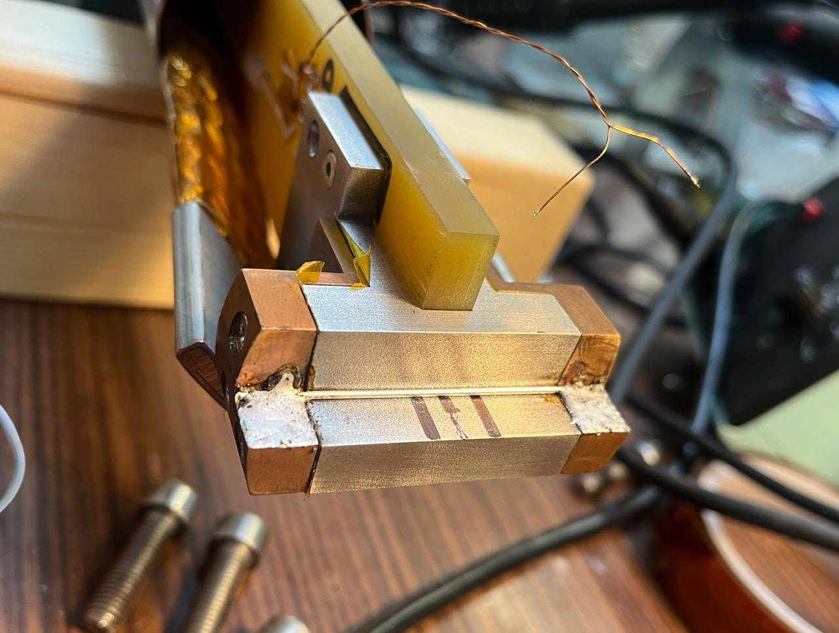
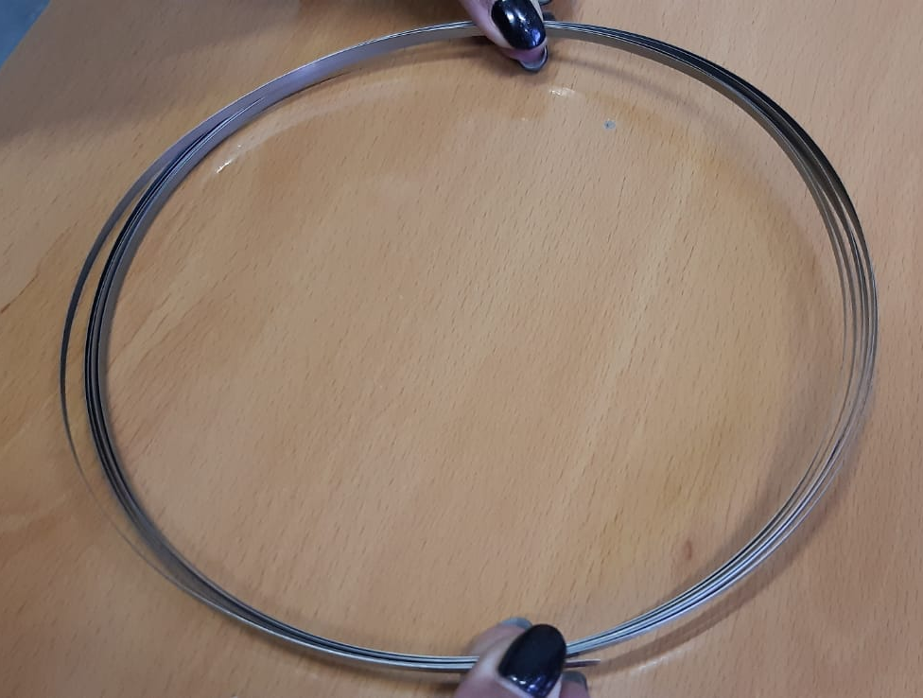
Results on «simple» tape for powders validation
Ag sheated
0,4 mm
2,5 mm
Sintered @ 840°C/10h
Andrea Malagoli HFM meeting February 12th, 2025

Slide 8
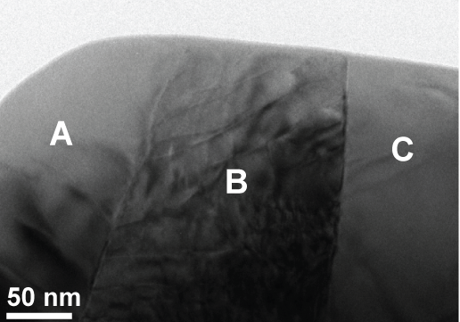
from powder to wire
GBs
Powder
P.I.T. wire
Purity and
homogeneity
High densification
Sheaths choice
Weal links? Connectivity?
Oxygen
contamination
Texturing
Round/isotropic multifilamentary wire
High Jc
above
LHe – 20K
Scalable processes
Granulometry
Andrea Malagoli HFM meeting February 12th, 2025

Slide 9
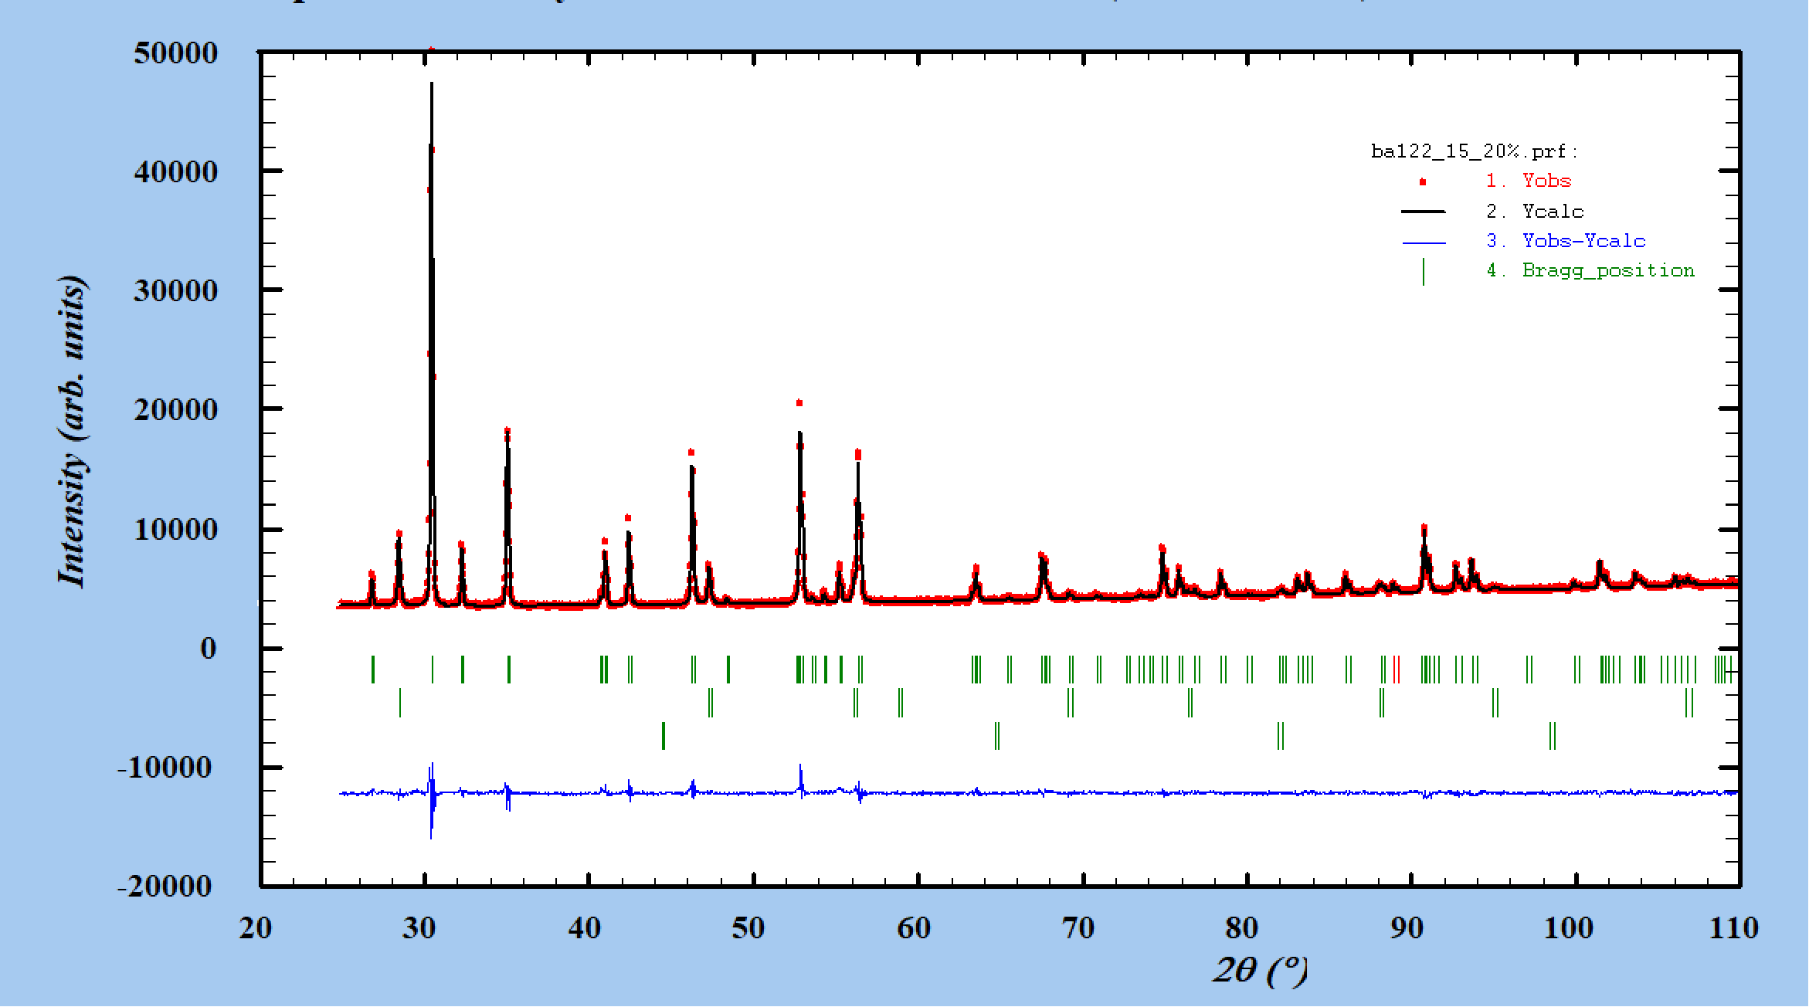
K content into the phase
K-excess effects on granulometry
(Ba_{0.6}K_{0.4+δ})Fe₂As₂
Rietveld Refinement of:
Phase purity
Cell parameters
K content
δ | 0 | 0.02 | 0.04 | 0.06 | 0.08
% | 0 | 5 | 10 | 15 | 20
Intriguingly, a diminishing trend in potassium content is observed as the initial stoichiometric excess of potassium increases.
EDX measurements confirm this trend
Andrea Malagoli HFM meeting February 12th, 2025

Slide 10
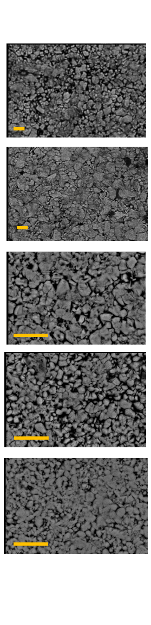
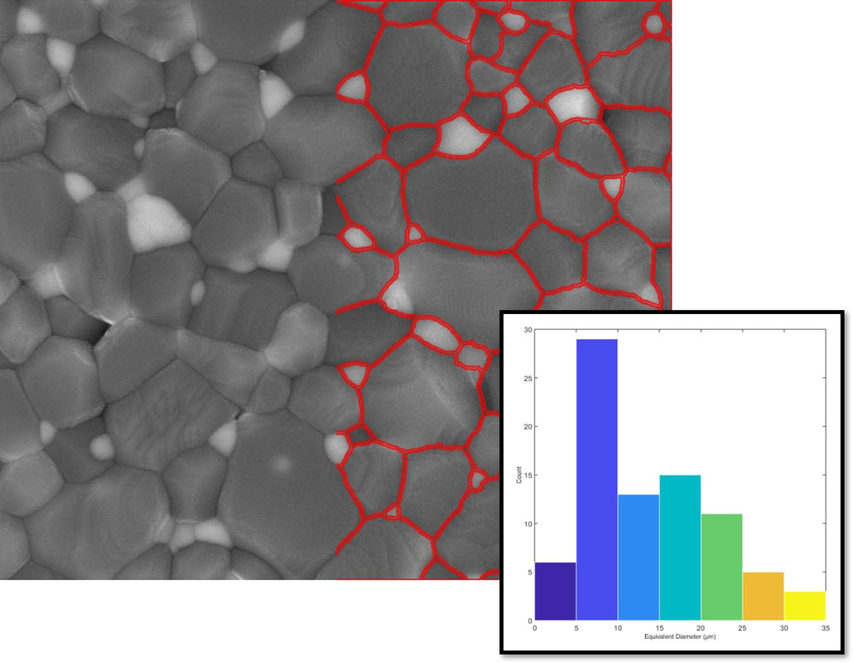

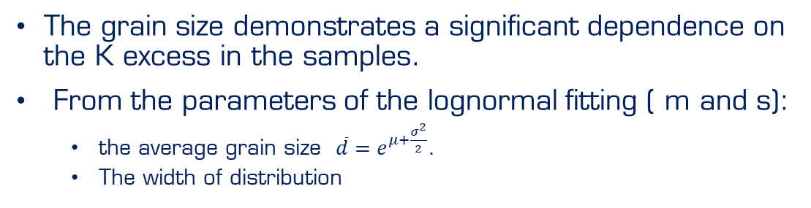
K-excess effects on granulometry
The grain size demonstrates a significant dependence on the K excess in the samples.
From the parameters of the lognormal fitting ( m and s):
  the average grain size $\overline{d}=e^{μ+\frac{σ^{2}}{2}}$.
  The width of distribution
Automatic grain size estimation
Grain diameters was estimated in SEM images by a Matlab routine
E. Bellingeri et al. SUST, 37, 2024
Clearly the K excess strongly enhanced the grain growth
Andrea Malagoli HFM meeting February 12th, 2025

Slide 11
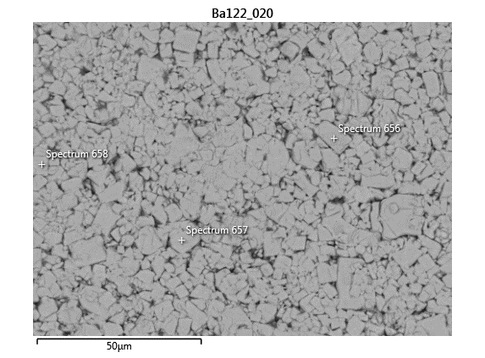
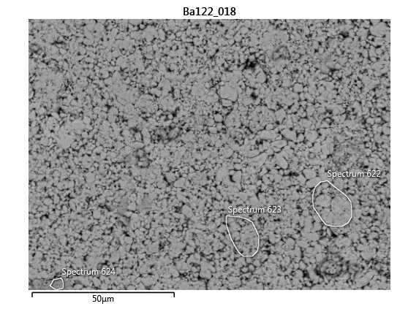
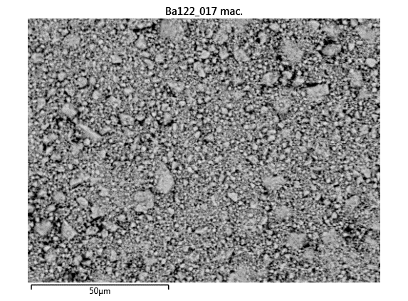
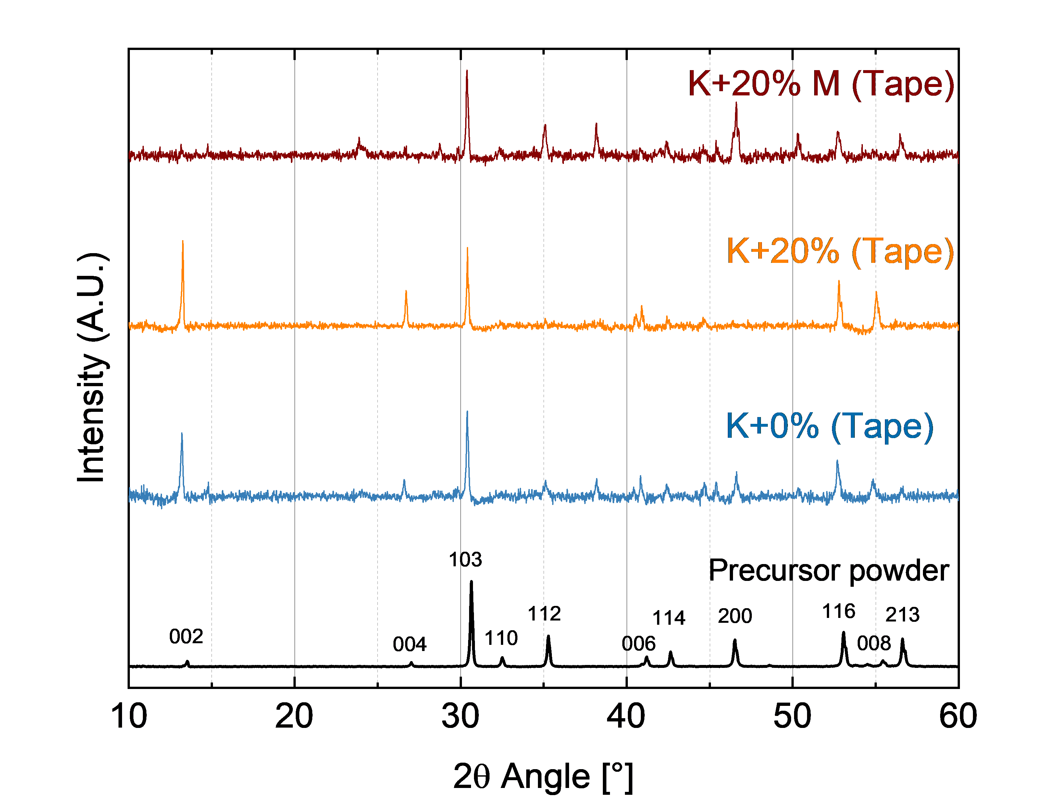
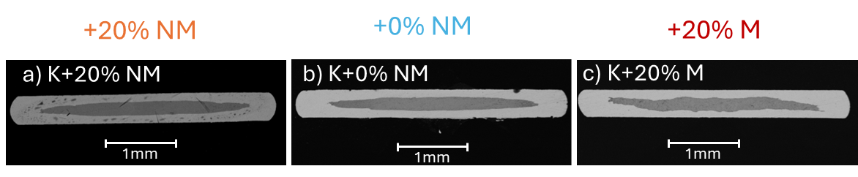



Let’s see the effect on the tapes
$$\overline{d}=8.3 μm$$
K+20%
$$\overline{d}=1.6 μm$$
K+0%
$$\overline{d}=0.9 μm$$
K+20%M
XRD measurements
A better texturing for the tape made with larger grains powder
Andrea Malagoli HFM meeting February 12th, 2025

Slide 12
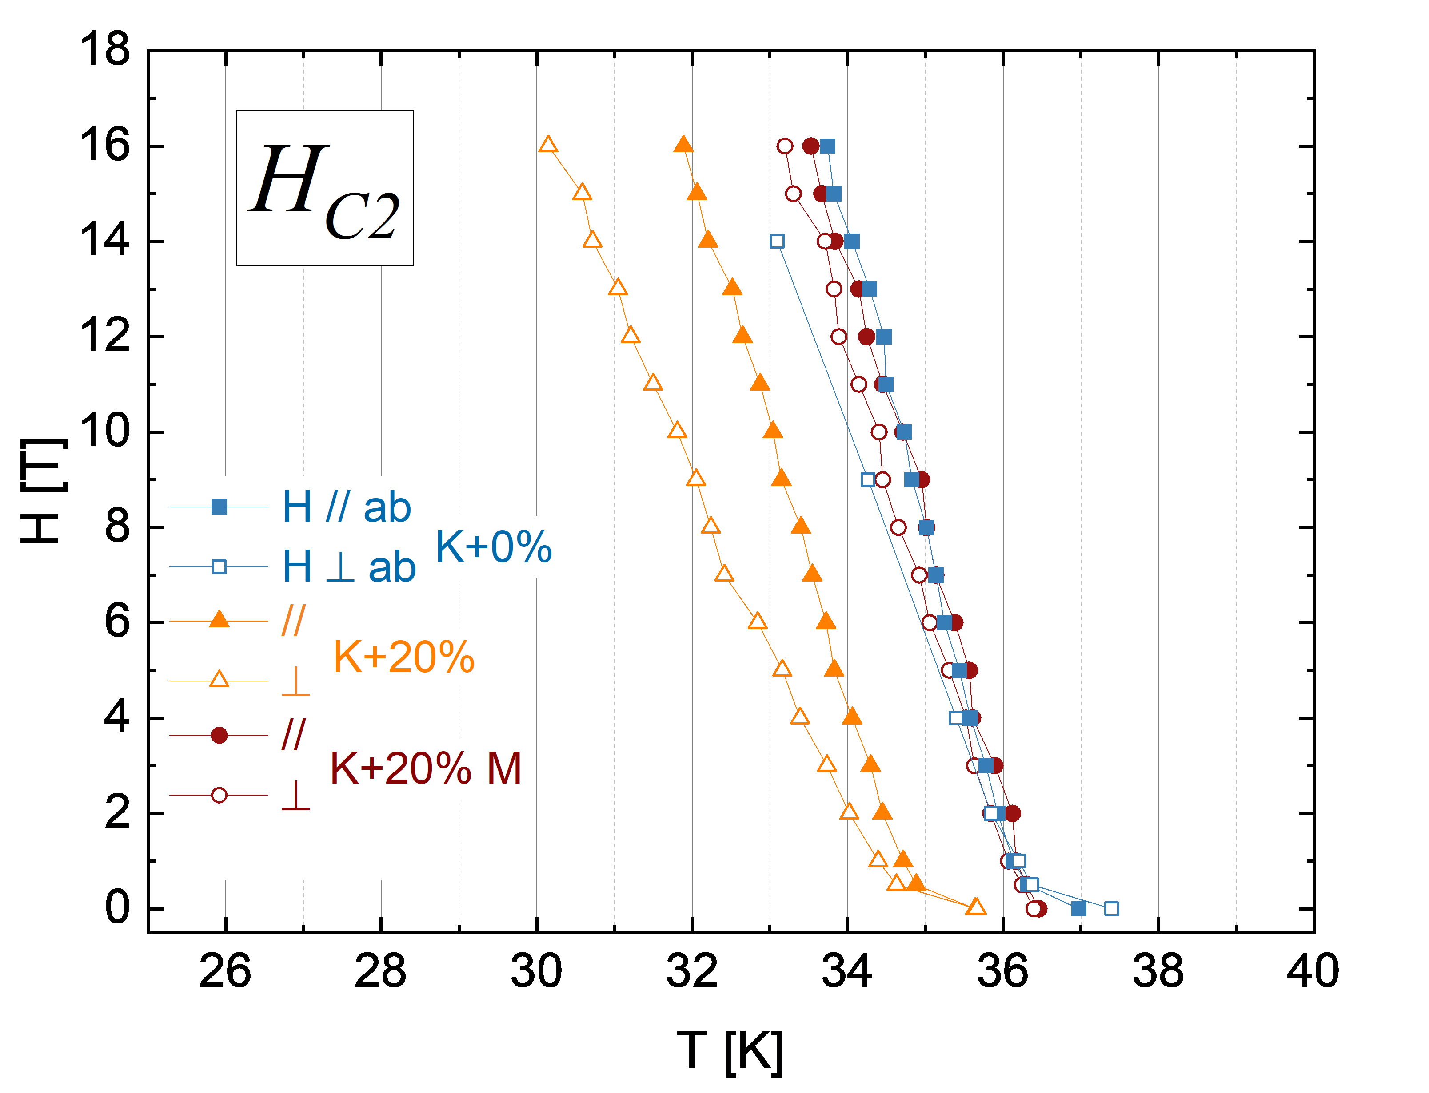
Let’s see the effect on the tapes
The upper critical field behavior of the tapes made with the powders with smaller granulometry is very similar and the values are higher than those of the tape made with the powder with the biggest grain size distribution. At the same time, the anisotropy is remarkably reduced.
The critical current decreases as the granulometry of the starting powder and grains texturing decrease. Moreover, a weak link behavior is visible, being this issue less severe for the bigger granulometry.
A. Traverso et al. IEEE-TAS, D.O.I.:10.1109/TASC.2025.3534744, 2025
Andrea Malagoli HFM meeting February 12th, 2025

Slide 13
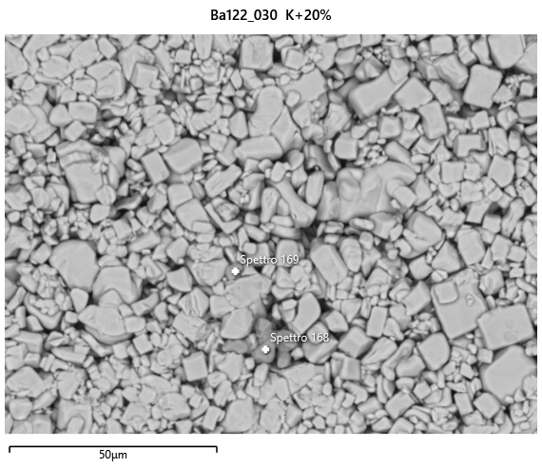
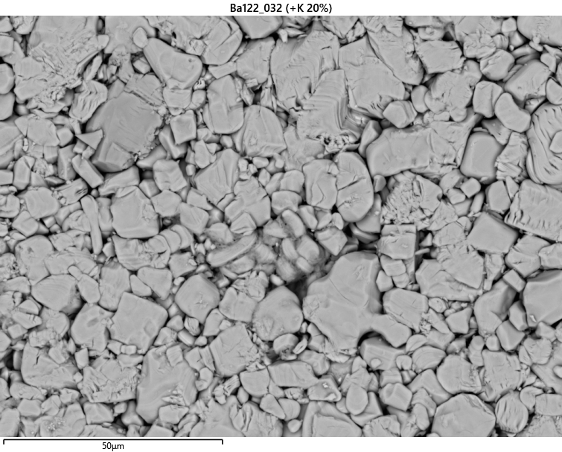
How to get better texturing and densification
Significant enhancement of the granulometry acting on the Heat Treatment for the powder synthesis
850°C/20h
900°C/35h
Andrea Malagoli HFM meeting February 12th, 2025

Slide 14
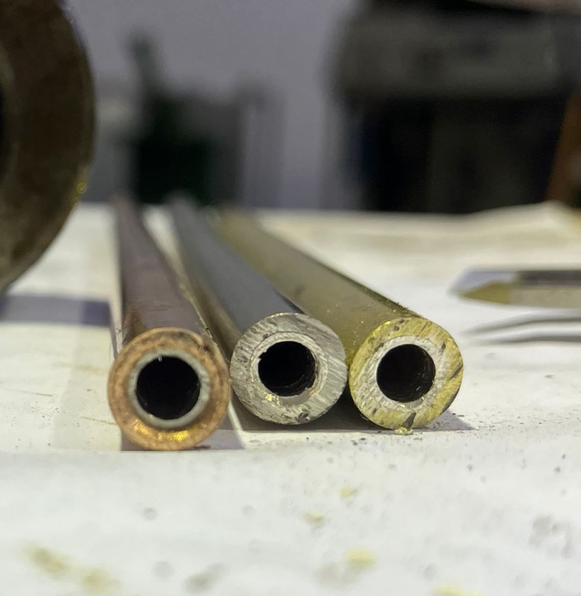
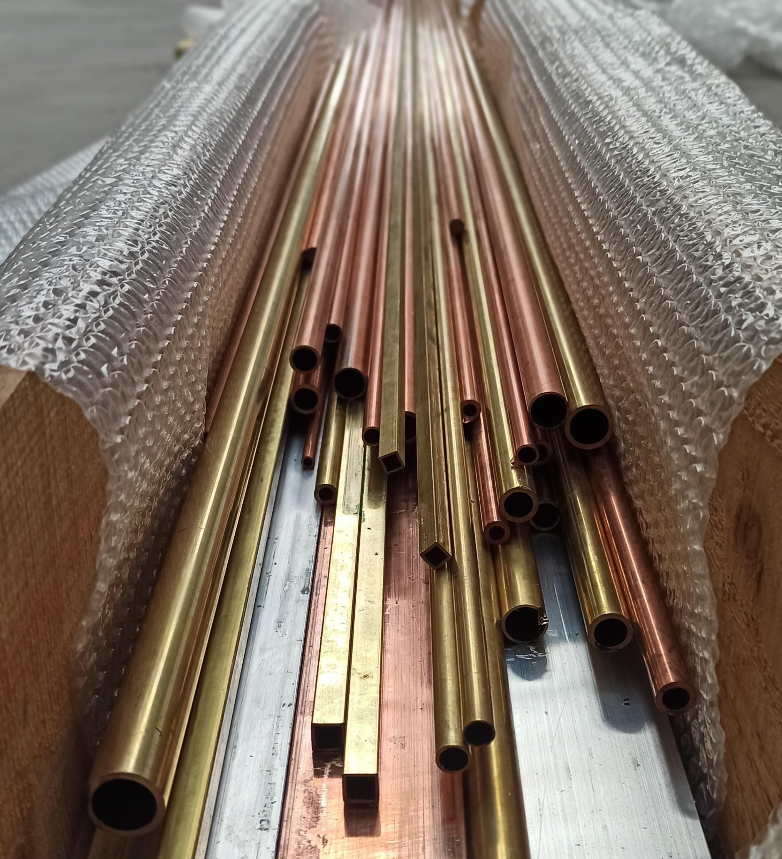
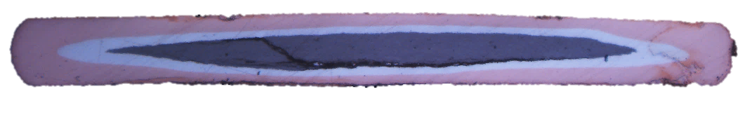
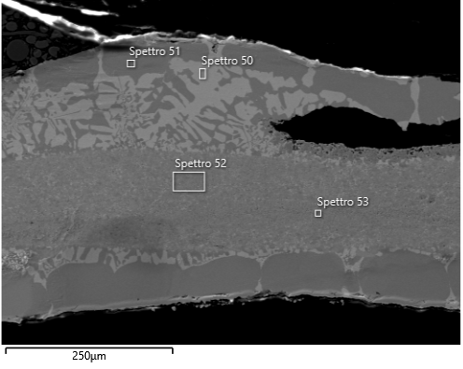
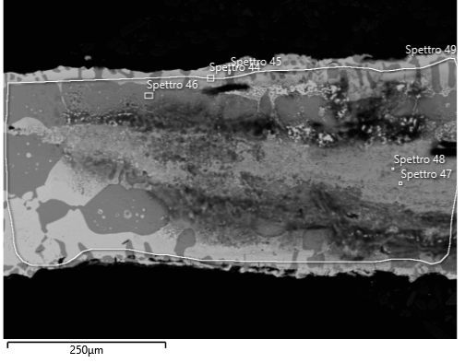
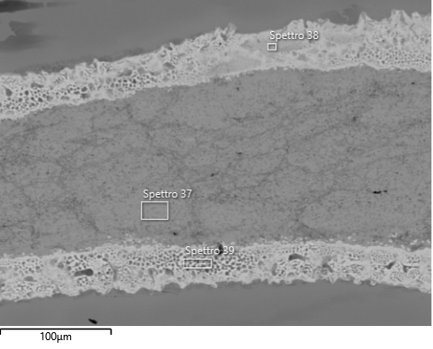
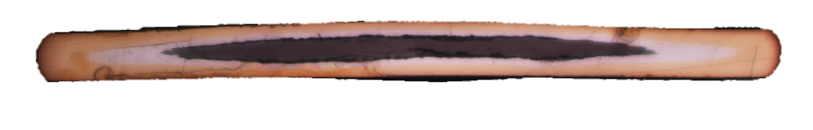
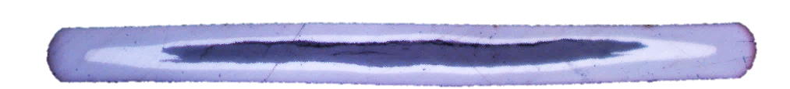
How to get better texturing and densification
Cu
CuZn
CuNi
Ag
BaK122
500 μm
Andrea Malagoli HFM meeting February 12th, 2025

Slide 15
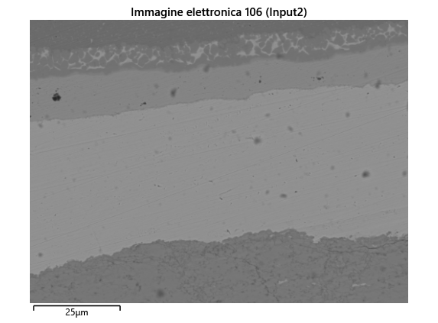
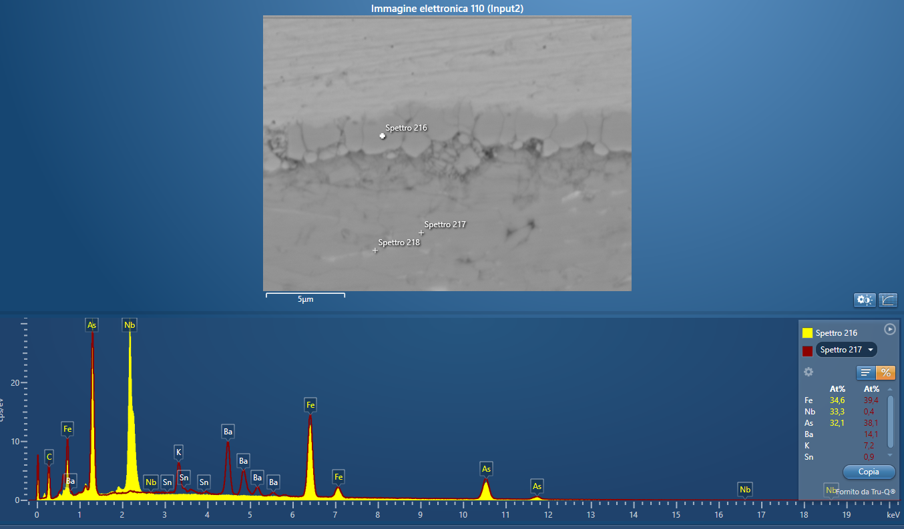
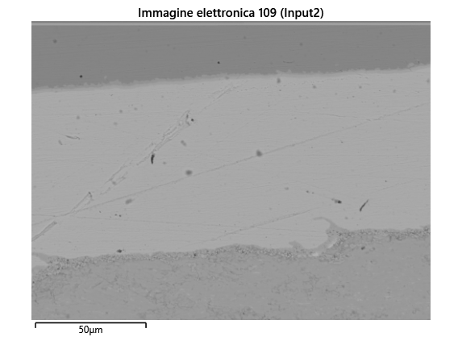
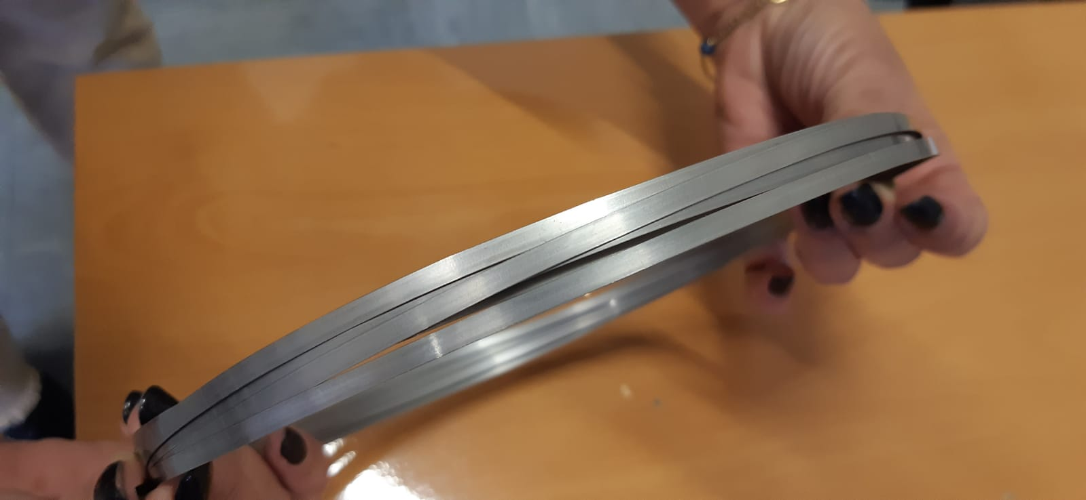
How to get better texturing and densification
Ba122
After HT
Ag
@840°C
Nb
Nb
CuNi
Ba122
After HT
@840°C
Andrea Malagoli HFM meeting February 12th, 2025

Slide 16
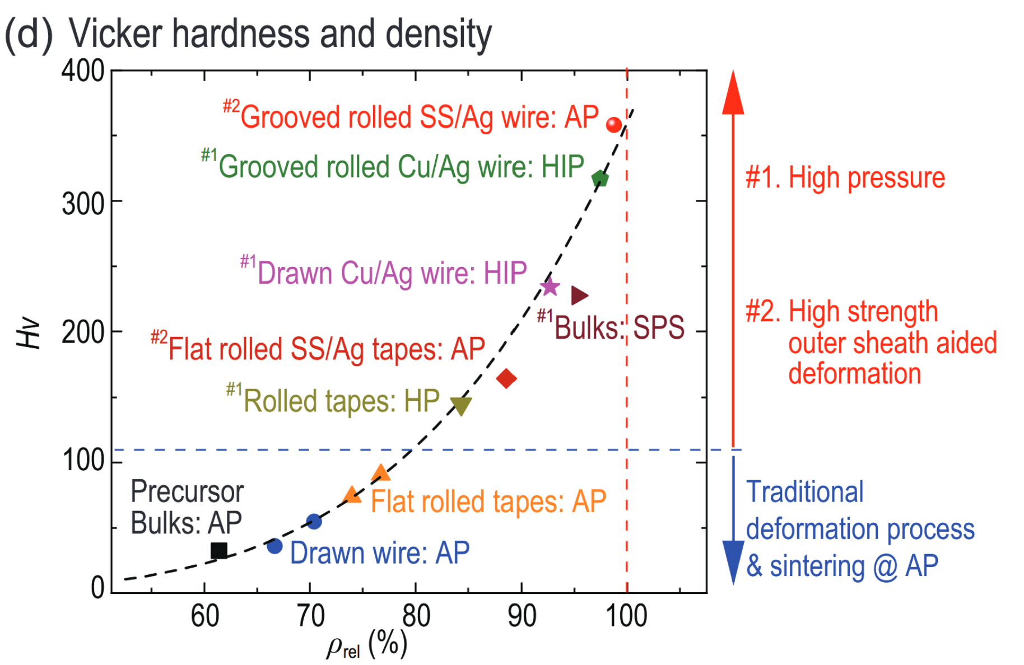
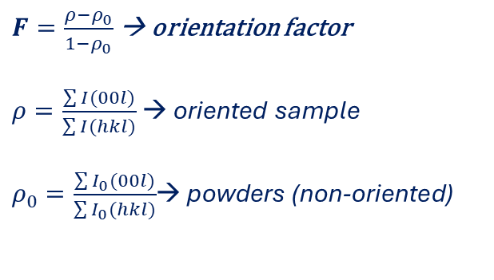
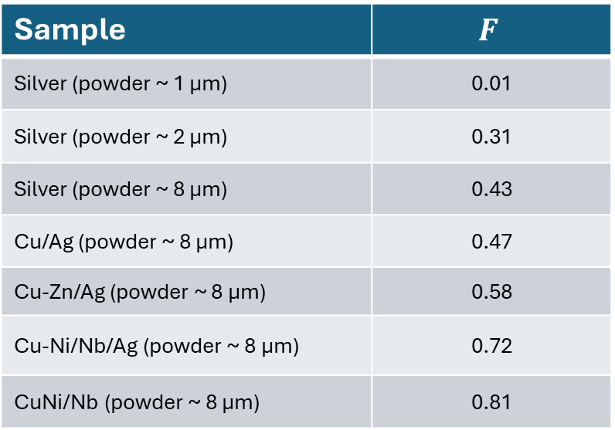
How to get better texturing and densification
Sample | $$F$$
Silver (powder ~ 1 μm) | 0.01
Silver (powder ~ 2 μm) | 0.31
Silver (powder ~ 8 μm) | 0.43
Cu/Ag (powder ~ 8 μm) | 0.47
Cu-Zn/Ag (powder ~ 8 μm) | 0.58
Cu-Ni/Nb/Ag (powder ~ 8 μm) | 0.72
CuNi/Nb (powder ~ 8 μm) | 0.81
CuNi @ SPIN AP
Brass @ SPIN: AP
Cu @ SPIN: AP
$F=\frac{ρ−ρ_{0}}{1−ρ_{0}}$ → orientation factor
$ρ=\frac{\sum{I(00l)}}{\sum{I(hkl)}}$ → oriented sample
$ρ_{0}=\frac{\sum{I_{0}(00l)}}{\sum{I_{0}(hkl)}}$→ powders (non-oriented)
from XRD analysis
Ref: Chiheng Dong, Qingjin Xu and Yanwei Ma
National Science Review 2024, Vol. 11, nwae122
Andrea Malagoli HFM meeting February 12th, 2025

Slide 17
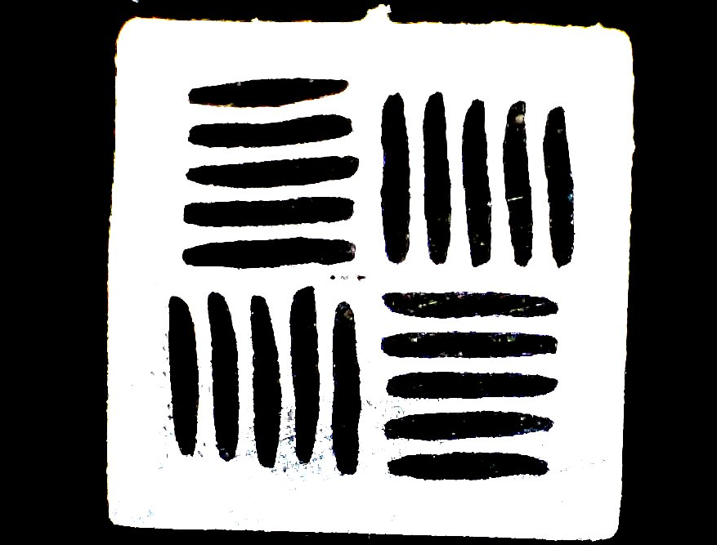
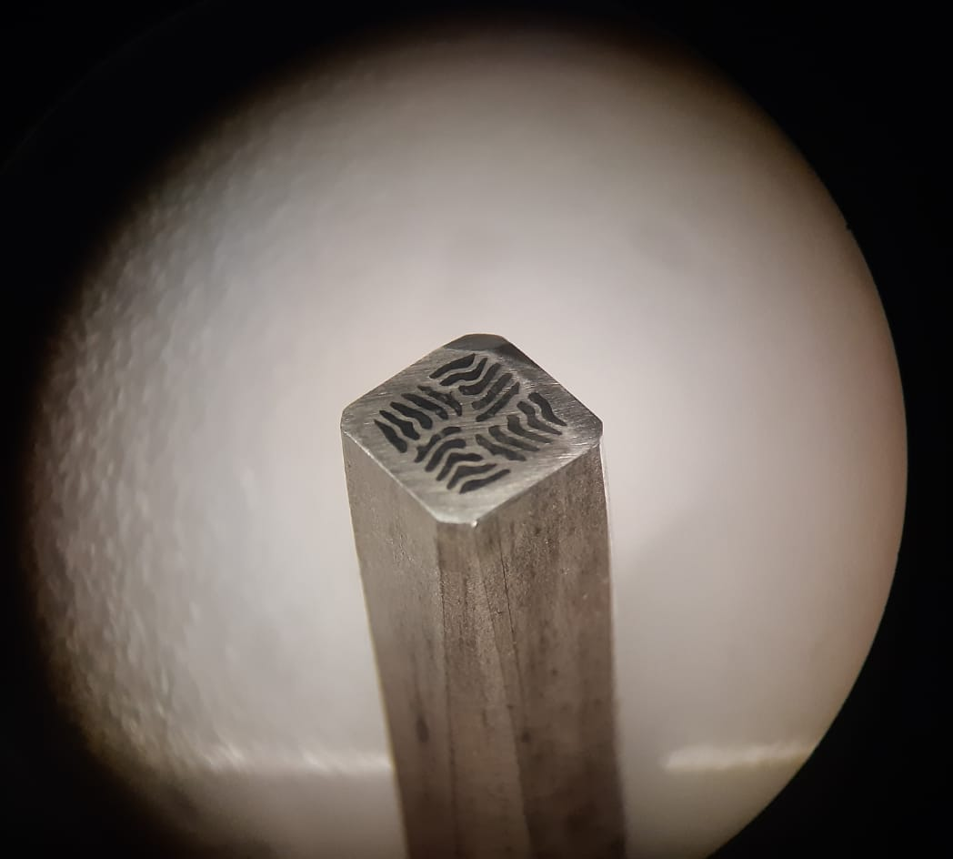
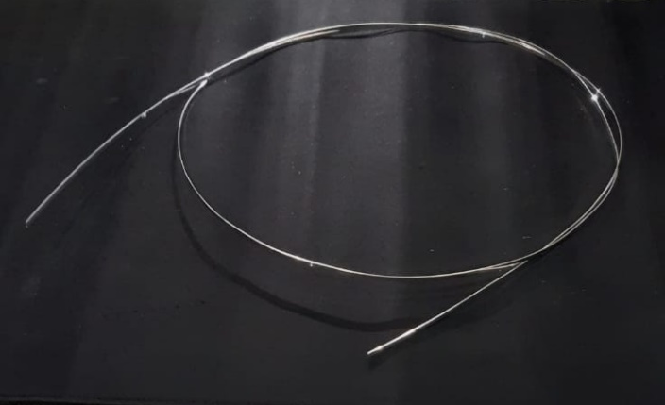


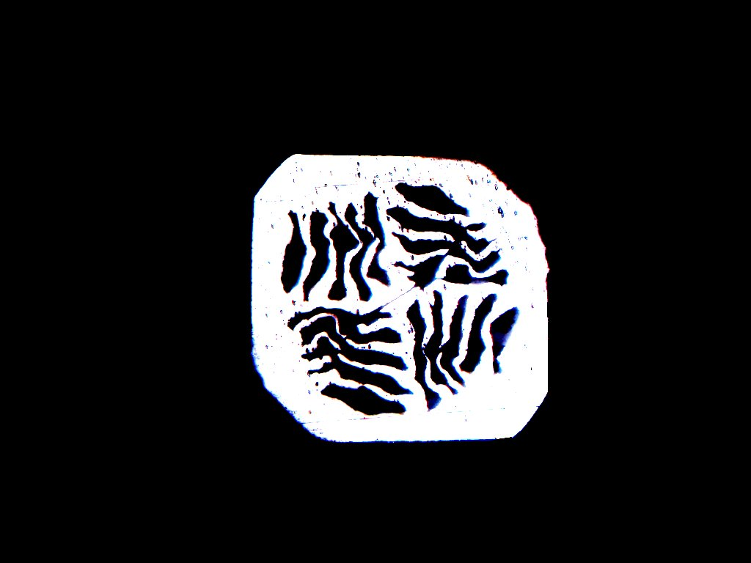
Future strategy and next steps
Development of innovative architecture for multifilamentary wires combining the necessity for grains orientation, superconducting core densification (our GDG process) and macroscopic isotropy of the wire
10 m of monofilamentary wire used for multifilamentary assemby
Monofilamentary sheath/barrier in Ag due to chemical compatibility
Harder external sheath: Copper, Cu-alloy, Nickel……
Andrea Malagoli HFM meeting February 12th, 2025

Slide 18
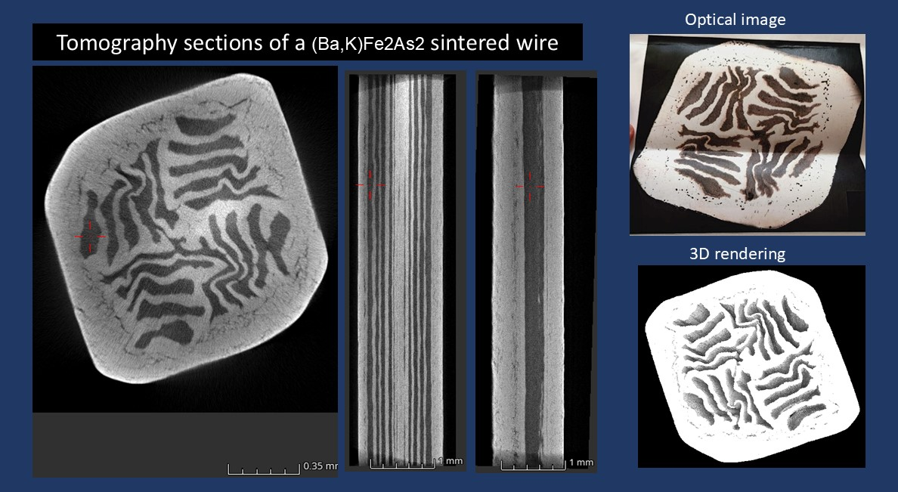
Preliminary results on Multifilamentary wire
Thanks to I. Tiseanu,INFLPR, RO
Andrea Malagoli HFM meeting February 12th, 2025

Slide 19
Preliminary results on Multifilamentary wire
Andrea Malagoli HFM meeting February 12th, 2025

Slide 20
Summary
Spin has started an intense R&D activity on Ba-122 wires with the aim to give a significative contribution in understanding if such superconductor can be a reliable alternative for high field applications
We set up a new scalable method based on «rotating furnace» to produce very homogeneous and pure SC powders. We are able now to produce 100 gr/7 days
A preliminary test on simple Ag sheathed tape showed the expected T_{C}, critical fields and critical current density.
We are starting now with the wire development in lengths of the order of 10 m, adapting our GDG process and testing different metallic sheath. Development of innovative multifilamentary wire to optimize grains orientation and superconducting core densification keeping macroscopical isotropy. The target is Jc = 10⁵ A/cm²@16T. Samples will be sent to CERN for Ic validation.
Next milestone: 10 m multifilamentary wire prototype.
Andrea Malagoli HFM meeting February 12th, 2025

Slide 21
Summary
Work Package | Tasks, deliverables | Task/deliverable description | Assigned to | Start | Planned end | Progress | Status | Comment on status
WP2.15 |  | KE5814, SPIN | A. Ballarino/A. Malagoli | 09/11/2023 | 31/10/2027
 | D1 | Report on laboratory upgrade and visit of infrastructure |  | 09/11/2023 | 30/04/2024 | 100% | Completed
 | D2.1 | Report on the Ba-122 powder synthesis process |  | 09/11/2024 | 30/04/2024 | 100% | Completed
 | D2.2 | Report on Ba-122 monofilamentary wire production including transport characterization. Prototype monofilamentary wire ~ 10 m |  | 09/11/2025 | 31/10/2024 | 100% | Completed
 | D3 | Report on powder compositional, structural and superconducting properties |  | 09/11/2026 | 30/04/2025 | 50%
 | D4 | Report on deformation process, sheaths and architecture of multifilamentary wires. Prototype multifilamentary wire ~ 10 m |  | 09/11/2027 | 31/10/2025 | 20%
 | D5.1 | Report on optimized production process including the heat treatment |  | 09/11/2028 | 30/04/2026
 | D5.2 | Report on superconducting characterization of multifilamentary wires. Optimized prototype multifilamentary wire 10m |  | 09/11/2029 | 31/10/2026
 | D6.1 | Report on the laboratory adaptation for long length wire fabrication |  | 09/11/2030 | 31/10/2027
 | D6.2 | Delivery of a batch of ~200 m long multifilamentary wire from CNR-SPIN to CERN |  | 09/11/2031 | 31/10/2027
Andrea Malagoli HFM meeting February 12th, 2025

