Slide 1
Critical Current Reduction by Transverse Pressure in Bi-2212 Rutherford cables up to 300 MPa at 11 T / 4.2 K
Anna Kario¹, Herman ten Kate¹, Simon Otten¹, Jorick Leferink¹, Sander Wessel¹, Cansu Topaloglu¹, Mark Smithers¹, Mohammed Abdul Rasheed¹, Melissa Goodwin¹, Daniel Davis², David Larbalestier², Ulf Trociewitz², Tengming Shen³, Amalia Ballarino⁴, ¹ University of Twente, ² NHFML, ³ LBNL, ⁴ CERN

Slide 2
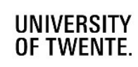
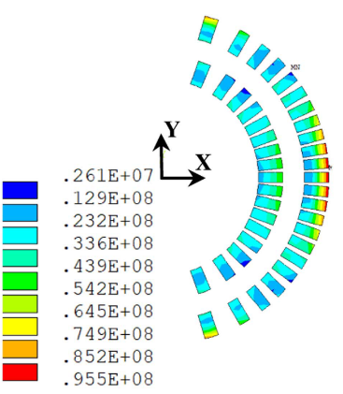
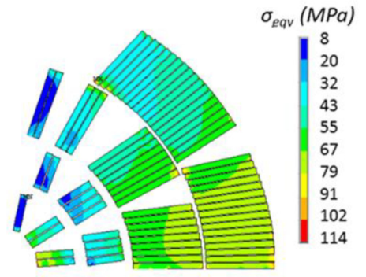
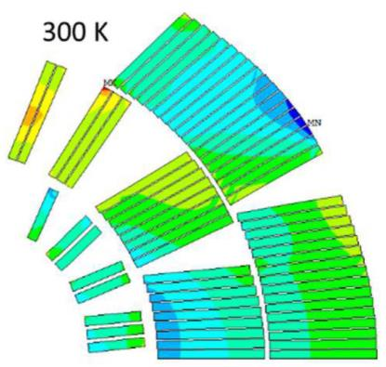
Motivation: Transverse Stress in dipole magnets
80 to 110 MPa level azimuthal stress expected in Bi-2212 based dipole magnet designs
Apart from one early date test (2000), there were no recent test data existing on cables
Experimental data on stress limits for recent Bi-2212 cables are needed.
Garcia Fajardo et al. (2022)
https://doi.org/10.1109/TASC.2023.3264788
Zlobin et al. (2022)
https://doi.org/10.1109/TASC.2022.3158635
Zlobin et al. (2023)
https://doi.org/10.1109/TASC.2023.3264165
96 MPa peak stress
104 MPa peak stress
80 MPa peak stress
Results are also highly relevant for high-field solenoids under high radial compressive load!

Slide 3
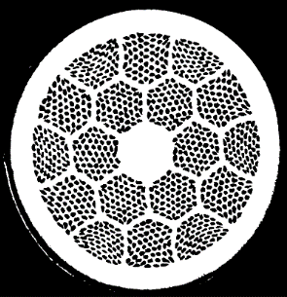
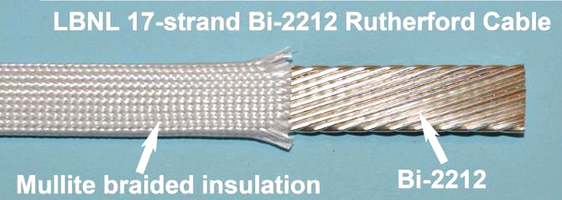
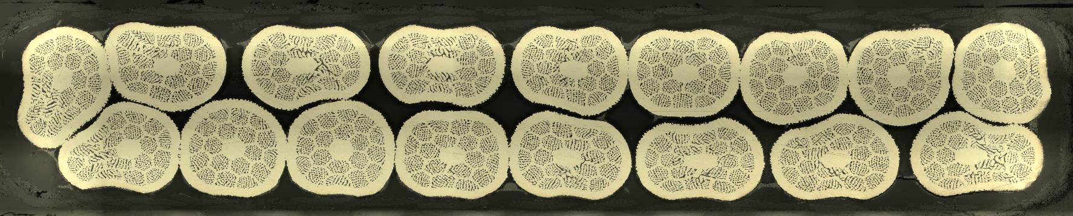
Wire and Cable properties of the 4 samples
Wire layout
Bi-2212 in Ag matrix
0.8 mm diameter
55 x 18 filaments
0.8 mm
Image by Zhang et al. (2018)
Image by Zhang et al. (2018)
Rutherford cable
17 strands
58 mm twist pitch
Size 7.8 mm x 1.4 mm
Mullite or alumina sleeve
No. | sample | powder | insulation
1 | LBNL1109 | Engi-mat LXB103 | Mullite sleeve
2 | LBNL2002 | Engi-mat LXB156 | Mullite sleeve
3 | LBNL1109 | Engi-mat LXB103 | Nextel pure alumina
4 | LBNL2002 | Engi-mat LXB156 | Nextel pure alumina
LBNL1109

Slide 4
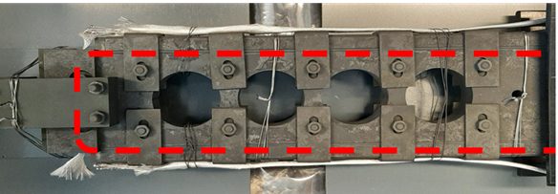
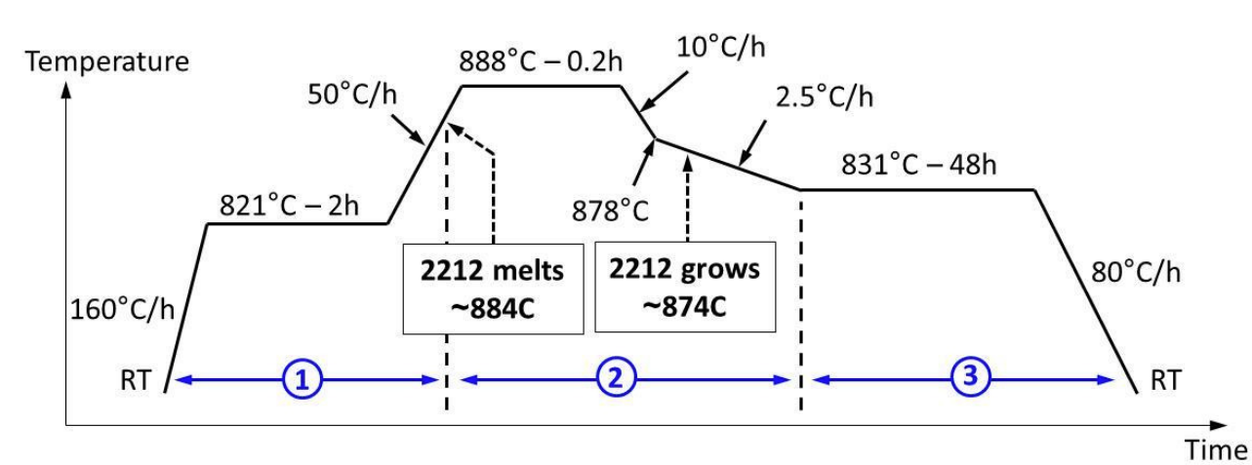
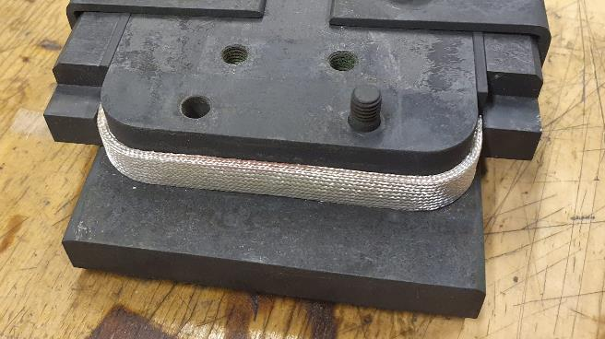
Sample heat treatment and impregnation
Heat treatment in furnace at NHMFL
U-shape for press experiment
OPHT at 50 bar in 1 bar oxygen
~890°C at melting
Vacuum impregnation at UT
CTD-101K at 60°C at 0.7 mbar
Cured for 5 hour at 110°C and 16 hour at 125°C
Flat surface
condition achieved
allowing even transverse pressure.
M Matras 2016, PhD thesis
45 mm

Slide 5
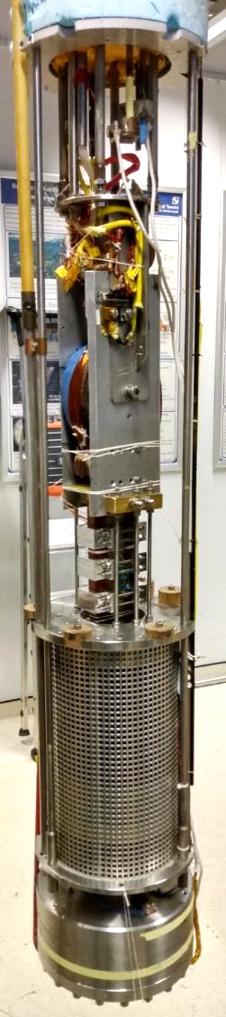
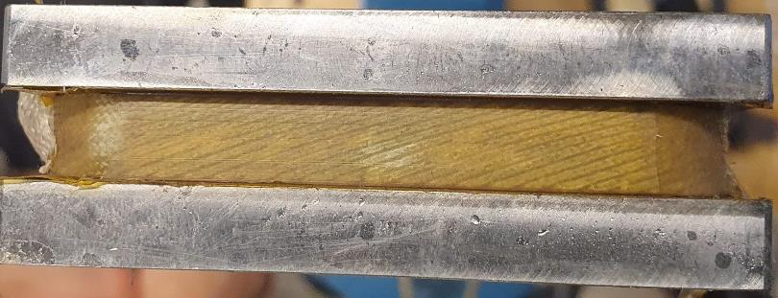
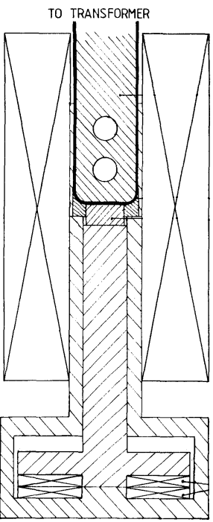
Transverse Pressure Facility
50 kA transformer
Cable sample in U-shape
Pressure on ≈ 45 mm straight cable section
Impregnated surface of the sample
Current supplied by 50 kA sc. transformer
Background field by 11 T solenoid magnet
Pressure of up to 250 kN generated by a set of repulsing coils
Allowing stress levels up to 300 MPa
In 4.2 K boiling helium bath
Accuracies: ΔI_{c}/I_{c} ≈ ±1% & Δσ_{t}/σ_{t} ≈ ±4%.
Sample holder
11 T solenoid
Press coils

Slide 6
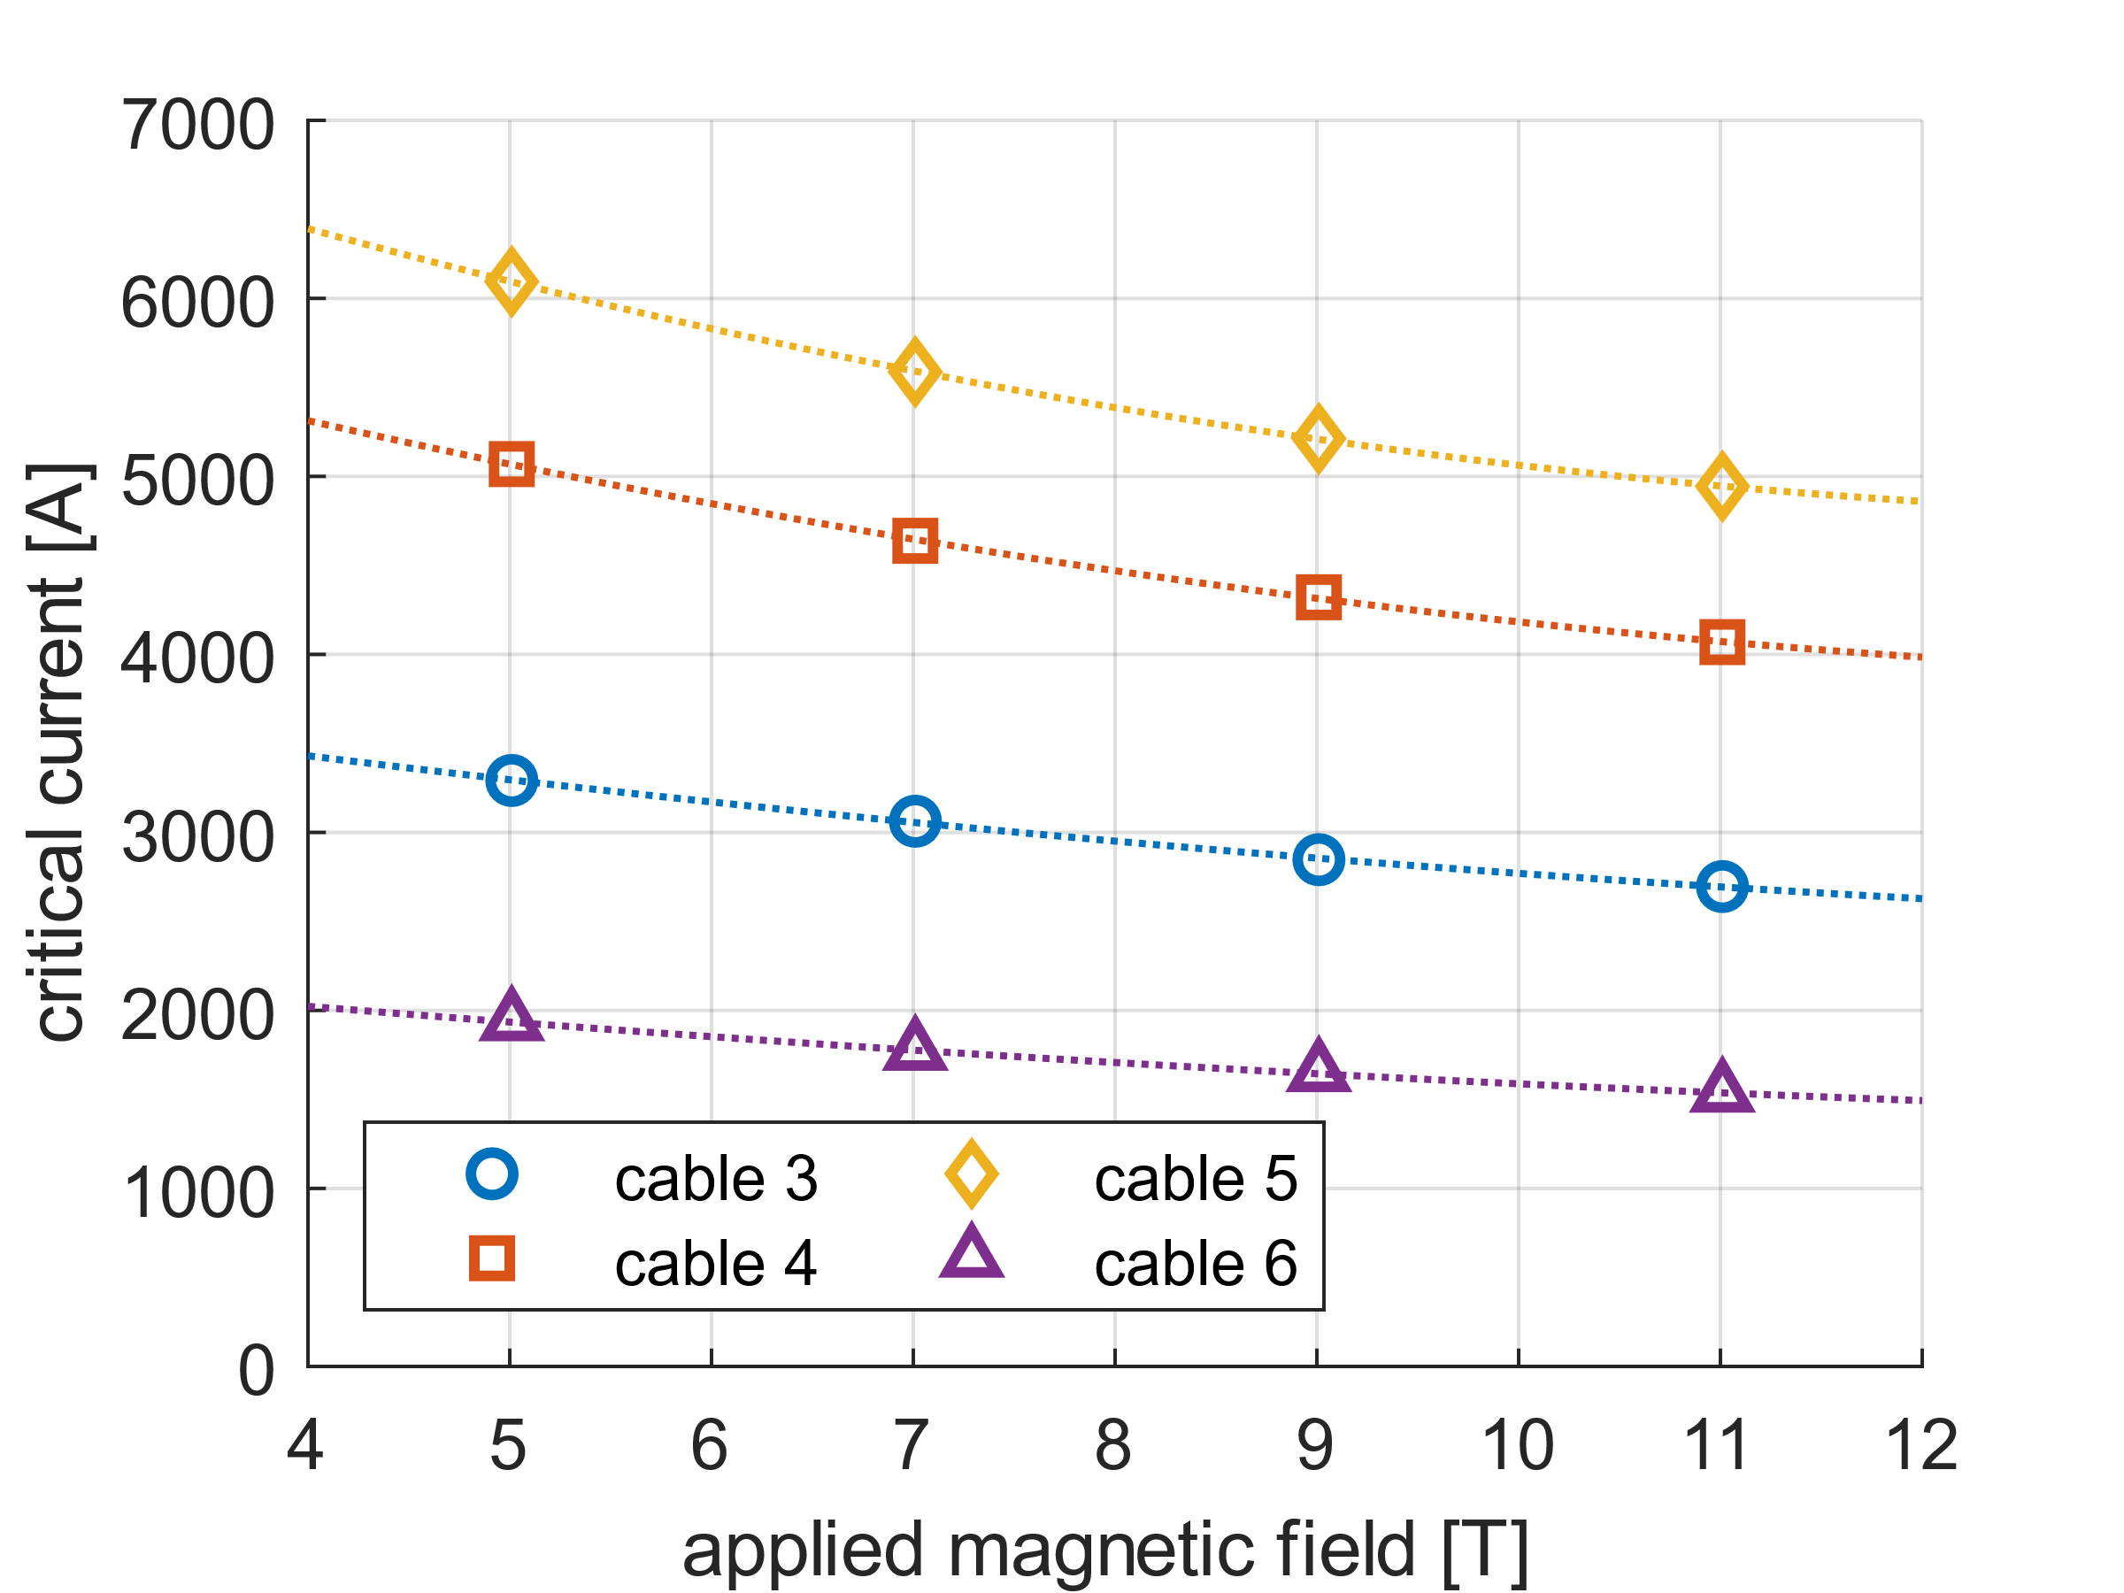
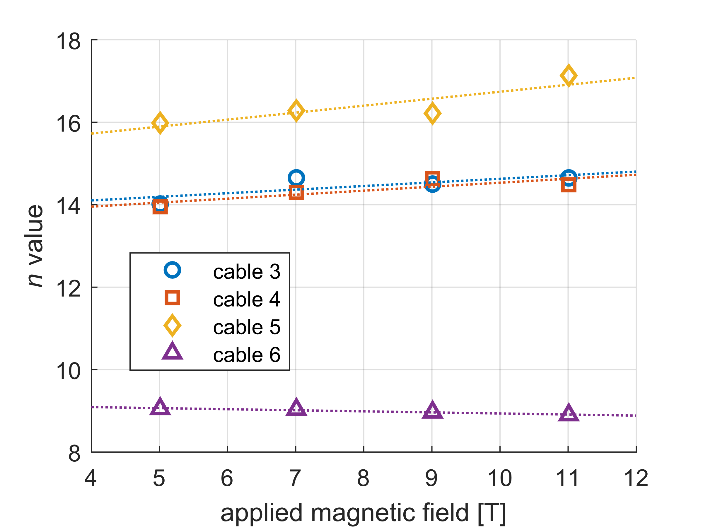
Virgin cable I_{c}(B_{a}) - Curves of all 4 samples
Cable 1
Cable 2
Cable 3
Cable 4
Cable 1
Cable 2
Cable 3
Cable 4
At 11 T /4.2 K and 10 MPa transverse stress: I_{c} ranges 1500 to 5000 A and n from 9 to 17
Same results expected but, a significant difference between the samples in both I_{c} and n!

Slide 7
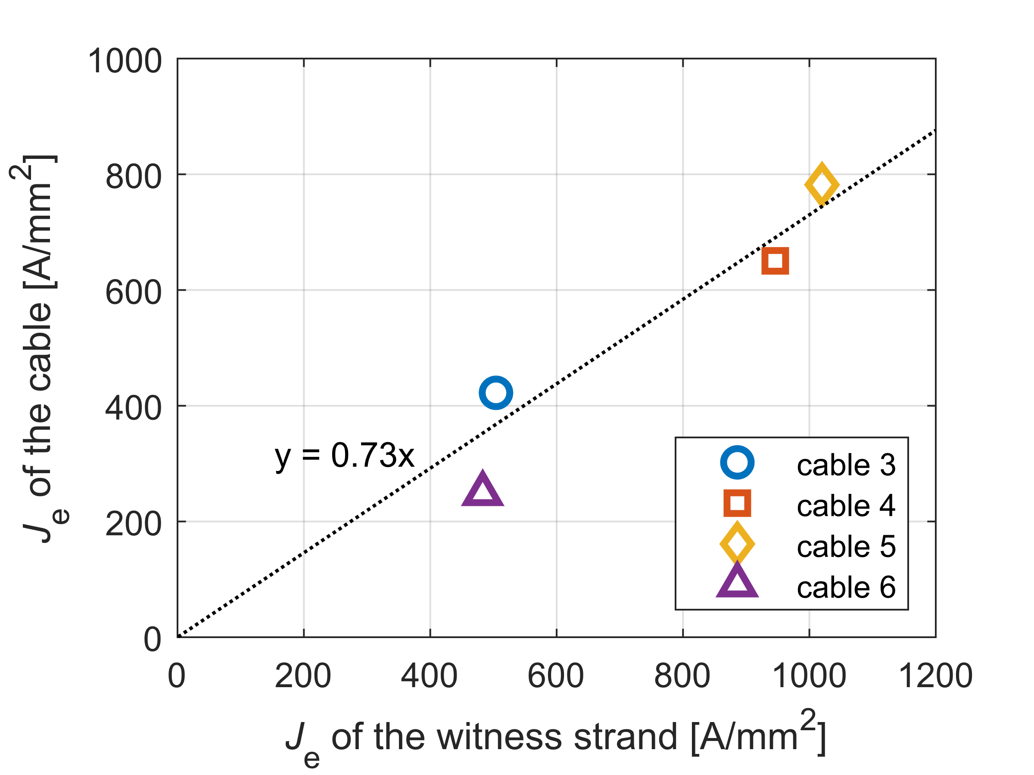
Why ? Comparison to witness strands
Note: witness strands and cables are not from the same powder/wire batches
Witness strands of samples 2 and 3 reached about expected performance (900 to 1000 A/mm² at 5T/4.2K)
Witness strands of cables 1 and 4 show roughly half this performance
Cable 1
Cable 2
Cable 3
Cable 4
I_{c} of witness strands and cable samples clearly correlate, strongly pointing at the powder/wire batch/heat treatment conditions as the cause….
Whole wire/cable critical current densities at 4.2 K and 5 T applied field

Slide 8
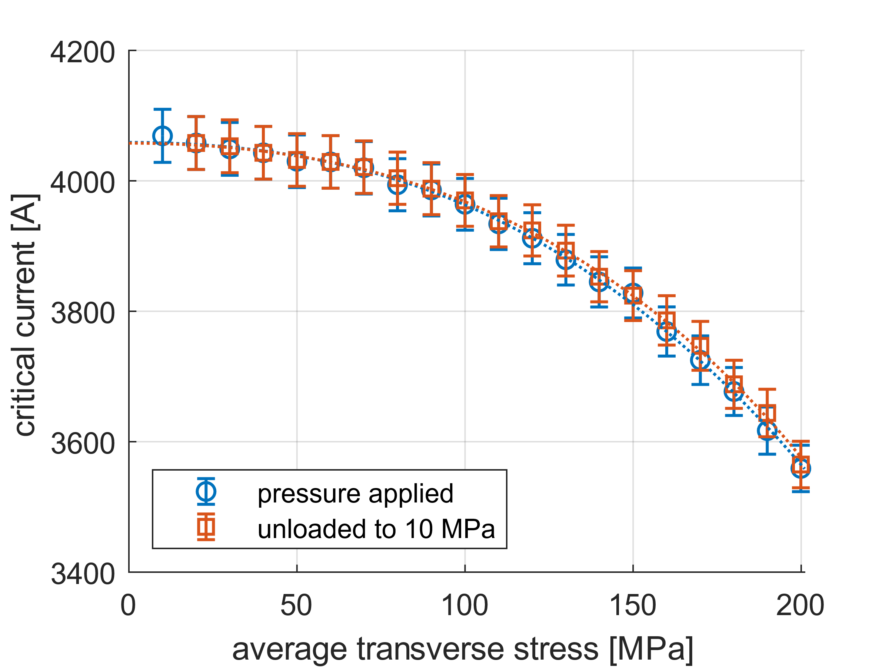
Transverse stress test: No reversibility seen!
Measurement sequence:
  10 MPa - 20 MPa
  10 MPa - 30 MPa
  10 MPa - 40 MPa
  etc.
Example Sample 2, representative for ALL samples measured.
Main observation:
Loaded curve = unloaded curve (within fraction of systematic measurement error)
Sample 2
T = 4.2 K
B_{a} = 11 T
There is NO significant reversible effect observed in any sample!
Meaning: I_{c} reduction through B_{c2} suppression due to lattice deformation is not visible, not significant.
Critical current vs. transverse stress

Slide 9
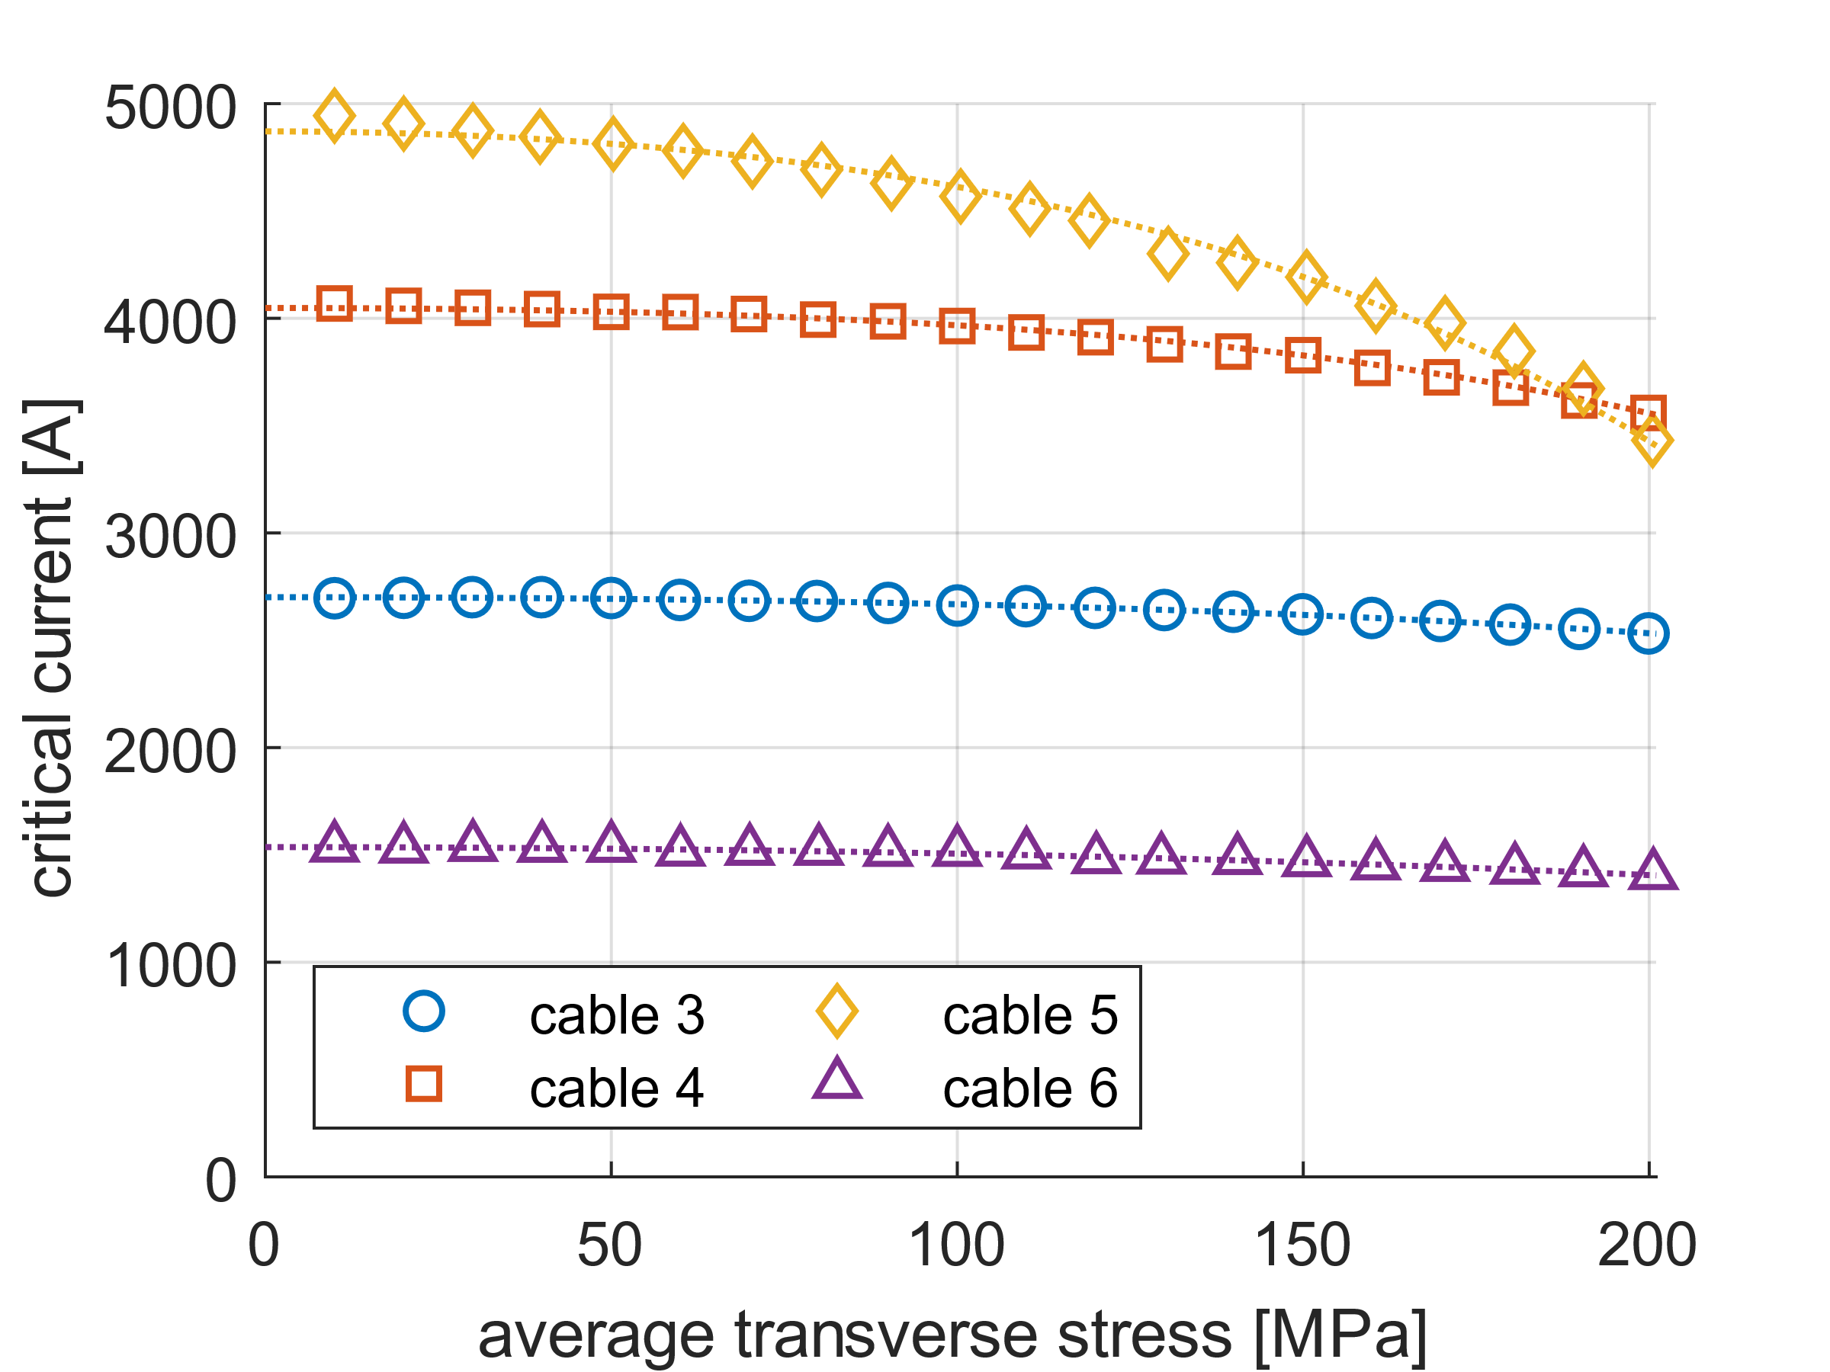
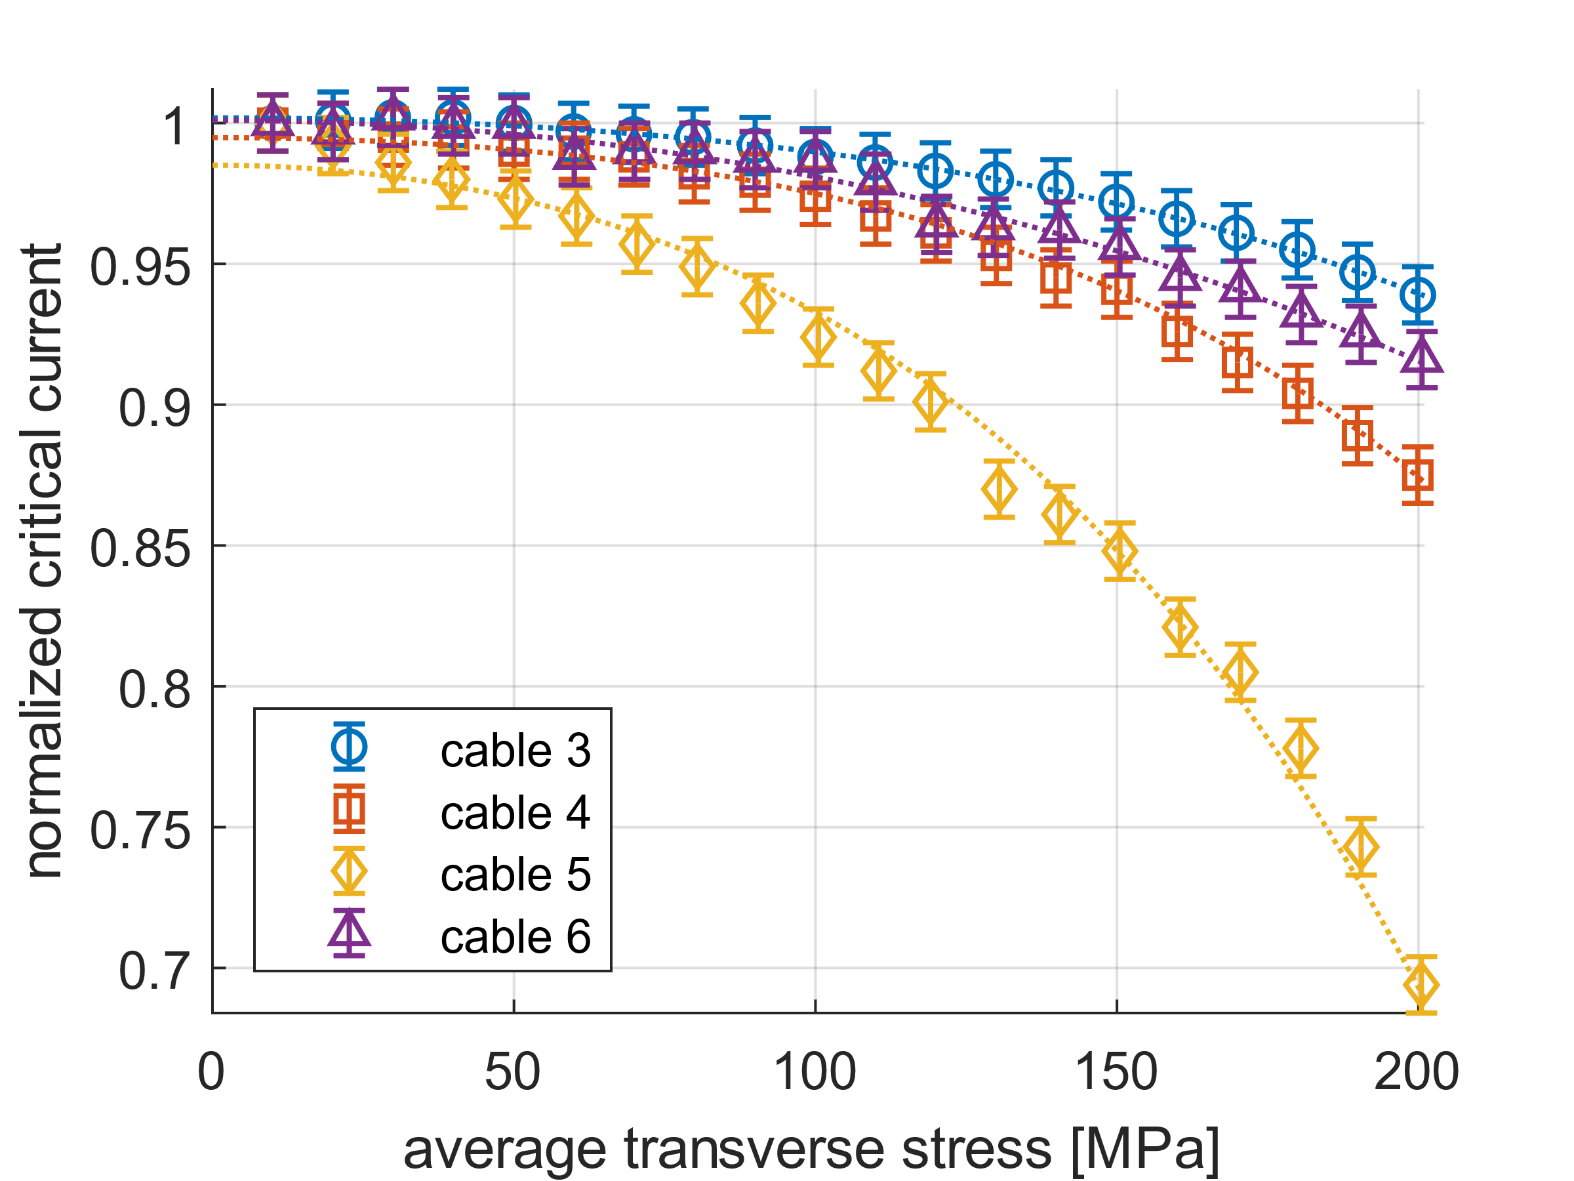
Transverse stress test: I_{c} (P) or I/I_{c}(P)
95%
Cable 1
Cable 2
Cable 1
Cable 2
Cable 3
Cable 4
Cable 3
Cable 4
Critical current vs. transverse stress
Normalized critical currents
Samples 3,4,6 reach 5% degradation above 130 MPa; Sample 5 at 80 MPa, but highest I_{c} !!
For a magnet with <150 MPa, cable 5 is the best conductor, even when degrading faster!
Just considering I/Ic is misleading.

Slide 10
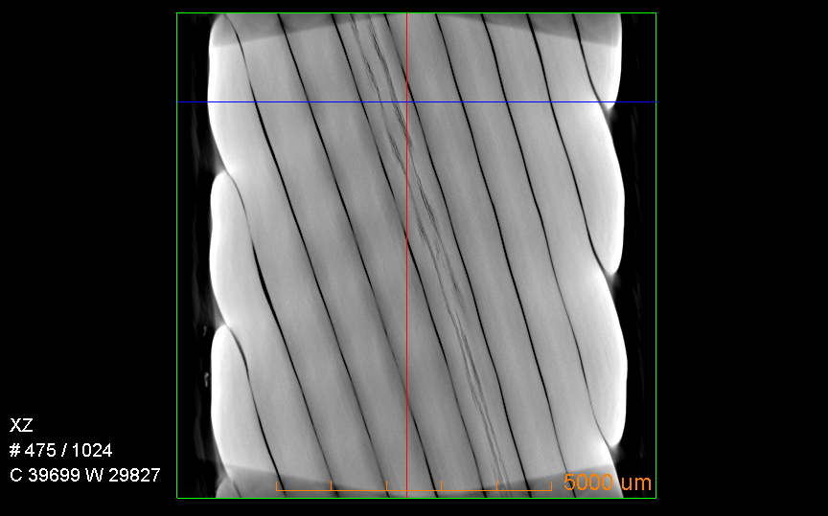
Microstructure: flavor of defects
Tomography of cable at ¾ wire height.
Long voids inside, along the wire.
Sample-2
Sample-1 200 MPa 92%
Sample-3 250 MPa 56%
Sample-2 300 MPa 40%
Here and there broken filaments, heavily distorted shape; not enough for 40 - 60% degradation.
10

Slide 11
Conclusion
Unique transverse pressure data on 4 Bi-2212 cable samples up to
300 MPa
Factor 3 difference found in cable critical currents (likely caused by differences in powder and wire batches, cabling, heat treatment)
5% degradation level is at 80 (high-I_{c} cable) to 200 MPa (lower-I_{c} cable).
Only 1 to 5% I_{c} reduction, and saturating, observed in all samples when cycling between 10 and 200 MPa and up to 200 cycles (good).
Contrary to Nb₃Sn, in Bi-2212 all changes in critical current are irreversible!
No cause for large degradation found in the microstructure at filament level.

