Slide 1

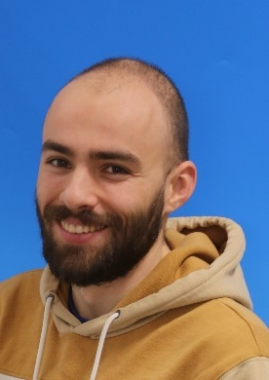








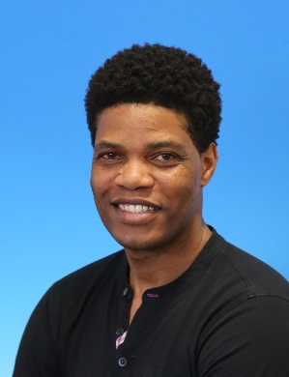

Demonstrator of metal-insulated REBCO high field magnet coils
T. Lécrevisse
E. Benoist
A. Blondelle
A. Caunes
M. Durochat
CEA-CERN HFM collaboration W2-11 agreement on HTS MI racetracks developments
Thibault Lécrevisse (CEA) on behalf of CEA team
Amalia Ballarino (CERN)
G. Lenoir
C. Genot
S. Somson
B. Maloeuvre
T. Barabe
E. Pepinter

Slide 2
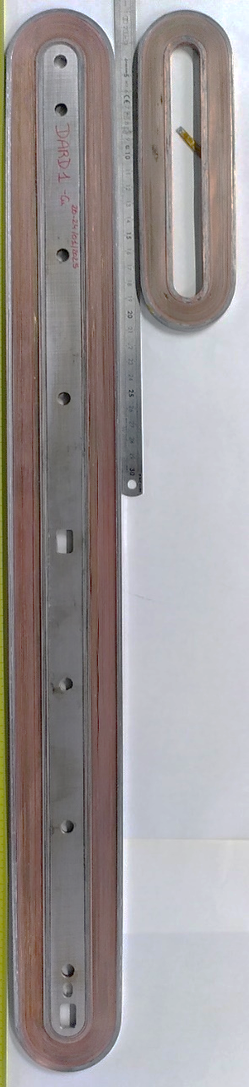
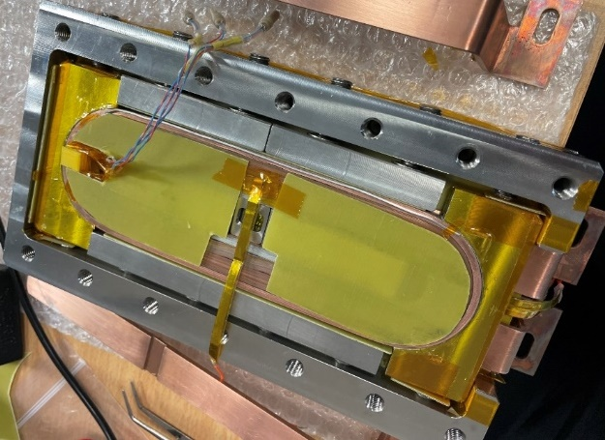
1. Agreement Status : Development main phases
Phase 3:
« EuCARD v3 »
MI cold bore 14 T⁺ magnet
Phase 2:
« EuCARD v2 »
Magnet MI 14 T⁺
Phase 1:
Racetrack MI (2-5 T)
(Ongoing activity at Irfu)
Metal Insulated for :
Costs / risks reduction
Conductor and design limit exploration
Compact 14 T⁺ REBCO mock-ups
140 mm
KE5647
600 mm
Start: 01/04/2023
End: 31/03/2025
31/05/2025

Slide 3
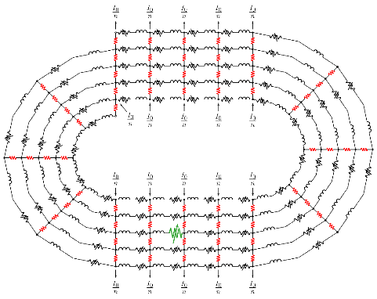
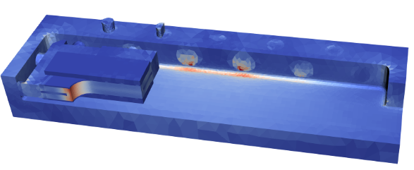
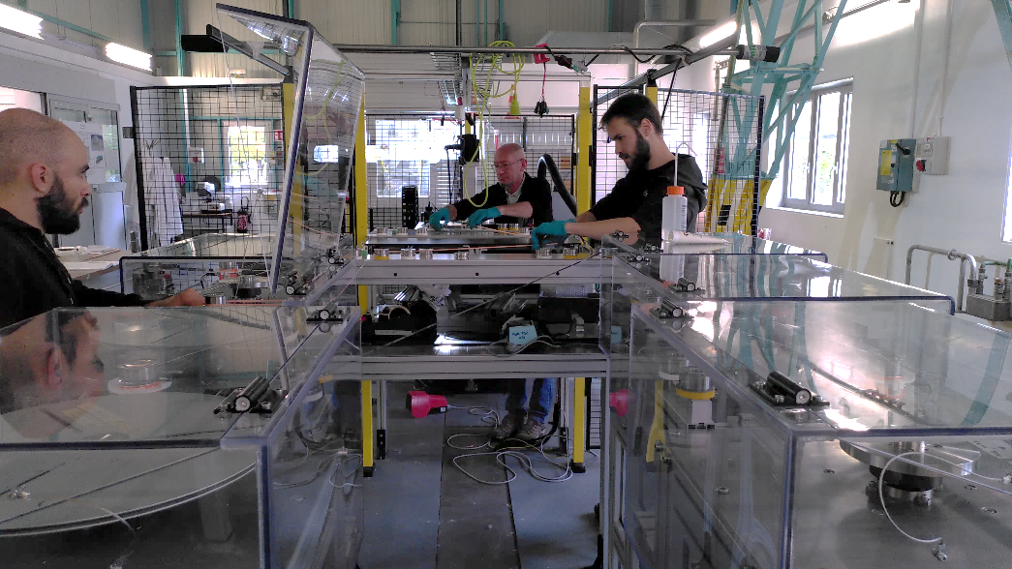
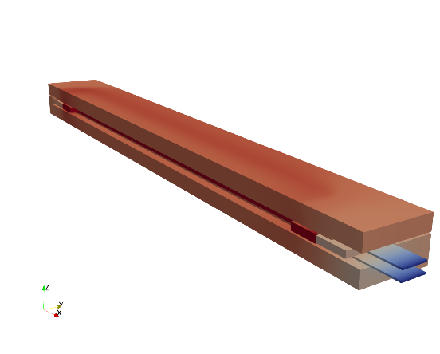
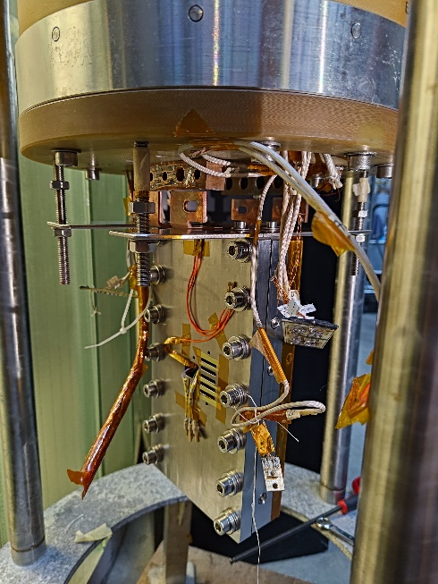
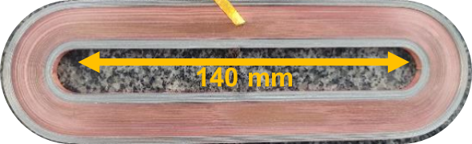
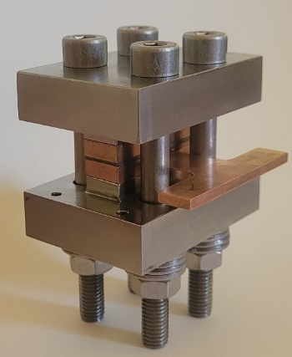
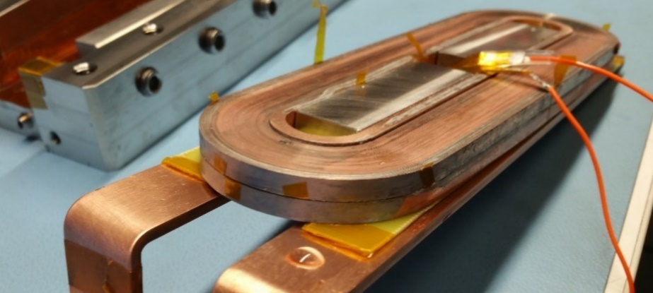
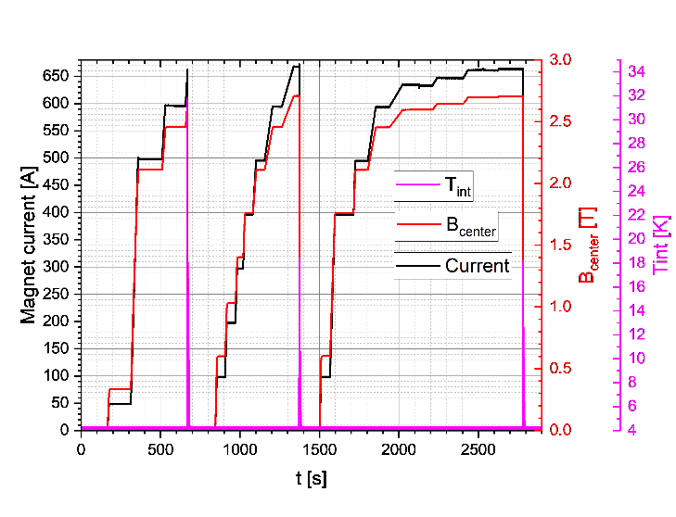
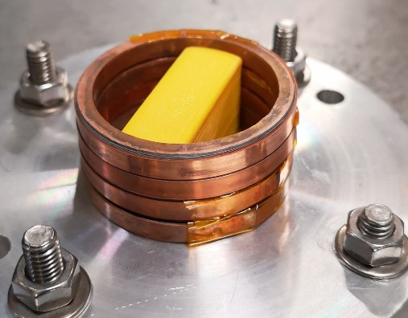
1. Agreement Status : Phase 1 axes
Modeling
MI Racetrack fabrication, assembly and tests
PEEC-R
3D FEM
R&D / Characterization
Electrical connections
Radial thermal conductivity
Winding & assembly
Test and analysis

Slide 4
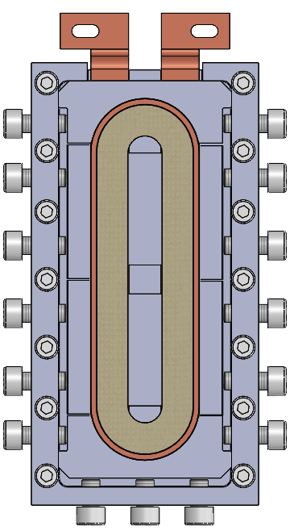
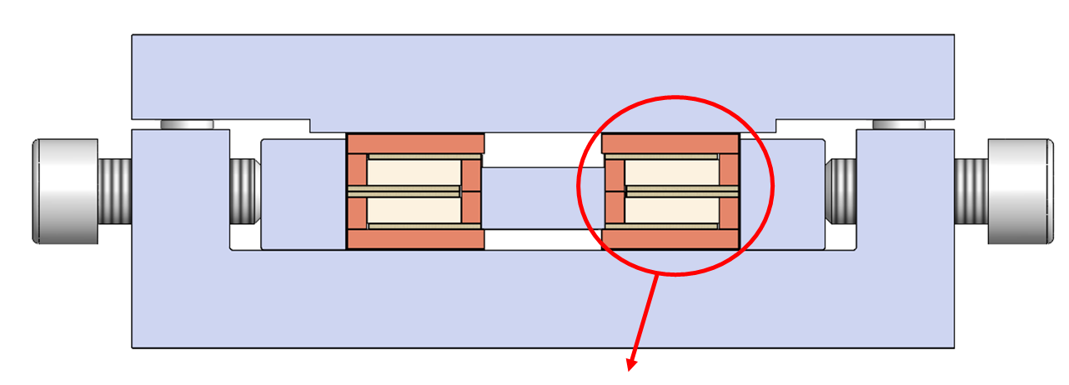
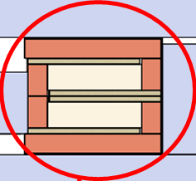
2. Mechanical structure
140 mm mechanical structure
Cooling
&
Current leads
G10 Insulation
Electrical
connections : Copper-Copper with Indium

Slide 5



2. Fabrication and short Racetracks assembly first tests
Racetracks fabrication
Double Racetracks assembly
Double Racetracks stack (DRT 78)
Inner / outer copper rings
3 Cernox
T_{ext}
T_{mid}
T_{int}
VTs
1 Arepoc Hall probe
DRT mechanical structure
Single MI racetrack (RT)
8 MI racetracks fabricated → 3 used (RT 5, 7, 8)

Slide 6
2. Two DRT tested at 77 K and 4.2 K
REBCO tape provided and characterized by CERN
Shanghai Superconductor Technology (SST), 4 mm wide and 74-78 µm thick
Co-winding of :1 REBCO tape with a 30 µm thick Durnomag®
$\sim$53 m of single 4 mm tape per Racetrack
DRT78 (quench simulation benchmark)
DRT75 (performance benchmark)
I_{c, tape} (77 K, s.f.) = 278 A
137 turns
I_{c, tape} (77 K, s.f.) = 199 A
133 turns
Racetrack #5
damaged
Racetrack #8
I_{c, tape} (77 K, s.f.) = 229 A
134 turns
I_{c, tape} (77 K, s.f.) = 229 A
134 turns
Racetrack #7
Racetrack #7
Second tested assembly :
Bottom RT7 from DRT78 assembly
8 Quenches
First tested assembly :
RT8 voluntary degraded by local heating during fabrication
6 Quenches

Slide 7
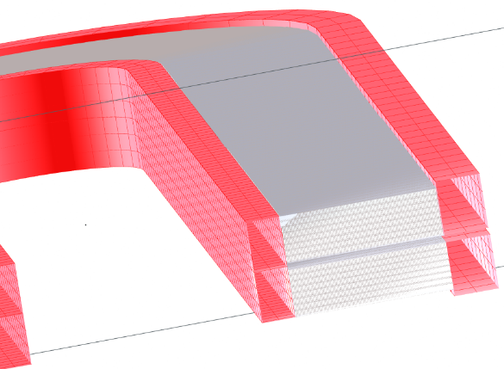
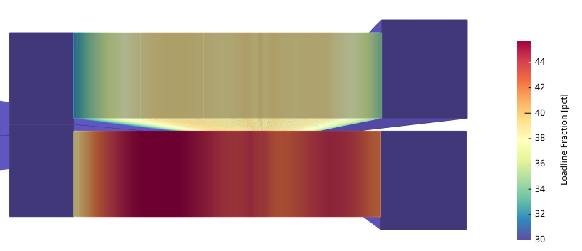
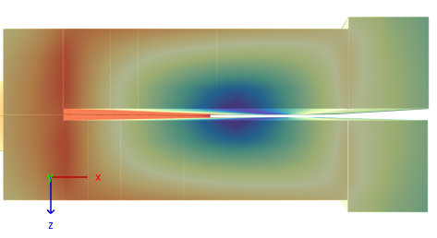

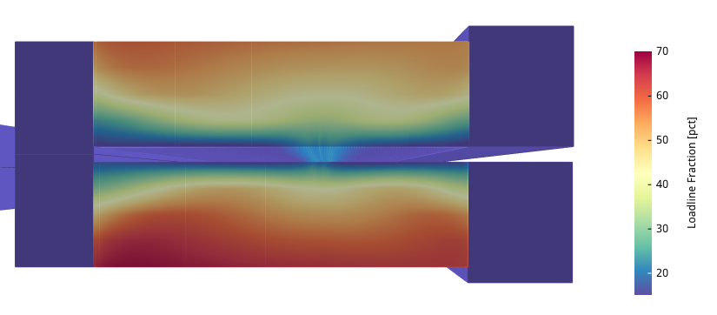
2. DRT75 magnetic design
Loadline estimation with Gui-RAT @ 670 A
With redistribution
RT 5
RT 7
W/o redistribution
RT 5
B_{peak} @ 670 A : 8.2 T
B_{center} @ 670 A : 3.6 T
RT 7
Est. Current limit around 980 -1460 A (RT7)

Slide 8
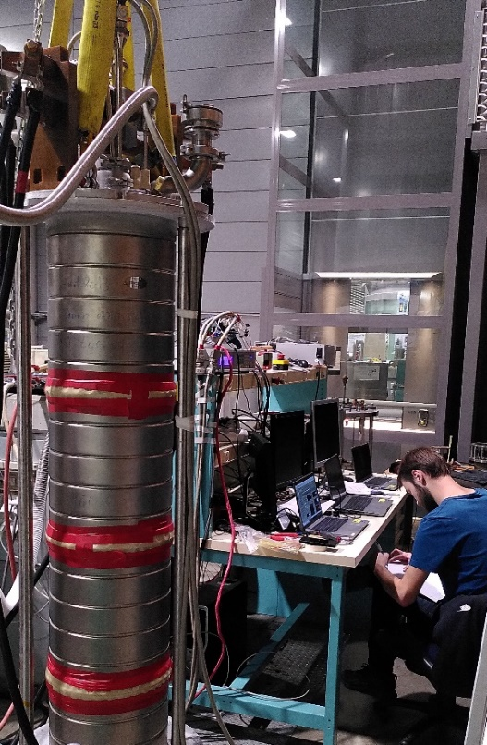
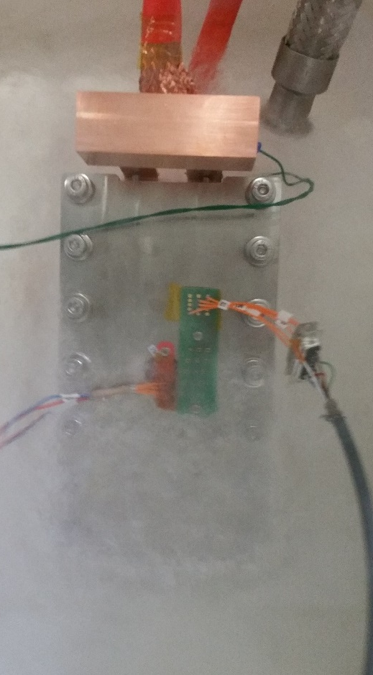
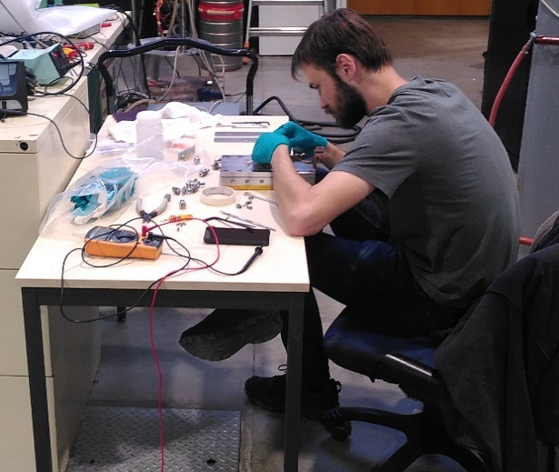
2. DRT75 tests
Self-Field Double Racetracks Tests
4.2 K Grenoble (Institut Néel)
04-14/11/2024
Next slides will focus on :
Current limitation
Magnetic Field generation
Protection
77 K Saclay

Slide 9

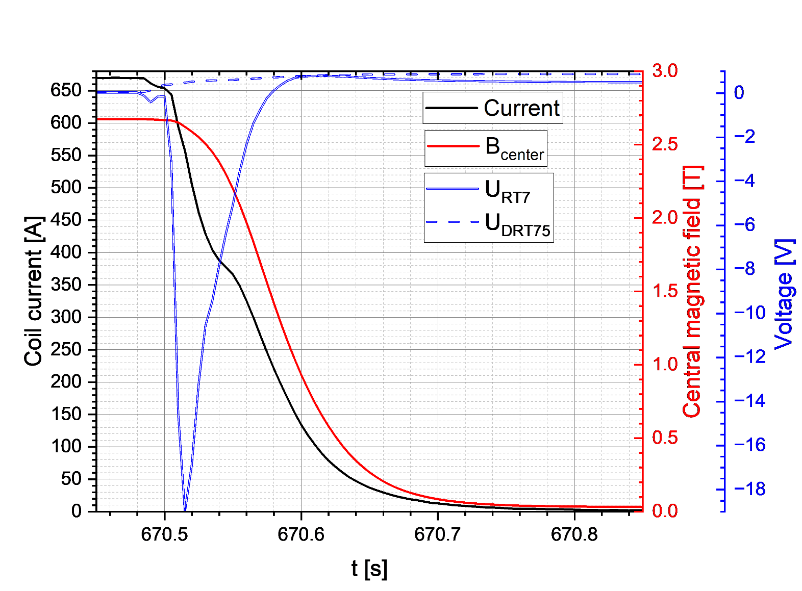
2. DRT75 tests : Quench and current limitation
DRT75 : test example
Quench #1
Pre-quench
Voltage limitation : current decay
Quench : voltage grow
Quench
#1
Quench
#2
Quench
#3
Reached 2.7 T @ 670 A
8 quenches @ > 1600 A/mm² (in the winding pack)
Lower magnetic field (< 3.6 T) and quench current (< 980-1460 A)
Quench protection by Power Supply voltage limitation (0.9 V)

Slide 10
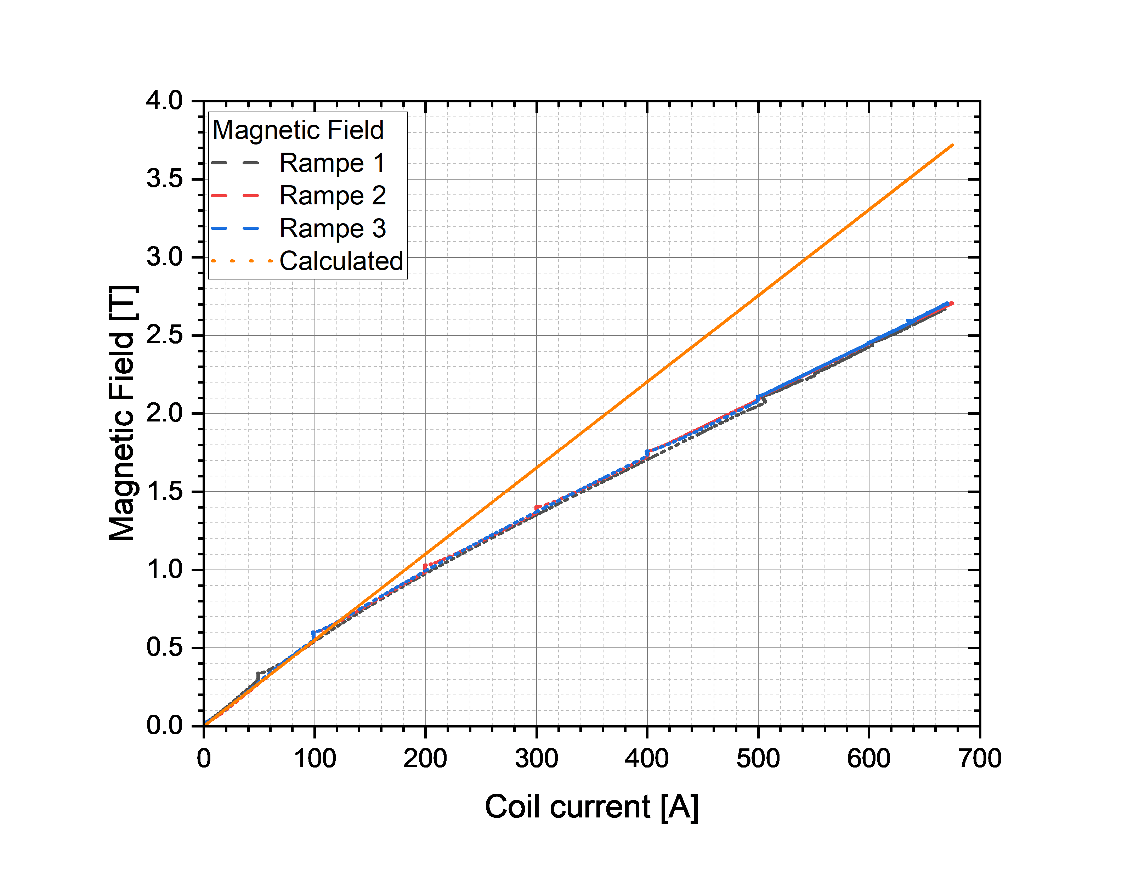
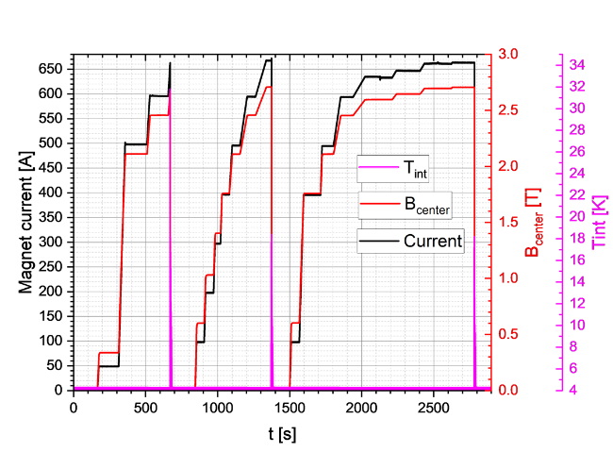
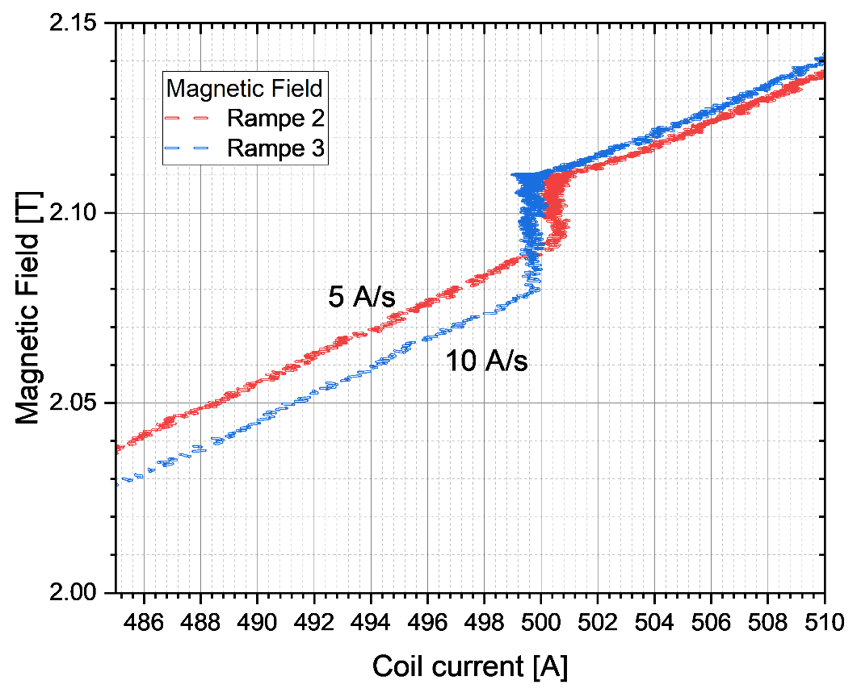
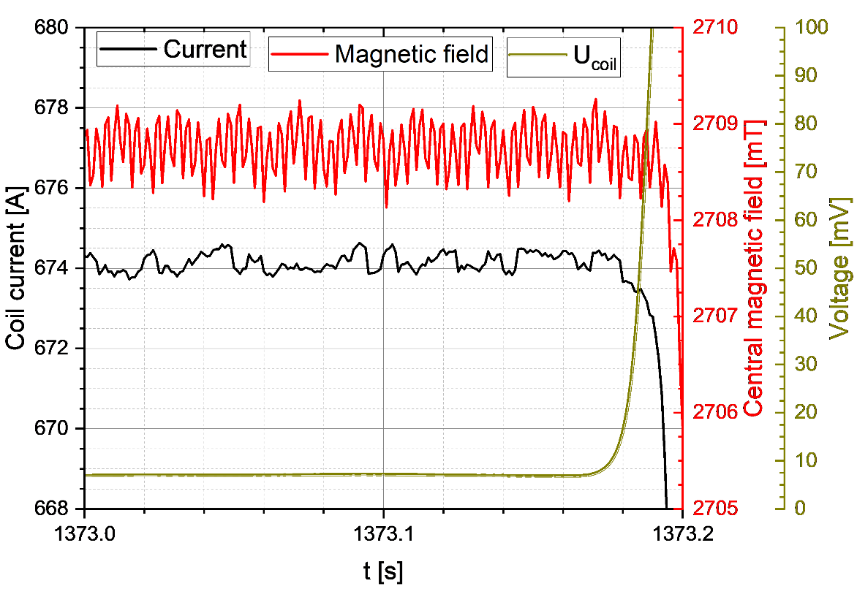
2. DRT75 tests : Magnetic Field generation
About 650 mT missing @ 500 A (23.5%)
About 980 mT missing @ 670 A (26.7%)
DRT75 : Magnetic induction non linearity
→ WHY ?
MI → bypassing current ?
→ Only about 15 mT (5 A/s) and 30 mT (10 A/s)
→ Field decay blow 1 mT @100 mV (quench)
1
2
3
Issue
Quench #2
Magnetization ?
→ Only a few mT
Good
Cannot explain the difference

Slide 11
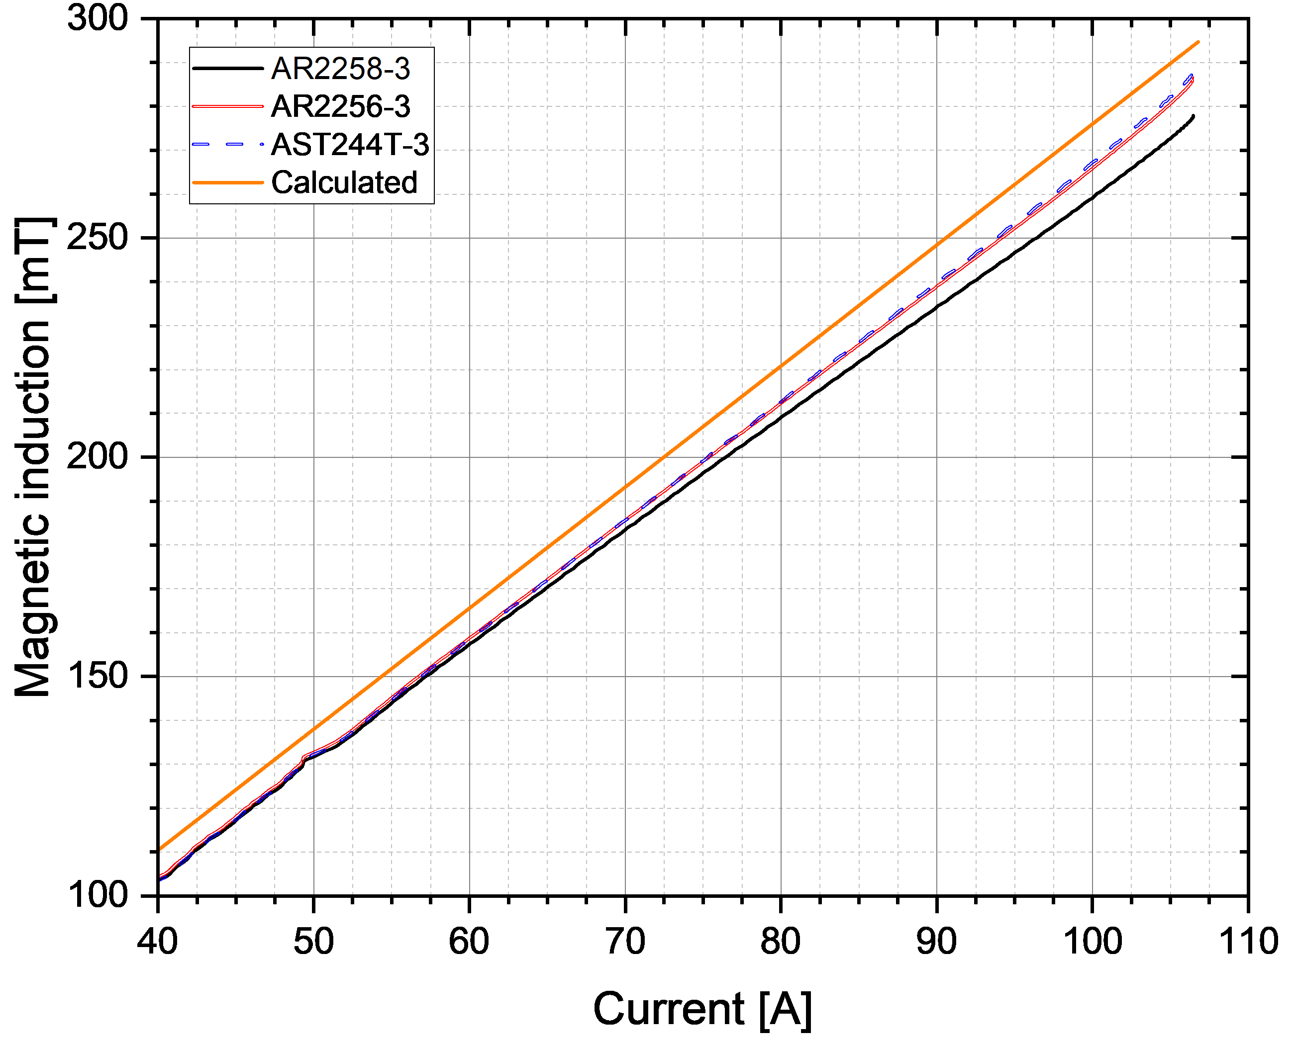
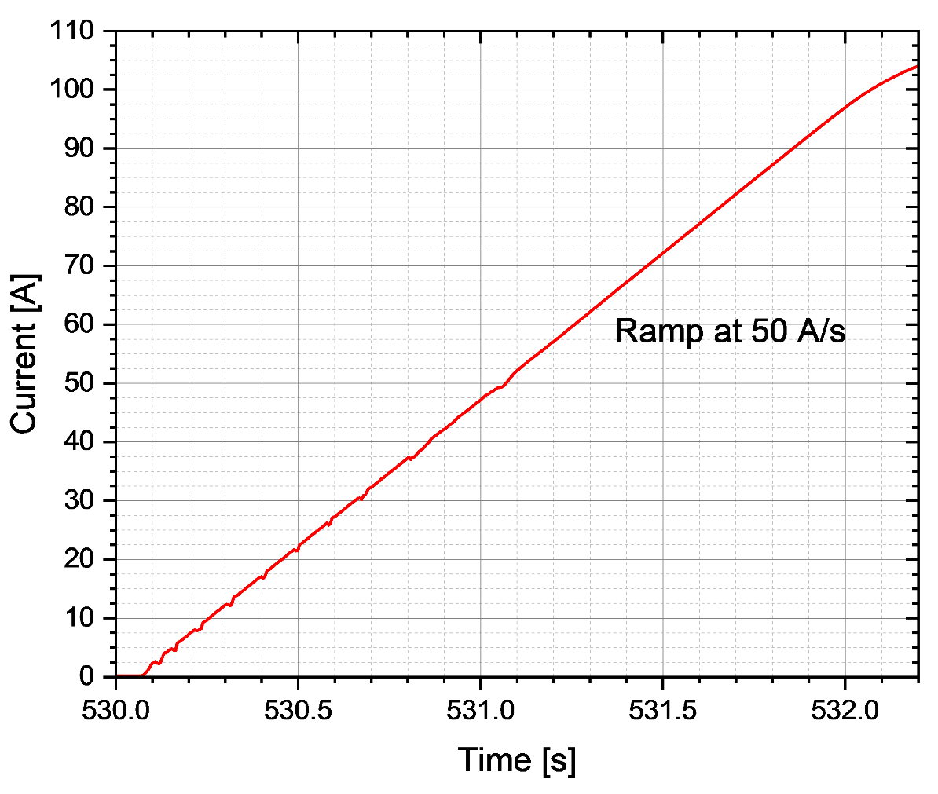
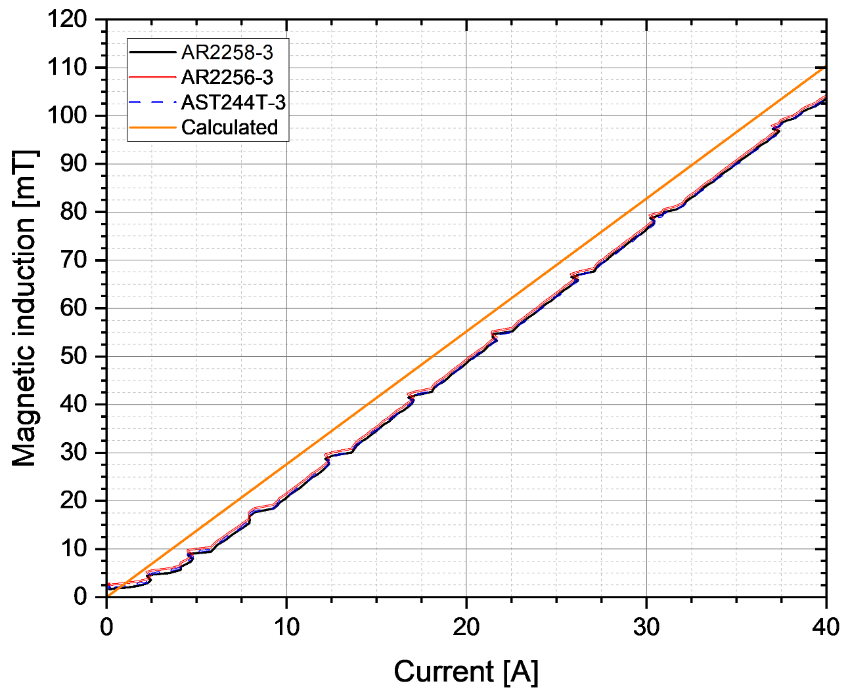
2. DRT75 tests : Hall probe issue
Arepoc Hall probe issue ? → comparison of AREPOC 2258 with an AREPOC 2256 and AST 244T @77 K
RT7 test at 77 K, SF
3rd charging
No difference between sensors
AREPOC 2258 diverged from other sensors
Linear coefficient adjusted
  Arepoc 2558 sensor got broken during transfer to a different setup → no correlation above 0.3 T available
New campaign with few calibrated sensors (remaining Arepoc and new AST 244T) (Planned week 10-2025)

Slide 12

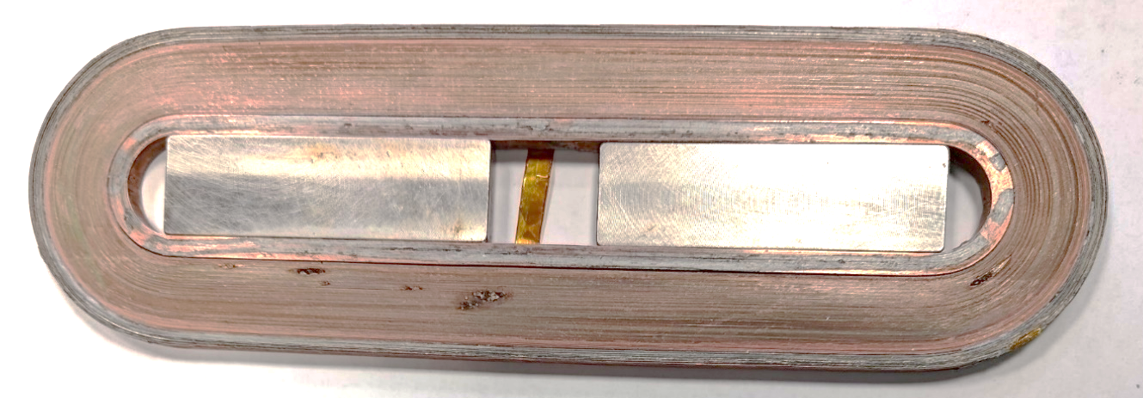
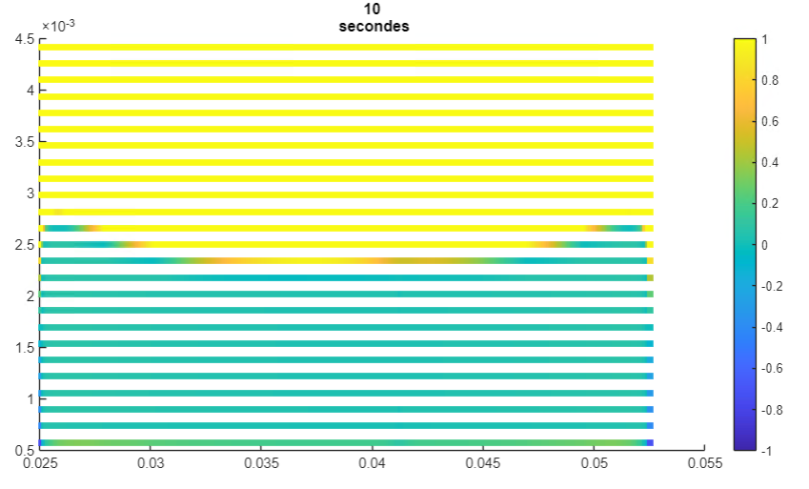
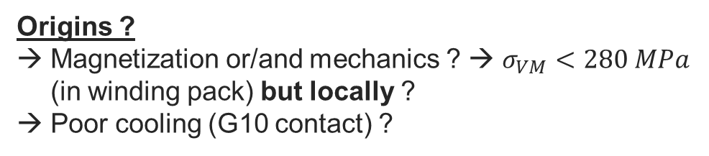
2. DRT75 tests : Quench current / protection
Quench and protection ?
Post mortem analysis ongoing (Metallography, Tomography X)
Locally burned parts
RT5
Origins ?
Magnetization or/and mechanics ? → $σ_{VM}<280 MPa$ (in winding pack) but locally ?
Poor cooling (G10 contact) ?
J/J_{c}
8 quenches at almost the same current (670 A / 1600 A/mm²)
Only 48-65 % of expected current
Localized burned parts in mid-plane for both RT
Magnetization and mechanical effect study ongoing
A-formulation 2D model : 2 Racetracks / 130 turns / 25 elements in width / 3 µm HTS layer / 670 A in 10 s

Slide 13
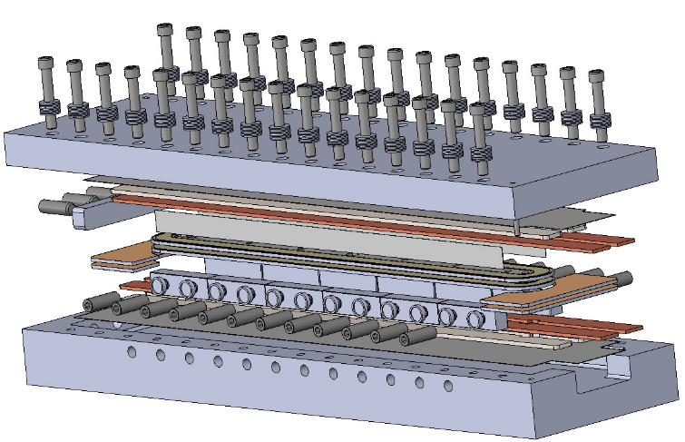
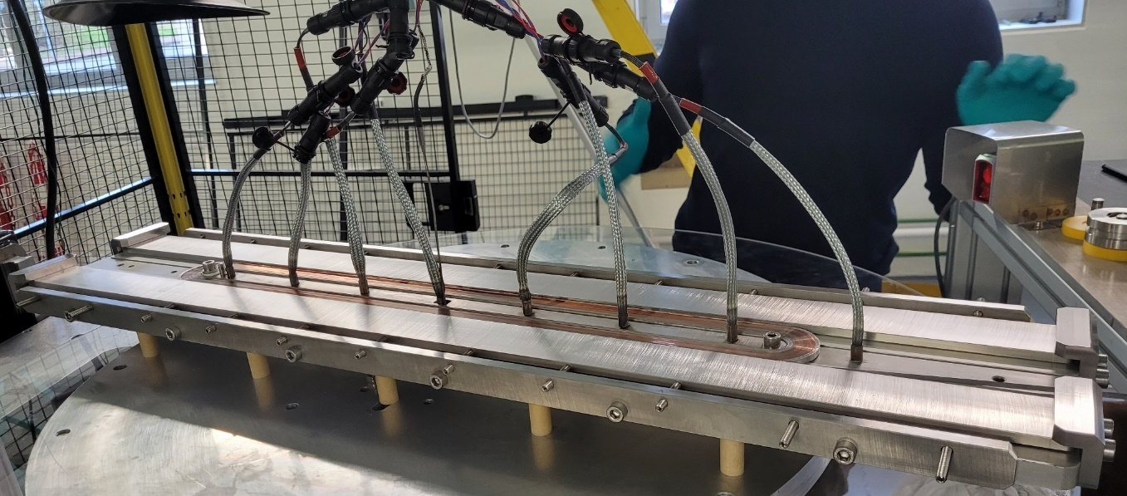
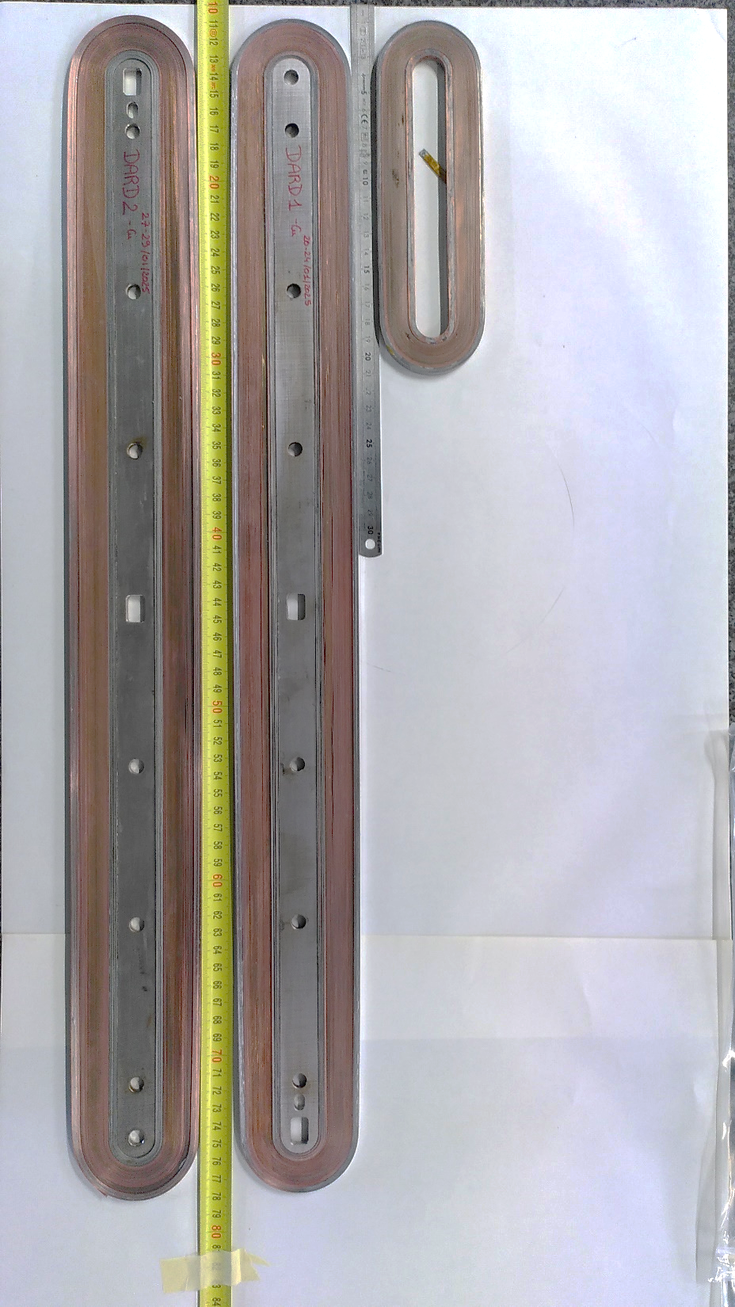
2. Exploring « long » racetracks
Target 600 mm long straight part (possibilities up to 900 mm with winding machine)
Ongoing (started 17/01/2025)
140 mm RT5
DARD1
600 mm structure
DARD2
Expected Week 7-8
600 mm DARD* winding
*Dummy Accelerator Racetrack for Development

Slide 14

3. Conclusion
Short MI Racetrack : a nice way for learning
  Fabrication
  DRT assembly
  Tests setup
  High J_{e} quench protection (>1600 A/mm²)
  Magnetic field generation to confirm (2.7 T or 3.6 T ?)
  Current limitation to understand
What next (S1 2025) ?
New run of RT and DRT measurement @4.2 K
→ Comparison with numerical models
“long” MI Racetrack
  600 mm dummy copper MI Racetracks
What next ?
SC “long” Racetrack fabrication
RT tests at 77 K
DRT assembly and test at 77 K
DRT transfer to CERN (May 2025)

Slide 15

Thank you for your attention
Any questions
T. Lécrevisse : thibault.lecrevisse@cea.fr
12/02/2025
15

Slide 16
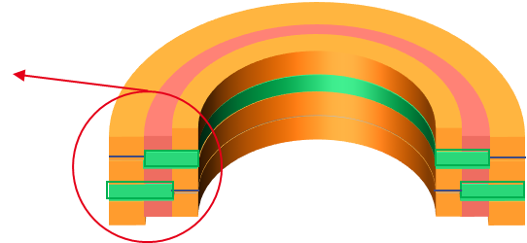
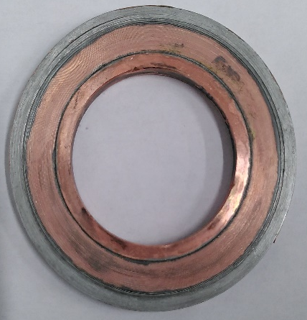
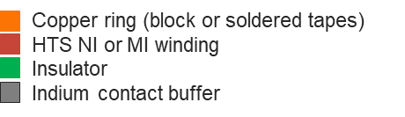
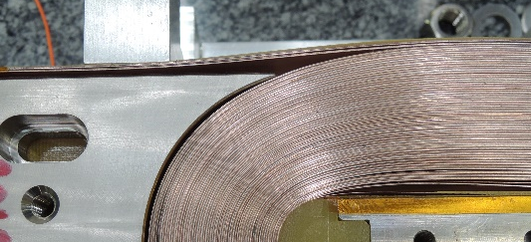
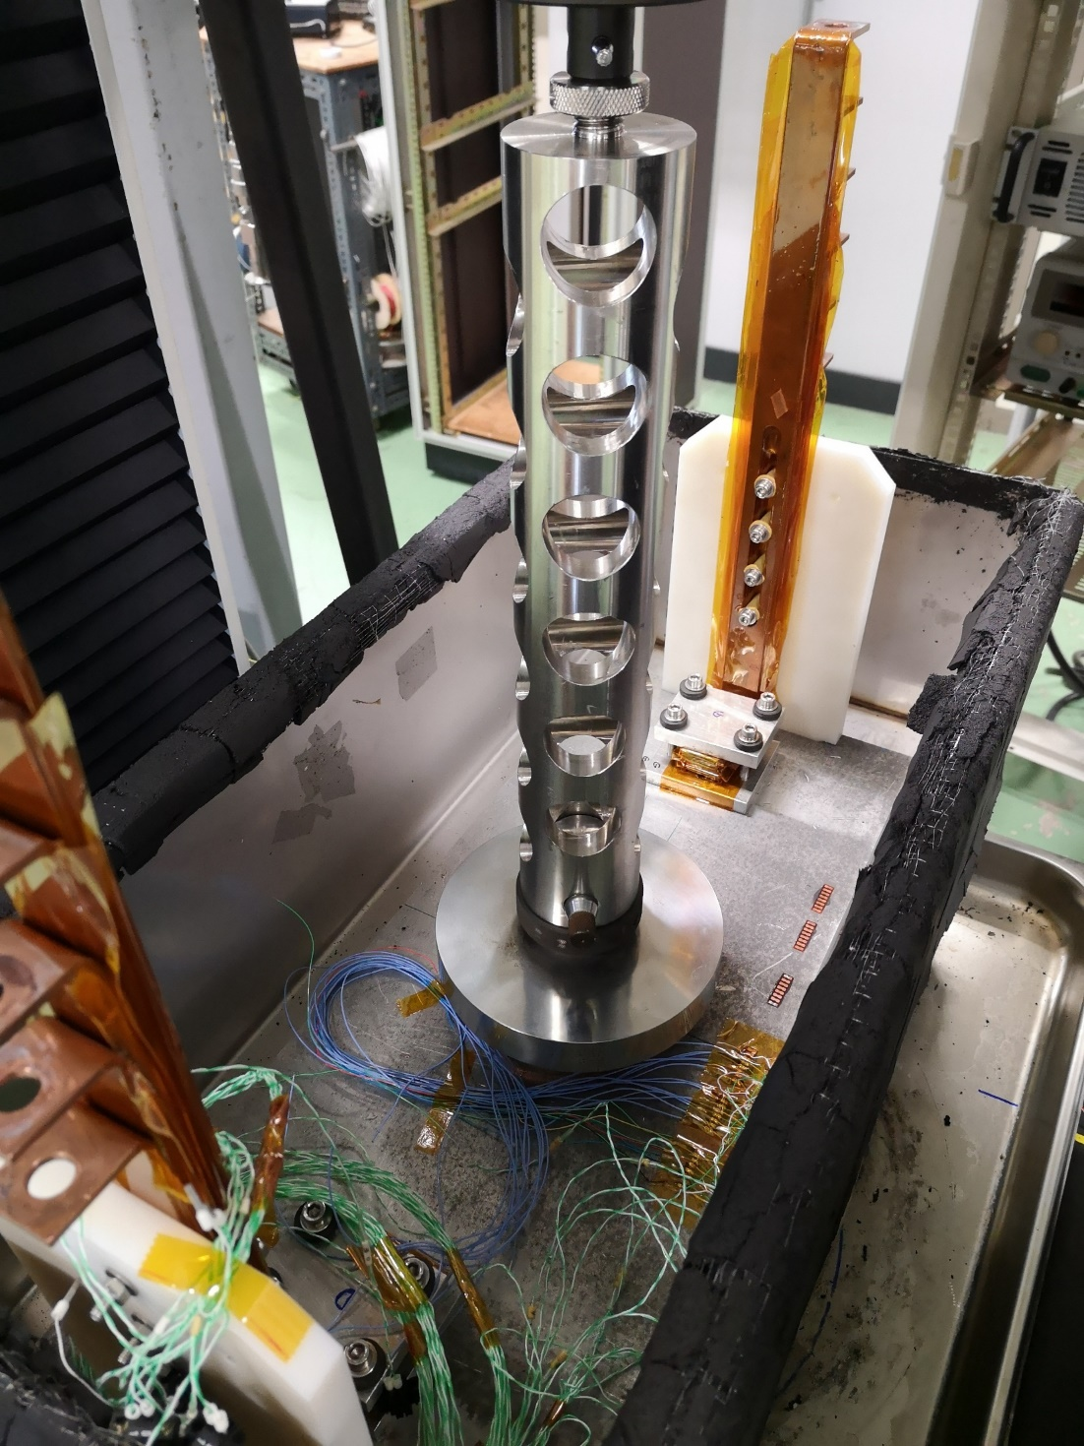
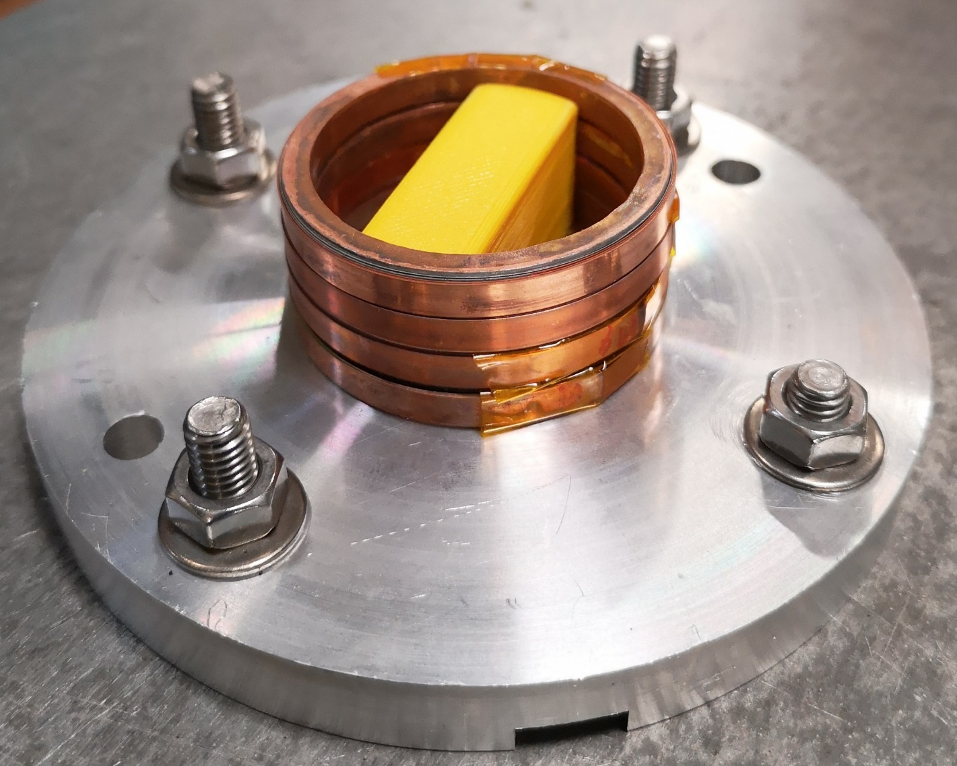
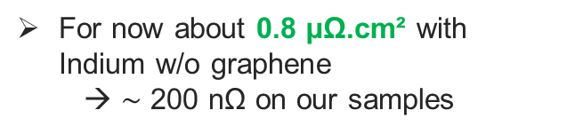
2. Activities overview : Integrated electrical connection
Integrated electrical connections
Integrated current leads
Copper Ring : Bulk or soldered tape
Copper – Copper with or w/o Indium
With or w/o graphene
Effect of pressure
Effect of copper roughness
Mechanical cycles
Thermal cycles (77 K)
Pressed
contact
Current leads
For now about 0.8 µΩ.cm² with Indium w/o graphene
  → $\sim$ 200 nΩ on our samples
Compressive plate
Sample
4 copper rings stacked together with Vtap to evaluate its resistivity
Optimize the contact resistance and evaluate the required contact area for each application
Test of evolution of contact resistivity in compressive testing machine @77 K

